Slide 1
Qubit inside 3D cavity
Alessandro D’Elia, Ph.D.
alessandro.delia@lnf.infn.it

Slide 2
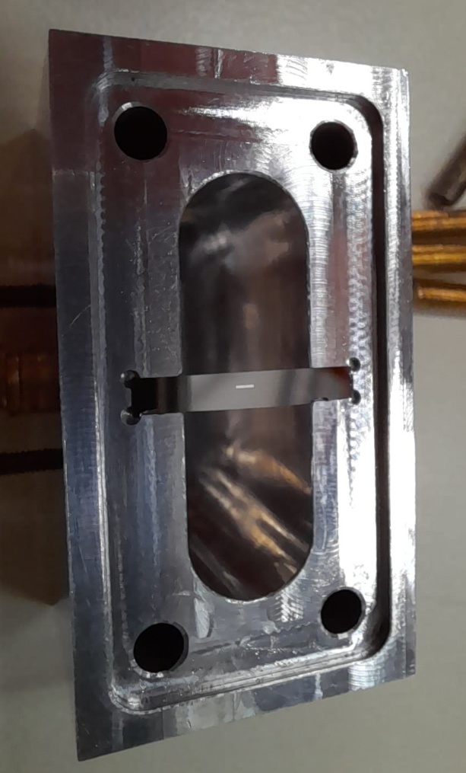
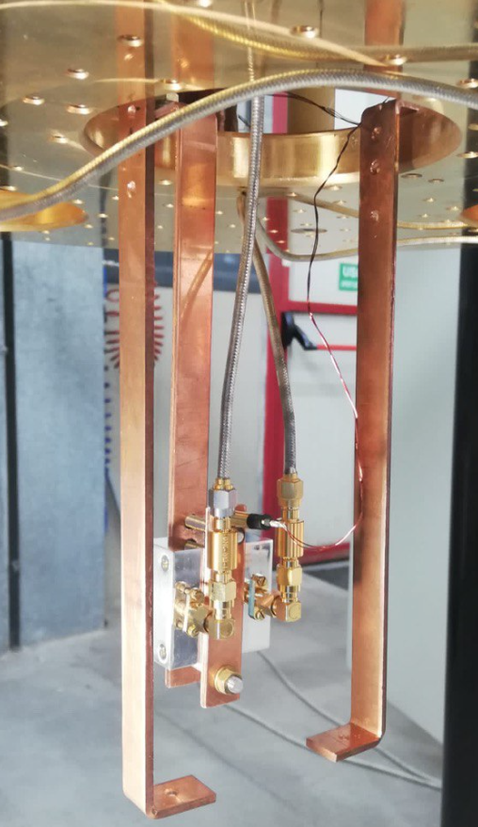
Qubit in 3D cavity
Dispersive regime
ω_{a}
ω_{r}
Δ~1 GHz
We read the Qubit state through a cavity masuerement

Slide 3
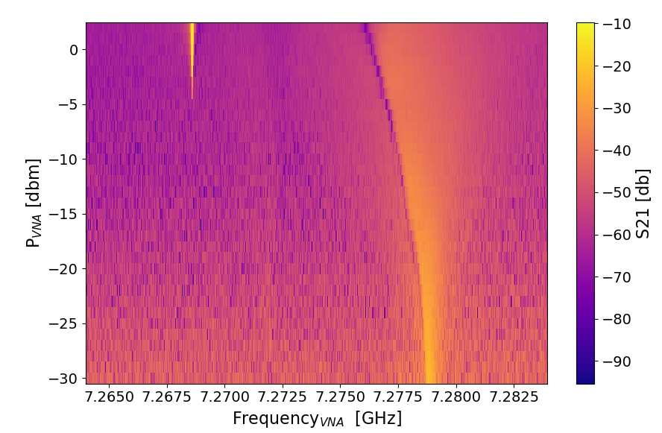
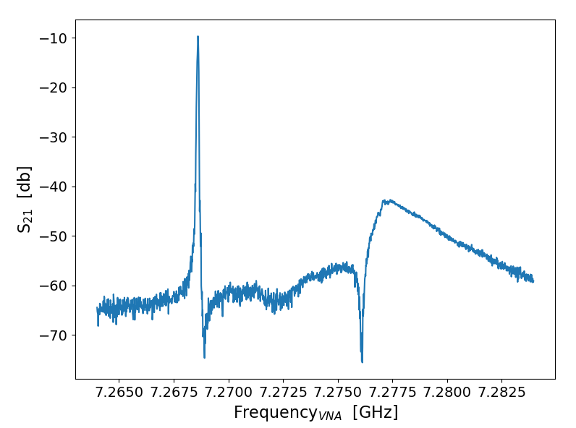
Qubit in 3D cavity: cavity spectroscopy
Bare cavity = 7.268 GHz

Slide 4
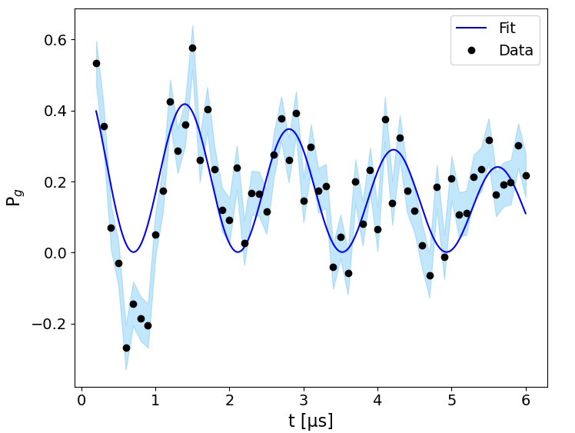
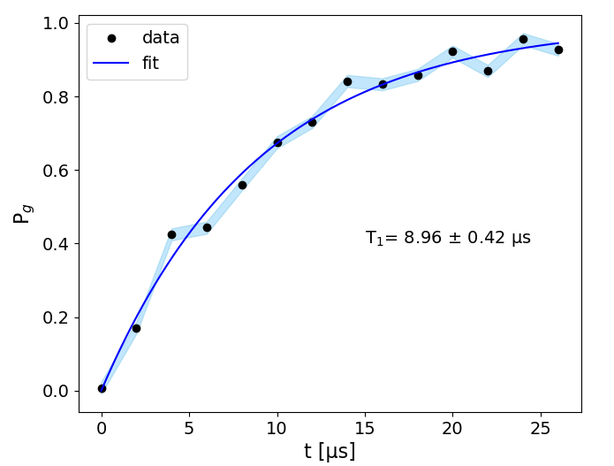
Qubit in 3D cavity: Rabi measurements
Rabi
T₁

Slide 5
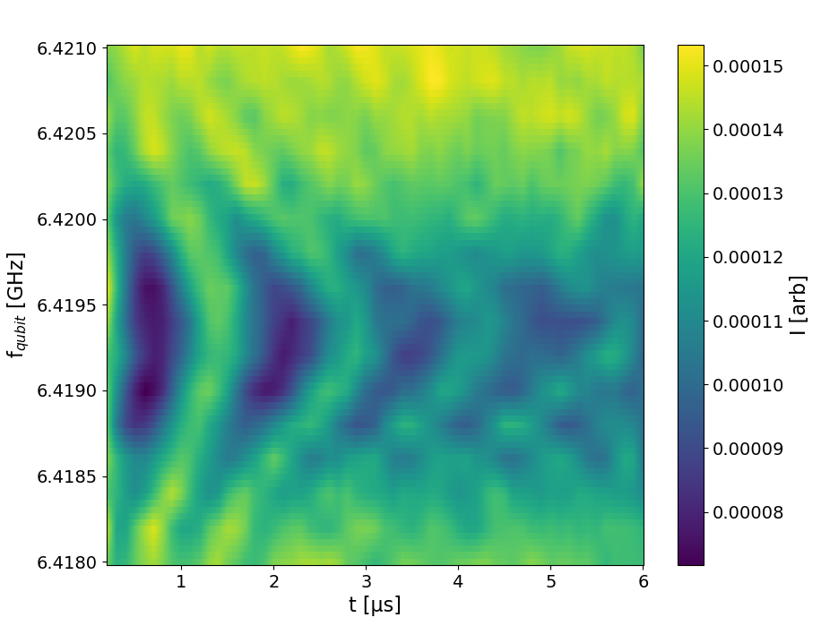
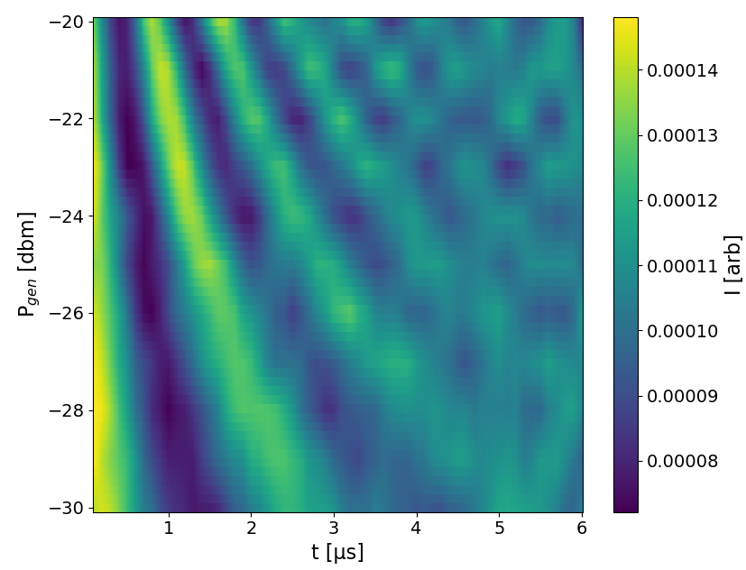
Qubit in 3D cavity: Chevron plot
Averaging over all the T₁ measurements
T₁ =8.74±0.13 μs

Slide 6
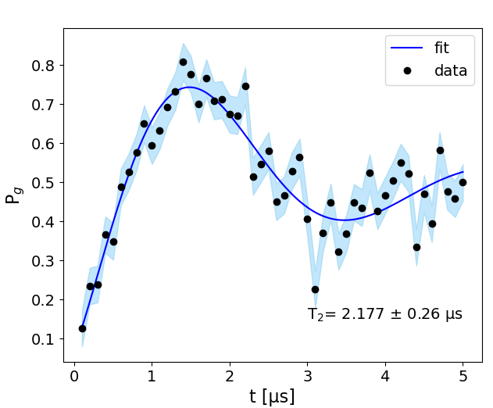
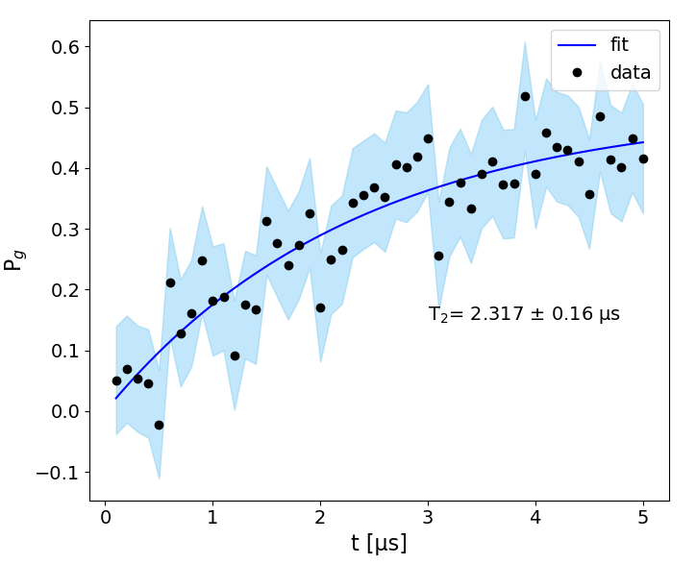
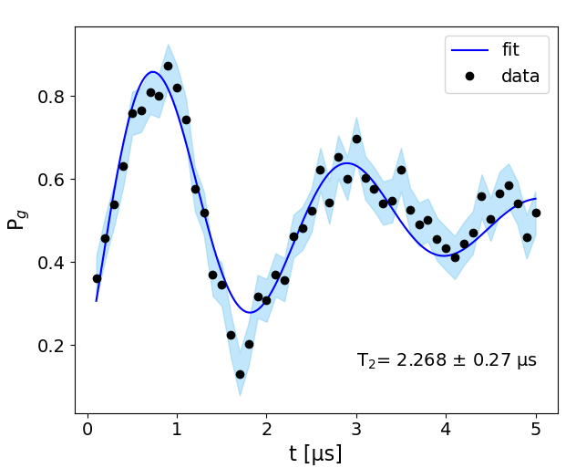
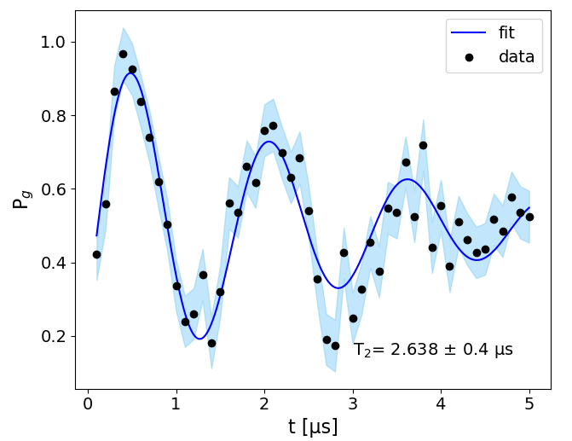
Qubit in 3D cavity: Ramsey spectroscopy
Δ=0 KHz
$$P_{g}=(\frac{1}{2}−\sin\left(2π∆×t\right))e^{−\frac{t}{2T_{2}}}$$
Δ=200 KHz
Δ=600 KHz
Δ=400 KHz
Averaging over all the T₂ measurements
T₂ =2.30±0.11 μs
Γ₂ = $\frac{{\text{Γ}}_{1}}{2}$+ Γ_{ϕ}
Γ_{ϕ}= $0.377\text{±0.}\text{02 }$MHz

Slide 7
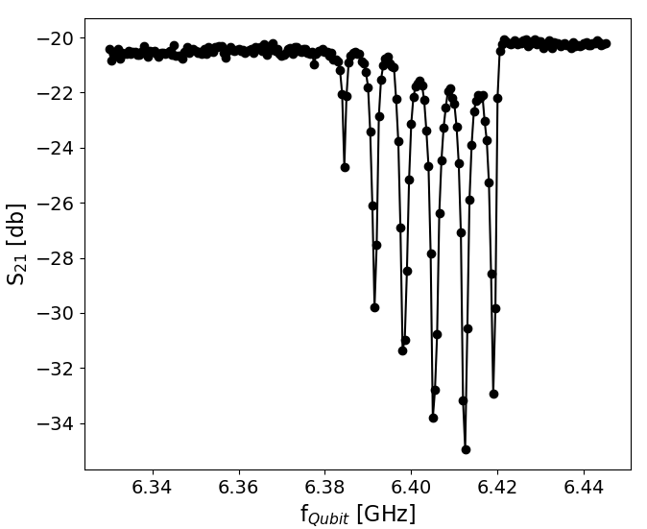
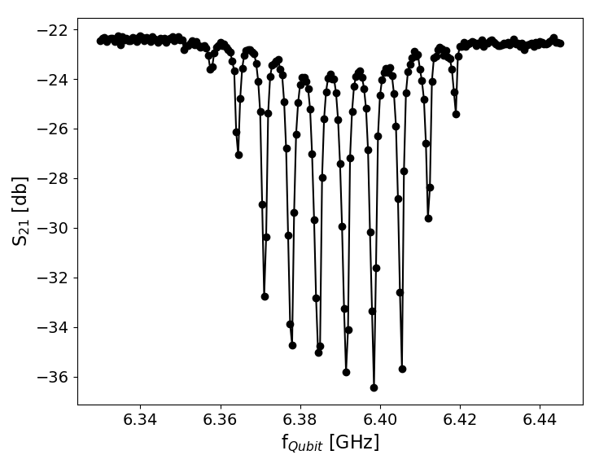
Qubit in 3D cavity: Resolving Photon Number
$\overline{n}$ $\sim$4
$$\left.|0\right\rangle$$
$$\left.|1\right\rangle$$
f_{VNA} = 7.227 GHz
P_{VNA}=-35 dbm
$$\left.|0\right\rangle$$
f_{VNA} = 7.227 GHz
$$\left.|2\right\rangle$$
$$\left.|1\right\rangle$$
2χ
$$\left.|2\right\rangle$$
PVNA=-30 dbm
χ =-3.41±0.08 MHz

Slide 8
Qubit in 3D cavity: Tabella riassuntiva
T₁ | 8.74±0.13 μs
T₂ | 2.30±0.11 μs
Γ_{ϕ} | $0.377\text{±0.}\text{02 }$MHz
χ | -3.41±0.08 MHz

