Slide 1
Qub-IT
2D design
Qub-IT meeting 19/04/2023
D. Labranca - H. Corti - R. Moretti

Slide 2
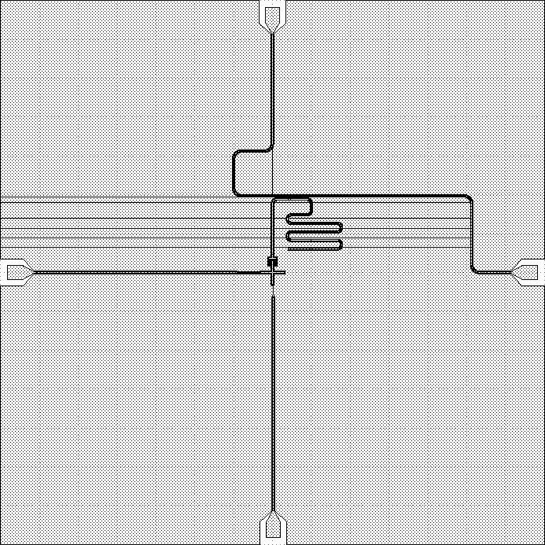
Latest design 2D qubit chip
Two chip versions of the same qubit design
Adaptability to different holders
The second chip design is based on AIVON holders and easily adaptable to any square-shaped holder
The main qubit parameters are exactly the same

Slide 3
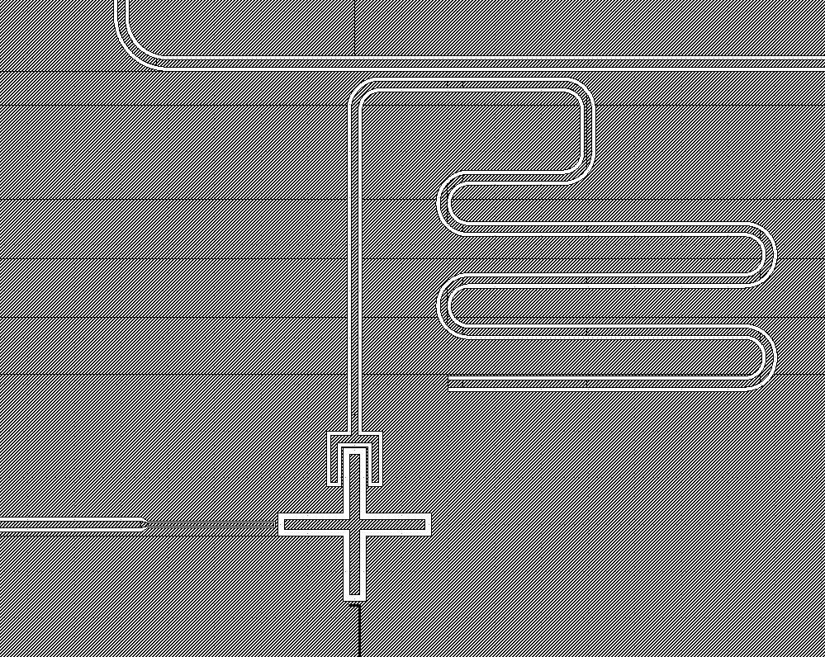
Latest design 2D qubit chip
Two chip versions of the same qubit design
Adaptability to different holders
The second chip design is based on AIVON holders and easily adaptable to any square-shaped holder
The main qubit parameters are exactly the same

Slide 4
10mm x 2.5mm Chip
Qubit shifted to one side to avoid drive-line and flux-line modes in simulations
The chip configuration still generates other low Q modes around 5 GHz (feedline and composite modes)
10 mm
2.5 mm

Slide 5
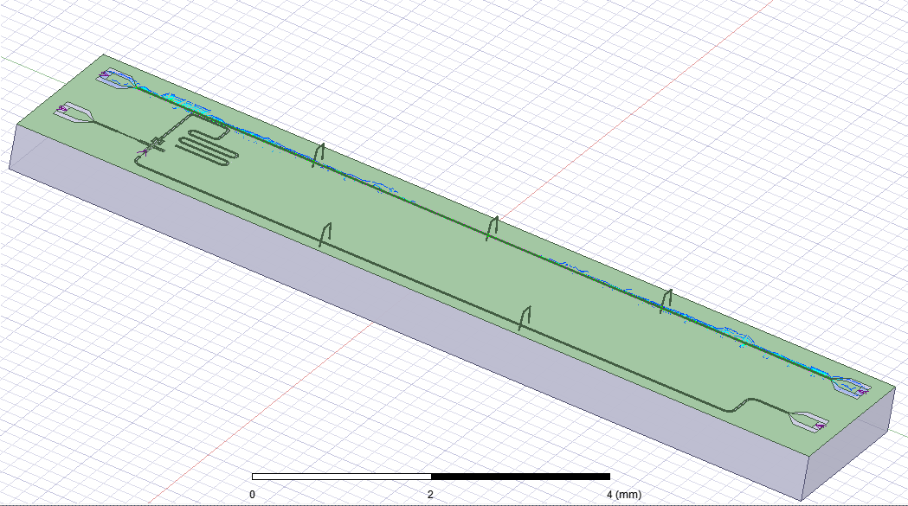
10mm x 2.5mm Chip
Qubit shifted to one side to avoid drive-line and flux-line modes in simulations
The chip configuration still generates other low Q modes around 5 GHz (feedline and composite modes)
10 mm
2.5 mm

Slide 6
7mm x 7mm Chip
7 mm
Exact same design of the main features of the chip
Adapted to a squared design (different holder compatibility)
Easier simulation
No common modes on chip
Results of the simulations of this chip are reliably transferable to the 10mm x 2.5 mm chip
7 mm

Slide 7
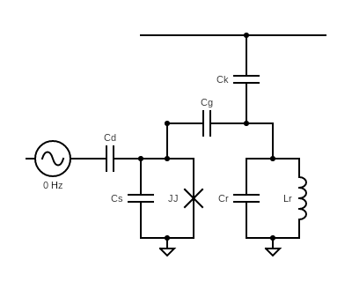
Equivalent circuit parameters
Feedline
From Q3D simulations:
Other parameters:
Parameter | Value
C_{S} - Qubit shunt | 87.403 fF
C_{G} - Coupling Q-R | 3.932 fF
C_{K} - Coupling R-F | 6.406 fF
C_{D} - Coupling drive-line qubit | 0.199 fF
Parameter | Value
L_{J} - Junction inductance | 10 nH
I_{C} - Critical current | 32.911 nA
C_{R} - Equivalent R capacitance | 404.072 fF
L_{R} - Equivalent R inductance | 1.638 nH

Slide 8
Equivalent circuit parameters
Feedline
From Q3D simulations:
Other parameters:
Parameter | Value
C_{S} - Qubit shunt | 87.403 fF
C_{G} - Coupling Q-R | 3.932 fF
C_{K} - Coupling R-F * | 6.406 fF
C_{D} - Coupling drive-line qubit | 0.199 fF
Parameter | Value
L_{J} - Junction inductance | 10 nH
I_{C} - Critical current | 32.911 nA
C_{R} - Equivalent R capacitance | 404.072 fF
L_{R} - Equivalent R inductance | 1.638 nH
*: in this configuration may be necessary to include a more complicated description of the cavity
https://aip.scitation.org/doi/pdf/10.1063/1.3692073

Slide 9
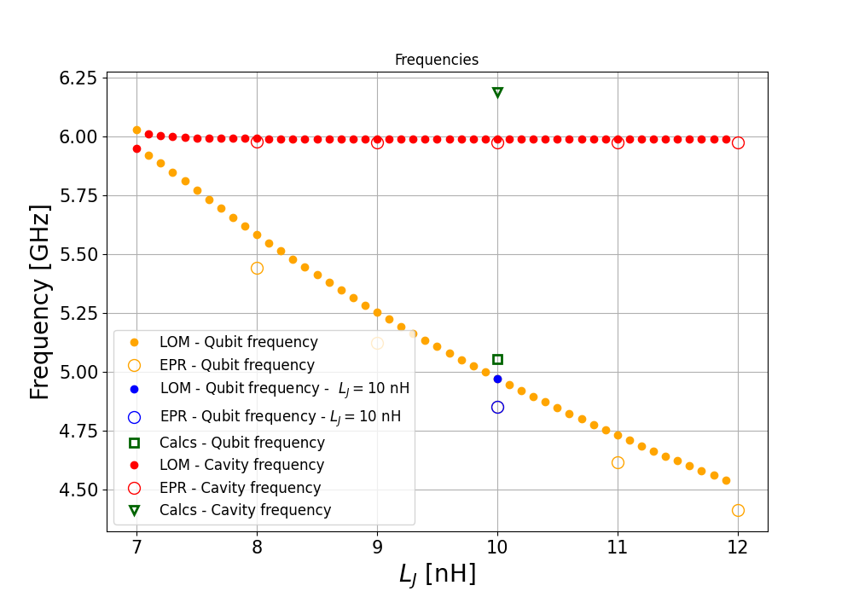
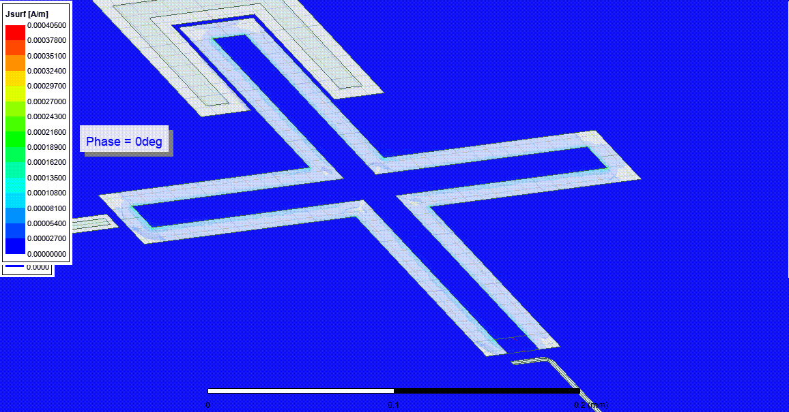
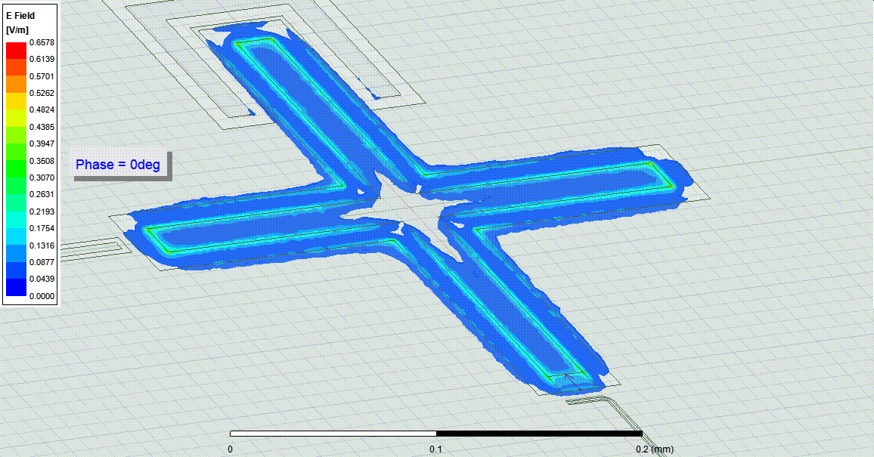
Simulation results - Frequencies
Blue: Comparison @ L_{J} = 10 nH between LOM, EPR simulations and calculations
LOM cavity frequency is chosen to be equal to the EPR simulation result for L_{J} = 10nH

Slide 10
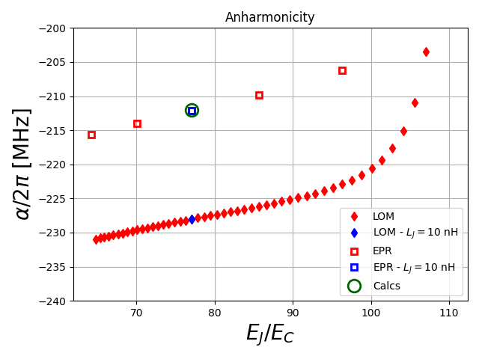
Simulation results - Anharmonicity

Slide 11
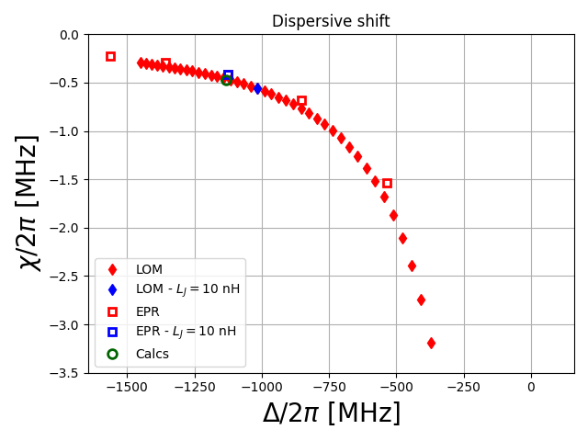
Simulation results - Dispersive shift
χ_{EPR}/2π = -0.438 MHz
χ_{LOM}/2π = -0.560 MHz
χ_{Calcs}/2π = -0.475 MHz
EPR and calcs are close, while LOM shows a dispersive shift of 100 kHz higher (already proved before with another design: 10.48550/arXiv.2207.09290)
Note: LOM definition of χ is treated differently than EPR in this case (see backup slides)

Slide 12
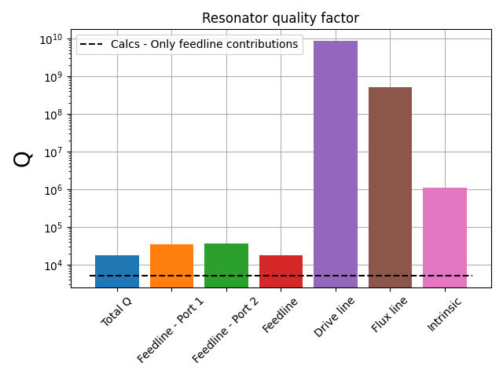
Simulation results - Cavity quality factor
Q_{EPR} ≈ 10⁴
Q_{Calcs} ≈ 10³
Calculated Q only accounts for feedline contributions but is about 3 times smaller than Q_{EPR}
Q_{EPR} is close to Ansys HFSS results and it is calculated as in https://arxiv.org/abs/2010.00620

Slide 13
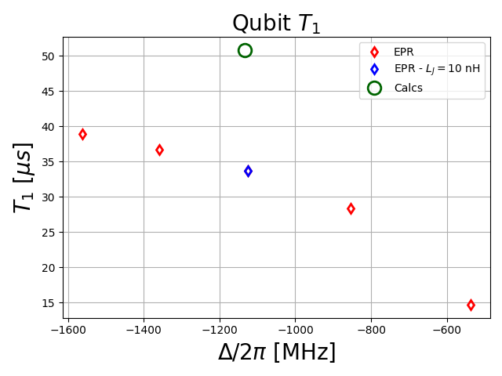
Simulation results - Qubit T₁
T₁^{EPR} is calculated from the qubit mode quality factor: 2πf_{o1}T₁=Q₀₁
T₁^{EPR} accounts for all 50Ω input ports at the launchpads
Calculated T₁^{Calcs} accounts only for the cavity contribution, but the order of magnitude seems right
T₁^{LOM} is still to be calculated (new LOM code from qiskit)

Slide 14
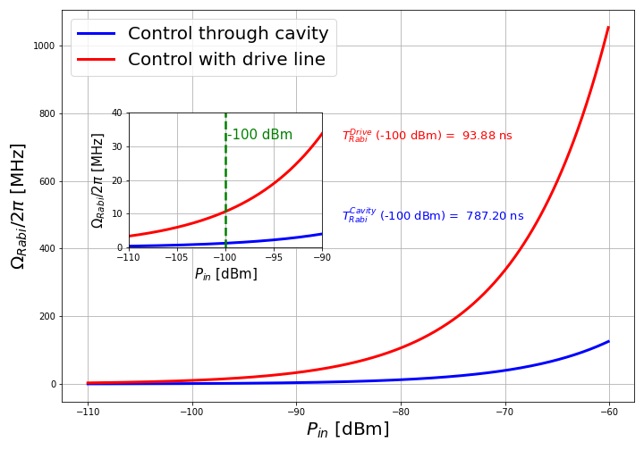
Simulation results - Rabi frequency
This plot is based on Claudio’s calculations (https://baltig.infn.it/qubit/qubit-wp1/-/blob/main/tutorial/NotaQubitDesign.pdf)
Added the calculation for the driveline using the capacitance C_{G} (from Q3D simulation) and it is based on Section IV.D.1 of this review: https://arxiv.org/abs/1904.06560

Slide 15
Backup slides

Slide 16
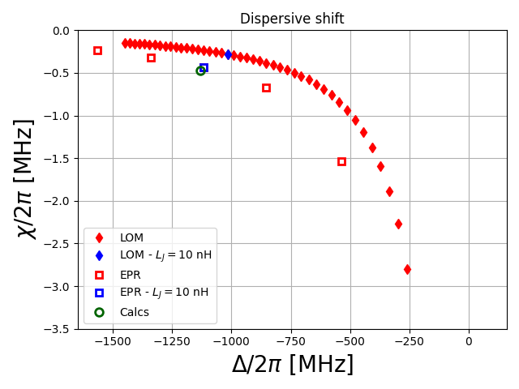
Dispersive shift - LOM treated as EPR
Larger discrepancy in LOM values
Seems like LOM χ values are treated differently in the code:
EPR returns 2χ (For sure)
LOM returns χ (To be checked)
The code for LOM was last year
Deeper look into it would solve these doubts

Slide 17
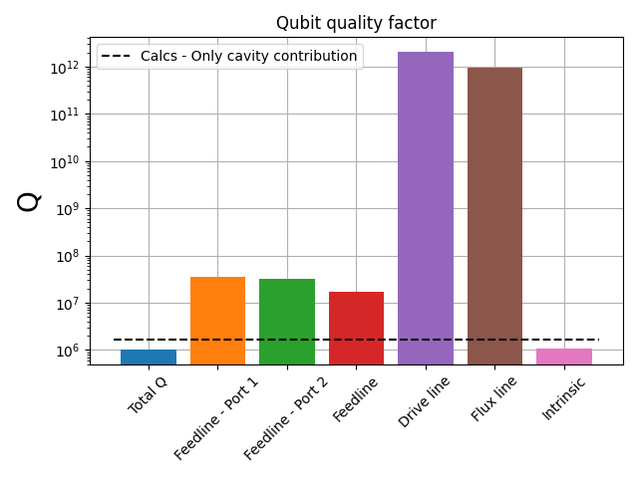
Simulation results - Qubit quality factor

Slide 18
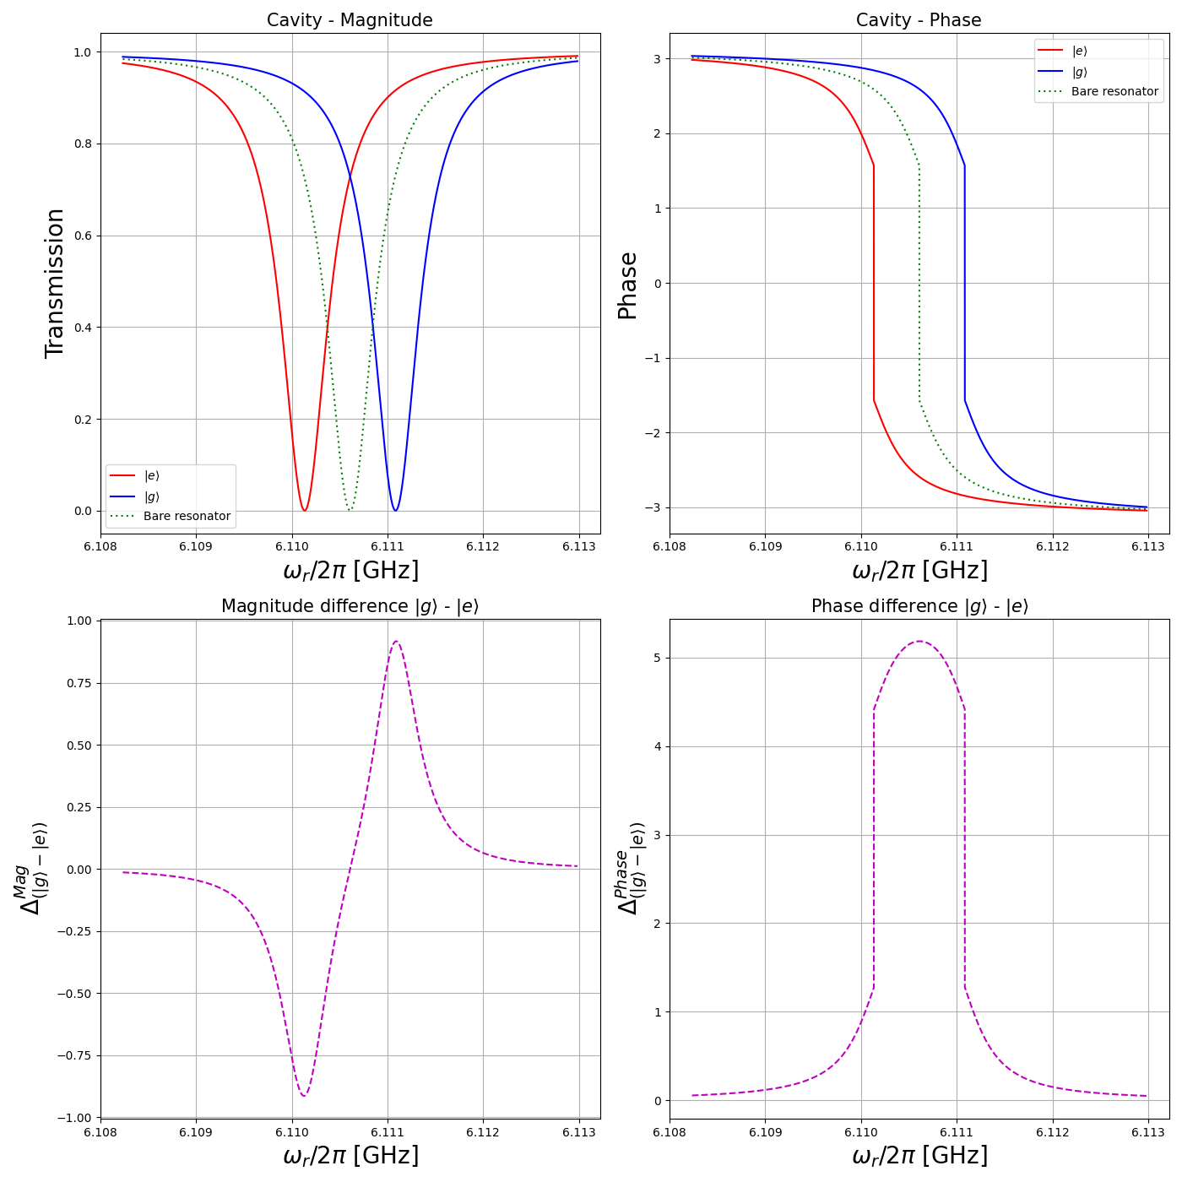
Readout cavity from calculations
Plots based on https://baltig.infn.it/qubit/qubit-wp1/-/blob/main/tutorial/NotaQubitDesign.pdf

