Slide 1
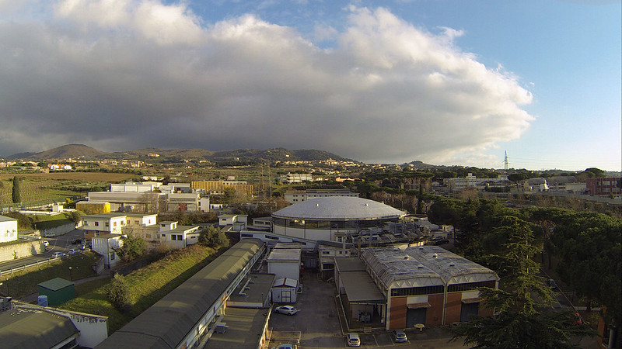
Accelerator LAB 2023 edition
Students welcome
Accelerator Physics PhD course
A. Gallo on behalf of the INFN LNF tutor team

Slide 2
A. Gallo
Welcome to INFN Frascati Labs
The aim is to give the students a glance of the experimental activities related to the various aspects of the accelerator physics and technology;
This is the first post-pandemic edition of the course;
For the first time it is organized in a residential and intensive format;
Students will be divided in 2 groups;
It will cover 8 hands-on experiences + an overview of the LNF e+/e- BTF facility;
Activities will start every morning at 9.15 and end at 4.00-5.00 pm, depending on the specific program;
Lunch is offered at LNF canteen from 1.15 pm, with the exception of Saturday April 15 (canteen is closed during weekends)
List of experiences:
MAGNETS
VACUUM
RF 1 (Electron Gun Cavity)
RF 2 (High Power RF pulse compressor)
ACCELERATOR CONTROLS
PLASMA for ACCELERATORS
STORAGE RING MEASUREMENTS
OPTICAL DIAGNOSTICS
2
Students welcome, April 12, 2023

Slide 3
A. Gallo
Program
 |  |  | Group A | Group B
APRIL 2023 | 12 | Wednesday | Vacuum A. Liedl / S. Bini | Magnet -Magnetic Measuremets L. Sabbatini / A. Vannozzi
 | 13 | Thursday | Magnet -Magnetic Measuremets L. Sabbatini / A. Vannozzi | RF1 - S band Gun F. Cardelli
 | 14 | Friday | Controls A. Stecchi / G . Di Pirro | Vacuum A. Liedl / S. Bini
 | 15 | Saturday | Storage ring measurements G. Franzini - C. Milardi / A. De Santis
 | 16 | Sunday | FREE | FREE
 | 17 | Monday | RF1 - S band Gun F. Cardelli | Plasma Lab A. Biagioni
 | 18 | Tuesday | Plasma Lab A. Biagioni | RF2 - Pulse compression L. Piersanti / M. Bellaveglia
 | 19 | Wednesday | Optical emittance measurement (+BTF visit) E. Chiadroni (+ L. Foggetta)
 | 20 | Thursday | RF2 - Pulse compression L. Piersanti / M. Bellaveglia | Controls A. Stecchi / G . Di Pirro
STUDENTS
GROUP A / GROUP B
Chiara Antuono
Lucio Crincoli
Angelica De Gregorio
Daniele Francescone
Emanuele Gueli
Michela Neroni
Gilles Jacopo Silvi
3
Students welcome, April 12, 2023

Slide 4
A. Gallo
Indico page
https://agenda.infn.it/e/LAB_ACC_2023
A web page has been prepared as a service tool for students and tutors. Here you may find:
Day-by-day program for both groups;
Meeting point location for each activity;
Tutor names;
Tutorial material (presentations, documents, …) used in each activity.
4
Students welcome, April 12, 2023

Slide 5
A. Gallo
Building #4
Aula Puls– 1st floor – VACUUM, OPTICAL DIAGNOSTICS
Aula Master – ground floor – CONTROLS
Building #2
Auletta DA – 1st floor – MAGNETS, STORAGE RINGS
Room 022 – ground floor – RF 1 & 2
Meeting
Points
DAFNE control room
Building #7
Meeting room
PLASMA
https://w3.lnf.infn.it how to get here
5
Students welcome, April 12, 2023

Slide 6
A. Gallo
Exam
The exam will consist in a series of written reports concerning each lab experience (pdf format, 3-6 pages each);
The reports are individual, but they can be prepared in collaboration with the other students of the group;
The tutors will correct the reports. If the content is considered poor or insufficient, tutors will ask proper modifications to the authors;
Tutors are available for consulting prior the report preparation and/or during the editing phase;
I will collect the reports ( alessandro.gallo@lnf.infn.it ) and dispatch them to the tutors
6
Students welcome, April 12, 2023

