Slide 1
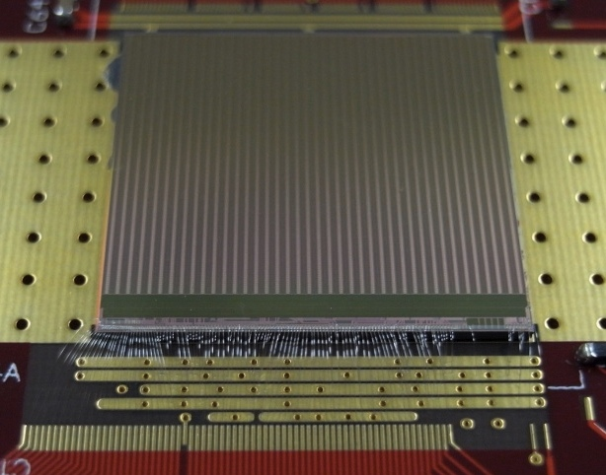
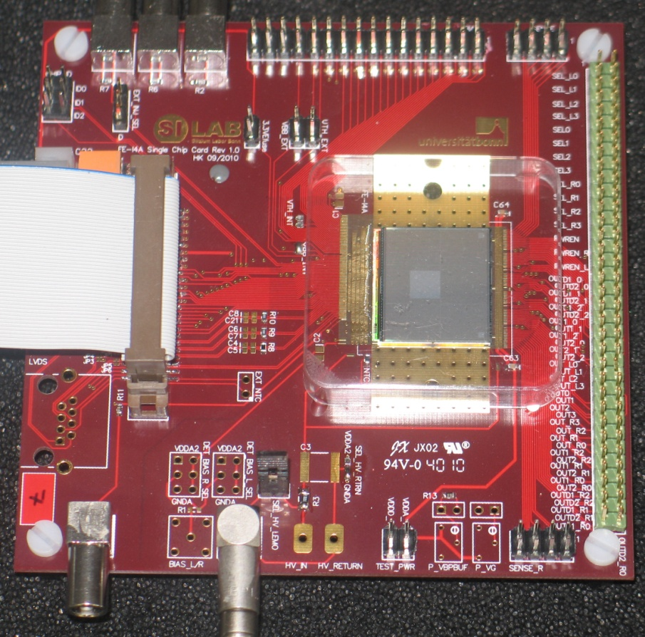
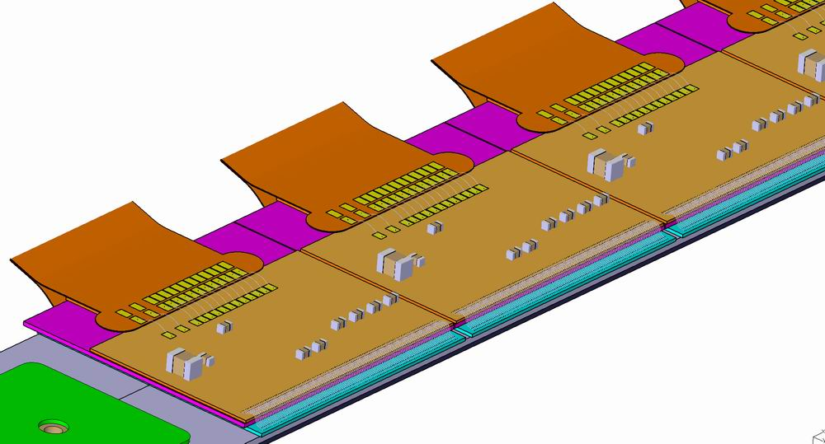
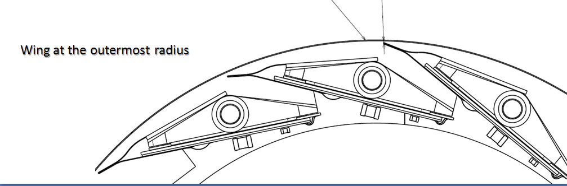
IBL e richieste finanziarie 2012
~2 cm
Chiara
FE-I4 R/O Chip
27 k Pixels
87 M transistors
~2 cm

Slide 2
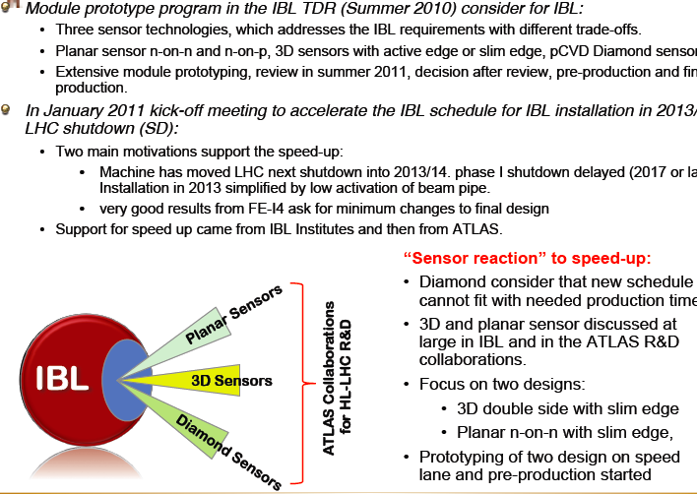
IBL – new schedule
Sensor Pre-production needed !
Sensor review July 5th ..

Slide 3
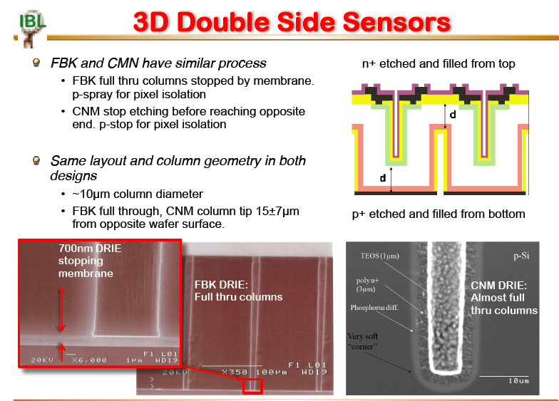
INFN ha finanziato il programma di pre-produzione a FBK (Ge,Ud)

Slide 4
IBL readout chip: FEI4
FEI4A Wafer received : 16 in hands and 20 more available
Tests
  Very high yield (9 wafer fully tested gave: about 70% of good “green” chips.
Irradiated with protons
  6, 75 and 200 Mrads. All chips working after irradiation. Analog performance little affected (Noise, Threshold).
Those chips tested as:
  SC chip cards : chip only
  Wafer probing automated
  Bumpbonding at IZM (1 wafer sofar, two more soon)
  SC cards with FEI4+ sensor
Analog tests started and show promising results
First FEI4+planar n-n sensor tested and FKB3D assemblies now in preparation for testbeam at DESY
AWN6TUH: 78% green
AUN6NGH: 67% green

Slide 5
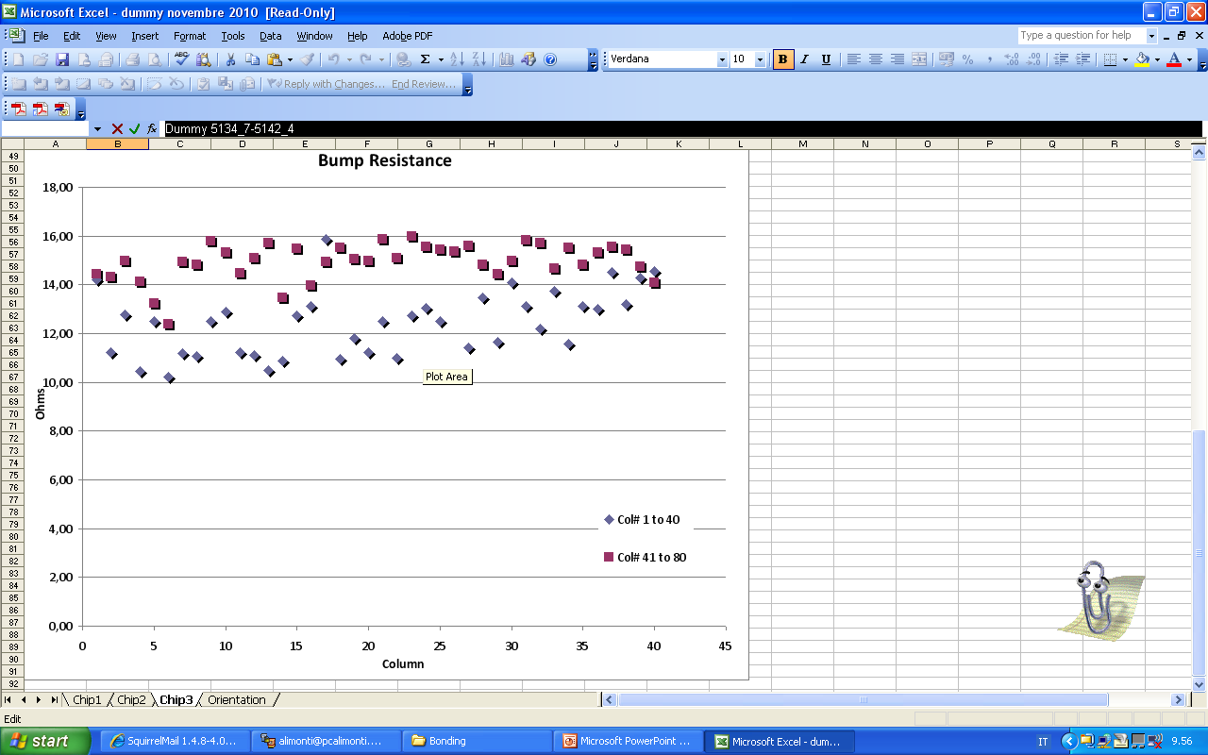
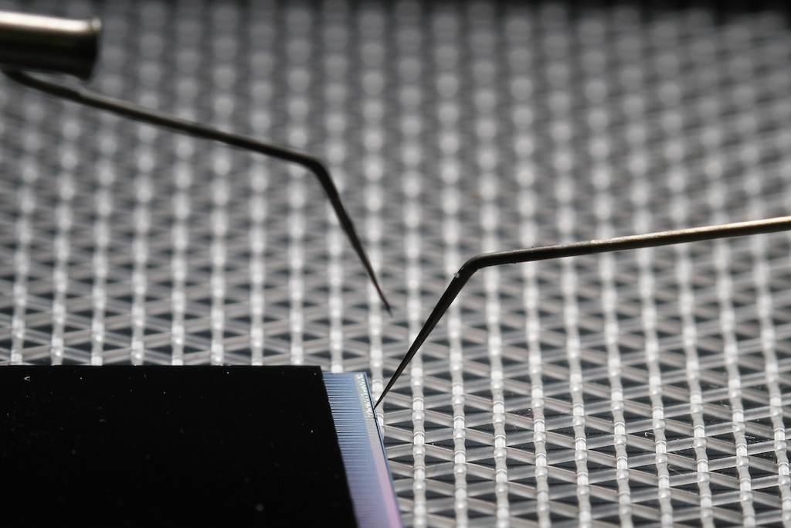
Bump Bonding
Un ordine di grandezza in più di bump (26880 anzichè 2880) a causa di maggior superficie FE (19x20 mm anzichè 7x11 mm) e minor dimensione pixel (50x250 μm invece di 50x400 μm )
FE dovra’ essere assottigliato, ~200 μm
Baseline – BB @IZM con SnAg
Ok per FEI4 thick, in sviluppo per FEI4 thinned
Indium bump bonding @Selex (Mi,Ge)
Verificare la tecnica con FE e sensori dummy (test di resistività catene di bump)
Assottigliare il FE e riverificare il bonding (test di resistività catene di bump)
Bonding moduli reali (assottigliati e non) e verifica della completa funzionalità
Situazione:
wafer sensori e FEI4 in lavorazione alla Selex
Next step: assottigliamento e taglio c/o DISCO)
→flipchip →test per inizio giugno
misure fatte a Genova
Dummy 5134_7-5142_4
Dummy
Resistenza ~13±3Ω per bump
OK !

Slide 6
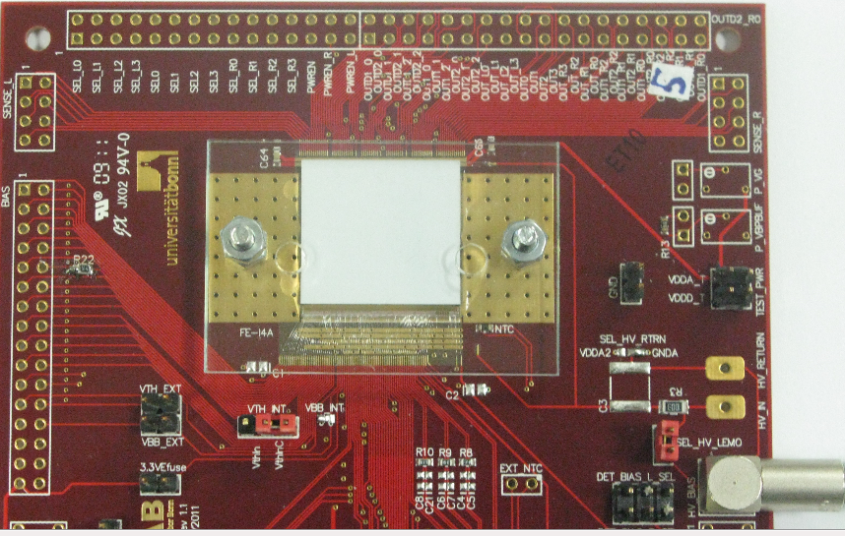
Moduli (Ge,Ud)
Stiamo acquisendo esperienza nei montaggi e successivi test dei FEI4. Questo ci mette in condizione di poter qualificare:
  Sensori : nelle prossime settimane previsti test su ~12 devices FBK-IZM, ma anche ~6 di CNM (Barcellona). Definiti test sistematici per arrivare alla sensor review. Previsti test di qualifica prima/dopo irraggiamento, in camera ambientale e anche con trigger esterno (utile per irradiated).
  Partecipazione Test Beam :
  - FBK FEI3 Irraggiati (2010 CERN)
  - 2011 DESY (telescopio Eudet)
  FBK-FEI3, FBK-FEI4 non irraggiati
  FBK-FEI4 @ Φ=2E15n_{eq}/cm² (p)
  work in progress
- 2011 CERN ← posticipato (problemi SPS)
  FBK-FEI4 vergini e irraggiati
  per qualifica IBL

Slide 7
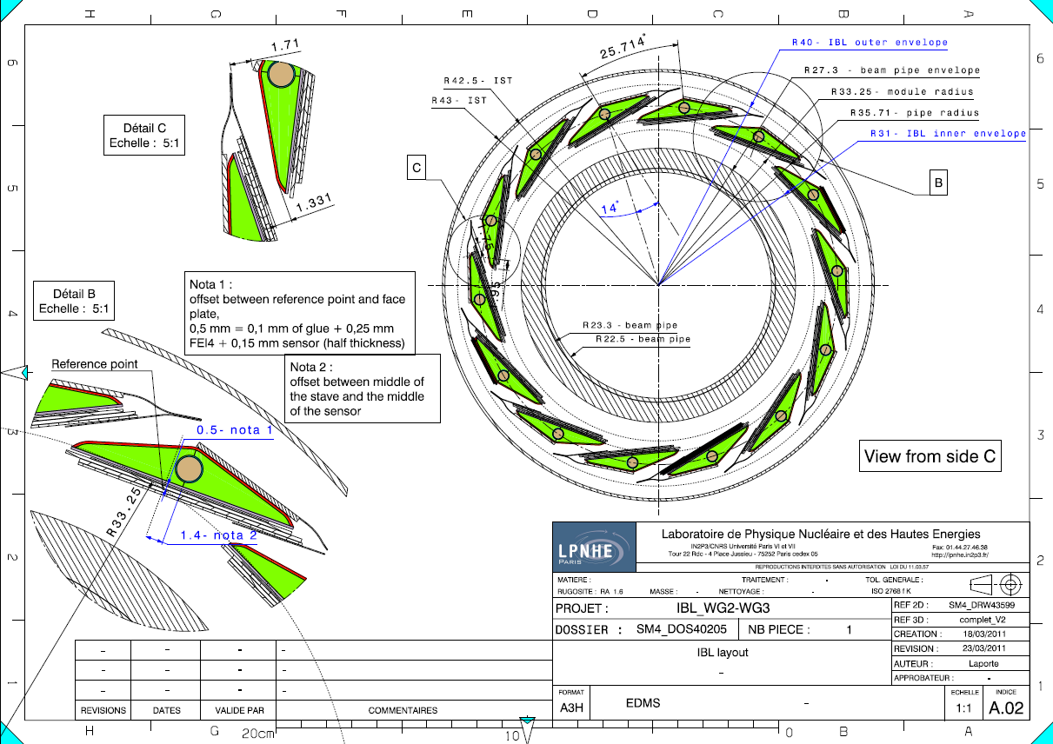
IBL Layout: 14 staves around beam pipe

Slide 8
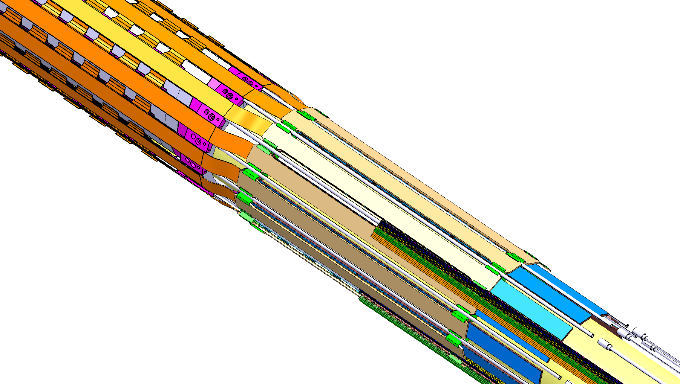
Stave and module arrangement
IP
14 staves
Each stave: 32 FEI4 chips
For 3D sensors: 1 sensors + 1 chip = 1 module
For planar sensors: 2 chips + 1 sensor = 1 module
Total installed 224 planar modules or 448 3D modules
Staves
Transition to cables
Services
Underside of stave: IBL modules
8
8

Slide 9
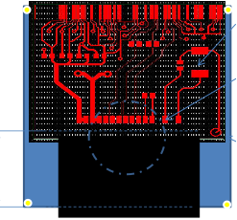
IBL : Thin modules to achieve low X0
Core focus: IBL modules with thin chips and module flex
  Module taskforce look at some of the pending questions related to the module design; expect results end May;
  Module flex: thin flex to connect stave flex to chip;
  allows module tests and burn-in prior to loading
  Module HV isolation, location for passive components,
  sensor alignment during loading .
Thin FEI4 bump-bonding:
  Develop handling wafer approach at IZM to achieve thin modules
Status: Achieved ~100µm thin chip assemblies with FE-I3 arrays using polyimide gluing to handling wafer:
  Bump yield is high but handling of the assemblies needs improvements to avoid problems afterwards.
  Laser ablation is not in-house at IZM.
More test structure for handling tests have been delivered to Bonn and will be tested in the next months.
  Sufficient for tuning the handling procedure.
7 wafers to be used by IZM dedicated to thin chip BB
Workplan established with IZM (May first thin BB assemblies)

Slide 10
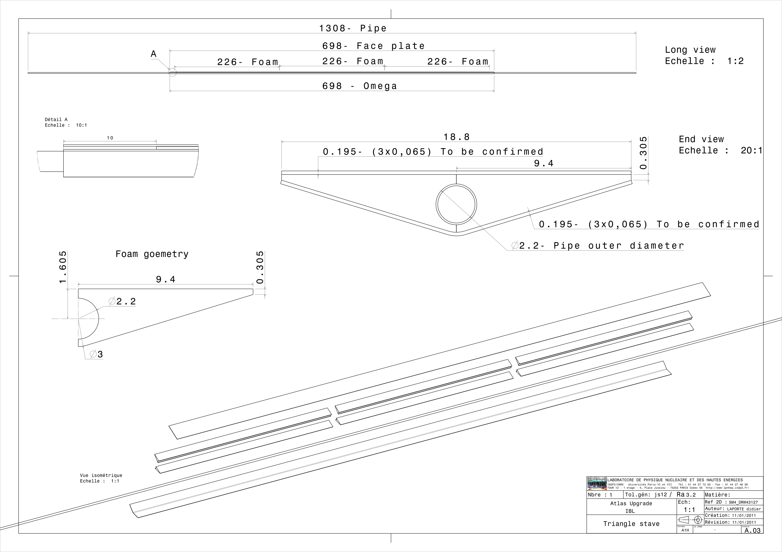
IBL Status: Staves
Core Stave topics:
  Bare stave manufacturing: mature now and finalize dimensions for final staves
  Module loading: gluing of modules to staves (without too much glue penedration to foam)
  Braising or welding of external pipes
  Stave flex: prototyping of mixed Cu/Al via flex circuit time consuming; parallel pursuit pure-Al flex. To speed up prototyping also produce now Cu-Cu flex for electrical tests and lamination of flex to stave setup
Bare stave:
  Orders for production materials in preparation
  Omega and top plate: K13C pre-preg;
  Ti pipe: received and under test/qualification, recently moved to 1.5mm ID
  Light Allcomp foam 0.22 g/cc material produced

Slide 11
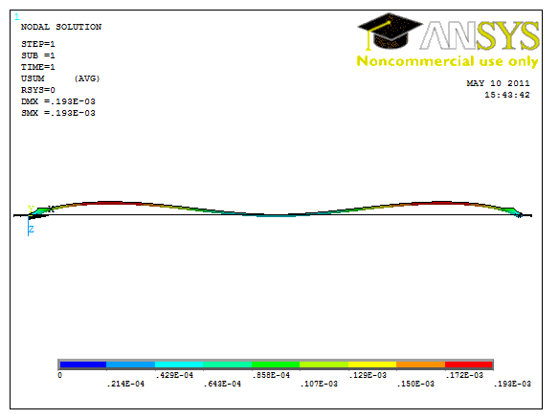
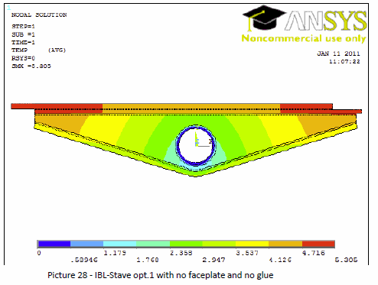
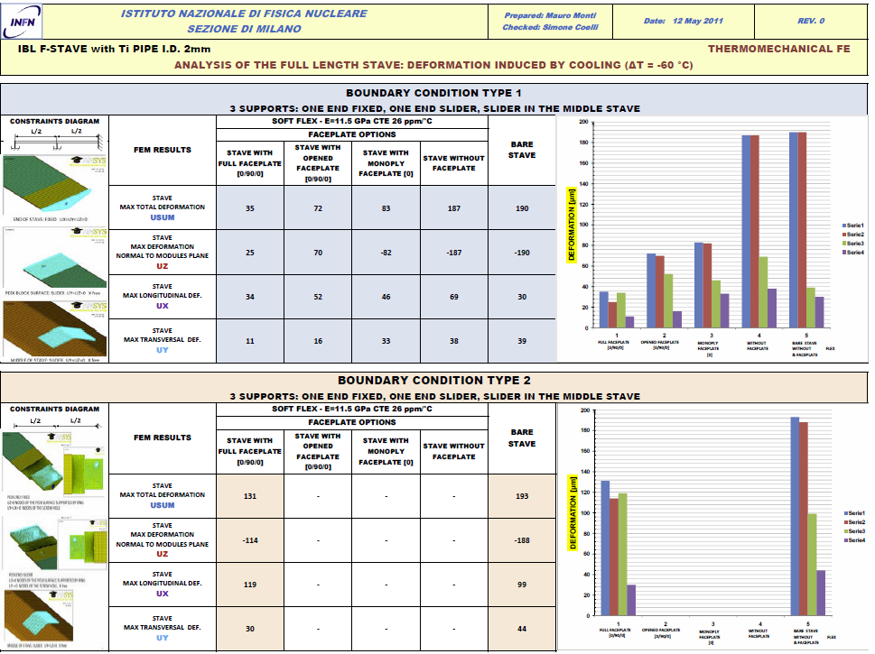
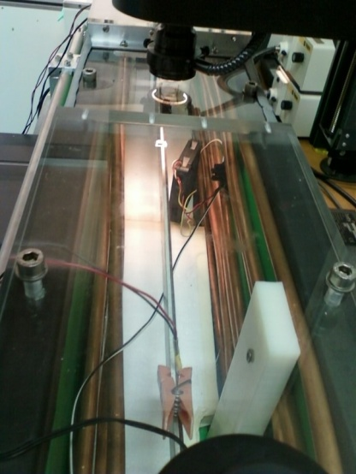
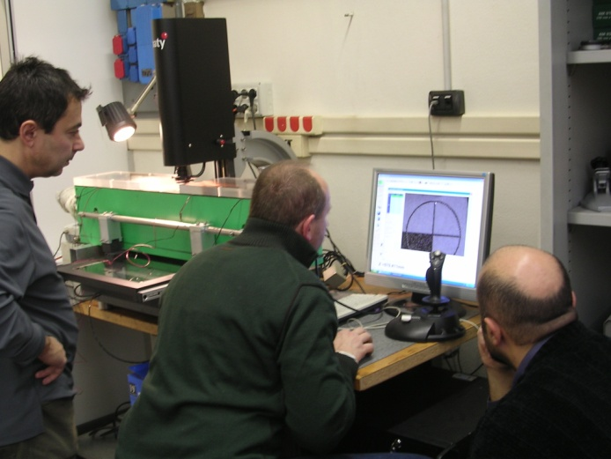
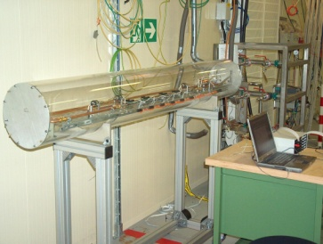
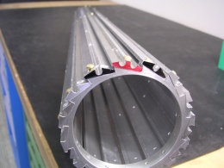
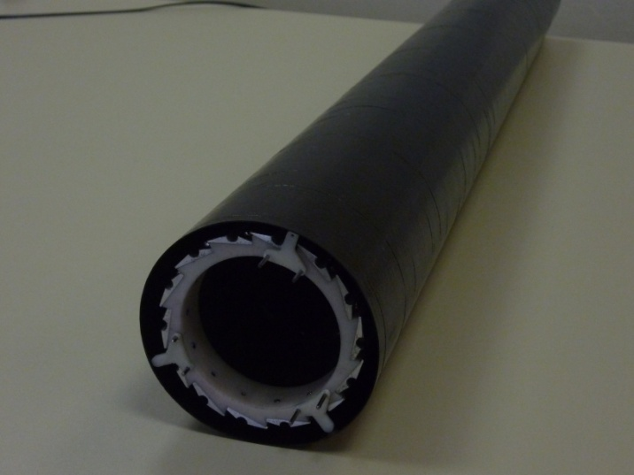
Progettazione e Test (Mi)
IBL stave Studio del supporto meccanico e condizioni di termalizzazione in tutte le ipotesi di progetto.
Considerando diversi tipi di flexbus, face-plate, nuove condizioni di vincolo e materiali.
analisi con metodo Elementi Finiti ANSYS + ESAComp per materiali compositi e anisotropi
simulazioni termiche per valutazione prestazioni del raffreddamento
deformazioni meccaniche indotte da variazioni di temperatura
analisi dinamica e stima frequenze proprie
misurazione di prototipi mediante metrologia ottica e raffreddamento con azoto
verifica e validazioni ipotesi dei modelli a elementi finiti
misurazione deformazioni indotte da raffreddamento fino a - 50°C
realizzazione in corso di set-up per misure di precisione in più punti lungo lo stave
misurazione di proprietà caratteristiche dei materiali
conduttività termica dei compositi
collaborazione con CERN e altri laboratori per costruzione prototipi e realizzazione prove
FEM Analysis
Cooling Box
IBL stave metrology
IBL Mock Up

Slide 12
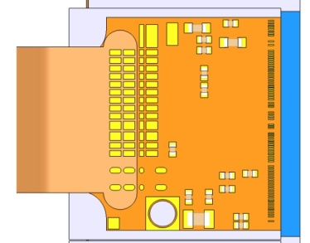
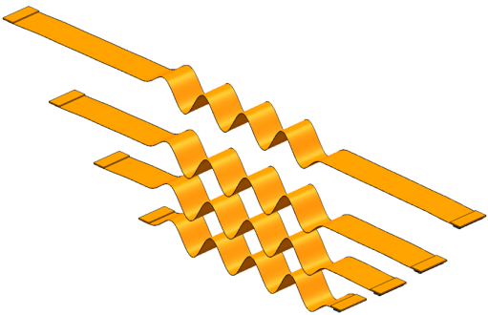
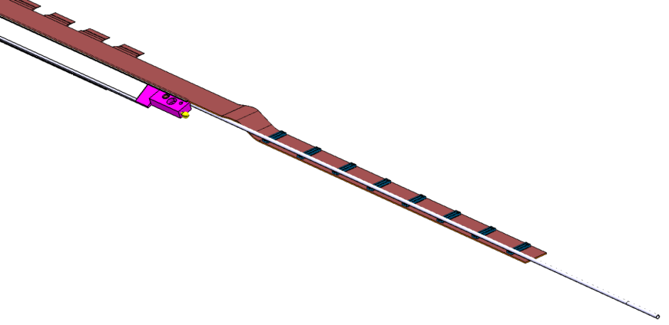
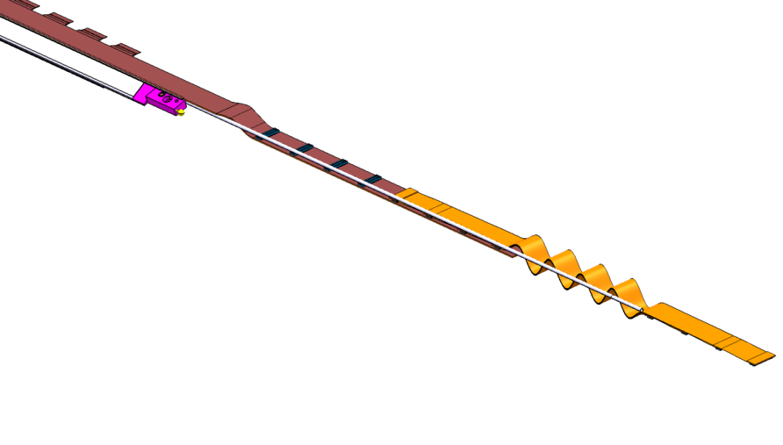
Stave Flex (Ge)
Abbiamo disegnato il module pigtail, circuito sottile da incollare sul modulo per portare segnali e alim dal flex al modulo.
  Input dalla Module TF
  https://edms.cern.ch/document/1138194/1
  In produzione alla Phoenix (VC) circa 200 pcs prototipi
Stiamo anche finalizzando il flex Al-Cu che connette moduli all’End of Stave.
  3 prototipi da Rui/Cern in test.
  Preproduzione, 12 pcs in autunno, poi produzione, ~50pcs.
  Problema e’ la connessione tra flex (semi-rigido) ai cavi (rigidi) e come compensare stress meccanici. Si pensa a un flex flessibile (Cern/Genova)
CTE measurements done in Genova
  Serves as input to FEA to estimate bow

Slide 13
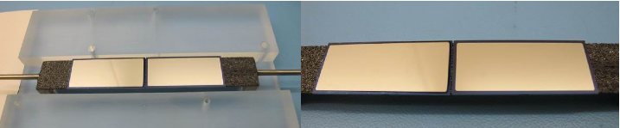
IBL status: Module loading to stave
Tool development ongoing in Geneva, first tests done on stave-lets with dummies to check module handling, glue dispersion and placement accuracy.
Stave lets loaded with silicon heaters
Issue with glue absorption in foam: will place thin single-layer or K13C pre-preg or thicker parylene on top to seal foam
  Handling of ultra-thin modules with possible danger of bump disconnection
  Connection of external pipes after loading without risk to modules.
  2 staves with Selex dummies + 1 with CNM dummy have been loaded , electr. test show no damage to bumps

Slide 14
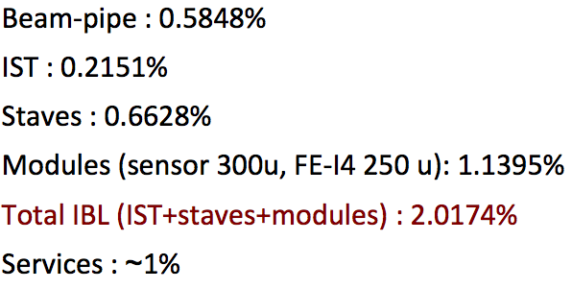
From design to real staves and modules: X0
Completed a first round of prototypes and measured weights, had additional components, realistic glue layers,….
Went from 1.5% (TDR) to 2.0% -> now go back and save material
Established an X0 task force:
  Keep tack of all material and components: have an update of X0 contineously
  Keep detector GEANT model up to date
  Investigate potential saving
Potential Savings
Stave: no faceplate | - 0.1%
Stave: 1.5mm ID pipe | - 0.1%
Modules: 230um sensor and thinner grease | - 0.1%
Modules: 100um FEI4 (150um under test by IZM) | - 0.18%
Total savings to target | -0.48%

Slide 15
IBL status: Stave 0
Stave-0 program: fully functional stave with modules
  Plan to build 1-3 fully functional staves with present qualification modules
    2 thin FEI4 wafers and present sensors could give up to 20 double-chip modules and 20 single chip modules
  Bare prototype staves and Cu/Cu flex: May
  Flex to stave lamination : urgent to start tests now; then May to do first Stave-0 laminations
  Module loading to stave 0: June to end August
  First electrical tests of stave-0: September/ October
  Stave FDR/PRR November (dicembre)

Slide 16
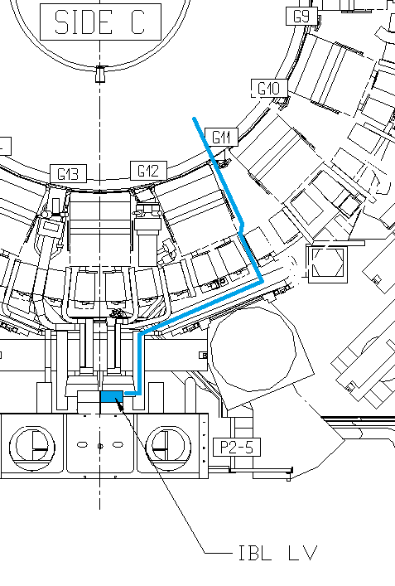
LV power system
Different VVDC channel approach
It is necessary to “integrate” the VVDC channel in the “LV/HV/DCS PP2 Patch Panel Concept”.
Some hypothesis:
A complex (LV/HV/DCS) type II cable is mandatory for easy installation
No separation of cables allowed before reaching PP2
Type II cables installed with both connectors mounted (manufacturer will deliver fully assembled cable)
Solution: Full redesign of the PP2 box to:
Accommodate 14 LV regulator boards + 1 VVDC board + 1 Controller
Separate the three cable species on a back panel
TO BE DONE IN ANY CASE

Slide 17
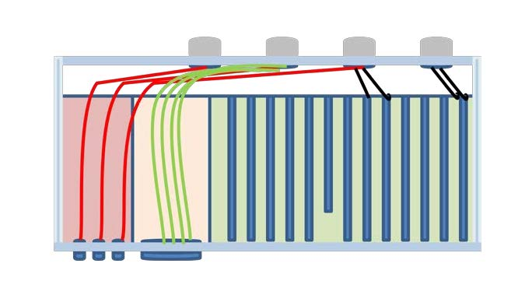
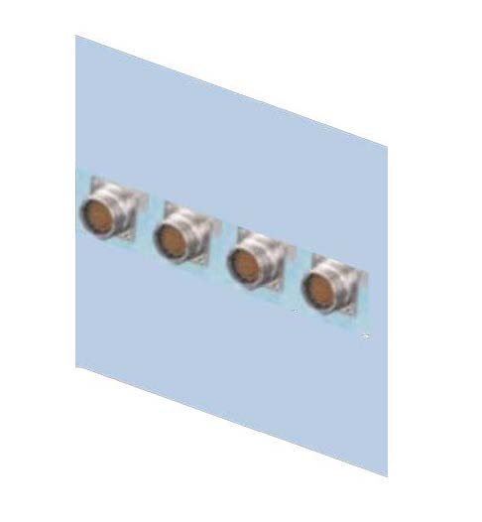
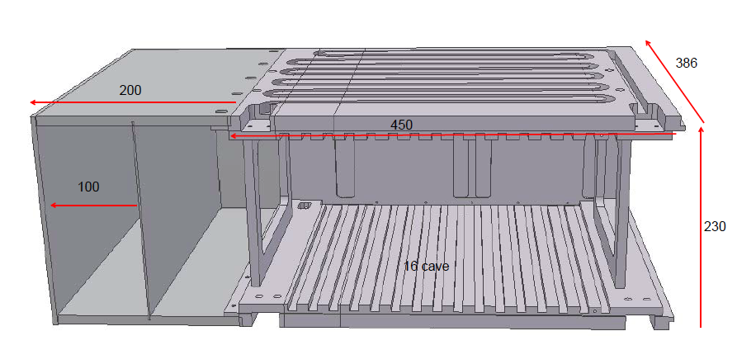
The “combined PP2 box” (Mi)
High Voltage cables
DCS Cables
SHORT Low Voltage cables
HV
DCS
LV
Three “zones” inside the same mechanical frame. HV and DCS zones will mimic a “patch panels”
The zones are separated by metal panels
Four rows of panel mount receptacles (µD 85 pin, female) will replace the existing “output board”. Prototype: one row only
Backplane layout
to be redone, part of the routing will be done through the cables

Slide 18
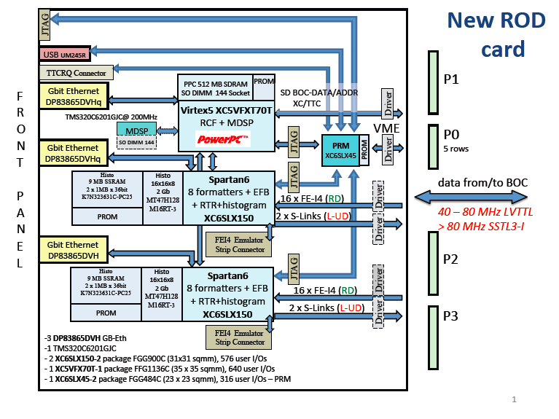
DAQ Development (Bo,Ge)

Slide 19
ROD Summary
ROD schematic is closed, with last-minute modifications (double
I/O standard)
  - final cross-checks and synthesizability of the circuit
ROD layout is started
  - floorplanning and tight contact with the layout designers – Signal Integrity, Timing Analysis – RX test on mounted boards
All the technical requirements from the IBL collaboration have been addressed
  - several modes of use for the ROD: w/wo VME crate, backward compatibility
ROD Firmware is always ongoing
  - VHDL, C-code
A full DAQ chain simulation environment is planned: never done for the present DAQ chain
  - FE VHDL and ROD code merging?, Full DAQ chain model ?
Hardware tests w/wo crates are planned in Bologna and at CERN

Slide 20
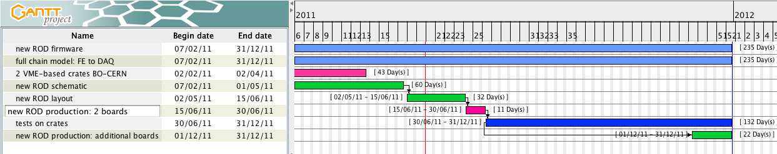
2011 ROD Feasible Schedule
ROD design and fabrication go ahead sharing the BOC schedule
Time-Plan compatibile with BOC-ROD tests on 2012

Slide 21
IBL schedule for installation 2013
During March worked out detailed schedule for installation 2013 for both scenarios (planar and 3D) based on informal input from main external vendors: CiS, CNM, FBK, IZM.
  Schedule has gone now to sensor for checks
  Tightly packed -> work steps depend strongly on each other, hence delays in component production are the key risks.
The schedule is aggressive but achievable if there are no major component failures and no major delays (e.g. due to late deliveries or late order placement)
Time critical items – We have now detailed work-plans for those items:
  Sensor pre-production run (start Feb) and sensor review/decision (July)
  FEI4 Version 2 submission (July 2011)
  Bump bonding of thin modules (workplan in preparation with IZM, aim to get first thin modules in approx 3 months)
  Stave 0 program to qualify full stave mechanically and electrically (requires rapid advancement on stave flex and module loading) (mechanical stave April-May, loaded Aug, tested Oct)
  Beam pipe qualification of split flange and order of beam pipe (submit order in April to receive pipe in July 2012 in SR1 ready for integration)

Slide 22
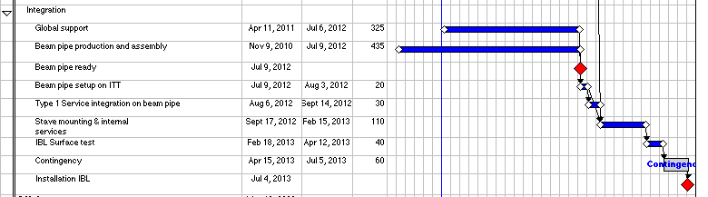
Integration and final tests
Start integration when ~ ½ staves done
Integration of type 1 services down before staves are mounted
Target Beam pipe in SR1 July 2012
Task | planar | 3D
Start stave loading | Sept 19, 2012 | Oct 15, 2012
Finish loading | Feb 15, 2013 | Mar 15, 2013
Ready for installation (12 wks contingency included) | July 4, 2013 | Aug 1, 2013

Slide 23
Summary
Installation 2013 Schedule is aggressive and requires swift move to production mode
Between now and summer 2011 several key component topics need to be addressed
  FEI4 Version 2 design
  Sensor pre-production
  sensor tests with FEI4 in testbeam and irradiations
  Final IBL module and bump-bonding of thin chips
  Stave flex and assembly of first fully functional multi-module stave (Stave 0)
Stave design is established and several prototypes are now constructed and measured
  Production material under procurement
Stave 0: assemble prototype staves with IBL qualification modules and test multi-module operation
Enter production for modules and staves this autumn

Slide 24
Richieste IBL 2012
Stime preliminari, dipendono dalle scelte finali
Acquisti dilazionabili se prolungamento DT nel 2013
 |  | ke
BO | produzione ROD e spare | 150
GE | produzione stave flex | 40
 | Produzione moduli | 25
 | acquisto PS HV (MOFA) | 55
 | acquisto HW DAQ (MOFA) | 30 | SR1
MI | pre-prod 10 schede PP2 e 4 crates | 30
 | integr BB selex | 20
 | acquisto PS LV (MOFA) | 95
 | extra costi prototyping/produzione | 30
UD | integraz. costo sensori | 40
 | Richieste (incluso MOFA) | 474
 | Richieste IBL | 294

