Slide 1
Status of FTK
& requests 2012
Next steps, funds in USA and Japan
Old Milestones: we are going to relax the schedule
Status of FTK work
Money requests for 2012
Paola Giannetti, INFN Pisa, for the FTK Group
ATLAS Italia, May 18, 2011

Slide 2
Next Steps
CERN/ATLAS: Approval at the June CB
TDR with tested prototypes confirming performance
EB/CB approval
LHCC approval
USA funds:
FY11: Engineering funds were delayed because there was no Congressionally approved US budget until a few weeks ago.
  We now have been told to expect ∼0.5 M$ for the remaining 6 months of the fiscal year for engineering and HOLAs.
  ⇒∼6 month delay in some areas
  FY12-16: MRI result expected by late summer.
  NSF officials have suggested another source of (non-HEP) funding if the MRI doesn’t succeed –a new mid-scale instrumentation program being established in the NSF Physics Division.
  US ATLAS, as part of its planning, is looking at how to fund FTK if non-HEP sources are not available
Japan funds: Much smaller amount. Discussions are going well. Increased responsibilities are possible.

Slide 3
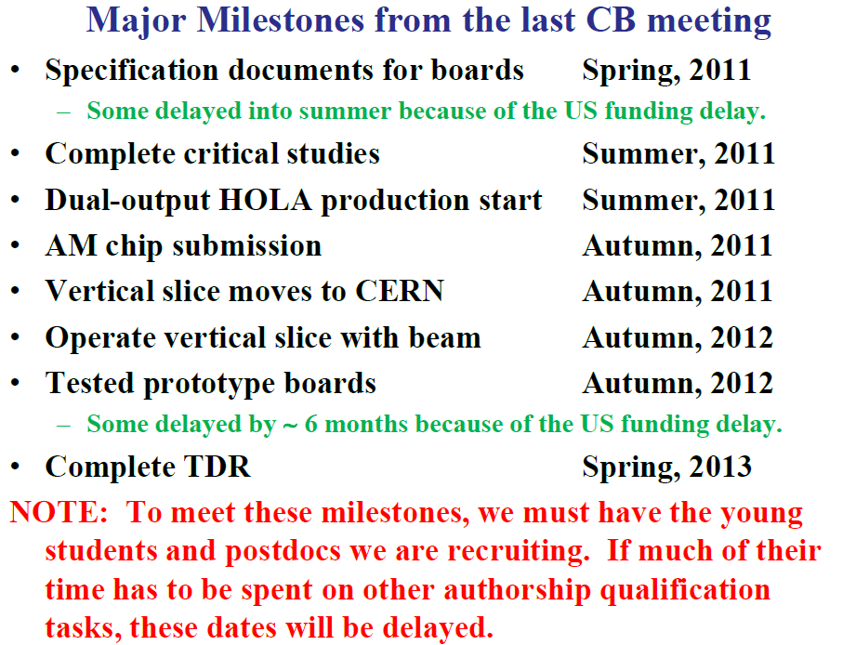
NEXT: DELAY this schedule: TDR ~ at end of 2013

Slide 4
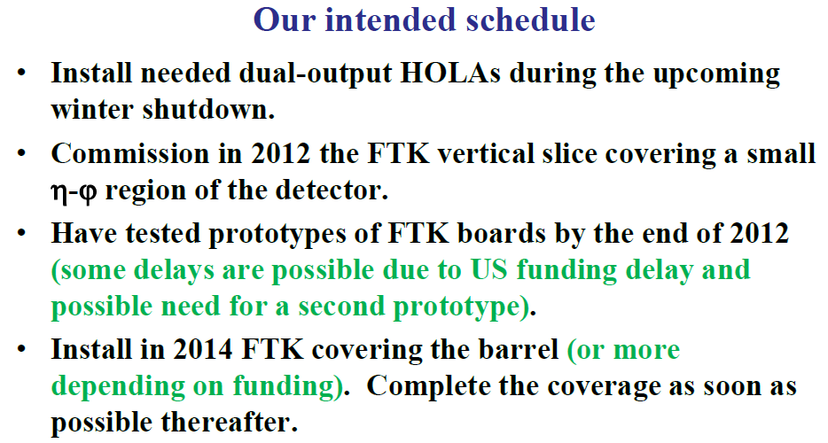
2013

Slide 5
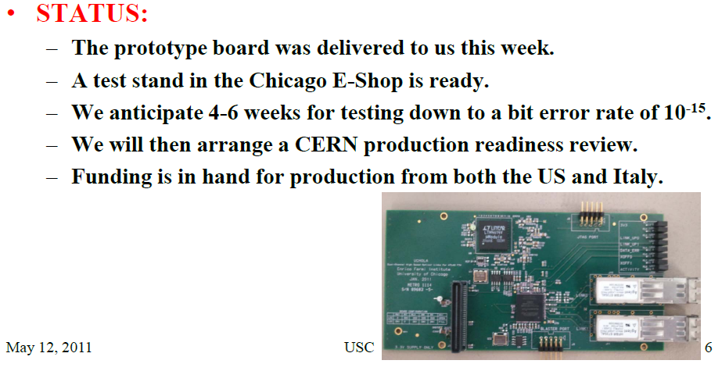
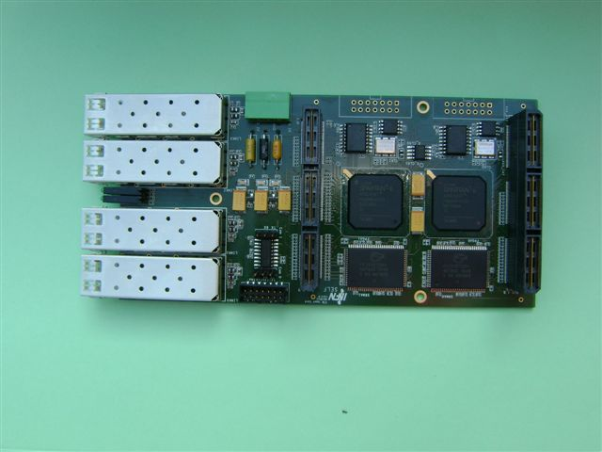
New mezzanines (Chicago, LNF)
DUAL OUTPUT HOLA
Kapliy, Shochet, Tang
Annovi, Beretta, Gatta
Clustering Mezzanine:
Under stand-alone tests
Next: to be inserted in the vertical slice
Collaborazione con Bologna: Villa e Pellegrini

Slide 6
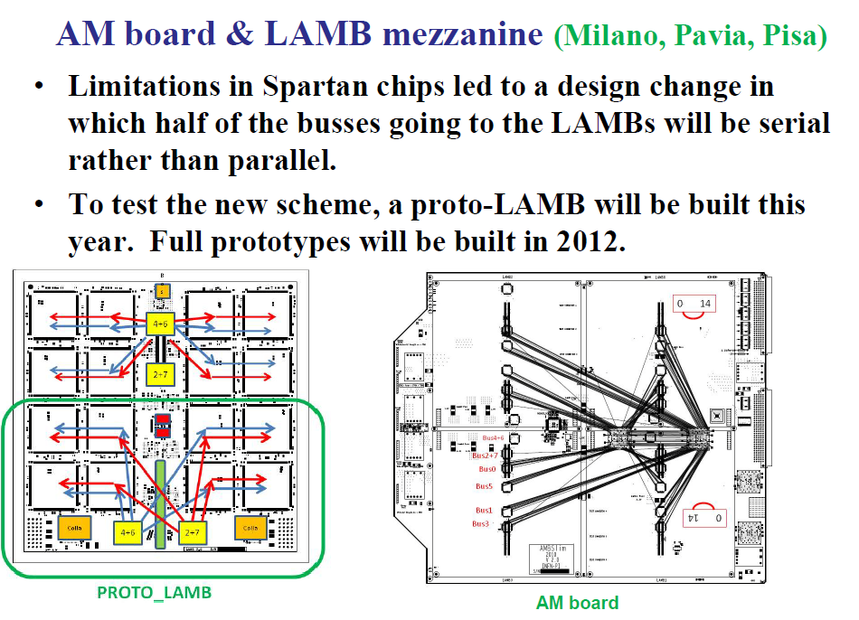
The associative memory system
Lanza, Giannetti, Piendibene
Andreani, Citterio, Giannetti, Piendibene

Slide 7

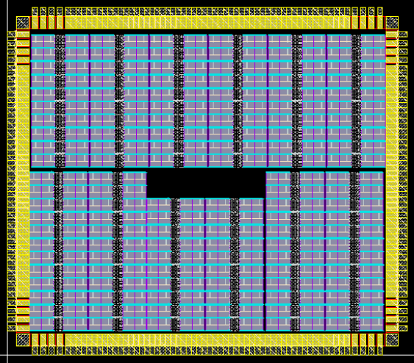
AMCHIP04 big Jump in technology!
(LNF, Pisa, Milano + ideas from USA)
Annovi, Beretta, Crescioli,
Liberali, Sacco, Stabile, Hoff
Consumption & pattern density as expected
90
nm
180
nm
3.80 mm
2010
65
nm
13 mm^2 = 8192 Patterns + 228 pads
Variable Resolution: high fake rejection with smaller banks
(Talk G. Volpi Animma 2011)
3.31 mm
2011
64 patterns= 2 full custum cells

Slide 8


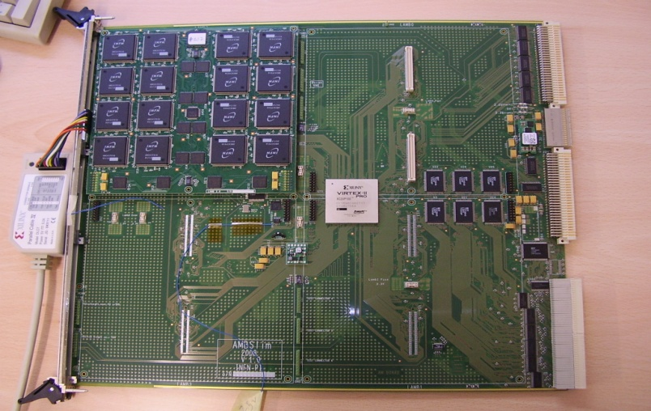
Vertical Slice plan (I version – simplified):
Bologna (EDRO) - Frascati (pixel clustering) -
Milano-Pavia-Pisa (AMboard). Today running @40 MHz
  Filar board as interface between SLINK and PC
S-link
NEXT: WE WILL
USE A TILAR
(A. Negri)
Roads
S-links
Pixel clust.
Pixel clust.
Pixels
Fired
channels

Slide 9
Vertical slice: 2011 workplan
2011 Development of global test of EDRO+AMBOARD (Villa, Giorgi, Annovi, Crescioli, Cervigni, Piendibene, Magalotti, Negri, Giannetti)
  Transfer CDF tests into TDAQ framework done
  EDRO & AMBOARD working in same crate under unique TDAQ software done
  LNF Mezzanine available: ongoing tests with Filar connections to PCs.
  FULL tests with EDRO & AMBOARD & clustering Mezzanine next
  Use of Tilar to connect to ROS next
  Tests with delivery of FTK data to many L2 CPUs when the CPUS will be in the lab
Setup of a “5kW” test stand” for boards/cooling tests (Giannetti, Lanza, Piendibene):
  PCB boards able to power 128 Amchips done, to be assembled (ordered chips, available in February).
  DELAY OF 1 COMPONENT (the DC-DC CONVERTERS) DUE TO JAPAN DISASTER
  Crate able to provide 5 kW to the boards AVAILABLE IN PISA – WILL BE AT CERN SOON
  Test of new board & production of ~5 of them - to be done
Final crate choice: discussing custom solutions with CAEN and Wiener.
Possibility to use CDF crates under study (A. Lanza, CAEN)

Slide 10
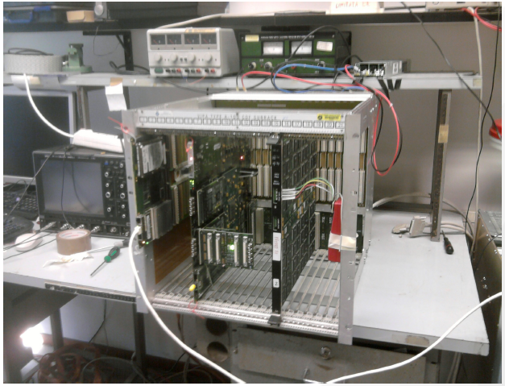
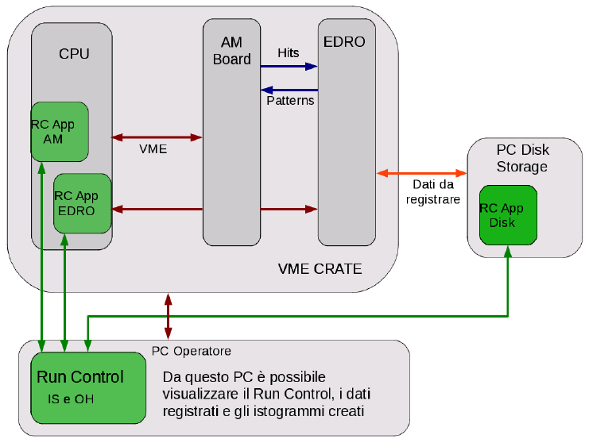
TEST SETUP used in BOLOGNA
Downloading hits from VME into
input FIFOs
AMBOARD
EDRO
SOFTWARE developed in Pisa
( Run Control application &
Monitoring Software )
integrated in the same partition
with the EDRO one
developed in Bologna
Tested simple
monitoring functions
No high frequency failures
Data (hits & roads) written on disk for analysis and search of low frequency failures

Slide 11
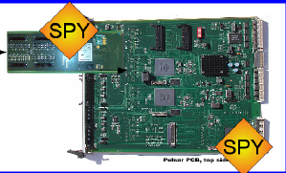
Vertical Slice plan II version (more complete):
+ DO (Bologna) & GigaFitter (from CDF)
Today running @40 MHz
  Filar board as interface between SLINK and PC
Tracks
S-link
GigaFitter
Roads
+
hits
S-link
S-links
Pixel clust.
DO
Pixel clust.
Pixels
Fired
channels

Slide 12
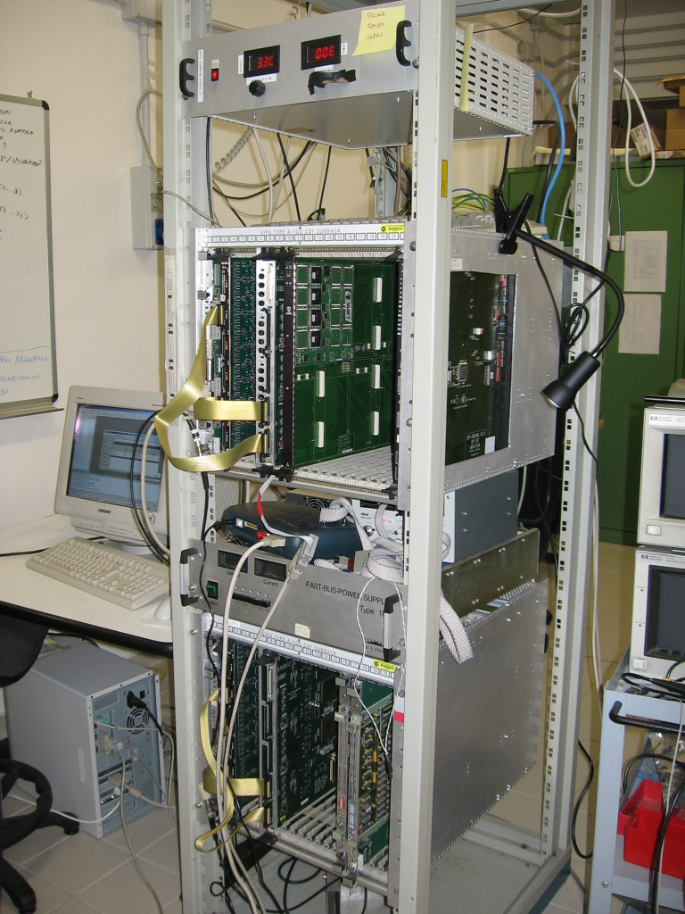
WHAT WE NEED IN THE LAB TO INSTALL
THE VERTICAL SLICE (NEXT October Version I) @ CERN
Presented to TDAQ by Negri – The lab now is empty!!
1 RACK
PISA
SETUP
1 CRATE FOR TESTS
1 CRATE FOR STORAGE OF SPARES
+
1 ROS WITH TILAR
TO RECEIVE DATA FROM FTK &
DISTRIBUTE THEM TO CPUs
1 GOOD OSCILLOSCOPE (+ 1LA?)
A COUPLE OF TABLES.
One should have 1 PC with FILAR
to be used to send pseudo detector data

Slide 13
Richieste 2012 – linee guida
Produzione rimandata
2011 si costruiscono pre-prototipi
2012 prototipi finali
chip AM 2012: possibilita’ di fare un’altro prototipo if needed
Richieste 2012
Milano: AMchip II : 60 keuro S.J. al test di AMchip I
Pisa: 15 keuro nuovo prototipo AMBoard
Pavia: 15 keuro LAMB
LNF: 15 keuro mezzanina e scheda test Amchip
Bologna: 3 keuro (spese di laboratorio)
Tot: 48 keuro + 60 keuro S.J.

Slide 14
Conclusions
Delays compared to the initial schedule due to change of LHC shutdown time:
  2015 installation of the first part of FTK
  ~end of 2013 submission of TDR
  Production delayed to 2014
  Challenging prototypes made into 2 steps
However FTK is very active and has a nice plan to take data with the vertical slice in 2012 and to demonstrate how useful is FTK

Slide 15
Backup

Slide 16
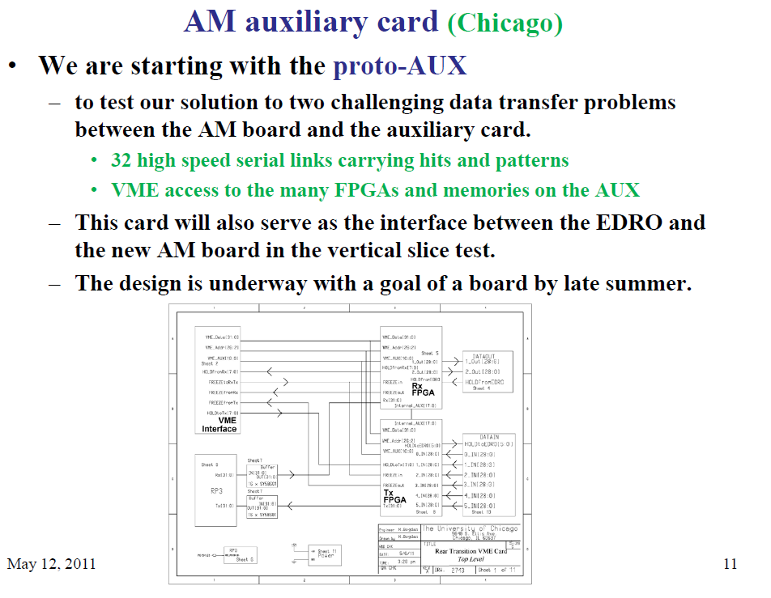

Slide 17
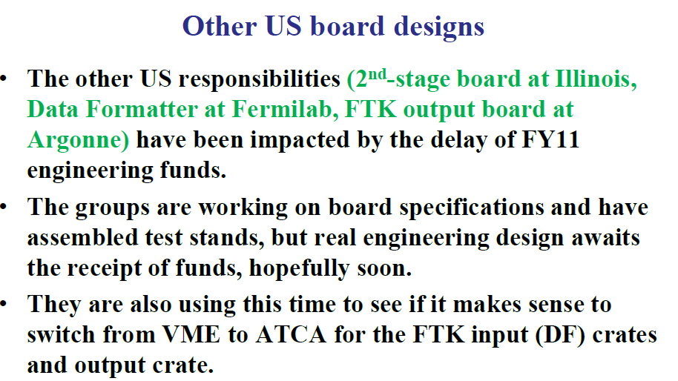

Slide 18
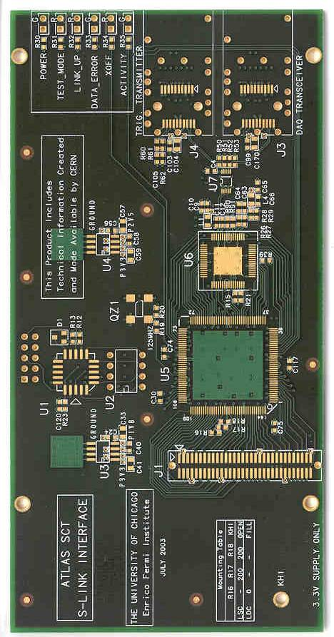
FTK: Projects to Institutions
Frascati-Waseda:
Clustering in
Pixels-SCT
mezznines
Pisa & Frascati & Fermilab
the AMChip could be 3D
USA-Italy
“2-outHola”
Pisa:
AMBoard
Pixels
& SCT
RODs
4 DF crates:
cluster finding
split by layer
8 “core” crates:
AMboard
Data Organizer
GigaFitter
Illinois:
Final board
in core crate
Fermilab:
DF motherboards
S-links
1 Readout Crate
Raw data
ROBs
Argonne
Chicago GigaFitter + Data Organizer + HW
Track data
ROB
USA+Italy: crates + links + backplanes…

Slide 19

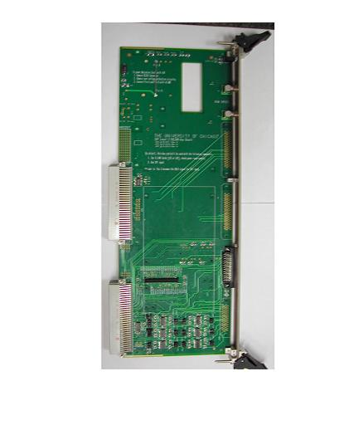
ITALIAN DUTIES for
3x10**34
OPTION A
PISA
CPU vme
DATA FORMATTER
FRASCATI
AM10+…..
AM15+…..
AM14+…..
AM9+…...
AM13+……
AM8+…..
AM11+…..
AM12+…..
AM7+TSP+DO+TF+HW
AM6+TSP+DO+TF+HW
AM4+TSP+DO+TF+HW
AM0+TSP+DO+TF+HW
AM5+TSP+DO+TF+HW
AM3+TSP+DO+TF+HW
AM2+TSP+DO+TF+HW
AM1+TSP+DO+TF+HW
11LayFit+ HW final
11LayFit+ HW final
11LayFit+HW
11LayFit+HW
Processing Unit
Pisa +Chicago
AUX card
Standard cell chip
DO+TF+HW
Interface
Connectors for
tracks output
FERMILAB
LAMB
Control
FPGA
DO
TF
HW
FPGA
for
Roads
DO
TF
HW
DO
TF
HW
Connectors for
Hits LVDS Cables
40 MHz clock
DO
TF
HW
FPGA
for
SS
Input
P3
serial
LVDS
DO
INPUT
FIFOs
SSMAP
AMBoard

