Slide 1
E_{T}^{miss} Performance in ATLAS data 2010
Rosa Simoniello
Università degli Studi di Milano & INFN

Slide 2
Italian groups working on E_{T}^{miss}
Milano group (Donatella Cavalli, Silvia Resconi, Caterina Pizio, Rosa Simoniello):
  Developed the E_{T}^{miss} algorithm → Collaboration with: Peter Lock (Arizona), Adam Yurkewicz (Stony Brook)
  MissingET package maintenance
  Silvia Resconi co-convener of “JetEtmiss data preparation Task Force”
  Strongly involved in E_{T}^{miss} commissioning since first data taking (co-editors of all E_{T}^{miss} CONF notes in ATLAS)
Frascati group (Mario Antonelli, Marianna Testa):
  Developed energy flow calibration for the low energy contribution to the E_{T}^{miss}
  Determination of the E_{T}^{miss} absolute scale using W →ℓν events (taking over from Caterina Pizio)

Slide 3
E_{T}^{miss} CONF notes
Note: ATLAS-COM-CONF-2010-008
Title: Performance of the missing transverse energy reconstruction in minimum bias
events at a Center-of-Mass Energy of 900 GeV and 2.36 TeV with the ATLAS
detector (15 Feb 2010)
Editors: Cavalli, D.; Pralavorio, P.
Note: ATLAS-COM-CONF-2010-039
Title: Performance of the missing transverse energy reconstruction in proton-proton
collisions at center-of-mass energy of 7 TeV with the ATLAS detector
(12 May 2010)
Editors: Baak, M.; Resconi, S.
Note: ATLAS-COM-CONF-2010-059
Title: Performance of the Missing Transverse Energy Reconstruction and Calibration
in Proton-Proton Collisions at a Center-of-Mass Energy of 7 TeV with the ATLAS
Detector (15 Jun 2010)
Editors: Cavalli, D.; Liang, Z.; Yurkewicz, A.
Note: ATLAS-COM-CONF-2011-035
Title: Reconstruction and Calibration of Missing Transverse Energy and Performance
in Z and W events in ATLAS Proton-Proton Collisions at √s=7 TeV
(approved 17 May 2011)
Editors: Cavalli, D.; Dobson, E.

Slide 4
Towards the E_{T}^{miss} PAPER
All E_{T}^{miss} results will enter in the E_{T}^{miss} PAPER (PERF-2011-007)
(D. Cavalli, S. Resconi co-editors) that should be published in June.
Supporting note:
Note: ATL-COM-PHYS-2011-417
Title: Reconstruction and Calibration of Missing Transverse Energy and Performance
in Z and W events in ATLAS Proton-Proton Collisions at √s=7 TeV
(supporting the respective CONF note)
Authors: 16 → Italians: Antonelli, M.; Cavalli, D.; Pizio, C.; Resconi, S.; Simoniello, R.,
Testa, M.
Note: ATL-COM-PHYS-2011-496
Title: Performance of Missing Transverse Energy Reconstruction and Calibration in
QCD and minimum bias events in ATLAS Proton-Proton Collisions at √s=7TeV
Authors: 5 → Italians: Cavalli, D.; Resconi, S.; Simoniello, R.
Note: ATL-COM-PHYS-2011-495
Title: Determination of the absolute scale of the Missing Transverse Energy using
W →ℓν events selected by ATLAS in Proton-Proton Collisions at √s=7 TeV
Authors: 4 → Italians: Antonelli, M., Pizio; C.; Testa, M.

Slide 5
Outline
General information about E_{T}^{miss} reconstruction
RefFinal algorithm
Performance in events with different topologies
φ^{miss} and ∑E_{T} distributions
E_{T}^{miss} Systematic Uncertainty
E_{T}^{miss} scale

Slide 6
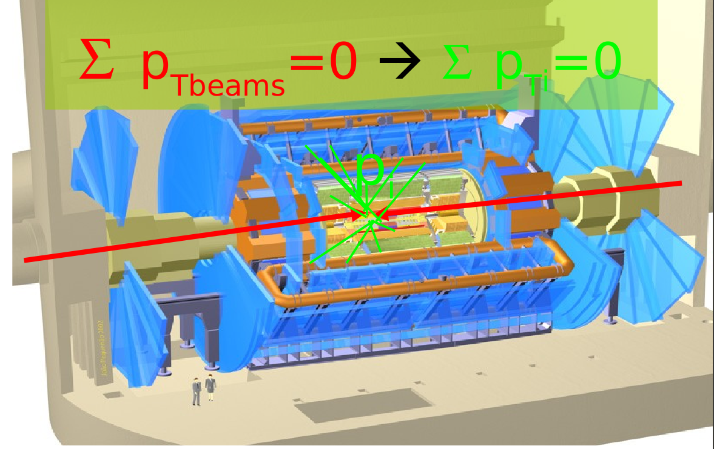
E_{T}^{miss} reconstruction in ATLAS
E_{T}^{miss} is a complex event quantity:
  It’s calculated adding all significant signals from all detectors:
    Calorimeters signals (input: cells, TopoClusters)
    Muon signals
    Tracks in region where the Calorimeter and the Muon Spectrometer are inefficient
Missing Transverse Energy:
{
Sum of energy of all
particles seen in the
detector

Slide 7
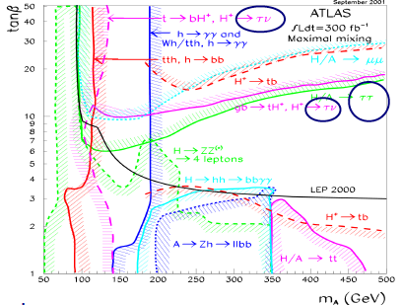
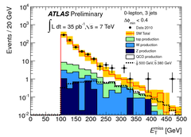
E_{T}^{miss} importance in ATLAS physics
TRUE ETMISS
FAKE ETMISS
True E_{T}^{miss} is due to not interacting particles in the detectors (ν, LSP)
A good E_{T}^{miss} measurements is crucial for studies of many physics channels in ATLAS:
  W → lν, Z→ττ, ttbar
  SM Higgs (VBFh→ττ, tth→ττ)
  MSSM Higgs (A/H→ττ, H±→τν)
    → reconstruct the invariant ττ mass
  SUSY (R-parity conservation)→ large E_{T}^{miss} signature → LPS
Particles outside the detector acceptance
Other particles arriving at the detector
Energy lost in dead materials
Electronic noise
Pileup
Problems in the detectors
A bad measurements of E_{T}^{miss} could fake a non-zero reconstructed E_{t}^{miss} in the event with no physical E_{T}^{miss} → QCD with fake E_{T}^{miss} are a background for inclusive no-lepton SUSY events

Slide 8
RefFinal algorithm
RefFinal algorithm
Best configuration
Eflow algorithm

Slide 9
RefFinal Algorithm
Electrons
Photons
Taus
Jets
SoftJets
Muons
TopoClusters
not in objects
Go back to constituent Calorimeter Topoclusters → Cells → apply overlap removal at Cell level
→ Cell calibration weights dependent on the object → add them to calculate partial terms
MET_RefEle
+
MET_Ref
+
MET_RefTau
+
MET_RefJet
+
MET_SoftJet
+
MET_RefMuon
+
MET_CellOut
+
MET_Muon
=
MET_RefFinal
cells are calibrated on the basis of the reconstructed physics object to which they belong
Very flexible algorithm → it allows to use the best calibration for each object

Slide 10
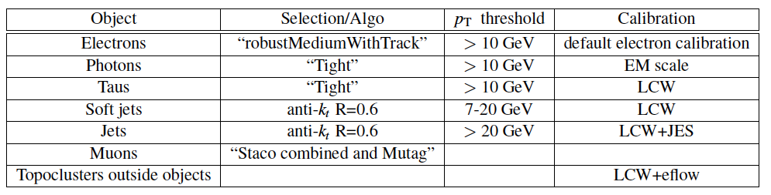
RefFinal Configuration
This configuration gives the best performance (see CONF note)
Recently recommended for future analysis in ATLAS
It is based on LCW (Local Hadron) calibration
Calibration of topoclusters outside reconstructed objects improved adding tracks information → next slide

Slide 11
Eflow Algorithm for CellOut
The CellOut term is improved using reconstructed tracks:
  add tracks which do not reach the calorimeter or do not seed a topocluster
  when a track is associated to a topocuster the track momentum is used instead of the topocluster energy.

Slide 12
E_{t}^{miss} performance in W/Z/Dijets events
E_{T}^{miss} distributions
φ^{miss} distributions
Diagnostic plot
Resolution curves
Linearity
∑E_{T} distribution

Slide 13
Data and MC samples
Analyzed data 2010:
Z→ll, W→lν:
  ≈ 36pb⁻¹
  similar selections used by WZ group
Dijets:
  ≈ 600nb⁻¹ (prescaled trigger)
  2 jets with p_{T}>25GeV
Minbias:
  ≈ 0.3nb⁻¹ → period A
Monte Carlo:
Pythia/MC@NLO samples (Z→ll, W→lν, Jx, minbias, EW backgrounds)
Same selection applied for data
In-time pileup

Slide 14
E_{T}^{miss} distribution
Z→ee
Z→µµ
ATLAS Preliminary
ATLAS Preliminary
W→eν
W→µν
ATLAS Preliminary
ATLAS Preliminary
MC normalised to data, after each MC sample is weighted with its cross-section and reweighted to the data nVertex distribution
Good data-MC agreement
Tails (in Z events) well understood (SM backgrounds, mis-measured jets)
QCD background not shown in the plots: ~ 1% in Z events, ~ 2-3% in W events

Slide 15
φ^{miss} distribution
Z→ee
W→eν
ATLAS Preliminary
ATLAS Preliminary
φ^{miss} very sensitive to all problems/non-uniformities in calorimeters
data-MC good agreement (improvements in rel16, data and MC have cell coordinates updated to reflect the measured position of FCal).
All E_{T}^{miss} distributions shown are calculated in |η|<4.5 due a still not perfect description of FCal in MC. Distributions in |η|<4.5 are still better then the ones in |η|<5 which, however, show a big improvement.

Slide 16
E_{T}^{miss} distributions of RefFinal terms (Z→ee)
2 balanced jets
Electrons term
0 jets
unbalanced jets pt>20GeV
ATLAS Preliminary
ATLAS Preliminary
Jets
p_{T}>20GeV
term
Jets 7GeV<p_{T}<20GeV term
Cells in topoclusters outside objects
ATLAS Preliminary
ATLAS Preliminary
Good agreement data-MC

Slide 17
E_{T}^{miss} distributions of RefFinal terms (Z→µµ)
Calo muon term
Muon term
ATLAS Preliminary
ATLAS Preliminary
Distribution of E_{T}^{miss} computed
with cells crossed by muons
in calorimeter
Distribution of E_{T}^{miss} computed
from reconstructed muons
Good agreement data-MC

Slide 18
Diagnostic plot (Z events)
Z→µµ
l+
E_{T}^{miss}
ATLAS Preliminary
p_{T}(Z)
Longitudinal axis
Hadronic recoil
l-
Perpendicular
axis
Z→µµ
E_{T}^{miss} should be balanced along the longitudinal axis
E_{T}^{miss} along longitudinal axis has a negative bias for low values of p_{T}^{Z}, probably due to underestimation of hadronic recoil
imperfections in CellOut and SoftJets terms calibration
CellOut improved with tracks (black dots) reduces the bias in events where there are no jets with p_{T}>7GeV
ATLAS Preliminary

Slide 19
Resolution curves
Data
MC
On x-axis there’s the ∑E_{T} of the whole event (calo+muon).
For W events the resolution is calculated only for MC because it is necessary the E_{T}^{miss,truth} value.
Leptons are better measured: Z events (two leptons) has a better resolution then W events (one lepton) which have a slightly better resolution then MinBias and QCD events.

Slide 20
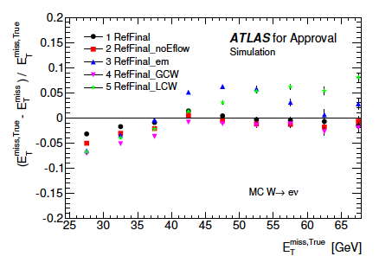
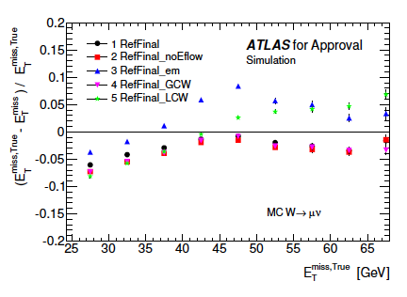
Linearity
W→eν
W→µν
ATLAS Preliminary
ATLAS Preliminary
Linearity from MC W events
E_{T}^{miss,reco} is positive by definition, so the linearity is negative for E_{T}^{miss} values near 0GeV (<40GeV)
Due to the finite detector resolution linearity distributions show a displacement from 0:
  Weν → at most 1%
  Wµν →at most 4% (tune better the contribution of muons in calo?)

Slide 21
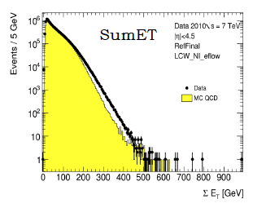
∑E_{T} distribution
Pythia MC09 (last year)
Pythia MC10 (now)
Pythia8 (CMS tune)
Not yet published by ATLAS
Pythia MC09 → mismodelling in the soft physics
Pythia MC10 → new tune to increase the underline event activity → improvements in data-MC agreements
Pythia8 (used by CMS)
  → Lower statistics available => compared
  with data from only one run
  → good agreement data-MC but still not
  perfect

Slide 22
E_{t}^{miss} Systematics
Systematic uncertainty from MC
Systematic uncertainty from topoclusters energy scale uncertainty

Slide 23
E_{T}^{miss} Systematic Uncertainty
The refined E_{T}^{miss} makes use of reconstructed objects, so its
systematic uncertainty can be calculated from the uncertainty on
each high-pt reconstructed objects (provided by CP ATLAS groups) and
from the uncertainty on SoftJets and CellOut terms.
The contribution of each term varies for different channels
in Z and W events the contribution of SoftJets and CellOut is important.
→What is done in the CONF note:
Evaluation of systematic uncertainty on SoftJets and CellOut term:
same approach as for evaluation of JES uncertainty:
systematic uncertainties from various sources estimated with MC dedicated simulation
same approach as for W/Z cross-section paper:
systematic uncertainty on SoftJets and CellOut is evaluated from the topocluster energy scale uncertainty
Notes:
23

Slide 24

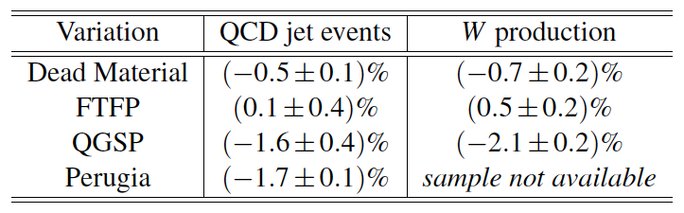

Systematic Uncertainty on CellOut and SoftJets terms
Evaluation from MC
Evaluation from topocluster energy scale uncertainty (very conservative estimation to be improved)
Used MC with different dead material description, shower models, underlying event and FSR
Shift topocluster energy scale with the formula:
CellOut Uncertainty ~ 13%
combining with MC uncertainties: CellOut Uncertainty ~ 13.2%
< 1 % on RefFinal
It gives an uncertainty on CellOut term of 2.6%.
In the same way, on SoftJets term we get
SoftJets Uncertainty ~ 10.5% → < 0.5 % on RefFinal

Slide 25
Systematic Uncertainty on CellOut and on RefFinal
CellOut
Impact of CellOut on RefFinal
ATLAS Preliminary
ATLAS Preliminary
Despite the uncertainty on SoftJets and CellOut terms are quite large (due to a very conservative estimation) , their effect on the whole E_{T}^{miss} RefFinal is small
In Top and SUSY events (where SoftJets and CellOut terms have a smaller contribution than the ones in W events) the impact on the RefFinal systematics uncertainty is smaller
Systematic uncertainty on LCW Jets given yesterday by jet group

Slide 26
E_{t}^{miss} SCAlE
M_{T} method

Slide 27
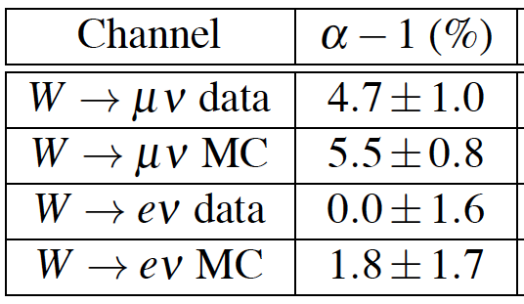
E_{T}^{miss} Scale
E_{T}^{miss} scale determined from the study of the shape of the lepton-neutrino transverse mass distribution in
W → lν events
Method sensitive to both E_{T}^{miss} scale (α) and resolution (σ)
E_{T}^{miss,true} (p_{T}^{ν}) scaled and smeared
Estimate background by fit data using a linear combination of signal and background M_{T} distributions obtained from the MC simulation (Ratio of Electroweak background fixed through ratio of cross sections)
E_{T}^{miss} scale results in agreement with Linearity results
Only statistical uncertainty
Systematic uncertainty ~ 1%
=> Total uncertainty ~ 2%

Slide 28
Conclusions
From validation plots in the last CONF note the RefFinal calibration is recommend for physical analysis in data 2010
The φ^{miss} and ∑E_{T} distributions show improvements
The systematics uncertainties for CellOut and softjets terms are also provided.
A first and preliminary evaluation of the E_{T}^{miss} absolute scale is done in-situ using W events.
Ongoing
Tool to provide MET_RefFinal systematic uncertainty
Study of the pileup in data 2011
Move the Milano group in the A/H→ττ analysis where the E_{T}^{miss} performance are crucial in invariant mass reconstruction (see Sofia’s talk)
Frascati group: optimization of the eflow algorithm and determination of E_{t}^{miss} scale with data 2011

Slide 29
Back up

Slide 30
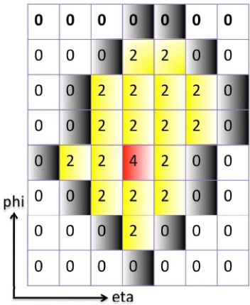
Topoclusters
Topo-Clusters are groups of calorimeter cells topologically connected
Noise suppression via noise-driven clustering thresholds:
  Seed, Neighbour, Perimeter cells (S,N,P) = (4,2,0)
  seed cells with |E_{cell}| > Sσ_{noise} (S = 4)
  expand in 3D; add neighbours with |E_{cell}|>Nσ_{noise} (N = 2)
  merge clusters with common neighbours
  add perimeter cells with |E_{cell}|>Pσ_{noise} (P = 0)

Slide 31
Local cluster weighting calibration scheme
(Local hadronic calibration or LCW)
Local Hadron Calibration classifies calorimeter clusters as hadronic and electromagnetic, according to cluster topology and weights each cell in clusters according to the cluster energy, the cell energy density, the pseudorapidity, the isolation and the depth in calorimeter. Additional corrections are applied for energy deposited in calorimeters outside of clusters and the energy deposited in dead material.
Finally, for the proper jet calibration, a p_{T} and η dependent correction is applied to reach the calibrated jet energy scale.

Slide 32
RefFinal Calibrations
Configuration | eγ | RefMuon | Jet (pt>20GeV) | Softjets (7GeV<pt<20GeV) | CellOut | Tau
RefFinal | default | STACO | AntiKt6 LCW+JES | AntiKt6 LCW | LCW+eflow | LCW
RefFinal_em | default | Muid | AntiKt4 EM+JES | AntiKt4 EM | EM | EM
RefFinal_GCW | default | STACO | AntiKt6 GCW+JES | AntiKt6 GCW | GCW | LCW
RefFinal_LCW | default | Muid | AntiKt6 LCW | AntiKt6 LCW | LCW | LCW
RefFinal_noTracks | default | STACO | AntiKt6 LCW+JES | AntiKt6 LCW | LCW | LCW

Slide 33
Data and Montecarlo samples used
DATA 2010: periods F-I ~36pb-1
--7 TeV e/γ and muon Streams - W/Z official skims - JetEtmiss D3PD
GRL inclusive for both electron and muon analysis
At least 1 good primary vertex, |vxp_z|<200mm, with Ntrack>=3
Jet-Cleaning : remove events with at least 1 jet with pT>20 GeV with
Antikt6TopoEM_IsBadMedium=1 (do not use jets if DR<=0.4 with electrons)
MONTE CARLO Pythia MC10
--Z/W events 100 + 100 Kevts/ 140+140 Kevts
events with in-time pileup →re-weight to match the number of vertex
distribution in data
--tt, WW, WZ, W→τν for background evaluation
--Minimum Bias for resolution comparison
Notes:
33

Slide 34
Z→ll selection “similar” to the ones adopted for Z analysis in rel16
Trigger
Muon Data:
Period F-G1 (runs 162347 to 165632) : EF_mu10_MG
Period G2-I1 (up to run 16757) : EF_mu13_MG
Period I1 (from run 167607) - I2 : EF_mu15
Muon MC:
EF_mu10_MG
Electron Data:
EF_e15_medium
Electron MC
EF_e15_medium
Z→ μμ: exactly 2 good muons of opposite charge
Combined muons, pT>20GeV and |η|<2.5
Cuts on number of hits used to reconstruct inner track
z displament from vertex <10mm
Isolation: ptcone20/pt<0.1.
Z→ee: exactly 2 electrons of opposite charge
ElectronMedium_WithTrackMatch electrons with pT>=20 GeV and |η|<=2.47
not in cracks
Remove electron clusters if in OTX
Z reconstructed mass in 66-116 GeV
~9000 Z→ee events and ~13000 Z→μμ events in data (~2% background expected)
~27000 Z→ee events and ~36000 Z→μμ events in MC
Notes:
34

Slide 35
W→lν selection “similar” to the ones adopted for Z analysis in rel16
Muons: use same criteria as Zμμ
Electrons: use ElectronTight_WithTrackMatch and Isolation: Etcone40/Et<0.5.
Di-lepton veto applied
- no other electrons medium pT>10
- no muon combined
EtMiss>25GeV
mT (lepton-EtMiss)>50 GeV
~85000 W→eν events and ~105000 W→μν events selected in data
(~5% background expected)
~40000 W→eν events and ~51000 W→μν events selected in MC
Notes:
35

Slide 36
Systematic uncertainty on RefJet
Systematic uncertainty on RefJet ~ 3-4%
=> on RefFinal: ~ 1% slightly increasing with ∑E_{T}
→in agreement with the ones obtained by jet group

