Slide 1
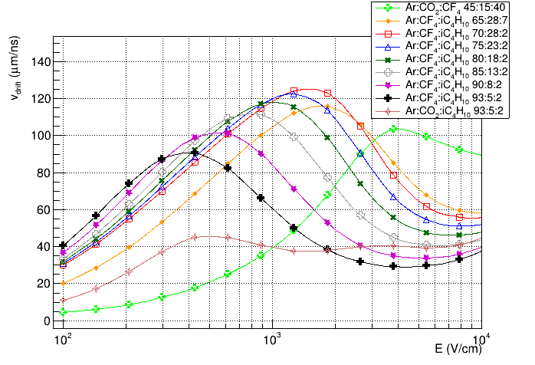
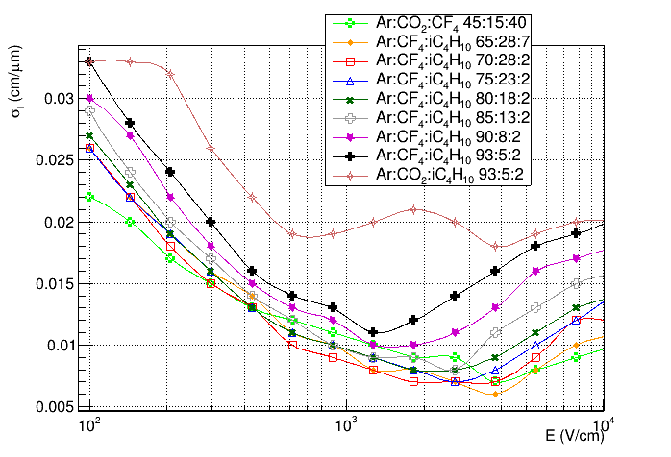
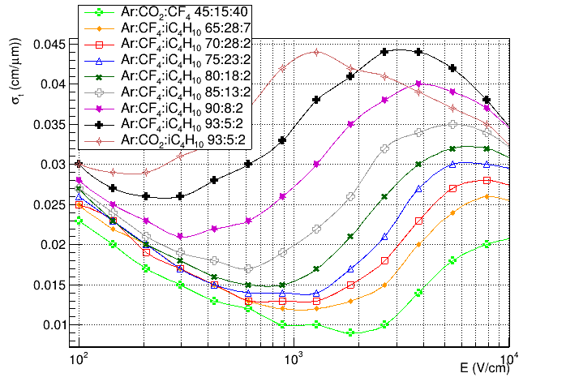
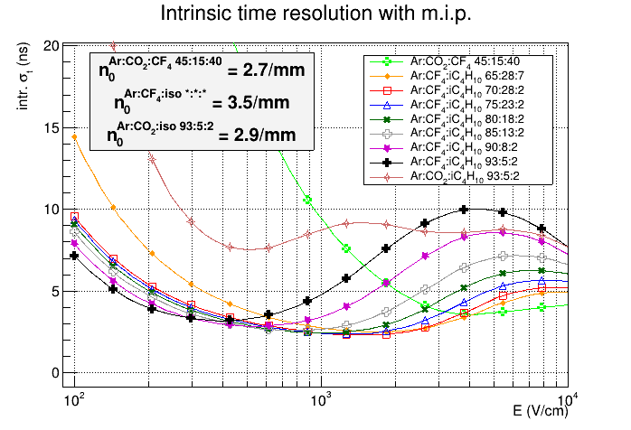
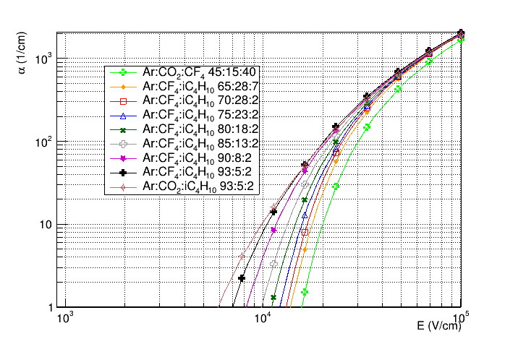
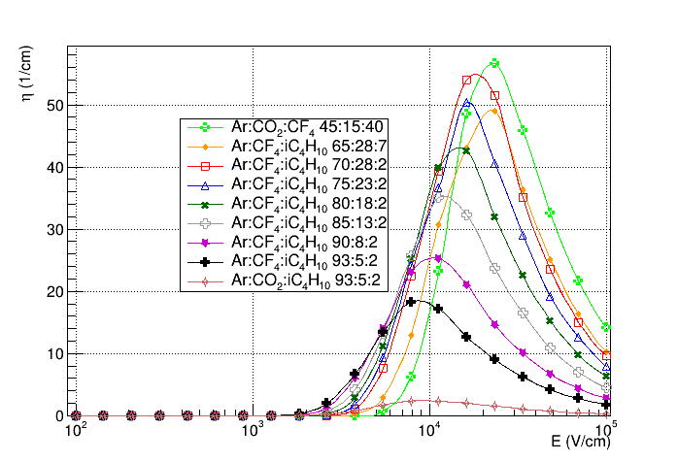
Gas Mixture properties with mip
Ar/CF4/ISO mixtures vs Ar/CO2/ISO & standard LHCb mixtures
Drift velocity
Long. Diffusion
Tran. Diffusion
125
90
45
Primary Ionization (mip)
Townsend coeff.
Attachment coeff.
Lower HV wrt 45/15/40
Similar wrt 45/15/40
7.5 ns
3 ns

