Slide 1

Beam coupling impedance and collective effects for the Future Circular Lepton Collider
Emanuela Carideo
Special thanks:
M. Migliorati, F. Zimmermann, M. Zobov, D.Quartullo, Y.Zhang, M.Behtouei, B.Spataro
FCCIS – The Future Circular Collider Innovation Study. This INFRADEV Research and Innovation Action project receives funding from the European Union’s H2020 Framework Programme under grant agreement no. 951754. The information herein only reflects the views of its authors and the European Commission is not responsible for any use that may be made of the information.

Slide 2
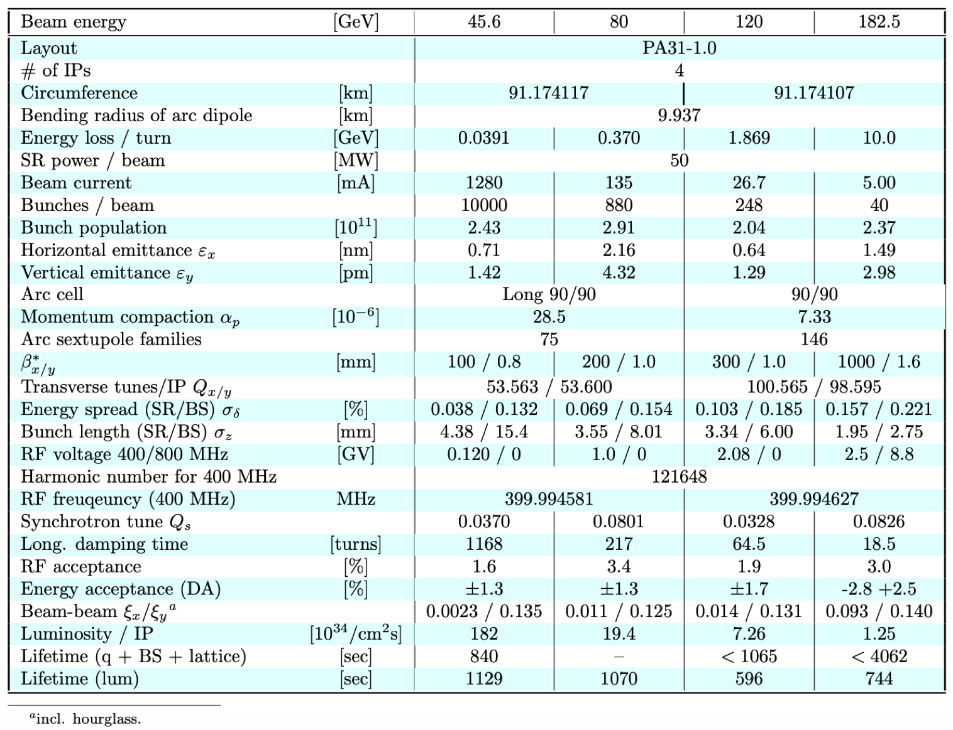
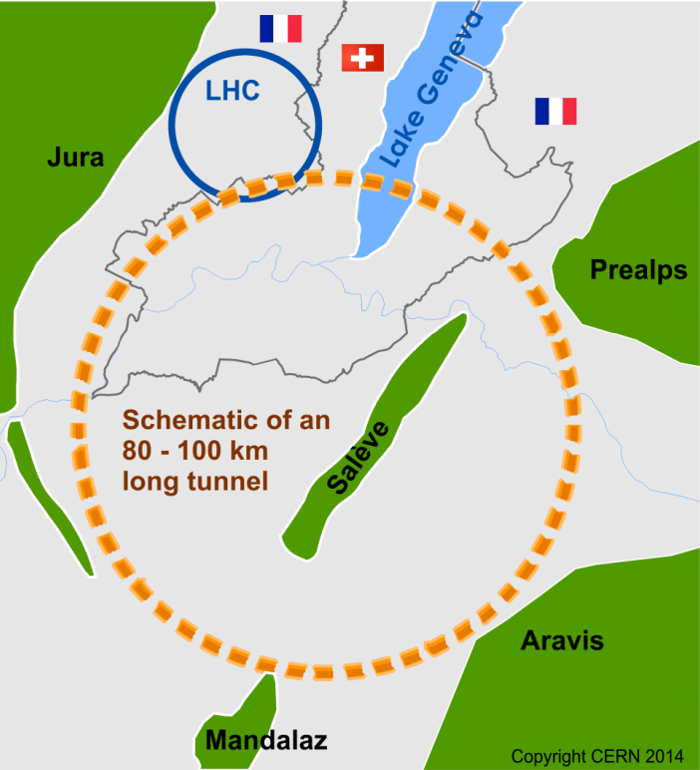


FCC-ee main parameters
High luminosity e⁺e⁻ collider as potential first step to cover a beam energy range from 45.6 GeV to 182.5GeV

Slide 3
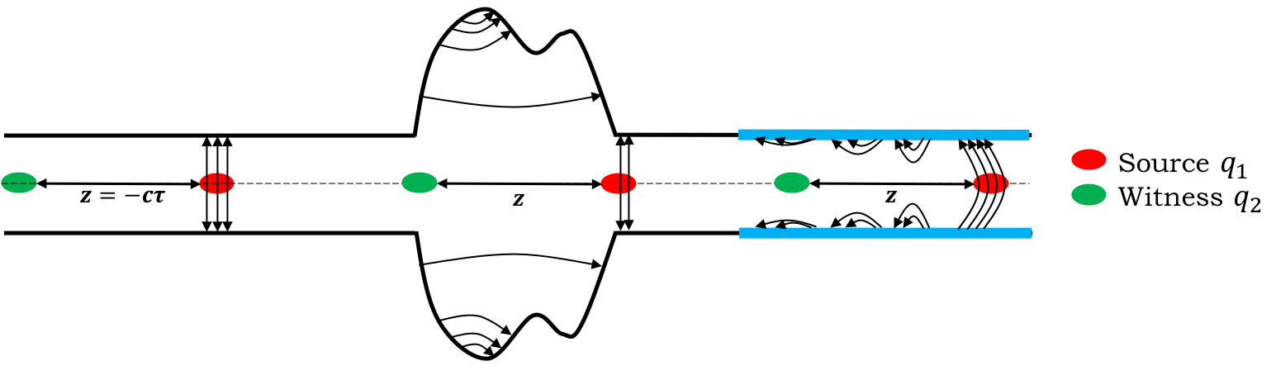
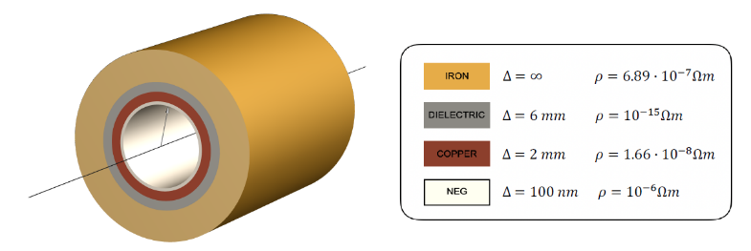
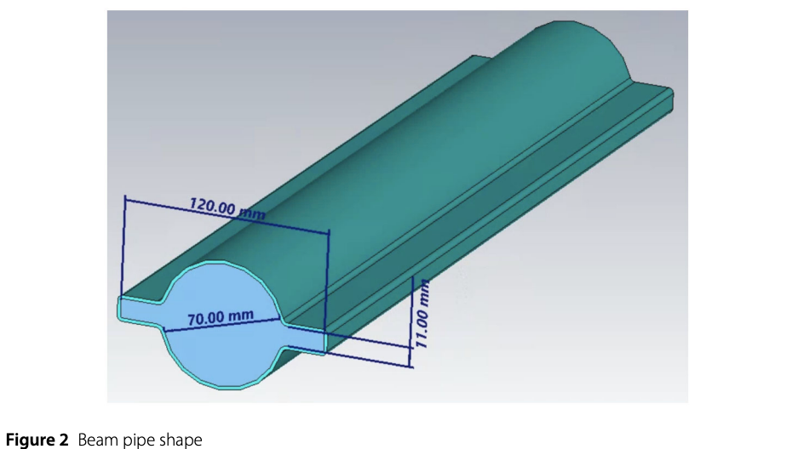
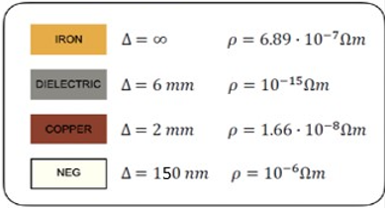

Resistive wall
      The interaction of the beam with the environment can produce wakefields (impedances in the frequency domain) that induce instabilities
      The resistive wall impedance is produced by the finite conductivity of the pipe walls. The presence of the coating affects the RW impedance, increasing its imaginary part. The coating of the copper surface is required to reduce the SEY of the beam pipe walls for EC mitigation. The presence of this film makes the surface resistance of the beam pipe higher than pure copper
      Since the resistive wall impedance is proportional to $C$, its contribution to the total machine impedance increases linearly with the machine length.
      The main difference between FCC-ee and other colliders is its large circumference ≈ $91.17$ km
      By increasing the machine length the contribution of the RW impedance assumes more and more importance with respect to other elements
35mm
      In FCC-ee, RW represents the main source of wakefields

Slide 4
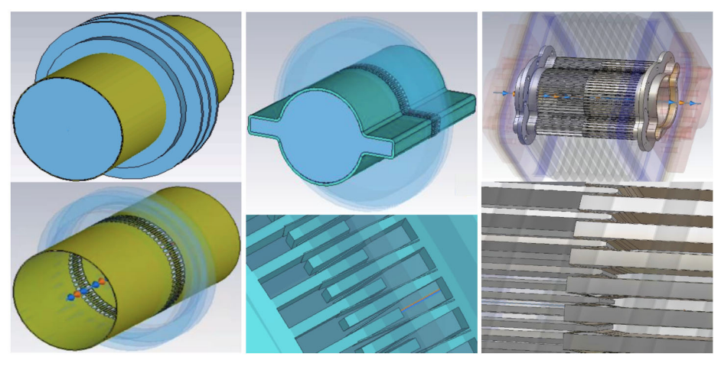
Main impedance sources: Bellows
They represent the second highest impedance source so far. We have used an upper pessimistic estimate of 20000 bellows
Simulated models of FCC-ee beam vacuum chamber including bellows. On the left there is a simplified model with circular geometry, in the centre a simplified model with winglets, on the right the realistic model
Other models are being considering for example from ESRF.

Slide 5
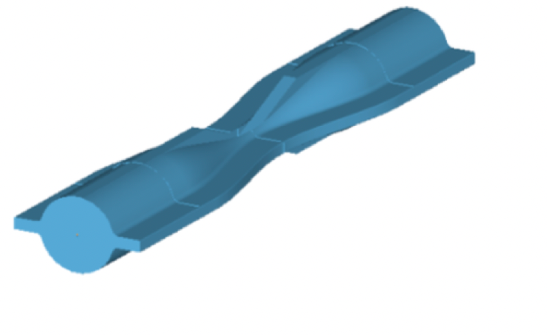
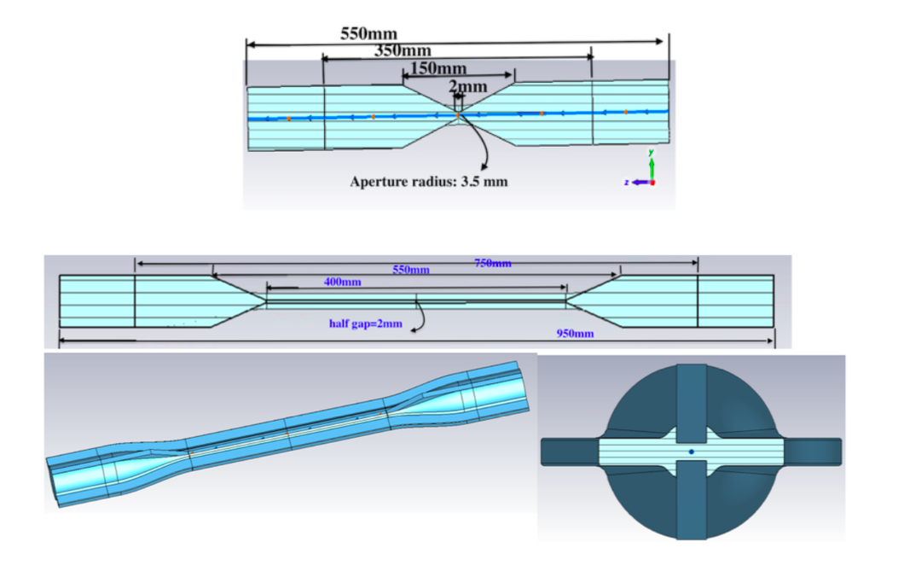
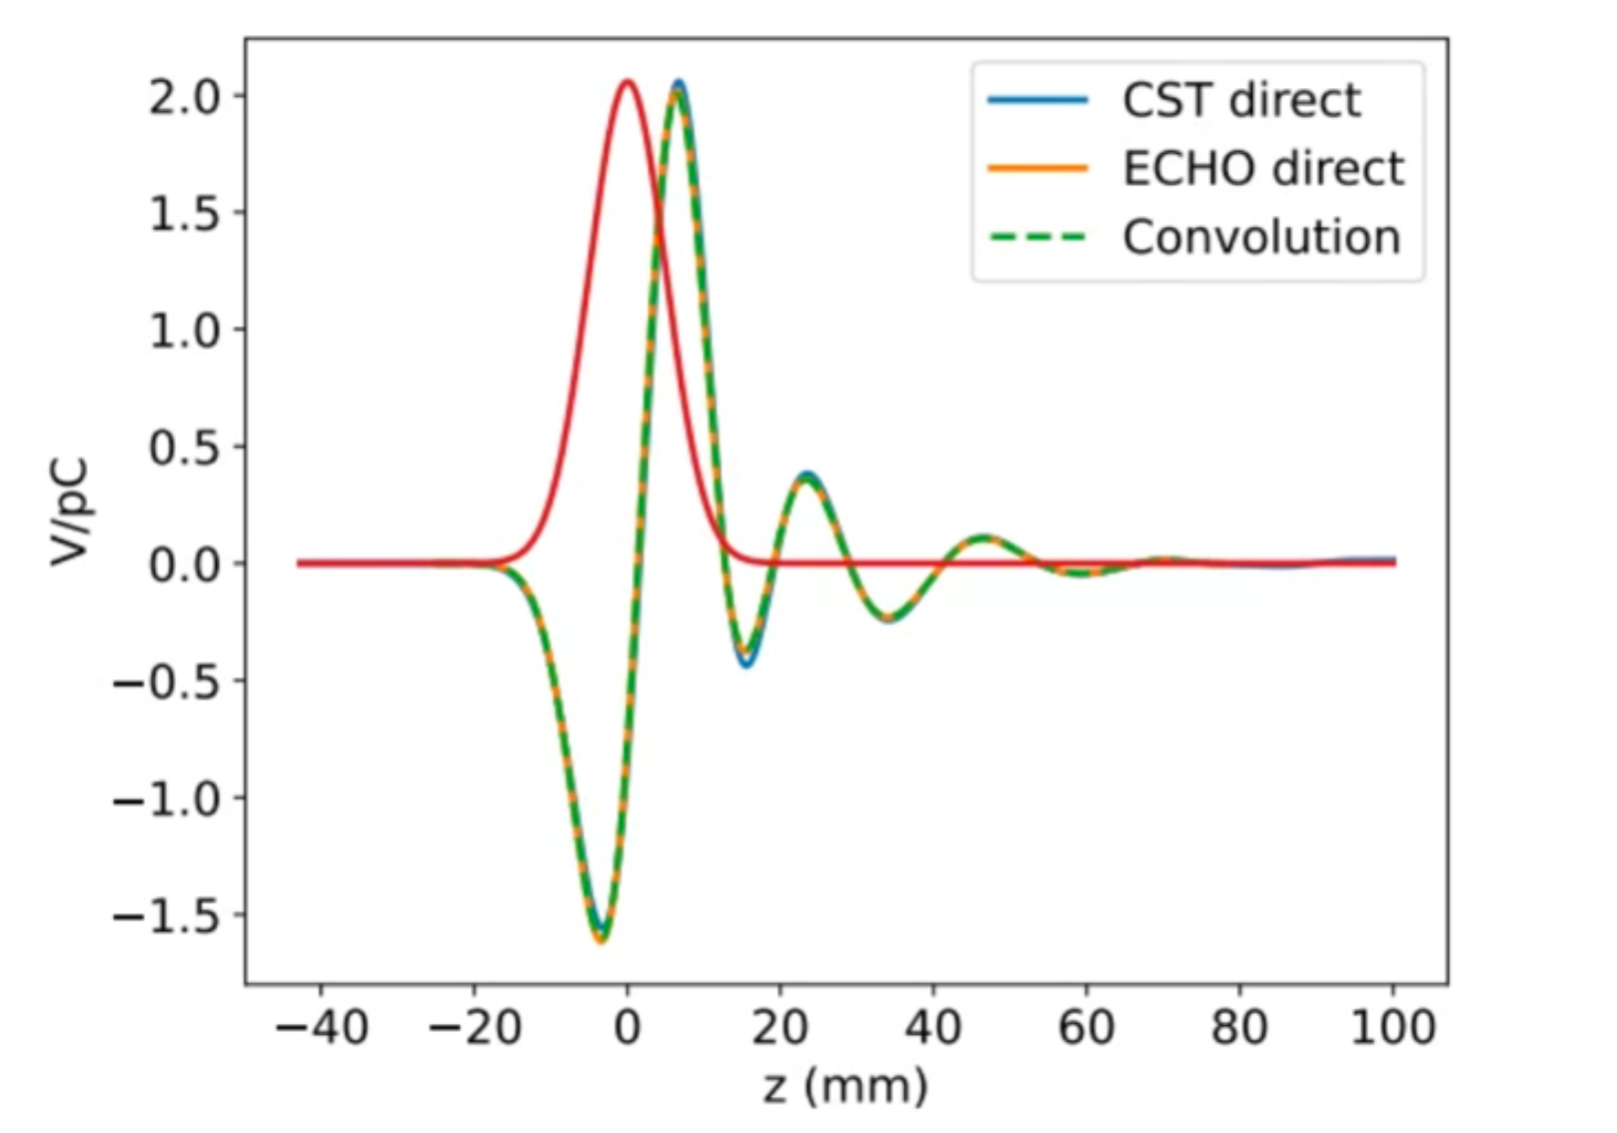
Collimation system : Geometrical impedance
Geometric longitudinal wakefield of a 5 mm Gaussian bunch

Slide 6
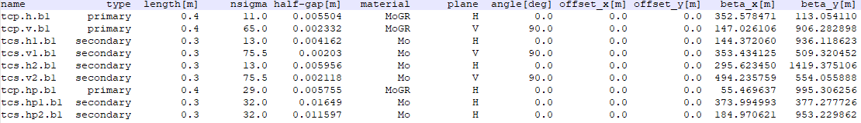
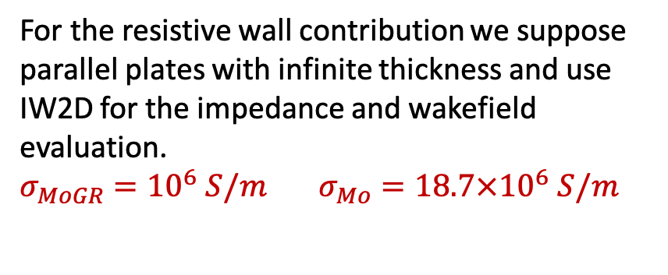
Collimation system : Resistive Wall
Table of the collimator settings for the Z machine and for the 4 IPs layout. The table includes both betatron and off-momentum collimators. The synchrotron collimators and masks upstream the IPs are not included in this table.
For the resistive wall contribution we suppose parallel plates with infinite thickness and use IW2D for the impedance and wakefield evaluation.
$σ_{MoGR}={10}^{6} S/m$ $σ_{Mo}={18.7×10}^{6} S/m$
beam

Slide 7
Collimation system
dipolar vertical impedance
dipolar horizontal impedance

Slide 8
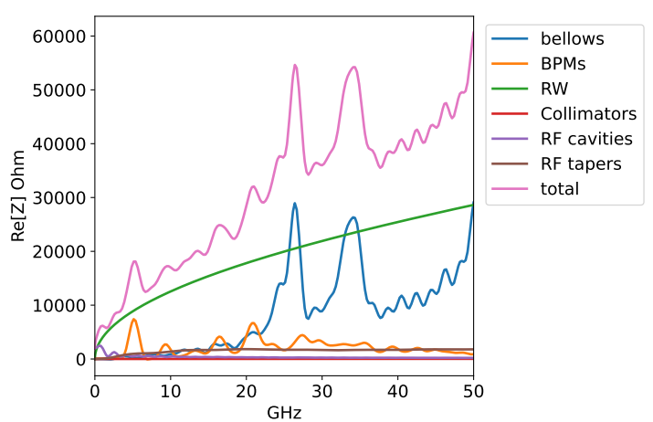
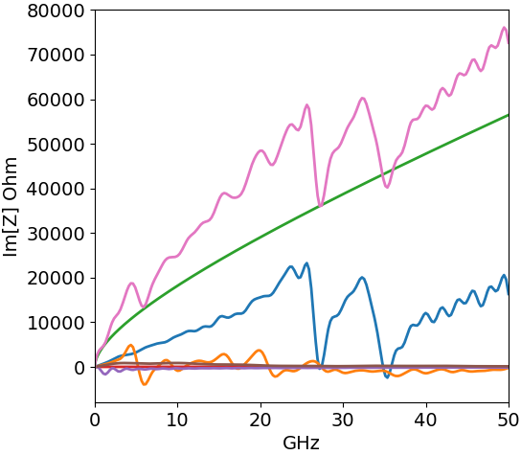
Total impedance: Longitudinal

Slide 9
Total impedance: Transverse Dipolar

Slide 10
Wake potential of 0.4 mm Gaussian bunch due to the main FCC-ee components, evaluated so far
How did we do these simulations?

Slide 11
Method to calculate the Wake Potential by software simulation: Comparison of the wake potential of 3.5 mm bunch length between PyHT and CST - Bellows
Wake potential for a Bellow of a 3.5 mm Gaussian bunch obtained directly by CST (blue curve) and with the convolution by using the wake potential of 0.4 mm Gaussian bunch (orange dots).

Slide 12
Method to calculate the Wake Potential by software simulation: BPMs

Slide 13
Method to calculate the Wake Potential by software simulation: Tapers

Slide 14
Method to calculate the Wake Potential by software simulation: RF Cavities

Slide 15
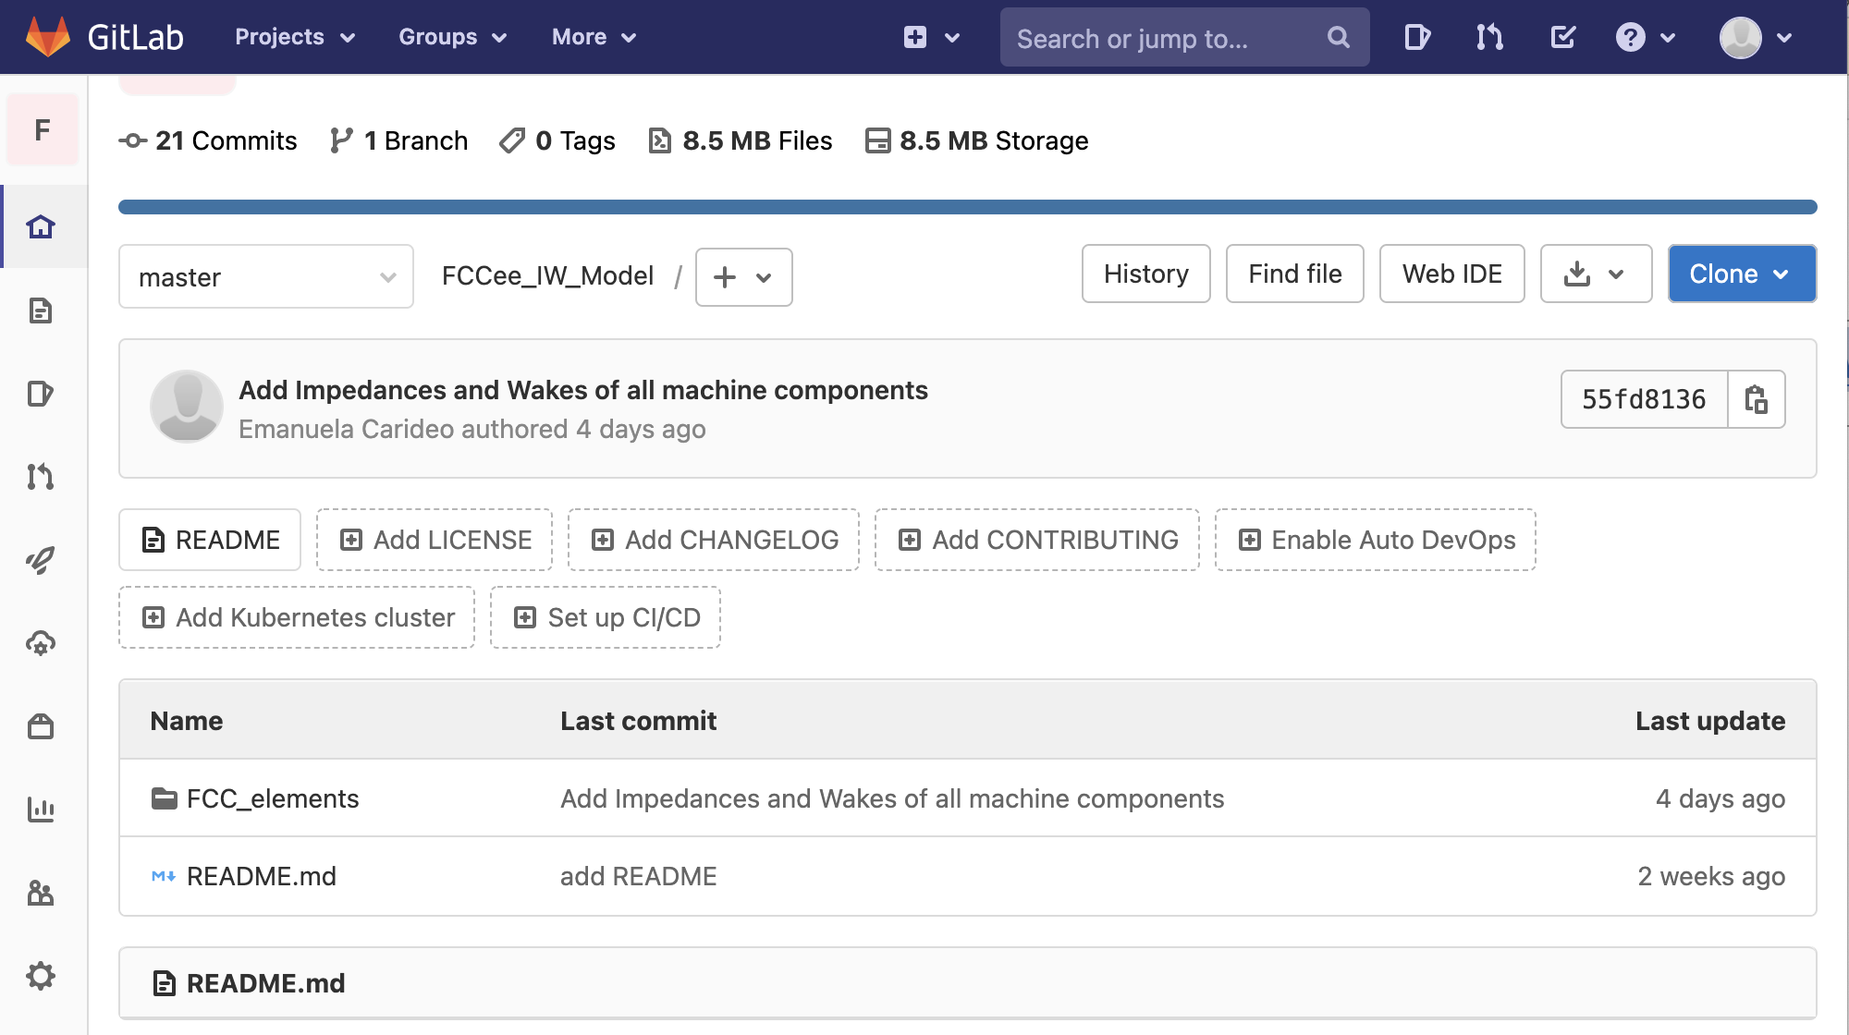
Wake and impedance repository for FCC-ee: https://gitlab.cern.ch/ecarideo/FCCee_IW_Model
A repository, or Git project, encompasses the entire collection of files and folders associated with a project. Working in repositories keeps development projects organized and organized and protected.
The Repository also provides more opportunities for project transparency and collaboration, working together to build the best possible final product.
How is it developed?
In this folder there are some of FCC-ee components and for each machine components the calculated impedance and wake

Slide 16
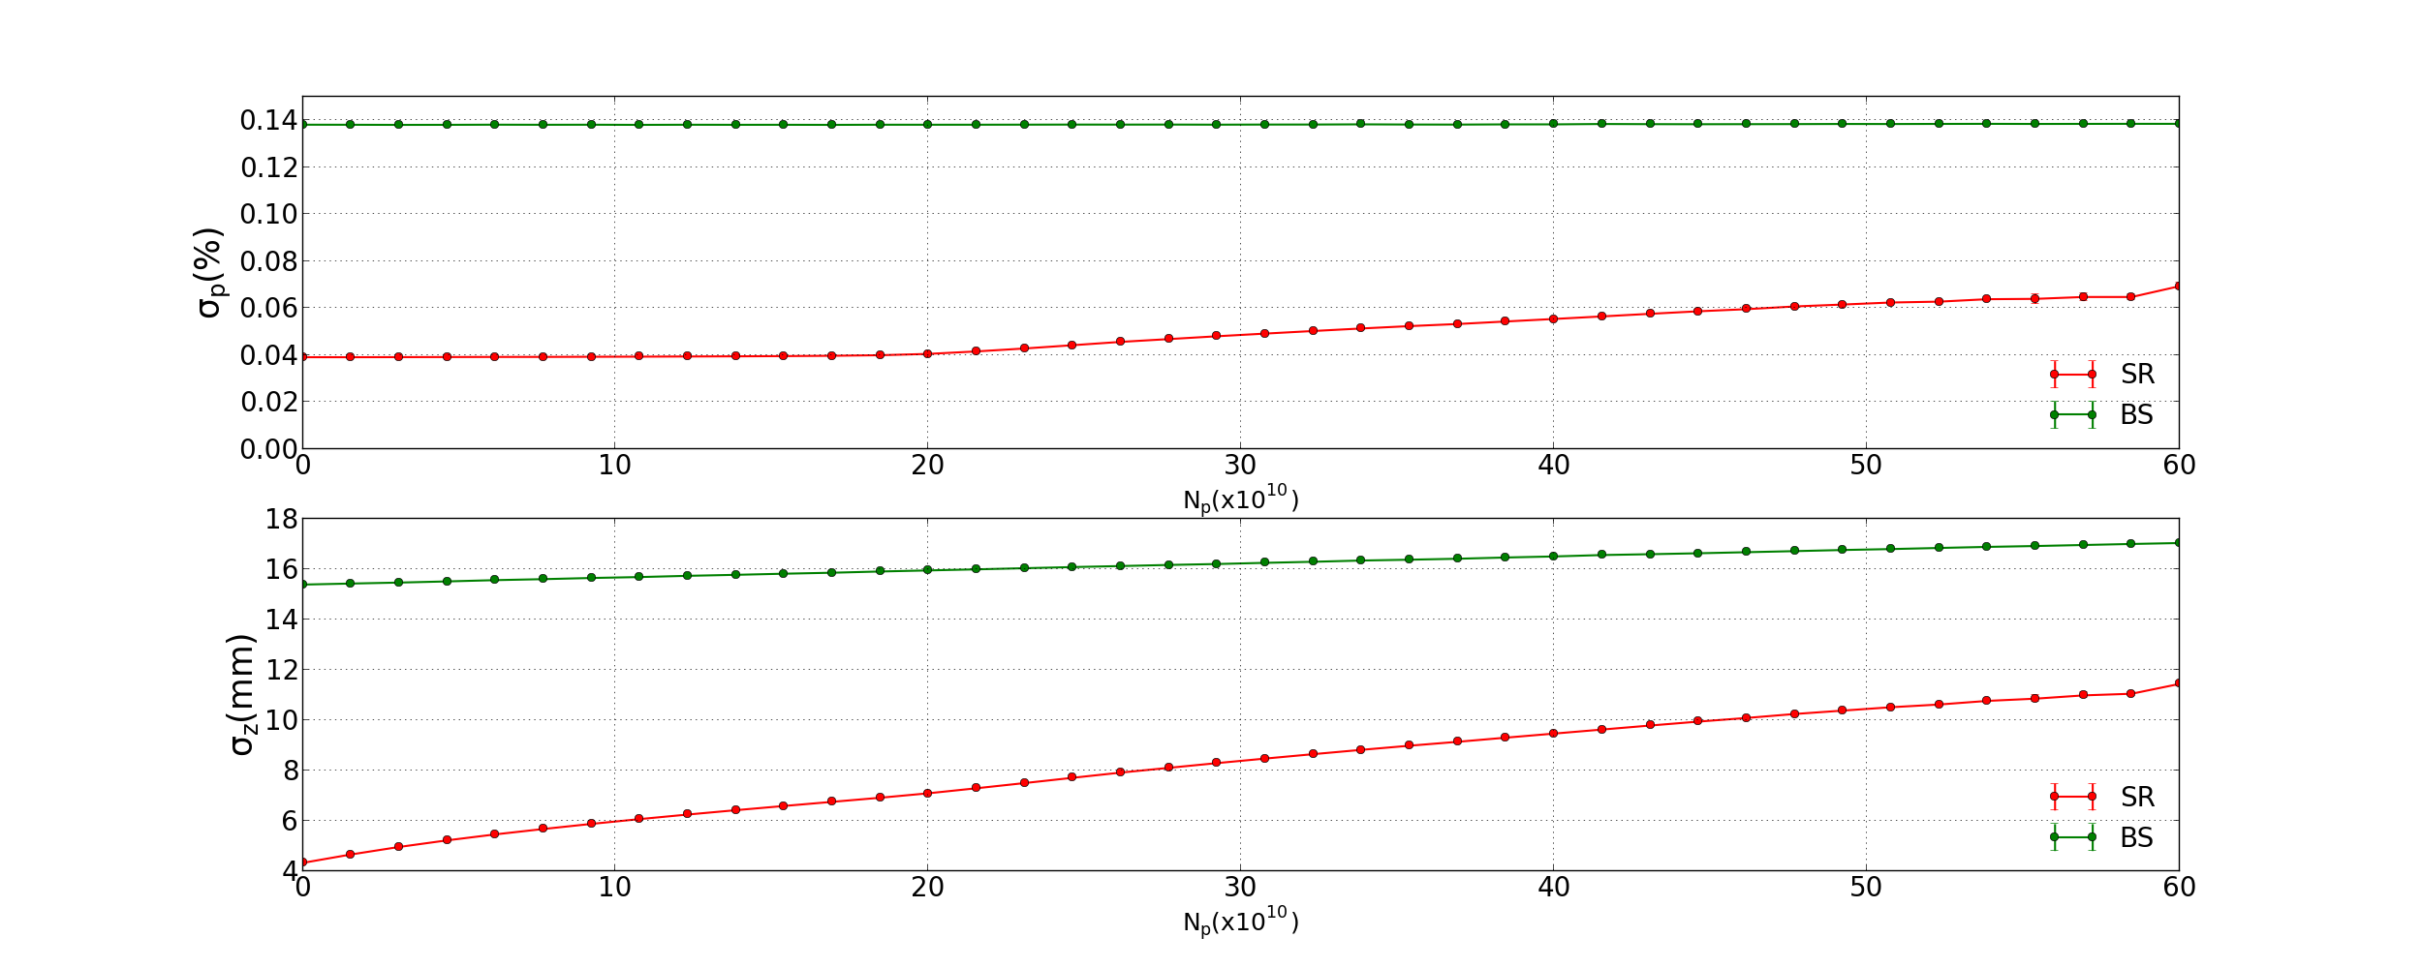
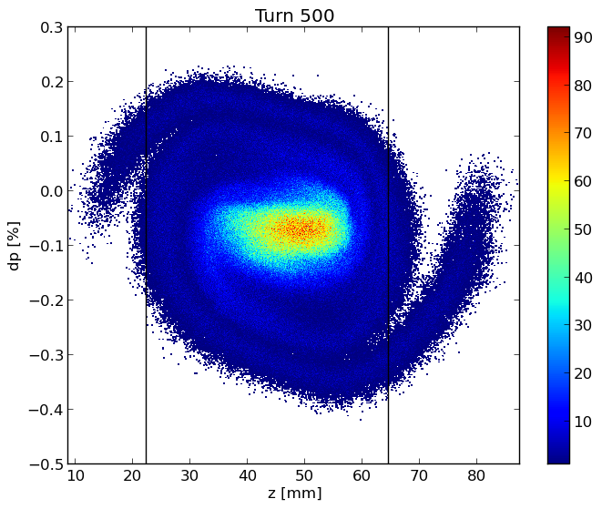
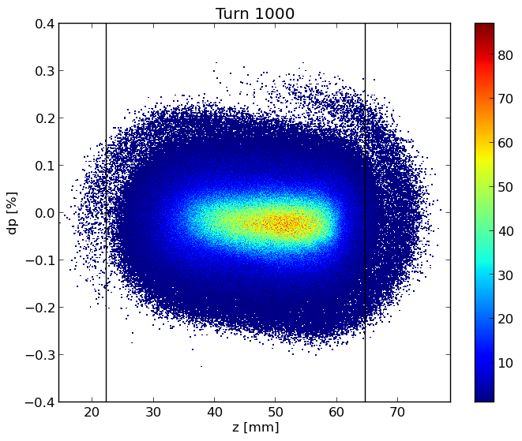
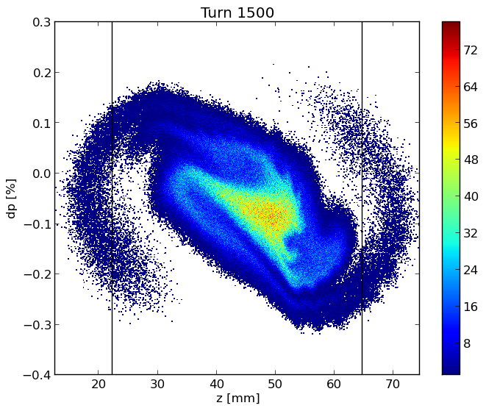
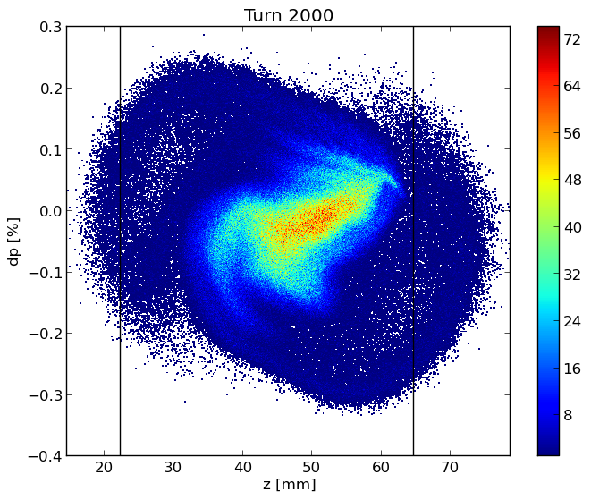
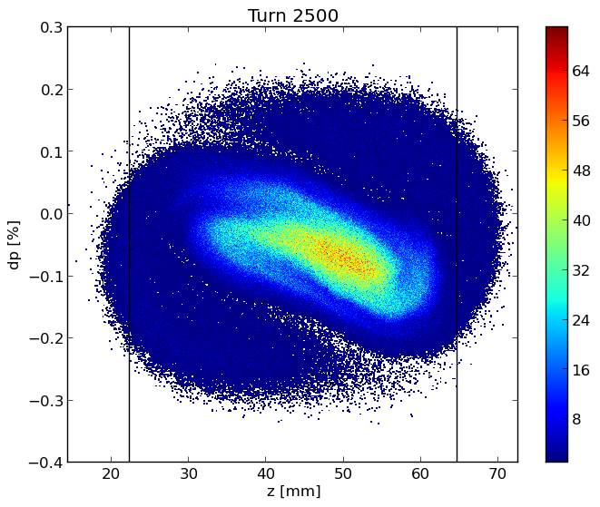
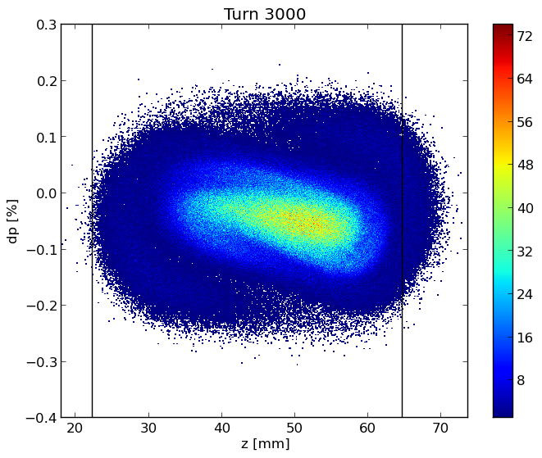
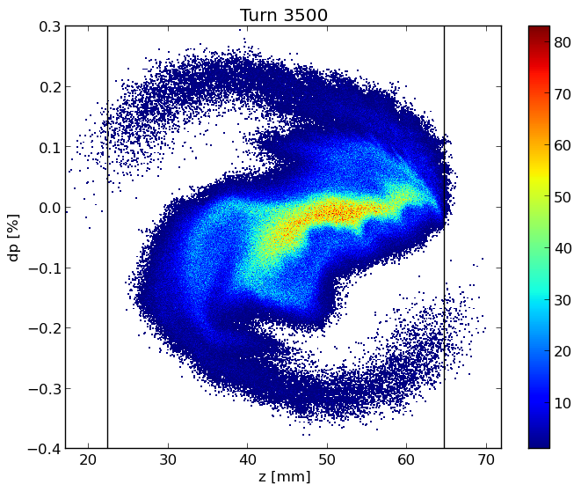
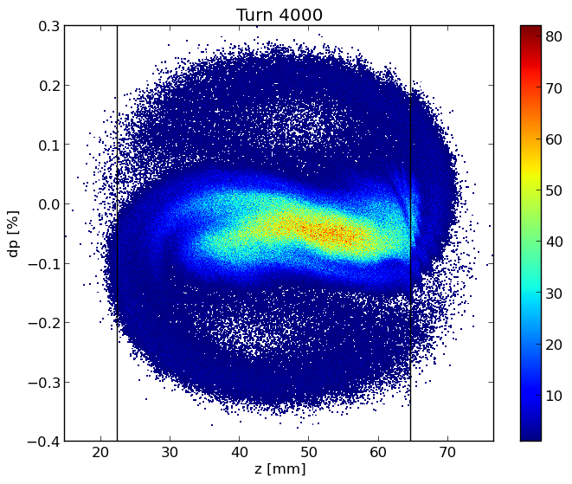
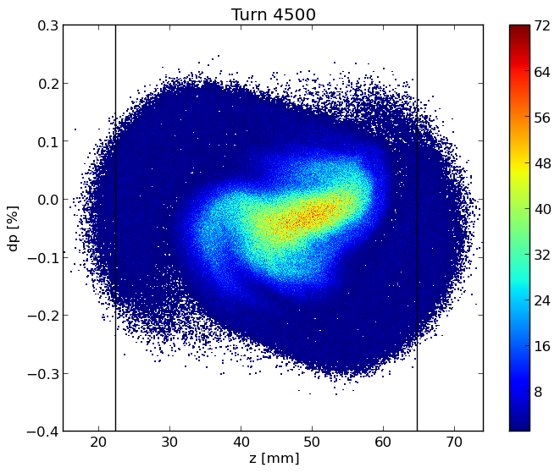
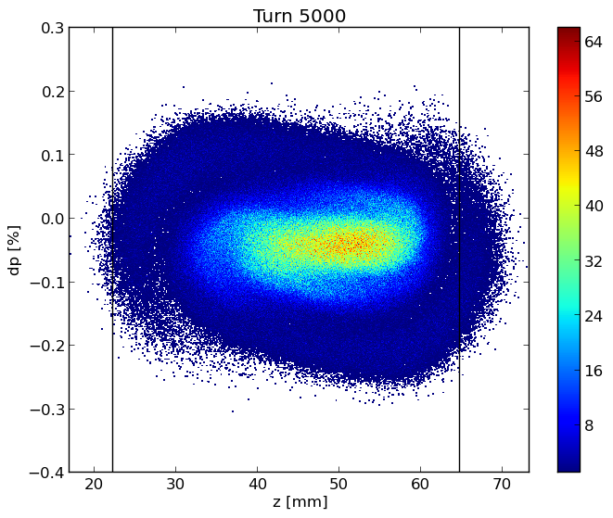
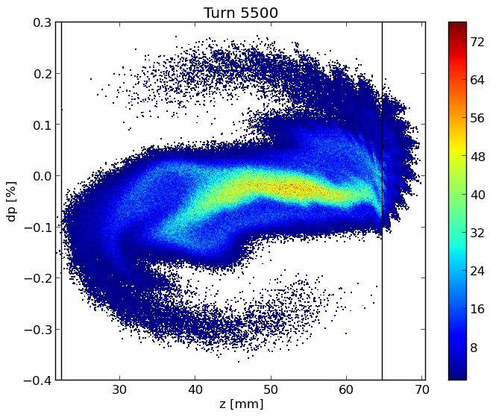
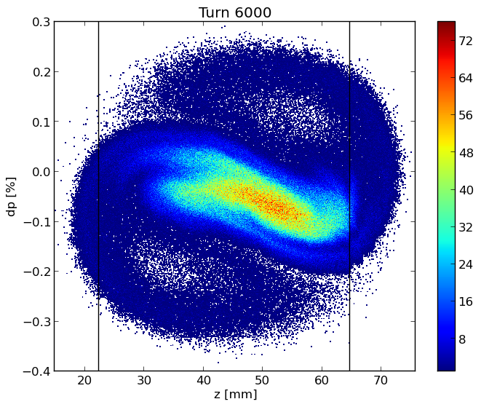
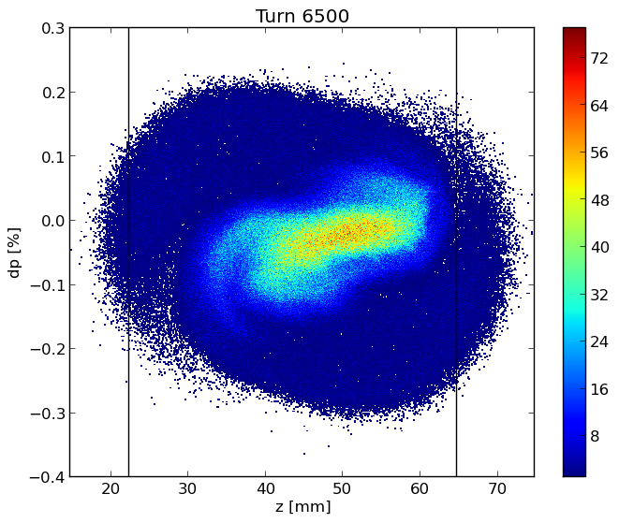
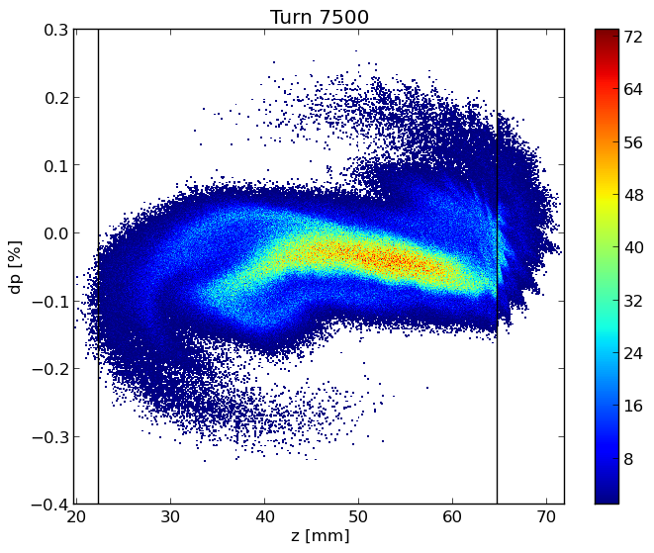
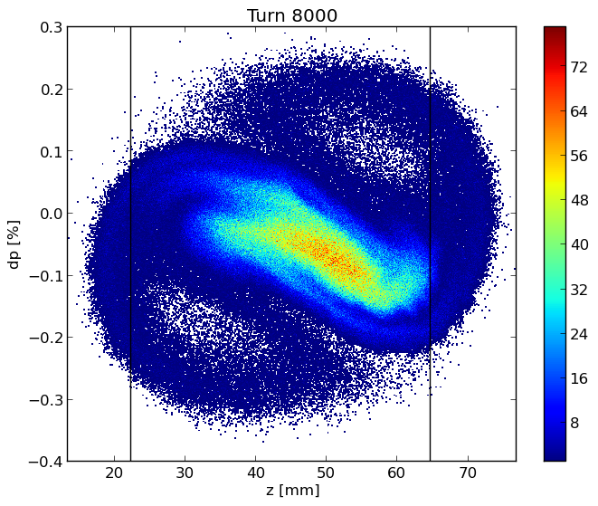
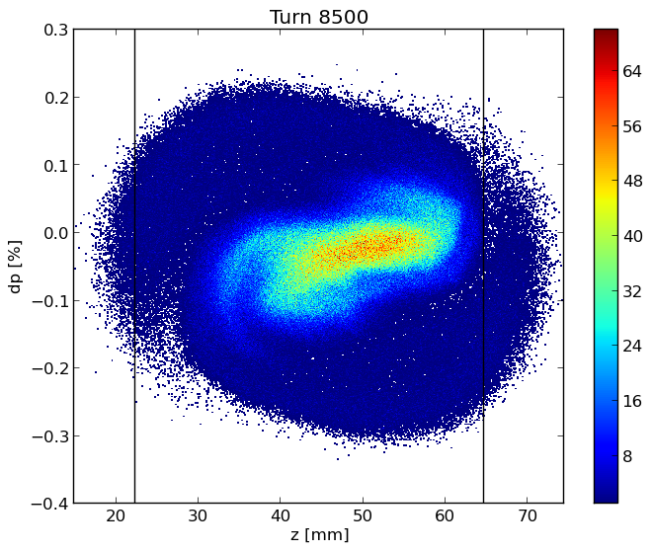
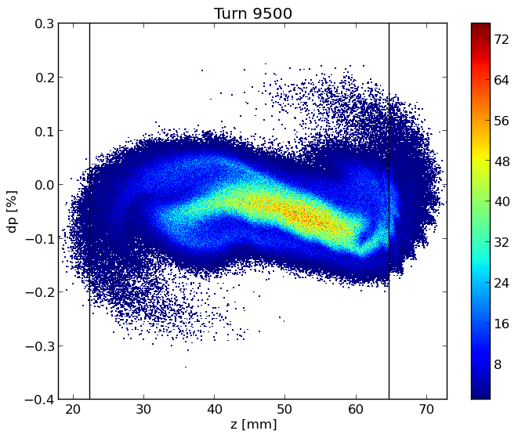
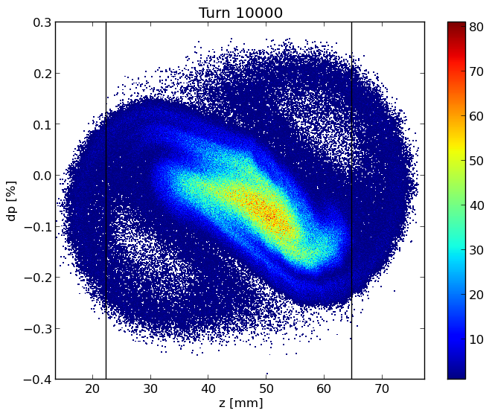
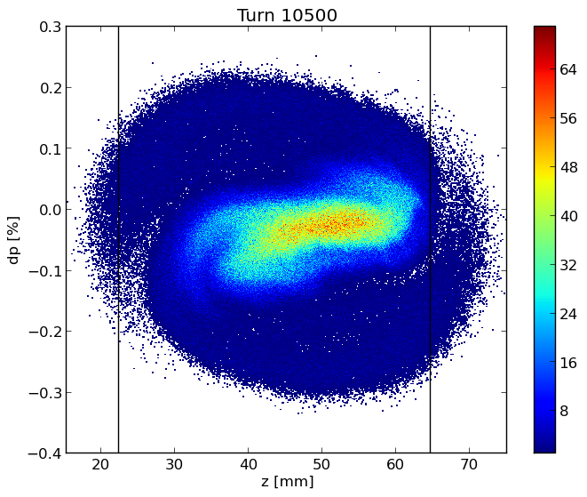
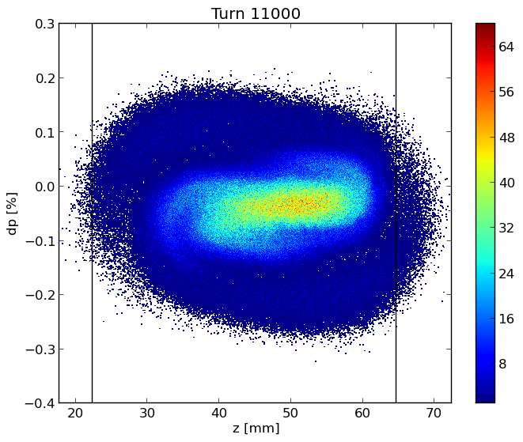
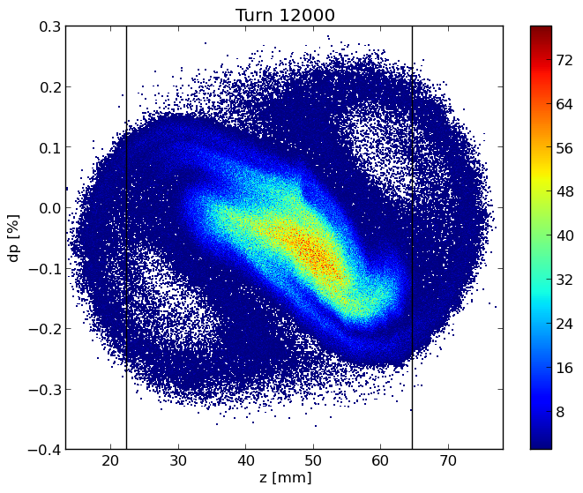

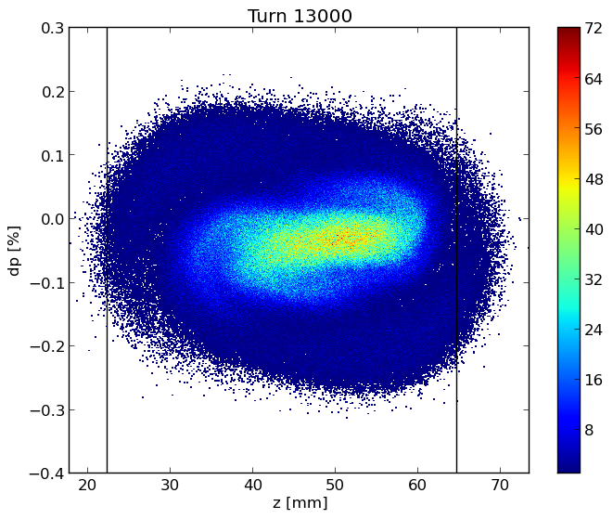
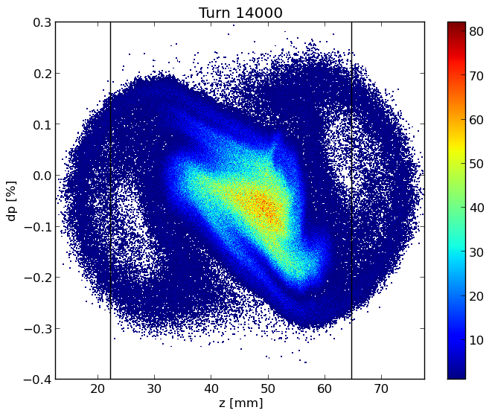
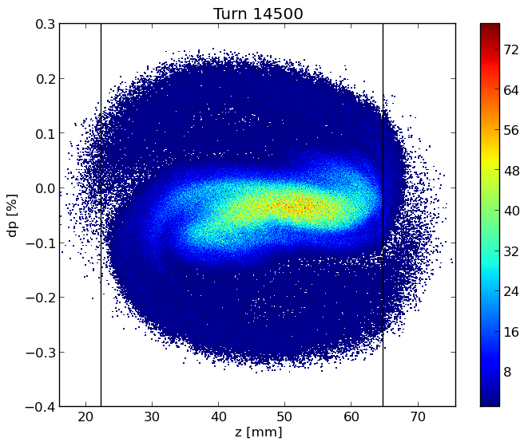
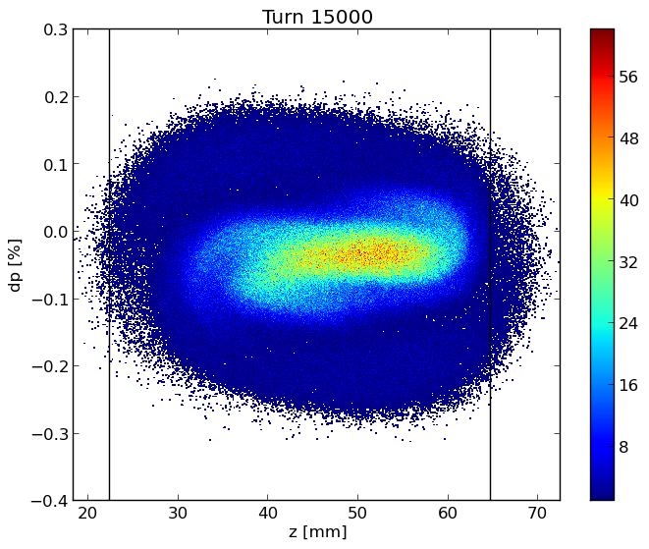
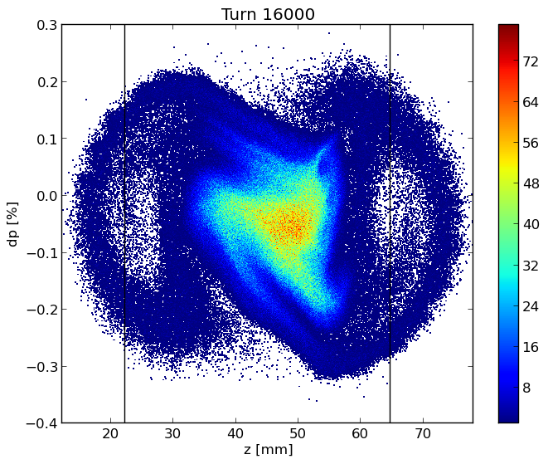
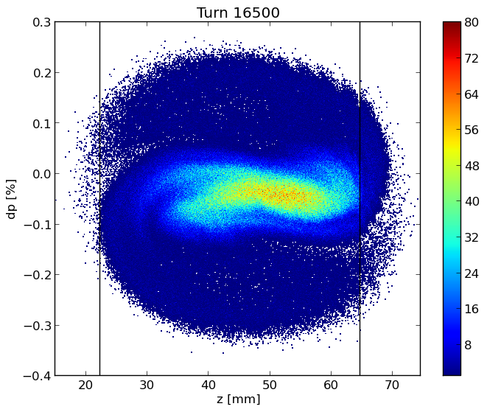

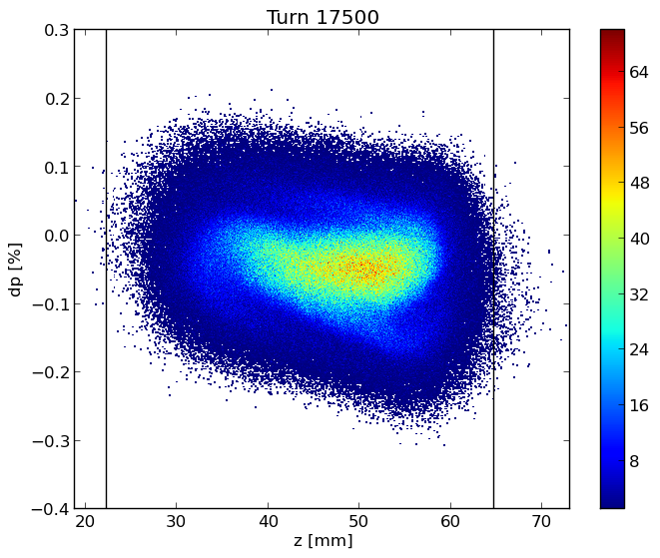
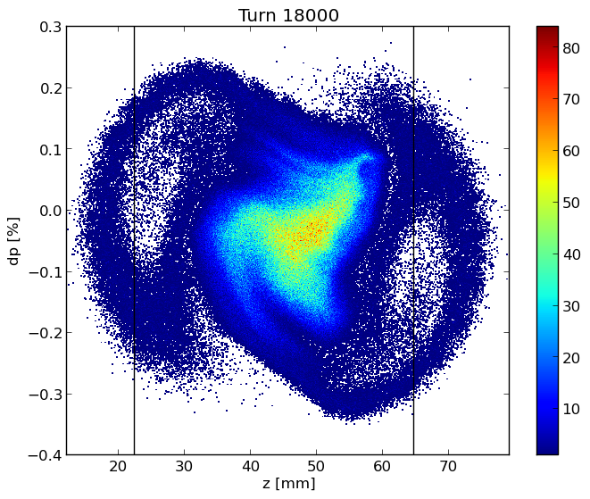
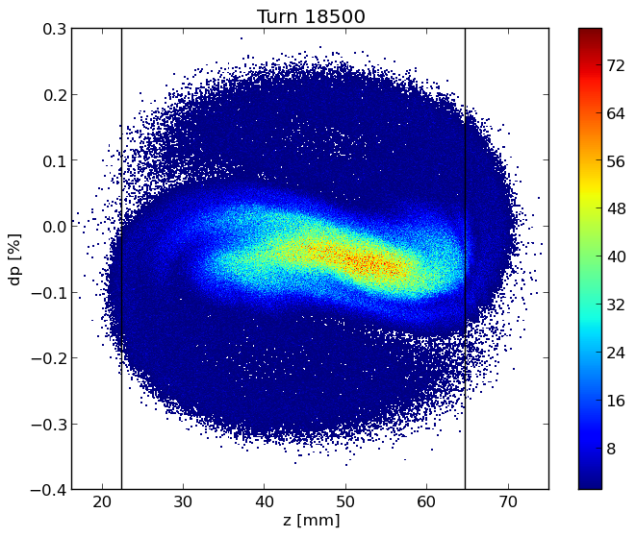
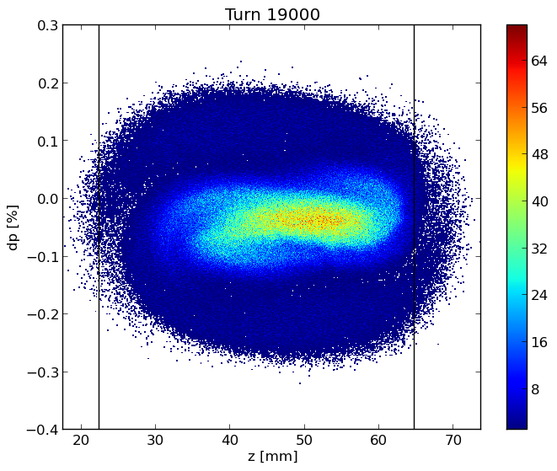
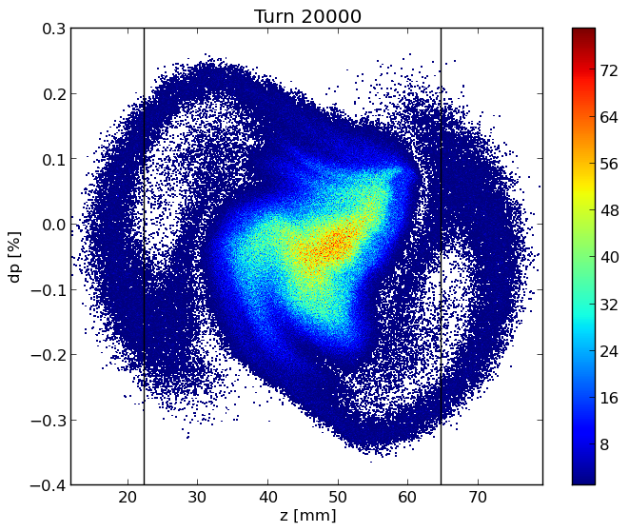
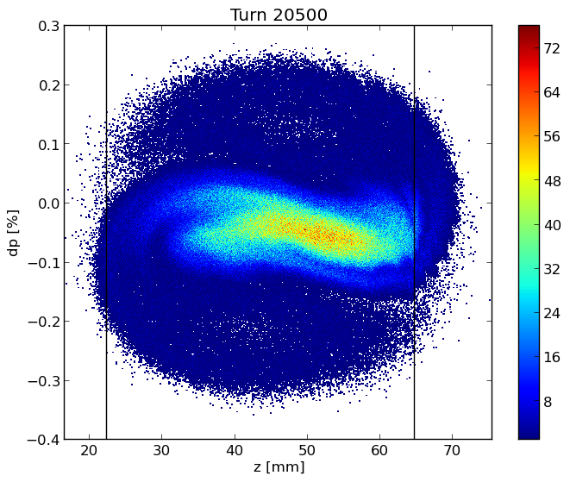

















Longitudinal Dynamics: Microwave Instability
Longitudinal phase space
SR bunch length = 4.37 mm
BS bunch length = 14.5 mm
Bunch length (bottom) and RMS energy spread (top) as a function of bunch population in the case with (BS) and without (SR) beamstrahlung, which is considered here independent of the longitudinal impedance.

Slide 17


Bunch length and energy spread for considered cases
The transverse impedance almost does not affect the longitudinal dynamics

Slide 18


Longitudinal Dynamics: Beam-Beam interaction
Blow-up of the horizontal beam size σ_{x}/σ_{x0} as a function of the bunch population and of the
horizontal tune scan without impedance( left) and if including the impedance
The stable area is represented by the white region, and the colour map close to the figure represents the increase of the horizontal beam size σ_{x} with respect to the nominal value.
Without the collective effects there is a stable area in the middle at any simulated intensity up to a bunch. When we include the impedance model shows how this stable region is reduced. We have a narrower stable region at the nominal intensity.

Slide 19
Transverse Dynamics: TMCI - PyHT & Delphi
The TMCI, Transverse Mode Coupling Instability,
occurs when the frequencies of two neighboring coherent oscillation modes merge together. Above the transverse instability threshold the bunch is lost and this makes the TMCI very dangerous for the beam.
In addition to simulations with the tracking code, the TMCI threshold has been also evaluated with the analytic Vlasov solver DELPHI
Real part of the frequency shift of the first coherent oscillation modes as a function of the bunch population without beamstrahlung, by considering only the RW impedance produced by a NEG film with 100 nm thickness given by IW2D.

Slide 20


TMCI instability
New parameter SR: Bunch length of 4.37 mm
On the top, real part of the frequency shift of the first coherent oscillation modes as a function of the bunch population without beamstrahlung, by considering only the transverse wakefield.
On the right, real part of the coherent tune shift as a function of intensity considering both longitudinal and transverse wakefield, by using PyHEADTAIL.

Slide 21
TMCI: longitudinal and transverse wake
New parameter BS: Bunch length of 14.5 mm

Slide 22
Mitigation techniques
Chromaticity
Higher momentum compaction
Higher harmonic cavity
Feedback system and transverse coupled beam instability
Reduction of β function at the interaction point

Slide 23


Chromaticity
On the left, real part of the frequency shift of the first coherent oscillation modes as a function of the bunch population without beamstrahlung, so considering a bunch length of 4.37mm and a value of Chromaticity of +5
On the right, real part of the frequency shift of the first coherent oscillation modes as a function of the bunch population without beamstrahlung, so considering a bunch length of 4.37mm and a value of Chromaticity of -5

Slide 24

Strong dependence of the TMCI from the Chromaticity
Real part of the frequency shift of the first coherent oscillation modes as a function of the bunch population considering a bunch length of 4.37mm and a value of Chromaticity of +50 (Unrealistic value)

Slide 25


Higher momentum compaction: MI
Energy spread and bunch length with the updated impedance model and the parameters of 2.1, with two different momentum compaction factors: 1.48 × 10⁻³ and 2.5 × 10⁻³

Slide 26




Higher momentum compaction: TMCI
Transverse dynamics analysis considering the transverse RW with a momentum compaction of 1.48 e⁻³ a bunch length of 3.5 mm (left) and of 14.5 mm (rigth) so considering the beamstrahlung effect.
Transverse dynamics analysis considering the transverse RW with a higher momentum compaction and bunch length of 4.5 mm (left) and of 15.2 mm (rigth) so considering colliding bunches, beamstrahlung effect.

Slide 27


Higher momentum compaction: beamstrahlung and collective effects in collision
The blow-up of the horizontal beam size as a function of the bunch population
Blow-up of the horizontal beam size σ_{x}/σ_{x0} as a function of the bunch population and of the horizontal tune scan for arc cell of 45 ◦ /45◦
The safe tune areas are much larger and less current dependent, and the horizontal size blow-up is much lower for the tunes affected by the X-Z instability.

Slide 28

Higher harmonic cavity
Bunch length, on the left, and energy spread, on the right, as a function of bunch population with and without the higher harmonic cavity system. The results are obtaining by using the code SBSC.

Slide 29


Feedback system and transverse coupled beam instability
The beam spectrum of some most dangerous coupled bunch modes and the transverse impedance of a 35 mm copper pipe without coating at low frequency
A robust feedback is required for the instability suppression!
The most dangerous mode is that closest to the origin (with negative frequency)
Rise time of about 6 revolution turns
Notes:
The transverse impedance is inversely proportional to the square root of the frequency

Slide 30



ITSR instability: Imaginary Tune Split and Repulsion
Only Transverse wakefield with resistive feedback at 10 turns damping time
Introduction
[…] However, a resistive transverse damper also destabilizes the single-bunch motion below the transverse mode coupling instability intensity threshold (for zero chromaticity), introducing a new kind of instability, which has been called ITSR instability (for imaginary tune split and repulsion). […]
$$N_{p}=16×{10}^{10}$$
$$N_{p}=18×{10}^{10}$$

Slide 31

ITSR instability: Imaginary Tune Split and Repulsion
Longitudinal and Transverse wakefield with a resistive feedback at 10 turns damping time
The spread in the synchrotron tune due to the longitudinal wakefield helps to mitigate the ITSR instability
$$N_{p}=34×{10}^{10}$$

Slide 32

ITSR instability: Imaginary Tune Split and Repulsion
Longitudinal and Transverse wakefield with a resistive feedback at 4 turns damping time
$$N_{p}=46×{10}^{10}$$
Beamstrahlung reduces the effect of the longitudinal wakefield which, on its turn, has a beneficial effect on the TMCI with a resistive transverse damper. What happens if both effects are present?

Slide 33




Reduction of β function at the interaction point
X-Z instability threshold is inversely proportional to the horizontal betatron function at the interaction point
It generates a reduction of the dynamic aperture and of momentum acceptance.
Normalized horizontal beam size $σ_{x}\backslash σ_{x,0}$as a function of the horizontal tune for a bunch population of N_{p} = 2.8 x 10¹¹ (on the left) and N_{p} = 1.4 x 10¹¹ (on the right) at different chromaticities with β∗_{x} = 10 cm.

Slide 34
Conclusions
The collective effects are particular important on the Z resonance due to the low energy and high beam current.
Simulations have been performed for the main elements to characterize and optimize the impedance of important machine components. The RW is the most important source of the machine impedance, followed by bellows and collimators.
Two collective effects codes have been compared, PyHT, tracking simulation code, and Delphi, a Vlasov solver. The comparison results demonstrate a good agreement between the two codes.
Studies of collective effects have been done without beam-beam interaction but with both longitudinal and transverse wakefields simultaneous which reveal a lower threshold for the TMCI due to the strong effect of the longitudinal wakefields.
Since the impedance is expected to increase with the addition of more components the situation could become worst. So we have studied eventual mitigation techniques.

Slide 35
Challenges and Future Plan
FCC-ee is an ongoing project, every time we analyze new devices, we find a continuous increase of the total machine impedance. For this reason, of course, we want to continue the work for the evaluation, reduction and optimization of the impedances of the main machine elements (e. g. collimators system which is an important source of transverse impedance), and also for implementing the FCC-ee repository.
Collective effects play an important role for the stability of the machine, an important aim will be to continue to investigate on the beam-beam effect, longitudinal and transverse coupling impedance
We need to look to other diversified mitigation techniques: Beam instability thresholds and stability regions can change according to the new impedance sources that will be gradually added.

Slide 36
Thanks for your kind attention!

Slide 37
Back up slides

Slide 38


NEG coating is needed to mitigate the electron cloud build-up in the positron machine and for pumping reasons in both rings.
IW2D results for a circular pipe.
Longitudinal Impedance
Transverse Impedance

Slide 39


More realistic model:
We estimated a factor 1.1 for winglets contribution
The quadrupole wake has been calculated but its contribute can be negligible
Contribution of the winglets: we used CST with a low conductivity material (but still in the good conductor regime). Then we divided the result by its surface impedance and multiplied it by the double-layer surface impedance
$$Z\left(ω\right)=\left(1+j\right)\sqrt{\frac{ωZ_{0}}{2σ_{c}c}}\frac{α\tanh\left[\frac{1+j}{δ_{1}}Δ\right]+1}{α+\tanh\left[\frac{1+j}{δ_{1}}Δ\right]} \left(α=\frac{δ_{1}}{δ_{2}}\right)$$

Slide 40
New evaluation of the impedances using different NEG coating : 100 nm 150 nm and 200 nm

Slide 41


Longitudinal dynamics

Slide 42

TMCI analyzes using wake with different NEGs : 100nm, 150 nm and 200 nm
On the letf the plot of the TMCI considering a wake with 100nm of NEG and a beam length of 3.5mm
On the right the plot of the TMCI considering a wake with 100nm of NEG and a beam length of 12.1mm

Slide 43

TMCI analyzes using wake with different NEGs :
100nm, 150 nm and 200 nm
On the letf the plot of the TMCI considering a wake with 150nm of NEG and a beam length of 3.5mm
On the right the plot of the TMCI considering a wake with 150nm of NEG and a beam length of 12.1mm

Slide 44


TMCI analyzes using wake with different NEGs : 100nm,150 nm and 200 nm
On the letf the plot of the TMCI considering a wake with 200nm of NEG and a beam length of 3.5mm
On the right the plot of the TMCI considering a wake with 200nm of NEG and a beam length of 12.1mm

Slide 45

Updated FCC-ee impedance model: 20000 Bellows
We initially considered a number of 8000 Bellows
BUT
85% of arcs (~ 79 km)
Every arc is 8m long
X2 because we have another bellow before any quadrupole
12000-13000 but to be sure we are performing our calculations considering up to 20000 bellows

Slide 46

Longitudinal wake potential and impedance for the three studied models of the bellow

Slide 47

Beam Position Monitors : #4000
The button has a diameter of 15 mm and a thickness of 3 mm
In order to push the higher order modes trapped in the BPM structure to higher frequencies a BPM design with a conical button, similar to the one used in SIRIUS
BPMs will be installed directly on the beam pipe with a rotation angle of 45°
CST perspective view of the four-button BPM

Slide 48

Collimation system : Models
CST collimator models for the SuperKEKB, thanks to Takuya Ishibashi.
CST vertical collimator models for the FCC-ee, proposed by Mauro Migliorati

Slide 49



Collimation system
$$Z(ω)\frac{β_{x,y}}{{<β}_{x,y}>}$$
$${<β}_{x,y}> =\frac{1}{C}\oint{β_{x,y}ds}=144.1, 241.5 m$$
$$NB: if we use {<β}_{x,y}> =\frac{C}{2πQ_{x,y}}=68 m$$
dipolar vertical impedance
dipolar horizontal impedance

Slide 50
Total impedance: Transverse Quadrupolar
The oscillations of bellows at high frequency are not physic but they don’t influenced the wake potential of longer bunch. NB the wake of the bellows is still a work in progress.

Slide 51


New Wakes with new machine parameters :
Longitudinal RW with 150nm of coating plus the Bellows without neglected the perturbation introduced by the lateral winglets used to place synchrotron radiation absorbers
https://indico.cern.ch/event/995850/contributions/4401571/attachments/2275135/3864813/FCCweek.pdf

Slide 52

Longitudinal dynamics: OLD machine parameters
Bunch length (bottom) and RMS energy spread (top) as a function of bunch population in the case with (BS) and without (SR) beamstrahlung, which is considered here independent of the longitudinal impedance.

Slide 53
TMCI
Without longitudinal resistive wall wakefield
SR: Bunch length of 3.5 mm
Considering the longitudinal resistive wall wakefield

Slide 54



Transverse RW for a beam length of 12.1mm:
TMCI analysis
Transverse wake: PyHT vs Delphi
Considering the longitudinal wakefield
Without longitudinal wakefield
Longitudinal wake

Slide 55

Interplay between beam-beam and longitudinal impedance
The study of the interplay between beam-beam interaction, beamstrahlung, and longitudinal collective effects has been performed with the simulation code IBB
Comparison between IBB, orange line, and PyHEADTAIL, blue line, of energy spread σp (top) and bunch length σz (bottom) as a function of the bunch population without collision.
IBB simulation results thanks to Yuan Zhang.

Slide 56

Reduction of β func. at the IP: Luminosity
At high intensity of Np = 2.8 × 10¹¹ and a chromaticity of 5 we lose about 15% of luminosity per IP, but this parameter still remains in a
good range, above 180 < 10³⁴/(cm²s)

