Slide 1
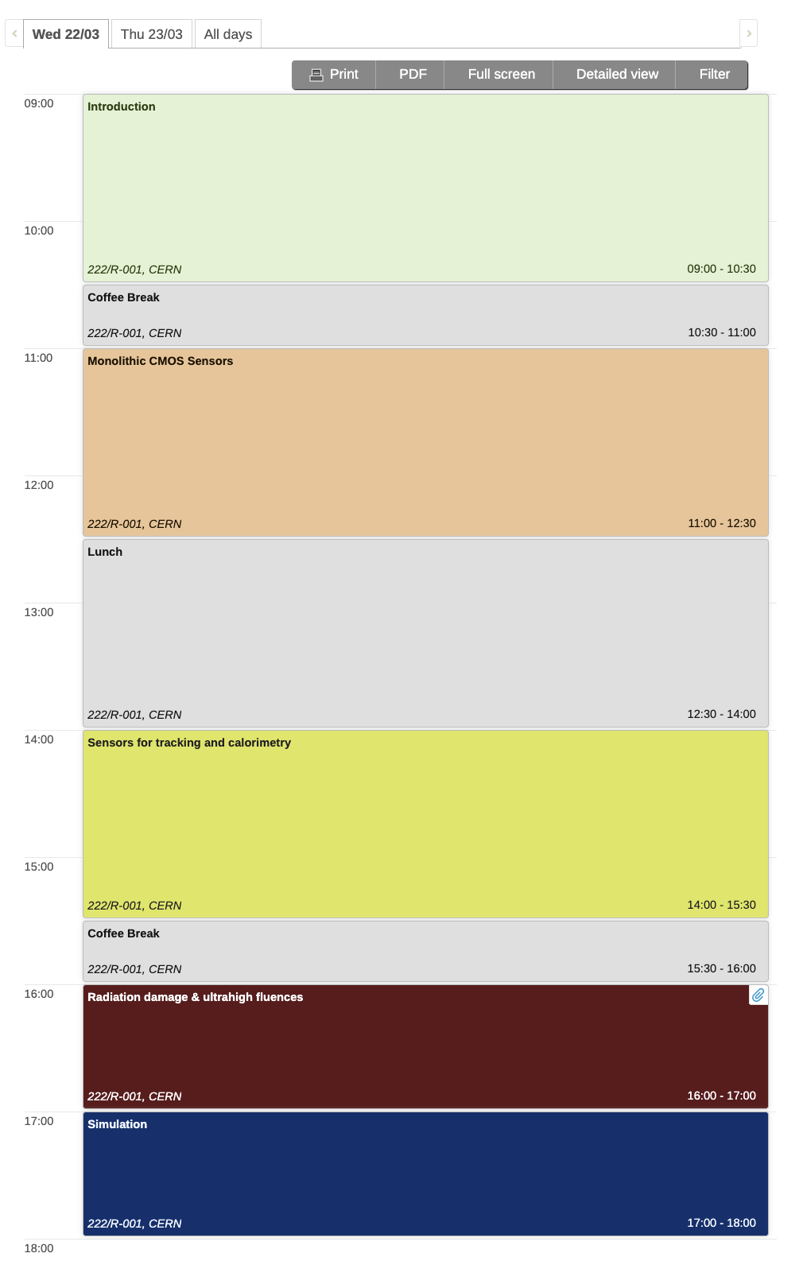
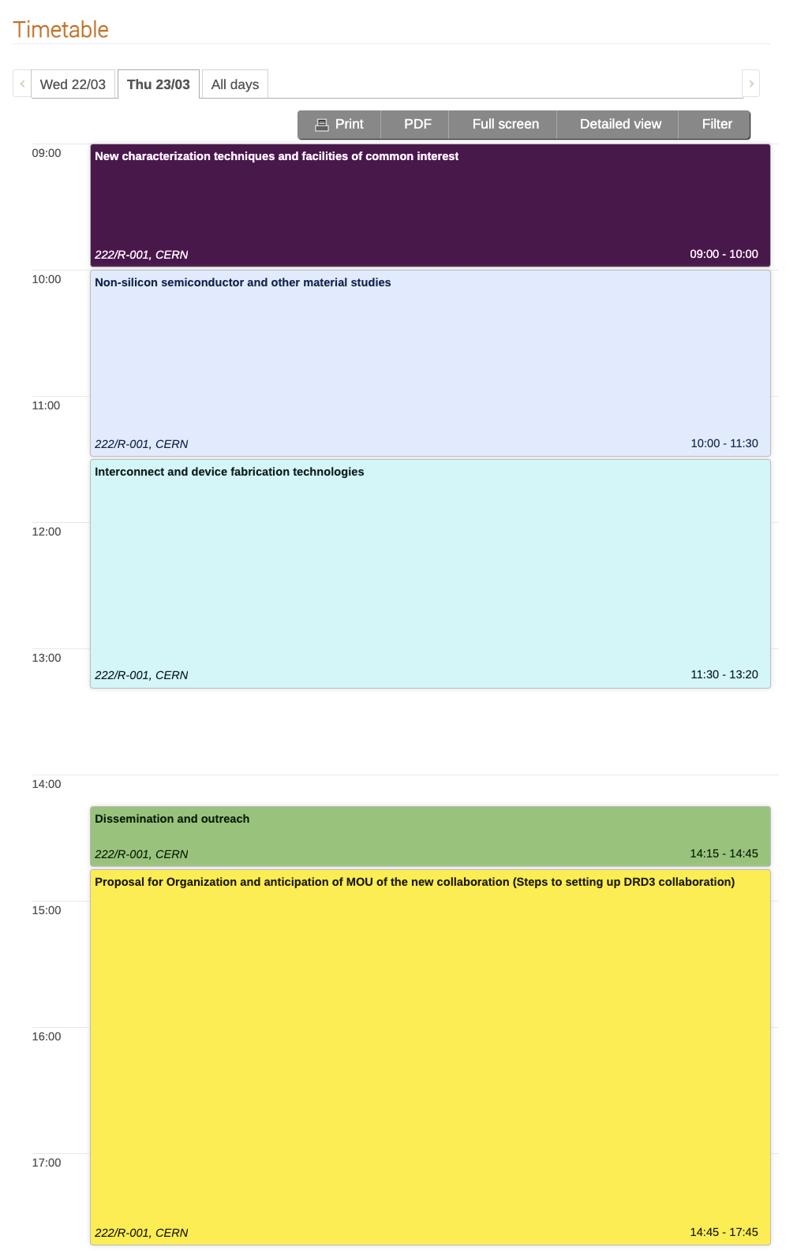
DRD3 - Workshop
Workshop date: March 22-23rd.
About 80 people in the room, and roughly as many online
2 days of presentation
Workshop focused on organization, milestones, and costing (we did not have scientific presentations)
Good attendance and participation
Good reception of the “Blue sky && strategic R&D”
Interest in “inclusion” of new groups and training
Presented a “legal” path to form the collaboration (chair of CB, spokespersons, WGs responsible)
Most debated topic: Money
Funding schemes, MoU, etc…

Slide 2
DRD3 – Status of questionaires
96 Institutes sent in their answer so far
Country

Slide 3
Funding, from the questionaires
Blue sky R&D
Funding method:
Metabolism of each group
EU, National projects
DRD3 common fund
Strategic R&D
Funding method:
Each institute asks its funding agency
This is a well-defined path
The large number of groups in DRD3 ensures strong R&D
Almost completely absent in the questionaries
This funding will be defined in the near future

Slide 4
Scientific structure
The scientific goals of the strategic R&D have been defined in the ECFA roadmap
WG1 MAPS
WG2 Silicon, 4D
WG3 Ex Fluence
WG4 Simulation
WG5 New Tech.
WG6 Behyond Silicon
WG7 Inteconnect
WG8 Outreach

Slide 5
Interesse Italiano in DRD3
 | WG1 CMOS | WG2 Silicon, 4D | WG3 Ex Fluence | WG4 Simulation | WG5 Tech | WG6 Non-Silicon | WG7 Inteconnect | WG8 Outreach |  | AidaInnova | Alice | ATLAS | Belle | CMS | DUNE | EIC | Euro-L | FCC | LHCb | NA62 | RD42 | RD50 | RD51 | RD53 | Ignite | CRESST | COSINUS | NUCLEUS
# istituti interessati per WG | 58 | 54 | 52 | 36 | 27 | 35 | 37 | 36 |  | 9 | 12 | 45 | 14 | 31 | 2 | 5 | 3 | 6 | 19 | 2 | 7 | 51 | 2 | 11 | 3 | 1 | 1 | 2
# Istituti italiani per WG | 6 | 7 | 6 | 2 | 5 | 3 | 7 | 2 |  | 0 | 1 | 2 | 1 | 6 | 0 | 0 | 0 | 2 | 2 | 1 | 0 | 5 | 0 | 3 | 3 | 0 | 0 | 0
% Italia per WG | 10 | 13 | 12 | 6 | 19 | 9 | 19 | 6 |  | 0 | 8 | 4 | 7 | 19 | 0 | 0 | 0 | 33 | 11 | 50 | 0 | 10 | 0 | 27 | 100 | 0 | 0 | 0
UniPavia | 1 | - | 1 | - | - | - | 1 | - |  | - | - | - | - | 1 | - | - | - | - | - | - | - | - | - | 1 | - | - | - | -
UniMi | 1 | 1 | - | - | 1 | 1 | 1 | - |  | - | - | 1 | - | - | - | - | - | 1 | 1 | - | - | - | - | 1 | 1 | - | - | -
UniFi | - | - | 1 | - | 1 | - | - | - |  | - | - | - | - | - | - | - | - | - | - | - | - | - | - | - | - | - | - | -
INFN To | - | 1 | 1 | 1 | - | - | - | - |  | - | - | - | - | 1 | - | - | - | - | - | - | - | 1 | - | - | - | - | - | -
INFN Pisa | 1 | - | - | - | - | - | 1 | 1 |  | - | - | - | 1 | - | - | - | - | - | - | - | - | 1 | - | - | - | - | - | -
INFN Genova | - | 1 | 1 | - | 1 | - | 1 | - |  | - | - | 1 | - | 1 | - | - | - | 1 | - | - | - | - | - | - | - | - | - | -
INFN Fi | - | 1 | - | - | 1 | 1 | 1 | - |  | - | - | - | - | 1 | - | - | - | - | 1 | 1 | - | - | - | - | 1 | - | - | -
INFN CNR Perugia | 1 | 1 | 1 | 1 | - | 1 | - | 1 |  | - | - | - | - | 1 | - | - | - | - | - | - | - | 1 | - | - | - | - | - | -
INFN Ba | 1 | 1 | 1 | - | - | - | 1 | - |  | - | 1 | - | - | 1 | - | - | - | - | - | - | - | 1 | - | 1 | 1 | - | - | -
FBK | 1 | 1 | - | - | 1 | - | 1 | - |  | - | - | - | - | - | - | - | - | - | - | - | - | 1 | - | - | - | - | - | -

Slide 6
Next steps
We don’t plan for a second workshop
Mid-April: Write-up of Draft1: each WG summarizes the session in ~ 1 – 2 pages, mostly tables with milestones, fte, and costing (but not coverage of the costs)
End of April: the write-up is sent to the community for comments (2-3 weeks)
Mid-May: expect comments from the community
End of May/ early June: Second draft of the write-up
After that: coordination with our DRDx, ECFA, preparation for the DRDC
Far future: founding meeting in Q4/2023
New DRD3 collaboration starts in Q1/2024
The new collaboration will write the MoU and will deal with the money mistery

Slide 7
Costing: do be done
Cost each WG according to the presented milestones

