Slide 1
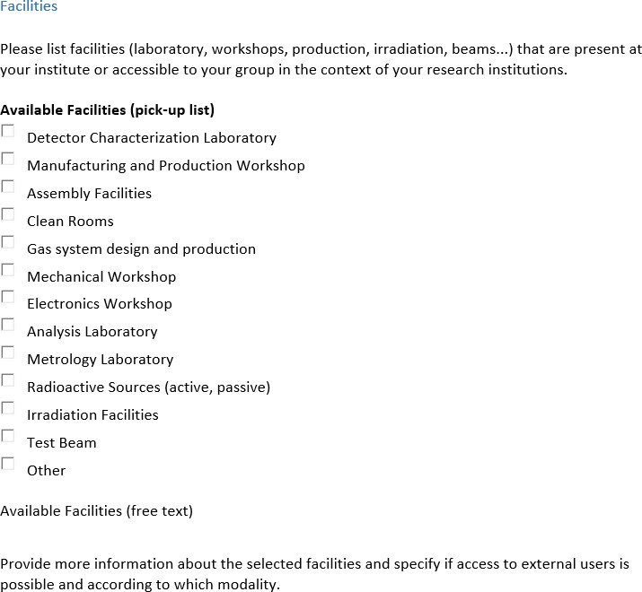
Survey Skeleton (I)

Slide 2
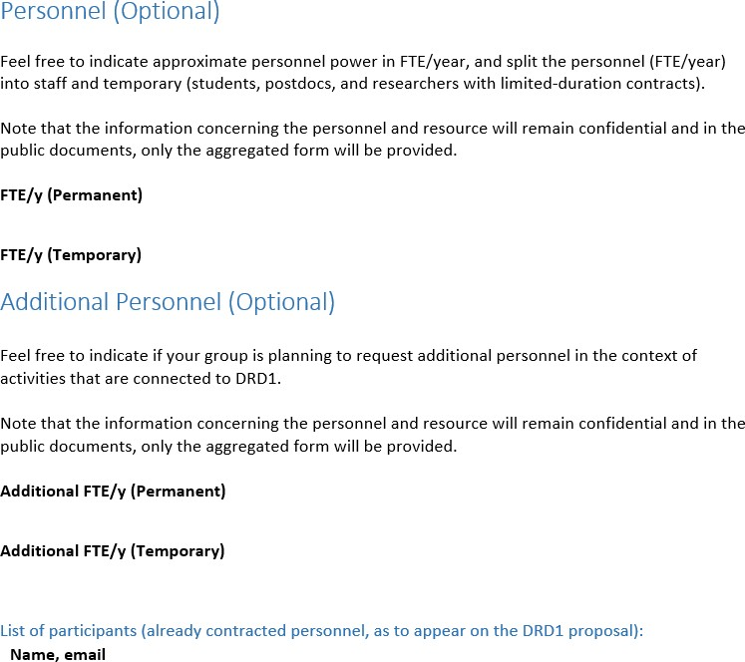
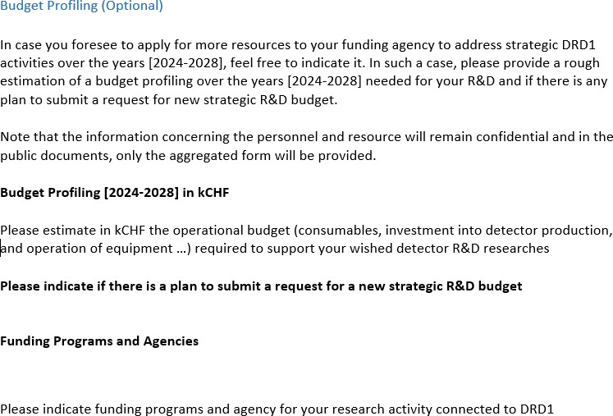
Survey Skeleton (II)

Slide 3
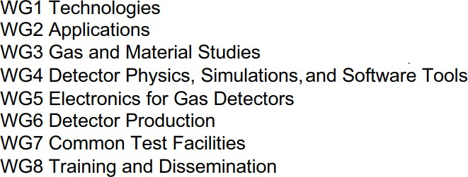
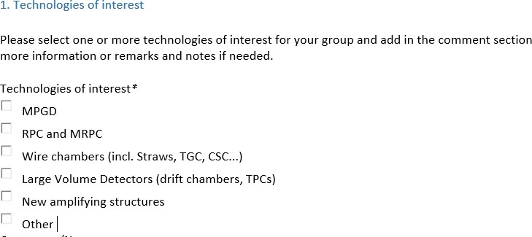
Survey Skeleton (WG1)

Slide 4
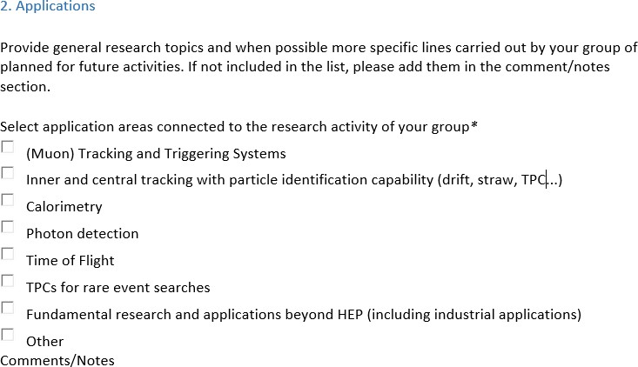
Survey Skeleton (WG2)

Slide 5
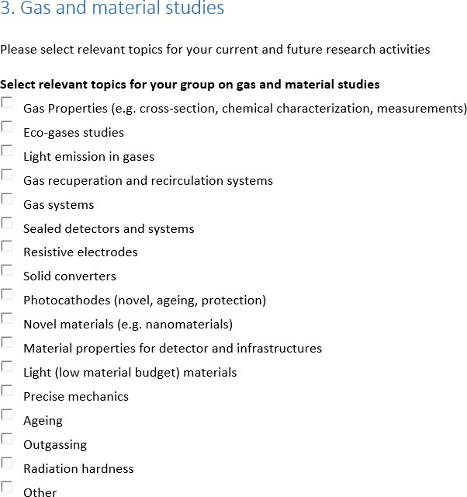
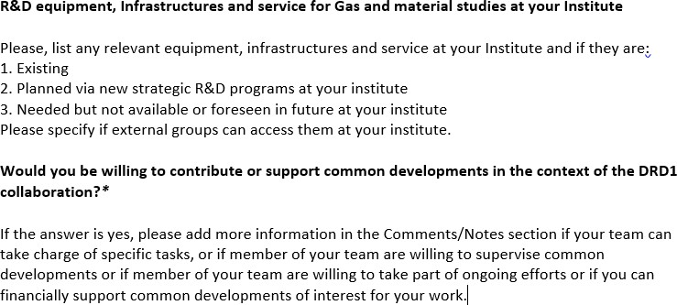
Survey Skeleton (WG3)

Slide 6
Survey Skeleton (WG4)

Slide 7
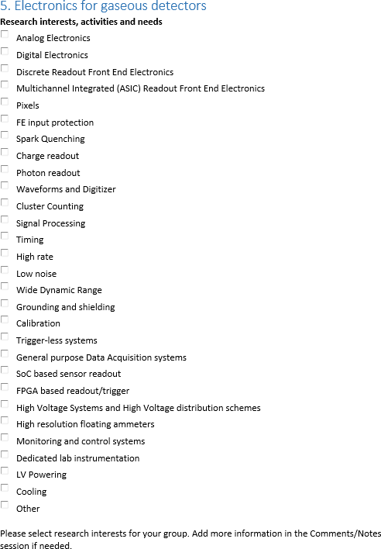
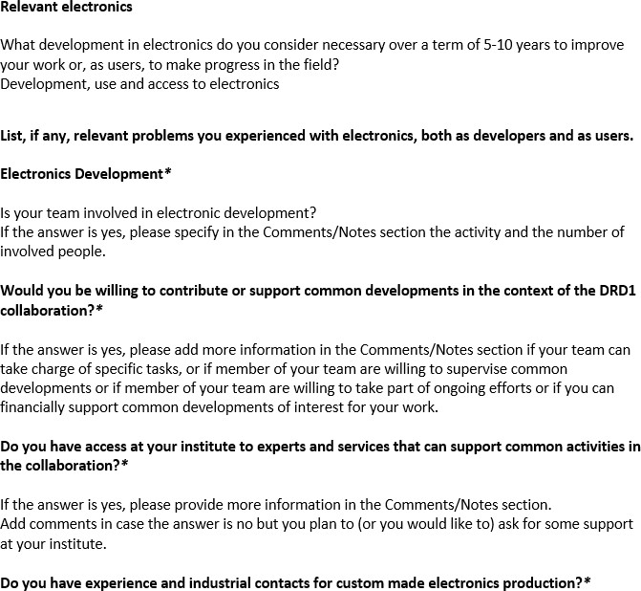
Survey Skeleton (WG5)

Slide 8
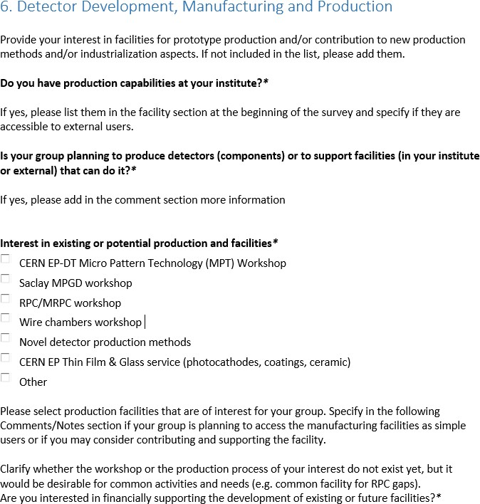
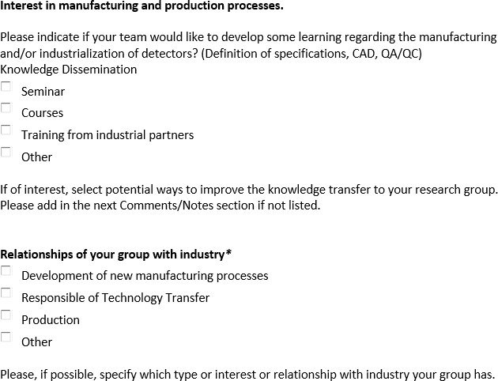
Survey Skeleton (WG6)

Slide 9
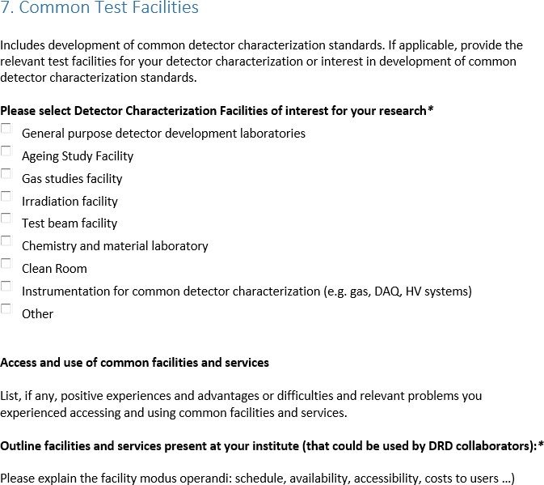
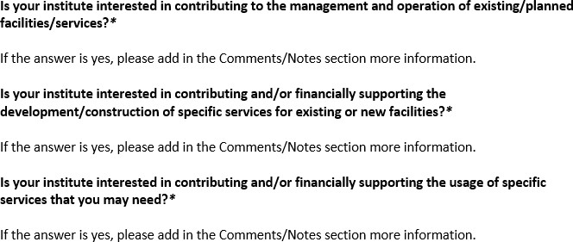
Survey Skeleton (WG7)

Slide 10
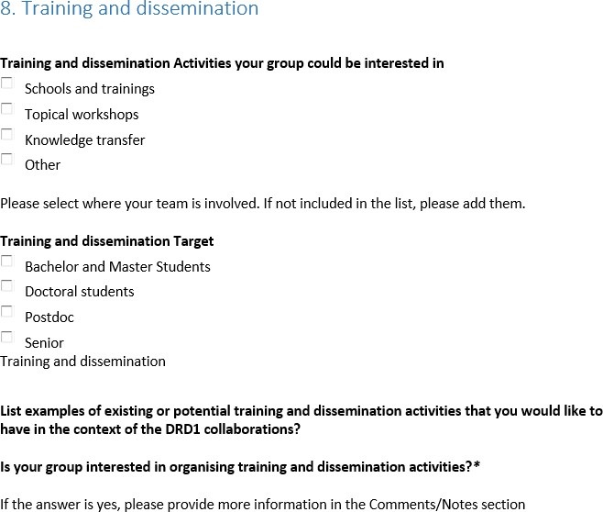
Survey Skeleton (WG8)

Slide 11
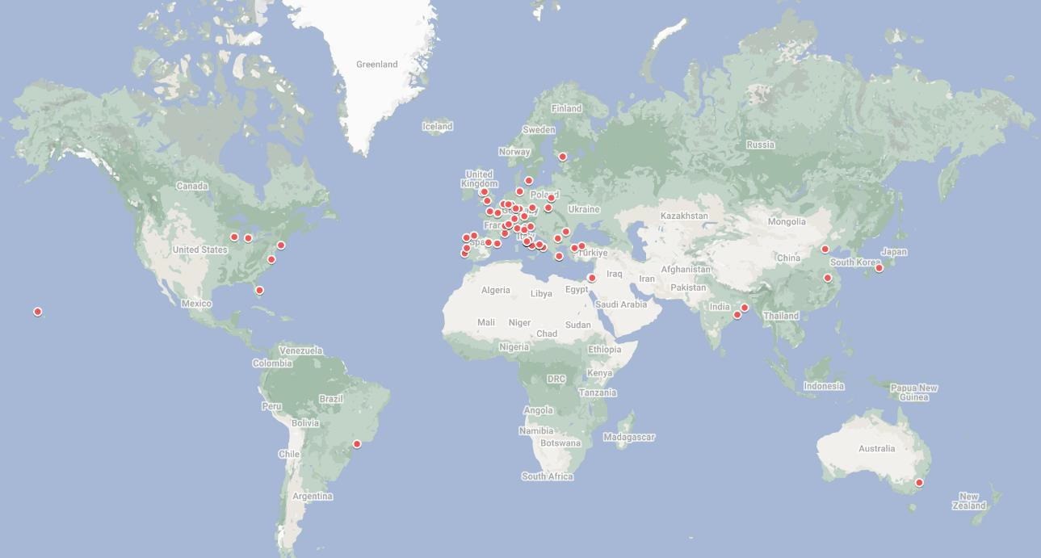
Number of Analyzed Submissions : 74

Slide 12
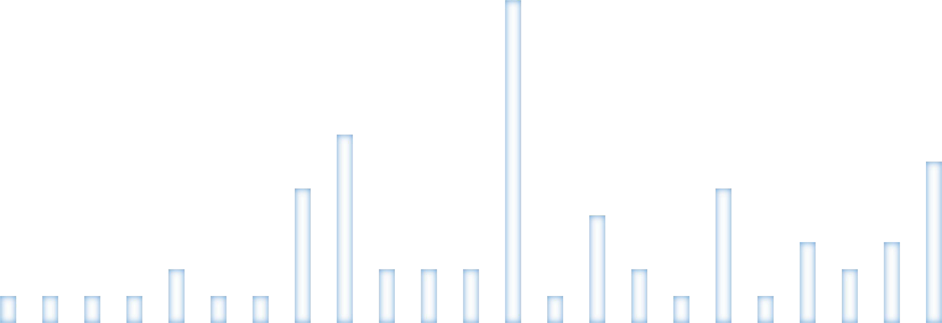
14
12
10
8
6
4
2
0
Bari Ferrara GSSI Lecce LNF Padova Pavia Roma Roma ToV Roma3 Trieste
Duplicates (most likely) Removed
Number of Analyzed Submissions : 74

