Slide 1
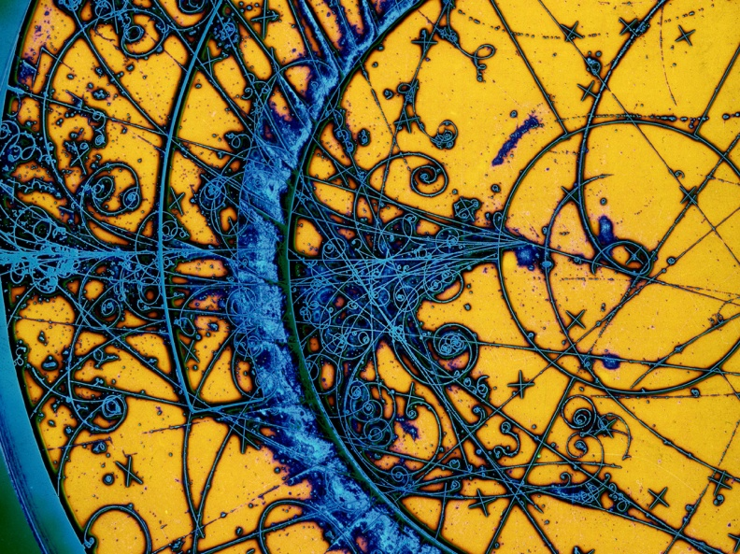
Italian National Institute of Nuclear Physics
27/09/2024
RICAP 2024
Prof.ssa Roberta Sparvoli
Director INFN Roma Tor Vergata

Slide 2
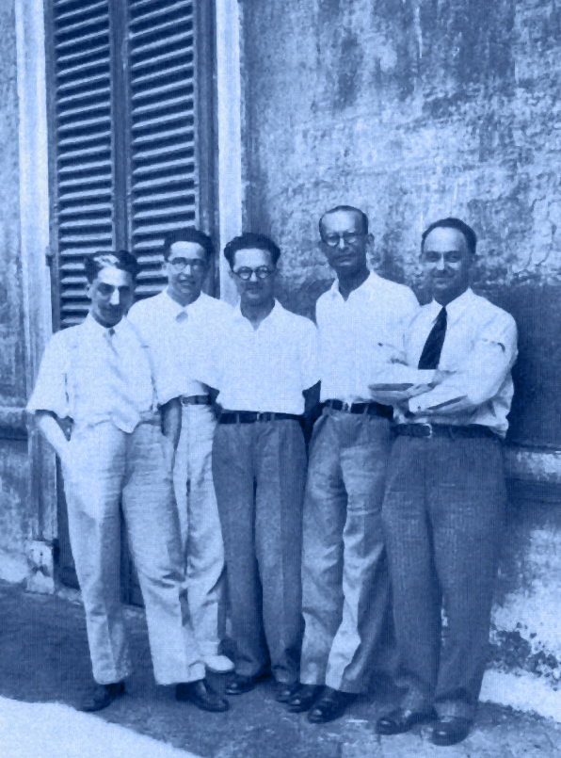
INFN was founded in 1951 and has a long and prestigious history descending from
Enrico Fermi and the «ragazzi di via Panisperna»

Slide 3
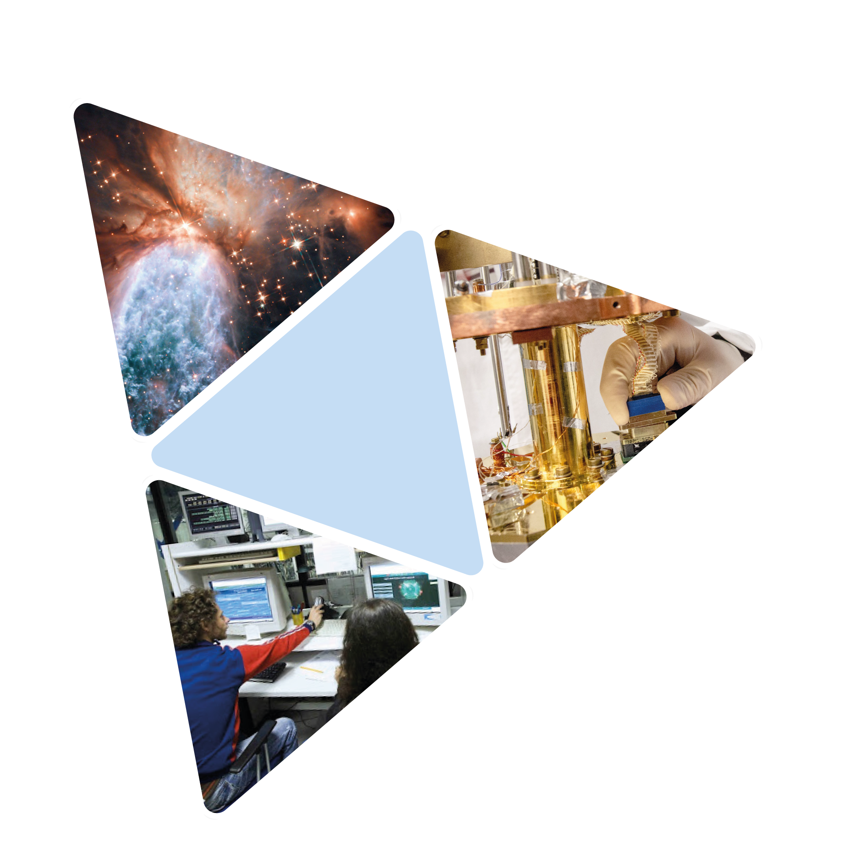

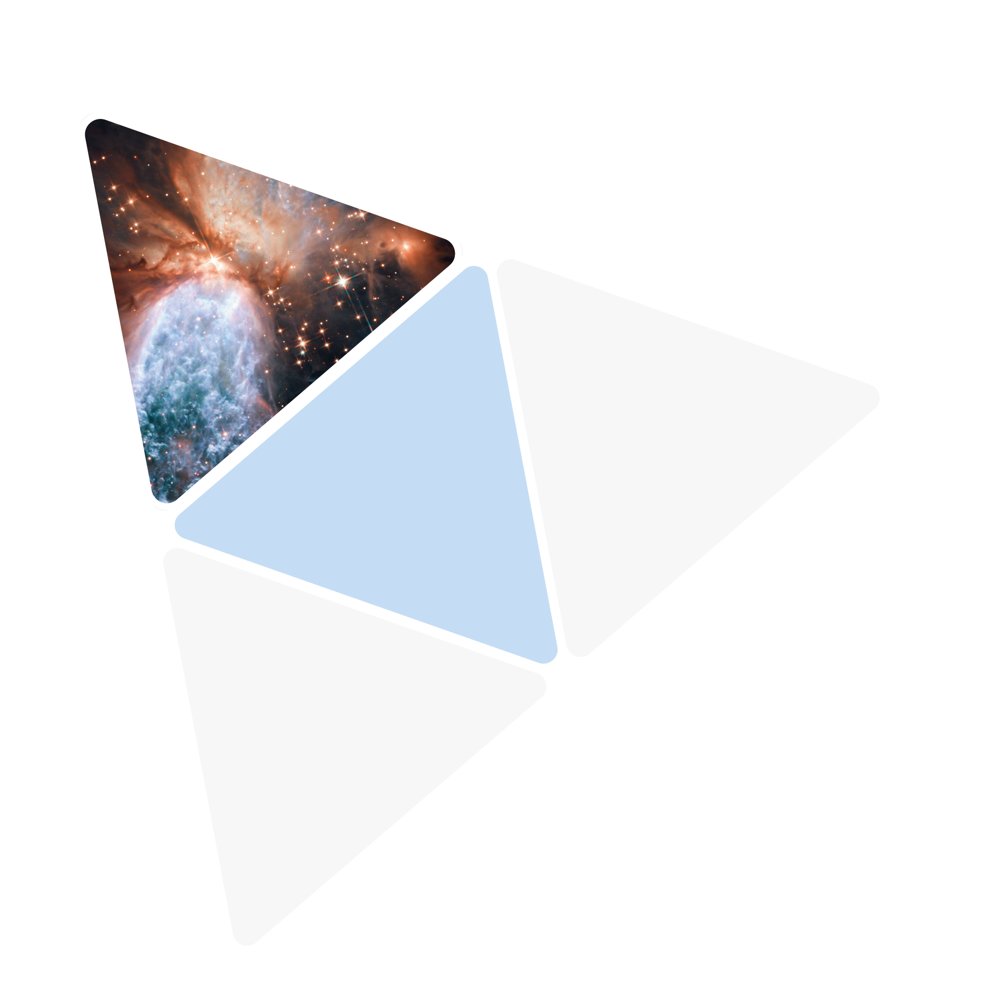
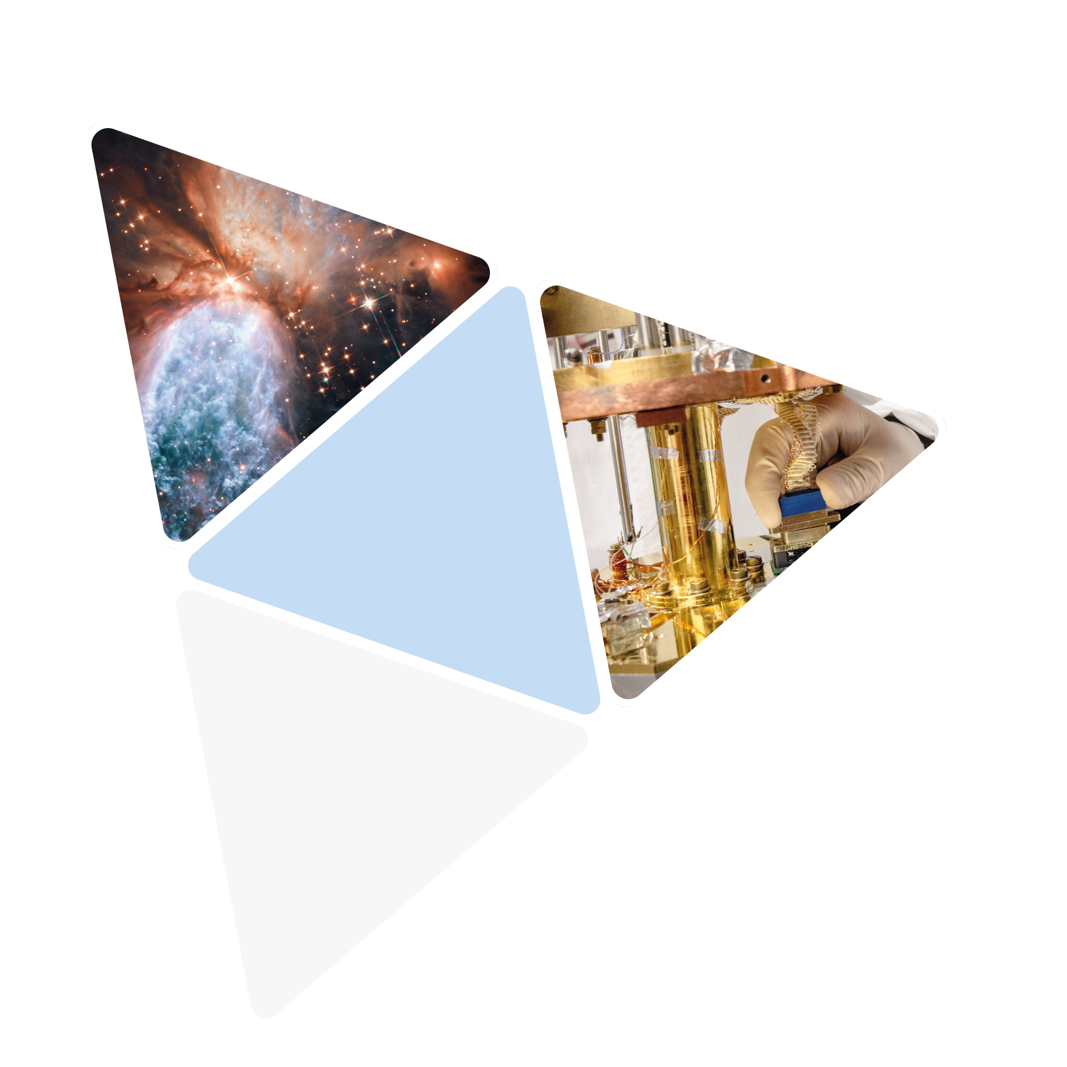
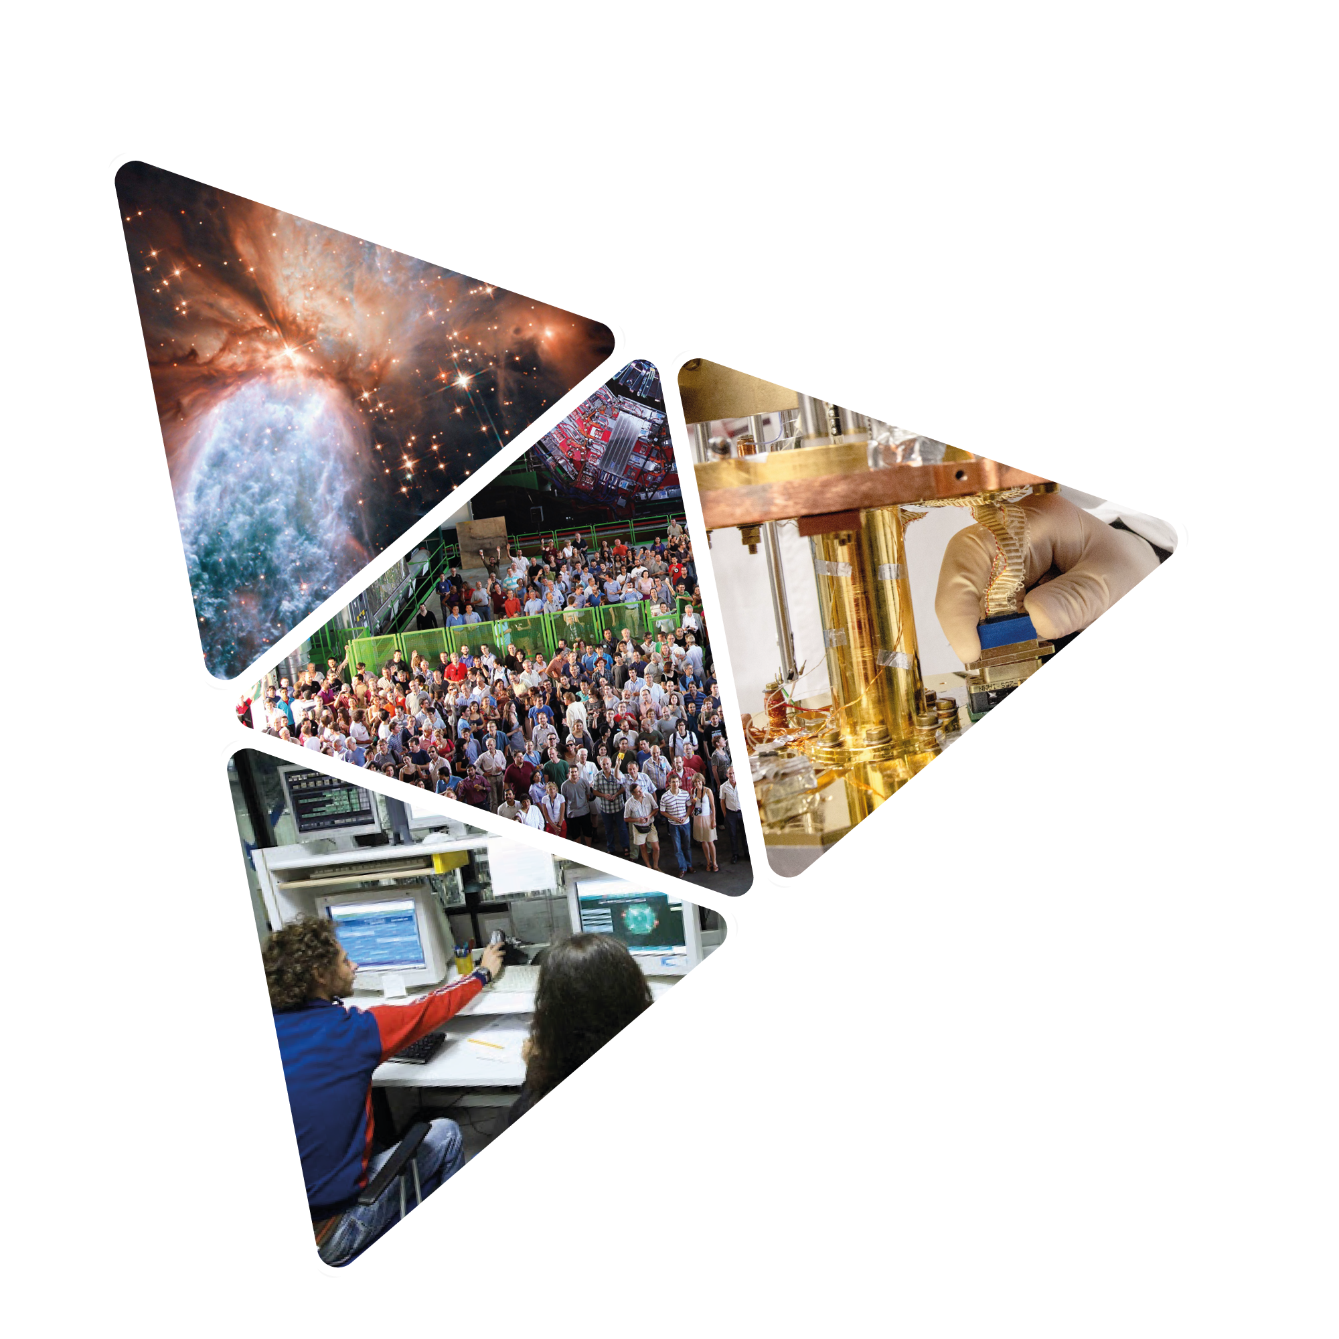
Pushing the frontiers of knowledge
The Big Bang secrets
Developing
new frontier technologies
Our
mission
Working together
with young people and
researchers from
all over the world
Forming
tomorrow’s scientist
and engineers

Slide 4
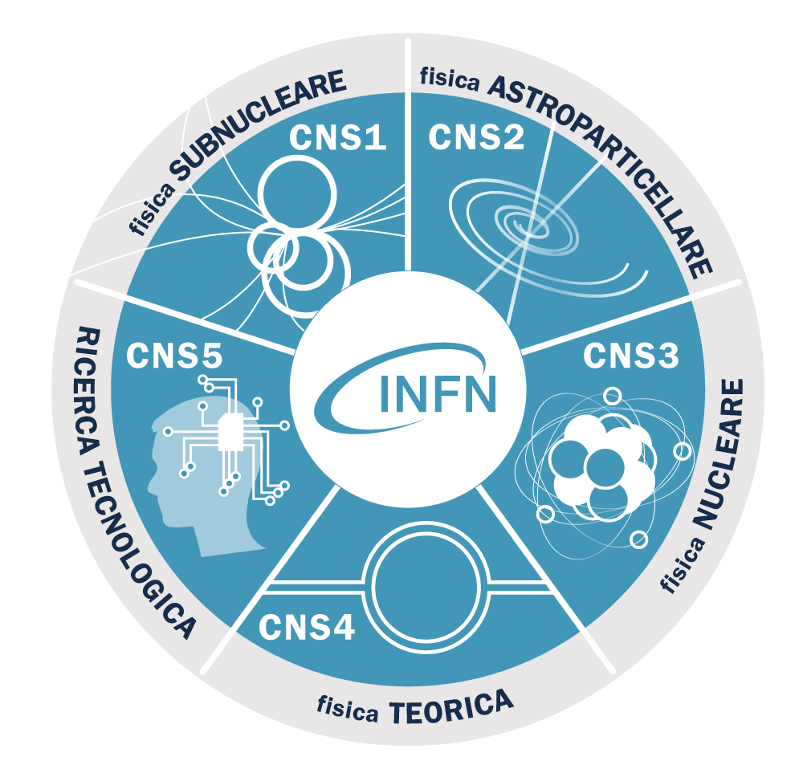
5 research
lines
5 Scientific Commissions

Slide 5
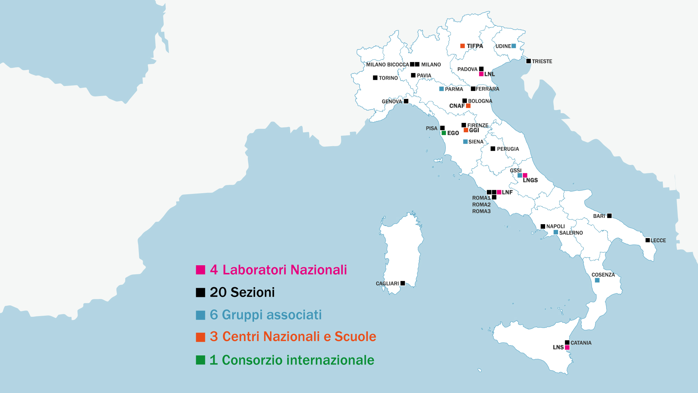

Infrastructures
INFN

Slide 6
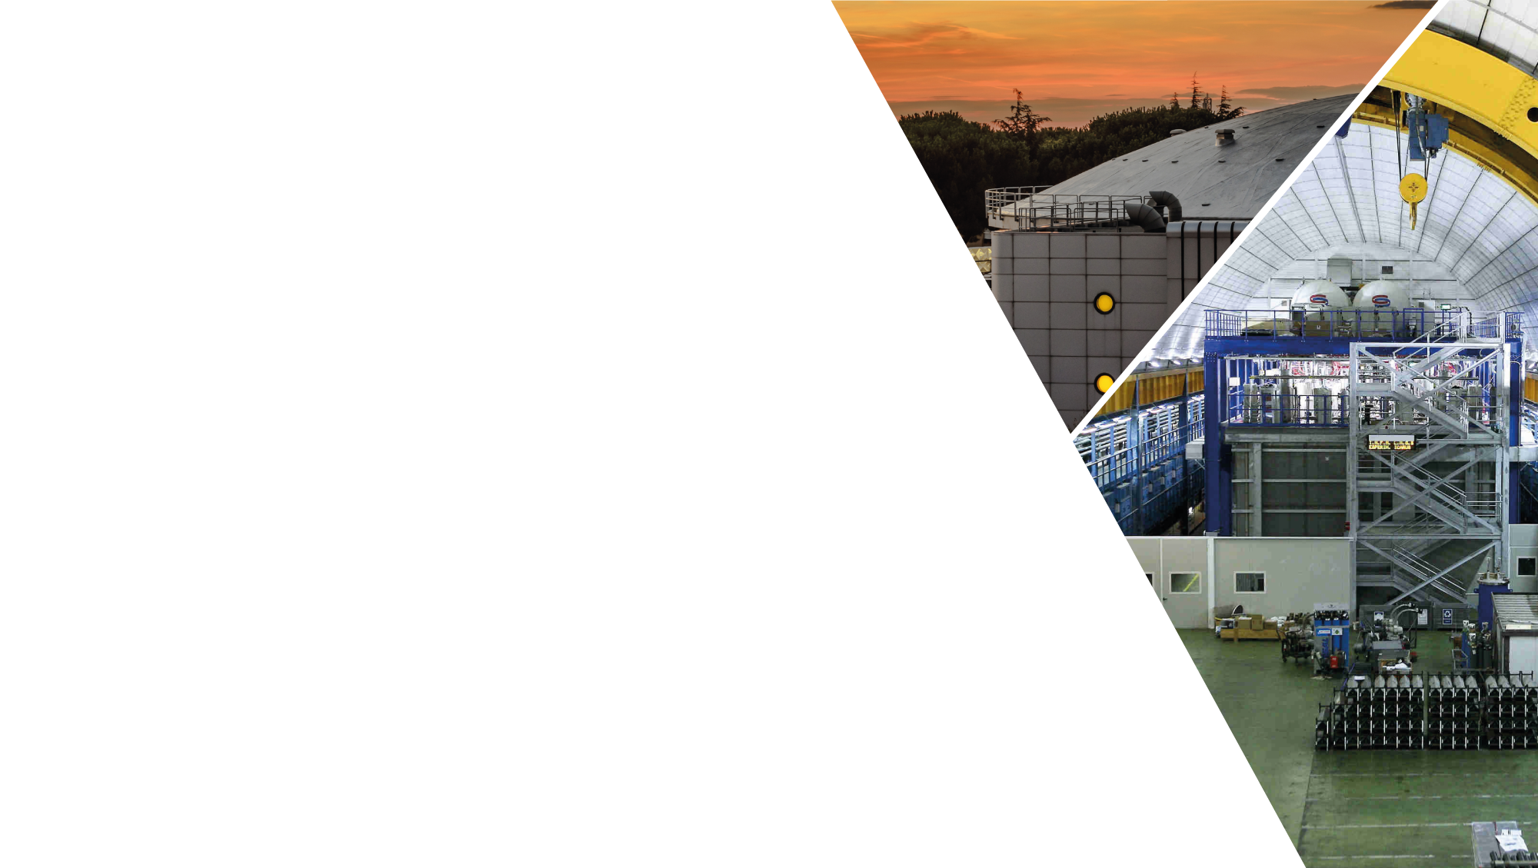
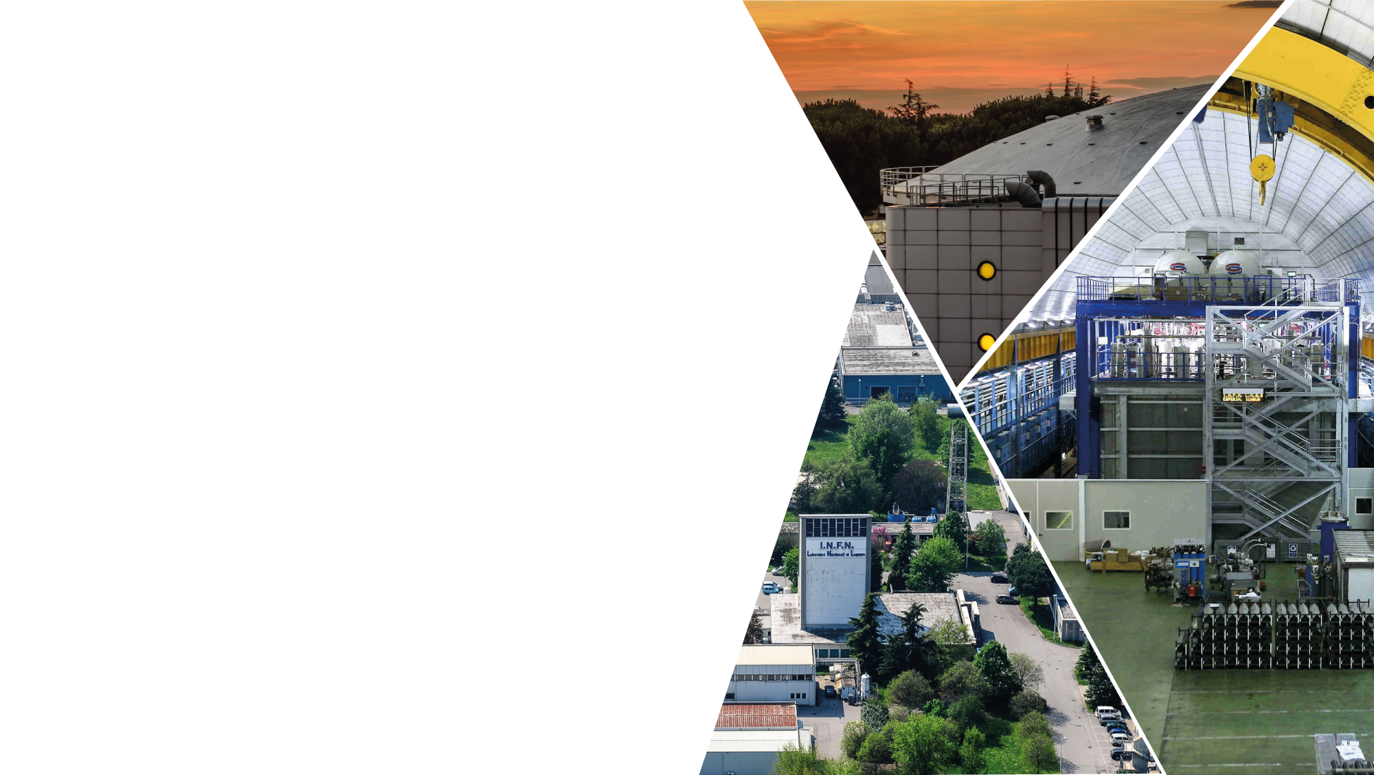
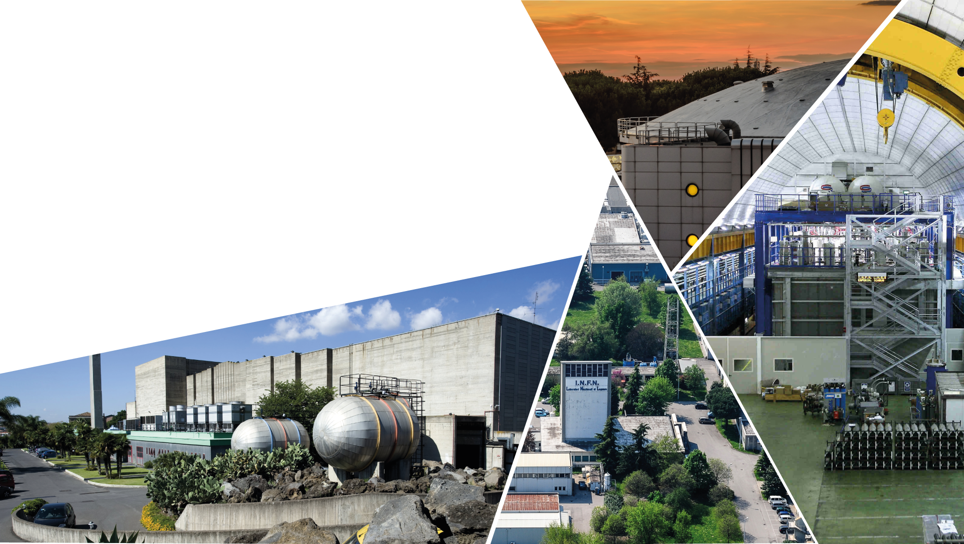


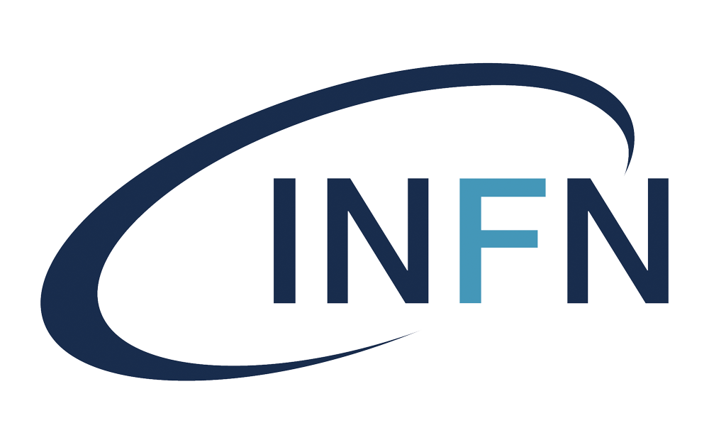
Infrastructures
INFN
Infrastrutture
dell’INFN
LNF
Laboratori Nazionali di Frascati
4 Laboratori Nazionali
4 National Laboratories
LNGS
Laboratori Nazionali del Gran Sasso
LNS
Laboratori Nazionali del Sud
LNL
Laboratori Nazionali di Legnaro

Slide 7

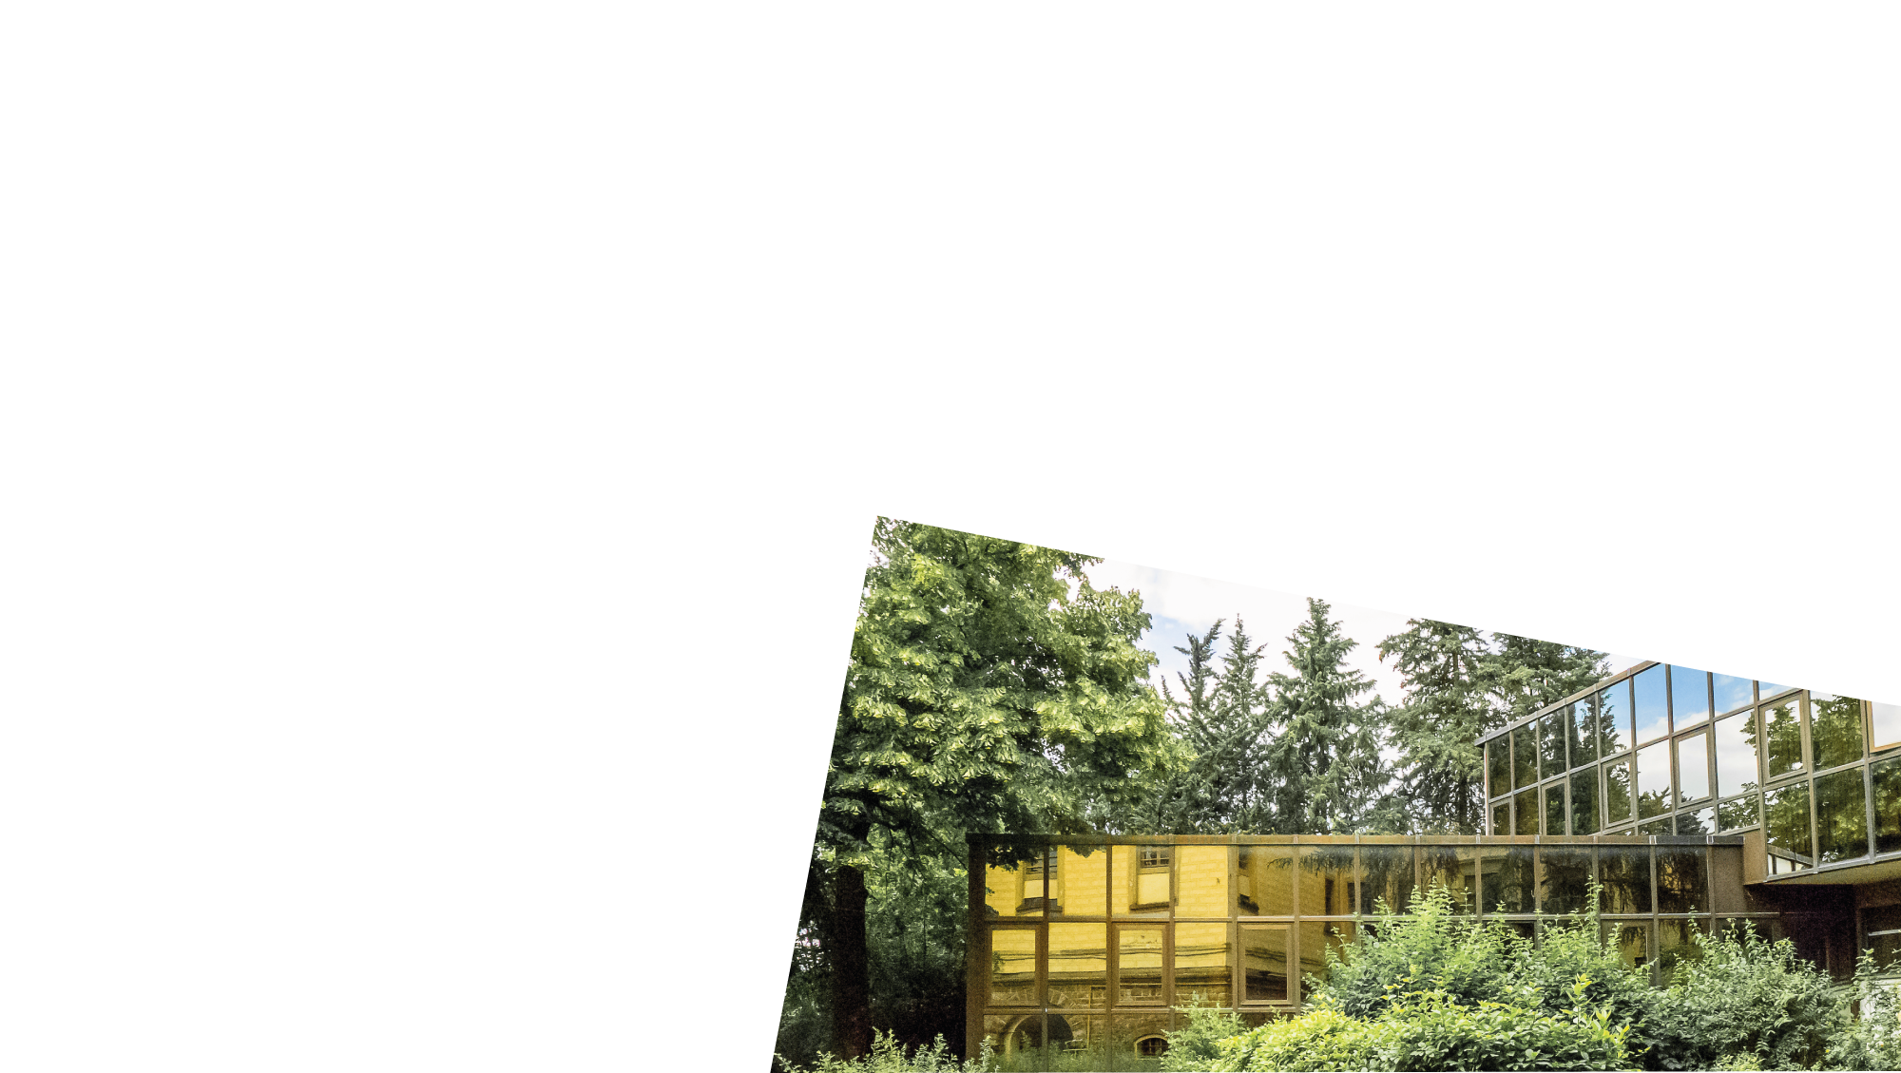
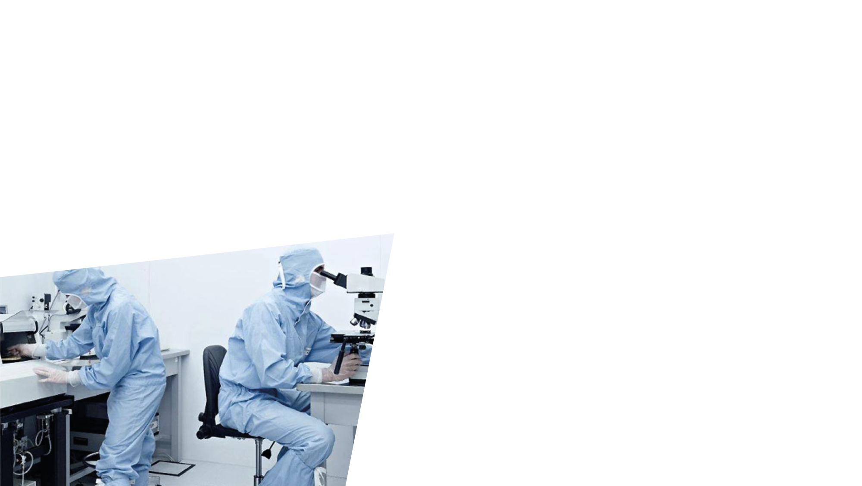
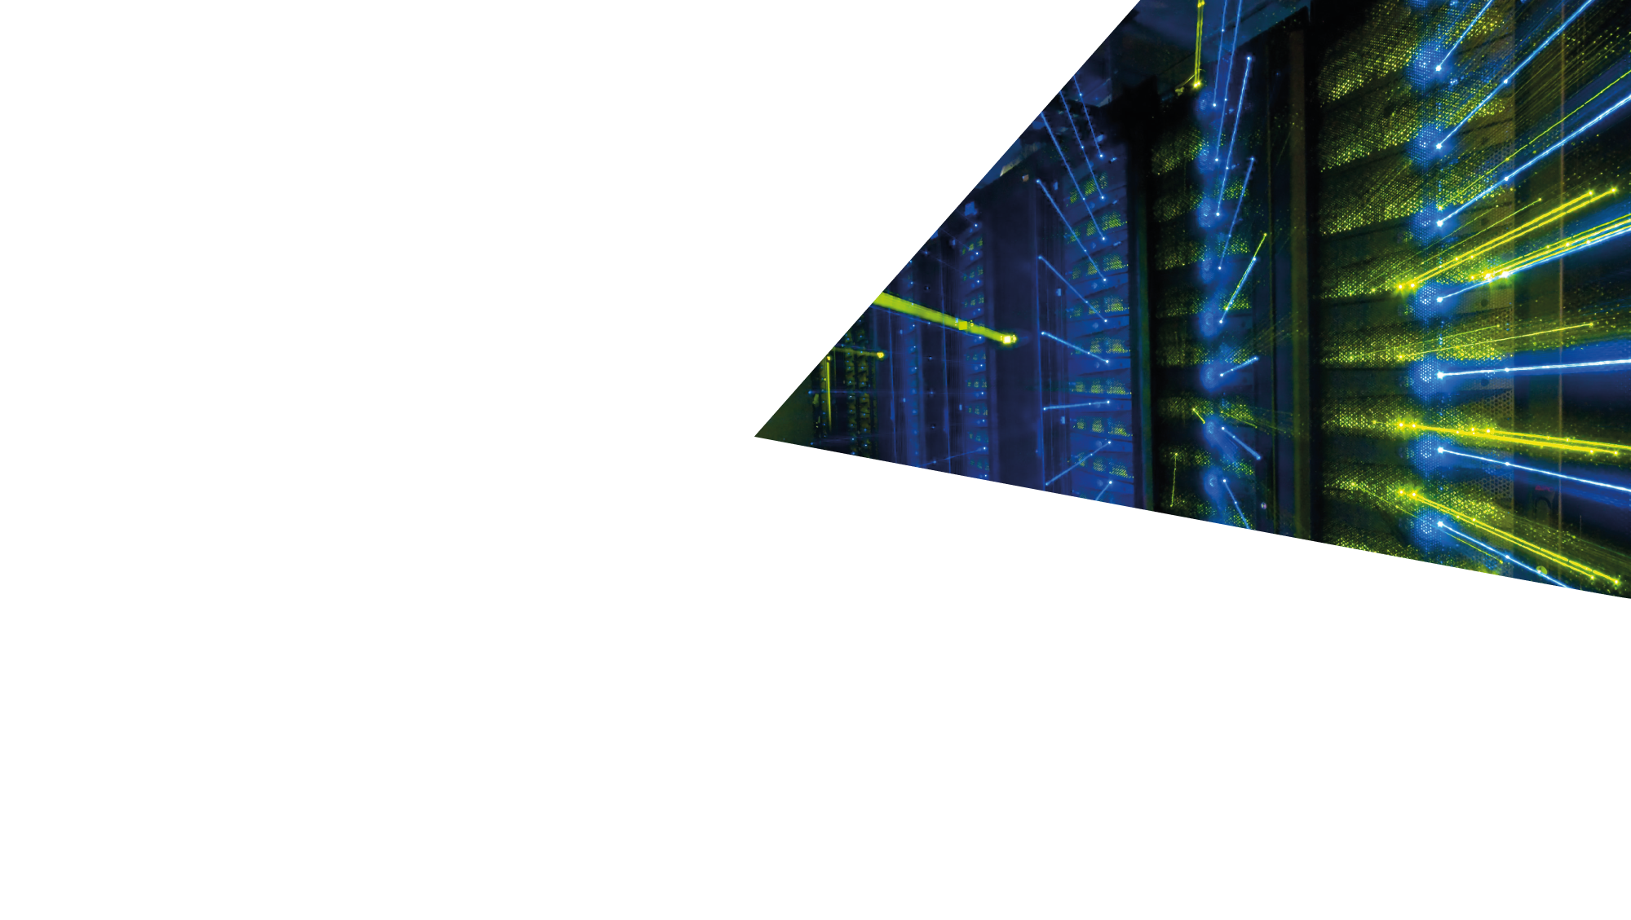
Infrastructures
INFN
Infrastrutture
dell’INFN
3 Centri Nazionali
CNAF
Centro per la ricerca e lo sviluppo
nelle tecnologie informatiche e telematiche
3 National Centers
TIFPA
Trento Institute for Fundamental
Physics and Applications
GGI
Galileo Galilei Institute

Slide 8
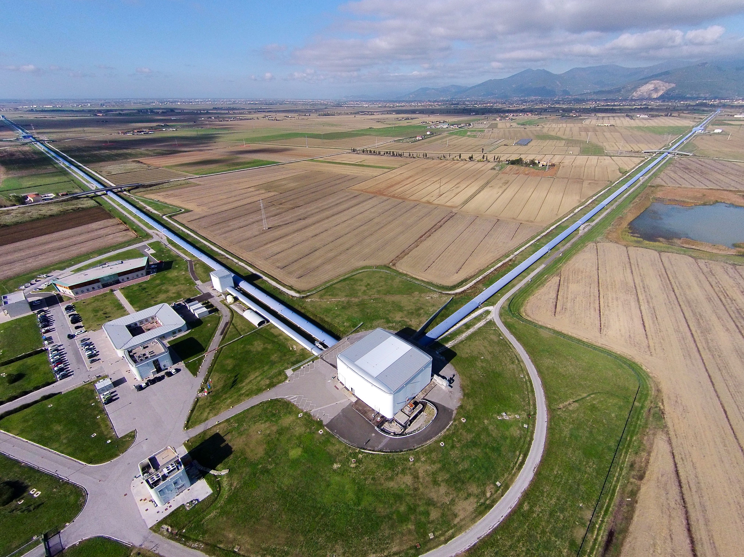
Infrastructures
INFN
Infrastrutture
dell’INFN
EGO-VIRGO
European Gravitational Observatory
1 consorzio internazionale
1 International Consortium

Slide 9
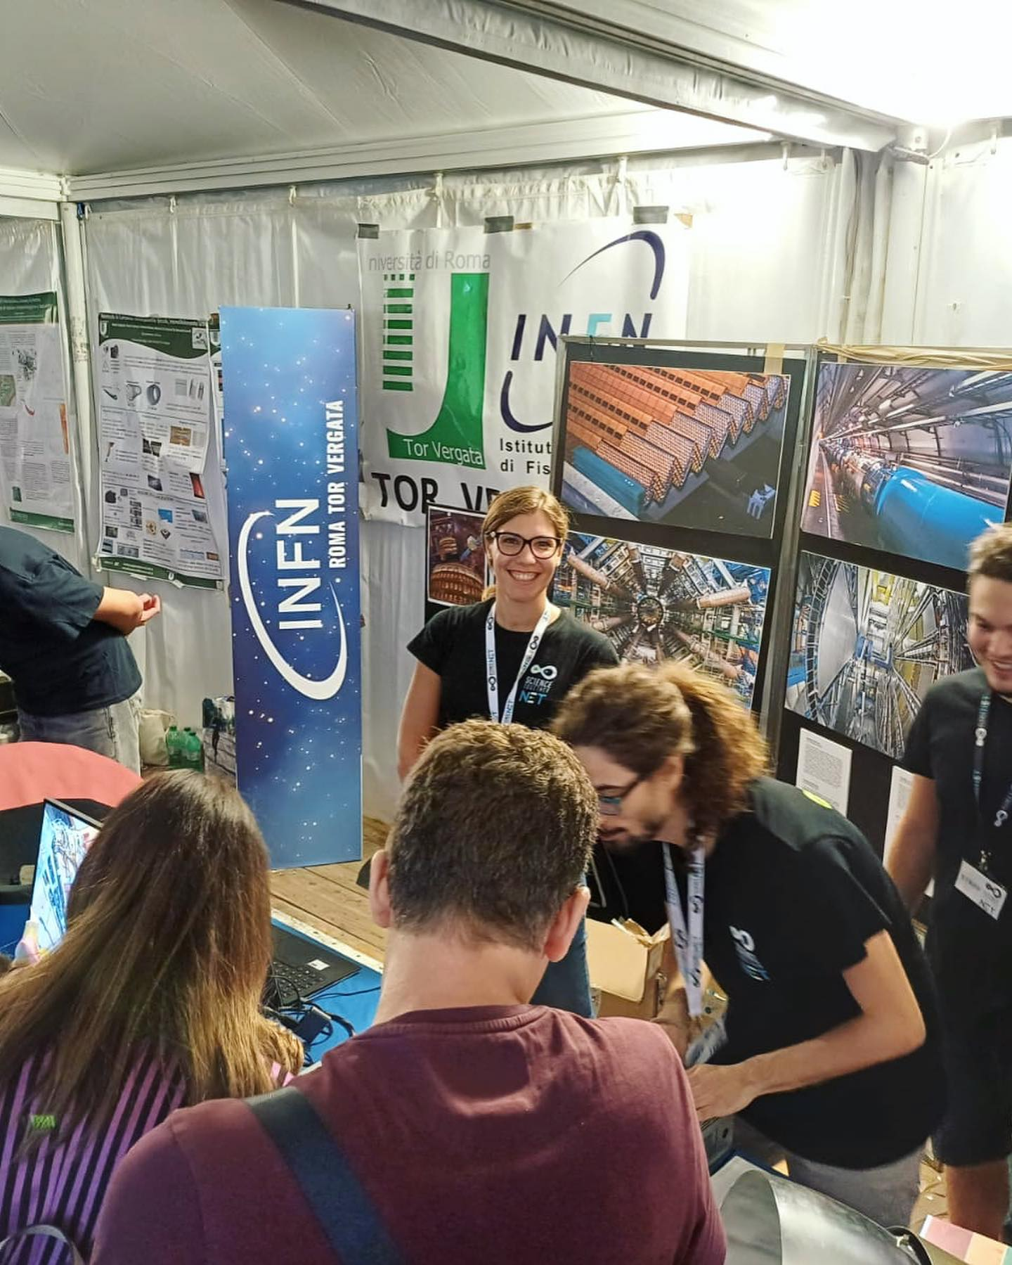
INFN Structure of the
«Tor Vergata» Rome University
The structure of Rome Tor Vergata was born in 1987 in the University of Rome Tor Vergata, with affiliations to the Departments of Physics, Chemistry, Engineering and Mathematics.
Today it has around 70 INFN staff and 200 professors, Ph.D.s and students associated with the organisation's research.
Research groups work on the study of particle, astroparticle and gravitational wave physics, nuclear physics, theoretical, multidisciplinary and applied physics.

Slide 10
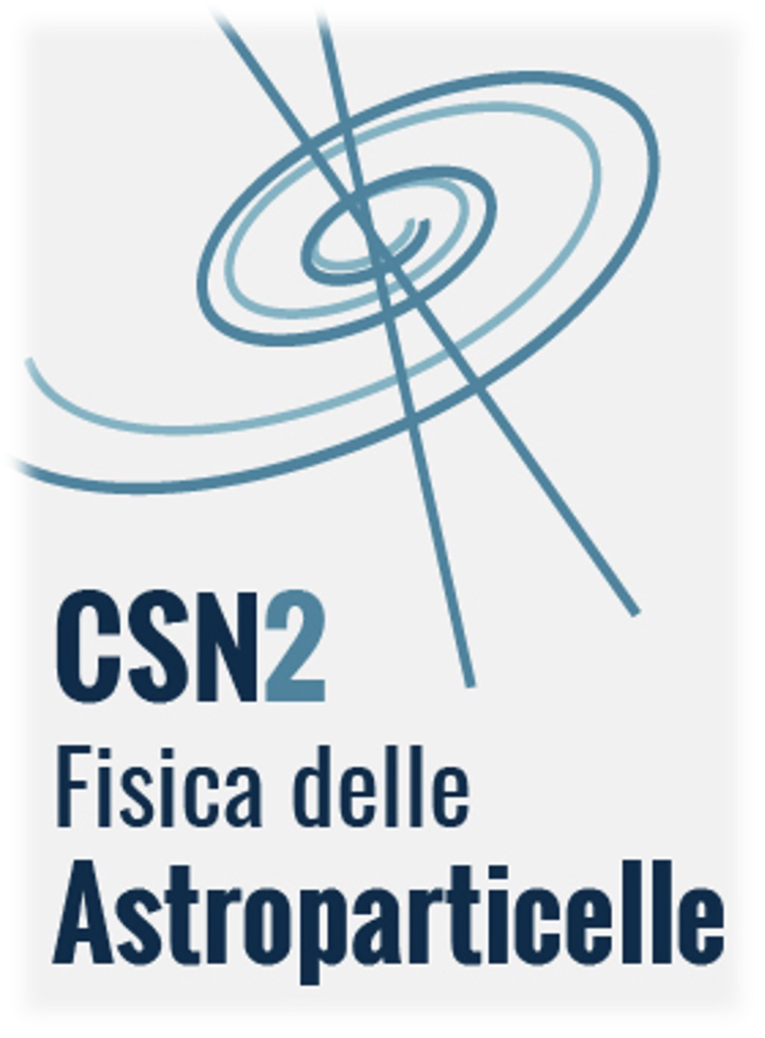
INFN
Tor Vergata
&
Astroparticle physics
Radiation from the Universe (photons, cosmic rays from space and at ground, neutrino astronomy)
FERMI, AMS-02, CSES-LIMADOU, IXPE, HERD
SPB-2/PBR, GAPS
AUGER, MAGIC/CTAO, SWGO
Gravitation (interferometers at ground and from space, tests of general relativity, quantum mechanics, QED and fundamentals)
VIRGO, LISA, ET
Dark Universe (direct and indirect DM, dark energy)
DAMA, LITEBIRD
Neutrino Physics (solar neutrinos, oscillation experiments, hierarchy and mass, Majorana vs Dirac mass term))
NUCLEUS, CUPID

Slide 11
Thanks for joining us at RICAP 2024 !

