Slide 1

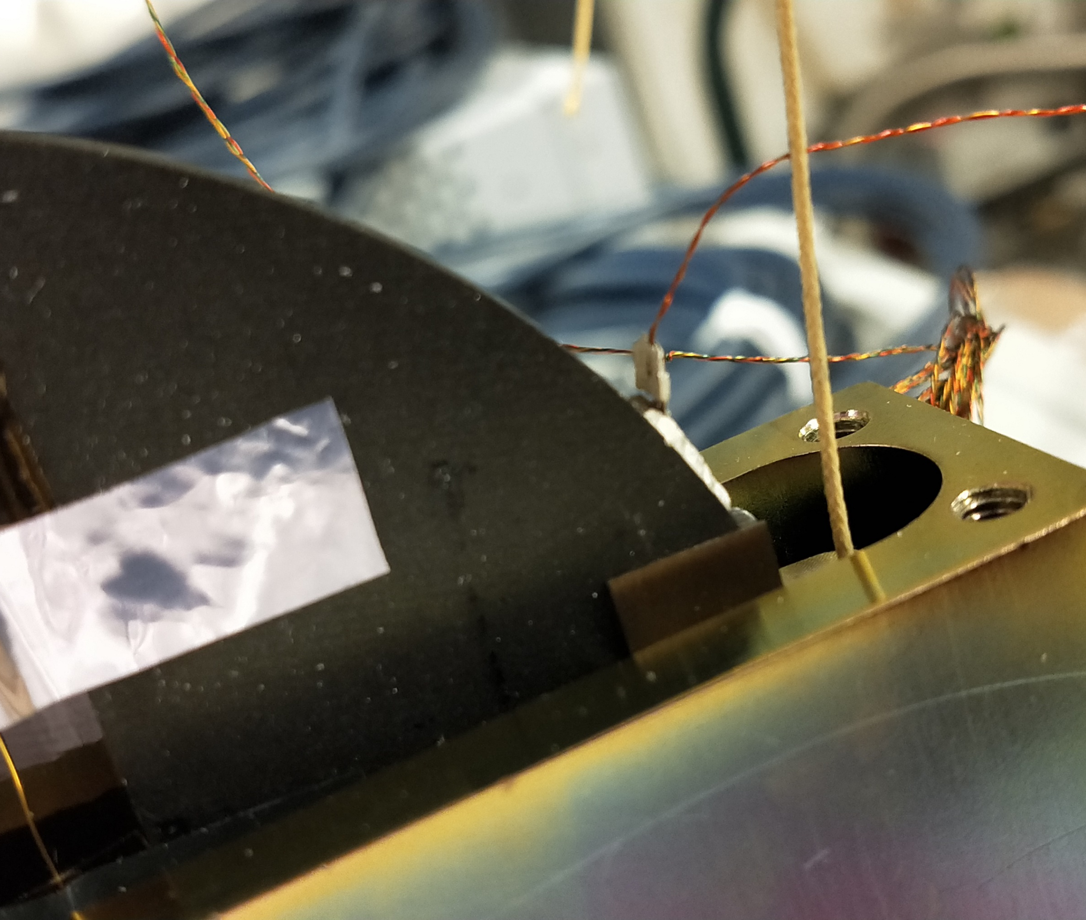






Exploring Vacuum-Gravity Interaction through the Archimedes Experiment: Recent Results and Future Prospects
Dr Valentina Mangano (INFN Roma)
on behalf of the Archimedes collaboration
presented by Piero Rapagnani
RICAP 2024
23–27 Sept 2024 Hotel Villa Tuscolana – Frascati (RM)

Slide 2
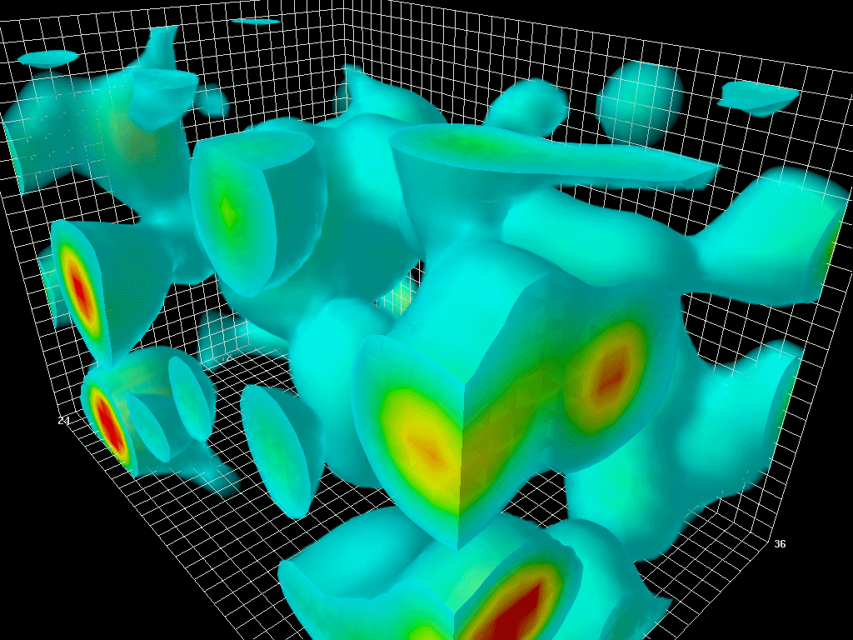
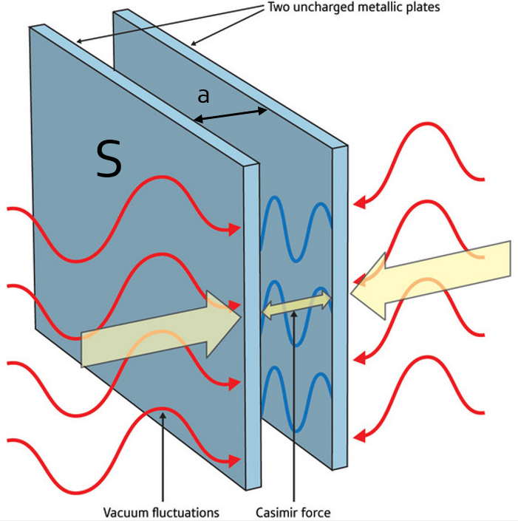
HOW TO WEIGH THE VACUUM?
Weigh the vacuum energy stored in a rigid Casimir cavity formed by parallel conductive plates.
The Casimir effect is one of the macroscopic manifestations of vacuum fluctuations.
Only some modes can resonate inside the Casimir cavity:
the ones which do not satisfy specific boundary conditions are expelled
and the total vacuum energy changes.
If the vacuum energy interacts with gravity,
a force directed upwards acts on the cavity and
is equal to the weight of the modes expelled from the cavity
(analogous to the Archimedes force) [*]:
The force depends on the vacuum energy inside the Casimir cavity.
$$\vec{F}=\frac{E_{C}}{c^{2}}\vec{g}$$
E_{C} = E(a) – E()
[*] G. Bimonte, E. Calloni, G. Esposito, L. Rosa – Physical Review D 76, 025008 (2007) – DOI: 10.1103/PhysRevD.76.025008

Slide 3
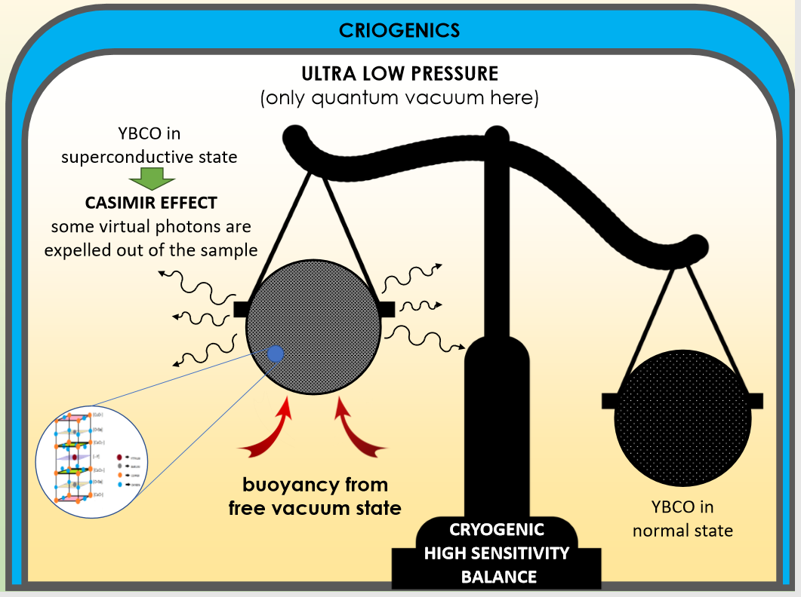
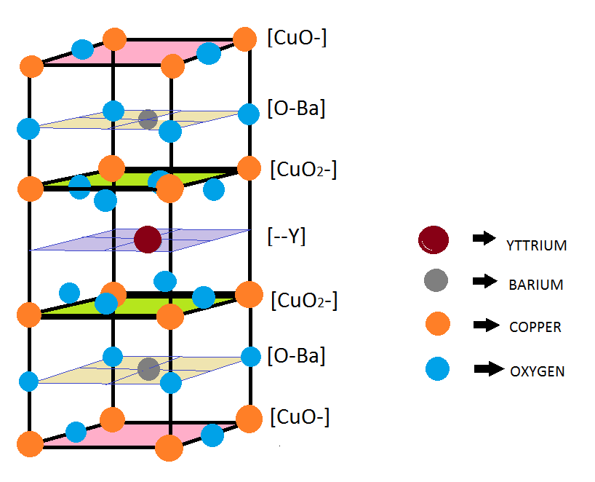
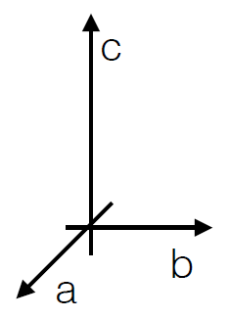
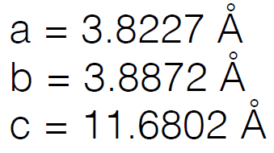
STRATEGY
modulation of the vacuum energy contained in a Casimir cavity
modulation of the reflectivity
of the plates with time
The idea is to modulate the vacuum energy of a rigid Casimir cavity by changing
the reflectivity of the plates with time.
A possible way to modulate the reflectivity is by performing a superconducting transition of the plates.
The variation of Casimir energy is relevant in case of type II high Tc layered superconductors (like YBCO and GdBCO), which behave as natural multi-layer Casimir cavities.
A transition from normal to superconducting state and vice versa can be induced by the modulation of the temperature of a superconductor.
superconducting transition
of the plates
thermal modulation around T_{c}
of a superconducting sample
Archimedes will measure the variation of the Casimir energy within this superconductor/multi-layer cavity [*]:
For a superconducting disc with diameter 100 mm and thickness 5 mm, the expected force on this object is
approximately 5.0·10⁻¹⁶ N (ΔE_{C} ~ 4.6 J).
$${\vec{F}}_{s}=\frac{{∆E}_{C}}{c^{2}}\vec{g}$$
courtesy of Dr Luciano Errico
[*] E. Calloni et al. – Physical Review D 90, 022002 (2014) – DOI: 10.1103/PhysRevD.90.022002

Slide 4
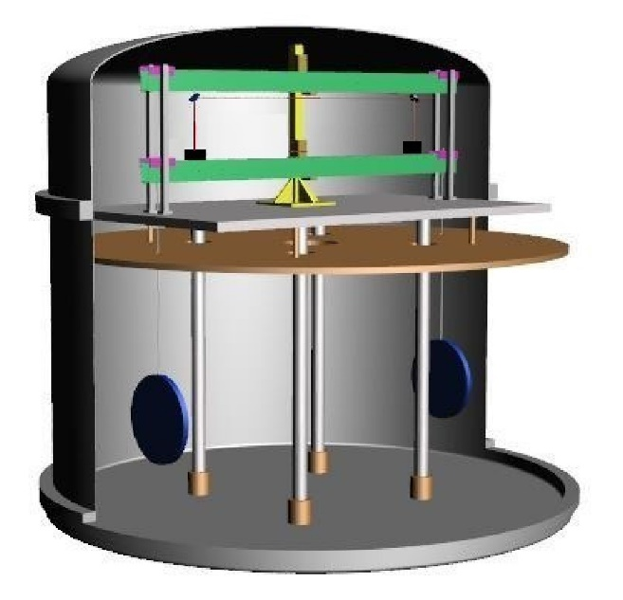
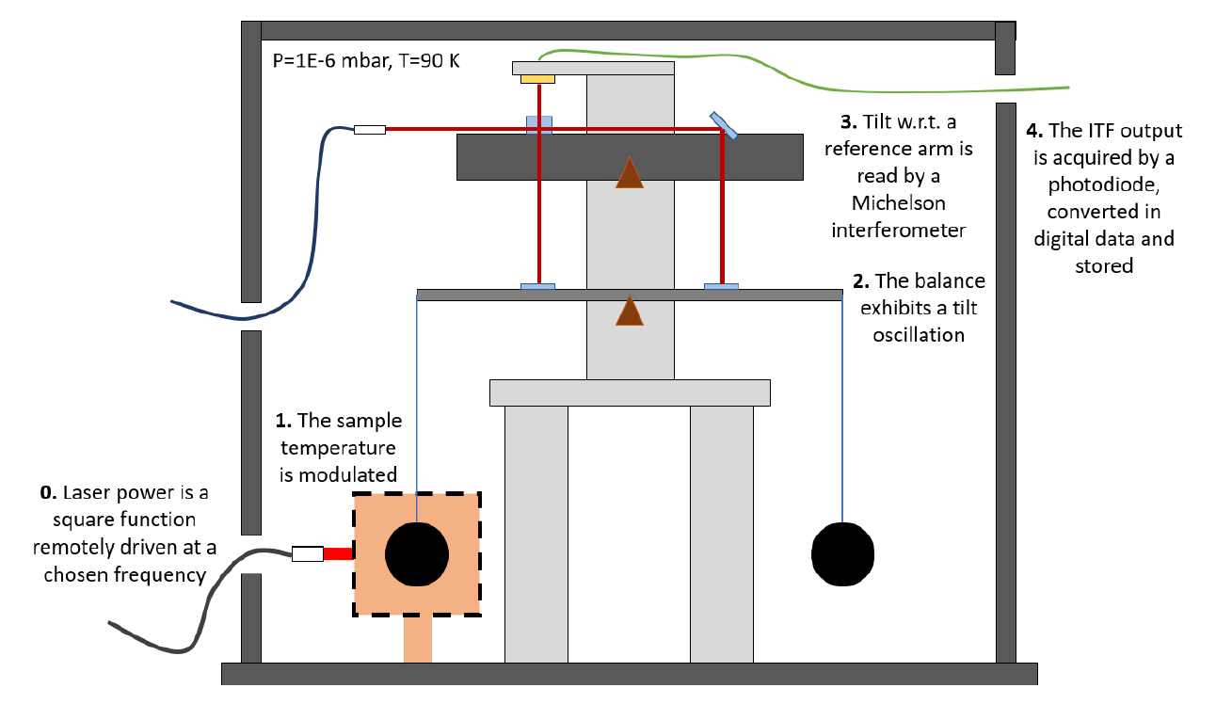
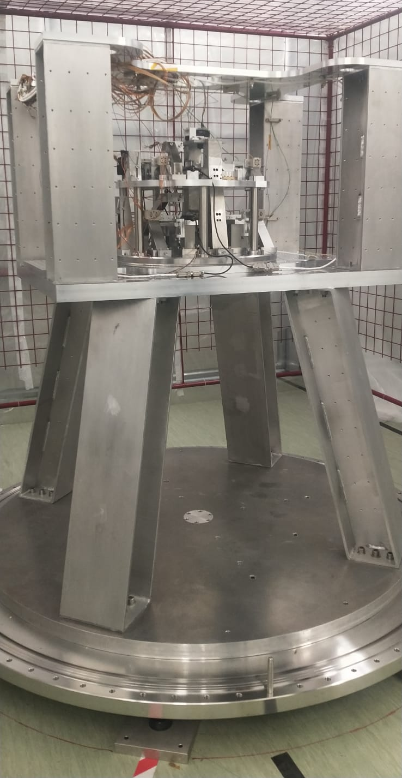
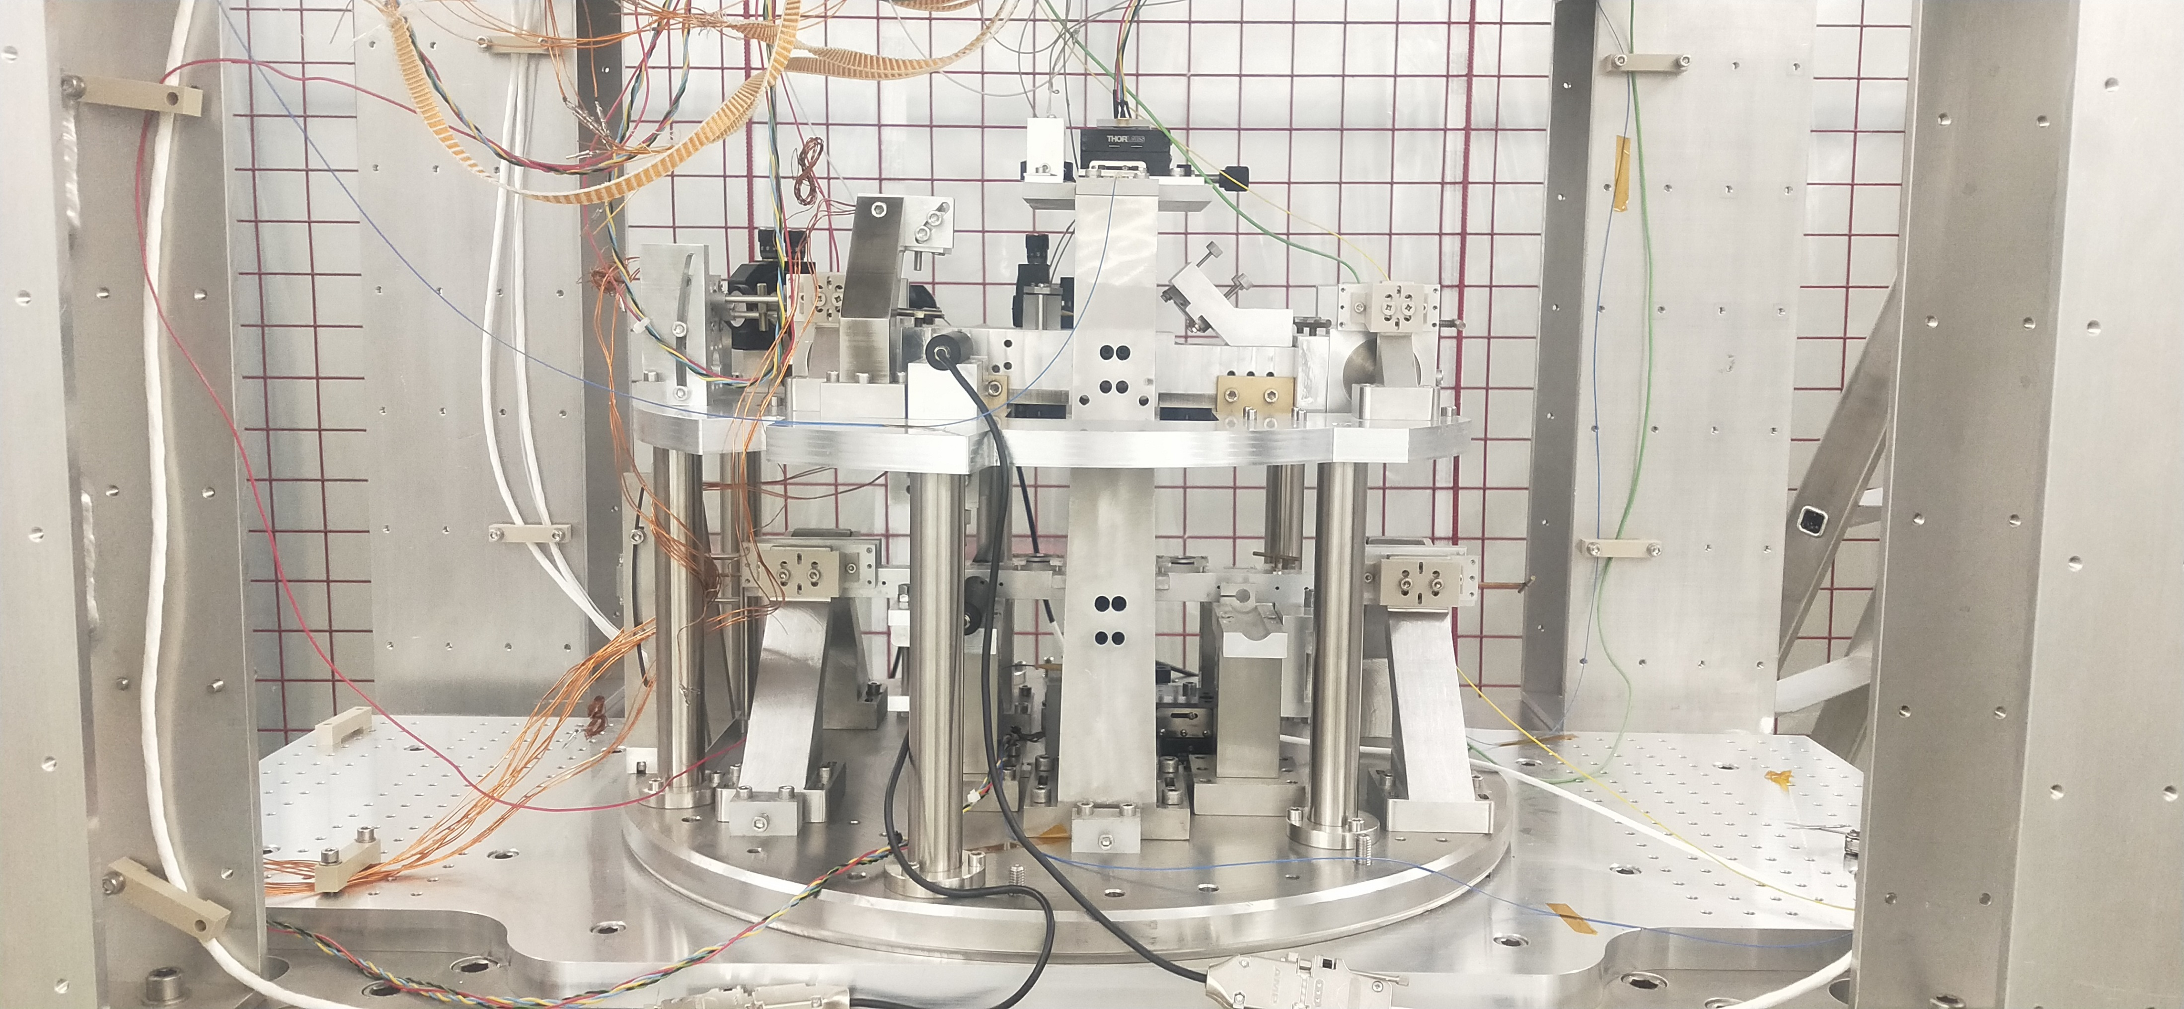
The BALANCE
reference arm
measuring arm
Suspending two equal superconducting discs at the ends of a balance arm at rest in a gravitational field and modulating the Casimir energy only in one superconductor, the variation in weight may be measured using a very high sensitivity cryogenic balance based on laser interferometry.
The modulation of the temperature of only one superconducting sample will produce a periodic signal of tilt of the measuring arm with respect to the reference arm taken into account, so that the ground tilt can be subtracted.
This torque signal will be read using a Michelson interferometer.
courtesy of Dr Luciano Errico

Slide 5
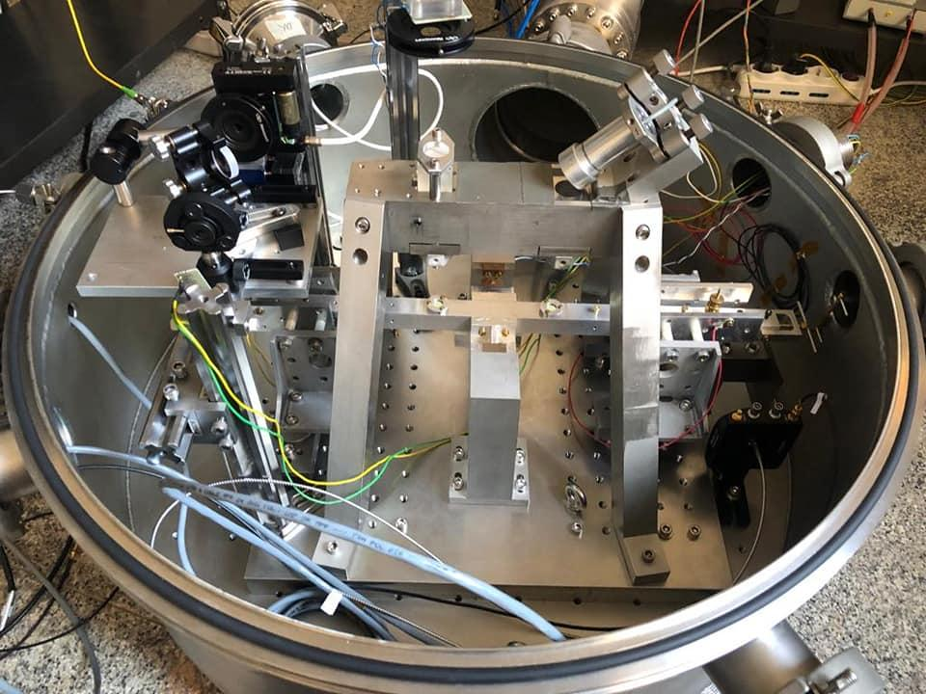
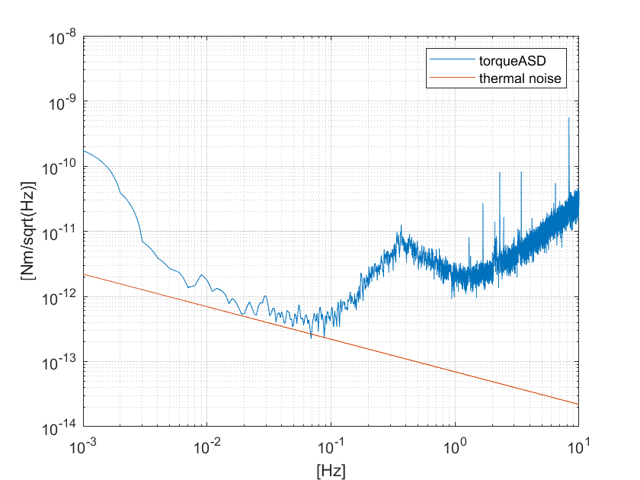
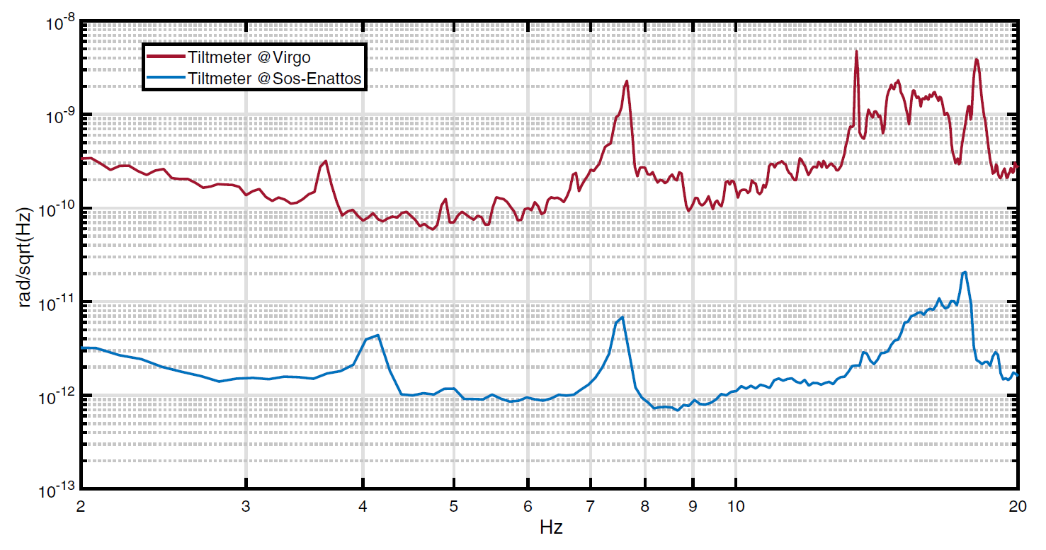
A prototype of balance was built to test every component and find the best optic-mechanical configuration for the final balance.
Tilt measurement comparison between Virgo gravitational wave interferometer (Cascina, Pisa) and Sos Enattos (Sardinia) sites.
Most sensitive tiltmeter in the world in the frequency band from 2 Hz to 20 Hz.
Preliminary
Prototype sensitivity in torque is limited by thermal noise.
5
$$6×{10}^{−13}{rad}/{\sqrt{Hz}}$$
https://doi.org/10.1140/epjp/s13360-021-01993-w

Slide 6
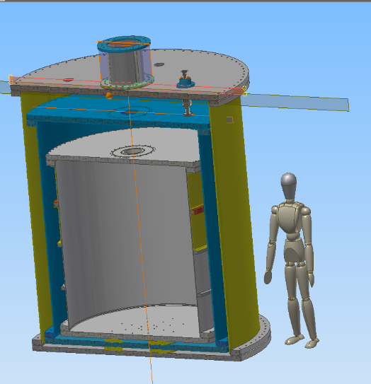
CRYOSTAT
Vacuum/Insulation Chamber
company: ???
material: steel
height , diameter: 3240 mm , 2730 mm
mass: 8100 kg
Nitrogen Chamber
company: Fantini Sud S.p.A. (Italy)
material: steel
height , diameter: 2003 mm , 2400 mm
mass: 6100 kg
Experimental Chamber
company: L.M.P. Amicuzi (Italy)
material: steel
height , diameter: 1780 mm , 2000 mm
mass: 3500 kg
The cryostat consists of three chambers.
The Experimental Chamber, that will hosts
the balance, will be completely submerged
in liquid Nitrogen inside the Nitrogen Chamber.
The volume of liquid Nitrogen in the tank is
approximately 4000 l.
An Aluminium screen around the Experimental Chamber ensures good thermal uniformity even with low liquid Nitrogen level.
Given a thermal input of about 2W/m², the evaporation time of liquid Nitrogen is estimated
to be about 5 months.
In the Insulation Chamber a vacuum (~10⁻⁶ mbar) will be created to isolate the system from the outside.
The Experimental Chamber can be used as a simple vacuum chamber at room temperature.

Slide 7
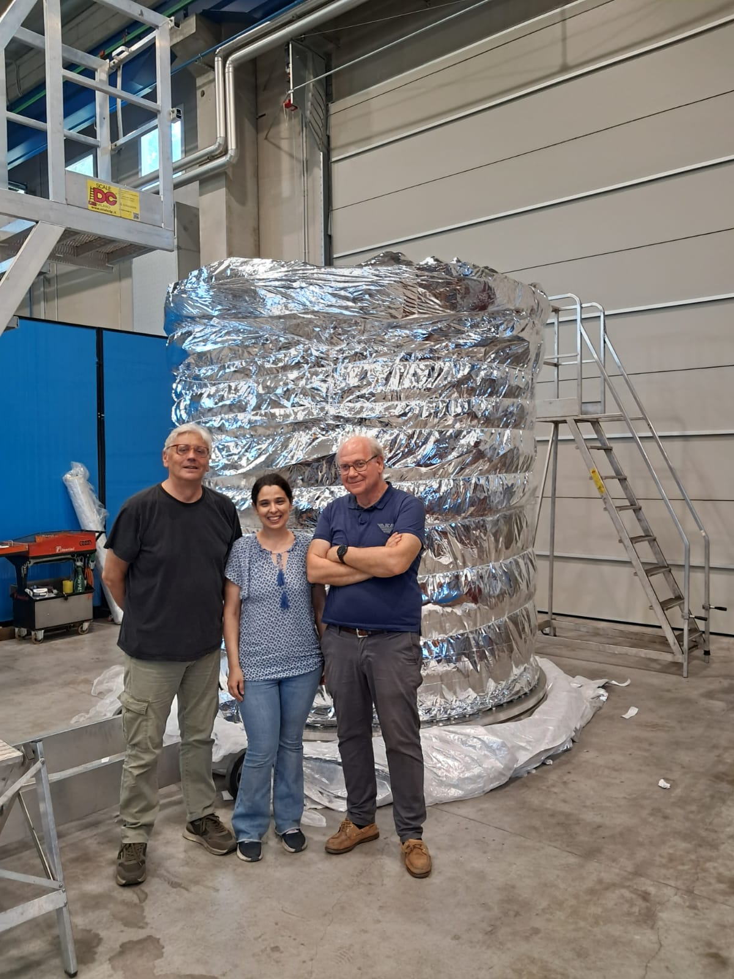
CRYOSTAT
Vacuum/Insulation Chamber
company: ???
material: steel
height , diameter: 3240 mm , 2730 mm
mass: 8100 kg
Nitrogen Chamber
company: Fantini Sud S.p.A. (Italy)
material: steel
height , diameter: 2003 mm , 2400 mm
mass: 6100 kg
Experimental Chamber
company: L.M.P. Amicuzi (Italy)
material: steel
height , diameter: 1780 mm , 2000 mm
mass: 3500 kg
The cryostat consists of three chambers.
The Experimental Chamber, that will hosts
the balance, will be completely submerged
in liquid Nitrogen inside the Nitrogen Chamber.
The volume of liquid Nitrogen in the tank is
approximately 4000 l.
An Aluminium screen around the Experimental Chamber ensures good thermal uniformity even with low liquid Nitrogen level.
Given a thermal input of about 2W/m², the evaporation time of liquid Nitrogen is estimated
to be about 5 months.
In the Insulation Chamber a vacuum (~10⁻⁶ mbar) will be created to isolate the system from the outside.
The Experimental Chamber can be used as a simple vacuum chamber at room temperature.
Valentina Mangano
Fulvio Ricci
Piero Rapagnani

Slide 8

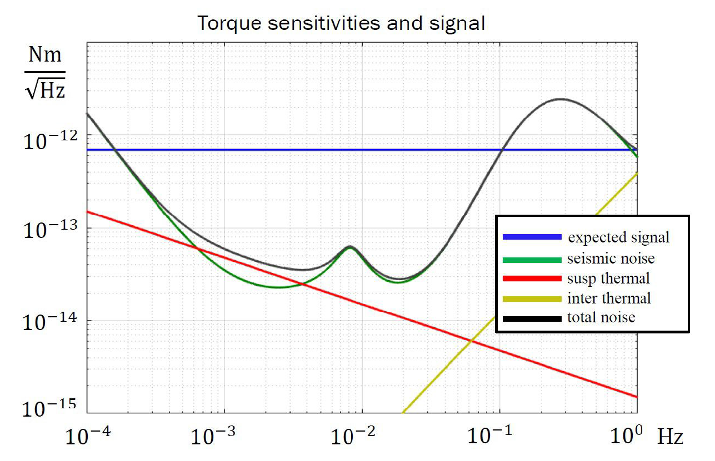
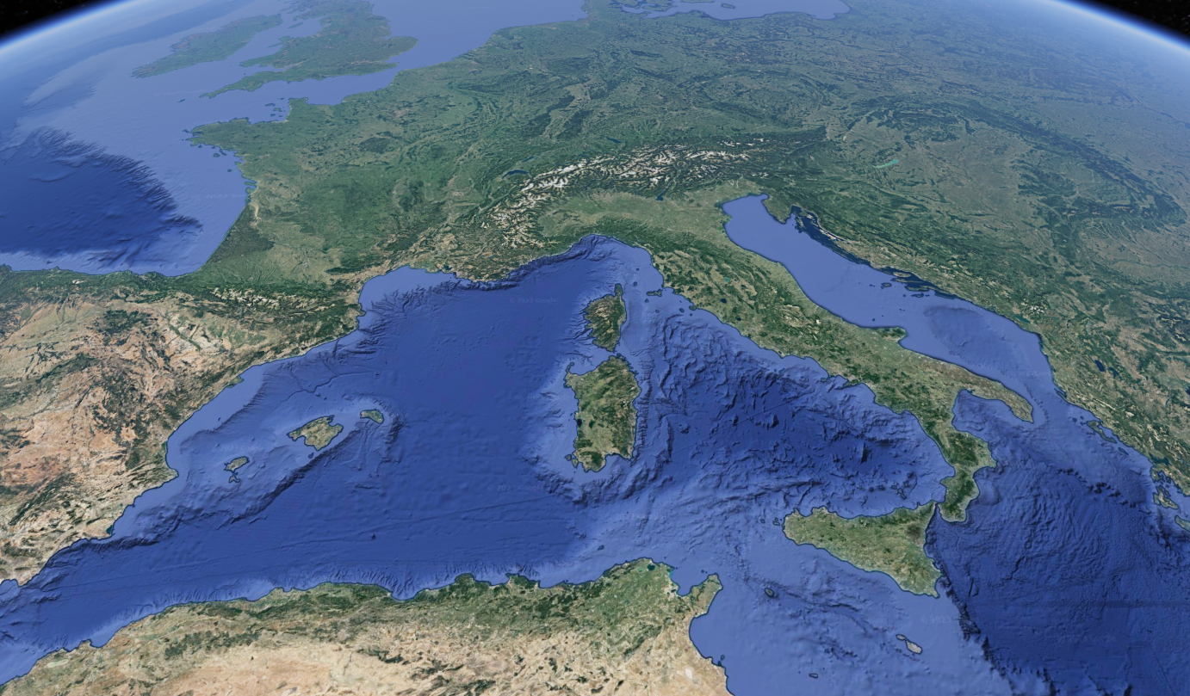
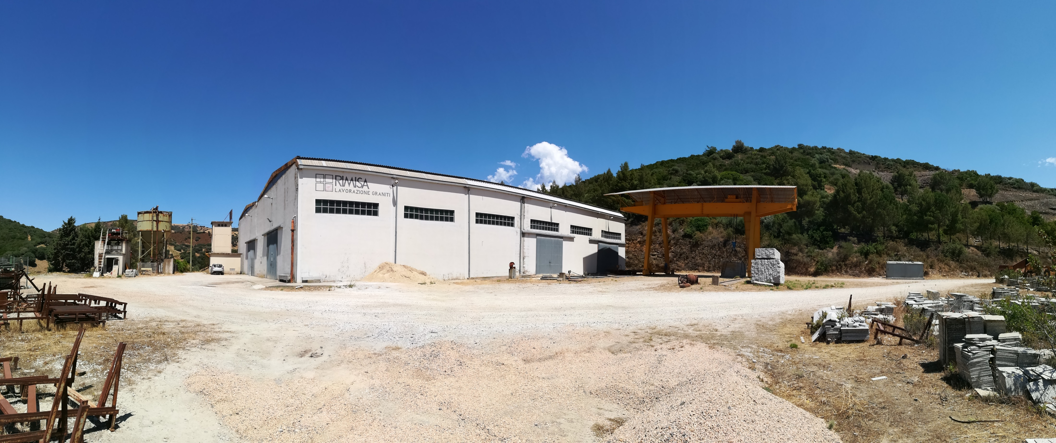
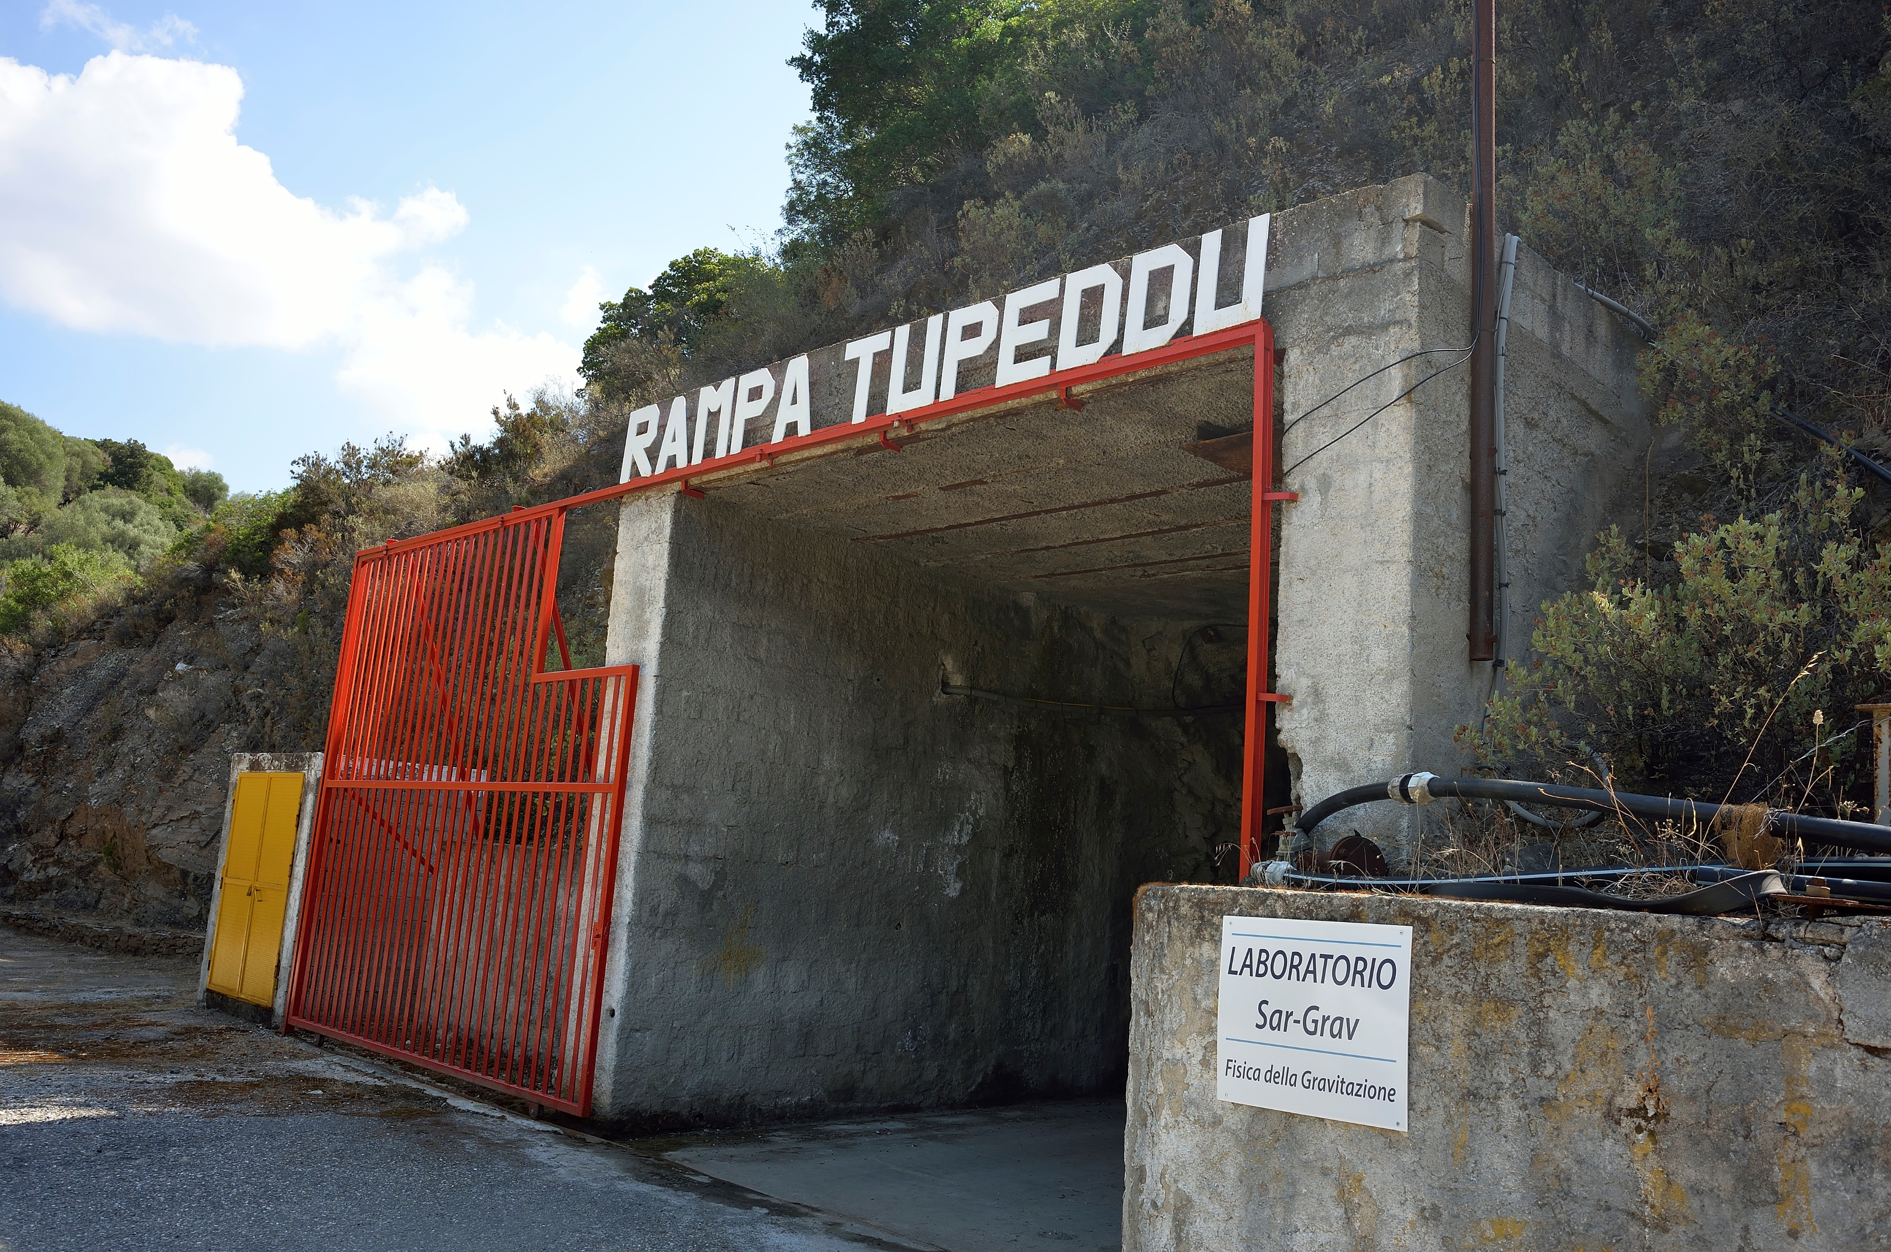
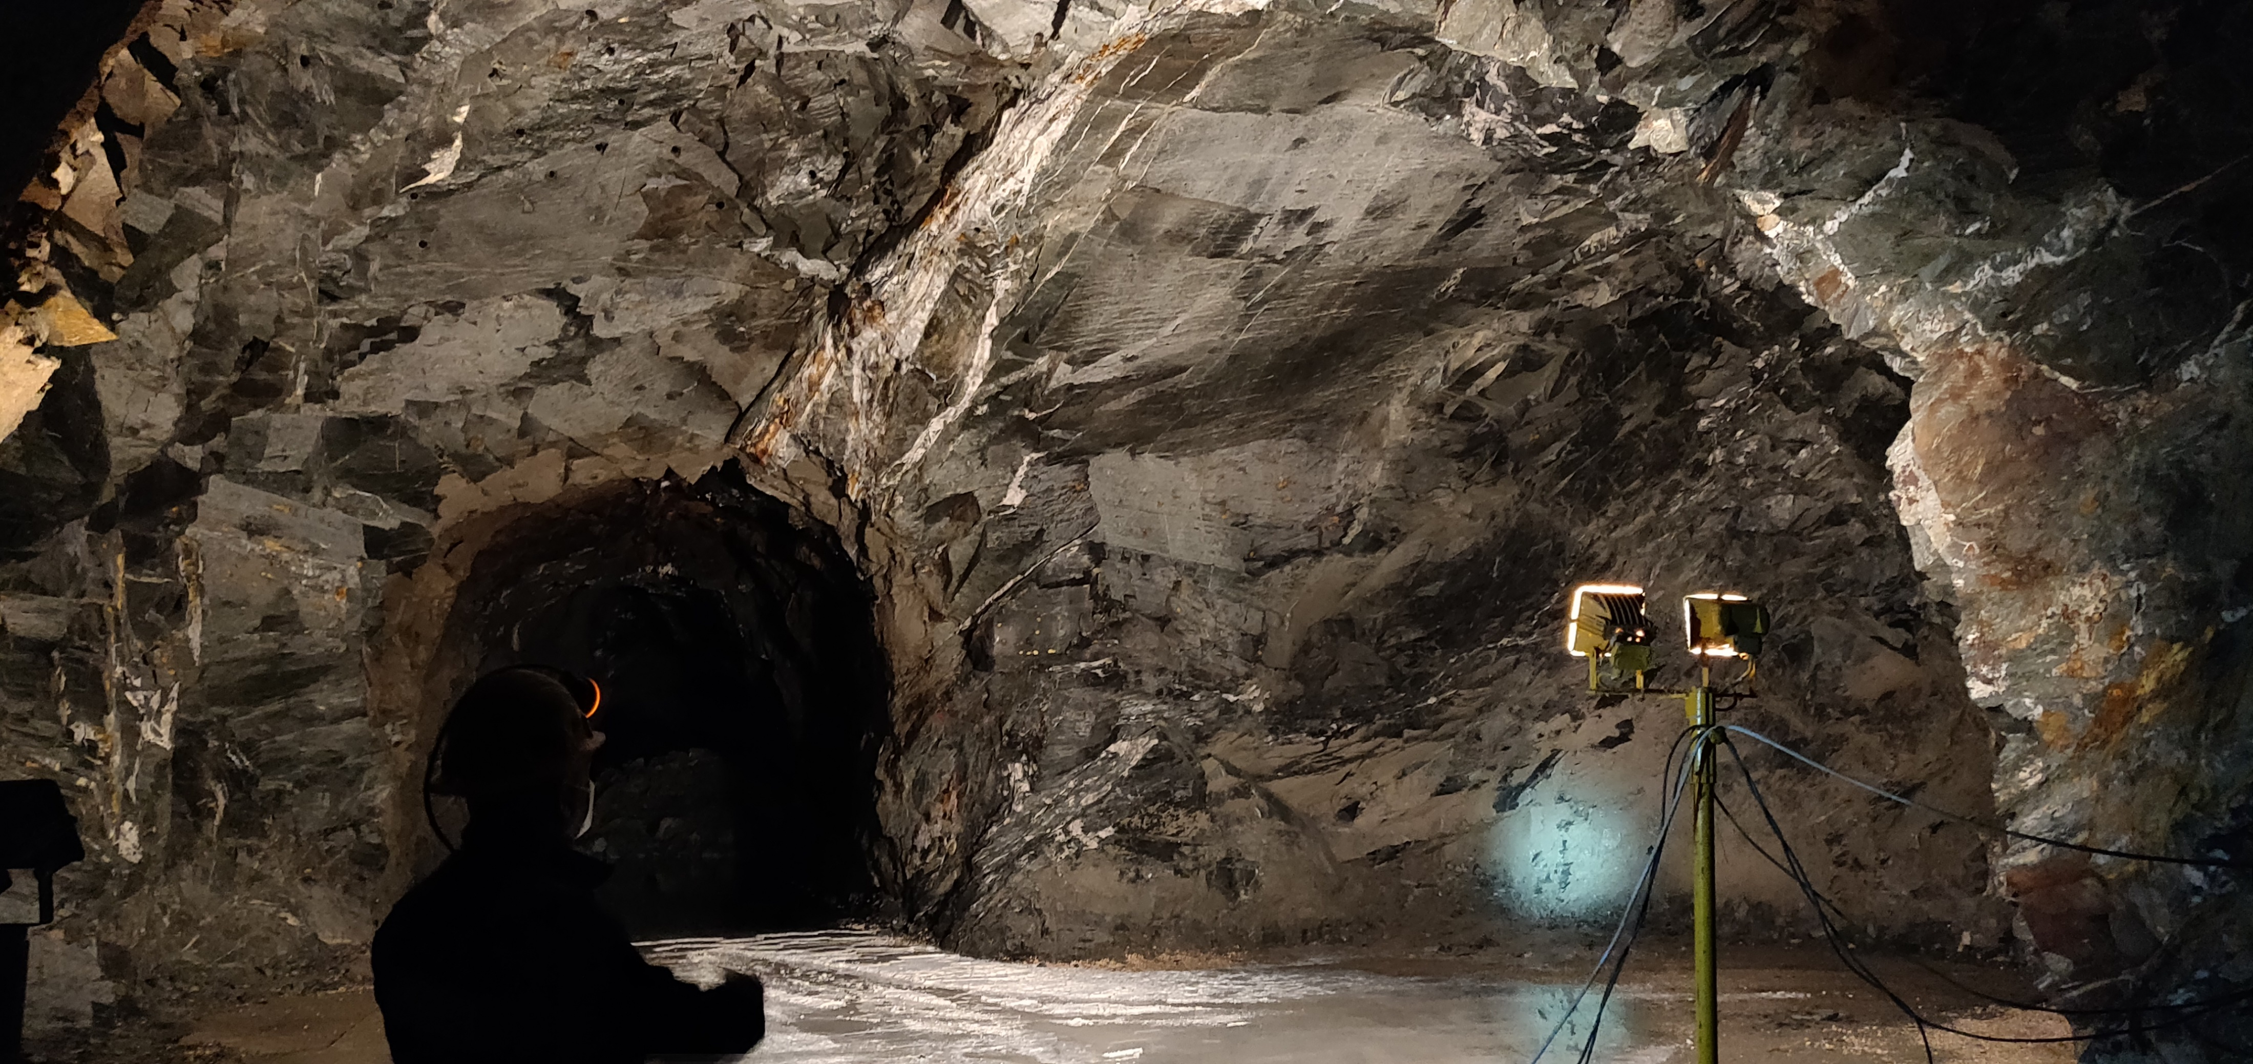
ARCHIMEDES
Archimedes is an INFN-funded fundamental physics experiment that searches for small weight variations induced by quantum vacuum fluctuations.
It is the first experiment to be installed in the Sar-Grav laboratory, in the area of the disused Sos Enattos mine near Lula (Nu, Sardinia). The SarGrav laboratory has both surface and underground facility, and is dedicated to the research on gravitational waves, gravitational physics and geophysics.
Archimedes will work in the frequency range from 5 mHz to 10 mHz and the signal will be limited by seismic and thermal noise.
Thanks to the unique geological properties of Sardinia and the low population density, Sos Enattos area is an excellent site to host experiments that require very low seismic noise levels. Working at cryogenic temperatures (cryostat) reduces the thermal noise.
7
Noise budget of the
Archimedes experiment

Slide 9
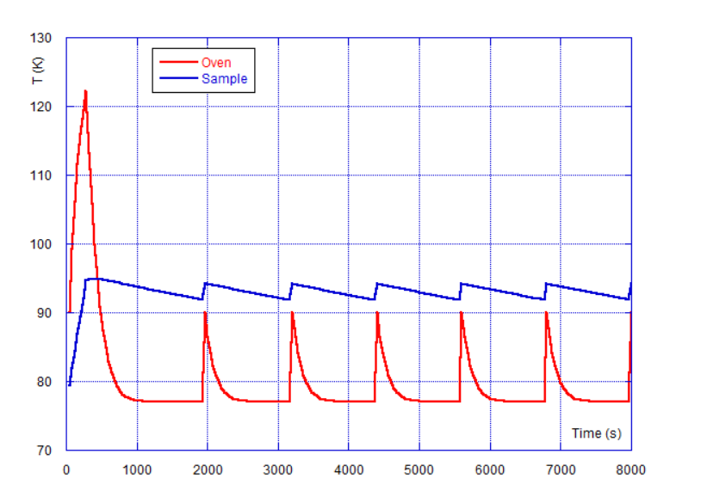
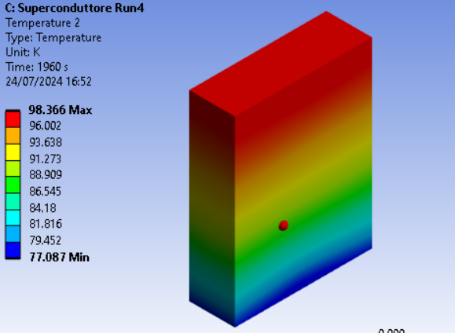
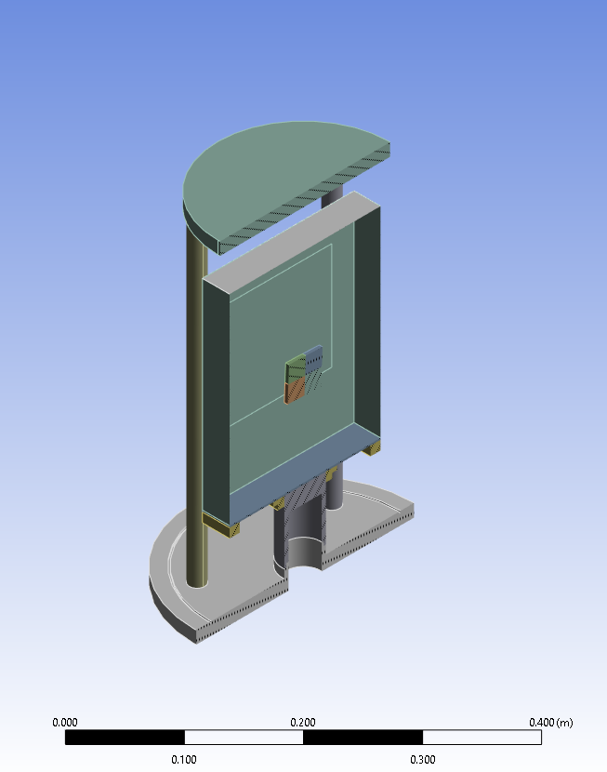
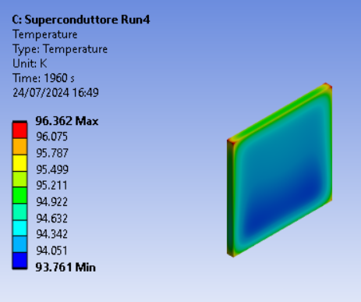
THERMAL MODULATION
Example simulation of the temperature modulation
The experimental chamber is kept at the liquid nitrogen temperature and act as thermal bath.
The thermal modulation must be done by radiative exchange
between sample and screen which surrounds it.
Modulation frequency and its amplitude around T_{c} depend on
the thermal properties of the materials.
A finite element study is important for the geometry definition
and the material choice.
The time constants are different because of the different mechanisms of heat exchange:
- in the screen the conductivity dominates;
- in the sample only the radiative mechanism is present.
After the sample has reached T_{c}, its temperature will be modulated by switching on and off a heater keeping the sample at a temperature with a modulation of 3 K around T_{c}.
OVEN
SAMPLE
courtesy of Dr Paola Puppo
doi:10.3390/physics2010001

Slide 10
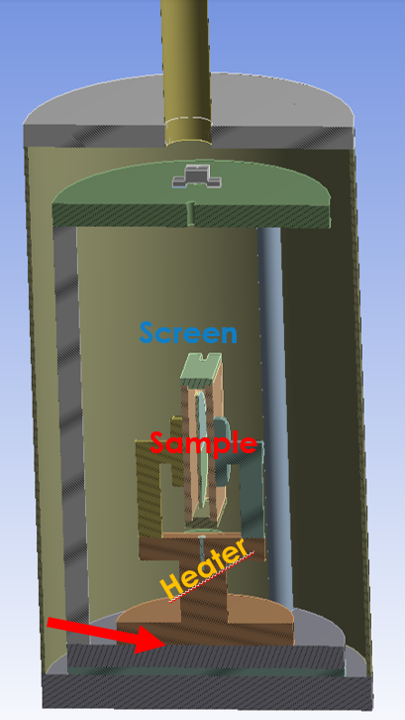
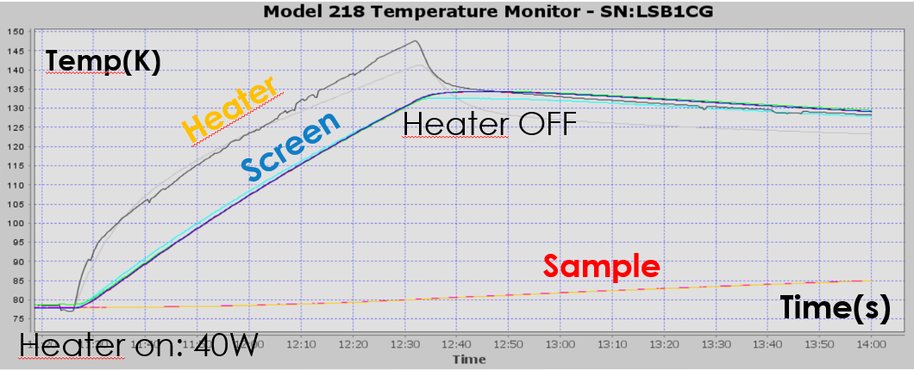
Old experimental set up
In the previous experimental configuration we experienced the presence of high thermal resistances between the oven and the cold finger increasing drastically the cooling times of the oven and the sample, and resulting in the impossibility to modulate
The problem was solved by removing such resistances
courtesy of Dr Paola Puppo

Slide 11
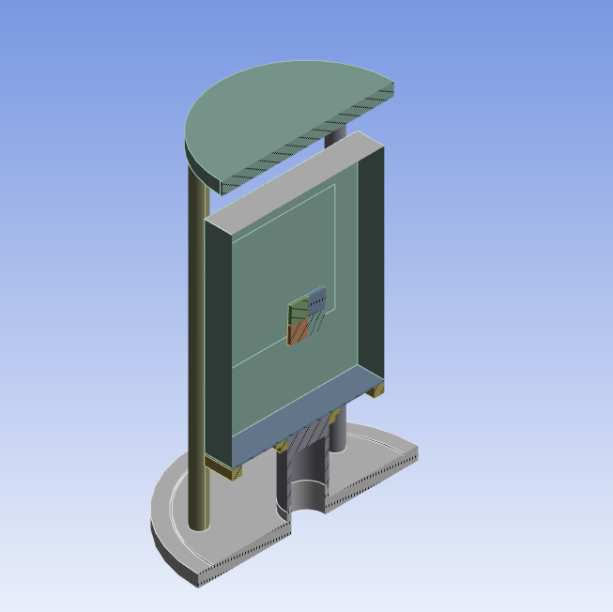
New experimental set up
The cold finger is the hollow botton of the chamber, filled by the liquid nitrogen.
The oven is directly connected to the cold finger.

Slide 12
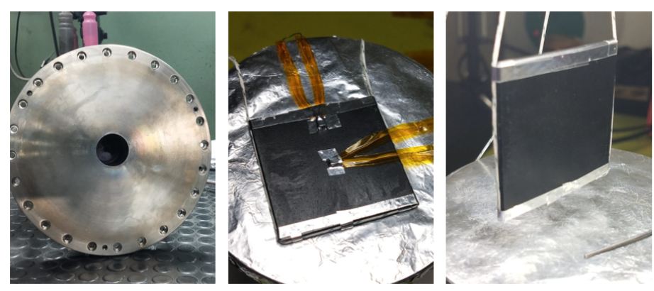
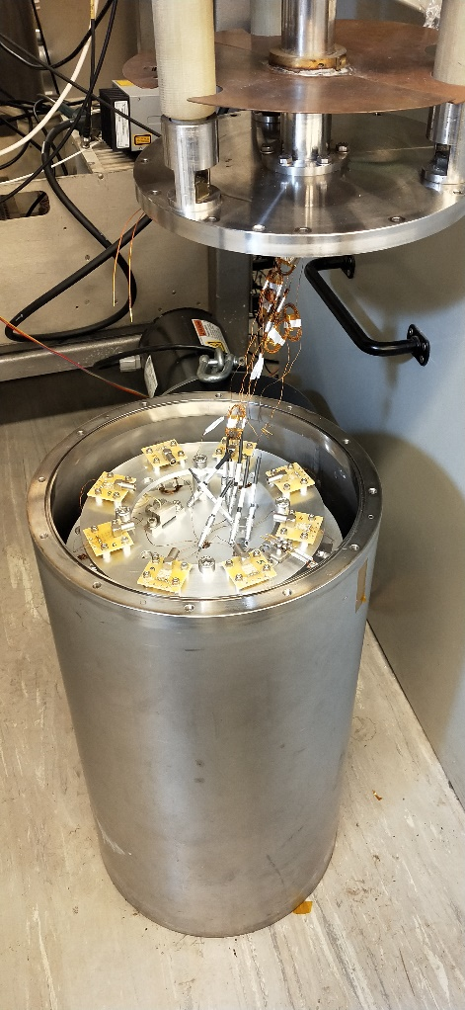
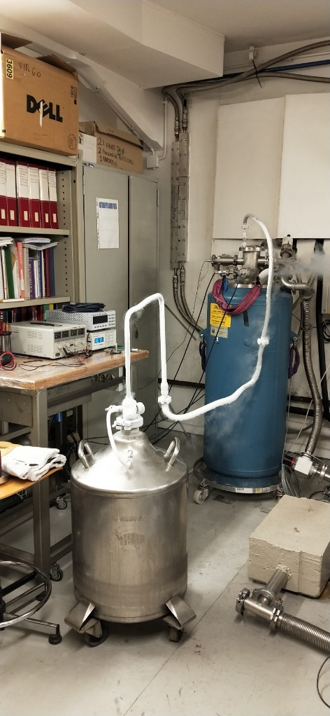
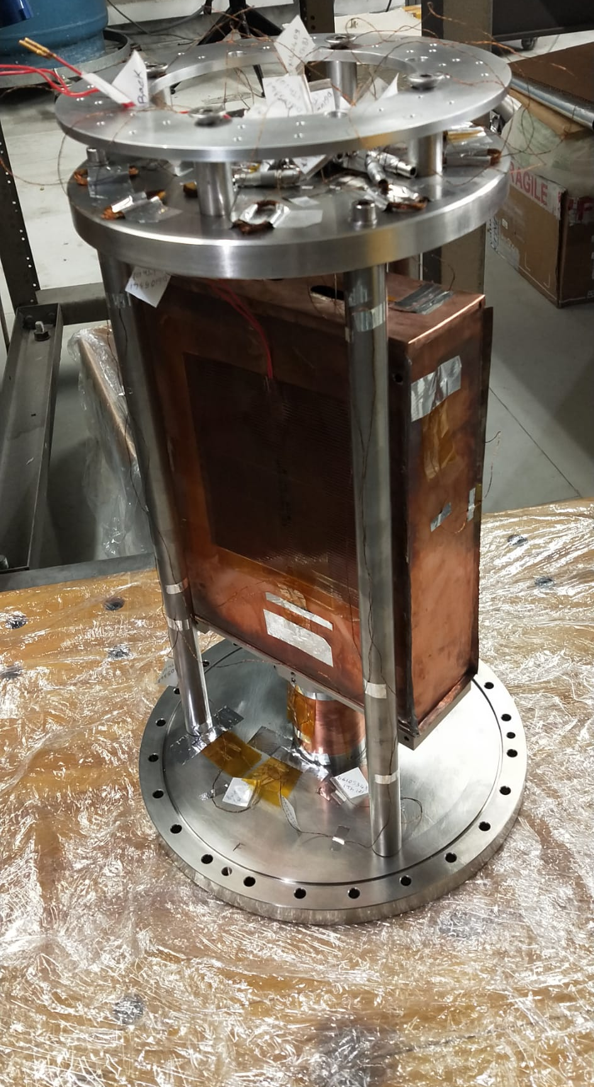
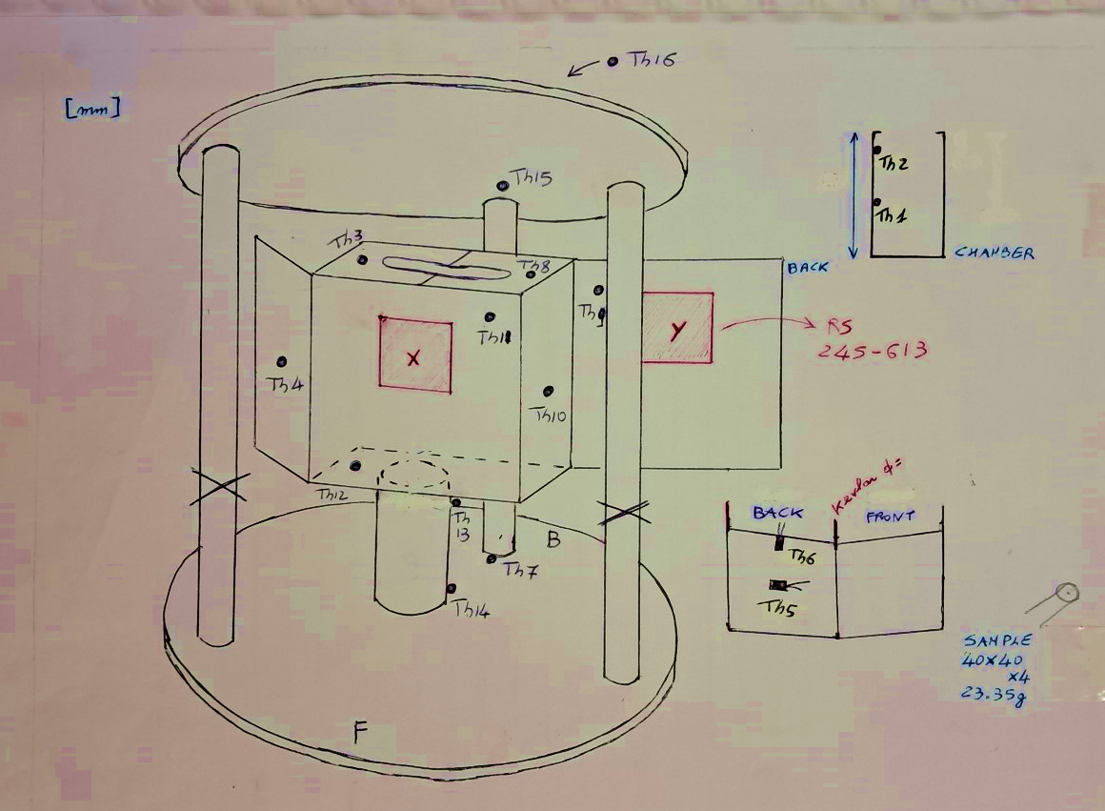
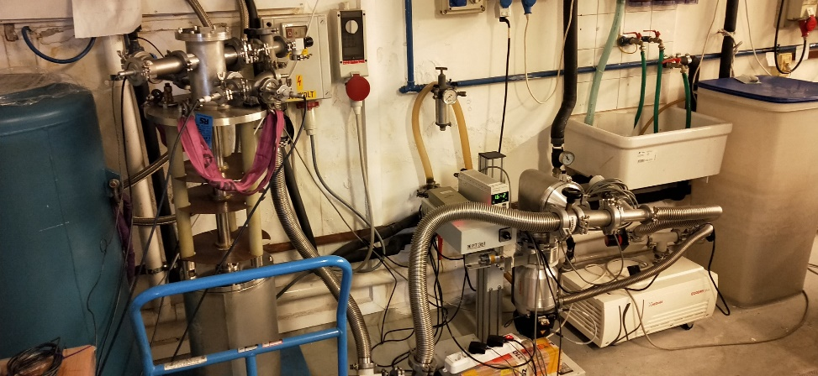
liquid nitrogen cryostat
experimental chamber
Oven and Heater
vacuum system

Slide 13
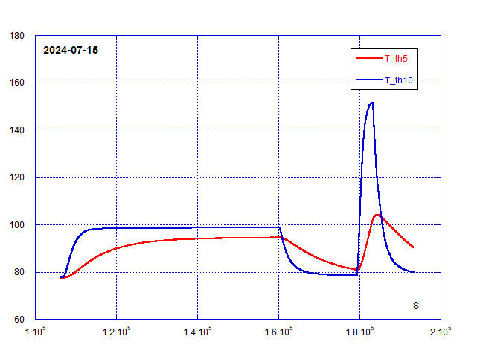
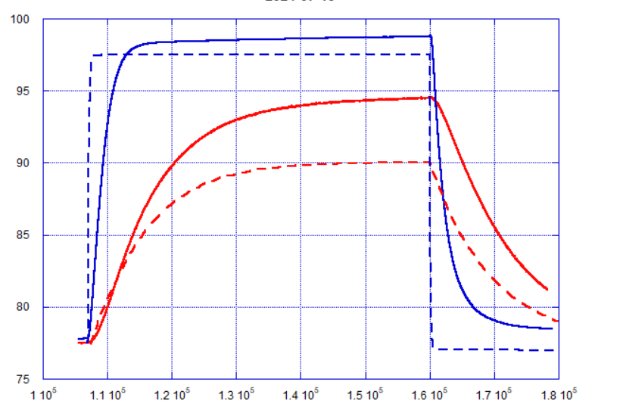
Procedure
creating vacuum (P ~ 10⁻⁵ mbar);
cooling down the system to the liquid nitrogen temperature;
heating the screen using a resistance
turning the resistance off.
What happens
The heat flows to the screen through the conductive copper support increasing its temperature.
The sample temperature increases through the radiative heat transfer with the screen.
The heating times are very different.
Once the resistance is turned off, the temperature of the screen decreases to 77 K through the cold finger
The temperature of the sample can be modulated.
But the modulation time is still high (about 600s)
Further improvements are in being set up.
Oven
K
Sample
P=10 W
P=1 W
K
Dashed lines:
FEM simulation
s
courtesy of Paola Puppo

Slide 14
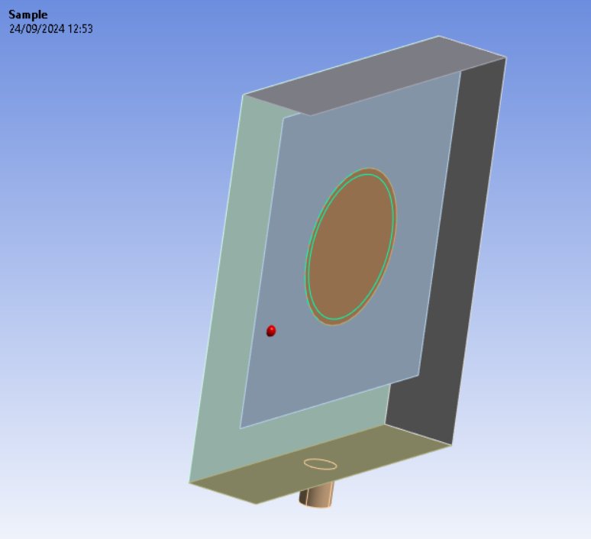
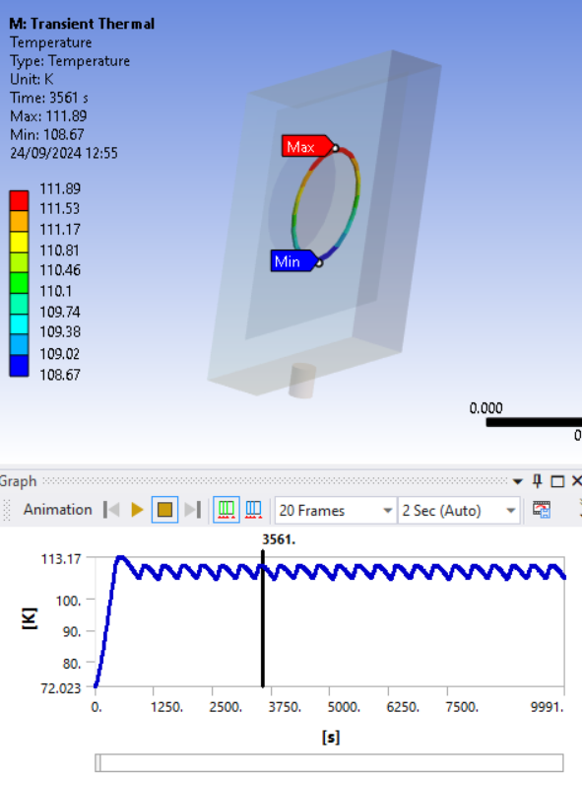
screen
BSCCO ring sample Graphite radiator
R_{in} = 92 mm 400x400 mm 500x100 mm P = 10 W
R_{out} = 100 mm thickness = 0.1 mm thickness = 0.1 mm
V = 20·10³ mm³
ring sample
radiator
cold finger
What’s next?
Upgrade of the sample shape
changing the shape of the sample, from disc to ring;
introducing a sample + radiator system to facilitate a faster heat exchange with the screen;
continuing to investigate alternative solutions.
Modulation of temperature between 107 K and 110 K of a few hundreds of s.
courtesy of Dr Luca D’Onofrio

Slide 15
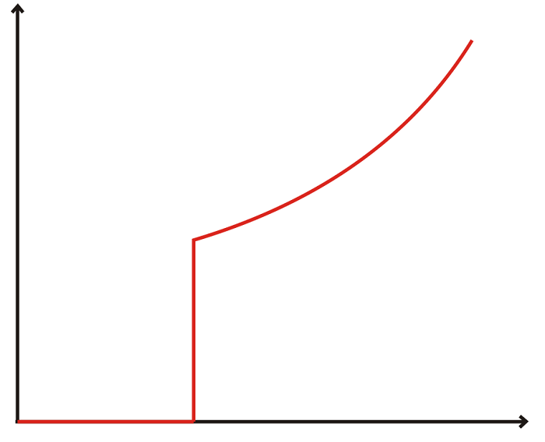
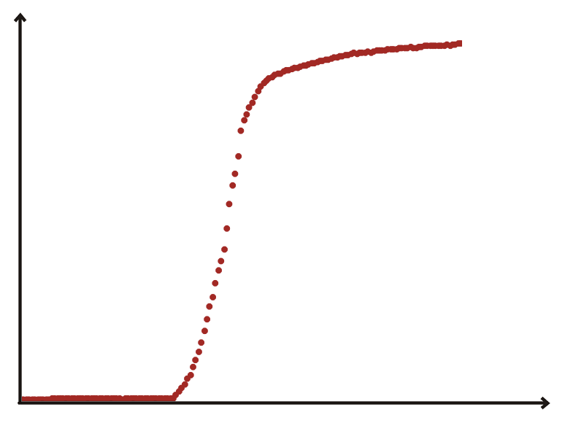
SAMPLES
R
T_{C} T
Ideal superconductor
real superconductor
Requirements:
T_{C} > 80 K and ΔT_{C} 2 K
Large mass > 200 g → samples with a 10 cm diameter
From the electrical resistance as a function of temperature plot it is possible to obtain information on the first requirement.
Also, these plots will let us understand the quality of a sample and if a certain degree of dis-uniformity exits in it.
R
ΔT_{C}
T_{C} T

Slide 16
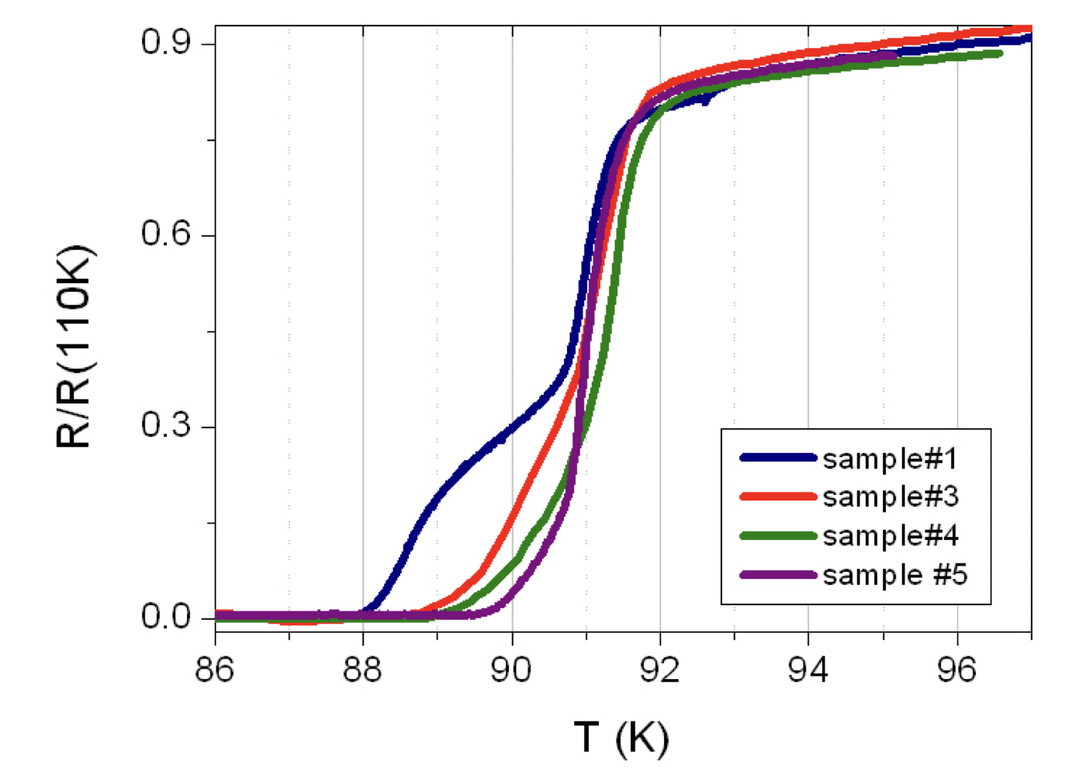
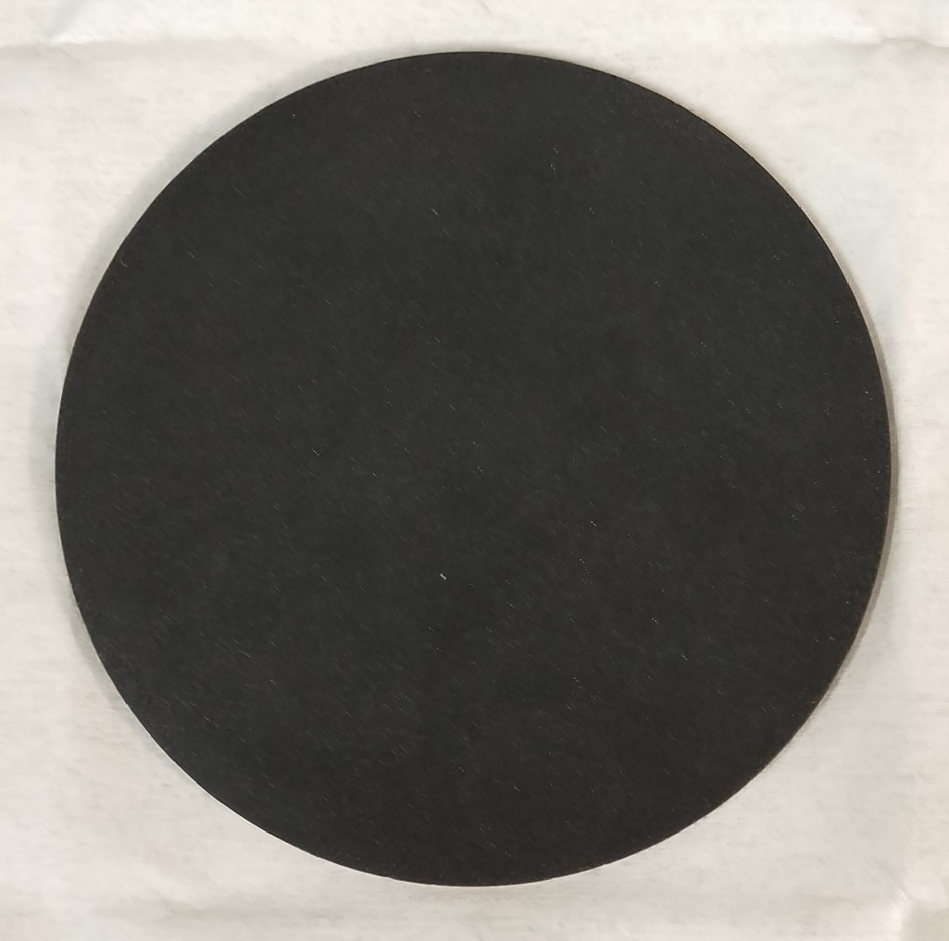
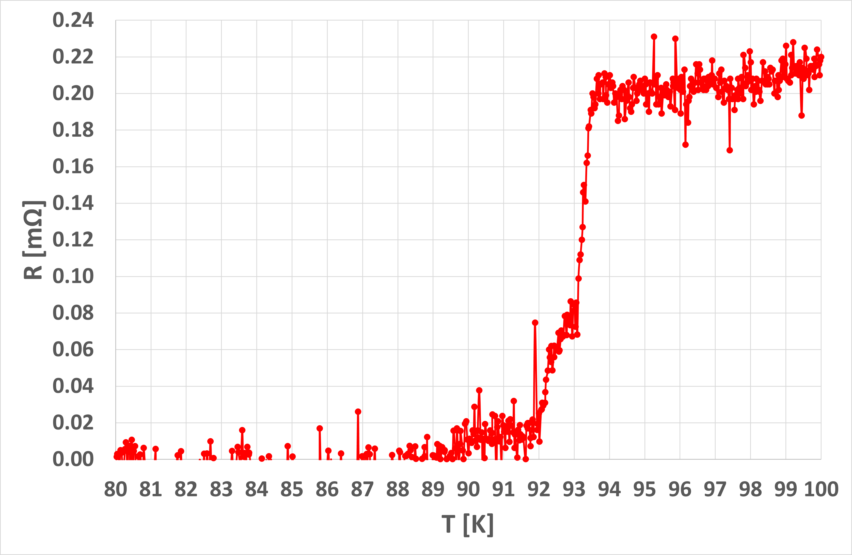
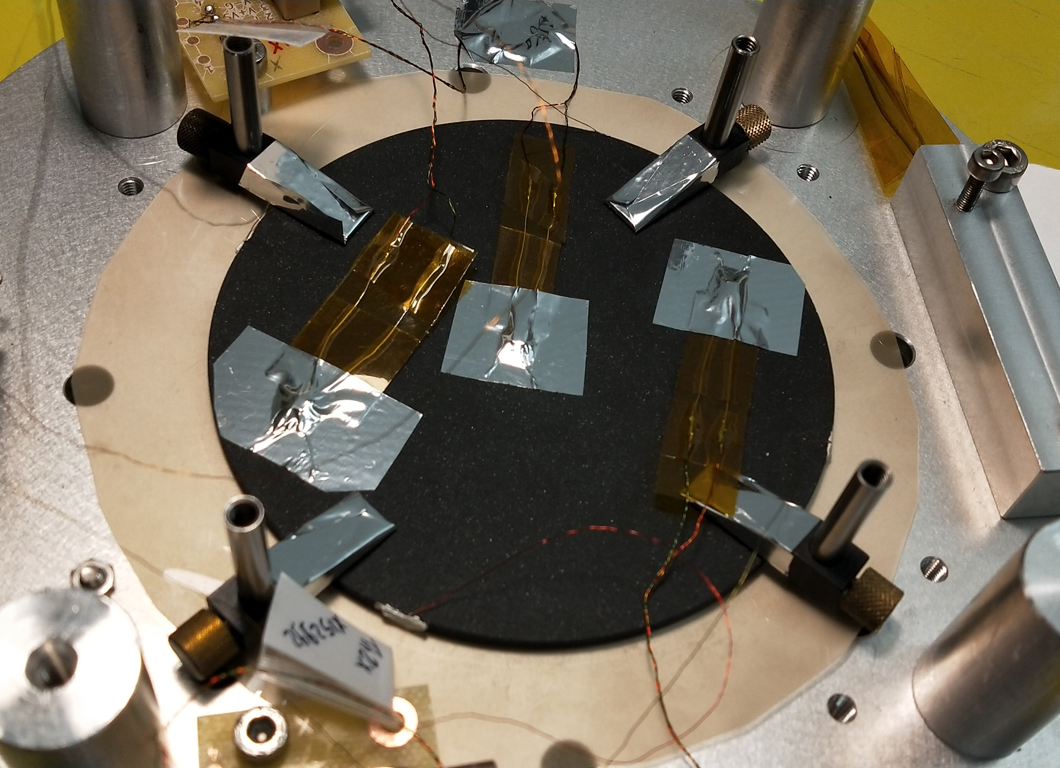
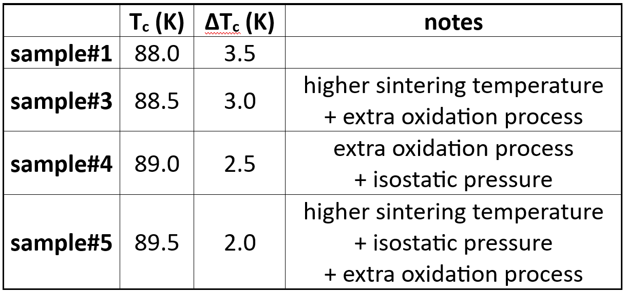
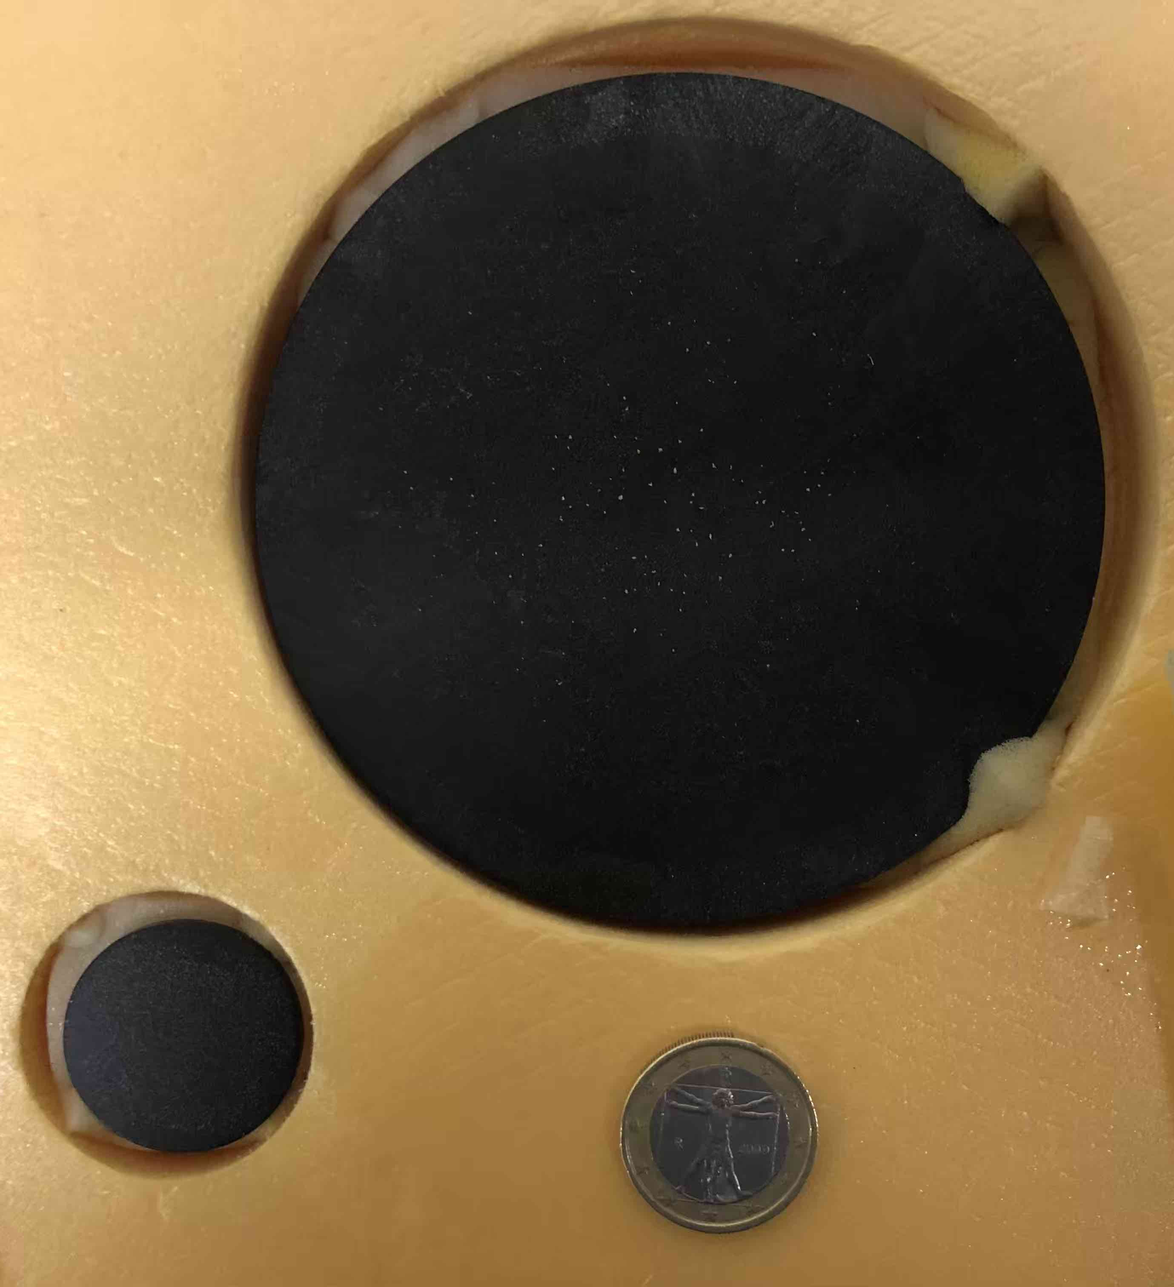
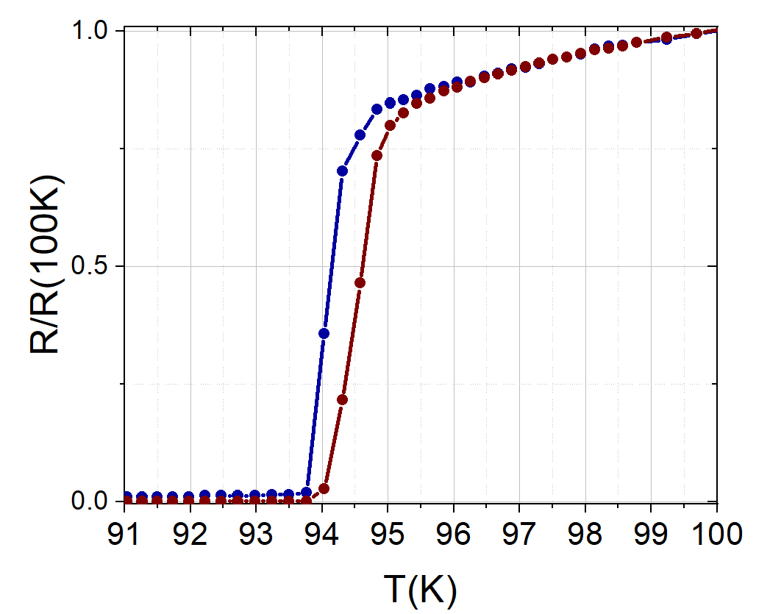
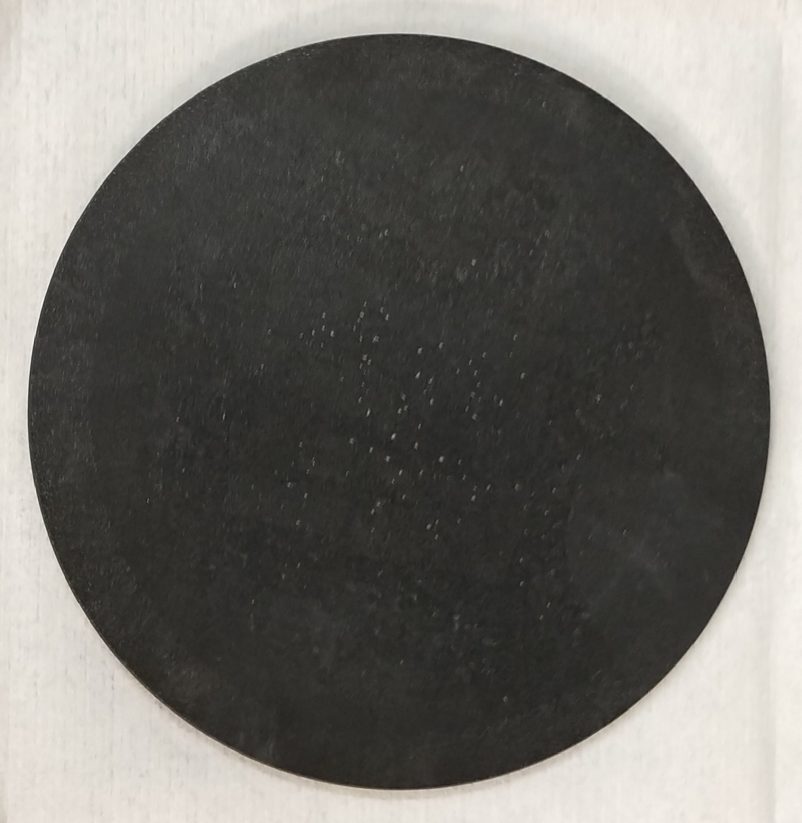
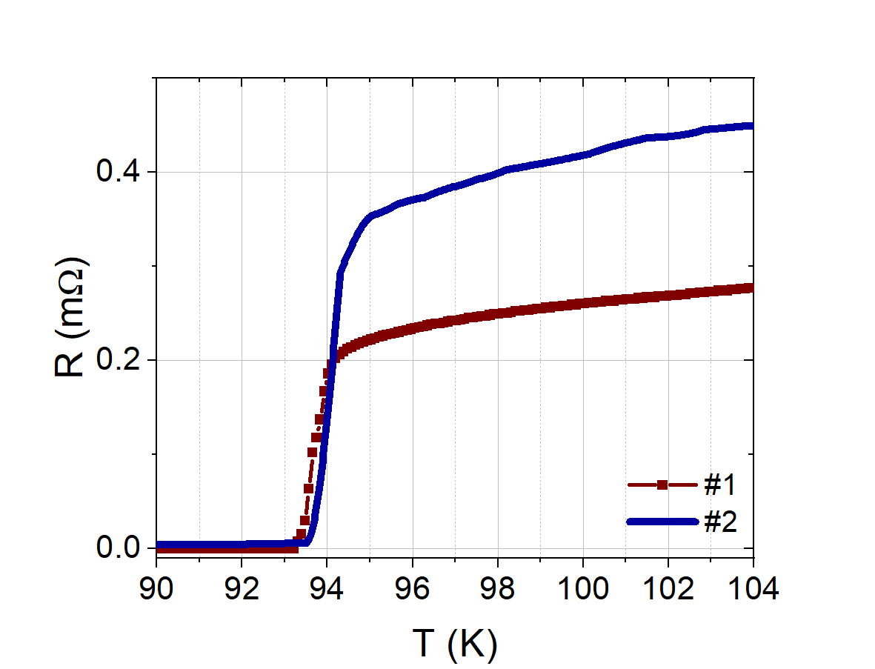

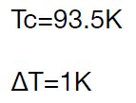
 | FRAGMENTS OF A DISC | ENTIRE DISC
Sintered YBCO Sintered YBCO discs were prepared in different sintering conditions (temperature, oxidation) in order to maximise T_{C} and reduce ΔT_{C} (CAN Superconductors).
crystalline GdBCO/Ag Single-domain melt-textured bulk pieces (CAN Superconductors).
T_{c} : 89.5 K
ΔT_{c}: 4.0 K
’’double’’ transition
diameter: 100mm
thickness: 3 mm
mass: ~ 124 g
(like sample#3)
diameter: 100mm
thickness: 4 mm
mass: ~ 213 g
courtesy of Dr Daniela Stornaiuolo
work in progress
courtesy of Dr Daniela Stornaiuolo

Slide 17

CONCLUSIONS
Archimedes is an experiment conceived to shed light on the discussed interaction between the gravitational field and the vacuum fluctuations.
The measurement must be performed using an extremely sensitive balance and modulating the temperature of superconductors at very low frequencies (about tens of mHz) and with amplitude of a few K.
The experiment will work at cryogenic temperature and in a seismically quiet site
An upgraded thermal modulation system have been set up and first promising results were obtained
The results of the simulations support the mechanically isolated system, composed of a ring sample (GdBCO or BSCCO) in thermal contact with a radiator, that exchanges heat only with its thermal bath whose temperature is modulated by the screen that surrounded this system.

Slide 18








SOME REFERENCES
doi: 10.1103/PhysRevB.106.134502
doi: 10.1103/PhysRevD.90.022002
https://www.scientificamerican.com/article/how-much-does-nothing-weigh/
Physics 2020, 2, 1–13; doi:10.3390/physics2010001
https://www.facebook.com/archimedes.experiment/

Slide 19

RICAP 2024
23–27 Sept 2024 Hotel Villa Tuscolana – Frascati (RM)

Slide 20
EXTRA SLIDES

Slide 21

The candidate sites for the ET are:
- Sos Enattos in Sardinia;
- Euregio Meuse-Rhine (EMR),
border region between Belgium,
the Netherlands and Germany;
- Lusatia in Saxony.
In the low frequency range of ET (from 2 Hz to 10 Hz),
Sos Enattos area is among the quietest sites in the world.
courtesy of Dr Luca Naticchioni

Slide 22



The van der Pauw method* allows the average resistivity ρ of a sample of any arbitrary shape to be estimated, provided:
the sample is two-dimensional (surface area >> thickness), solid (no holes) and homogeneous in thickness;
the contacts are sufficiently small and placed at the circumference of a sample.
Four contacts are placed on the periphery of a sample (four-point technique):
a fixed current is injected through one pair of contacts (for example I_{AD}) and the voltage is measured across the other pair of contacts (for example V_{BC}).
From these two values, the corresponding resistance is obtained using Ohm’s law: R_{AD,BC}= V_{BC} / I_{AD}.
f
t: thickness of sample
R_{vert} = (R_{AD,BC}+R_{DA,CB}+R_{BC,AD}+R_{CB,DA})/4
R_{horiz} = (R_{AB,DC}+R_{BA,CD}+R_{DC,AB}+R_{CD,BA})/4
R_{max} (R_{min}) : max (min) between R_{vert} and R_{horiz}
* van der Pauw, ‘A method of measuring specific resistivity and Hall effect of discs of arbitrary shape’, Philips Research Reports 13 1-9 1958.

