Slide 1
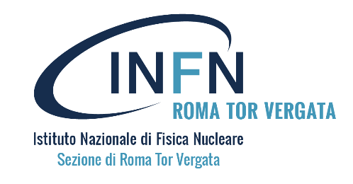
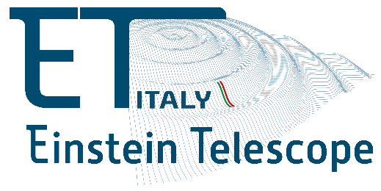
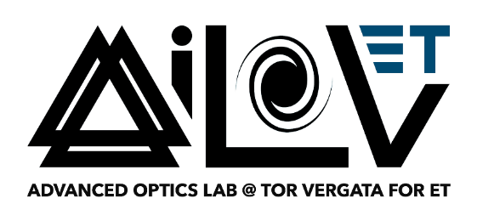

Advanced Optics Research in Gravitational Wave Detection
Diana Lumaca, L. Aiello, E. Cesarini, M. Cifaldi, V. Fafone, M. Ianni, M. Lorenzini, Y. Minenkov, I. Nardecchia, P. P. Palma, A. Rocchi, V. Scacco, C. Taranto
RICAP-24 Roma International Conference on AstroParticle Physics
Notes:
Good afternoon, everyone! I’m Diana Lumaca, and today I’ll talk about advanced optics research in gravitational wave (GW) detection.

Slide 2
Outline
A new era in astrophysics
Gravitational Waves detection
  Sensitivity curves
  Present and future GW detectors (Virgo, LIGO, KAGRA, ET)
Core optics: advanced optical technologies
Power-induced optical aberrations
  Thermal Compensation System
  Adaptive optics developments
Development of materials for ultra-low loss optical coatings
  Candidate materials
  Coating deposition techniques and treatments
  Coating structure and design
  Experimental investigation techniques
Conclusions
Notes:
Here’s the outline of my presentation. I’ll start with a brief introduction to multimessenger astrophysics and the principles behind GW detection, followed by a discussion on core optic technologies, managing power-induced aberrations, and research on ultra-low loss optical coatings.
------------
Here is the outline of my presentation. After a really brief introduction about the born of multimessenger astrophysics and the principle behind the GW detection, I’ll show you the core optic technologies and how to tackle with power induced aberrations and which is the research behind the development of matyerials for ultra-low loss optical coatings

Slide 3
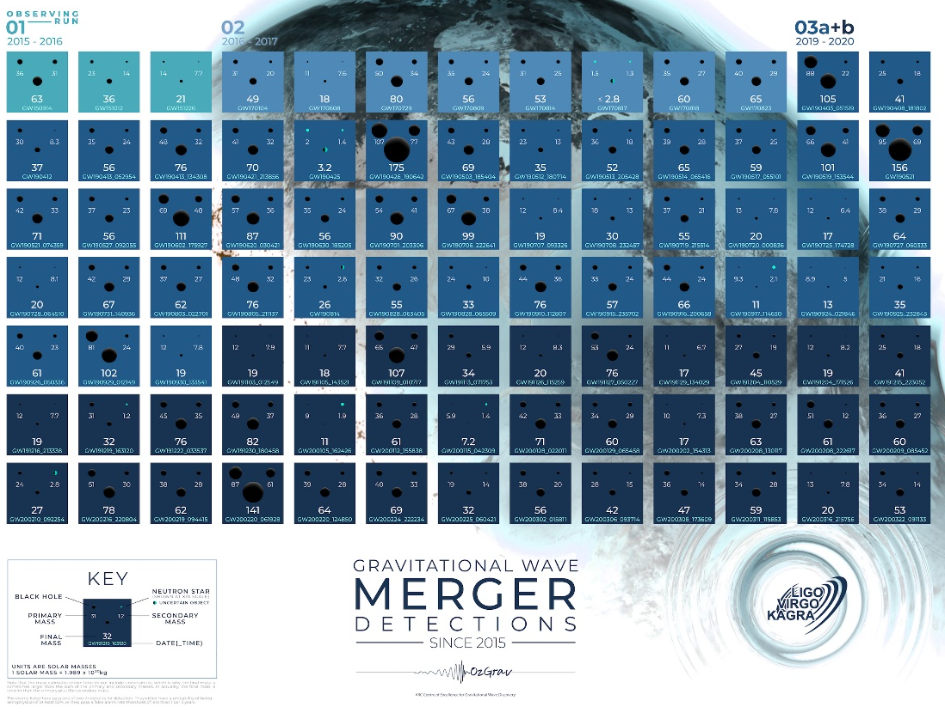
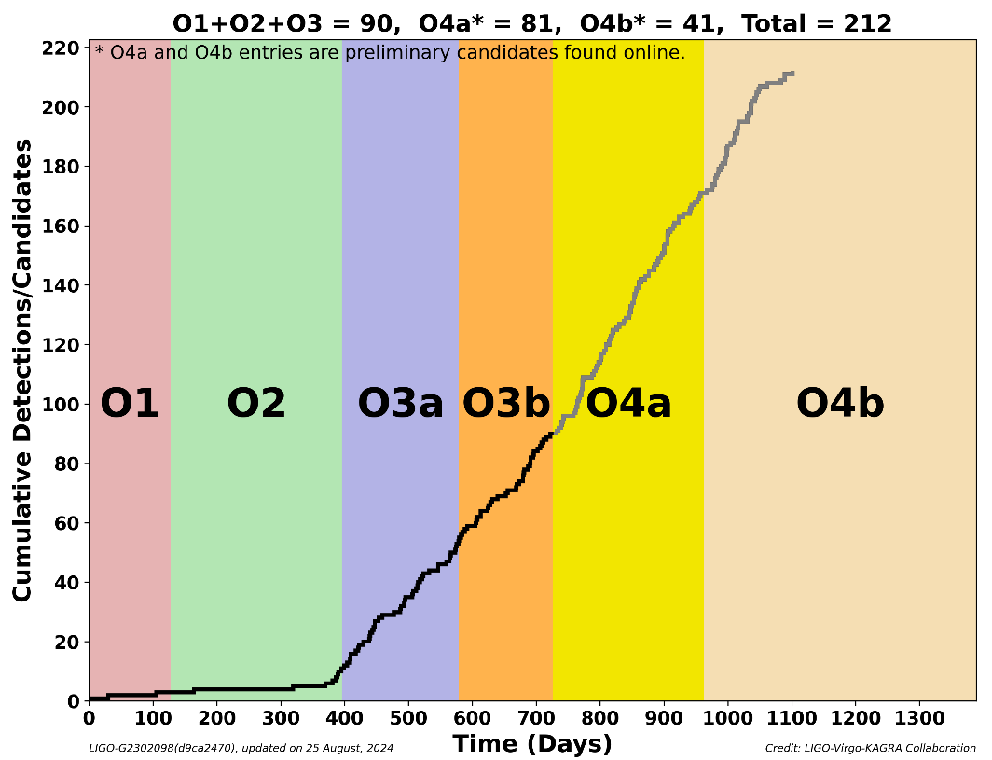
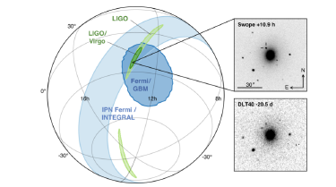
A new era in astrophysics
[Credit: LIGO/Virgo/KAGRA/C. Knox/H. Middleton]
O1: Sept. 2015 – Jan. 2016
GW150914: the birth of GW astronomy
O2: Nov. 2016 – Aug. 2017
GW170814: the first triple detection
GW170817: the first neutron stars merger detected
O3a: Apr. 2019 – Sept. 2019
GW190521: BH-BH merger to IMBH
O3b: Nov. 2019 – Mar. 2020
GW200115: the brightest NS-BH merger
O4a May 2023 – Jan. 2024
O4b: Apr 2024 – June 2025
  LIGO+Virgo
  Kagra to join in 2025 to complete commissioning
https://dcc.ligo.org/LIGO-G2302098
NS-BH coalescences
  GW191219_163120: extremely unequal mass components: 31M☉ + 1.2 M☉, and the lightest NS ever observed
  GW200115_042309: the brightest BH-NS coalescence detected up to now 6 M☉ + 1.4 M☉
BH-BH coalescences
  GW200220_061928: probably the binary black hole which has the highest total mass in O3b: 87 M☉ + 61 M☉ -> 148 M☉
  GW191129_134029 has the lowest total mass of the O3b events that we are confident are binary black holes. Their total mass is about 17.5 M☉ (about 10.7 M☉ and 6.7 M☉ for each black hole). The black hole resulting from the merger has a mass of about 16.8 M☉.
Notes:
Since the first GW detection in 2015, many signals have been observed during the four observational runs. Here’s a graphical representation of all detections up to O3 and some preliminary results from O4. The list on the left highlights some significant events.
-------------
Since first GW detection occurred in 2015 many other GW observations occurred during the 4 observational runs. Here is a graphic reproduction ofd all the detection happened until the end of O3 and some preliminary results from the ongoing run O4 . The list (w the link to the publication) represent just some of the more significant events.

Slide 4
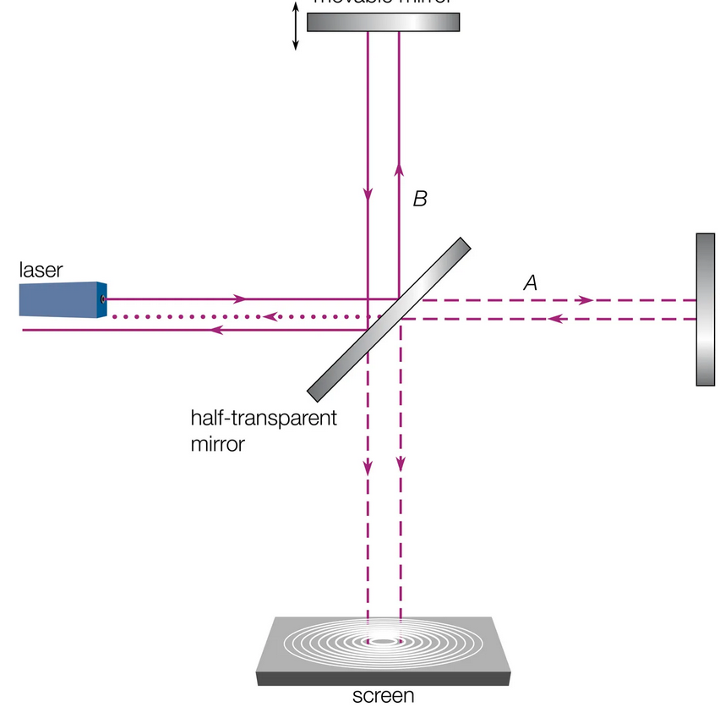
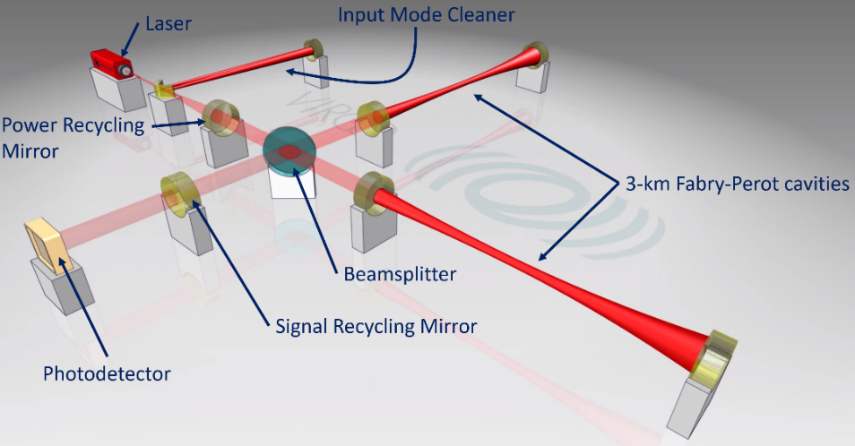
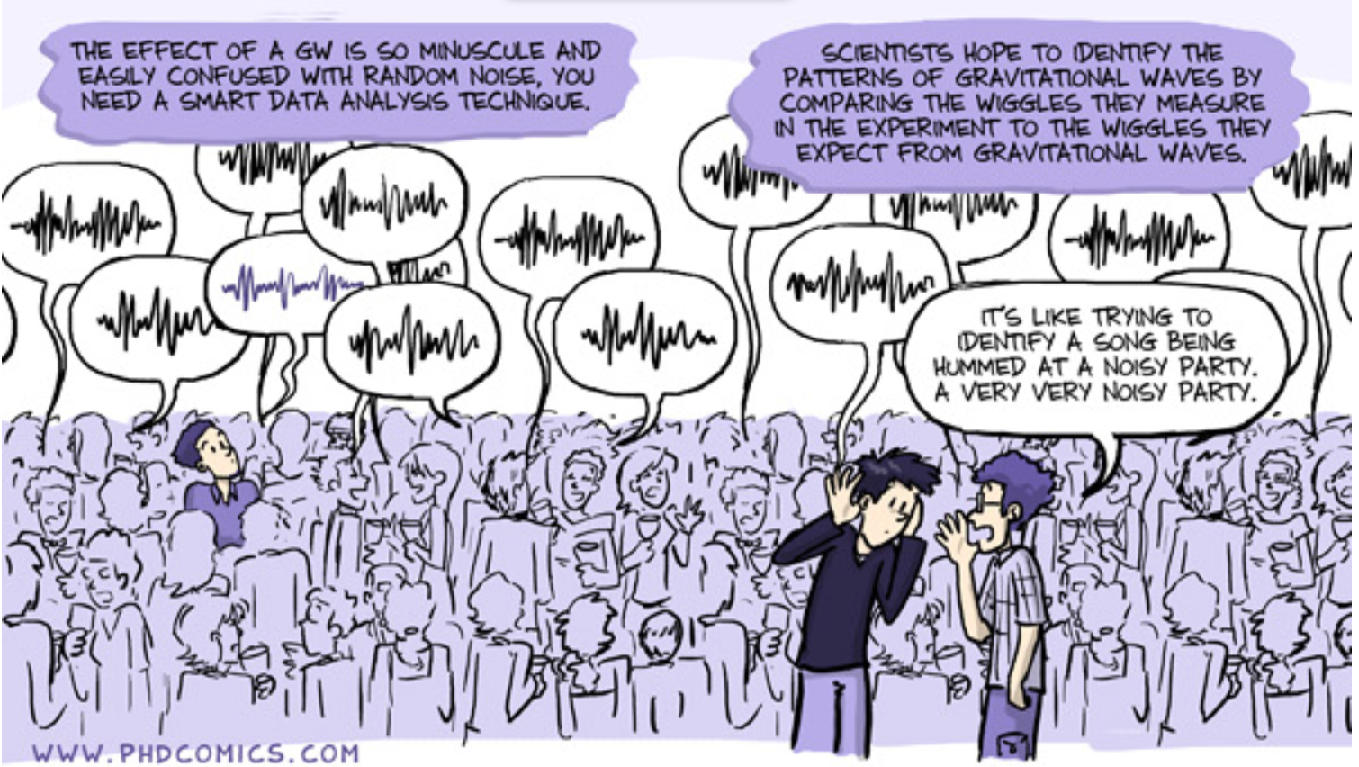
Gravitational wave detection
The winning strategy was to use the light of a laser as a ruler in an interferometric detector.
Simple idea of Michelson Interferometer setup, on which many upgrades have been made to further improve its sensitivity.
System of freely falling bodies (mirrors)
As a gravitational wave passes, the distance between two bodies subjected only to gravitational forces changes by: $∆L=\frac{1}{2}hL$
Notes:
The key to detecting these signals is using laser light as a ruler in interferometric detectors based on a Michelson setup, enhanced with cavity arms to extend the optical path length of light hundreds times longer, power and signal recycling cavities, seismic isolation systems for all the optics and putting everything under vacuum to limit also air vibration issues . However, being so sensitive makes the interferometers vulnerable to noise, it is like trying to identify a song hummed at a noisy party
----------------------------
So, which is the mechanism that hallowed us to detect these signals?
The winning strategy was to use the light of a laser as a ruler in an interferometric detector. They are simply based on a Michelson ITF setup, on which many upgrades have been made to further improve its sensitivity.
For example, cavity arms make the optical path length of light hundreds times longer and other two optical cavities allows to recycle power and signal, many control systems have been integrated, suspensions isolate all the optics from seismic motion and putting everything under vacuum limit also air vibration issues.
Being so sensitive is necessary but also double-edged sword, because ITFs are sensitive also to many different sources of noise. It is like trying to identify a song hummed at a noisy party.
positions of mirror surfaces in optical cavities are monitored by laser beams

Slide 5

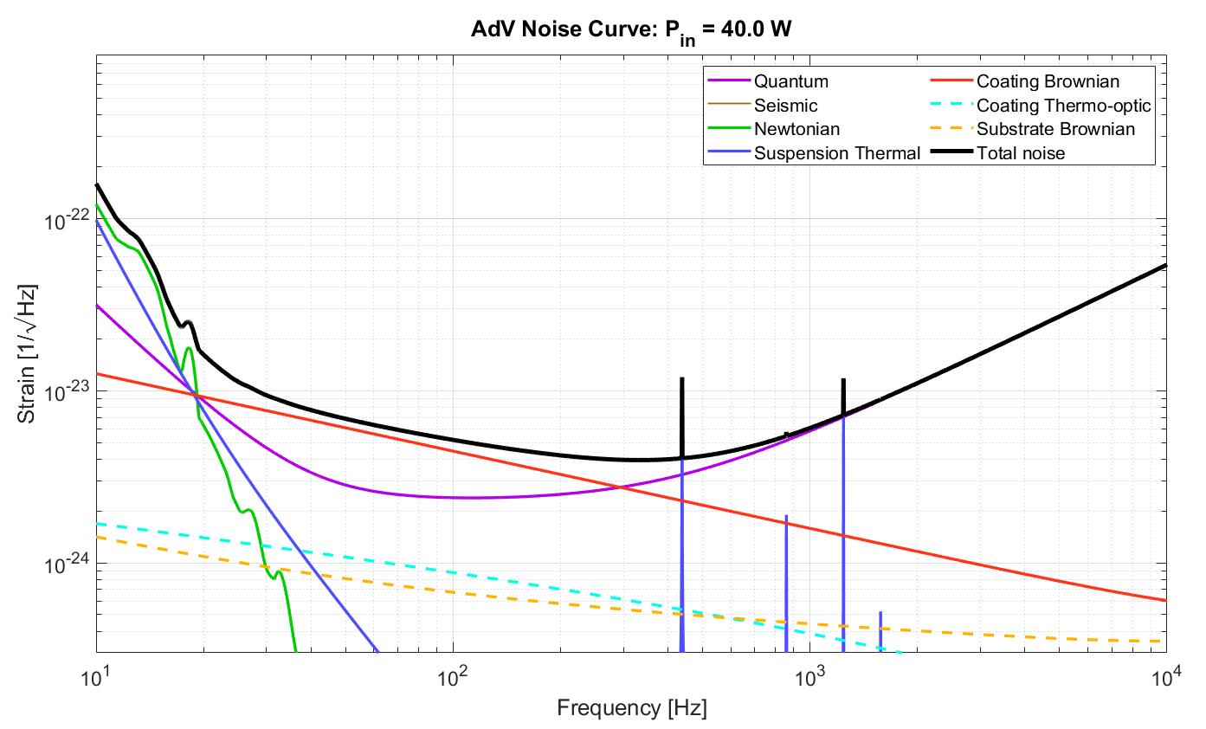

Sensitivity curves
AdV+ project sensitivity curve
The sensitivity curve of a GW detector reveals its detection capabilities, influenced by fundamental and technical noises.
Newtonian noise < 10 Hz
Thermal noise $\sim$10 - 300 Hz
Shot noise > 300 Hz
Notes:
The sensitivity curve of a GW detector reveals its detection capabilities, influenced by fundamental and technical noises. Typically, below 10 Hz, Newtonian noise dominate; thermal noise (TN) limiting the mid frequencies; shot noise affecting higher frequencies.
-----
The sensitivity curve of a GW detector give us its potentiality of detection. It is the sum of fundamental and technical noises: the most limiting noise are Newtonian noise at frequencies below 10 Hz, TN in the mid frequency range and shot noise over 300 Hz. Since the mid region has been really fruitful until now, the reduction of TN is fundamental importance.

Slide 6

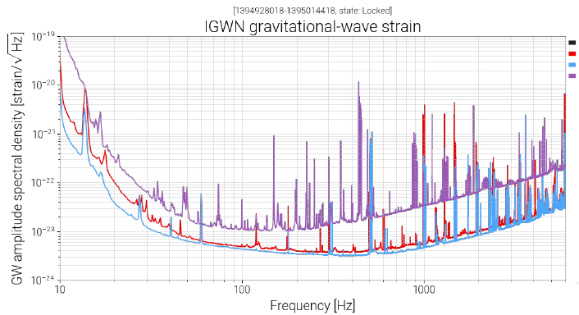
Advanced GW Detectors
3 km arm Michelson interferometer tuned at dark fringe
40 kg, SiO2 substrate
Circulating TEM₀₀ mode from CW Nd:YAG source @1064 nm+ injected sidebands
Optical path folding with resonant Fabry Perot arm cavities
Power-recycled/Signal-recycled configuration
High intra-cavity power build up (~ 200 kW)
GEO600
Hanford
Livingston
Virgo
Notes:
An example of advanced GW detectors is Advanced Virgo Plus (AdV+), a 3 km Michelson interferometer using 40 kg silica mirrors as free-falling test masses . The setup includes multiple cavities to enhance the optical path and recycle power, achieving high power buildup, up to hundreds kW in the cavities.
-----
And example of Advanced GW detectors, now observing, is AdV+ which is a 3km long arm Michelson ITF tuned @dark fringe, which uses 40 kg withed SiO2 mirrors as free falling test masses .
As shown by piernicola (?) the layout more complicate than the simple Michelson ITF presents many cavities to increase the opticalò parth of the linght and to to recicle the power and the singnals inside the ITF. The build up of the power in the cavity is particularly high up to 200kW (P inj ?)

Slide 7
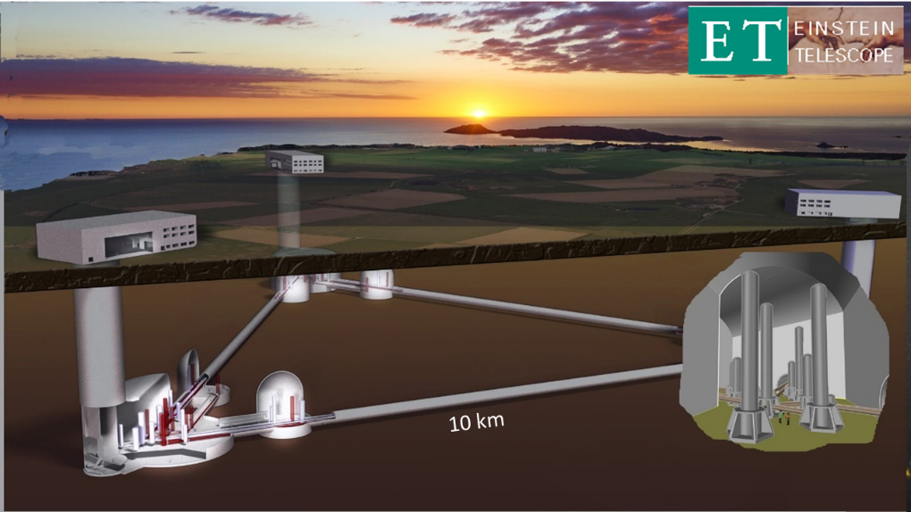


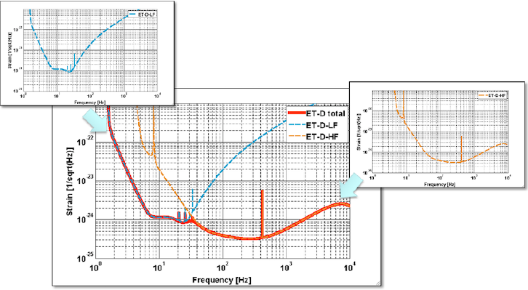
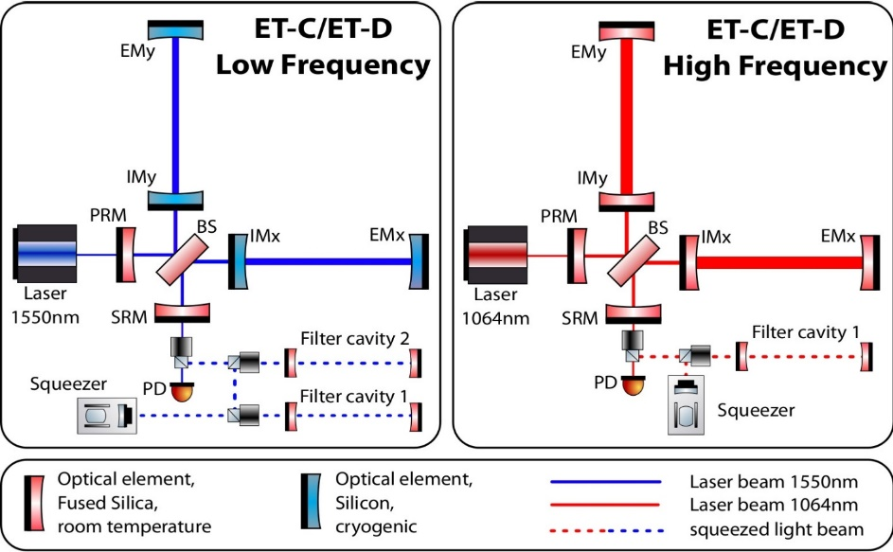
3G detectors
Third-generation, gravitational-wave observatory:
a greatly improved sensitivity
  underground infrastructure
  10km long arms
  three nested detector: each will comprise two interferometers, one specialised for detecting low-frequency (ET-LF) gravitational waves and the other one for the high-frequency (ET-HF) part.
  cryogenic temperature (down to 10 – 20K)
  200 kg, Si or Sapphire substrate
KAGRA (2.5 Gen)
Cosmic Explorer
http://www.et-gw.eu/
Notes:
The Einstein Telescope (ET), instead, will be a third-generation GW observatory with a 10 km triangular configuration. ET plans to have three nested detectors, each with low and high-frequency specialized interferometers, enhancing overall sensitivity. ET will feature cryogenic mirrors to counteract CTN, underground infrastructure against seismic and Newtonian noises, and improved noise reduction strategies, building on lessons from current detectors like KAGRA.
----------
ET instead will be a third generation GW interferometer observatory. Obviously, the main goal is to improve the sensitivity and many challenging upgrades wrt nowadays ground-based detectors are foreseen to do that. Between them, ET will be an underground infrastructure, with arm length of 10 km and a triangular configuration with 3 nested detectors each of them made of two interferometers, one specialised in low frequency observation (ET-LF) and the other one in high frequency (ET-HF) observation. In this way the overall sensitivity curve, build by the composition of the sensitivity of the two interferometer, gain a larger and lower bandwidth. From the point of view of ET-LF, also cryogenic and heavy mirrors will be adopted to counteract thermal noise. Some of these upgrade has been already at least partially tested on KAGRA (a 2.5 generation detector), like underground and cryogenic, but in particular the latter will be even more challenging together with vacuum, for ET.

Slide 8
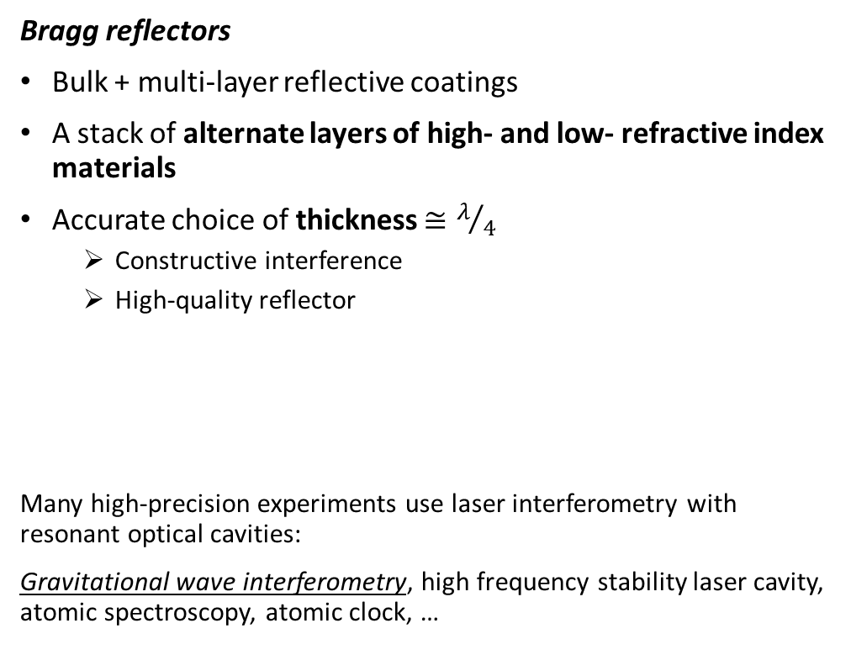

Core optics – dielectric optical mirrors
Bragg reflectors
Bulk + multi-layer reflective coatings
A stack of alternate layers of high- and low- refractive index materials
Accurate choice of thickness $≅λ/4$
  Constructive interference
  High-quality reflector
Many high-precision experiments use laser interferometry with resonant optical cavities:
Gravitational wave interferometry, high frequency stability laser cavity, atomic spectroscopy, atomic clock, …
n_{L}
n_{H}
$$r=\frac{1−n_{sub}{\left(\frac{n_{L}}{n_{H}}\right)}^{2N}}{1+n_{sub}{\left(\frac{n_{L}}{n_{H}}\right)}^{2N}}$$
n_{L}
N doublets
n_{H}
n_{L}
n_{H}
BULK
n_{sub}
Notes:
The enabling technology for GW detectors are the dielectric mirrors made of a bulk material and a reflective multilayer coating, known as Bragg reflectors. These coatings can be precisely designed to achieve high reflectivity at specific wavelengths, and it is possible with an accurate choice of the thicknesses of the layers.
----
So it is worth to see how dielectric mirrors are made. In general, they are composed by a bulk material and a multilayer reflective coating, that is a stack of alternate layers of high and low refractive index materials, that alter the optical properties of the bulk, in this case the goal is to make the reflectivity higher at a certain wavelength and it is possible with an accurate choice of the thicknesses of the layers. This kind of reflectors take the name of Bragg reflectors.
Bragg reflectors: each layer boundary causes a partial reflection of an incident optical wave and for waves whose vacuum wavelength is close to four times the optical thickness of the layers, the many reflections combine with constructive interference.

Slide 9
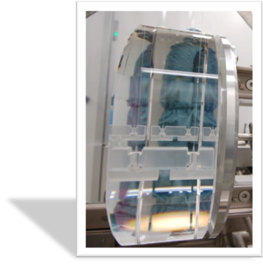
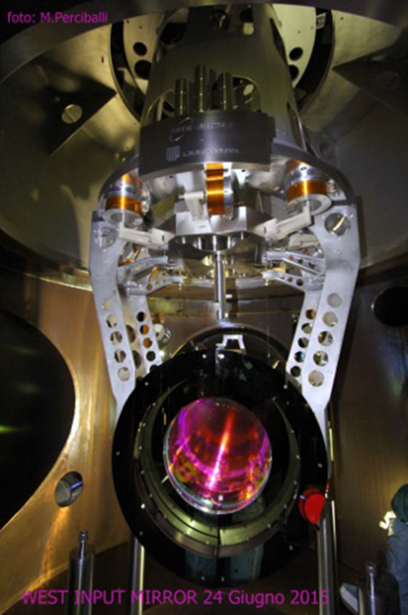
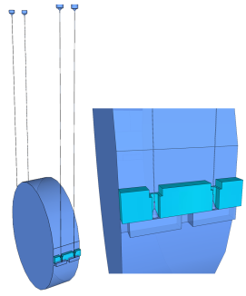
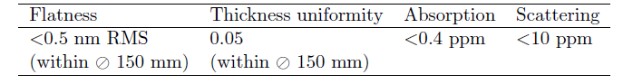
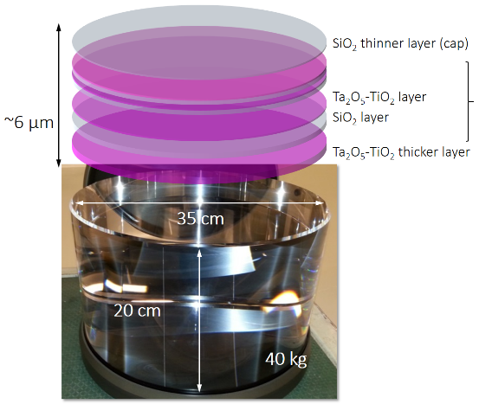
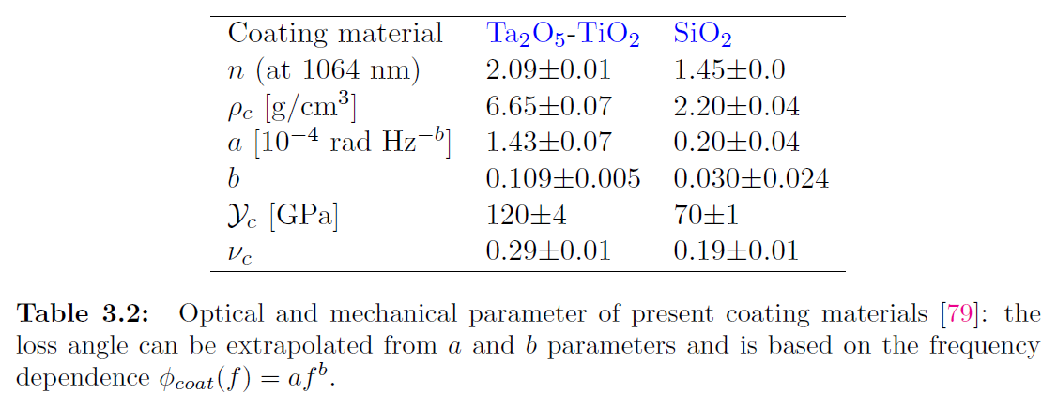
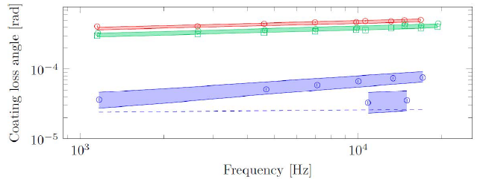

Core optics – state of the art
Test masses (mirrors) in AdV+:
  made with high purity fused silica, SiO₂
  diameter 35 cm, 40 kg
Suspended to filter out seismic motion, in a quasi-monolithic fused silica arrangement, in vacuum
Multi-layered coating made of amorphous oxides (TiO₂:Ta₂O₅/SiO₂ )
  with very low absorption < ppm
Ta₂O₅
Ta₂O₅-TiO₂
SiO₂
G. Cagnoli et al., Mode-dependent mechanical losses in disc resonators, Phys. Lett. A (2018), Vol 382
Notes:
Currently, Adv detectors mirrors are fused silica bulk of 40 kg weight, suspended to filter seismic motion, in a quasi-monolithic fused silica arrangement, in vacuum, with coatings on top which are composed by a stack of titania doped tantala and fused silica layers, deposited at LMA in Lyon. These coatings are the best optical component ever manufactured so far, in terms of excellent surface figure, really low absorption, very low scatter, but improvements are still necessary.
In the bottom right plot you can see the level of the current coatings mechanical loss angle, that needs to be further reduced. We’ll come back to this later.

Slide 10
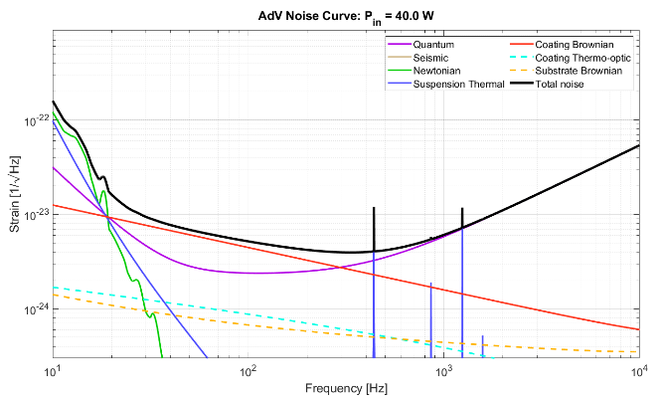

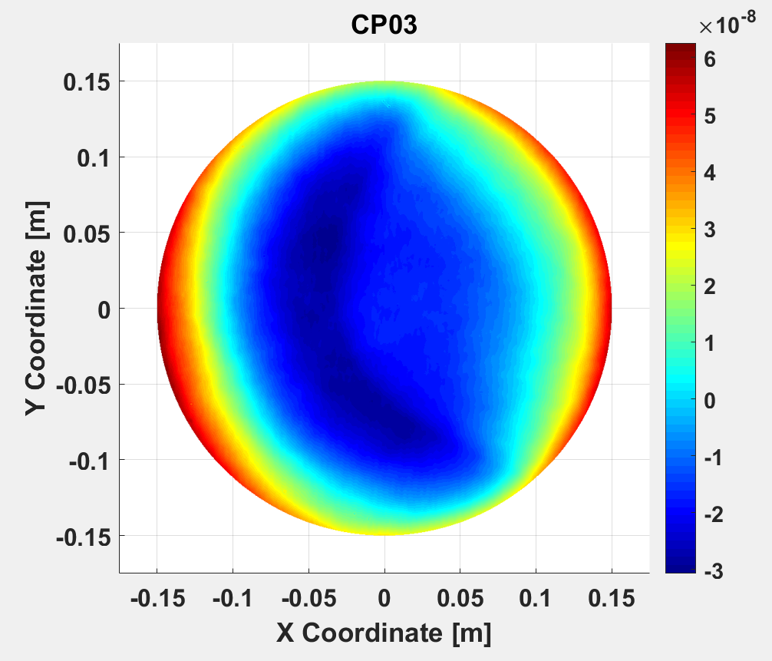
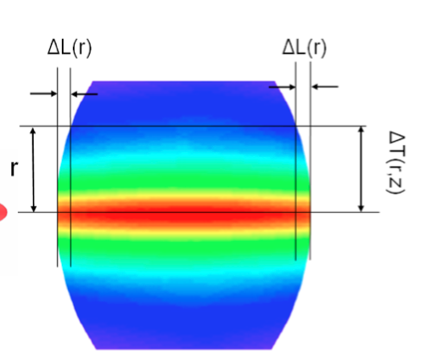

Power induced optical aberrations
AdV+ project sensitivity curve
imperfections in the production process of the mirrors (cold defects);
absorption of optical power in the coatings and substrates of the optics (dynamical effects).
Sources
Power absorbed in optics ≲ 100 mW
Inhomogeneity of refractive index, impurities …
Manufacturing errors (mismatch of radius of curvature, …)
Thermal lens
Thermal lensing
Thermo-elastic effect
Effects
$$∆{OPL}_{R}≈2α\int_{0}^{h}{∆T dz}$$
OPL distortions due to dependence of refractive index from temperature variation
Change of radius of curvature (RoC) of mirrors due a non-zero material’s thermal expansion coefficient.
Notes:
Power circulating in the interferometer arms (to reduce shot noise at high frequency) can cause optical aberrations due to absorbed heat, despite the optimized coatings.
This results in in a radial temperature gradient within the mirrors causing thermal effects: thermo-refractive due to the refractive index dependence on the temperature; and thermo-elastic effects, due to a non-zero material’s thermal expansion coefficient. Both decrease the circulating cavity power.
The Thermal Compensation System (TCS) addresses these aberrations to maintain optimal interferometer performance.
-------
But we have said that to increase the OPL of the light, cavities have been added in the arms and the power circulating in it rise up to hundreds of kW and despite the optimal optical characteristics, some power is absorbed by the mirrors and can cause optical aberration
To improve the sensitivity at high frequency, in first and second gen. detector, the power circulating is increased through optical cavities in the interferometer’s arm by a factor around 300 with respect to simple Michelson configuration.
Tangled with that, the core optics coating absorptions, though optimized to be just of the order of parts per million, result in a radial temperature gradient within the mirrors causing thermal effects:
thermo-refractive substrate, due to the refractive index dependence on the temperature;
thermo-elastic surface deformation, due to a non-zero material’s thermal expansion coefficient.
All these mechanisms induce optical aberrations, that can decrease the circulating power inside the cavity.
The Thermal Compensation System is designed to contrast the aberrations coming both from cold defects and thermally driven effects

Slide 11
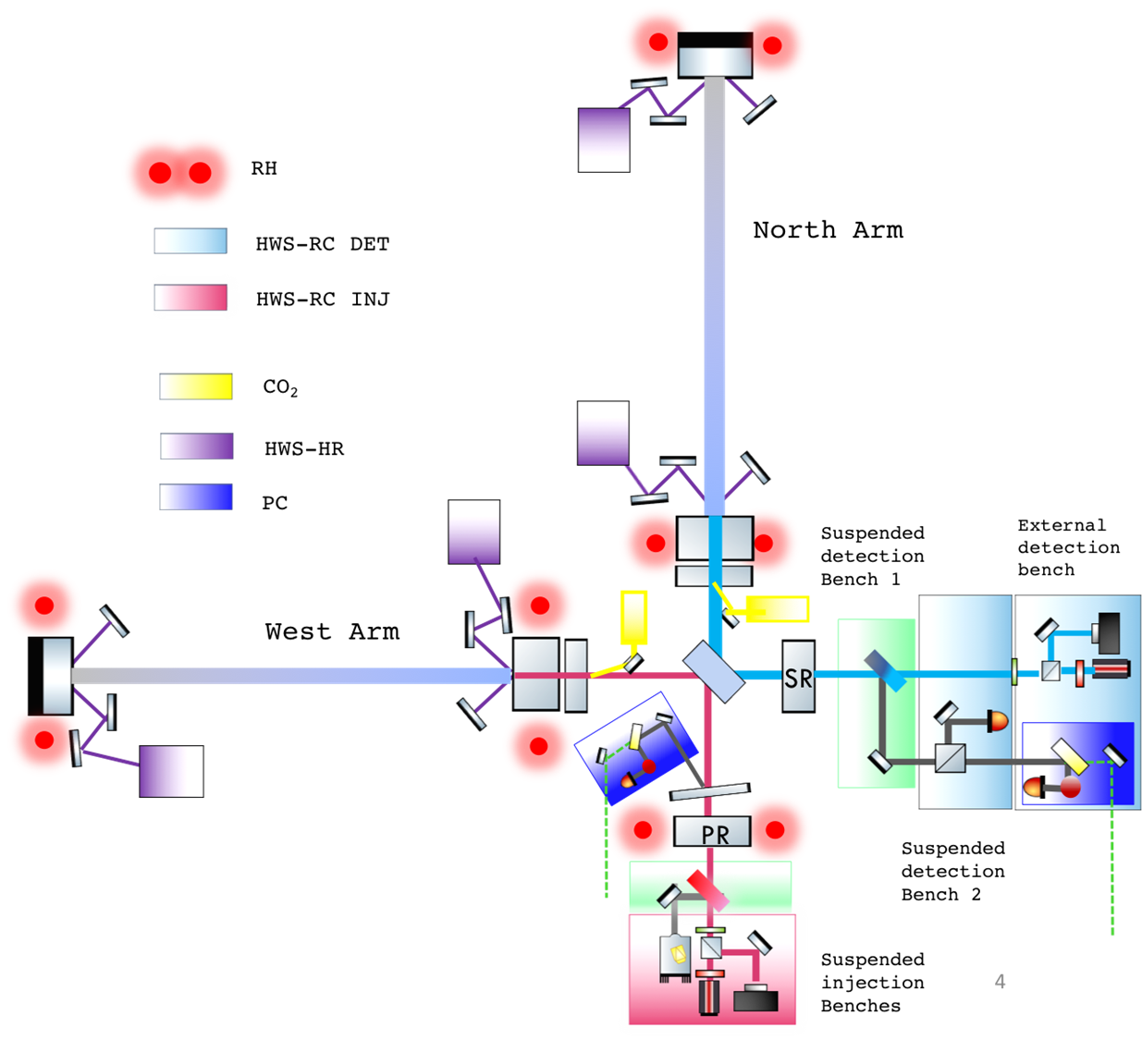
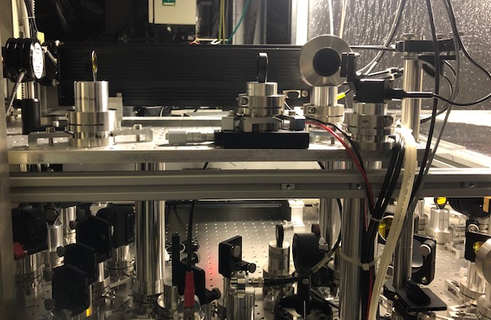
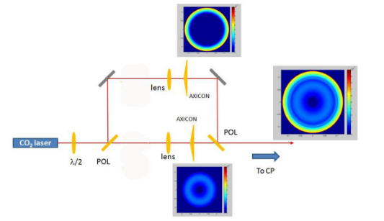
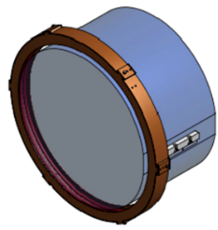
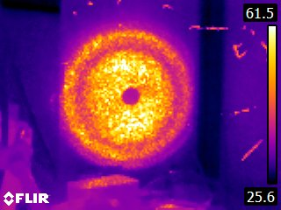
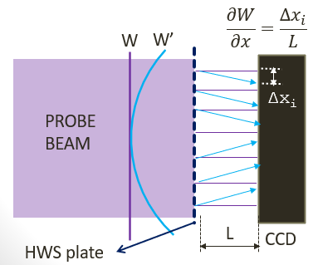
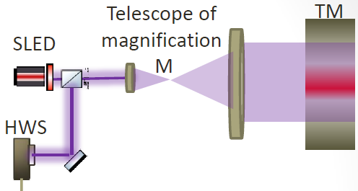
Thermal Compensation System (TCS)
Strategy: introduce a complementary distortion with respect to the main laser one, restoring the nominal optical configuration.
TCS actuators :
CO₂ laser projector (50 W & 10 W)
  Axisymmetric center & annular patterns
Ring Heaters on AR surface
dynamical adaptive optical system
TCS sensing :
Hartman Wavefront Sensors (HWS)
Phase Cameras
Notes:
The Thermal Compensation System is designed to contrast the aberrations coming both from cold defects and thermally driven effects.
The strategy is to induce in the optics a complementary distortion, with respect to the one given by the aberrations, restoring the nominal optical configuration of the interferometer.
The Advanced Virgo TCS features both high-performance sensors and actuators, making it a dynamical adaptive optical system.
Among actuators, there are the CO2 laser projectors, properly shaped, to produce the double axicon system to compensate for the thermal lensing. And the Ring Heaters, whose name is self-explanatory who we can compensate for radius of curvature deformations due to thermo-elastic effect.
Everything is monitored, for example, through Wavefront Sensors called Hartman and a probe beam.

Slide 12
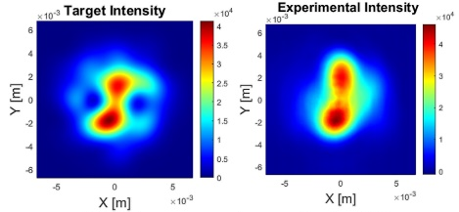
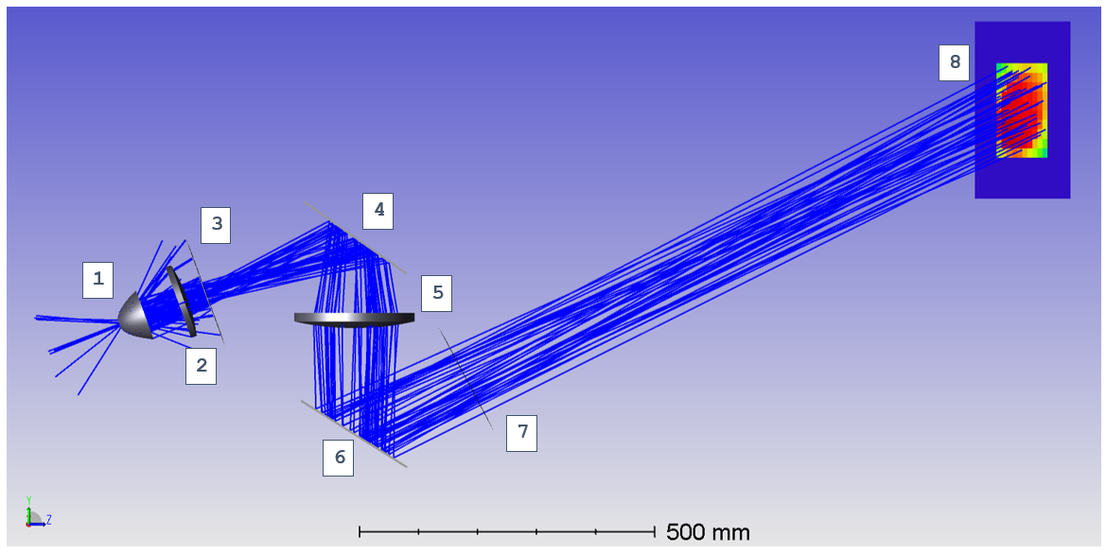
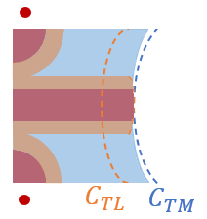
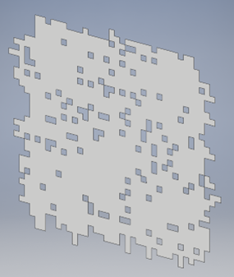
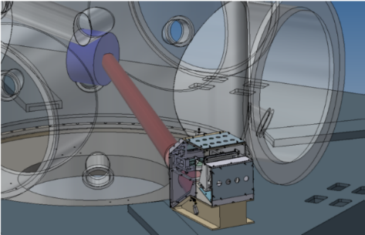
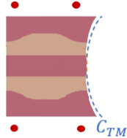
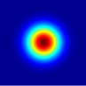
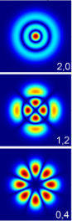
Future adaptive optic developments
The TCS has proven to be more versatile than originally anticipated, showing utility in various contexts.
Adaptive optics, with its flexibility, will be a key feature in future detectors:
Increased laser power will amplify the impact of residual optical aberrations;
Readiness to address unexpected defects and compensate for operational aberrations not accounted for in the initial design;
The need for independent actuators to prevent interference and ensure efficient compensation.
Deformable Mirror (DM)
imprint a phase on CO2
beam to obtain the desired
intensity pattern
Correction of non axisymmetric residual
Double RH
RH introduces a thermal lens (C_{TL}) inside the bulk
The C_{TL} could be compensated, placing a second RH near the HR surface, such that the OPL is almost constant along the thickness.
CO₂ Mode Cleaner (MC)
Efficiency of DAS correction strictly related to the laser beam quality
TEM₀₀ Gaussian VS High Order Modes
Mode cleaner cavity for high power 𝑪𝑶_{𝟐} laser has never been realized before
0,0
Point Absorbers (PA) mitigation
Highly absorbing areas on the coatings of the core optics
The corrective heating pattern is reproduced by a binary mask illuminated by a thermal source, with each hole acting as an actuator.
CAD: T. Zelenova
Notes:
TCS has proven versatile beyond initial expectations.
Future detectors will need advanced adaptive optics to manage increasing laser power and evolving aberrations.
In this perspective, I’ve reported just some of the ongoing research to further improve the system.
Current research includes deformable mirrors for non axysimmetric residual, mode cleaners for high-power lasers to reduce HOM content, double ring heaters, and advanced heating patterns for point defects correction.
Among all of them:
DM system is composed by a mirror, who’s surface can be properly modified to imprint a phase on CO2 beam to obtain the desired intensity pattern at a given plane to correct non-axisymmetric residual
MC will be needed since CO2 lasers are affected by the presence of High Order Modes in addition to the TEM₀₀ Gaussian one. Mode cleaner cavity for lasers at different wavelengths are currently widely used, but a mode cleaner for high power 𝑪𝑶𝟐 laser has never been realized before.
Double RH arises from the fact that a single RH introduces also thermal lens inside the bulk, due to the increasing of the Optical Path Length (OPL) along the thickness as a function of the temperature variation due to the absorbed power radiated by the RH. Thanks to the fact that a RH change (almost only) the curvature on the opposite surface, the curvature induced by the thermal lens of the RH could be compensated, placing a second RH near the other surface.
Finally, PA are Highly absorbing areas on the coatings of the core optics, this set up can correct the deformation through a customer heating pattern produced by a binary mask iulluminated by a thermal source
Over time the TCS has proven to be more versatile than originally anticipated, showing utility in various contexts. Adaptive optics, with its flexibility, will be a key feature in future detectors because Increased laser power will amplify the impact of residual optical aberrations. Based on previous experience, it will be needed to address unexpected defects and aberrations not accounted initially and more independent actuators will be preferred to prevent interference and ensure efficient compensation.

Slide 13
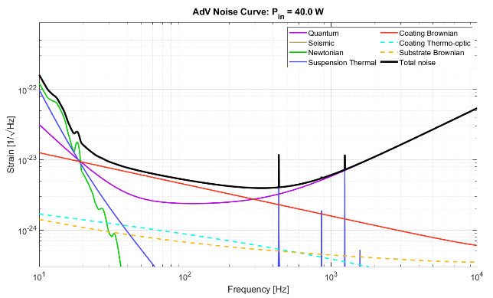
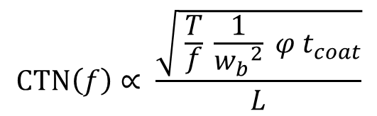
Coating thermal noise
AdV+ project sensitivity curve
Coating thermal noise (CTN) limits the detection in the middle frequency bandwidth
The key parameters are:
Mechanical loss
Temperature
Coating
thickness
$$CTN\left(f\right)∝ \frac{\sqrt{ \frac{T}{f} \frac{1}{{w_{b}}^{2}} φ t_{coat}}}{L}$$
V_nEXT (post O5) upgrades:
Larger beams on end test masses
6 cm radius ⇒ 10 cm radius
Larger end mirrors
  35 cm diameter ⇒ 55 cm diameter
  40 kg ⇒ 100 kg
  New suspensions/seismic isolators for large mirrors
New mirror coatings
Lower mechanical losses by a factor 3, less point defects, better uniformity
Arm length
Beam-size
3° generation detectors (ET):
Cryogenic temperature (down to 10 – 20K)
10km long arms
Larger beams on larger test masses
New mirror coatings
Notes:
On the other hand, coating thermal noise (CTN) is another key challenge, since represents a limit in middle frequency band.
It is driven by the fundamental thermodynamic fluctuations of the mirror’s coating.
In the specific case of GW detectors, CTN expression presents these main dependences.
Strategies to reduce CTN include using ultra-low loss coatings, larger beams and mirrors, and possibly cryogenic mirrors.
Reducing the coating loss angle is a priority for the next observing runs and next generation detectors.
-------------
we have seen that the middle frequency band is limited by CTN. TN is a very general fact: it is related to the stability of thermodynamic equilibrium of a system. In a real system not a 0K, observable quantities are subjected to spontaneous stochastic fluctuations largely unpredictable.
in the specific case of GW detectors, CTN expression presents these main dependences.
In preparation for future observing runs, the chosen strategy was to reduce a factor 3 the coating loss angle (fattore 3 rispetto a O5 + fattore 3 rispetto a O4) and to increase the beam size (and also end test masses).
This goal will increase the observable range of the detector, this means to see more GW sources (in terms of observable volume), or to observe at a higher rate, that is make statistic on the GW signals.
For future GW detectors also other two parameters will be addressed by increasing the arm length up to 10km and going to cryogenic temperature.
Now, ss I anticipate, we’ll focus on the mechanical loss parameter, wehich represent the dissipative behavior of the system
--------
Descrivere cosa sono le perdite meccaniche? Another important parameter can be defined thinking to the fact that when a system is dissipative, its response to a step solicitation is characterized by a finite relaxation time, so there is a phase lag between an applied input and the system response: this phase lag is represented by the loss angle phi

Slide 14
Development of materials for ultra-low loss optical coatings
GOAL:
increase the mechanical performances of today's reflective coatings, retaining their outstanding optical and morphological properties
Candidate materials
  Trial and error approach VS systematic approach
  deeper understanding of the underlying physical mechanisms driving the losses
Amorphous materials
  Overall disordered structure, locally arranged.
Dissipative mechanism
Two Level System (TLS): metastable states separated by an energy barrier
  Floppy (optimal distribution of TLS) materials
    TiO2:GeO2, TiO2:SiO2
  Stiff (reduced number of TLS) materials
    SiN, aSi
Crystalline coatings
  Band gab free of localized states, dissipative mechanisms are limited
  transfer and maximum available size; development costs are currently a major limitation
  GaAs/AlGaAs, crystalline coatings
Notes:
To improve coating performance, we’re exploring materials with lower mechanical losses while maintaining optical quality.
In the past a trial and error approach have been followed. Today a more systematic approach have been chosen, supported by a deeper understanding of the underlying physical mechanisms driving the losses.
Candidates include:
amorphous materials, with an overall disordered structure, but locally arranged. The dominant dissipative mechanism arise from the presence of the metastamble states (two level system). The strategy is to go for floppy material with an optimal distribution of TLS or stiff ones with a reduced number of TLS
In crystalline coatings, instead, due to their nature, dissipative mechanisms are limited. The major limitation for these material is the maximum available size and the transfer (since their ar typically grown on crystalline substrate).
-------
Due to the crystalline nature, their good optical and mechanical quality is kept at cryogenic temperatures

Slide 15
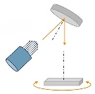

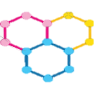
Development of materials for ultra-low loss optical coatings
GOAL:
increase the mechanical performances of today's reflective coatings, retaining their outstanding optical and morphological properties
Different deposition methods and fine-tuning deposition parameters
Ion Beam Sputtering (IBS)
Magnetron Sputtering (MS)
Chemical Vapor Deposition (CVD)
Molecular-beam epitaxy (MBE)
Post-deposition treatments
Annealing
  improve the atomic organization of the coating in the medium-range order and reduce its mechanical loss angle
  modify the chemical composition (desorption of contaminants)
  controlled crystallization
Mixing
Enhances material properties (like refractive index and mechanical losses)
Prevents crystallization, allowing for higher annealing temperatures.
Reduces stress
Introduces an additional variable that must be precisely managed during fabrication
Notes:
Not only the materials but also the deposition techniques and post-treatments, such as annealing, play a crucial role in optimizing mechanical properties. Co-deposition and drugging can further enhance performance.
----------------
Not only the material itself play a role for mechanical performances.
Different deposition methods and the fine tuning of deposition parameters can affect it, as well as post deposition treatments (annealing is typically used to relax stress inside the deposited films, to induce desorption of unwanted contaminants or to induce controlled crystallization) and mixing/ co-deposition, that mean drugging matherials to enance its properties, prevent uncontrolled crystallization and reduce stresses.

Slide 16
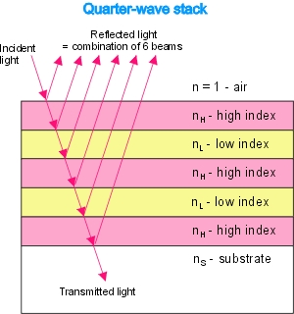
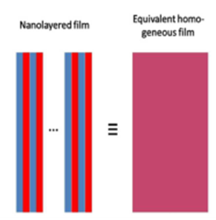
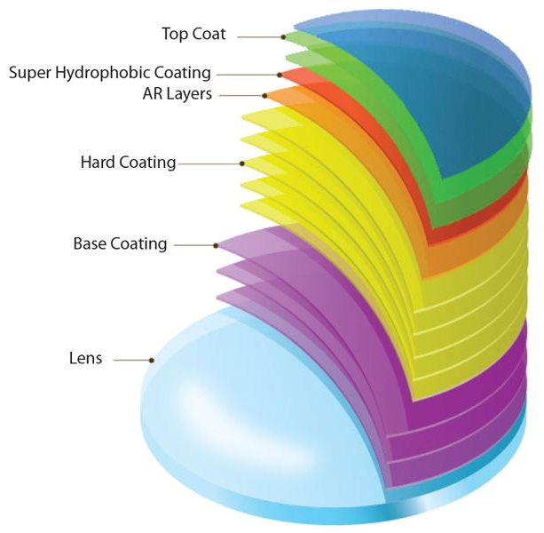
Development of materials for ultra-low loss optical coatings
GOAL:
increase the mechanical performances of today's reflective coatings, retaining their outstanding optical and morphological properties
Bragg reflectors: thickness optimization, to maintain the desired reflectivity and reduce coating thermal noise (CTN)
Nano-layering: periodic stack of ultrathin (nanometer-scale) films that behaves like a homogeneous material with a tunable refractive index. It can be annealed at higher temperatures, thanks to geometrical suppression of crystallization
Coating structure and design
Multimaterial approach: Combination of different materials with low optical absorption near the surface and minimized mechanical losses deeper within
Notes:
Finally, the design of the coating structure, including layer thickness optimization and multi-material approaches, also impacts performance. This fine-tuning is essential for balancing optical and mechanical requirements.
Finally, also the coating structure and design play a role.
We’ve seen that GW mirrors are bragg reflectors in which thinkness of layers play an important role. The optimization of this parameter can improve the mechanical perfomrances . As well as nanolayering, mainly used to geometrically suppress crystallization and multimaterial approach allowed to profit of matherels with best optical absorption near the surface and best mechanical one depper within.

Slide 17
Development of materials for ultra-low loss optical coatings
GOAL:
increase the mechanical performances of today's reflective coatings, retaining their outstanding optical and morphological properties
Investigation techniques:
Optical properties: measurement of optical absorption and/or extinction coefficient and refractive index (spectroscopic ellipsometry)
Mechanical dissipation properties: measurement of loss angle and substrate preparation procedure (thermal annealing and polishing of barrel), density and elastic constants (Brillouin spectroscopy); numerical simulations (molecular dynamics, FEA)
Microscopic structure: chemical composition and stoichiometry (XPS), crystallization (XRD, Raman spectroscopy); local molecular structures (Raman sp.); topology and surface composition (AFM and SEM)
Thermal and opto-thermal properties: optical path as a function of temperature (thermo-refractive measurement); measurement of the coefficient of linear thermal expansion (Curvature measurement)
Comprehensive picture of the relevant physics of a given material
Candidate materials
Coating deposition techniques
and treatments
Coating structure and design
Notes:
All this is supported by a plethora of investigation techniques, listed here, that probe optical, mechanical, microscopical and thermal properties to have a comprehensive picture of the relevant physics of these coatings, ensuring continuous improvements.

Slide 18
Conclusion
Current coatings are the best optical component ever manufactured so far, in terms of excellent surface figure, really low absorption, very low scatter.
Improvements are still needed to tackle with:
Power induced optical aberrations
  Introduce a complementary distortion with respect to the main laser one with TCS
  Improve aberration identification and correction of non axisymmetric residual and point-like defects
  Ready to address unexpected defects and compensate for operational aberrations not accounted for in the initial design
  Indipendent actuators to prevent interference and ensure efficient compensation
Coating thermal noise
  Many knobs for reduce CTN (T, thick, beam size, loss angle)
  Ultra-low loss material research
    Chose candidate materials with systematic approach
    Coating deposition techniques and treatments
    Coating structure and design
    Extensive experimental investigation techniques
Notes:
In conclusion, Current coatings are exceptional, but further advancements are required to manage power-induced optical aberrations through adaptive optics and to reduce CTN with novel ultra-low loss materials. These improvements are crucial for the next generation of GW detectors.

Slide 19
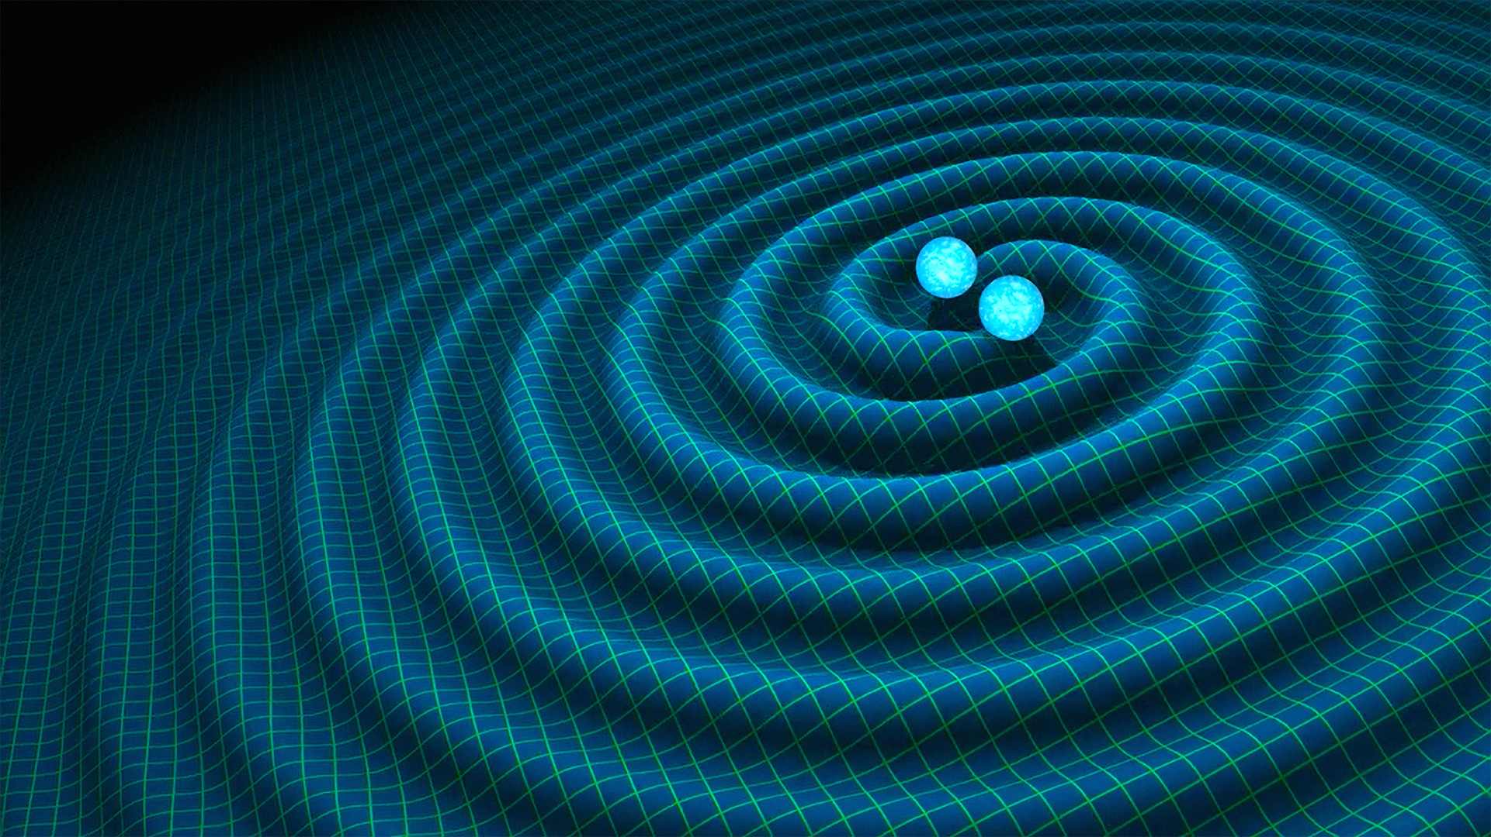
Thank you for your time and attention!
Contact: diana.lumaca@roma2.infn.it

