Slide 1
probing astrophysical GeV neutrino emissions with IceCube and KM3NeT
J. Mauro*
G. de Wasseige
on behalf of
KM3NeT Collaboration
IceCube Collaboration

Slide 2
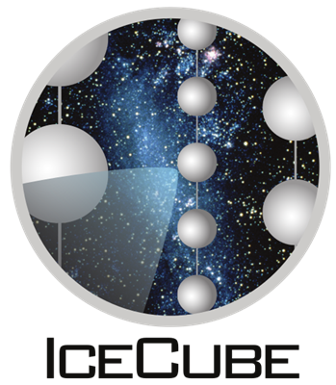
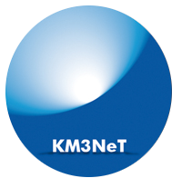
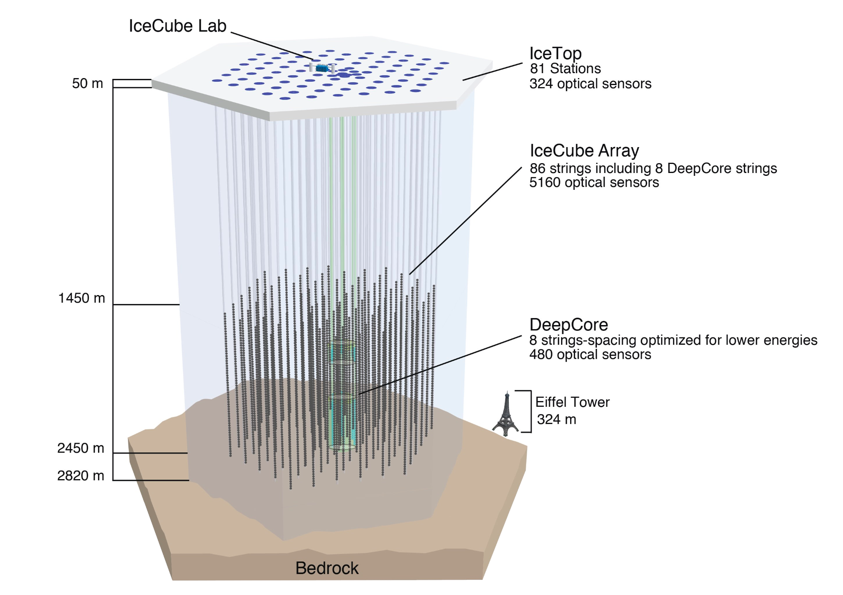
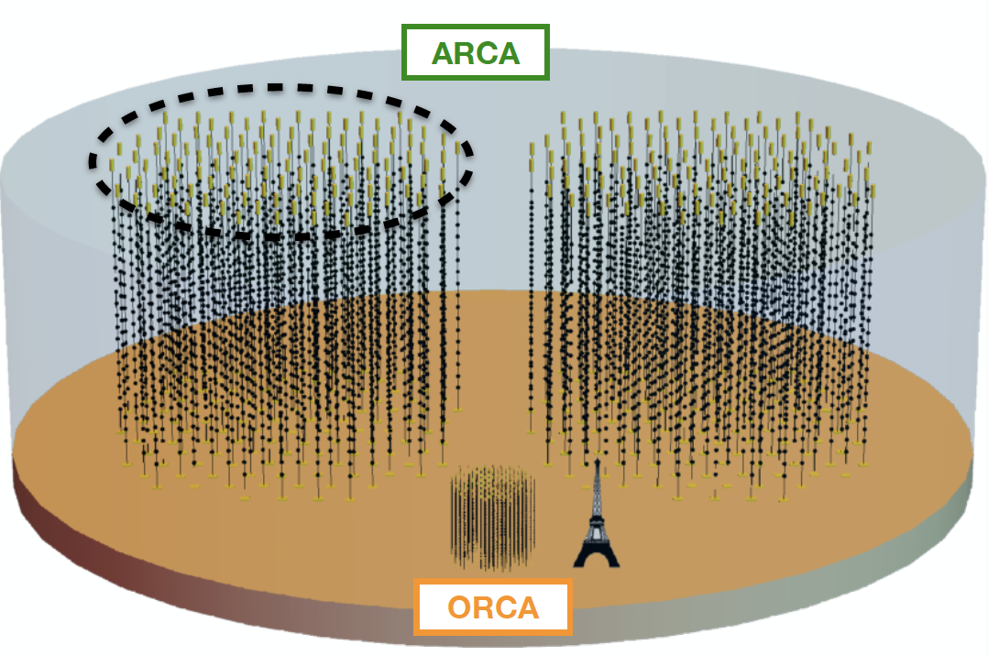
Location: South Pole
Size: 1 km³
86 strings (8 DeepCore)
5160 optical modules
Location: Mediterranean Sea
Size: 1 km³ (planned)
230 lines (ARCA) + 115 lines (ORCA)
6210 optical modules
23-27 September 2024
KM3NeT Collaboration
IceCube Collaboration
Notes:
today I’m presenting for both IceCube and km3net experiments, so I do realize that many of you are familiar with them, you’ve seen some talks before me but I just want to show them side by side and highlights how are they different. well first of all they’re both Cherenkov neut detectors, so they have the same detection principle, IceCube is in Ice at the south pole. While km3net is being deployed in the mediterranean sea. ice and water don’t have the same properties so the amount of light and distance that the detected light travels is going to be different. they’re both roughly a km3, with km3net currently being only a fraction still. With the main physics goal being high energy neutrino astro but both experiment have a denser instrumented array. deepcore in IceCube which is located at core of the larger ic array and ORCA in km3net which is altogether a separate array which is dedicated to study neutrino oscillation and for what concerns us lowen astro

Slide 3
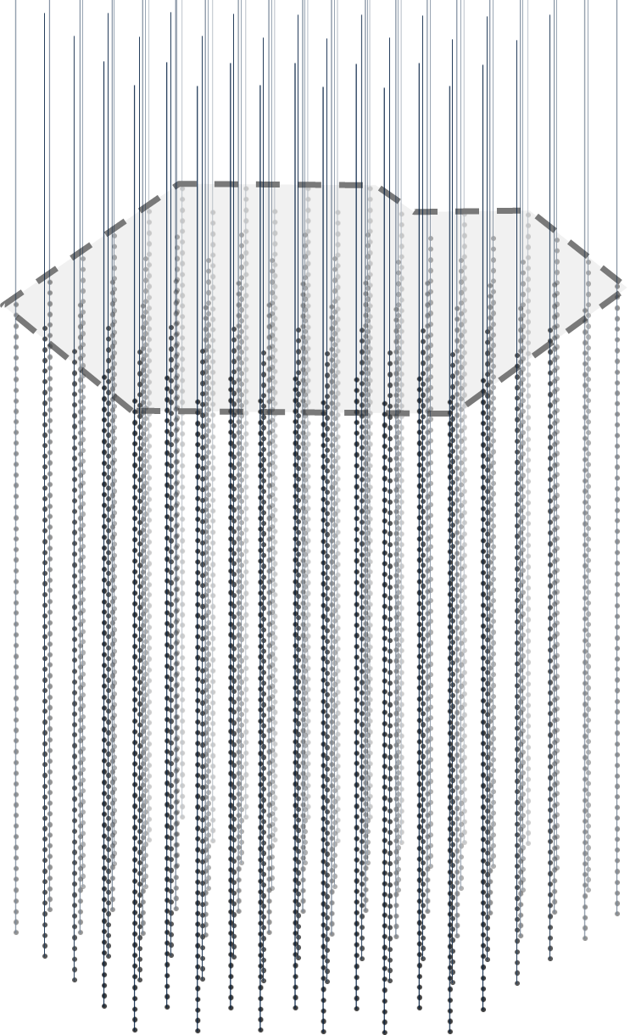
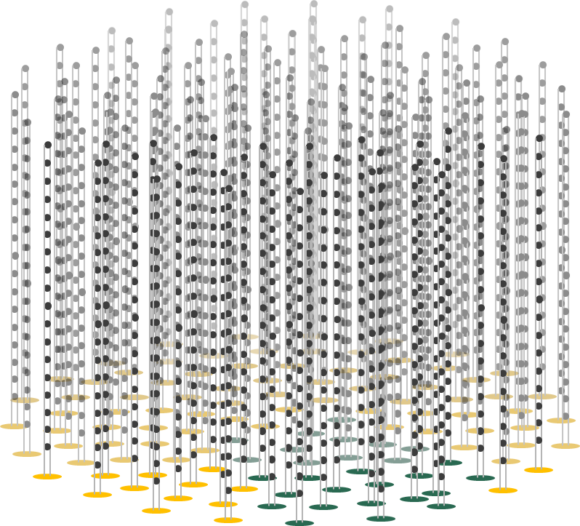
$$E_{ν_{μ} }\sim 10TeV$$
23-27 September 2024
KM3NeT Collaboration
IceCube Collaboration
Notes:
now I’ve told you that essentially the two detector have the same detection principle which is quite straight forward I’ve drawn a diagram of what an high energy muon neutrino might look like, you see that the Cherenkov light allows to reconstruct the direction of the incoming particle to very high precision depending on factors.

Slide 4
$$E_{ν_{μ} }\sim 1GeV$$
23-27 September 2024
KM3NeT Collaboration
IceCube Collaboration
Notes:
but when we move to low energies around 1 gev this is what we have. you understand this is much more of a challenge to detect in particular wevirtually do not have directional reconstruction.

Slide 5
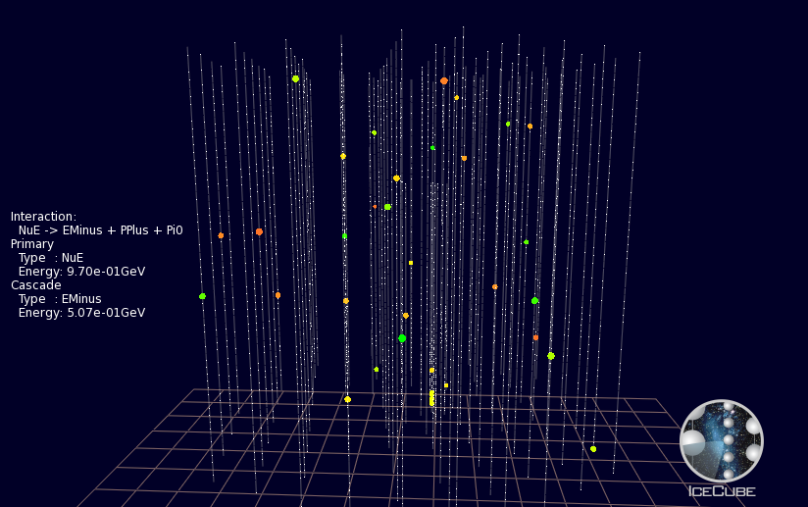
$$E_{ν_{μ} }\sim 1GeV$$
23-27 September 2024
KM3NeT Collaboration
IceCube Collaboration
Notes:
and ok it gets worse because at this point we become sensitive to low level background noise. so for example thisi is a IC simulation and in red a 500 MeV electron neutrino while the rest is detector noise. So why do we even want to do that, so one reason is that we have such a large instrumented volume that even little sensitivity to GeV neutrino actually makes competitive with tank based experiments. of course since we cannot point back in the sky at sources we can only look for transients. basically you search for time correlation between the source and an excess in your low-en neutrino rate.

Slide 6
MeV-GeV neutrino selections
see G. Vannoye’s talk
CCSN
ORCA
TRACKS
SHOWERS
CCSN
ELOWEN
GRECO
O(10) MeV
0.5 GeV
5 GeV
1 TeV
E_{ν}
23-27 September 2024
KM3NeT Collaboration
IceCube Collaboration

Slide 7
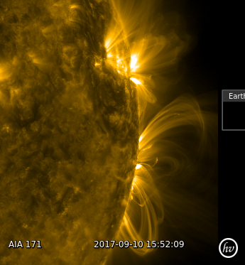
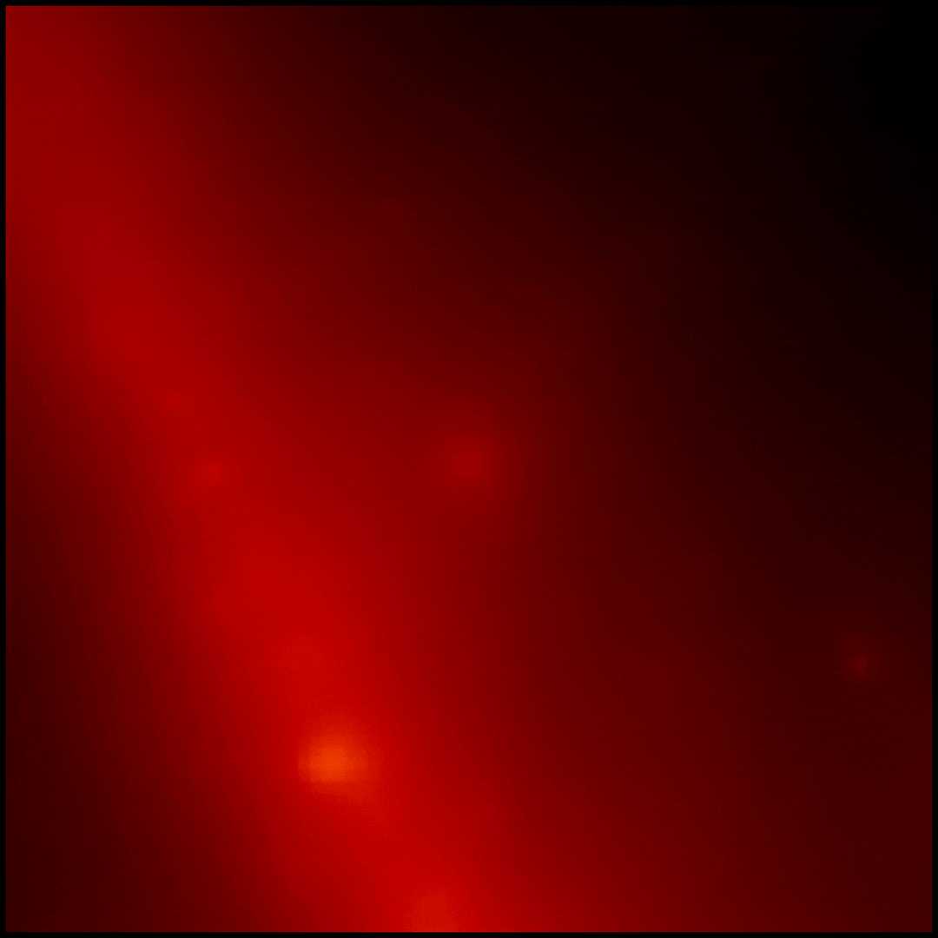
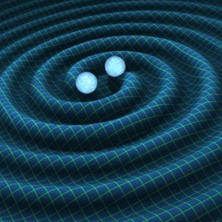
MeV-GeV neutrino sources
Solar Flares
GRBs
GWs
Credit: NASA/SDO
Credit: NASA/DOE/Fermi LAT Collaboration
Credit: R. Hurt/Caltech-JPL
G. de Wasseige, “Solar Flare Neutrinos in the Multi-Messenger Era: Flux Calculations and a Search with the IceCube Neutrino observatory”, PhD thesis Vrije Universiteit Brussel (2018)
K.Murase, et al., “Subphotospheric Neutrinos from Gamma-Ray Bursts: The Role of Neutrons”, Phys. Rev. Lett. 111 (2013)
K. Asano, K. Murase “Gamma-Ray Bursts as Multienergy Neutrino Sources”, Adv. in Astro., 568516 (2015)
23-27 September 2024
KM3NeT Collaboration
IceCube Collaboration

Slide 8
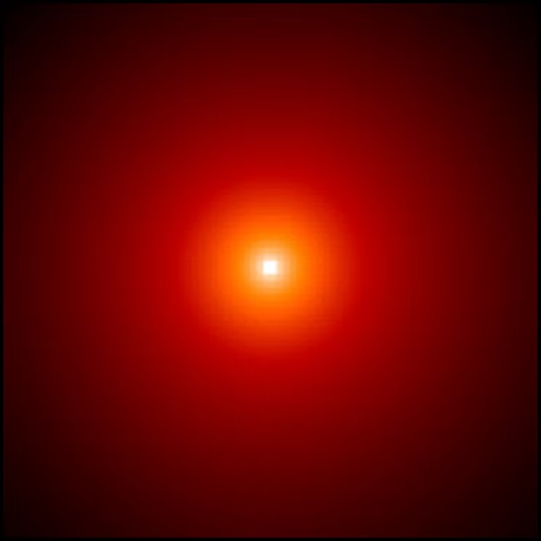
MeV-GeV neutrino sources
Solar Flares
GRBs
GWs
Credit: NASA/SDO
Credit: NASA/DOE/Fermi LAT Collaboration
Credit: R. Hurt/Caltech-JPL
G. de Wasseige, “Solar Flare Neutrinos in the Multi-Messenger Era: Flux Calculations and a Search with the IceCube Neutrino observatory”, PhD thesis Vrije Universiteit Brussel (2018)
K.Murase, et al., “Subphotospheric Neutrinos from Gamma-Ray Bursts: The Role of Neutrons”, Phys. Rev. Lett. 111 (2013)
K. Asano, K. Murase “Gamma-Ray Bursts as Multienergy Neutrino Sources”, Adv. in Astro., 568516 (2015)
23-27 September 2024
KM3NeT Collaboration
IceCube Collaboration

Slide 9
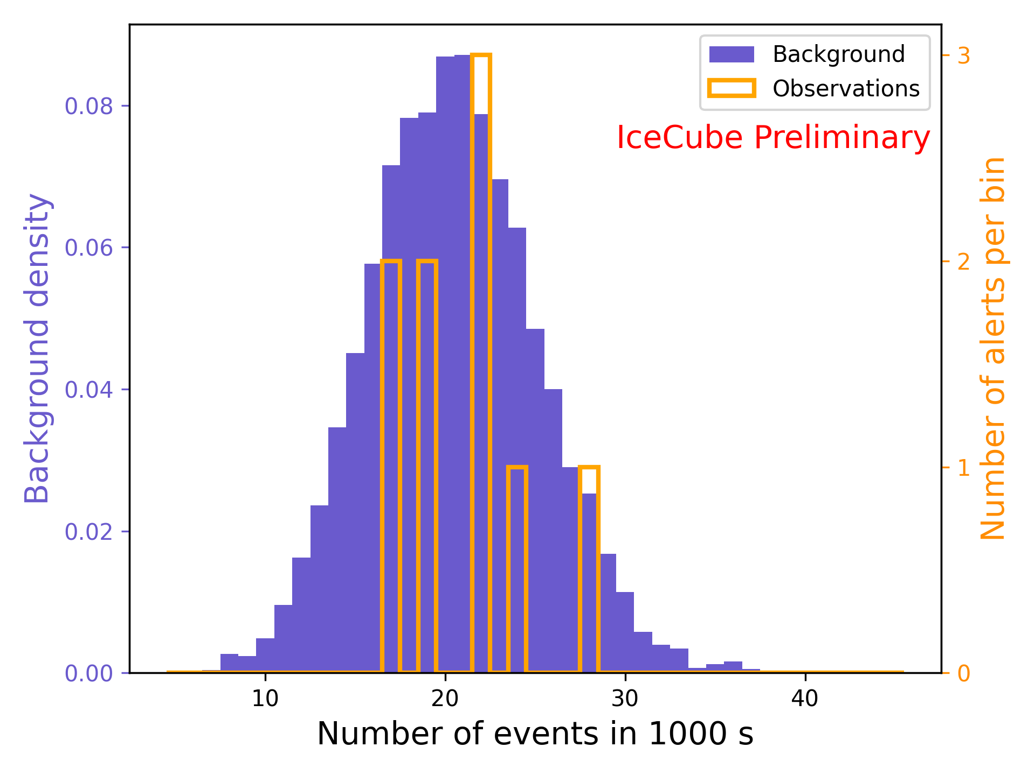
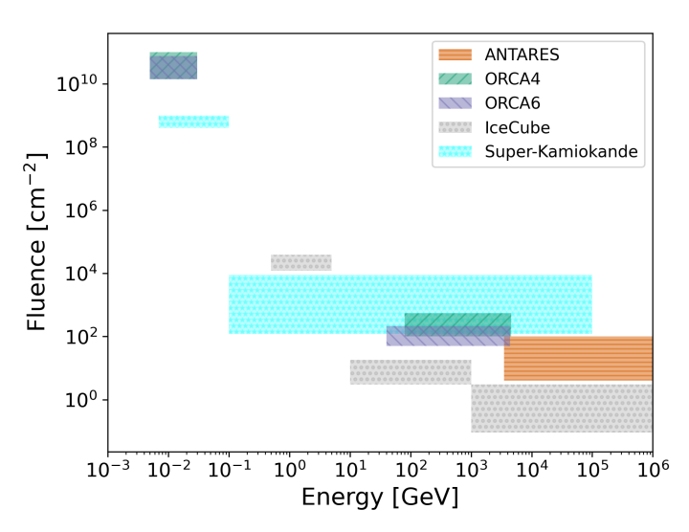
Gravitational waves follow-up
O4
O3
K.Kruiswijk, M. Lamomoureux, G. de Wasseige, on behalf of the IceCube Collaboration, “First results of low-energy neutrino follow-ups of Run O4 compact binary mergers with the IceCube Neutrino Observatory”, PoS(ICRC2023) 444 (2023)
KM3NeT Collaboration, “Searches for neutrino counterparts of gravitational waves from the LIGO/Virgo third observing run with KM3NeT”, JCAP 04 (2024)
23-27 September 2024
KM3NeT Collaboration
IceCube Collaboration

Slide 10
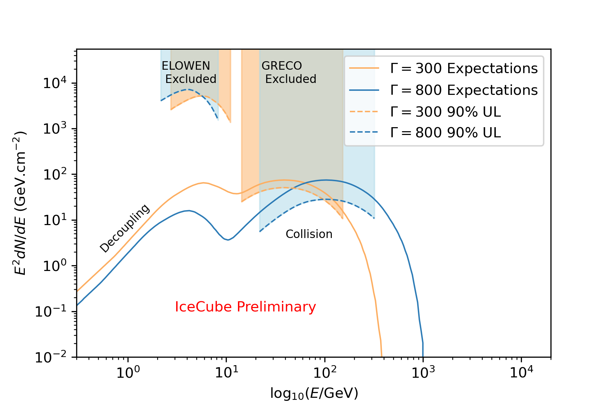
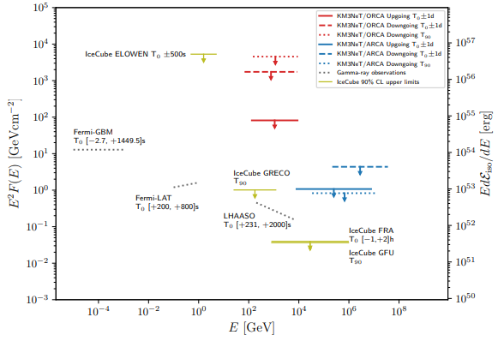
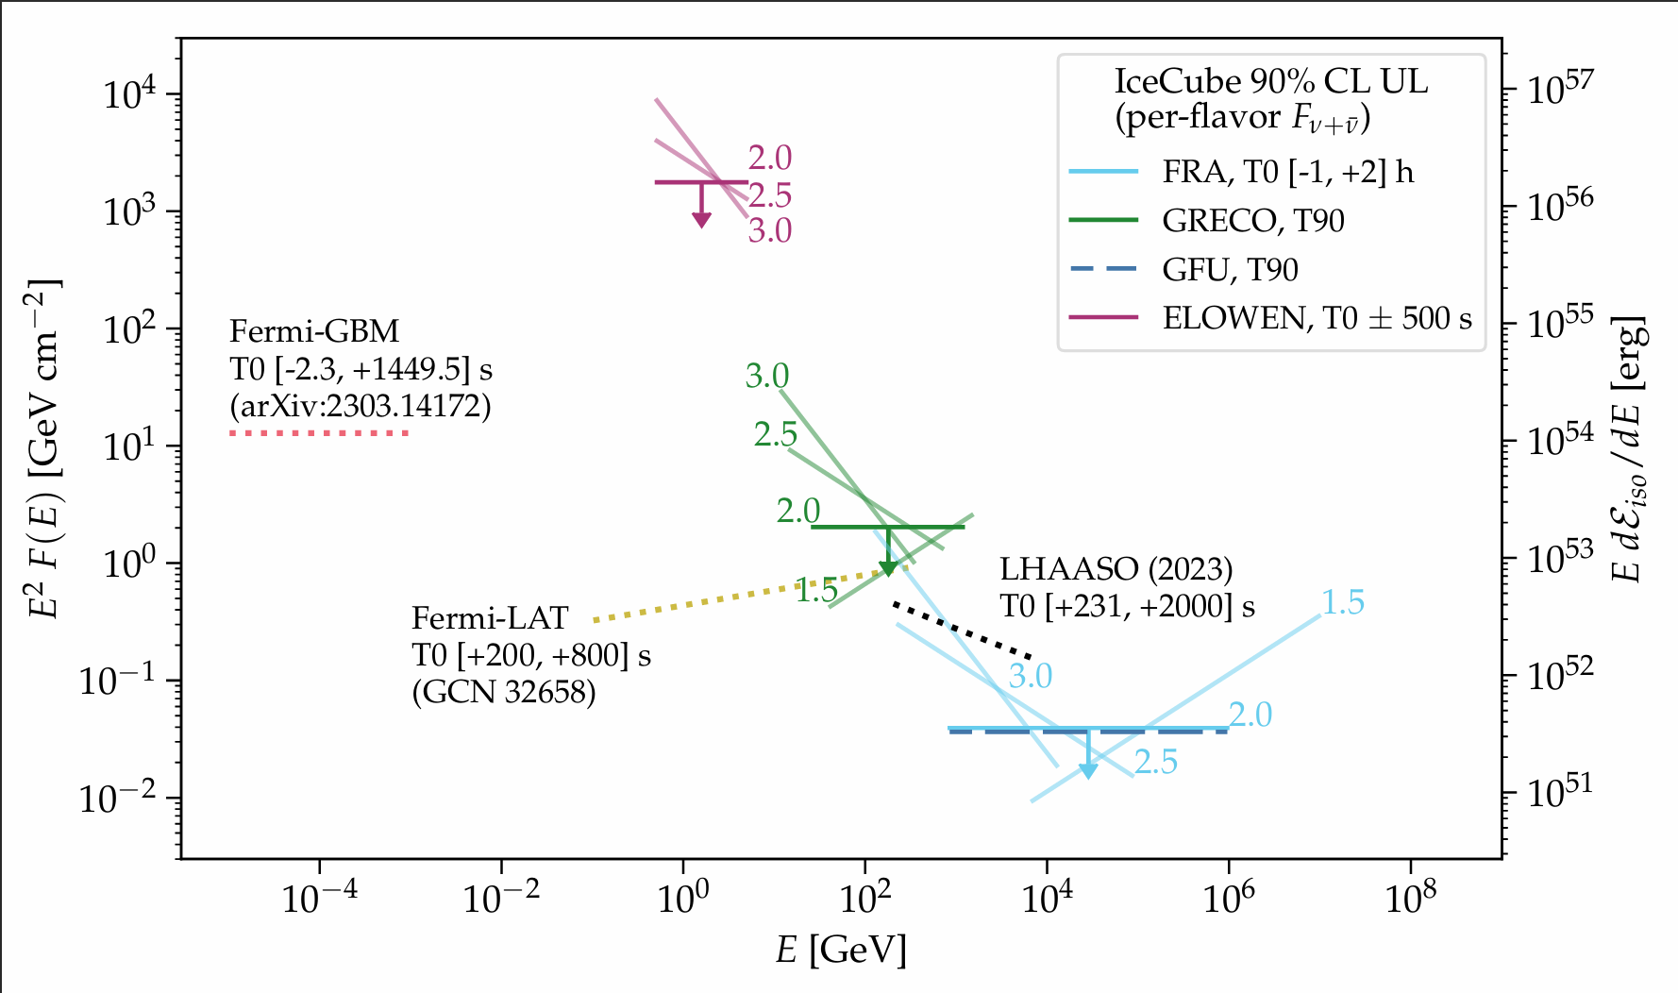
GRB 221009A
K.Kruiswijk, B.Brinson, R. Procter-Murphy, J. Thwaites, N. Valtonen-Mattila on behalf of the IceCube Collaboration, “IceCube search for neutrinos from GRB 221009A”, PoS(ICRC2023) 444 (2023)
see IceCube Collaboration, Erratum:“Limits on Neutrino Emission from GRB 221009A from MeV to PeV Using the IceCube Neutrino Observatory”, ApJL 970 (2023)
see J. Palacios González’s talk
KM3NeT Collaboration, “Search for Neutrino Emission from GRB 221009A using the KM3NeT ARCA and ORCA detectors”, JCAP 08 (2024)
IceCube Collaboration, “Limits on Neutrino Emission from GRB 221009A from MeV to PeV Using the IceCube Neutrino Observatory”, ApJL 946 (2023)
23-27 September 2024
KM3NeT Collaboration
IceCube Collaboration

Slide 11
Prospects

Slide 12
Improvements of IceCube GeV selection
G. de Wasseige, K.Kruiswijk, on behalf of the IceCube Collaboration, “Probing neutrino emission at GeV energies from
astrophysical transient events with the IceCube
Neutrino Observatory”, PoS(ICRC2023) 444 (2023)
It’s possible to implement zenith reconstruction in the ELOWEN selection using Boosted Decision Trees.
This will improve the sensitivty of IceCube to 0.5-5 GeV neutrinos from transients sources
23-27 September 2024
KM3NeT Collaboration
IceCube Collaboration
Notes:
today I’m presenting for both IceCube and km3net experiments, so I do realize that many of you are familiar with them, you’ve seen some talks before me but I just want to show them side by side and highlights how are they different. well first of all they’re both Cherenkov neut detectors, so they have the same detection principle, IceCube is in Ice at the south pole. While km3net is being deployed in the mediterranean sea. ice and water don’t have the same properties so the amount of light and distance that the detected light travels is going to be different. they’re both roughly a km3, with km3net currently being only a fraction still. With the main physics goal being high energy neutrino astro but both experiment have a denser instrumented array. deepcore in IceCube which is located at core of the larger ic array and ORCA in km3net which is altogether a separate array which is dedicated to study neutrino oscillation and for what concerns us lowen astro

Slide 13
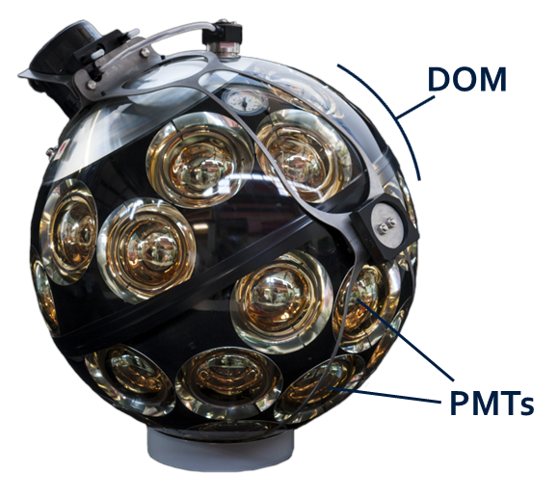
Novel KM3NeT GeV selection
KM3NeT Collaboration, “The KM3NeT multi-PMT optical module”, JINST 17 (2022)
KM3NeT’s Digital Optical Module (DOM) is made of 31 3” PMTs.
KM3NeT’s DOM allows for better reconstruction at high energies, and for noise rejection at single-DOM level.
Low-level data stored by KM3NeT is filtered requiring at least two-hits coincidences on the same DOM.
Low-level data originates mostly from ⁴⁰K decay and bioluminescence
23-27 September 2024
KM3NeT Collaboration
IceCube Collaboration
Notes:
today I’m presenting for both IceCube and km3net experiments, so I do realize that many of you are familiar with them, you’ve seen some talks before me but I just want to show them side by side and highlights how are they different. well first of all they’re both Cherenkov neut detectors, so they have the same detection principle, IceCube is in Ice at the south pole. While km3net is being deployed in the mediterranean sea. ice and water don’t have the same properties so the amount of light and distance that the detected light travels is going to be different. they’re both roughly a km3, with km3net currently being only a fraction still. With the main physics goal being high energy neutrino astro but both experiment have a denser instrumented array. deepcore in IceCube which is located at core of the larger ic array and ORCA in km3net which is altogether a separate array which is dedicated to study neutrino oscillation and for what concerns us lowen astro

Slide 14
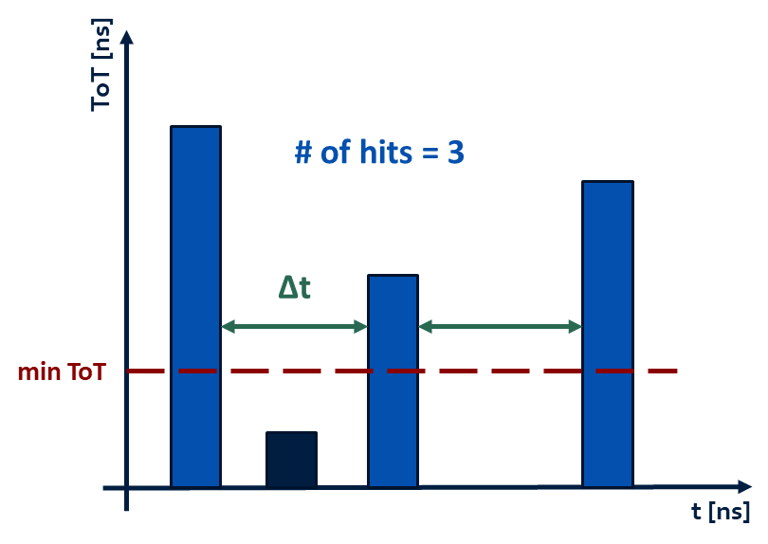
ToT = Time over Threshold
Single-DOM events are defined as group of PMT hits, that are recorded on the same DOM with a time offset ∆t < 30 ns.
Only hits with ToT > 5 ns are used, and
Only events with number of hits > 2 are kept.
By comparing data (background) with neutrino simulations (signal), we optimise the cuts on ∆t, min ToT, and min # of hits by looking at fractional increments in the percentage of survived ToT.
23-27 September 2024
KM3NeT Collaboration
IceCube Collaboration
Notes:
today I’m presenting for both IceCube and km3net experiments, so I do realize that many of you are familiar with them, you’ve seen some talks before me but I just want to show them side by side and highlights how are they different. well first of all they’re both Cherenkov neut detectors, so they have the same detection principle, IceCube is in Ice at the south pole. While km3net is being deployed in the mediterranean sea. ice and water don’t have the same properties so the amount of light and distance that the detected light travels is going to be different. they’re both roughly a km3, with km3net currently being only a fraction still. With the main physics goal being high energy neutrino astro but both experiment have a denser instrumented array. deepcore in IceCube which is located at core of the larger ic array and ORCA in km3net which is altogether a separate array which is dedicated to study neutrino oscillation and for what concerns us lowen astro

Slide 15
Z. Zhang, et al., “Hierarchical Graph Pooling with Structure Learning”, arXiv preprint (2019)
Hierarchical Graph Pooling
It selects the subset of most representative nodes to produce a lower dimensional representation of the graph.
Structure Learning
It learns a refined structure of the graph by computing a similarity between nodes. It allows to avoid highly disconnected graphs after pooling.
23-27 September 2024
KM3NeT Collaboration
IceCube Collaboration
Notes:
today I’m presenting for both IceCube and km3net experiments, so I do realize that many of you are familiar with them, you’ve seen some talks before me but I just want to show them side by side and highlights how are they different. well first of all they’re both Cherenkov neut detectors, so they have the same detection principle, IceCube is in Ice at the south pole. While km3net is being deployed in the mediterranean sea. ice and water don’t have the same properties so the amount of light and distance that the detected light travels is going to be different. they’re both roughly a km3, with km3net currently being only a fraction still. With the main physics goal being high energy neutrino astro but both experiment have a denser instrumented array. deepcore in IceCube which is located at core of the larger ic array and ORCA in km3net which is altogether a separate array which is dedicated to study neutrino oscillation and for what concerns us lowen astro

Slide 16
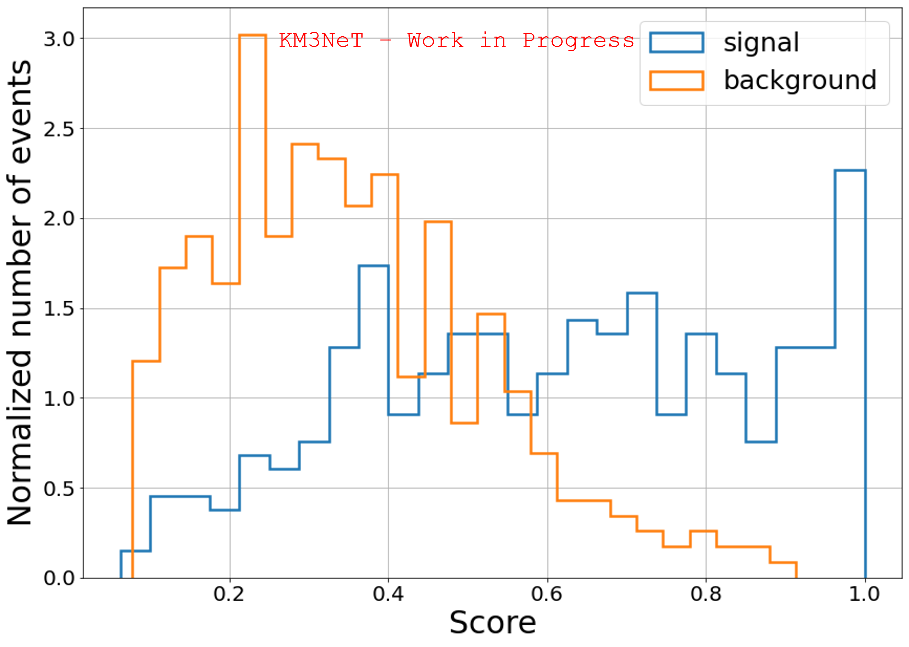
Best epoch of 100 on the validation sample:
JM, G. de Wasseige, on behalf of the KM3NeT Collaboration “Improving the sensitivity of KM3NeT to MeV-GeV neutrinos from solar flares”, PoS ICRC2023 (2023)
875 background events (data),
and 875 signal events (simulations)
Dataset split into
50% training,
10% validation,
and 40% test
23-27 September 2024
KM3NeT Collaboration
IceCube Collaboration
Notes:
today I’m presenting for both IceCube and km3net experiments, so I do realize that many of you are familiar with them, you’ve seen some talks before me but I just want to show them side by side and highlights how are they different. well first of all they’re both Cherenkov neut detectors, so they have the same detection principle, IceCube is in Ice at the south pole. While km3net is being deployed in the mediterranean sea. ice and water don’t have the same properties so the amount of light and distance that the detected light travels is going to be different. they’re both roughly a km3, with km3net currently being only a fraction still. With the main physics goal being high energy neutrino astro but both experiment have a denser instrumented array. deepcore in IceCube which is located at core of the larger ic array and ORCA in km3net which is altogether a separate array which is dedicated to study neutrino oscillation and for what concerns us lowen astro

Slide 17
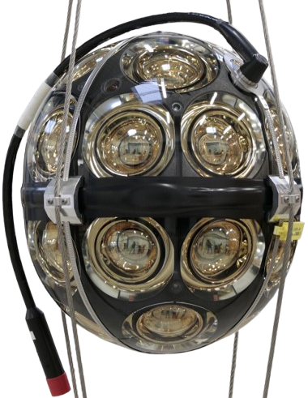
IceCube Upgrade
IceCube Collaboration, “Acceptance Tests of more than 10 000 Photomultiplier Tubes for the multi-PMT Digital Optical Modules of the IceCube Upgrade”, JINST 19 (2024)
The upcoming IceCube Upgrade will include new multi-pmt DOMs (mDOMs)
IceCube mDOMs are made of 24 3.1” PMTs.
This represents an opportunity to improve the current low-energy selections using the information provided by the individual DOMS.
Credit: Timo Karg (DESY)
23-27 September 2024
KM3NeT Collaboration
IceCube Collaboration
Notes:
today I’m presenting for both IceCube and km3net experiments, so I do realize that many of you are familiar with them, you’ve seen some talks before me but I just want to show them side by side and highlights how are they different. well first of all they’re both Cherenkov neut detectors, so they have the same detection principle, IceCube is in Ice at the south pole. While km3net is being deployed in the mediterranean sea. ice and water don’t have the same properties so the amount of light and distance that the detected light travels is going to be different. they’re both roughly a km3, with km3net currently being only a fraction still. With the main physics goal being high energy neutrino astro but both experiment have a denser instrumented array. deepcore in IceCube which is located at core of the larger ic array and ORCA in km3net which is altogether a separate array which is dedicated to study neutrino oscillation and for what concerns us lowen astro

Slide 18
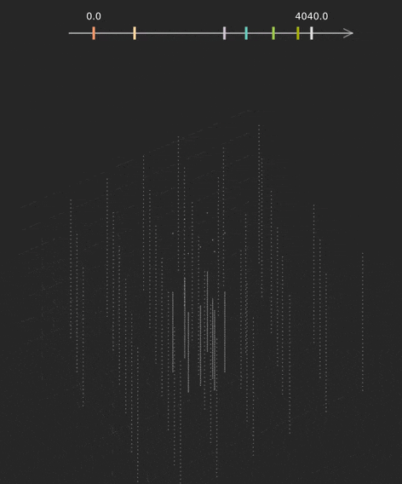
Novel IceCube sub-GeV selection
Sub-trigger neutrino events with unsupervised learning techniques.
From IceCube’s HitsPool data acquisition system, clustering methods are used to find bursts imposing minimal spatial and temporal coincidences.
Structure found in data may be evidence of the existence of multiple classes (e.g., detector noise and sub-GeV neutrinos).
23-27 September 2024
KM3NeT Collaboration
IceCube Collaboration
Notes:
today I’m presenting for both IceCube and km3net experiments, so I do realize that many of you are familiar with them, you’ve seen some talks before me but I just want to show them side by side and highlights how are they different. well first of all they’re both Cherenkov neut detectors, so they have the same detection principle, IceCube is in Ice at the south pole. While km3net is being deployed in the mediterranean sea. ice and water don’t have the same properties so the amount of light and distance that the detected light travels is going to be different. they’re both roughly a km3, with km3net currently being only a fraction still. With the main physics goal being high energy neutrino astro but both experiment have a denser instrumented array. deepcore in IceCube which is located at core of the larger ic array and ORCA in km3net which is altogether a separate array which is dedicated to study neutrino oscillation and for what concerns us lowen astro

Slide 19
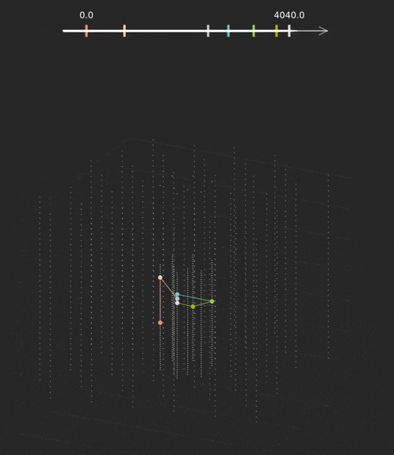
Novel IceCube sub-GeV selection
Sub-trigger neutrino events with unsupervised learning techniques.
From IceCube’s HitsPool data acquisition system, clustering methods are used to find bursts imposing minimal spatial and temporal coincidences.
Structure found in data may be evidence of the existence of multiple classes (e.g., detector noise and sub-GeV neutrinos).
23-27 September 2024
KM3NeT Collaboration
IceCube Collaboration
Notes:
today I’m presenting for both IceCube and km3net experiments, so I do realize that many of you are familiar with them, you’ve seen some talks before me but I just want to show them side by side and highlights how are they different. well first of all they’re both Cherenkov neut detectors, so they have the same detection principle, IceCube is in Ice at the south pole. While km3net is being deployed in the mediterranean sea. ice and water don’t have the same properties so the amount of light and distance that the detected light travels is going to be different. they’re both roughly a km3, with km3net currently being only a fraction still. With the main physics goal being high energy neutrino astro but both experiment have a denser instrumented array. deepcore in IceCube which is located at core of the larger ic array and ORCA in km3net which is altogether a separate array which is dedicated to study neutrino oscillation and for what concerns us lowen astro

Slide 20
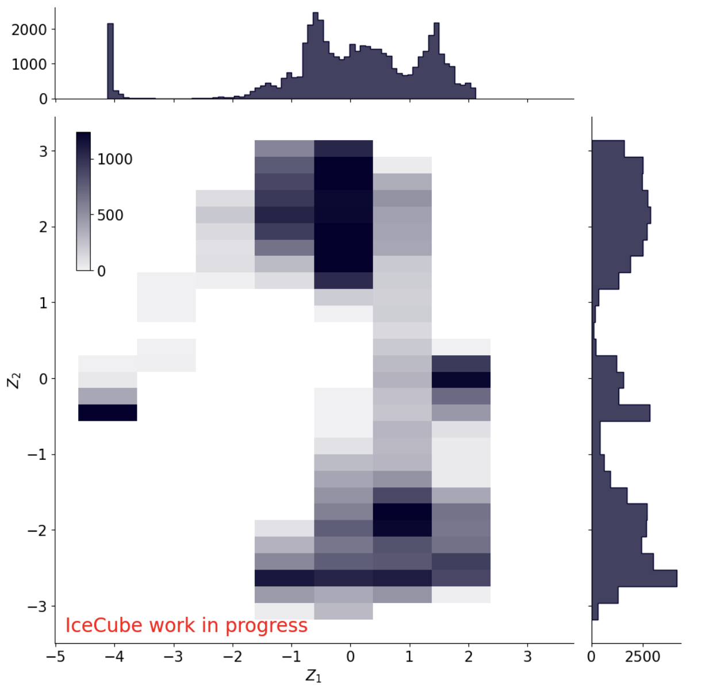
Novel IceCube sub-GeV selection
Sub-trigger neutrino events with unsupervised learning techniques.
From IceCube’s HitsPool data acquisition system, clustering methods are used to find bursts imposing minimal spatial and temporal coincidences.
Structure found in data may be evidence of the existence of multiple classes (e.g., detector noise and sub-GeV neutrinos).
23-27 September 2024
KM3NeT Collaboration
IceCube Collaboration
Notes:
today I’m presenting for both IceCube and km3net experiments, so I do realize that many of you are familiar with them, you’ve seen some talks before me but I just want to show them side by side and highlights how are they different. well first of all they’re both Cherenkov neut detectors, so they have the same detection principle, IceCube is in Ice at the south pole. While km3net is being deployed in the mediterranean sea. ice and water don’t have the same properties so the amount of light and distance that the detected light travels is going to be different. they’re both roughly a km3, with km3net currently being only a fraction still. With the main physics goal being high energy neutrino astro but both experiment have a denser instrumented array. deepcore in IceCube which is located at core of the larger ic array and ORCA in km3net which is altogether a separate array which is dedicated to study neutrino oscillation and for what concerns us lowen astro

Slide 21
Recap
Large-volume neutrino telescopes are a powerful tool in the search for low energy neutrinos from astrophysical transients
Important results have been already obtained (GRBs, GW, Solar Flares)
Using machine learning it is possible to further boost the sensitivities in the MeV-GeV range
Multi-PMT modules provide important additional information to help filter low-level noise
Thanks for your attention :)
23-27 September 2024
KM3NeT Collaboration
IceCube Collaboration
Notes:
today I’m presenting for both IceCube and km3net experiments, so I do realize that many of you are familiar with them, you’ve seen some talks before me but I just want to show them side by side and highlights how are they different. well first of all they’re both Cherenkov neut detectors, so they have the same detection principle, IceCube is in Ice at the south pole. While km3net is being deployed in the mediterranean sea. ice and water don’t have the same properties so the amount of light and distance that the detected light travels is going to be different. they’re both roughly a km3, with km3net currently being only a fraction still. With the main physics goal being high energy neutrino astro but both experiment have a denser instrumented array. deepcore in IceCube which is located at core of the larger ic array and ORCA in km3net which is altogether a separate array which is dedicated to study neutrino oscillation and for what concerns us lowen astro

Slide 22
Backup Slides

