Slide 1

The challenge of low frequency sensitivity in ground-based GW detectors
Maddalena Mantovani*
D. Bersanetti, M. Boldrini, J. Casanueva Diaz, C. De Rossi, M. Pinto, P. Ruggi, P. Spinicelli, M. Van Dael
*European Gravitational Observatory (EGO), Italy

Slide 2
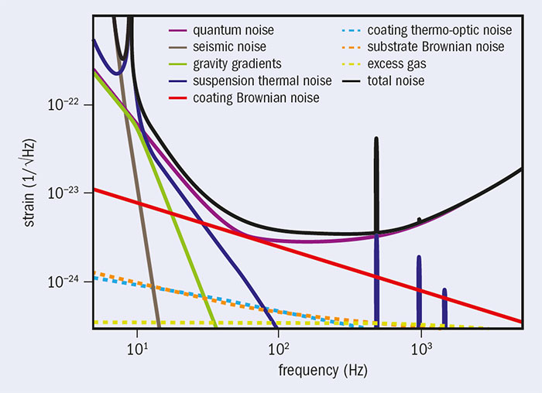
GW detector sensitivities @ Low frequency
Detect new gravitational signals: continuous waves emitted from isolated neutron stars or binary systems long before merging
Better parameter estimation of binary systems during the in-spiral phase.

Slide 3
GW detector sensitivities @ Low frequency
The fundamental noises that limit the sensitivity at low frequency are:
Seismic noise
Suspension thermal noise
Radiation pressure noise
but…

Slide 4
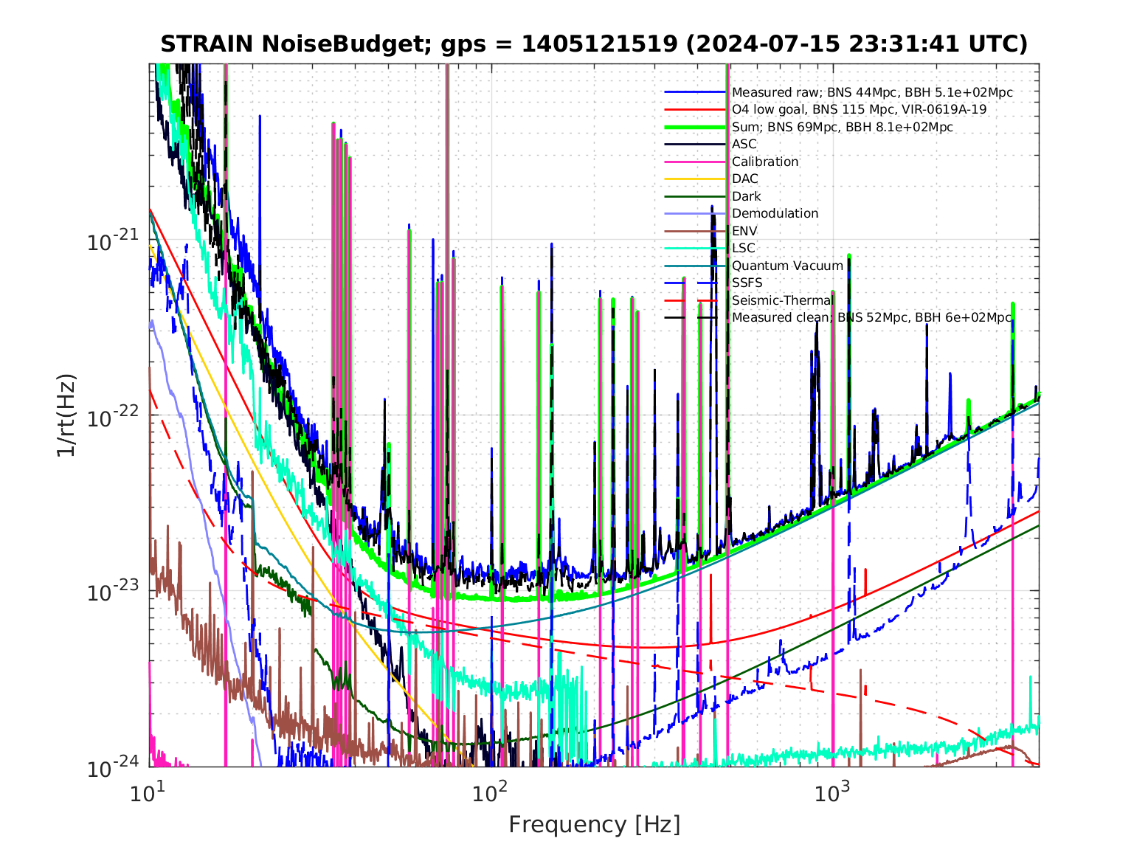
Actual limit at low frequency
Advanced Virgo
Advanced LIGO
Longitudinal
Angular
Longitudinal
Angular
None of the present detectors has reached the design sensitivity at low frequency. They are not being limited by fundamental noises, but by control noises

Slide 5
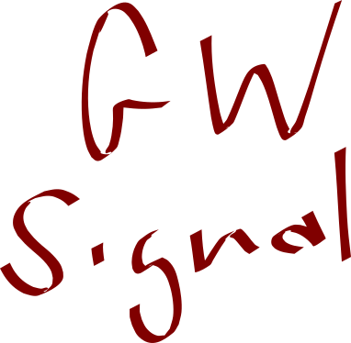
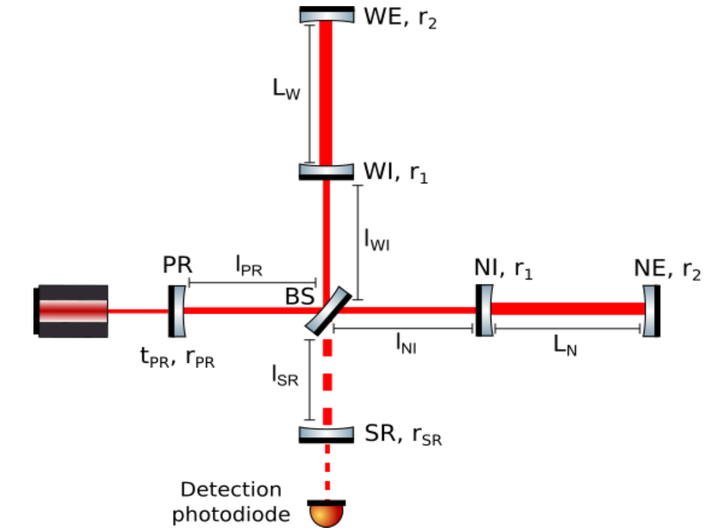
Why?
The detector shows its best sensitivity only if the main optical components are kept in precise microscopic positions (with very high accuracy, from 10⁻¹⁶m to 10⁻¹²m and 10⁻⁹rad) in order to have:
Long arm cavities on resonance
Power recycling cavity on resonance
Signal recycling cavity on anti-resonance
MICHelson in destructive interference
Mirrors aligned on the beam
The mirrors usually move orders of magnitude more than that

Slide 6
Why?
Active control servos are implemented to reach and maintain the mirrors in the optimal position and to reduce the residual mirror motion
This inevitably re-introduces the auxiliary degrees of freedom (dofs) control noise into the GW signal (through opto-mechanical coupling).
E N Tapia San Martín et al 2023 Class. Quantum Grav. 40 185008

Slide 7
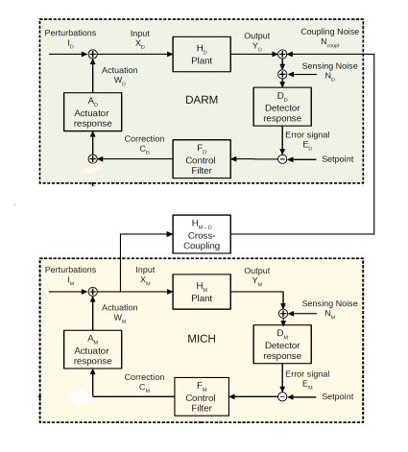
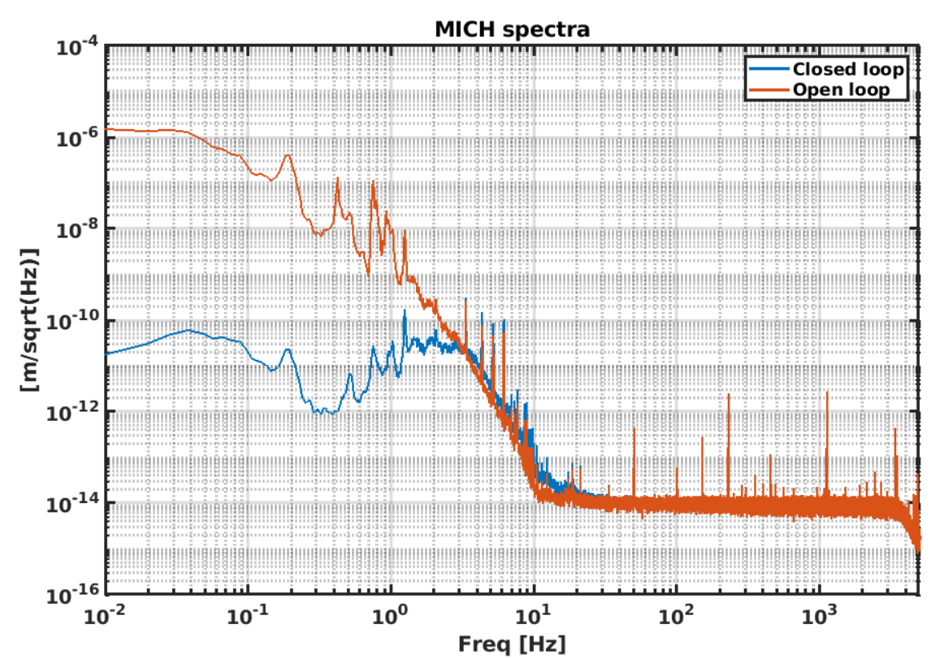
Example of Auxiliary degrees of freedom couplings (MICH)
In order to reach and keep the precise microscopic position within the required accuracy, the auxiliary degrees of freedom are actively controlled
Reduction of the MICH residual motion
Sensing noise
“The longitudinal control for the Advanced Virgo Plus gravitational wave detector” (PhD Thesis, Università di Trento, December 2022) M. Valentini https://tds.virgo-gw.eu/ql/?c=18934

Slide 8
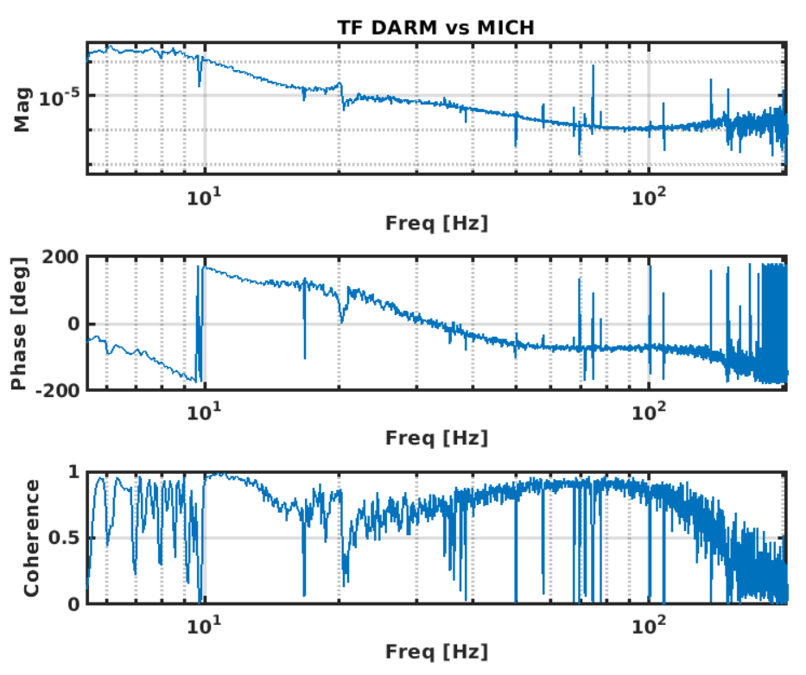
Example of Auxiliary degrees of freedom couplings (MICH)
MICH coupling to DARM (GW signal)
[a.u.]
The auxiliary degree of freedom is opto-mechanically coupled to the GW signal (DARM).
The control noise of the auxiliary degrees of freedom will be reintroduced in the GW signal
[a.u.]
The coupling can be affected/worsened due to detector optical defects. These couplings are present also between auxiliary dofs which can worsen the noise and robustness performances

Slide 9
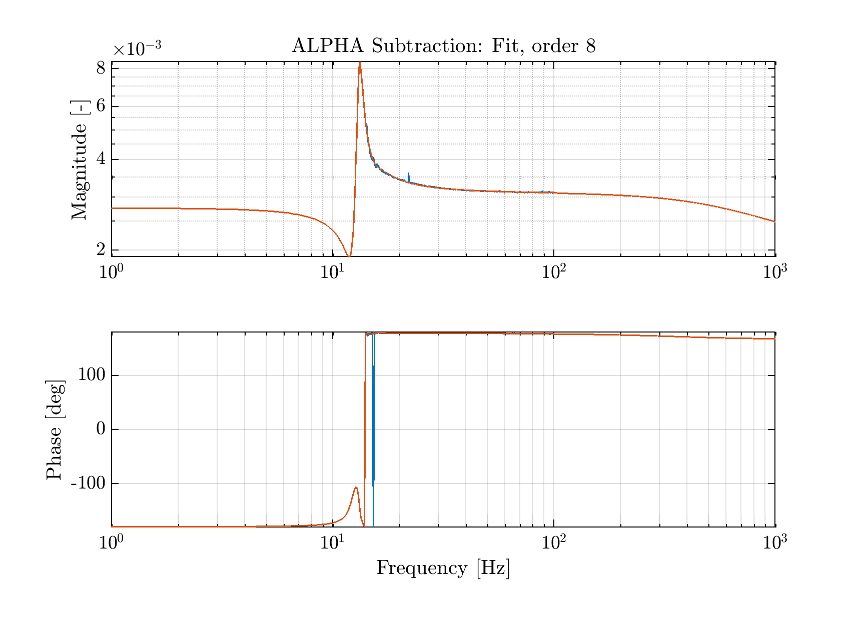
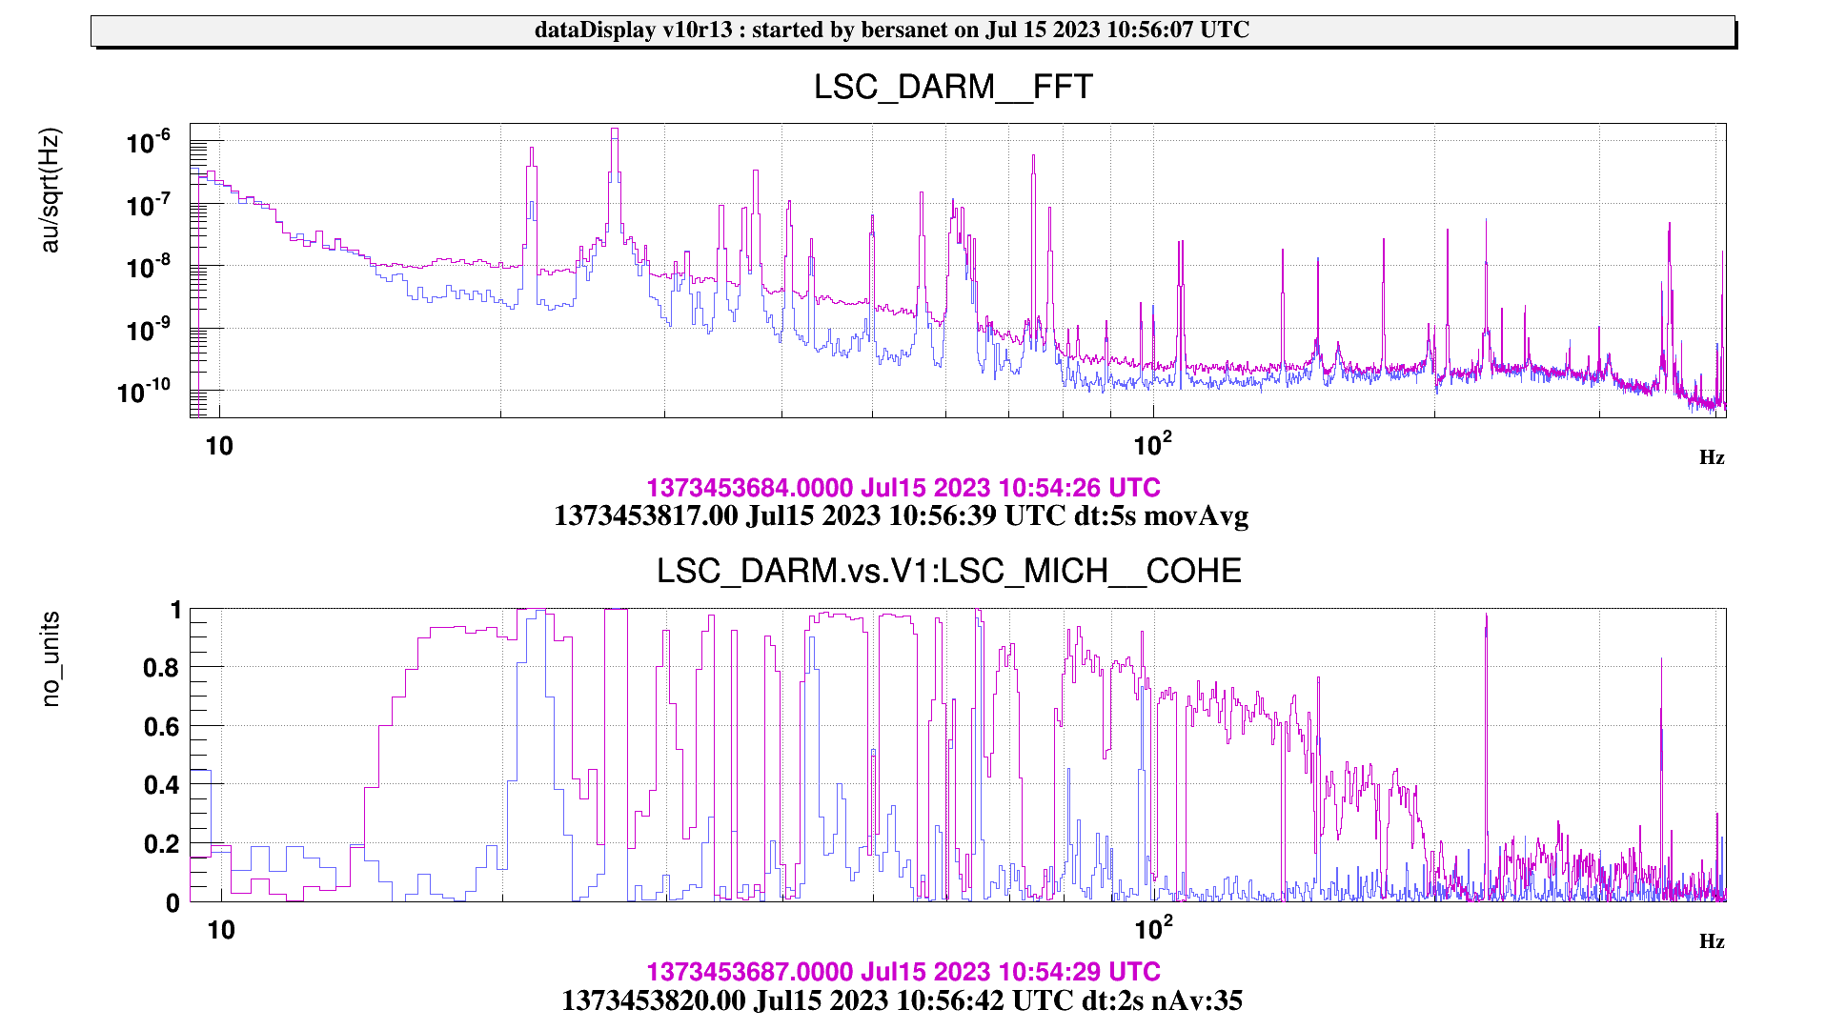
@ present : How to improve it?
Reduce the optical defects to improve the couplings of the auxiliary degrees of freedom
Improve the photodiode sensing noise (improve electronics or increase the impinging power making sure to have the sensors shot noise limited)
Improve the controllers
Feed-forward techniques (https://tds.virgo-gw.eu/ql/?c=2055)
Online diagonalization between auxiliary degrees of freedom (van Dael et al 2024 Class. Quantum Grav. https://doi.org/10.1088/1361-6382/ad7cb9)
Effect of the feed-forward on DARM
https://logbook.virgo-gw.eu/virgo/?r=60841

Slide 10
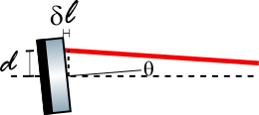
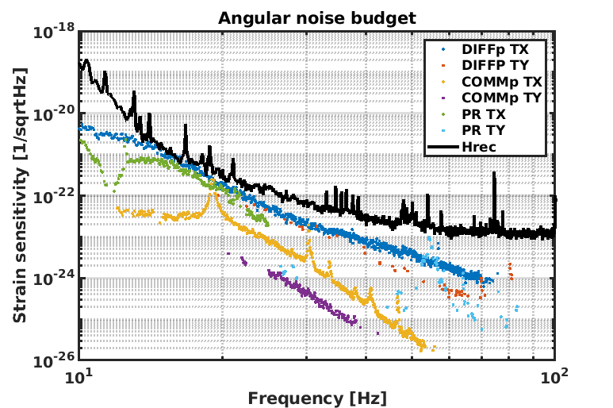
not only longitudinal dofs… Angular noise
The angular noise couples to the longitudinal direction proportionally to the beam/mirror decentering
Reduce the optical defects to lower the couplings of the angular degrees of freedom
Improve the photodiode sensing noise (improve electronics or increase the impinging power making sure to have the sensors shot noise limited)
Improve the controllers
Minimize the longitudinal angular coupling (dithering technique(*) or angle/length feed-forward technique (**))
(*) A.Allocca, et. al. ”Interferometer Sensing and Control for the Advanced Virgo Experiment in the O3 Scientific Run”, Galaxies , vol.8, n.4, https://doi.org/10.3390/galaxies8040085
(**) Controls Issues in Advanced LIGO, Jenne Driggers GWADW 2019
Example of Advanced Virgo angular noise budget
https://logbook.virgo-gw.eu/virgo/?r=65106

Slide 11
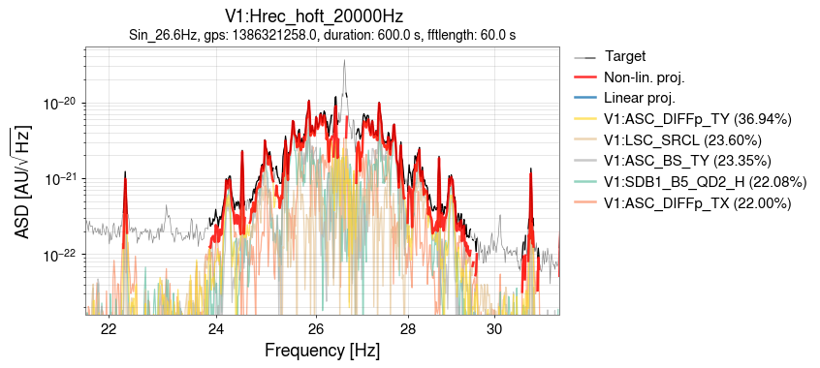
Non-linear noise : low frequency modulations
One of the most challenging noise contributions at low frequency is due to the non linear coupling.
The various auxiliary degrees of freedom are modulated at low frequency due to oscillations in the working point (especially due to alignment fluctuations).
These noise contributions cannot be suppressed using standard feed-forward techniques, which act in the linear regime.
The non-linear noise can be mitigated by improving the accuracy in the modulating dofs. Moreover, the suppression of non-linearities could be done using noise regression methods, which uses witness channels to make noise predictions. This method can be used to determine complex non-linear noise couplings in the detector signals(*).
Studies are on-going to implement the non-linear noise suppression in the GW signal(**)(***).
(**) Yu, Hang, e Rana X. Adhikari. 2022. «Nonlinear Noise Cleaning in Gravitational-Wave Detectors With Convolutional Neural Networks». Frontiers in Artificial Intelligence 5: Art. No. 811563.
(***) G. Vajente, Y. Huang, M. Isi, J. C. Driggers, J. S. Kissel, M. J. Szczepańczyk, and S. Vitale Phys. Rev. D 101, 042003 – Published 18 February 2020
https://logbook.virgo-gw.eu/virgo/?r=60971
(*) C F Da Silva Costa et al 2018 Class. Quantum Grav. 35 055008

Slide 12
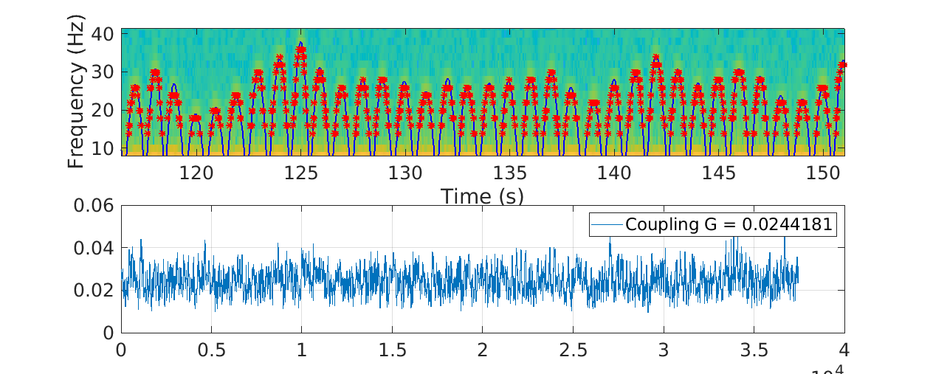
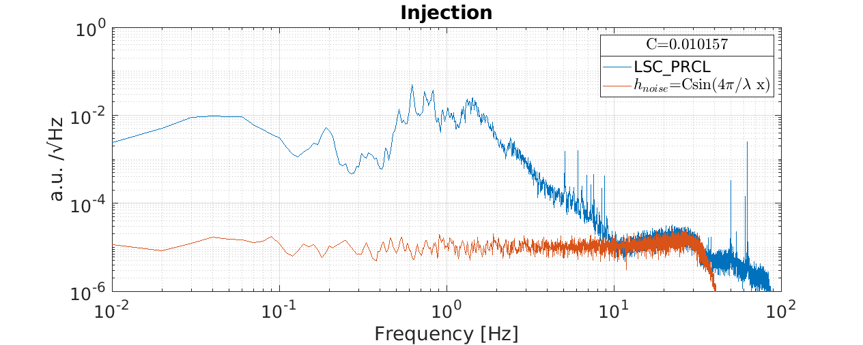
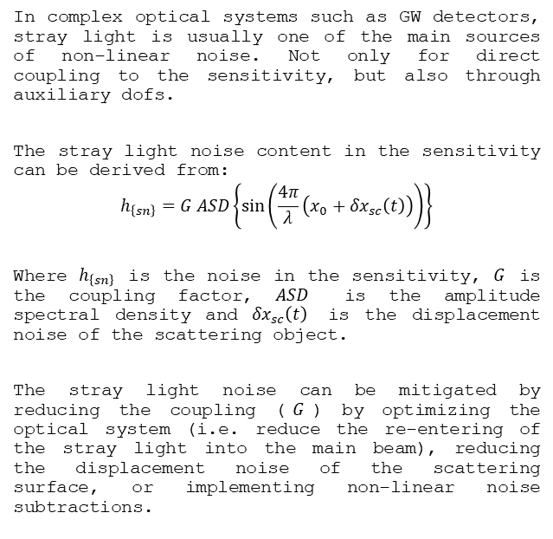
Non-linear noise : stray light noise
In complex optical systems such as GW detectors, stray light is usually one of the main sources of non-linear noise. Not only for direct coupling to the sensitivity, but also through auxiliary dofs.
The stray light noise content in the sensitivity can be derived from:
$$h_{\left\{sn\right\}}=G ASD\left\{sin⁡\left(\frac{4π}{λ}\left(x_{0}+{δx}_{sc}\left(t\right)\right)\right)\right\}$$
Where $h_{\left\{sn\right\}}$ is the noise in the sensitivity, $G$ is the coupling factor, $ASD$ is the amplitude spectral density and ${δx}_{sc}\left(t\right)$ is the displacement noise of the scattering object.
The stray light noise can be mitigated by reducing the coupling ($G$) by optimizing the optical system (i.e. reduce the re-entering of the stray light into the main beam), reducing the displacement noise of the scattering surface, or implementing non-linear noise subtractions.
f_{cut} depends on the scatterer displacement
The amplitude depends on G
https://logbook.virgo-gw.eu/virgo/?r=63491

Slide 13
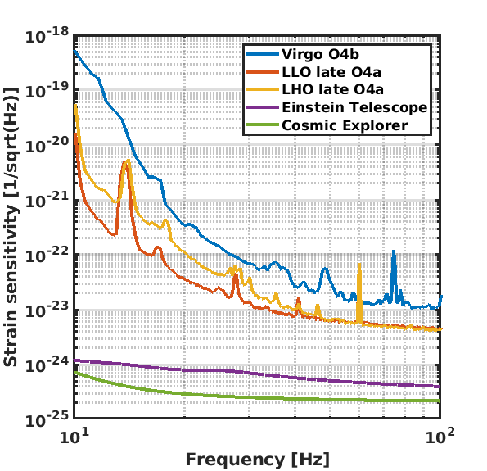
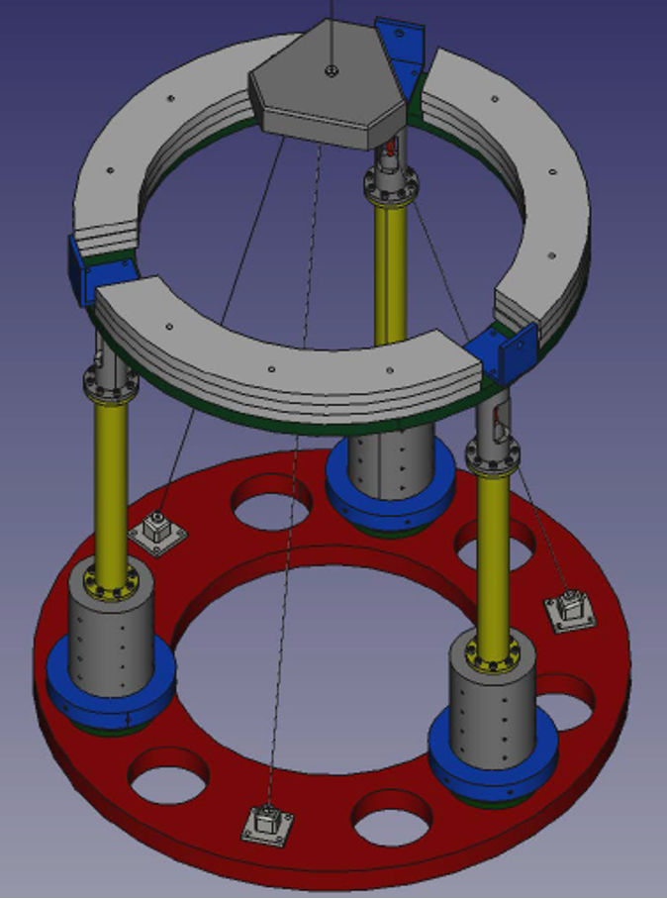
How to improve for NextGen detectors?
For the next generation detectors the low frequency sensitivity is extremely challenging. Several orders of magnitude of improvement in the low frequency region are required. Thus:
The suppression of seismic noise in the detection band has to be improved
Improved and compact super-attenuators to better kill seismic noise @ few Hz (e.g M. Razzano’s talk)
Suspension thermal noise
Go cryogenic!
Gravity gradient noise
- Go underground! See D. Rozza’s talk
M. Razzano

Slide 14
How to improve for NextGen detectors?
But this is not enough, the control noise re-introduction will be still the major offender. The solution would be to have large suppression of the seismic motion at low frequency to strongly reduce the control bandwidths
Pre-isolate the suspensions
  R&D on 6D sensors
  R&D on Inter-locks of the platforms.
  The platforms relative displacements (angle and distance) are controlled, reducing the longitudinal residual motion by 3 orders of magnitude and the residual angular motion to 1 nrad/sqrt(Hz) @ 100mHz.
“Active platform stabilization with a 6D seismometer” Appl. Phys. Lett. 121, 174101 (2022)
S. M. Koehlenbeck, et. al. ”A study on motion reduction for suspended platforms used in gravitational wave detectors.” Sci Rep 13, 2388 (2023). https://doi.org/10.1038/s41598-023-29418-x

Slide 15
How to improve for NextGen detectors?
Very large test masses to reduce (*)
  Radiation pressure noise
  Alignment noise:
  Heavy (High moment of inertia) test mass to reduce the Sidles/Sigg mode frequency (radiation pressure effect). Lower angular mode frequencies => lower angular control noise
Diagnosis of stray light using instrumented baffles (**)
Magnetic noise (***)
  Better grounding
  Avoid noisy electronic devices
  Increase distance between electronics/cables and optical components
  Passive magnetic shields
(**) “Stray light noise simulations for the Einstein Telescope and Virgo and the use of instrumented baffles” DOI: https://doi.org/10.22323/1.449.0551
M_tot/M_fin
(*) B. Lanz “100 kg optic with upgraded suspension for LIGO A#” GWADW 23
(***) Site-selection criteria for the Einstein Telescope. Rev. Sci. Instrum. 91, 094504 (2020); doi: 10.1063/5.0018414

Slide 16
Conclusions
Reaching the low frequency design sensitivity is a challenge for the present detector, which have as main limitations:
Control noise (longitudinal and angular)
Non linear noise (stray light, non-linear couplings of auxiliary degrees of freedom)
It will be even more challenging for the next generation of gravitational wave detectors
But, Strong R&D efforts from the entire GW community bring great hope for overcoming the low-frequency barrier

Slide 17
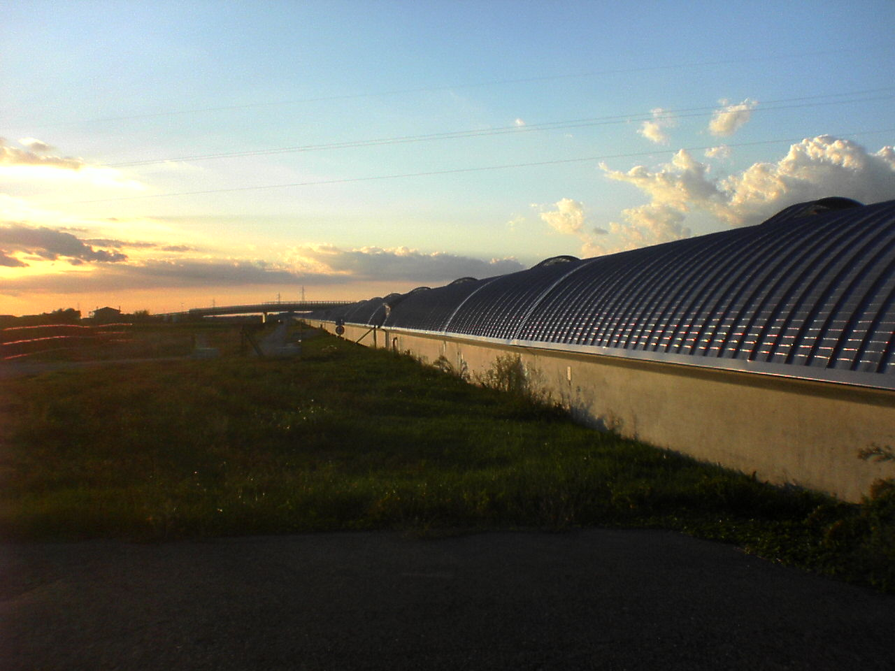
The end...
And thanks to The LIGO Scientific Collaboration,
the Virgo Collaboration, and the KAGRA Collaboration.

