Slide 1
Results and Prospects of LHAASO
Cosmic Ray Composition
and Energy Spectra Measurement
Shoushan Zhang
on behalf of the LHAASO collaboration
Institute of High Energy Physics，CAS，China
The 9th Roma International Conference on Astro-Particle Physics (RICAP-2024)
23 - 27 September., 2024 Roma, Italy
Notes:
Good afternoon everyone， My name is Shoushan. Thank you very much for giving me an opportunity to introduce the LHAASO charged cosmic ray measurement here.

Slide 2
Outline
Introduction
CR Spectra around the Knees
  Pure Protons
  Light Component (H + He)
  All Particle Spectrum and Composition
Summary & Outlook
Notes:
First is the introduction

Slide 3
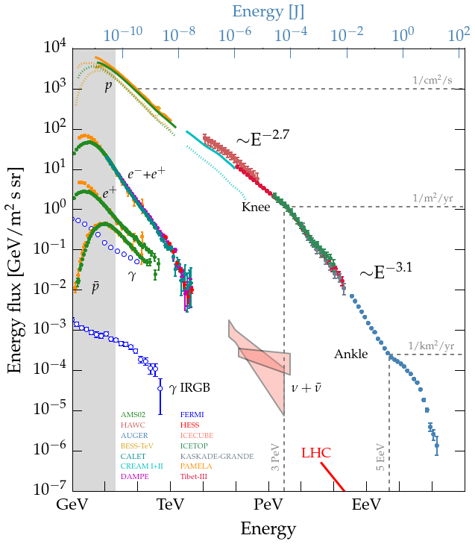
Cosmic rays
Proton, helium nuclei and heavier nuclei , all the way to uranium
Discovered in 1912, many things (e.g. source, acceleration mechanism) about cosmic rays remain a mystery more than a century later
Individual energy spectra play am important role to solve the mystery
  Proton knee, helium knee, iron knee …
  The knee indicates the energy limit for cosmic ray acceleration by astrophysical sources.
C.Evoli 10.5281/zenodo.1468853
Notes:
Although the Cosmic ray was discovered in 1912, many things, such as source acceleration mechanism of cosmic rays remain unknow.
Individual energy spectra play am important role to solve the mystery. Especially, proton, helium, iron spectra etc. around the knee.
Because the knee indicates the energy limit for cosmic ray acceleration by astrophysical sources.

Slide 4
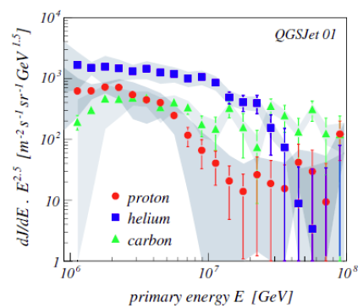
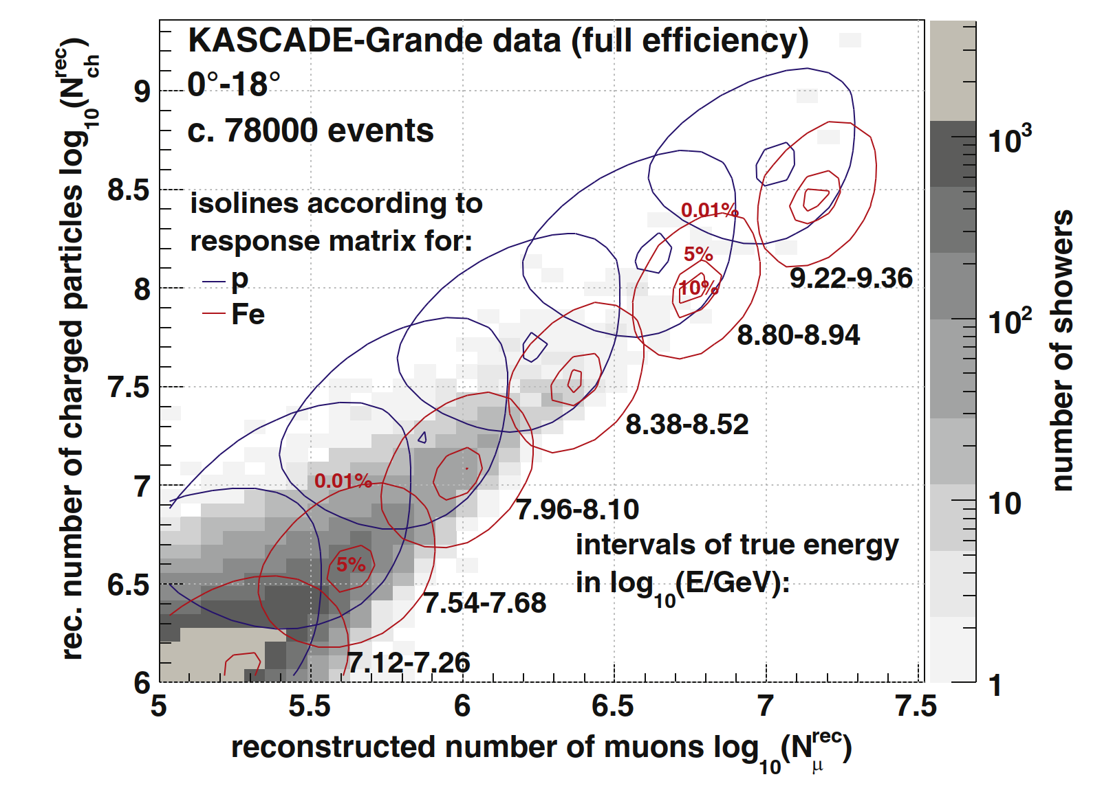
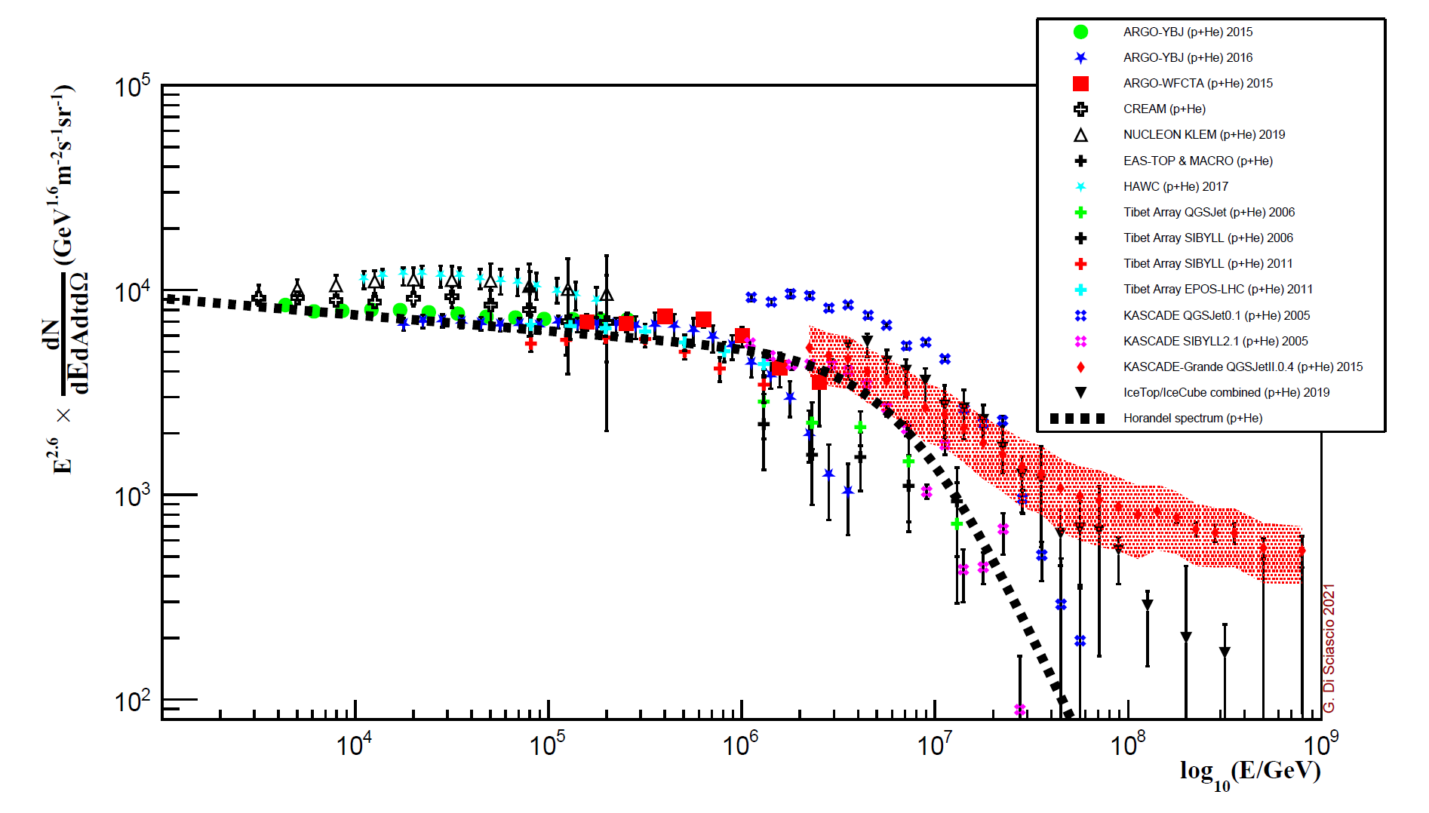
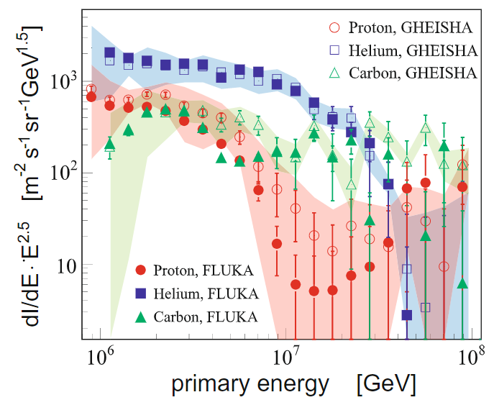
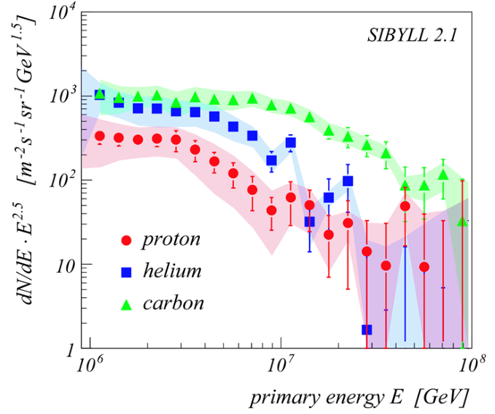
KASCADE experiment
  Altitude： 110m
  Unfolding： μ and electron matrix
  The results strongly depend on the hadronic interaction models
Individual components of CRs energy spectrum measurement are very important, but not easy.
2005年
+GHEISHA
Proton + helium
2009年
2005年
+GHEISHA
QGSJet01
Appl. Sci. 2022, 12, 705.
Notes:
Previous ground-based array experiments, such as KASCADE, have resolved the single component energy spectrum of cosmic rays through the unfolding method. But its results strongly depend on the hadronic interaction models. You can see QGSJet and SYBLL, big difference.
Individual components of CRs energy spectrum measurement are very important, but not easy.

Slide 5
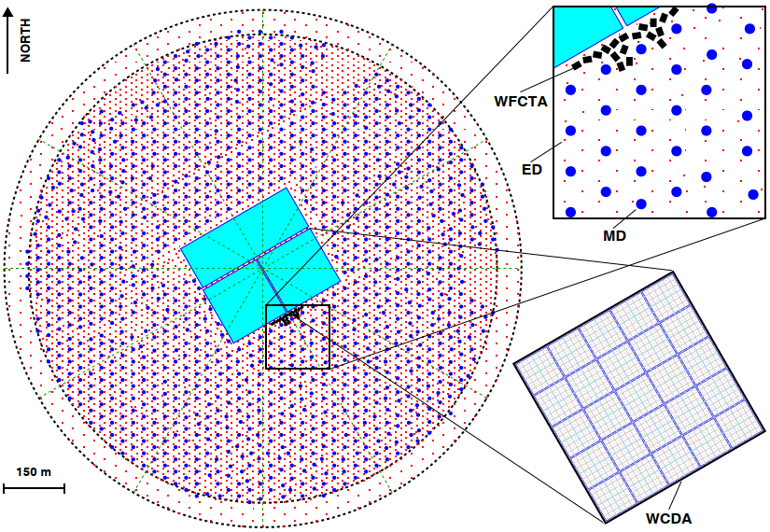
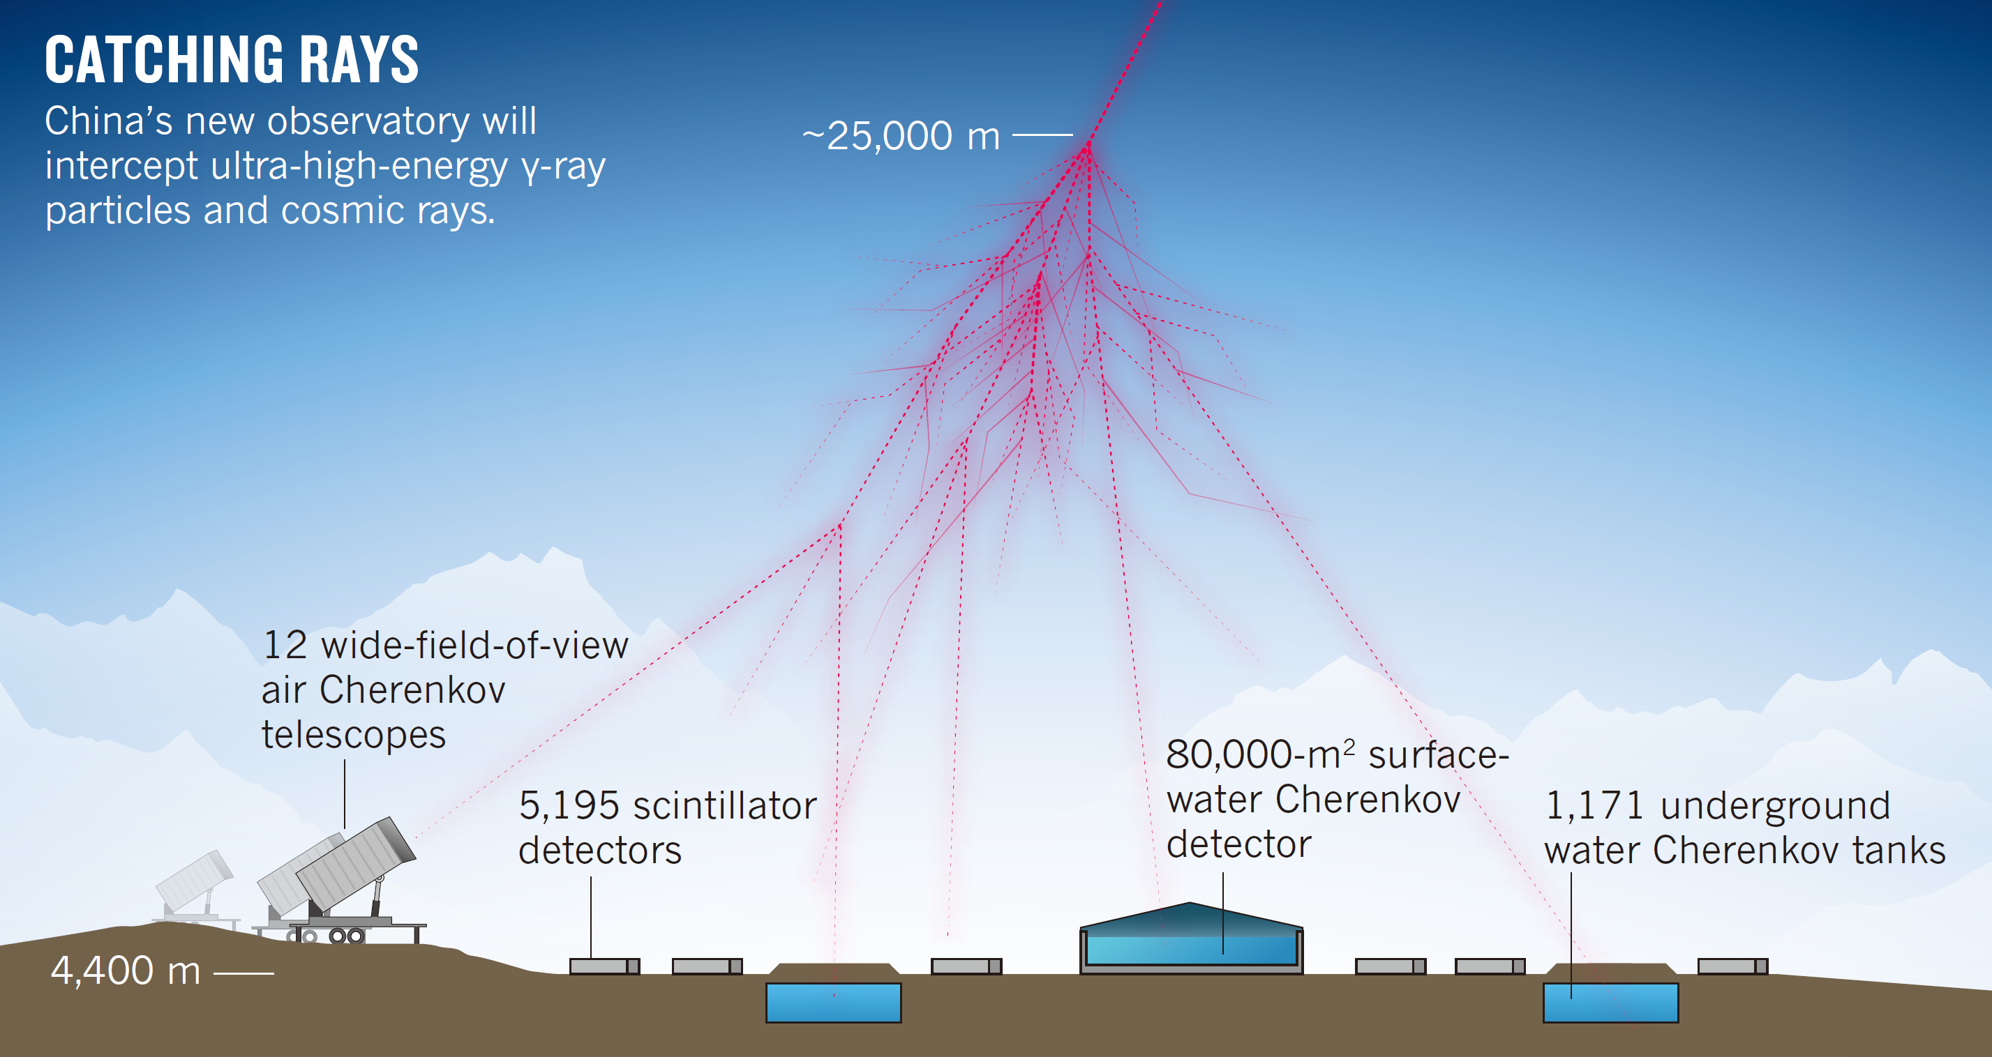
Hybrid Detection of EAS
High Energy Cosmic Rays
Large High Altitude Air Shower Observatory (LHAASO)
LHAASO Physics Topics
Gamma Ray Astronomy
Charged CRs measurement
New Physics Frontier
18
78,000
1188
(muon detectors)
4,410 m
Notes:
The Large High Altitude Air Shower Observatory (LHAASO) is a detector array designed to address this challenge. LHAASO consists of 18 Cherenkov telescopes, about 5200 scintillator detectors and about 1200 muon detectors and 78,000 square meter water Cherenkov detector array. Its physics topics include gamma ray astronomy, charged CRs measurement and new physics frontier.

Slide 6
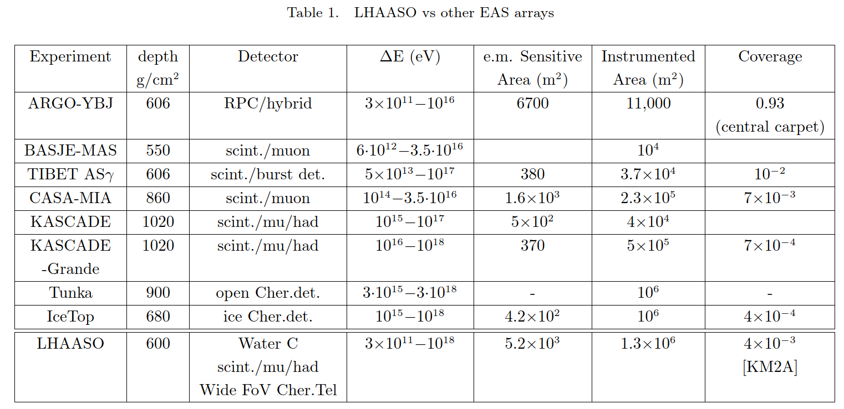
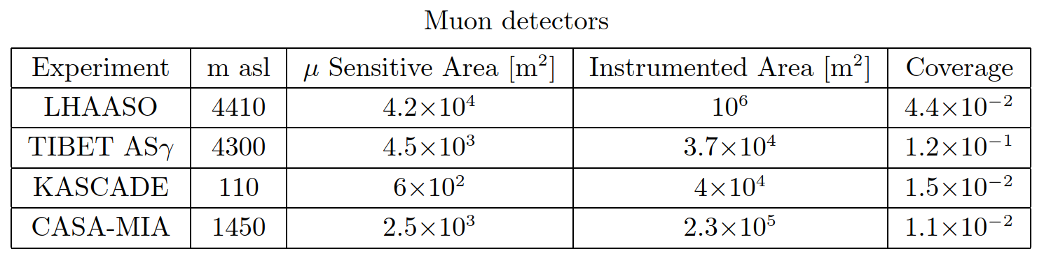
Notes:
LHAASO has the world’s largest muon detector array, and thus has the strongest component discrimination ability.

Slide 7

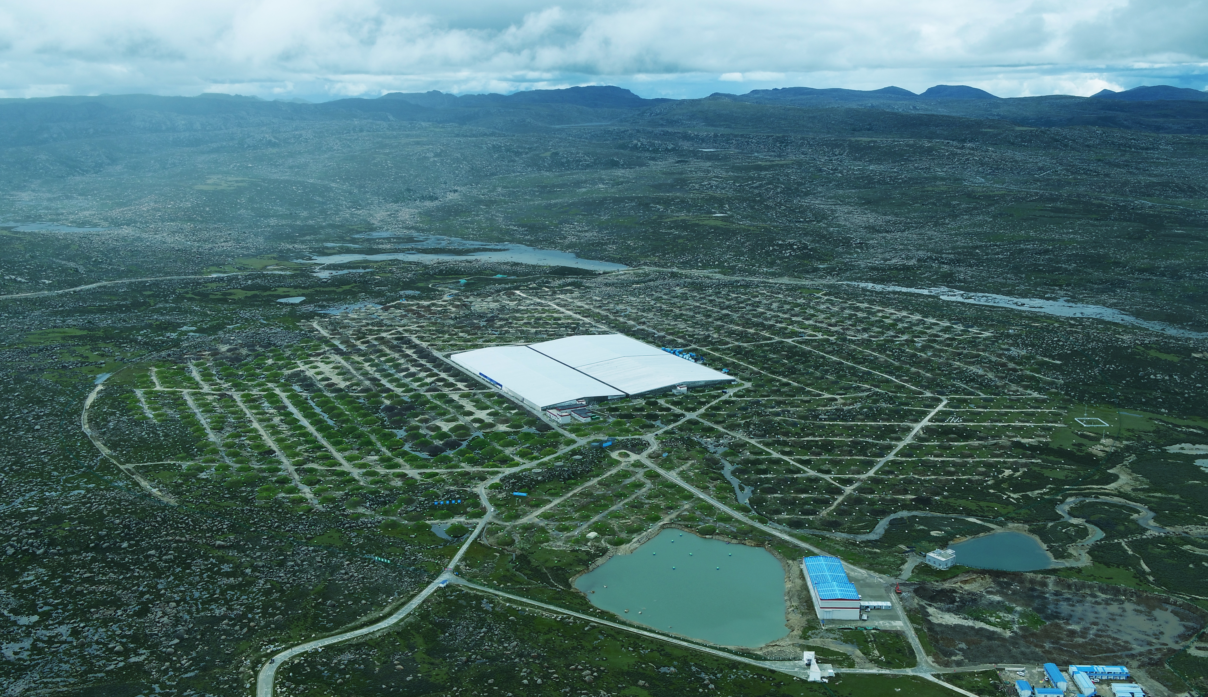
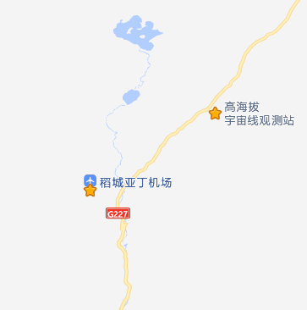
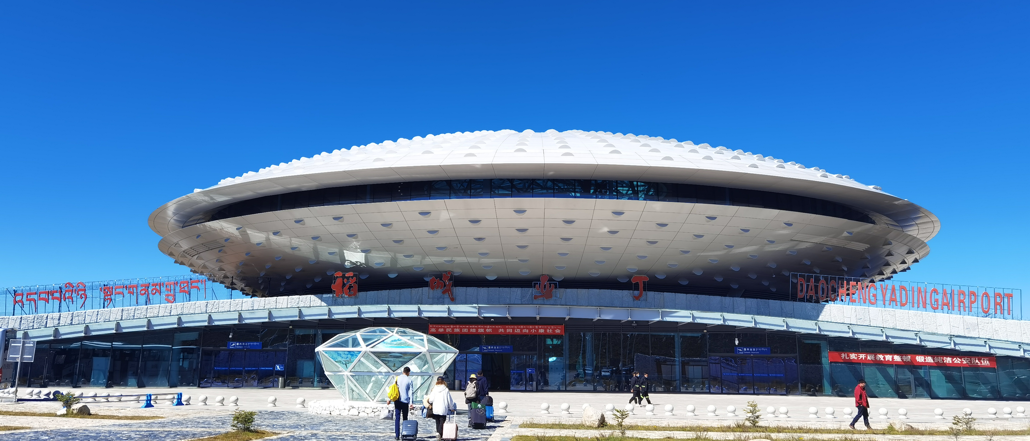
The Site
Bird’s eye view of LHAASO，2021-08
Location：29o21’ 27.6” N , 100o08’19.6” E
Altitude: 4410 m
2021-07 completed built and in operation
LHAASO
~10KM
Airport
LHAASO, Nature Astronomy 5:849 (2021)
(Aug. 2018, at 4410 m a.s.l. )
Notes:
LHAASO was in operation in July 2021, it is located on Haizi mountain Sichuan China. The altitude is about 4400 meters. It is easy to reach LHAASO site. The distance between Daocheng Airport and LHAASO site is about 10 kilometers. The detector array has an area of 1.3 square kilometers. The center is a water Cherenkov detector array, and the outside is a muon detector and scintillator detector array.

Slide 8
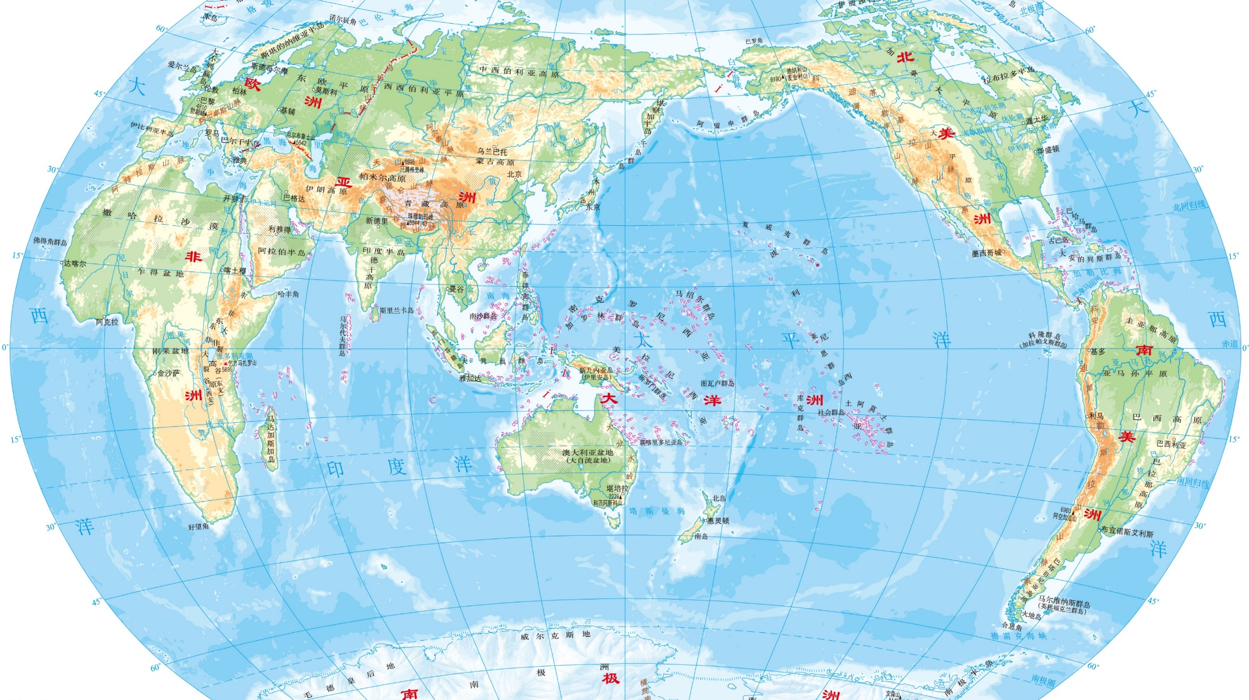
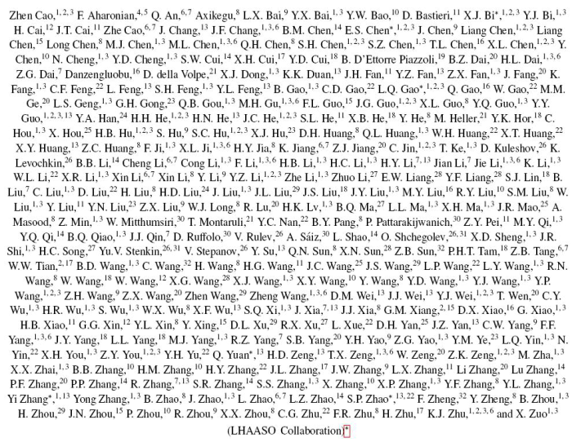
LHAASO: Multi-Messenger Collaboration Network
The LHAASO collaboration has signed MOUs with 8 international detector collaboration.
ANTARES (NT)
KM3Net (NT)
Baikal-GVD (NT)
VERITAS (CT)
LST/CTA-N (CT)
LHAASO Coll.：
6 countries
32 institutions
300 members
MAGIC(CT)
Space borne Exp.
eROSITA(X-ray)
DAMPE(γ-ray, CR)
Notes:
LHAASO has established a Multi-Messenger Collaboration Network. It has signed MOUs with neutrino telescopes: Antares and KM3net and Baikal-GVD, Cherenkov telescope array: CTA-LST, MAGIC and VERITAS, Space borne experiment: eRosita and DAMPE. LHAASO collaborates with 300 scientists from 6 countries and 32 institutions.

Slide 9
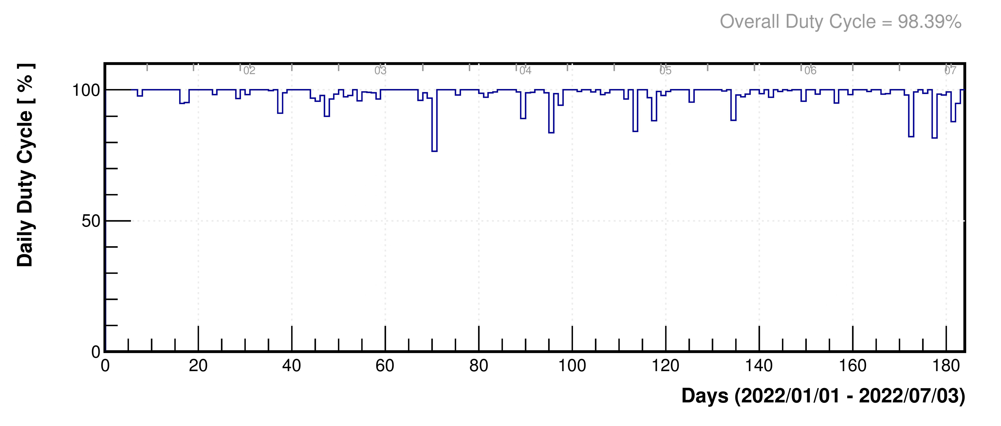
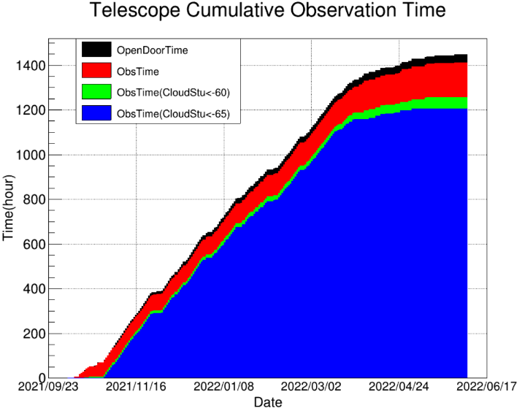
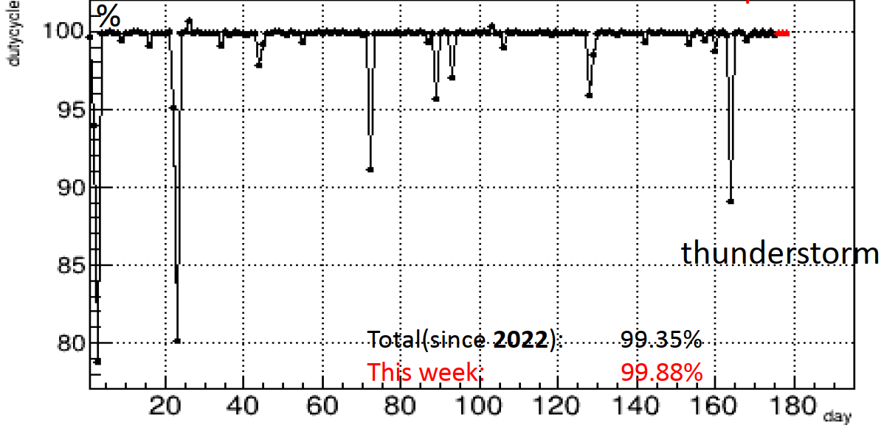
Operation of LHAASO
KM2A is operated with >99.4% duty cycle and event rate 2x10⁸ /day
WCDA is operated with 98.4% and event rate 3x10⁹ /day
Data acquisition time of WFCTA >1400 hrs and number of matched events ~70 million
Notes:
LHAASO runs very stably. The duty cycle is very high. The observation time for Cherenkov telescope is about 1400hours per year.

Slide 10
CR Spectra around the Knees
  Pure Protons
  Light Component (H + He)
  All Particle Spectrum and Composition
Notes:
Ok, let me turn to introduce CR spectra around the knee.

Slide 11
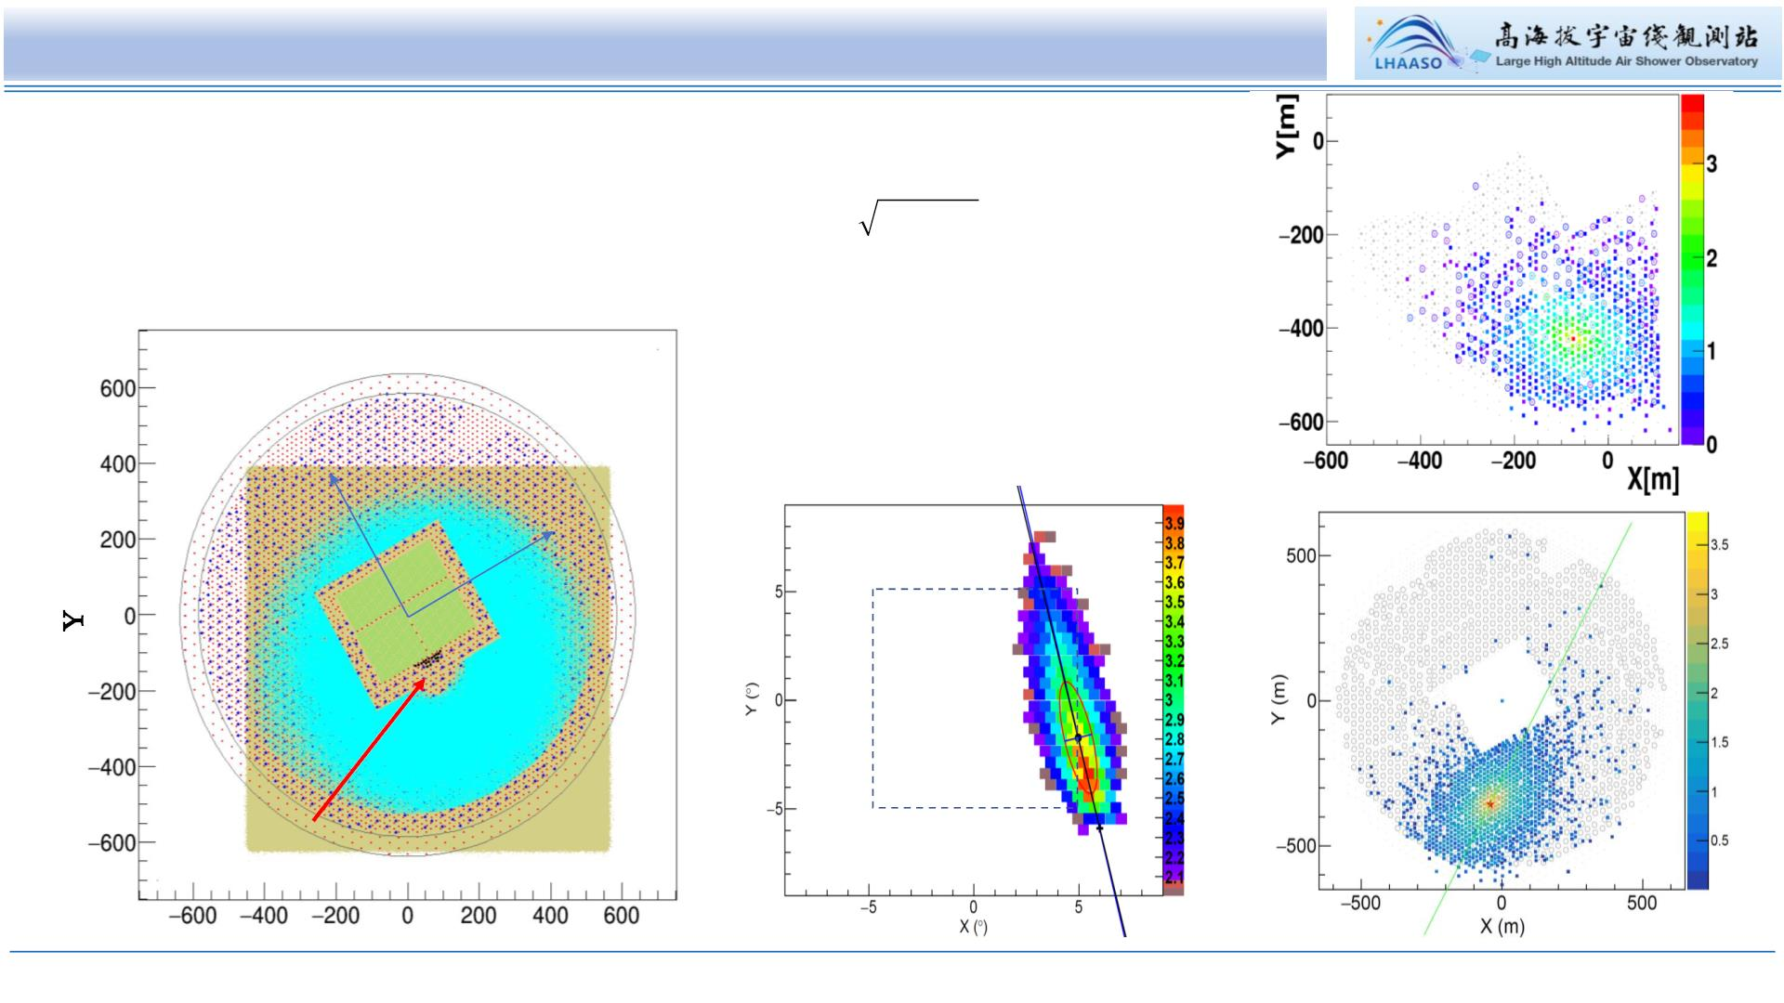
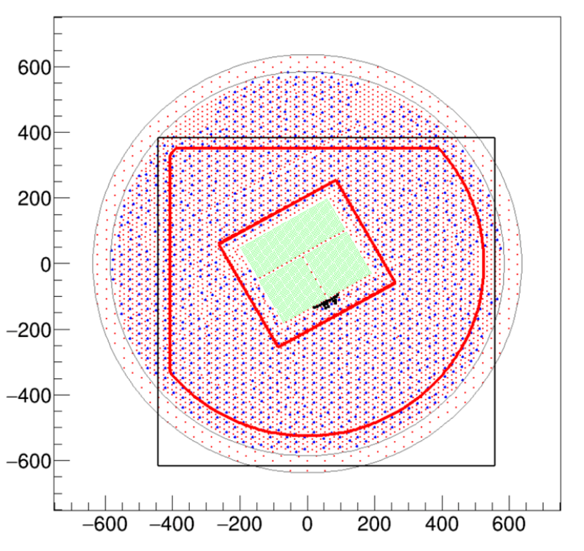
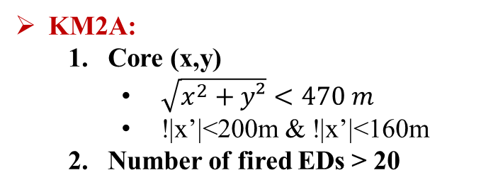
Hybrid Measurement of CR Showers around the Knee
WFCTA: Cherenkov telescopes
  Number of pixels：Npix≥7
  FoV: 10°× 10° out of 16°× 16°
  for the centroid of the image
  R_{p}: 150 – 300 m
KM2A:
  Core (x,y)
    $\sqrt{x^{2}+y²}<470 m$
    !|x’|<200m & !|x’|<160m
  Number of fired EDs > 20
KM2A
measures
μ-content
KM2A
KM2A
Y’
X’
KM2A
measures
shower
GEO
WCDA
Y(m)
WCDA
WFCTA
WFCTA
image
X (m)
46
Notes:
Cuts for High quality shower measurement: For Cherenkov telescopes require at least 7 fired pixels in each image. FoV: 10°× 10° out of 16°× 16°
for the centroid of the image to contain full image in the camera，impact parameter Rp range from 150 – 300 m，KM2A：Number of fired EDs > 20，core location at least 50 m away from the edge of the KM2A detector array. Muon contents in KM2A and shower core and direction reconstructed by EDs of KM2A.

Slide 12
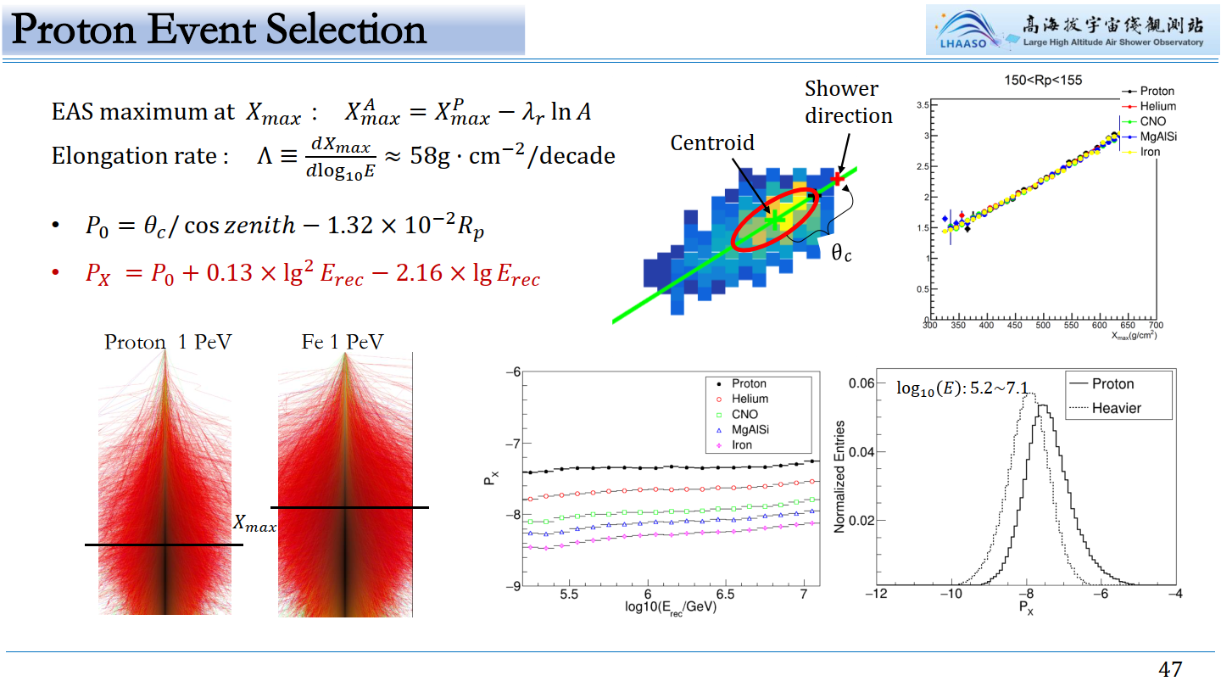
Xmax Measurement by WFCTA
Notes:
The angular distance between the centroid of the image and the shower direction is related to the Xmax.
This the proton shower and the Xmax is deeper than that of iron.
Xmax is a good mass sensitivity parameter, so, we define angular distance as one of the component discriminators and normalize it using Rp and shower energy.

Slide 13
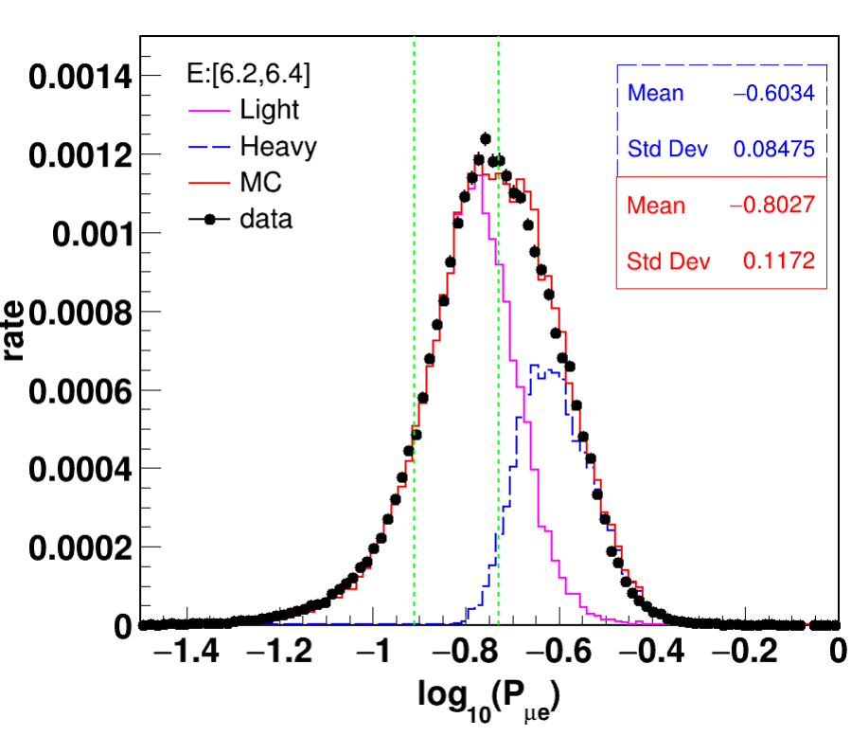
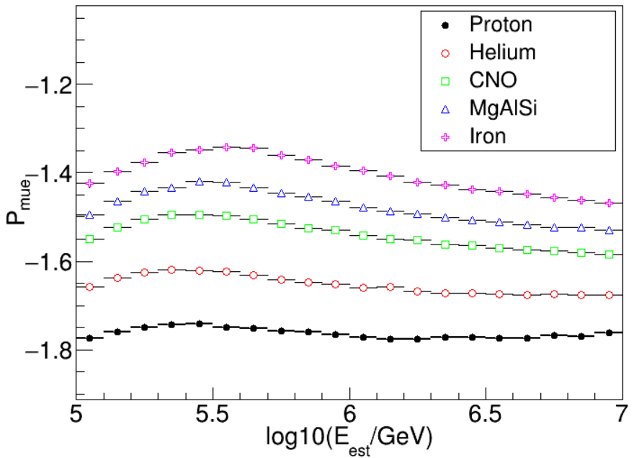
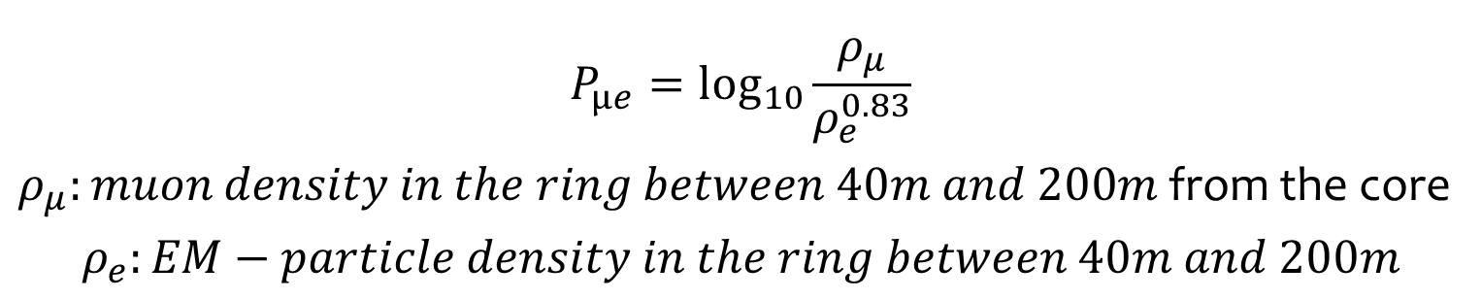
Muon Content in Showers
$$P_{μe}=\log_{10}{\frac{ρ_{μ}}{ρ_{e}^{0.83}}}$$
$ρ_{μ}:muon density in the ring between 40m and 200m$from the core
$$ρ_{e}:EM−particle density in the ring between 40m and 200m$$
Notes:
Muon content is a powerful component discriminator. We define the parameter of Pue, the ratio of muon density to particle density in the shower, which is almost independent of the shower energy.

Slide 14
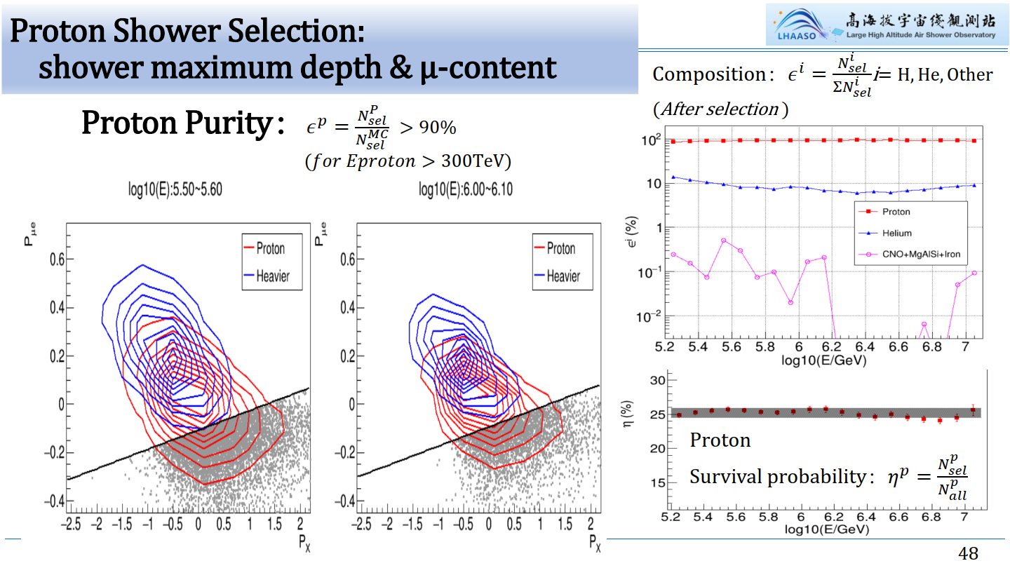
Notes:
Proton Shower selection uses the parameters of shower maximum depth and muon content we defined before.
The purity is more than 90% with a selection efficiency of 25%. You can see, the contamination dominates by Helium.

Slide 15
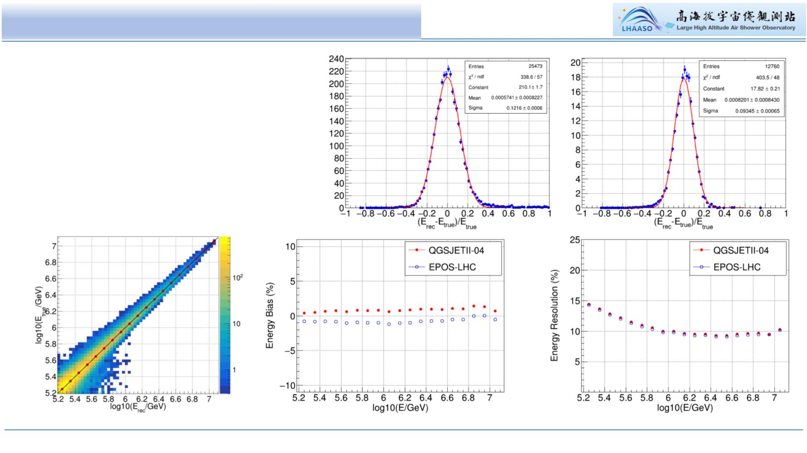
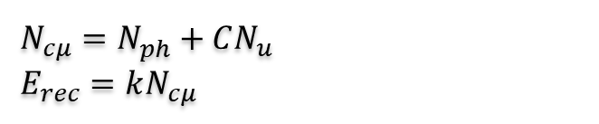
Proton Energy Reconstruction
• Energy Resolution：<15%
• Systematic Bias：<2%
(independent of shower energy)
• Uncertainty mainly due to hadronic
interaction models：~1.4%
$$N_{cμ}=N_{ph}^{}+CN_{u}^{}$$
$E_{rec}=kN_{cμ}$
Notes:
We use Cherenkov photons and Number of muons to reconstruction shower energy.
The energy resolution is about 15% with systematic bias less than 2%.
And the uncertainty is mainly due to hadronic interaction models: about 1.4%.

Slide 16
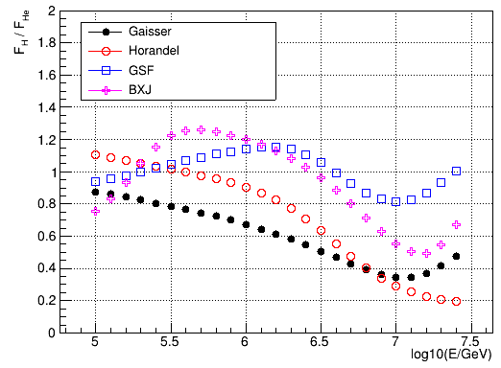
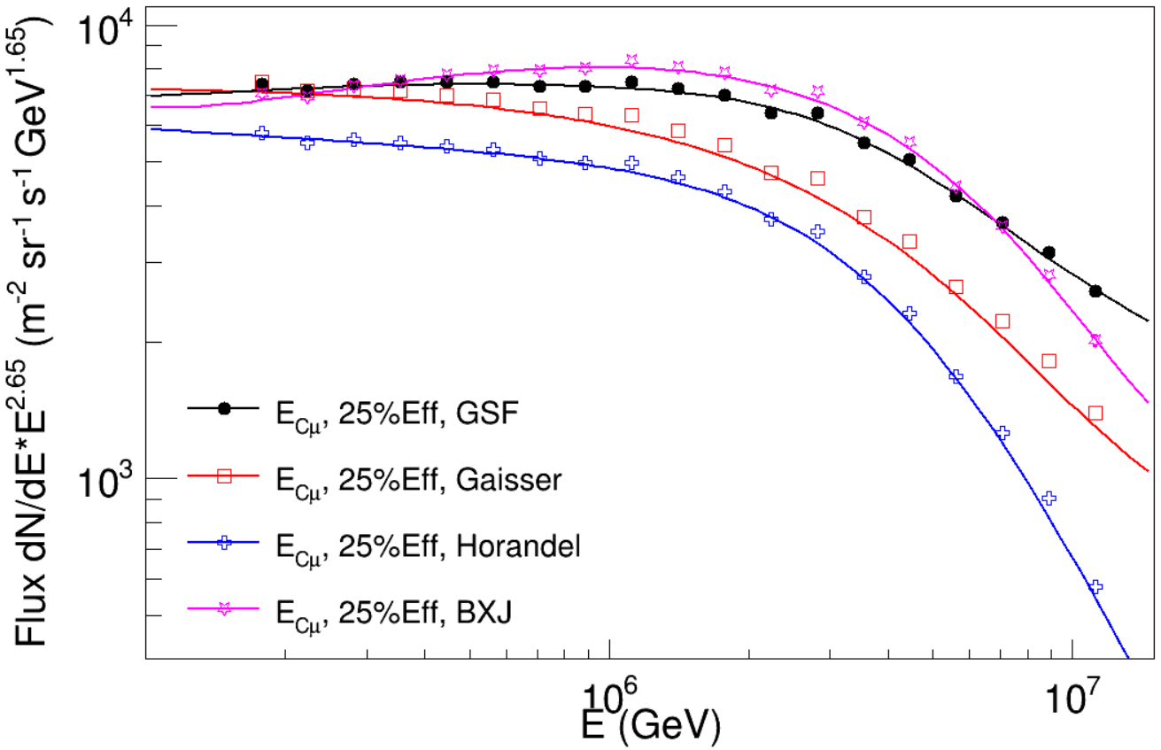
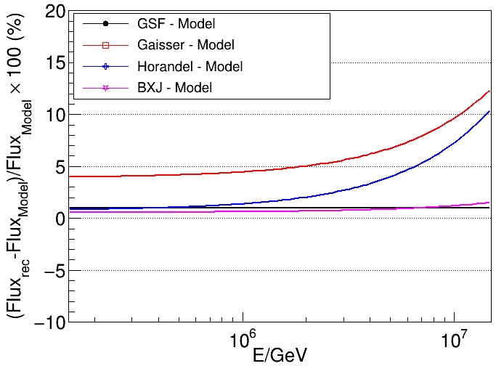
Tests using generated samples
Ratio of proton vs Helium nuclei
in composition assumptions
Re-produced pure-proton spectra under
4 assumption of composition mixtures
a factor of 1.5
Gaisser Model: Gaisser, T.K., Stanev, T. & Tilav, S. Front. Phys. 8, 748–758 (2013)
Horandel Model: Horandel J R. Astroparticle Physics, 2003, 19(2):193–220
GSF Model: H. P. Dembinski, R. Engel, A. Fedynitch, T. Gaisser, F. Riehn, and T. Stanev, PoS ICRC2017, 533 (2018)
BXJ Model: Lv X.-J., Bi X.-J., Fang K., et al. , arXiv:2403.11832. (2024)
Notes:
We test our method using different composition models. Helium is the main contamination in the proton samples.
The difference in the ratio of proton to helium between different composition models is more than 1.5 times.
Pure-proton spectra can be reproduced well under 4 assumption of composition mixtures

Slide 17
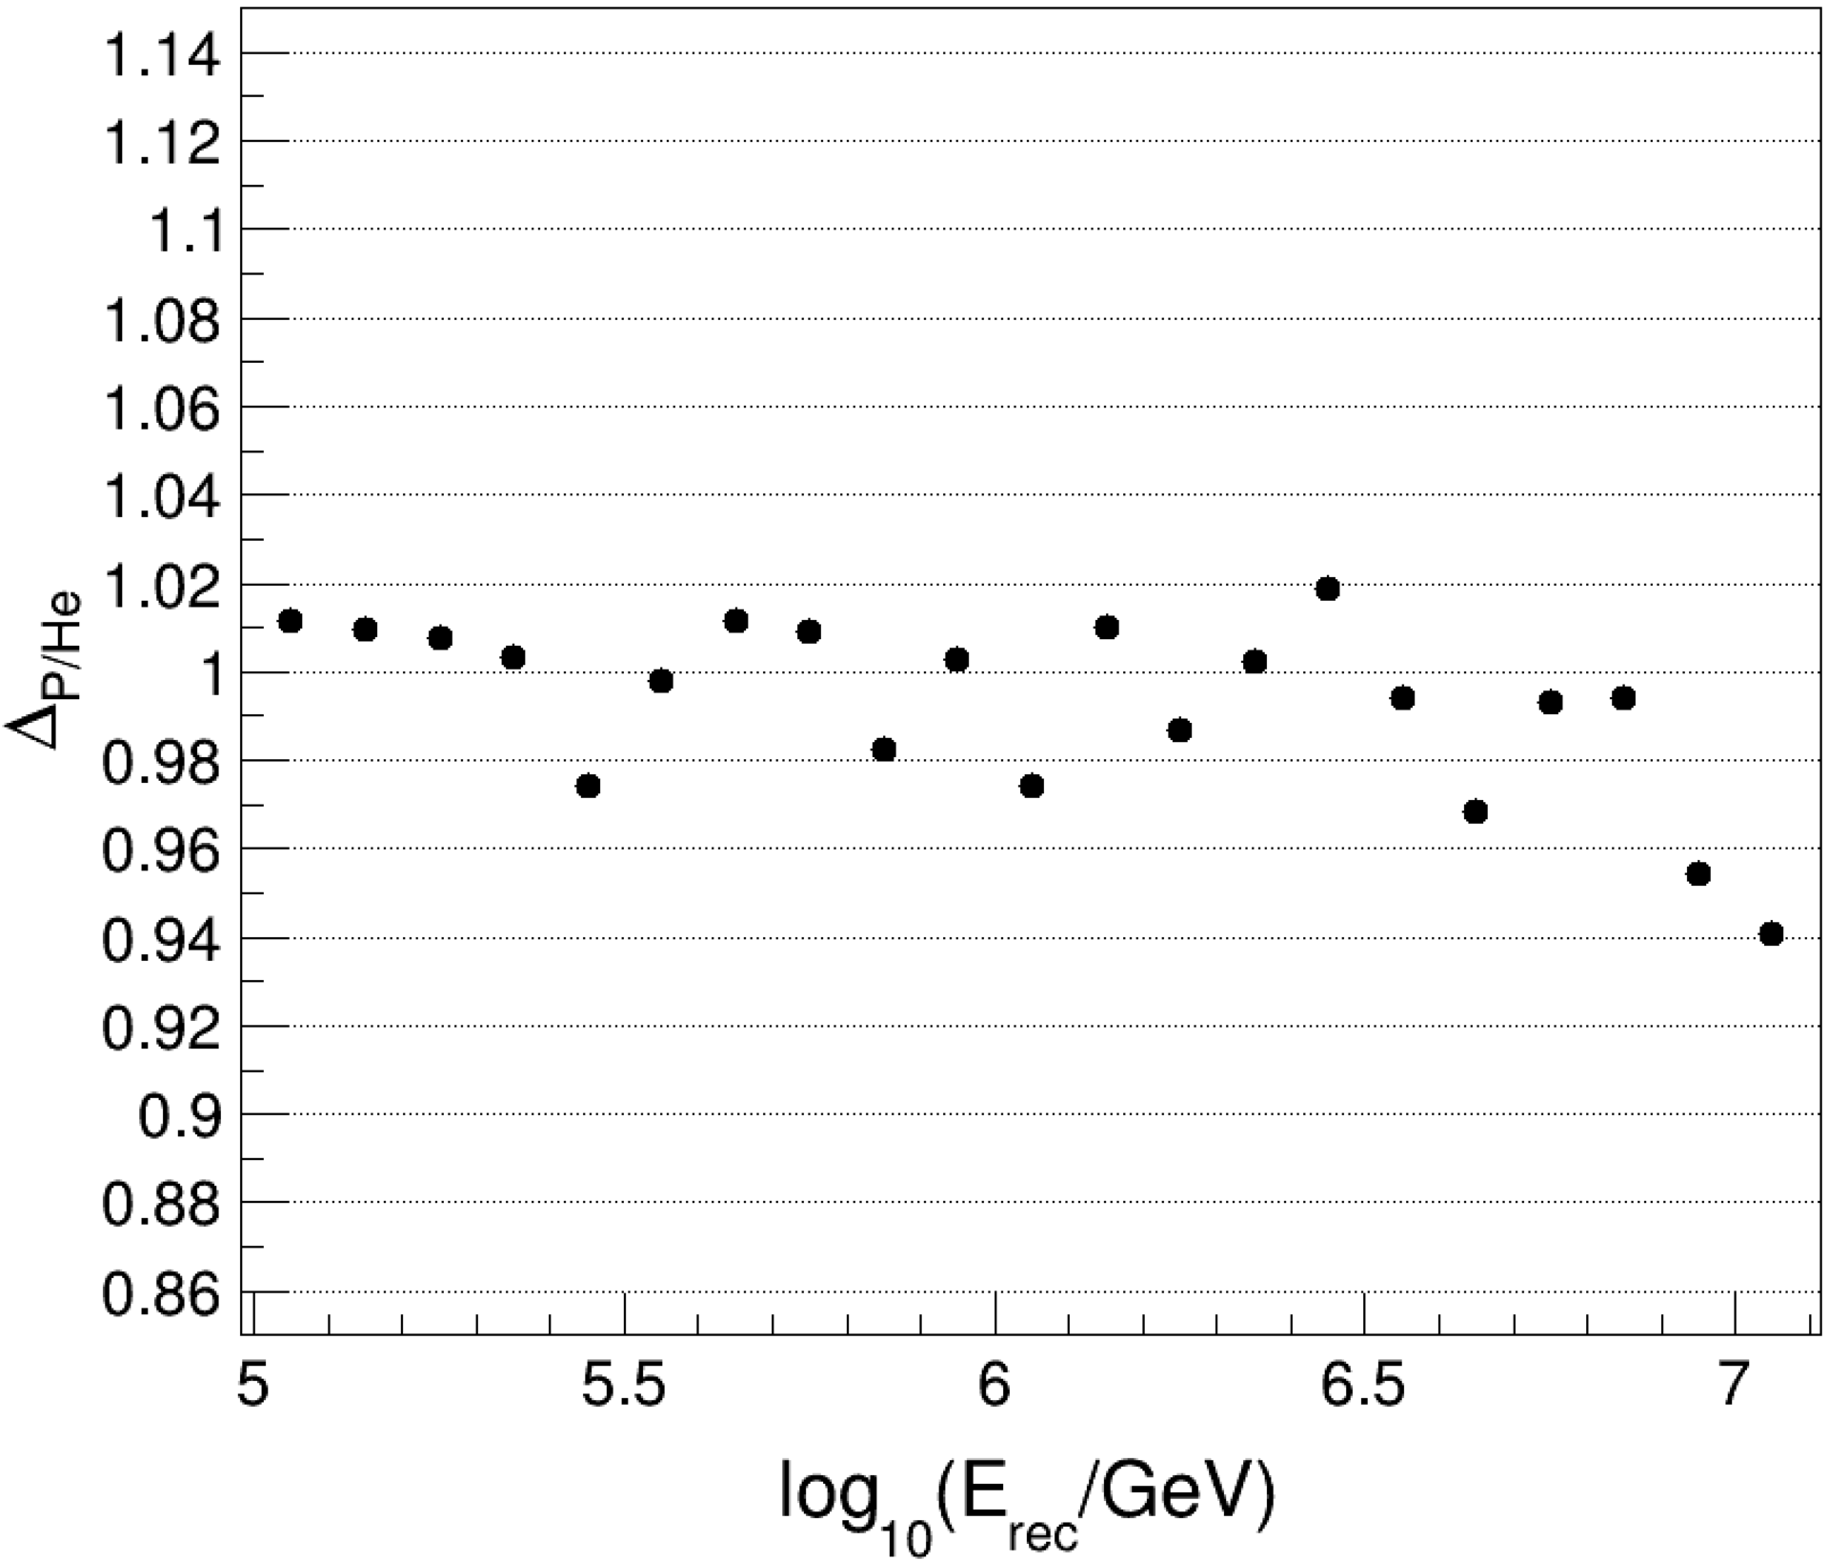
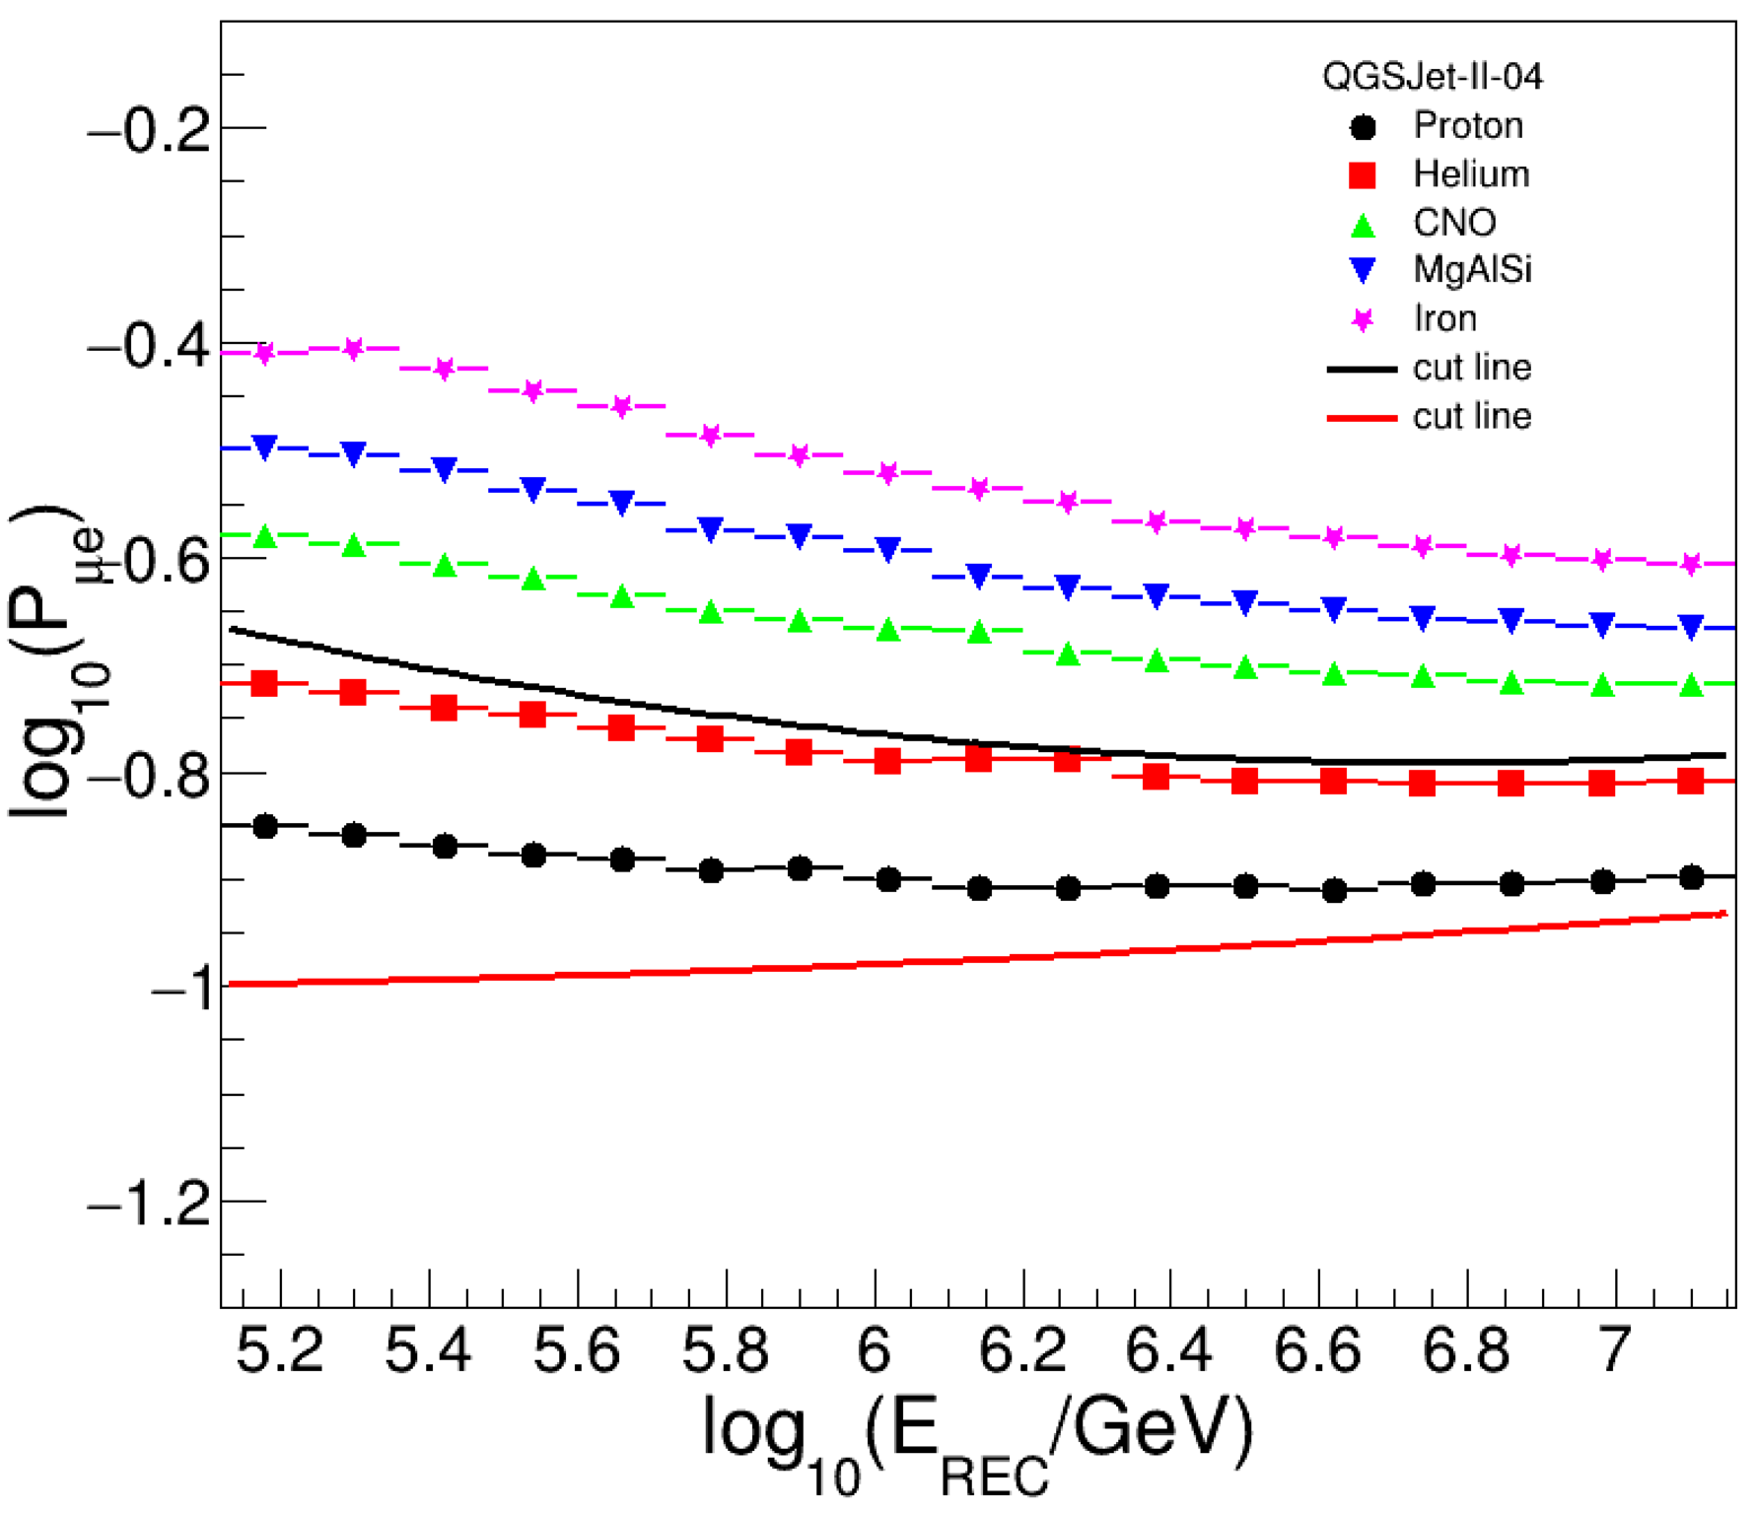
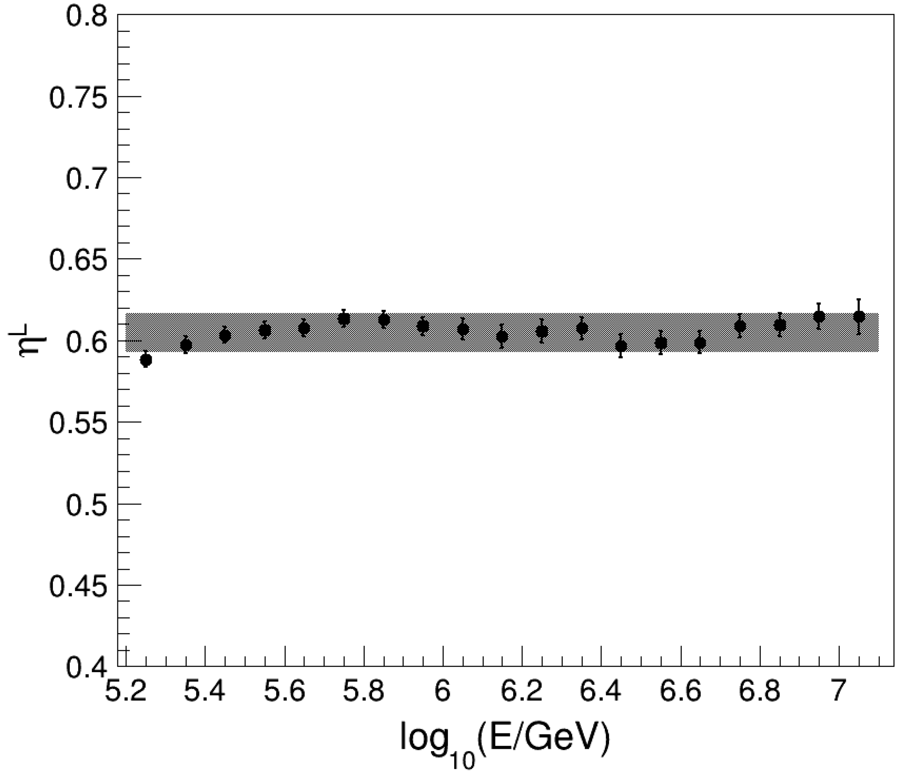
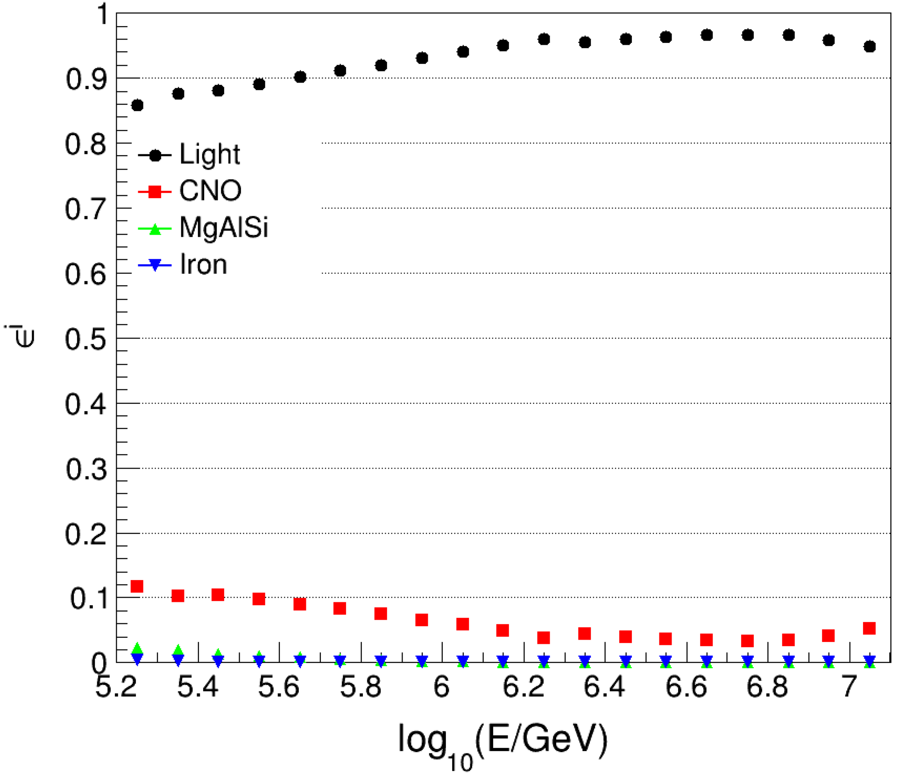
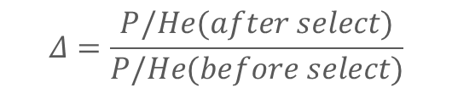
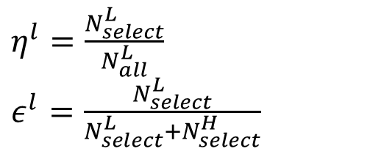
Light component (H+He) events selection
$$Δ=\frac{P/He(after select)}{P/He(before select)}$$
P/He remains almost constant!
Purity>90%
$η^{l}=\frac{N_{select}^{L}}{N_{all}^{L}}$
$ε^{l}=\frac{N_{select}^{L}}{N_{select}^{L}+N_{select}^{H}}$
Notes:
For Light component events selection, we use the dual cuts to maintain the proton to helium ratio after selection almost the same as before.
The purity of light component is about 90% with a selection efficiency of 60%.

Slide 18
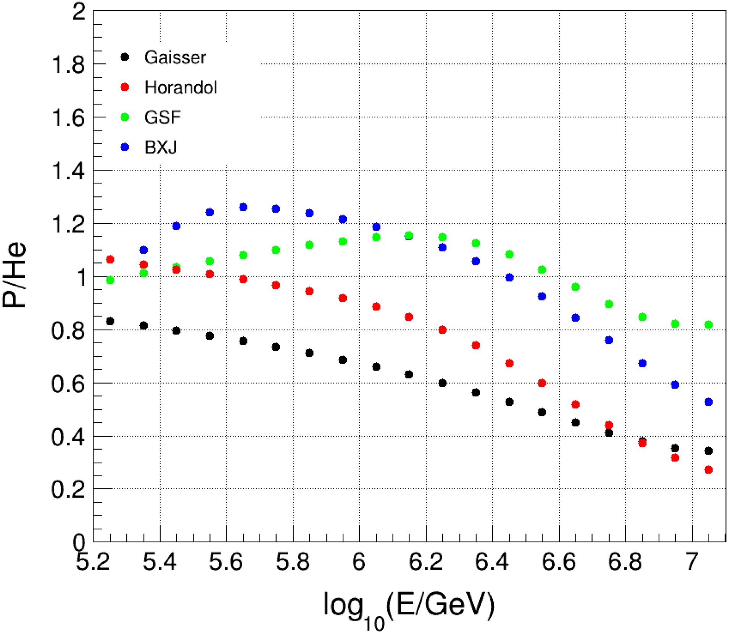
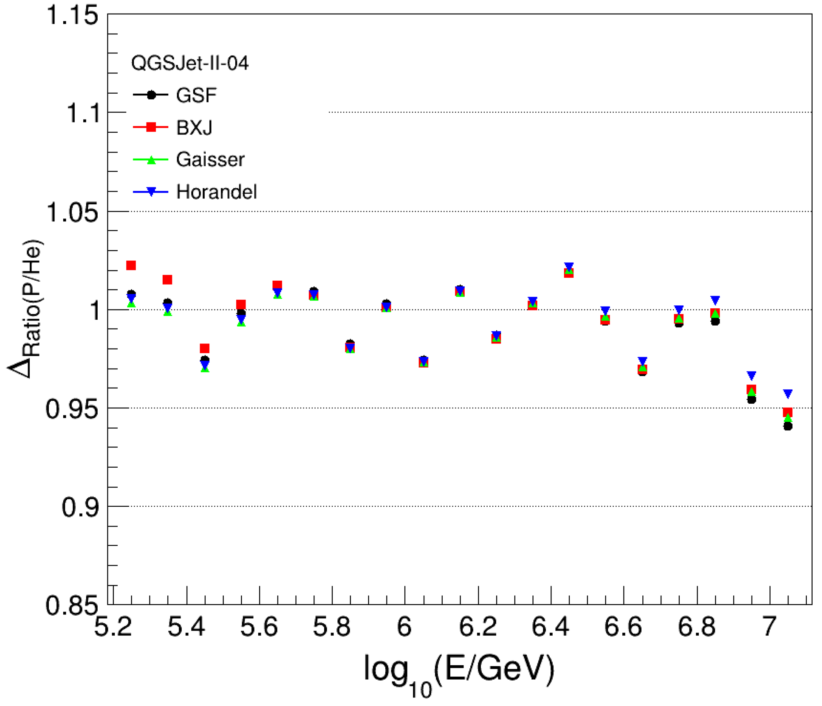
Light component (H+He) → Helium Spectrum
Different composition models test
After dual cuts
The P to He ratio after composition selection is almost the same as before
  The variation of the P/He ratio is within ±3% after composition selection
Light component (H+He) Spectrum – Proton Spectrum → Helium Spectrum
Notes:
For different composition models, the P to He ratio after composition selection still keep the same as before
It is very important for measuring the helium spectrum. The helium spectrum can be obtained by subtracting the proton spectrum from the light component spectrum.

Slide 19
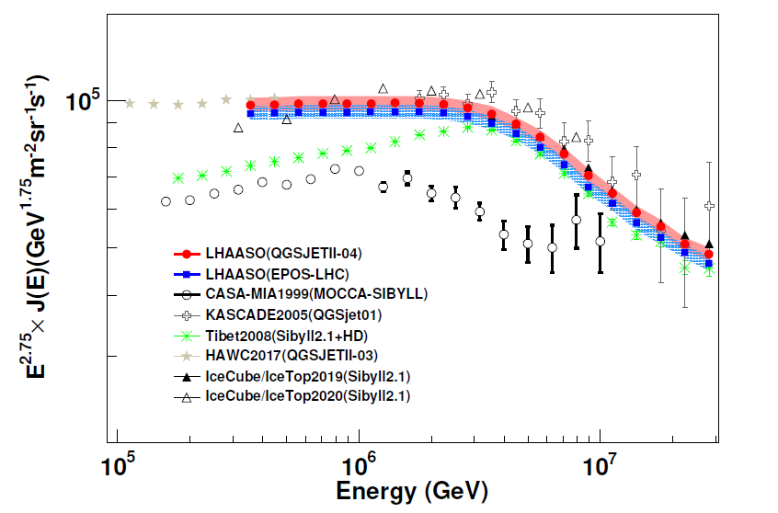
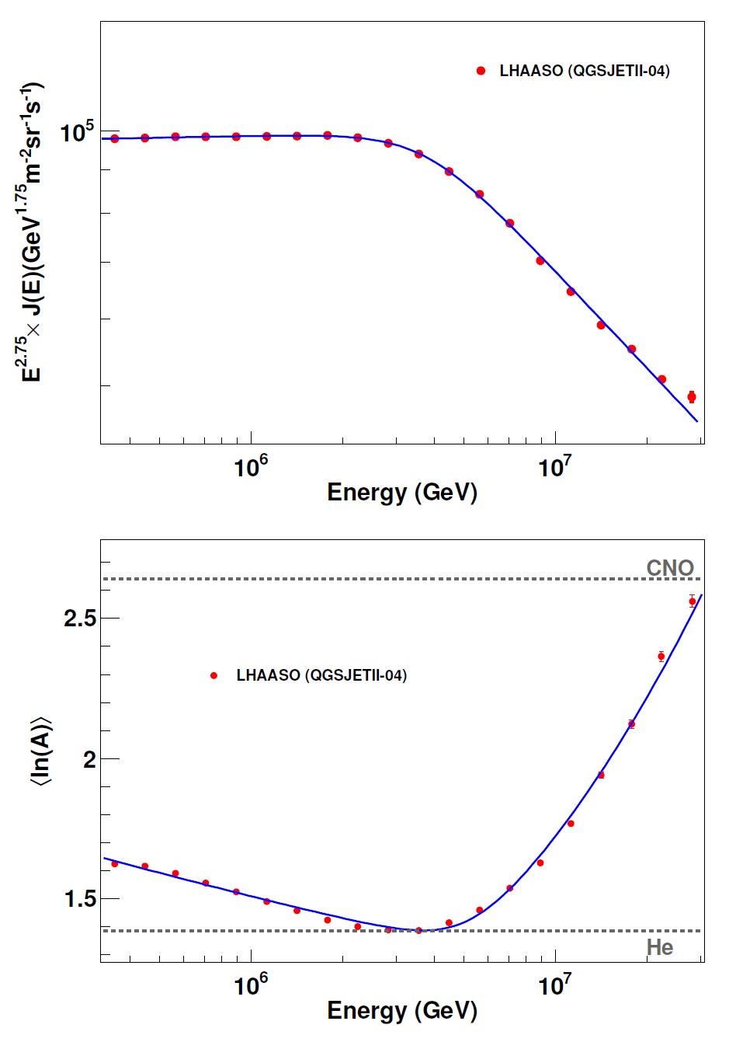
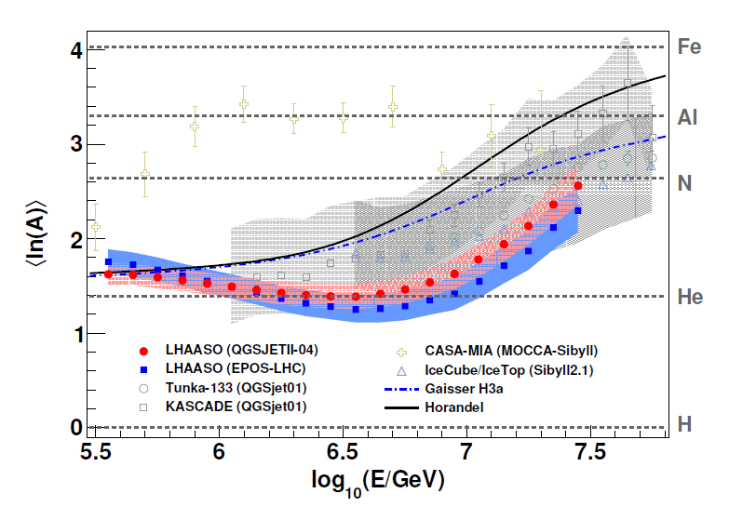
All-particle energy spectrum & composition by LHAASO
(from 0.3 to 30 PeV)
LHAASO Collaboration, PHYSICAL REVIEW LETTERS 132, 131002 (2024)
Systematic uncertainties are sufficiently small
This unveils a clear correlation between the flux and the composition at the knee
Knee: 3.72 PeV
γ1 = -2.743±0.005
γ2 = -3.13±0.005
S = 4.1±0.1
Notes:
LHAASO has accurately measured the knee of all particle energy spectrum and composition.
The systematic uncertainties are sufficiently small.
Thus, the results unveil a clear correlation between the flux and the composition at the knee.

Slide 20
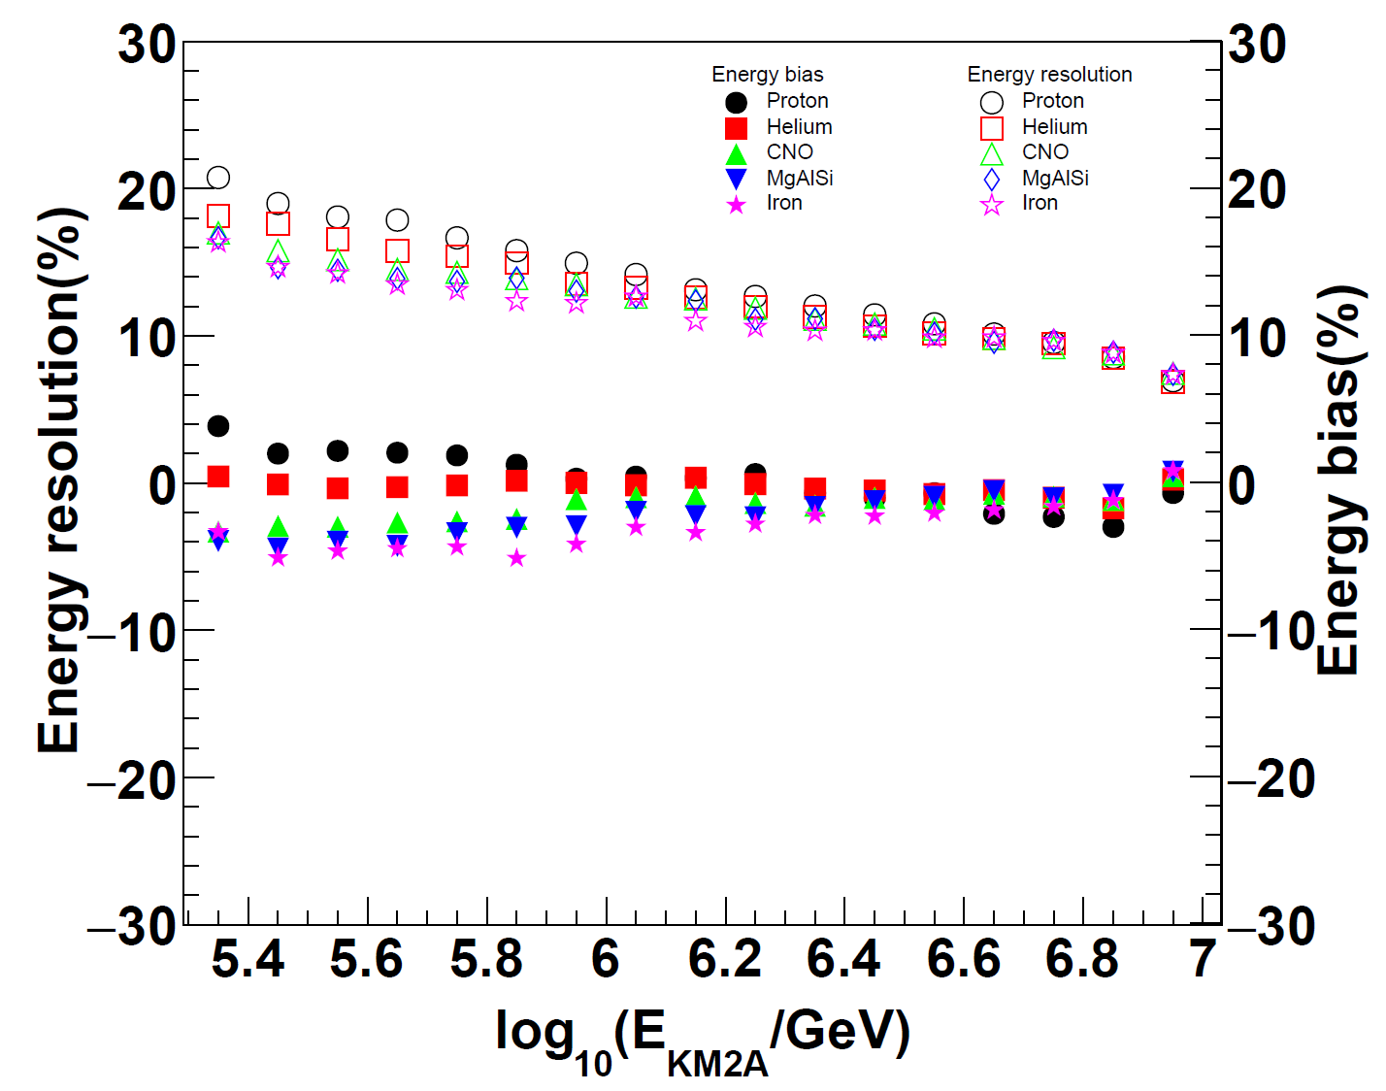
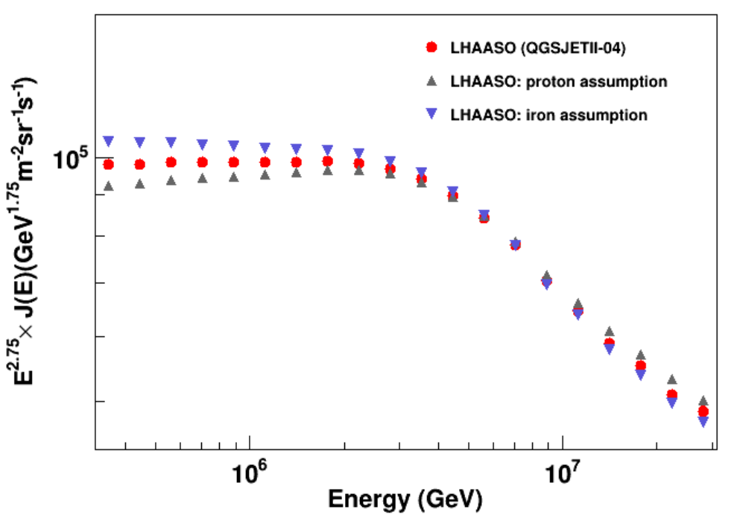
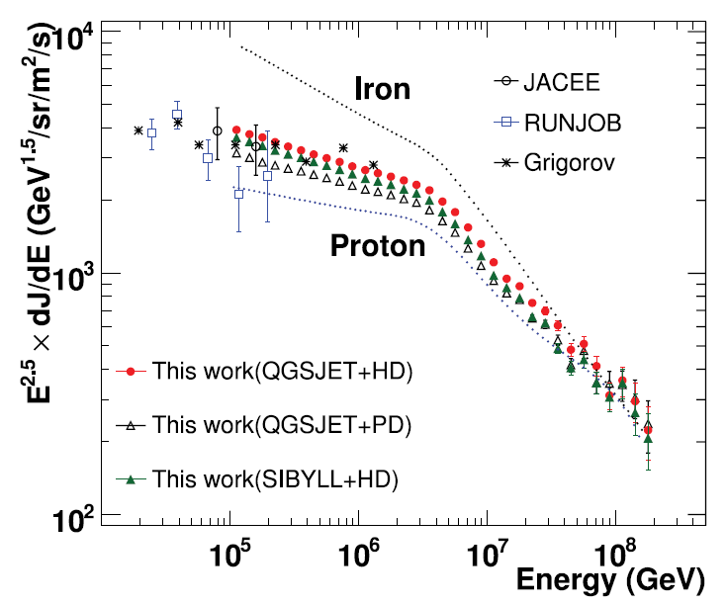
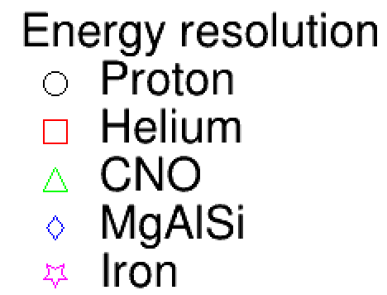
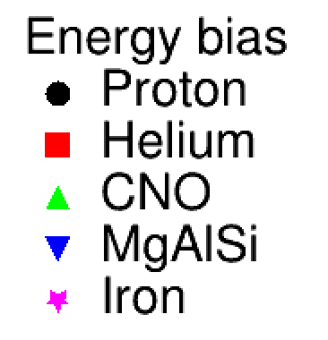
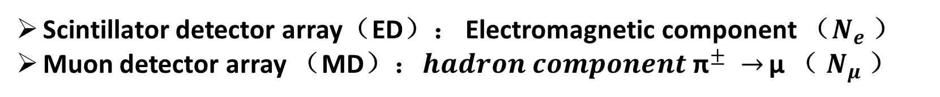



Energy reconstruction
Energy reconstruction independent of the primary CR component
Scintillator detector array（ED）： Electromagnetic component （$N_{e}$）
Muon detector array （MD）：${hadron component \text{π}}^{±} →$ μ （ $N_{μ}$）
$E_{0}=E_{e}+E_{h}≈N_{e}^{max}×E_{c}^{e}$+${ aN}_{μ}×E_{c}^{π}$
$${N_{eμ}=N}_{e}+aN_{μ}$$
E_{rec}=b $×N_{eμ}$
J. Matthews, Astropart. Phys. 22, 387 (2005)
PHYSICAL REVIEW D 106, 123028 (2022)
Notes:
We use Muon contents in muon detectors and particles in Scintillator detectors to reconstruct shower energy, which is almost independent of the primary CR component.
So the systematic uncertainties are very small.

Slide 21

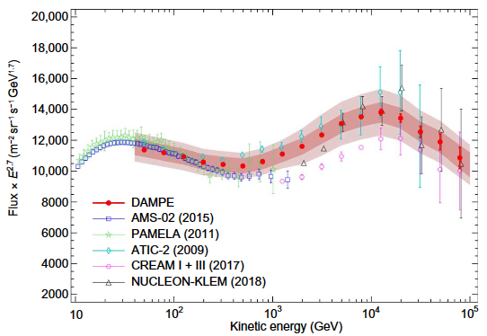
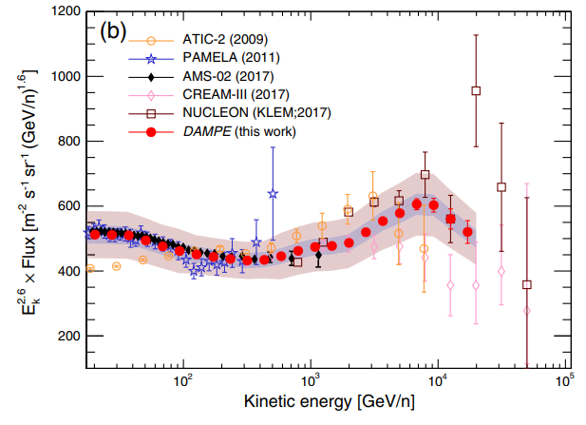


Helium
Proton
DAMPE (2019)
DAMPE (2021)
Bump：~13.6 TeV for Proton and
~34.4 TeV for Helium
Charge Z dependent？
  The ratio of Proton bump and Helium bump is 2.5 ± 0.8
Iron spectra from 100 TeV to several PeVs will be measured by LHAASO and can answer the question clearly.
588
6877
LHAASO iron spectra expectation
21
Notes:
We also plan to measure the iron spectrum from 100 TeV to several PeVs, which can answer the question raised by Dump experiment:
weather the bumps of proton and helium below 100TeV depends on Charge Z.

Slide 22
Summary & Outlook
Measuring CR Spectra of Individual Species around knees is a big step towards understanding the knee feature
  The spectra of proton, helium and proton+helium around knees are planned to be submitted to the journal this year
All particles energy spectrum from 300 TeV to 30 PeV has been measured by LHAASO-KM2A with high accuracy, revealing a clear correlation between the flux and the composition at the knee
The iron spectrum around 400 TeV will be finished next year
And iron spectrum around the knee is the goal in 3 years.

Slide 23
Thanks !

Slide 24

LHAASO a complex for both γ-astronomy
and Cosmic Ray research
The ½ array started operation in 2019 and the full array in 2021
KM2A: Scintillator counters
(ED) and muon counters (MD)
Water Cherenkov Detector
Array (78,000 m²)
Wide FoV Cherenkov
Telescope Array
1188 MDs
18 telescopes
FoV: 360°×16°
3120 units
30m
5216 EDs
Ver y sensitive
γ-ray telescope above
10 TeV (~15 mCU)
Ver y sensitive
γ-ray survey telescope
above 1 TeV (15 mCU)
Ver y unique
spectrometer of CR H,
He and Fe above 30 TeV
Notes:
Show you photos of Scintillator counters (ED) and muon counters (MD), Water Cherenkov Detector Array, a Wide FoV Cherenkov Telescope.

Slide 25





KM2A: 1.36 (km)²
5195 EDs
  1 m² each
  15 m spacing
1188 MDs
  36 m² each
  30 m spacing
Scintillator Detectors （ED）
Inner View of one ED
μ±
Muon detector（MD）
Notes:
The Big Earth Bag is a muon detector, typically buried underground and covered by about 2.5 meters of soil. The spacing between muon detectors is about 30 meters. These rectangular small squares are scintillation detectors with a spacing of about 15 meters.

Slide 26






LHAASO-KM2A
Selection of γ–rays out of CR background
Active Area for Muons vs. Array Area: 4%
~1 PeV CR event: many muons
~ 1 PeV γ–ray event ：very few muons
from the Crab
Area：
1.3 km²
Detectors：
5216 ED
1188 MD
Energy Range：
0.01-10 PeV
Notes:
Muon detectors play a crucial role in identifying gamma rays and cosmic rays. This is an example of 1 PeV cosmic ray event. The circle represents the muon, you can see a large number of muons in this event. In constrast, the 1 PeV gamma ray events from Crab measured by LHAASO showed only a few muons.

Slide 27





Water Cherenkov Detector Array (WCDA)
WCDA-3
Energy rang
  WCDA-1
    300 GeV – 10 PeV
  WCDA-2 and WCDA-3
    100 GeV - 10 TeV
WCDA-2
WCDA-1
WCDA-3
WCDA-1
WCDA-2
Total area: $78,000m^{2}$
Total units: 3,120
Unit size: $5m×5m×4.4m$
Two type of PMTs in each unit:
  8 inches and 1.5 inches for WCDA-1
  20 inches and 3 inches for WCDA-2 and WCDA-3
4.4
8’’PMT
PMT
1’’PMT
1.5’’PMT
Notes:
The water Cherenkov detector array (WCDA) has three large pools and 3120 units. The size of each unit is 5 meters by 5 meters, and the water depth is about 4.4 meters. There are two types of PMTs In each unit. 8 inches and 1.5 inches for WCDA-1. 20 inches and 3 inches for WCDA-2 and WCDA-3.

Slide 28

Inside of WCDA-3
WCDA-1 started operating in April 2019
WCDA-2 started operating in January 2020
WCDA-3 started operating in March 2021
300 m
Notes:
Here show you a big event measured by WCDA, triggering three pools. This is the interior of the WCDA, big PMT and small PMT.

Slide 29









Wide Field of View Cherenkov Telescope (WFCTA)
Telescope parameters:
~5 m² spherical mirror
Camera: 32×32 SiPMs array
FOV:
Pixel size:
18 Telescopes
Mirror
SiPM camera
SiPM and Winstone cone
Notes:
Ok, 18 wide field of view Cherenkov telescopes. Each telescope has a 5 m2 spherical mirror, 32×32 SiPMs array and covering a field of view of 16 degree by 16 degree, with pixel size of 0.5 degree by 0.5 degree. The main scientific goals of these telescopes is to measure cosmic ray composition and energy spectrum.

