Slide 1
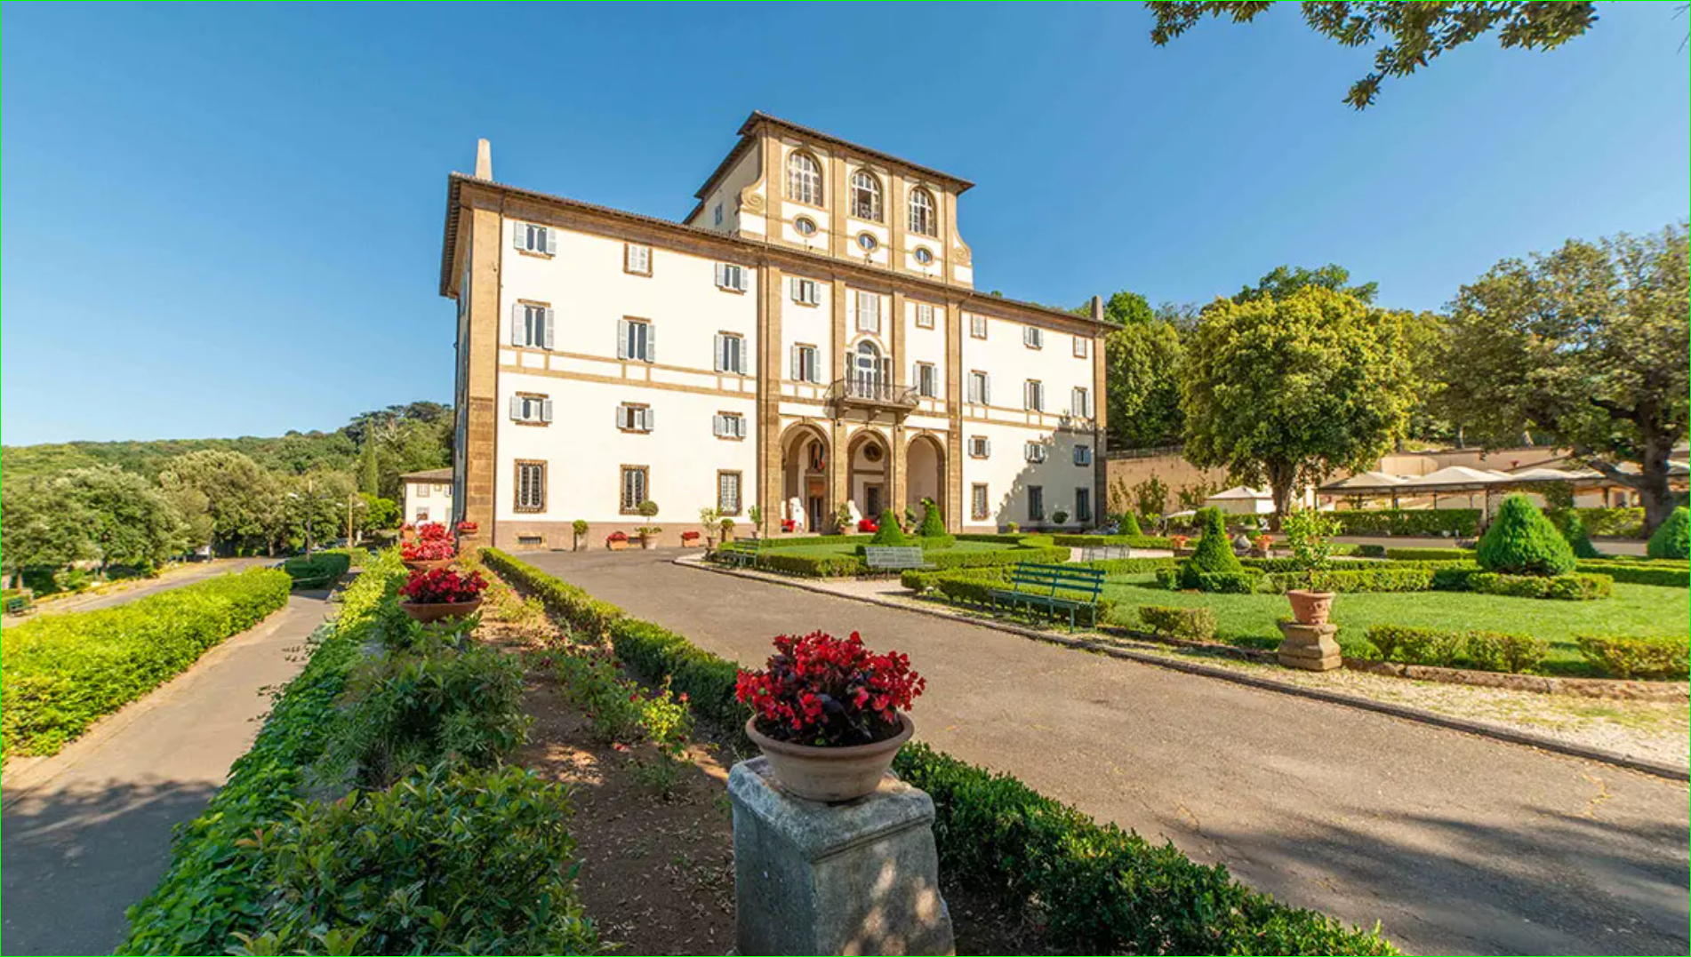
Frascati, 24 September, Daniele Fargion, RICAP 2024 On Cosmic Rays Puzzle

Slide 2
A century of Cosmic Ray deflections: Any good reason for a never ending, « blind man’s fly» ?

Slide 3
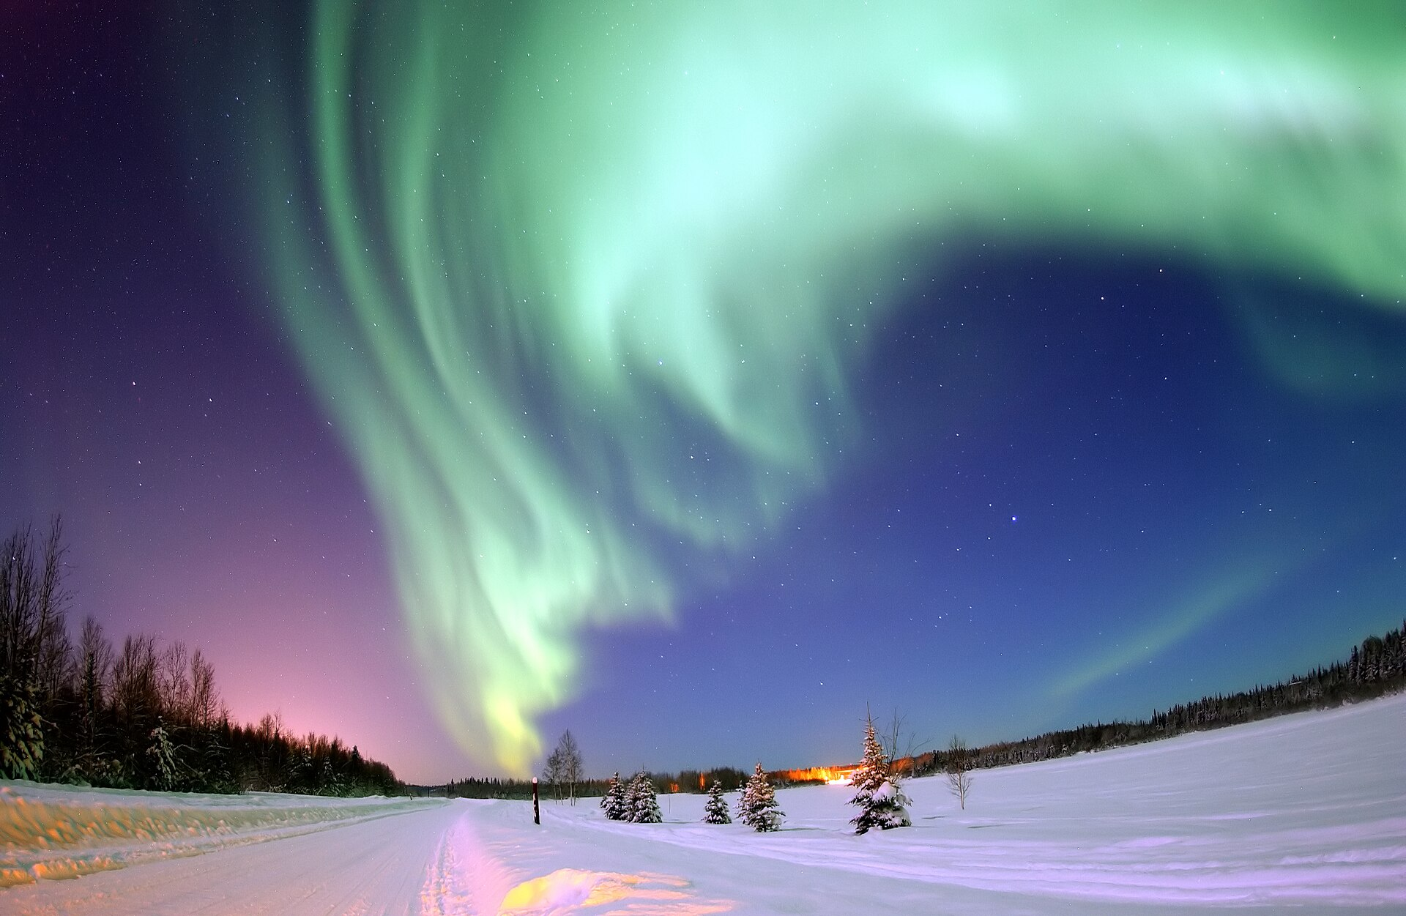
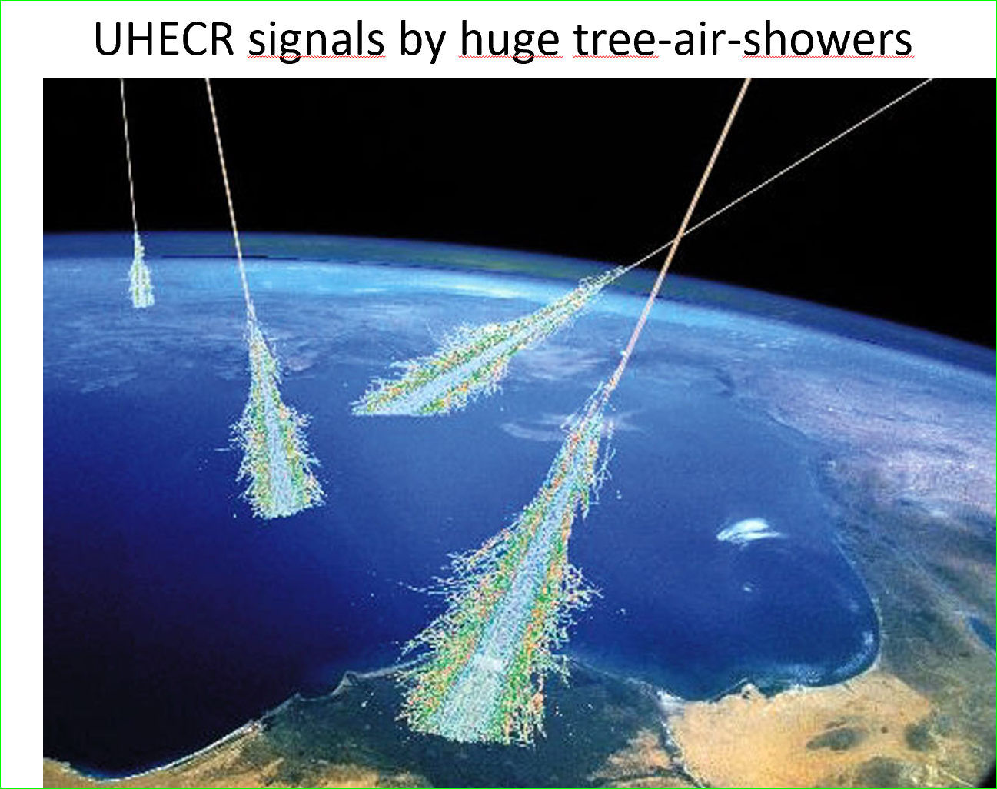
A brief Summary of «Cosmic Rays»
UHECR
UHECR

Slide 4
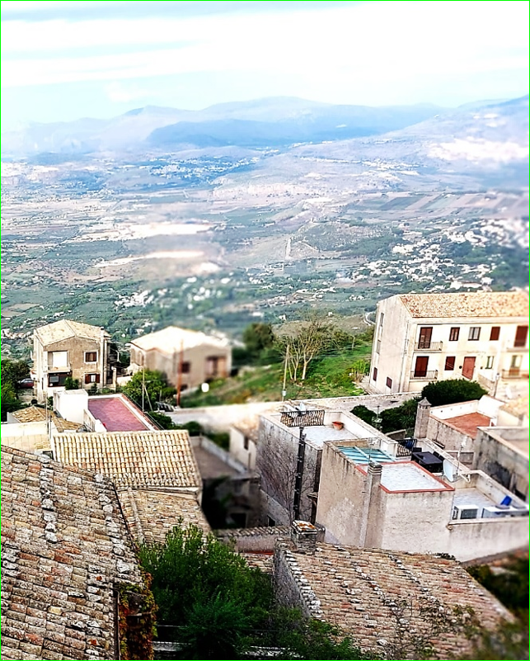
Cosmic Rays, Charged, Bent and much Smeared. But, UHECR, are less smeared , more bounded: A new UHECR (> tens EeV) « Astronomy» ?

Slide 5
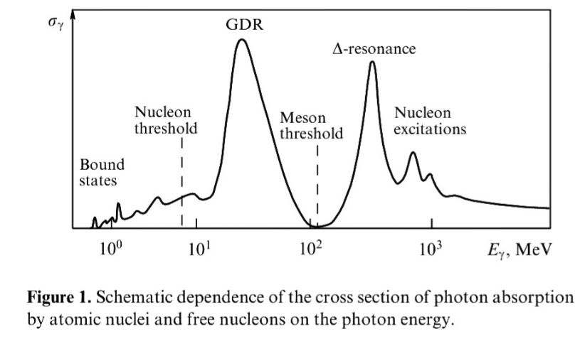
The Two different nuclear cut off to UHECR by relic 1:photons: GZK: Greisen, Zatzepin,Kuzmin 2:and GDR : Giant Dipole Resonance
GZK photopion cutoff occur at tens EeV, it makes UHECR constrained near, ………………………………………………………40 Mpc (1% Cosmic radius)
GDR = photonuclear distruption by Giant Dipole resonance
makes (to lightest nuclei ) a severe cut off at tens EeV ,
constrained in a nearer, ………… 4 Mpc (0.1% Cosmic radius)
GDR
GZK

Slide 6
UHECR bounded by GZK (p) and GDR (He) cut off both in energy and distances

Slide 7
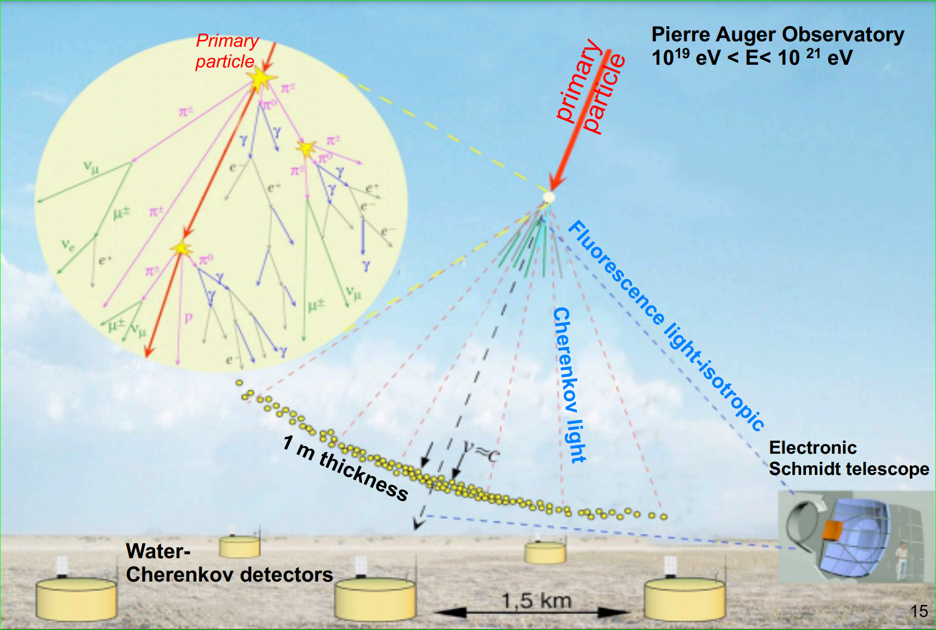
Rare Air Shower detection for UHECR, energy and composition. Largest (3000 km square) Auger arrays (South) and TA (600 km square) (North)

Slide 8
Lightest to Heavy nuclei confined in Nearest Universe by Daniele Fargion, see also UHECR Clustering: Lightest Nuclei from Local Sheet Galaxies https://doi.org/10.3390/universe10080323

Slide 9
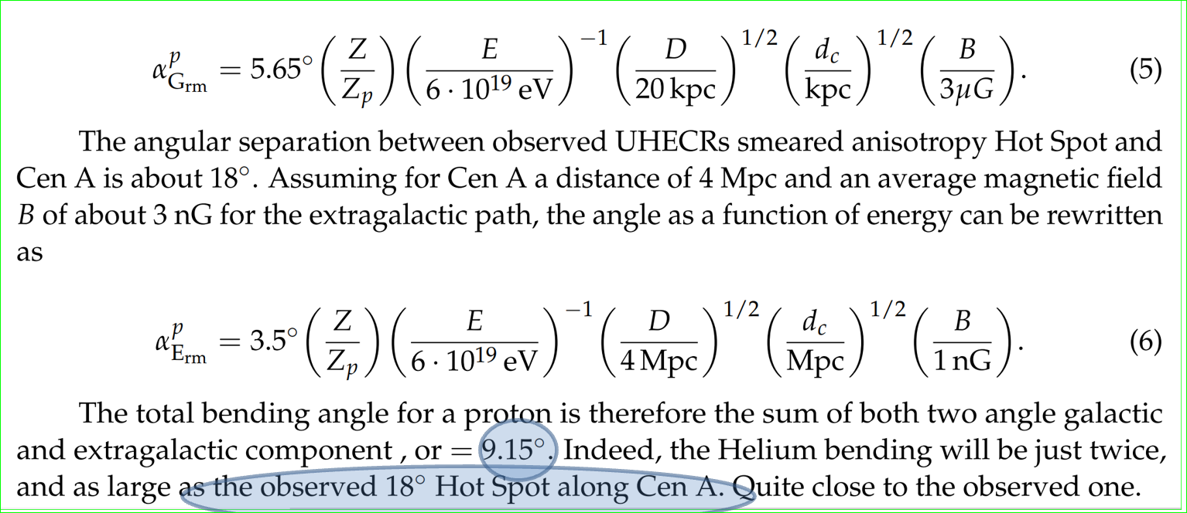
Bending charges , nucleon, nuclei in UHECR at GZK: for Proton <-> 9°, for He-> 18° Therefore: Who and Where are the sources ?
Random Galactic and Extra Galactic bending

Slide 10
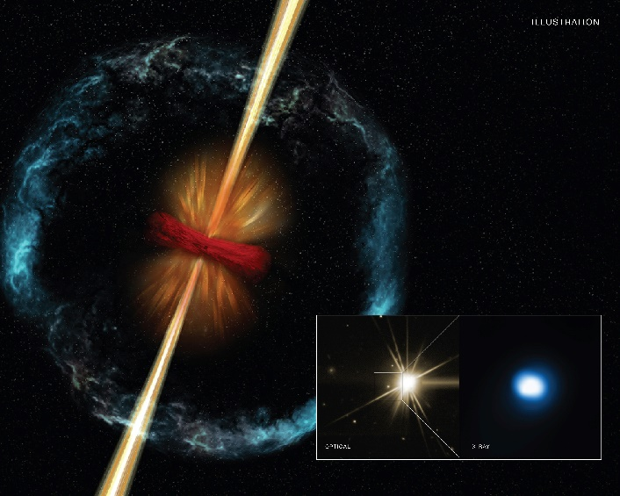
AGN and GRB Jets: BH+Accretion disk Ideal smoking gun sources for UHECR!

Slide 11
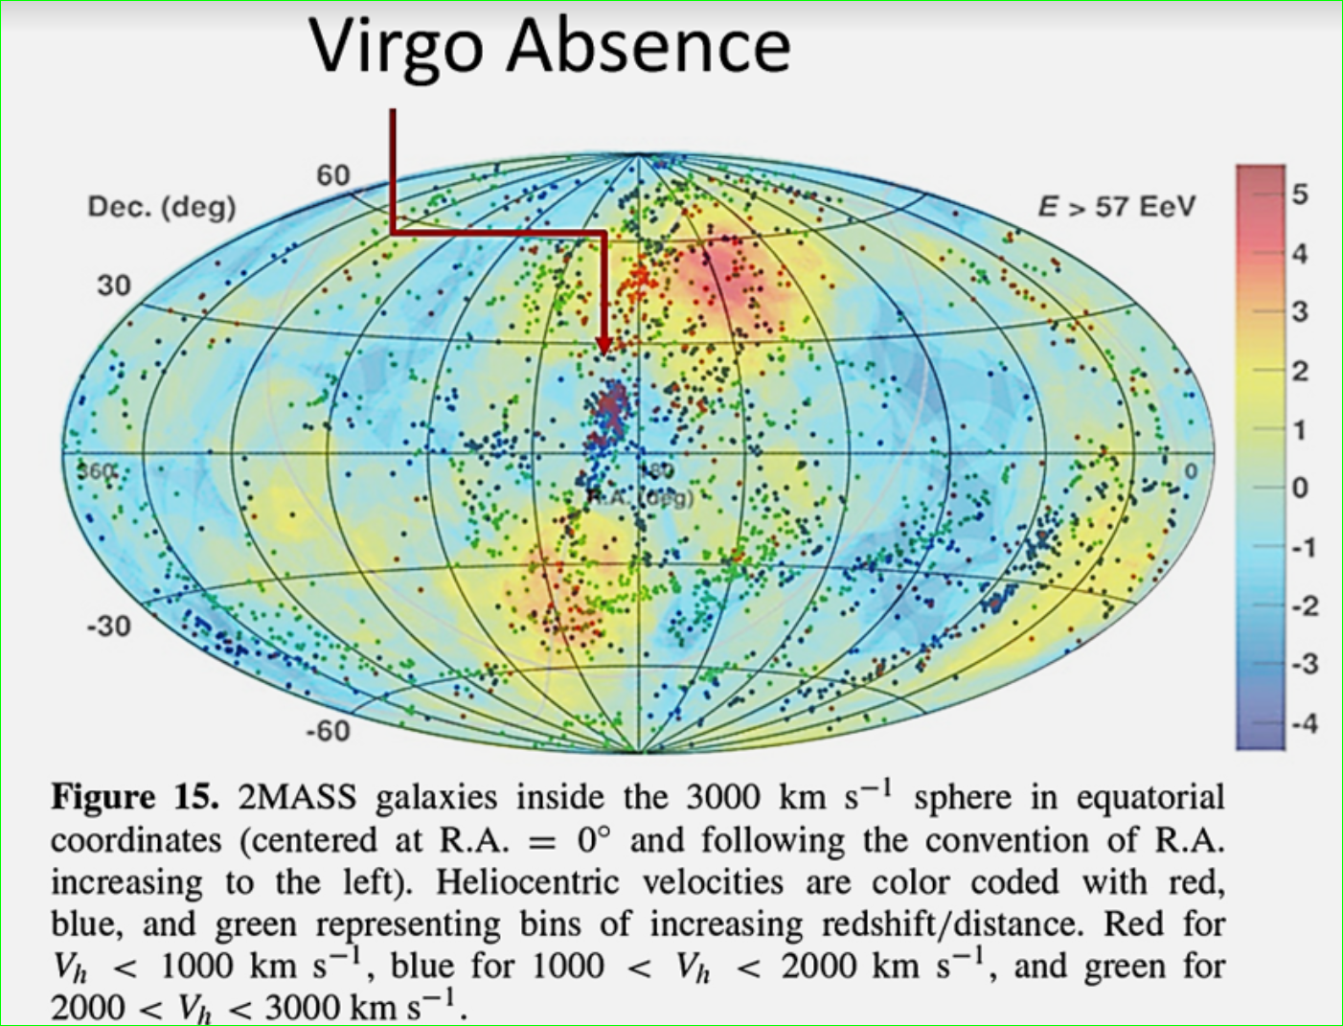
THE GZK cut off UNIVERSE
CAS A
M 82
M 31
Cyg X3
Virgo
Crab
SS 433
NGC 253
CenA
VELA
LMC
SMC

Slide 12
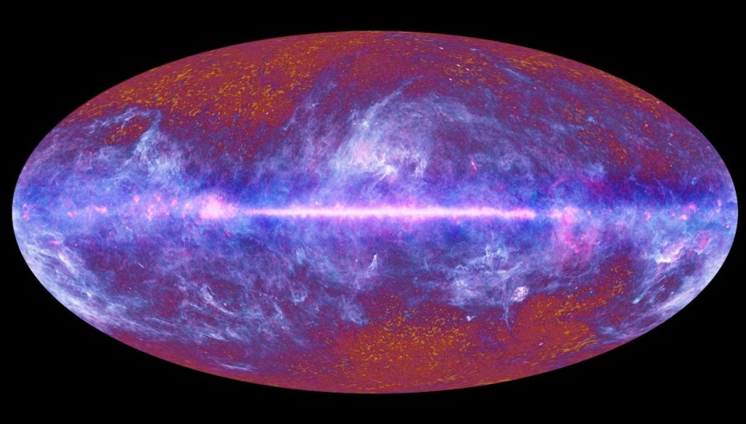
AGAIN: expected VIRGO CLUSTER DOMINANCE (40 Mpc): GALACTIC COORDINATE : but, only 1 clustering-→ Cen A

Slide 13
How to make Virgo opaque, while only Cen A observable?
if Proton are the UHECR, than Virgo should shine at GZK cut off , 40 Mpc… (but it doesn’t)
But, if UHECR are (He,..Lightest nuclei),
They should shine at a GDR cut off, much smaller, …………………4 Mpc,…therefore….:
Virgo is absent (as it is far),
but, Cen A, not: it is within 4 Mpc.

Slide 14
Distances flight for lightest UHECR Nuclei: D-He-Li-Be, very narrow→ 4 Mpc cut off VIRGO (20 Mpc) IS FILTERED !! BUT Cen A, M82, NGC 253, NOT!!.

Slide 15
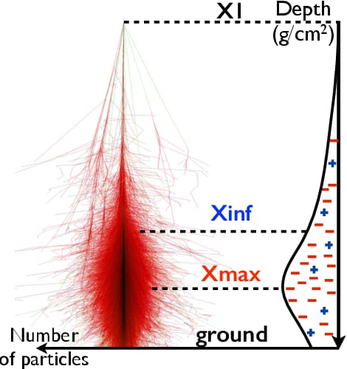
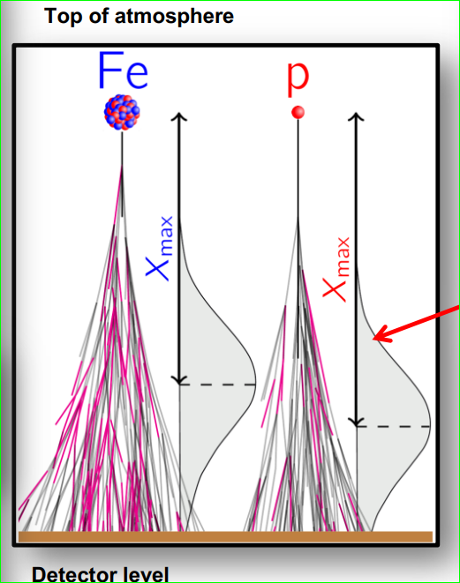
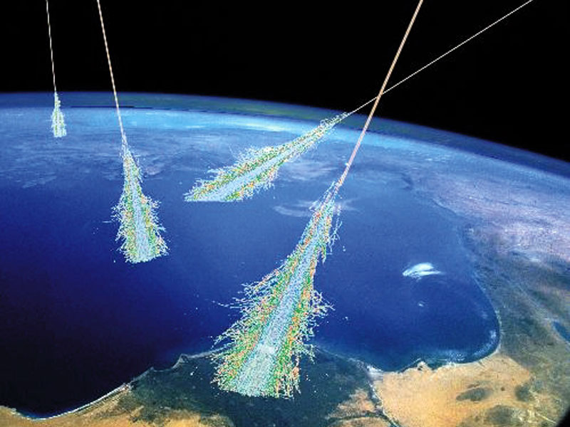
A different way to verify the COMPOSITION : A Test for UHECR observed by their huge tree-air-showers. AUGER JCAP 2018: arxiv:1612.07155 Their air shower «three» structure = Slanth Depth <=> is the imprint. The lightest, less cross section, more penetrating, lower altitude The heavier,larger cross section, less pennetrating, higher altitude

Slide 16
Composition evolution : from lightest to heavy nuclei with UHECR energy growth

Slide 17
Composition evolution with UHECR energy growth by Slanth Depth, Xmax :He-Be dominant from ten EeV up to 40 – 50 EeV

Slide 18
Photon Astronomy versus UHECR (by proton or Lightest Nuclei)

Slide 19
UHECR clustering + associated sources: all within 4 Mpc: observations up 2024
Cen A,(AUGER) 2007,
M82 (Telescope Array) 2009,
NGC 253 (D:F: and AUGER) 2014
Other, not yet widely accepted
LMC (DF) , Cas A, Cyg X3 , (2012-2024)
SS 433 (DF) (2014-2024)
M31 (DF) (2018-2024),
Maffei Galaxies (Taylor, DF), (2023-2024)
LOCAL SHEET GALAXIES (2023-2024)

Slide 20
2014 :the Council of Giants at Local Sheet Within the GDR cut off

Slide 21
Council of Giants: just a dozen of objects

Slide 22
The Local Sheet Galaxies, or the Council of Giants map, galactic coordinate

Slide 23
The Local Sheet- A Few Mpc distances South-North UHECR sky asymmetry

Slide 24
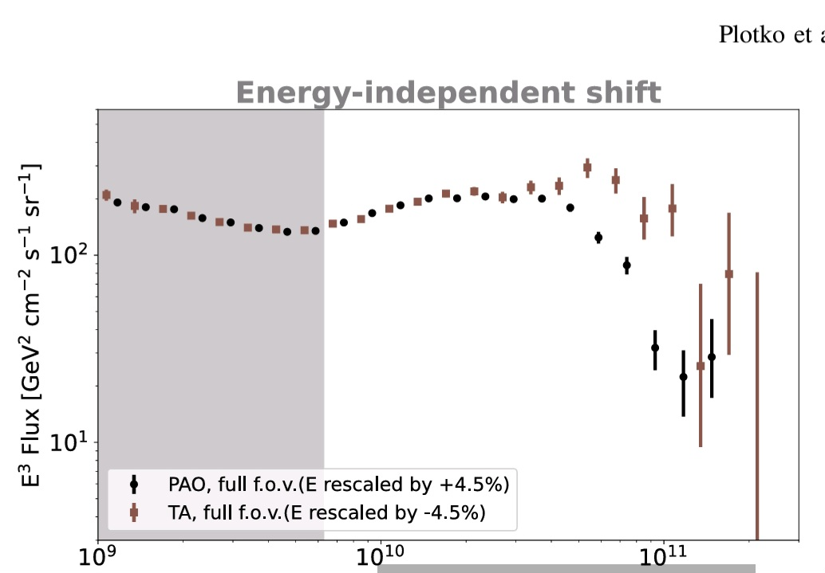
North versus South , AUGER-TA sky puzzling asymmetry along the UHECR GZK cut off

Slide 25
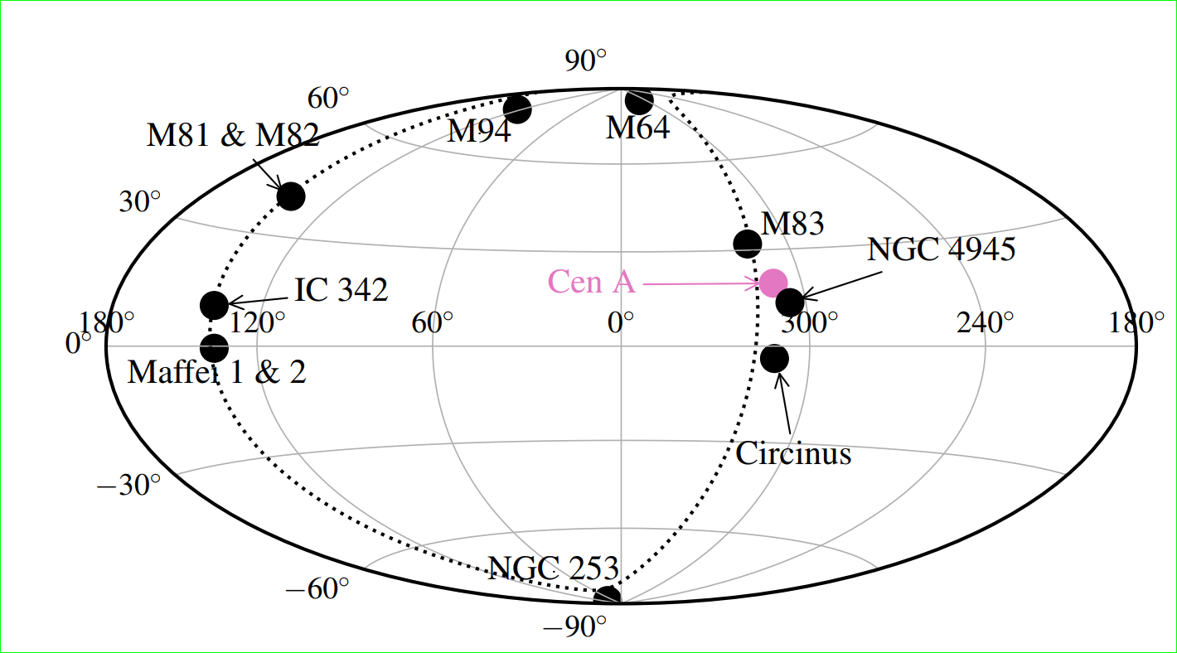
Galactic Coordinate: Hot Spots and Local Sheet Sources++ Multiplets
https://arxiv.org/pdf/2302.06489

Slide 26
Stellar Mass and Star Formation Rate within a Billion Light-years, by Jonathan Biteau 2021 the Andromeda-Local Sheet-VIRGO mass distribution

Slide 27
2024, Celestial Coordinate Hot Spots and Amaterasu

Slide 28
AUGER : the Supergalactic versus LOCAL SHEET= Plane , July 2024 , A very missing Virgo
https://arxiv.org/pdf/2407.06874

Slide 29
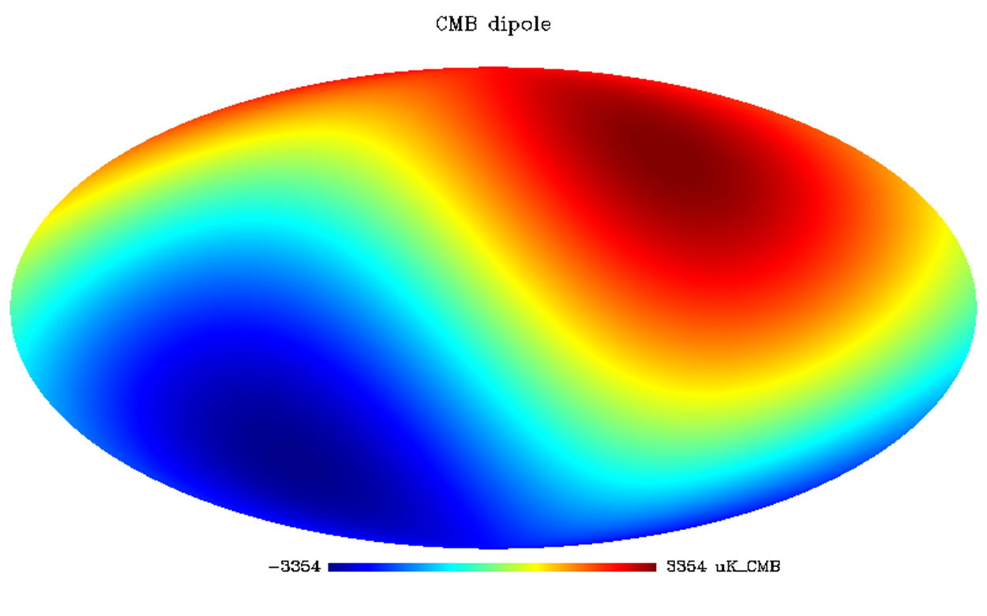
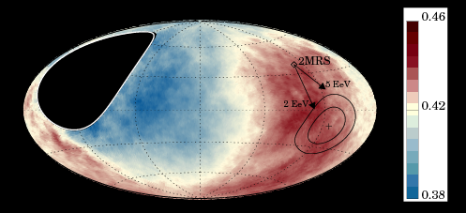
UHECR DIPOLE: Different direction and SIZE of EeV AUGER anisotropy respect to the cosmic big bang dipole-Virgo-- - Great Attractor-and the galactic speed

Slide 30
Auger Dipole at 4-8, 8-16, 16-32, >32 EeV

Slide 31
Galactic coordinate—AUGER Dipole Anisotropy-Hot spots- Local Sheet Sources

Slide 32
Galactic Coordinate: Hot Spots and Local Sheet Sources++ Multiplets

Slide 33
Additional Multiplets and puzzling clustering at 3C454

Slide 34
Amaterasu, most recent TA 220 EeV UHECR: a SS433 heavy bent Ni UHECR?

Slide 35
Conclusions
UHECR clustering are mostly due to lightest nuclei: D,H,Be,Li
UHECR are mainly made by GRBs and AGN jets
Such UHECR are bounded within 4 Mpc in Local Sheet Galaxies
The first clustering : Cen A, M82, NGC 253 are found and confirmed; M31, Maffei Galaxies, Cas A, also start to arise.
Multiplets from Cen A and NGC 253 have been foreseen/observed.
UHECR Asymmetry North South made by few Local Sheet masses asymmetry in sky
UHECR AUGER Dipole fed by NGC 253 and , possible LMC, Vela, Crab
If Mrk os 3C454 AGN and UHECR cluster correlate more with time, and their composition is mainly nucleon like,..then .. Z burst model based on ZeV-relic neutrino scattering, overcome the puzzle: A Great neutrino discover

Slide 36
2008-2024: UHECR Lightest nuclei Model evolution
arXiv:2408.07172 , UHECR Clustering: Lightest Nuclei from Local Sheet Galaxies
arXiv:2303.08922 , UHECR Signatures and Source➔......
arXiv:1412.1573, The meaning of the UHECR Hot Spots: A Light Nuclei Nearby Astronomy ➔…….
arXiv:0908.2650, Coherent and random UHECR Spectroscopy of Lightest Nuclei along CenA…
arXiv:0801.0227
Light Nuclei solving Auger puzzles. The Cen-A imprint

Slide 37
Thank You for your Ultra High Energy attention

Slide 40
Summary 2 (2014, ten years ago)
Same message in earliest time:

Slide 41
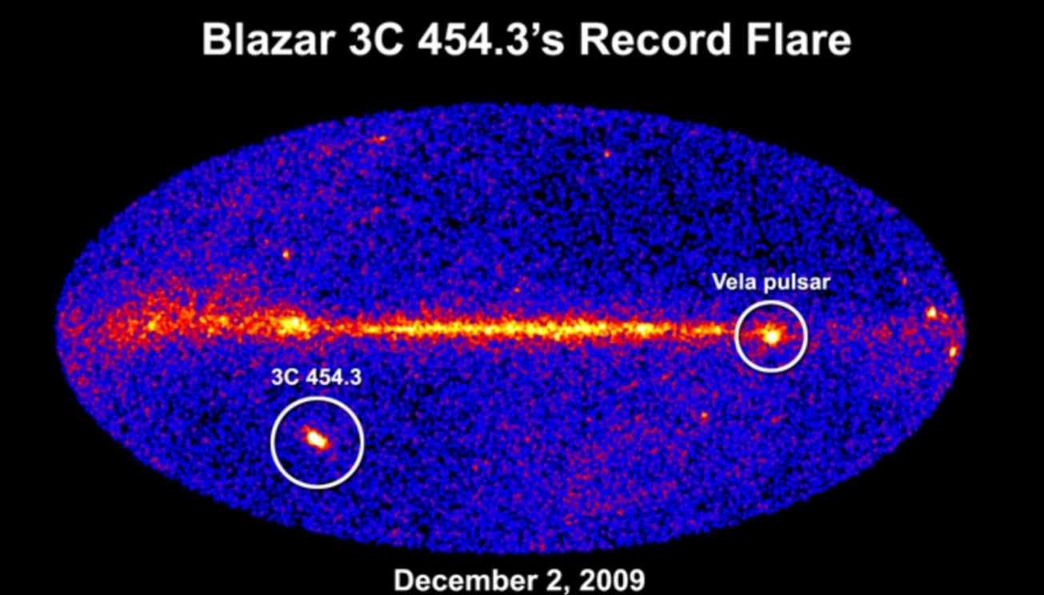
Z-resonance on 3C454 : neutrino-neutrino relic in UHECR puzzle?
3C454

Slide 42
Far AGN correlating UHECR and UHE ZeV neutrino scattering on relic eV ones
arXiv:2310.19227 [pdf, other]
The unprecedented flaring activities around Mrk 421 in 2012 and 2013: The test for neutrino and UHECR event connection
Authors: Nissim Fraija,et al

Slide 43
Uhe ZeV neutrino scattering on relic ones (about 1-0.2 eV mass)

Slide 44
Conclusion 2
Ten EeV dipole is fed by NGC 253 AGN and by the local Vela, Crab. LMC and possibly, also, by Andromeda, Fornax D.
Puzzling 3C454 clustering , Amaterasu, if a real one, might be related to UHE ZeV neutrino scattering onto relic ones in a hot, dark halo.
THE Z-BURST lead to nucleon-composition
Heavy galactic nuclei lead to Ni-like composition

Slide 45
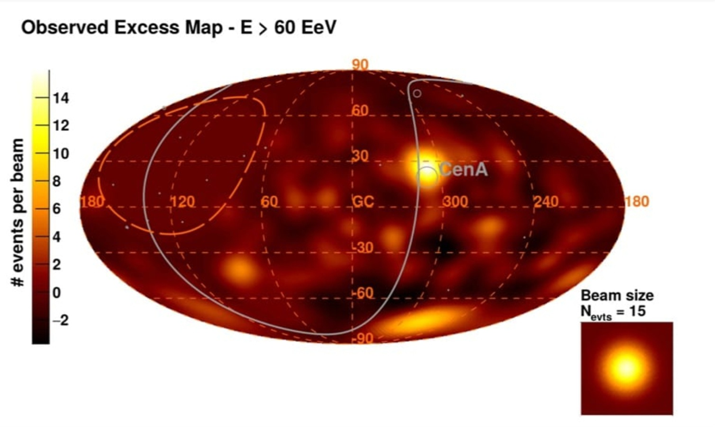
A UHECR heaviest nuclei CR connection? Most energetic UHECR much bent

Slide 46
UHECR spectra evolution: 2019 composition models

Slide 47
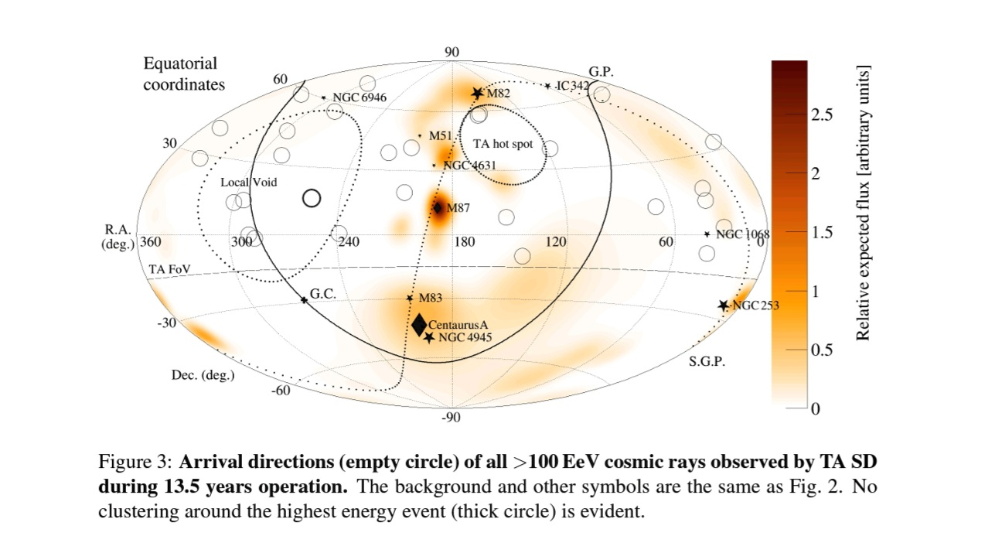
10 years ago

Slide 48
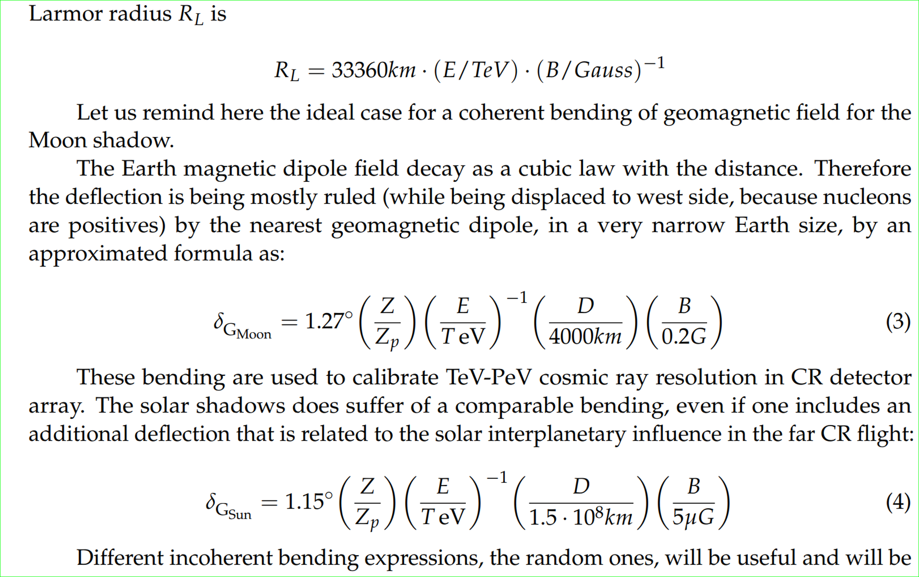
Bending charges in magnetic fields
The TeVs CR Lunar and Solar Shadows bending

Slide 49
Amaterasu Highest event: From SS433?

Slide 50
Apparent GZK cut off at 100 EeV in UHECR led to models based on photopion opacity =
Most preferred protons as
UHECR
These UHECR protons could fly almost undeflected, 40 Mpc , at hundred EeV energy
Within such «GZK distances» Virgo cluster should shine bright

Slide 51
However
UHECR the clustering observed by AUGER since 2007 is showing on a mysterious VIRGO absence….
IF UHECR were proton than…
VIRGO at 20 Mpc, it had to rise bright

Slide 52
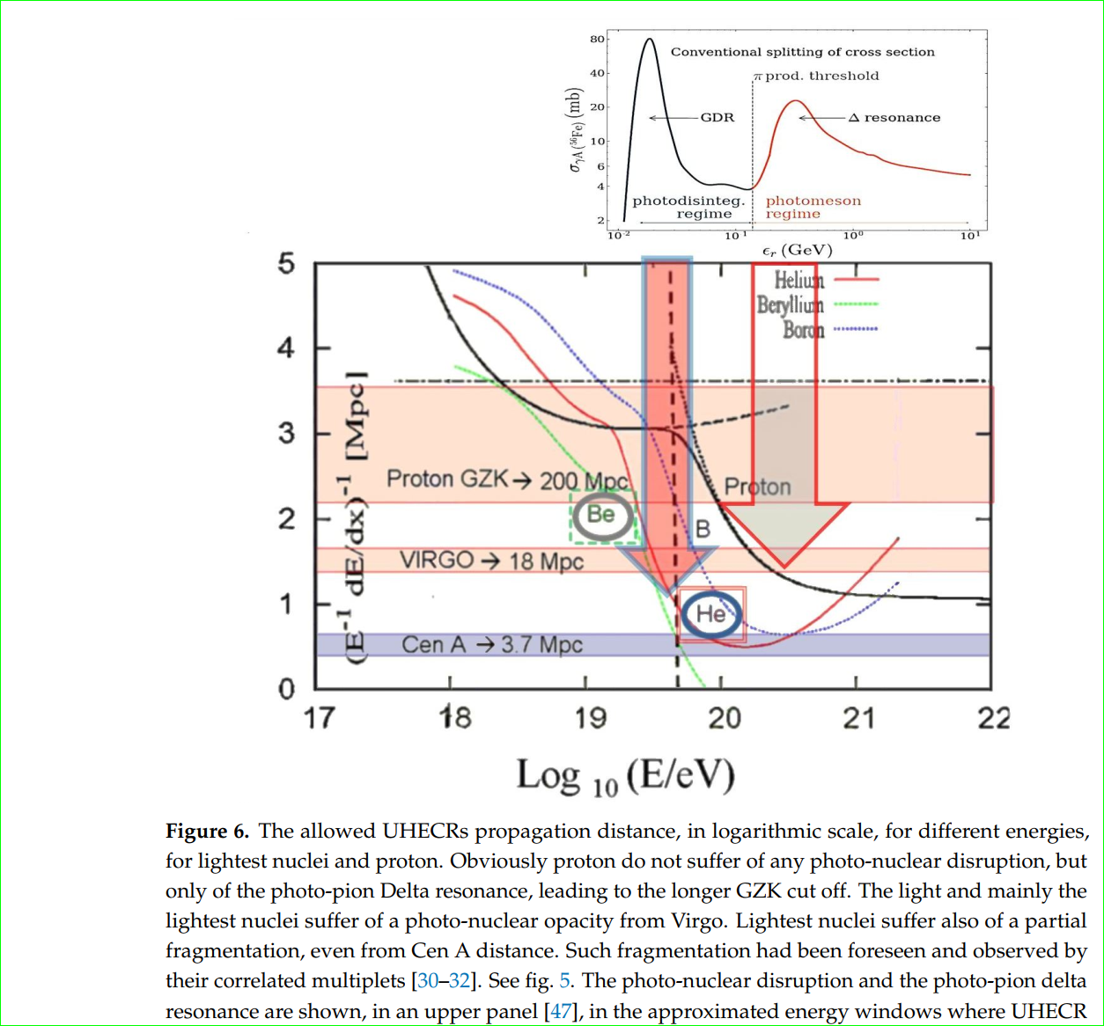
The UHECR suffer of photo-pion opacity: the GZK cut off (and also photo nuclear disruption by Giant Dipole Resonance, GDR)
GDR
GZK

