Slide 1
CNAO Status
M. Pullia

Slide 2

Inspirit
In December INSPIRIT project ended. All the project goals were successfully fullfilled:
  Installation of the low energy line to connect the new source to the rest of the machine

Slide 3
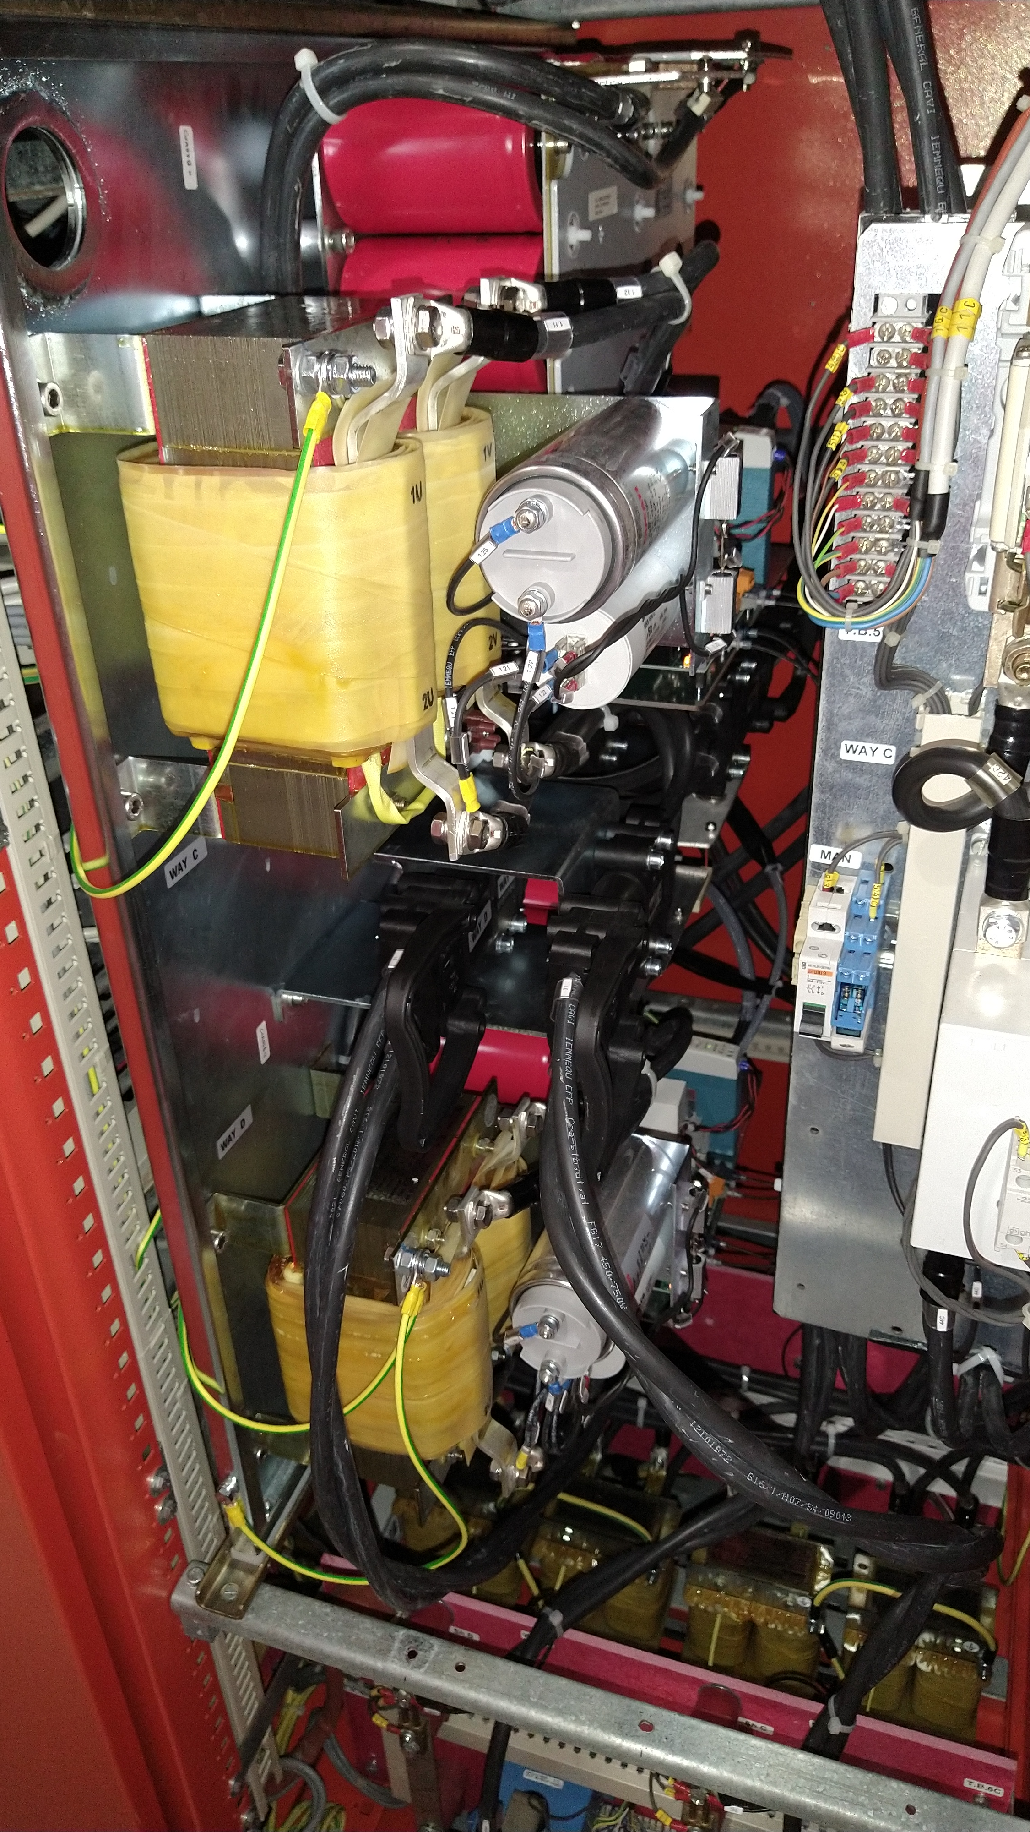
Inspirit
In December INSPIRIT project ended. All the project goals were successfully fullfilled:
  Installation of the low energy line to connect the new source to the
  rest of the machine
  Revamping of HEBT steerers power supplies

Slide 4
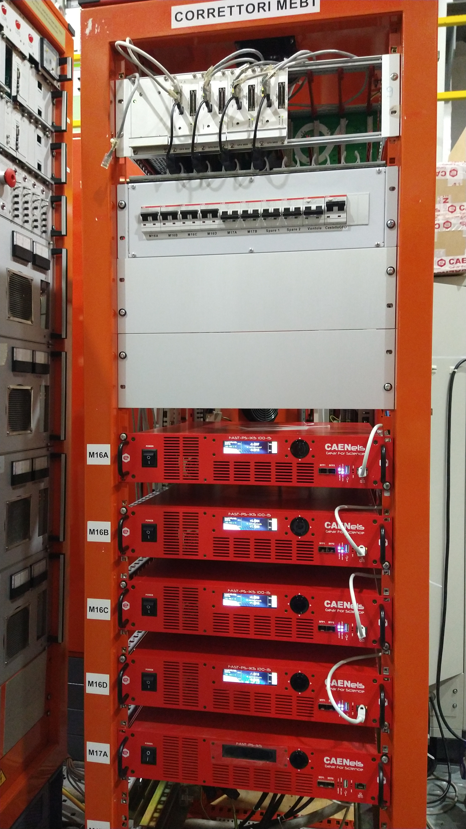
Inspirit
In December INSPIRIT project ended. All the project goals were successfully fullfilled:
  Installation of the low energy line to connect the new source to the
  rest of the machine
  Revamping of HEBT steerers power supplies
  Revamping of MEBT steerers power supplies

Slide 5
Inspirit
In December INSPIRIT project ended. All the project goals were successfully fullfilled:
  Installation of the low energy line to connect the new source to the
  rest of the machine
  Revamping of HEBT steerers power supplies
  Revamping of MEBT steerers power supplies
  Commissioning of a new PS for the HEBT switching magnet: it will be installed next week.

Slide 6
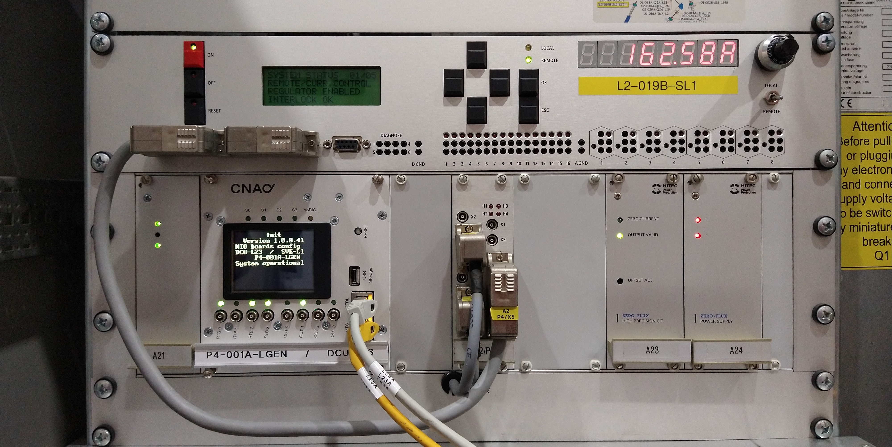
Inspirit
In December INSPIRIT project ended. All the project goals were successfully fullfilled:
  Installation of the low energy line to connect the new source to the
  rest of the machine
  Revamping of HEBT steerers power supplies
  Revamping of MEBT steerers power supplies
  Commissioning of a new PS for the HEBT switching magnet: it will be installed next week.
  Installation of a new control system for the linac magnets power supplies

Slide 7
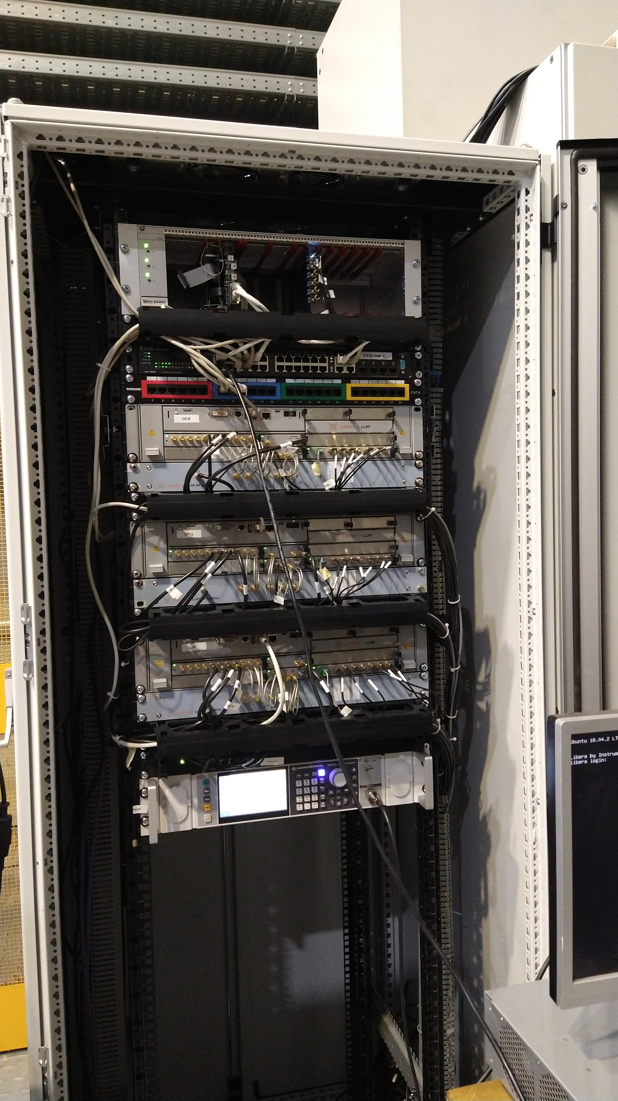
Inspirit
In December INSPIRIT project ended. All the project goals were successfully fullfilled:
  Installation of the low energy line to connect the new source to the
  rest of the machine
  Revamping of HEBT steerers power supplies
  Revamping of MEBT steerers power supplies
  Commissioning of a new PS for the HEBT switching magnet: it will be installed in 2 weeks.
  Installation of a new control system for the linac magnets power supplies
  Installation of new digital LLRFs for the three linac amplifiers

Slide 8
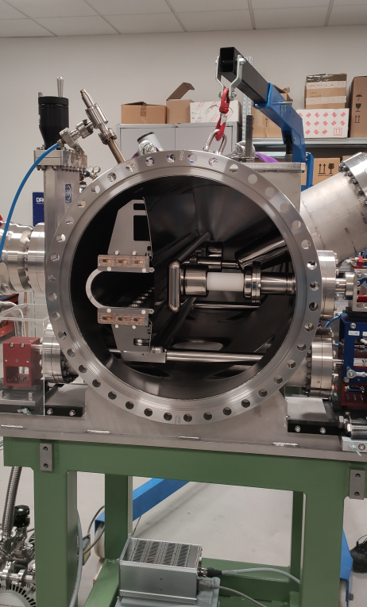
Inspirit - Electrostatic septum
Delivered to CNAO
Assembly and commissioning
in progress
Tests of controls and motion
foreseen in July
It will be installed next year

Slide 9
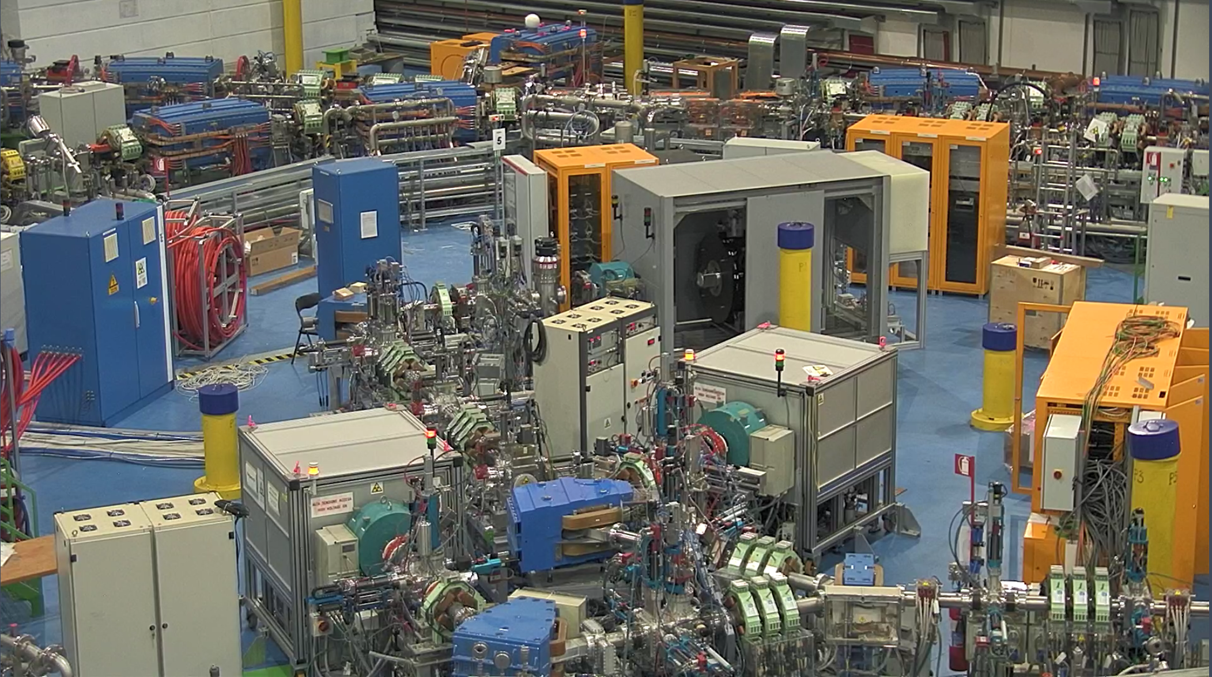
Inspirit – third source
Source in the synchrotron hall

Slide 10
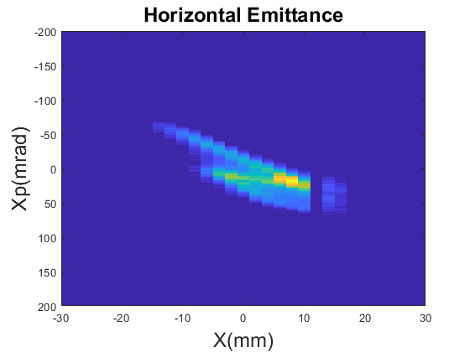
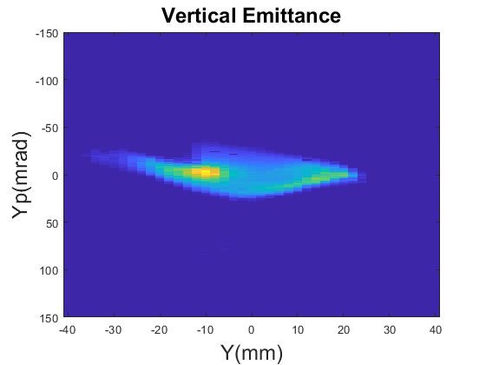
First He Beam!
20 Nov 2022
First beam needed to reach Inspirit goal
and to conclude the Inspirit project
Now waiting for authorization

Slide 11
Waiting for authorization
Feedback from ISIN: clarifications required
Questions answered a the beginning of May

Slide 12
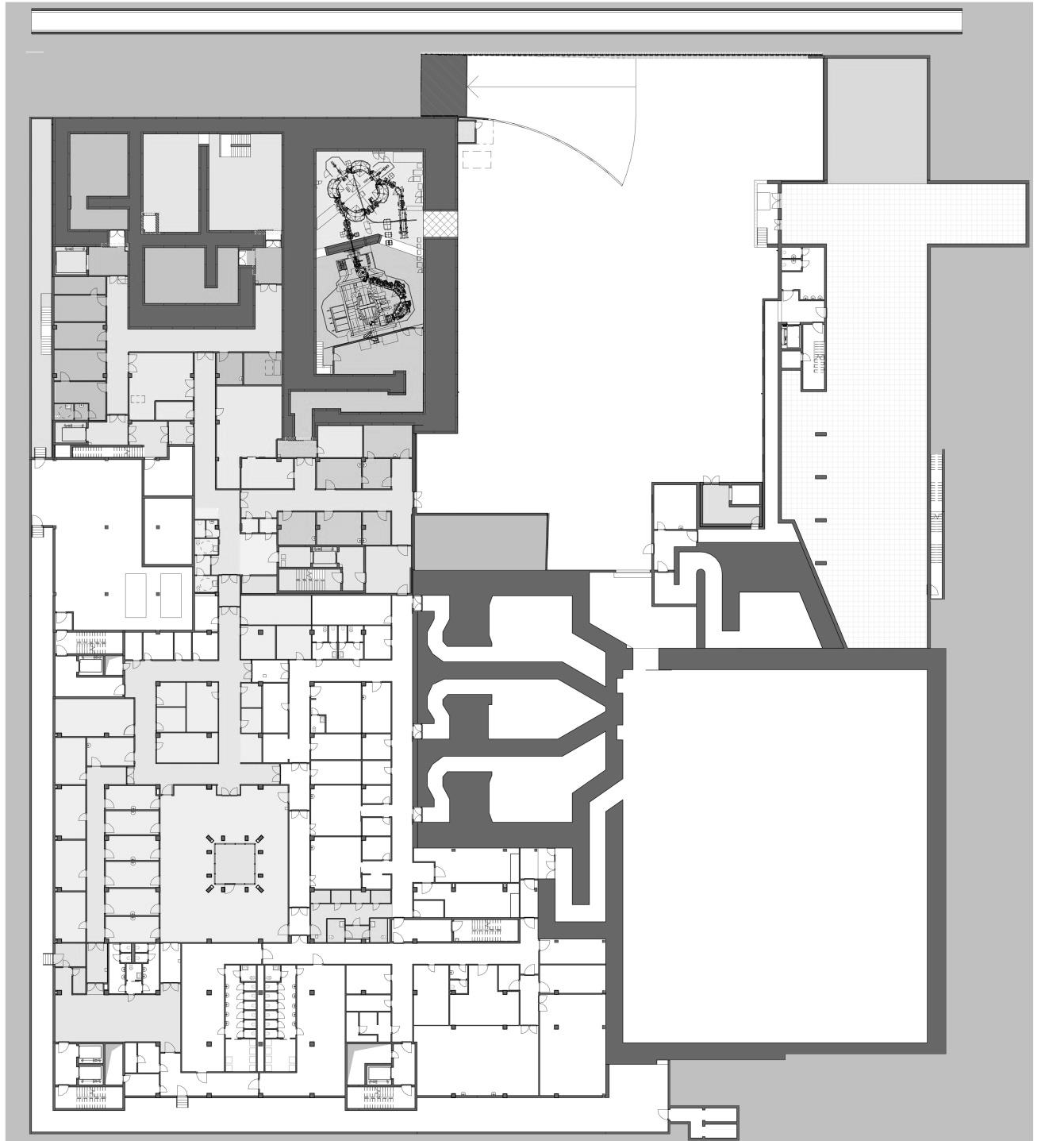

Expansion:
New facilities
EXPANSION AREA:
BNCT
EXPANSION AREA:
PT
Level -1 – End 2023
EXPANSION AREA:
DRESSING ROOMS AND TOILETS
EXPANSION AREA:
STORAGE AND ELEVATOR AREAS
REARRANGEMENT FOR PATIENTS WAITING AREA; AMBULATORIES AND ANCILLARY AREAS
REARRANGEMENT FOR
PERSONNEL DRESSING ROOMS

Slide 13
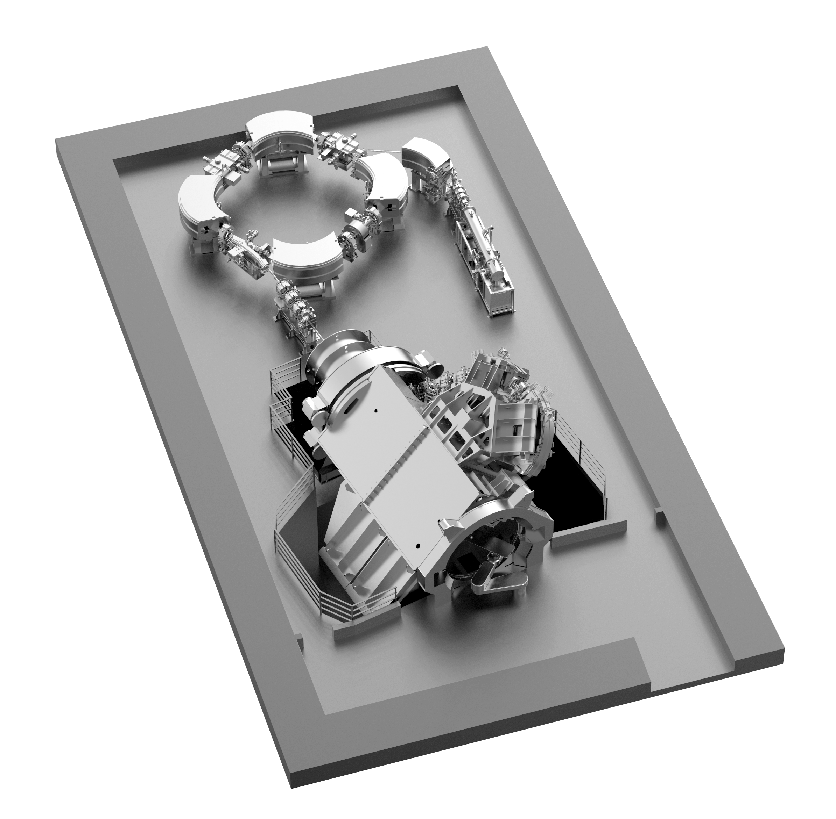
Hitachi Protontherapy gantry system layout
Installation of a state-of-the-art single room facility for protons, equipped with an isocentric gantry
Main features:
synchrotron, 5.7 m diameter;
70-230 MeV energy range;
active pencil beam scanning;
organ motion management functionality;
large irradiation field (30 x 40) cm²; for paediatric patients, to ease cranio-spinal irradiations reducing to a minimum the required field patching;
360 deg rotating gantry, 6 dof robotic couch;
possibilities of treatments in anaesthesia.
Courtesy of M. Necchi
Notes:
Contract Hitachi Dic. 2019;

Slide 14
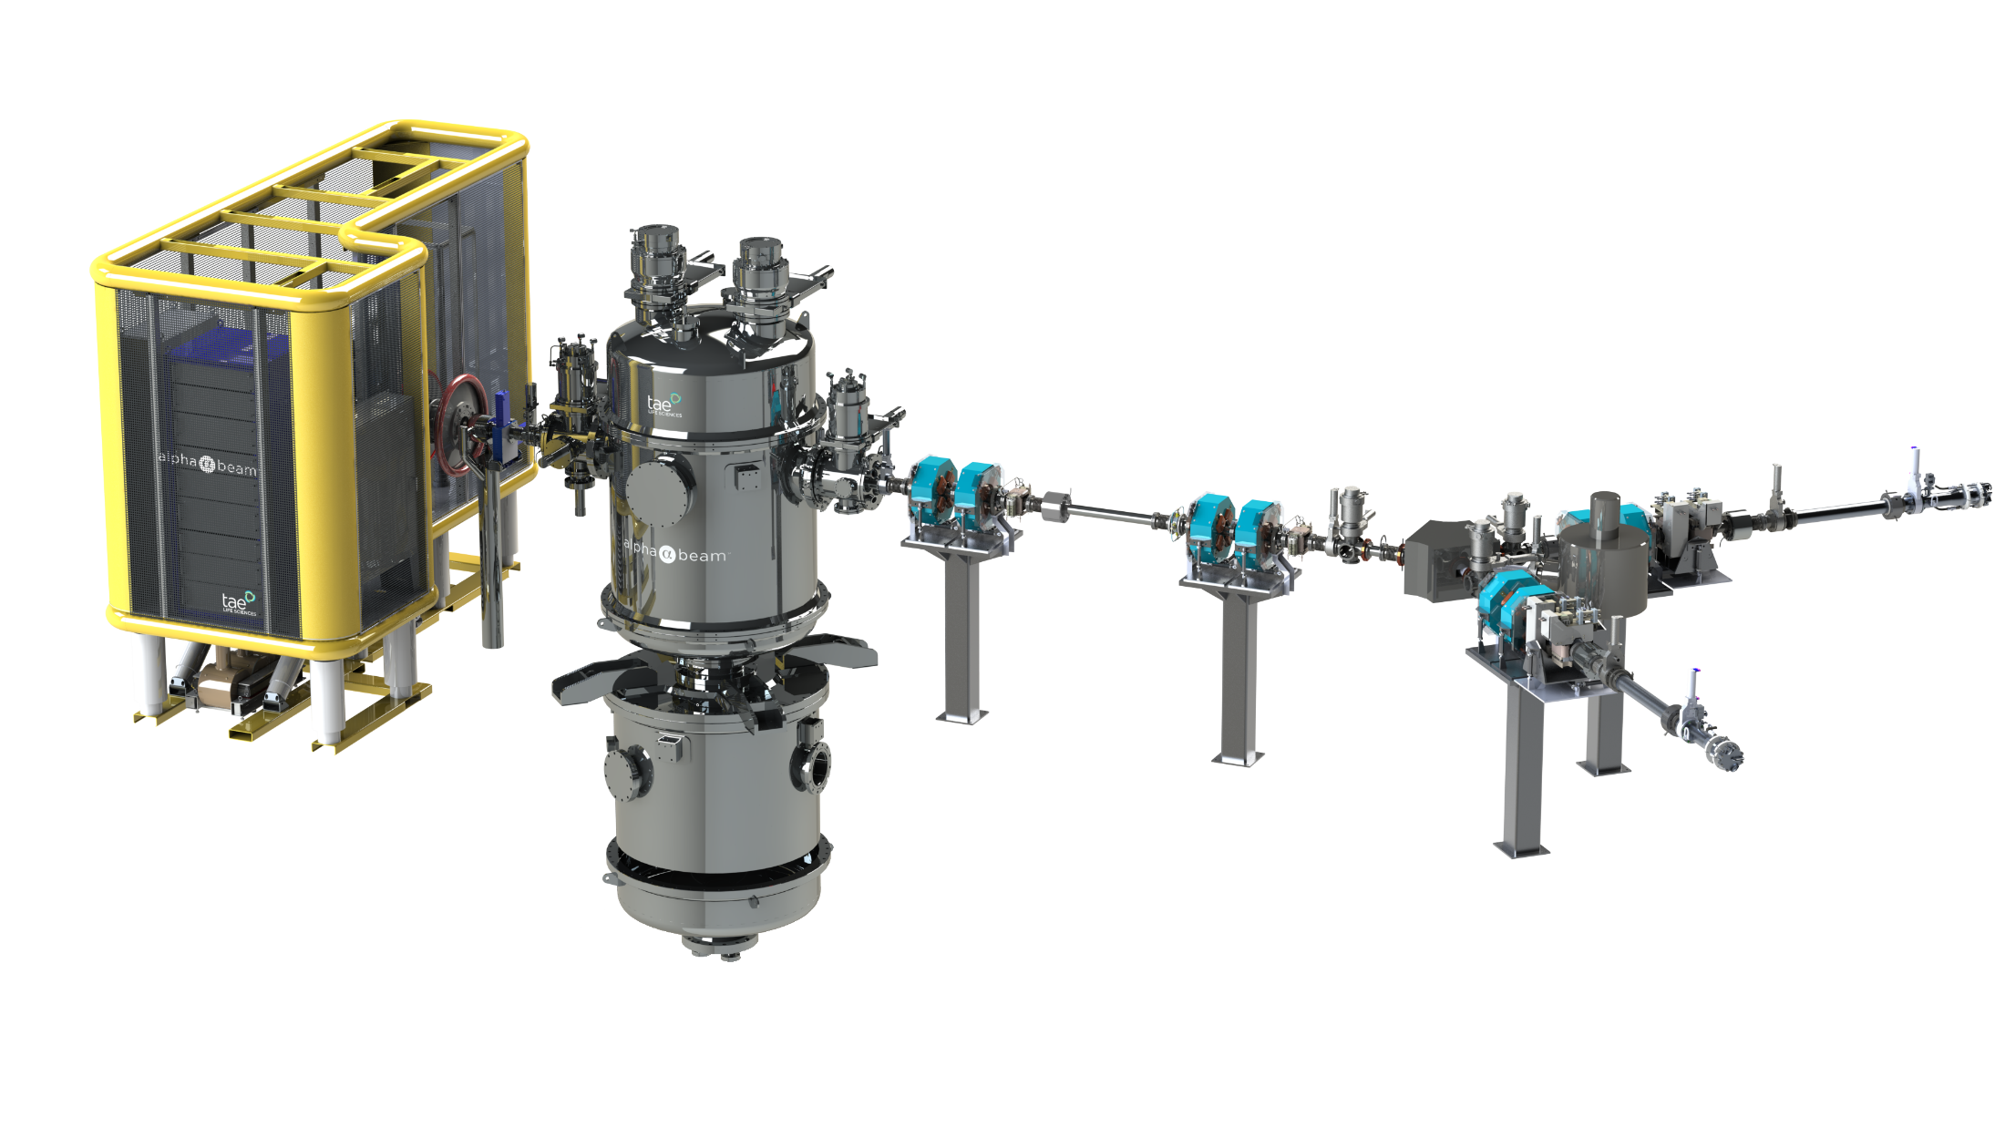

BNCT: tandem accelerator
Proton energy 2.5 MeV
Intensity 10-15 mA
p-Li reaction
Notes:
Collaboration agreement TLS Nov. 2020;

Slide 15
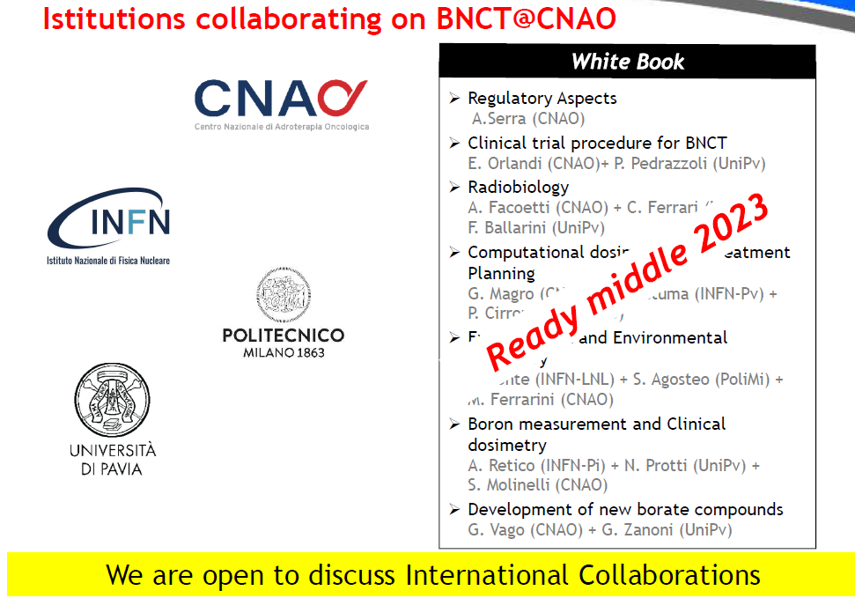

Slide 16
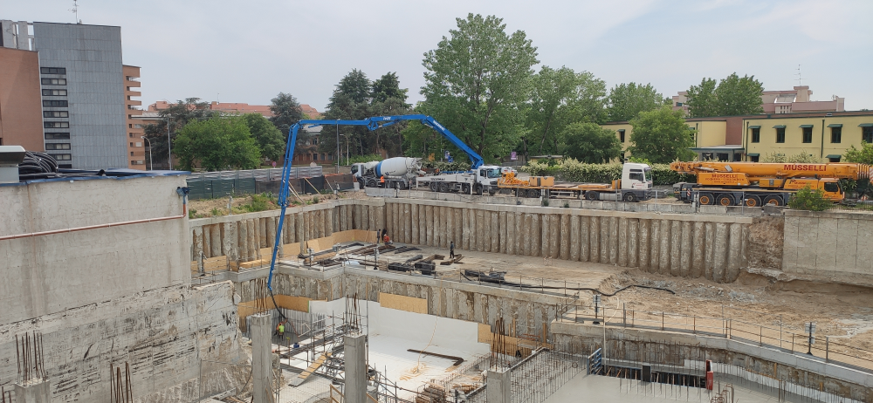
Accelerator and gantry room ready for Hitachi by the end of the year
Completion by May 2024
Notes:
Contract AR.CO Ottobre 2021.
Concrete casting
- the accelerator and gantry rooms for Hitachi will be ready by October 30th, 2023. By ready they mean that all the structures will be completed; the finishing of the walls will be there; all the plants elements (ducts, pipes, cable trays, electrical panel) will be installed, but they will not be connected to working plants (I will return to this in a moment). The basic idea is that the rooms are in a condition such that there is (almost) no need for ARCO's people to enter them anymore.
- The entire building, that is Hitachi and BNCT parts plus all the plants, will be completed and functional by April 30th, 2024.
In particular, the plants will be progressively activated in the last part of this period, since the electrical supply comes from an electrical room that is located on the top of the building, and in particular above the BNCT part; since this part will be completed by mid-January 2024 the electrical supply to the plants will come at the end.

Slide 17
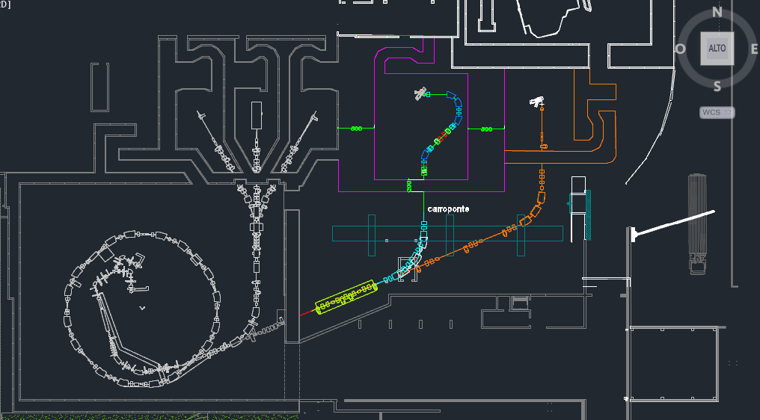
Carbon Gantry

Slide 18
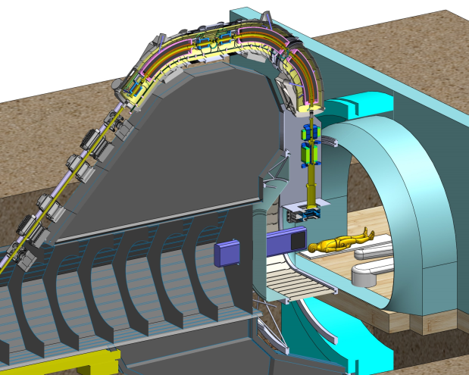
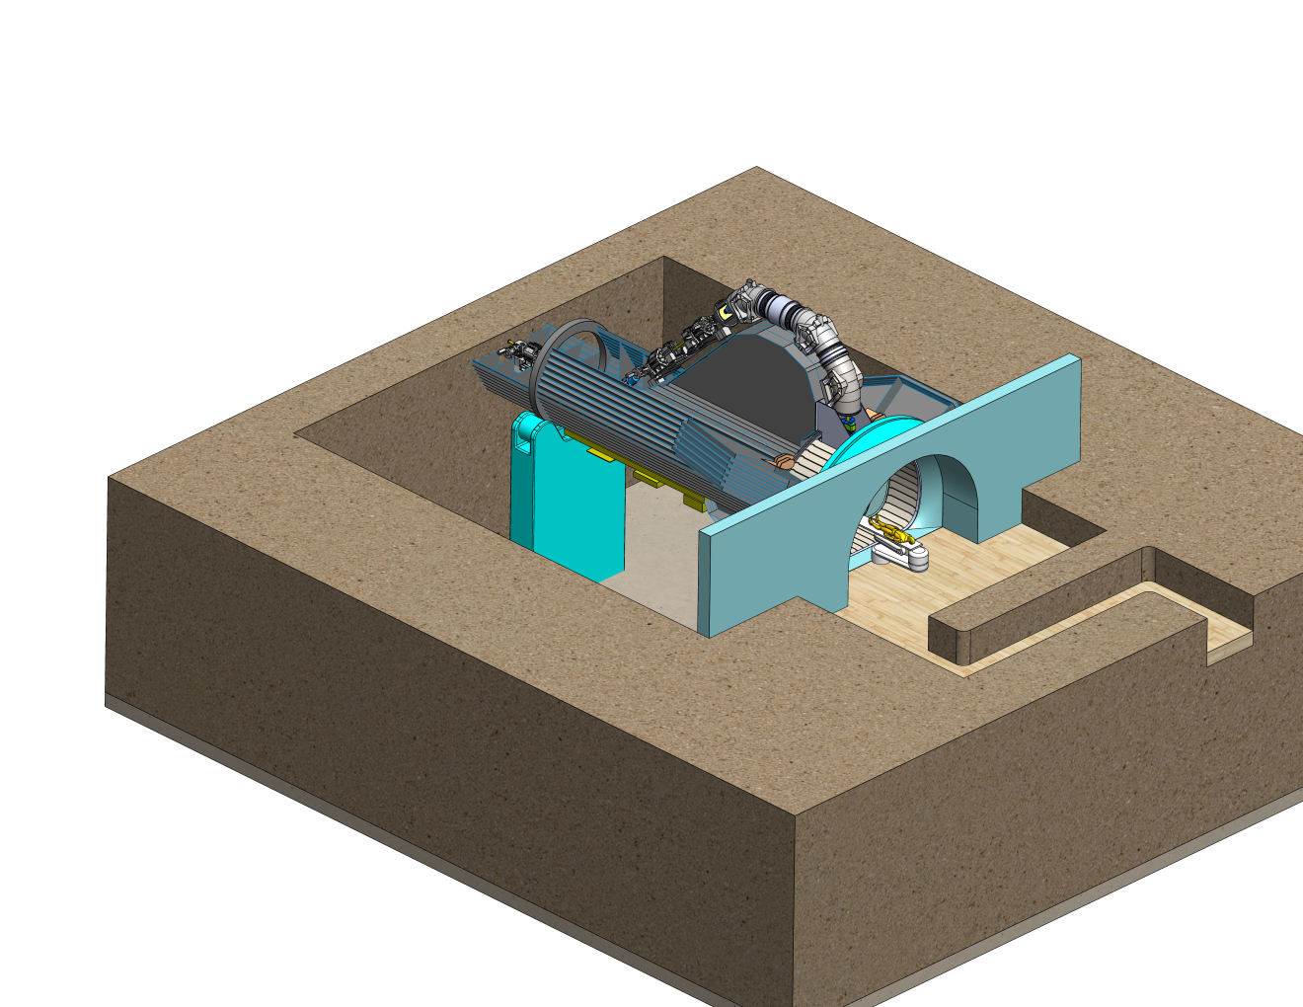
Carbon Gantry
Comparison of options and choice
360°
Gradient free SC dipoles
with spool piece quads
No large momentum acceptance

Slide 19

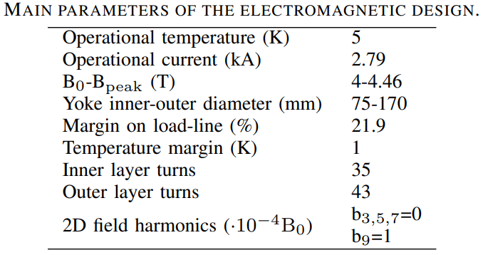
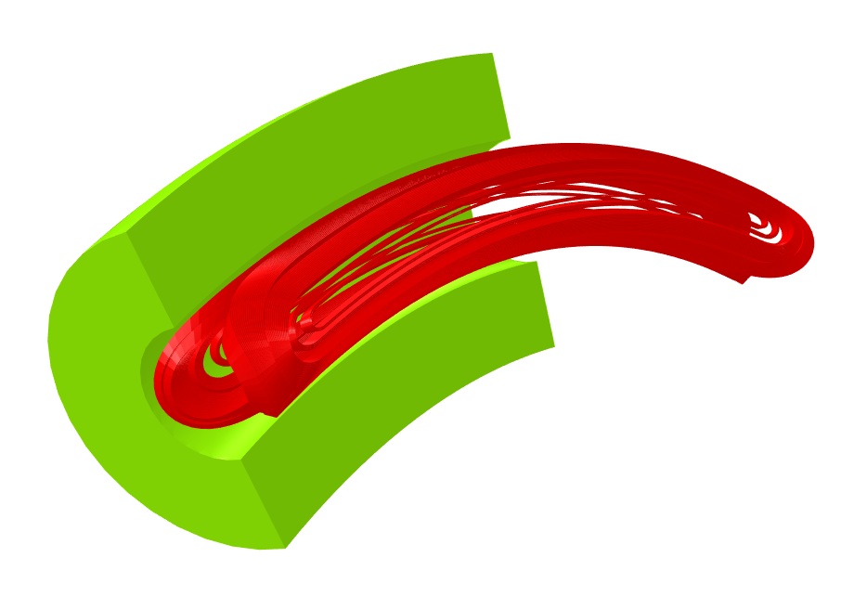
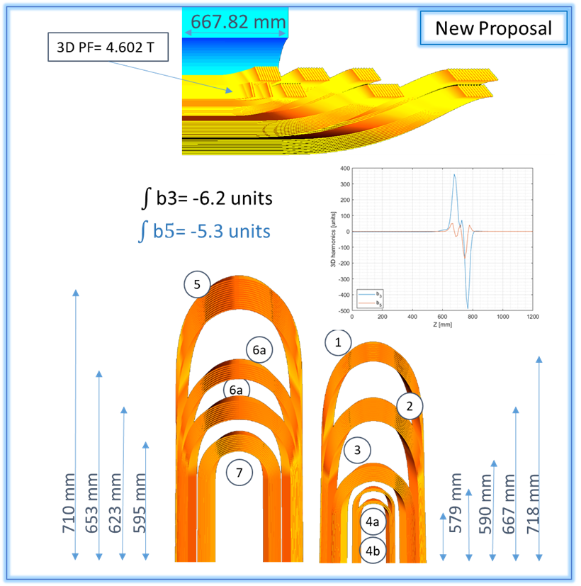
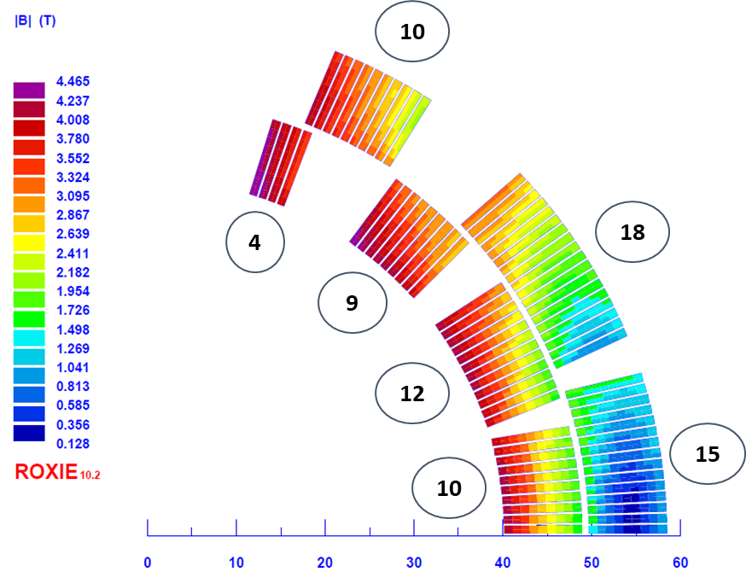
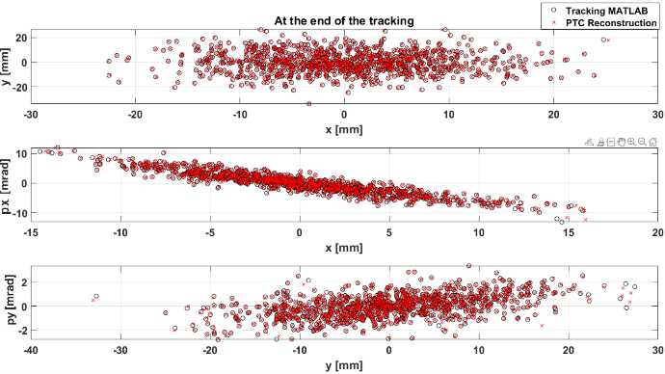
INFN-MI/GE, UniMi/Ge
SC magnets electromagnetic design
  OPERA 3D curved
Electromagnetic design loop closed!
ROXIE 3D straight
ROXIE 2D
  Beam optics simulations (CNAO)
Courtesy M. Prioli

Slide 20
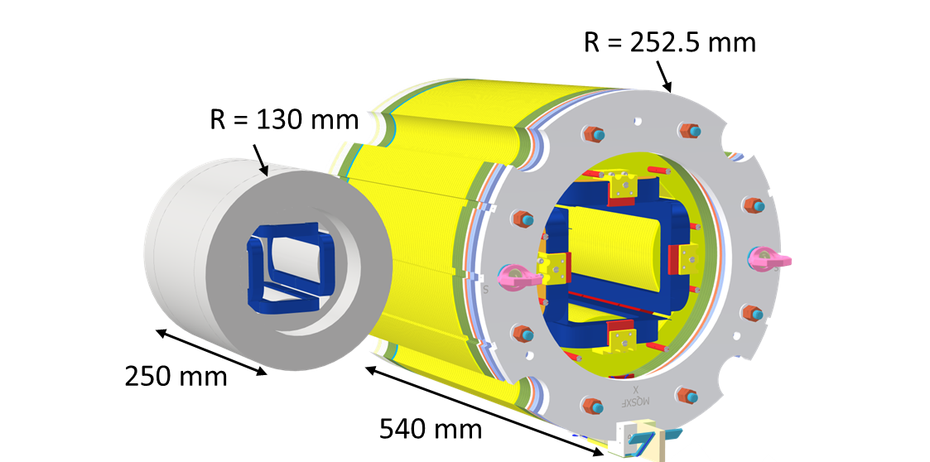
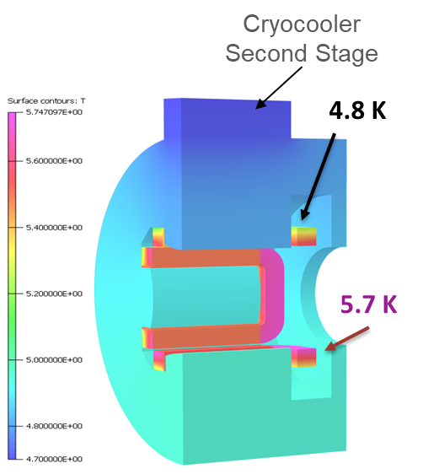
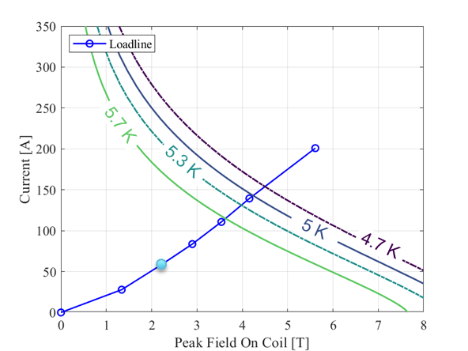
INFN-MI, UniMi
SC magnets quadrupole spool pieces
HL-LHC Skew quadrupole
SIG spool piece quadrupole
The gantry optical layout requires spool piece quadrupoles at each end of the dipole magnets
One possibility is to leverage on the INFN-MI LASA experience on the superferric HOC magnets for HL-LHC
First design:
40 T/m @ R_{ref} =26.7 mm of magnet field gradient
175 mm of magnetic length
60% margin on the loadline @ T = 5.5 K.
Indirect Cooling (gas vs cryocooler)
The thermal design is more demanding!
Courtesy of S. Mariotto, F. Mariani
Courtesy M. Prioli

Slide 21
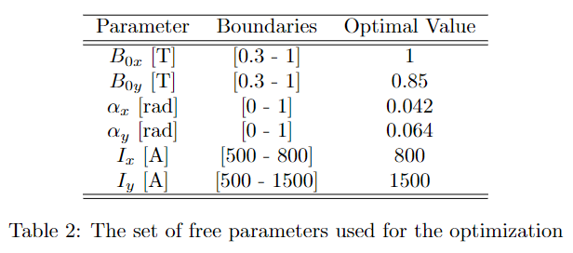
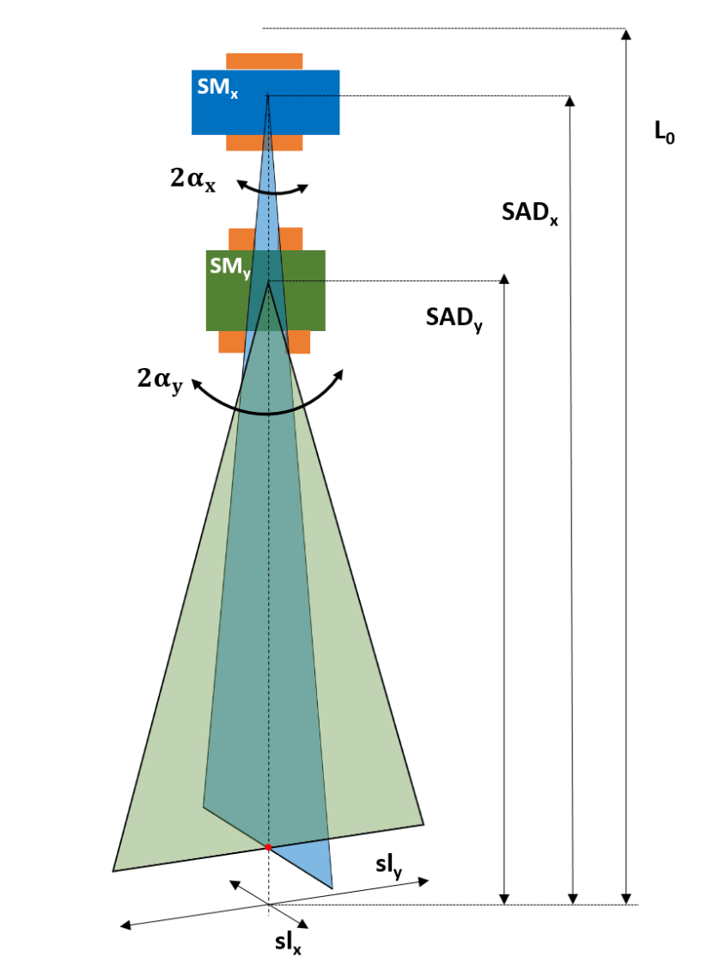
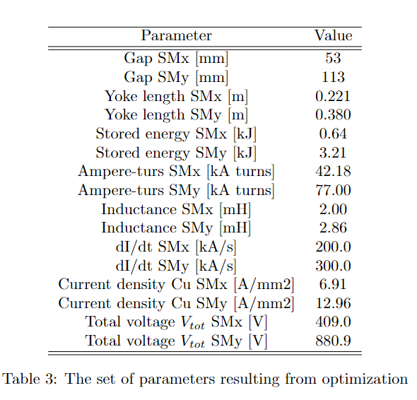
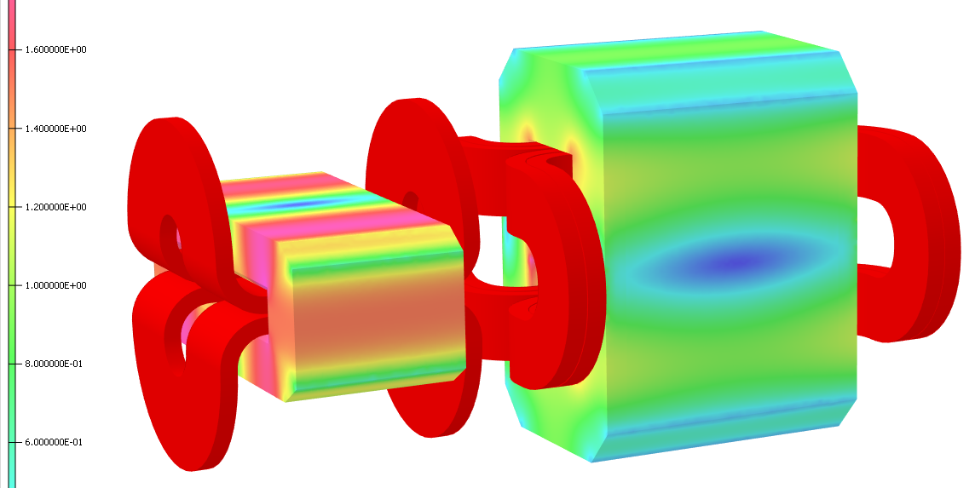
Coordinated by CNAO in SIGRUM
Scanning magnet system
Design targets:
Wide area 240 x 300 mm²
Scanning speed: 20 m/s
Beam accuracy better than 0.5 mm
Technical implications:
Demanding power supply (MedAustron)
→ Possibility of including a complete system demonstrator
Field repeatability 0.3 % in transient

Slide 22

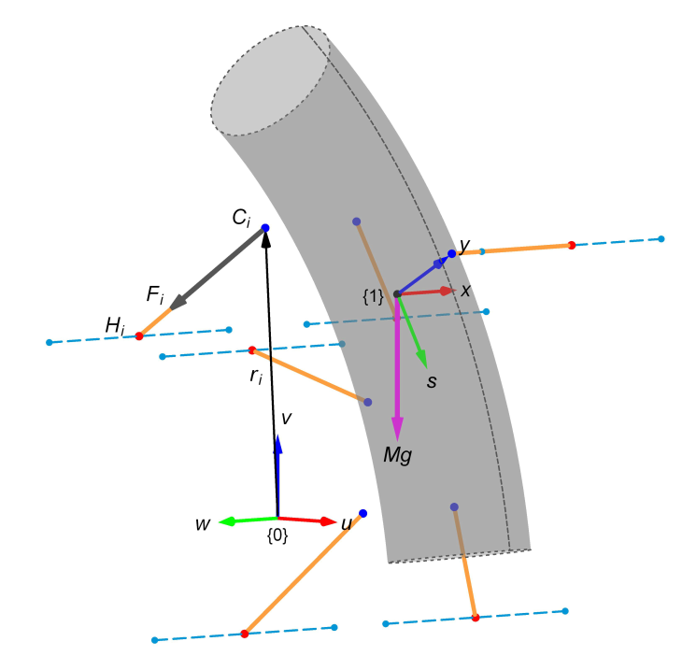
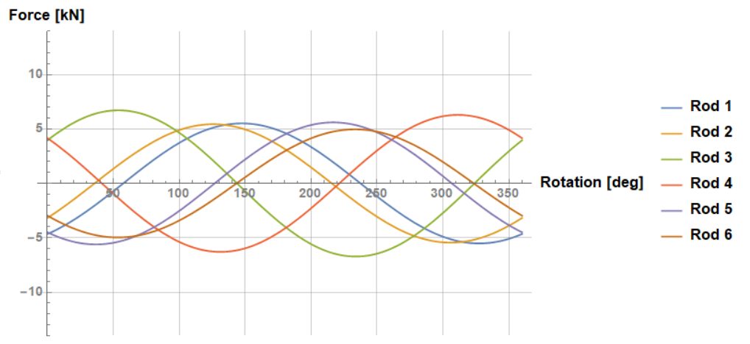
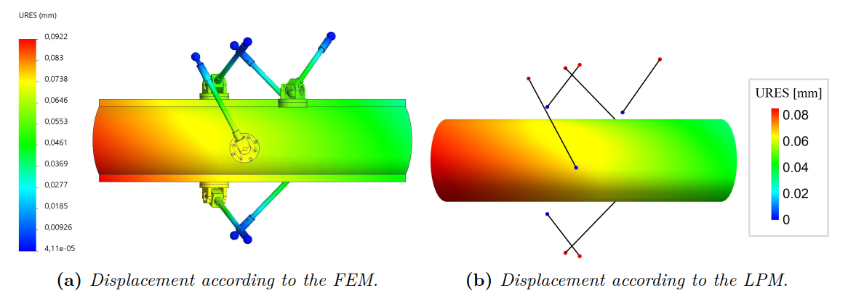
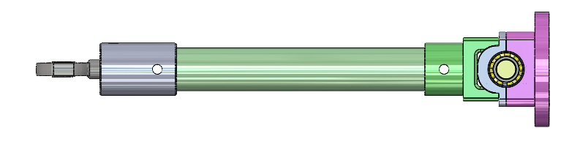
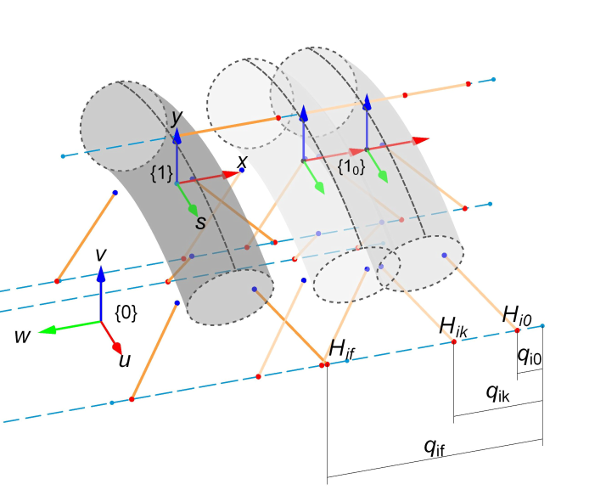

Cold-warm supports deformation
1
Equilibrium solution
2.5
Benchmark
2
DPK update and solution
Rod length
Cold joint position
Warm joint position
DPK
Position
Rotation
Courtesy of L. Piacentini

Slide 23
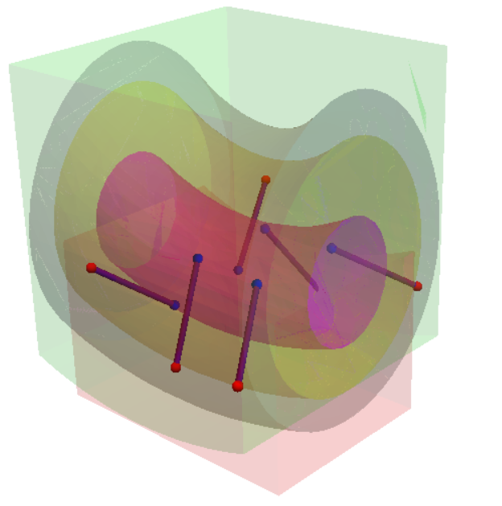
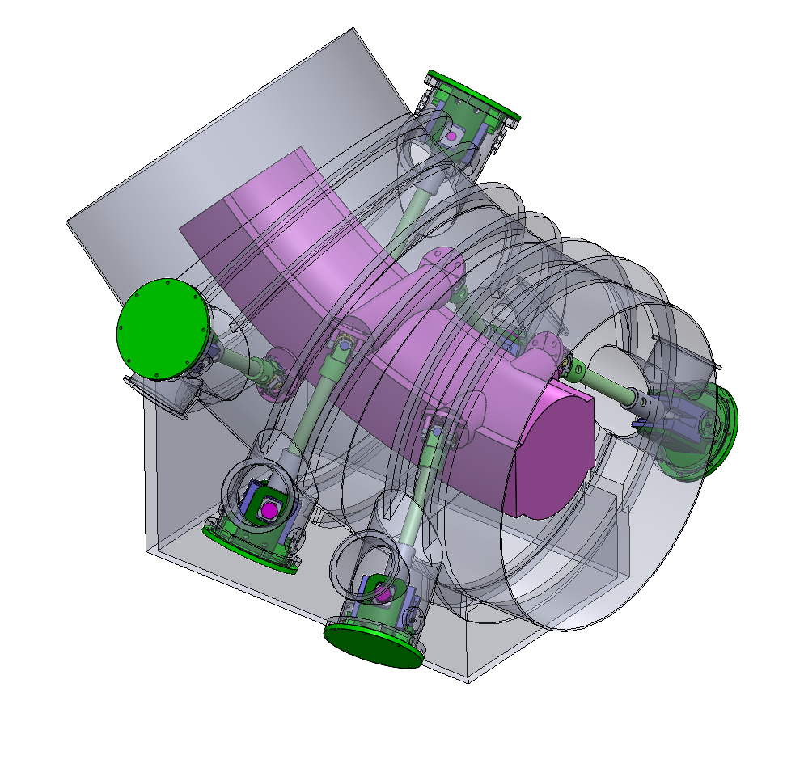
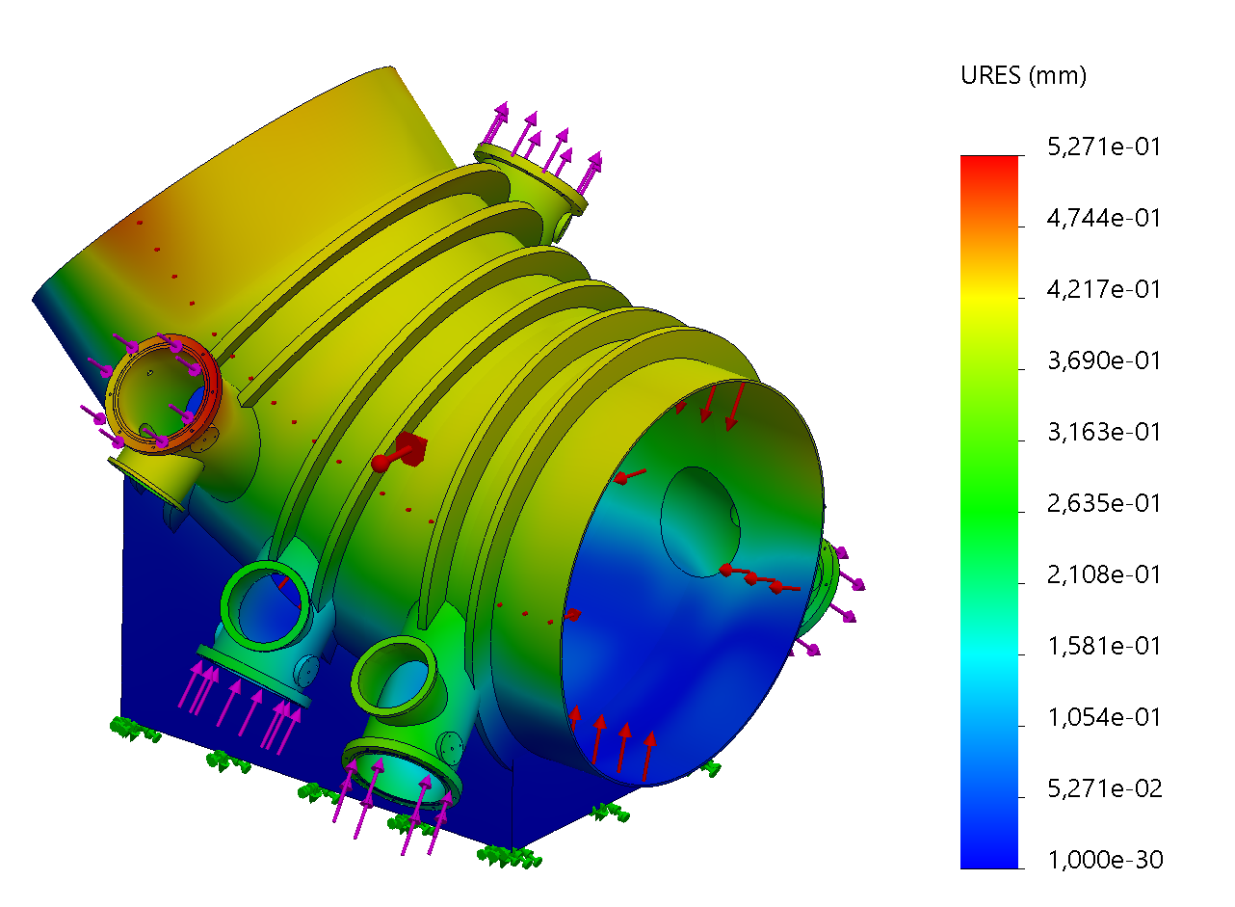
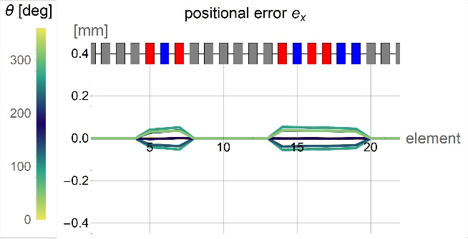
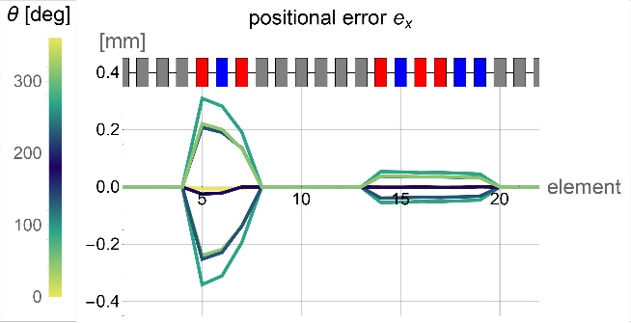
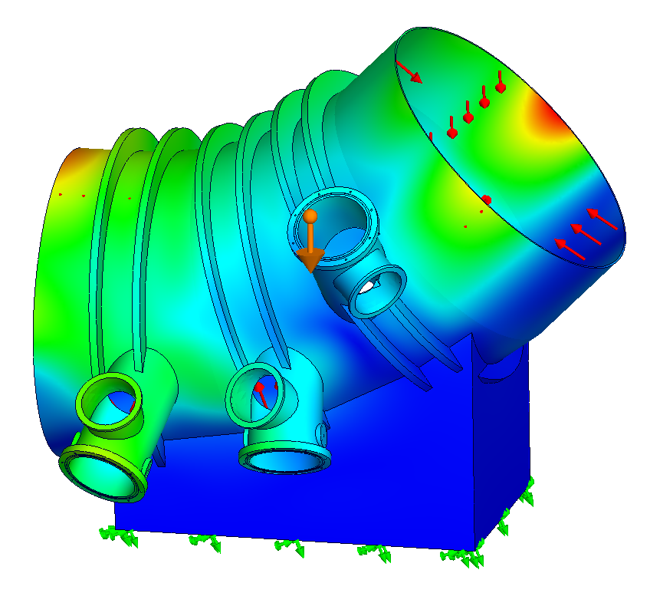
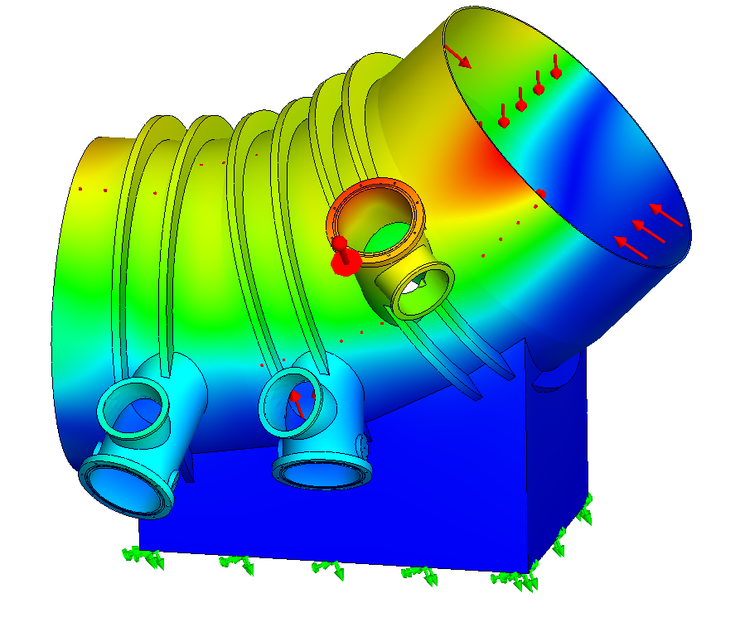
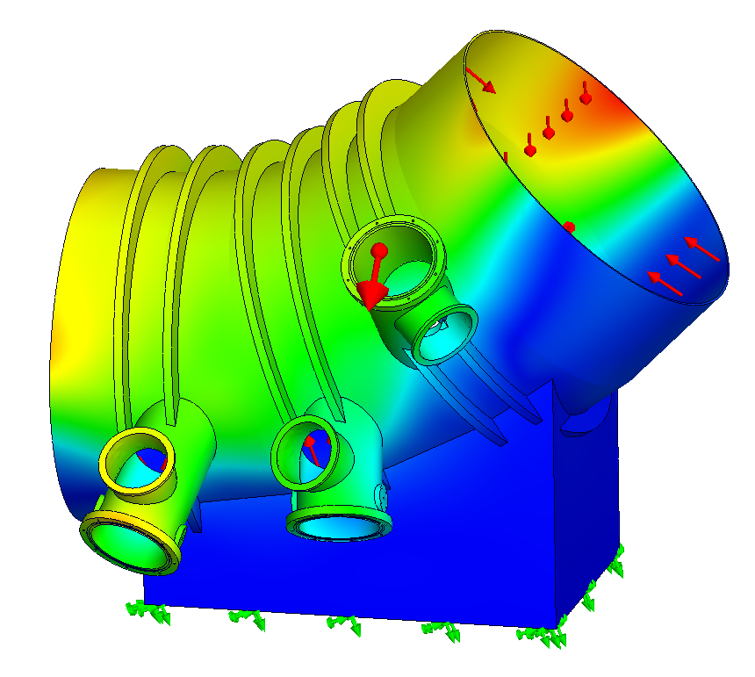
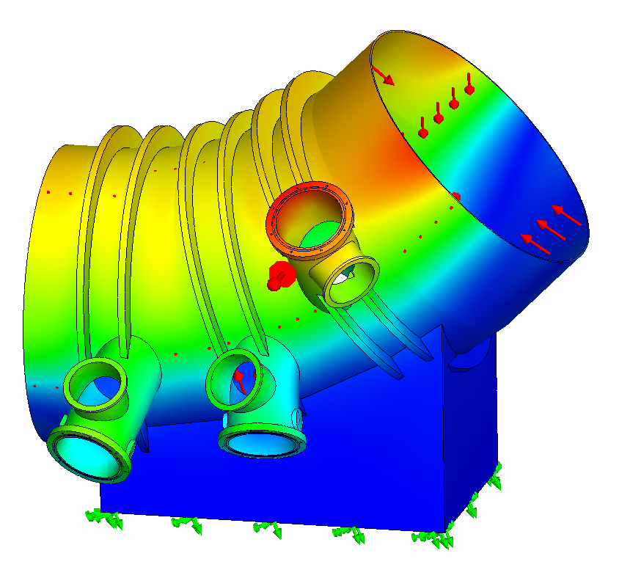
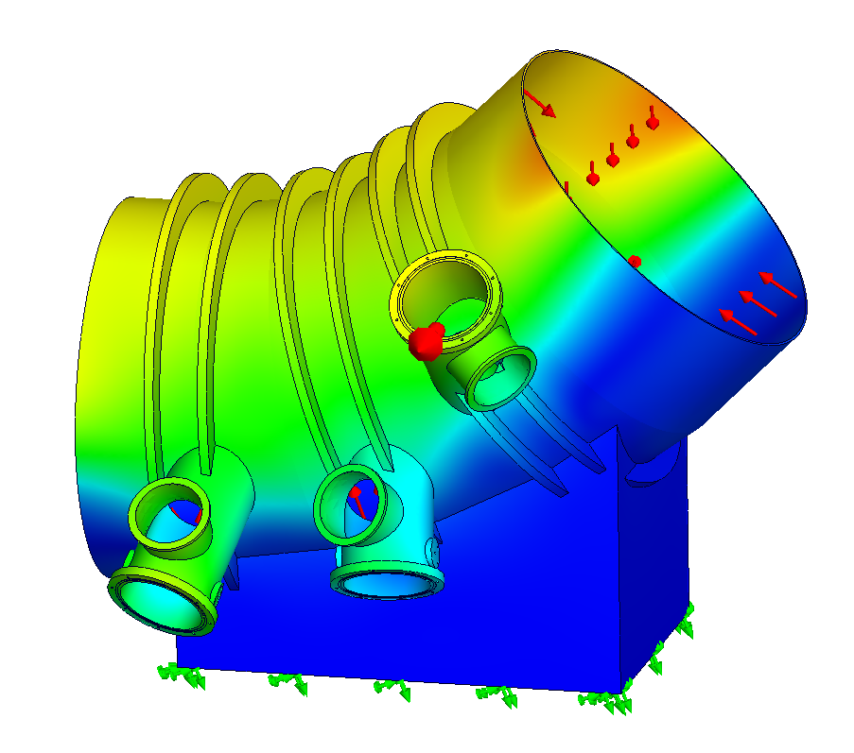
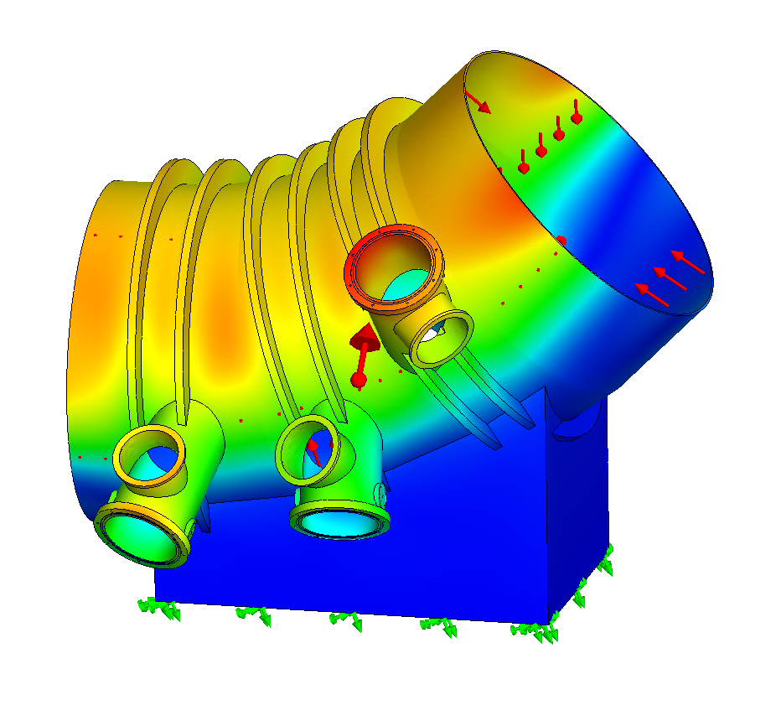
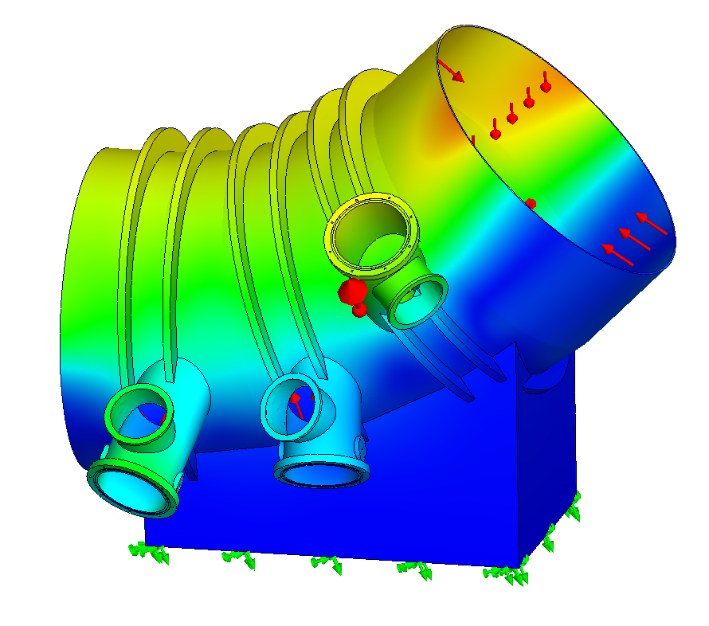
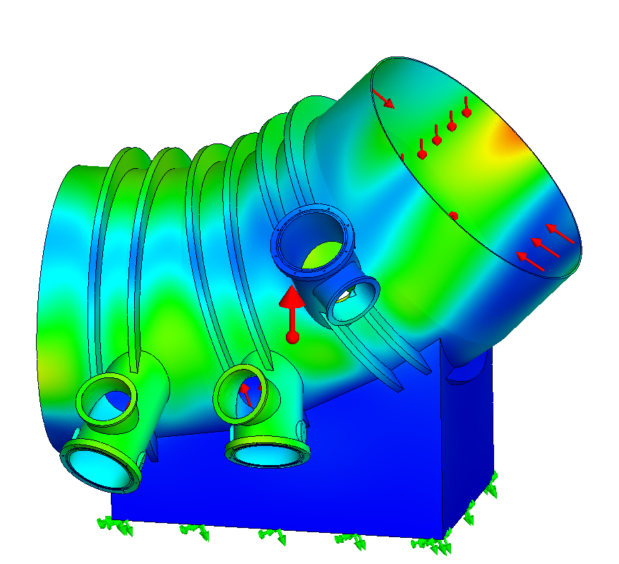
Next step: Vacuum vessel stiffness (VV)
1
Design and FEAs
2
VV stiffness effect
Systematic error
Geom. configuration
3D model design
FEAs
0°
270°
90°
180°
Courtesy of L. Piacentini

Slide 24

Doctoral school in hadrontherapy
Second year
application open
until July 5th
https://www.iusspavia.it/en/education/doctoral-programmes/hadron-academy-risk-and-complexity-high-tech-medical-innovation/call

Slide 25
Thank you for your attention
“Physics is like sex: sure, it may give some practical results, but that's not why we do it. ”
R. Feynmann

