Slide 1
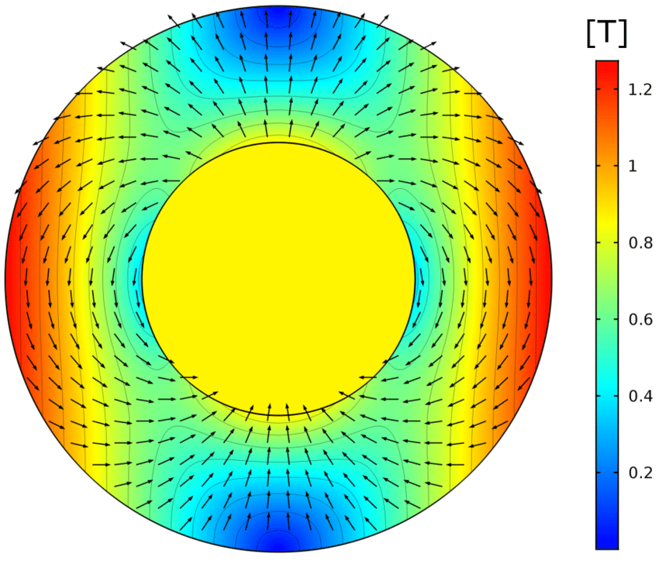
Magnet status
M. Villa
for A. Moggi, L. Sabbatini, E. Spiriti, S. Tomassini

Slide 2
Conclusions
Shown in Perugia
11 dec 2023
Where do we stand now?
The firm underestimated the difficulties at the beginning
They are solving all the problems
We agreed on a delivery by jun 23 (driver: magnet procurement)
We foresee a visit at Sigma-phi during assembly
After delivery, add 1-2 monthes for magnet characterization at LNF
Executive summary:
in autumn 2023 we’ll probably have a magnet to use!

Slide 3
March 2023 status
Since december we discussed all mechanical details to have a working system → well balanced
Magnet design was frozen (till the end of April) and magnetic materials have been ordered
So far so good … till march 2023

Slide 4
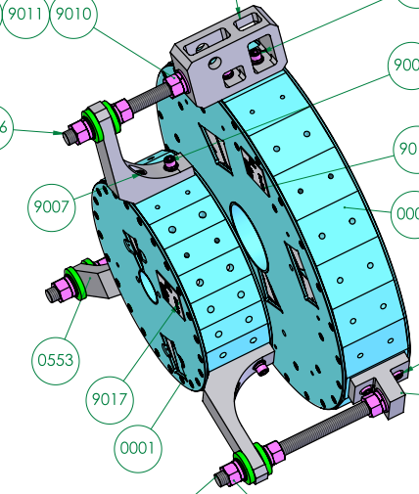
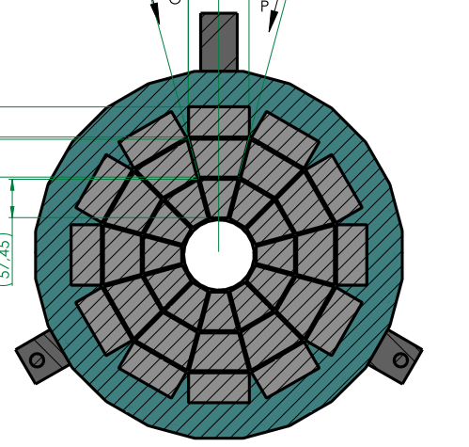
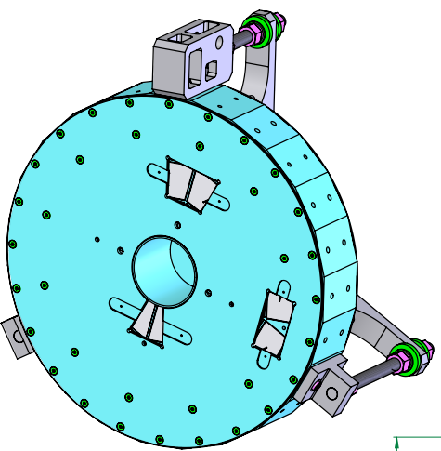
Actual (may 2023) status
Three elements are needed for the assembly of the magnets:
Yokes
Magnetic elements
Assembly tools
Assembly tools delayed by two monthes: delivered last Friday
Magnetic elements shipped by train. Arrived mid may.
Yokes and other mechanical pieces are at the firm since march.

Slide 5
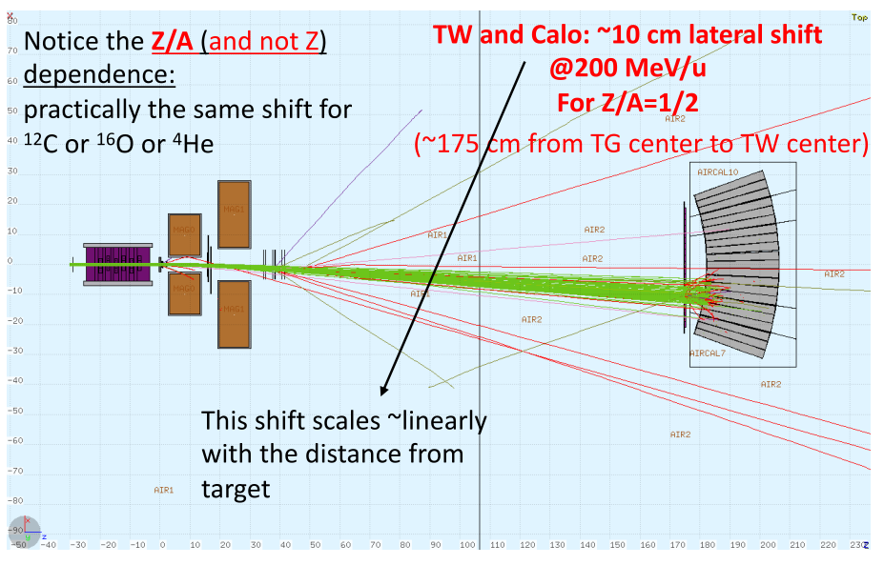
Last change requested: B versus
CDR & initial magnet design: B field in the +y direction
CNAO Experimental
Hall
GB & SM
simulations
XPR walls (approx)

Slide 6
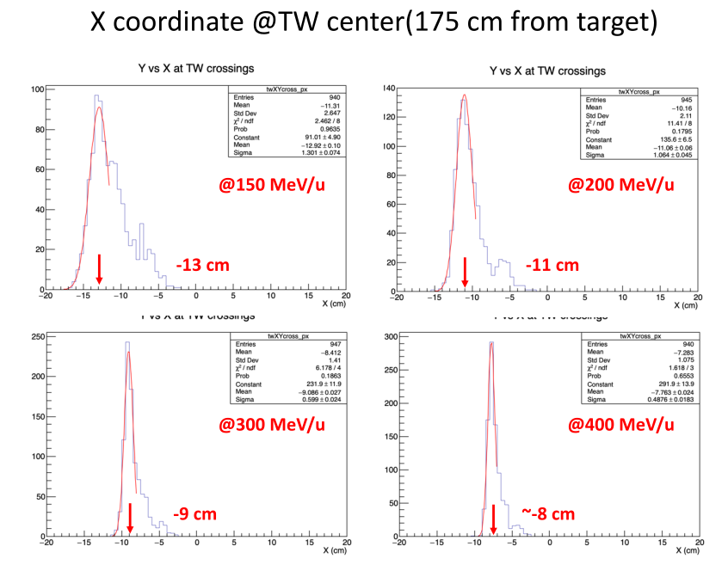
Results for any Z=N beam
⁴He, ¹²C, ¹⁶O
Protons (N=0) are deviated by twice of the shown admount
Credits to GB & SM

Slide 7
Other considerations
We are interested to have the beam at the center of the TW & CALO
→ we’ll shift TW & CALO accordingly, coming closer to the wall and reducing working space
Walls are a (significant) source of secondary radiation: while it should be negligible for what regards tracking, noise at the TW and at the CALO might reduce the TW HIT & CALO efficiency.
Soo….
Smart suggestion (MM): what about to change the B polarity ?
Charged fragments will be deviated toward the left, away from the wall…

Slide 8
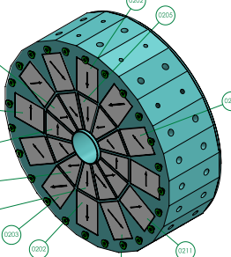
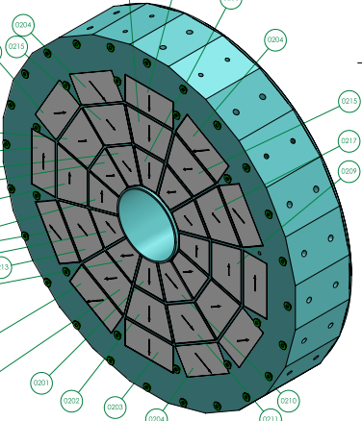
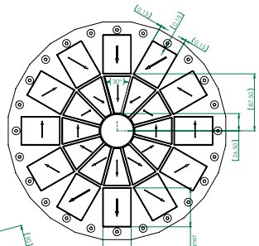
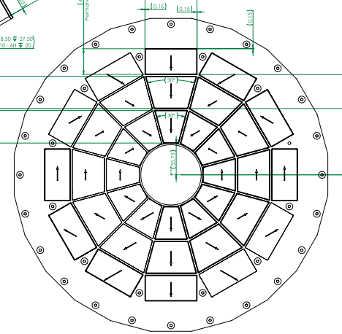
Decision taken: B is pointing downwards
The firm ensured us that is can be done just changind the assembly order: no delays, no extra costs

Slide 9
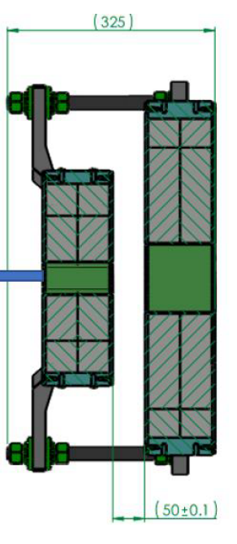
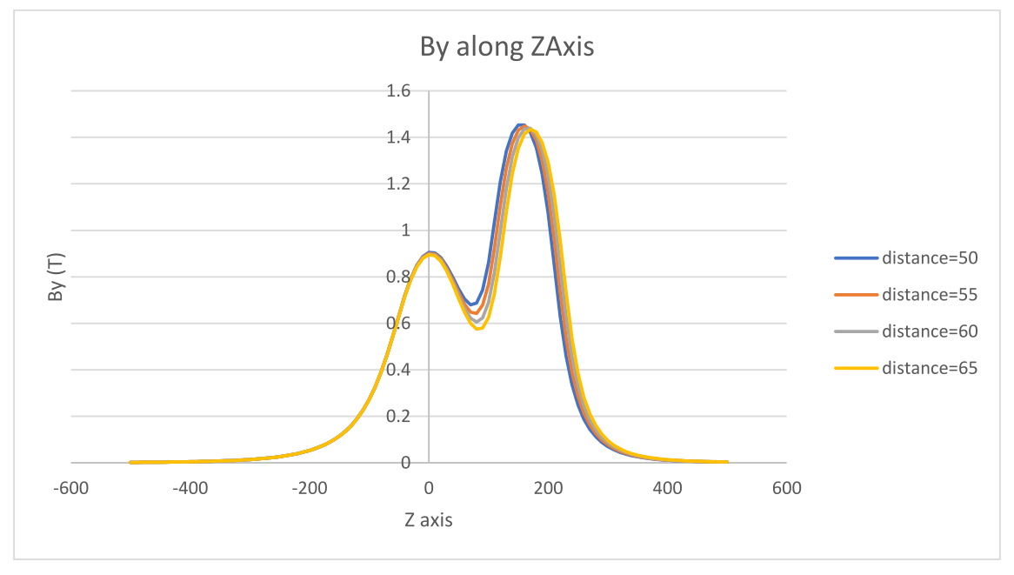
Magnetic field
-B_{y} (T)
Distance fixed to 55 mm

Slide 10
Current time scale
Manifacturing M1: from 05/06 up to 27/06/23
Manifacturing M2: from 26/06 up to 19/07/23
Assembly M1+M2: from 20/07 to 26/07/23
Measurements @ SigmaPhi: from 27/07 to 02/08/23
Assembly and packing: from 03/08 to 30/08/23 (vacation time)
Shipment: 31/08/23
Arrival at LNF: 13/09/23
Measurements at LNF: one week from 13/09 to 15/10/23

Slide 11
Conclusions
The firm is entering in the assembly phase since TODAY!
It is still a difficult phase → surprises can happen
Time estimates were «conservative».
Current timeline allows us 4-6 weeks of magnet tests in Frascati before the next data taking (need just 2 days + thinking+1 day)
Stay positive!!

