Slide 1
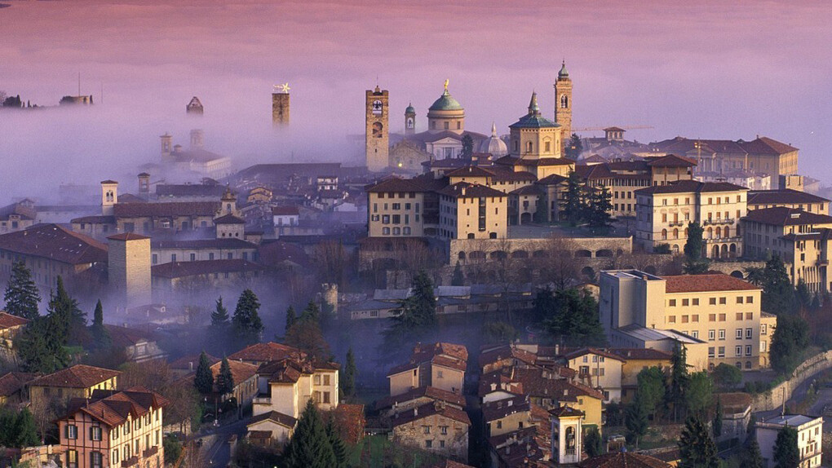
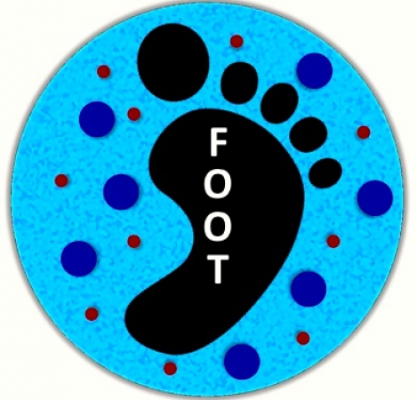
XIV FOOT meeting Introductory remarks

Slide 2
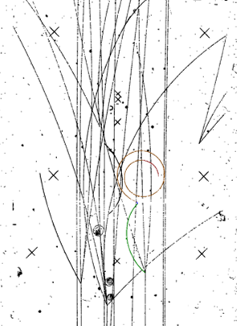
Detector status
Electronic set-up:
For the first time we see the possibility to have
A complete detector by october 23
Good knowledge of installed detectors
Data taking this year will be the first with the full detector
Emulsions:
Good experience with standard emulsions
NIT emulsions already tested →a data taking using them for physics has to be planned

Slide 3
Tools
Monte Carlo:
Continuously evolving and following the different set-ups used in data takings or contributing to the definition of the set-ups!
Trigger and Data Acquisition:
Evolving with time and detectors on the beam line
More online controls; not yet finished!
Reconstruction software:
Shoe: continuously evolving with the different set-ups. More features at each release. Well developed and tuned on MC data; requires tuning at each data taking (alignment, noise, detectors on the beam line….)
Emulsions: properly running
Tools are being used to get some physics!

Slide 4
Data takings
Electronic set-up:
GSI 2021 (¹⁶O, 200-400 MeV)
HIT 2022 (⁴He, several energies)
CNAO 2022 (¹²C, 200 MeV)
Emulsions:
GSI 2019
GSI 2020
At the moment we do not lack data samples; for some of them, we just await volontiers!
Future campaigns (2023, 2024) will take advantage of the full detector and of our improved knowledge on the detectors and reconstruction programs

Slide 5
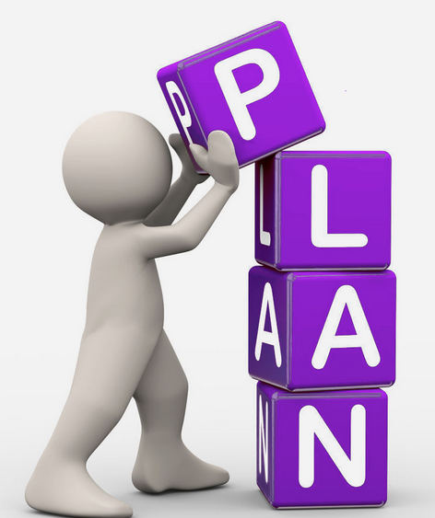
FOOT impact on the community
The FOOT community is active on several fronts:
PRIN 2022 won with direct involvement in FOOT:
Giuliana Galati (DAEMON)
Matteo Morrocchi (TOFPIRad)
Eleuterio Spiriti (High performance DMAPS for HT)
(but also: Michela, Giuseppina, Giovanni,
Ester, Francesca … who am I missing? Apologies for missing ones…)
Paper and conference proceedings
Proposal writing
ESA fund requests 2023, Horizon Europe 2023 (space)
Agencies planning:
INFN Mid-term plan,
NuPECC Long term plan
All these activities are are signs of a healthy
and active collaboration!

Slide 6
Time to start the meeting!
Please stay in the allocated time
Please upload your presentation as soon as possible
Have a fruitfull meeting!

