Slide 1
Hitachi Storage Solutions
Hitachi HDD Directions
HDD Actual Technology & Evolution
HDD Performance Comparison
Performance prediction tool
Proprietary – Do not reproduce or distribute without the written consent of Hitachi Data Systems

Slide 2
Topics
New products to leverage new technologies
  Continuous improvement from the existing
  Adapt what is known to new needs
Evolution scale
  Where we are coming from, what drives us, where are we going
The new Wave
  What are we targeting and why
  Product principles

Slide 3
Storage Directions

Slide 4

The Genesis of a New Products
When we introduce new products
  New technology availability
    i.e. processors, disks, connectivity, etc.
      Older technology end of life
  New functionalities
    Improvement or new ways to handle/store/protect your information
  Meet market prices
    Price erosion and business value
How do we introduce new products
  Continuous improvement philosophy
    Build on what is proved and known
  Functional continuation with the past
    Not a simple swap but a progressive substitution
  Enhance the legacy
    Up to the previous technology reasonable capability

Slide 5
Direction of Hitachi Core Technology – Continuous Evolution
2004 | 2007 | 2010-2012 | 2014~2015 and beyond
Fully Virtualized
Storage Array
Scalable Virtualized
Modular System
Simplification and Efficiency
Storage Capacity Virtualization (Dynamic Provisioning)
Storage Device Virtualization
Note: Dates shown are general targets; no commitment for any new product release

Slide 6
New Technologies Directions
Notes:
Explain what we will use to design and deliver the next platform addressing the

Slide 7
Hard Disk Drive Directions
SAS 3G
FC HDD
300/450/600/900GB FC 4G / SAS 6G
73/146/300GB FC 4G / SAS 3G
73GB/146GB FC 2G
3.5”
10K 15K
Enterprise Performance Disks
400GB-600GB FC/4G
73GB/146GB / 300GB FC 2G/4G
Next Generation HDD technology
146GB/300GB SAS 6G
FC 2G
73GB/146GB SAS 6G
FC 2G
2.5”
7200 10K 15K
146GB/300GB SAS 6G
450GB/600GB /900GB SAS 6G
73GB/146GB SAS 3G
300GB/450GB/600GB SAS 6G
500GB SAS 6G
1TB SAS 6G
PATA
SCSI
4TB SATA 3G /SAS 6G
3.5”
7,200 rpm
1.5TB/2TB SATA 3G /SAS 6G
Enterprise Value Disks
500GB PATA/SATA 1.5G
750GB/1TB SATA 3G
750GB/1TB SATA 3G/6G
2.5”
7,200 rpm
500GB SATA 3G
>1TB SATA 6G
2005 2006 2007 2008 2009 2010 2011 2012

Slide 8
Where’s the Solid State?

Slide 9
What Are We Keeping: Changing Enterprise Data Profile
Consumption of Enterprise
Disk Capacity by Type
(EB)
CAGR
121.1%
63.7%
Flash?
43.9%
32.3%
Source: IDC 2008

Slide 10

Flash Memory Drives/SSD - Adoption
What prevent a faster adoption? In first place, Cost!!!!!!
Sources: IBS, IDC, Gartner
HDD compared: SATA

Slide 11
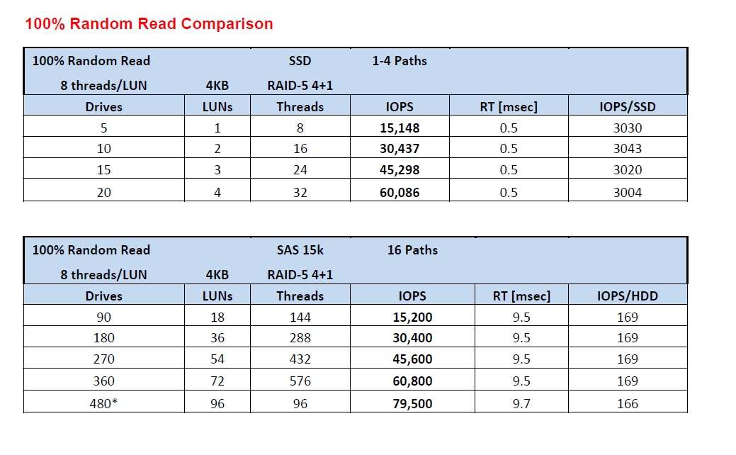
Random Read SAS vs SSD

Slide 12
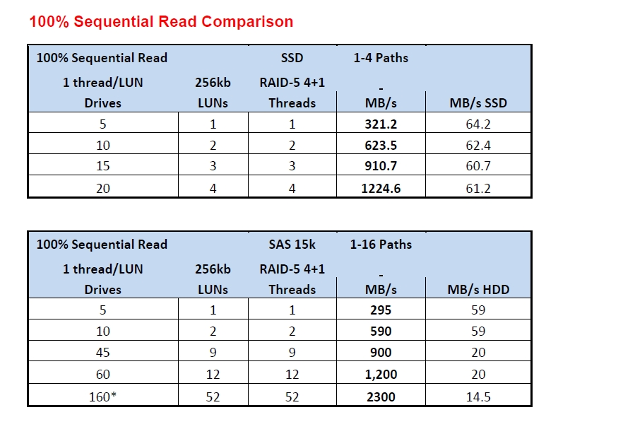
Sequential Read SAS vs SSD

Slide 13
New Technologies Effects
Efficiency, efficiency, efficiency
  “Thought Leader “ approach vs. “me-too” features
Floor space efficiency
Higher TB/sq. ft.
SFF drives/SSD; 2x more HDD/sq. ft., high density package (19” rack)
Power efficiency
Lower KVA/sq. ft.
Modular architecture, low power memory, 2.5”drive, solid state drives, flash protected cache (minimal batteries), fan and hard disk drive power control
Performance efficiency
Higher system throughput
Faster processors, high speed memory, large cache, Hitachi Dynamic Provisioning, fast connections
Capacity efficiency
Higher utilization
Dynamic provisioning, hierarchical tiers
Virtualization and solution services
Better resources utilization
Power consumption monitoring function and operation report and assessment
Operational efficiency
Easier to use, configure, optimize, lower TCO
Improved GUI, command line interface, automation policies

Slide 14
Adjusting to the Workload Heat…..
Data Heat Index
Space efficiency and high performance combined by using more granular data movement control
Right data, right place, right time
High Activity
Working Set
Normal
Working Set;
a “Shock Absorber”
Quiet data,
Archival,
Residual data,
and free space

Slide 15
The Economic Impact of Automated Tiering
Workload
High
5%
50% I/O
Tier0 $/GB = 10 → @ 5% = 0.05
15%
30% I/O
Tier1 $/GB ratio = 5 → @ 15% = 0.75
80%
20% I/O
Tier2 $/GB ratio = 1 → @80% = 0.8
Total $/GB ratio = 1.6
Low
Notes:
A look at the economic impact; with just 60% increase over the cost of the lowest tiers, we can, in this example, provide 80% of the workload from much higher and performing storage elements

Slide 16
Product Familily

Slide 17
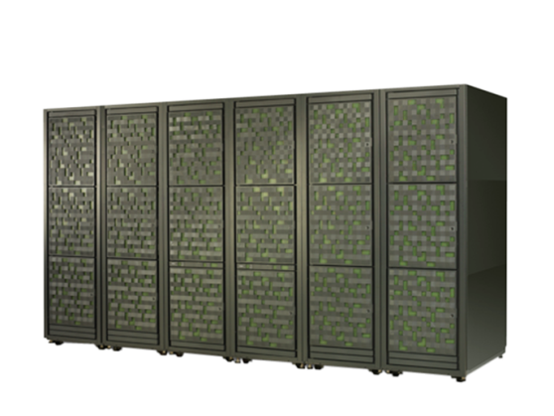








Integrated Scalable Storage Portfolio
Functionality
3D Scaling
Platform
Hitachi Virtual Storage Platform
VSP
Intelligent Virtual
Storage Systems
Hitachi Universal Storage Platform®
USP VM
USP V
Advanced Midrange
Storage Systems
Hitachi Adaptable Modular Storage
AMS2100
AMS2300
AMS2500
Hitachi NAS Platform
Hitachi Content Platform
Hitachi Data Discovery Suite
File and
Content Storage
Scalability
Notes:
5/18/2011
17

Slide 18
Performance Prediction Tools
Example of use

Slide 19
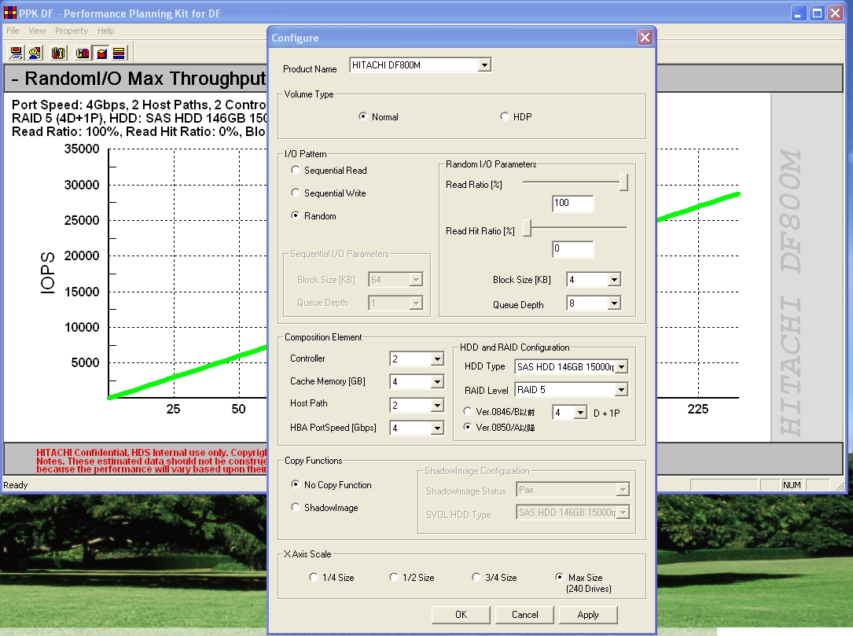

Slide 20
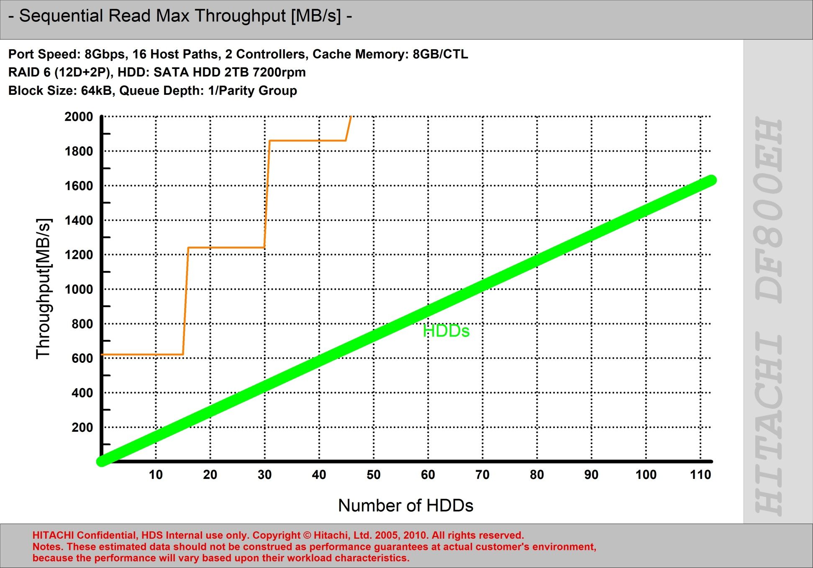

Slide 21
Questions?
Thanks!

