Slide 1
Storage plans for CERN and for the Tier 0
Alberto Pace (and the IT-DSS group)
CERN, IT Department
Presentation for the CCR INFN GRID Workshop, May 18th, 2011

Slide 2
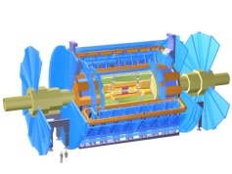
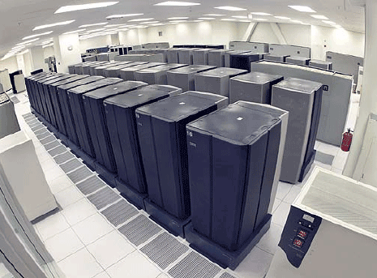
Planned Architecture
LHC Experiments
ANALYSIS
XROOT,
Mounted file system
ASGC
Tier-1s data
replication
CASTOR
BNL
FNAL
Disk Pools
FZK
EOS
IN2P3
Managed
on demand
replication
CNAF
Scalable
Secure
Accountable
Globally accessible
Manageable
Multiple level of services
Arbitrary availability
Arbitrary reliability
Arbitrary performance
Decoupled from HW
NDGF
NIKHEF
PIC
RAL
tape servers
TRIUMF

Slide 3
Planned Architecture
TIER 0
CASTOR
LHC Experiments
ANALYSIS
XROOT,
Mounted file system
ASGC
Tier-1s data
replication
CASTOR
BNL
FNAL
Disk Pools
FZK
EOS
IN2P3
Managed
on demand
replication
CNAF
Scalable
Secure
Accountable
Globally accessible
Manageable
Multiple level of services
Arbitrary availability
Arbitrary reliability
Arbitrary performance
Decoupled from HW
NDGF
NIKHEF
PIC
RAL
tape servers
TRIUMF

Slide 4
CASTOR for the Tier 0
CASTOR is and will remain the main strategy for all CERN Tier-0 operation
Write in real time raw data from all the LHC experiments to tape
Replicate in real time the raw data to the 11 Tier-1 sites
CASTOR has been consolidated in the last year, reaching unprecedented availability and performances.
6 GB/s sustained in production, 220 TB/day
20+ PB recorded in 2010
Plans to further improve the tape area to reach native speed of next drive generation > 300 MB/s/drive and the announced extended capacity (multi TB tapes)

Slide 5
Architectural changes
These major improvements have been achieved by separating Tier-0 operation from data analysis
Large data volumes, bulk streams of data, managed replications = CASTOR
Random data access and analysis = EOS (see later)
Castor is an effective solution for ARCHIVED storage (instead of NEARLINE storage)
Tape recalls efficiently managed if aggregated.
Plan to reduce end-user random access to tapes (accepted by nearly all LHC experiments)

Slide 6
Planned developments
Plan to simplify the current castor scheduler by removing the LSF scheduler.
This will ensure that the CASTOR stager and scheduler will support even the most demanding Tier-0 load for the next years
Native disk throughput available to experiments
Reduced external dependencies, simplified and streamlined operation
New tape writing approach
Postpone writing until enough to fill a (substantial fraction of a) tape to achieve high aggregate transfer rates (> 5GB/s), splitting write streams onto several tapes
Plans to achieve native drive speed by writing synchronized tape marks every 4 GB of data – See picture on next slide

Slide 7
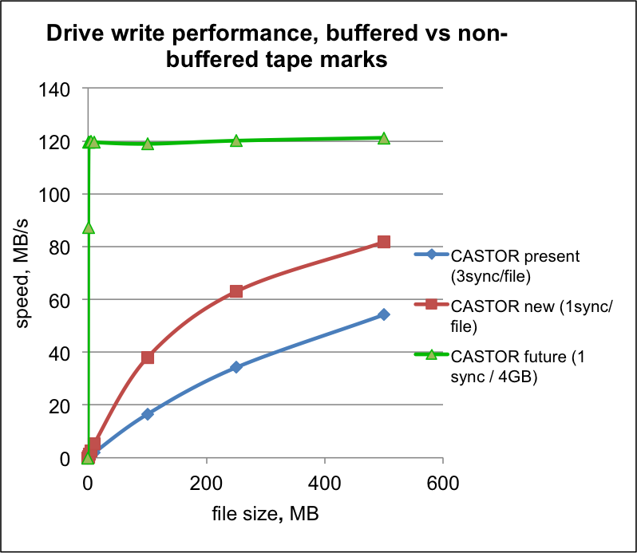
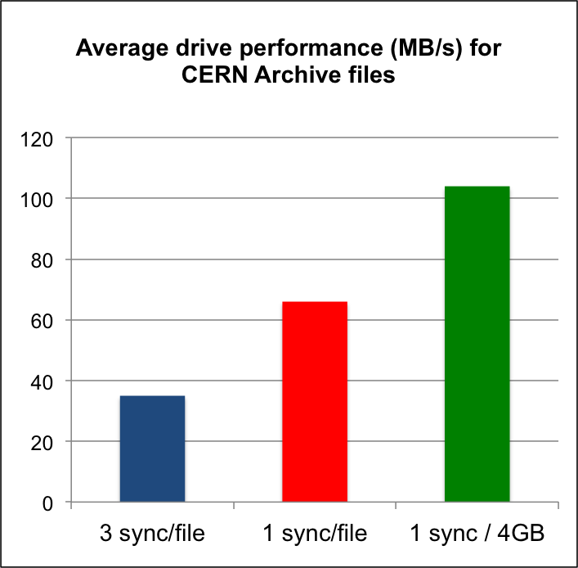
Tape Writing
2012
(planned)
2011
(current)
2010
Average file size of
Currently written files
200 MB

Slide 8
Additional improvements
CASTOR old nearline approach: If user file is not on disk, recall it immediately from tape
Many tapes get (re)mounted and number of files read is low (1-2 files, 2 min for mounting / unmounting). Poor effective read performance (~35 MB/s average), reaching 18K tape mount/day
Many drives used: reduced drive availability for write
By artificially limiting the number of available drive for reading we dramatically improve the recall efficiency (See pictures on next 2 slides)
This increased tape storage granularity from files to data (sub)sets (freight-train approach) is managed by production managers

Slide 9
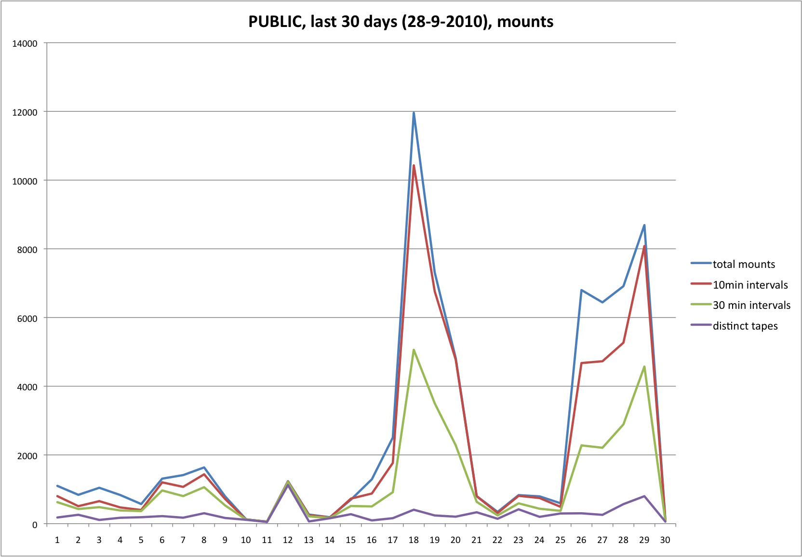
Tape Reading: multiple tape recalls
Efficiency improvements
by delayed recalls
https://twiki.cern.ch/twiki/bin/view/DSSGroup/RecallPolicyConfiguration
https://twiki.cern.ch/twiki/bin/view/DSSGroup/CastorRecallAnalysis082010

Slide 10
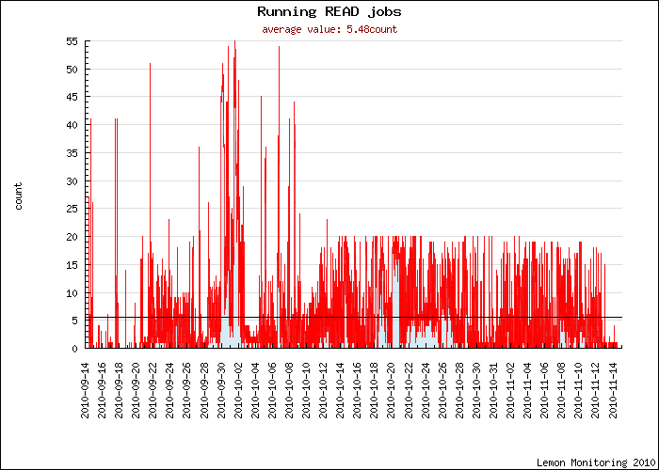
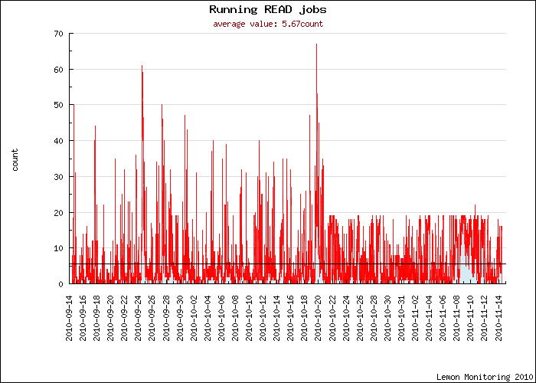
Tape read performance
read mount policies deployed
Max 20 drives for recall
~ 10 hours of mount/unmount!

Slide 11
Planned Architecture
LHC Experiments
ANALYSIS
EOS
ANALYSIS
XROOT,
Mounted file system
ASGC
Tier-1s data
replication
CASTOR
BNL
FNAL
Disk Pools
FZK
EOS
IN2P3
Managed
on demand
replication
CNAF
Scalable
Secure
Accountable
Globally accessible
Manageable
Multiple level of services
Arbitrary availability
Arbitrary reliability
Arbitrary performance
Decoupled from HW
NDGF
NIKHEF
PIC
RAL
tape servers
TRIUMF

Slide 12
Task separation
Separation between Tier-0 and analysis activities at CERN
Misbehaving end-users will not impact Tier-0 performance and operation
The EOS Solution chosen for analysis has been optimized to solve the requirements of the current LHC experiments and is no longer bound to follow compromises required by the Tier-0 rigid operation

Slide 13
EOS Client protocols
EOS has taken the native unmodified XROOT protocol. Motivations:
Designed for root and all LHC experiment frameworks. Fulfil the complete set of experiment’s requirements, natively, perfect compatibility.
Client side page cache and optimized amount of data transfer per network roundtrip via vector reads (very appealing for WAN transfers and ROOT-based analysis on large file, as only partial file content is cached)
Wide area access (including global namespace redirectors)
Following carefully NFS investigation done in IT-GT and DESY and considering offering NFS 4.x / HTTP / Amazon S3 services as strategic options for the future

Slide 14
EOS Namespace
Strategic development area
Service reliability, performance, scalability, availability all affected by this critical component
File index in memory
10⁹ files = ~20GB per view
Metadata read from disk/buffer cache
Both read and write scaling out approaches exist
See:
http://indico2.twgrid.org/MaKaC/contributionDisplay.py?contribId=313&sessionId=118&confId=3
http://indico.cern.ch/contributionDisplay.py?contribId=42&sessionId=3&confId=92498

Slide 15
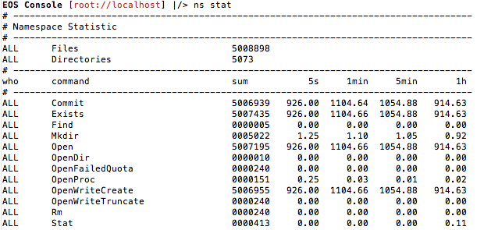
Write performance
10 Mio Files namespace size
22 ROOT clients 1 kHz
1 ROOT client 220 Hz
1 kHz

Slide 16
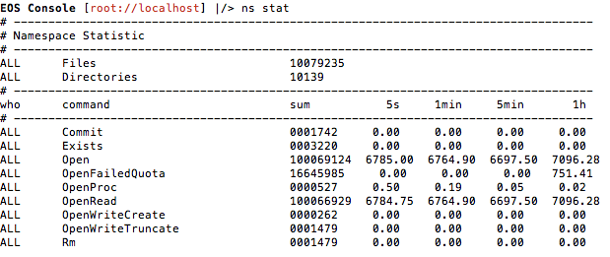
Read performance
10 Mio Files namespace size
100 Million read open
350 ROOT clients 7 kHz
CPU usage 20%
7 kHz

Slide 17
Namespace performance indicators
Find 10 million file names: 62.5 kHz
Find 1.2 million file ids on file system 1: 330 kHz
Find 1.2 Mio. file names on file system 1: 90 kHz

Slide 18
EOS reliability
EOS is attempting to implement “arbitrary” reliability
Strategic development area
Today: “Reliability of the service” = “reliability of the hardware”
To have high reliability, we need reliable hardware
Disk mirroring everywhere, increased cost
When hardware fails, the data on it becomes unavailable. It is a service failure
When we have a service failure we must intervene as fast as we can.
Important constraints on the sysadmin team
Requires a piquet with engineers on call
Draining and restore operations take lot of time, affecting also availability
We need services immune from hardware failures
We require service levels to be changed by tuning configuration parameters
Without developments and without custom hardware
Service levels must be arbitrary in terms of:
Reliability of data (probability that data is lost)
Performance / Throughput
Availability of the service (probability to have service interruptions without data loss)

Slide 19
Types of arbitrary reliability
Plain (reliability of the service = reliability of the hardware)

Slide 20
Types of arbitrary reliability
Plain (reliability of the service = reliability of the hardware)
AVAILABLE IN EOS

Slide 21
Types of arbitrary reliability
Plain (reliability of the service = reliability of the hardware)
Replication
Reliable, maximum performance, but heavy storage overhead
Example: 3 copies, 200% overhead
{
100%
300%
Any of the 3 copies is enough to reconstruct the data
checksum

Slide 22
Types of arbitrary reliability
Plain (reliability of the service = reliability of the hardware)
Replication
Reliable, maximum performance, but heavy storage overhead
Example: 3 copies, 200% overhead
AVAILABLE IN EOS
{
100%
300%
Any of the 3 copies is enough to reconstruct the data
checksum

Slide 23
Types of arbitrary reliability
Plain (reliability of the service = reliability of the hardware)
Replication
Reliable, maximum performance, but heavy storage overhead
Example: 3 copies, 200% overhead
Reed-Solomon, double, triple parity, NetRaid5, NetRaid6
Maximum reliability, minimum storage overhead
Example 10+3, can lose any 3, remaining 10 are enough to reconstruct, only 30 % storage overhead
100%
130%
Any 10 of the 13 chunks are enough to reconstruct the data
checksum

Slide 24
Types of arbitrary reliability
Plain (reliability of the service = reliability of the hardware)
Replication
Reliable, maximum performance, but heavy storage overhead
Example: 3 copies, 200% overhead
Reed-Solomon, double, triple parity, NetRaid5, NetRaid6
Maximum reliability, minimum storage overhead
Example 10+3, can lose any 3, remaining 10 are enough to reconstruct, only 30 % storage overhead
NetRaid 5 prototype
AVAILABLE IN EOS
100%
130%
Any 10 of the 13 chunks are enough to reconstruct the data
checksum

Slide 25
Types of arbitrary reliability
Plain (reliability of the service = reliability of the hardware)
Replication
Reliable, maximum performance, but heavy storage overhead
Example: 3 copies, 200% overhead
Reed-Solomon, double, triple parity, NetRaid5, NetRaid6
Maximum reliability, minimum storage overhead
Example 10+3, can lose any 3, remaining 10 are enough to reconstruct, only 30 % storage overhead
Low Density Parity Check (LDPC) / Fountain Codes / Raptor Codes
Excellent performance, storage overhead acceptable
Example: 8+6, can lose any 3, remaining 11 are enough to reconstruct, 75 % storage overhead (See next slide)

Slide 26
Example: 8+6 LDPC
0 .. 7: original data
8 .. 13: data xor-ed following the arrows in the graph
Any 11 of the 14 chunks are enough to reconstruct the data using only XOR operations (very fast)
100%
(original data size)
175%
(total size
on disk)
138%
(max size required
To reconstruct)
checksum

Slide 27
Types of arbitrary reliability
Plain (reliability of the service = reliability of the hardware)
Replication
Reliable, maximum performance, but heavy storage overhead
Example: 3 copies, 200% overhead
Reed-Solomon, double, triple parity, NetRaid5, NetRaid6
Maximum reliability, minimum storage overhead
Example 10+3, can lose any 3, remaining 10 are enough to reconstruct, only 30 % storage overhead
Low Density Parity Check (LDPC) / Fountain Codes
Excellent performance, more storage overhead but better than simple replication
Example: 8+6, can lose any 3, remaining 11 are enough to reconstruct, 75 % storage overhead
In addition to
File checksums (available today)
Block-level checksums (available today)
Planned research
Activity for EOS

Slide 28
EOS Summary
Arbitrary reliability built from JBOD configurations
plain
replica (synchronous replication)
Network RAID5 (untested prototype)
pluggable encoding algorithms (planned for 2012)
the plugin structure in the EOS framework allows to integrate storage-side codecs in a flexible way
Empowering:
Dispersed storage, unbreakable storage
Arbitrary level of services
Deliver customized services using common solution
High performance, low latency solutions (3 replicas standard + 6 replicas for hot files)
Very large disk pools, extremely reliable, at very low cost (only 30% more than raw disk), large amount of data online voiding the need for end-user tape recall

Slide 29
Conclusion
Many areas of possible developments
Focusing were we expect high returns
Current priority areas
EOS technologies validations
Namespace
Reliability
Castor Tape developments. Major increases in data rates without increasing the number of drives

