Slide 1
Solutions for WAN data access: xrootd and NFSv4.1
Andrea Sciabà
Workshp CCR INFN GRID 2011 La Biodola, May 16-20

Slide 2
Outline
Xrootd as a WAN data access protocol
CMS
ATLAS
The NFS 4.1 protocol and WLCG
Status and plans

Slide 3
What is xrootd?
A file access and data transfer protocol
Typically (but not necessarily) used for ROOT files
An actual storage solution for scalable and low latency data access
Supports clustering of xrootd servers
Also in the WAN
Consists of xrootd-cmsd server pairs
xrootd: handles data and redirections
cmsd: clusters the xrootd daemons together

Slide 4
CMS global xrootd: purpose and goals
Purpose
Provide a service which allows jobs to seamlessly access data located on remote sites with an acceptable loss of efficiency
Goals
Reliability: seamless failover
Transparency: global name space
Usability: native to ROOT
Global: applicable to all CMS data
Automatic caching not a primary goal
Adopted technology is xrootd
Global redirector mechanism
xrootd data access protocol

Slide 5
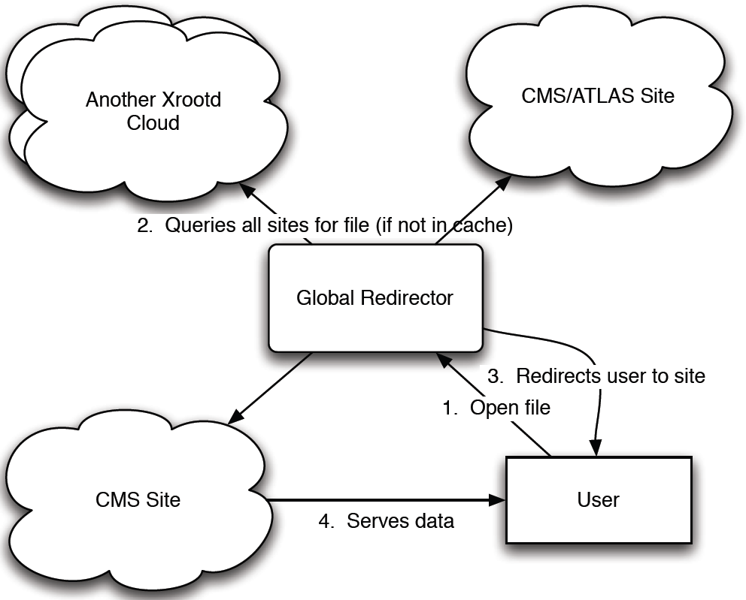
A global xrootd federation

Slide 6
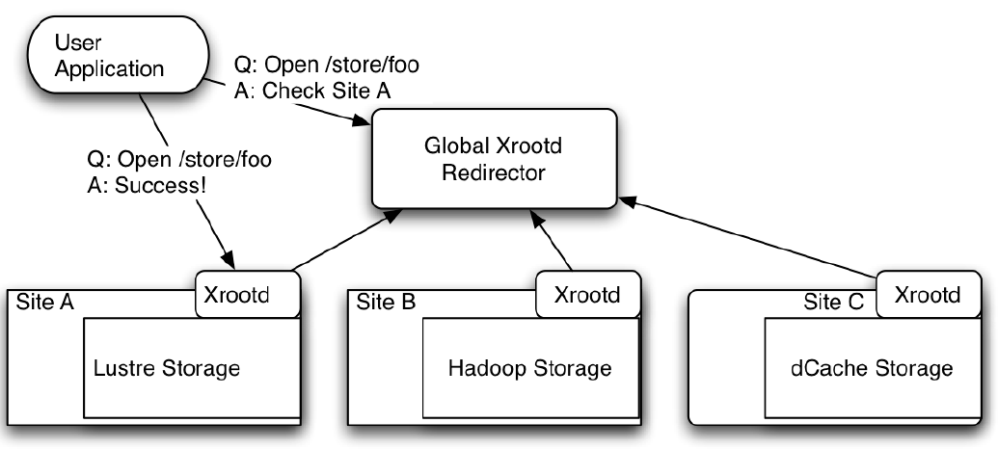
xrootd architecture
System overlaid on existing SEs
Xrootd, dCache, HDFS, POSIX-based
Needs an xrootd proxy (or door) at each site

Slide 7
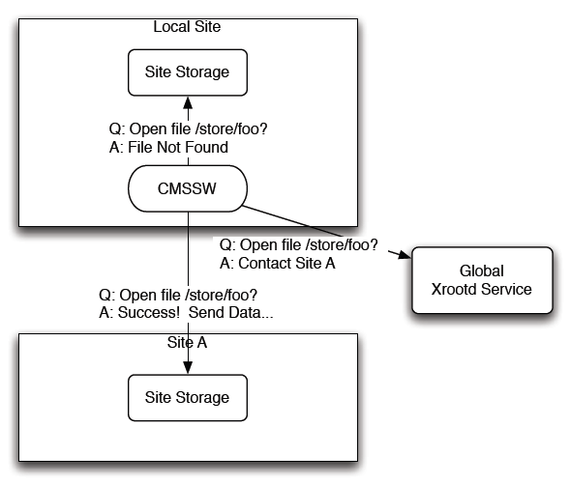
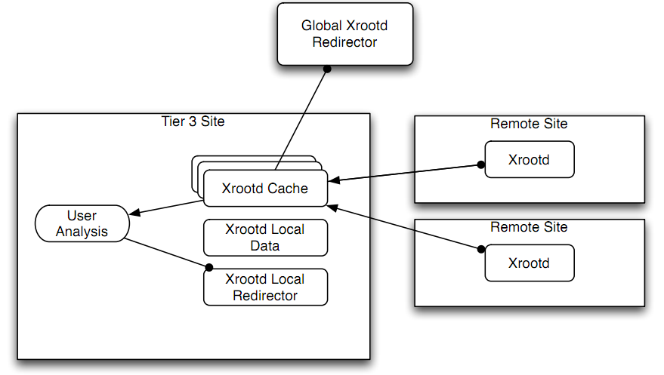
Use cases
Fallback: seamless failover even between sites
Interactive use: debug single files
Overflow: allow jobs to go to sites without the data
(Caching): xrootd-enabled T3 can locally cache remote data

Slide 8
Current status
A prototype was already successfully demonstrated
One global redirector
CMSSW improved for high latency data access
First production deployment in the US
1 Tier-1, ~6 Tier-2; few users so far
Adds a “regional” redirector layer
Adds a monitoring system based on Nagios, MonALISA, email alerts
Fallback use case done on May 1st
Overflow use case due on June 1st
Interactive use due on August 1st

Slide 9
Xrootd monitoring
Using Nagios
Status of servers and redirectors
Check availability of random files
Using MonALISA
File-open and read rates
Transfer rates
CPU, memory, disk, network etc. for xrd servers (optional)
Future improvements
Per user / per file statistics to detect system misuse

Slide 10
Issues
Redirection to broken servers possible
Truncated files visible to users
Can exhaust network bandwidth at large scales (if sites do not throttle bandwidth of network services)
Important monitoring information still missing
Opened files and rates per user (now only per host)
Namespace query rates
Caching is an open issue

Slide 11
ATLAS xrootd
Goals similar to the CMS system, but more focus on caching and replication
Access data at Tier-3 sites via xrootd to reduce load on Tier-1/2 sites
Tier-3 sites can fetch data from Tier-1, Tier-2 or other Tier-3
Automatic replication of popular datasets
Easy to fetch ROOT files from remote sites to a desktop at CERN

Slide 12
Tasks specific to ATLAS
Define and implement a global name space
Global physical dataset path (PDP)
Couple xrootd to LFC
Enable local file caching at Tier-3 sites
Use the xrootd transfer service (FRM) plugin to copy files between different xrootd servers or even from non-xrootd SEs
Support ATLAS data security policies

Slide 13
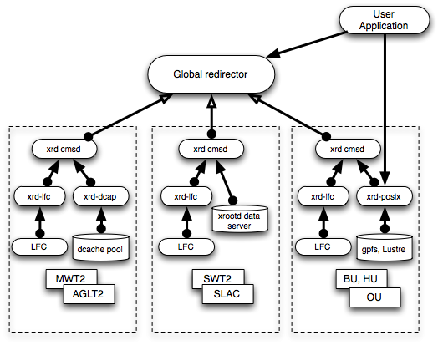
Architecture

Slide 14
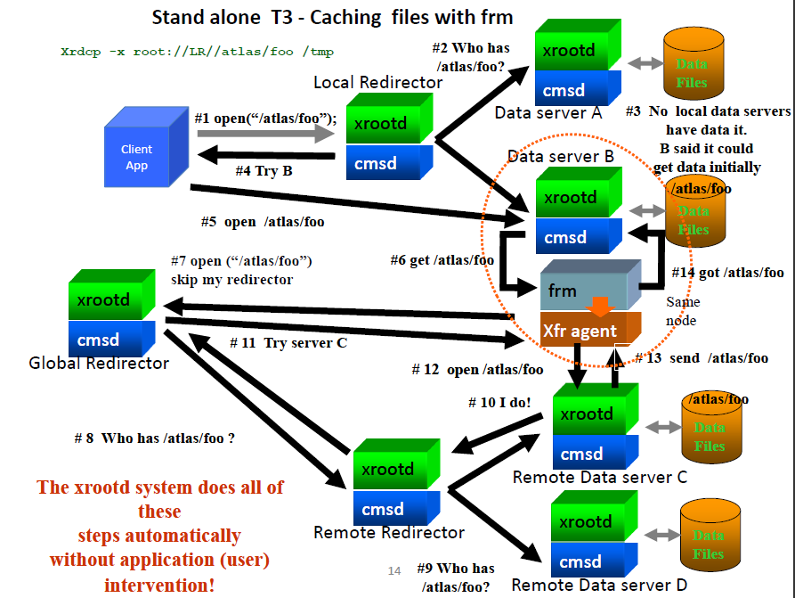
Caching via xrootd

Slide 15
Status
Demonstrator finished, now in preproduction phase
Deployed in the US at 4 Tier-2, 2 Tier-3, 1 test site
ATLAS DDM client tools adapted to get files via their PDP
Testing Tier-3 xrootd transfer service using
Native xrdcp copy
Automatic file transfers between Tier-3 sites
Trigger from user root analysis jobs

Slide 16
Plans
Move to production phase
Set up a global redirector at BNL
Add more sites in US and in Europe
Test Tier-3 site caching
Add another global redirector in Europe
Use X.509 for authentication/authorization

Slide 17
NFS 4.1 and pNFS: introduction
Why is pNFS interesting?
What is the status and timeline for pNFS deployment ?
Availability of components
Protocol verification and performance evaluation
Issues to be considered
Security
Wide area transfers
Some results from the dCache NFS 4.1/pNFS evaluation at Grid-Lab
Status of DPM NFS 4.1

Slide 18
Why is pNFS interesting
Benefits of parallel I/O
Delivers very high application performance
Allows for massive scalability without diminished performance
Benefits of NFS (or mostly any standard)
Interoperability among vendor solutions
Eliminates risks of deploying proprietary technology

Slide 19
Additional benefits
Simplicity
Regular mount point and real POSIX I/O
Can be used by unmodified applications
Data client provided by the OS vendor
Smart caching (block caching) done by OS vendors

Slide 20
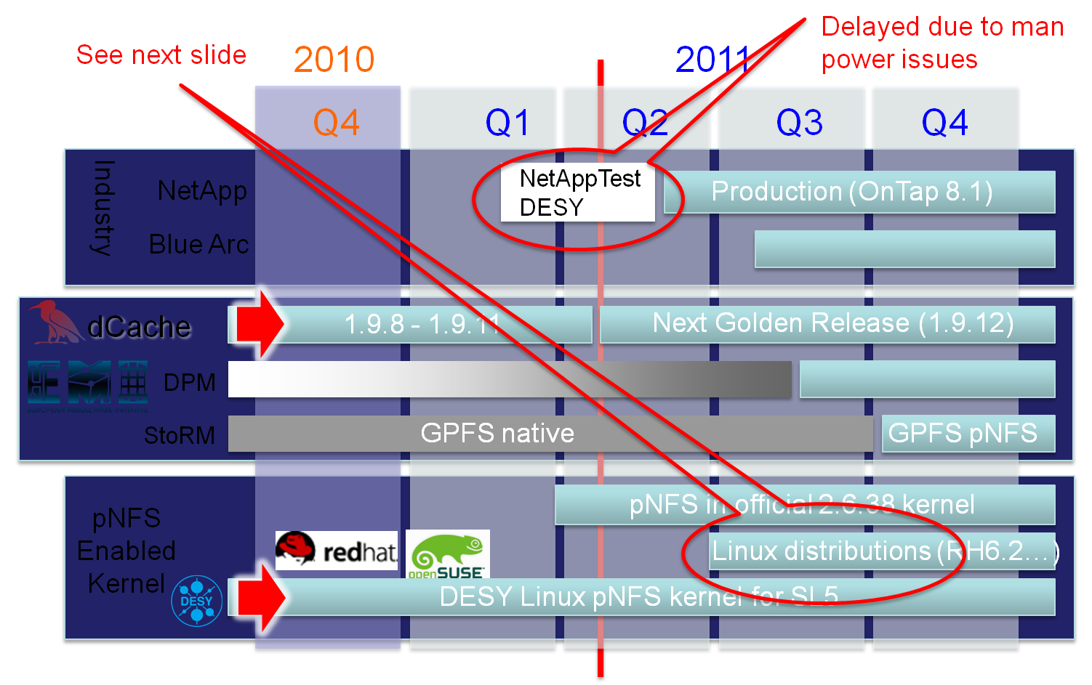
Availability for production use

Slide 21
pNFS client support in SL5/6
Full NFS 4.1/pNFS client available in 2.6.38
Redhat already back-ported pNFS into 2.6.32
but only available for business partners right now
Official back port into RH6.x (kernel rh-2.6.32) expected with RH6.2 (maybe earlier)
Based on RH6.x it appear in SL6.x

Slide 22
pNFS EMI server support
dCache
Full implementation available starting from 1.9.11
Plain and Kerberos authentication
DPM
Read and write, ready to test
Plain and Kerberos authentication
StoRM
Will become available with GPFS pNFS availability

Slide 23
Non-EMI implementations
GFS2
Available with 2.6.38 (now)
Uses pNFS for reading and only NFS 4.1 for writing
NetApp
Available with ONTAP® 8.1 (Nowi)
DESY waiting for a test system
Others
IBM, BlueArc, EMC … are all members of the relevant CITI projects and have server software ready but seem to be reluctant to provide products just yet

Slide 24
Security issues
All tests (up to now) done without strong authentication
NFS4.1/pNFS clients are only available with Kerberos authentication
How about X509 certificates?
Theoretically possible but kernel developers only interested in Kerberos
Existing solution: creating a Kerberos token from a X509 certificate

Slide 25
Wide Area issues
On wide area performance:
No tests done yet
Planned between DESY and CERN after CERN test system will become available

Slide 26
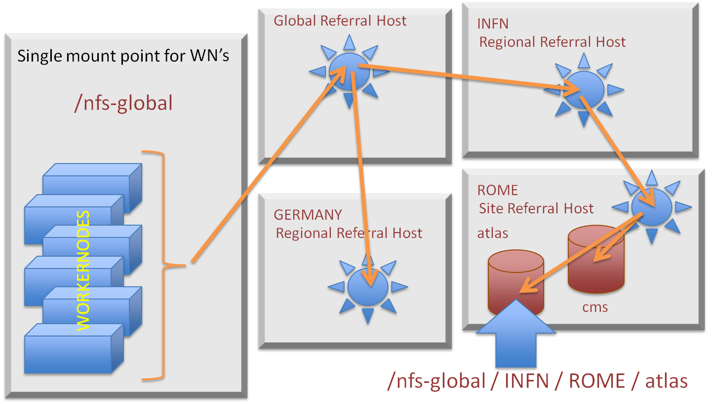
Possible wide area NFS 4.1 deployment
NFSv4 referrals permit a server to redirect a client to another location
Central configuration of referral hosts through FedFS
Notes:
FedFS is a set of open protocols that permit the construction of a scalable, federated file system namespace accessible to unmodified NFSv4[.1] clients

Slide 27
DESY Grid Lab
Since mid of last year, DESY provides a Tier 2-like testbed with dCache/pNFS server and pNFS-enabled SL5 worker nodes
Available to verify a client/framework against pNFS (NFS 4.1)
DESY folks together with ATLAS, CMS and with help of ROOT have been running all kind of evaluations
Results have been presented at CHEP’10 and at 2010 Spring HEPIX

Slide 28
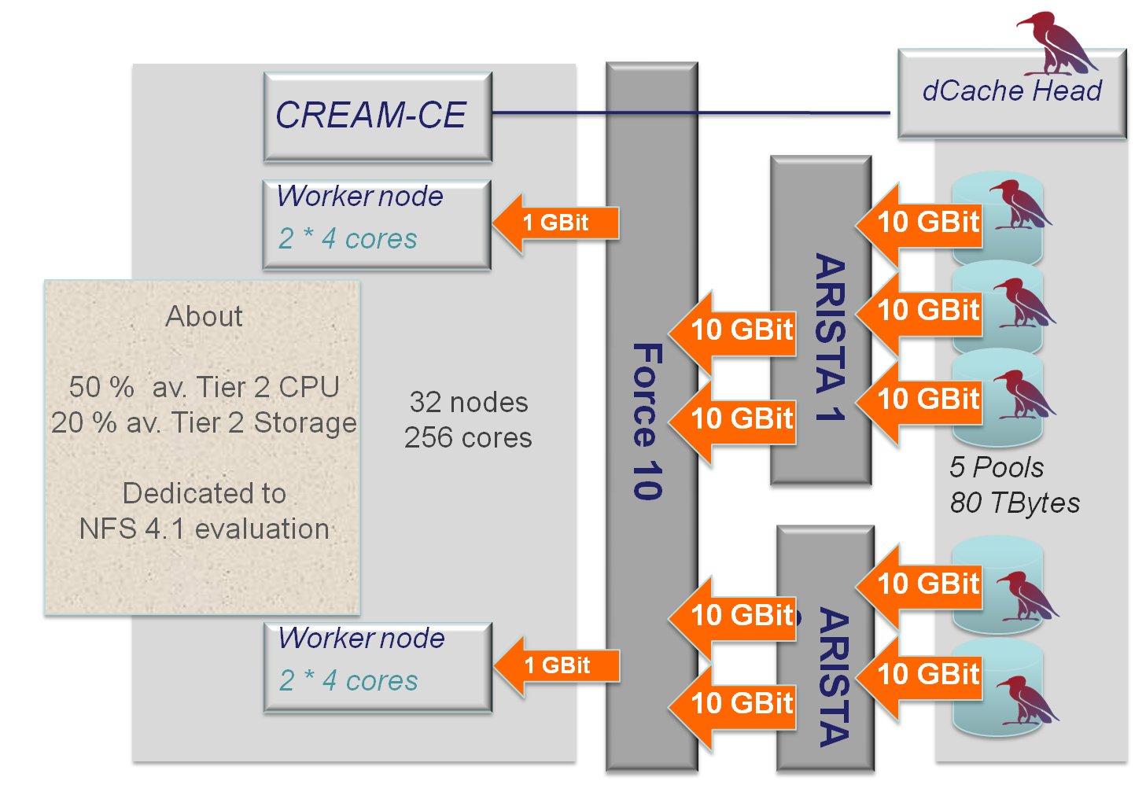
The DESY pNFS “Tier 2”

Slide 29
Performance limitations
Removing server disk congestion effect by keeping all data in file system cache of the pool
Limited WN
1Gb network
Limited 20 Gb network
dCap
NFSv4.1
Mbytes/sec
Limited by
disk bandwidth
Number of threads
Total throughput does not depend on the protocol

Slide 30
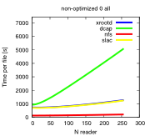
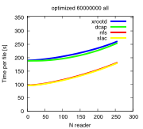
xRoot / NFS 4.1 in dCache (I)
Reading an entire ROOT file using a ROOT script
Worst Case for ROOT
Best Case for ROOT
Non-Optimized Files
Read entire file
TreeTCache OFF
Optimized for ROOT
Read entire file
TreeTCache ON
For full file read, NFS behaves as well as SLAC/xRoot
Xrootd/dCache
If setting is bad for ROOT, SLAC and dCache xroot implementations behave the same
Xrootd/SLAC
NFS/pNFS

Slide 31
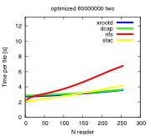
xRoot / NFS 4.1 in dCache (II)
Trying to find a case where NFS 4.1 is really bad (and found one)
Optimized for ROOT
Read two branches
TreeTCache ON
Xrootd/SLAC
Xrootd/dCache
NFS/pNFS
dCap (old vers)
Vector read effect. The ROOT driver is not doing vector read for plain file systems but for dCap/xRoot

Slide 32
DPM NFS 4.1 – status
First full feature prototype in use internally
Integrated in a DPM testbed at CERN
Mounted on a client machine running a 2.6.37 kernel
Standard NFS functional tests running daily
Features
Namespace management (mkdir, ls, rm, stat, …)
Permissions (with Kerberos authentication)
Space usage reports (du, df, …)
Ongoing
Extend tests to real world use cases from experiments
Performance improvements in the DPM to cope with NFS access patterns (heavy on metadata queries)

Slide 33
Conclusions (I)
Both ATLAS and CMS are now starting to put in production a globally distributed data storage based on xrootd
Main goals are seamless access, fallback, diskless Tier-3’s, caching
dCache and DPM seriously committed to provide NFS 4.1 support
dCache.org is member of the CITI group which is coordinating the NFS 4.1 efforts
Compatibility regularly verified

Slide 34
Conclusions (II)
NFS 4.1 performance
Already exceeding expectations in dCache
Measurements strongly depend on
the way the file (ROOT) was written
the access profile (ROOT script)
Still the protocol seems to be well understood by dCache
Performance tests in DPM to be performed using real applications

Slide 35
Acknowledgements
Thanks to B. Bockelman (CMS), P. Fuhrmann (dCache), D. Benjamin (ATLAS) for their input

