Slide 1
EMI: dal Produttore al Consumatore
Francesco Giacomini
Workshop CCR/INFNGrid
La Biodola, 16-20 Maggio 2011
© Cristina Aiftimiei
WLCG GDB, CERN, 11 May 2011

Slide 2
Consumers and Producers
Requirements
PTB
Requirements
Technical Plans
Development and Test Plans
Development Testing
Certification
Certification
Validation
Release
Maintenance Support
Software & Services
SA1
JRA1
SA2
SA1
JRA1

Slide 3
SLAs, MoU and Networking
SLA + MoU
MoU
Common initiatives

Slide 4
EMI 1 in the Release Plan
Start
EMI 1
EMI 2
EMI 3
Major releases
Supp. & Maint.
Support & Maintenance
Support & Maintenance
Support & Maintenance
01/05/2010
31/10/2010
30/04/2011
30/04/2012
28/02/2013

Slide 5
EMI 1 (Kebnekaise)
EMI 1 is the result of 1 year of activity:
Continuous support and maintenance for the ARC, dCache, gLite and UNICORE
Collection of requirements, planning, development/integration/ standardization, testing, verification
EMI 1 Release → 12.05.2011

Slide 6
EMI 1 (Kebnekaise)
Two distinctive aspects:
A distribution snapshot with common objectives and following common integration, standardization, quality criteria
A collection of Products (services, clients, libraries, metapackages) providing specific functionality

Slide 7
EMI 1 in Numbers
61 Products from ARC, dCache, gLite, UNICORE
https://savannah.cern.ch/task/?group=emi-releases
333 EMI packages
192 external deps, 172 from SL5/EPEL, 20 managed by EMI
100% of RPMS
86% of SRPMS
Latest builds:
http://etics-repository.cern.ch/repository/reports/id/d46efe8d-1efd-4874-aeaa-0d9b500125c4/sl5_x86_64_gcc412EPEL/-/reports/index.html
http://etics-repository.cern.ch/repository/reports/id/666bad57-0214-471c-8f9b-b02032c3e375/sl5_ia32_gcc412EPEL/-/reports/index.html

Slide 8
EMI 1 Repository
EMI 1 Package Repository:
base
updates
third-party
base and updates are signed with an EMI key
Repo files and public key can be installed
using an rpm (emi-release-1.0.0-1.noarch.rpm)
Manual download from the repository

Slide 9
EMI 1 Overall Features
Single distribution from the same repository of all products from ARC, dCache, gLite, UNICORE
Standard packaging and installation paths according to Fedora guidelines
External dependencies almost entirely taken from base OS (SL5) or EPEL
Built on SL5 x86_64 (fully supported) and i386 (partially supported)
Several integration and standardization changes:
Use of the same Globus libraries for all services (from EPEL, maintained by IGE)
Use of the same version of each dependency

Slide 10
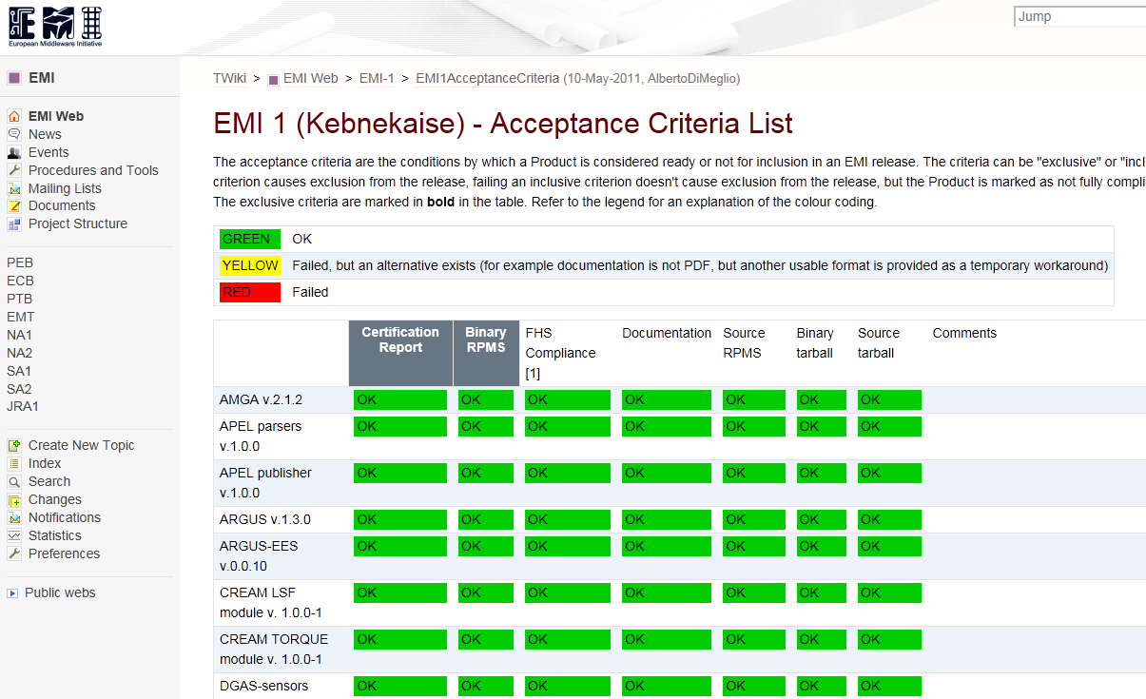
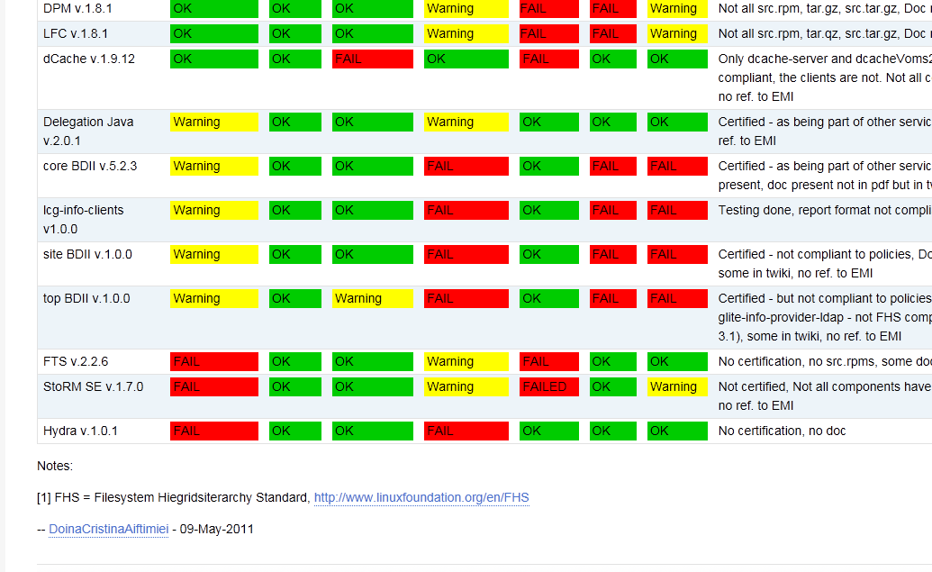
EMI 1 Release Criteria
The release snapshot is based on the achievement of a set of “acceptance criteria” (certification, package formats, documentation, etc)
https://twiki.cern.ch/twiki/bin/view/EMI/EMI1AcceptanceCriteria

Slide 11
EMI 1 Products
All Products individually tracked
https://savannah.cern.ch/task/?group=emi-releases
Many enhancement in all Products, most notably:
CREAM: http://bit.ly/cream_emi1
Bug fixes ~ 24
DPM: http://bit.ly/dpm_emi1
Bug fixes ~ 10
VOMS: http://bit.ly/voms_emi1
Bug-fixes ~ 34
WMS: http://bit.ly/wms_emi1
Bug fixes ~ 40
11/05/2011
EMI 1 and WLCG
11

Slide 12
EMI 1 Known Issues
Components not in as of 12/05/2011:
FTS, Storm, Hydra
Certification not completed in time
BDII released but:
Certification report could be more detailed
Not all RPMs comply with the standard fs hierarchy
Documentation missing
A number of outstanding bugs not yet fixed
Torque support
Best effort, but we are working to address this
Commitment to work on these issues in the coming days and provide updates/fixes

Slide 13
Next Steps
As of next week:
start regular updates – support and maintenance phase
every product/component maintained independently (but only backward compatible changes)
Start porting to SL6 and Debian (precise schedule to be worked out)
Start EMI 2 development work, based on prioritized requirements
Start the “EMI Release Preview Testbed”

Slide 14
SLA
Signed with EGI on 2011-04-15
It covers Software releases, Requirements analysis, Requirements and software testing reports, Web-based support
Defines roles and responsibilities
Outlines the parameters of all covered services
E.g. for support it defines response (not solution) times depending on priority:
4 hours for Top Priority
2 days for Very Urgent
5 days for Urgent
15 days for Less Urgent

Slide 15
EMI Release Preview Activity
EMI-coordinated release assessment with external entities (aka volunteers)
Volunteer 'sites' (12) providing hardware resources and administration effort to install and configure products
Volunteer 'user communities' (6) providing effort to test the products deployed by volunteer sites using community-specified use cases
MoUs in place/being established with some of these volunteers (5)
Release preview wiki, including list of volunteers and service inventory:
https://twiki.cern.ch/twiki/bin/view/EMI/EMIReleasePreview

Slide 16
EMI Requirements Analysis Phase
The EMI 2 major requirements analysis phase ended last week
Based on requirements received from EGI, WLCG and some user communities
Analyzed, prioritized and recorded in the EMI Requirements tracker:
http://savannah.cern.ch/emi-req
Taking into account the effort and resources available, we are always open to further discussions on these requirements and their priorities
Minor requirements submitted through GGUS at any time will be considered

Slide 17
Communication Channels
emi-announce@eu-emi.eu
http://mail.eu-emi.eu/mailman/listinfo/emi-announce
User Forums:
http://www.eu-emi.eu/forums-mls
EMI 1 web site:
http://www.eu-emi.eu/emi-1-kebnekaise
Package Repository:
http://emisoft.web.cern.ch/emisoft/index.html

Slide 18
Thank you
EMI is partially funded by the European Commission under Grant Agreement INFSO-RI-261611

