Slide 1
Performance Improvements in a Large-Scale Virtualization System
Davide Salomoni, Anna Karen Calabrese Melcarne, Gianni Dalla Torre, Alessandro Italiano, Andrea Chierici
Workshop CCR-INFNGrid, 2011

Slide 2
Why this presentation
CNAF deeply involved in virtualization
WNoDeS
CCR Virtualization group
Modern CPU “ask” to be used with virtualization
Will show all the tests we performed aimed to solve bottlenecks and to improve virtual machines speed
These results do not apply only to WNoDeS
See also SR-IOV poster

Slide 3
WNoDeS Release Schedule
WNoDeS 1 released in May 2010
WNoDeS 2 “Harvest” public release scheduled for September 2011
More flexibility in VLAN usage - supports VLAN confinement to certain hypervisors only
libvirt now used to manage and monitor VMs
Either locally or via a Web app
Improved handling of VM images
Automatic purge of “old” VM images on hypervisors
Image tagging now supported
Download of VM images to hypervisors via either http or Posix I/O
Hooks for porting WNoDeS to LRMS other than LSF
Internal changes
Improved handling of Cloud resources
New plug-in architecture
Performance, management and usability improvements
Direct support for LVM partitioning, significant performance increase with local I/O
Support for local sshfs or nfs gateways to a large distributed file system
New web application for Cloud provisioning and monitoring, improved command line tools

Slide 4
Alternatives to mounting GPFS on VMs
Preliminary remark: the distributed file system adopted by the INFN Tier-1 is GPFS
Serving about 8 PB of disk storage directly, and transparently interfacing to 10 PB of tape storage via INFN’s GEMSS (an MSS solution based on StoRM/GPFS)
The issue, not strictly GPFS-specific, is that any CPU core may become a GPFS (or any other distributed FS) client. This leads to GPFS clusters of several thousands of nodes (WNoDeS currently serves about 2,000 VMs at the INFN Tier-1)
This is large, even according to IBM, requires special care and tuning, and may impact performance and functionality of the cluster
This will only get worse with the steady increase in the number of CPU cores in processors
We investigated two alternatives, both assuming that an HV would distributed data to its own VMs
sshfs, a FUSE-based solution
a GPFS-to-NFS export
GPFS-based
Storage
VM
(GPFS)
VM
(GPFS)
VM
(GPFS)
Hypervisor (no GPFS)
VM
(sshfs)
VM
(sshfs)
VM
(sshfs)
Hypervisor ({sshfs,nfs}-to-GPFS)
GPFS-based
Storage

Slide 5
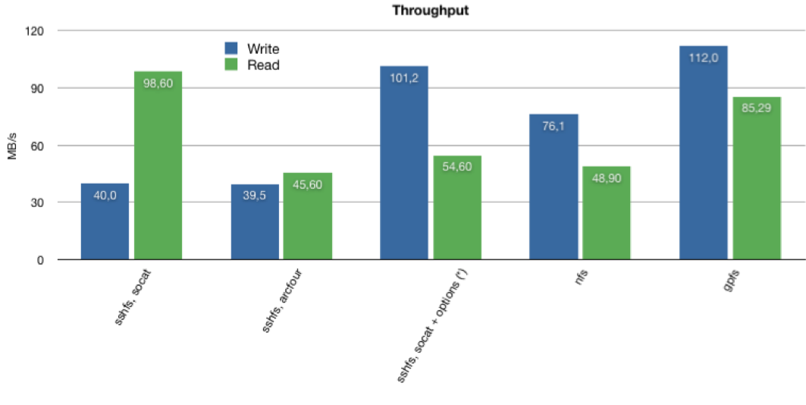
sshfs vs. nfs: throughput
sshfs throughput constrained by encryption (even with the lowest possible encryption level)
Marked improvement (throughput better than nfs) using sshfs with no encryption through socat, esp. with some tuning
File permissions are not straightforward with socat, though
(*) socat options: direct_io,
no_readahead, sshfs_sync
GPFS on VMs (current setup)

Slide 6
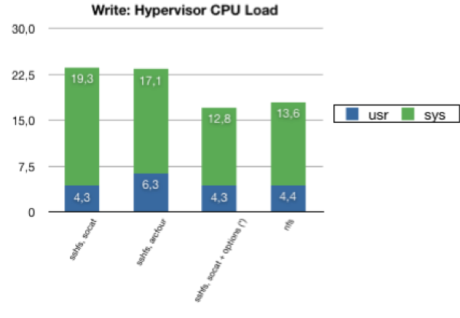
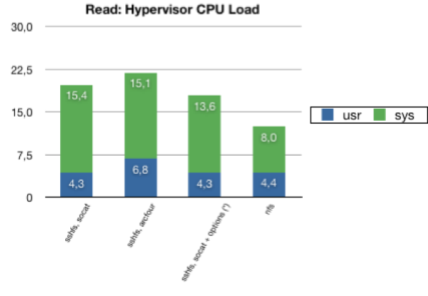
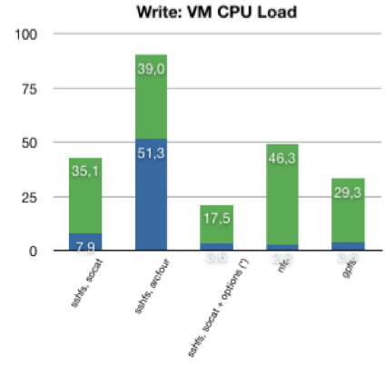
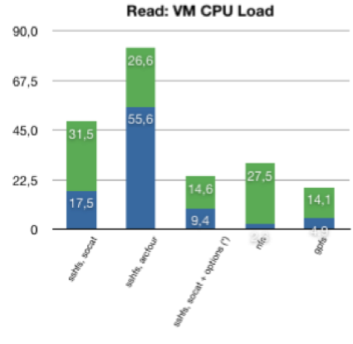
sshfs vs. nfs: CPU usage
Write
Overall, socat-based sshfs w/ appropriate options seems the best performer
(*) socat options: direct_io,
no_readahead, sshfs_sync
GPFS on VMs (current setup)
Read
GPFS on VMs (current setup)

Slide 7
sshfs vs. nfs Conclusions
An alternative to direct mount of GPFS filesystems on thousands of VMs is available via hypervisor-based gateways, distributing data to VMs
Overhead, due to the additional layer in between, is present. Still, with some tuning it is possible to get quite respectable performance
sshfs, in particular, performs very well, once you take encryption out. But one needs to be careful with file permission mapping between sshfs and GPFS,
Watch for VM-specific caveats
For example, WNoDeS supports hypervisors and VMs to be put in multiple VLANs (VMs themselves may reside in different VLANs)
Support for sshfs or nfs gateways is scheduled to be included in WNoDeS 2 “Harvest”
VirtFS (Plan 9 folder sharing over Virtio - I/O virtualization framework)investigation in the future, but native support by RH/SL currently missing

Slide 8
VM-related Performance Tests
Preliminary remark: WNoDes uses KVM-based VMs, exploiting the KVM -snapshot flag
This allows us to download (via either http or Posix I/O) a single read-only VM image to each hypervisor, and run VMs writing automatically purged delta files only. This saves substantial disk space, and time to locally replicate the images
We do not run VMs stored on remote storage - at the INFN Tier-1, the network layer is stressed out enough by user applications
Tests performed:
SL6 vs SL5
Classic HEP-Spec06 for CPU performance
Iozone for local I/O
Network I/O:
virtio-net has been proven to be quite efficient (90% or more of wire speed)
We tested SR-IOV, see the dedicated poster (if you like, vote it! ☺)
Disk caching is (should have been) disabled in all tests
Local I/O has typically been a problem for VMs
WNoDeS not an exception, esp. due to its use of the KVM -snapshot flag
The next WNoDeS release will still use -snapshot, but for the root partition only; /tmp and local user data will reside on a (host-based) LVM partition

Slide 9
Testing set-up
HW: 4x Intel E5420, 16 GB RAM, 2x 10k rpm SAS disk using a LSI Logic RAID controller
SL5.5: kernel 2.6.18-194.32.1.el5, kvm-83-164.el5_5.9
SL 6: kernel 2.6.32-71.24.1, qemu-kvm-0.12.1.2-2.113
SR-IOV: tests on a 2x Intel E5520, 24 GB RAM with an Intel 82576 SR-IOV card
iozone: iozone -Mce -l -+r -r 256k -s <2xRAM>g -f <filepath> -i0 -i1 -i2

Slide 10
HS06 on Hypervisors and VMs (E5420)
Slight performance increase of SL6 vs. SL5.5 on the hypervisor
Around +3% (exception made for 12 instances: -4%)
Performance penalty of SL5.5 VMs on SL5.5 HV: -2.5%
Unexpected performance loss of SL5.5 VMs on SL6 vs. SL5.5 HV
ept — Extended Page Tables, an Intel feature to make emulation of guest page tables faster.

Slide 11
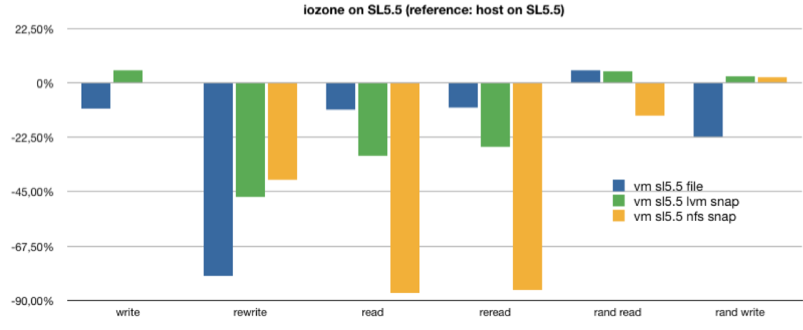
iozone on SL5.5 (SL5.5 VMs)
iozone tests with caching disabled, file size 4 GB on VMs with 2GB RAM
host with SL5.5 taken as reference
VM on SL5.5 with just -snapshot crashed
Based on these tests, WNoDeS will support -snapshot for the root partition and a (dynamically created) native LVM partition for /tmp and for user data
A per-VM single file or partition would generally perform better, but then we’d practically lose VM instantiation dynamism

Slide 12
iozone on SL6 (SL5.5 VMs)
Consistently with what was seen with some CPU performance tests, iozone on SL6 surprisingly performs often worse than on SL5.5
Assuming RHEL6 performance will be improved by RH, using VM with -snapshot for the root partition and a native LVM patition for /tmp and user data in WNoDes seems a good choice here as well
But we will not upgrade HVs to SL6 until we are able to get reasonable results in this area

Slide 13
iozone on QCOW2 image file

Slide 14
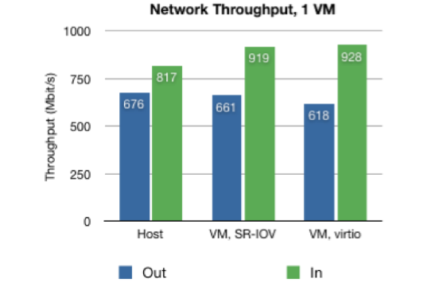
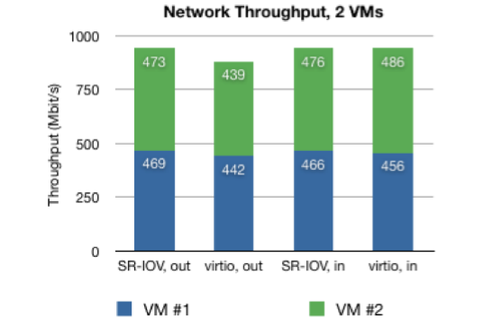
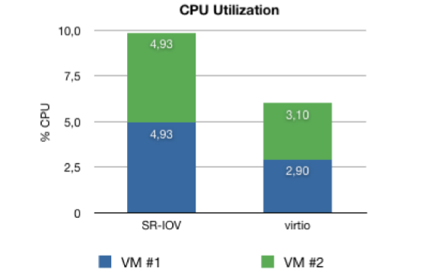
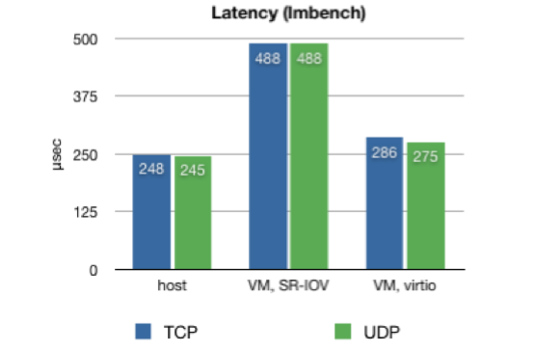
Network
SR-IOV slightly better than virtio wrt throughput
Disappointing SR-IOV performance wrt latency, CPU utilization

Slide 15
The problem we see for the future
Number of cores in modern CPUs is constantly increasing
Virtualizing to optimize (cpu/ram) resources is not enough
O(20) cores per cpu will require 10GBps nics (at least at T1)
Disk i/o is still a problem (it was the same last year, no significant improvement has been done)

Slide 16
Technology improvements
SSDs may help
Did not arrive on time to be tested ☹
Great expectations, but price will prevent massive adoption at least in 2011
SR-IOV nics are very interesting
Drivers have to improve
SL6: virtualization embedded
KSM, hugetlbfs, pci-passthrough
Still problems with performance
KVM VirtFS: para-virtualized FS

Slide 17
Conclusions
VM performance tuning still requires detailed knowledge of system internals and sometimes of application behaviors
Many improvements of various types have generally been implemented in hypervisors and in VM management systems. Some not described here are:
VM pinning. Watch out for I/O subtleties in CPU hardware architectures.
Advanced VM brokerage. WNoDeS fully uses LRMS-based brokering for VM allocations; thanks to this, algorithms for e.g. grouping VMs to partition I/O traffic (for example, to group together all VMs belonging to a certain VO/user group) or to minimize the number of active physical hardware (for example, to suspend / hibernate / turn off unused hardware) can be easily implemented (whether to do it or not depends much on the data centers infrastructure / applications)
The steady increase in the number of cores per physical hardware has a significant impact in the number of virtualized systems even on a medium-sized farm
This is important both for access to distributed storage, and for the set-up of traditional batch system clusters (e.g. the size of a batch farm easily increases by an order of magnitude with VMs).
The difficulty is not so much in virtualizing (even a large number of) resources. It is much more in having a dynamic, scalable, extensible, efficient architecture, integrated with local, Grid, Cloud access interfaces and with large storage systems.

