Slide 1


Sviluppo middleware sostenibile
Il caso di EMI
Francesco Giacomini
Workshop CCR/INFNGrid
La Biodola, 16-20 Maggio 2011
©Alberto Di Meglio
EGI UF/EMI TF, Vilnius, 11-14 April 2011

Slide 2
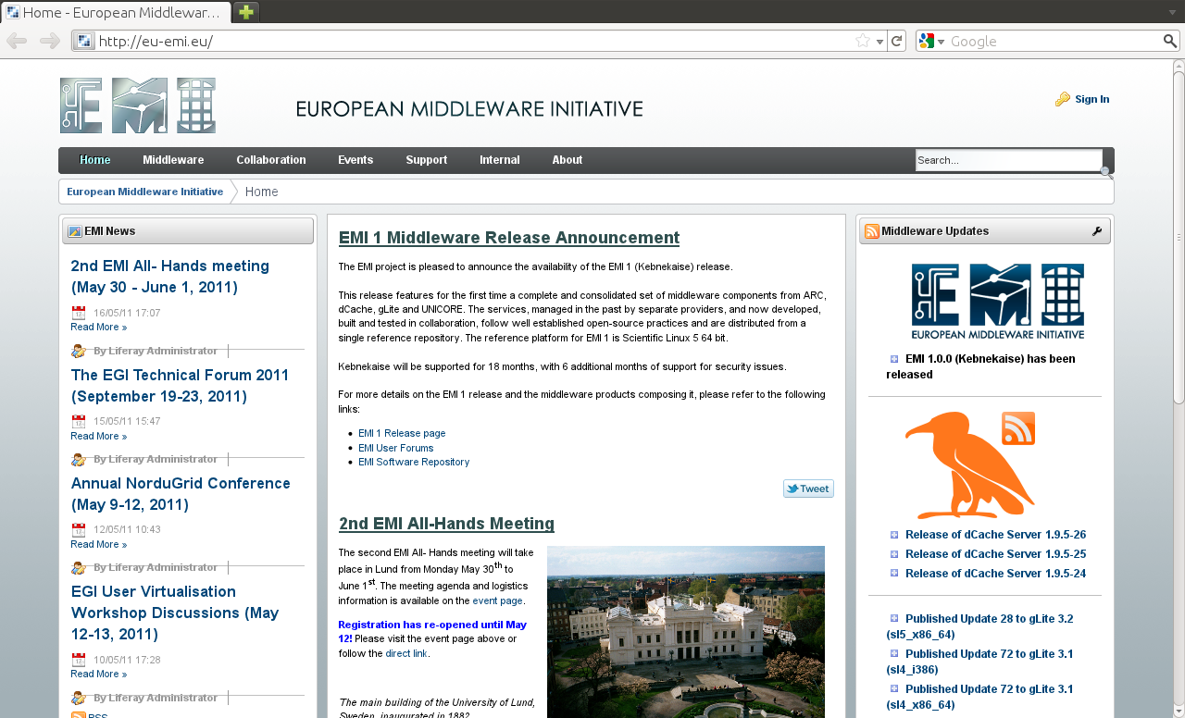
EMI 1 (Kebnekaise) is out

Slide 3











A European Vision
Today
?
Sustainability
Persistence
Interoperability
Easier Access
Yesterday

Slide 4
EMI Mission Statement
The European Middleware Initiative (EMI) project represents a close collaboration of the major European middleware providers - ARC, gLite, UNICORE and dCache - to explore and implement sustainable models to support, harmonise and evolve the distributed computing and data management middleware for deployment in EGI, PRACE and other distributed e-Infrastructures

Slide 5


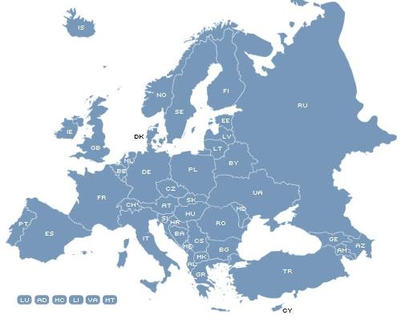

















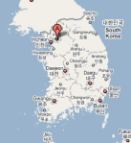
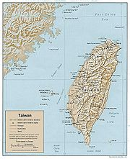





Partners (26)

Slide 6
Open Source Models
Community model
Apache, Eclipse
Red Hat, Canonical
MySQL, gSOAP
EMI and other publicly funded projects
Support contracts or Subscription model
Dual-licensing or Commercial model
Macro R&D Infrastructures model

Slide 7
Open Source Models
Incubation in the right condition becomes
Community model
Macro R&D Infrastructures model
Support contracts or Subscription model
Dual-licensing or Commercial model

Slide 8






Sustainability Drivers
Expansion of the user base
Decrease of costs
Commercial activities

Slide 9
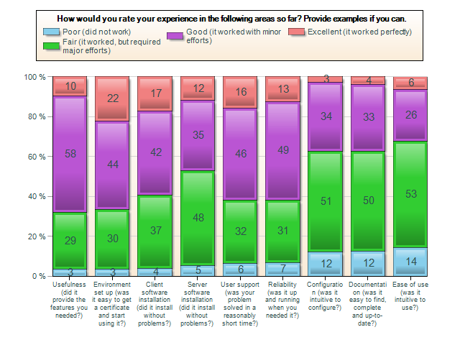
Expansion of the user base
From EMI Distributed Computing Survey, Feb 2011

Slide 10













Expansion of the user base

Slide 11



Reduction of costs and effort
Simplification, off-the-shelf software
Best practices and policies
Standard QA and software processes (ITIL)
Standardization
  Active involvement in OGF and SIENA
  EMI ES contributed to OGF PGI
  Proposal on Storage Accounting Records
  Support for GLUE 2 .0, SAML
  Use of standard SSL, http (webdav), NFS1.4/pNSF

Slide 12


Involvement of commercial partners
On three fronts
  Making the software more standard
  Working on business models and market analysis
  Promoting the creation of professional, SLA-based services
Dual licensing model is interesting

Slide 13



EMI Middleware Evolution
Before EMI
3 years
After EMI
Applications Integrators, System Administrators
Standard interfaces
Specialized services, professional support and customization
Standard interfaces
EMI Reference Services
Standards,
New technologies (clouds)
Users and Infrastructure Requirements

Slide 14
Release Plan
EMI Reference
Services
Start
EMI 1
EMI 2
EMI 3
Major releases
Supp. & Maint.
Support & Maintenance
Support & Maintenance
Support & Maintenance
01/05/2010
31/10/2010
30/04/2011
30/04/2012
28/02/2013

Slide 15
EMI 1 (Kebnekaise)
First important step in the implementation of the roadmap:
  ARC, dCache, gLite, UNICORE integrated in the same distribution
  Standard packaging and installation paths according to Fedora guidelines
  Distributed as RPMS and Source RPMS
  External dependencies almost entirely taken from base OS (SL5) or EPEL
  Use of the same Globus libraries for all services (from EPEL, maintained by IGE)

Slide 16
EMI 1 (Kebnekaise)
  Support for SAML, http/webdav for file access, initial support for Glue 2.0
  NFS1.4/pNSF support in dCache, other storage services to follow
  First implementation of WMS on SL5 64bit
  Argus integration for policy management

Slide 17
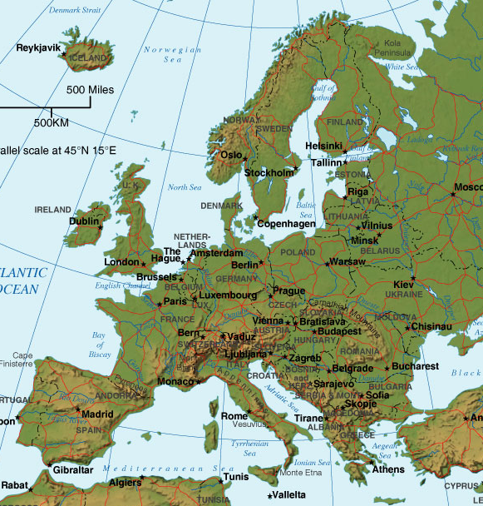
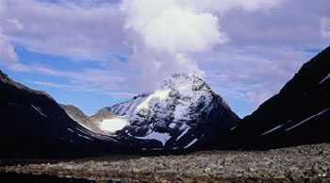
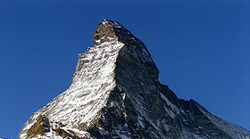

Release Codenames
EMI 1
Kebnekaise (SW), 2104 m
EMI 2
Matterhorn (CH), 4478 m
EMI 3
Monte Bianco (IT/FR), 4810 m

Slide 18

Thank you
EMI is partially funded by the European Commission under Grant Agreement INFSO-RI-261611

