Slide 1
Technology of Beam Driver for Plasma Accelerators
27 July 2023 - 2 August 2023
Ettore Majorana Center (Sicily, IT)
Enrica Chiadroni (Sapienza Univ. - SBAI Dept. and INFN - LNF )

Slide 2
Outline
Particle-driven Plasma Accelerators
Driver beam generation and optimization towards a beam-driven plasma-based user facility
EuPRAXIA@SPARC_LAB through the SPARC_LAB Experience
Conclusions
Notes:
which provide the accelerating structure

Slide 3
Challenges of beam-driven PWFA
Typically in plasma wakefield accelerators we have
gradient of several GV/m
strong focusing fields of several 100 kT/m
the matched beam size of the witness beam is small , σw ≈ µm
optical beta function of witness beam is small, e.g. β ≈ µm
tolerances for emittance growth is small! (100% growth for 1σ offset)
Energy spread <-> uniformity of the accelerating fields (in r, z)
Control charge and beam loading to compensate energy spread
Use short bunches to minimize energy spread
Emittance preservation <-> focusing field (in r,z)
Alignment control between wakefield driver and witness electron bunch at 1 µm level
Stability

Slide 4
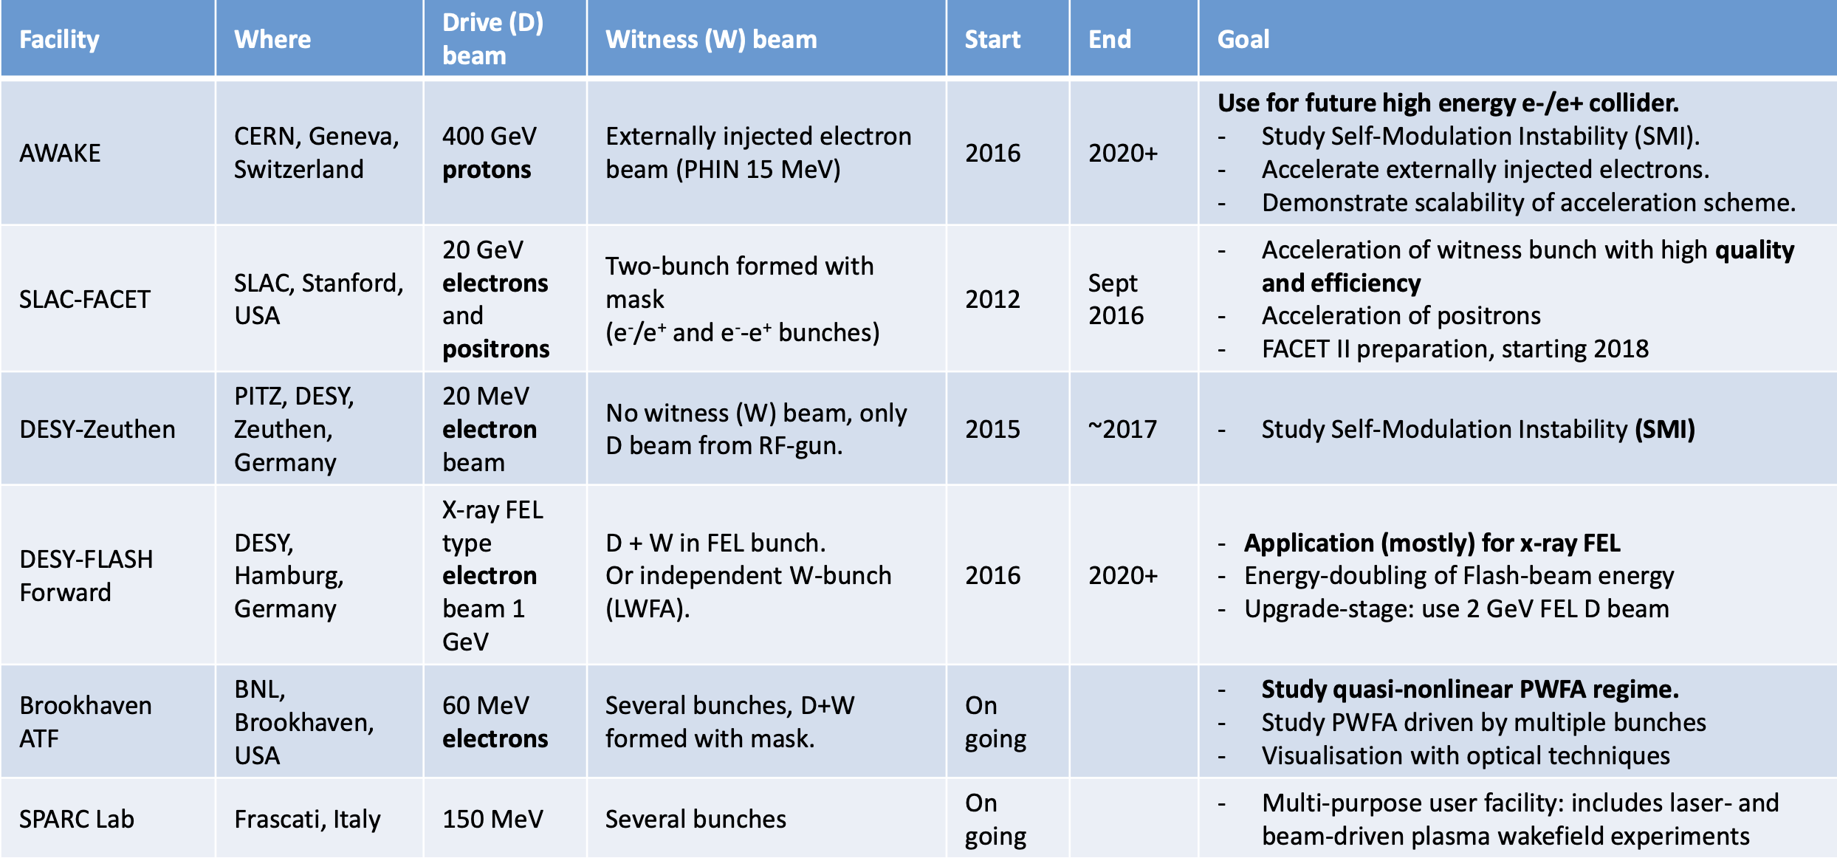
Beam-driven PWFA worldwide
Credits: E. Gschwendtner, 2019

Slide 5
Beam-driven PWFA worldwide
Credits: E. Gschwendtner, 2019
SPARC_LAB

Slide 6
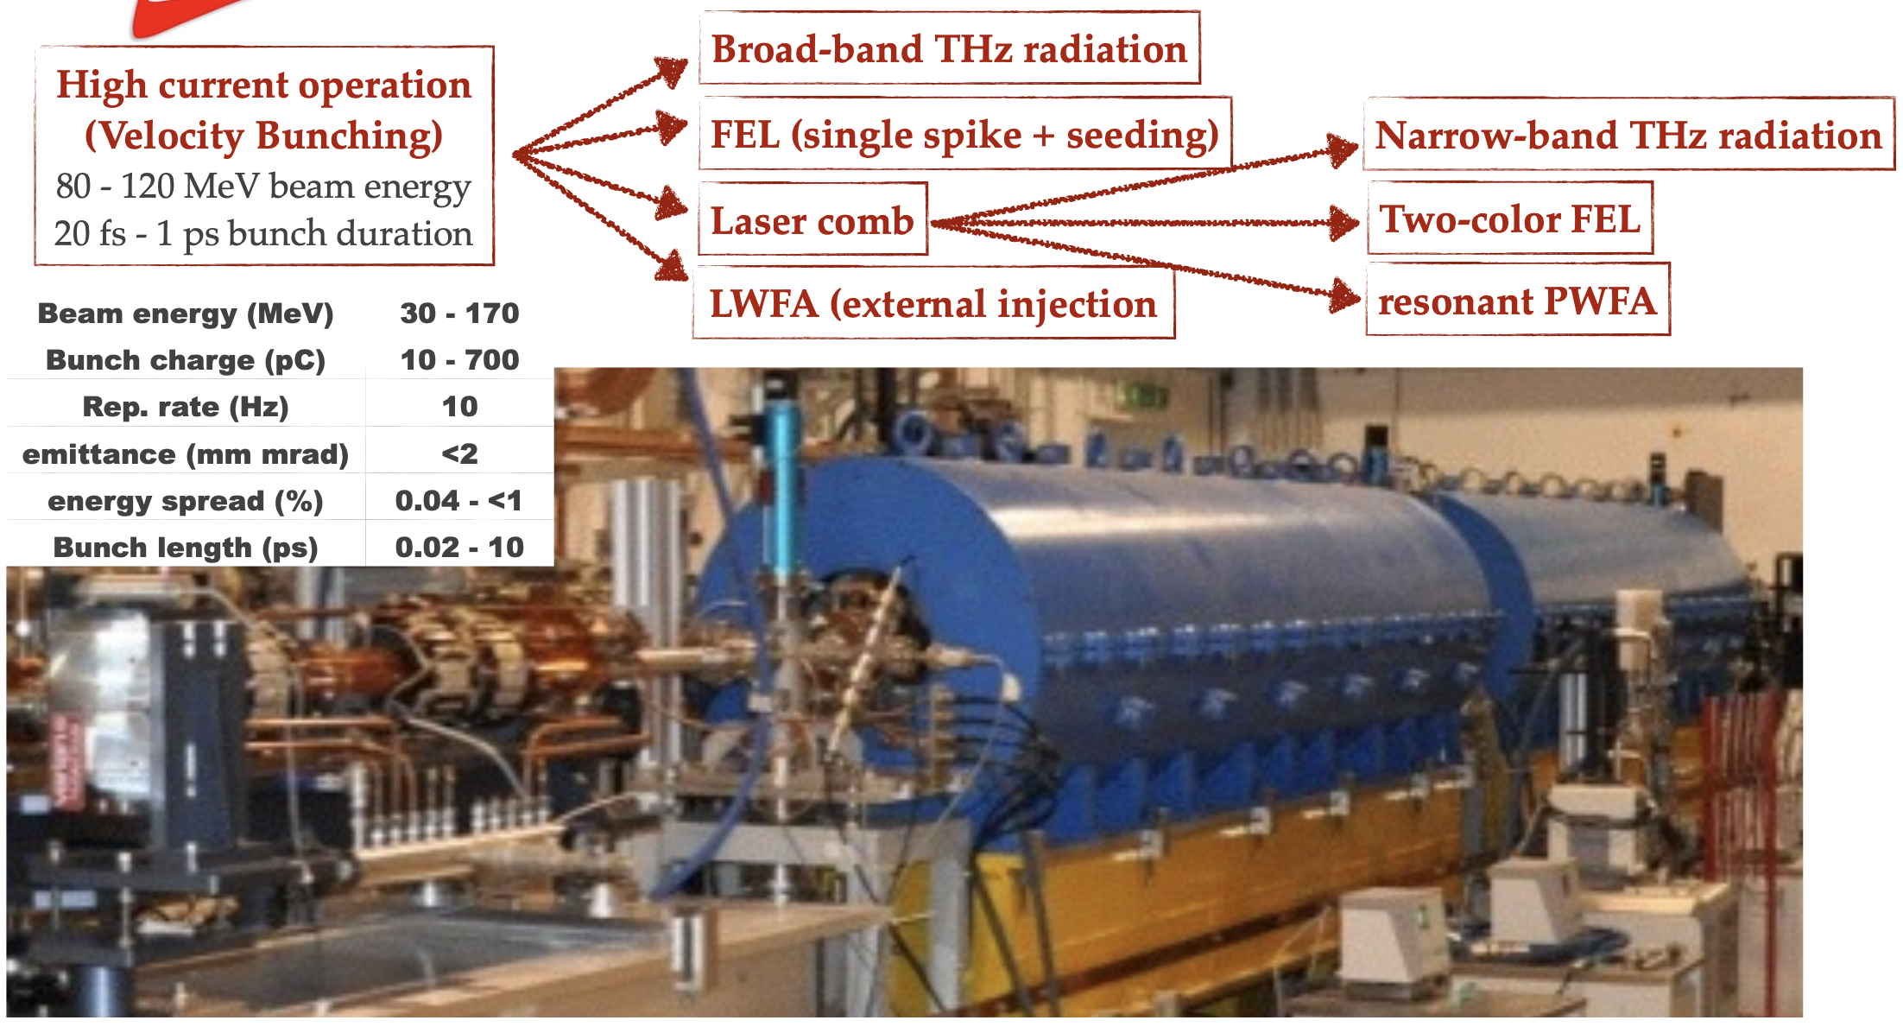
High Brightness Photo-injector

Slide 7
High Brightness Photo-injector

Slide 8
Multi-bunch Shaping in a Photo-Injector
Laser Comb Technique at SPARC_LAB (INFN)
Comb-like laser
P. O. Shea et al., Proc. of 2001 IEEE PAC, Chicago, USA (2001) p.704.
M. Ferrario et al., Int. J. of Mod. Phys. B, 2006

Slide 9
Multi-bunch Shaping in a Photo-Injector
Laser Comb Technique at SPARC_LAB (INFN)
Comb-like laser
P. O. Shea et al., Proc. of 2001 IEEE PAC, Chicago, USA (2001) p.704.
M. Ferrario et al., Int. J. of Mod. Phys. B, 2006

Slide 10
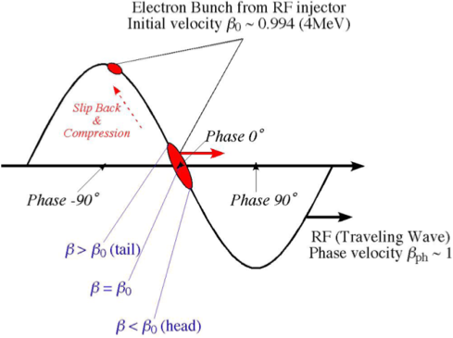
Multi-bunch Shaping in a Photo-Injector
Laser Comb Technique at SPARC_LAB (INFN)
Comb-like laser
Velocity bunching
P. O. Shea et al., Proc. of 2001 IEEE PAC, Chicago, USA (2001) p.704.
M. Ferrario et al., Int. J. of Mod. Phys. B, 2006

Slide 11
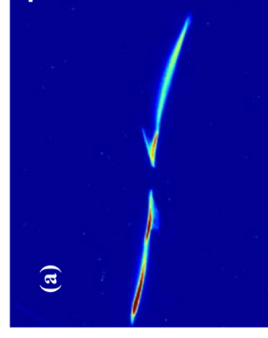
Multi-bunch Shaping in a Photo-Injector
Laser Comb Technique at SPARC_LAB (INFN)
Comb-like laser
Velocity bunching
P. O. Shea et al., Proc. of 2001 IEEE PAC, Chicago, USA (2001) p.704.
M. Ferrario et al., Int. J. of Mod. Phys. B, 2006

Slide 12
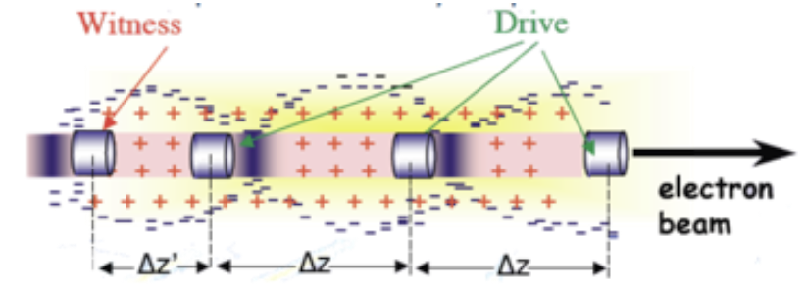
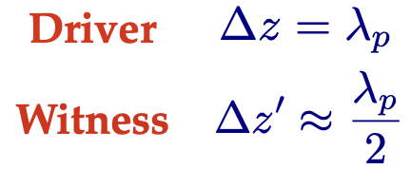
Resonant PWFA
Bunch spacing depends on the plasma density
Increase in energy of a trailing particle ∆γmec² ∼ eE+,maxLd = Rγbmec²
Preservation of witness emittance and length
Better control of the energy spread
Notes:
Multi-bunch shaping is one of the most promising candidates
Weak blowout regime with resonant amplification of plasma wave by a train of HBEBs injected into the preformed plasma (by electric discharge)
5GV/m with a train of 3 bunches, 100 pC/bunch, 20 mm spot size, ne 1022 e/m-3 at lp = 300 mm
Ramped bunch train configuration to enhance transformer ratio
Synchronization with an external laser is not needed
Challenge: creation and manipulation of driver bunches and matching all the bunches with the plasma
High quality bunch preservation during acceleration and transport

Slide 13
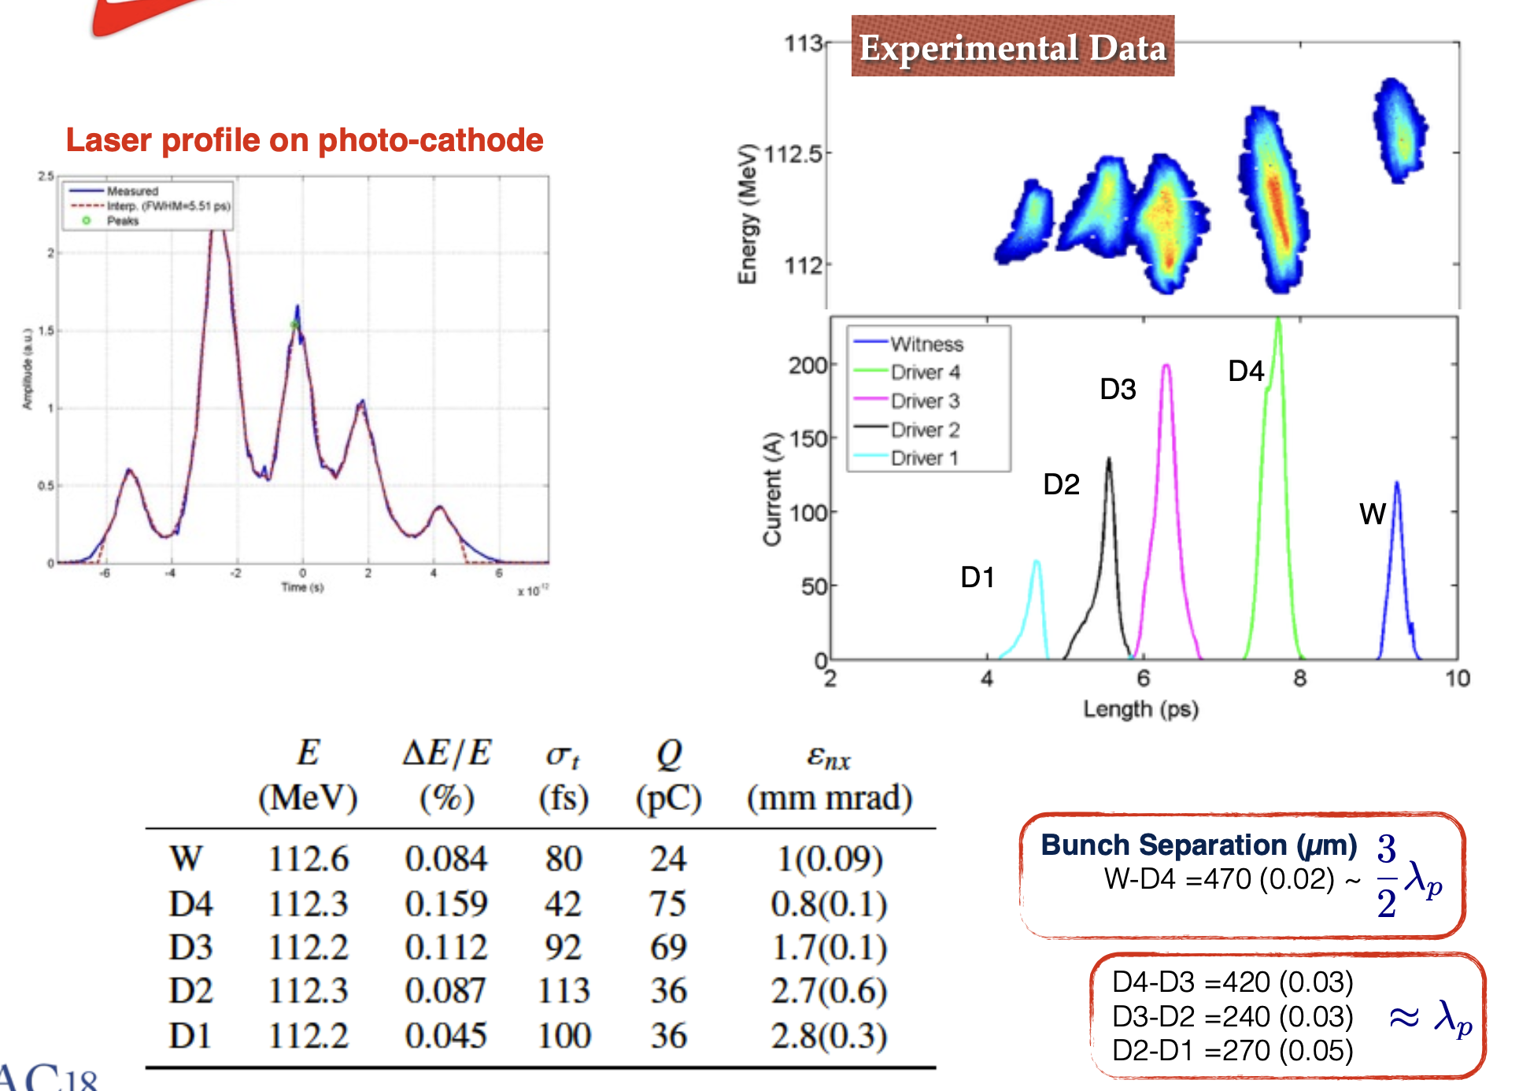
Ramped Bunch Train

Slide 14
Interaction with Plasma
Hybrid kinetic-fluid simulation by Architect from measured drivers parameters

Slide 15
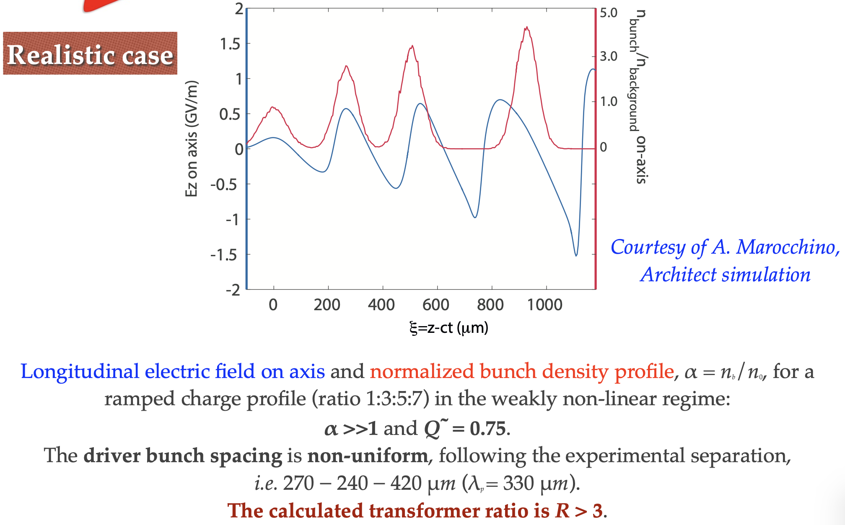
Interaction with Plasma
Hybrid kinetic-fluid simulation by Architect from measured drivers parameters
E. Chiadroni et al., NIM A 865, 139-143 (2017)

Slide 16
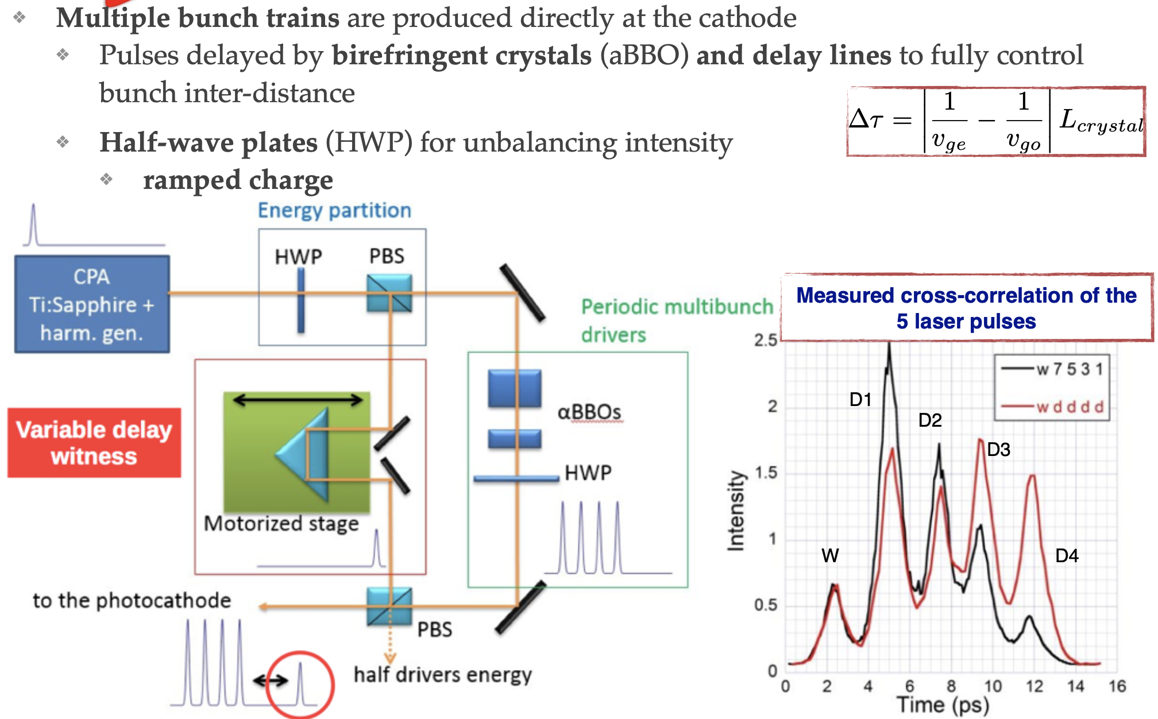
Laser Comb Pulse Shaping

Slide 17
Multibunch Source Masking

Slide 18
Beam Quality Preservation
Well matched driver beam

Slide 19
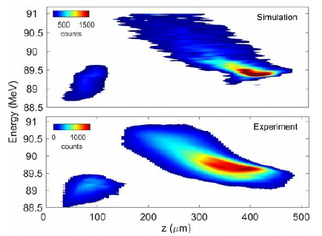
Two-beam configuration
Two-bunches configuration produced directly at the cathode with laser-comb technique
200 pC driver followed by witness bunch (20 pC)
Ultra-short durations (200 fs + 30 fs)
Separation approximately equal to half plasma wavelength (~1.2 ps)
3 cm long 3D-printed plastic capillary, 1 mm diameter aperture
plasma is produced by ionizing hydrogen gas, injected through two inlets, by means of a high-voltage discharge (12 kV, 300 A) at 1 Hz repetition rate

Slide 20
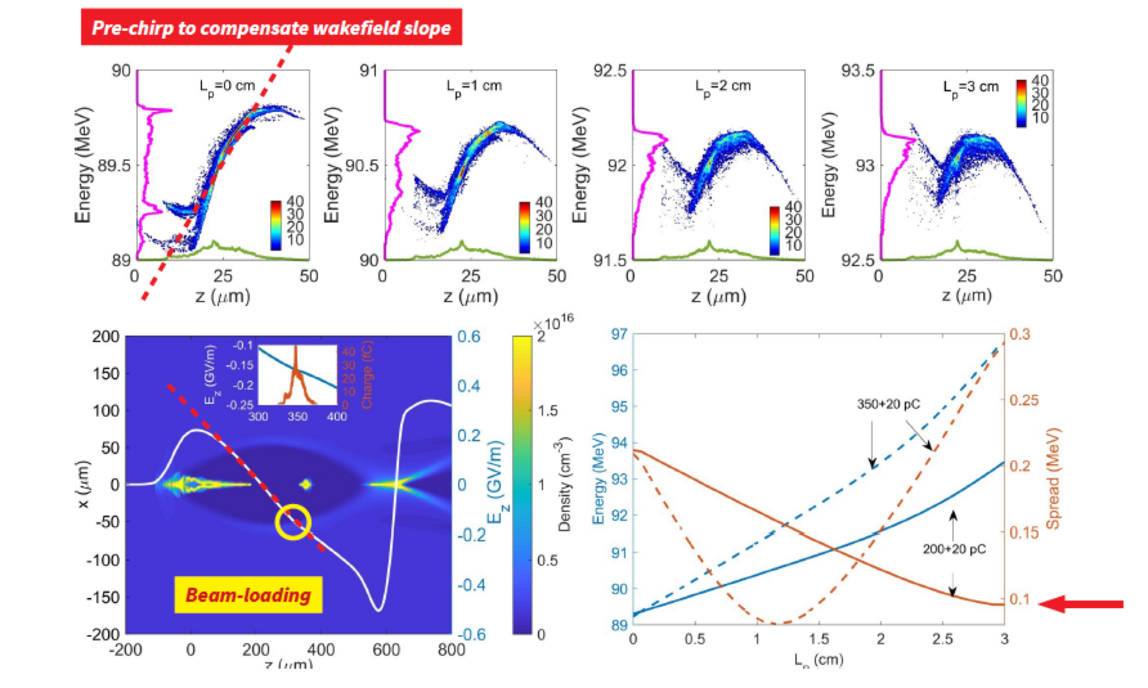
Beam Quality Preservation

Slide 21
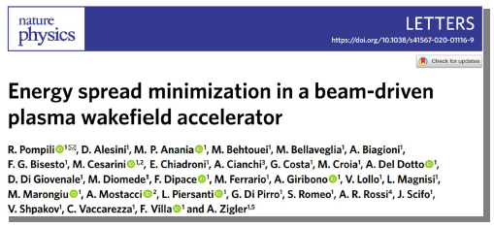
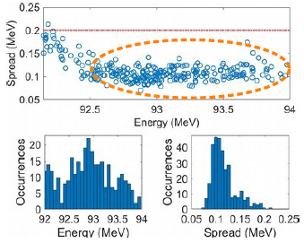
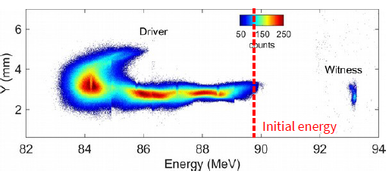
Beam Quality Preservation
Energy spread compensation at SPARC_LAB
4 MeV acceleration in 3 cm plasma with 200 pC driver
~133 MV/m accelerating gradient
2x10¹⁵ cm⁻³ plasma density
First ever demonstration of energy spread reduction
Spread from 0.2% to 0.12%
Energy jitter of the witness energy is 0.5 MeV

Slide 22
Beam Quality Preservation
Normalised emittance measurement

Slide 23
Gas-filled Capillary
Discharge Stabilisation

Slide 24
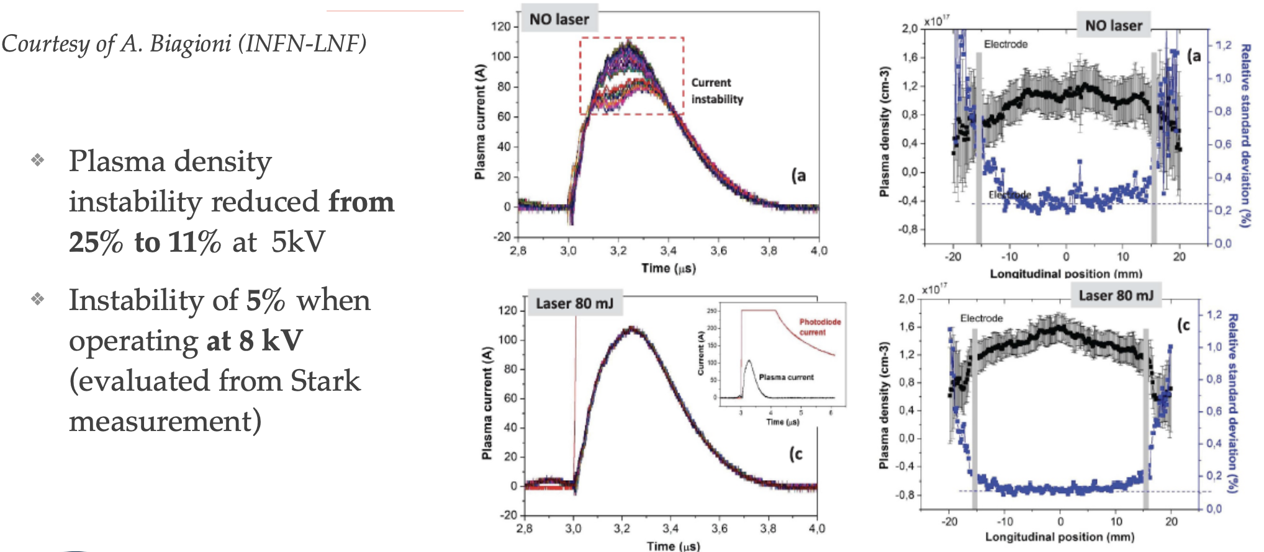
Gas-filled Capillary
Discharge Stabilisation

Slide 25
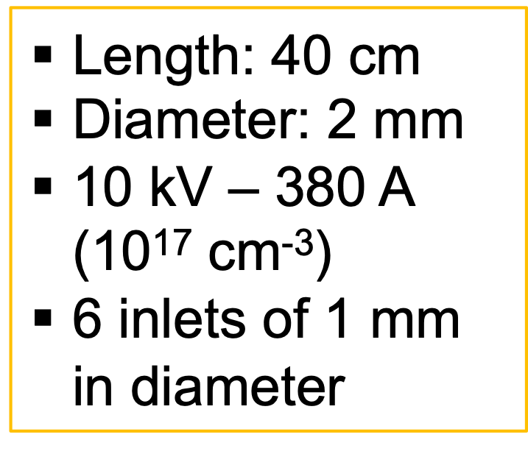
First EuPRAXIA plasma source enabling 1.1 GeV (1.5 GV/m) in 40 cm length capillary (n = 10¹⁶ cm⁻³)
Courtesy of A. Biagioni (INFN-LNF)

Slide 26
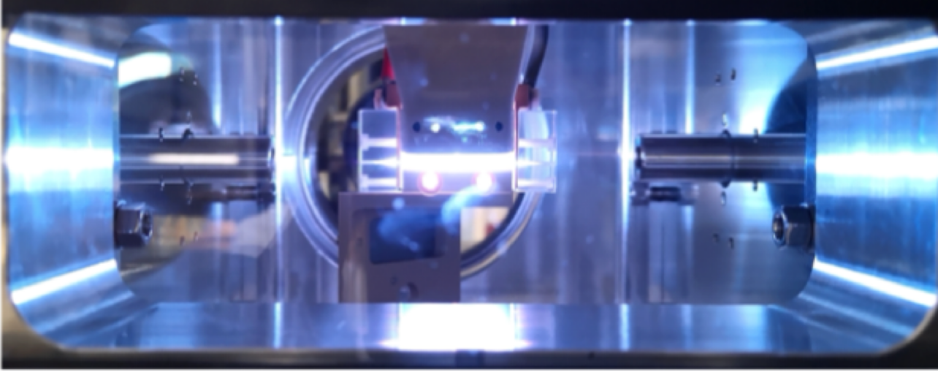
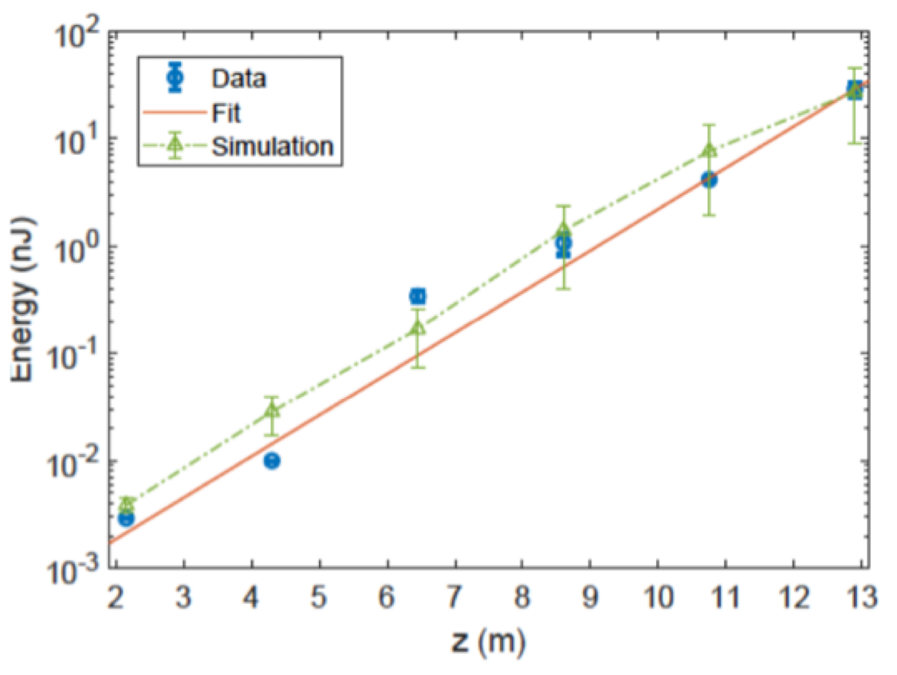
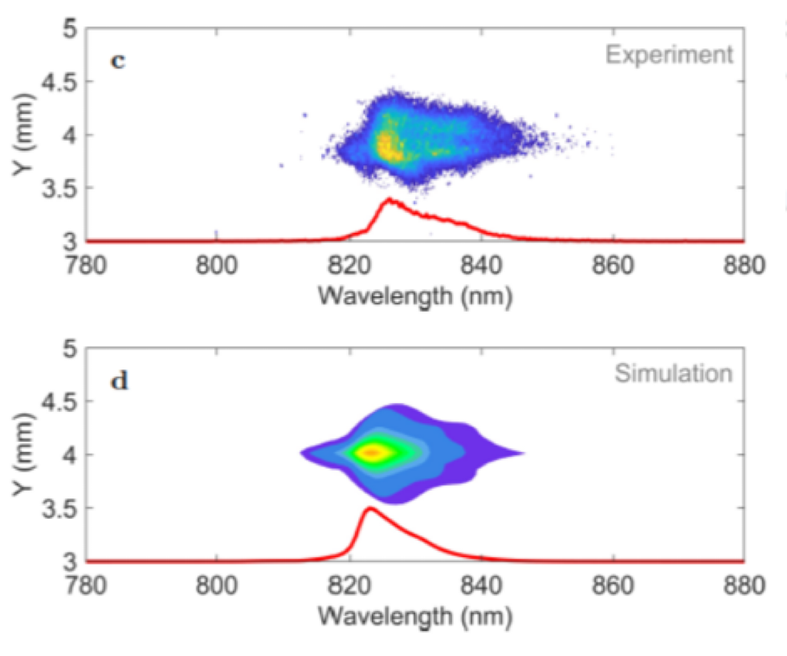
First SASE FEL lasing from a beam-driven PWFA
Feasibility proof at at SPARC_LAB (INFN, Frascati)
R. Pompili et al., Nature 605, 659–662 (2022)

Slide 27
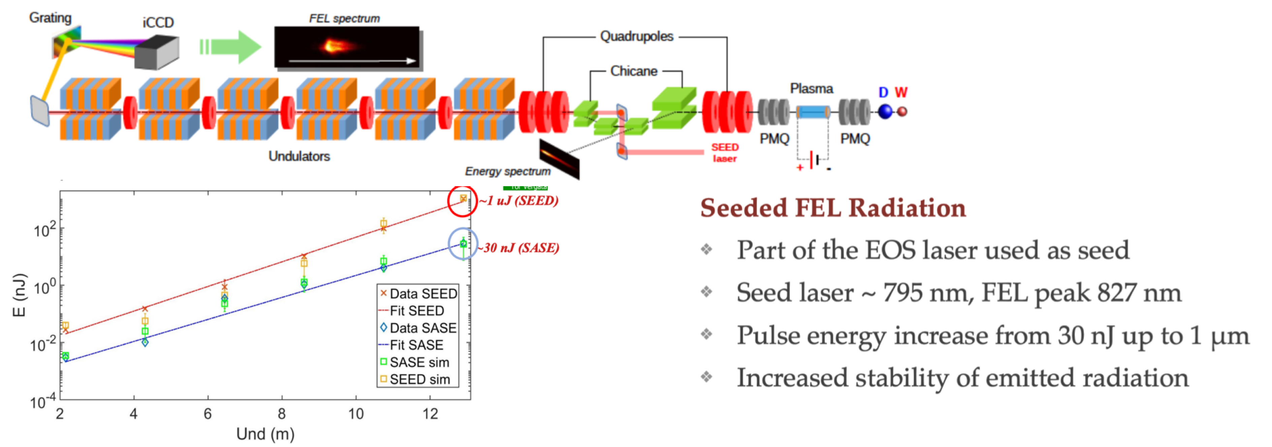
First Seeded FEL lasing from a beam-driven PWFA
Feasibility proof at SPARC_LAB (INFN, Frascati)
M. Galletti et al., Phys. Rev. Lett. 129, 234801 (2022)

Slide 28
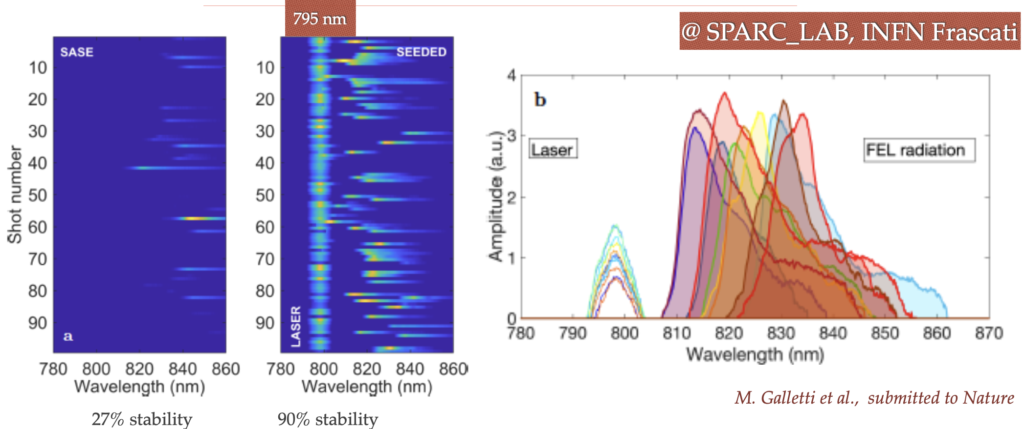
First Seeded FEL lasing from a beam-driven PWFA
Feasibility proof at SPARC_LAB (INFN, Frascati)

Slide 29
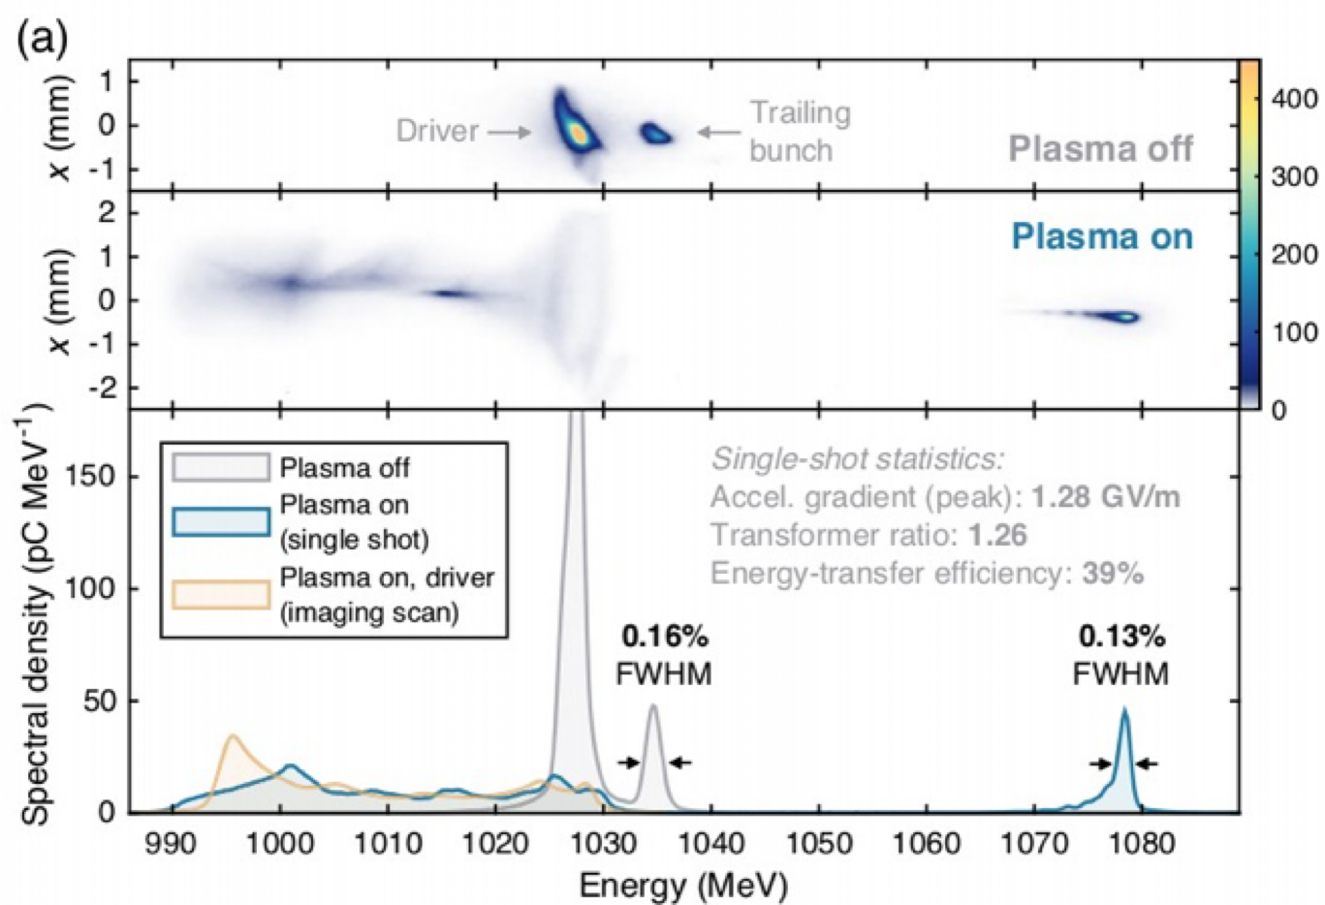
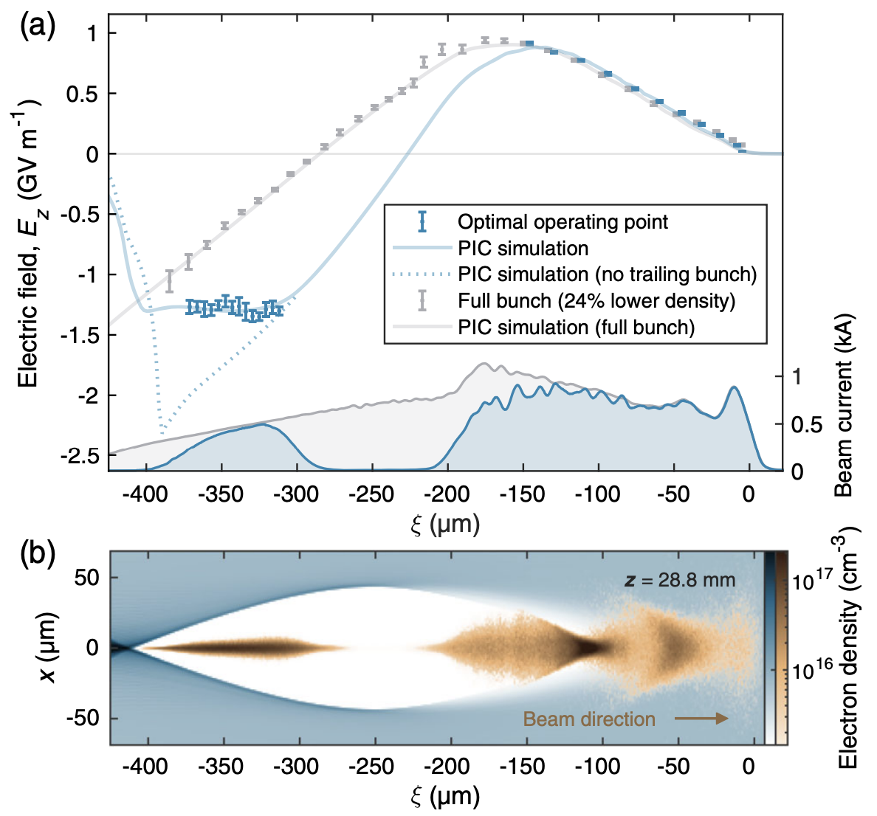
Other Advances towards Beam Quality
Lindstrøm, Carl Andreas, et al. "Energy-spread preservation and high efficiency in a plasma-wakefield accelerator." Physical review letters 126.1 (2021): 014801.
Direct measurement of the wakefield flattening
Notes:
Lindstroem: We experimentally demonstrate such optimal beam loading in a nonlinear electron-driven
plasma accelerator. Bunches with an initial energy of 1 GeV were accelerated by 45 MeV with an energy transfer efficiency of ~42% at a gradient of 1.3 GV/m while preserving per-mille energy spreads with
full charge coupling, demonstrating wakefield flattening at the few-percent level.

Slide 30
Solving Beam Quality Issues
Several key challenges facing plasma-based facility operation under control
stabilization and control of the acceleration process (R. Pompili et al., Energy spread minimization in a beamdriven plasma wakefield accelerator, Nat. Physics 17, no. 4, pp. 499-503, 2021; Ferran-Pousa et al., PRL 123, 054801, 2019)
energy spread mitigation, normalized emittance preservation, overall stability gain
Improvements still needed to guarantee continuous operation
sub-percent to sub-per-mille energy spread and mm mrad to sub-mm mrad emittances
increase of the repetition rate from a few hertz to kilohertz (R. D Arcy et al., Recovery time of a plasma-wakefield accelerator, Nature 603, pp. 58–62, 2022)
improvement of shot-to-shot stability

Slide 31
Conclusions
Impressive progress worldwide has been done toward the operation of a FEL user facility
Recent demonstration of SASE FEL driven by PWFA (SPARC_LAB, INFN -Frascati), LWFA (SIOM, Shangai) and LWFA Coxinel experiment at HZDR (Dresden)
The success of these research efforts is predicated on the ability of the community to overcome several key challenges facing plasma-based FEL operation
stabilization and control of the acceleration process, which turns into energy spread mitigation, normalized emittance preservation, overall stability gain
However, still improvements are needed in terms of
electron beam quality
sub-percent to sub-per-mille energy spread and mm mrad to sub-mm mrad emittances
increase of the repetition rate from a few hertz to kilohertz
improvement of shot-to-shot stability
An entire community is working hard to achieve this result and the selection of EuPRAXIA, as first ever plasma accelerator project, in the ESFRI Roadmap is the validation of the quality and readiness of the work done and the technology
The R&D now concentrates on beam stability, staging, high repetition rate, continuous operation, as necessary steps towards the realization of compact plasma-based accelerator facilities
Plasma-based, ultra-high gradient accelerators therefore open the realistic vision of very compact accelerators for scientific, commercial and medical applications

Slide 32
References
Active-Plasma lenses
Van Tilborg, J., et al. "Active plasma lensing for relativistic laser-plasma-accelerated electron beams." Physical review letters 115.18 (2015): 184802.
Van Tilborg, J., et al. "Nonuniform discharge currents in active plasma lenses." Physical Review Accelerators and Beams 20.3 (2017): 032803.
Lindstrøm, C.A., et al. "Emittance preservation in an aberration-free active plasma lens." Physical review letters 121.19 (2018): 194801.
Plasma “dechirper”
Wu, Y. P., et al. "Phase space dynamics of a plasma wakefield dechirper for energy spread reduction." Physical review letters 122.20 (2019): 204804.
D’Arcy, R., et al. "Tunable plasma-based energy dechirper." Physical review letters 122.3 (2019): 034801
Beam Loading
Kirchen, Manuel, et al. "Optimal Beam Loading in a Laser-Plasma Accelerator." Physical Review Letters 126.17 (2021): 174801

