Slide 1
Plasma Accelerators
27 July 2023 - 2 August 2023
Ettore Majorana Center (Sicily, IT)
Overview of different schemes
Enrica Chiadroni (Sapienza Univ. - SBAI Dept. and INFN - LNF )

Slide 2
Outline
Basic principle of plasma-based acceleration
Issues contributing to improving acceleration techniques
Current research highlights
Other uses for plasma in the accelerator field
Plasma lenses
Plasma wigglers/undulators
Conclusions

Slide 3
Relativistic Plasma Waves
Courtesy of M. Ferrario

Slide 4
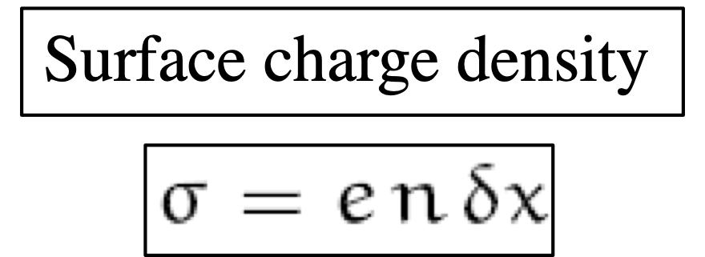
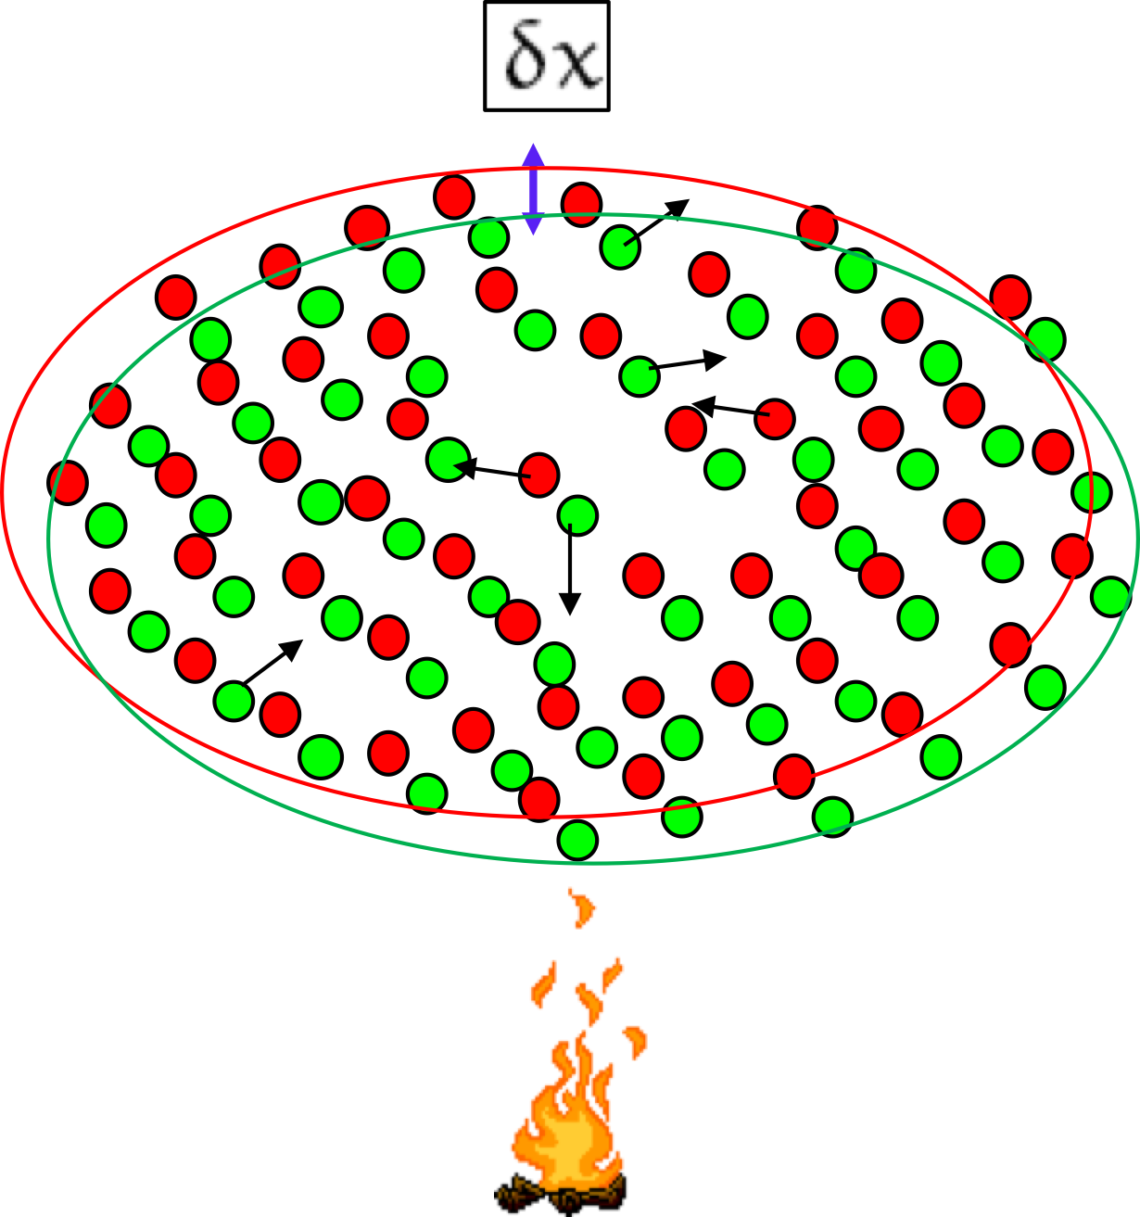
Relativistic Plasma Waves
Courtesy of M. Ferrario

Slide 5
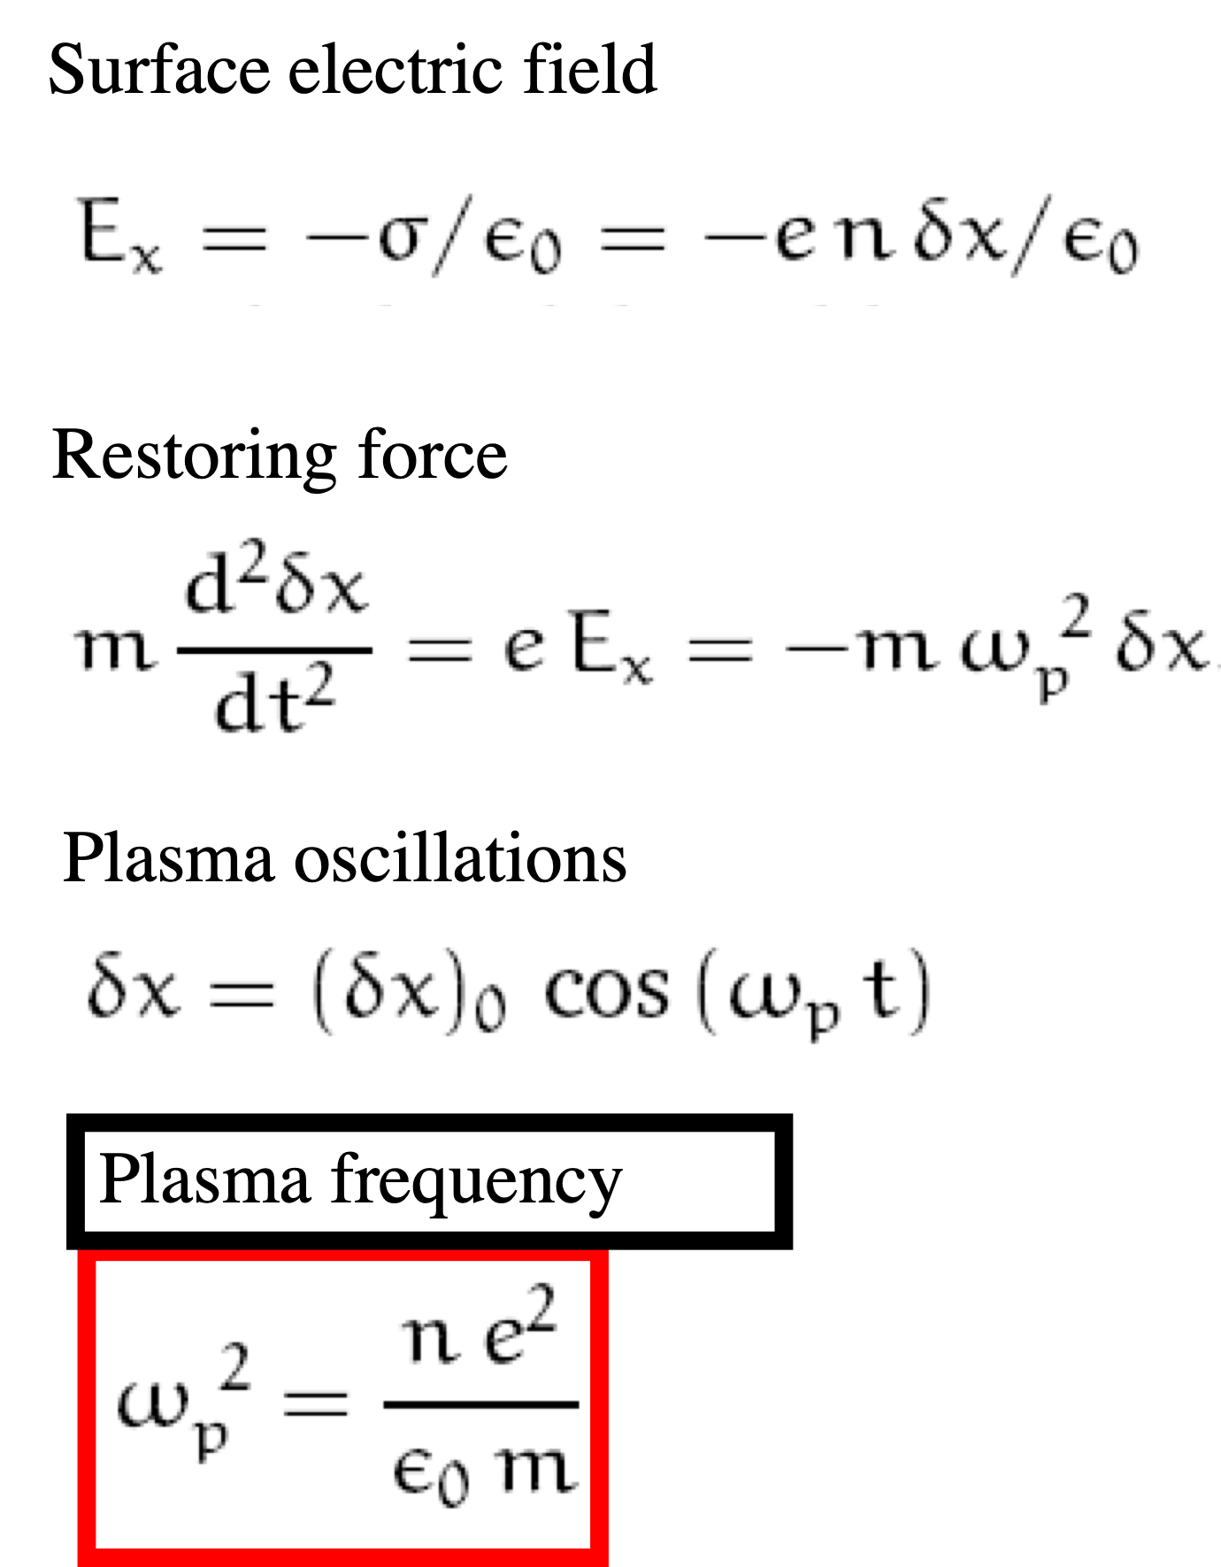
Relativistic Plasma Waves
Collective behavior !!
Courtesy of M. Ferrario

Slide 6
Relativistic Electron Electrostatic Plasma Wave
$$ω_{p}=\sqrt{\frac{n_{0}e^{2}}{m_{e}ε_{0}}}$$
Plasma angular frequency/regular frequency
$$f_{p}=\frac{ω_{p}}{2π}≈9\sqrt{n_{0}}$$
The oscillations lead to local compression (bunching) and rarefaction in the electron density
Electron oscillations are fast, ions are regarded as stationary
The disturbance does not propagate as a wave
Plasma oscillation is purely an electrostatic oscillation

Slide 7
Acceleration in Plasma Waves

Slide 8
$$γ_{p}=\frac{1}{\sqrt{1−\frac{v_{p}^{2}}{c^{2}}}}>>1$$

Slide 9
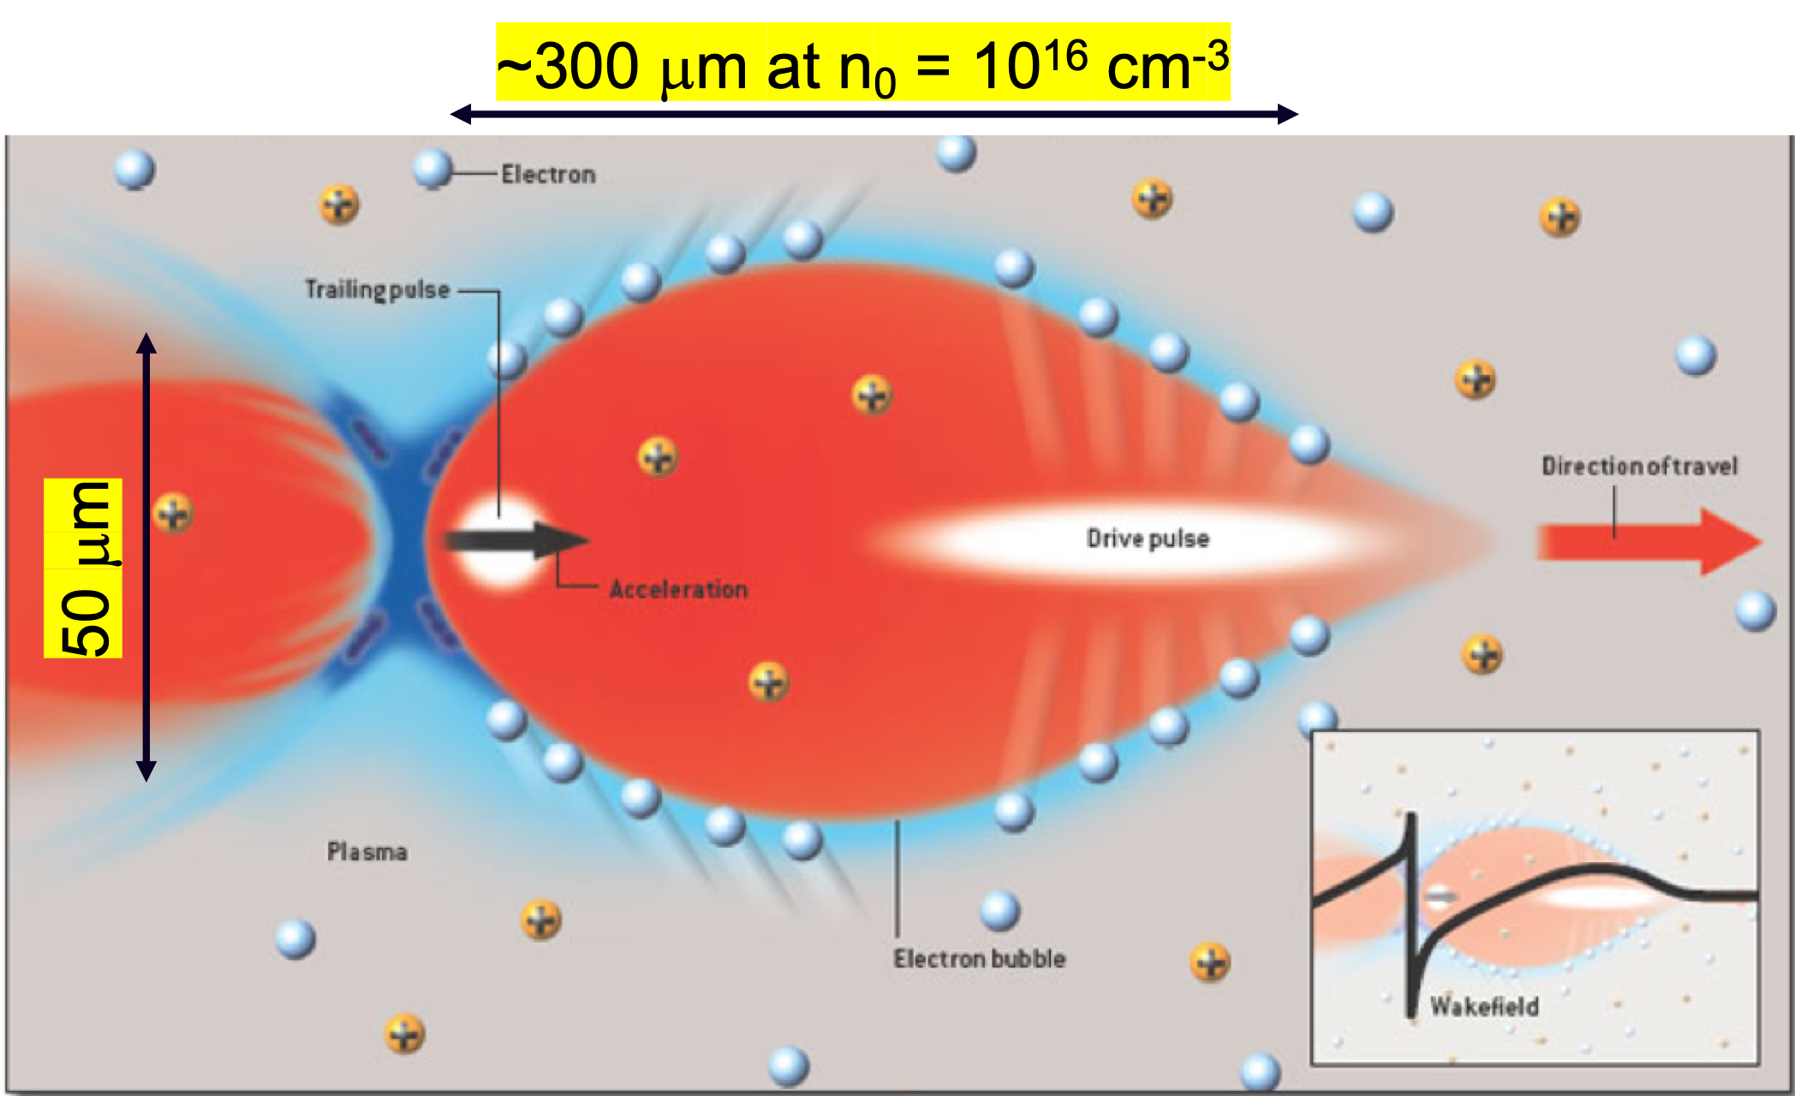
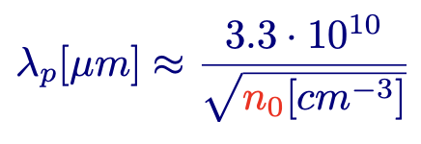
Cold Wavebreaking Field
Characteristic scale length of the accelerating field, i.e. the plasma wake, is the plasma wavelength λ_{p}
Credits: C. Joshi, UCLA
The ionized plasma can sustain accelerating gradient 2-3 orders of magnitude larger than in conventional RF-based accelerators
Maximum accelerating field a plasma can sustain: Cold wave breaking field

Slide 10
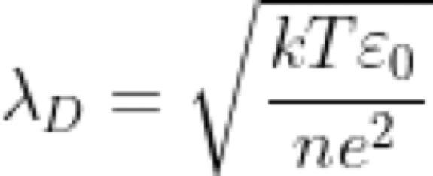
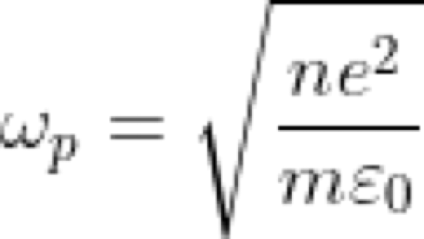
Plasma Definition
A partially or completely ionized gas, globally neutral, is a plasma if it exhibits a collective behavior
Coulomb shielding
Dimensions >> Debye length
Plasma Oscillations
Temporal response >> ωp⁻¹
The large electric fields a plasma can sustain are supported by collective motion of plasma electrons, forming a space charge disturbance moving at a speed slightly smaller than c

Slide 11
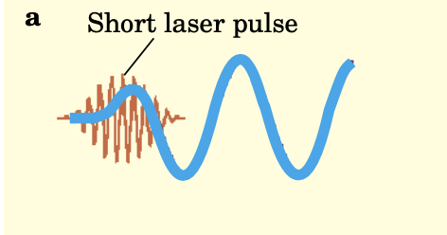
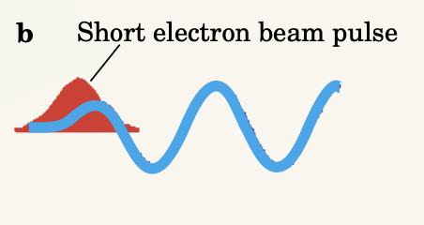
Collective Fields to Accelerate Charged Particles
First Ideas
1956, G I Budker and V I Veksler of the (then) USSR (Budker G I 1986 Proc. CERN Symp. on High Energy Accelerators vol 1 (Geneva: CERN) pp 68–80)
Use of the fields generated in a plasma by the passage of a medium-energy electron beam to accelerate ions to high energy
Toshi Tajima and John Dawson of UCLA (Phys. Rev. Lett. 43 267 (1979))
Use of a relativistically propagating disturbance or a wake created in a plasma by the passage of a short laser pulse to accelerate electrons to ultrahigh energies in a short distance
Pisin Chen at al., (Phys. Rev. Lett. 54 693 (1985))
instead of a laser pulse, one can use a high-current bunch of electrons to generate very high electric fields in a plasma that can be used to accelerate particles extremely rapidly
Laser Wakefield Accelerator
Plasma Wakefield Accelerator
The plasmas does not only provide high acceleration gradients, ~GV/m, but they also serve to focus accelerated beam to micrometer scale spot size
Credits: C. Joshi and T. Katsouleas, AIP Physics Today 2003

Slide 12
Basic Assumptions
Upstream from the laser or beam driver, each fluid can be treated as at rest or cold
For underdense plasmas, the phase velocity of the excited wakefields is roughly the speed of light, c
Compared with this speed, all the initial thermal velocities of plasma particles can be treated as zero
Wavelike assumption
Fields in the wake depend on the variable ct−z, where the phase velocity of the wave is essentially c
Quasi-static approximation
The driver evolves on a time scale much longer than the plasma response
the driver can be consider as non-evolving when calculating the plasma response. Therefore, the wake depends weakly on the distance the driver has moved into the plasma

Slide 13
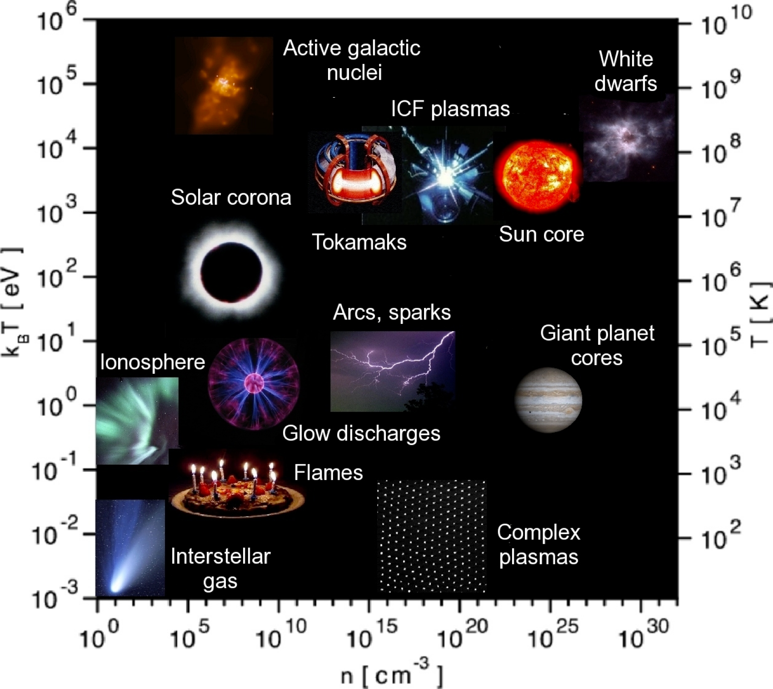
Plasma States
In Nature and in Laboratory
Notes:
Grafico temperatura-densita’

Slide 14
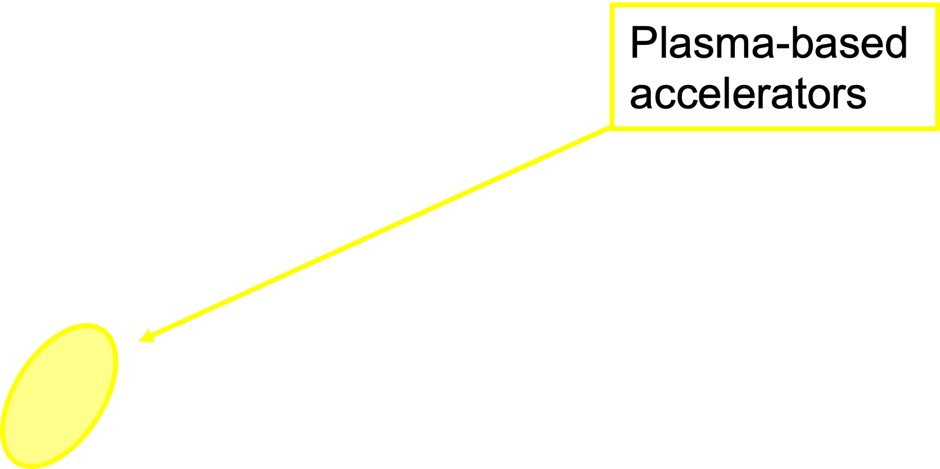
Plasma States
In Nature and in Laboratory

Slide 15
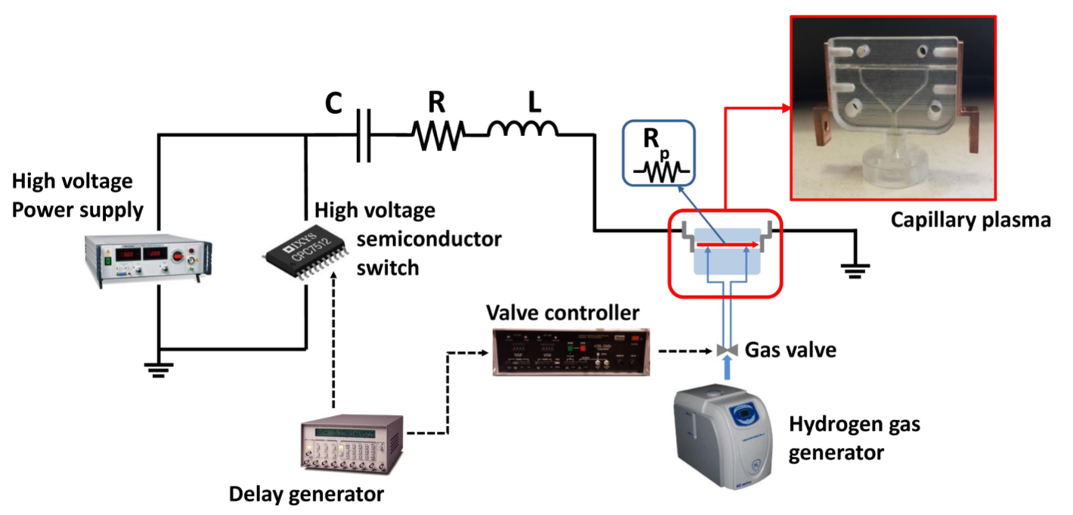
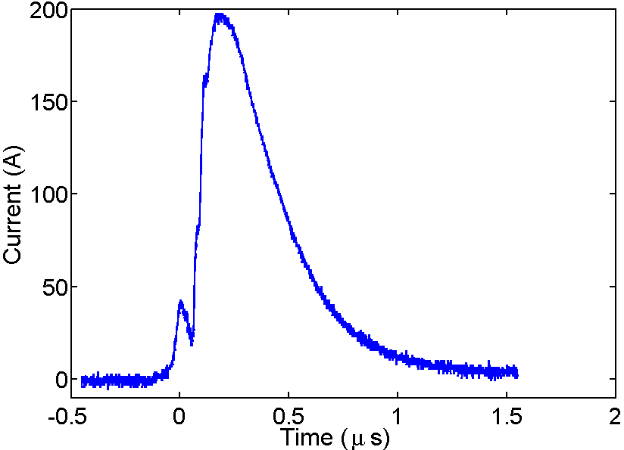
Plasma Source
Gas-filled capillary
L = 3 cm
PH2 = 10 mbar
Total discharge duration :800 ns
Voltage : 20 kV
Peak current : 200 A
Capacitor : 6 nF
H2-filled capillary discharge
H2-filled capillary discharge
Courtesy of A. Biagioni (INFN - LNF)
Notes:
Gas-filled capillary: The capillary is filled with hydrogen set at 10mbar (~100mbar outside the chamber).
A valve opens for few ms (~5ms) letting gas flow inside the capillary.
A discharge of ~20kV and 200A ionizes the gas.
L = 600 nH
R = ??
Rp = ??

Slide 16
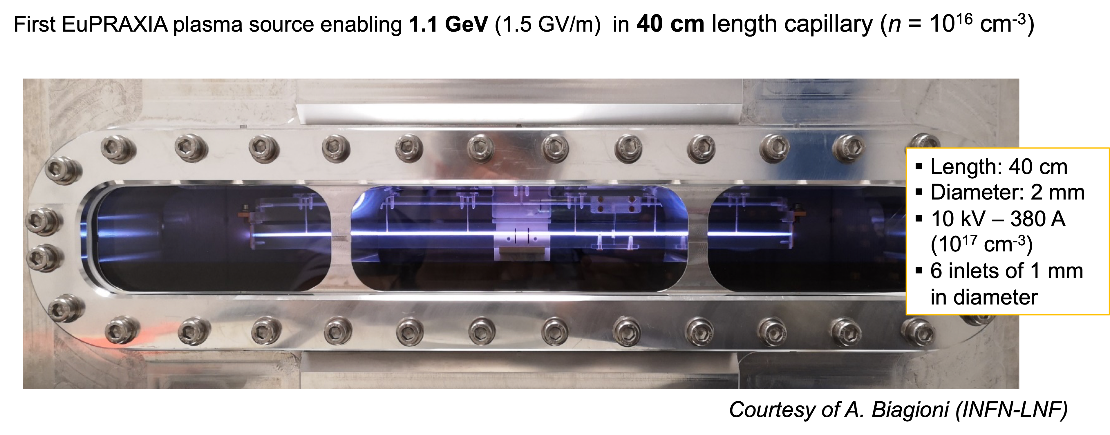
Plasma Source
Gas-filled capillary

Slide 18
Response of a homogeneous plasma to a high frequency field
Let’s consider a charge q in an oscillating electric field with a non-uniform envelope
Slowly varying envelope approximation (SVEA):
Non relativistic equation of motion
but not negligible (II order theory)
Position of q = “slow” drift + “fast” oscillation
Hypotheses

Slide 19
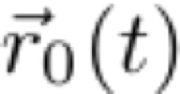
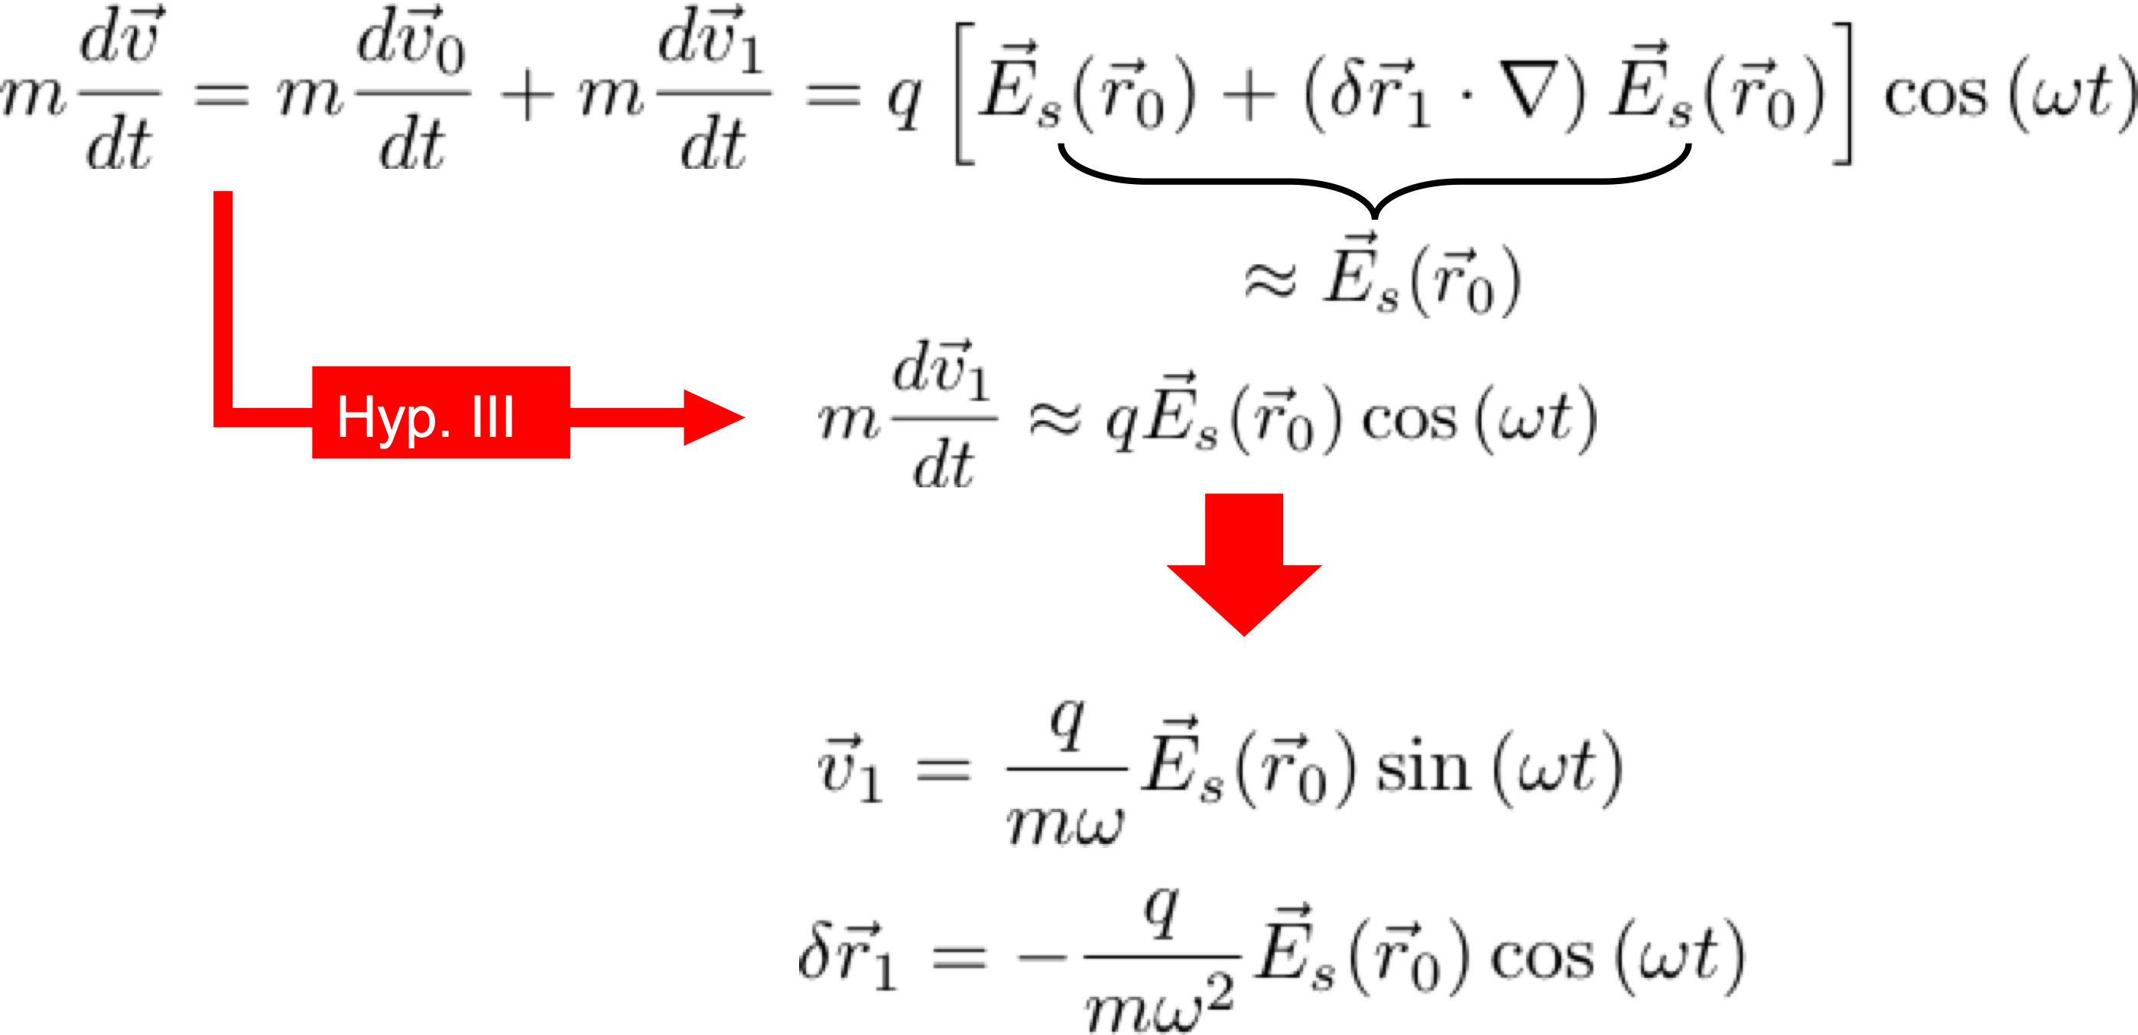
Fast Oscillations of Electrons
Let’s first neglect the B field and Taylor expand the E field around

Slide 20
From III Maxwell equation:
The particle motion equation can be written as
Notes:
dr1 =displacement with respect to the equilibrium r0

Slide 21
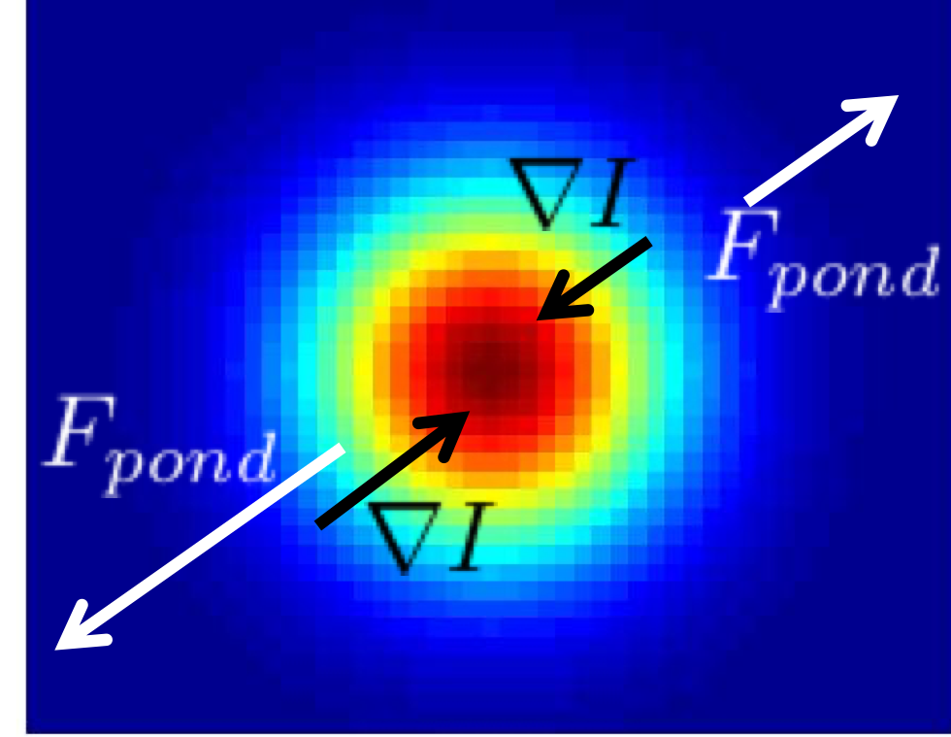
Ponderomotive Force
Ponderomotive force
Ponderomotive force per unit volume

Slide 22
Acceleration Mechanism

Slide 23
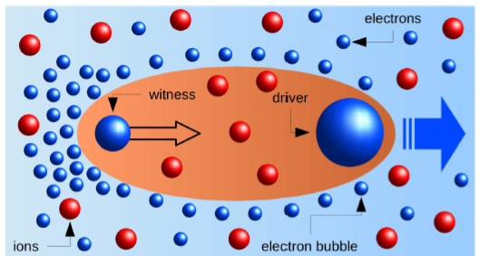
Self-Injection and External Injection of Electrons
The driver, creating the bubble, can be either a dense relativistic particle beam (PWFA) of sub-
ps duration and kA level peak current
ultra-intense laser pulse (LWFA), ~10¹⁸ W/cm², of few 10s fs duration
❖ Rapid acceleration of injected electrons to ultra-relativistic energies, inside the micrometer-sized structured plasma environment
❖ the trapped electron beam remains short, dense, and free of
significant space-charge driven emittance degradation
enrica.chiadroni@uniroma1.it
❖ ❖
❖
❖
The witness can be either self-injected or externally injected

Slide 24
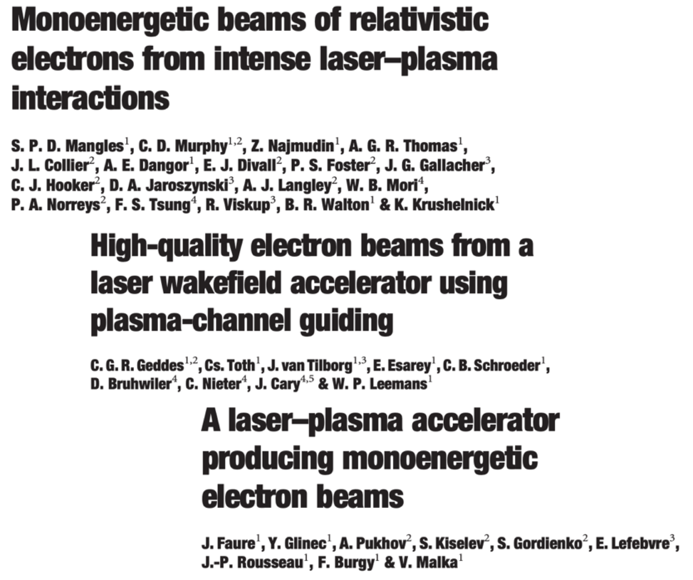
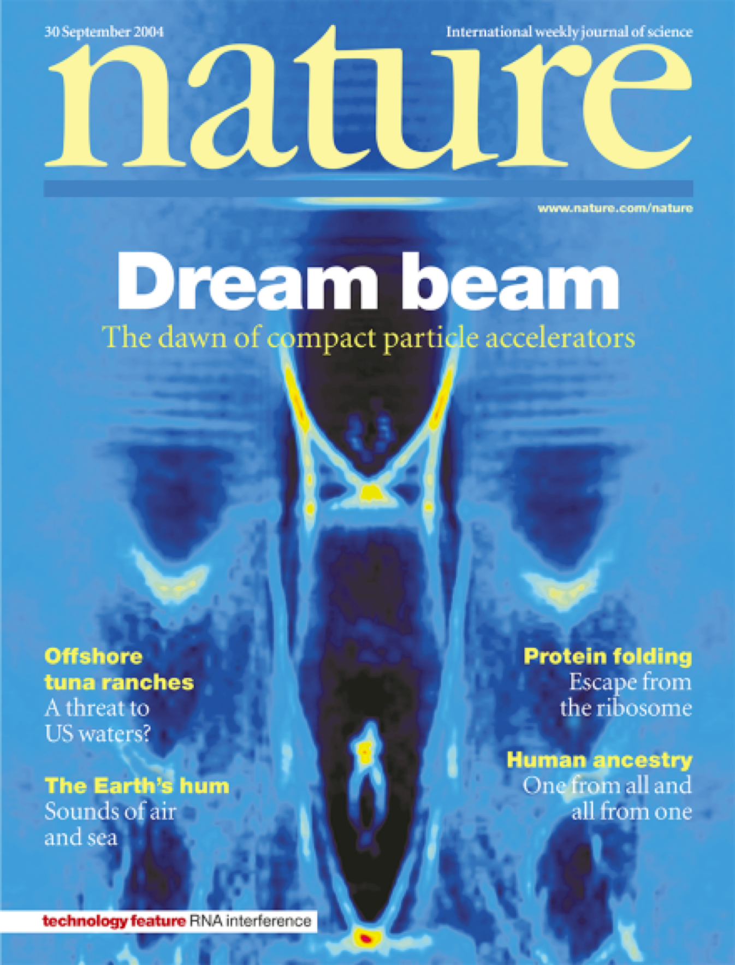
The Dawn of Compact Accelerators
September 2004
Notes:
Malka’s next talk for an insight on LWFA

Slide 25
The Dawn of Compact Accelerators
September 2004
See Malka’s talk for an insight on Laser Wakefield Acceleration
Notes:
Malka’s next talk for an insight on LWFA

Slide 26
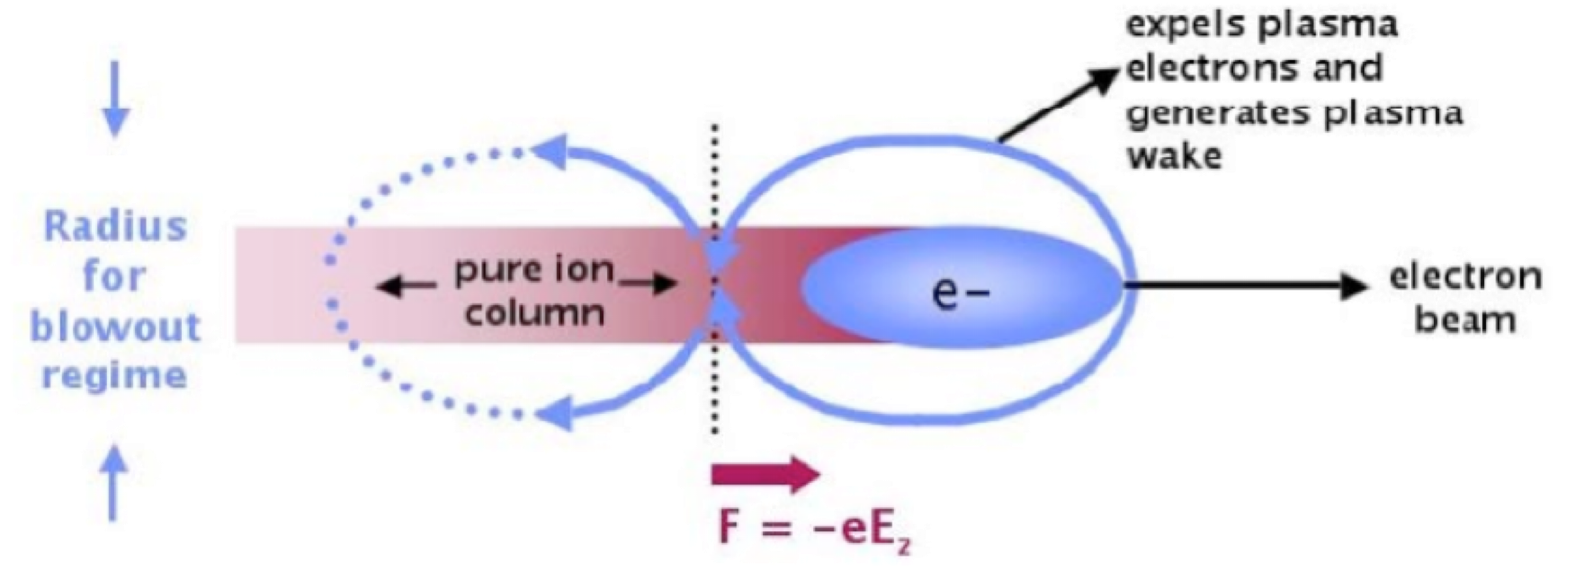
Particle-driven Plasma Wakefield Acceleration
Single bunch
The high-gradient wakefield is driven by an intense, high-energy charged particle beam as it passes through the plasma.
The space-charge of the electron bunch blows out plasma electrons which rush back in and overshoot setting up a plasma oscillation
First demonstration of the excitation of a wakefield by a relativistic beam in the linear regime, i.e. beam density typically less than the plasma density => J. Rosenzweig et al., Phys. Rev. Lett. 61, 98 (1988)
Peak acceleration gradient ~ 1.6 MeV/m, but the experiment clearly showed the wakefield persisting for several plasma wavelengths

Slide 27
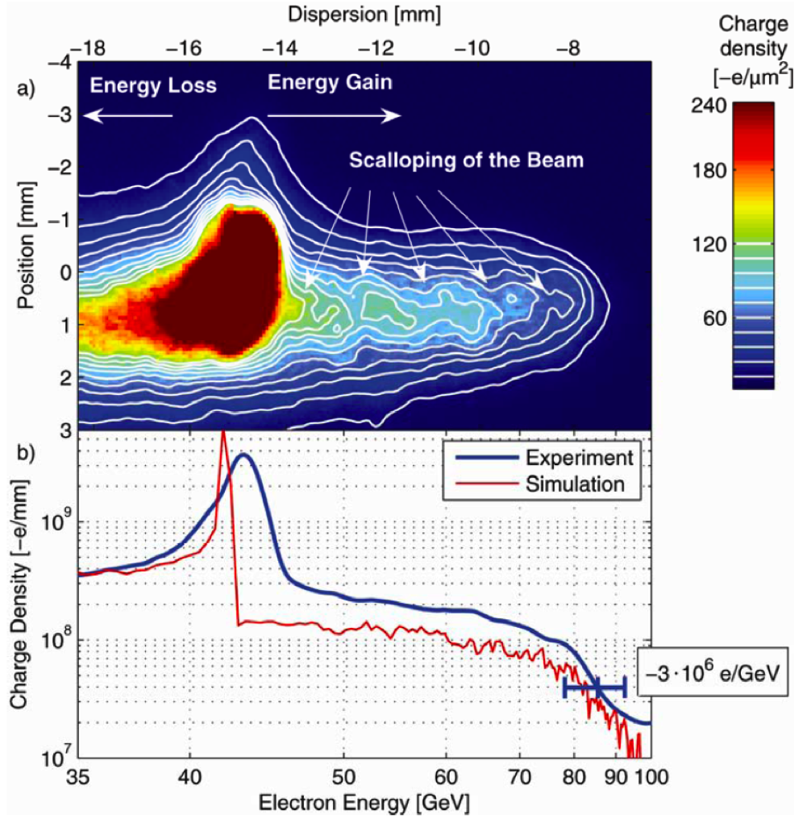
PWFA: Energy doubling in a meter scale
Blumenfeld, I. et al. Nature 445, 741–744 (2007)
Credits: P. Muggli
Gaussian electron beam with 42 GeV, 3nC @ 10 Hz, sx = 10µm, 50 fs
85cm Lithium vapour source, 2.7x10¹⁷cm⁻³
Accelerated electrons from 42 GeV to 85 GeV in 85 cm
Reached accelerating gradient of 52 GeV/m
Energy gain of the 3 km-long SLAC linac
Single bunch
∆E/E >> 1%

Slide 28
Two-bunch Train PWFA
Bunch length of tens of fs down to fs scale
A second, appropriately phased accelerating beam (witness beam), containing fewer particles than the drive beam, is then accelerated by the wake
Bunch train (D+W) for bunch acceleration (∆E/E<<1)

Slide 29
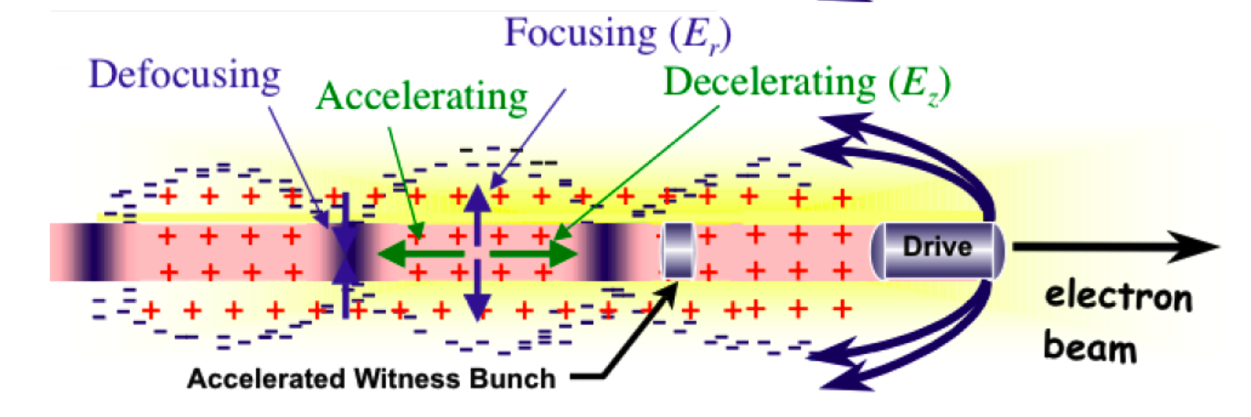
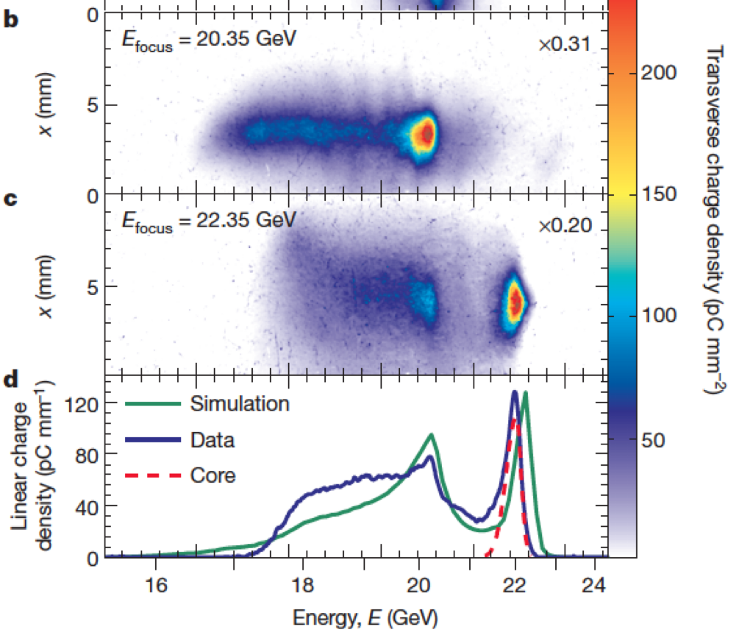
PWFA: High-efficiency acceleration
Litos, M. et al. Nature 515, 92–95 (2014)
Injection of two beams into the plasma
One drives the wake, driver, one samples the wake, witness
Beam loading is key for
Narrower energy spread, ∆E/E <<1%, and high efficiency

Slide 30
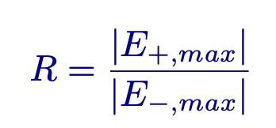
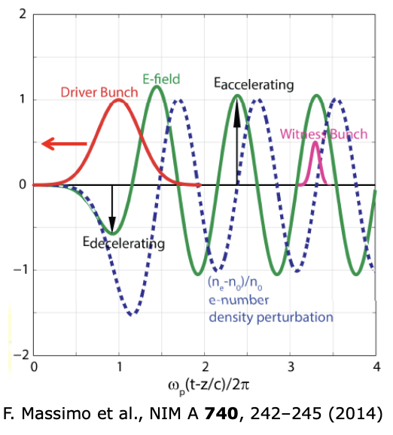
Limitation of PWFA
Energy gain
PWFA acting as an energy transformer has the great potential to double beam energy in a single stage
The energy transfer from the drive bunch to the plasma is optimized by maximizing the transformer ratio
Wakefield theorem*
Symmetric drive bunch current profile in a single-mode structure: the maximum accelerating field behind the drive bunch cannot exceed 2 times the maximum decelerating field amplitude along the drive bunch
*V. V. Tsakanov, Nucl. Instrum. Methods Phys. Res., Sect. A 432, 202 (1999)

Slide 31
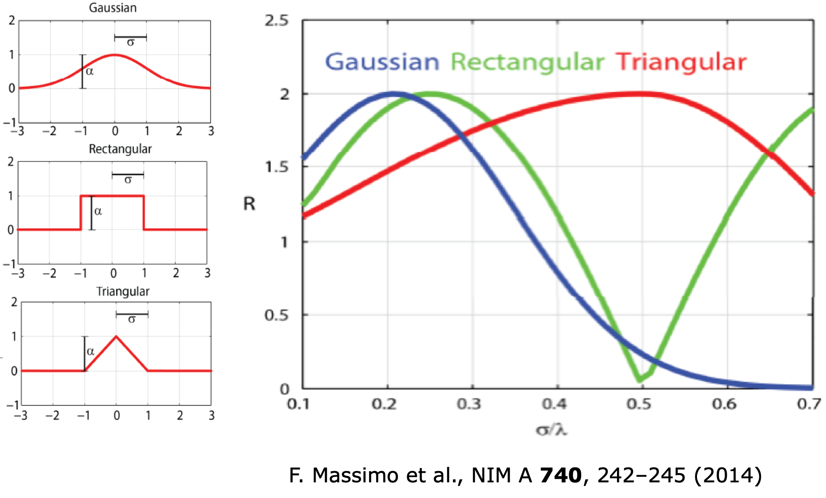
Limitation of PWFA
Energy gain
The transformer ratio critically depends on the bunch shape and on the density ratio
<< 1
R ≤ 2
Notes:
Semi-analitical model. One dimensional, fluid, relativistic, cold plasma equations have been numerically solved.

Slide 32
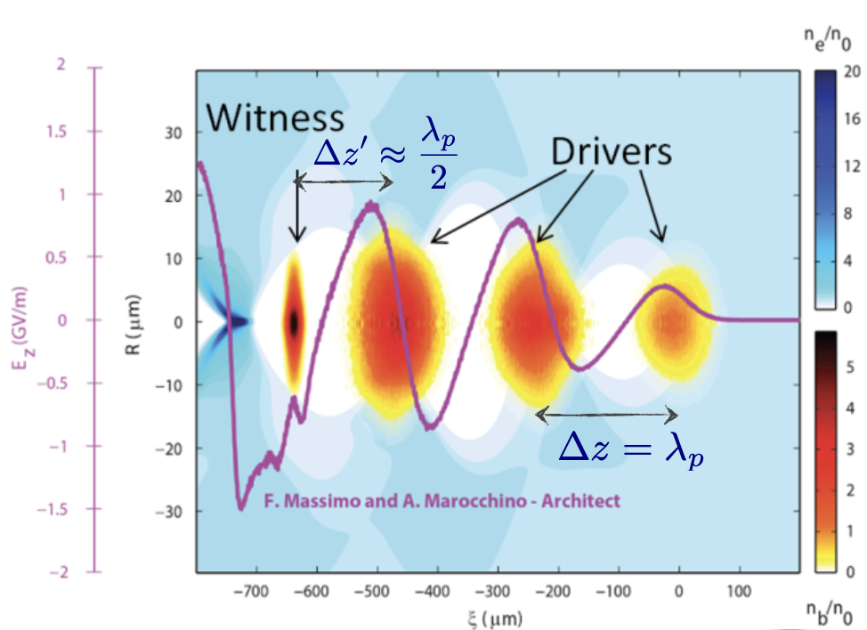
Enhancing Transformer Ratio
By properly tailoring the driver bunch shape, the witness beam energy might be more than doubled when
The maximum possible transformer ratio for a bunch with given length and total charge corresponds to that charge distribution which causes all particles in the bunch to see the same retarding field*
Tailoring longitudinal current profile such that all longitudinal slices lose energy at the same rate
Asymmetric drive bunch current profile, i.e. triangular, double triangle, doorstep-like distributions, or multiple ramped bunch trains, overcome this limit (R.Ruth et al., PA 1985; W. Lu et al.,PAC 2009)
*K. Bane, P. Chen, and P. B. Wilson, SLAC-PUB-3662,1985

Slide 33
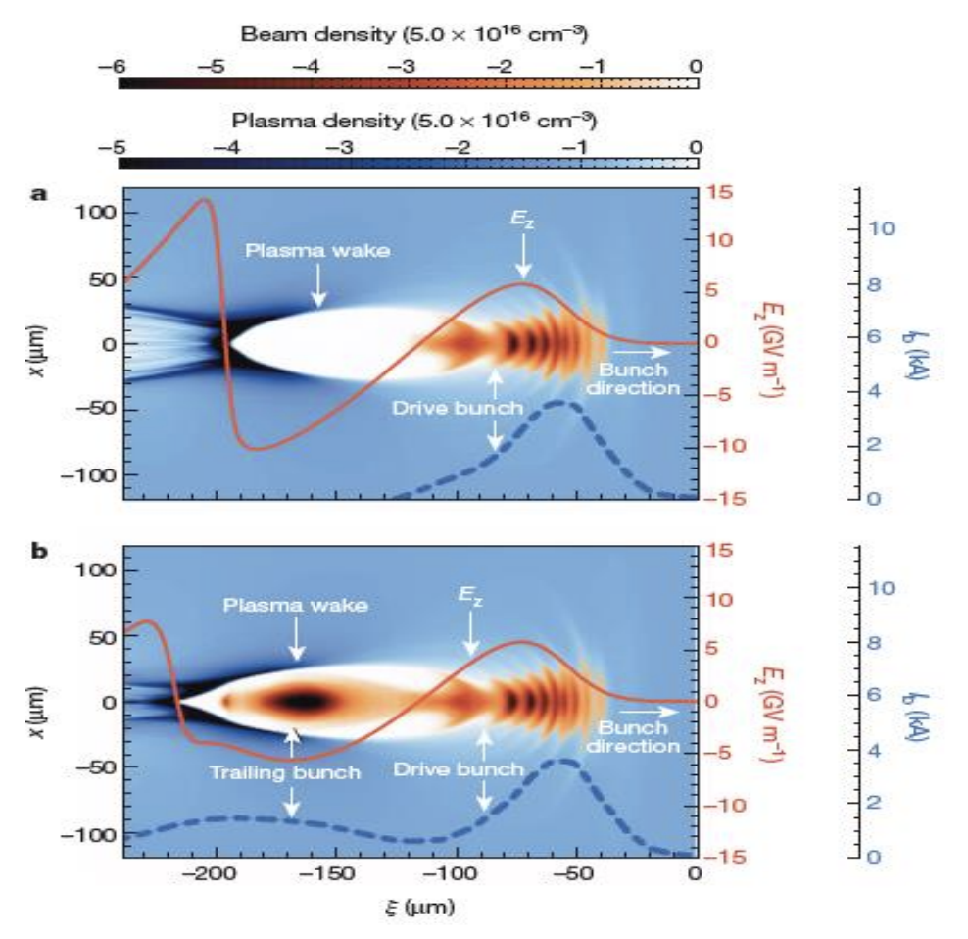
PWFA: High-efficiency acceleration
Litos, M. et al. Nature 515, 92–95 (2014)
Electric field in plasma wake is loaded by presence of trailing bunch
Allows efficient energy extraction from the plasma wake

Slide 34
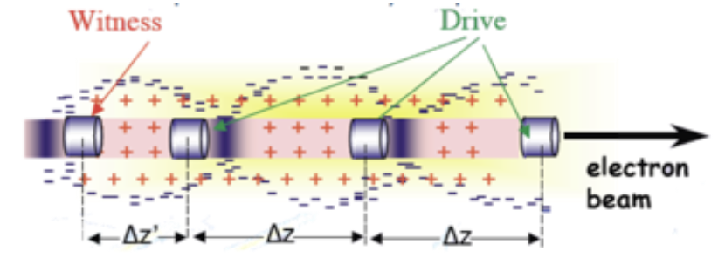
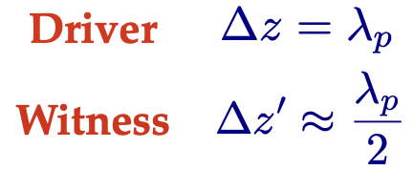
Resonant PWFA
Multi-bunch shaping
Bunch spacing depends on the plasma density
Increase in energy of a trailing particle ∆γmec² ∼ eE+,maxLd = Rγbmec²
Preservation of witness emittance and length
Better control of the energy spread

Slide 35
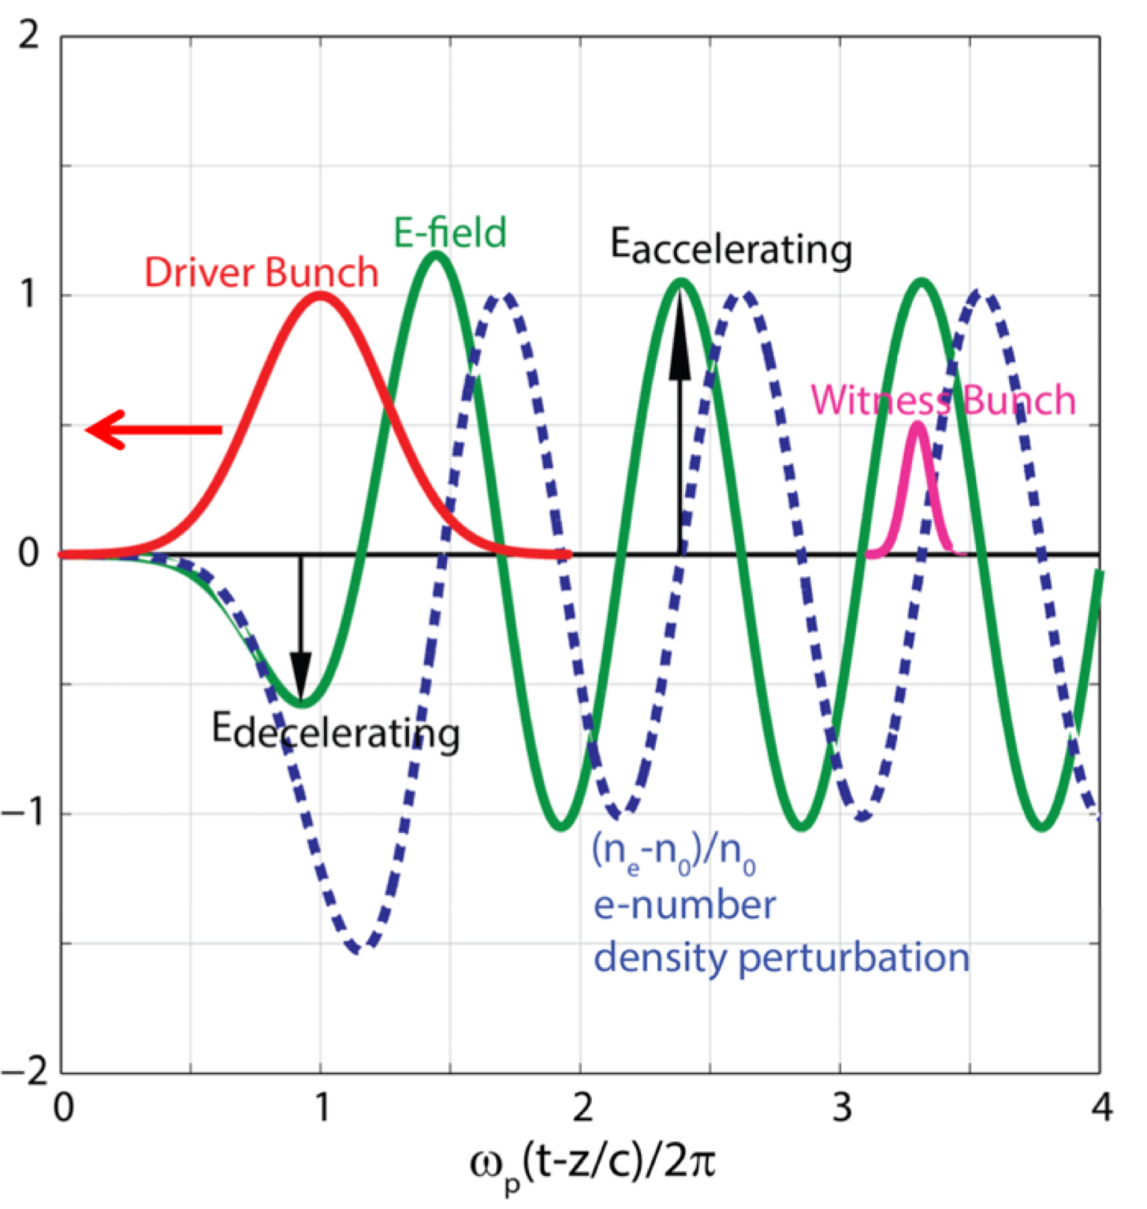
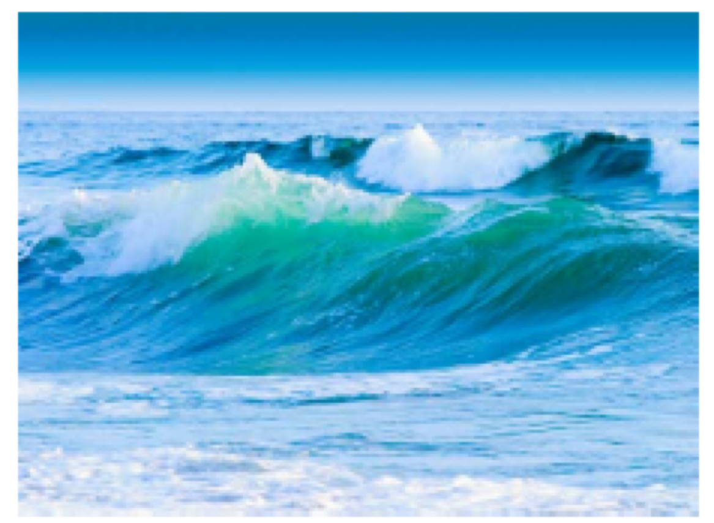
From Linear Regime: nb<<n0
Focusing force is sinusoidal
Lower wakefields
Transverse forces not linear in r
Symmetric for positive and negative witness bunches
Well described by theory
Notes:
The plasma response to the perturbation introduced by the electron beam can be expressed by the degree of nonlinearity of the plasma dynamics that defines the plasma wave regime.

Slide 36
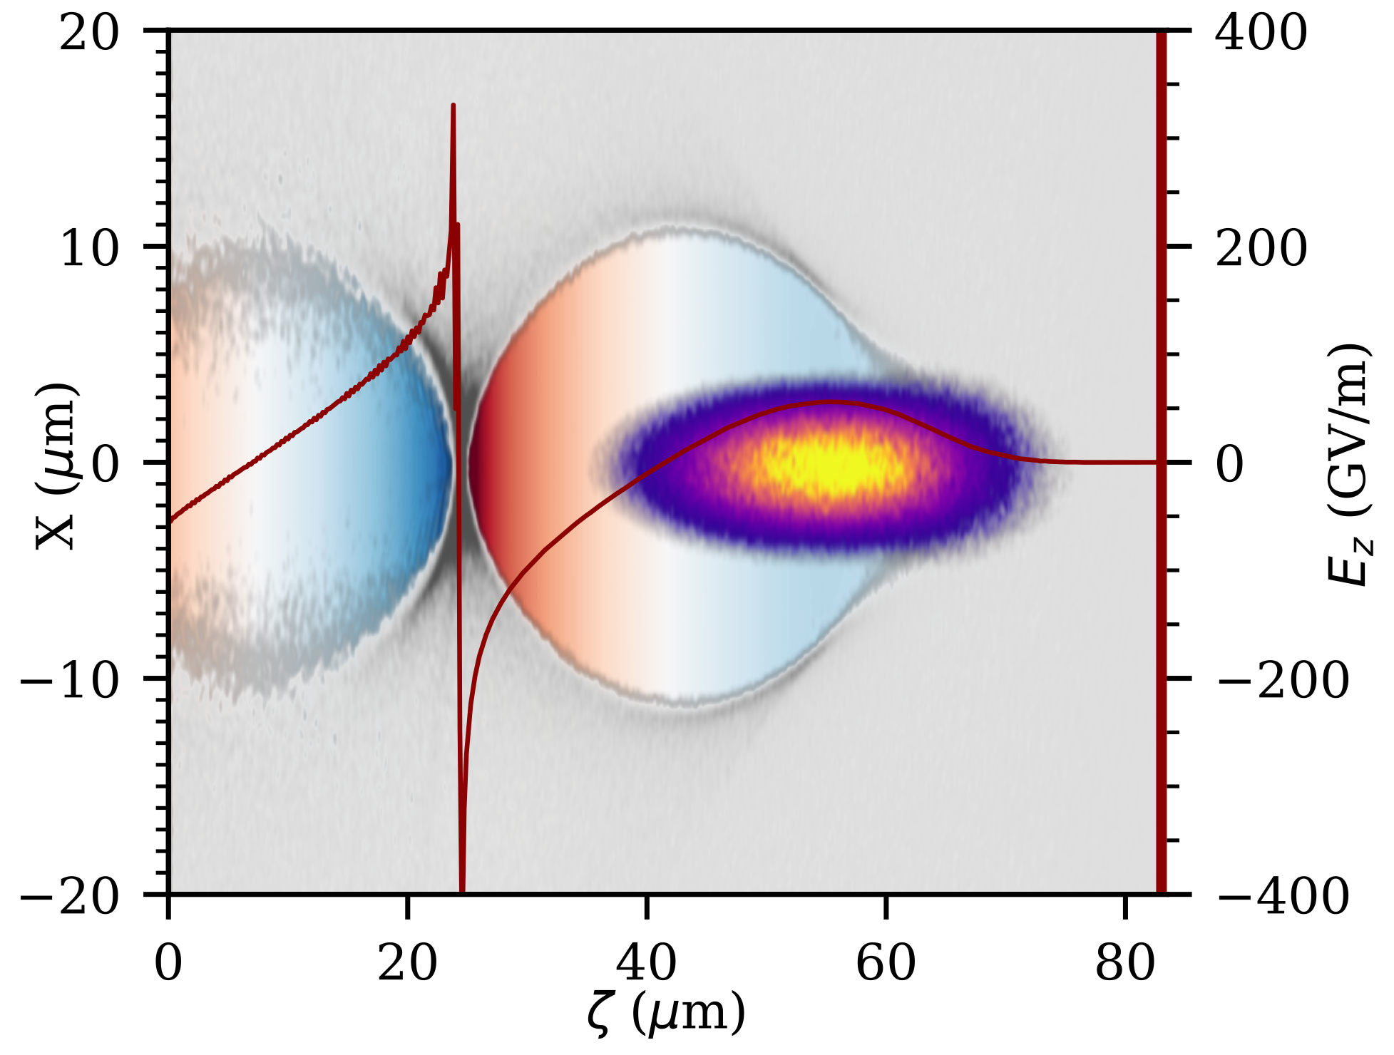
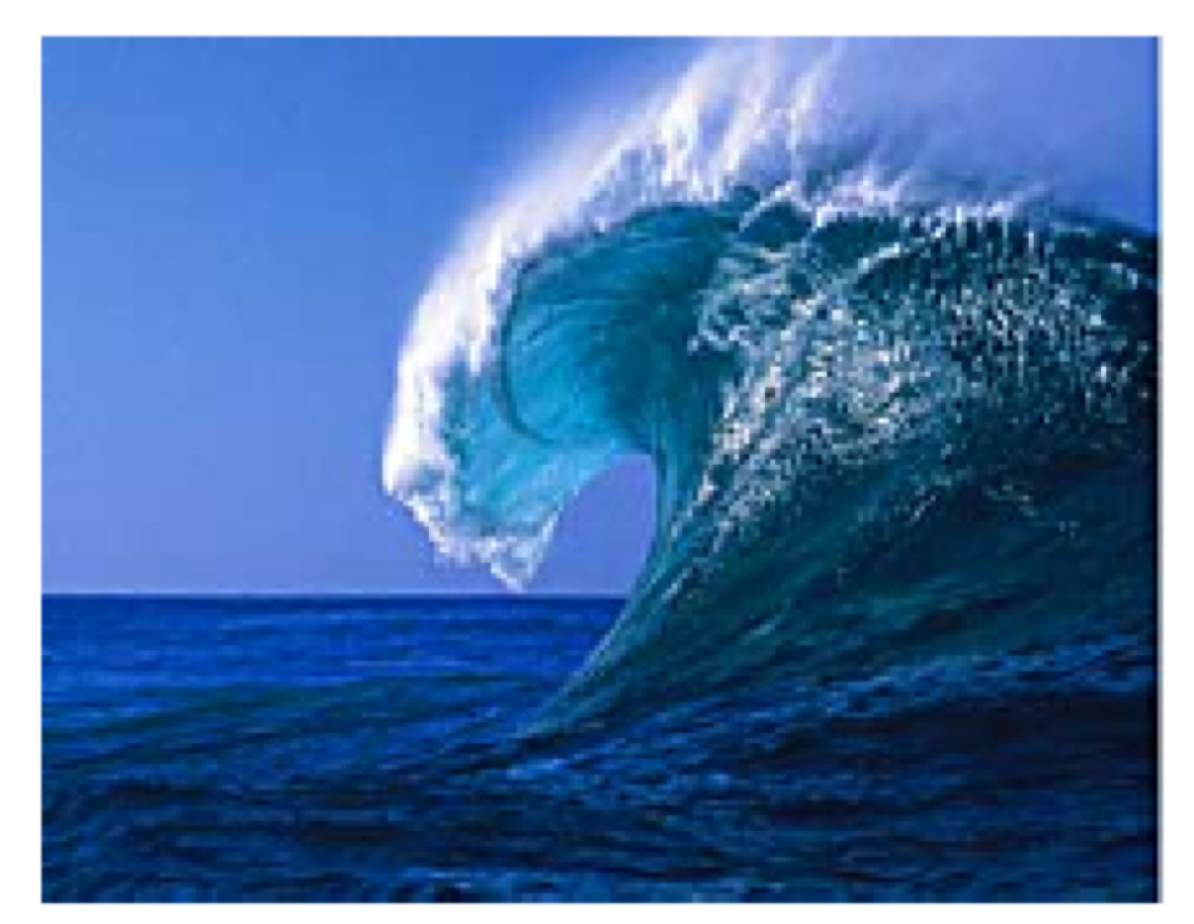
to Quasi-Linear and Non-Linear Regime
The wake structure depends on the driver pulse «intensity»
Ez
Higher wakefields
transverse forces linear in r (emittance preservation)
High charge witness acceleration possible
Requires more intense drivers
Not ideal for positron acceleration

Slide 37
Quasi-non Linear Regime
Condition for blow-out
Bubble formation w/o wavebreaking, λp is constant
Resonant scheme in blowout
Linear focusing force => emittance preservation
A measure of non-linearity is the normalised charge
Using low emittance, high brightness beams
Quasi-non Linear Regime
$$\frac{n_{b}}{n_{p}}>1$$
$$\overset{˜}{Q}≡\frac{N_{b}k_{p}^{3}}{n_{p}}=4πk_{p}r_{e}N_{b}$$
<<1 linear regime
>1 blowout regime
$$\overset{˜}{Q}<1\text{and}\frac{n_{b}}{n_{p}}>1$$
$$n_{p}={10}^{16}cm^{−3},Q_{b}=200pC,σ_{t}=180fs,σ_{x}=5.5μm\text{=>}n_{b}≈5n_{p}\text{and}\overset{˜}{Q}≈0.8$$
Notes:
The figures of merit are the beam charge in the cubic plasma skin-depth, kp^-3, the so-called reduced charge

Slide 42
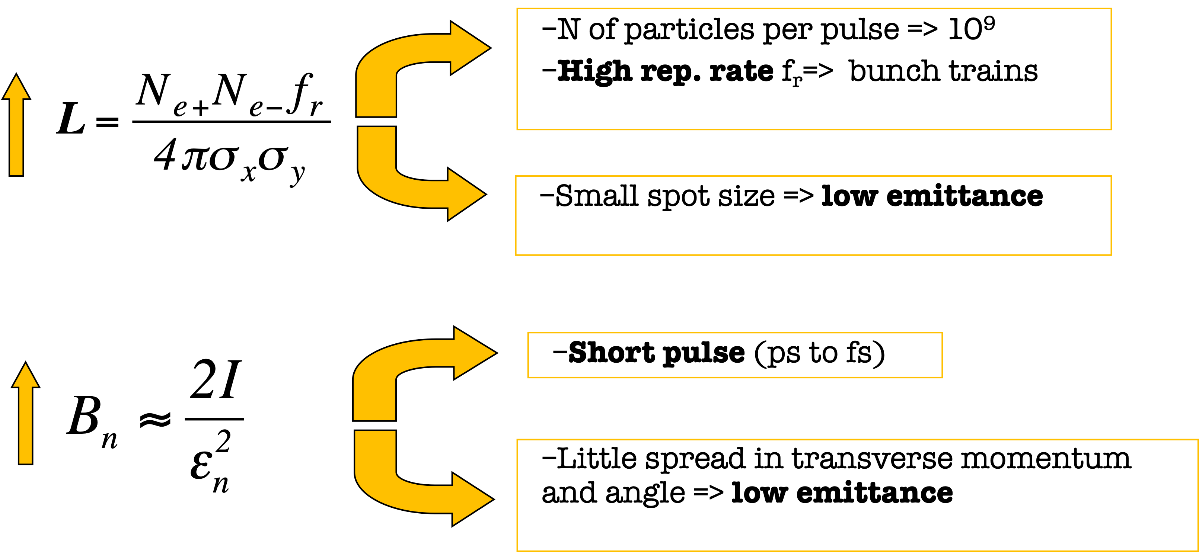
High Quality Beams
Notes:
Modern accelerators require high quality beams: ==> High Luminosity & High Brightness
==> High Energy & Low Energy Spread

Slide 43
Towards the Applications
Multi-GeV acceleration of high brightness electron beams in cm-scale plasma structures
Injection and matching to plasma accelerating module
The beam has to be focused to the matching spot to prevent envelope oscillations that may cause emittance growth
Blow-out regime
$$β_{matching}=\frac{\sqrt{2γ}}{k_{p}}$$
$$α_{matching}=0$$
Typical numbers
Matching condition
$$k_{p}=\frac{2π}{λ_{p}}$$
$$γ=1000$$
$$σ_{matching}=\sqrt{\frac{β_{matching}ε_{n}}{γ}}≈μm$$
$$λ_{p}(μm)≈\frac{3.3⋅{10}^{10}}{\sqrt{n_{0}(cm^{−3})}}$$
$$n_{0}={10}^{16}cm^{−3}$$
$$ε_{n}=1mmmrad$$

Slide 44
Towards the Applications
Extraction from plasma accelerating module
plasma fields stronger than in conventional accelerators
beams experience huge transverse size variation when propagating from the plasma outer surface to the conventional focusing optics
the particle transverse motion becomes extremely sensitive to energy spread
the beam angular divergence has to be reduced and the transverse spot size increased to limit the chromatic induced emittance degradation in vacuum
M. Migliorati et al., PRST AB 16, 011302 (2013)
Notes:
And recall the high rep rate and low energy spread

Slide 45
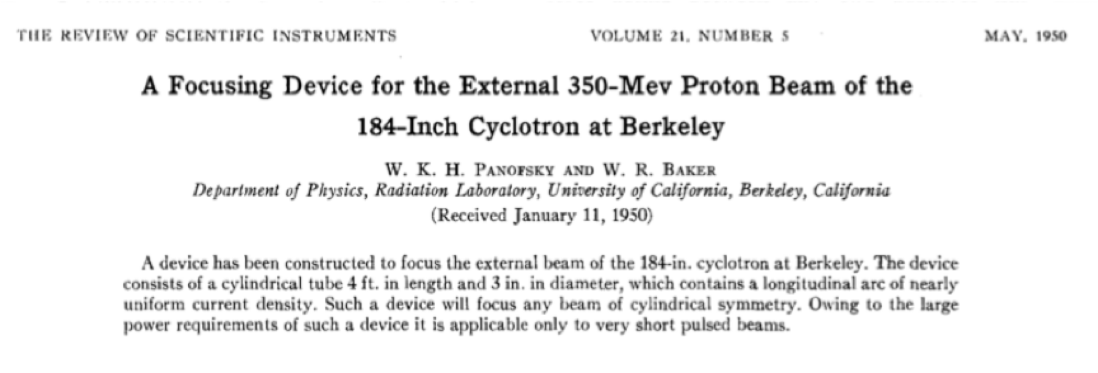
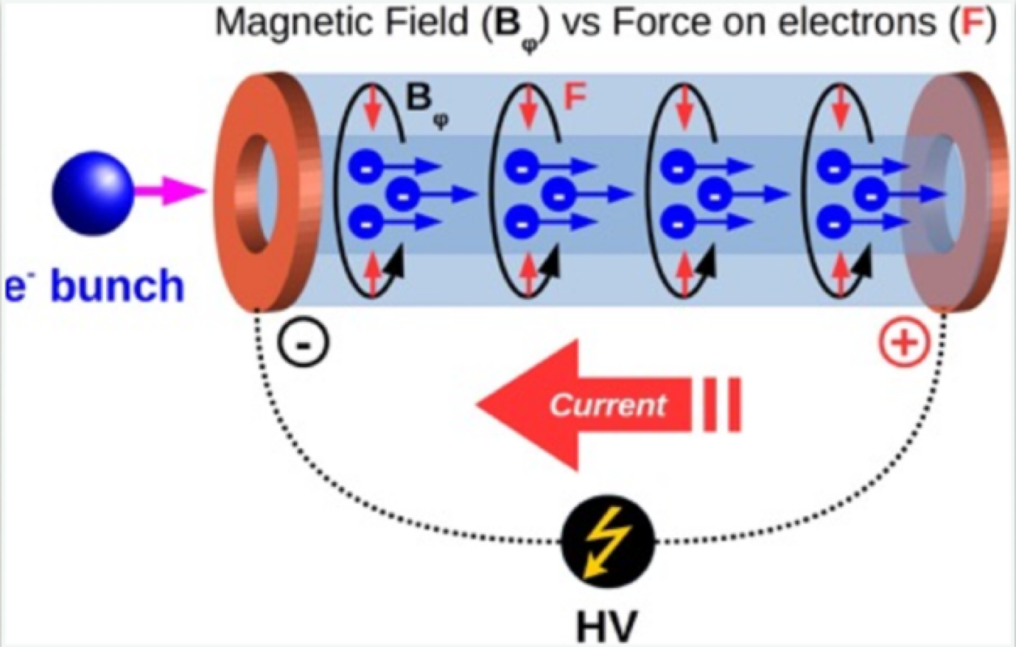
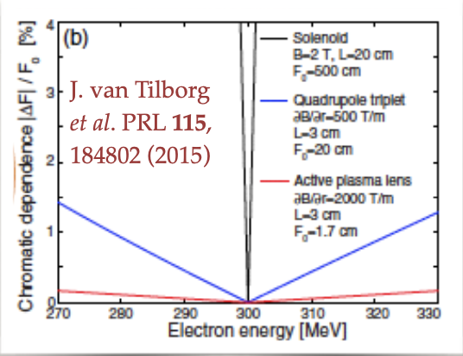
Active Plasma Lenses
Discharge current in gas-filled capillary
Cylindrical symmetry
purely radial focusing effect
Tunability
Focusing strength k∝γ ⁻¹
High focusing gradient ~ kT/m
short focal length
weak chromaticity

Slide 46
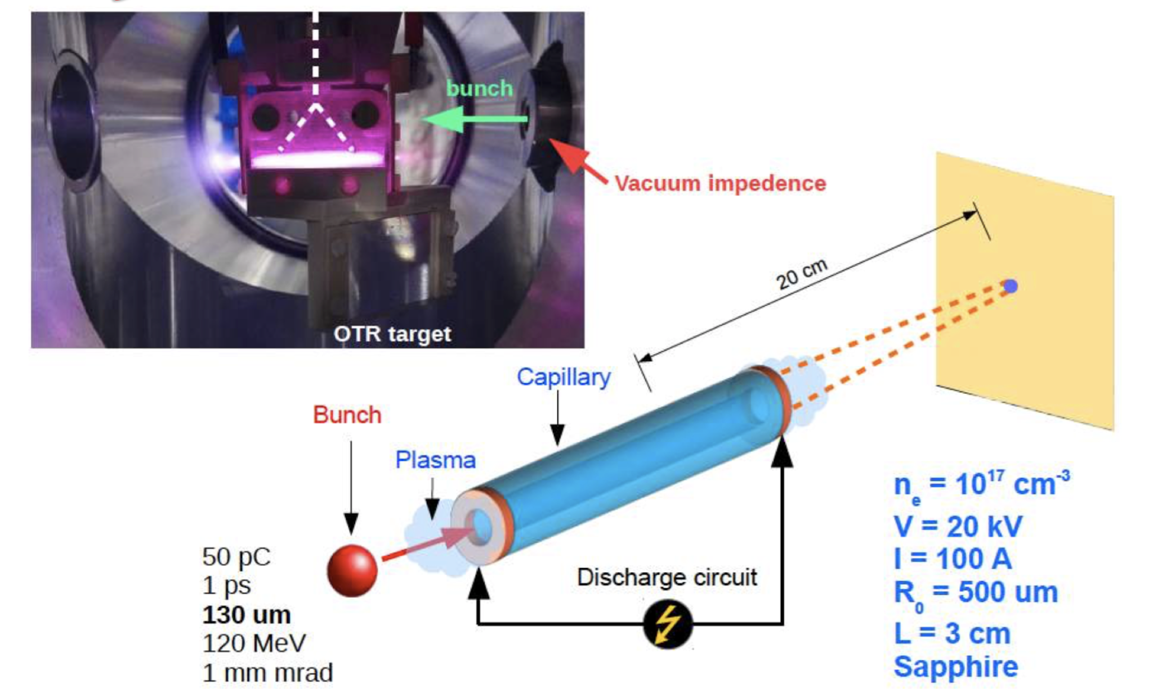
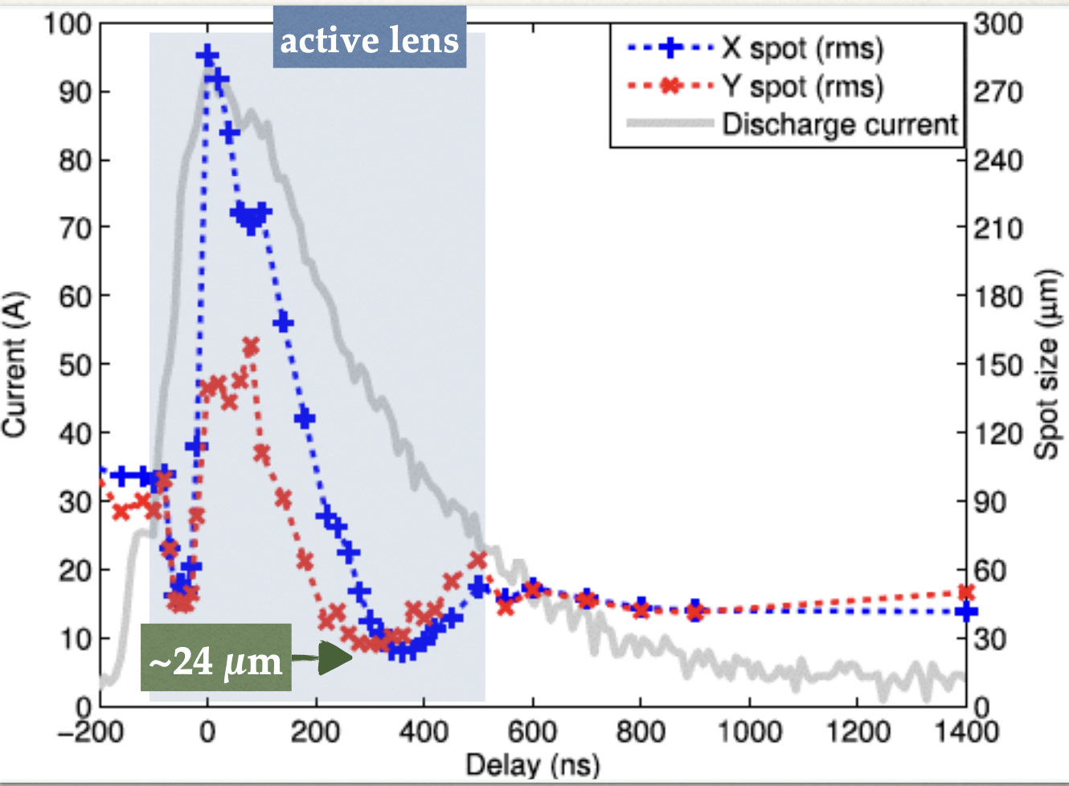

Slide 47
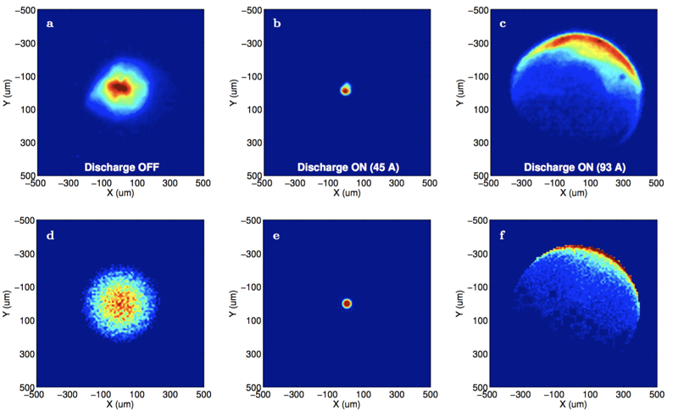
Active Plasma Lens
Measurements at SPARC_LAB
Measurements
Focusing gradient
~ 100 T/m
Beam dynamics and beam -plasma simulation

Slide 48
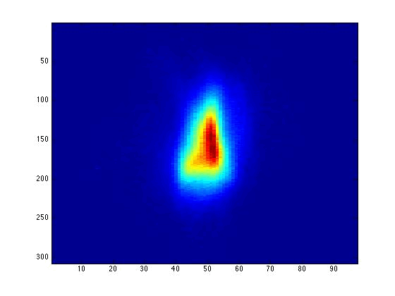
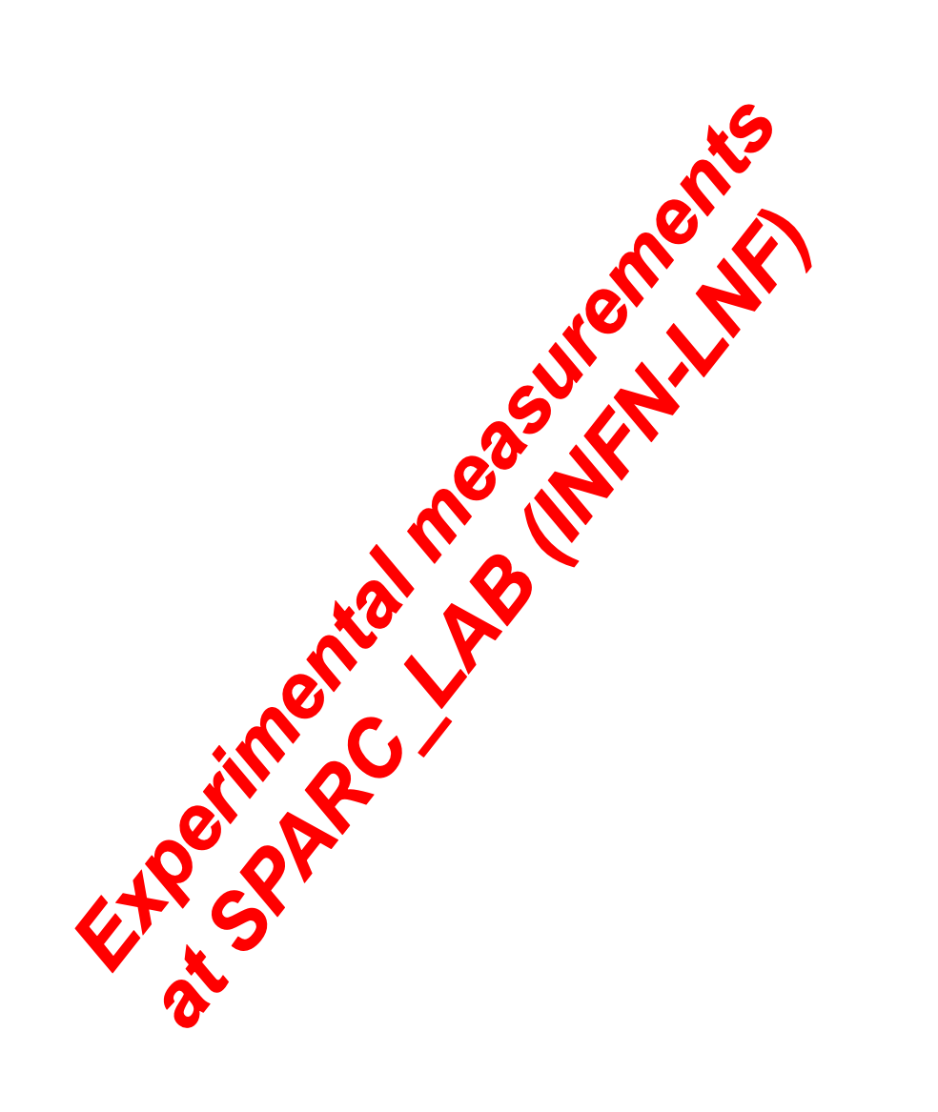
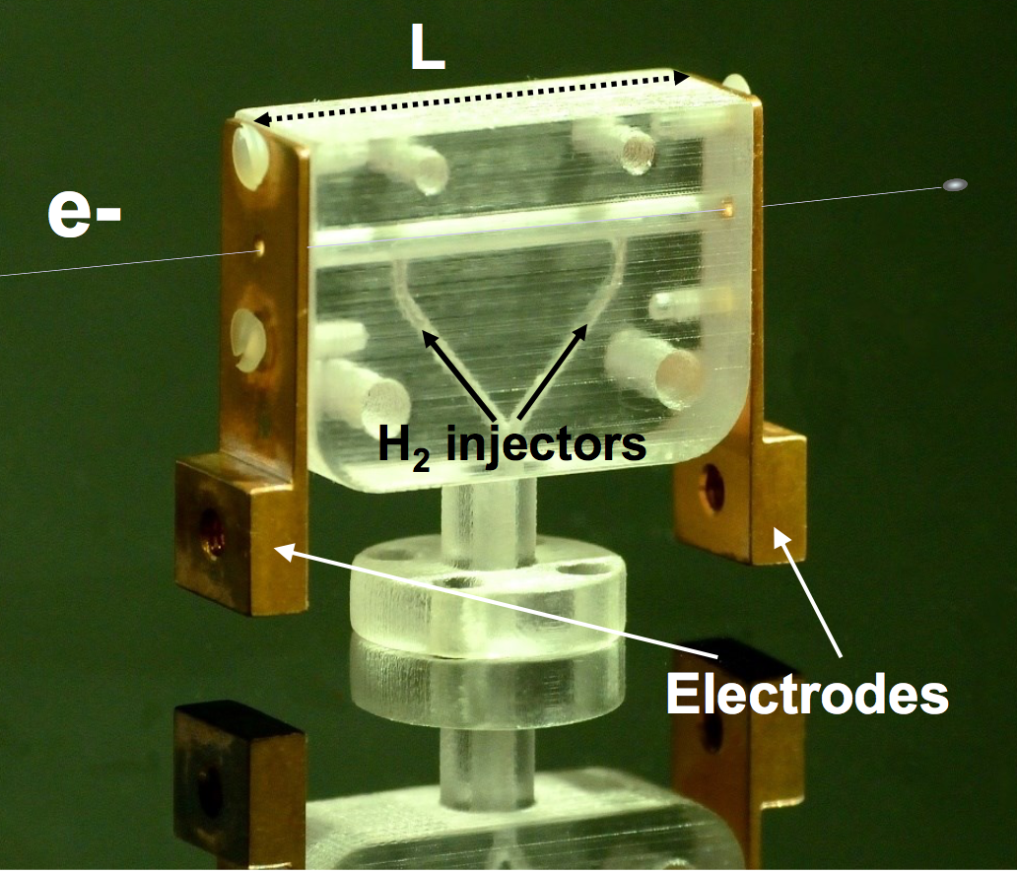
Plasma lens vs conventional focusing
Single Quadrupole Magnet
Single Plasma Lens

Slide 49
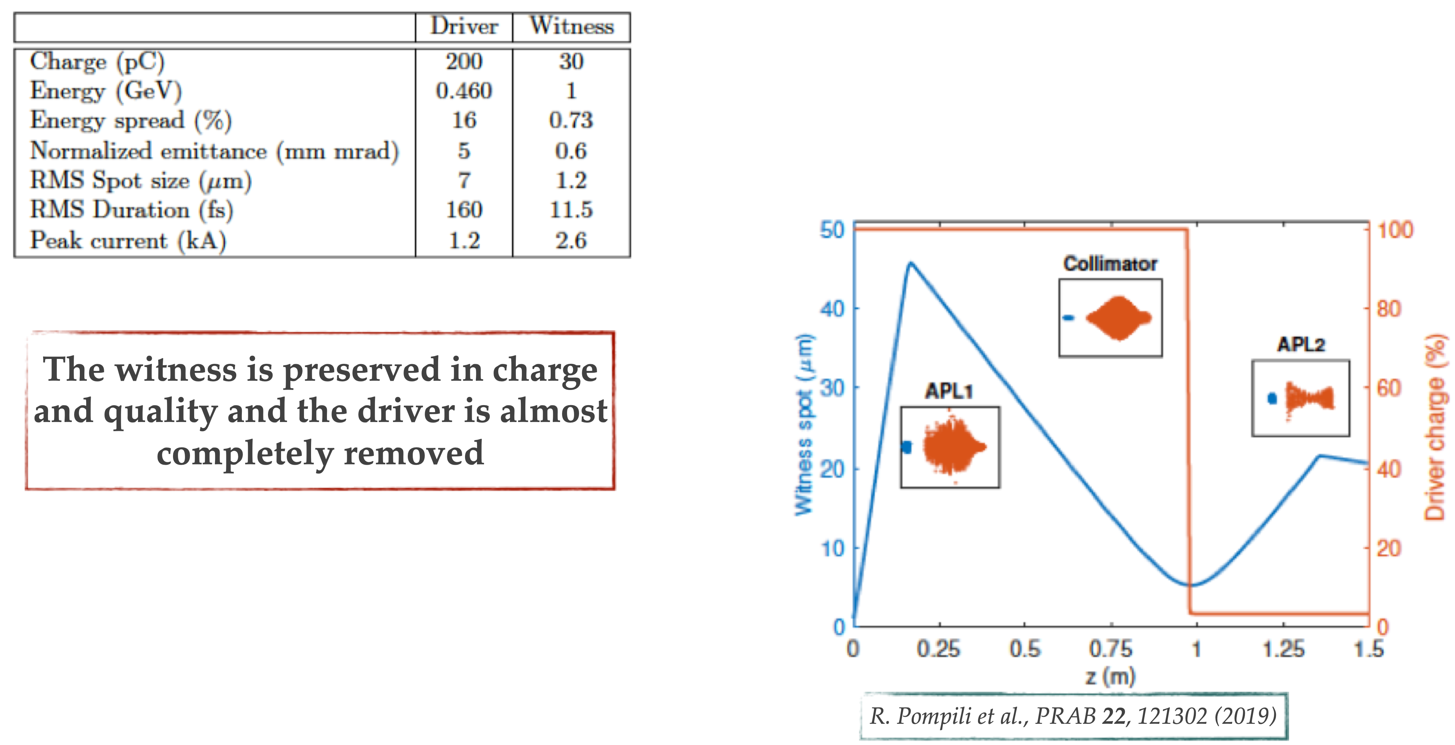
Extraction Beamline
EuPRAXIA@SPARC_LAB Case
R. Pompili et al., Phys. Rev. AB 22, 121302 (2019)

Slide 50
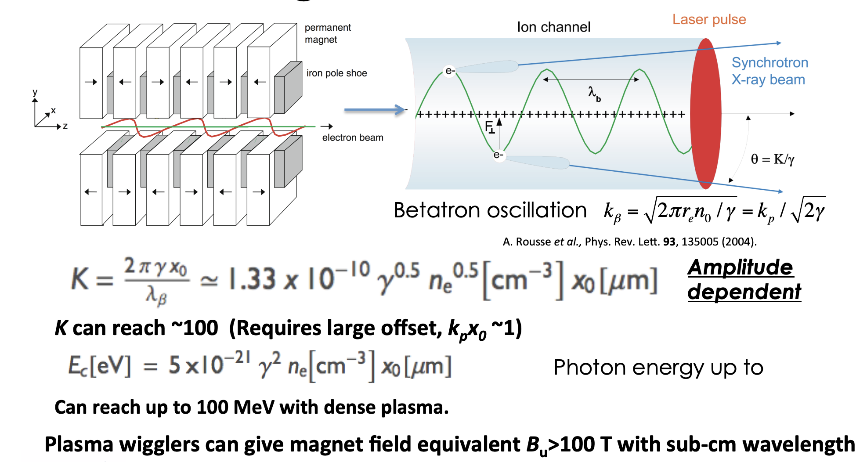
Plasma Wigglers
Betatron radiation based radiator
Courtesy of J. Rosenzweig
S. Kiselev et al., PRL 93, 135004 (2004)
Notes:
Correggere K

Slide 51
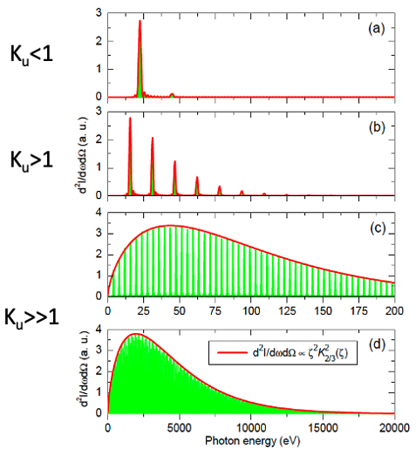
Radiation properties

Slide 52
Conclusions
Plasma-based acceleration techniques have demonstrated accelerating gradients up to 3 orders of magnitudes beyond presently used RF technologies
Plasma-based acceleration techniques have provided solid feasibility proofs of FEL lasing paving the way to applications
Successful efforts on improving beam quality
R&D on beam stability, staging and continuous operation, as necessary steps towards the realization of compact plasma-based accelerator facilities
Challenges in high repetition rate
Plasma-based, ultra-high gradient accelerators therefore open the realistic vision of very compact accelerators for scientific, commercial and medical applications

Slide 53
References
Plasma lens experiments
J. van Tilborg et al. PR-AB 20, 032803 (2017)
S. Kuschel et al., Phys. Rev. Accel. and Beams 19, 071301 (2016)
Other Wakefields schemes
Recent papers

