Slide 1
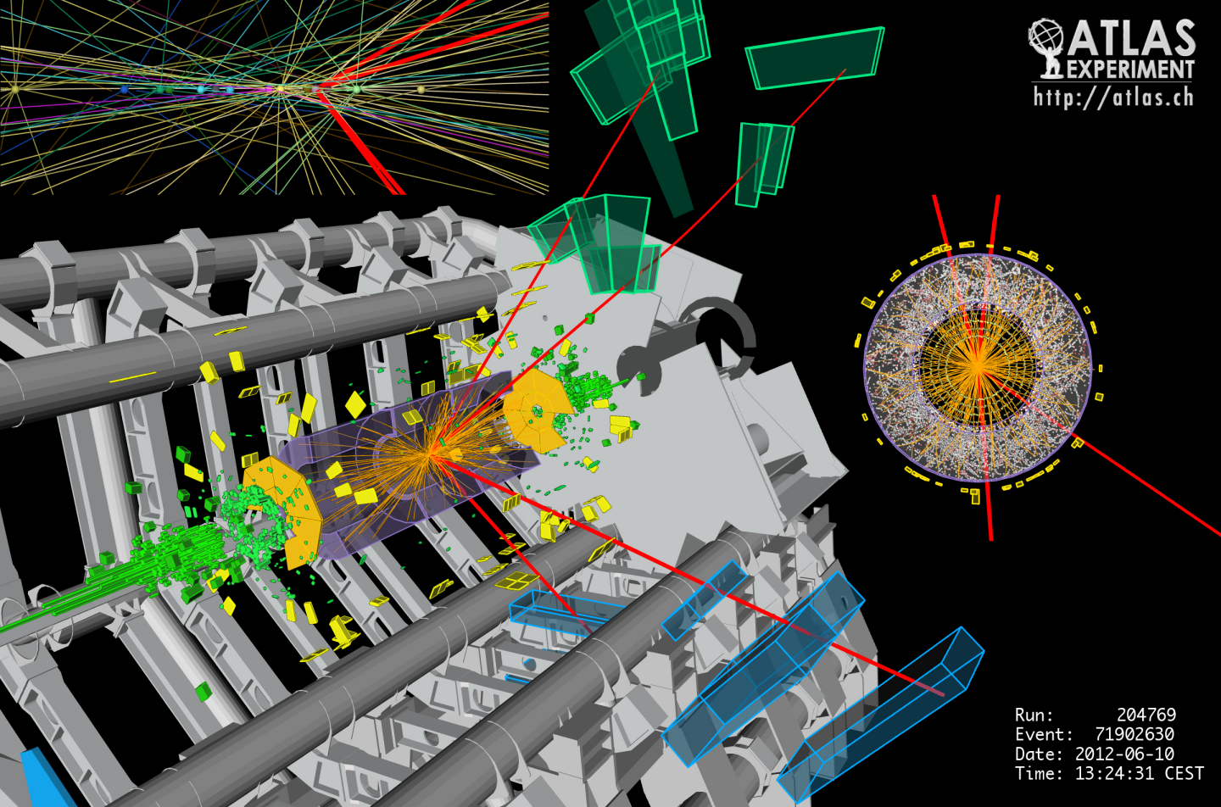
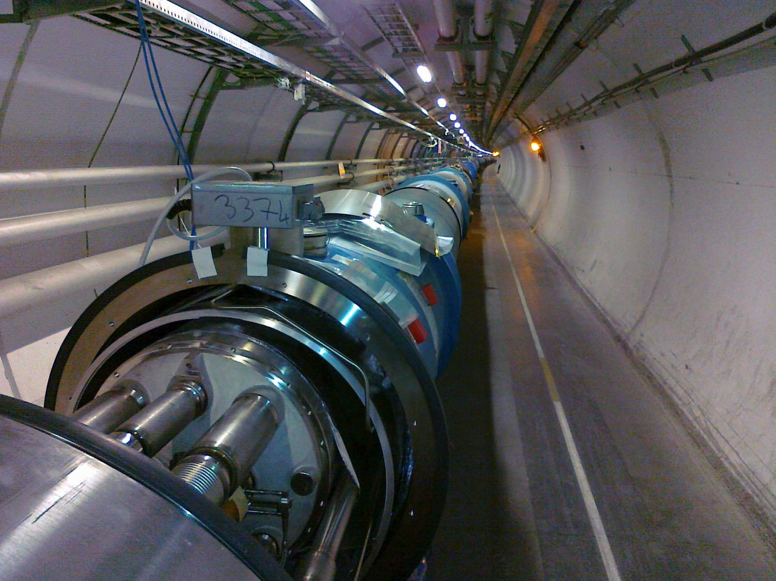
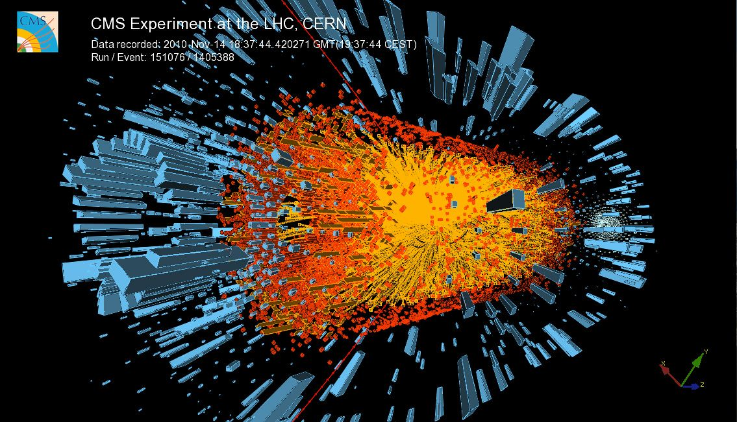

Magnets
Part II
Luca.Bottura@cern.ch
Erice, Sicilia, 27 July - 2 August 2023

Slide 2
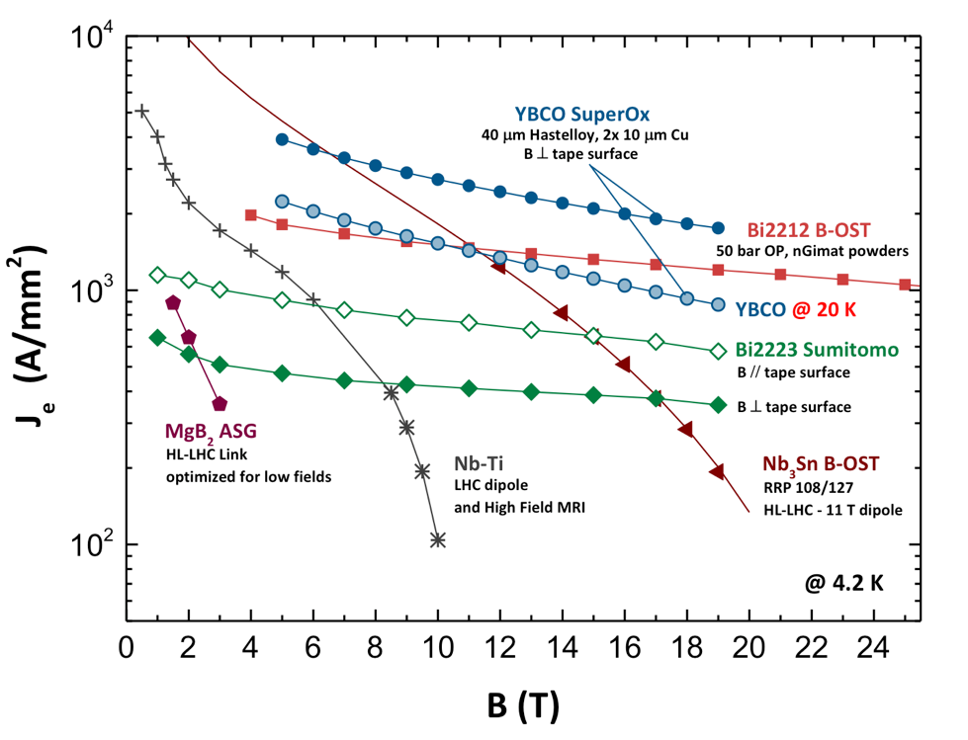
Superconductors J_{E}
Graphics by courtesy of C. Senatore, University of Geneva
Can we really achieve 1000 A/mm² ???

Slide 3
Overview
Accelerator magnets and examples
HEP detector magnets and examples
Resistive and coil magnet designs
Superconductors and their delicacies
Performance limits of accelerator magnets
Muon collider magnet challenges
Summary and perspective

Slide 4
Overview
Accelerator magnets and examples
HEP detector magnets and examples
Resistive and coil magnet designs
Superconductors and their delicacies
Performance limits of accelerator magnets
Muon collider magnet challenges
Summary and perspective

Slide 5
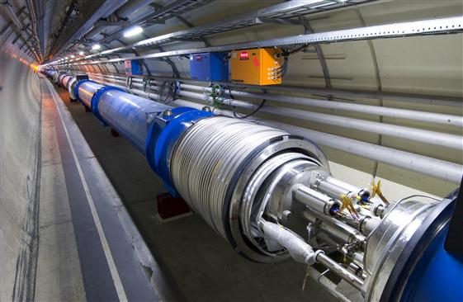
Stability and quench event-tree
External perturbation:
flux jump
conductor motions
insulation cracks
AC loss
heat leaks
nuclear heat
(degradation)
…
Stable operating condition
Approach Jc(T, B, …)
Transition to normal state and Joule heat generation in current sharing
Heat balance
Perturbation spectrum
heat generation >
heat removal
no
yes
stability analysis
quench analysis
Stable operating condition
Quench

Slide 6
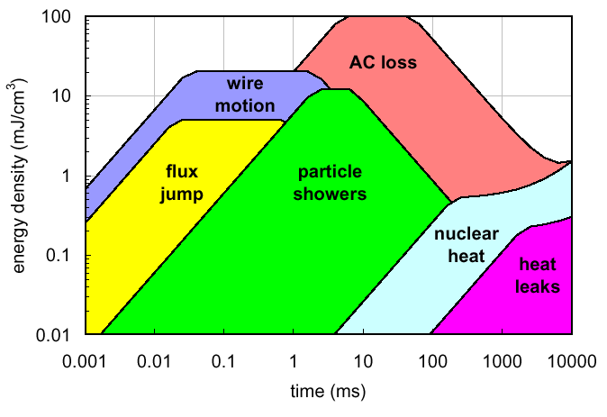
Perturbation overview

Slide 7

Is it stable ?
Superconductor stability is the art of balancing large stored energies (and potential for energy release) with a little capital
Extremely important in LTS-based magnet to reach the desired performance (10 MJ vs 10 mJ)
  Generally not an issue for HTS-based magnets
Stability is not absolute, it implies comparing the perturbation spectrum to the available margin
Several strategies can be applied to achieve stable operating conditions under the envelope of foreseeable perturbation spectrum

Slide 8
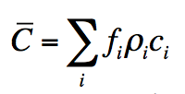
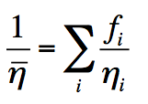
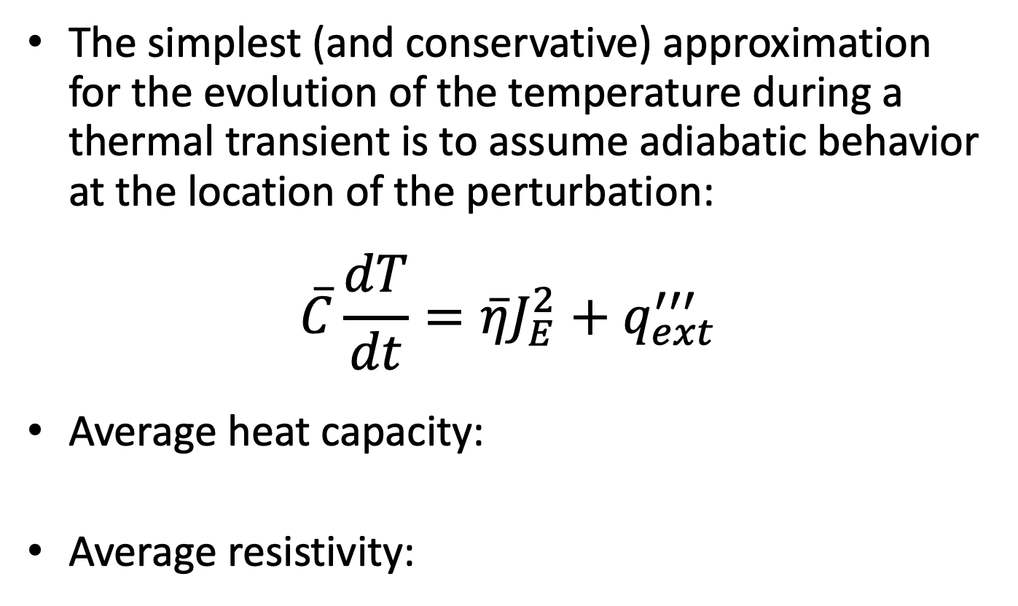
Adiabatic heat balance
The simplest (and conservative) approximation for the evolution of the temperature during a thermal transient is to assume adiabatic behavior at the location of the perturbation:
$$\overline{C}\frac{dT}{dt}=\overline{η}J_{E}^{2}+q_{ext}^{′′′}$$
Average heat capacity:
Average resistivity:

Slide 9
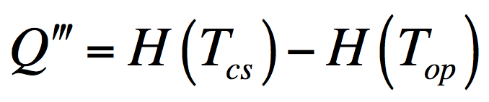
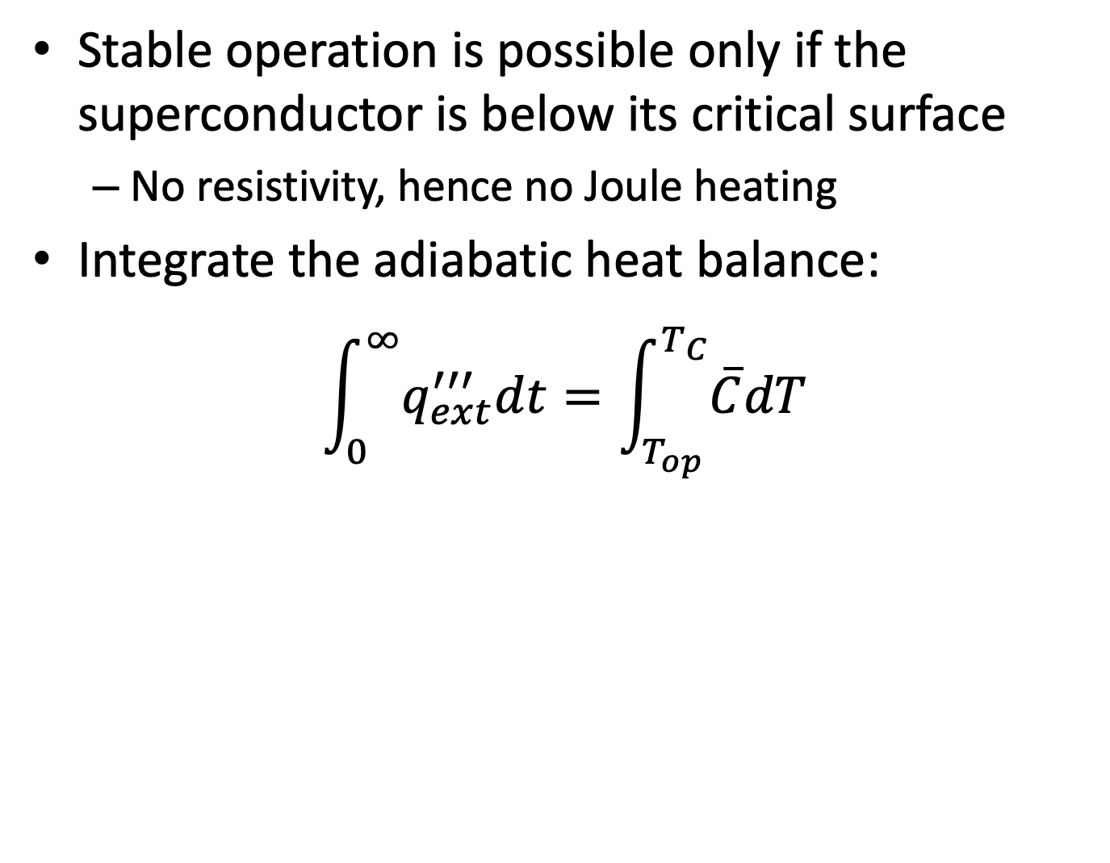
Adiabatic stability
Stable operation is possible only if the superconductor is below its critical surface
  No resistivity, hence no Joule heating
Integrate the adiabatic heat balance:
$$\int_{0}^{∞}{q_{ext}^{′′′}dt}=\int_{T_{op}}^{T_{C}}{\overline{C}dT}$$
energy margin
volumetric enthalpy

Slide 10
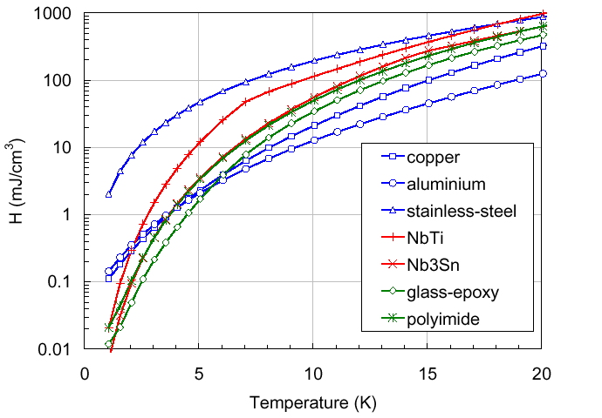
Enthalpy reserve
Enthalpy reserve increases massively at increasing T: stability is not an issue for HTS materials ?!?
≈100
2
≈30
Enthalpy reserve is of the order of the expected perturbation spectrum: stability is an issue for LTS magnets
≈3
2
2
do not sub-cool if you can only avoid it !

Slide 11
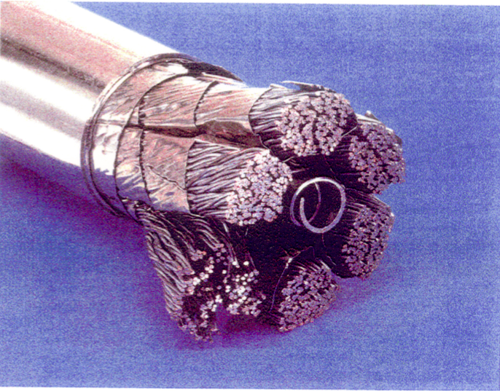
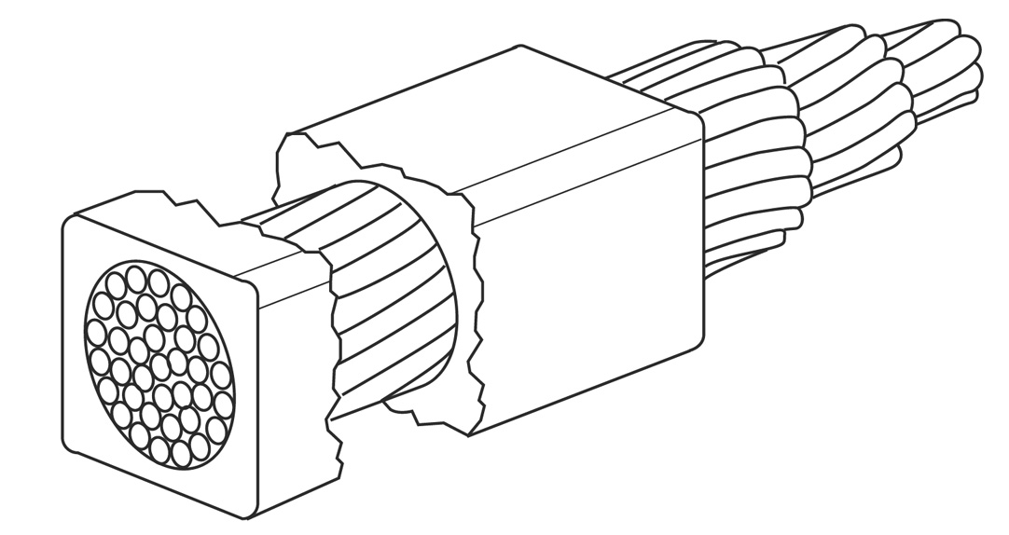
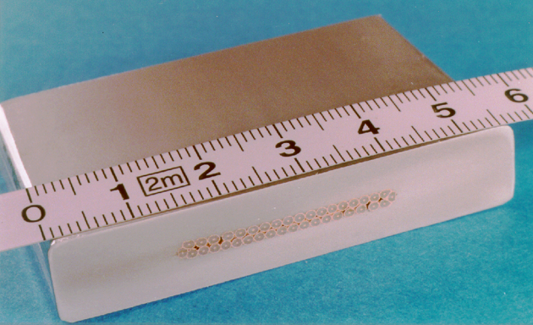

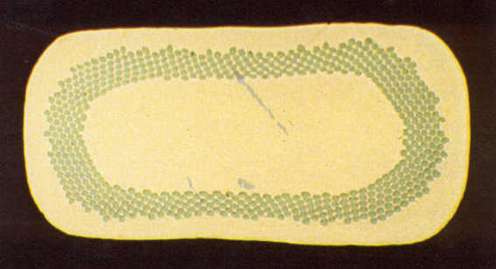
A summary of LTS strategies
Cold end
1000
CICC
Cryostable
100
Energy margin (mJ/cm³)
Adiabatic
10
MPZ/MQE
1
1
10
100
1000
Operating current density (A/mm²)

Slide 12
Limit 1 – Operating margin
A superconductor requires a minimum operating margin to run stably
Stable operation in the vicinity of the critical current is not practical, it will lead to inevitable resistive transitions and down times
The margin should not degrade as the magnet goes trough its normal operating life (including CD/WU, powering, quenches), lest the operating point will need to be lowered
Corollary – for a given superconducting material this sets an upper limit on the field

Slide 13
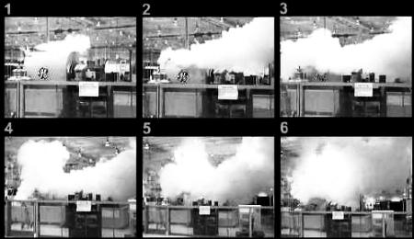

What is a quench ?
Quench is the result of the resistive transition, leading to appearance of voltage, temperature increase, thermal and electro-magnetic forces, and cryogen expulsion
This is a quench of a GE MRI magnet during tests at the plant
This is the result of the chain of events triggered by a quench in an LHC bus-bar

Slide 14
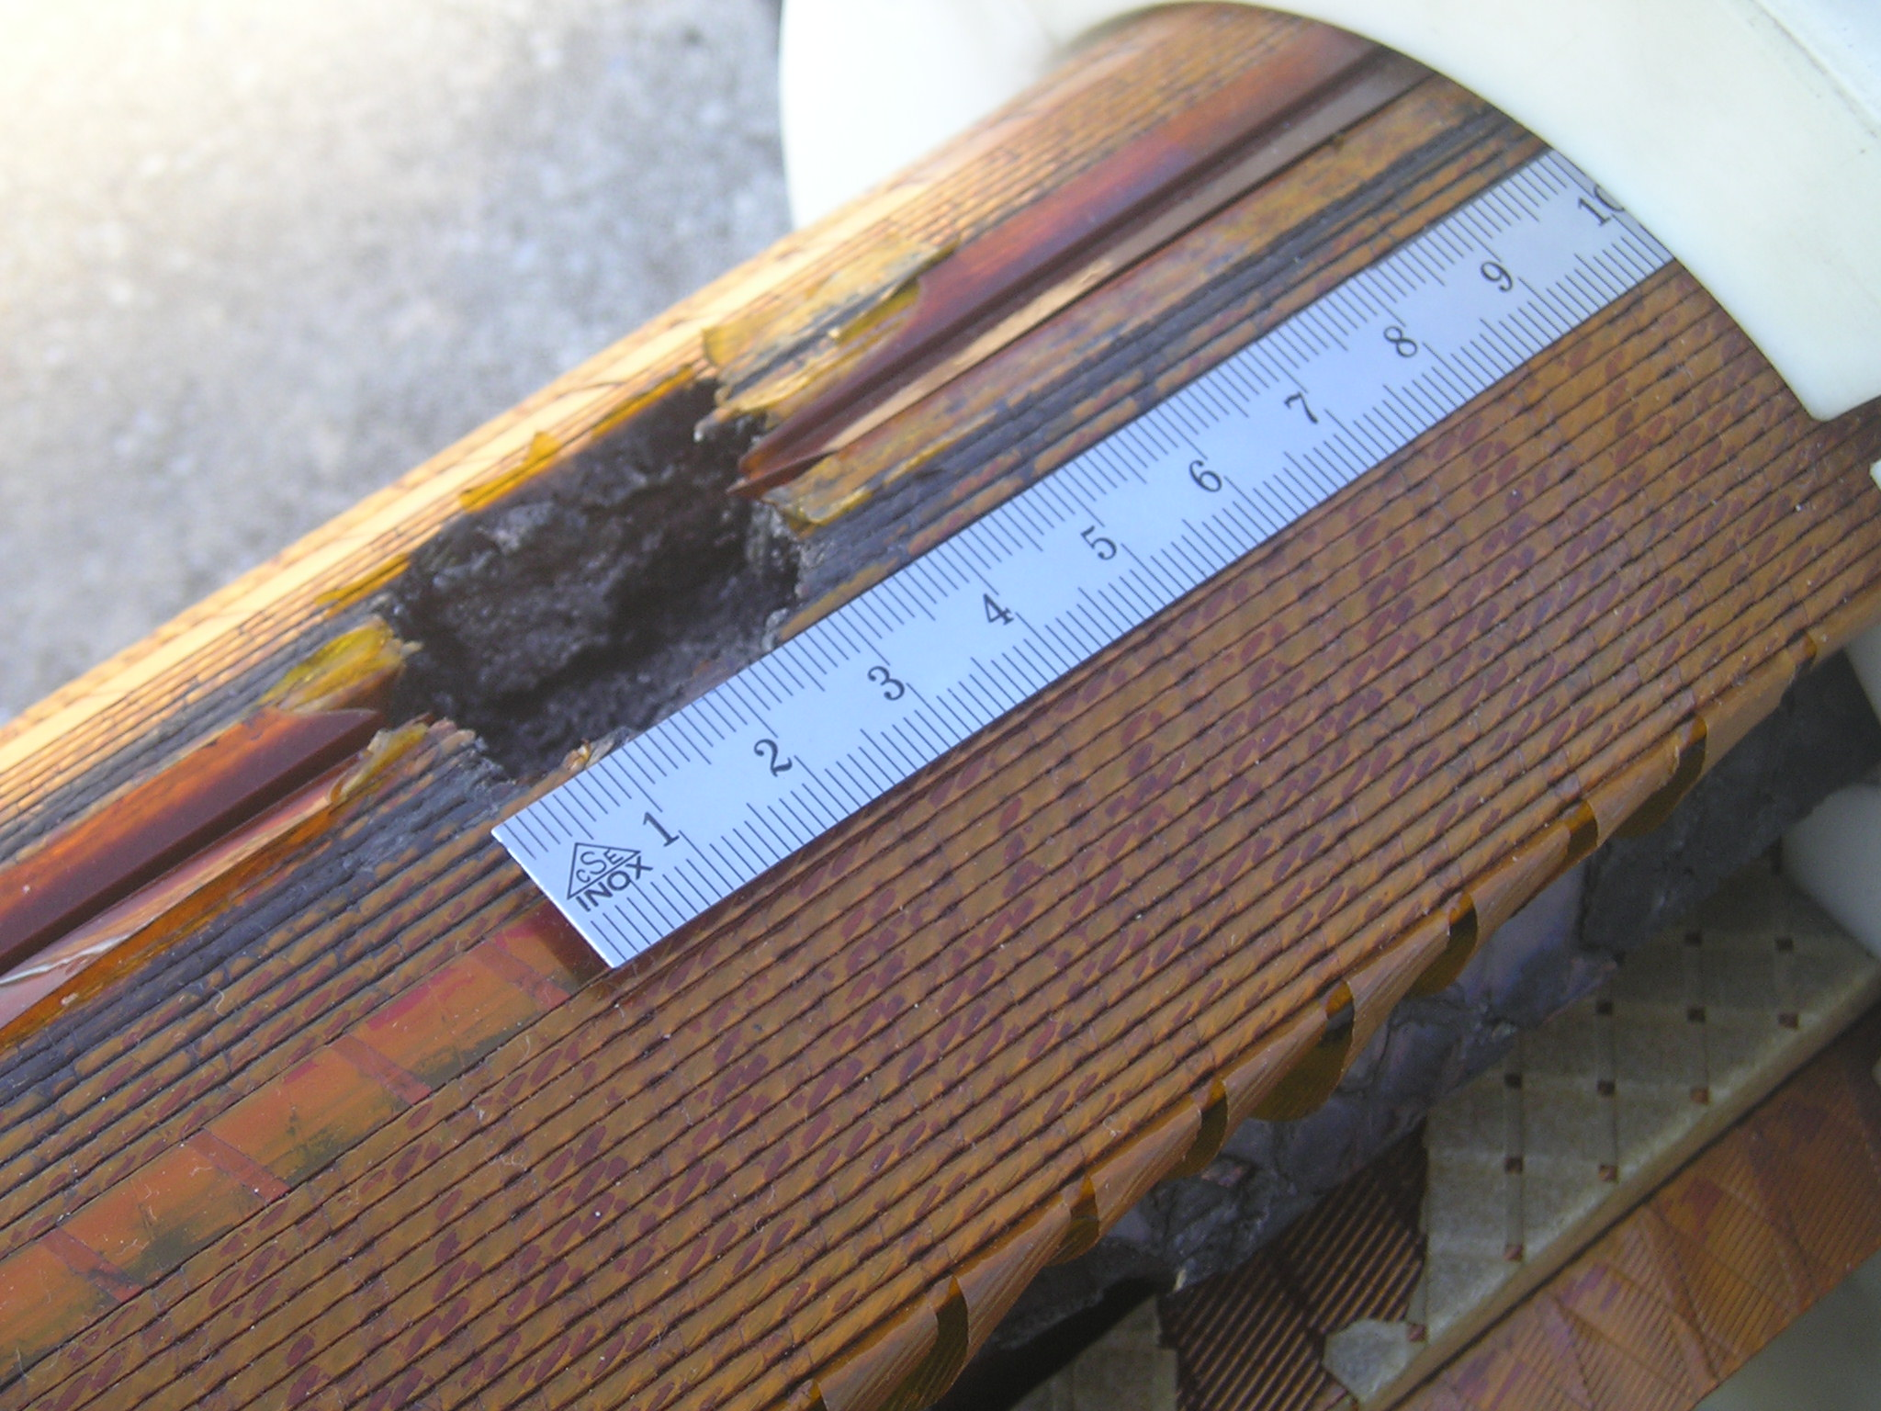
Why is it a problem ?
Magnetic energy stored in the field:
  converted to heat through Joule heating R_{q}I²
If this process happened uniformly in the winding:
  Cu melting temperature 1356 K
  corresponding E_{m}=5.2 109 J/m³
  limit would be Bmax ≤ 115 T: NO PROBLEM !
BUT
the process does not happen uniformly: as little as 1 % of the magnet mass may absorb the total energy – damage potential !
L
R_{q}

Slide 15
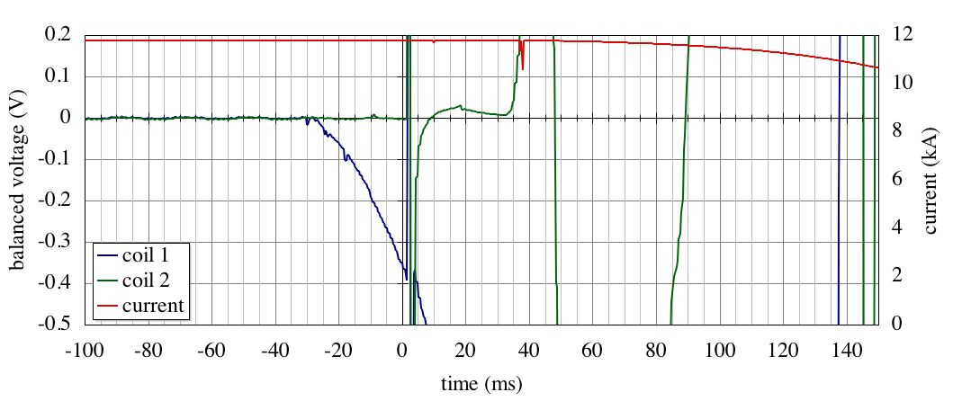
Detection, switch and dump
Example of an LHC dipole magnet training quench
precursor
switch
dump
propagation
detection threshold
detection
fire heaters
trigger (t=0)
t_{detection}
t_{delay}
t_{switch}
t_{dump}
t_{quench} ≈ t_{detection} + t_{delay} + t_{switch} +f t_{dump}
t_{discharge}

Slide 16
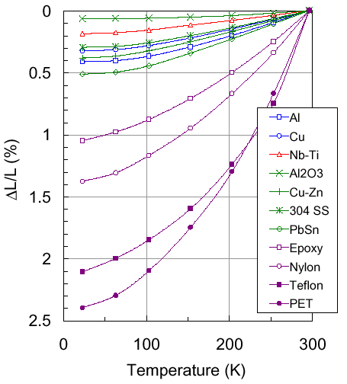
Hot-spot limits
the quench starts in a point and propagates with a quench propagation velocity
the initial point will be the hot spot at temperature T_{max}
T_{max} must be limited to:
  limit thermal stresses (see graph)
  avoid material damage (e.g. resins have typical T_{glass} of 100 ∘C)
T_{max} < 300 K for well-supported coils (e.g. accelerator magnets)
T_{max} < 100 K for
negligible effect

Slide 17
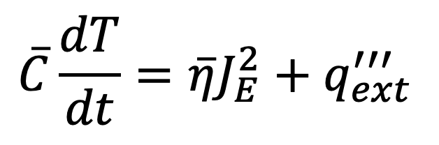
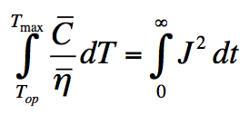
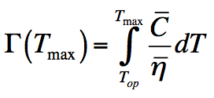
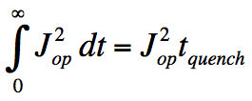
Hot spot temperature
adiabatic conditions at the hot spot :
can be integrated:
Perturbation is over
B.J. Maddock, G.B. James, Proc. IEE, 115 (4), 543, 1968
total volumetric heat capacity
cable operating current density
stabilizer resistivity
The function Γ(T_{max}) is a cable property
The integral of J depends on the circuit quench integral

Slide 18
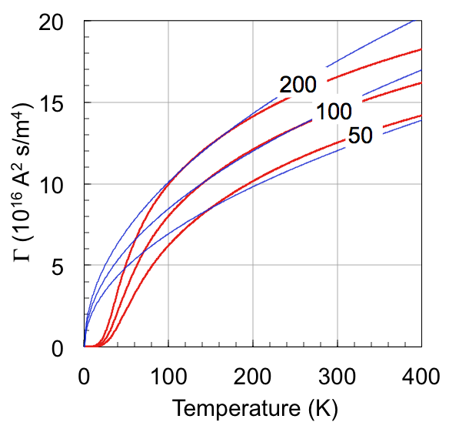


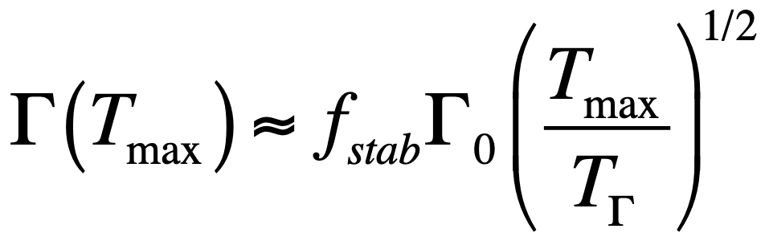
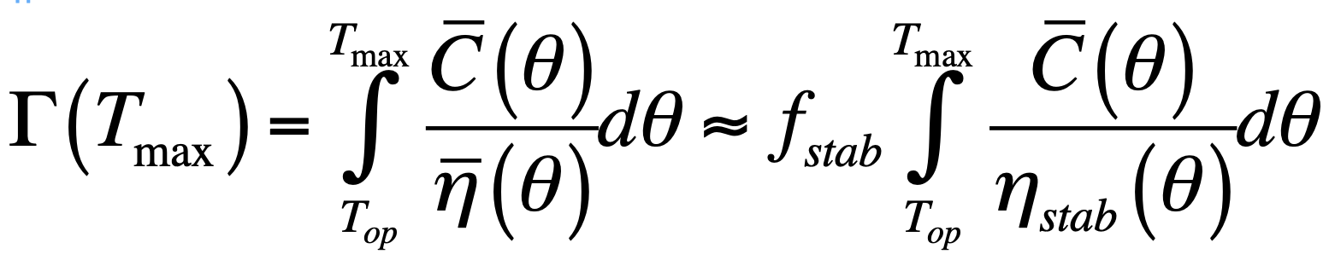
Γ(T_{max}) for pure materials
Copper at B=0 T
Assume that the cable is made of stabilizer only (good first guess):
Γ(T_{max}) is a material property and can be tabulated
A useful approximation is:
Wilson’s Gamma

Slide 19
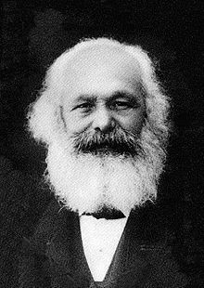
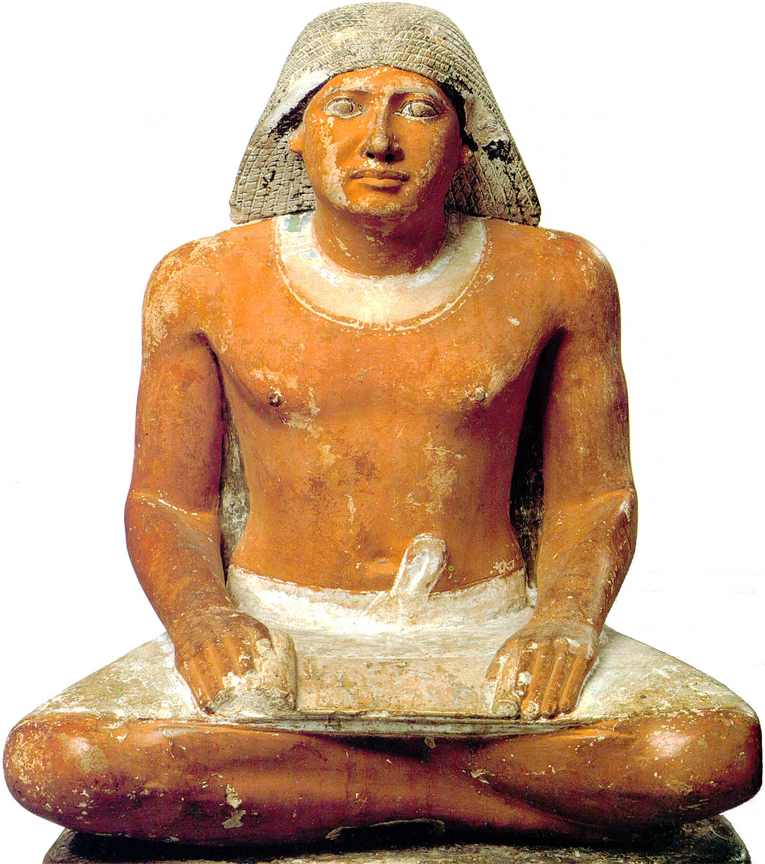
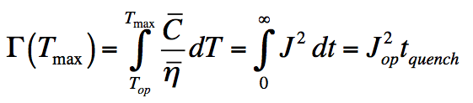
Quench Capital vs. Tax
The real problem is to determine the integral of the current waveform: how much is the quench time t_{quench} ?
Consider two limiting cases:
  External-dump: The magnet is dumped externally on a large resistance (R_{dump} >> R_{quench}) as soon as the quench is detected
  Self-dump: The circuit is on a short circuit and is dumped on its internal resistance (R_{dump} = 0)

Slide 20
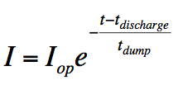
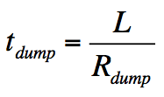
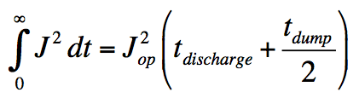
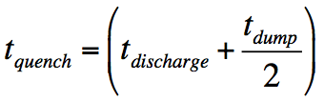
External dump of a magnet
B.J. Maddock, G.B. James, Proc. Inst. Electr. Eng., 115, 543, 1968
The magnetic energy is extracted from the magnet and dissipated in an external resistor:
The quench integral is:
and the quench time is:
S
S
L
L
R_{dump}
R_{dump}
R_{quench}
normal operation
quench

Slide 21
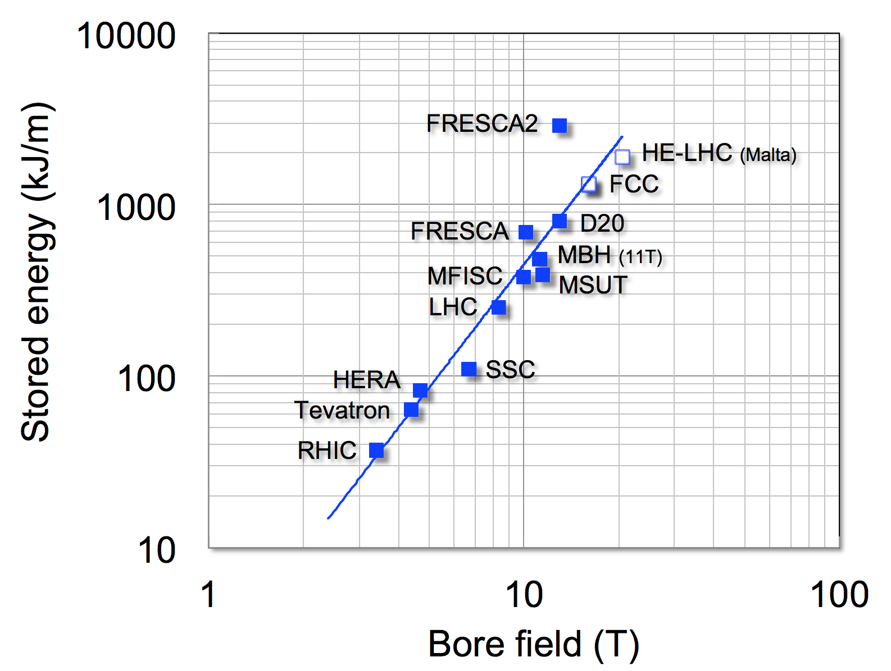
Protection at high fields
Energy per unit length in a sector coil of inner radius R_{in}, outer radius R_{out}, coil width w = R_{out}-R_{in} producing a dipole field B
Voltage per unit length for an external dump with time constant τ
A simple exercise:
J_{Cu} ≈ 1000…1250 (A/mm²)
dT/dt ≈ 1000…2000 (K/s)
τ_{(300 K)}≈ 0.15…0.3 (s)
I_{op} ≈ 15 (kA)
E/l ≈ 1000 (kJ/m)
V/l ≈ 500…1000 (V/m)
It is not possible to protect accelerator magnet strings using an external dump

Slide 22
Magnet strings
Magnet strings (e.g. accelerator magnets, fusion magnetic systems) have exceedingly large stored energy (10’s of GJ):
    Energy dump takes very long time (10…100 s)
    The magnet string is subdivided and each magnet is by-passed by a diode (or thyristor)
M₁
M₂
M₃
M_{N}
normal operation
quench

Slide 23
Quench heaters
heater
The quench is spread actively by firing heaters embedded in the winding pack, in close vicinity to the conductor
Other methods can be used to trigger a distributed quench
advantages:
  homogeneous spread of the magnetic energy within the winding pack
disadvantages:
  active
  high voltages at the heater
winding

Slide 24
Self dump of a magnet
The magnetic energy is completely dissipated in the internal resistance, which depends on the temperature and volume of the normal zone
In this case it is not possible to separate the problem in quench integral and cable property, but we can make approximations
Assume that:
  The whole magnet is normal at t_{discharge} (perfect heaters)
  The current is constant until t_{quench} then drops to zero
  Wilson’s Gamma and the power resistivity
S₁
L
S₂
R_{quench}
normal operation
quench

Slide 25
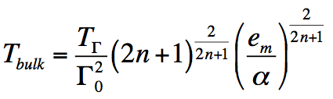
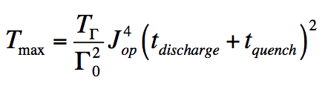
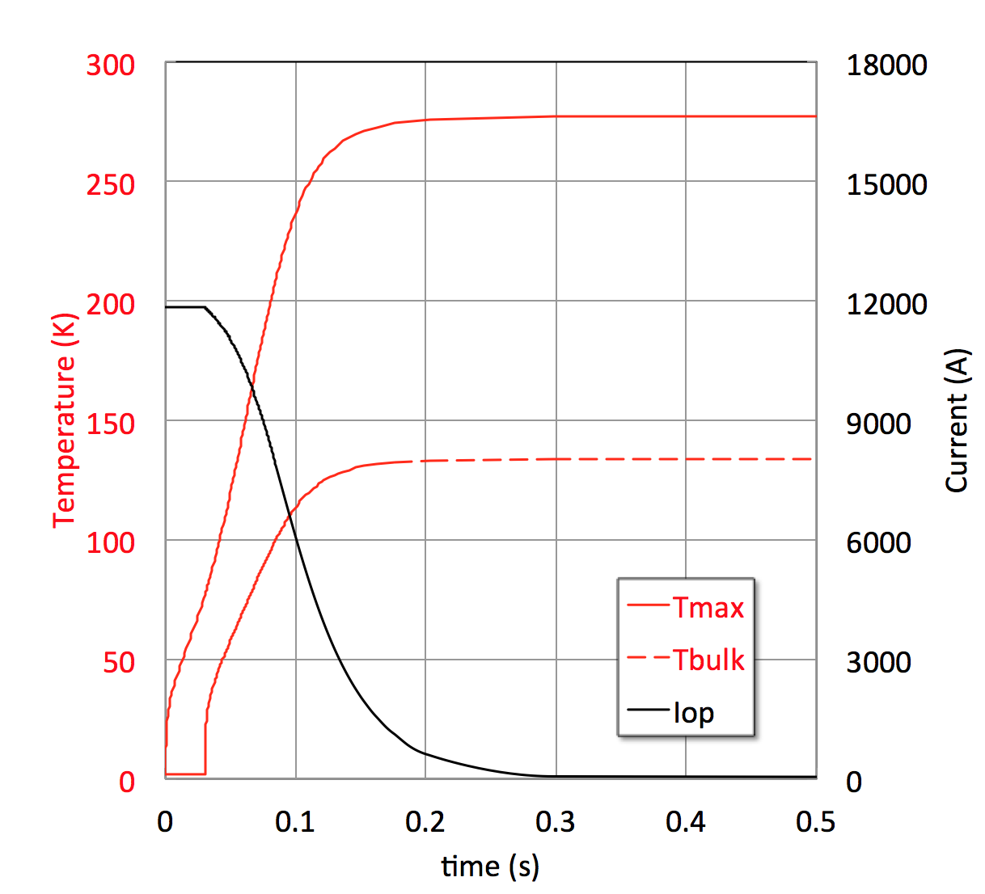
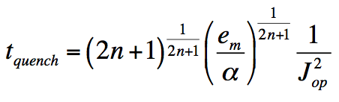
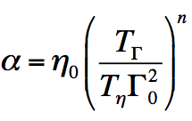
Scaling for self dump
Temperature
Quench time
magnet bulk
hot-spot
J and t
C/η

Slide 26
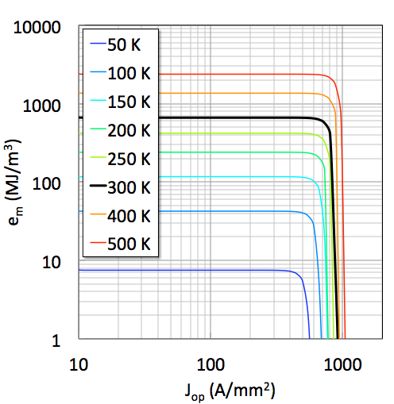
Sample scaling study – self dump
T_{max}
e_{m} limited
Cu/Nb₃Sn
f_{Cu} = 0.55
f_{SC} = 0.45
I_{op} = 10 kA
t_{discharge} = 0.1 s
J_{op} limited

Slide 27
Hot spot temperature limits
Courtesy of S. Izquierdo Bermudez, PhD, 2023
The material enthalpy in a self-dumped magnet limits the stored energy density

Slide 28
Limit 2 – Quench protection
An upper bound on hot spot temperature sets a limit on the current density and the magnetic energy density of a coil
Corollary – this sets an upper limits to the maximum affordable field
HL-LHC (12 T, T_{hot} ≈ 300 K) achieves an overall current density in the coil of 520 A/mm² and a stored magnetic energy density of 100 MJ/m³
FCC-hh (16 T, T_{hot} ≈ 350 K) is designed for a current density in the coil of 500 A/mm² and a stored magnetic energy density of 160 MJ/m³

Slide 29
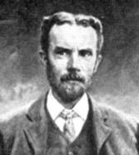
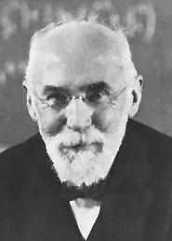
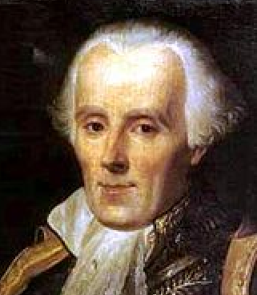
Forces
(O. Heaviside) E.A. Lorentz, P.S. Laplace
An electric charged particle q moving with a velocity v in a field B experiences a force F_{L} called electromagnetic (Lorentz) force (N):
A conductor carrying current density J (A/mm²) experiences a (Laplace) force density f_{L} (N/m³):

Slide 30
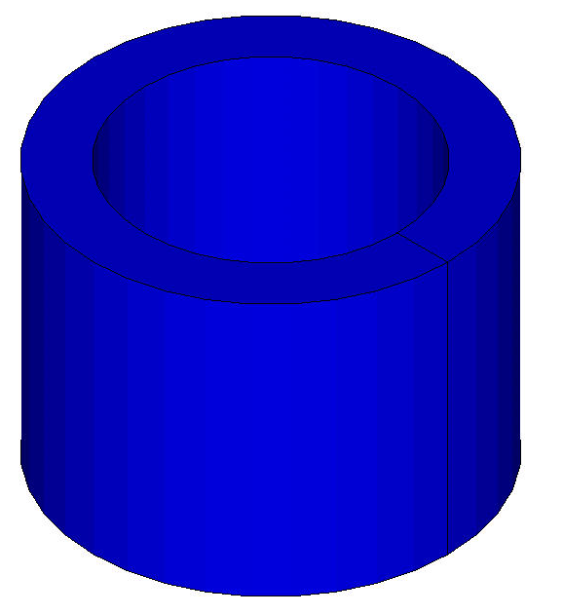
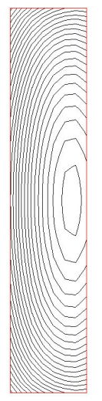
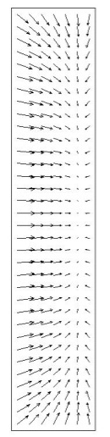
Electromagnetic forces - solenoid
Graphics by courtesy of P. Ferracin, S. Prestemon, E. Todesco
The e.m. forces in a solenoid tend to push the coil
  Vertically, towards the mid plane (Fy < 0)
  Radially, outwards (Fr > 0)
The radial force produces a hoop stress
Field
Force
Fr
Fy
Fy
Fr

Slide 31

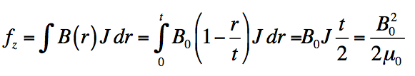

Magnetic pressure
Ideal case of an infinite solenoid
    Vertical and uniform magnetic field
    Radial and uniform electromagnetic force
Magnetic pressure
z
J
B₀
f_{r}
r
f_{r}
t
B₀ = 16 T ➔ p = 1000 bar

Slide 32
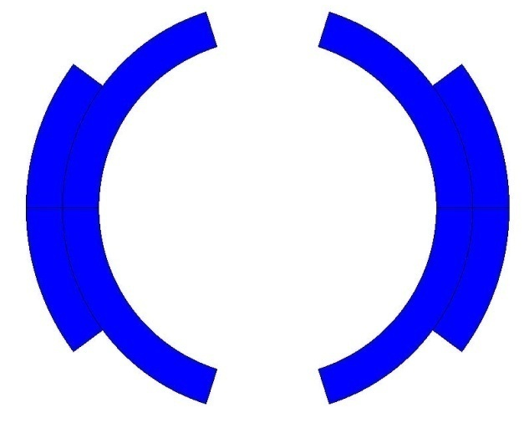
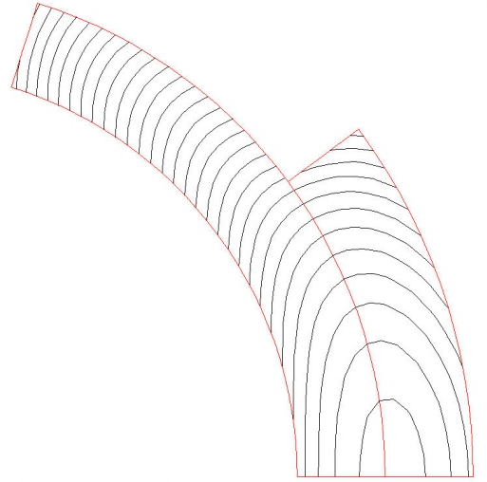


Electromagnetic forces: dipole
The electromagnetic forces in a dipole magnet tend to push the coil:
  Vertically, towards the mid plane (Fy < 0)
  Horizontally, outwards (Fx > 0)
Field
Force
Tevatron dipole
Fx
Fy
Graphics by courtesy of P. Ferracin, S. Prestemon, E. Todesco

Slide 33

Forces in dipole coils
Lorentz forces in the plane of a thin coil of radius R_{in} generating a dipole field B (thin shell approximation), referred to a coil quarter
Force per coil quadrant in high-field dipoles built or designed for accelerators applications and R&D
Force increases with the square of the bore field
  Requires massive structures (high-strength materials, volume, weight)
  The stress limit is usually in the superconducting coil (superconductor and insulation, mitigated by J_{e}≈1/B)
In practice the design of high field magnets is limited by mechanics

Slide 34







Magnet structures
2002, LBNL: Bladder and keys
R.R. Hafalia, et al., IEEE TAS, 12(1) (2002), pp. 47-50.
mid 1970’s, FNAL: Collared coils
A. Tollestrup, Proc. Int Conf. on the History of Original Ideas and Basic Discoveries in Particle Physics, Erice (1994).
2017, FNAL: SM cos(θ)
V. Kashikin, et al., Proc. IPAC, Copenhagen (2017), pp. 3597-3599.
2014, LBNL: CCT
S. Caspi, et al., IEEE TAS (2014), p. 4001804.
1998, TAMU: Stress management
N. Diaczenko, et al., Proc. PAC, Vancouver (1997), pp.3443-3345.
1975, MIT: CICC
M.O. Hoenig, et al., Proc. 5th Magn. Tech. Conf., Frascati(1975), p. 519.

Slide 35


Stress in high field magnets
High field superconductors (Nb₃Sn, REBCO, Bi-2212, Bi-2223, …) are brittle materials and stress/strain sensitive
Cracks development
Stress limited
reducing J
FCC
HE-LHC
QXF
Unconstrained scaling
11T
LHC

Slide 36
Limit 3 – Stress and strain
Allowable stress sets an upper limit to the maximum current density and field
Corollary – this sets an upper limits to the maximum affordable field
HL-LHC (12 T) achieves a design electromagnetic stress of approximately 100 MPa
FCC-hh (16 T) is designed for electromagntic stress of 150 MPa (limit of Nb₃Sn)

Slide 37



High field solenoids
Hybrid HTS 45.5 T insert
Superconducting
HTS is the only path beyond 16 T
All SC 32 T HTS insert

Slide 38





High field dipoles (FCC-hh)
Upper limit of LTS (Nb₃Sn)
HTS is the only path beyond 16 T

Slide 39
Overview
Accelerator magnets and examples
HEP detector magnets and examples
Resistive and coil magnet designs
Superconductors and their delicacies
Performance limits of accelerator magnets
Muon collider magnet challenges
Summary and perspective

Slide 40





Muon Collider magnets
HTS !
NC ±1.8 T, 400 Hz 100 mm x 30 mm
SC < 10T
100 mm x 30 mm
20 T, 200 mm
Radiation heat load ≈ 5…10 kW
Radiation dose: 80 MGy
HTS ?
SC dipole
NC dipole
NC dipole
SC dipole
RCS
> 40 T, 60 mm
16 T peak, 150 mm
Radiation heat load ≈ 5 W/m
Radiation dose ≈ 20…40 MGy
HTS ?
HTS !

Slide 41




Target and capture solenoid (20 T)
A Portone, P. Testoni, J. Lorenzo Gomez, F4E
Operating field: 20 T
Operating temperature: 20 K
MIT “VIPER” conductor
MuCol HTS conductor
Operating current: 61 kA
M. Takayasu et al., IEEE TAS, 21 (2011) 2340
Z. S. Hartwig et al., SUST, 33 (2020) 11LT01
Strong connection to HTS magnets for fusion

Slide 42





Final cooling (40 T)
σ_{max} = 600 MPa
A. Dudarev, CERN
Inner Ring
‘Correction’ Coil
Outer Ring
Bore
40 T solenoid design
‘Modular’ Coil
1 % Field Homogeneity
Support Plate
B. Bordini, CERN
T. Mulder, CERN
B. Bordini, CERN
Strong connection to HTS magnets for science

Slide 43



Back to the future – NI coils
Non-insulated winding
Nb₃Sn tapes (12 mm width, 0.1 mm thickness) produced at RCA, 1965

Slide 44





Accelerator magnets (±1.8 T)
Warm dipoles are pulsed from
-Bmax to +Bmax at high speed (0.35 to 6.37 ms) every 200 ms
5.07 kJ/m
5.65…7.14 kJ/m
5.89 kJ/m
The main challenge is the management of the power in the resistive dipoles (several tens of GW):
Minimum stored magnetic energy
Highly efficient energy storage and recovery
A simple HTS racetrack dipole could match the beam requirements and aperture
HTS flat racetracks
b3 = -7.2 units
b5 = -1.4 units
b7 = -0.03 units
peak field
10.4 T
Cold dipoles provide a steady baseline field of about 10 T
Rectangular magnet bore 100 mm x 30 mm
F. Boattini, CERN

Slide 45


Collider magnets limits (Nb₃Sn)
Stress limit
Margin limit
Stress limit
Margin limit
Dipoles
Quadrupoles
Present design range
Present design range
Work in progress to provide analytical expression for the magnet design limits (including protection and cost)
  Maximum field and gradient vs. magnet aperture in LTS and HTS
  Combined function limits B+G and B/G

Slide 46



The need for energy
CERN uses today 1.3 TWh per year of operation, with peak power consumption of 200 MW (running accelerators and experiments), dropping to 80 MW in winter (technical stop period)
Electric power is drawn directly from the French 400 kV distribution, and presently supplied under agreed conditions and cost
Supply cost, chain and risk are obvious concerns for the present and future of the laboratory

Slide 47



Future helium supply is limited and entails a substantial economical and availability risk
Courtesy of F. Ferrand, CERN

Slide 48






Energy efficient cryogenics
W/Q = (T_{h}-T_{c})/T_{c}
Credits to P. De Sousa and R. Van Weelderen, CERN
LHC
(FCC)
Need efficient cryo-plant and heat removal scheme in the range of 10…20 K (see work at ESS)
RHIC
Tevatron
HERA
LHC
Nb-Ti
8T
5T
ESS
The 60…80 K range would be a dream…
Nb₃Sn
16T
12…14T
This could be the best range of operating temperature of a future HEP collider
HTS
40…60T
20…40T
a few T
1.9
4.2
77
HTS may be the only path towards a future collider

Slide 49





Conductor cost
Grateful thanks to fusion !
Based on CERN orders and requests for quotations 2010-2022
Normalised costs are not aligned to currency, nor corrected for inflation
Impressive cost reduction in HTS !

Slide 50

Compact windings
We need to increase the winding current density to fall in a reasonable range of tape length (the same applis to conductor mass for LTS)
Unresolved issues:
  Winding geometry for tapes and stacks (ends, alignment, transposition possibly superfluous ?)
  Mechanics of coils under the exceptional electromagnetic loads (longitudinal stress in the range of 600 MPa, transverse stress in the range of 400 MPa)
  Quench management at high current and energy density (above 100 MJ/m³)
  Radiation hardness of materials and coils (40…80 MGy and 10²² n/m²)
350 A/mm²
500,000 km
950 A/mm²
150,000 km

Slide 51


The HEP push towards HTS
Operate SC magnets at higher cryogenic temperature (gas)
Reduce energy consumption
(FCC-ee 350 MW, FCC-hh 580 MW)
Increase energy efficiency
(COP at 1.9 K is about 1000)
Avoid large liquid helium bath and operate with gas (lower density)
Risk with helium supply chain
(FCC-hh would require 900 tons of lHe)
Reduce SC cost per unit length and current
Infrastructure (magnet) cost
(FCC-hh quoted at 9 BCHF)
Increase coil current density to decrease conductor inventory
Calculation example
(T. Lecrevisse, CEA)
Compact HTS windings
Target J_{E} 1000 A/mm²
Operation in gaseous He
Range of 15…25 K
5 T at 2800 A
J_{E} = 250 A/mm²
16 T at 2800 A
J_{E} = 850 A/mm²

Slide 52
Overview
Accelerator magnets and examples
HEP detector magnets and examples
Resistive and coil magnet designs
Superconductors and their delicacies
Performance limits of accelerator magnets
Muon collider magnet challenges
Summary and perspective

Slide 53
Summary and perspective
Superconducting magnets, one of the key technologies of accelerators, may be on the verge of a grand change. Thanks to HTS, and driven by:
  Needs for yet higher fields, as usual, but also …
  … considerations of energy efficiency, supply chain risk reduction and sustainability
This will be possible overcoming known limitations from mechanics and quench protection by:
  Innovation (e.g. non-insulated windings), that …
  … break the scalings I discussed here
These are exciting times for all, for you foremost !

Slide 54


Magnetars – the ultimate frontier !
Magnetar found very close to the supermassive black hole, Sagittarius A*, at the center of the Milky Way
10⁸…10¹¹ T
Image courtesy of NASA

