Slide 1
Funded by the European Union (EU). Views and opinions expressed are however those of the author only and do not necessarily reflect those of the EU or European Research Executive Agency (REA). Neither the EU nor the REA can be held responsible for them.
Muon beam fast acceleration Collider ring
Antoine CHANCE
CEA

Slide 2
Outline
The fast beam acceleration
How fast?
Which fast acceleration?
What fast accelerator layout?
Can we power a fast acceleration?
The collider
Luminosity considerations.
The challenges of the interaction region.
Impact of the muon decays.

Slide 3
Reminder on design baselines
Design oriented on reaching the performance parameter [webpage]
The relevant target parameters for the collider are:
Parameter | Unit | 3 TeV | 10 TeV
L | 10³⁴ cm⁻²s⁻¹ | 1.8 | 20
N | 10¹² | 2.2 | 1.8
f_{r} | Hz | 5 | 5
<B> (average) | T | 7 | 10.5
ε_{L} (norm, 1σ_{z}σ_{E}) | MeV m | 7.5 | 7.5
σ_{E} / E | % | 0.1 | 0.1
σ_{z} | mm | 5 | 1.5
Repetition rate of 5 Hz → Pulsed accelerators
See C. Rogers presentation
Muon Collider(s): why, gain and challenges
Given by muon cooling
Defines β*
(equal to bunch length)

Slide 4
Part 1: The fast muon acceleration
Base for the work is the US Muon Accelerator Program (MAP)
After muon cooling, acceleration with a linac and recirculating linacs (RLA, linacs with arcs to go in the same linac several times) up to 60 GeV.
Linac: fastest acceleration
Limitations: becomes long when energy goes up, wakefields
1 bunch per beam

Slide 5
Part 1: The fast muon acceleration
Base for the work is the US Muon Accelerator Program (MAP)
High energy complex consist of a chain of rapid cycling synchrotrons (RCS)
1 bunch per beam
Part of interest

Slide 6
Top level requirements for the high energy complex
Goal: Accelerate one single bunch beam of µ+/µ-
with a charge of about 2e12 muons/bunch.
with a repetition frequency of 5 Hz.
from about 60 GeV to 5 TeV.
Figure of merit:
Fast acceleration (the muons decay).
Feasible (if possible ;-)).
Cost efficient (should be cheaper than a 100-km-long linac).
Power efficient (do not use a nuclear plant to power the RCS!).

Slide 7
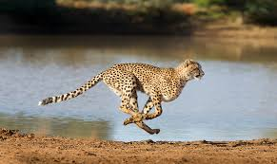
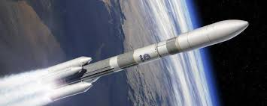
How fast?

Slide 8
How fast? Survival rate
Muons decay very fast (Rest lifetime: $τ_{μ}$=2.2 µs; rest muon mass $E_{μ}=105.66$MeV).
Let us consider the bunch population evolution with:
$E_{inj}$, $E_{ext}$ the total muon energy at injection and extraction
$N_{inj}$, $N_{ext}$ the muon bunch population at injection and extraction
A total acceleration time $τ_{acc}$
Evolution of muon population $N$ with time:
$$\frac{dN}{dt}=−\frac{N}{γ\left(t\right)τ_{μ}}⇒\frac{dN}{N}=−\frac{dt}{γ\left(t\right)τ_{μ}}⇒\log{\frac{N\left(t\right)}{N_{inj}}}=−\int_{0}^{t}{\frac{du}{γ\left(u\right)τ_{μ}}}$$
$$\frac{N_{ext}}{N_{inj}}=exp \left[−\frac{1}{τ_{μ}}\int_{0}^{τ_{acc}}{\frac{dt}{γ\left(t\right)}}\right]$$
Depends only on injection and extraction energies and ramp strategy
Independent of accelerator type or ring size

Slide 9
How fast? Linear vs sinusoidal ramp
 | Linear | Sinusoidal
Energy ramp | $$E\left(t\right)=E_{inj}+G_{acc, lin} e c t$$ | $$E\left(t\right)=\frac{E_{ext}+E_{inj}}{2}−G_{acc, sin}\frac{e cτ_{acc,sin}}{π}cos\frac{πt}{τ_{acc,sin}}$$
Survival rate | $$\frac{N_{ext}}{N_{inj}}=exp \left[−\frac{τ_{acc,lin}}{τ_{μ}}\frac{E_{μ}}{E_{inj}}\frac{log\frac{E_{ext}}{E_{inj}}}{{E_{ext}/E}_{inj}−1}\right]$$ | $$\frac{N_{ext}}{N_{inj}}=exp \left[−\frac{τ_{acc,sin}}{τ_{μ}}\frac{E_{μ}}{E_{inj}}\frac{1}{\sqrt{{E_{ext}/E}_{inj}}}\right]$$
Acceleration time | $$τ_{acc,lin}={−τ}_{μ}log\frac{N_{ext}}{N_{inj}}\frac{E_{inj}}{E_{μ}}\frac{E_{ext}/E_{inj}−1}{log\frac{E_{ext}}{E_{inj}}}$$ | $τ_{acc,sin}={−τ}_{μ}log\frac{N_{ext}}{N_{inj}}\frac{E_{inj}}{E_{μ}}\sqrt{\frac{E_{ext}}{E_{inj}}}$
Gradient | $$G_{acc, lin}=−\frac{E_{μ}}{ecτ_{μ}}\frac{1}{log\frac{N_{ext}}{N_{inj}}}log\frac{E_{ext}}{E_{inj}}$$ | $$G_{acc, sin}=−\frac{E_{μ}}{ecτ_{μ}}\frac{1}{log\frac{N_{ext}}{N_{inj}}}\frac{π}{2}\frac{E_{ext}/E_{inj}−1}{\sqrt{E_{ext}/E_{inj}}}$$
$\frac{τ_{acc,sin}}{τ_{acc,lin}}=\frac{\sqrt{\frac{E_{ext}}{E_{inj}}}}{\frac{E_{ext}}{E_{inj}}−1}log\frac{E_{ext}}{E_{inj}}$ and $\frac{G_{acc,sin}}{G_{acc,lin}}=\frac{π}{2}\frac{\frac{E_{ext}}{E_{inj}}−1}{log\frac{E_{ext}}{E_{inj}}\sqrt{\frac{E_{ext}}{E_{inj}}}}$ only dependent on energy ratio.

Slide 10
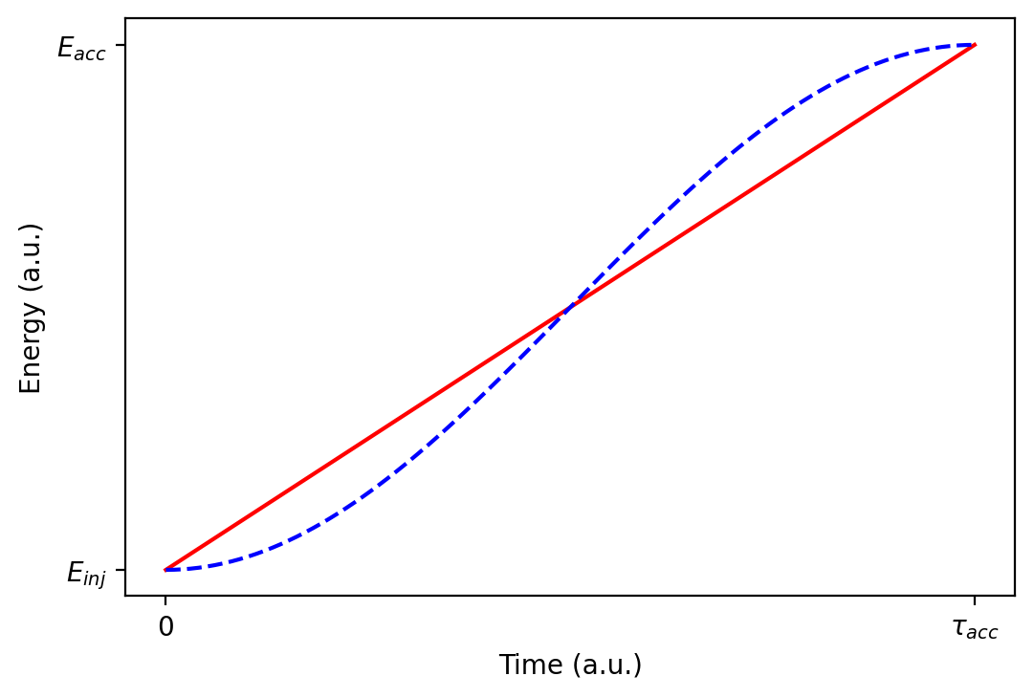
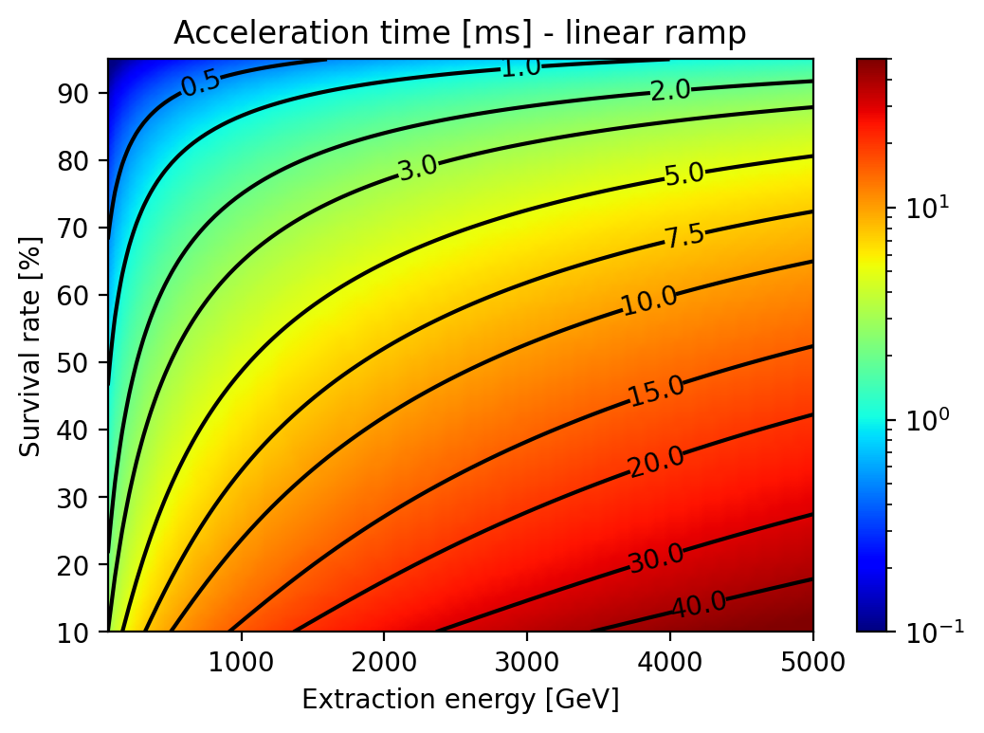
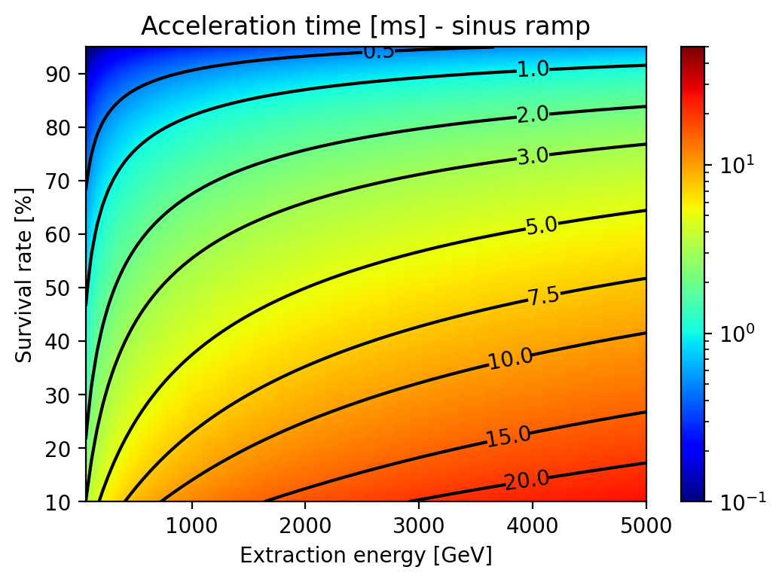
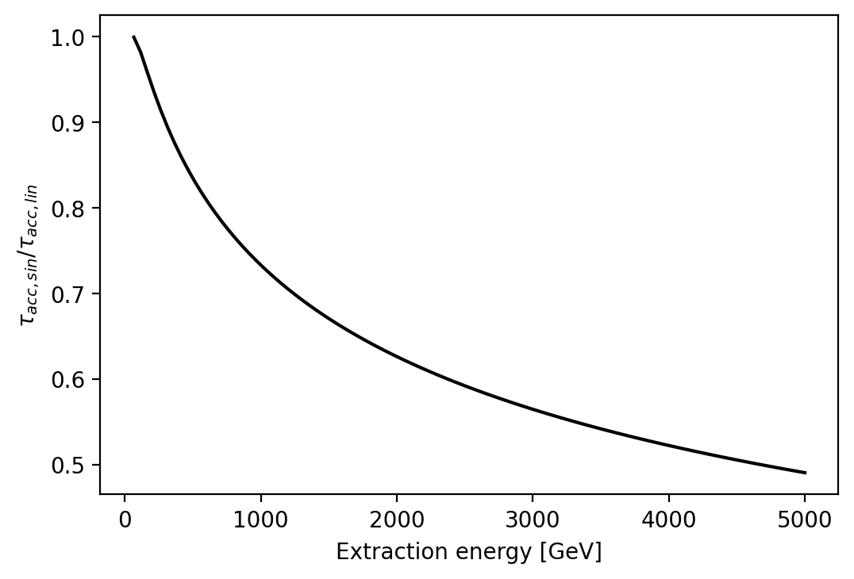
Accelerating time energy and survival time
Survival time of 65% to go to 5 TeV if linear ramp of 10 ms.
Acceleration time of 0.3 ms to go to 300 GeV with a survival of 90%.
You need to accelerate faster with a sine-like ramp.

Slide 11
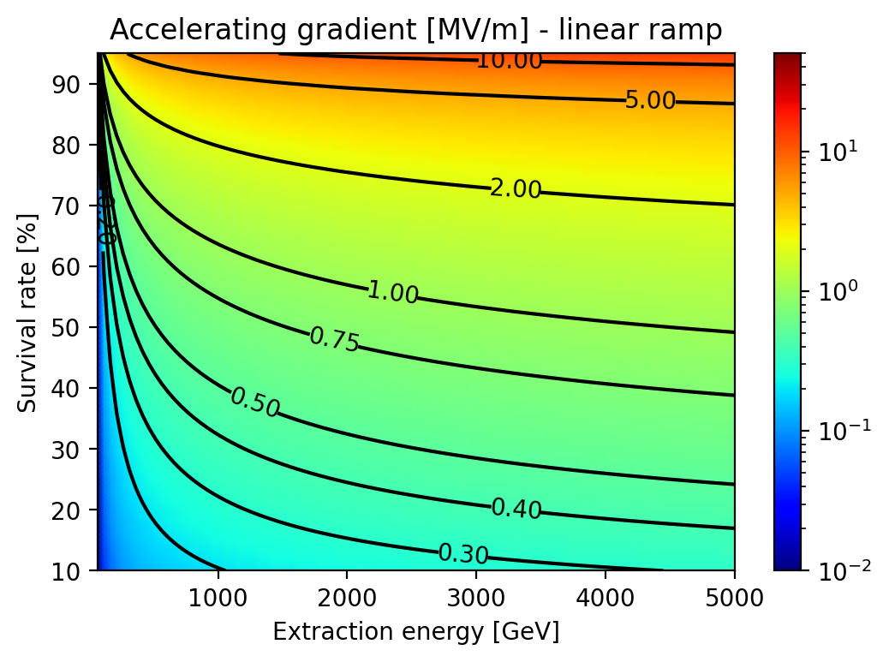
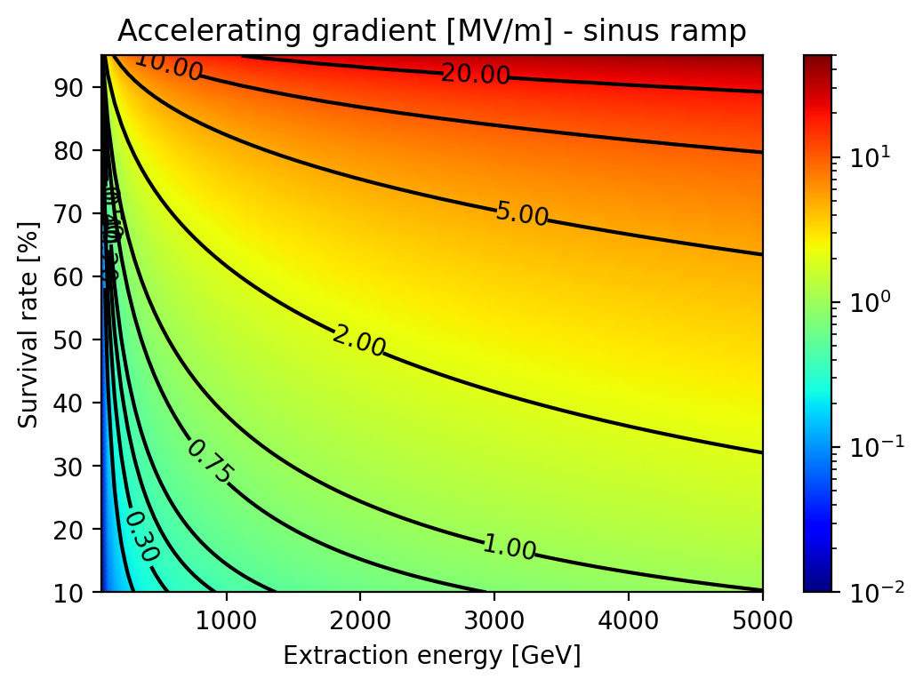
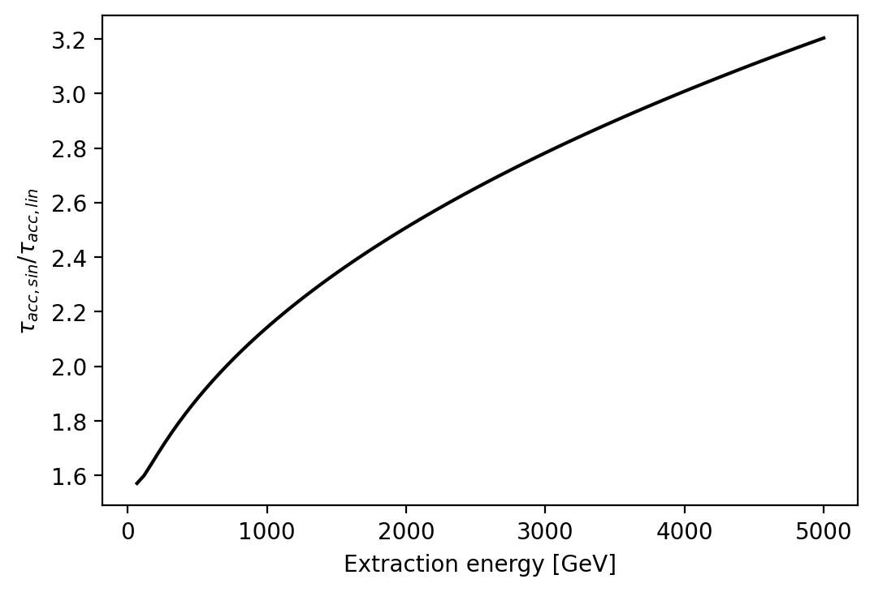
Accelerating gradient energy and survival time
Average gradient of 1.65 MV/m to go to 5 TeV if linear ramp of 10 ms.
Sine-like ramps requires shorter accelerating time and higher gradient (factor 2) at the same time for the same survival rate: linear ramp is preferred.

Slide 12
How fast? Conclusion
To keep 65% of the muons to the collider, we need:
To accelerate from 60 GeV to 5 TeV in only 10 ms with linear ramp.
An average gradient of 1.65 MV/m corresponding to an average energy gain of 494 TeV/s.
SPS: energy gain of 80 GeV/s.
X-FEL: final energy of 17.5 GeV in 1.7 km: gradient of 10 MV/m.
We are near to be as fast as in an SC Linac!!!
We need a lot of RF cavities!
See Claude Marchand’s presentation on RF
What accelerator can reach such a speed?

Slide 13
Which fast accelerator?
Reminder:
We need an average gradient $G_{acc}$ of 1.65 MV/m.
The total RF voltage is simply given by:
$$V_{tot, RF}= G_{acc}L_{ring}$$
To minimize the RF budget we should have $L_{ring}$ as small as possible.
Small is beautiful!
The magnetic ramp is given by
$$\dot{B}=\frac{\dot{E}}{ρc}=2π\frac{G_{acc}}{L_{dipole}}=2π\frac{G_{acc}}{L_{ring}}\frac{L_{ring}}{L_{dipole}}>1kT/s$$
A small ring implies a higher magnetic slope.

Slide 14
Which fast accelerator?
Magnetic slope of 1 kT/s:
Currently only pulsed warm dipoles (maximum 2 T) can handle such a slope.
Some R&D on HTS pulsed dipoles but 10 T is currently excluded.
What circumference with 1.8 T in the dipoles?
5 TeV → $Bρ=16.7 \text{kT}\text{.}\text{m}$
Filling factor $FF=\frac{L_{dipole}}{L_{ring}}\text{=0.6}$(we need to keep place for RF).
$L_{ring}=\frac{2πBρ}{FF×B }=\frac{2π×16700}{0.6×1.8 }=97 \text{km}\text{! }$→ That is the FCC tunnel.
How can we keep an affordable circumference and a fast acceleration?

Slide 15
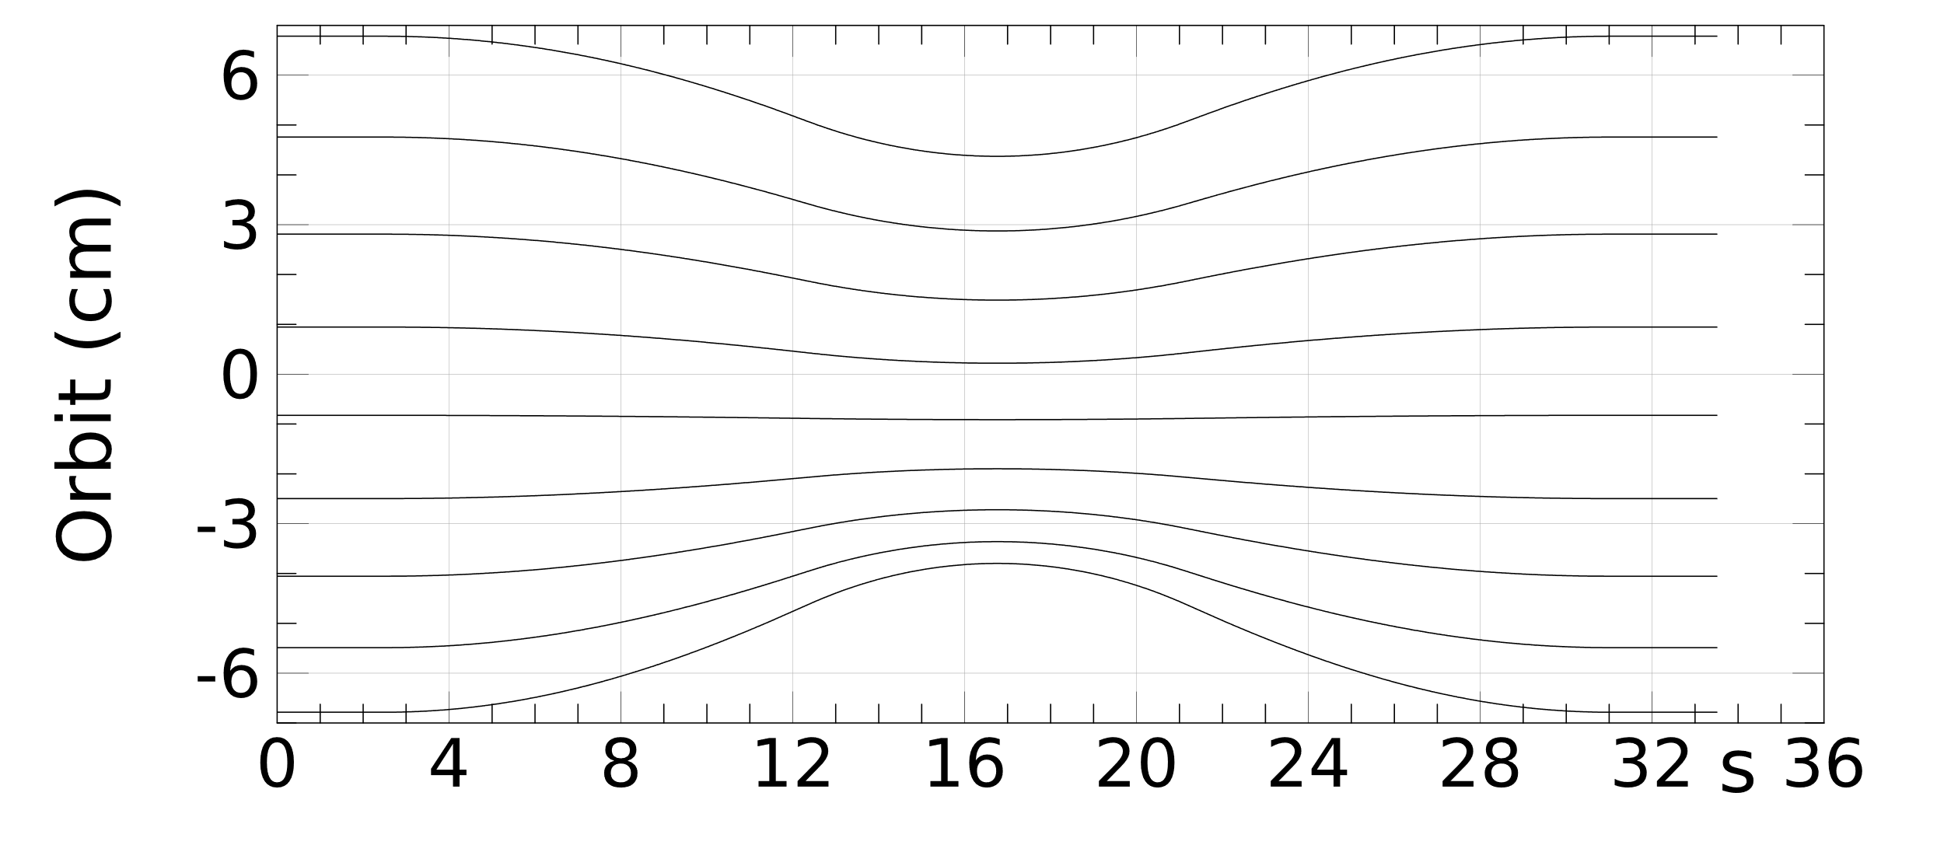
Which fast accelerator? Fixed-field
Solution 1): we use static SC dipoles without pulsating the magnets.
Linear collider (CLIC-like).
Even with an average accelerating gradient of 100 MV/m, we need a linac of 100 km!
Excluded !
FFA (Fixed Field Alternating gradient accelerator).
Large energy range (e.g., factor of 2) in a single beamline
Magnet fields do not vary with time
Alternating gradient focusing in compact cells for small orbit excursion
Interesting solution
Courtesy: J. Scott Berg

Slide 16
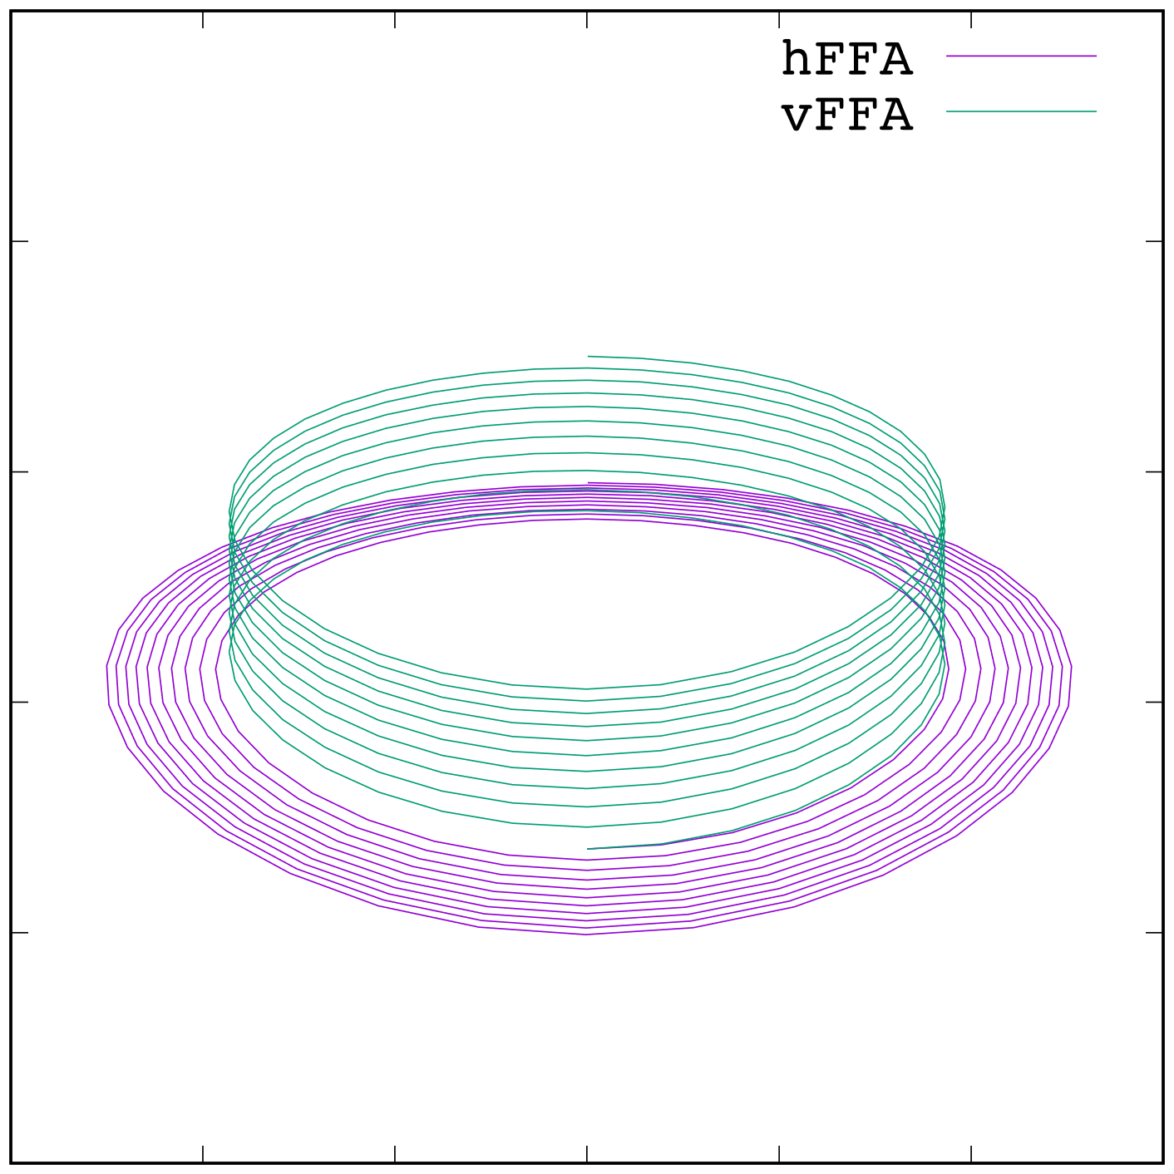
Vertical and Horizontal FFAs
Courtesy: J. Scott Berg, S. Machida
Original FFAs are midplane-symmetric: “horizontal”
Closed orbits in the midplane
Orbit length varies with energy
Variation small; stay near RF crest, “serpentine” acceleration
Vertical FFAs
Closed orbits displaced vertically
Orbit lengths same: fixed RF frequency
Skew focusing
Complex magnetic fields (exponential vertically)

Slide 17
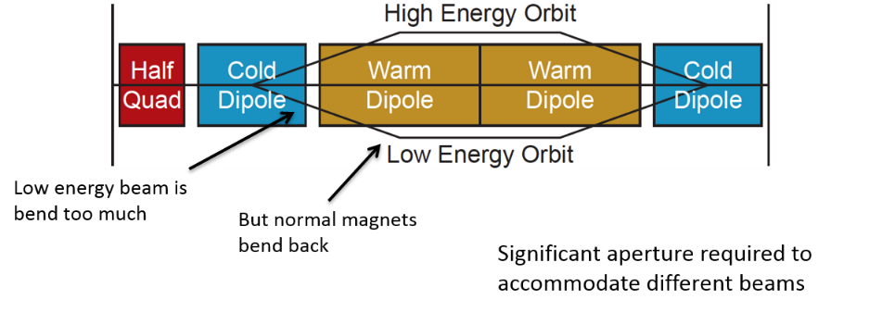
Which fast accelerator? The hybrid synchrotron
Solution 2): we increase the average magnetic field by interleaving pulsed warm dipoles and static SC dipoles.
That is the principle of the hybrid synchrotron.

Slide 18
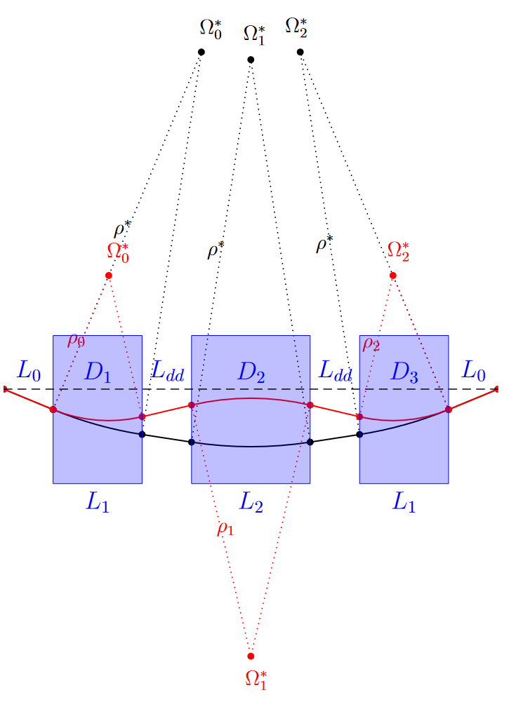
Hybrid RCS magnet layout
SC magnets provide high average B, but not fast ramping → fixed-field, $B_{sc}=10$ T
NC magnets require fast ramping within $B_{nc}=±1.8$ T Decided for realistic values: below saturation of both technologies
Beam orbit not constant during acceleration
Orbit length and f_{rev} ≠ const.
f_{RF} tuning must be provided
SC
NC
SC

Slide 19
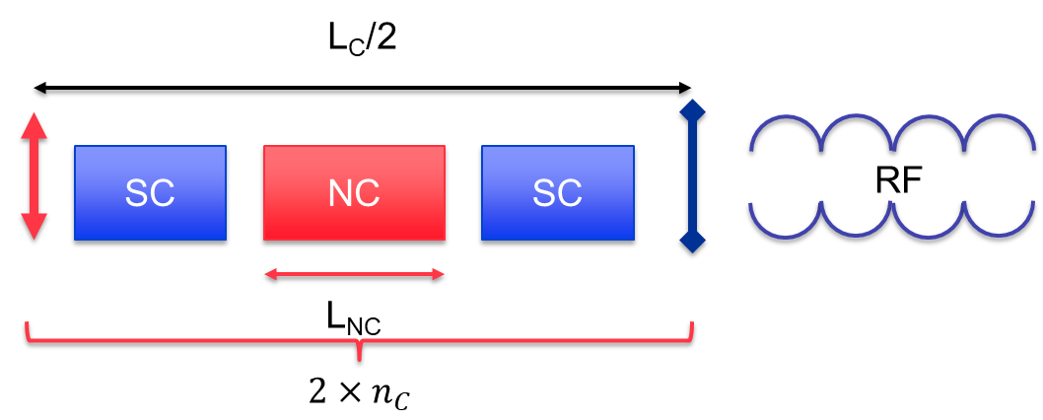
What dipole length in a hybrid synchrotron?
At injection and extraction energies, the total angle is always $2π$.
$$\left\{\begin{aligned}\frac{B_{NC, inj}L_{NC}}{Bρ_{inj}}+\frac{B_{SC }L_{SC}}{Bρ_{inj}}=2π \\ \frac{B_{NC, ext}L_{NC}}{Bρ_{ext}}+\frac{B_{SC }L_{SC}}{Bρ_{ext}}=2π\end{aligned}\right.⇔\left\{\begin{aligned}L_{NC}=2π\frac{Bρ_{ext}−Bρ_{inj}}{B_{NC,ext}−B_{NC,inj}}=π\frac{Bρ_{ext}−Bρ_{inj}}{B_{NC}} \\ L_{SC}=2π\frac{Bρ_{inj}B_{NC,ext}−Bρ_{ext}B_{NC,inj}}{B_{SC}(B_{NC,ext}−B_{NC,inj})}=π\frac{Bρ_{inj}+Bρ_{ext}}{B_{SC}}\end{aligned}\right.$$
The dipole length depends on the dipole fields and injection and extraction energies.
The filling pattern does not matter.

Slide 20
The high-energy complex
Chain of rapid cycling synchrotrons, counter-rotating µ+/µ- beams → 60 GeV → 314 GeV → 750 GeV → 1.5 TeV → 5 TeV
Hybrid RCSs have interleaved normal conducting (NC) and superconducting (SC) magnets.
To go to 5 TeV, we have not one but four RCS:
Tradeoff between the ring size, survival rate, acceleration speed (at low energy, the ring can be smaller and thus we can accelerate faster).
This would be the first hybrid RCSs in the world!

Slide 21
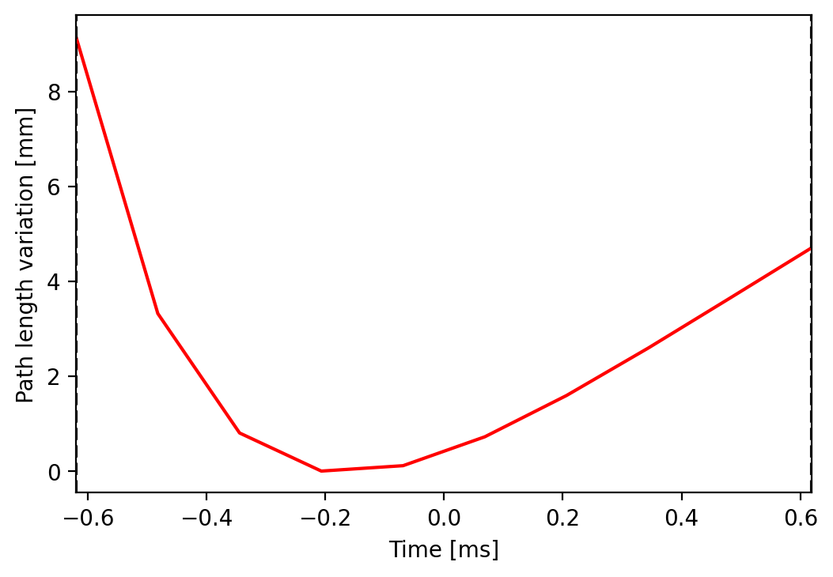
Trajectory variation Example for RCS2
The path length is not constant
RF frequency needs to be tuned.
What frequency range and tuning speed?
$\frac{Δf}{f}=\frac{ΔL}{2πR}≈1.52×{10}^{−6}⇒Δf≈2kHz→\frac{dΔf}{dt}≈10 MHz/s$
Driver for the tuner technology change.
From injection to extraction the trajectory goes from the inner side to the outer side.
The trajectory difference goes up to more than 13 mm.
Should be taken into account for field quality definition.

Slide 22
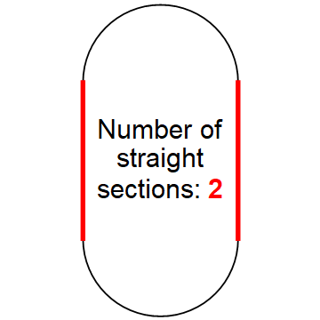
What ring shape?
?

Slide 23
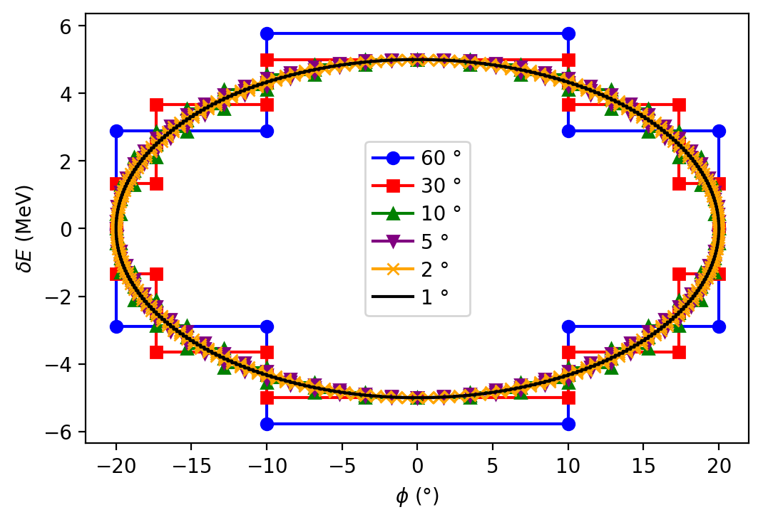
What ring shape?
Number of synchrotron oscillations per turn proportional to $√V_{RF}$:
Stable synchrotron oscillations and phase focusing only for $Q_{s}≪\frac{1}{π}$
LHC: Q_{s}=0.005
T. Suzuki, KEK Report 96-10

Slide 24
What ring shape?
Number of synchrotron oscillations per turn proportional to $√V_{RF}$:
Stable synchrotron oscillations and phase focusing only for $Q_{s}≪\frac{1}{π}$
The pulsed synchrotrons would exceed this limit: 0.3 < Qs < 1.5
Several longitudinal kicks/turn for small Qs between stations, i.e., small $\frac{Q_{s}}{n_{RF}}$
Distribute RF system over $n_{RF}$ sections
$n_{RF}$ is an important quantity to determine!
$n_{RF}$ gives also the minimum number of arcs.
LHC: Q_{s}=0.005
T. Suzuki, KEK Report 96-10

Slide 25
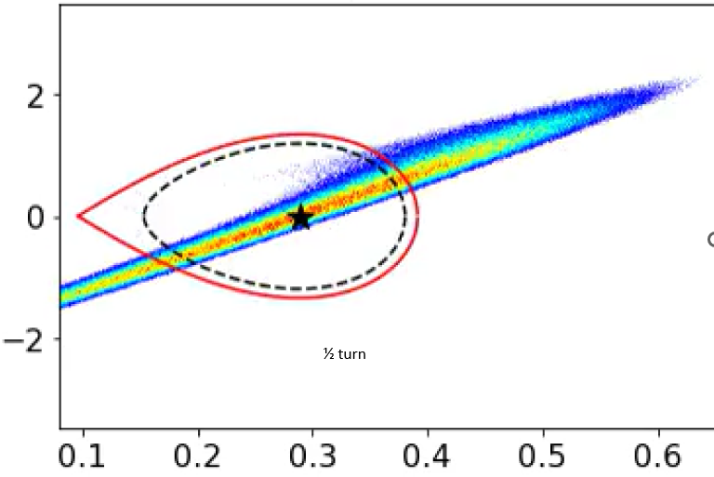
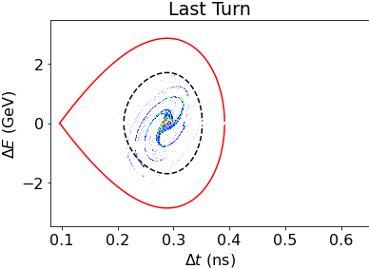
How many RF stations? Examples: nRF = 4
Courtesy: F. Batsch
RCS1, no induced voltage, $ε_{L}$ = 0.31 eVs
$$\frac{Q_{s}}{n_{RF}}=\frac{1.5}{4}=0.38$$
¼ turn
High Q_{s} destroys bunch!
28 July 2023
25

Slide 26
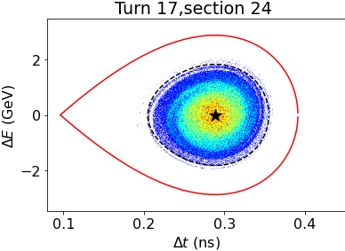
How many RF stations? Examples: nRF = 32
Courtesy: F. Batsch
RCS1, no induced voltage, $ε_{L}$ = 0.31 eVs
$$\frac{Q_{s}}{n_{RF}}=\frac{1.5}{32}=0.05$$
Emittance growth: 4%
28 July 2023
26

Slide 27
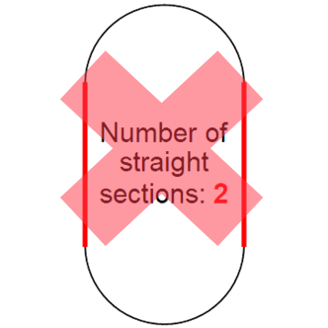
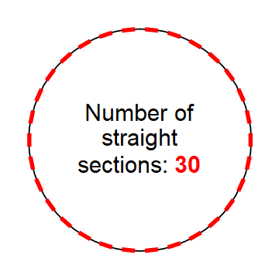
How many RF stations
Why not always choosing a very high n_{RF}
Higher n_{RF} results in higher construction / cooling / cryogenics and powering costs, even though the number of cavities is constant and defined by ΔE per turn, plus lattice restrictions
→ Criteria: emittance growth versus n_{RF}
For RCS1, n_{RF} ≈ 32 best candidate
For RCS2 and 3, n_{RF} ≈ 24 could be enough

Slide 28
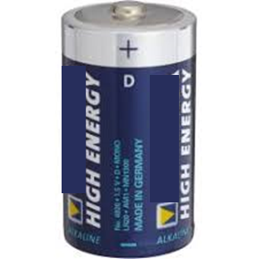
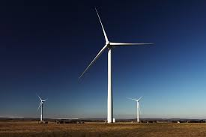
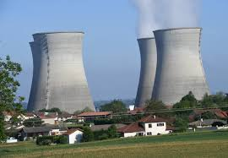
Which magnet powering ?

Slide 29
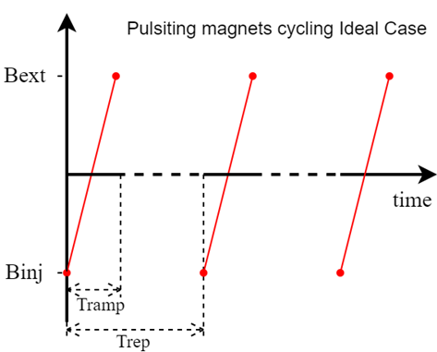
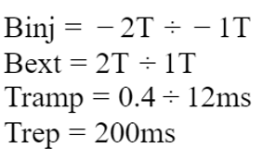
Magnetic ramp First considerations
Aim: Powering dipole magnets with fast rising magnetic field
with repetition frequency of 5Hz
Example:
Powering dipoles for a B field swing 4T (-2T → 2T) in 2 ms
Energy stored in the magnetic fields of the dipoles
$E_{B_{max}}=\frac{B_{max}^{2}}{2 μ_{0}}. \underset{V_{gap}}{\underbrace{L_{ramp}.H_{gap}.W_{gap}}}≈64 \text{MJ}$
Linear ramp requires a huge amount of power : $P\left(t\right)=\frac{V_{gap}}{2μ_{0}}.\frac{ΔB^{2}}{ΔT}$ =128 𝐺𝑊 !!!
Solving this with Conventional Power Electronics is virtually impossible
Energy stored in Converter much higher than 64 MJ (2-3 times more )
Complex/costly/lossy converter

Slide 30
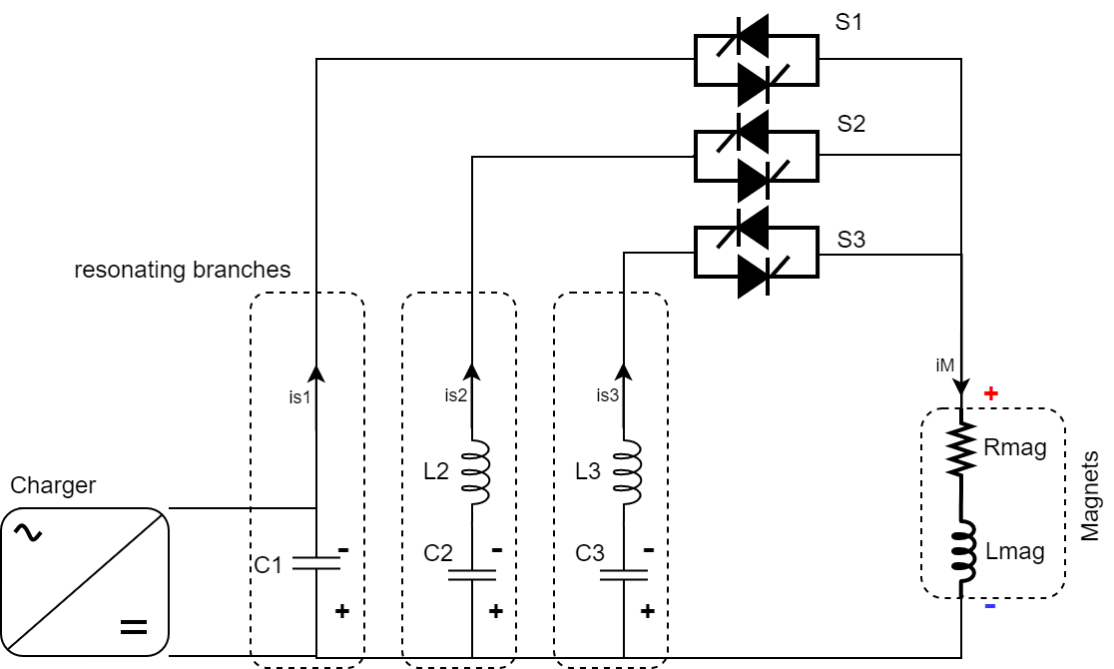
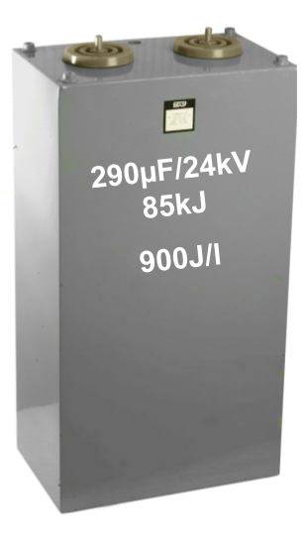
Alternative Approach: Resonent converter
Natural resonant discharge
The energy initially stored in the capacitors is transfer to the magnets
Lineal ramp approximated by resonance of two harmonics
Active Filter (AF)
Built with modern power electronics.
Corrects current through magnet (α B-Field) to make it linear
Advantages
Less power handle by Power Electronics
Minimum energy storage configuration
But a pure linear ramp is costly for the powering:
Approximated by a harmonic system.
Full wave resonance
Courtesy: F. Boattini
Total energy: 50-150 MJ
Magnet losses: 4-8 kW/m

Slide 31
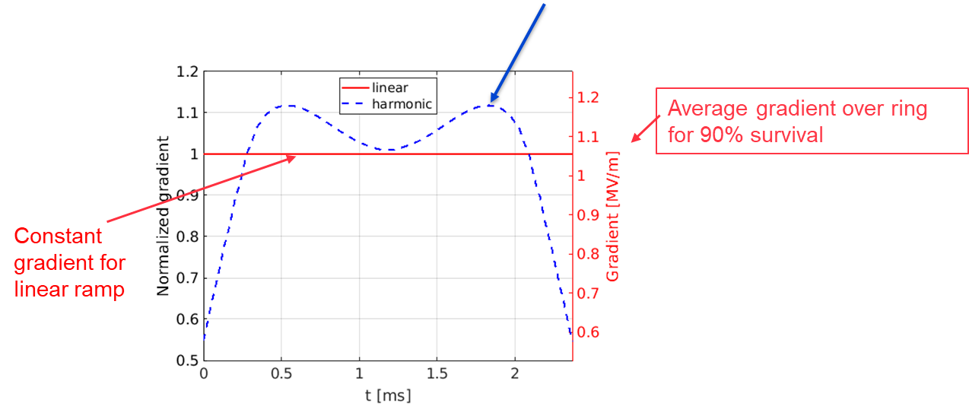
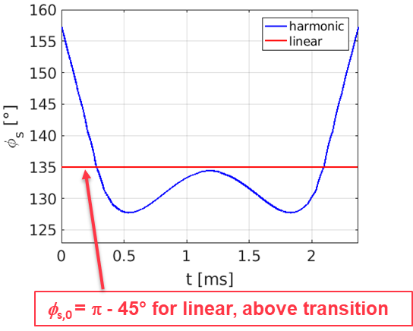
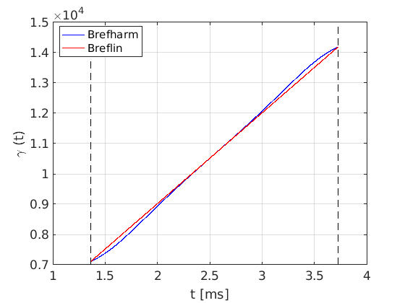
Fast ramp: Tradeoff between RF and magnet budget
Courtesy: F. Batsch and F. Boattini
Powering and ramping function optimization ongoing, combined with synchronous phase and RF voltage optimization.
Example of ramp
V_{acc} and G_{acc} must be increased by 12% to achieve the same $τ_{acc}$ ≠ 200% as for a sine-like ramp!

Slide 32
Fast acceleration summary
Example parameters for the muon fast acceleration
 | RCS1 | RCS2 | RCS3 | RCS4
Hybrid RCS | No | Yes | Yes | Yes
Circumference [m] | 5990 | 5990 | 10700 | 26659
Injection/extraction energy [TeV] | 0.06/0.314 | 0.314/0.75 | 0.75/1.5 | 1.5/4.2
Survival rate [%] | 90 | 90 | 90 | 90
Acceleration time [ms] | 0.34 | 1.10 | 2.37 | 5.75
Number of turns | 17 | 55 | 66 | 65
Energy gain/turn [GeV] | 14.8 | 7.9 | 11.4 | 41.5
NC dipole field [T] | 0.36/1.8 | -1.8/1.8 | -1.8/1.8 | -1.8/1.8
SC dipole field [T] | - | 10 | 10 | 16
NC ramp rate [T/s] | 4199 | 3281 | 1518 | 626
Number of arcs | 34 | 26 | 26 | 26
Number of cells/arc | 7 | 10 | 17 | 19
Cell length [m] | 21.4 | 19.6 | 20.6 | 45.9
Path length diff. [mm] | 0 | 9.1 | 2.7 | 9.4
Orbit difference [mm] | 0 | 12.2 | 5.9 | 13.2
Min. dipole width [mm] | 17.4 | 19.6 | 10.7 | 18.8
Min. dipole height [mm] | 14.8 | 6.4 | 4.2 | 4.4
Detailed parameter table
(by F. Batsch):
Very fast acceleration.
Needs for a lot of RF cavities.
Hybrid synchrotron:
Static SC dipoles
Fast pulsed warm dipoles.
Powering is a hot topic.
Distributed RF stations.
Path length and orbit vary during the acceleration.

Slide 33
Part 2: The collider
Base for the work is the US Muon Accelerator Program (MAP)
Collision of one bunch of µ⁺/µ⁻ at 10 TeV center of mass.
1 bunch per beam
Part of interest

Slide 34
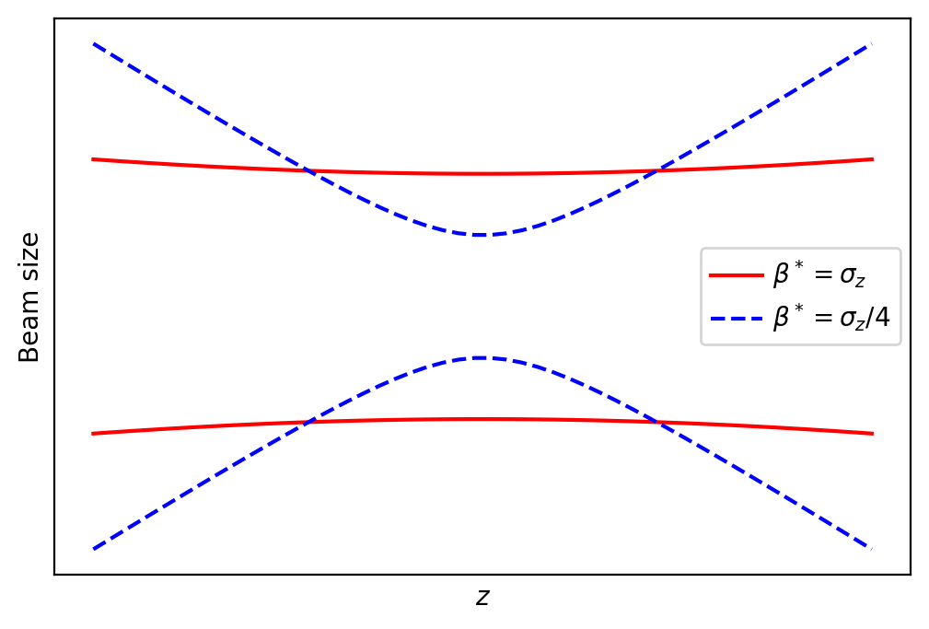
Collider performances: Luminosity per IP
$N$ the number of muons in bunch
$f_{hg}$ the “hourglass” luminosity reduction factor a function of ${σ_{z}}/{β^{∗}}$
$$\overline{L}=\frac{N^{2}}{4π ε_{ph}β^{∗}}\frac{1}{T_{rev}}f_{hg}\frac{f_{r}γ{ τ}_{μ}}{2}$$
round muon beams and one bunch per beam
$f_{r}$ the complex repetition rate (~5 Hz)
$ε_{ph}={ε_{n}}/γ$ the physical rms emittance
Revolution time $T_{rev}=2π\frac{γ E_{μ}}{e c^{2 }\overline{B}}$
$β^{∗}$ the Twiss betatron function at the IP
$β^{∗}=σ_{z}$ to keep $f_{hg}=0.758$

Slide 35
Collider performances: Luminosity per IP
$f_{r}$ the complex repetition rate (~5 Hz)
$f_{hg}$ the “hourglass” luminosity reduction factor a function of ${σ_{z}}/{β^{∗}}$
$N$ the number of muons in bunch
$$\overline{L}=\frac{e c^{2} τ_{μ}}{16 π^{2} E_{μ}}\frac{N^{2}f_{r}γ^{2}}{ε_{n}ε_{L}}{σ_{δ}\overline{B}f}_{hg}$$
round muon beams and one bunch per beam
$\overline{B}$ the average magnetic field
$ε_{n}$ the normalized rms emittance
$ε_{L}$ the normalized longitudinal emittance
$σ_{δ}$ the RMS energy spread

Slide 36
Collider performances: How to maximize luminosity
$$\overline{L}=\frac{e c^{2} T_{μ}}{16 π^{2} E_{μ}} \frac{\left(f_{r} N γ\right) N γ }{ ε_{n} ε_{L}}{{\overline{B}σ}_{δ}f}_{hg}$$
Constant $11.83 {\text{T}}^{−1}$:
Nothing to do
We cannot change the physics ;-)

Slide 37
Collider performances: How to maximize luminosity
$$\overline{L}=\frac{e c^{2} T_{μ}}{16 π^{2} E_{μ}} \frac{\left(f_{r} N γ\right) N γ }{ ε_{n} ε_{L}}{{\overline{B}σ}_{δ}f}_{hg}$$
Incoming beam
Emittances determined by ionization cooling
Luminosity per beam power increase with beam power $∝ \left(f_{r} N γ\right)$ under assumptions made
Large bunch population $N$ gives higher luminosity and corresponds to lower repetition rate for a given beam power => nominal $N/{ε_{n}}$ close to limitations of the beam-beam interactions at the collision point

Slide 38
Collider performances: How to maximize luminosity
$$\overline{L}=\frac{e c^{2} T_{μ}}{16 π^{2} E_{μ}} \frac{\left(f_{r} N γ\right) N γ }{ ε_{n} ε_{L}}{{\overline{B}σ}_{δ}f}_{hg}$$
Collider parameters
Large (average bending) magnetic field $\overline{B}$ helps → Small circumference.
Large longitudinal acceptance to operate with large rms momentum spread $σ_{δ}$
Hour-glass effect small: small ${β^{∗}= σ}_{z}$ - both a challenge for lattice design
Consequence of assumption and optimizations made:
Bunch length $σ_{z}$ and $β^{∗}$ decrease with energy
Divergence at IP independent of energy!
Lattice design becomes more difficult for higher energies.

Slide 39
Nominal 10 TeV com Collider Parameters
Parameter | Symbol | Value
Beam energy | $$E$$ | $$5000 \text{GeV}$$
Relativistic Lorentz factor | $$γ$$ | $$47 322$$
Circumference | $$C$$ | $$≈10 000 \text{m}$$
Magnetic (average bending) field | $$\overline{B}$$ | $$≈10.48 \text{T}$$
Repetition rate | $$f_{r}$$ | $$5 \text{Hz}$$
Bunch intensity (one bunch per beam) | $$N_{μ}$$ | $$1.8∙1012$$
Beam power per beam | $$P_{B}$$ | $$7.2 \text{MW}$$
Normalized transverse rms emittance | $$ε_{n}$$ | $$25 μ\text{m}$$
Physical transverse rms emittance | $$ε_{ph}$$ | $$0.528 \text{nm}$$
Long. geometric rms emittance $γ σ_{z} σ_{δ}$ | $$ε_{L}$$ | $$70 \text{mm}$$
Rms relative momentum spread | $$σ_{δ}={σ_{p}}/p$$ | $${1∙10}^{−3}$$
Rms bunch length | $$σ_{z}$$ | $$1.5 \text{mm}$$
Twiss betatron function at the IP | $$β^{∗}$$ | $$1.5 \text{mm}$$
Rms beam size at IP | $$σ_{⊥,IP}$$ | $$0.89 μ\text{m}$$
Luminosity | $$L$$ | $$19.5∙{10}^{34} {\text{cm}}^{−2}{\text{s}}^{−1}$$
Beam-beam tune shift per IP |  | $$0.078$$

Slide 40
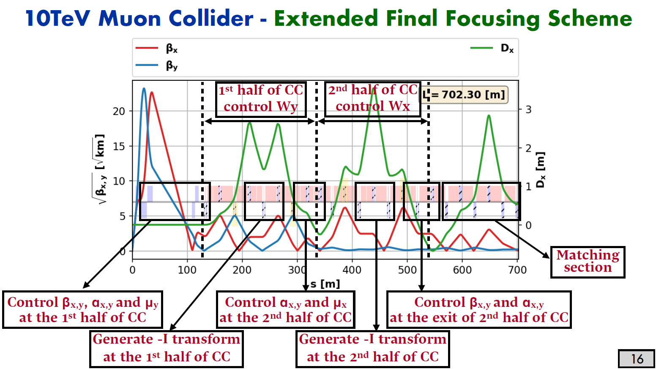
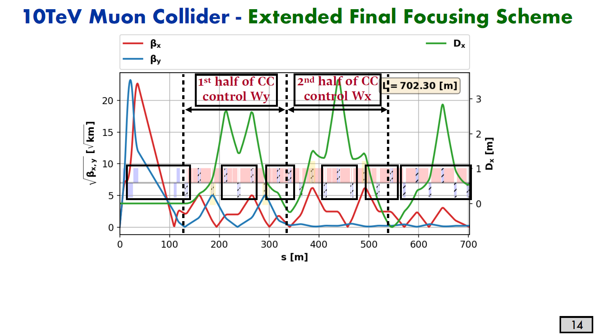
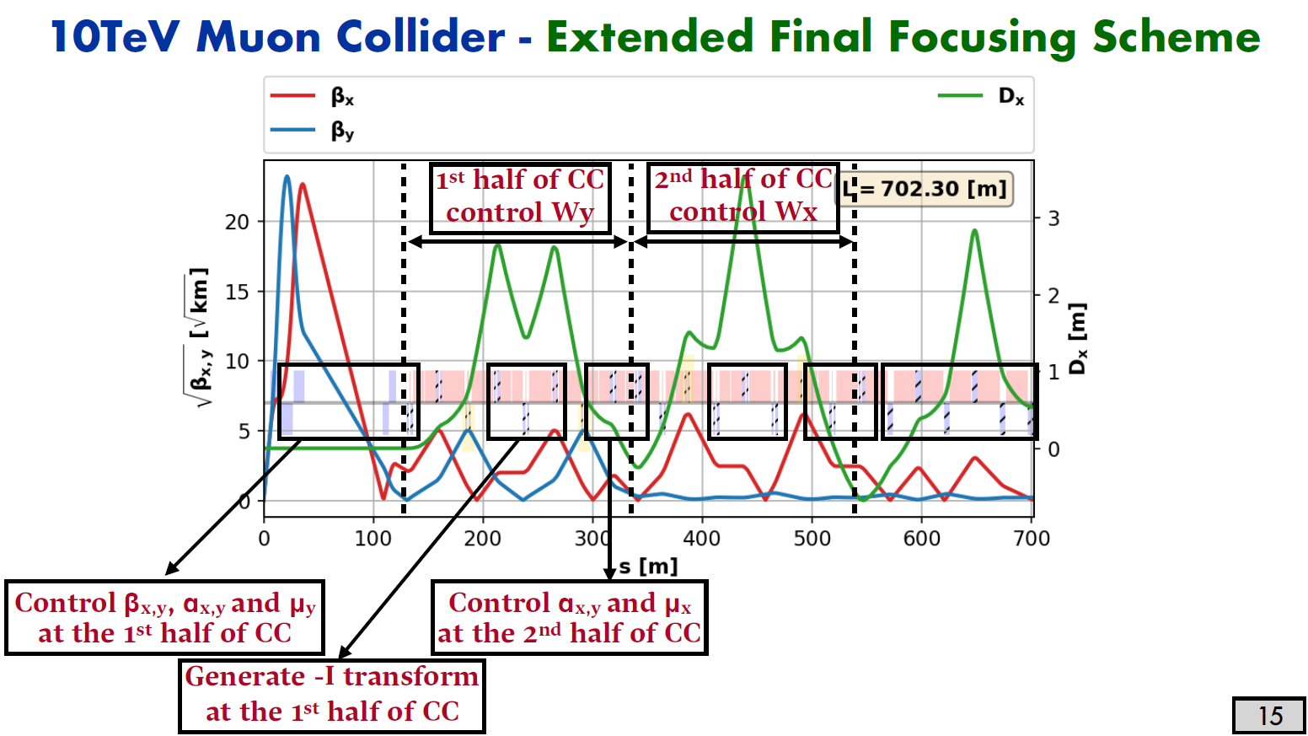
The interaction region A complex correction scheme
Courtesy: K. Skoufaris

Slide 41
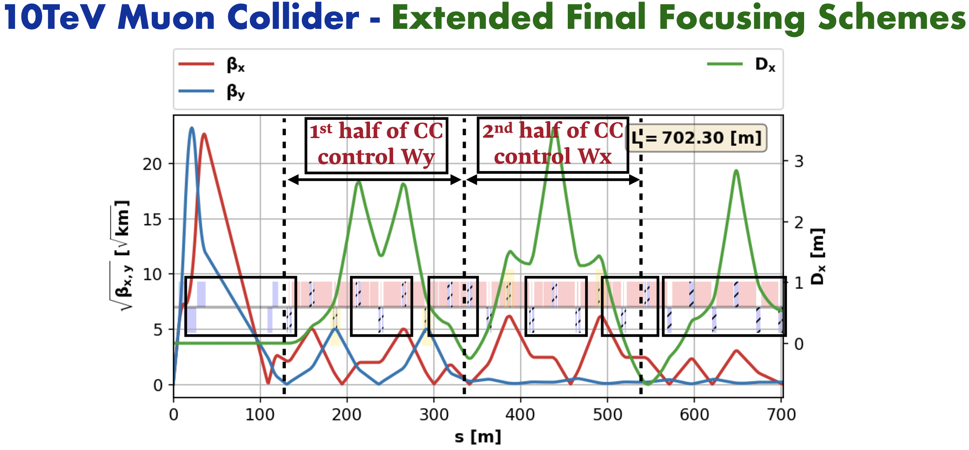
The interaction region A complex correction scheme
Courtesy: K. Skoufaris
Strong quadrupoles at locations with large Twiss betas and large momentum spread
Strong chromatic aberrations from IP to be corrected by local chromatic compensation (CC)
Sections with large beam sizes and, thus, apertures.

Slide 42
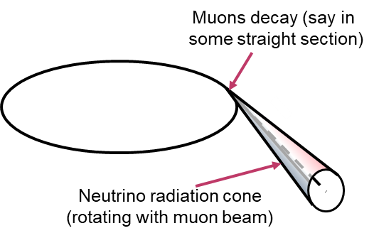
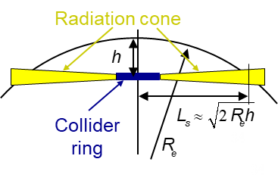
Neutrino Radiation Issue
Courtesy: C. Carli
Radiation due to neutrino beam reaching the earth surface
Narrow radiation “cone” for a short piece of the machine
Very small interaction cross sections
Earth does not act as shielding (very small cross sections)
Showers from neutrinos interacting close to earth surface generate dose seen at surface
Strong increase of maximum dose with muon energy
Cross sections about proportional to energy
Typical energy per interaction of neutrino with matter proportional to muon energy
Opening of radiation cone inversely proportional to muon energy

Slide 43
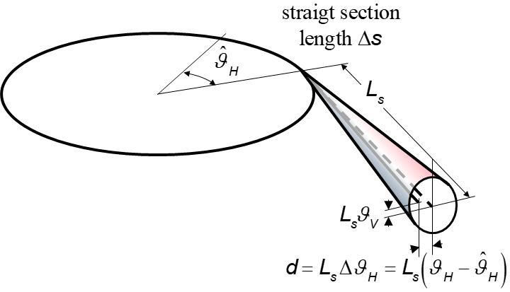
Neutrino Radiation Issue Source terms
Without mitigation measures gives
$σ_{θ_{H}}^{2}=\frac{1}{6γ^{2}}+ε_{ph}γ_{H}\left(s\right)+{\left(σ_{δ}^{2}∙D′(s)\right)}^{2}$
$σ_{θ_{V}}^{2}=\frac{1}{6γ^{2}}+ε_{ph}γ_{V}\left(s\right)$
with $γ_{H}$ and $γ_{V}$ the Twiss $γ$ function in the horizontal and vertical plane and $D′(s)$ the derivative of the dispersion
To minimize the radiation issue, we should:
Reduce as much as possible the straight sections
Have large divergence (small bettron function) and dispersion derivative.

Slide 44
Neutrino Radiation Issue Mitigation by “Wobbling”
Wobbling of machine in vertical direction – part of MAP proposal
High precision movement system for time-dependent mechanical deformation of ring around arc.
Vertical slope modulation within $±1 \text{mrad}$ reduce peak dose by factor ~100
For 10 TeV com collider with 10 km circumference and say 3.6 km arcs
Combination of pieces of parabola – two pieces with opposite curvature one period
Horizontal magnetic field (average) of ±0.11 T needed for vertical deflections

Slide 45
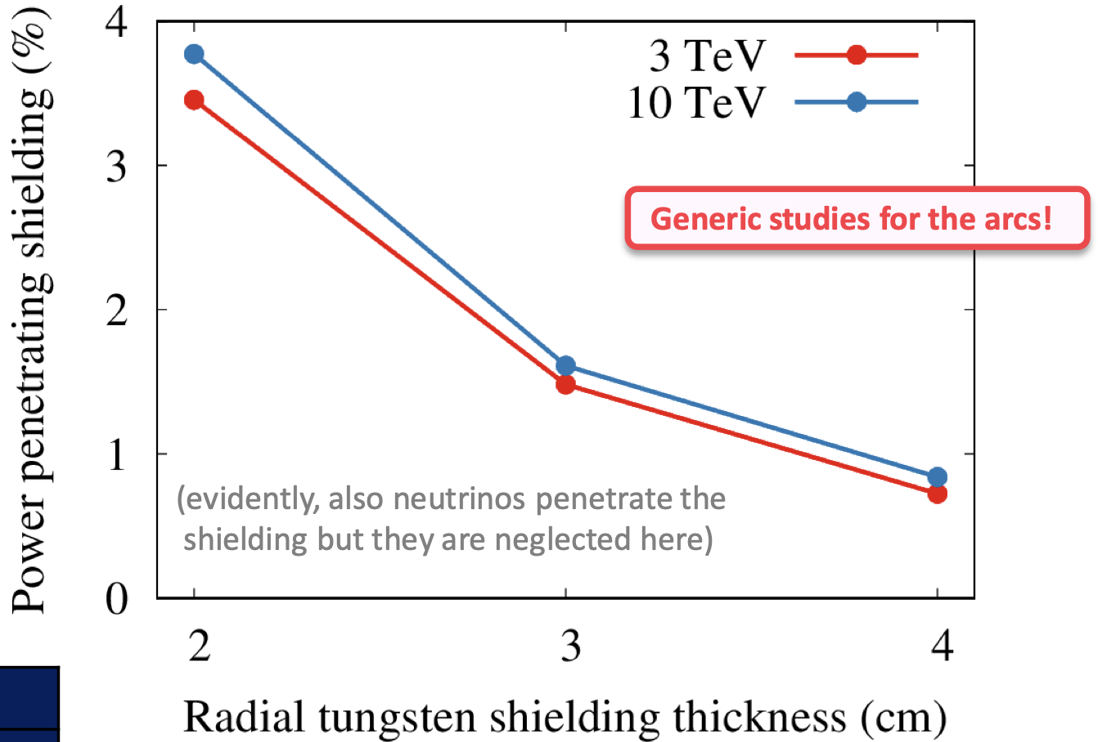
Muon Decay radiation and heat load
Almost all injected muons decay! (assuming no dumping of “residual intensity”)
Electrons and positron generate showers.
W absorber to intercept most of shower (~500 W/m with nominal C and average field)
Residual power ”leaking” into cold mass
Cryo load, radiation damage etc. “under control” with 30 mm to 40 mm
Current topic:Impact of muons lost on apertures?
May localized (at acceptance limitation) losses generate significant additional cryogenic load?
See G. Lerner presentation
Muon Collider technology challenges: beam losses & shielding

Slide 46
Collider Summary
Parameters driven by maximization of luminosity
Little (no?) margin to change without lumi reduction
Collider design challenging
Optics for small $β^{∗}$ with large beam rigidity and momentum spread
Energy deposition and radiation from muon decay products
Radiation due to neutrinos reaching Earth’s surface
Some of the impacts on hardware
High field, large aperture magnets, most of the them combined function (e.g., horizontal bending, quadrupolar component and small vertical bending for “wobbling”)
Showers from muon decay products mostly stopped by W absorber
“Wobbling” scheme – challenging mechanical system, impact optics design

Slide 47
Look for a good muon complex receipt
Neutrino radiation
Stability
Cost
RF cavities
Accelerator
physicist
Fast ramping magnets
Energy inefficiency
Optics
High-energy complex
Shielding
Thank you for your attention !

Slide 48
Any questions ?
Big thanks to F. Batsch, J. Scott Berg, F. Boattini, C. Carli, A. Lechner, G. Lerner, S. Machida, K. Skoufaris for the material

Slide 49
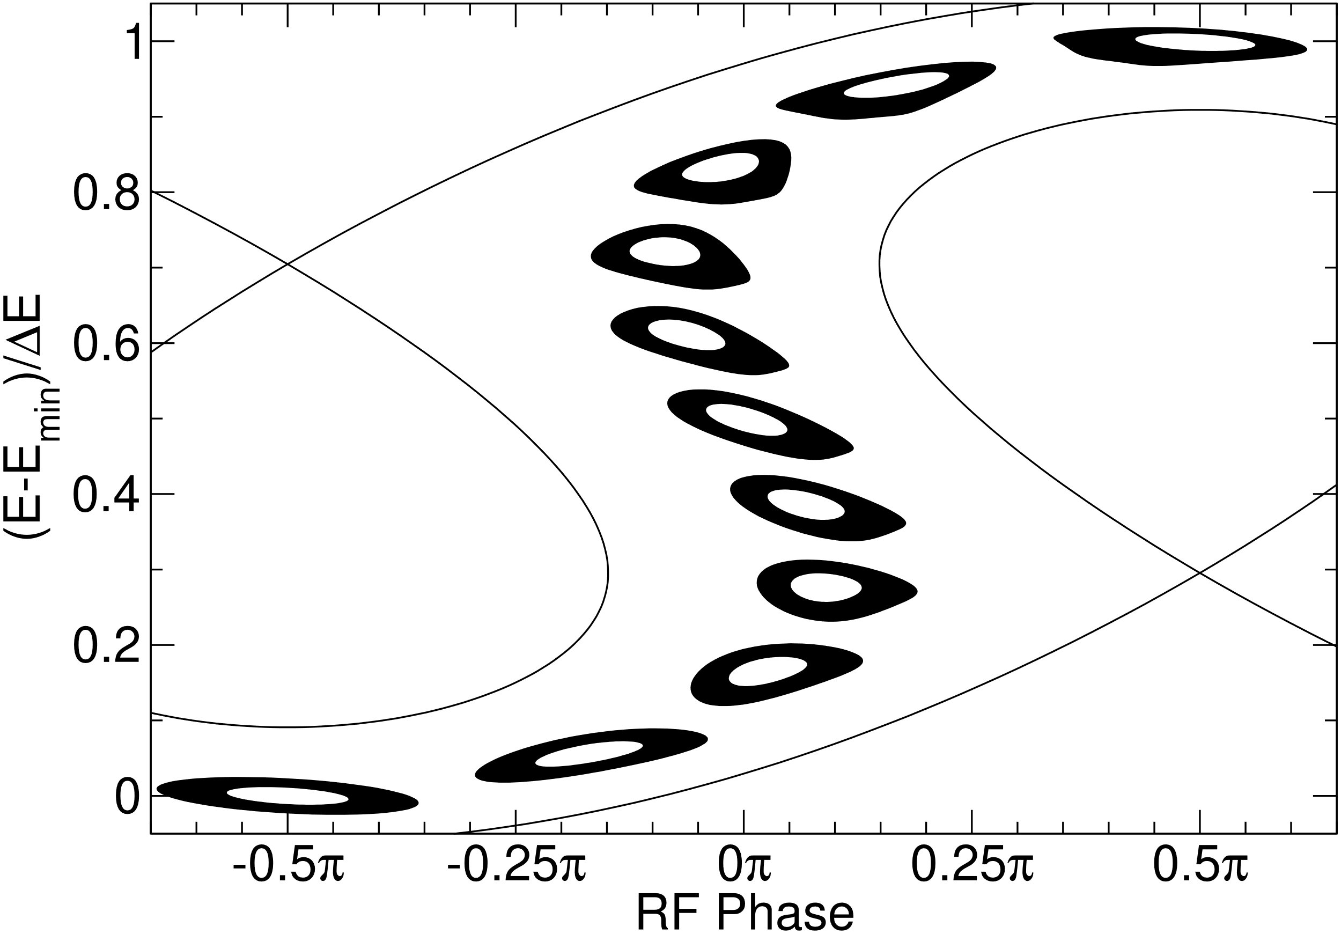
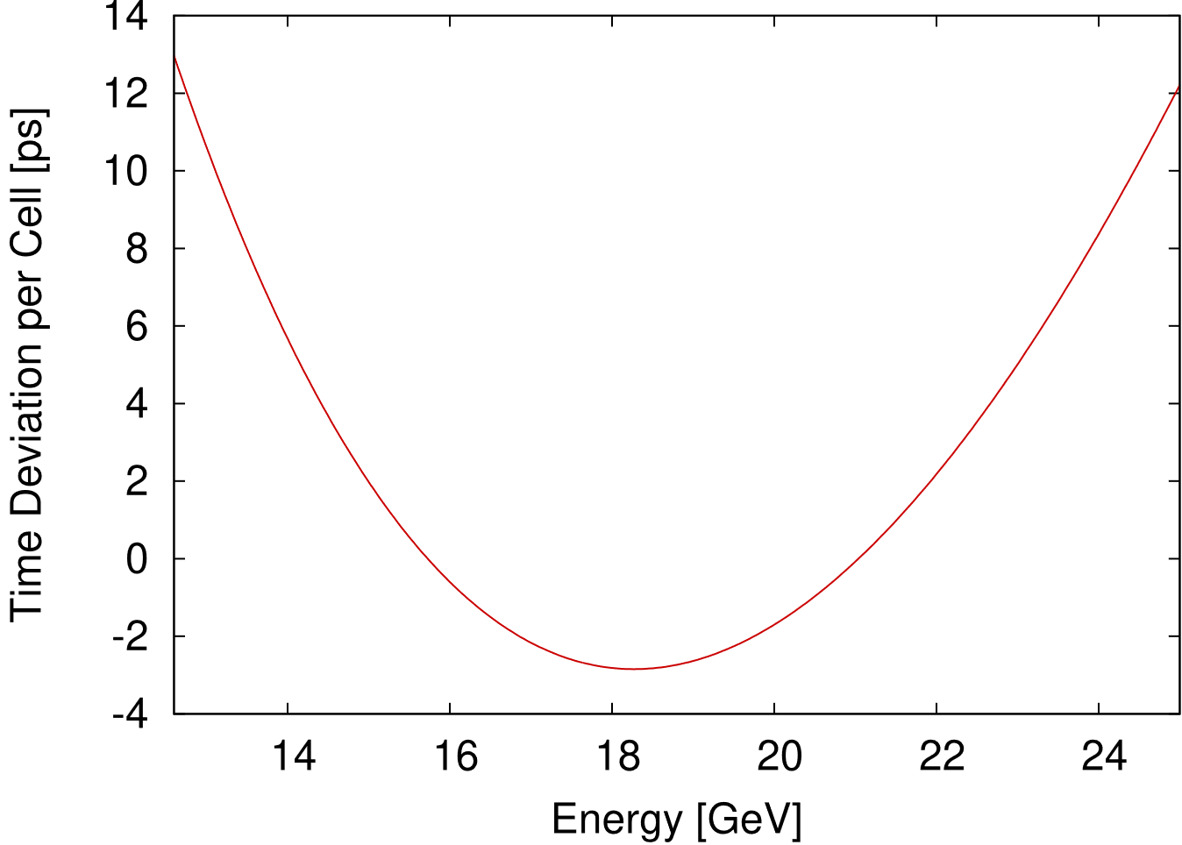
Acceleration in a horizontal FFA
Design is optimized for peak field
Need to consider longitudinal dynamics
One option is to shift RF phase
Without shifting phase, can do serpentine acceleration
Requires designing for a more symmetric time of flight vs. energy
Will lead to higher fields

Slide 50
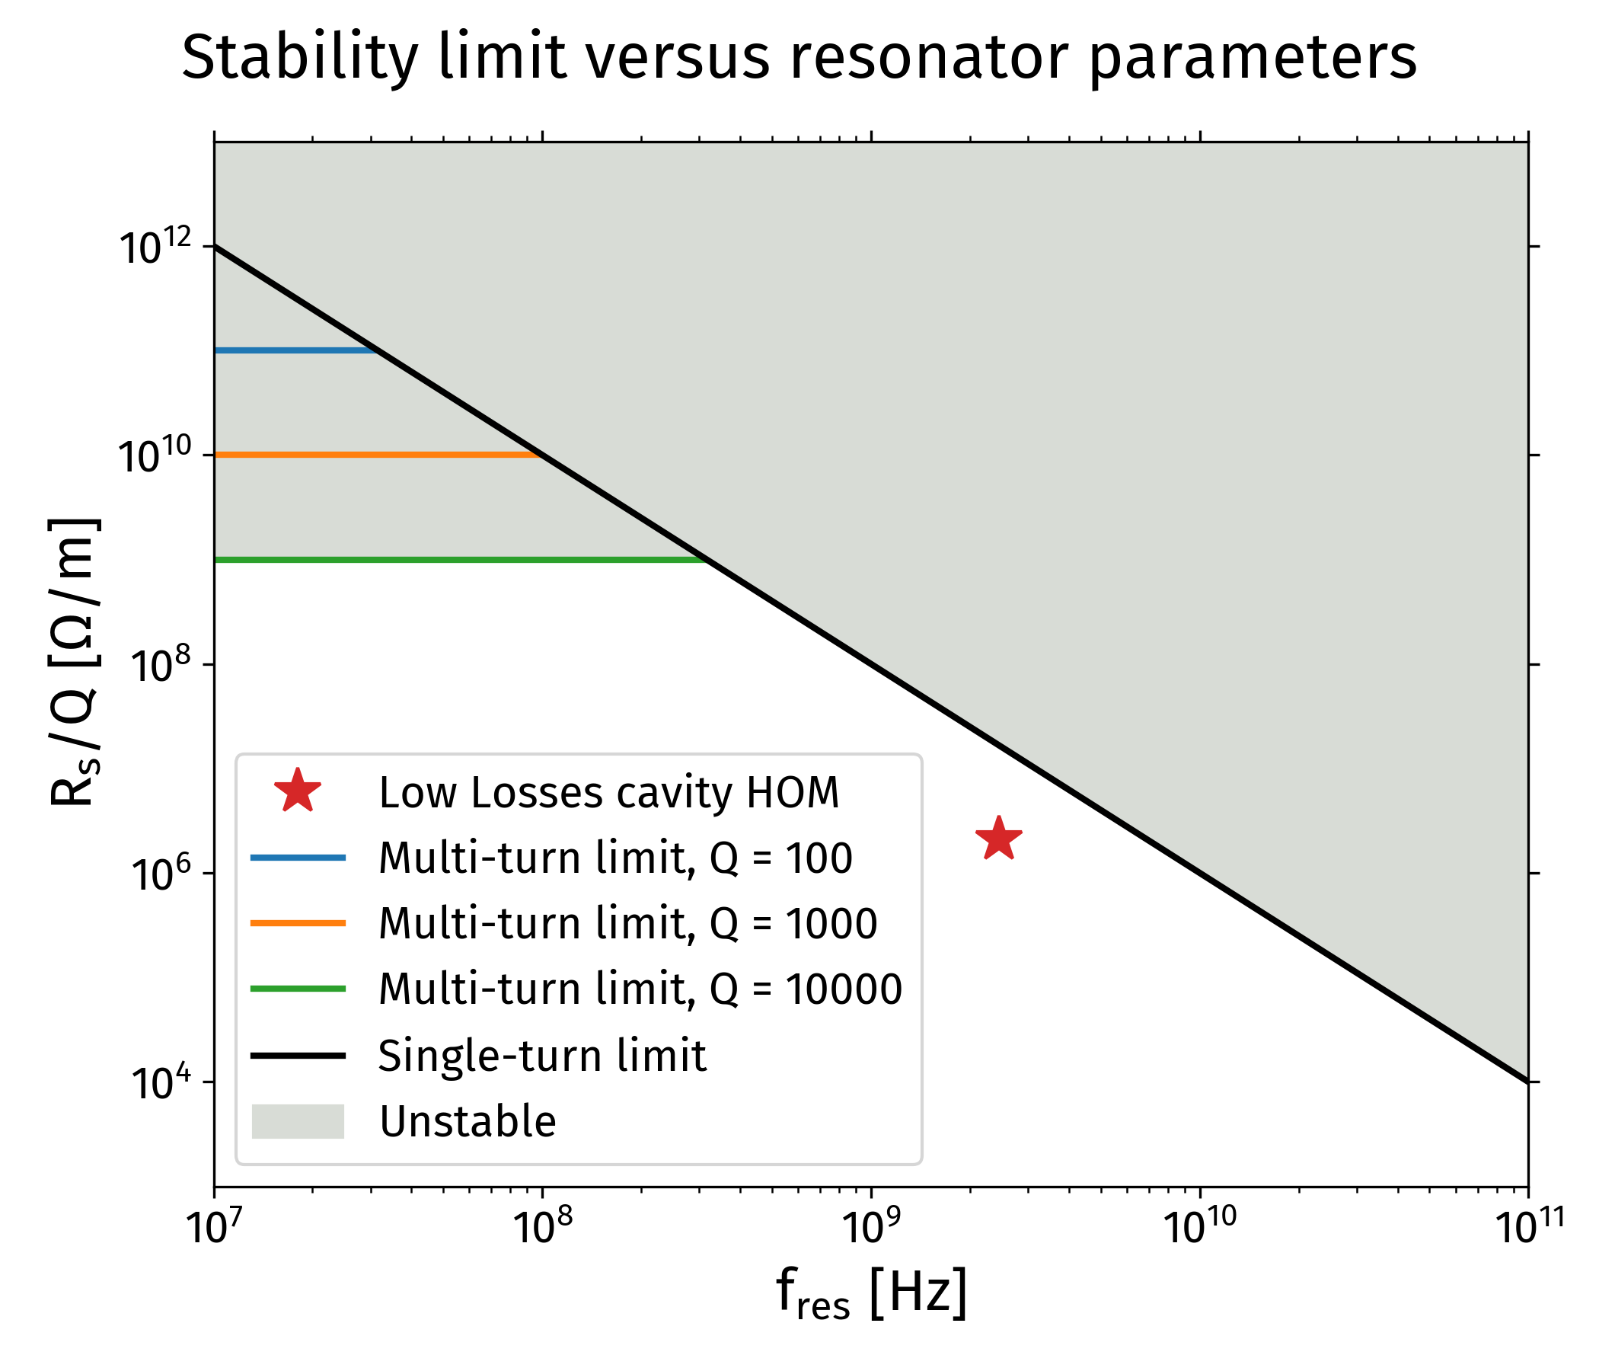
RCS 1: general stability criteria for RF cavity High Order Modes (HOMs)
Cavity HOMs will create resonant wakefields
Derived from simulations general stability criteria:
R_{s} < 100 [MΩ/m] * Q / f² [GHz²] (single turn)
R_{s} < 10¹³ Ω/m (multi-turn)
Example application for the most critical HOM of ILC-type cavity
[R_{s}/Q]_{threshold} = 100/2.45² = 16.7MΩ/m
[R_{s}/Q]_{total} = 2.1 MΩ/m
HOM below the predicted stability limit by factor 8
Courtesy: David Amorim

Slide 51
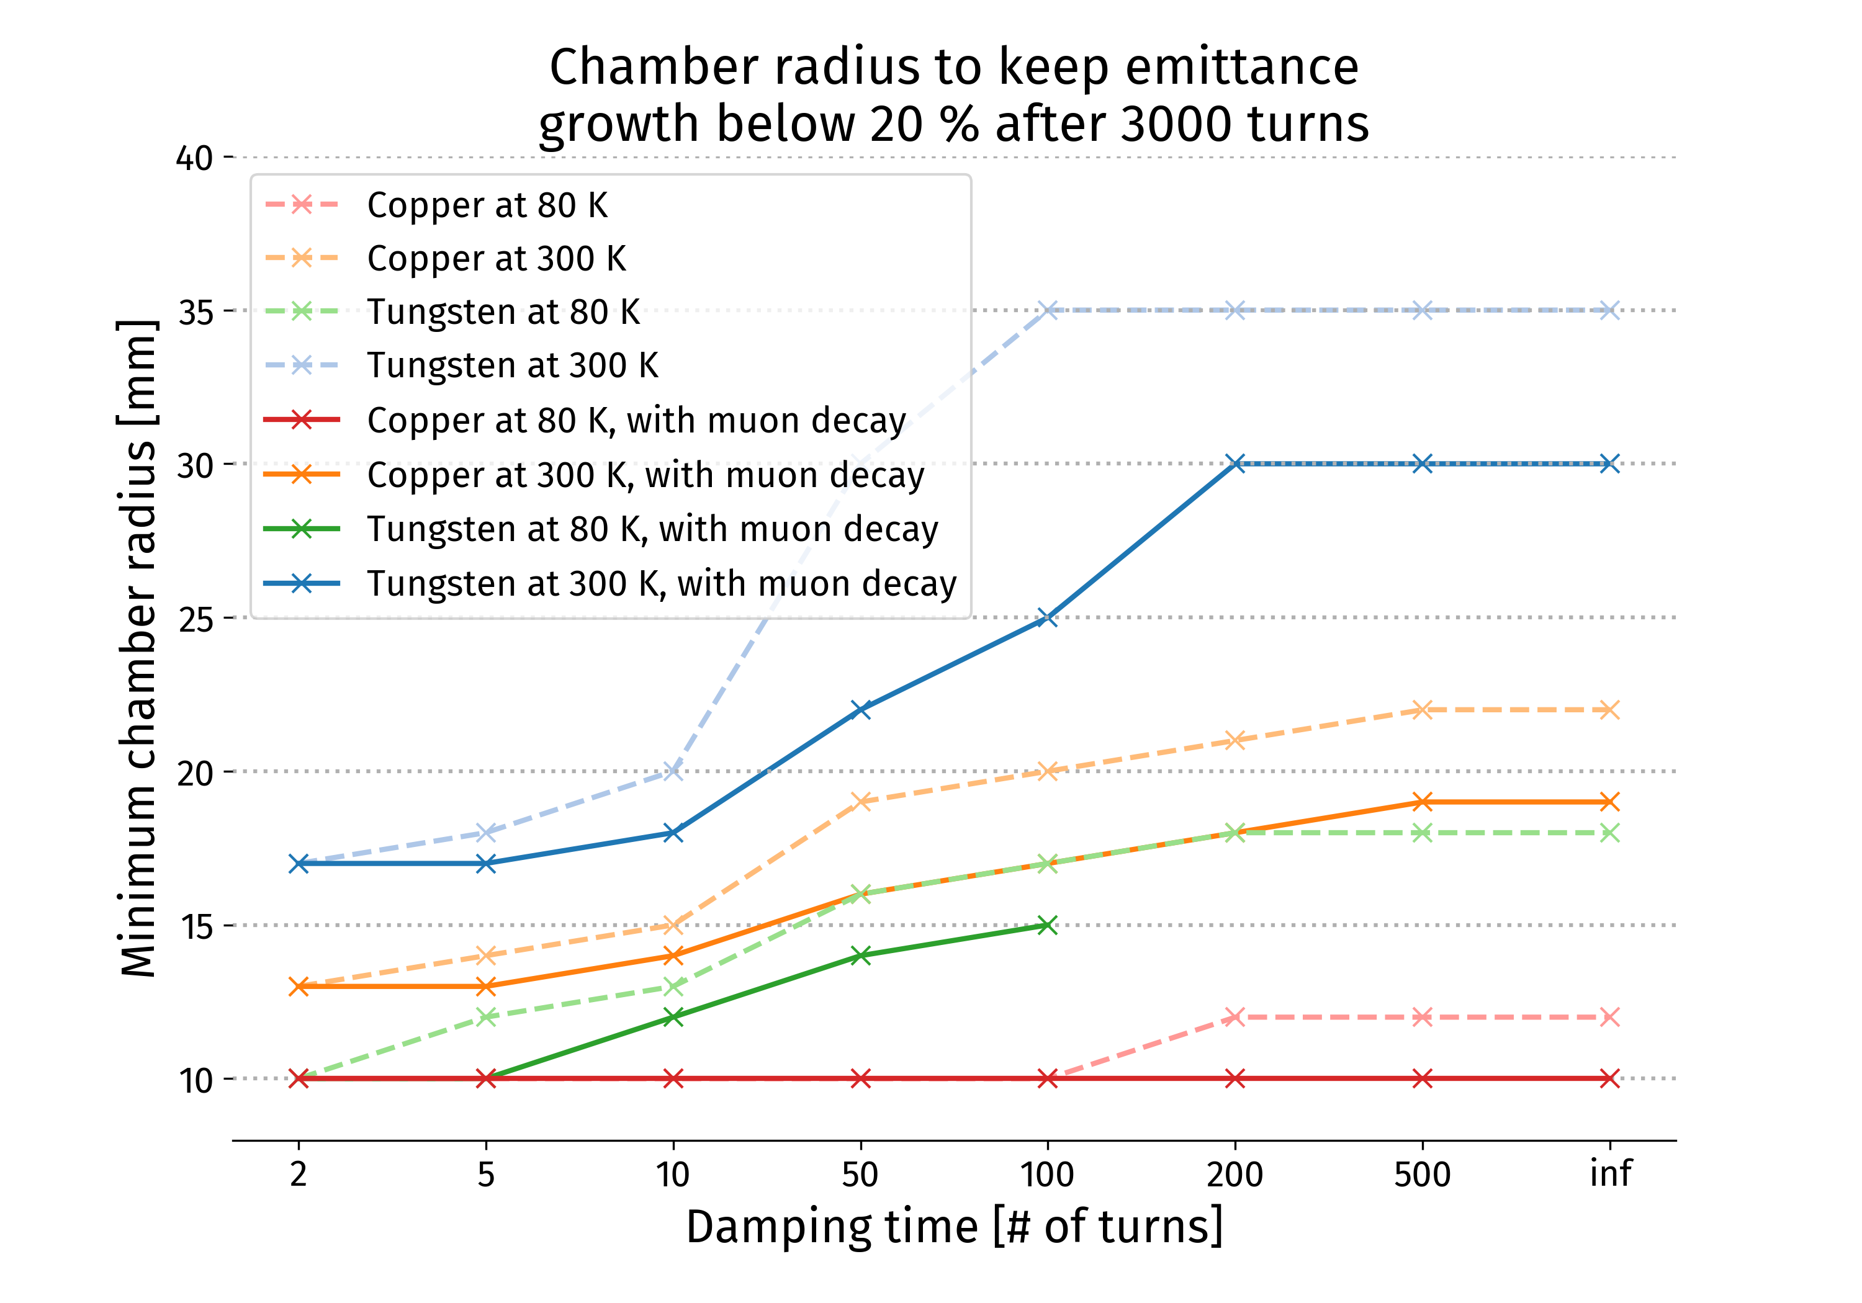
10 TeV collider: Minimum chamber radius achievable versus material
Investigate different materials for the vacuum chamber
Tungsten 300 K and 80 K, Copper 300 K and 80 K
Find the chamber radius such as the emittance growth stays below 20 % for different damper gains.
With 100-turn damper: 17 mm radius required with Copper at 300 K, versus 25 mm with Tungsten at 300 K
Courtesy: David Amorim

