Slide 1
Parameters for (future) light sources and free-electron lasers
Eduard Prat, Paul Scherrer Institut
International school on Novel acceleration schemes and enabling technologies
Erice, 29 July 2023

Slide 2
Contents
Introduction
From synchrotron radiation to FELs
Electron beam requirements
Typical layout, electron beam dynamics, facilities
Future trends
Conclusion

Slide 3
I. Introduction

Slide 4
Overview
Initial clarification: Light sources = synchrotron facilities
Light sources and X-ray free-electron laser (FELs) facilities are unique tools providing extremely brilliant X-rays that allow the study of matter with atomic spatial resolution.
Synchrotron light sources consist of electron circular accelerators and produce synchrotron radiation in bending magnets and undulators.
X-ray FEL facilities are based on electron linear accelerators and generate more intense and shorter pulses suitable for time-resolved experiments.
In this lecture we will review the following:
  Basics of synchrotron, undulator, and FEL generation
  For both types of facilities: electron beam requirements, typical layout, basics of electron beam dynamics, current and future facilities, and future trends

Slide 5
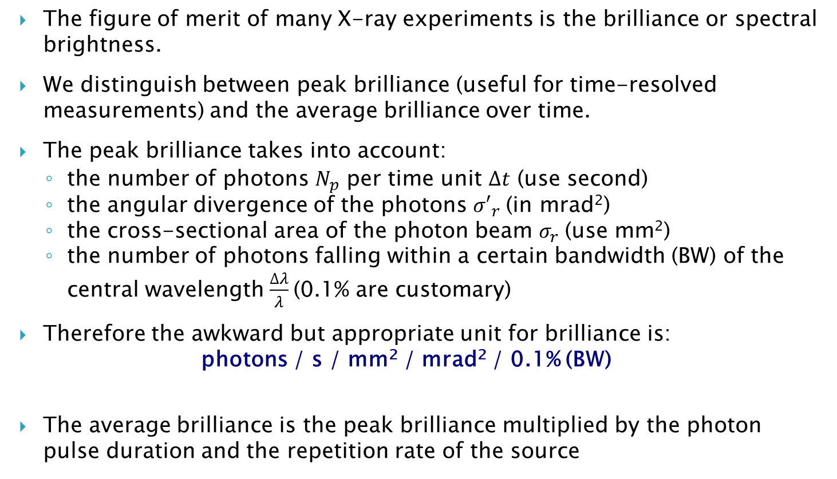
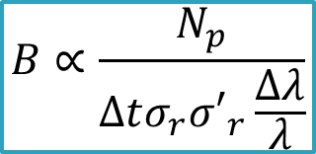
Brilliance (photon beam)
The figure of merit of many X-ray experiments is the brilliance or spectral brightness.
We distinguish between peak brilliance (useful for time-resolved measurements) and the average brilliance over time.
The peak brilliance takes into account:
  the number of photons $N_{p}$ per time unit $∆t$ (use second)
  the angular divergence of the photons ${σ′}_{r}$(in mrad²)
  the cross-sectional area of the photon beam $σ_{r}$(use mm²)
  the number of photons falling within a certain bandwidth (BW) of the central wavelength $\frac{∆λ}{λ}$(0.1% are customary)
Therefore the awkward but appropriate unit for brilliance is:
photons / s / mm² / mrad² / 0.1% (BW)
The average brilliance is the peak brilliance multiplied by the photon pulse duration and the repetition rate of the source
$$B∝\frac{N_{p}}{∆tσ_{r}{σ′}_{r}\frac{∆λ}{λ}}$$
Notes:
On Earth the Sun has a brilliance of 10¹⁰ photons/s/mm²/mrad²/0.1% (BW)
Some other terms are used in the literature
brightness (should be reserved for the phase-space density of particle beams)
intensity (should only be used for power per unit area!)
photon flux (is the number of photons per time and area, it misses divergence and bandwidth)

Slide 6
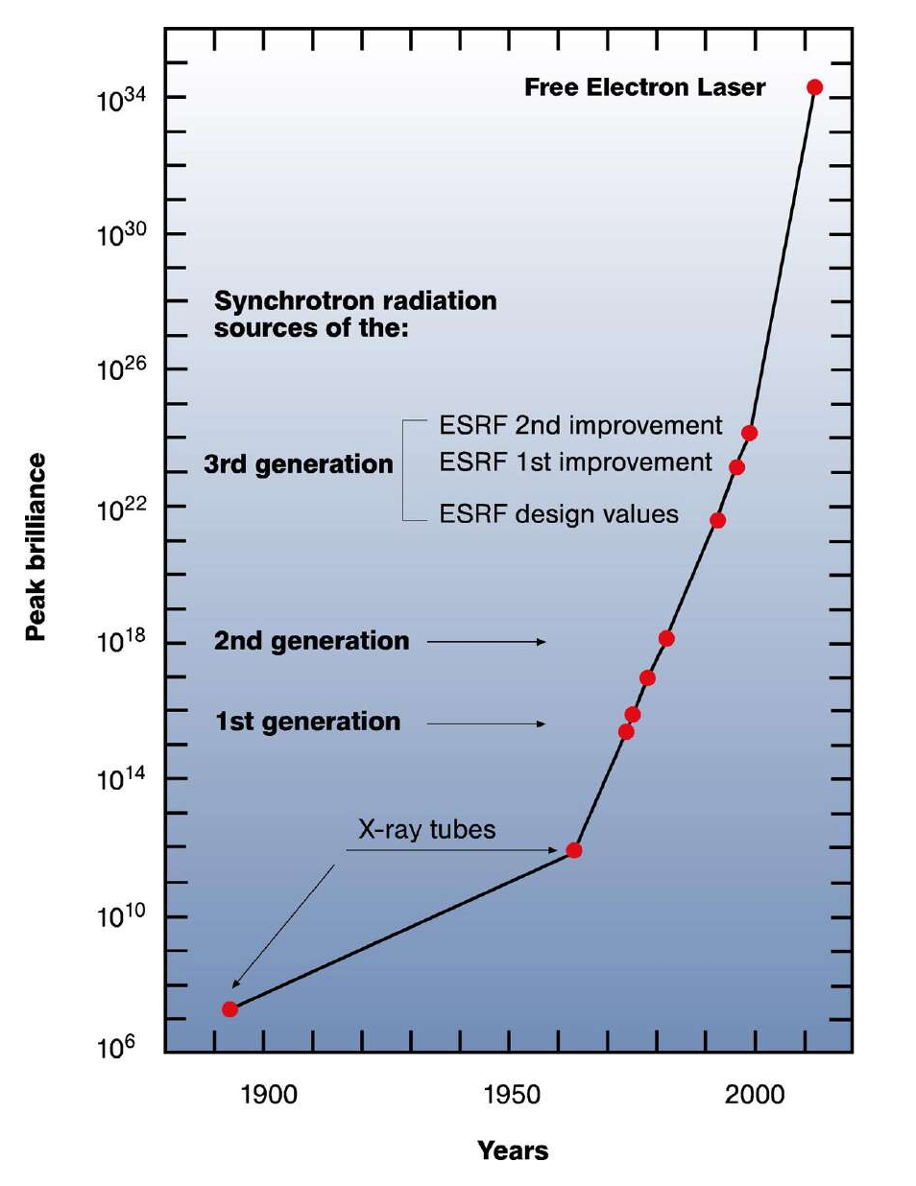
Historical evolution of peak brilliance
Synchrotron radiation machines of different generations are based on circular accelerators and can provide a peak brilliance up to 10²⁵.
X-ray FEL facilities are based on linacs. Thanks to the increased pulse energies, shorter pulses, and lower bandwidths, FELs provide peak brilliances much higher than synchrotron facilities (up to 10³⁵)
Synchrotrons have higher repetition rates and longer pulses → difference in average brightness is reduced to 10-100.
The values of the figure consider standard SASE-FELs. Seeded-FELs have demonstrated the possibility to reduce the bandwidth and therefore to increase the brilliance by 10-100.
Notes:
Only linacs can provide the required electron beam to drive the FEL process
about 10 orders of magnitude higher than third-generation synchrotrons).

Slide 7
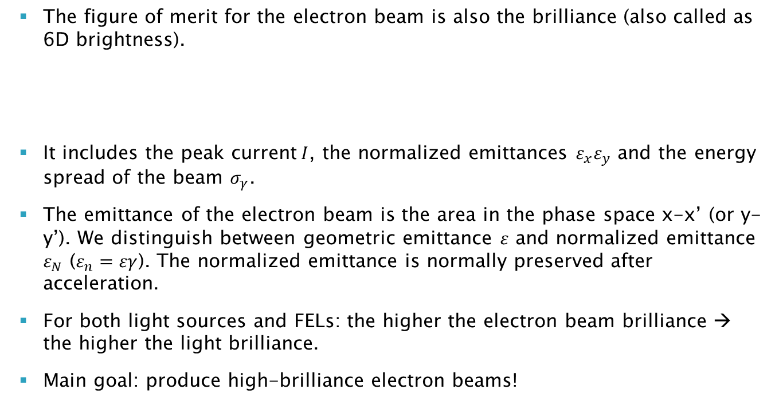

Brilliance (electron beam)
The figure of merit for the electron beam is also the brilliance (also called as 6D brightness).
It includes the peak current$I$, the normalized emittances $ε_{x}ε_{y}$ and the energy spread of the beam $σ_{γ}$.
The emittance of the electron beam is the area in the phase space x-x’ (or y-y’). We distinguish between geometric emittance $ε$ and normalized emittance $ε_{N}$ ($ε_{n}=εγ$). The normalized emittance is normally preserved after acceleration.
For both light sources and FELs: the higher the electron beam brilliance → the higher the light brilliance.
Main goal: produce high-brilliance electron beams!
$$B_{6D}=\frac{2I}{ε_{x}ε_{y}σ_{γ}}$$

Slide 8
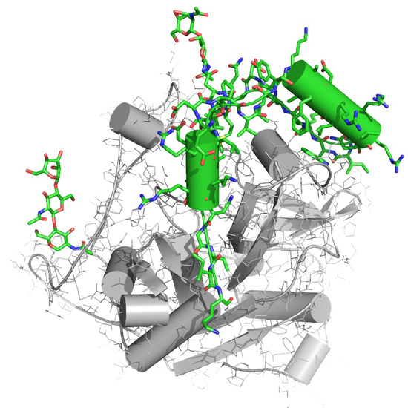

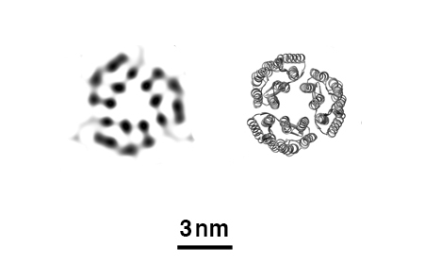
Science with light sources
Synchrotron machines and FELs are unique light sources to probe any kind of matter at atomic scales
They can address fundamental research questions across the disciplines of physics, chemistry, materials and life sciences.
Examples:
  Crystallography to determine structure of biomolecules → discovery of new drugs for challenging diseases
  Follow the steps of photosynthesis in plants → new energy solutions
reconstruction
known
Ref. PNNL, FELs of Europe, European XFEL

Slide 9
II. From synchrotron radiation to FELs.

Slide 10
Synchrotron and undulator radiation

Slide 11
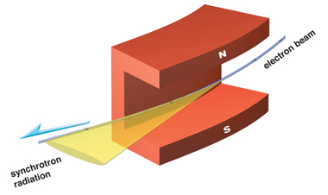
Synchrotron radiation
Accelerated charged particles emit electromagnetic radiation following Maxwell equations
In the case of radially accelerated charges, the associated radiation is called synchrotron radiation.
This phenomenon occurs in bending magnets and was first observed in synchrotron facilities, where the beam energy and magnet dipole strengths are ramped up synchronously → hence the name “synchrotron radiation”
The radiated power is proportional to m^{–4} (m: charged particle mass)
→ in practice only relevant for electron machines!
For electron machines, synchrotron radiation is boon and bane:
  SR is the main obstacle for circular machines to reach higher energies
  But SR (today) is also the main application of circular electron machines and thus the primary motivation to build them!
  → most of recent design work has gone into optimizing SR for experimental and industrial use
    → also the reason why many particle physics laboratories have become photon science laboratories (SLAC, DESY, PSI, Cornell...)

Slide 12
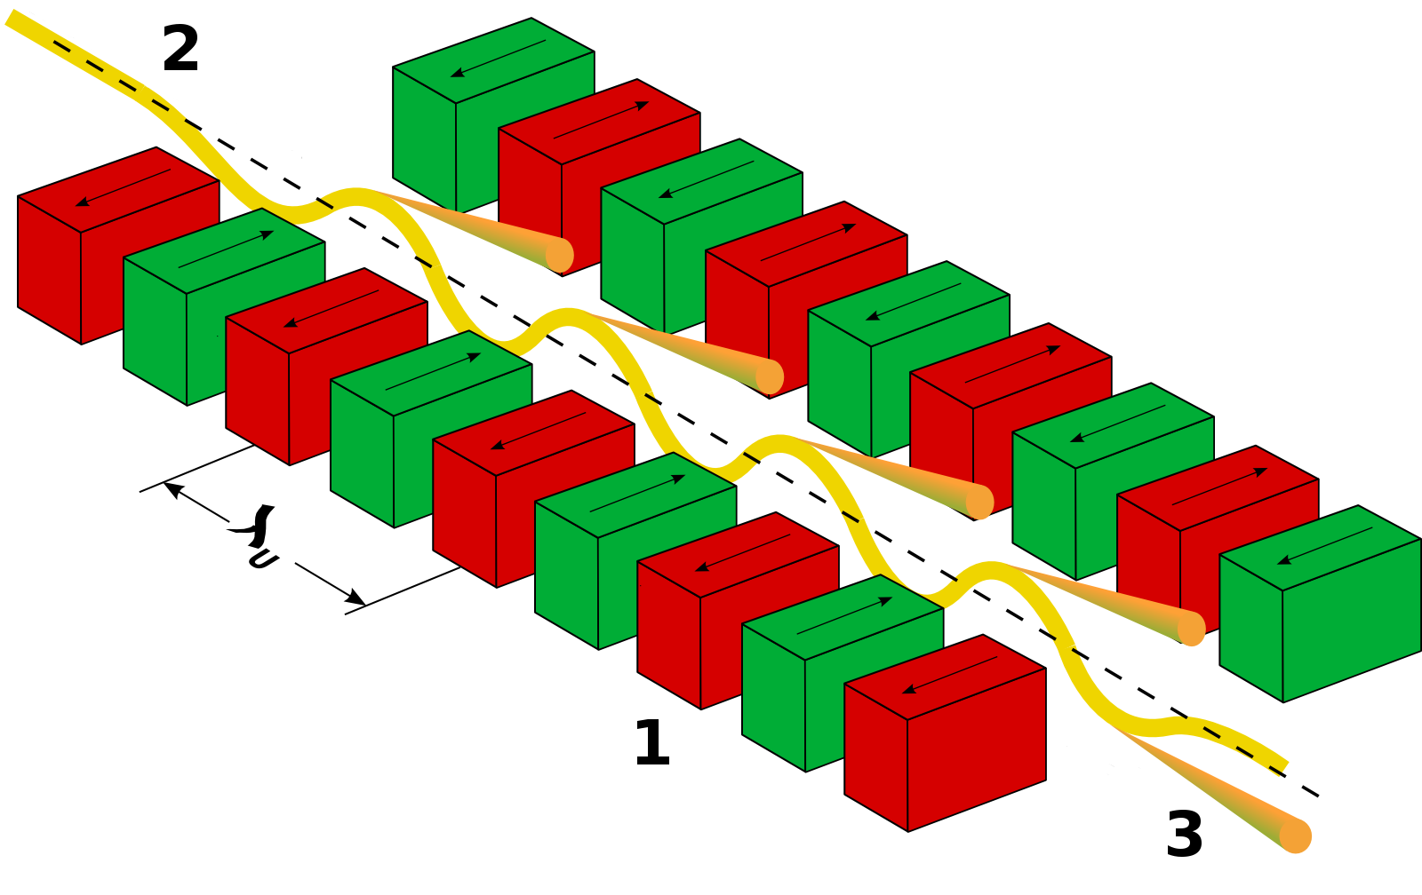
Undulator radiation
Undulators are periodic structures of dipole magnets with alternating polarity. An undulator is defined by the number of bending magnets N and the period λ_{u} (with typical values of few cms).
The radiation emitted in undulators has higher power and better quality than the radiation emitted in an individual bending magnet.
A main advantage: the deflection alternates so that the global electron trajectory is straight (in contrast to the curved trajectory in bending magnets) → increase of the radiation flux at the experimental station

Slide 13

Undulator Field
Transverse magnetic field which switch polarity multiple times, defining the undulator period λ_{u}
On-axis field:
Planar Undulator
Helical Undulator
$$k_{u}=\frac{2π}{λ_{u}}$$
  Here we limit ourselves to planar undulators
The field is normally described
by the undulator parameter
K is typically of the order of 1
Notes:
Two types of undulators:
Planar: magnetic field components in one transverse direction → electron trajectories also in one plane
Helical: field in two directions → helical trajectory of the electrons.

Slide 14
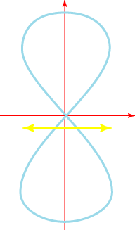
Motion in the undulator
Transverse
Longitudinal wiggle has twice the period.
Causes a figure “8” motion in the co-moving frame.
x
Longitudinal
z
Average over one period

Slide 15
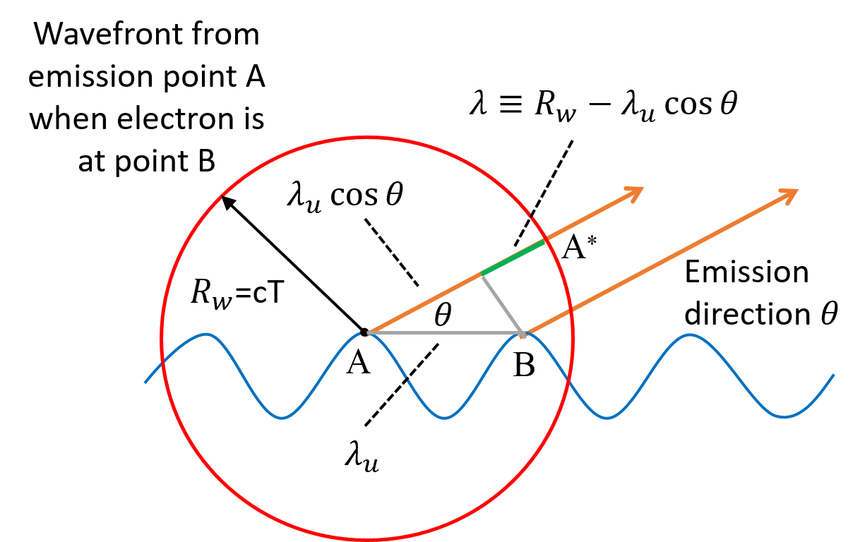
Resonance Condition (I)
The electron must slip back by exactly one radiation wavelength (or a multiple n) over one undulator period
Condition to have a constructive interference between the radiation emitted by the same electron at different undulator positions

Slide 16
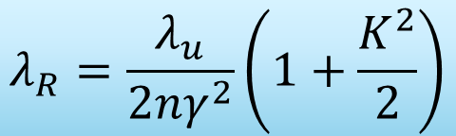
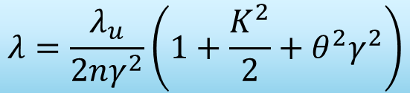

Resonance Condition (II)
$$nλ=R_{w}−λ_{u}\cos{θ}$$
w
For small angles
$$λ=\frac{λ_{u}}{2nγ^{2}}\left(1+\frac{K^{2}}{2}+θ^{2}γ^{2}\right)$$
Wavelength increases with emission direction θ
In the forward direction (θ=0) we obtain the so-called resonance condition
$$λ_{R}=\frac{λ_{u}}{2nγ^{2}}\left(1+\frac{K^{2}}{2}\right)$$
Notes:
ADD HARMONICS!

Slide 17
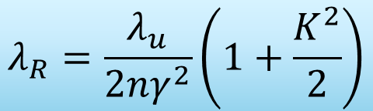
The Resonant Wavelength
The radiation wavelength is much shorter than undulator wavelength (γ² factor)
The wavelength can be controlled by
  Changing the electron beam energy,
  Varying the magnetic field (requires K significantly larger than 1)
Example (SwissFEL): an undulator period of 15 mm, a K-value of 1.2 and an energy of 5.8 GeV (γ=11000) would give 1 Å radiation
$$λ_{R}=\frac{λ_{u}}{2nγ^{2}}\left(1+\frac{K^{2}}{2}\right)$$

Slide 18
Free-electron lasers

Slide 19
Introduction
In an FEL, there is not only a coherent contribution of the radiation produced in each undulator period, but also a coherent addition of the radiation produced by each electron.
In this case, the coherence is related to the formation of particle distributions with dimensions smaller than the resonant wavelength (called microbunching).
Because of this, the radiation power is proportional to the square number of electrons within the cooperation length of the FEL process.
This implies that FEL radiation power is orders of magnitude higher than the power of standard undulator radiation.

Slide 20
Overview
The FEL process starts with an initial radiation field (in the standard FEL configuration is associated to the spontaneous undulator radiation produced by the electron beam).
This field induces an energy modulation to the electron beam with a period equal to the radiation wavelength λ
The energy modulation is then converted to density modulation (or microbunching), also with a period equal to λ
This microbunching results into an increase of the emitted radiation, which contributes to enhance the energy modulation, and so on
Induced energy modulation
Increasing density modulation
FEL: Run-away process
(collective instability)
Enhanced emission
Notes:
The FEL is a circular runaway process consisting in a simultaneous growth of the radiation field, the electron beam energy modulation, and the electron beam density modulation (microbunching).

Slide 21
Coupling between electrons and photons
The transverse oscillation of the electrons allows the coupling between the electrons and the photons
The energy transfer is proportional to
The electron moves either with or against the field line, losing or gaining energy depending on the sign of
In the resonance condition, the direction of energy transfer remains constant over many periods. For instance, after half undulator period the radiation field has slipped half wavelength, both velocity and field have changed sign and the direction of energy transfer stays the same.
Notes:
The energy transfer between an electron and the photon is proportional to ~v?~E , where ~v? is the transverse velocity of the electron and ~E is the radiation field.

Slide 22
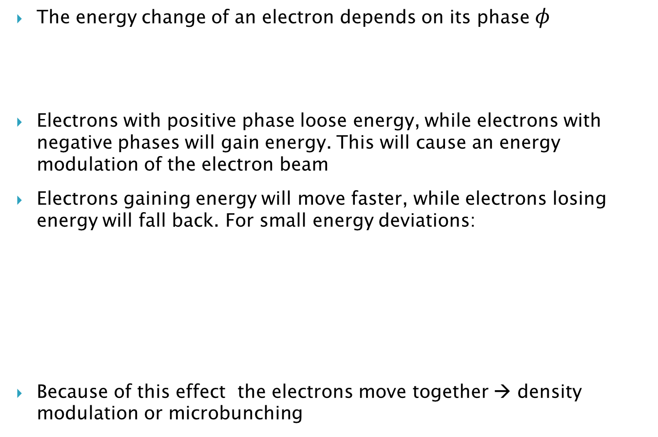

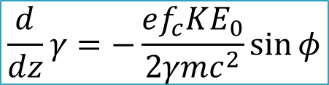
Energy modulation & microbunching
The energy change of an electron depends on its phase $φ$
Electrons with positive phase loose energy, while electrons with negative phases will gain energy. This will cause an energy modulation of the electron beam
Electrons gaining energy will move faster, while electrons losing energy will fall back. For small energy deviations:
Because of this effect the electrons move together → density modulation or microbunching
$$\frac{d}{dz}γ=−\frac{ef_{c}KE_{0}}{2γmc^{2}}\sin{φ}$$
f_{c}: coupling factor (<1)
Δγ = 0
Δγ > 0
$$\frac{d}{dz}φ=2k_{u}\frac{Δγ}{γ}$$
z
Δγ < 0

Slide 23
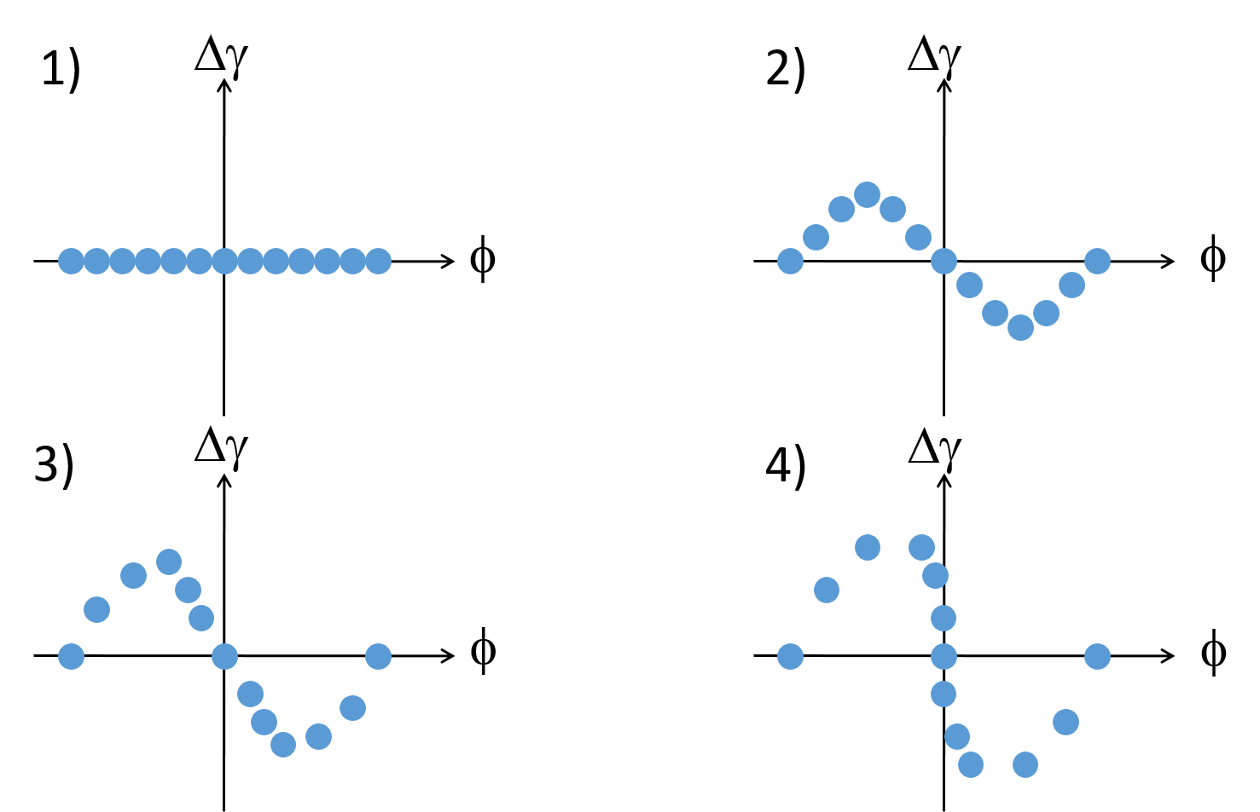
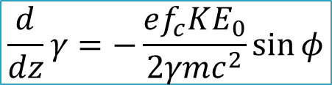
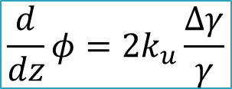
Motion in Phasespace
$$\frac{d}{dz}γ=−\frac{ef_{c}KE_{0}}{2γmc^{2}}\sin{φ}$$
Wavelength typically much smaller than bunch length.
Electrons are randomly spread out initially over all phases.
$$\frac{d}{dz}φ=2k_{u}\frac{Δγ}{γ}$$
Microbunching has periodicity of FEL wavelength. All electrons emit coherently.

Slide 24
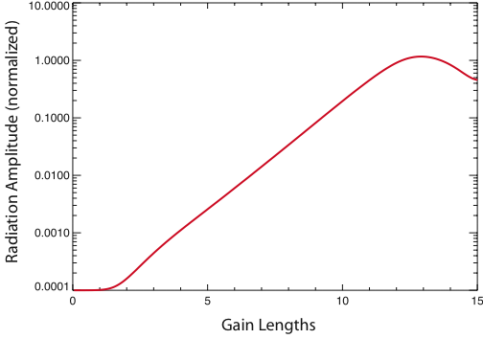
The Generic Amplification Process
Beyond saturation there is a continuous exchange of energy between electron beam and radiation beam.
Saturation (max. bunching)
Exponential Amplification
FEL Gain
Start-up Lethargy
Lethargy at start-up is the response time till some bunching has formed.
Gain length (L_{g}): distance so that the power gets multiplied by a factor of e (in exponential regime)

Slide 25
FEL Modes
SASE FEL (Self-Amplified Spontaneous Emission)
FEL Amplifier (starts with an input signal)
Output
Electrons
Undulators
Spontaneous emission (shot noise)
is a broadband seed of “white noise”
Seed
Output
Electrons
Undulators
Seed must be above shot noise power (~kW for X-rays). Output resembles the characteristics of the seed
Most FEL facilities are based on the SASE process due to its simplicity

Slide 26
SASE FELs
FEL starts with the broadband signal of spontaneous radiation (almost a white noise signal)
SASE-FEL radiation is coherent in the transverse direction but not in the longitudinal one → spikes in spectrum and time profile.
The FEL bandwidth is of the order of the FEL parameter (see later)
t_{c}
1/t_{b}
SwissFEL simulation for 0.1 nm radiation
t_{b}
1/t_{c}
Spike width in time corresponds to full spectral width
Full pulse duration corresponds to spike width in spectrum

Slide 27
Seeded FELs
The output radiation resemble the characteristics of the seed. For example, if the seed has a single mode in spectrum and time, the output radiation will also consist of a single mode.
Seeding is used to improve the longitudinal coherence or to reduce the bandwidth of SASE-FELs. Fully coherent pulses can be obtained with the seeded-FEL process.
There are various seeding methods: self-seeding and external seeding
SwissFEL simulation for 0.1 nm radiation
Seeded case: one spike, bandwidth highly reduced

Slide 28
The Pierce Parameter ρ
FEL parameter ρ. Typical values for X-rays= 10⁻⁴ – 10⁻³
Scaling of 1D theory
f_{c}: coupling factor (~0.9 for planar undulator)
I: electron peak current
σ_{x}: transverse beam size
I_{A}: Alfven current (~17 kA)
Gain length
Efficiency
SASE Spike Length
Bandwidth

Slide 29
III. Electron beam requirements

Slide 30
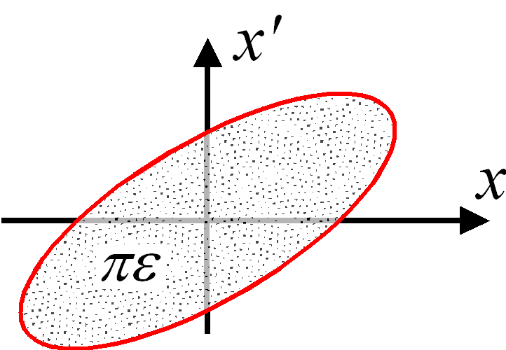
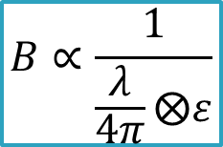
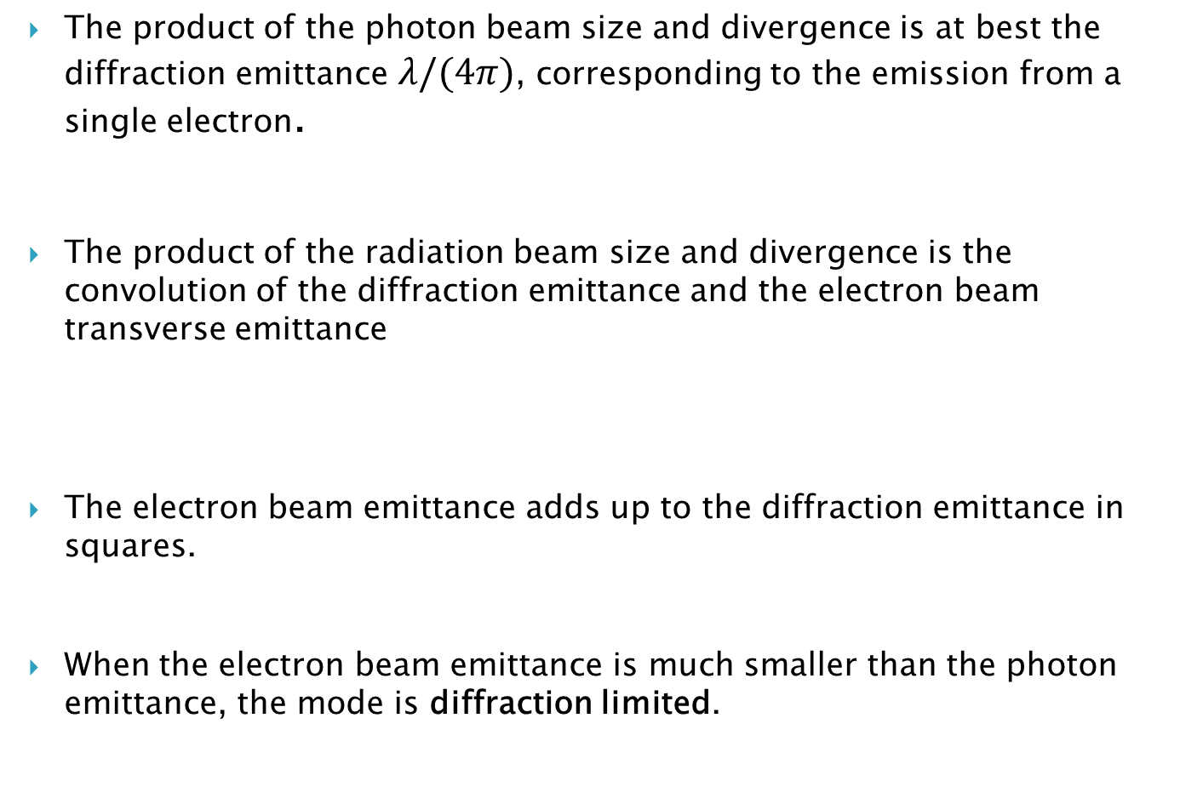


Importance of the emittance
The product of the photon beam size and divergence is at best the diffraction emittance $λ/(4π)$, corresponding to the emission from a single electron.
The product of the radiation beam size and divergence is the convolution of the diffraction emittance and the electron beam transverse emittance
The electron beam emittance adds up to the diffraction emittance in squares.
When the electron beam emittance is much smaller than the photon emittance, the mode is diffraction limited.
$$B∝\frac{1}{σ_{r}{σ^{′}}_{r}}$$
$$σ_{r}{σ^{′}}_{r}≥\frac{λ}{4π}$$
$$B∝\frac{1}{\frac{λ}{4π}⨂ε}$$
Smaller emittance → higher brilliance
Notes:
Therefore, the electron beam transverse emittance is a fundamental parameter significantly contributing to the brilliance via the actual photon beam size and divergence.

Slide 31
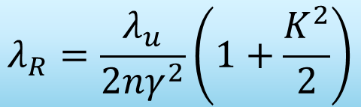
Requirements for light sources (X-rays)
$$λ_{R}=\frac{λ_{u}}{2nγ^{2}}\left(1+\frac{K^{2}}{2}\right)$$
The energy of the electrons in the storage ring is of several GeV for X-rays. Higher electron beam energies allow higher photon energies and higher radiation fluxes but also require higher magnetic strengths (or larger circumference) and higher power consumption of the RF system to replenish the loss of energy.
Emittance: the lower the emittance → the higher the brilliance
Electron beam properties are the result of an equilibrium in the storage ring (see later)… but electron beam in the injector needs certain beam quality:
  Geometric emittance < 100 nm
  Pulse duration < 100 ps
  Energy spread < 1%

Slide 32
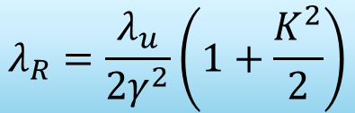
Requirements for FELs (X-rays)
$$λ_{R}=\frac{λ_{u}}{2γ^{2}}\left(1+\frac{K^{2}}{2}\right)$$
The electron beam energy needs to be at the GeV level for X-rays
A better FEL performance, i.e. higher powers and shorter gain lengths, are obtained for larger ρ parameters. We want:
  large peak currents (at the kA level or 10s of fs electron pulse durations)
  small transverse beam sizes (10s of μm)
  larger undulator fields K (but require higher electron beam energies for the same wavelength)
Additionally:
  Lower energy spreads (10⁻³ – 10⁻⁴, see next slides)
  Low emittances (< 1 μm, see next slides)
  Transverse overlap between electrons and photons → orbit alignment at the μm level

Slide 33
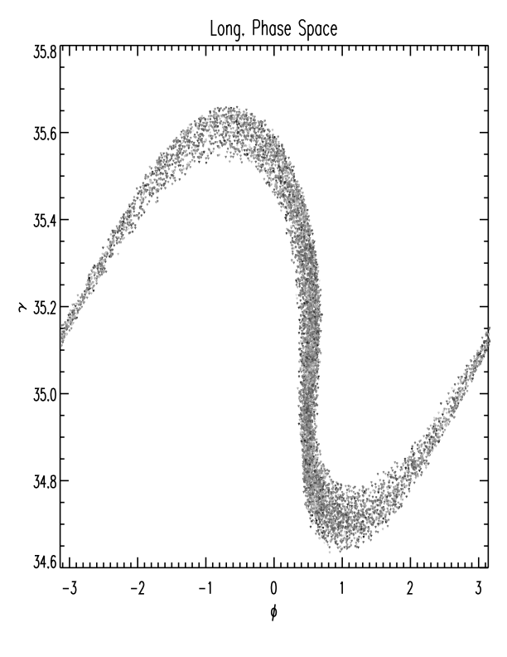
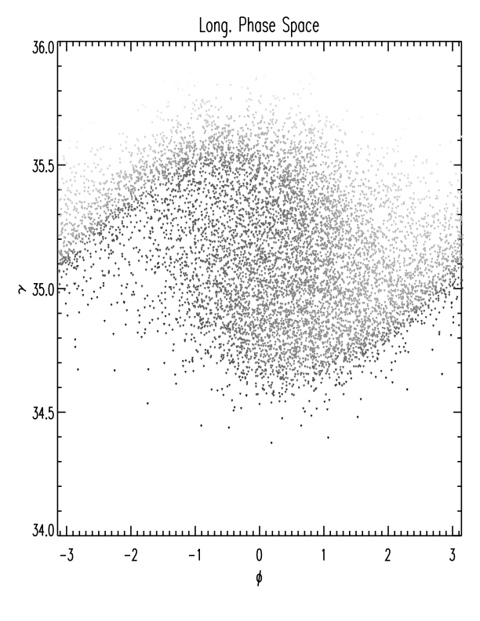
FELs: Energy Spread
Only electrons within the FEL bandwidth, which is around the Pierce parameter, can contribute to FEL gain.
Consequently, the relative energy spread of the electron beam needs to be smaller than the ρ parameter for an efficient FEL amplification
Small spread
Large spread
Strong Bunching
Weak Bunching
Energy spread constraint:
For X-rays: relative energy spread needs to be smaller than 10⁻³ – 10⁻⁴
Besides this limit: lower energy spread preferred. The lower the energy spread, the better the FEL performance

Slide 34
FELs: Emittance
The radiation “emittance” of the fundamental mode of the field is λ/4π.
Electrons enclosed on this effective phase-space ellipse of the photons will emit coherently into the fundamental mode
Electrons outside this ellipse will emit into higher modes and will not contribute to the amplification of the fundamental mode.
x’
Emittance constraint:
x
For X-rays: normalized emittance needs to be smaller than ~1 μm
Besides this limit: lower emittance preferred. The lower the emittance, the better the FEL performance

Slide 35

Summary of requirements for FELs
FEL performance is determined by the electron beam: the current, the size, the energy spread and the emittance, i.e. the 6D brightness.
For X-rays, the electron beam needs to have:
  ~GeV energies ~kA peak currents 0.01-0.1% energy spreads
  ≤ μm normalized emittances tens of μm beam sizes
Circular accelerators are not capable of delivering the required electron beam properties (in particular not the high peak current).
State-of-the-art X-ray FEL facilities employ RF linear accelerators to provide the drive electron beam (see next chapter).
Future: novel acceleration (more compact) to provide such electron beam.
$$B_{6D}=\frac{2I}{ε_{x}ε_{y}σ_{E}}$$

Slide 36
IV. Typical layout, electron beam dynamics, facilities

Slide 37
Typical layout

Slide 38
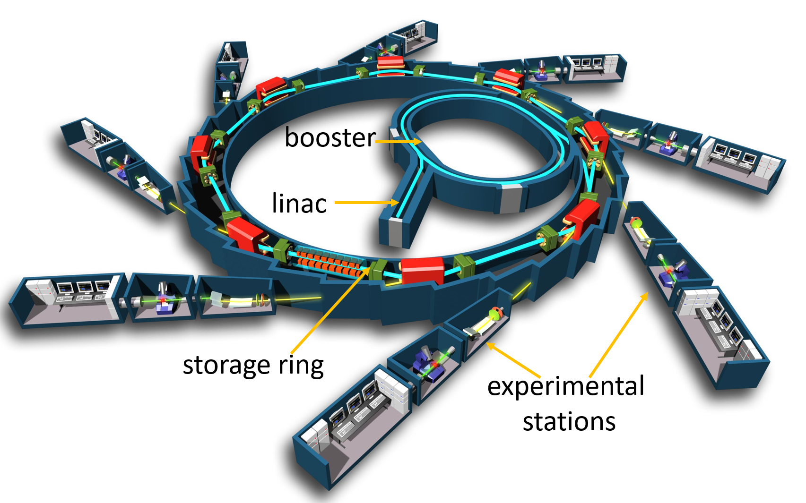
Layout of SR facilities
There are 4 main parts in a SR facility:
Linac:
  Electron source (cathode) &
  RF sections: acceleration up to ~100 MeV
Booster:
  RF cavities to accelerate the beam to its final energy (several GeV)
  It can be of the same size (better) or smaller than the storage ring
Storage ring
  Accumulation of electrons &
  Production of SR in bending magnets and undulators
Experimental stations
  Use of SR
Linac + booster = injector

Slide 39
Other aspects
The booster ring can be of the same size or smaller than the storage ring. The former case is the typical choice of modern machines. Advantages: saving in building space and shielding, better emittance, etc.
RF cavities in the storage ring resupply the energy lost by the electrons due to the emission of synchrotron radiation.
The radiation is produced in bending magnets and insertion devices placed in the straight sections of the storage ring.
The storage rings typically incorporate a variety of undulators covering a wide spectrum of synchrotron light between ultra-violet to hard X-rays.
Synchrotron light machines operate with a relatively large number of experimental stations. As an example, in the SLS there are presently16 beamlines in user operation.

Slide 40
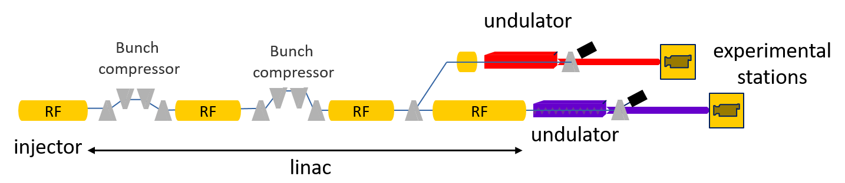
Layout of X-ray FEL facilites
There are 4 main parts in an FEL facility:
Injector: production of electron beams with
  low energy (5-10 MeV)
  low energy spread (~1e⁻⁴)
  low emittance (<1 μm),
  low peak current (10-20 A; e.g. 100-200 pC in 10 ps)
Linac:
  acceleration (to ~GeV energies) with radiofrequency (RF) cavities &
  bunch compression (to kA bunches with 10s of fs), done in 2-3 stages
Undulator: several (>10) modules, each few meters long and with a period of few cm
Experimental stations (use of FEL radiation)

Slide 41
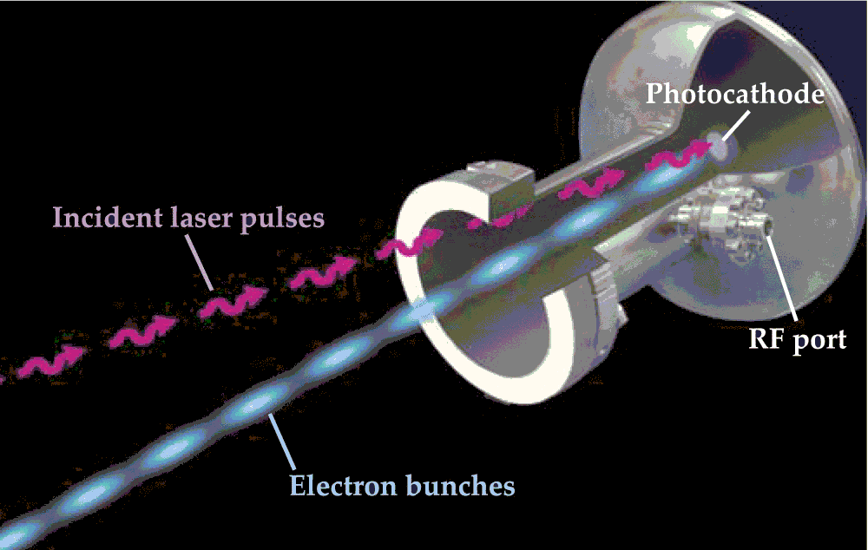
Electron sources
RF photo-injectors are normally used to generate high-brightness electron beams
Electrons are produced via the photo-electric effect by a laser of a proper wavelength impinging on a photocathode mounted inside an RF gun.
Final energy of the electrons is of few-several MeV, peak current of 10-20 A
Cathode material: copper, sometimes with Cs2Te coating (higher quantum efficiency)
RF photo-injector
Notes:
Other (less bright) alternatives: thermionic or DC guns

Slide 42
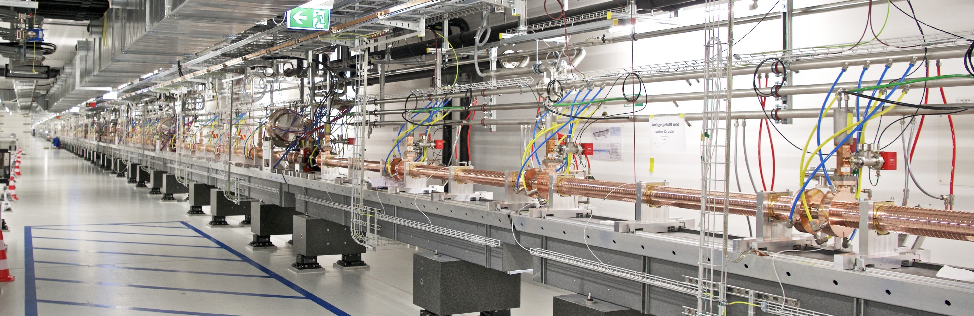
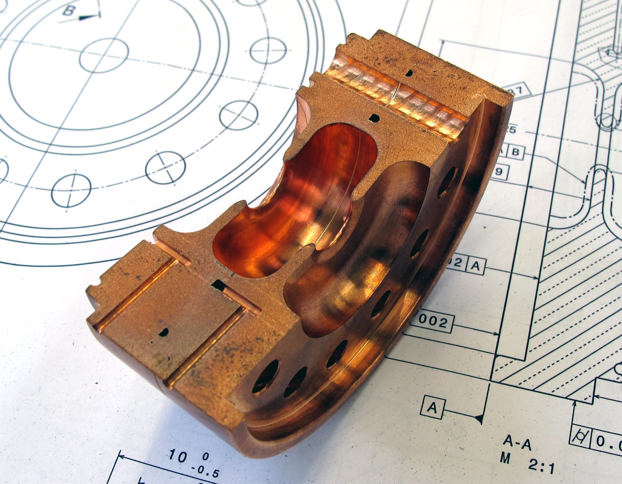
Linac
The accelerating frequency is in the GHz range. For instance, LCLS uses S-band (~3 GHz) while SACLA and SwissFEL use C-band (~6 GHz).
Higher frequencies permit acceleration of the beam over shorter distances → more compact linac.
The linac can consist of normal-conducting RF cavities (“warm” technology) or superconducting ones (“cold” technology).
In the latter case, many more pulses per second can be accelerated (e.g., 27 000 pulses per second at the European XFEL with superconducting RF compared to 100 pulses per second at SwissFEL with normal RF).
Notes:
42

Slide 43
Electron beam dynamics

Slide 44
Light sources: equilibrium
The emission of synchrotron radiation by the electrons in the storage ring gives rise to both radiation damping and quantum excitation.
Classical radiation damping is related to the continuous loss of energy of the electrons in bending magnets and undulators and its compensation in the RF cavities.
Energy is also lost in discrete units or “quanta,” i.e., photons whose energy and time of emission vary randomly. This randomness introduces a type of noise or diffusion, causing a growth of the oscillation amplitudes of the electrons.
The distribution of the electrons in the storage ring, (i.e., emittance, pulse duration and energy spread), are determined by the equilibrium between radiation damping and quantum excitation.

Slide 45
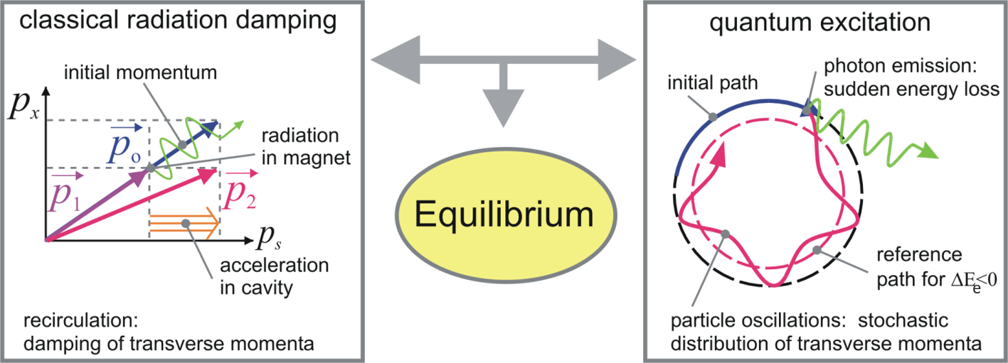
Equilibrium transverse emittance
The continuous emission of SR causes a momentum reduction in both longitudinal and transverse directions. The RF cavities restore only the longitudinal momentum → the transverse momenta and the emittance are reduced.
Due to quantum emission of radiation, some electrons lose energy and follow different paths due to the finite dispersion in the lattice, causing the emittance to increase.

Slide 46
Other properties
Vertical emittance.
  The theoretical vertical dispersion is zero, since the design dispersion is only horizontal.
  In practice, the emittance is dominated by magnet alignment errors. Third-generation machines typically achieve vertical emittances on the order of 1% or less of the horizontal emittance. SLS example: 1 pm.
The bunch length and the energy spread of the electrons are also the result of the equilibrium between radiation damping and quantum excitation. Bunches are typically a few mm long, while relative energy spreads are usually at the 0.1% level.
The accumulated currents typically amount to a few hundred mA (averaged over a full turn).
Synchrotrons operate at relatively high bunch frequencies. For example, SLS works with a 500 MHz repetition rate.
The design and operation optimization of synchrotron light sources includes addressing many issues such as chromaticity correction and the optimization of beam lifetime and dynamic aperture.

Slide 47
FEL beam dynamics
In linac-based X-ray FELs the electron beam properties are not the result of an equilibrium due to the emission of synchrotron radiation as in circular accelerators.
The properties are defined at the electron source, i.e., the RF photoinjector.
The normalized emittances will ideally be preserved through the linac according to Liouville’s theorem. Liouville’s theorem will not be fulfilled and the beam emittances will be increased in the presence of some deteriorating stochastic effects such as intra-beam scattering, non-linear space-charge forces or emission of coherent synchrotron radiation.
The main goal in designing and operating an FEL facility is:
  Produce a high-brightness electron beam at the injector
  Accelerate and compress the beam in the linac while preserving its quality as much as possible.
Notes:
Other (less bright) alternatives: thermionic orThe RF photoinjector produces electron beams with typical energies between 5 and 10 MeV, peak
currents DC guns

Slide 48
Emittance optimization in RF photoinjectors
The RF photoinjector produces electron beams with typical energies between 5 and 10 MeV, peak currents of 10–20 A, low normalized emittances (μm or below) and energy spreads of few keV.
The emittance of the source is determined by three different components:
  intrinsic emittance of the cathode (depending on the laser size)
  space-charge forces
  RF field effects in the gun.
The gun gradient is set as high as possible with available technology. At SwissFEL, the maximum field is 100 MV/m, giving 7.1 MeV at the gun exit.
The gun is equipped with a solenoid magnet used to focus the electron beam.
The laser spot size and the field generated by the gun solenoid are optimized to counteract the contributions of the intrinsic emittance (smaller for smaller spot size) and space charge (smaller for larger spot size) to the final emittance.
Notes:
Other (less bright) alternatives: thermionic orThe RF photoinjector produces electron beams with typical energies between 5 and 10 MeV, peak
currents DC guns

Slide 49
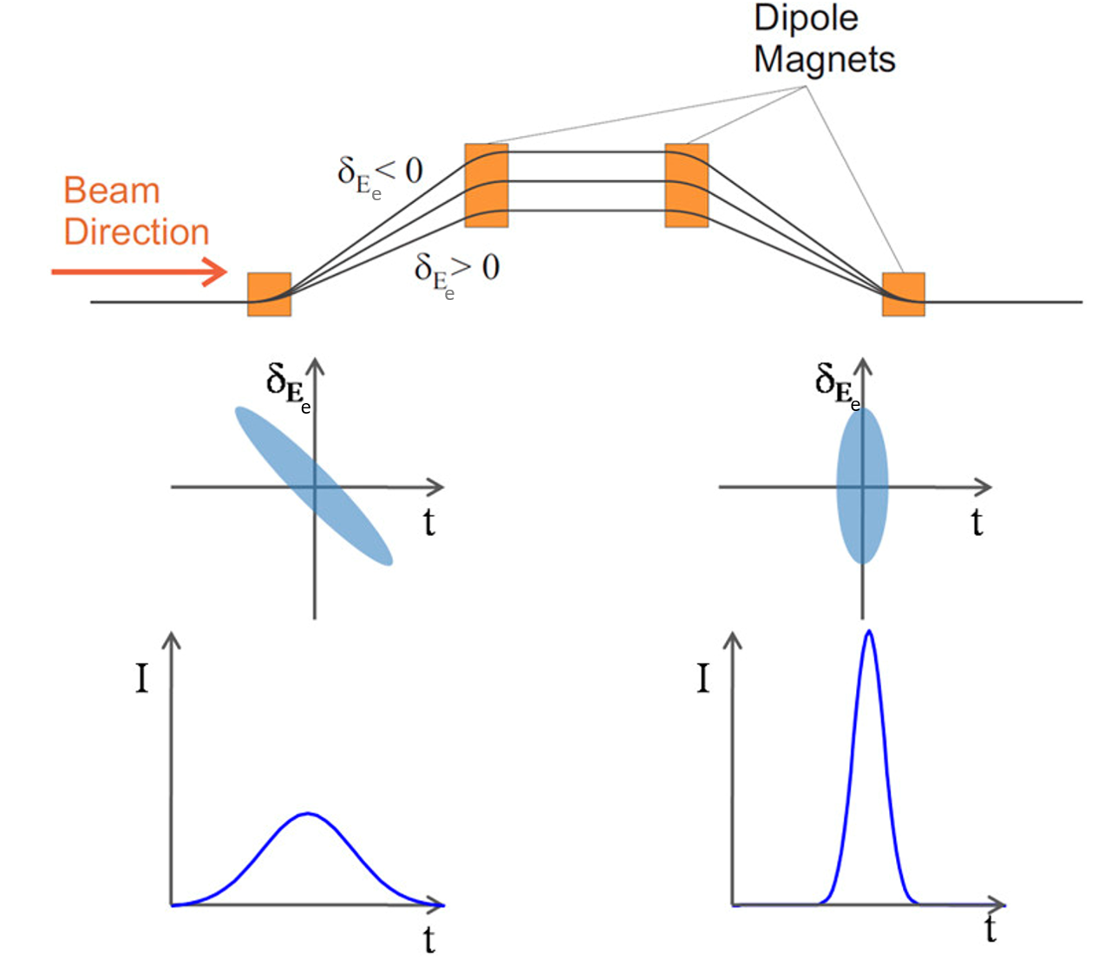
Bunch compression
Principle
Energy chirp generation with RF
Transport through magnetic chicanes
Compression thanks to the energy-dependent path along the chicanes
Where to compress?
Early compression→ high charge density beams at low energies→ emittance increase
Late compression→ transport of long bunches trough the linac → emitance increase (due to RF-curvature, wake fields, …)
Typically: compression done in 2 or 3 stages
  1st bunch compressor at few hundreds of MeV
  2nd bunch compressor at more than 1 GeV
  Both stages compressing by a factor of ~10

Slide 50
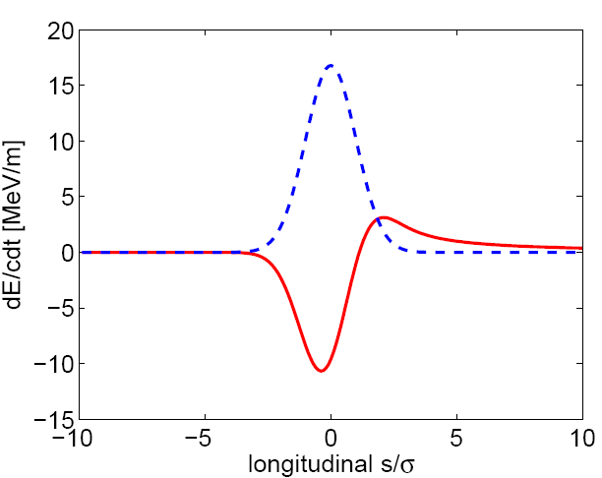
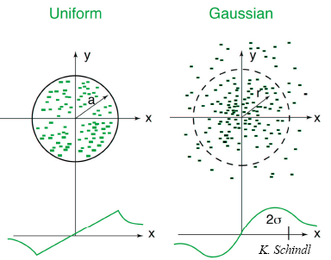
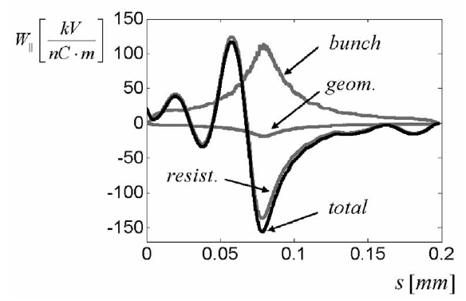
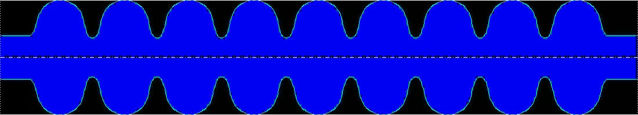
Self Interactions
High charge densities give rise to strong electro-magnetic fields generated by the electron bunches. Electrons within the bunch experience these fields.
Coherent Synchrotron Radiation
Space Charge fields
Wake fields
tail
head
tail
head

Slide 51
Light sources vs FELs

Slide 52
Electron beam properties
 | Synchrotrons | X-ray FELs
Geometric emittance | ≥ 300 pm in X ≥ 1 pm in Y Asymmetric beam | ≥ 10 pm in X ≥ 10 pm in Y Round beam
Energy spread | ~10⁻³ | ~10⁻⁴
Peak current | ~10 A | ≥ 1 kA
Pulse durations | ~10 ps | ≤50 fs

Slide 53
Photon beam properties
 | Synchrotrons | X-ray FELs
Pulse energy | ~nJ | ~mJ
Relative bandwidth | ≫10⁻⁴ | ~10⁻⁴
Peak brilliance | 10²⁵ - 10²⁷ | 10³⁵ - 10³⁷
Repetition rate | ~500 MHz | 0.1 kHz – 1 MHz
User accessibility | Good >50 facilities, up to 50 beamlines per facility | Worse 5-10 facilities, up to 10 beamlines per facility

Slide 54
Current and future facilities

Slide 55
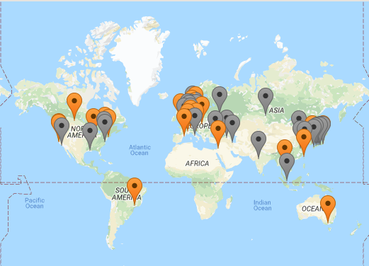
Synchrotron Light Sources Around the World
There are around 50 synchrotron light sources around the world (operational or under construction)
There are about 15 new projects based on 4th generation designs (MBA lattice)
lightsources.org

Slide 56
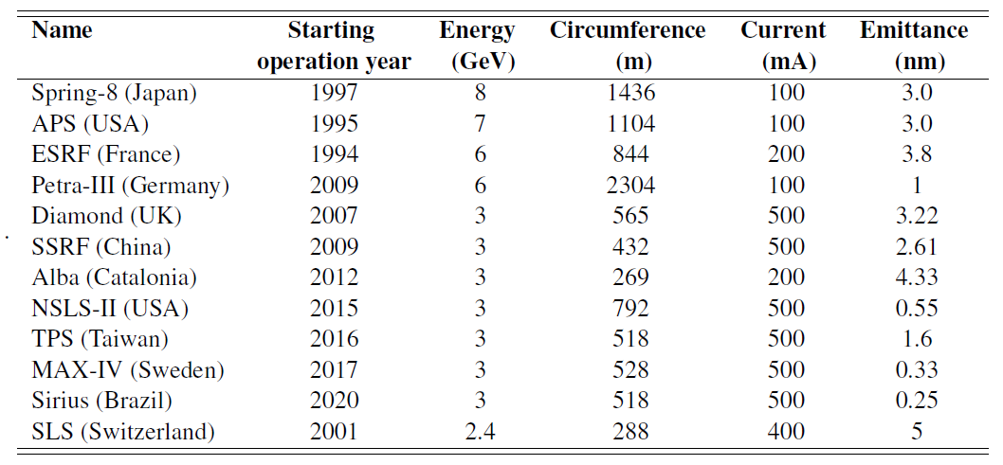
Main parameters of some SR facilities

Slide 57

X-ray FEL Projects Around the World
FLASH: first soft X-ray with high repetition rate (MHz), 2007
LCLS: first hard X-ray, 2009
SACLA: compact hard X-ray, 2011
FERMI: first soft X-ray seeded-FEL, 2013
PAL-XFEL: hard X-ray with low (20 fs) timing jitter, 2016
E-XFEL: hard X-ray with high repetition rate, 2017
SwissFEL: compact hard X-ray driven by low emittance beam, 2017
FLASH
FERMI
E-XFEL
PAL
XFEL
LCLS
SwissFEL
SACLA
LCLS-II
SHINE
All present facilities are based on SASE, except FERMI.
Most facilities have the option of self-seeding
Future facilities: LCLS2 and SHINE (high repetition rate)

Slide 58
Hard X-ray FELs comparison
 | LCLS ^{*1} | SACLA ^{*2} | PAL-XFEL ^{*3} | E-XFEL ^{*4} | SwissFEL ^{5*}
Country | USA | Japan | Korea | Germany | Switzerland
Starting oper. year | 2009 | 2010 | 2017 | 2017 | 2018
Energy (GeV) | 14.3 | 8.5 | 10 | 17.5 | 5.8
Length (km) | 3.0 | 0.75 | 1.1 | 3.4 | 0.74
Pulses per second | 120 | 60 | 60 | 27000 | 100
Normalized emittance (nm) | 400 | 1000 | 550 | <600 | 200
Construction cost (M$) ^{*6} | 415 | 370 | 400 | 1600 | 280
*1: [P. Emma et al, Nat. Phot. 4, 641 2010]
*2: [T. Ishikawa et al, Nat. Phot. 6, 540, 2012]
*3: [H. Kang et al, Nat. Phot. 11, 708, 2018]
*4: [W. Decking et al, Nat. Phot. 14, 391, 2020]
*5: [E. Prat et al, Nat. Phot. 14, 748, 2020]
*6: [E. Cartlidge, Science 354, 6308, 22, 2016]
Notes:
SwisFEL is
The most compact (as SACLA) X-ray FEL
Driven by an electron beam with the lowest energy and emittance
The most cost-effective X-ray FEL

Slide 59
V. Future trends

Slide 60
Light sources

Slide 61
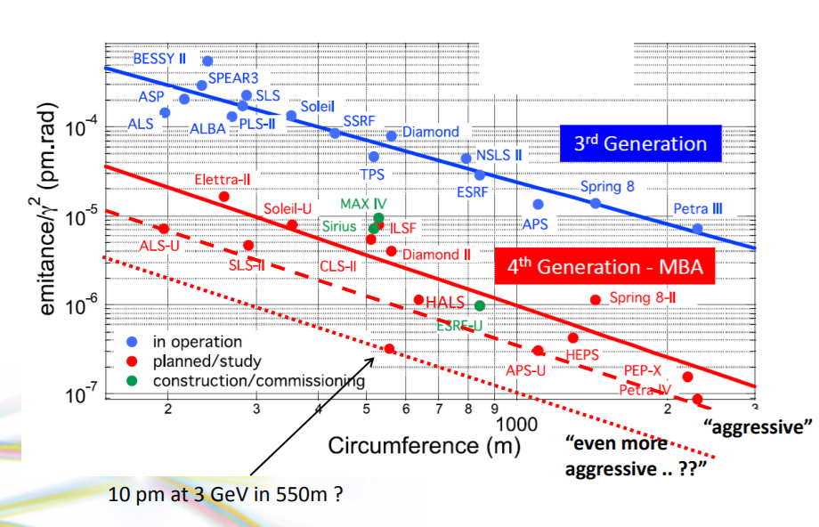
General trend: emittance reduction
MAX-V 19BA?
courtesy A. Nadji, Soleil
Main trend: reduce emittance (mostly with MBA lattice) to enhance brilliance

Slide 62
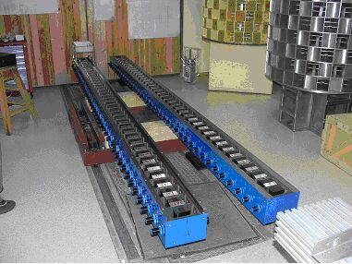
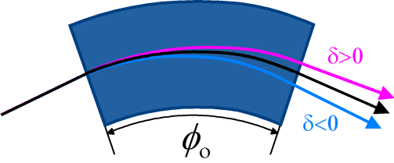
Emittance optimization
Maximize radiation damping
  increase radiated power ⇨ pay with RF-power
    High field bending magnets
    Damping wigglers (DW)
Minimize quantum excitation
  keep off-momentum orbit close to nominal orbit
  minimize dispersion at locations of radiation (bends)
    Multi-Bend Achromat lattice (MBA). Many short (= small deflection angle) bends to limit dispersion growth. [D. Einfeld, SRN 27, 4, 2014].
    Longitudinal Gradient Bend (LGB)
    highest radiation at region of lowest dispersion and v.v.
δ =Δp/p
3rd generation light sources: emittance of few nm
4th generation (MBA, LGB, DW): emittance < 1 nm
Notes:
MBA is an old idea (90s) that became recently possible with the option to miniaturize components

Slide 63
Steady-state microbunching (SSMB)
Idea: SSMB is generated by phase-space manipulation of an electron beam. Result: high repetition rate (advantage of light sources) with high power (advantage of FELs). [D. Ratner and A. Chao, PRL 105, 154801, 2010]
First proof-of-principle demonstration at 1064 nm. [X. Deng et al, Nature 590, 576, 2021].
Recent calculations show 3 orders of magnitude higher brilliance than standard light sources. [X. Deng et al, JSR 30, 35, 2023]

Slide 64
Replace injector by a plasma source
DESY has proposed a 500 MeV linac based on plasma (and other conventional components). [S. Antipov et al, PRAB 24, 111301, 2021]
It could be extended to replace the whole injector (linac + booster)?
Benefits: reduce footprint and energy costs

Slide 65
FELs

Slide 66
Overview of future trends
High repetition rates (from ~100 Hz to ~1 MHz) → superconducting RF technology
Tailor FEL properties to user needs: short pulses, high power, longitudinal coherence, multiple pulses, etc → Mainly by electron beam shaping.
High electron beam brilliance (better FEL performance) → high-gradient injectors.
Compact and cost-effective facilities to enhance accessibility:
  High-gradient acceleration
  Short-period undulator (less energy required)

Slide 67
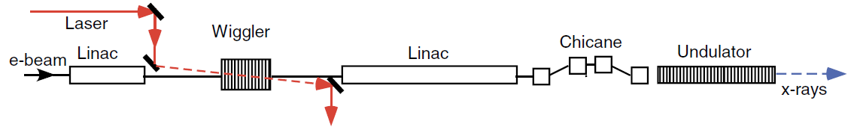
Tailor FEL properties: shorter pulses
FEL pulse duration is mostly defined by the electron beam pulse duration which is able to lase (proper current, emittance, trajectory, etc.). The lower limit is in principle the FEL slippage (100’s of as for X-rays).
Standard pulse duration is of few tens of fs. Short pulses below 1 fs have been achieved in X-rays in two ways: 1) Make a short electron beam (strong compression) , 2) Select a small fraction of the electron beam to lase (by spoiling all the electrons except a small fraction of it.
Attosecond pulses generated and measured at @ LCLS: [J. Duris et al, Nat. Phot. 14, 30, 2020]
Future: shorter pulses (record so far is few hundreds of attoseconds), higher powers (above 1 TW).
energy modulation
density modulation

Slide 68
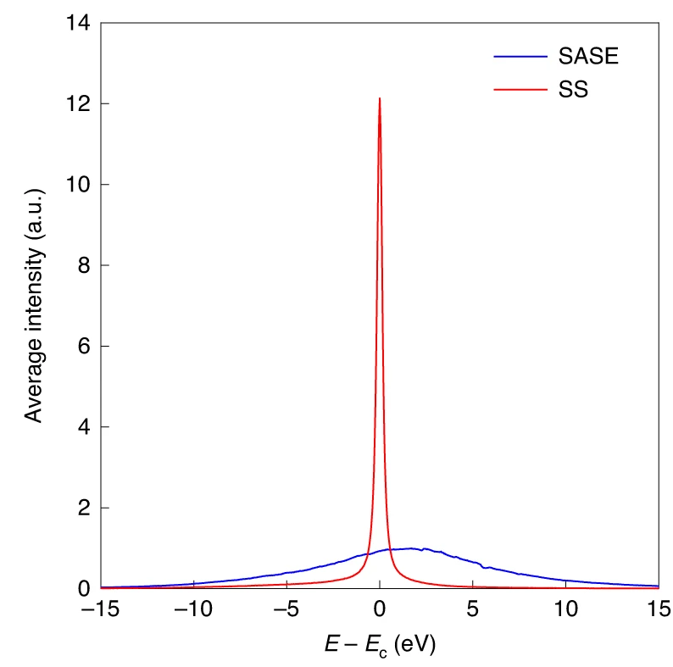
Tailor FEL properties: longitudinal coherence
Standard SASE-FELs have poor longitudinal coherence. There are different ways to improve it, mostly with seeding schemes.
The seed can be an external laser or a monochromatized SASE signal (self-seeding).
e-
1st undulator section
SASE FEL
Grating monochromator
2nd undulator section
Seeded FEL
FEL
Self-seeding has been shown down to ~0.1 nm.
External seeding is better (higher stability, shaping options, synchronization) but so far has been demonstrated for ~3 nm.
Future: external seeding for hard X-rays
Recent results at PAL-XFEL
[I. Nam et al, Nat. Phot. 15, 435, 2021]

Slide 69
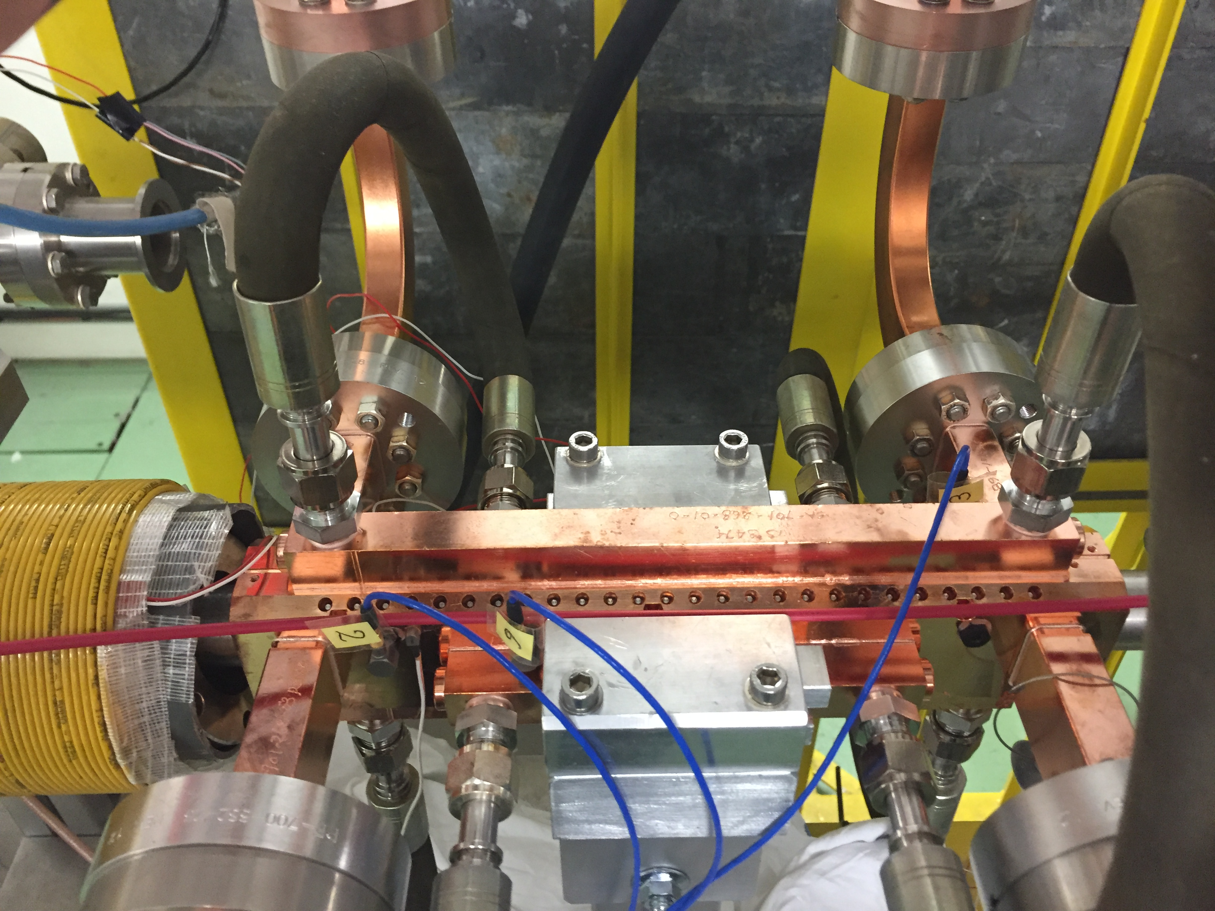


High-gradient options
Metallic accelerating structures:
E = 100 MV/m – 1 GV/m
Dielectric structures (laser or particle driven)
  E < 10 GV/m
Plasma acceleration (laser or particle driven):
E < 100 GV/m
Related issues: good electron beam quality, power sources and efficiency, stability, reliability, synchronization, repetition rate, etc.
Courtesy of M. Ferrario

Slide 70

High-gradient rf guns to improve electron beam brilliance
$$B_{6D}=\frac{2I}{ε_{x}ε_{y}σ_{E}}$$
FEL performance depends on electron beam brilliance
Extensive worldwide efforts around the globe to enhance the electron beam brilliance of FEL sources (i.e. to improve emittance and increase current).
Tendency to use electron guns with high-frequency (C band or X-band) and high gradient.
Notable example: 400 MV/m demonstrated at Argonne with X-band gun. [W. Tan et al, PRAB 25, 083402, 2022].
Future: show brilliance improvements

Slide 71


Plasma acceleration
Several worldwide efforts to accelerate electron beams with plasma while having suitable beam quality for FEL process. Outstanding achievements in the last couple of years, e.g.:
  FEL amplification at 27 nm with 500 MeV beam from laser-plasma acceleration. [W. Wang et al, Nature 595, 516, 2021]
  FEL generation at 800 nm with 90 MeV beam (6 MeV from plasma acceleration). [R. Pompili et al, Nature 605, 659, 2022].
Future: X-ray FEL
~12 m

Slide 72


Two X-ray FEL future projects based on new technologies
EuPRAXIA (Europe): X-ray FEL based on plasma acceleration, initial project phase funded.
[R. Assman et al, EPJST 229, 3675, 2020]
UC-XFEL (UCLA): X-ray FEL based on high-gradient cryogenic RF, design phase.
[J. Rosenzweig et al, NJP 22, 093067, 2020]
Total length ~40 m

Slide 73
VI. Conclusion

Slide 74
Conclusion
Light sources and X-ray FELs are invaluable research tools capable of observing matter with spatial resolution at the atomic level.
X-ray FELs offer higher peak brilliance, higher pulse energies and a better time resolution suitable to study the dynamics of processes occurring at the atomic level … but synchrotrons have a higher repetition rate and provide easier access to the scientific community.
Both tools require GeV electron beams with high brilliance (specially FELs).
Future trends:
  Light sources: improve emittance, SSMB to increase power, plasma injectors to reduce footprint and costs
  FELs: tailor properties, improve brilliance and reduce footprint/costs with high-frequency RF and plasma sources

Slide 75
Thanks for your attention!

