Slide 1
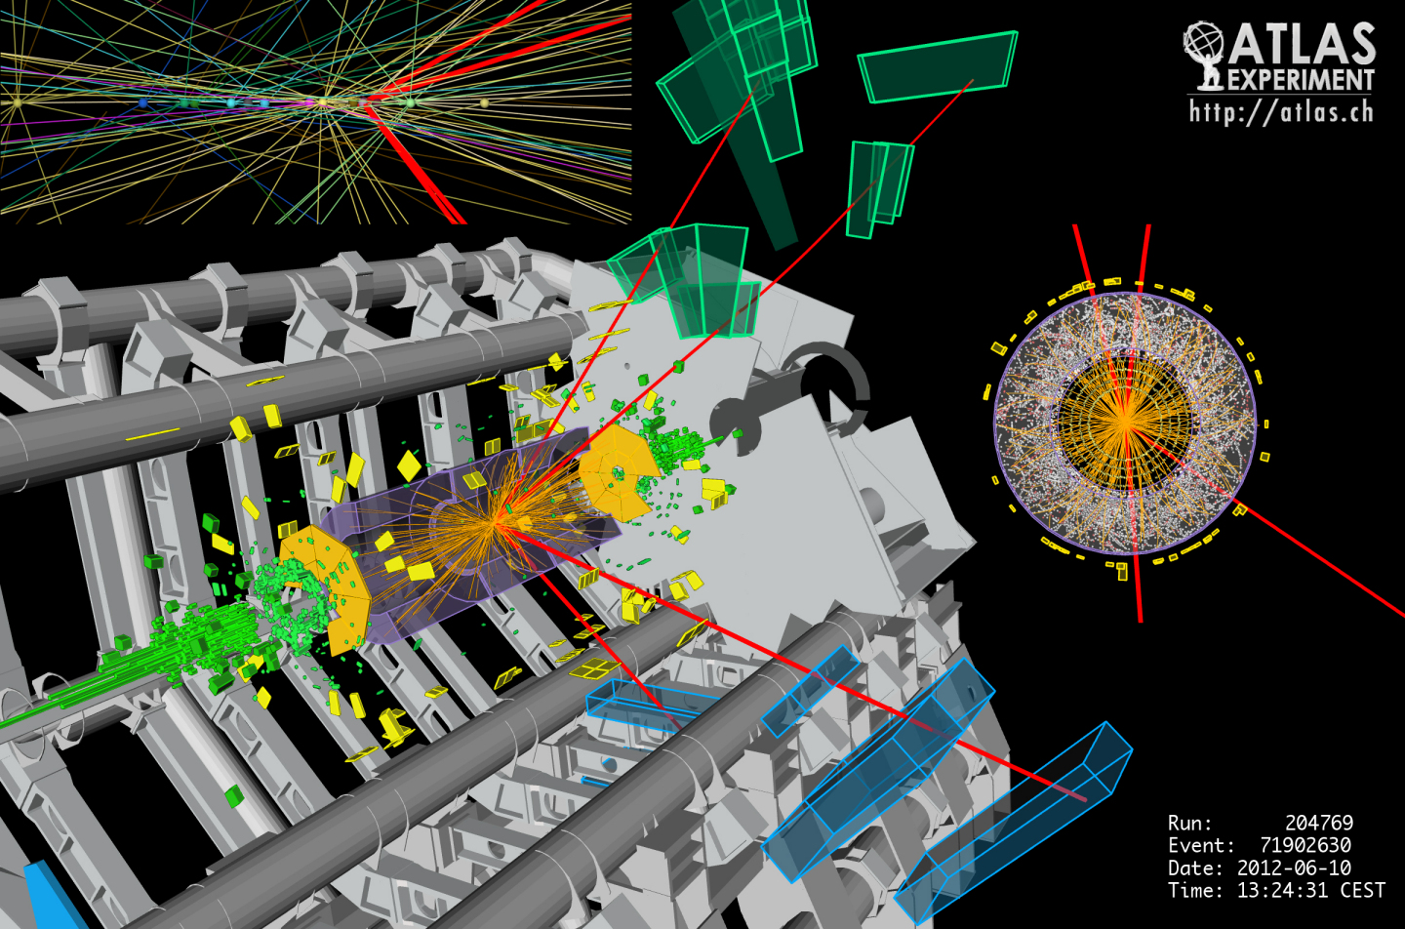
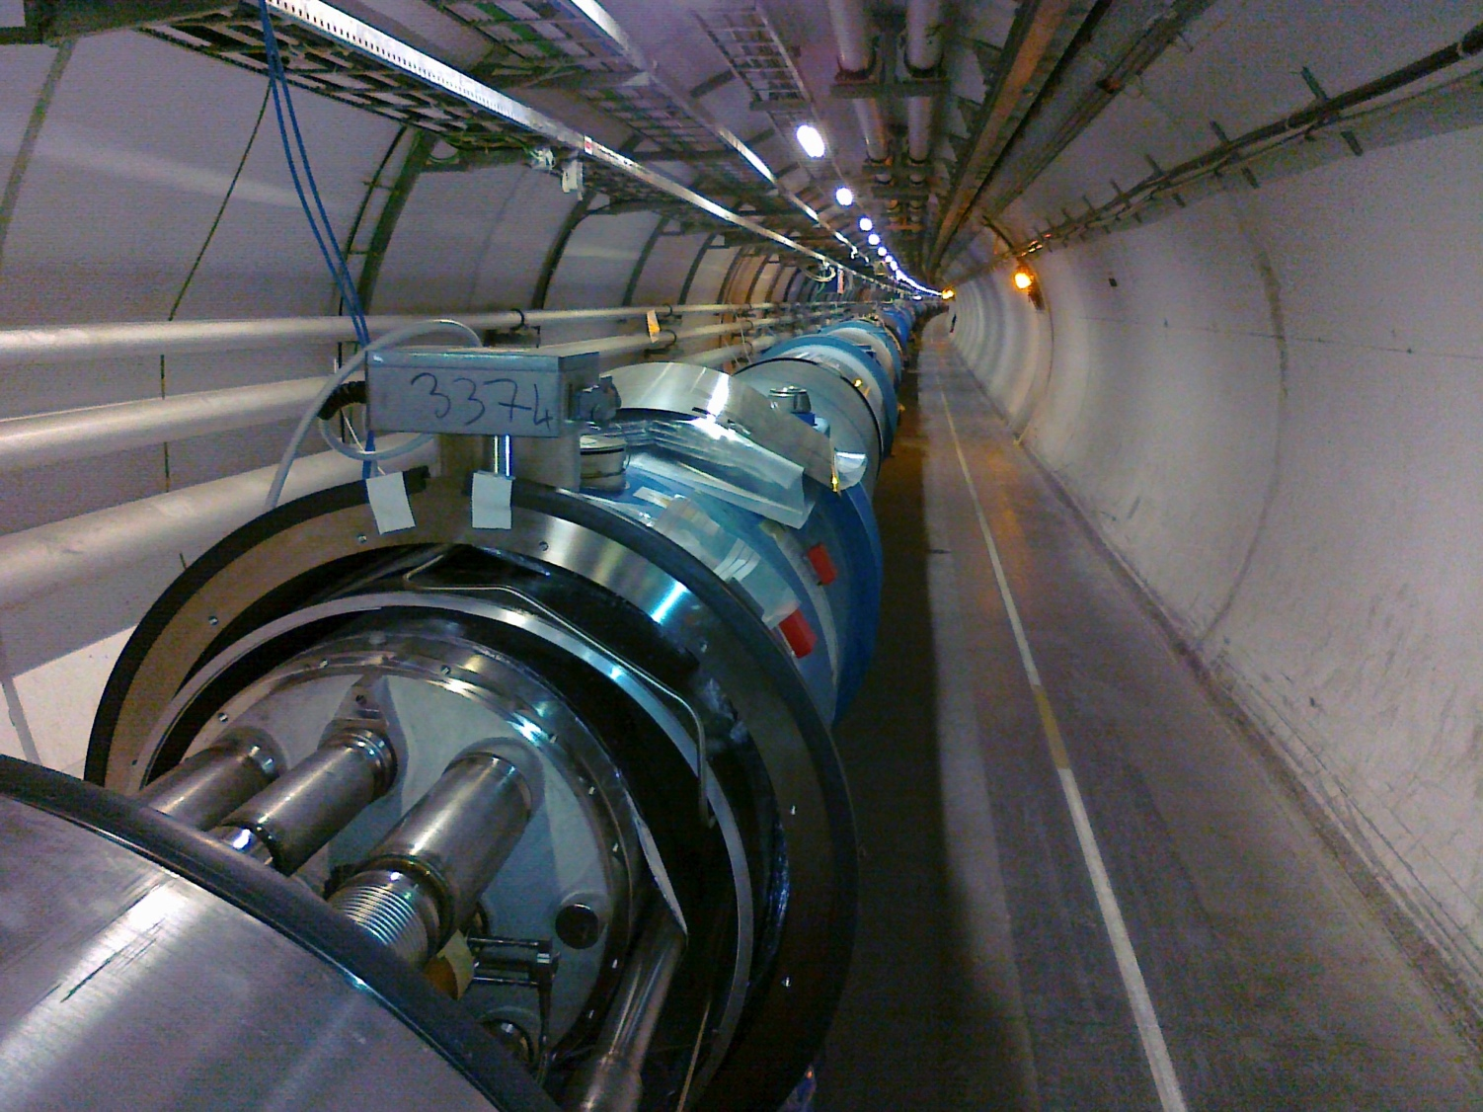
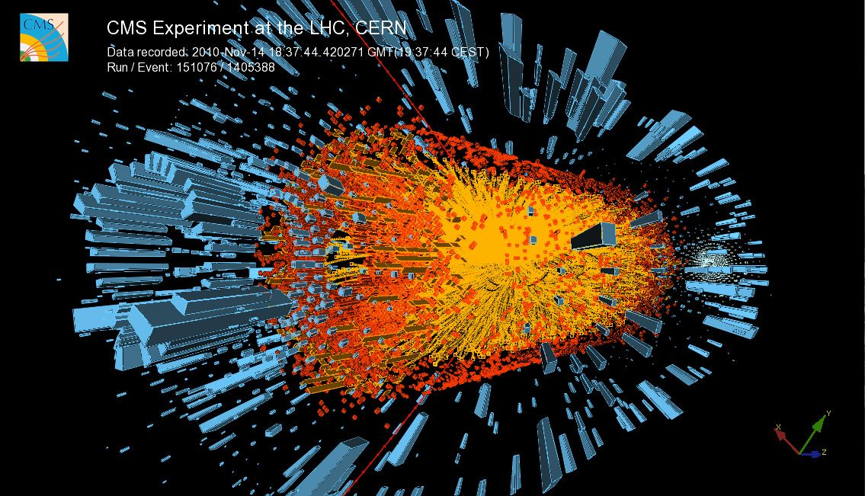
Magnets Superconductors
Luca.Bottura@cern.ch
Erice, Sicilia, 27 July - 2 August 2023

Slide 2
A great physics problem in 1900
ρ
What is the limit of electrical resistivity at the absolute zero ?
… electrons flowing through a conductor would come to a complete halt or, in other words, metal resistivity will become infinity at absolute zero.
“X-rays are an hoax”
“I have not the smallest molecule of faith in aerial navigation other than ballooning or of expectation of good results from any of the trials we hear of”
"There is nothing new to be discovered in physics now. All that remains is more and more precise measurement”
W. Thomson (Lord Kelvin)
T

Slide 3
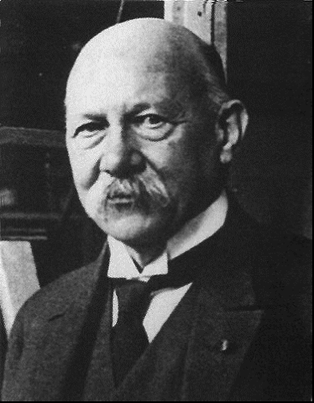
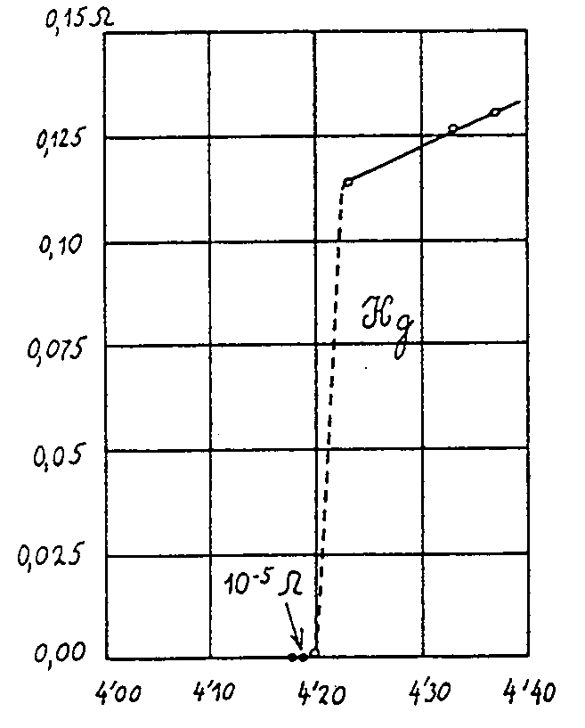
Superconductors Pre-history
… thus the mercury at 4.2 K has entered a new state, which, owing to its particular electrical properties, can be called the state of superconductivity…
H. Kamerlingh-Onnes (1911)

Slide 4
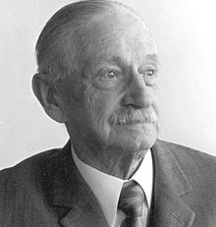
A fundamental definition of superconductors
W. Meissner, R. Ochsenfeld
Type I (κ < 1/√2)
Complete field exclusion
Raise field
superconducting
Pure metals
B_{C} ≈ 10⁻³…10⁻² T
B
Meissner & Ochsenfeld, 1933
Example of magnetic levitation
B
Levitated magnet
normal-conducting
Cool
down
Superconducting disk

Slide 5
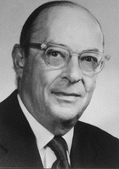
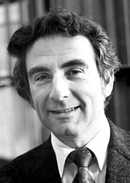
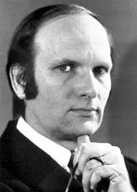
Cooper Pairs
Bardeen, Cooper and Schrieffer
Normal conductor
scattering of e⁻
finite resistance due to energy dissipation
Proper physics: a gas of Fermions. The conduction electrons at the Fermi surface have large energy (few eV) and interact with lattice defects, displacements or thermal excitations (hence ρ(T))
Superconductor
paired electrons forming a quasi particle in condensed state
zero resistance because the scattering does not excite the quasi-particle
Proper physics: paired electrons in the vicinity of the Fermi surface, with opposite momentum and spin (bosons with zero spin). The binding energy introduces a small energy gap between paired and unpaired state. An external electric field makes the pair drift.

Slide 6
Pairing mechanism
t₁
Lattice displacement
⇓
phonons (sound)
⇓
coupling of charge carriers
Only works at low
temperature
Bardeen, Cooper, Schrieffer (BCS) - 1957
100-1000 nm
t₂
Proper physics: the binding energy is small, of the order of 10⁻³ eV. Pairs can be broken easily by thermal energy. The interaction is long range, and Cooper pairs overlap and can exchange electrons

Slide 7
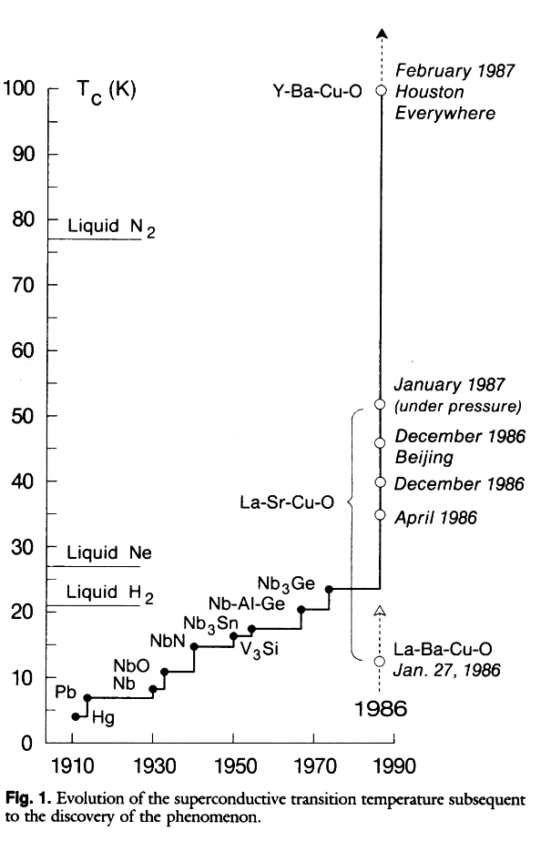
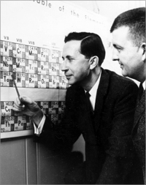
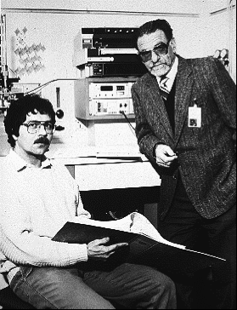
1986 - A Big Surprise
Theoretical limit around 30 K
One Thousand and One Superconductors
B. Matthias (1918-1980)
Bednorz and Mueller
IBM Zuerich, 1986

Slide 8
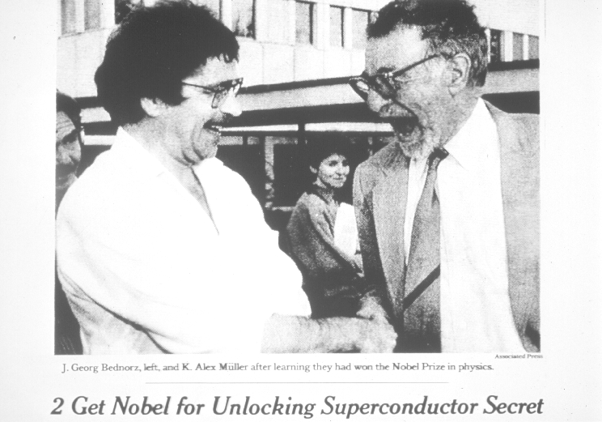
1987 - The prize !

Slide 9
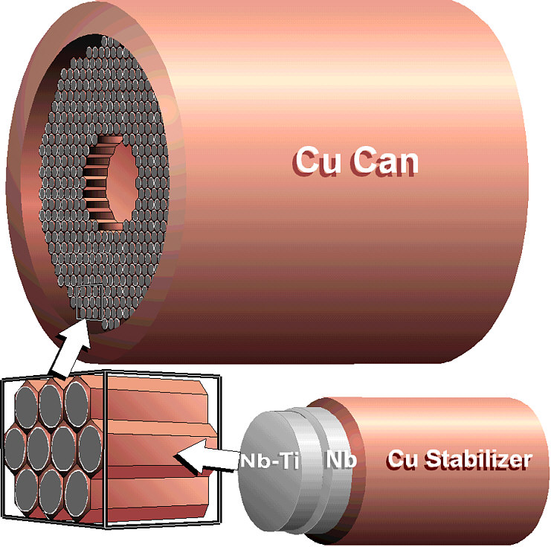
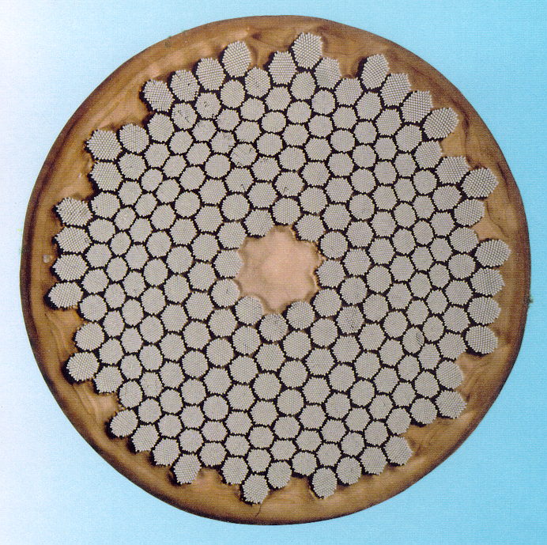
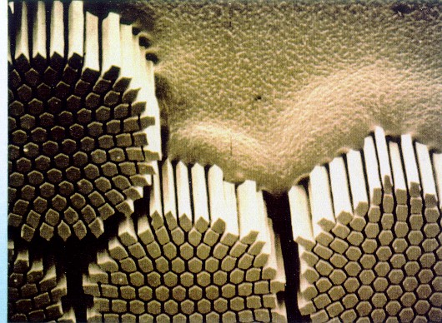
Nb-Ti manufacturing route
Graphics by courtesy of Applied Superconductivity Center at NHMFL
NbTi billet
I_{C}(5 T, 4.2 K) ≈ 1 kA
extrusion
cold drawing
≈1 mm
heat
treatments
NbTi is a ductile alloy that can sustain large deformations
LHC wire

Slide 10
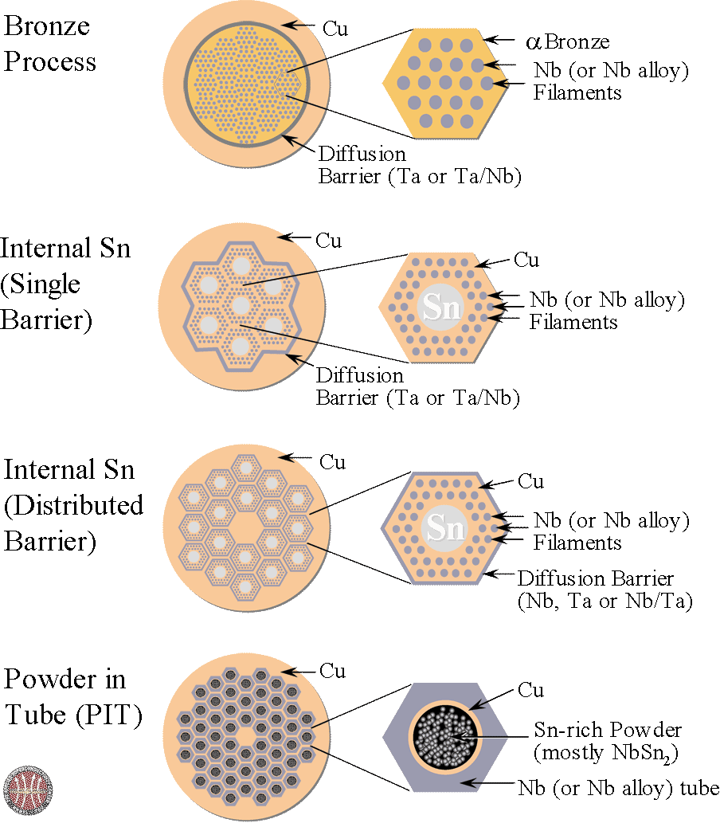
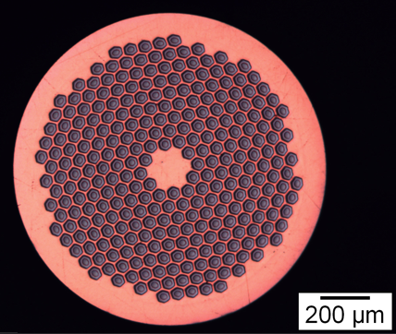
Nb₃Sn manufacturing routes
Graphics by courtesy of Applied Superconductivity Center at NHMFL
Nb₃Sn is brittle and cannot be drawn in final form. The precursors are drawn and only later the wire is heat-treated to ≈650 C for several hrs, to form the Nb₃Sn phase
I_{C}(12 T, 4.2 K) ≈ 1.5 kA

Slide 11
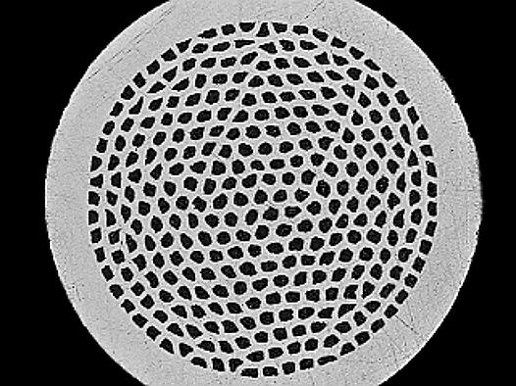
BSCCO manufacturing routes
Graphics by courtesy of Applied Superconductivity Center at NHMFL
BSCCO is also brittle: a special sequence of rolling and sintering heat treatments must used. Silver has the important feature that it is transparent to Oxygen at high temperature, but does not react with it
Oxide powder in tube OPIT
1) draw down BSCCO powder in a silver tube
2) stack many drawn wires in another silver tube and draw down again
3) roll the final wire to tape and heat treat at 900C in oxygen to melt the B2212
BSCCO wire and tape
I_{C}(20 T, 4.2 K) ≈ 1 kA

Slide 12
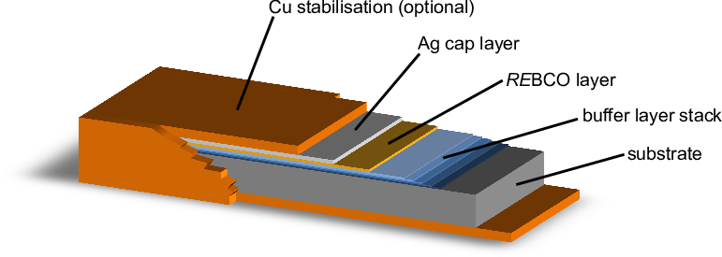
REBCO manufacturing routes
REBCO has better critical properties than BSCCO but, unlike BSCCO, grains do not align during processing. If grains are not aligned the supercurrent cannot jump between the grains. The manufacturing processes are all forcing a certain degree of alignment in the microstructure
1) produce a tape with an aligned texture
2) coat the tape with a buffer layer
3) coat the buffer with a layer RE-Ba₂Cu₃O₇ such that the texture of the RE-BCO follows that of the buffer and substrate
1 μm
≈0.1 mm
I_{C}(20 T, 20 K) ≈ 1 kA

