Slide 1
Introductions to accelerators II:
Transverse Dynamics
Dr Tatiana Pieloni (Tatiana.Pieloni@epfl.ch)
Laboratory for Particle Accelerator Physics, EPFL

Slide 2
Linear Dynamics - continued
practical questions to be answered:
How to ensure bound motion of a particle beam?
What are conditions for stability?
Amplitude and frequency of particle oscillations?
Statistical beam properties like beam width and angular spread?
How to design magnet lattices (arrangements of dipoles and quads in a line)?
Chromaticity
What is the impact of field errors in bending and focusing magnets?

Slide 3
Statistical Beam Properties
Single particle Phase space ellipse
Courant-Snyder Invariant of motion
Particle Action versus beam emittance
Emittance and distribution function
Liouville theorem
consequences of conservation of emittance

Slide 4
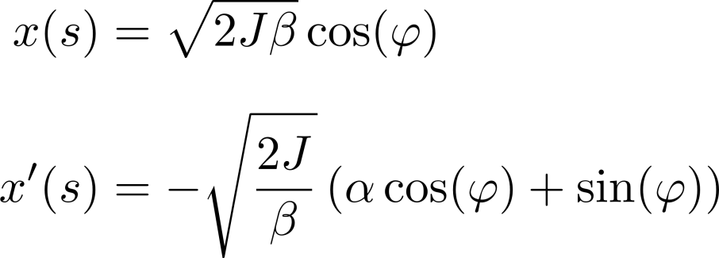
Phase Space Ellipse
x’
4
2
1
J = particle action (oscillation amplitude)
observing the coordinates of a particle at one location in a ring for consecutive turns
x, x’ describe an ellipse in phase space when ϕ is varied
example μ_{x} ≈ 0.37×2π phase advance per turn
x
3
see also Schmüser/Rossbach sect. 4.3/4.4, Wiedemann chap. 8.1.2

Slide 5



Courant-Snyder Invariant
at one location this phase space ellipse is sampled by a particle with action J
when moving along the magnet lattice, the ellipse is changing shape, but it stays an ellipse
the area of the ellipse is invariant (Courant-Snyder Invariant) and equals 2π × action.
the unit is [m⋅rad], or often [mm⋅mrad]
this constant of motion refers to a single particle, emittance is a statistical property
x’
x
E.D. Courant and H.S. Snyder, Theory of the Alternating Synchrotron, Annals of Physics 3 (1958) 1

Slide 6
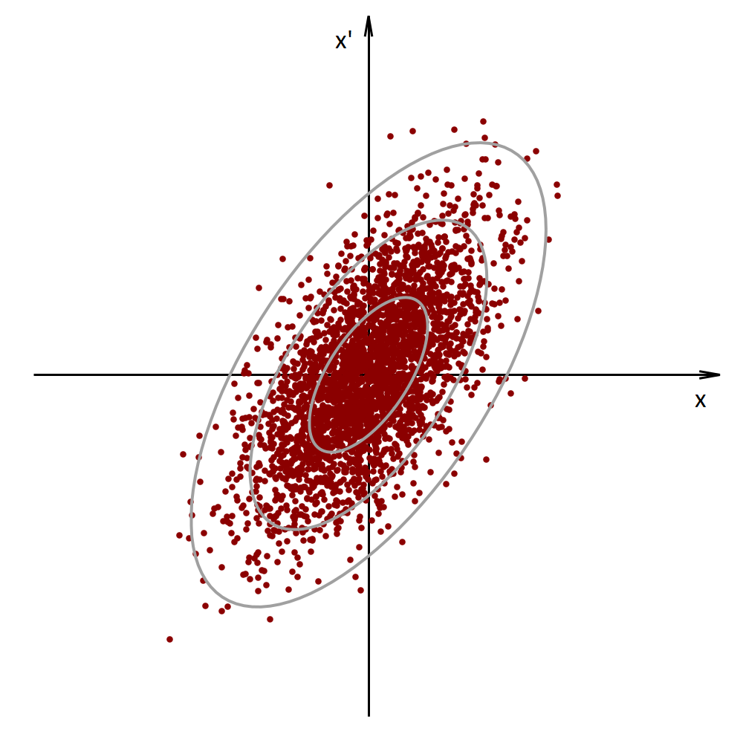
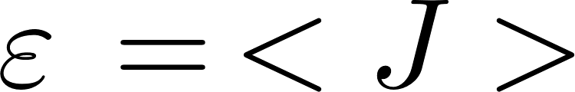
Action vs. Emittance
single particles are associated with a particular ellipse
when observing a beam with a wire scanner a (projected) rms (root mean square) width σ_{x} is measured; one ellipse corresponds to σ_{x}
emittance ε is the average value of action J
σ_{x}

Slide 7
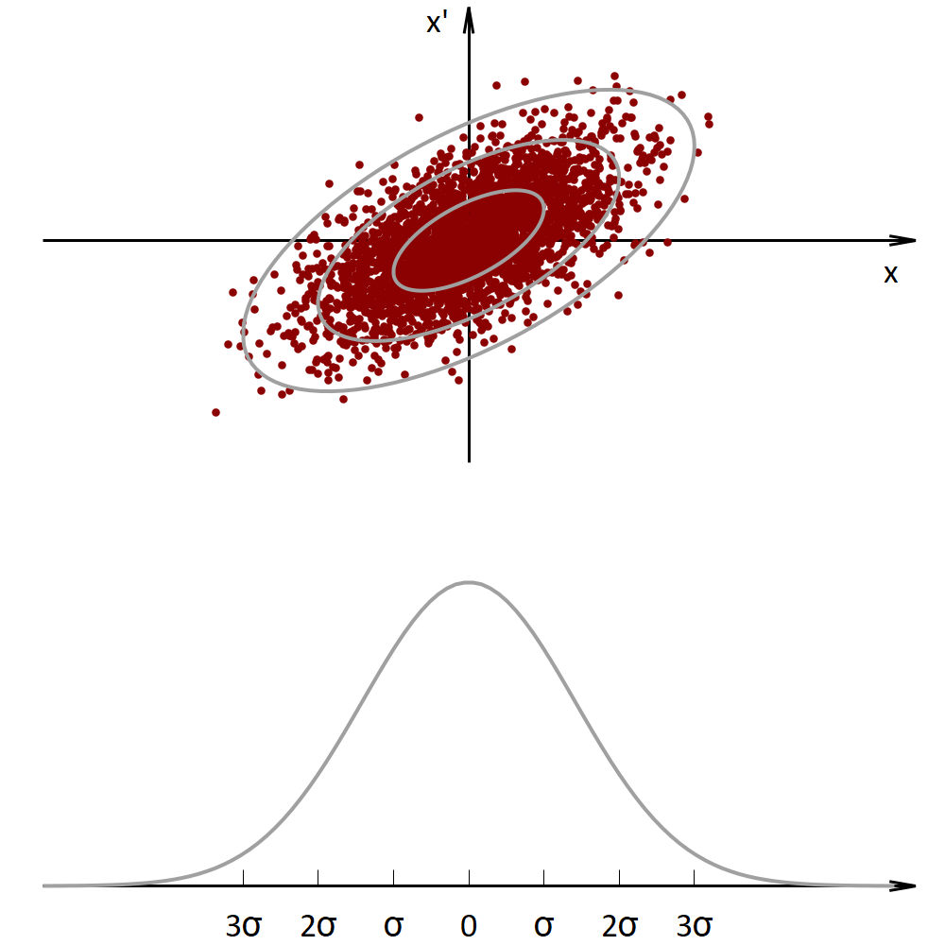
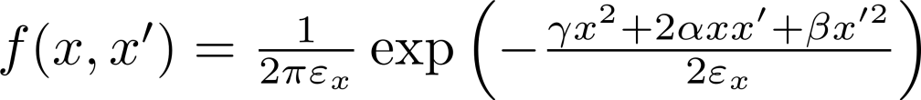
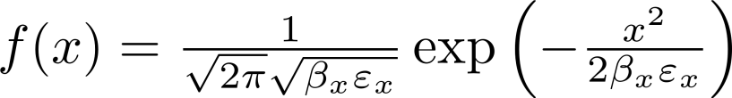
Beam Emittance
beam emittance as statistical property:
two-dimensional Gaussian distribution:
projected Gaussian distribution:
see Wiedemann sec. 8.1.3

Slide 8
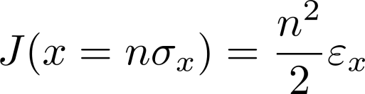
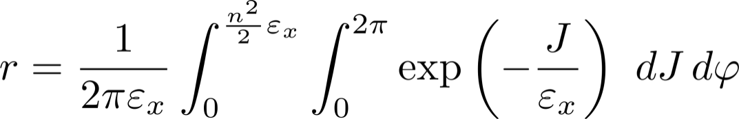

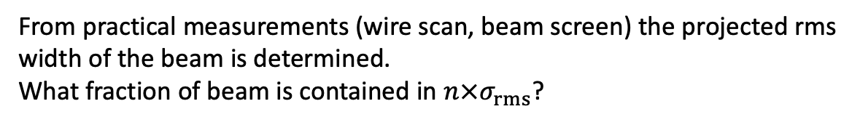
Fractions of Beam in rms widths
From practical measurements (wire scan, beam screen) the projected rms width of the beam is determined.
What fraction of beam is contained in $n×σ_{rms}$?
compute the beam fraction inside an ellipse corresponding to n×σ_{x}:
note: This applies for a two dimensional Gaussian distribution.
rms width n | beam fraction r
1 | 39%
2 | 86%
3 | 99%

Slide 9
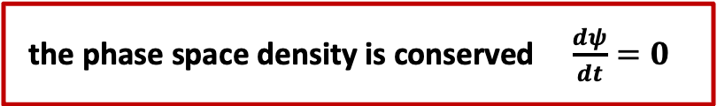
Liouvilles Theorem
Beams subject to conservative forces as in our accelerator (without dissipative forces i.e. synchrotron radiation) → preserve the phase space density over time
the phase space density is conserved $\frac{dψ}{dt}=0$
The phase space density behaves like an incompressible liquid.
p
q
see also Wiedemann sec. 8.1.1

Slide 10
Conservation of Emittance
p_{x}
p_{x}
x
x
with a given emittance a beam can be made small with large angular spread, or can have small angular spread with a large size

Slide 11

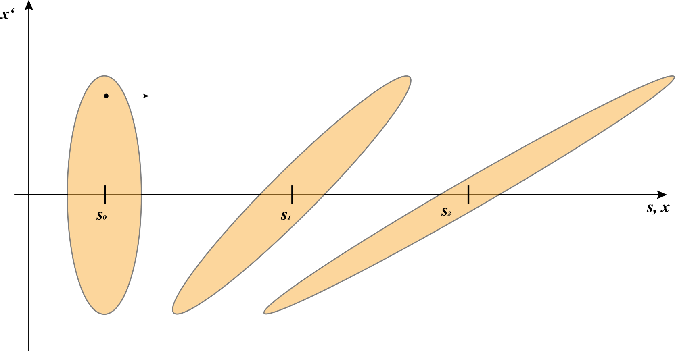
Phase Space Ellipse in Drift Space
remember:

Slide 12
Phase Space Ellipse after focusing
Quad
x‘
s, x
di
v
e
r
ging
f
ocusing
c
o
n
v
e
r
ging
beam
di
v
e
r
ging
beam
quadrupole
beam
w
ai
s
t
beam

Slide 13
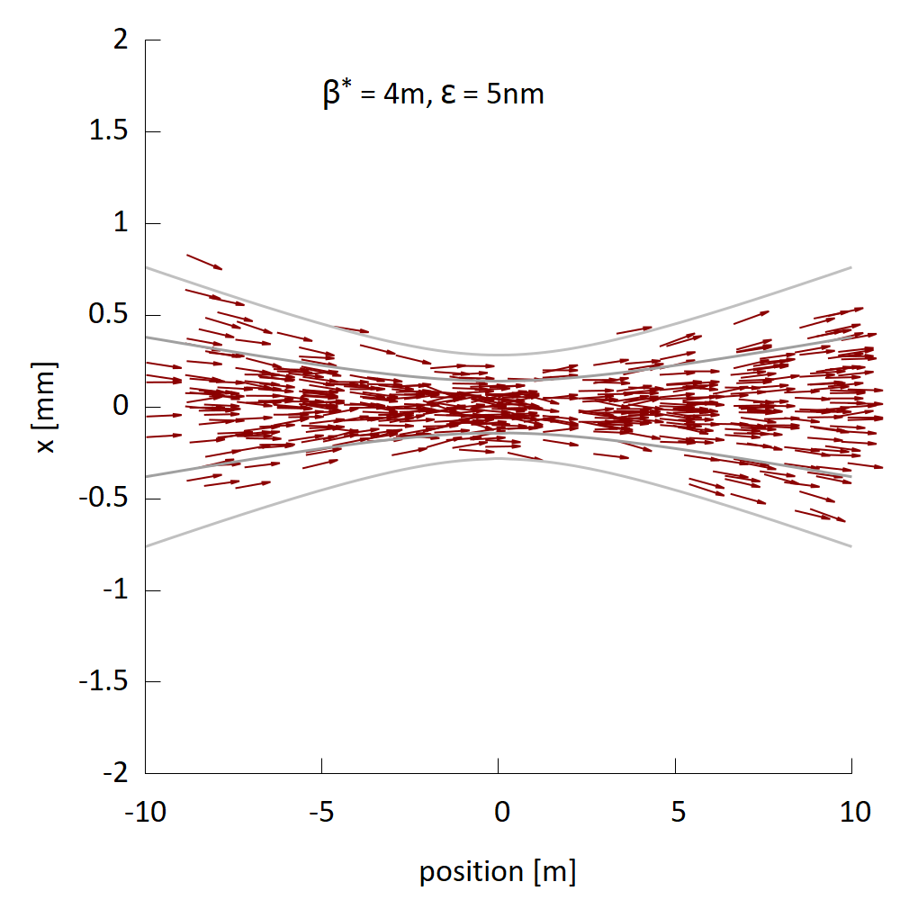
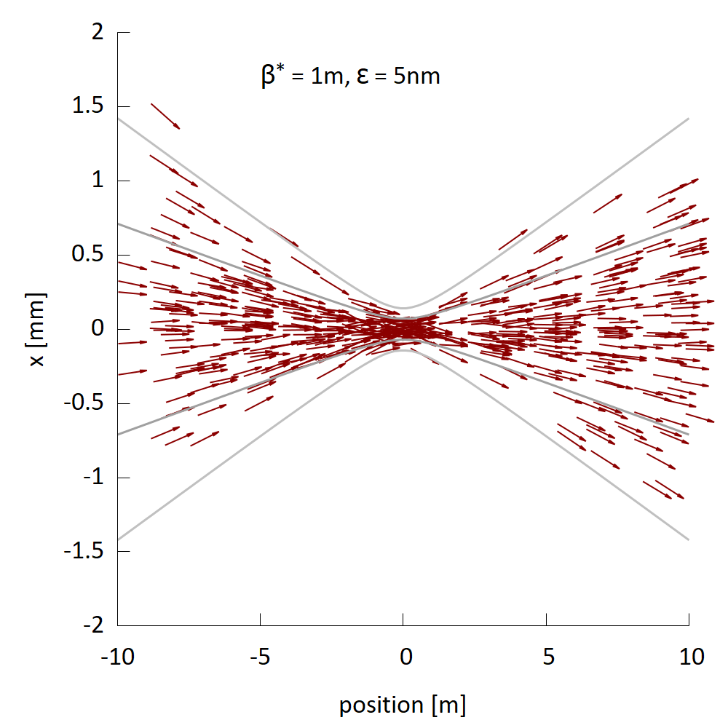
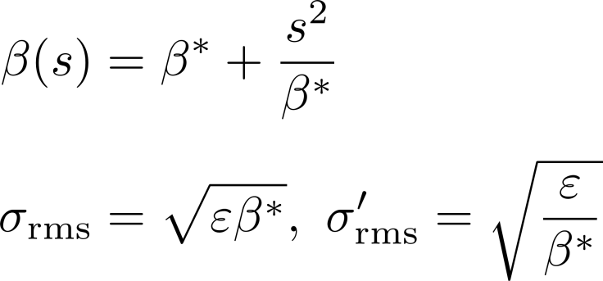
Beam Waist (e.g. interaction point collider)
β* = Beta function at waist

Slide 14

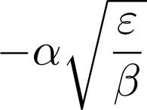

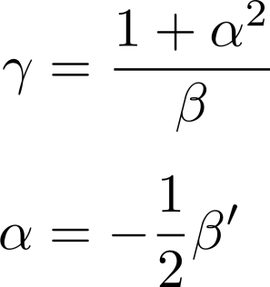



Phase Space Ellipse - Parameters
x’
reminder:
x
for upright ellipse:

Slide 15
Remarks on Beam Distributions
Electrons
in a ring electrons radiate photons which continuously mixes particles in phase space and generates an equilibrium Gaussian distribution
i.e. a large injected beam will shrink to equilibrium while a small beam will grow
Protons, Ions
“protons never forget” G.Voss
can have “strange” distributions since those depend on the history of beam generation and acceleration; i.e. no damping mechanism
however: in practice often close to Gaussian distribution

Slide 16
Next: FODO Lattices
FODO parameter space
FODO with bending magnets

Slide 17
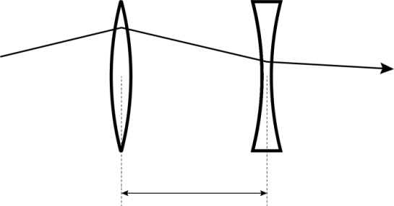
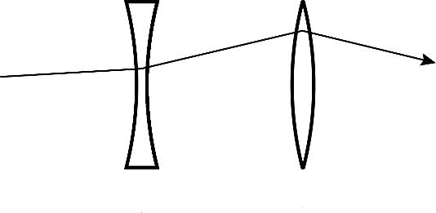
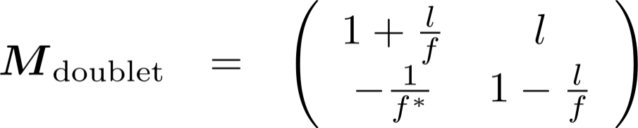
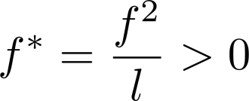
Reminder: Quadrupole Doublet
l
→ M_{doublet} is always focusing

Slide 18
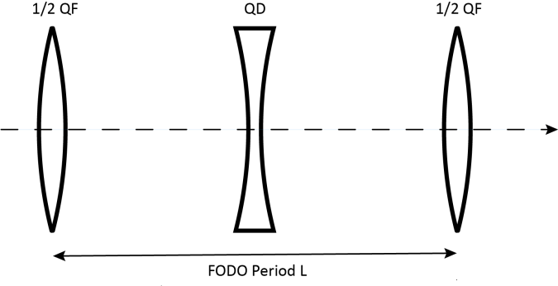
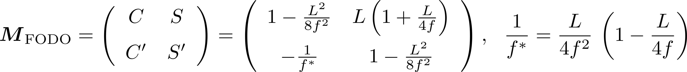
FODO Cell
Unit sequence of magnets used to build an accelerator
Alternating gradients → net focusing!

Slide 19
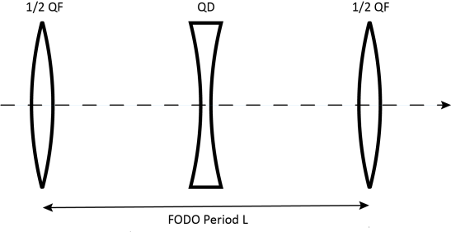
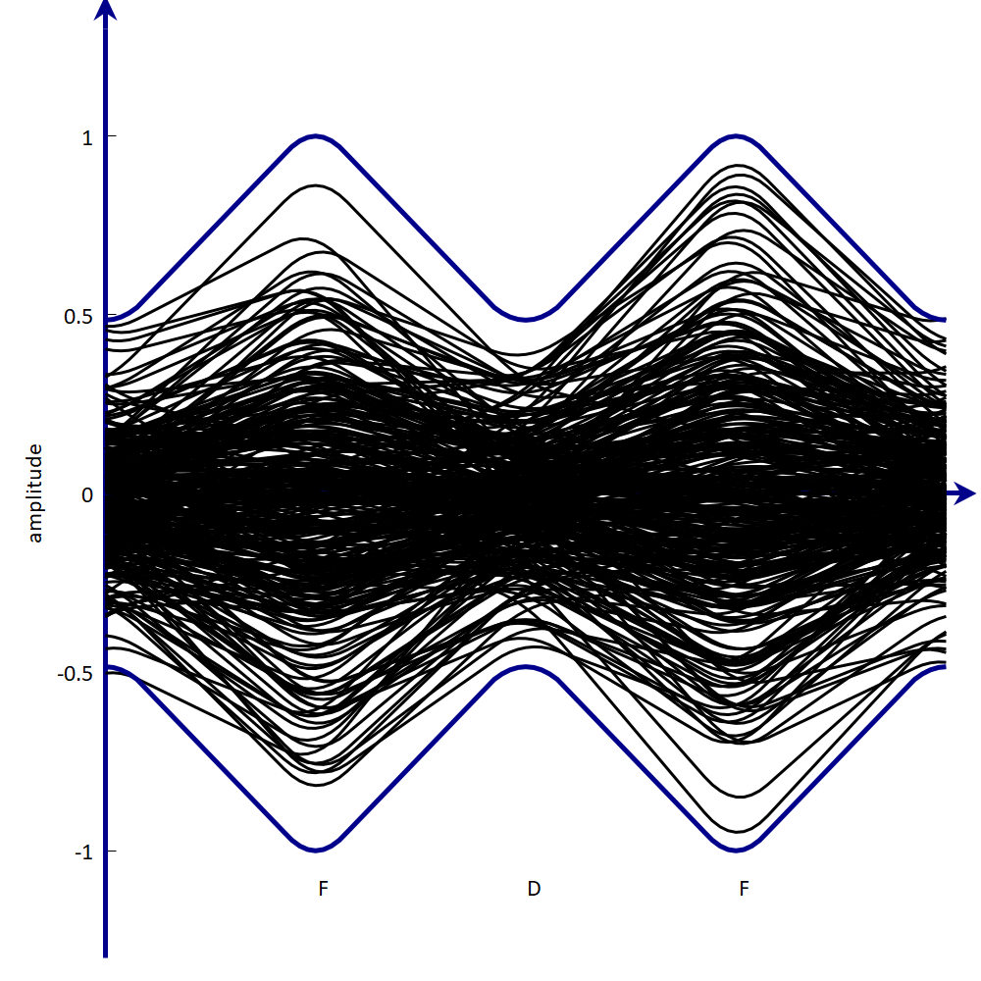
FODO Cell II
illustration:
particle trajectories of varying phase and amplitude in a FODO cell
Gaussian (projected) profile

Slide 20
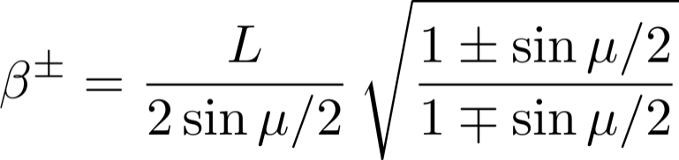
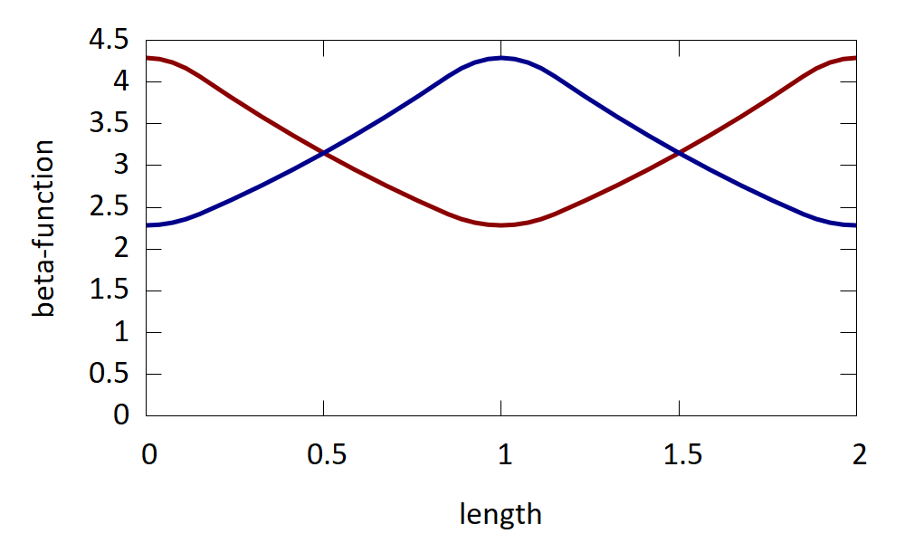
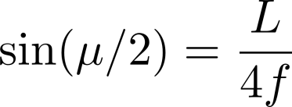
FODO Cell Parameters
we obtain for β⁺ in the focusing quad and β⁻ in the defocusing:
β⁺
phase advance per cell:
β⁻
see Wiedemann sec. 10.1

Slide 21
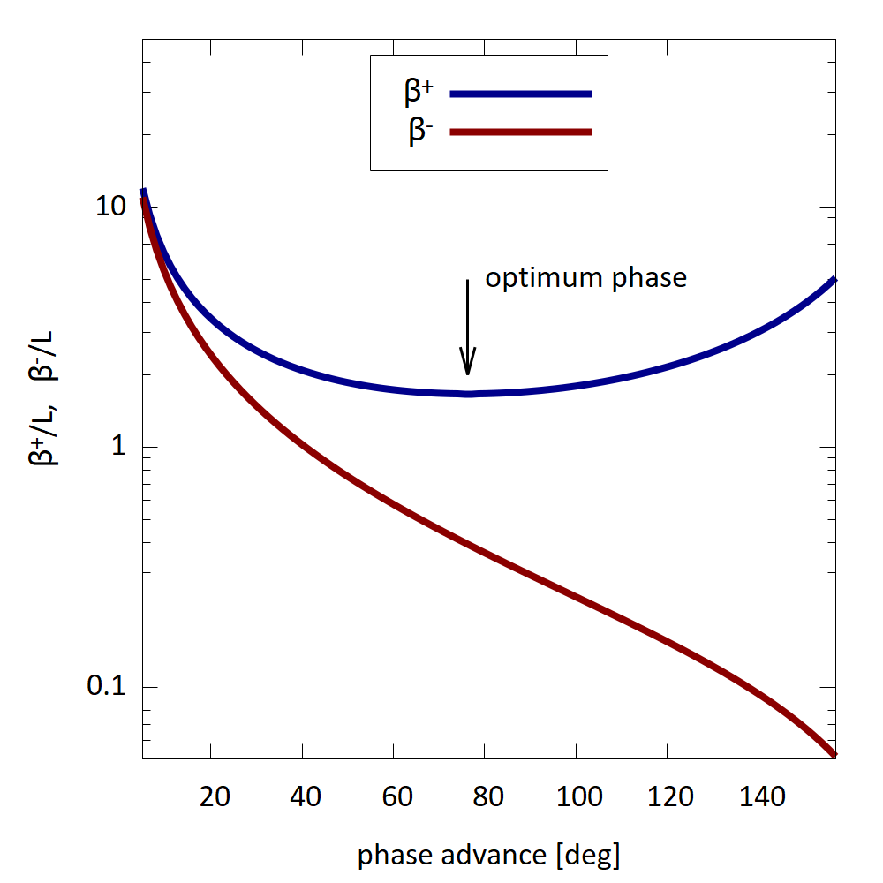
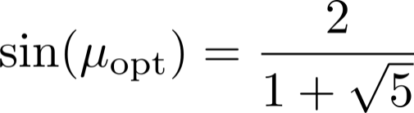
FODO Cell: choice of phase advance
β⁺ reaches minimum at μ_{opt}=76.3deg
at this point the vacuum chamber needs a minimal size
Example LEP(CERN) operating modes:
µ_{x}/µ_{y} [degrees]:
60/60, 90/60, 90/90, 102/90
(stronger foc. = smaller emittance)
note scaling per L

Slide 22
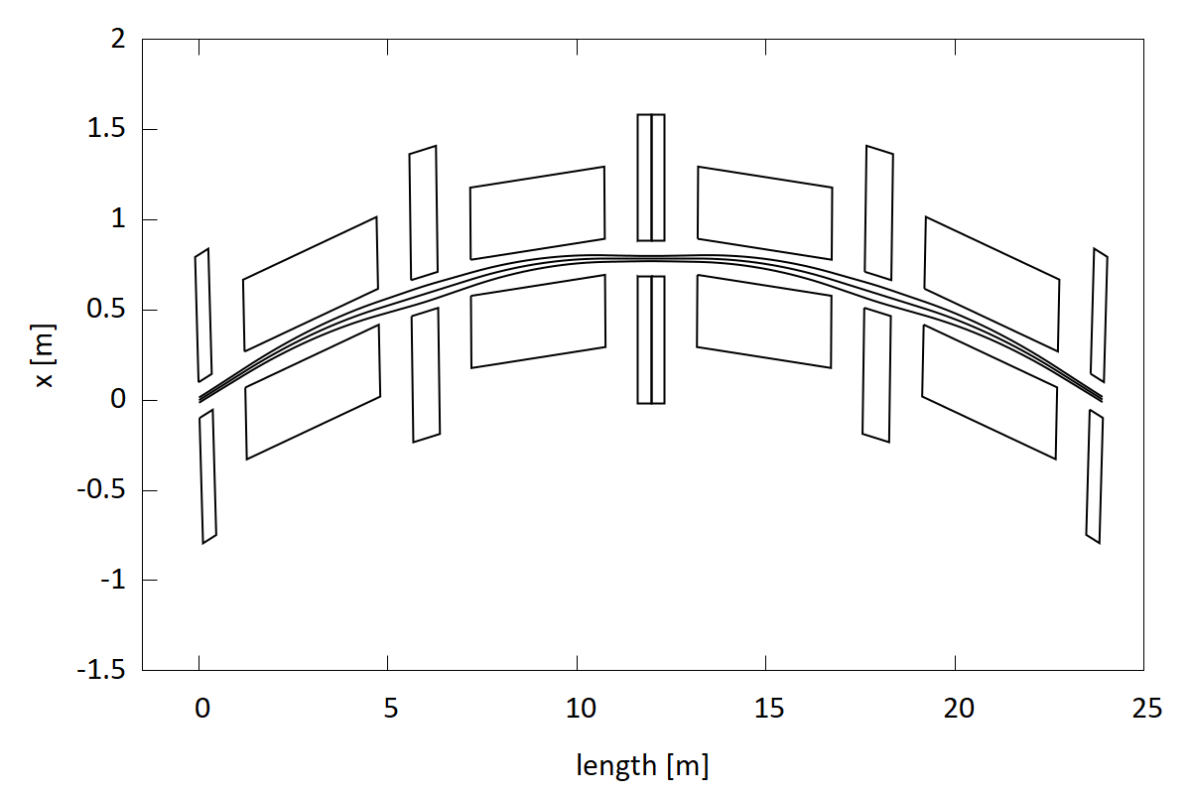
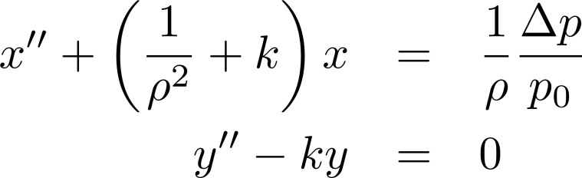
FODO Cell with Bending Magnets
FODO structure with bending magnets to form a ring - the standard scheme for synchrotrons
example:
2 FODO cells
ρ = 55m
separated function
F
B
D
B
F
B
B
D/2
D/2

Slide 23
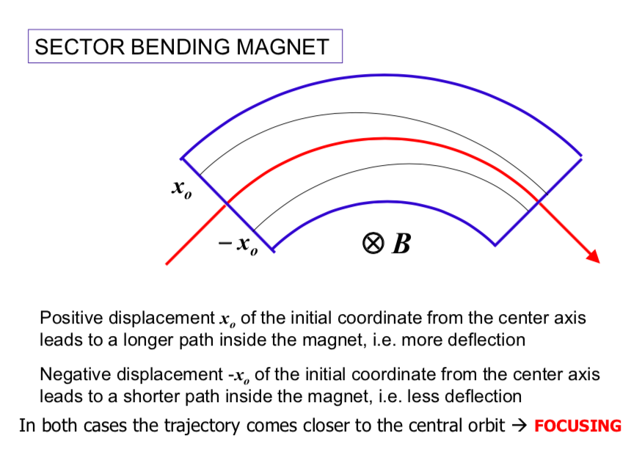
Weak focusing can be neglected for machines with large bending radius

Slide 24
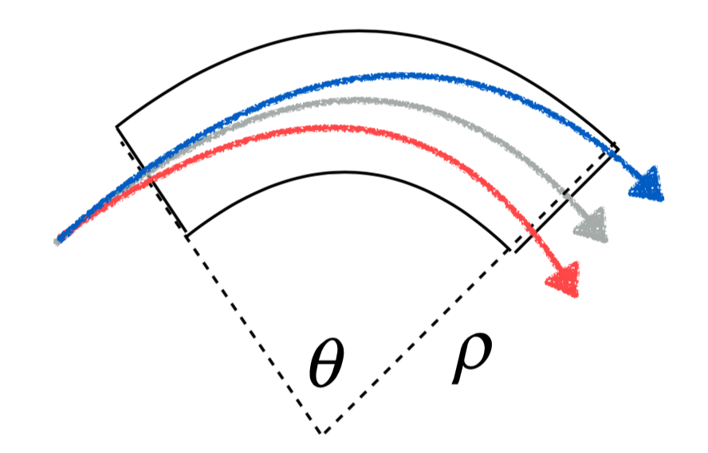
Dispersion
….for particles with δ energy equations of motion change!
Bending in a dipole changes with the particle energy…

Slide 25
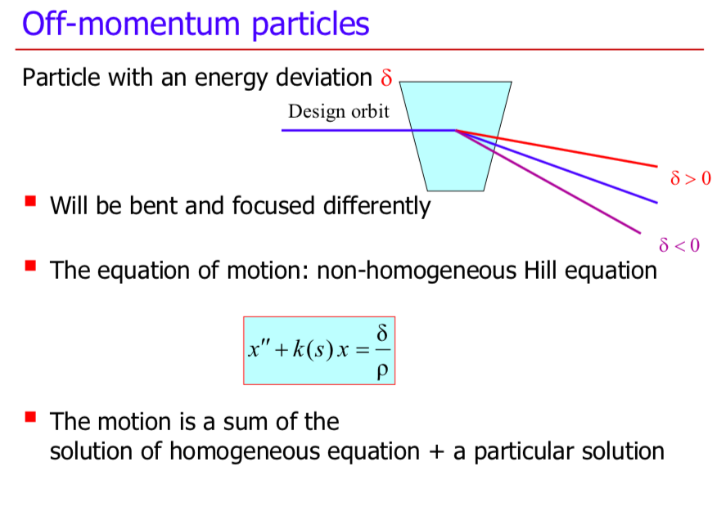

Slide 26
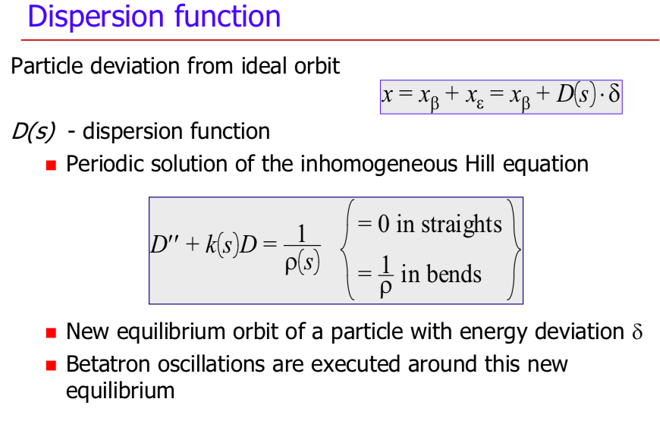

Slide 27
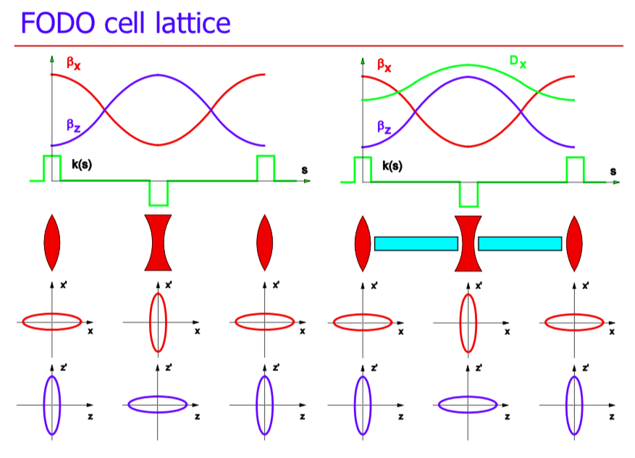
D(s) is a periodic function in FODO cells
Notes:
TODO…

Slide 28
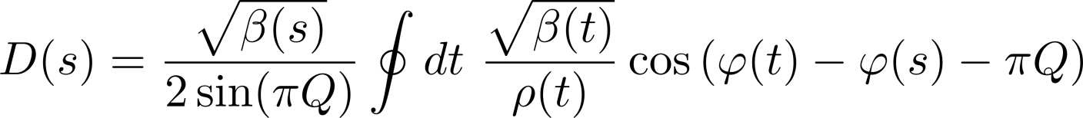
Dispersion Function in a Ring
the dispersion function at position s is calculated by integrating over contributions from bending magnets (1/ρ≠0) around the ring:
D, D’ are periodic functions:

Slide 29
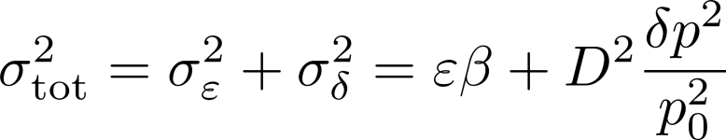
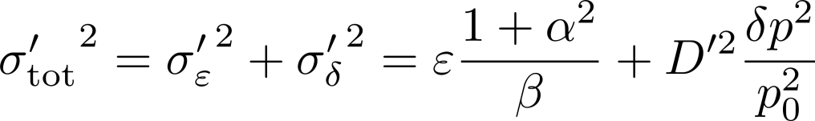
Beam size with finite momentum spread
besides emittance also momentum spread may contribute to beam size and angular spread, via dispersion function; when the beam momentum spread is δ:
x’
quadratic addition of transverse and longitudinal contributions:
δ < 0
δ > 0
x
at some locations the momentum contribution should be suppressed by designing for D=0, D‘=0
examples:
interaction point in a collider where beams should be as small as possible
undulators/source magnets, where divergence of emitted radiation should be small

Slide 30
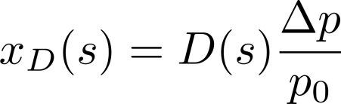
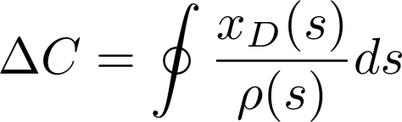
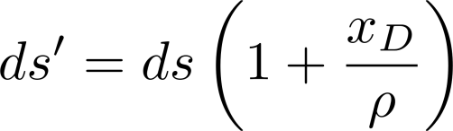

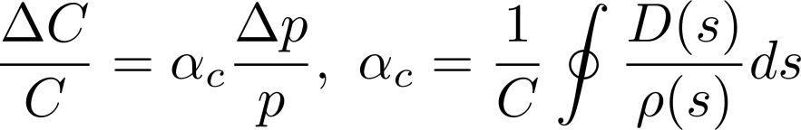
Path Length Change with Momentum
for an off-momentum particle the path length changes; consider a particle on a closed dispersion trajectory, i.e. no betatron oscillation: J=0, but Δp ≠0
the change in circumference for this particle is:
x
ρ
we introduce the momentum compaction factor α_{c}:
see Wiedemann sec. 8.4.6

Slide 31
Next: Chromatic Focusing Error
Focusing Error - What happens?
Chromaticity
Correction using Sextupole Magnets

Slide 32
Chromatic Errors
a spread of momentum leads to chromatic aberrations, similarly to aberrations of optical lenses:
nominal focal length
Δp/p < 0
Δp/p = 0
Δp/p > 0

Slide 33
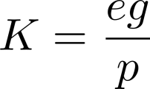
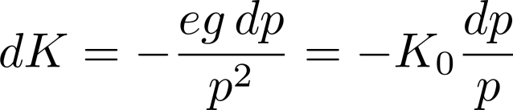
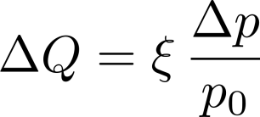
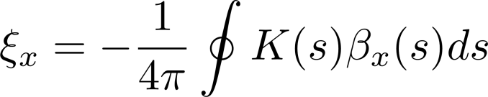
Chromaticity
particles with momentum deviation are focused differently, leading to a shift of the betatron frequency
Chromaticity ξ = change of tune per relative change of momentum:
integration over gradients around ring, betafunction as “sensitivity factor”:
see Wiedemann sec. 15.4.1

Slide 34
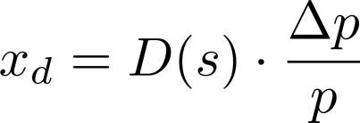
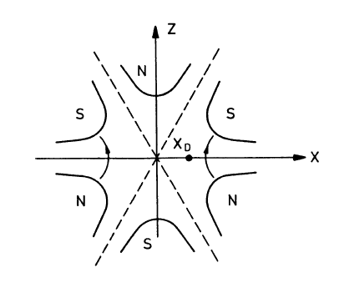
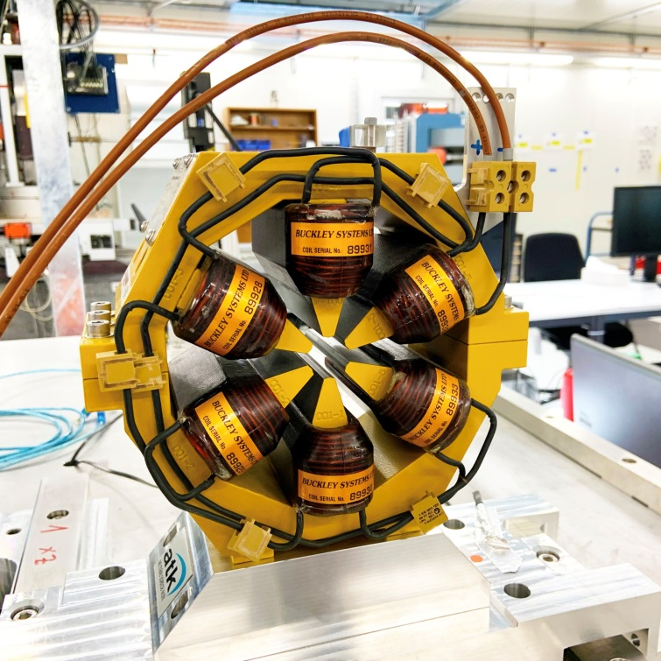
Sextupol Magnet
Sextupoles are placed in a region of finite dispersion:
sort particles according to their energy deviation
[PSI / SLS Sextupol]

Slide 35

Chromaticity – Correction using Sextupoles
nominal focal length
Δp/p > 0
positive dispersion
D_{x} > 0
Δp/p = 0
Δp/p < 0
a sextupol acts like a position dependent quadrupole
quadrupol
sextupol
see Wiedemann sec. 15.4.2
total chromaticity in a ring:

Slide 36

Caution with Sextupoles
while sextupoles can correct chromatic focusing errors, they are nonlinear elements
nonlinear elements drive resonances and reduce the dynamic aperture of a ring, which must be carefully optimized when designing a ring
phase space portrait with sextupole kick

Slide 37
Next: Lattice Imperfections
closed orbit distortion
gradient errors

Slide 38

Closed Orbit
The stable mean value around which the particles oscillate is called the closed orbit. Every particle in the beam oscillates around the closed orbit.
the oscillating trajectory is not closed
in practice the closed orbit does not exactly follow the design orbit, but deviates due to small errors
the closed orbit represents the beam center, particles with nonzero actions oscillate around it
to assess practical implications and tolerances the effect of orbit distortions must be estimated
[closed orbit – conceptual sketch]
see Wiedemann sec. 15.2.3

Slide 39
The closed orbit
The general expression of the closed orbit X_{co}(s) in the presence of a deflection θ is:
kink at the location of the deflection
amplitude modulated by the envelope β
oscillating term
X_{co}(s)
divergence for Q = n

Slide 40
Unintended deflection
The first source is a field error (deflection error) of a dipole magnet.
This can be due to an error in the magnet current or in the calibration table (measurement accuracy etc).
  The imperfect dipole can be expressed as a perfect one + a small error.
real dipole
ideal dipole
small dipole error
=
+
A small rotation (misalignment) of a dipole magnet has the same effect, but in the other plane.
real dipole
ideal dipole
small dipole error
=
+

Slide 41


Unintended deflection
The second source is a misalignment of a quadrupole magnet.
  The misaligned quadrupole can be represented as a perfectly aligned quadrupole plus a small deflection.
real quadrupole
ideal quadrupole
small dipole error
=
+
Non-zero magnetic field on the beam axis !
No magnetic field on the beam axis

Slide 42




Effect of a deflection
We set the machine tune to an integer value:
  Q = n ∈N
Deflection
Beam direction
X_{co}(s)
Turn no 1
When the tune is an integer number, the deflections add up on every turn !
  The amplitudes diverge, the particles do not stay within the accelerator vacuum chamber.
Turn no 2
Turn no 3
Turn no 4

Slide 43


Effect of a deflection
Deflection
Beam direction
X_{co}(s)
We set the machine tune to a half integer value:
  Q = n+0.5, n ∈N
Turn no 1
Turn no 2
For half integer tune values, the deflections compensate on every other turn !
  The amplitudes are stable.
Turn no 3
Turn no 4
  This looks like a much better working point for Q!

Slide 44







Many turns reveal something
Let’s plot the 50 first turns on top of each other and change Q.
  All plots are on the same scale
Q = n + 0.5
Q = n + 0.4
Q = n + 0.3
Q = n + 0.2
Q = n + 0.1
Q = n + 0.05
Q = n
The particles oscillate around a stable mean value (Q ≠ n)!
The amplitude diverges as we approach Q = n → integer resonance
  We just encountered our first resonance – the integer resonance that occurs when Q = n ∈N

Slide 45
Gradient Error
most simple case: the distortion of the gradient is short and can be treated as a thin lens
K(s)
C
s
we want to know:
the tune shift caused by the error
the modification of the beam width (via computing Δβ(s))

Slide 46

Gradient Error - Calculation
method: modify 1-turn transport matrix by multiplying thin lens error matrix
resulting tune shift for distributed gradient errors:
see Wiedemann sec. 15.3.1
solution explodes for Q → Integer × 0.5
note: double frequency
this error modulates the beam width around the ring
the effect is called „Beta-Beat“
the Beta-Beat propagates at the double frequency of an orbit distortion

Slide 47

Gradient Error Example continued
accelerator lattice with 13 regular FODO cells, one quad in center has an error of +2%
when Δβ/β is plotted against phase advance we see the “error kick” and the double beat frequency

Slide 48
Next: Lattice Insertions
low Beta insertion

Slide 49

Low Beta Insertion
concept sketch: using a quadrupole doublet it is possible to focus particles in the horizontal and vertical planes simultaneously through the interaction point
incoming trajectories, parallel to reference orbit, in x,y

Slide 50


Low Beta Insertion
the most simple IR configuration
doublet focusing
large beta function in doublet → aperture limitation for ring
see also Wiedemann sec. 10.2.4

Slide 51

Low Beta Insertion – Example of LHC
LHC interaction region
with Low-Beta + D.S.

Slide 52
Beam Waist (e.g. interaction point collider)
β* = Beta function at waist

Slide 53



Orbit Correction:
Reminder - Closed Orbit Distortion by Kick θ
kick θ is caused by an unwanted magnetic field, or an off-set quadrupole (errors)
however, kick can be applied also on purpose to correct the orbit
with several kicks θ_{j} the contributions are added:

Slide 54






Orbit Correction
given is a set of beam positions representing an orbit $x_{k}$
calculate a set of (wanted) corrector strengths $θ_{j}$ to minimize the orbit amplitide
this can be formulated as a problem of linear algebra (R_{kj} coefficients last slide):
this is solved exactly for $N_{pos}=N_{cor}$, however in practice we need flexible solutions
Singular Value Decomposition (SVD) is one approach:
W = diagonal matrix with singular values, inversion simple
solution:
$N_{pos}=N_{cor}$: exact solution
$N_{pos}<N_{cor}$: minimizes $|\vec{θ}|$ (magnet currents)
$N_{pos}>N_{cor}$: minimizes $|\vec{x}|$ (rms orbit deviation)
→ in practice this is done using computer codes of the accelerator control system
see Wiedemann sec. 15.4.2

