Slide 1
Introduction of the students: one slide - one minute

Slide 2




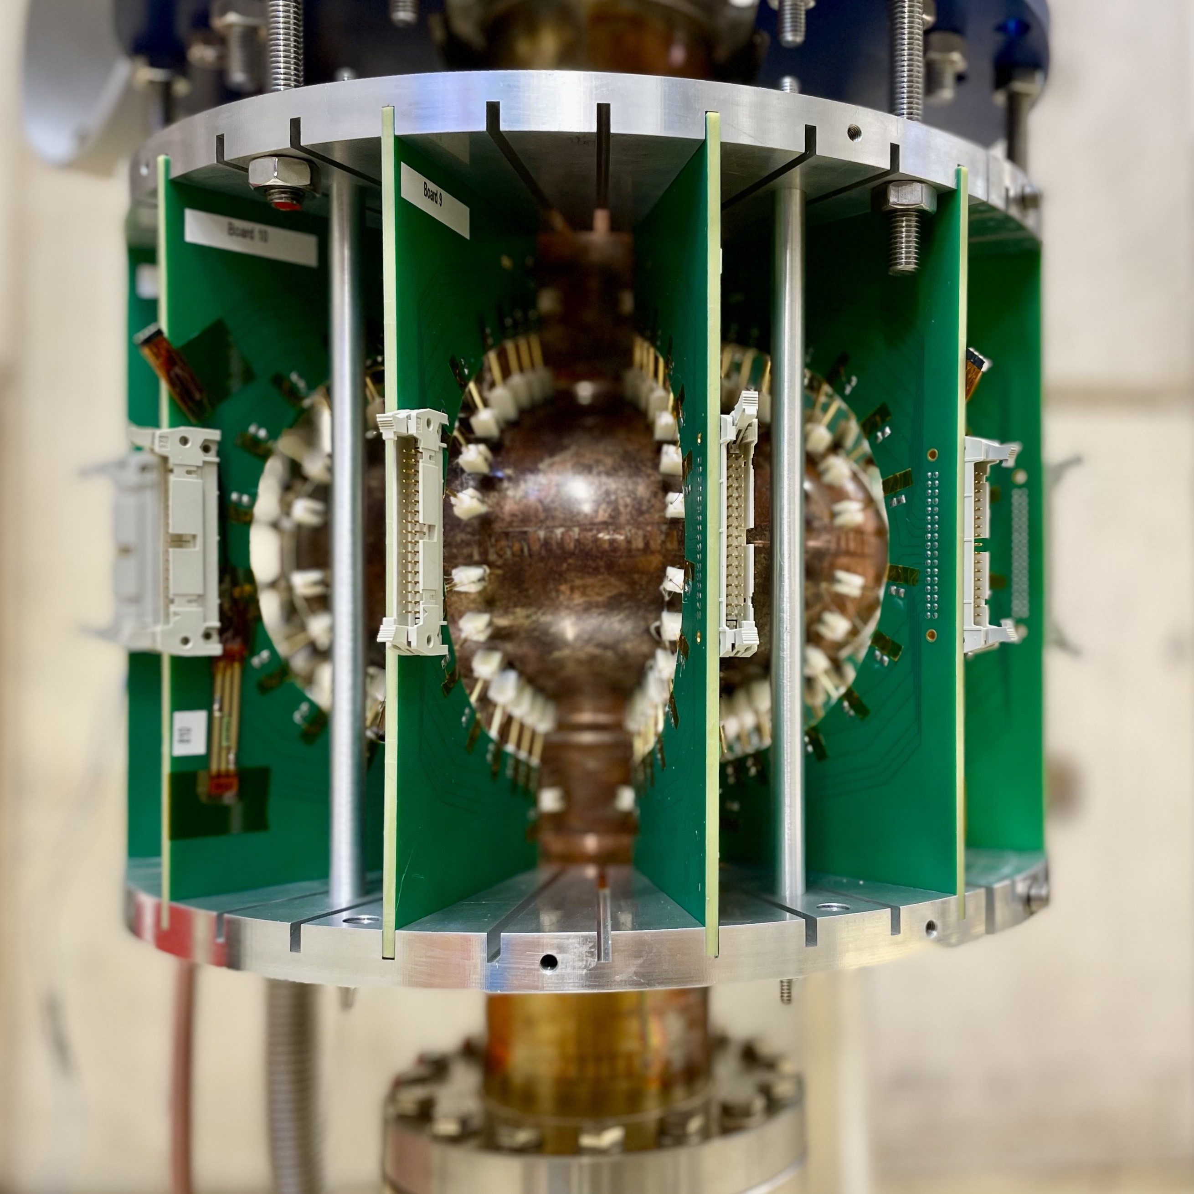
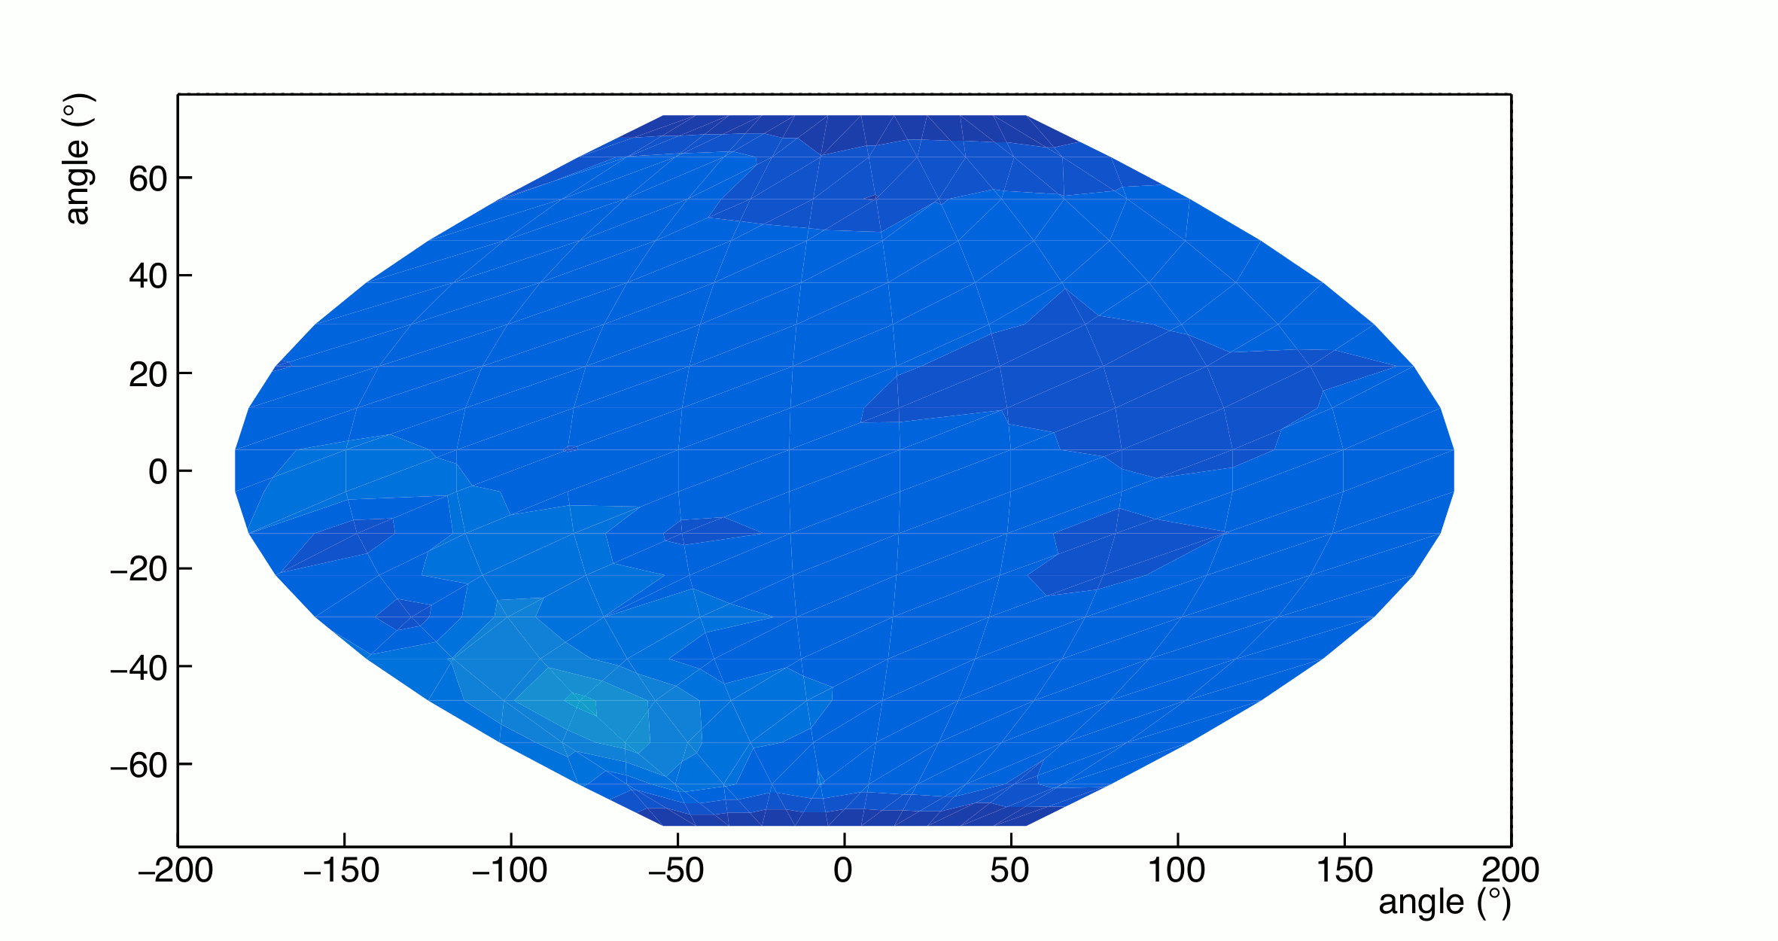

Antonio Bianchi
PhD at University of Torino and INFN
  Dissertation: “R&D Studies on Eco-friendly Gas Mixtures for Resistive Plate Chambers at the ALICE Muon Spectrometer”
Postdoctoral research: System Run Coordinator of the Muon Identifier
CERN Senior Fellowship: thermal mapping system for superconducting radio-frequency cavities
INFN Technologist
  IRIS Project

Slide 3
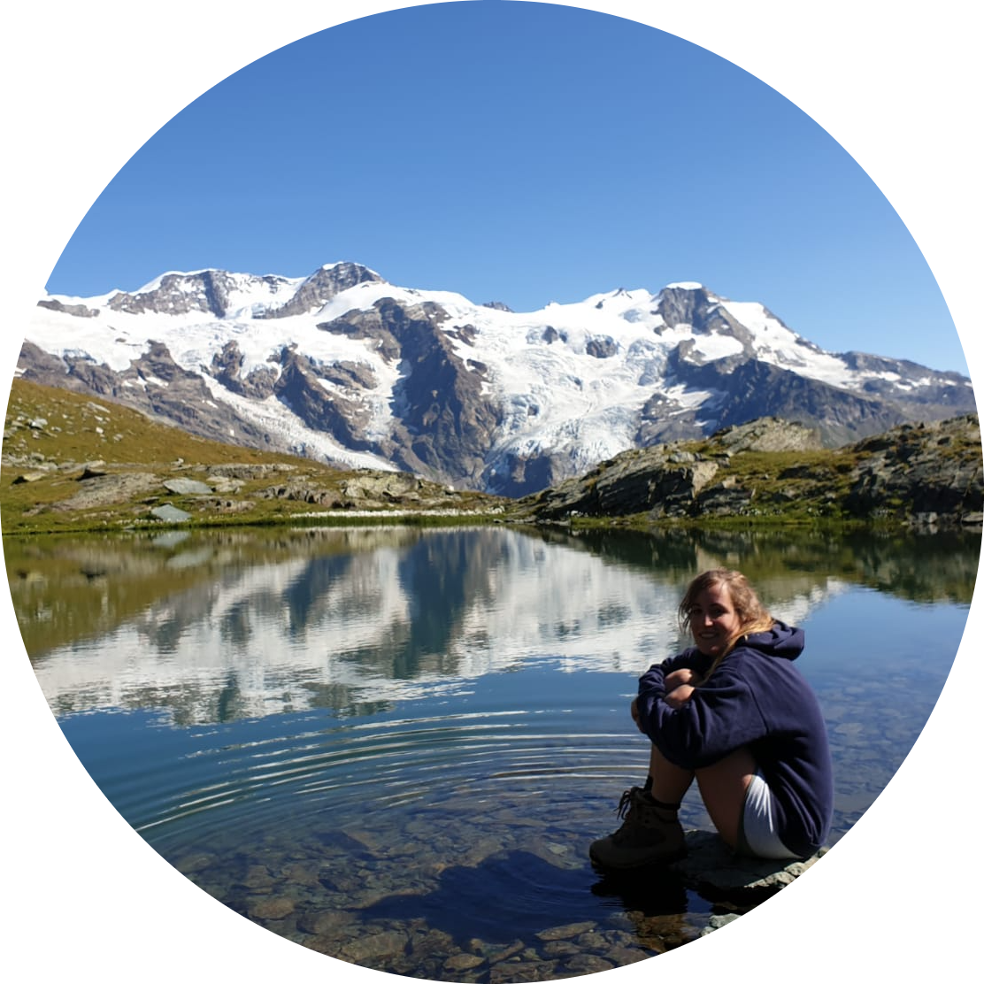


Marta Della Torre
Age: 31
Degree: Physics (Astrophysics)
Position: After the graduation I have worked four years as consultant in a big company where I learned how to manage the executive aspects of digital projects. Moreover, I monitored the economics and Gantt pianification and through data analysis in power BI I identified the more suitable technical solution. Now I took the chance to return working at INFN in Milan. In particular, I work as project manager for PNRR - IRIS
Hobbies: Astrophysics, Bruce Springsteen, Trekking, Reading
WHY HERE? PNRR-IRIS (Innovative Research Infrastructure on applied Superconductivity) is a big infrastructure projects in the field of the Applied Superconductivity. My job consists of following and monitoring all steps of the project and for this reason, I would like to know more about the latest technologies and ambitions of this branch in order to better understand the needs and challenges.
Erice – 27th July – 2nd August

Slide 4

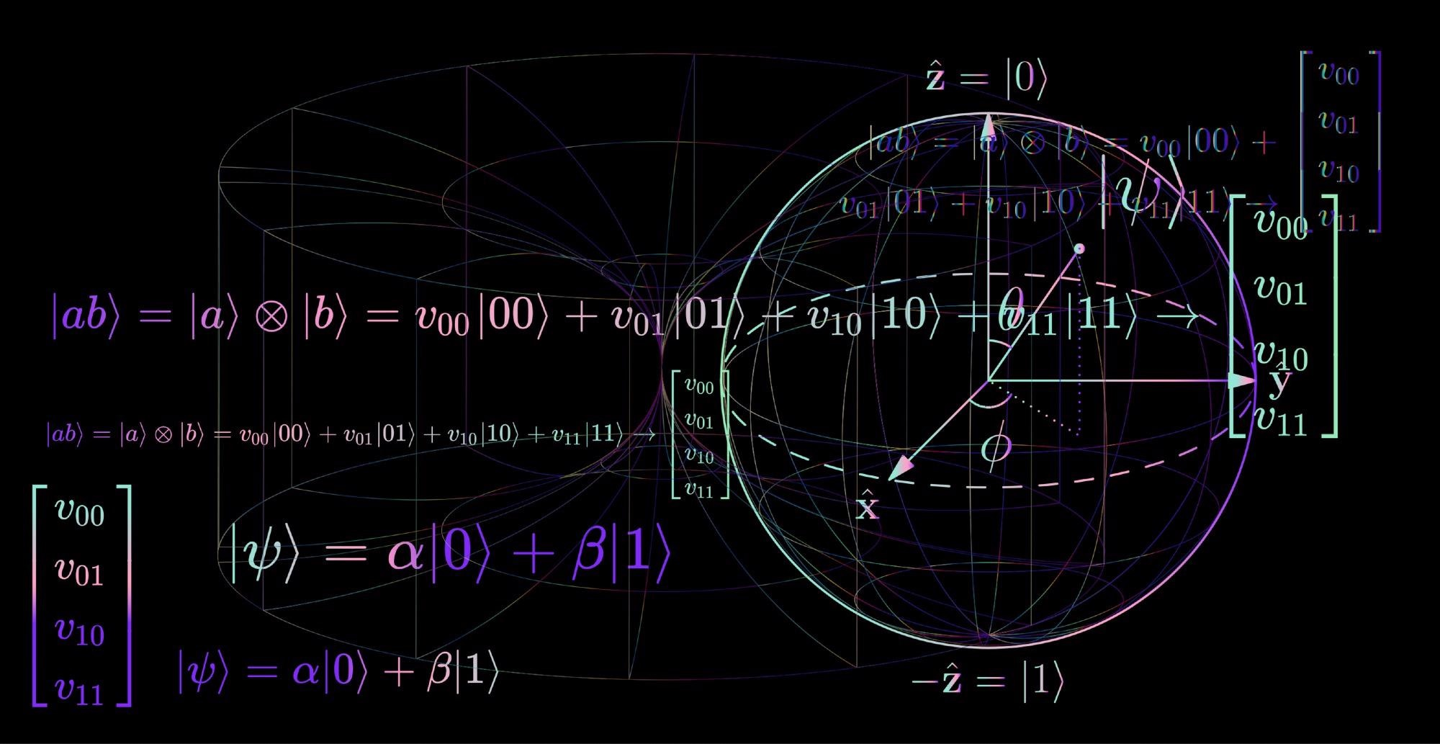
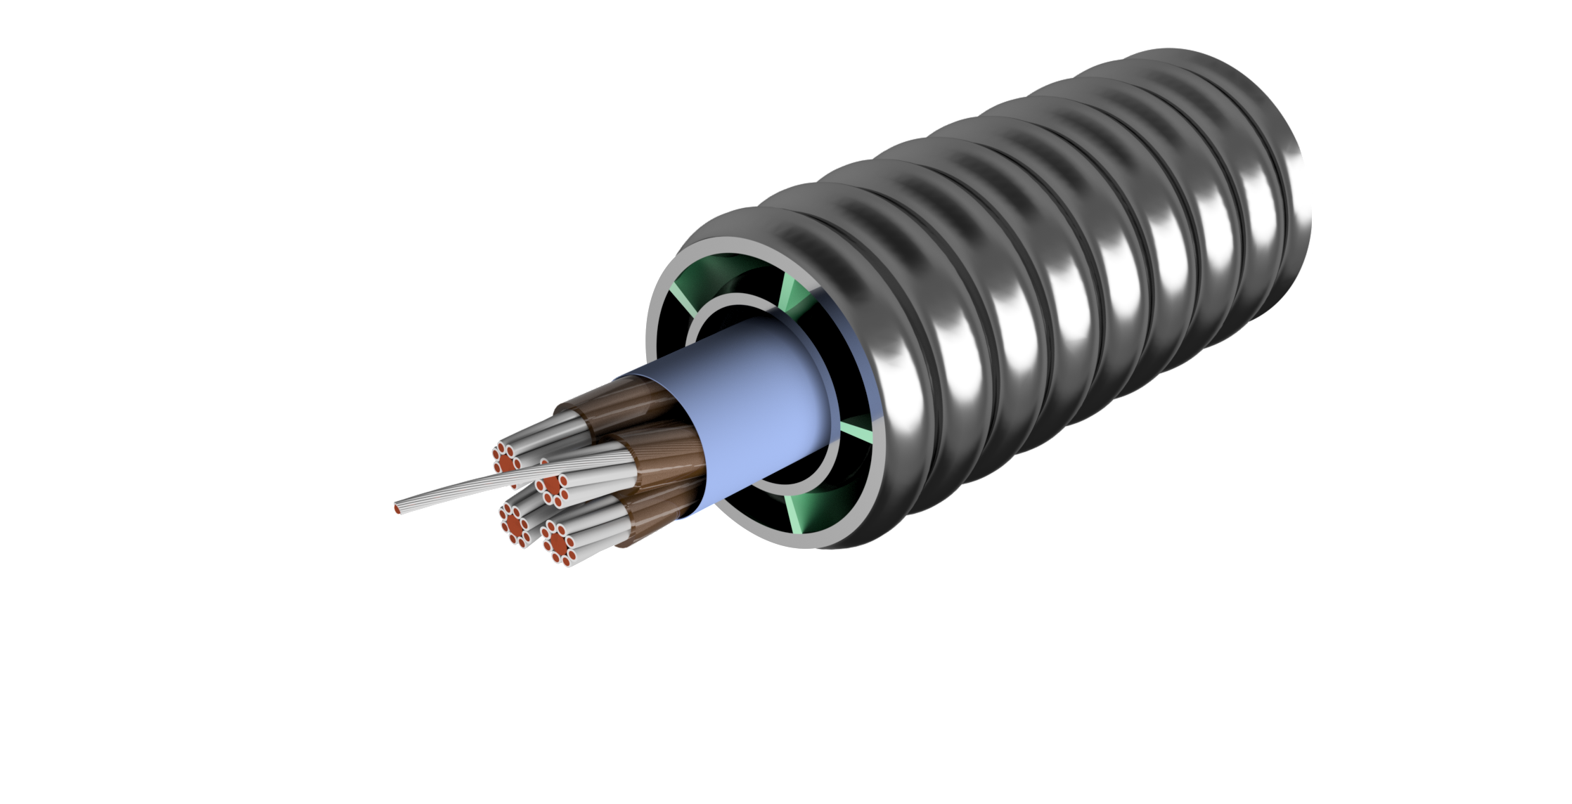

Stefano Maffezzoli Felis
LASA – INFN Milano
April 2014
Master’s degree in physics
December 2014 – October 2022
IT Consultant in IBM
November 2022
Ph.D. in accelerator physics

Slide 5

BEATRICE SERENELLINI
Master's Degree in Electronic Engineering at Sapienza University of Rome
Master thesis on supervised neural network for energy measurement of an electron beam in radio frequency guns
Currently employed at the INFN Frascati National Laboratories in the radio frequency service of the accelerator division
The activity consists of the study and characterization of Low Level RF systems for interfacing with control systems and use of machine learning methodologies

Slide 6


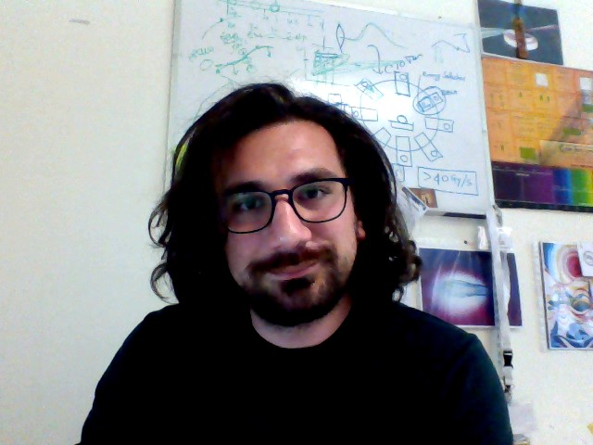
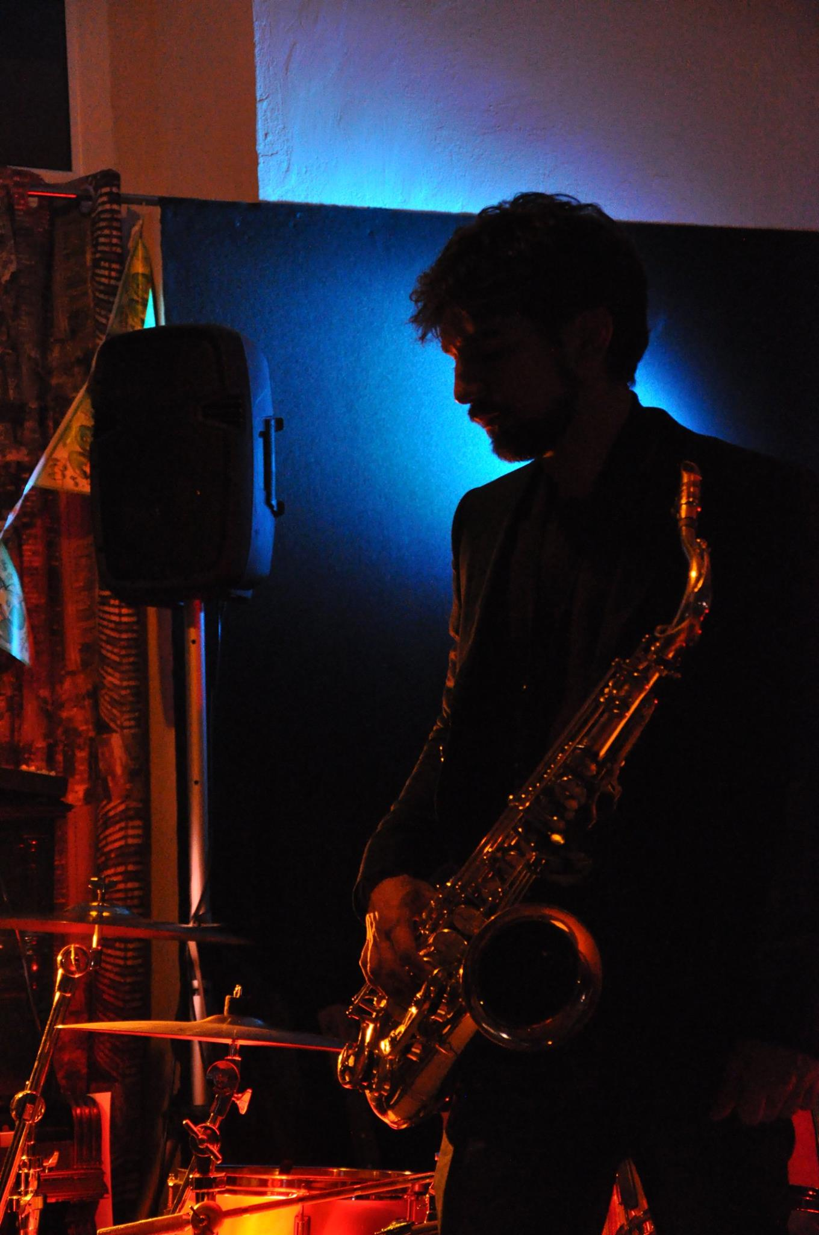
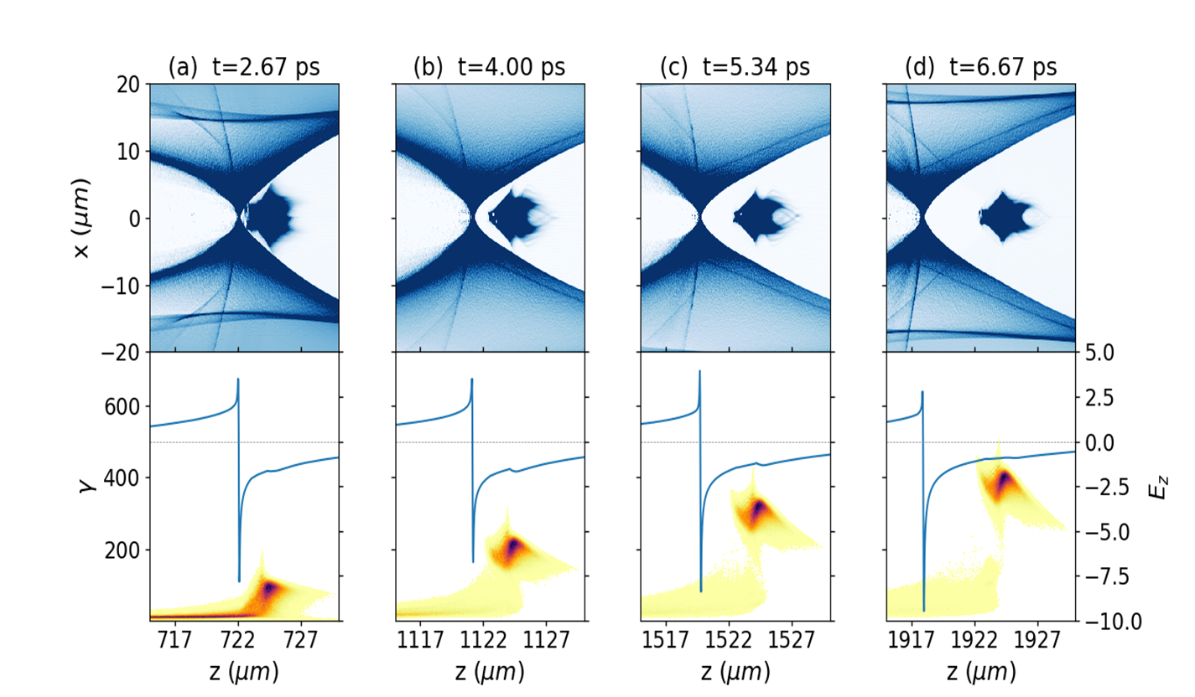
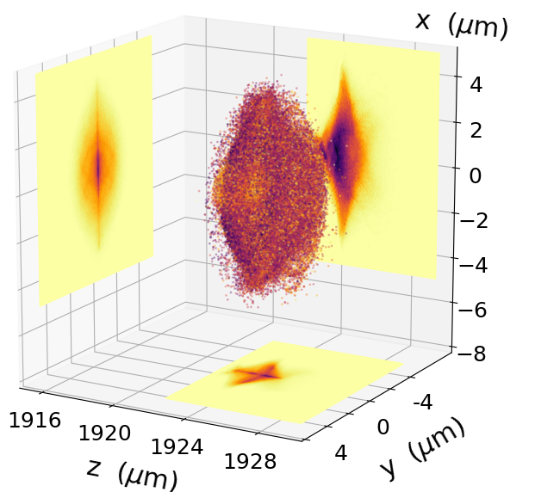
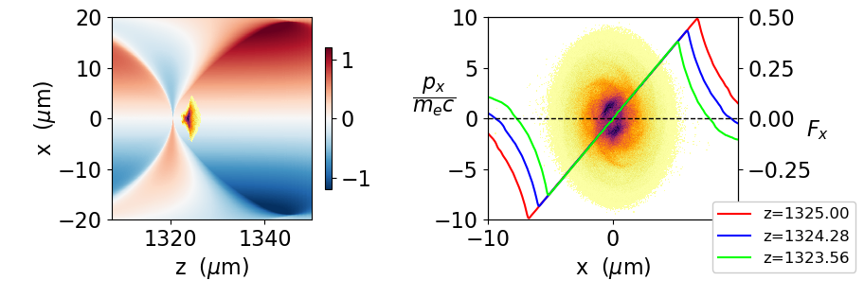
Nice to meet you!
Starting as musician, ended up as plasma physicist!
PhD student @ CNR-INO (Pisa)
Laser-plasma interaction for particle acceleration
I’m the «epic» Sax guy!
I’m the Computer guy !
Master thesis:
‘Acceleration of an ionization injected bunch in a laser-driven plasma bubble wakefield’
Laser driven bubble regime
Acceleration and focusing of electron bunch injected via ionization of Nitrogen
Tailoring the density downramp to preserve emittance from degradation
27/07/2023
Federico Avella
International School of Particle Accelerators – Erice2023

Slide 7
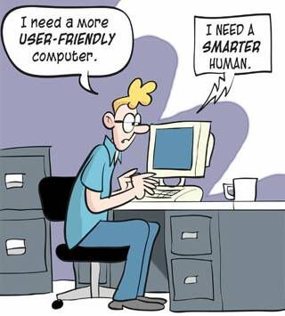
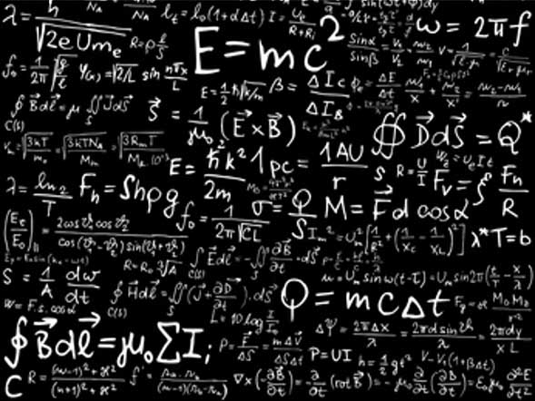
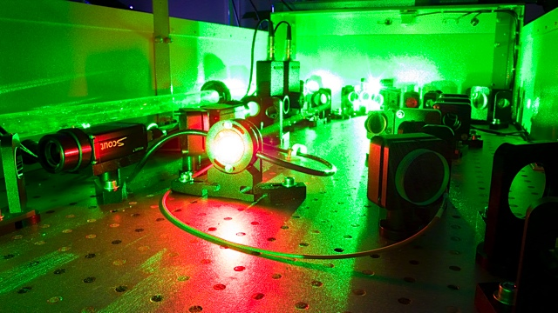
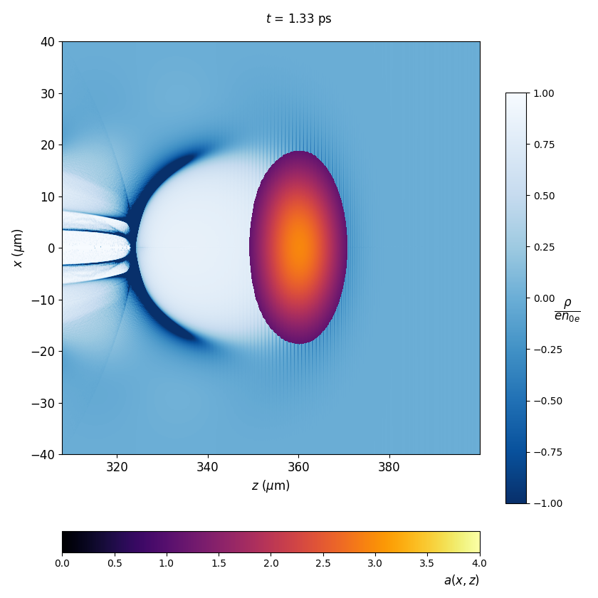
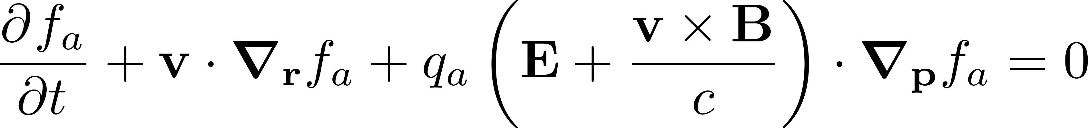
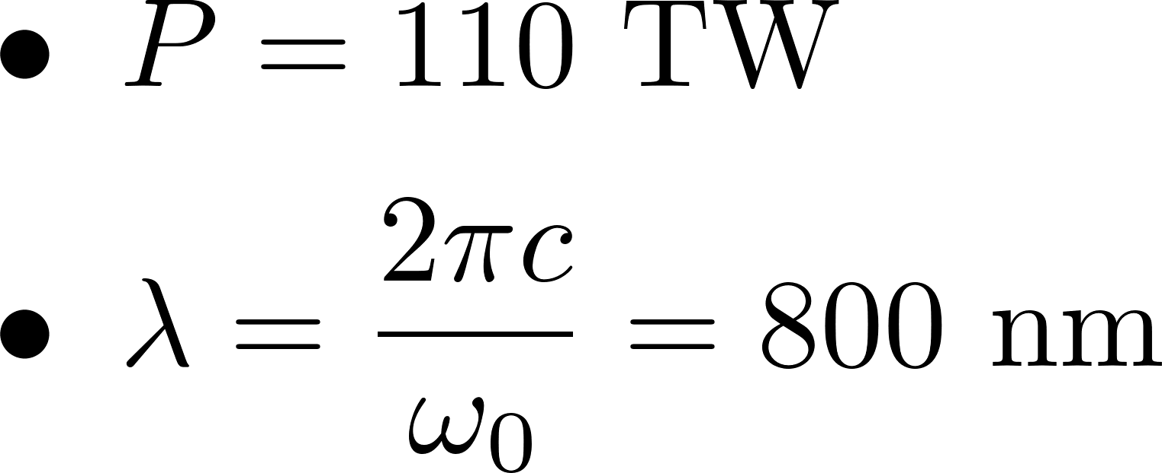
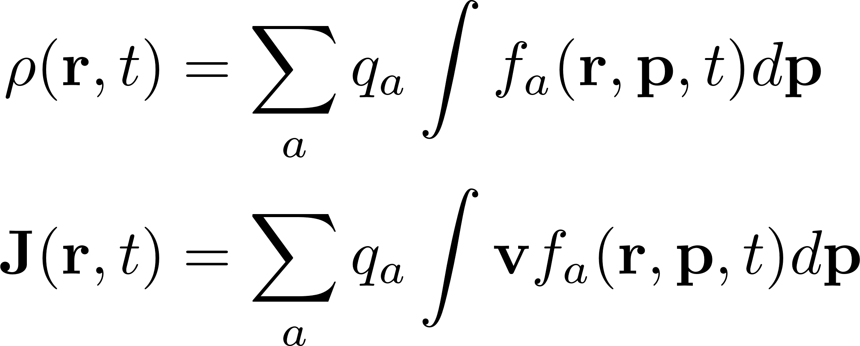
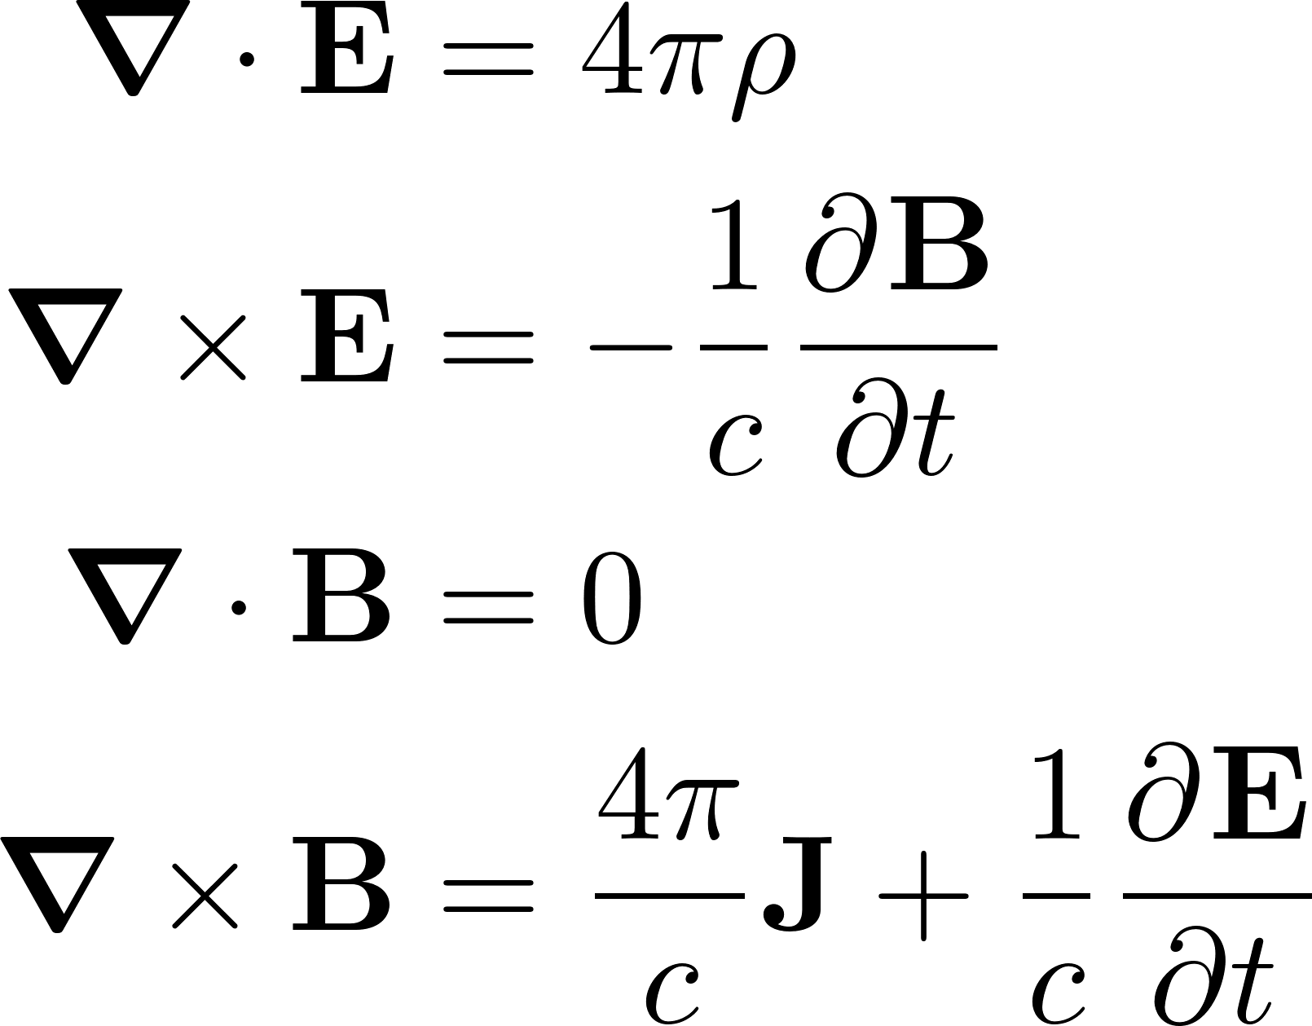
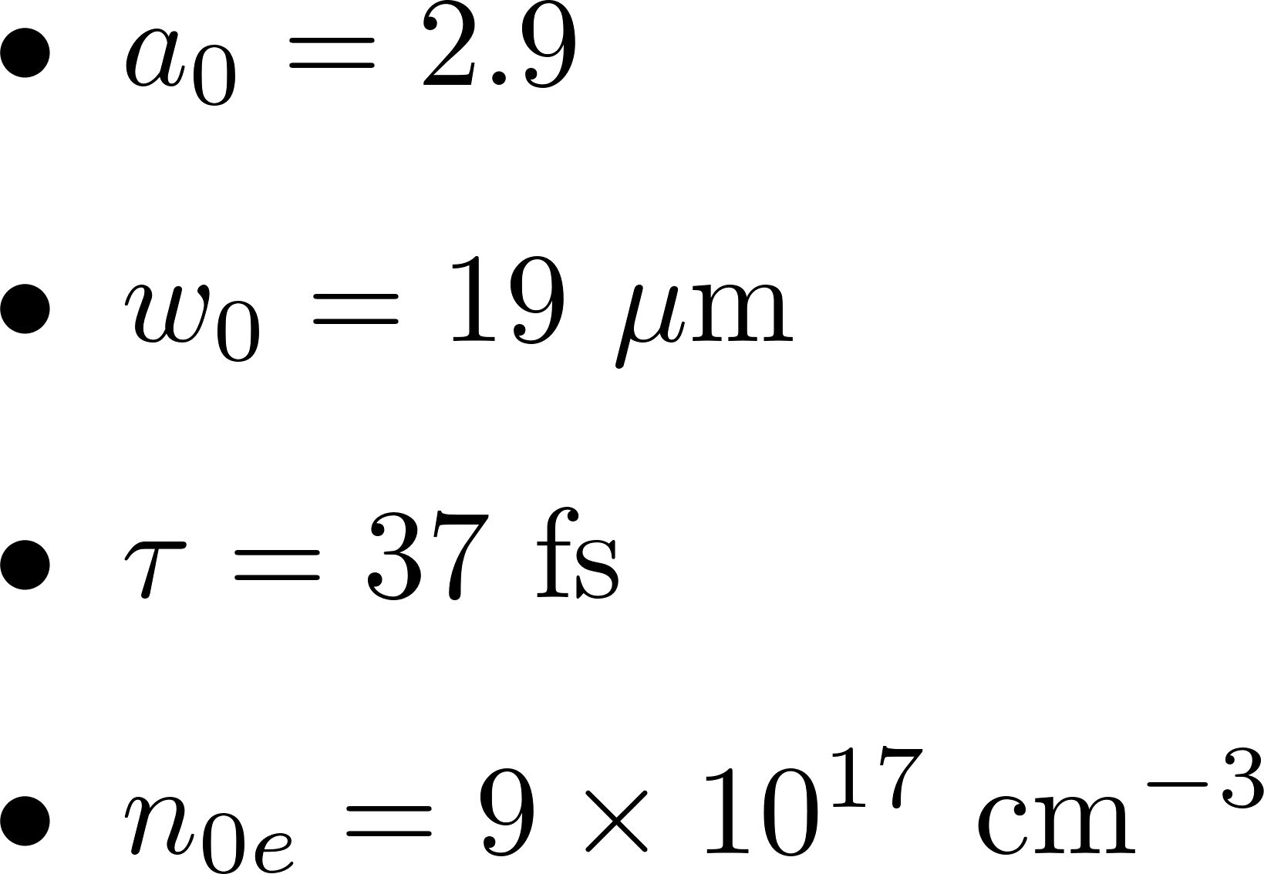
The third way: simulations
‘Work as a Theoretical’
‘Think as an Experimental’
‘Paid like a Musician’
Laser Ti:Sapphire
27/07/2023
Federico Avella
International School of Particle Accelerators – Erice2023

Slide 8



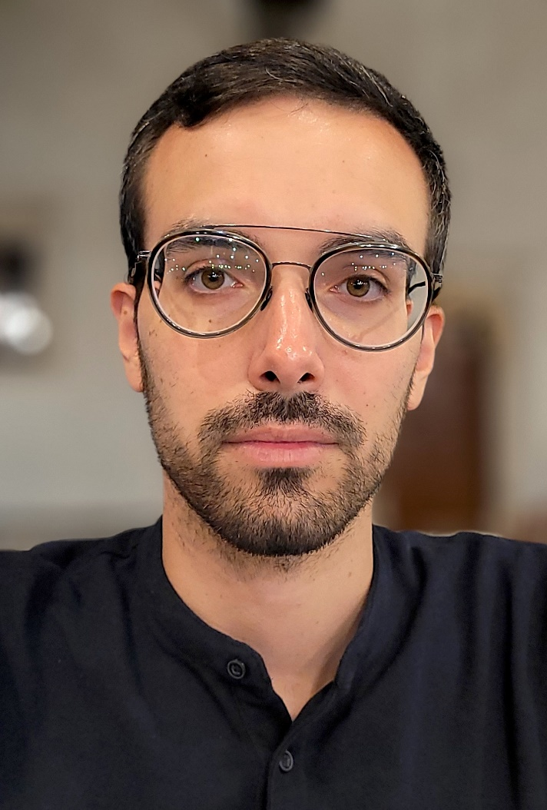
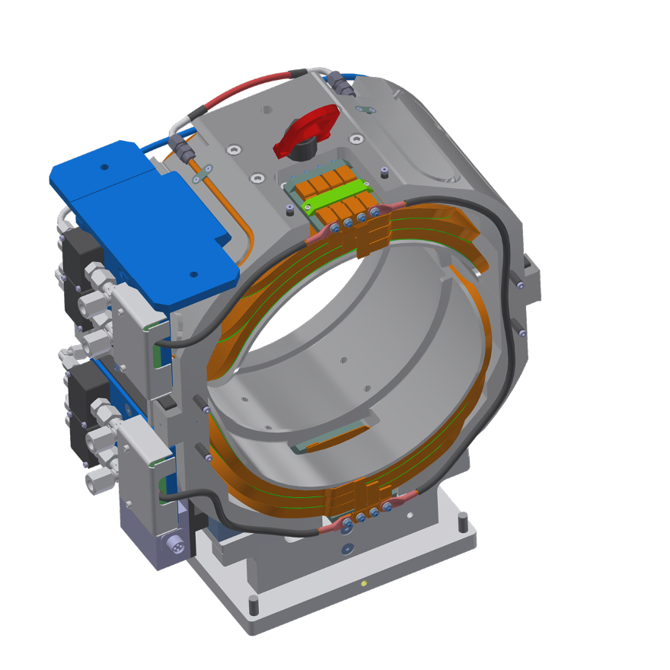
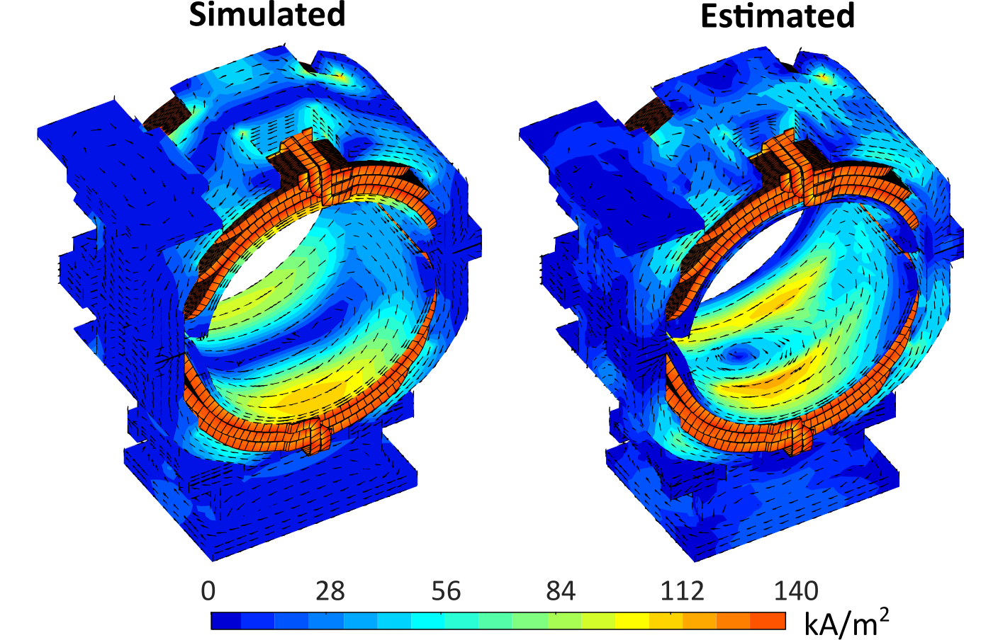
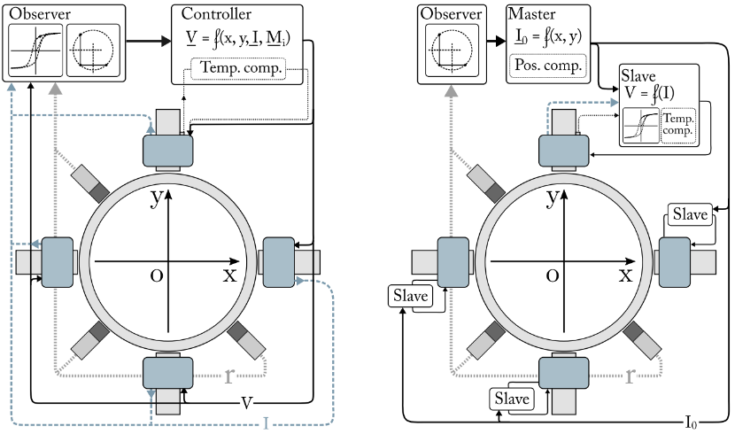
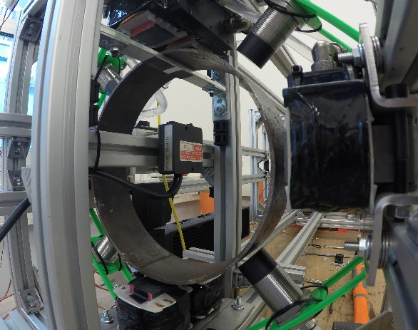
Stefano Sorti
CURRENT POSITION:
RTDa (researcher), Physics Department
Università degli Studi di Milano
PNRR_IRIS project, WP9: Energy Saving HTS Magnets for Sustainable Accelerators
Eddy-currents model for ELENA corrector dipole
EDUCATION:
Ph.D. in Mechanical Engineering
Politecnico di Milano / CERN
3 years DOCT at TE/MSC/MM (now TM)
Thesis: Dynamic characterization of normal-conducting magnets.
M.Sc. in Mechanical Engineering
Politecnico di Milano
Specialization in mechatronics and robotics
Thesis: Model and control of high-gap active magnetic levitation bearings.
Multi-dofs control logics and experimental set-up for HG-AMB

Slide 9
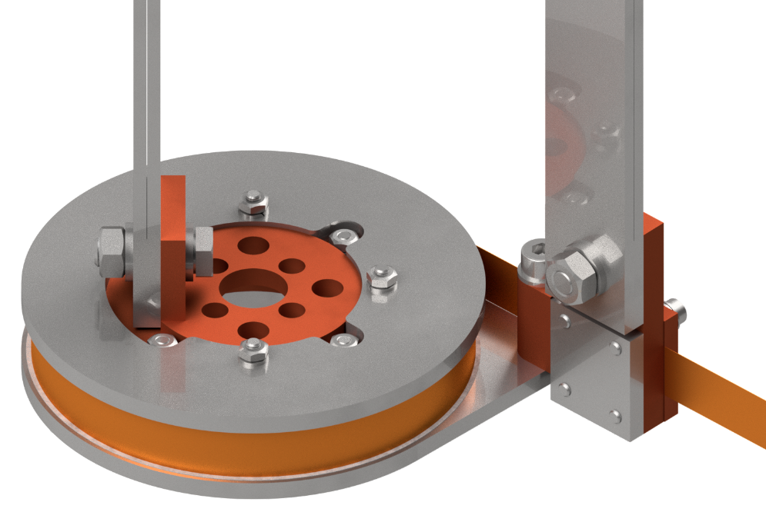
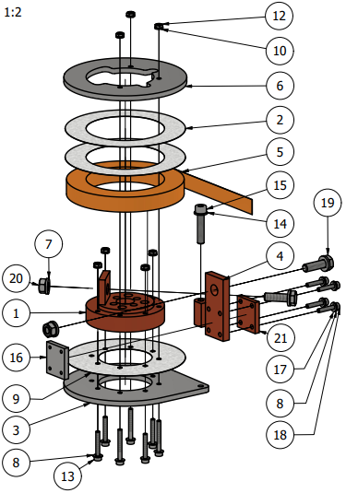
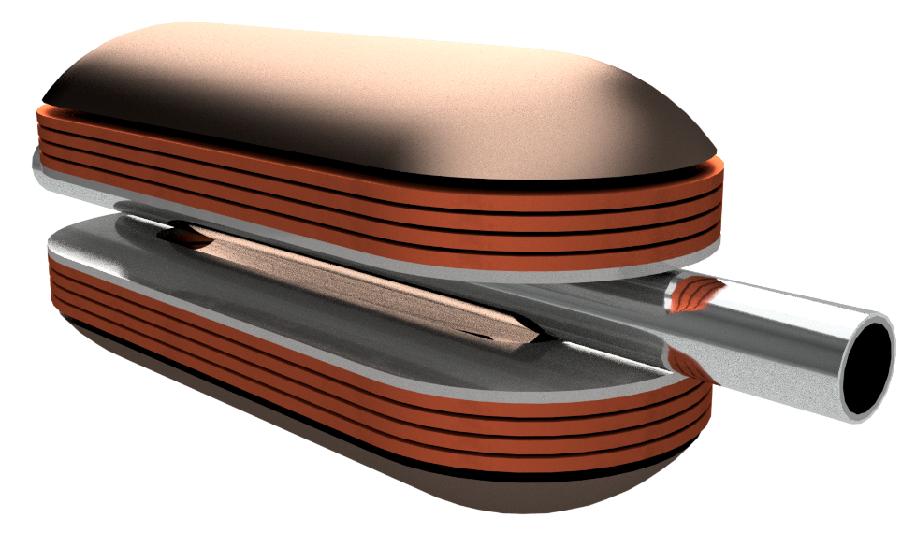
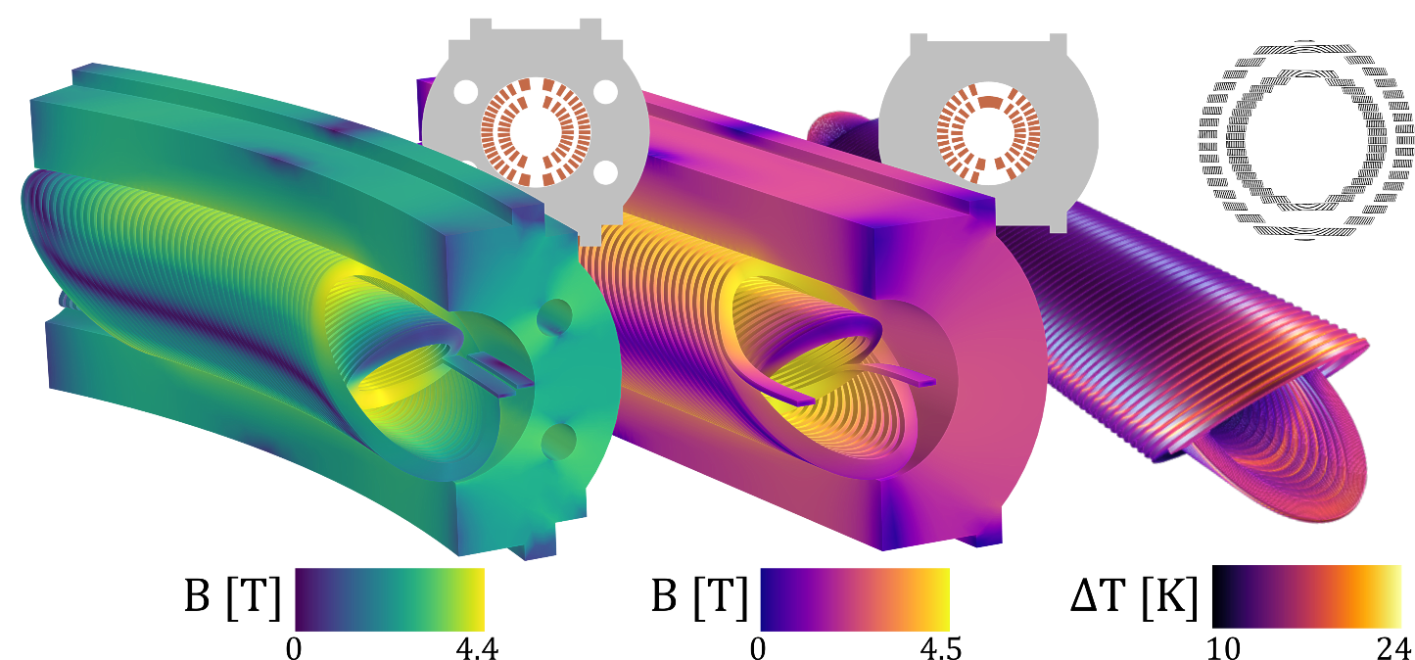
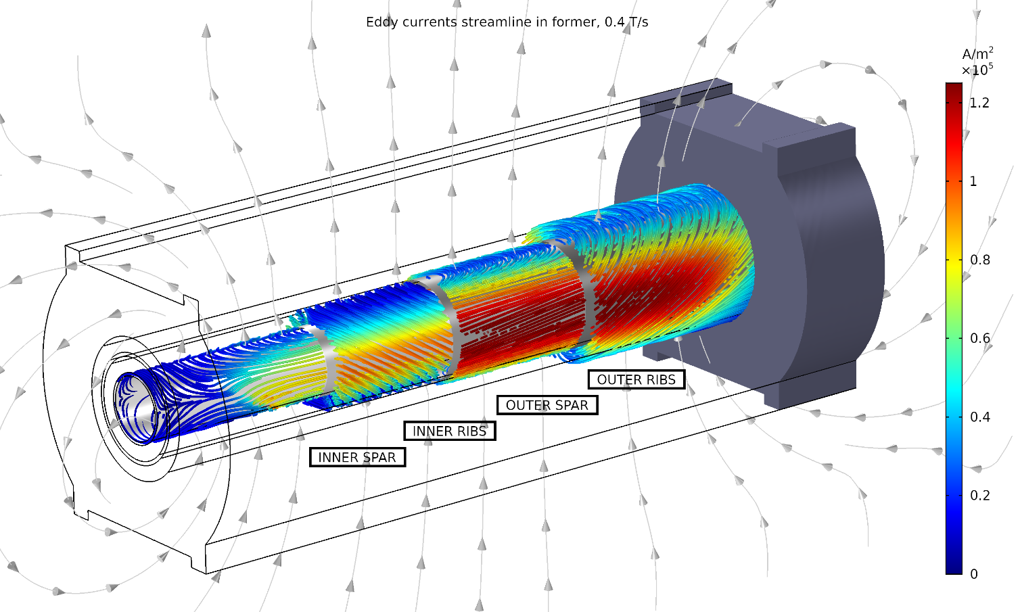
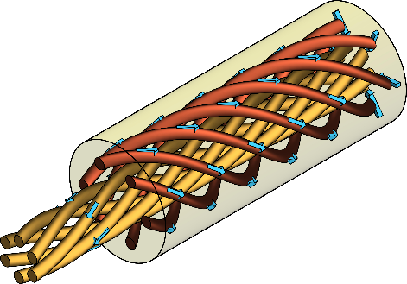
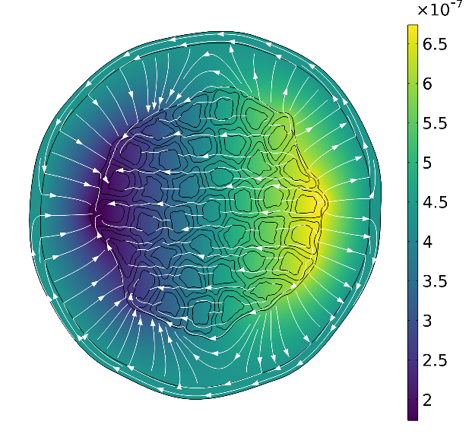
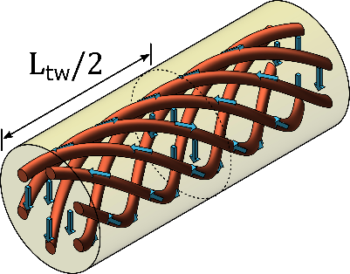
Stefano Sorti
CURRENT PROJECTS & ACTIVITIES:
Energy-saving magnet for accelerators,
demonstrator for PNRR_IRIS project
Small-scale experiments of HTS coils
for Muon Collider solenoids
Conceptual design of a ramped CCT magnet with
HTS conductors for I.FAST project
Studies of superconductor and resistive losses in LTS
MOTIVATIONS TO BE AT INFN ACCELERATOR SCHOOL:
Gain a broader knowledge of particle accelerators,
including the ones farthest from my activities
Networking and exchanging with colleagues
Find inspiring ideas for my activities

Slide 10
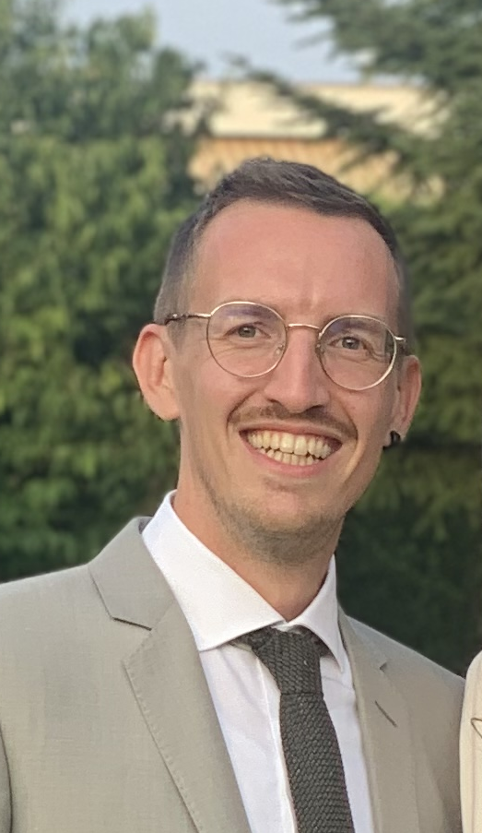
Personal Presentation
Pietro Rebesan
Education Titles
07/2022 | Ph.D. in Mechanical Engineering – Politecnico di Milano – XXXIV Cycle
02/2017 | Master’s degree in Mechanical Engineering – University of Padua
Professional Experiences
2017 – 2018 SID Project | Research Grant, Department of Engineering and Management (DTG), University of Padua Development of porous metallic components for functional applications.
2018 – 2021 SATELLES Project | Research Grant , INFN – Padua Division: Design and manufacturing of support systems for laser retroreflector system for space applications. (Product Quality Assurance)
2021 – 2023 DTT Project – INFN | Research Grant, INFN – Padua Division: Design and implementation of parts of the acceleration system of the DTT Project (Divertor Tokamak Test) by means of Metal Additive Manufacturing, particularly focusing on the Laser Powder Bed Fusion (L-PBF) technique.
Since June 2023 INFN – Padua Division | Technologist - In the Mechanics Design workgroup/DIAM workgroup, INFN – Padua Division → I take part in Mechanics Design activities, especially those focused on Development and Innovation in Additive Manufacturing …

Slide 11
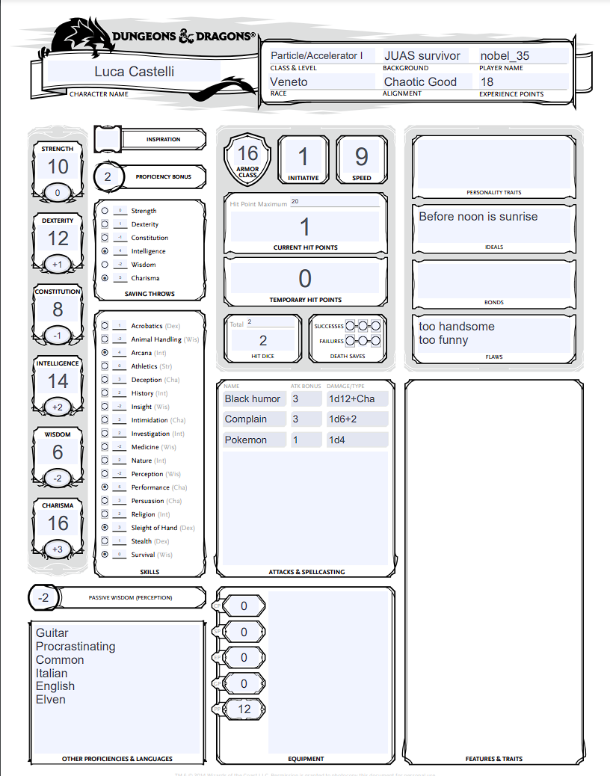
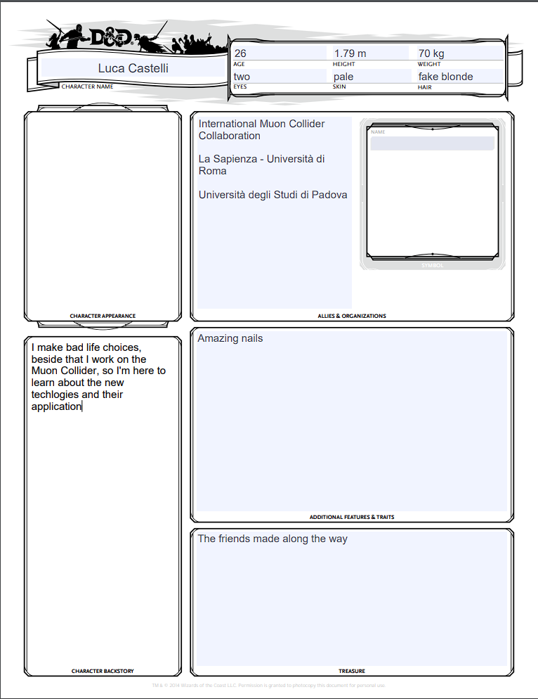
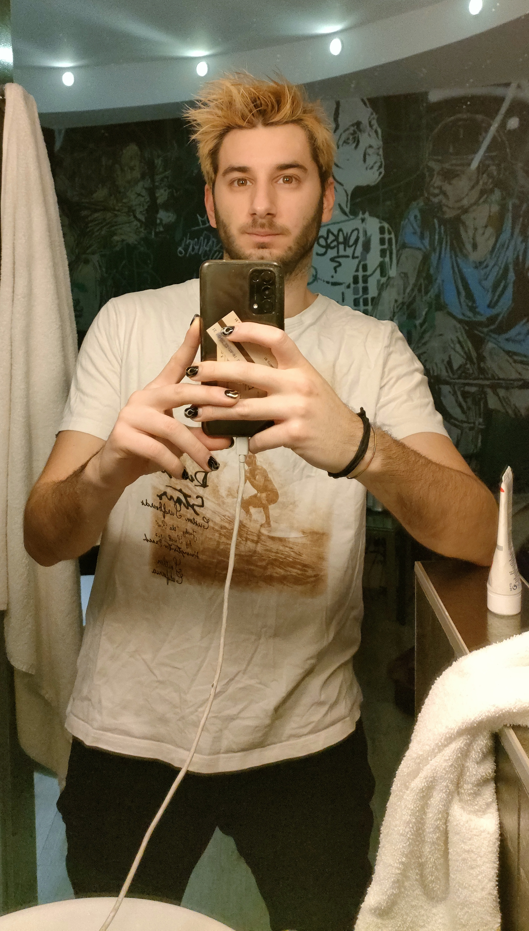

Slide 12


Lucia Canonica
2012 Ph.D in Physics at Genova University
Postdoctoral researcher at:
  Gran Sasso National Laboratory, INFN (IT)
  MIT (US)
  Max Planck Institut for Physics (DE)
Since 06.2023 at INFN LASA (IRIS project)
Background:
  astroparticle physics experiments (dark matter search and neutrino physics)
  Development of cryogenic detectors (operating at 10 mK)
Motivation:
  New in the field

Slide 13
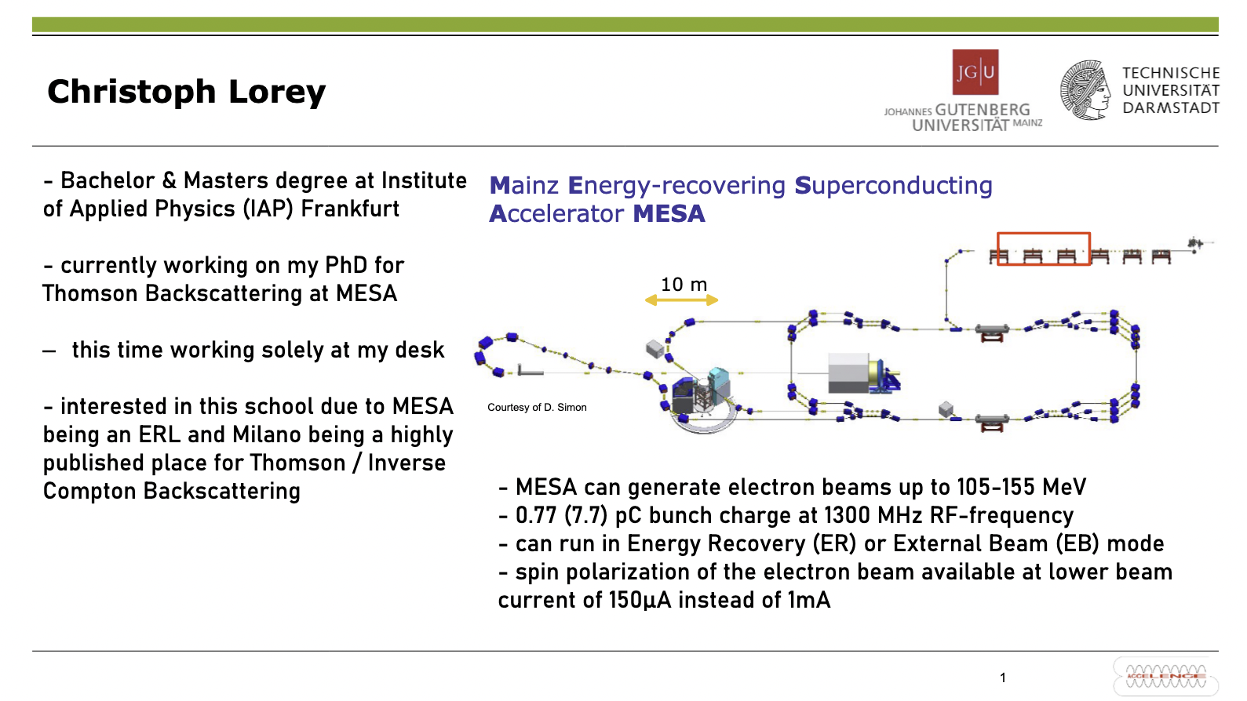

Slide 14
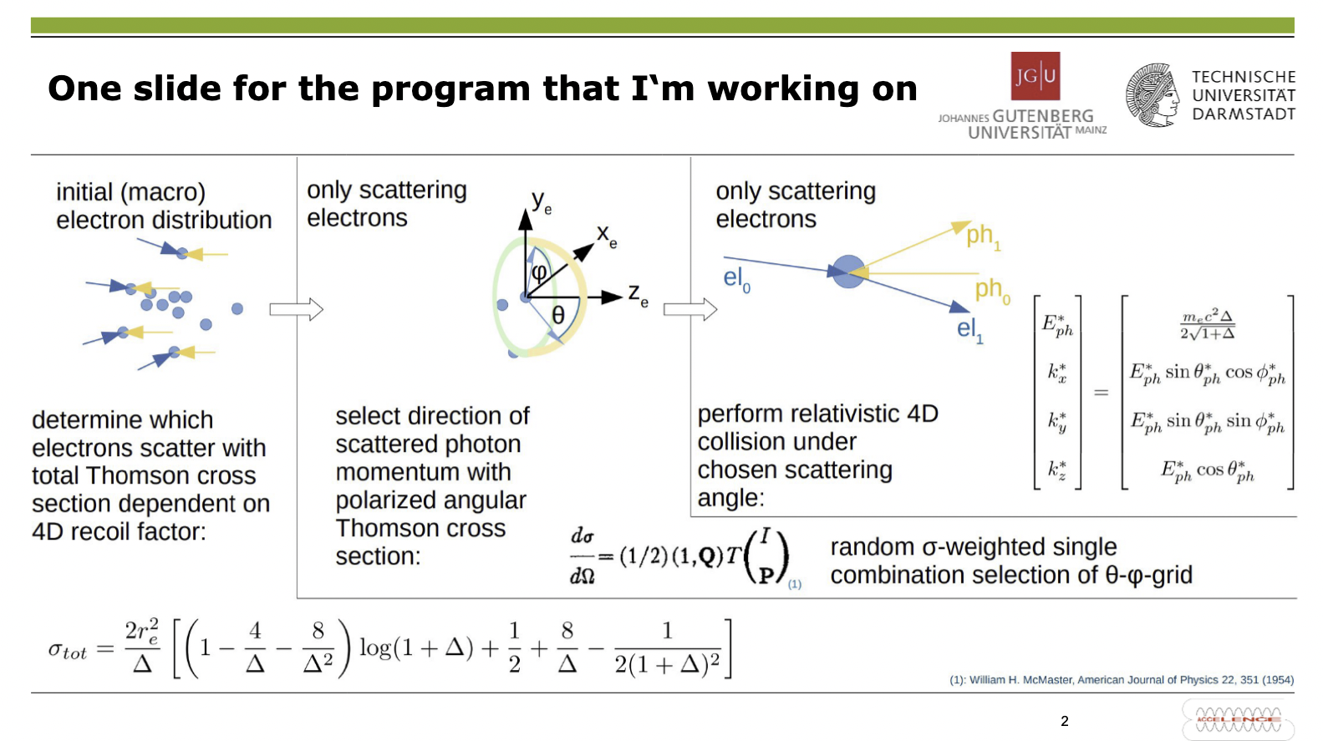

Slide 15
Introduction – Adya Uluwita

Slide 16


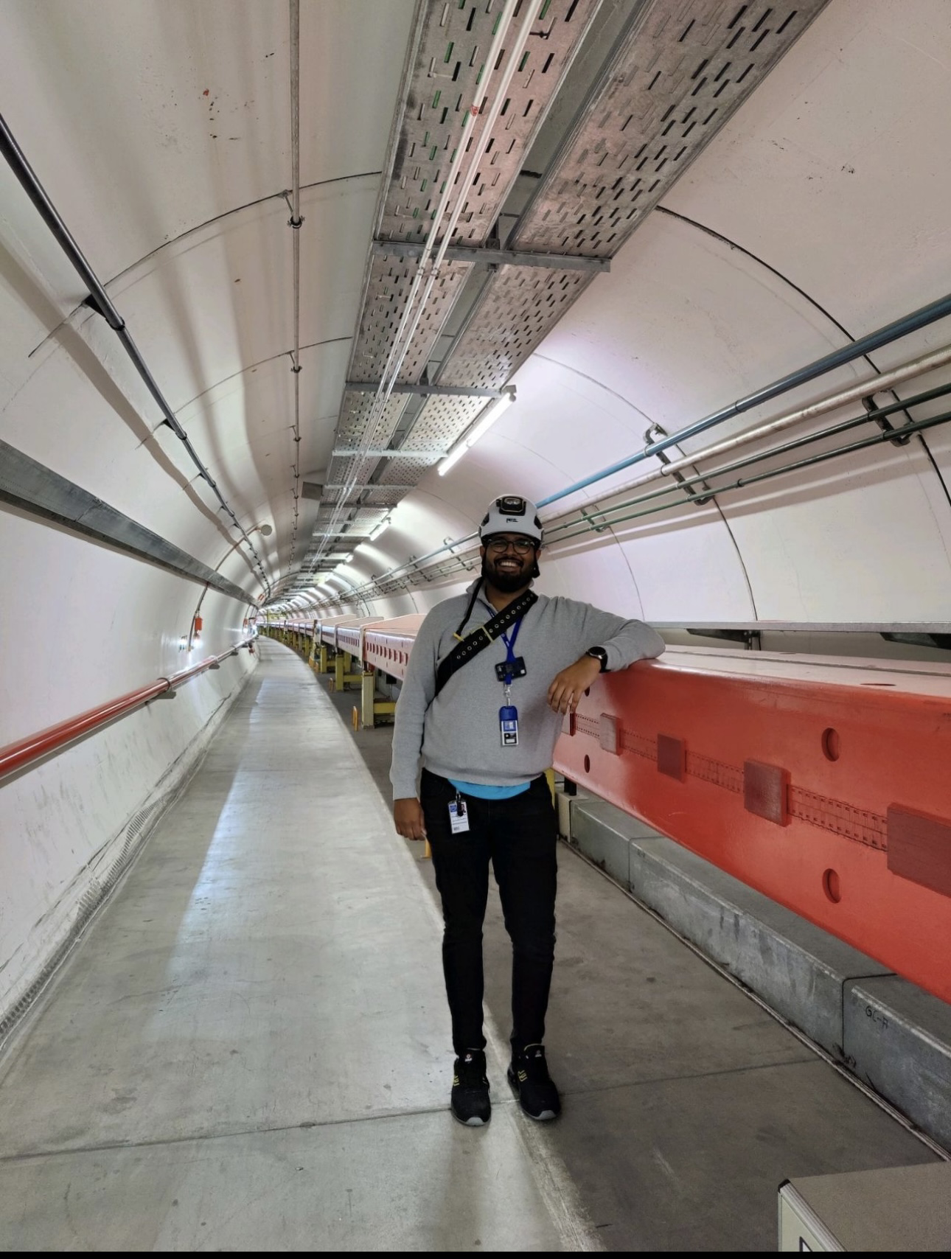
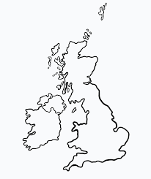
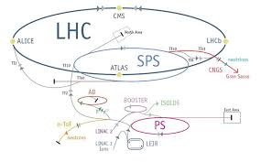
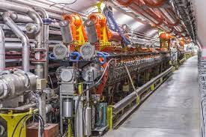


Background
Adya Uluwita
University of Birmingham
University of Brighton
16
Notes:
Talk about the groups progress column to show they are doing.

Slide 17

17

Slide 18
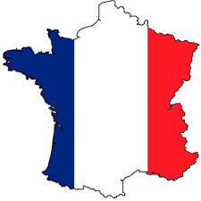
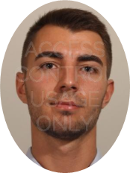





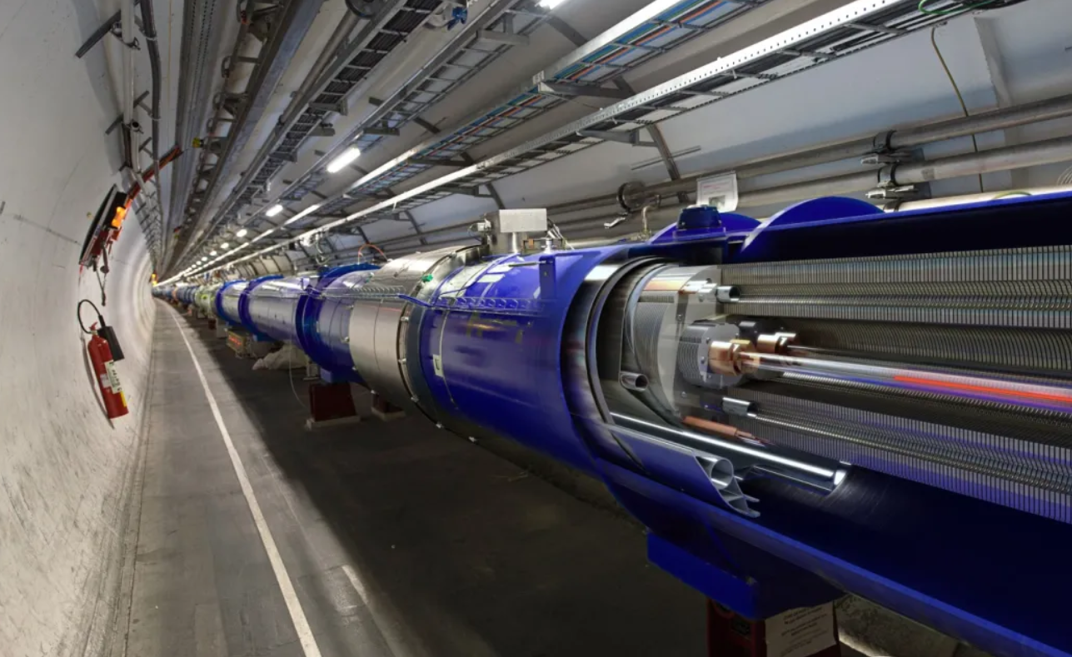





Antoine BARDON
Study Maths and Physics
Mechanical Engineer
Master in management (Poland)
CERN LHC facility coordinator
  Scheduling and coordination of installation activities during programmed stops

Slide 19
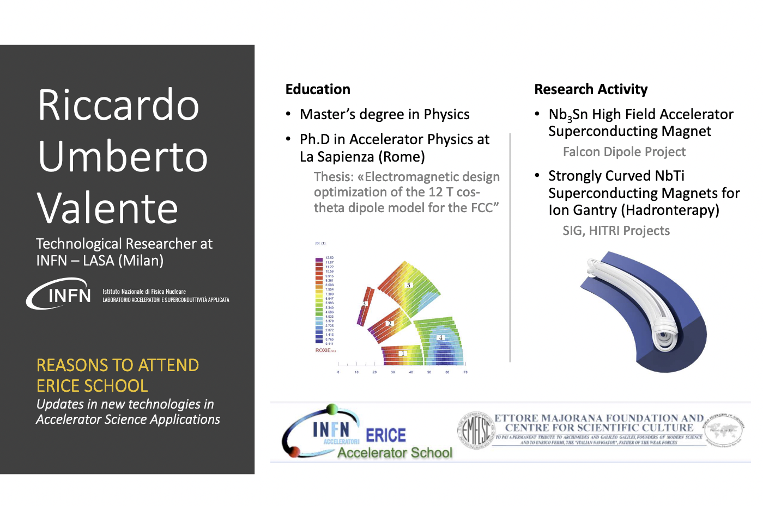

Slide 20
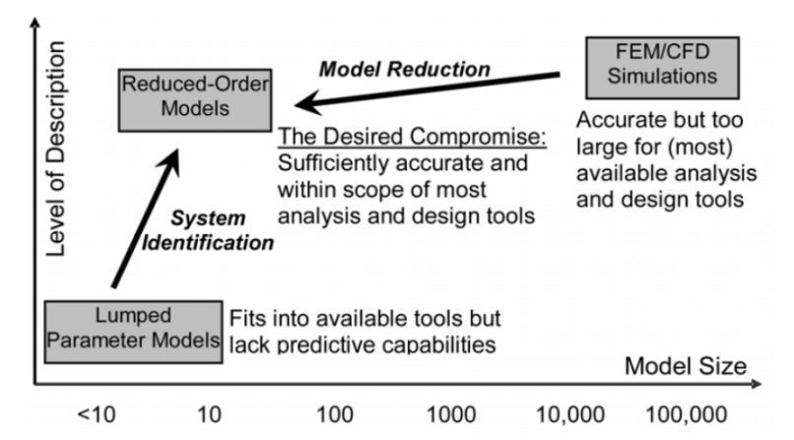

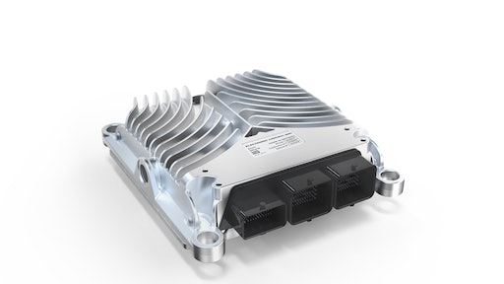
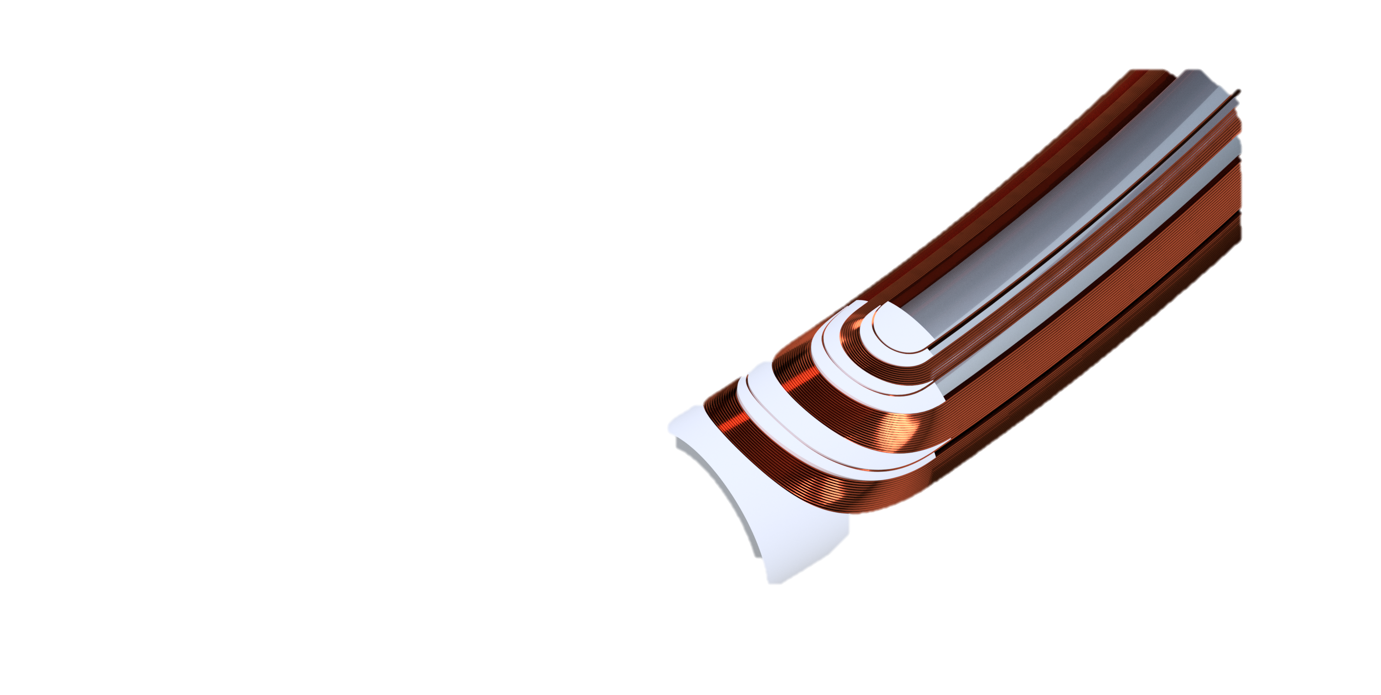

Anna Giulia Carloni
Master degree in Nuclear Engineering
(October 2020)
Research fellow at INFN Milano, LASA laboratory
(November 2022- current date)
System engineer at Dana Mechatronics
( December 2021- October 2022)
Reasons to attend ERICE Accelerator School:
Widen the spectrum of knowledge on Accelerator Science Applications
Updates in technologies for Accelerators
Current research activity (at INFN): Strongly Curved NbTi Superconducting Magnet for Ion Gantry (Hadrontherapy)

Slide 21
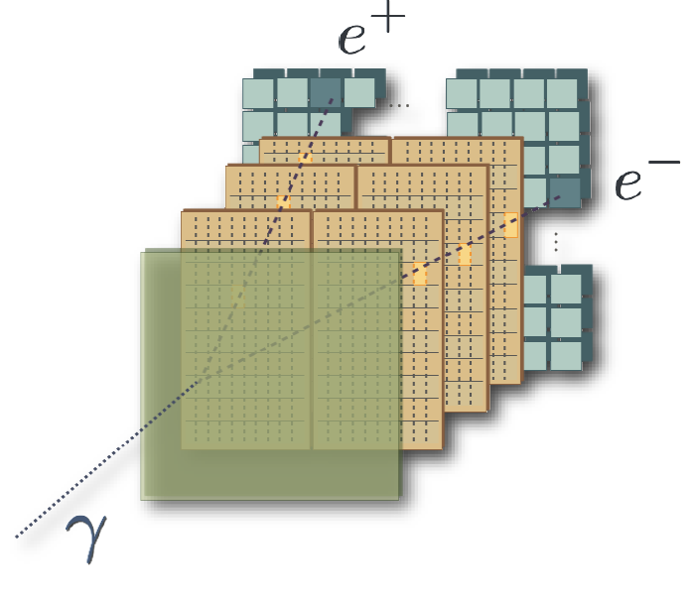







Lorenzo Balconi
Background
Bachelor degree in physics
  Università degli studi di Milano
  Feasibility study of a range monitoring technique using prompt gamma in particle therapy
Master degree in physics
  Università degli studi di Milano & RFX
  Spectroscopic diagnostics for negative ions plasma sources
λ [nm]
International School of Particle Accelerators – Erice 2023

Slide 22






Lorenzo Balconi
Current Activities
Currently PhD at Milano LASA
  ESMA IRIS
  HTS dipole demonstrator for future particle accelerators
  Muon collider
  Small Pancakes in HTS, Insulated & Non-insulated Xperiments
International School of Particle Accelerators – Erice 2023

Slide 23


Slide 24



International School of Particle Accelerators– Erice 2023
CLAUDIA SALVIA
October 2020 Bachelor’s Degree in Scienze Fisiche
July 2023 Master’s Degree in Physics – Nuclear physics
Thesis Title: Modelling radio-frequency waves
propagation in hot magnetized plasma

Slide 25






International School of Particle Accelerators– Erice 2023
CLAUDIA SALVIA
Research activities :
Msc Thesis
Magnetically confined plasma in Tokamak :
n ∼ 10²⁰ m⁻³
T ∼ 10 KeV
MODELLING RADIO-FREQUENCY WAVES PROPAGATION IN HOT-MAGNETIZED PLASMA
Wave propagation and interaction in the plasma chamber by modelling
a hot electromagnetic tensor
THE AUXILIARY HEATING POWER SYSTEM
Three components:
  Electron cyclotron resonance heating (ECRH) 25 MW
  Ion cyclotron resonance heating (ICRH) 6 MW
  Neutron ion beams injection (NBI) 10 MW
Figure. 3-Strap antenna CST model for ICH.
Credit: DTT
Figure. Pictorical view of DTT tokamak basic machine.
Credit: DTT.
1

Slide 26

International School of Particle Accelerators – Erice 2023
Giulia Emma
2014 – 2019 Bachelor’s Degree (University of Catania)
Thesis title: ”Spettroscopia ottica ad alta risoluzione di plasmi di idrogeno e argon” (INFN - LNS)
2019 – 2022 Master’s Degree (University of Catania)
Thesis title: ”High resolution optical emission spectroscopy
characterization of hydrogen and argon laboratory
magnetoplasmas of astrophysical interest” (INFN - LNS)
2023 – ongoing Research grant (INFN- LNS & Consorzio RFX for DTT project)
Project title: ”Design and development of a reflectometric system for the DTT plasma diagnostics”
Flexible Plasma Trap at INFN LNS

Slide 27





Research activities
Plasma characterization
(density, temperature, instabilities…)
Compact traps
n_{e} ∼10¹⁰ - 10¹³ cm⁻³
T_{e} ∼ 0.01 - 10 KeV
Magnetically confined plasmas
Fusion devices
n ∼ 10²⁰ m⁻³
T ∼ 10 KeV
What do we need?
Multi-diagnostic setup
Spectrum Analyzer
Langmuir Probe
Invasive tools
Plasma Emitted Radiation
RF
IR
VISIBLE & UV
EUV
SOFT X-RAY
HARD X-RAY
𝛾-RAY
3 kHz – 300 GHz
300 GHz – 430 THz
1,6 – 12 eV
10 – 120 eV
0,12 – 12 KeV
10 – 100 KeV
∼ 1 MeV
Non invasive tools
Optical plasma observation
X-ray Pinhole camera
SDD – HpGe – X-ray Detectors
Microwave interferometry and polarimetry
Plasma diagnostics’ applications to:
ECR Ion sources for particle accelerators
DTT framework: Nuclear fusion Energy
Interdisciplinary research:
Measure in-plasma 𝛽-decays of selected radioactive isotopes (¹⁷⁶Lu, ¹³⁴Cs, and ⁹⁴Nb)
Reproduce the plasma environments of KNe in laboratory and study plasma opacity
Main goal: Improve ion beam’s performances for particle accelerators
How: probe plasma properties (i.e. n_{e}, T_{e}, n_{i}, T_{i}, CSD, instabilities)
Intensity, quality and stability of the ion beam
Main goal:
R&D work for the optimization the DTT diagnostic system for plasma control and its performance’s improvements
Strong impact on
D. Mascali+., Universe 8, 80 (2022)
PANDORA framework: Nuclear astrophysics interest
R. Martone +., DTT - Interim Design Report (2019)
GIULIA EMMA International School of Particle Accelerators – Erice 2023
27

Slide 28






Sapienza University of Rome - Laboratori Nazionali di Frascati (INFN)
Lucio Crincoli
Master degree in nuclear engineering at Politecnico di Milano
PhD student in accelerator physics at Sapienza University
Research activities in the field of plasma-based particle acceleration at SPARC_LAB (LNF)
Electric field
Witness bunch
Driver bunch

Slide 29




Sapienza University of Rome - Laboratori Nazionali di Frascati (INFN)
Plasma sources design for plasma-based particle accelerators
Experimental and numerical characterization:
Uniformity
Longevity
Staging

Slide 30


Slide 31


Slide 32

International School of Particle Accelerators - ERICE_2023
Ettore Majorana Center
Gilles Jacopo Silvi

Slide 33






I am a Ph.D. student in the Sapienza University of Rome Accelerator Physics Program.
My Ph.D. thesis “Beam dynamics studies for high gradient high brightness C-band RF photoinjector” focuses on a start-to-end beam dynamics study to achieve optimum configuration for a C-band photoinjector.
Background and activities :
Nuclear engineering
My master’s thesis was focused on beam dynamics simulation for the S-band RF gun at SPARC_LAB.
I collaborate with the SPRAC_LAB group at INFN-LNF with beam dynamics simulations for the SPARC accelerator and experimental measurements in the control room.
Beam dynamics optimization with the comb configuration for the Particle Driven Wakefield Acceleration (PWFA) for the EuPRAXIA@SPARC_LAB RF injector.
Motivation :
During these years I successfully attended and passed training courses: in January-February 2021 I attended joint Universities Accelerator School (JUAS) the Course “Science of Particle Accelerator”, in the following months I attended “Physics of High Brilliance Accelerators” and “Physics, Technology, and Applications of Linear Accelerator” courses which allowed me to acquire knowledge on accelerating structures and plasma acceleration. The International School of Particle Accelerator is a great opportunity to fully enter in the particle accelerator world and improve my knowledge.

