Slide 1
INFN Accelerator School
IV course of the
INTERNATIONAL SCHOOL OF PARTICLE ACCELERATORS
«KJELL JOHNSEN, GUSTAV VOSS AND EDMUND WILSON»
Topic:
Novel acceleration schemes and enabling technologies:
Muon Collider, Plasma acceleration, ERL and dielectrics.

Slide 2
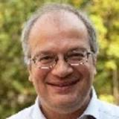
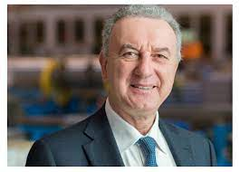
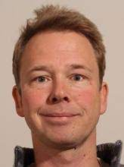
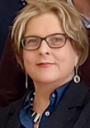
The directors
Dr Ralph Assmann
  Desy (previously at CERN till 2012)
  moving to GSI in September 1st, 2023 as Head of Acceleration Operation and Development (ACC) with professorship at Univ. of Frankfurt
  LHC collimation system, Euepan network for Plasma Accelerators, EuPraxia
Prof. Lucio Rossi
  1981 Univ of Milano and INFN-Mi, 2001-2020 CERN, 2020 Univ.of Milano & INFN-Mi
  Italian Sup Cyclotron, LHC SC Magnet Sytem & Superconductor, founder and director (2011-2020) of HL-LHC, Project coordinator of PNRR-IRIS 2022-2025
Dr. Frank Tecker
  CERN
  PS, CLIC, CTF3
  Director of the CERN Accelerator School
Thanks to Tiina Benson,
our tireless problem solver

Slide 3
2023: The beginning of the INFN Accelerator school
2020 INFN has started the initiative of INFn-Accelerators (https://acceleratori.infn.it/it/)
Among various initiatives, the start of the INFN Accelerator School, using infrastructure of Erice
2023 there are specialized courses on:
  CAS: on RF and on Magnets
  IAS: SC for accelerators
We have decided to have a general school
  No specific technology, No specific accelerator layot (FCC, or linear collider or orhter)
→ the conclusion was to offer an overview on
  Novel acceleration schemes and enabling technologies: Muon Collider, Plasma acceleration, ERL and dielectrics.
  However, with an introduction to basic and to the present limits and goals
  Covering the classical domain of accelerator for fundamental physics…
The next INFN accelerator school will be in 2025.

Slide 4
Professorship and attendance
Difficult to put together the professor team given the vacatin period…
We succeed but relatively late (lat confirmation end of April)
So, notice of the school rather late
Competition with many other school this year → medium attendance
→ profit to live the school in an interactive methods
Attendance is quite variable, mostly beginners
anyway, difficult to find student (and even professors) expert on all these various field…
So I asked the professor team for a adequate level of lecturing …

Slide 5
All of you should have access to Indico page…
https://agenda.infn.it/event/35286/timetable/#20230727

Slide 6
Practical Information
Wear always the badge when in the Center and also around in Erice
Follow indications
The Center reception is practical always open.
Marsala room in the evening the best place to chat and live in a “academia” atmosphere… also to build your network among peers and with professors,

Slide 7

60 years of experiments at accelerators have discovered the set of fundamental particles
bottom
top
Higgs
strange
up - down
charm
L
H
C
electron
muon
neutrinos
tau
neutrino
el
mu
tau
accelerators
1900
1910
1920
1930
1940
1950
1960
1970
1980
1990
2000
2010
photon
gluon
W, Z

Slide 8
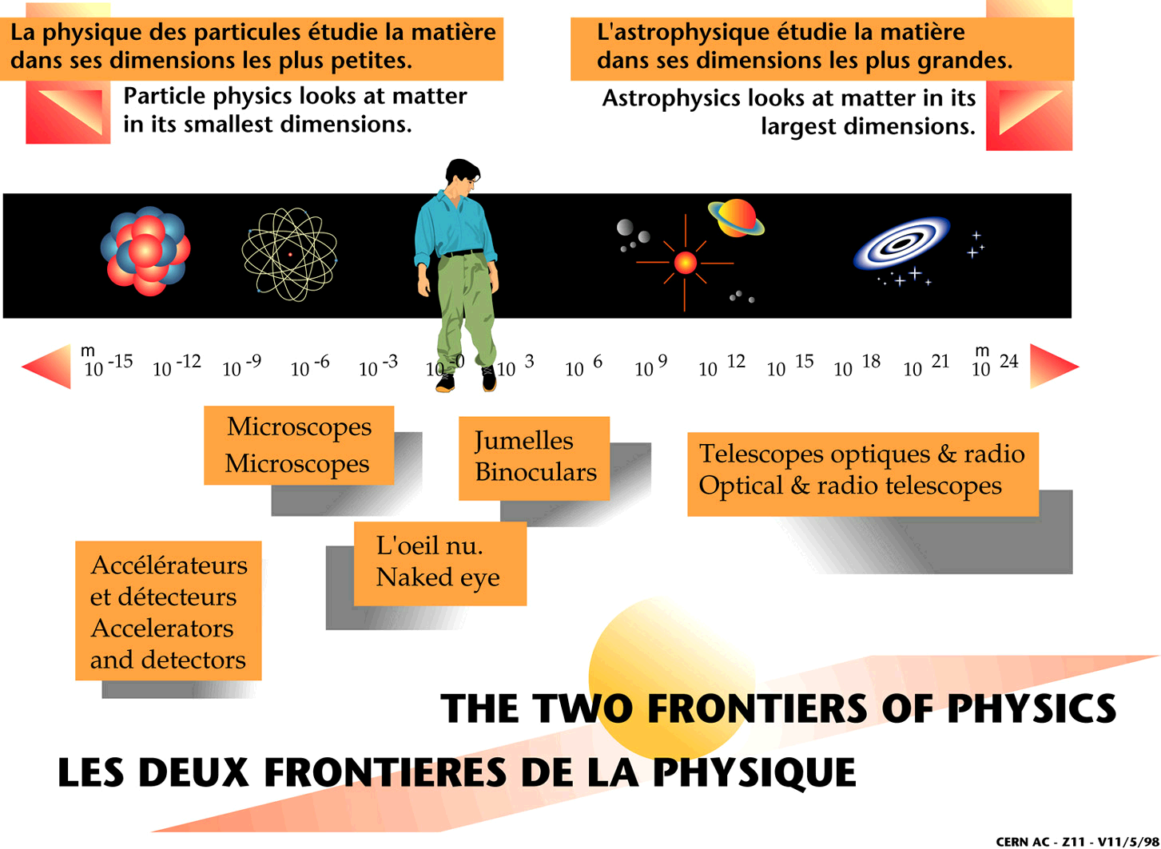
Accelerators gain us one frontier of the physics spectrum
Why accelerators? To investigate Particle Physics
Accelerators
Microscopes
Binoculars
Optical, radio télescopes
Particle physics looks at matter in its smallest dimensions and accelerators are very fine microscope or, better, atto-scope!
λ = h/p ; @LHC: T = 1 TeV ⇒ λ ≅ 10⁻¹⁸ m = 1 am (actually 30 zm)

Slide 9
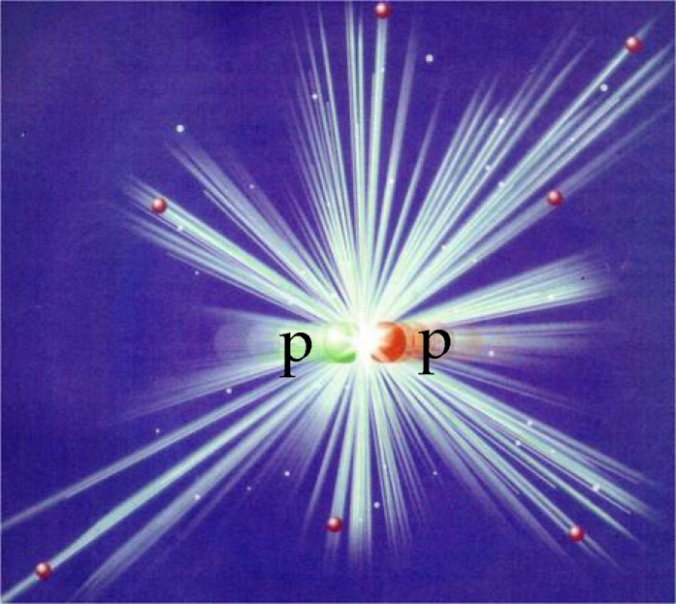
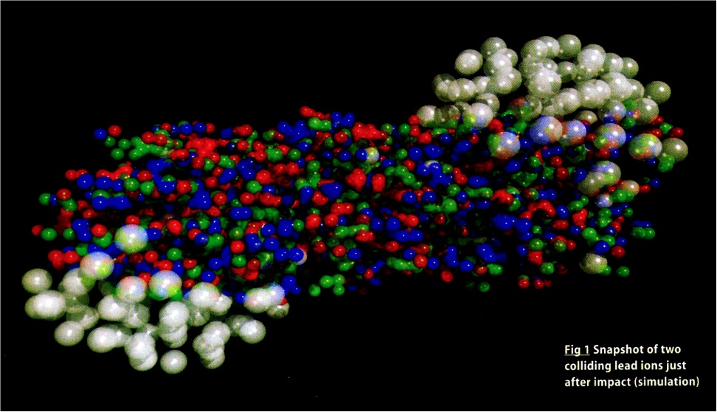
…back to Big Bang
Trip back toward the Big Bang: t_{μs}≅1/E²_{Gev}
T ≅ 1 ps for single particle creation
T ≅ 1 μs for collective phenomena QGS (Quark-Gluon Soup)
But we are left with the task of explaining how the rich complexity that developed in the ensuing 13.7 billion years came about…
Which is a much more complex task!

Slide 10
Accelerators: the two frontiers
2 routes to new knowledge about the
fundamental structure of the matter
High Energy Frontier
New phenomena
(new particles)
created when the
“usable” energy > mc² [×2]
High Precision Frontier
Known phenomena studied
with high precision may show
inconsistencies with theory

Slide 11
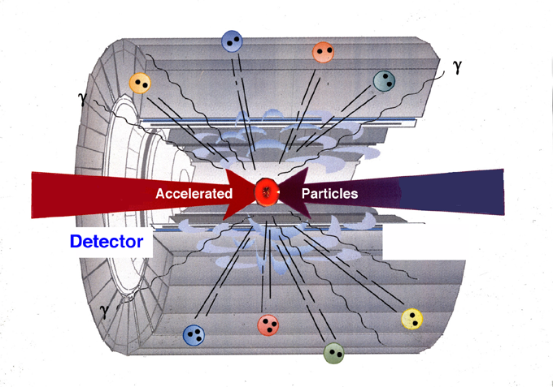
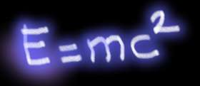
The method of HEP colliders
Methods of Particle Physics
1) Concentrate energy on particles (accelerator)
2) Collide particles (recreate conditions after Big Bang)
3) Identify created particles in
Detector (search for new clues)
And both of them need high technology like superconductivity

