Slide 1
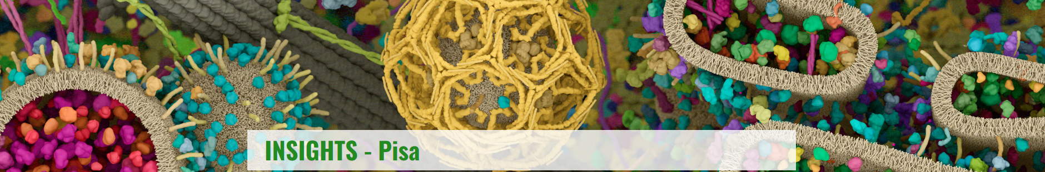


The challenges of beam monitoring from particle therapy
to FLASH radiotherapy.
Anna Vignati
Dip. Fisica Università degli Studi di Torino e INFN Torino

Slide 2
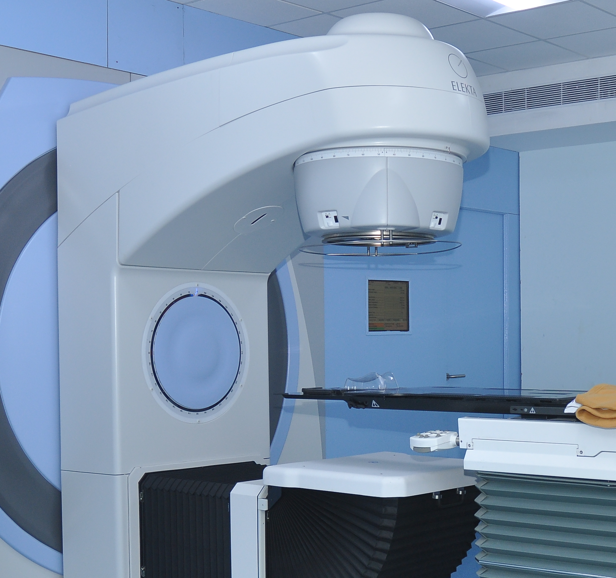
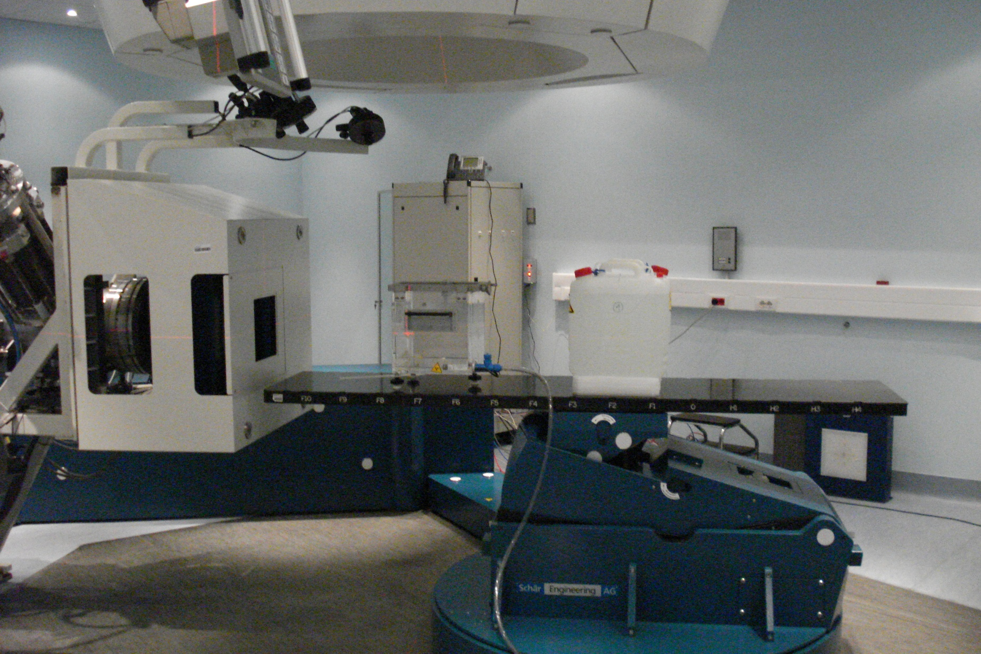

The role of beam monitors…
…is the continuous check of beam parameters to correct or interrupt the irradiation in case of values out of clinical tolerances. [Giordanengo, Palmans Med Phys. 2018]
Beam
Beam
TARGET
Anna Vignati – UniTo and INFN

Slide 3


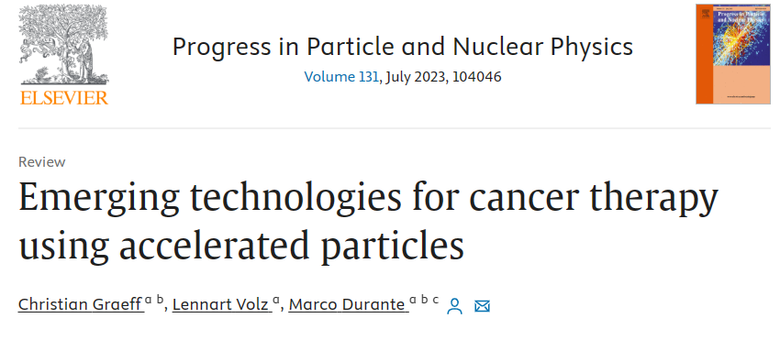

The role of beam monitors…in the near future?
Ultra-high dose rate radiotherapy (FLASH)
Technology innovation in charged particle therapy
Anna Vignati – UniTo and INFN

Slide 4



The role of beam monitors…in UHDR RT
Radiation delivered in < 200 ms
at Ultra-High Dose Rate
(average dose rate > 40 Gy/s)
Decreasing toxicity maintaining tumor control: FLASH effect
few flash cards on FLASH RT
Because of the heavy saturation (i.e. non linearity) of conventional transmission chambers in UHDR,
new beam monitoring devices are needed
The roles of dose-per-pulse, instantaneous dose-per-pulse, pulse duration and frequency still remain to be understood.
[Di Martino et al 2020 Frontiers]
[Oesterle et al. 2021 J App Clin Med Phys]
Anna Vignati – UniTo and INFN

Slide 5
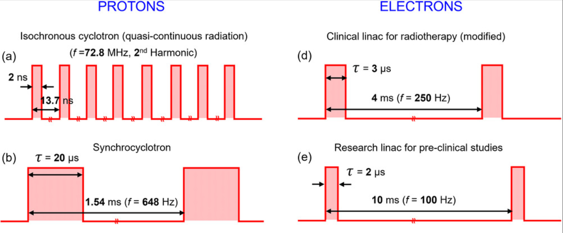
Beam temporal structure
F Romano et al. Ultra-high dose rate dosimetry: Challenges and opportunities for FLASH radiation therapy. Medical Physics, 2022
Anna Vignati – UniTo and INFN

Slide 6

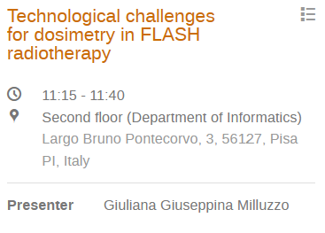
All you need is…
High temporal resolution
  ideally: intra-pulse monitoring;
  reaction time: inter-pulse;
High spatial resolution
  Flatness, symmetry
  Maximum acceptable dose uncertainty
Beam transparency
Large response dynamic range
Large sensitive area
Radiation hardness
(Beam energy)
Anna Vignati – UniTo and INFN

Slide 7

The role of beam monitors…in UHDR RT
Ionization chambers for proton UHDR beams
optimization of existing technologies,
investigation of novel radiation detection methods.
Anna Vignati – UniTo and INFN

Slide 8
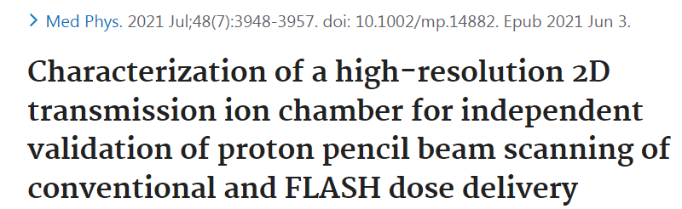
Wei Zou, Eric S Diffenderfer et al.
¹Department of Radiation Oncology, Hospital of the University of Pennsylvania, Philadelphia, USA.
²Pyramid Technical Consultants, Inc, Boston, USA.
³IBA PT Inc, Louvain-La-Neuve, Belgium.
High-resolution position sensing transmission ionization chamber with a purpose-built multichannel electrometer for both conventional and FLASH dose rate proton RT.
64x64 mm² sensitive area
3 active chambers [1 with thin 1 mm gap integral electrode; two with two sets of 64 parallel strip electrodes of 1 mm width].
Air (Helium or Argon)
Bias voltage >200 V (lower than 1000 V/mm)
Polyimide film as electrode substrate
spot positioning accuracy 0.10 ± 0.08 mm
k_{s} <1,005 with <0,5% uncertainty
good linearity (compared with Faraday cup measurements)
Anna Vignati – UniTo and INFN

Slide 9
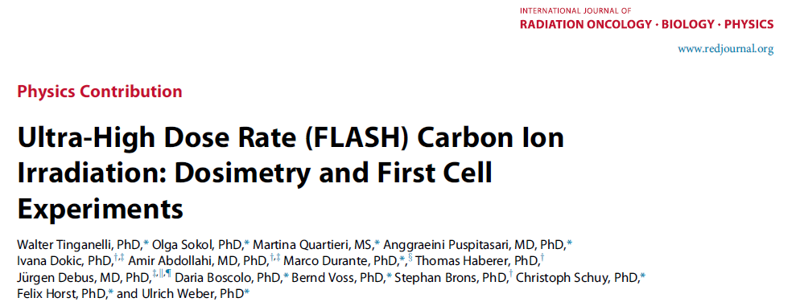
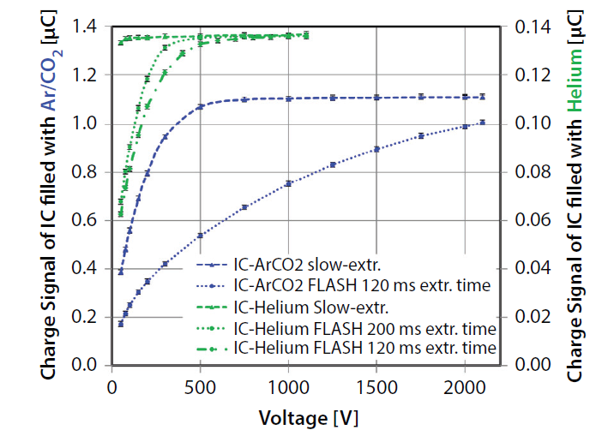
Tinganelli et al.
GSI Helmholtzzentrum fuer Schwerionenforschung, Darmstadt, Germany
Heidelberg Ion-Beam Therapy Center, Heidelberg, Germany
The Heidelberg Ion-Beam Therapy Center (HIT) synchrotron extracts ≥ 5·10⁸ ¹²C ions in 150 ms.
The beam monitors were filled with helium.
20x20 mm² sensitive area
2 active gaps [10 mm each].
Bias voltage >500 V
Anna Vignati – UniTo and INFN

Slide 10
The role of beam monitors…in UHDR RT
Ionization chambers for charged particle UHDR beams
Beam current transformers for electron UHDR beams
optimization of existing technologies,
investigation of novel radiation detection methods.
Anna Vignati – UniTo and INFN

Slide 11
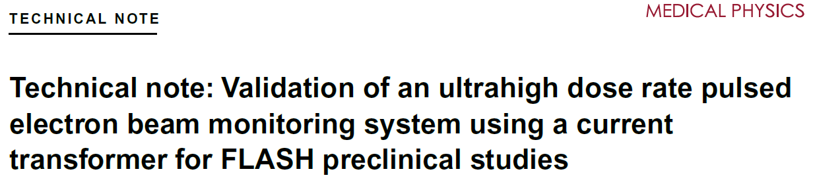
Jorge et al. - Lausanne, Switzerland
Oriatron eRT6
Limitation: inability to monitor the beam's spatial profile (flatness and symmetry)
Do we still need to check the beam profile?
Very High Electron Energy (VHEE)…pencil beams?
Anna Vignati – UniTo and INFN

Slide 12

Jorge et al. - Lausanne, Switzerland
Oriatron eRT6
Limitation: inability to monitor the beam's spatial profile (flatness and symmetry)
In a radiofrequency powered linac, the power generated by the RF source can be written as:
Do we still need to check the beam profile?
$$W_{TOT}=W_{LINAC}+W_{e−beam}$$
Very High Electron Energy (VHEE)…pencil beams?
Probably, only the beam energy can change
Energy variation
[Di Martino et al. Front. Phys.2020]
Anna Vignati – UniTo and INFN

Slide 13

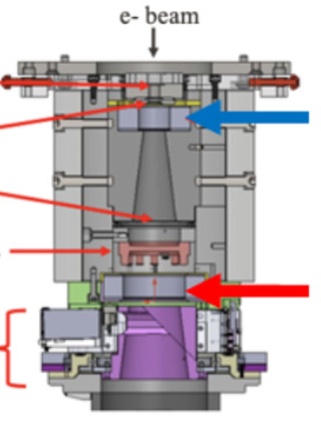
Volume24, Issue2,
February 2023
Jorge et al. - Lausanne, Switzerland
Liu et al. – MD Anderson Cancer Center
Oriatron eRT6
Mobetron
Limitation: inability to monitor the beam's spatial profile (flatness and symmetry)
Exit window
Do we still need to check the beam profile?
Primary scattering foil
Upper BCT
Secondary scattering foil
Very High Electron Energy (VHEE)…pencil beams?
Ion chambers
Optics
Lower BCT
Probably, only the beam energy can change
Anna Vignati – UniTo and INFN

Slide 14


The role of beam monitors…in UHDR RT
Scintillators, air fluorescence, solid state detectors (et al…)
?
FRIDA INFN project
optimization of existing technologies,
investigation of novel radiation detection methods.
Anna Vignati – UniTo and INFN

Slide 15
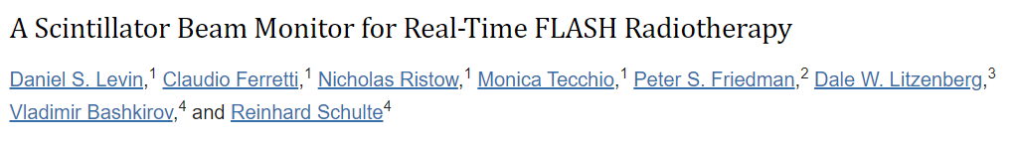
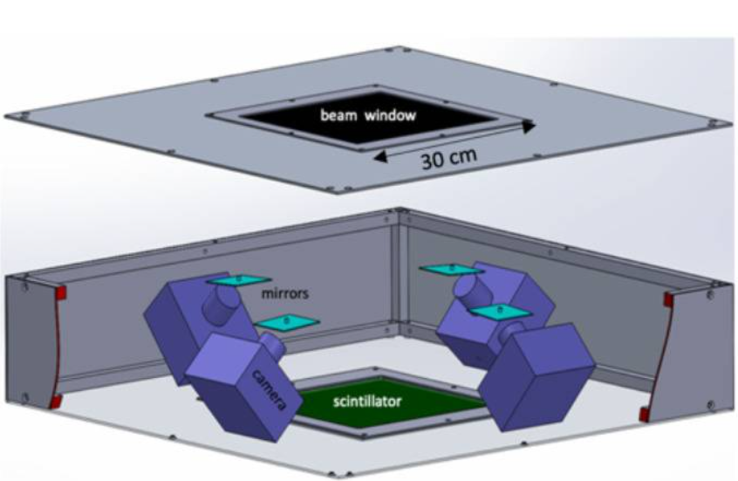
University of Michigan, Loma Linda University Hospital,
Integrated Sensors LLC
large area coverage (30 cm × 30 cm);
beam transmissive (<1 mm water equivalent);
a linear response over a broad dynamic range;
radiation tolerance;
real-time analysis IEC-compliant fast beam-interrupt signal;
two-dimension beam imaging with spatial resolution < 0,5 mm.
Anna Vignati – UniTo and INFN

Slide 16
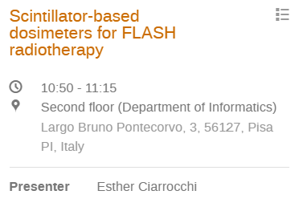
University of Michigan, Loma Linda University Hospital,
Integrated Sensors LLC
large area coverage (30 cm × 30 cm);
beam transmissive (<1 mm water equivalent);
a linear response over a broad dynamic range;
radiation tolerance;
real-time analysis IEC-compliant fast beam-interrupt signal;
two-dimension beam imaging with spatial resolution < 0,5 mm.
Anna Vignati – UniTo and INFN

Slide 17
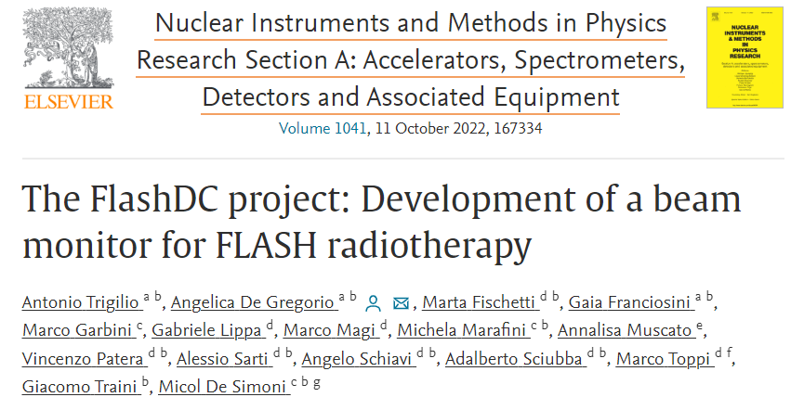
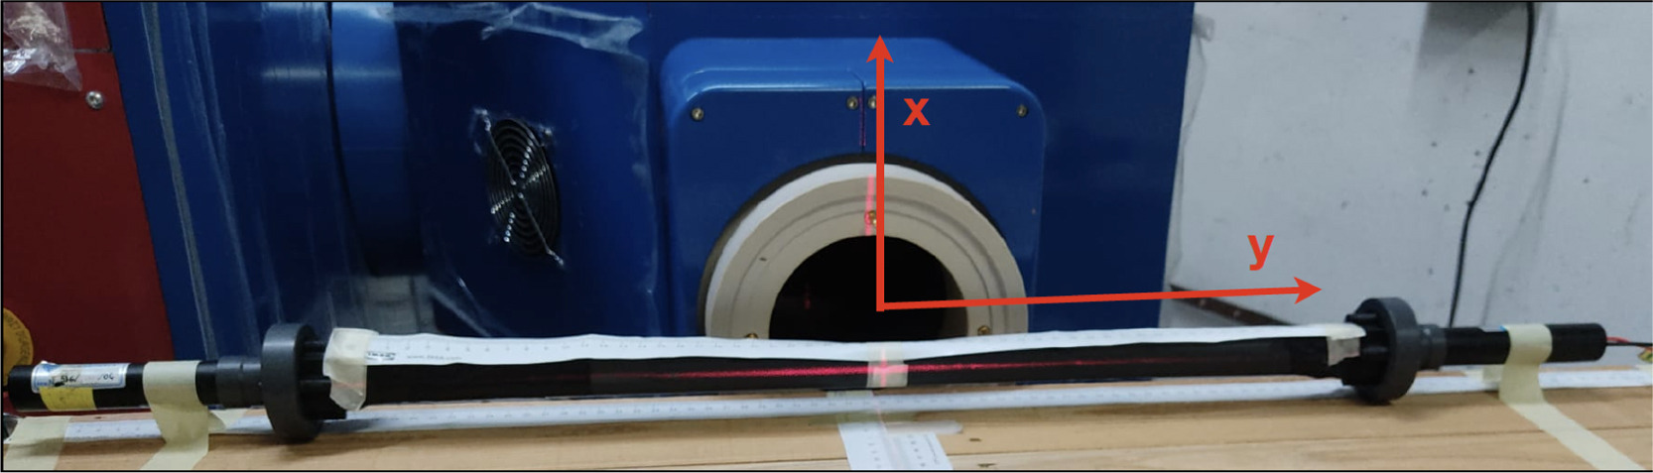
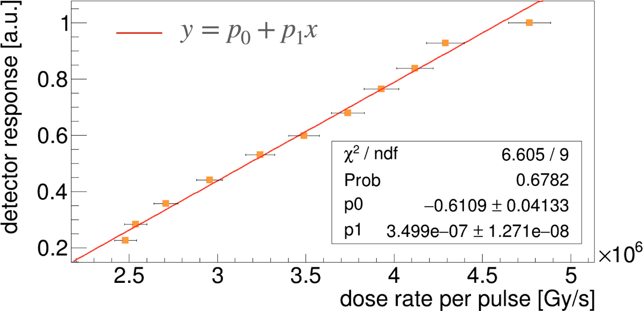
Dipartimento di Fisica, Sapienza Università di Roma
INFN sezione Roma I
Active volume of 2x2x60 cm³ air enclosed by a 5 um thick layer of black Tedlar
light sensors on the two opposite edges
Beam position
Number of electrons
9 MeV UHDR pulsed electron beams accelerated from the ElectronFLASH linac at the Centro Pisano for FLASH Radiotherapy
Anna Vignati – UniTo and INFN

Slide 18
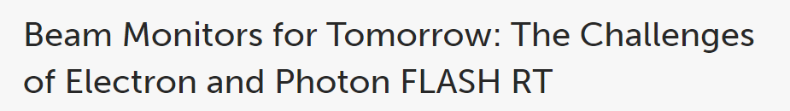
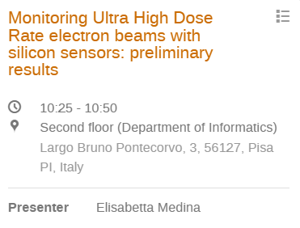

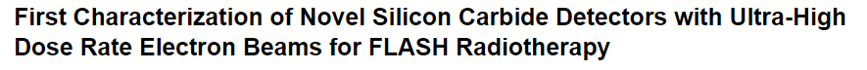
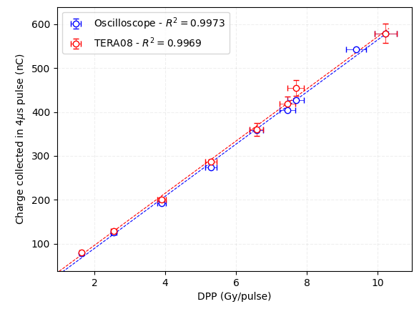

Vignati, Giordanengo, Fausti, Marti Villarreal, Mas Milian, Mazza, Shakarami, Cirio, Monaco, Sacchi
Università degli Studi di Torino INFN Torino, Italy
Romano, Milluzzo, Di Martino, D’Oca, Felici, Galante, Gasparini, Mariani, Marrale, Medina, Pacitti, Sangregorio, Vanreusel, Verellen, Vignati, Camarda
INFN Catania, SIT Sordina, CPRF Pisa, INFN e Università Torino, STLab et al.
PiN planar silicon sensor
Signal integration
2.2 mm²
RC
TERA08 chip
FPGA
Oscilloscope
UNPUBLISHED RESULTS!
30/45𝜇m thickness
9 MeV e- UHDR beams @ CPFR EF linac
Anna Vignati – UniTo and INFN

Slide 19

Vignati, Giordanengo, Fausti, Marti Villarreal, Mas Milian, Mazza, Shakarami, Cirio, Monaco, Sacchi
Università degli Studi di Torino INFN Torino, Italy
Romano, Milluzzo, Di Martino, D’Oca, Felici, Galante, Gasparini, Mariani, Marrale, Medina, Pacitti, Sangregorio, Vanreusel, Verellen, Vignati, Camarda
INFN Catania, SIT Sordina, CPRF Pisa, INFN e Università Torino, STLab et al.
PiN planar silicon sensor
Signal integration
2.2 mm²
RC
TERA08 chip
FPGA
Oscilloscope
UNPUBLISHED RESULTS!
30/45𝜇m thickness
Anna Vignati – UniTo and INFN

Slide 20
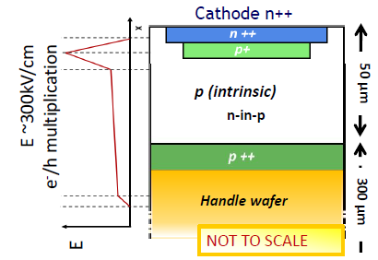
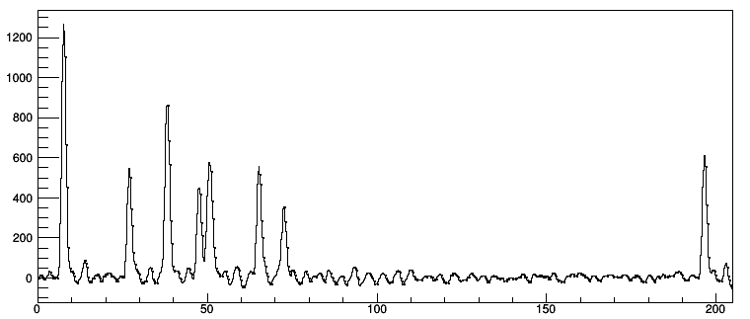


Thin p⁺ gain layer implanted under the n⁺⁺ cathode
Controlled low gain (~ 10-30)
Gain increases with bias voltage
High Signal/Noise ratio
Small thickness of active volume 50 µm
Reduced beam perturbation, signal steepness
Loss of signal due to reduced thickness compensanted by internal gain
Ultra-Fast Silicon Detector (UFSD) (LGAD technology)
227 MeV protons
Signal integration
2.2 mm²
Signal [ADC counts]
Threshold
Abacus chip
FPGA
Digitizer
30/45𝜇m thickness
time [ns]
Anna Vignati – UniTo and INFN

Slide 21
Thin p⁺ gain layer implanted under the n⁺⁺ cathode
Controlled low gain (~ 10-30)
Gain increases with bias voltage
High Signal/Noise ratio
Small thickness of active volume 50 µm
Reduced beam perturbation, signal steepness
Loss of signal due to reduced thickness compensanted by internal gain
Ultra-Fast Silicon Detector (UFSD) (LGAD technology)
Signal integration
Short signal duration (< 2 ns) → particle counting
Excellent time resolution (tens of ps)
→ beam energy measurement from time-of-flight
2.2 mm²
Abacus chip
FPGA
Digitizer
30/45𝜇m thickness
Anna Vignati – UniTo and INFN

Slide 22

Thin p⁺ gain layer implanted under the n⁺⁺ cathode
Controlled low gain (~ 10-30)
Gain increases with bias voltage
High Signal/Noise ratio
Small thickness of active volume 50 µm
Reduced beam perturbation, signal steepness
Loss of signal due to reduced thickness compensanted by internal gain
Ultra-Fast Silicon Detector (UFSD) (LGAD technology)
Signal integration
Short signal duration (< 2 ns) → particle counting
Excellent time resolution (tens of ps)
→ beam energy measurement from time-of-flight
single
2.2 mm²
particle
Abacus chip
counting
FPGA
Digitizer
excellent
time
30/45𝜇m thickness
resolution
Anna Vignati – UniTo and INFN

Slide 23
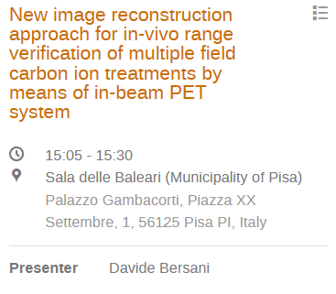
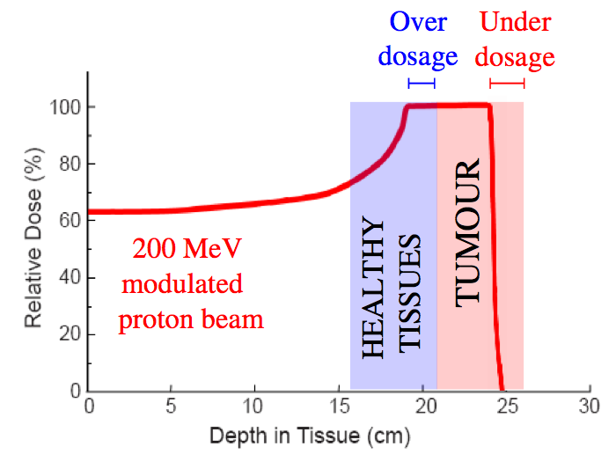

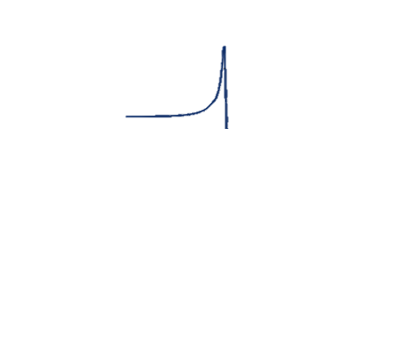
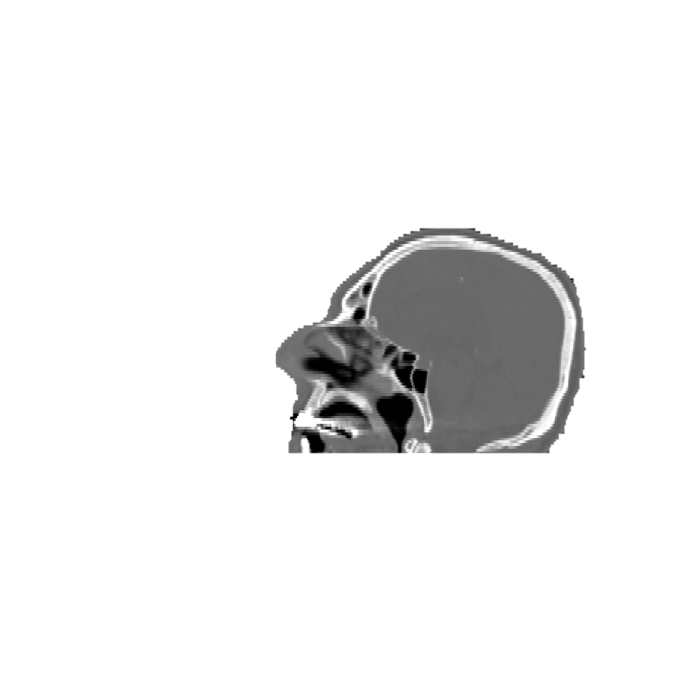
The role of beam monitors…and online range verification in PT
Zhu X, Fakhri GE. Theranostics. 2013;3(10):731-740.
𝛄 511 keV
single
Annihilation photons from positron emitters
prompt photons from nuclear de-excitation
secondary charged fragments
Charged particles
2.2 mm²
particle
UFSD
counting
beam
excellent
time
resolution
𝛄 prompt
𝛄 511 keV
courtesy of E. Fiorina, F. Pennazio, V. Ferrero
neutrons

Slide 24


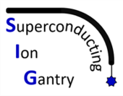
The role of beam monitors…and online range verification in PT
PI: Francesco Pennazio
INFN CSN5 Young Researcher grant
I3PET
PI: Veronica Ferrero
INFN CSN5 Young Researcher grant
𝛄 511 keV
single
Annihilation photons from positron emitters
prompt photons from nuclear de-excitation
secondary charged fragments
Charged particles
2.2 mm²
particle
UFSD
counting
beam
Prompt
excellent
gamma
time
resolution
timing
𝛄 prompt
𝛄 511 keV
courtesy of E. Fiorina, F. Pennazio, V. Ferrero
neutrons

Slide 25
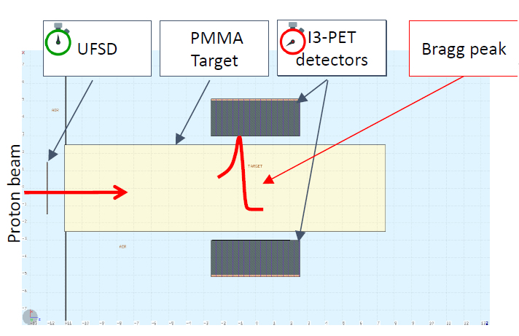
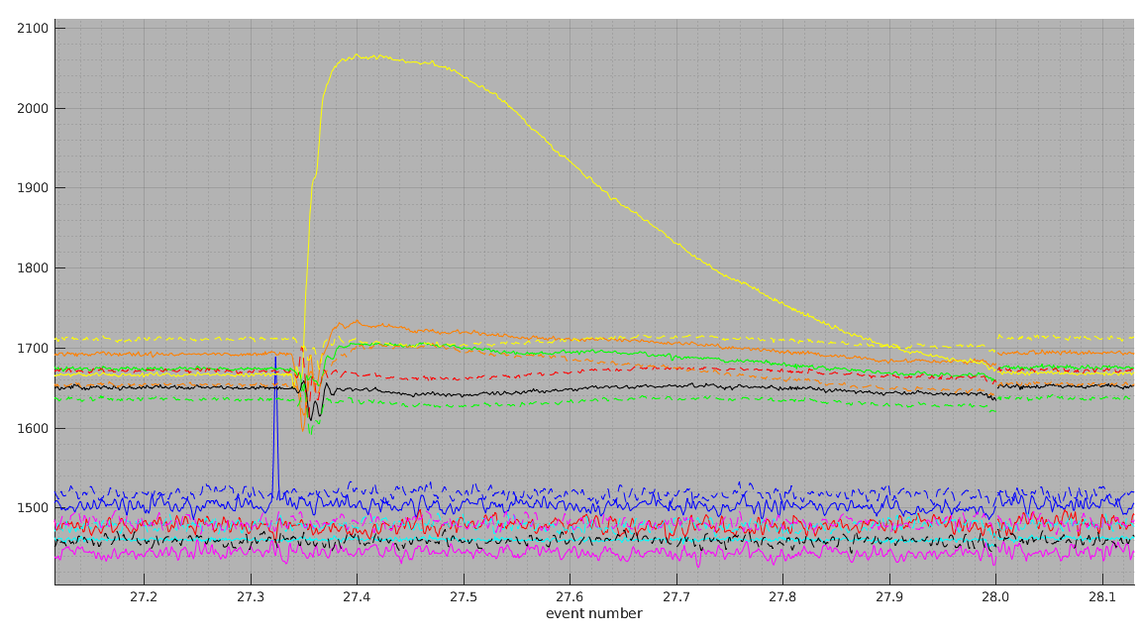
The role of beam monitors…and online range verification in PT
Prompt γ
PI: Francesco Pennazio
INFN CSN5 Young Researcher grant
I3PET
First PGT measurements
PI: Veronica Ferrero
INFN CSN5 Young Researcher grant
Secondary radiation
Primary beam
𝛄 511 keV
single
Annihilation photons from positron emitters
prompt photons from nuclear de-excitation
secondary charged fragments
Charged particles
2.2 mm²
particle
UFSD
counting
beam
Prompt
excellent
gamma
time
resolution
timing
𝛄 prompt
𝛄 511 keV
courtesy of E. Fiorina, F. Pennazio, V. Ferrero
neutrons

Slide 26
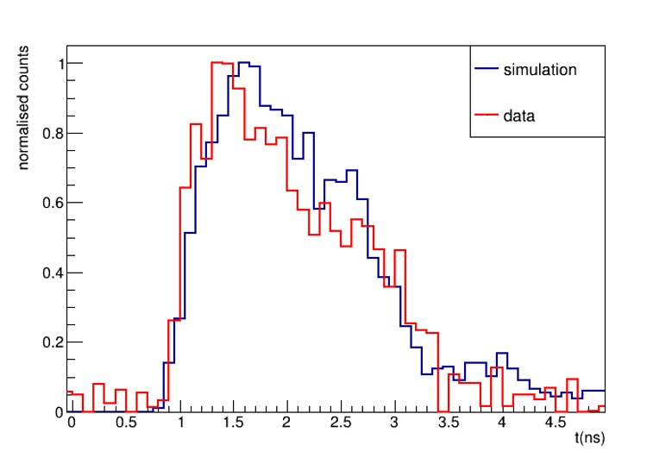
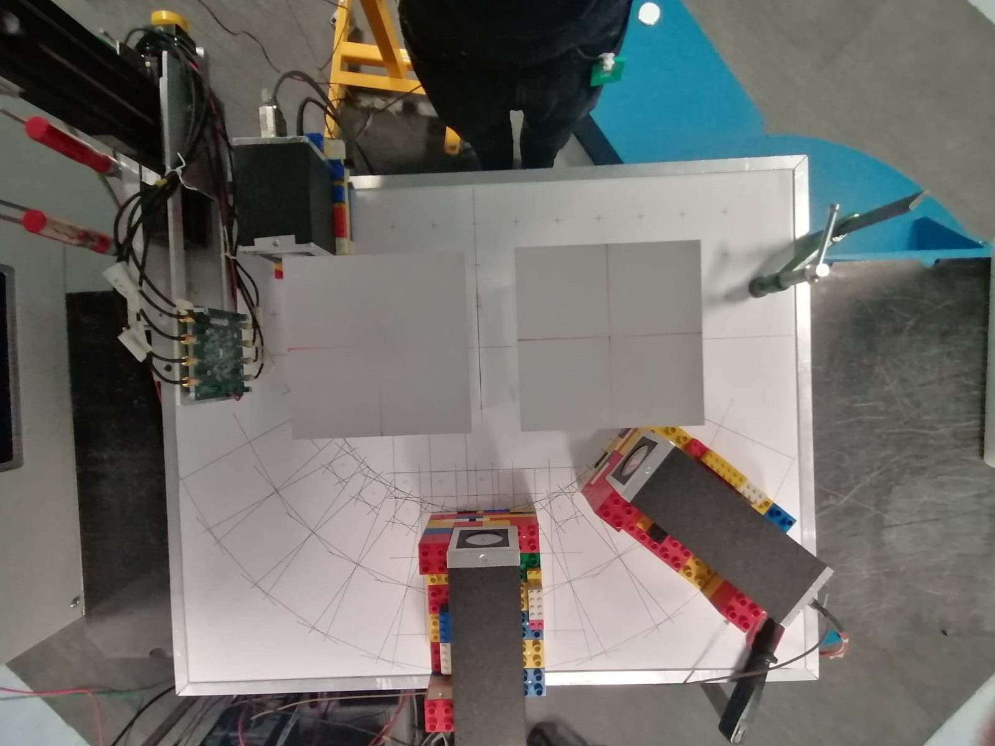
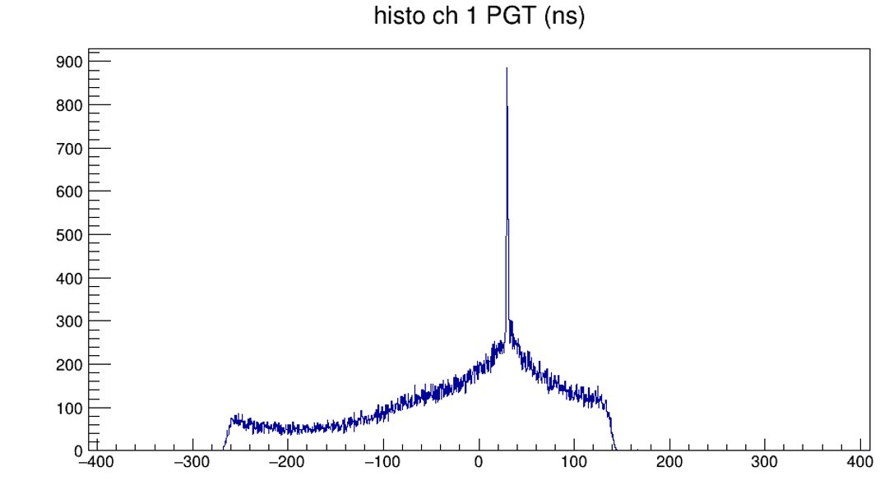
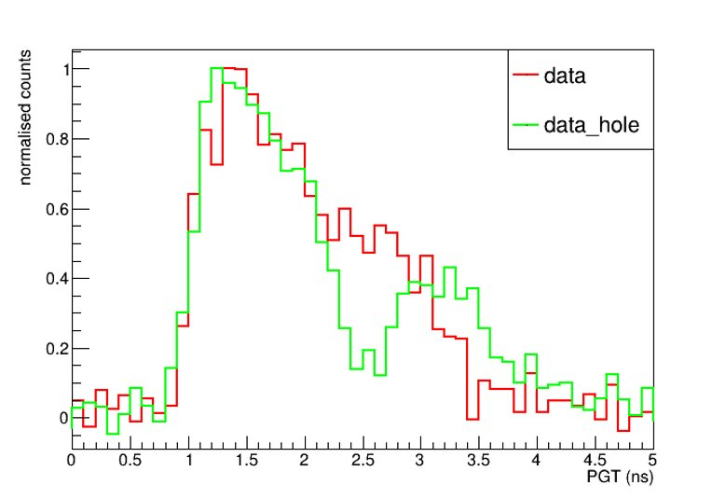
The role of beam monitors…and online range verification in PT
PGT TOF distribution
227 MeV protons on PMMA
Beam average rate 10⁷ pps
beam
beam
Integrate Dose Delivery System and Range Verification System
Combine different signals
Improve clinical performance
courtesy of E. Fiorina, F. Pennazio, V. Ferrero
Anna Vignati – UniTo and INFN

Slide 27



There are not yet validated and standardized protocols for UHDR beam dosimetry for FLASH RT and detectors for dosimetry and beam monitoring have not been fully established.
[F Romano et al. Medical Physics, 2022]
The future of proton and heavy ion therapy therefore depends on technological improvements to make particle therapy cheaper, more conformal and faster.
[C Graeff, L Volz, M Durante. Progress in Particle and Nuclear Physics, 2023]
…to reduce treatment margins
Maybe…
a combination of different technologies would be a viable solution
Anna Vignati – UniTo and INFN

Slide 28
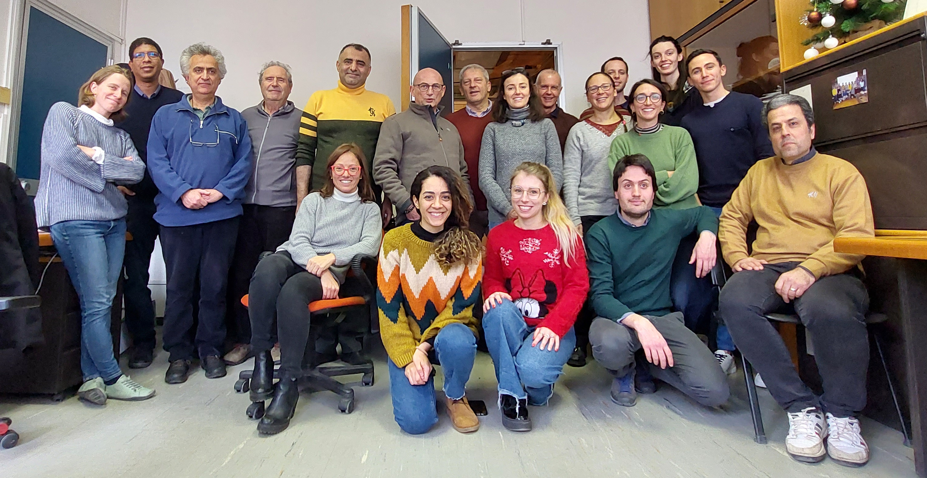
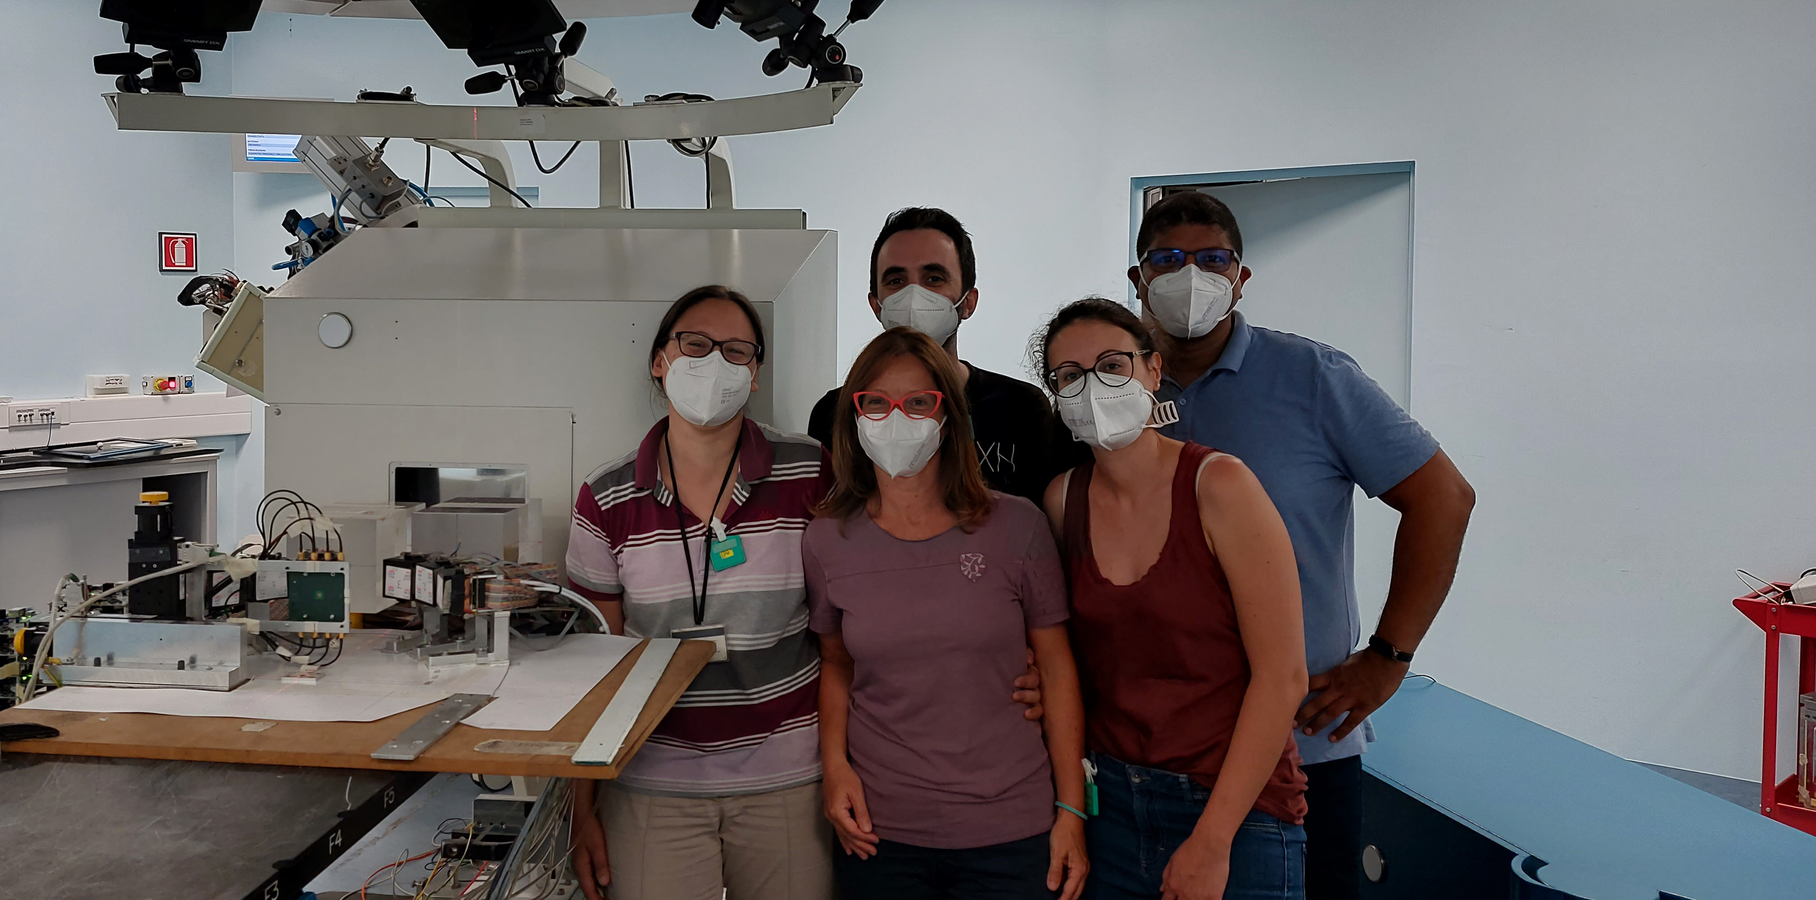

Thank you!
anna.vignati@unito.it
Anna Vignati – UniTo and INFN

