Slide 1
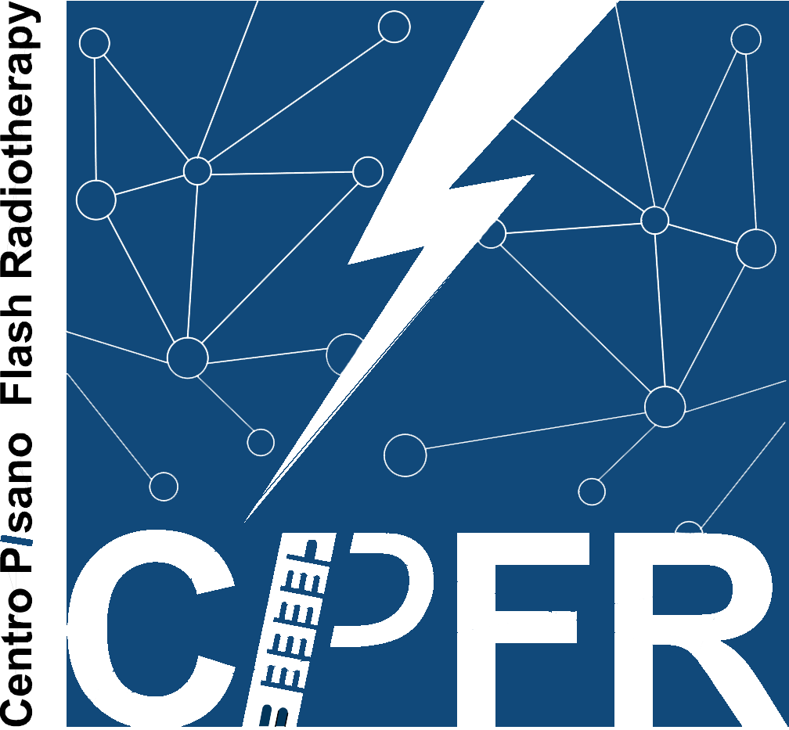
UHDP mini-beam beams with electrons, implementation and dosimetric characterization in FLASH therapy
Jake Harold Pensavalle^{1,2,3}
1 Centro Pisano Multidisciplinare sulla Ricerca e Implementazione Clinica della Flash Radiotherapy (CPFR), Pisa, Italy
2 Scuola di Specializzazione in Fisica Medica (SSFM), University of Pisa, Pisa, Italy
3 Sordina IORT Technologies S.p.A., Research and development, Aprilia, Italy

Slide 2
Outline
Introduction:
Spatially fractionated radiotherapy
CPFR and mini-beam flash:
Design and implementation of a MB-FLASH beam in Pisa
Future perspectives:
MIRO

Slide 3
Introduction
Radiation therapy (RT) is one of the most important methods for cancer treatment, with more than 50% of patients expected to undergo RT treatments in 2025.
So far, the primary driver of development in RT has been technological: more efficient accelerators and increasingly advanced imaging techniques have allowed for the delivery of the prescribed dose in a more efficient and localized manner.
However, the optimization in terms of the obtained dose conformity has now reached a plateau, limited by the reproducibility during treatment (patient positioning setup errors, patient movement, patient anatomical changes, etc.), and it does not address the limitation in radiation therapy caused by the inability to irradiate large volumes of "parallel" response tissues (effectively treating locally advanced tumors in the lungs, brain, etc.).
For this reason, in recent years, the driving force of development has shifted to the biological aspect, seeking to widen the "therapeutic window" (differential response between healthy and tumor tissue) through non-conventional irradiation regimens, both in spatial (SFRT) and temporal (FLASH) terms.

Slide 5
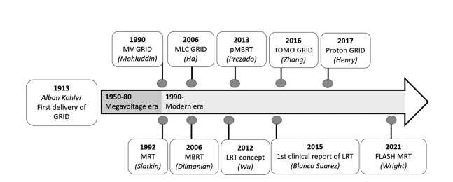
Spatially Fractionated Radiotherapy: From Inception to Today

Slide 6
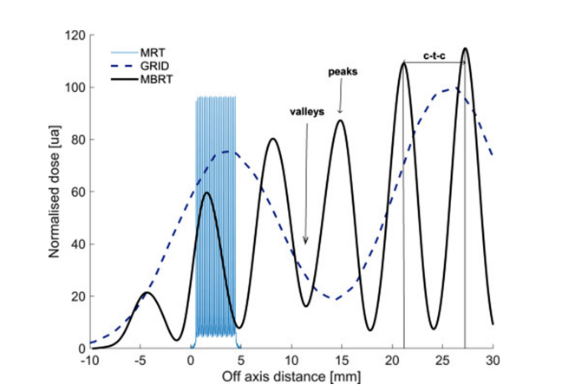
Spatially Fractionated Radiotherapy: Types and Applications
Spatially Fractionated Radiotherapy: Types and Applications
Spatially Fractionated Radiotherapy: Types and Applications

Slide 7
Spatially Fractionated Radiotherapy: Types and Applications

Slide 8
Spatially Fractionated Radiotherapy: Biological Hypothesis
Immunomodulation: In the context of SFRT, inflammation and the activation of the immune system seem to play a crucial role in the anti-tumor response. Studies have identified changes in genes associated with immunity and inflammation in both healthy and tumor tissues after irradiation with MRT. This suggests that SFRT may activate both innate and adaptive immune cells.
Cellular Migration: It is hypothesized that the migration and proliferation of stem cells in low-dose regions may explain the sparing of normal tissues. Some studies have observed different migration patterns between tumor and normal tissues.
Chemical Mechanism: Exposure to ionizing radiation produces oxygen-free radicals in tissues, such as hydroxyl radicals and hydrogen peroxide. One model suggests that hydrogen peroxide produced in high-dose regions diffuses into low-dose regions, causing damage to proteins, lipids, and DNA. This can contribute to both bystander and abscopal effects. Some evidence indicates that the production of free radicals in proton irradiation may be more significant than in photon irradiation.

Slide 9
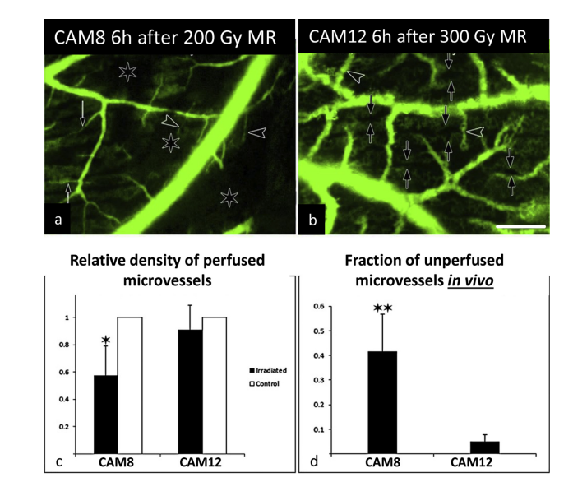
Spatially Fractionated Radiotherapy: Biological Mechanisms
Vascular Effects: Exclusively in experiments involving Micro-Beam Radiation Therapy (MRT), there are differential vascular effects between tumor and normal tissues. MRT appears to preferentially damage immature blood vessels in tumors, while mature vessels in healthy tissues remain intact. This can lead to a deterioration of tumor vascularization, reduced blood perfusion, and tumor hypoxia.

Slide 10
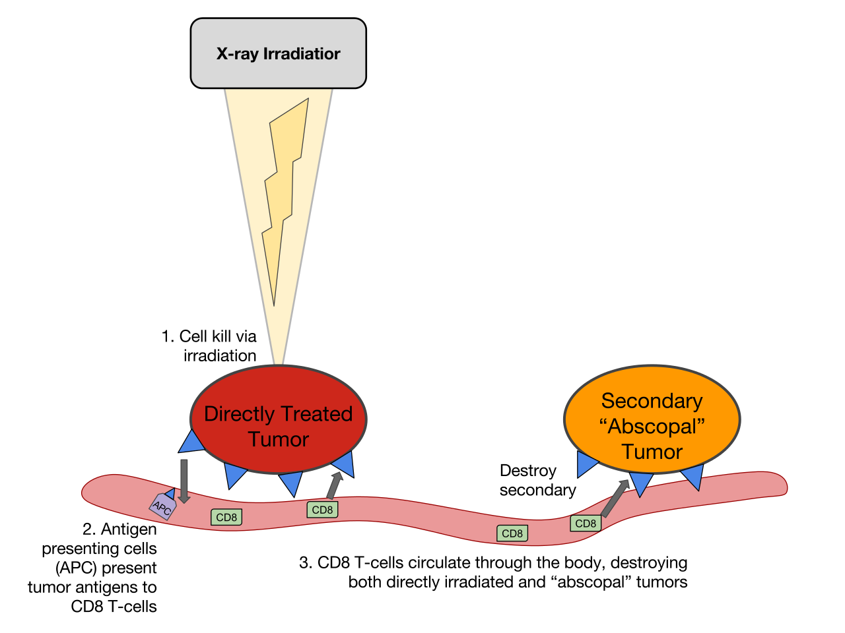
Spatially Fractionated Radiotherapy: Biological Mechanisms
Cellular Signaling Effects (Bystander Effect/Abscopal Effect): In SFRT, both bystander effects, involving cells in low-dose regions, and abscopal effects, which occur when the localized treatment of a tumor triggers a response not only in the treated tumor but also in tumors outside the treatment field, are observed. This is particularly relevant in the treatment of metastatic tumors. Bystander effects involve increased expression of genes associated with DNA repair, cell cycle arrest, and apoptosis in cells exposed to radiation.

Slide 11
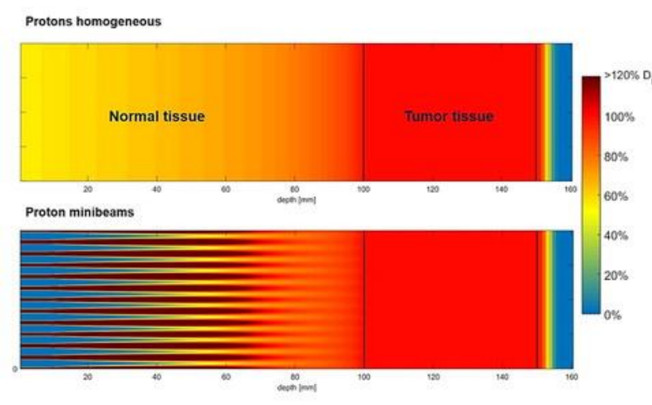
Mini-beam RT: The Current State of the Art
Microbeam Radiation Therapy (MRT) has significant limitations, especially in clinical applications:
It uses kV photon beams produced by large synchrotrons.
The FLASH effect is inherent in the delivery mode (dose rate > 10,000 Gy/s).
Mini-Beam Radiation Therapy (MBRT), characterized by millimeter-sized beamlets, overcomes these limitations. It utilizes less expensive accelerators, higher energies, and the use of charged particles.
The state-of-the-art is represented by Mini-Beam Radiation Therapy with protons (pMBRT). This approach combines the more localized dose distribution in the Bragg peak region of protons with the ability to simultaneously achieve a homogeneous dose distribution in the tumor and a heterogeneous dose distribution (mini-beam) in normal tissues (selective mini-beam effect on organs at risk). Tissue sparing is evident, while tumor iso-effectiveness is still under investigation.
In Spatially Fractionated X-ray Radiation Therapy, on the other hand, multiple fields are required to achieve dose homogenization in the target (selective mini-beam effect on organs at risk), which increases the technical challenges.

Slide 12
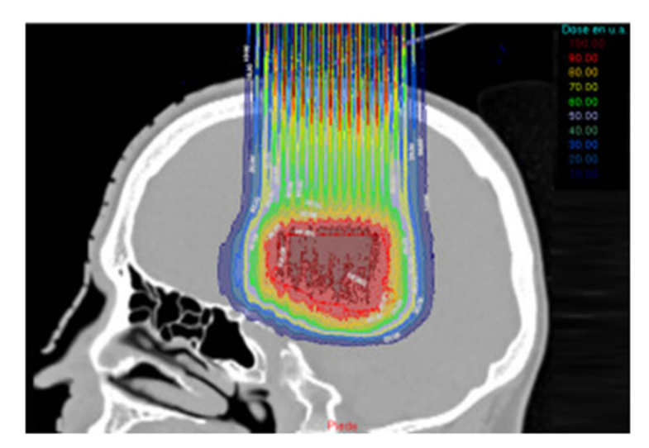
Mini-beam RT: The Current State of the Art

Slide 13
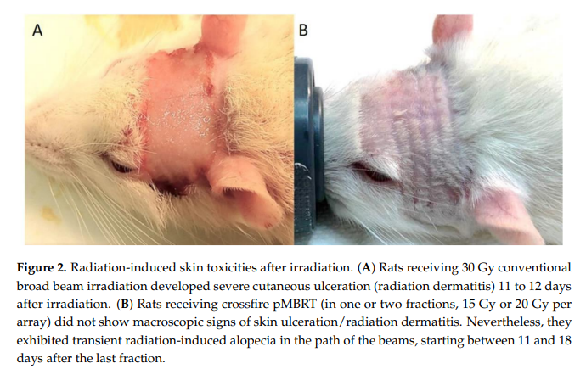
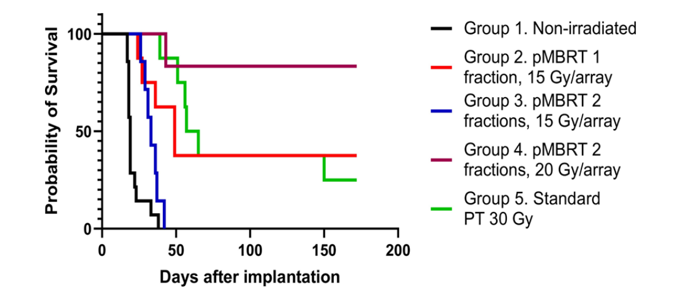
Mini-beam RT: The Current State of the Art

Slide 14
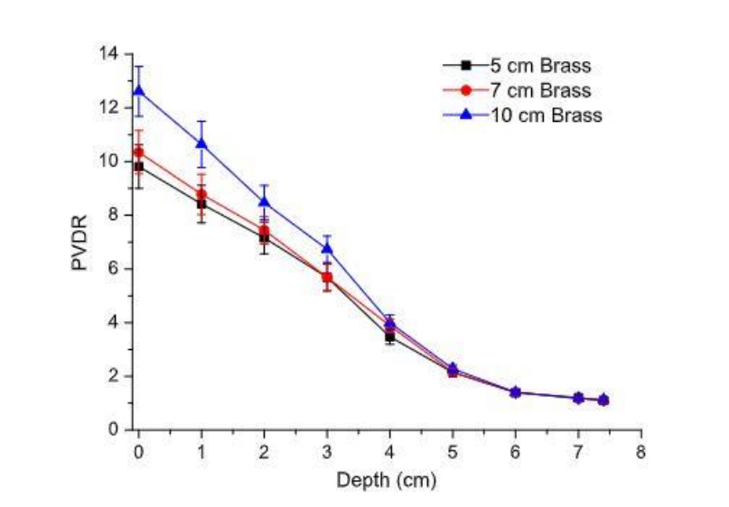
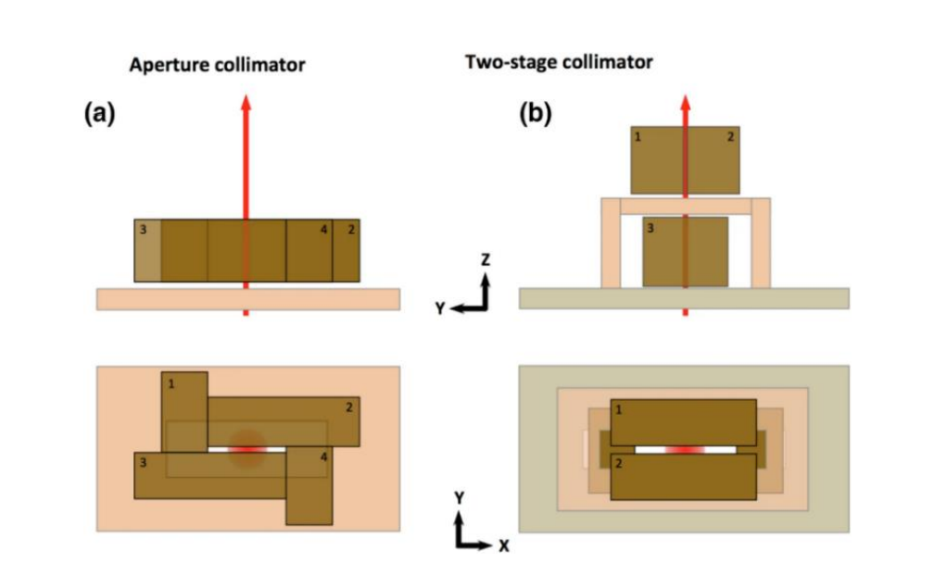
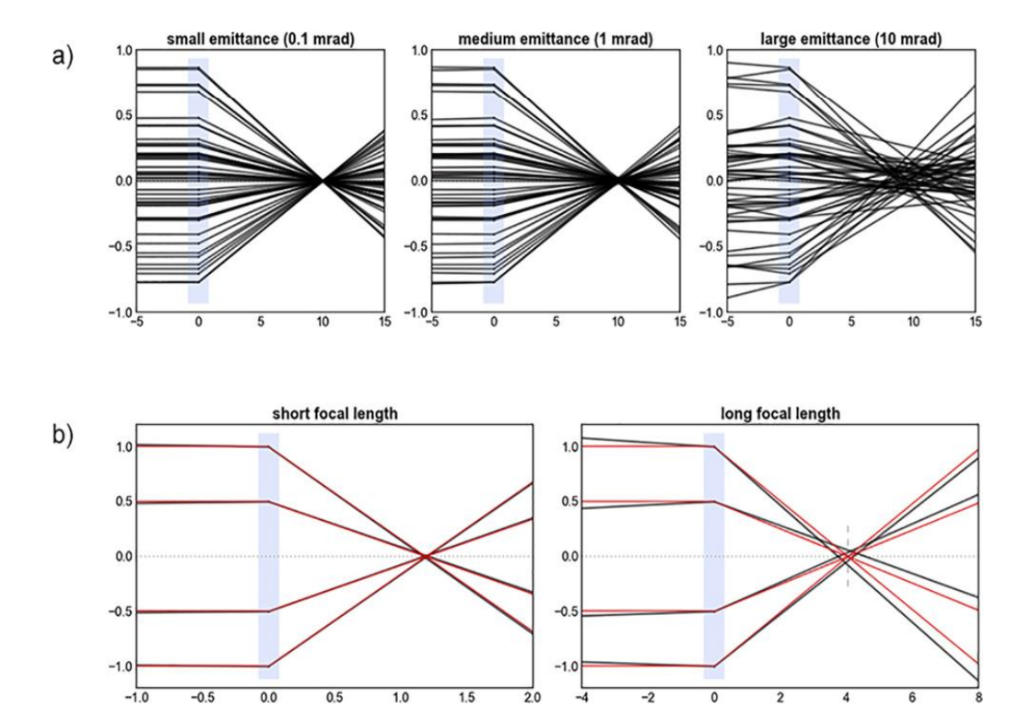
Mini-beam RT: The Current State of the Art
To generate a proton Mini-beam, specialized collimators are typically used (with attention to secondary products), or direct modulation of pencil beams through magnetic focusing.
In the context of SFRT, pMBRT is the gold standard.

Slide 15
Mini-beam and CPFR: Why switch to electrons?
Things change when you want to incorporate FLASH. Although there are centers working on it, combining FLASH and pMBRT is technologically challenging.
Obtaining FLASH and MBRT with electrons is simpler, and it is possible to vary the beam parameters, both spatial and temporal, involved in the effects in a controlled and flexible manner, independently of each other.
Research on low-energy electron mini-beams forms the basis for acquiring knowledge applicable to Very High-Energy Electrons (VHEE), which will enable the utilization of the FLASH effect for treating deep-seated tumors, where it is necessary to penetrate several centimeters of healthy tissue to reach the target. This makes the synergistic use of the mini-beam effect (achieved through dose-painting, as it is the pencil beam delivery mode) important for sparing these tissues, since electrons have significant surface dose deposition.
This is what is intended to be done at the Pisa Flash Radiotherapy Center (CPFR).

Slide 16
Mini-beam and CPFR: Objective
Achieve an electron beam with MB-FLASH characteristics to study both effects for application in a combined context.
Establish a rigorous experimental system for in vitro/in vivo experiments with flexibility in irradiation modes, including CONV, FLASH, MB-CONV, and MB-FLASH.
Evaluation of clinical mini-beam protocols, and comparison between conventional and MB planning with experimentally determined biological modifying factors.

Slide 17
Mini-beam and CPFR: Objective
Establishing a rigorous experimental system for in vitro and in vivo experiments with the flexibility to irradiate with conventional (CONV), FLASH, MB-CONV, and MB-FLASH techniques is crucial for acquiring quantitative radiobiological data to provide insights into:
The beam parameters that influence both effects.
The quantitative dependence of the magnitude of the effect on these parameters.
Any synergistic effects between the techniques.
Understanding the radiobiological mechanisms underlying both effects.
Obtaining an electron beam with MB-FLASH characteristics is essential for studying the potential optimization of the combined effect in a clinical context. This approach will allow researchers to investigate how these unique irradiation techniques interact and potentially enhance their effectiveness in the treatment of various conditions, such as cancer.

Slide 18
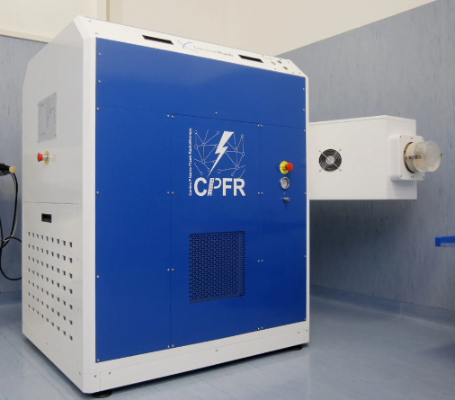
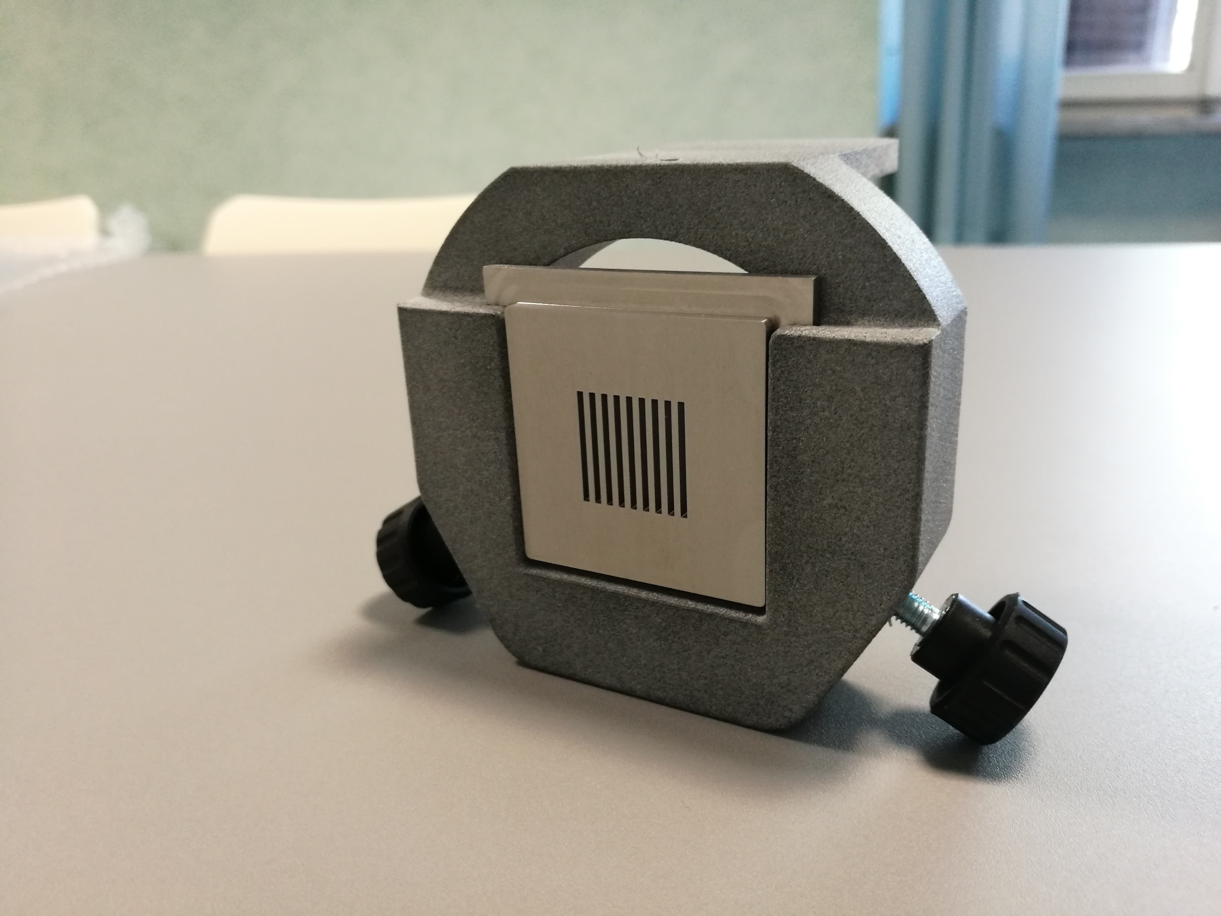
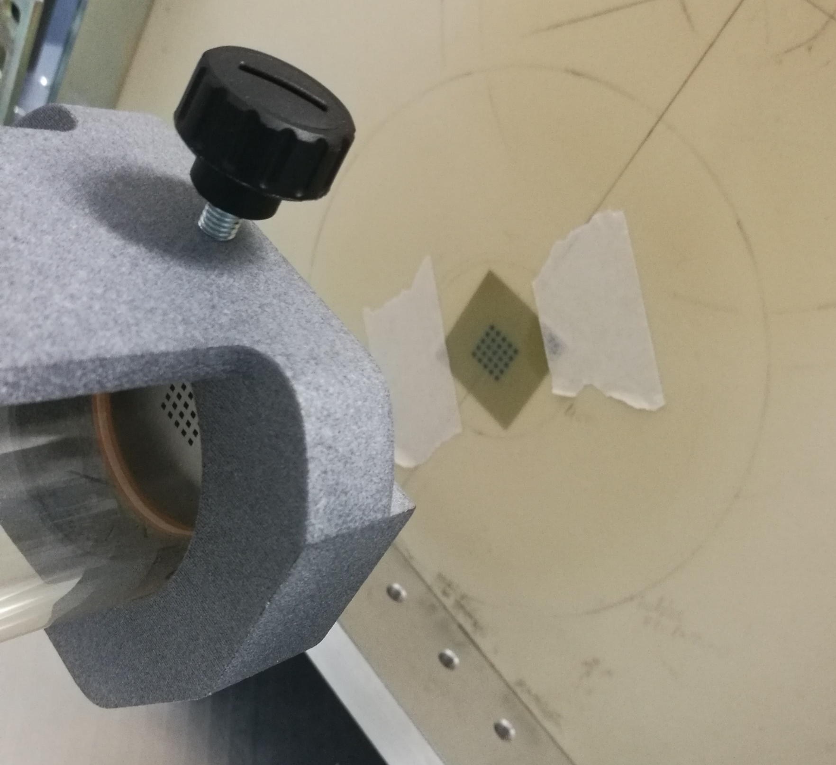
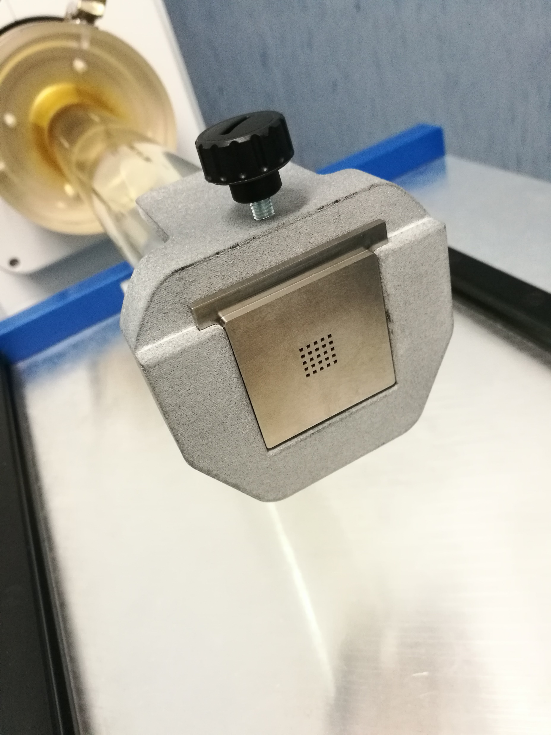
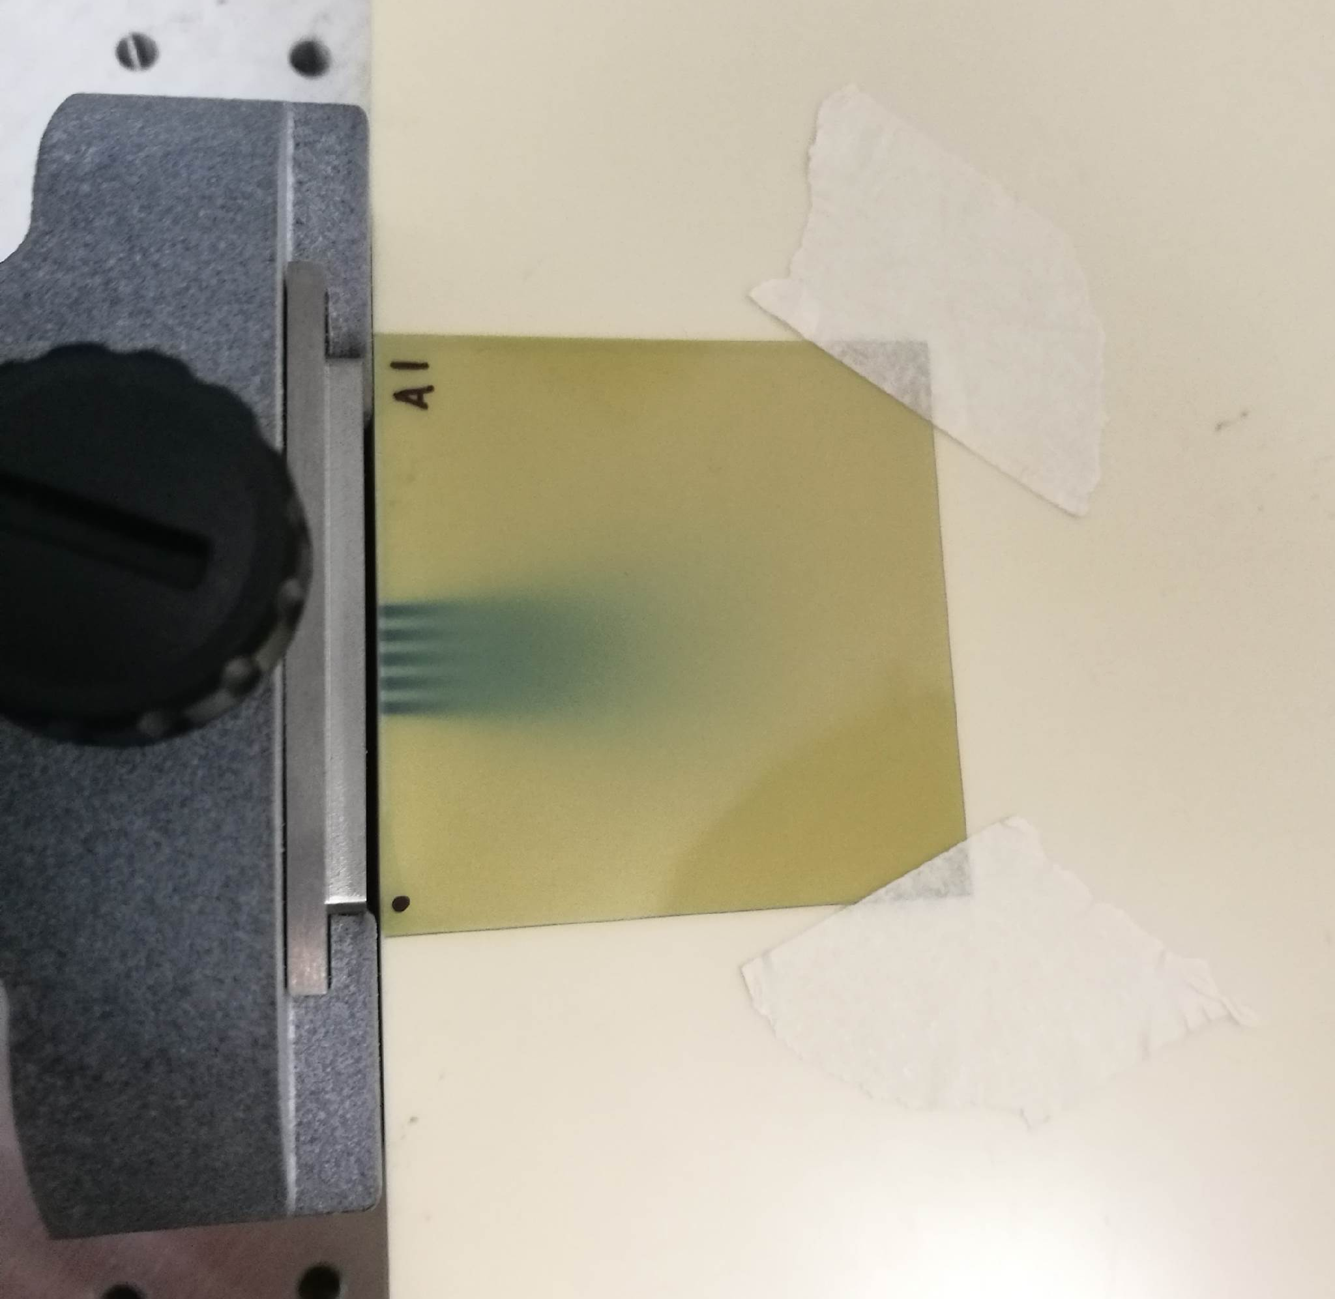
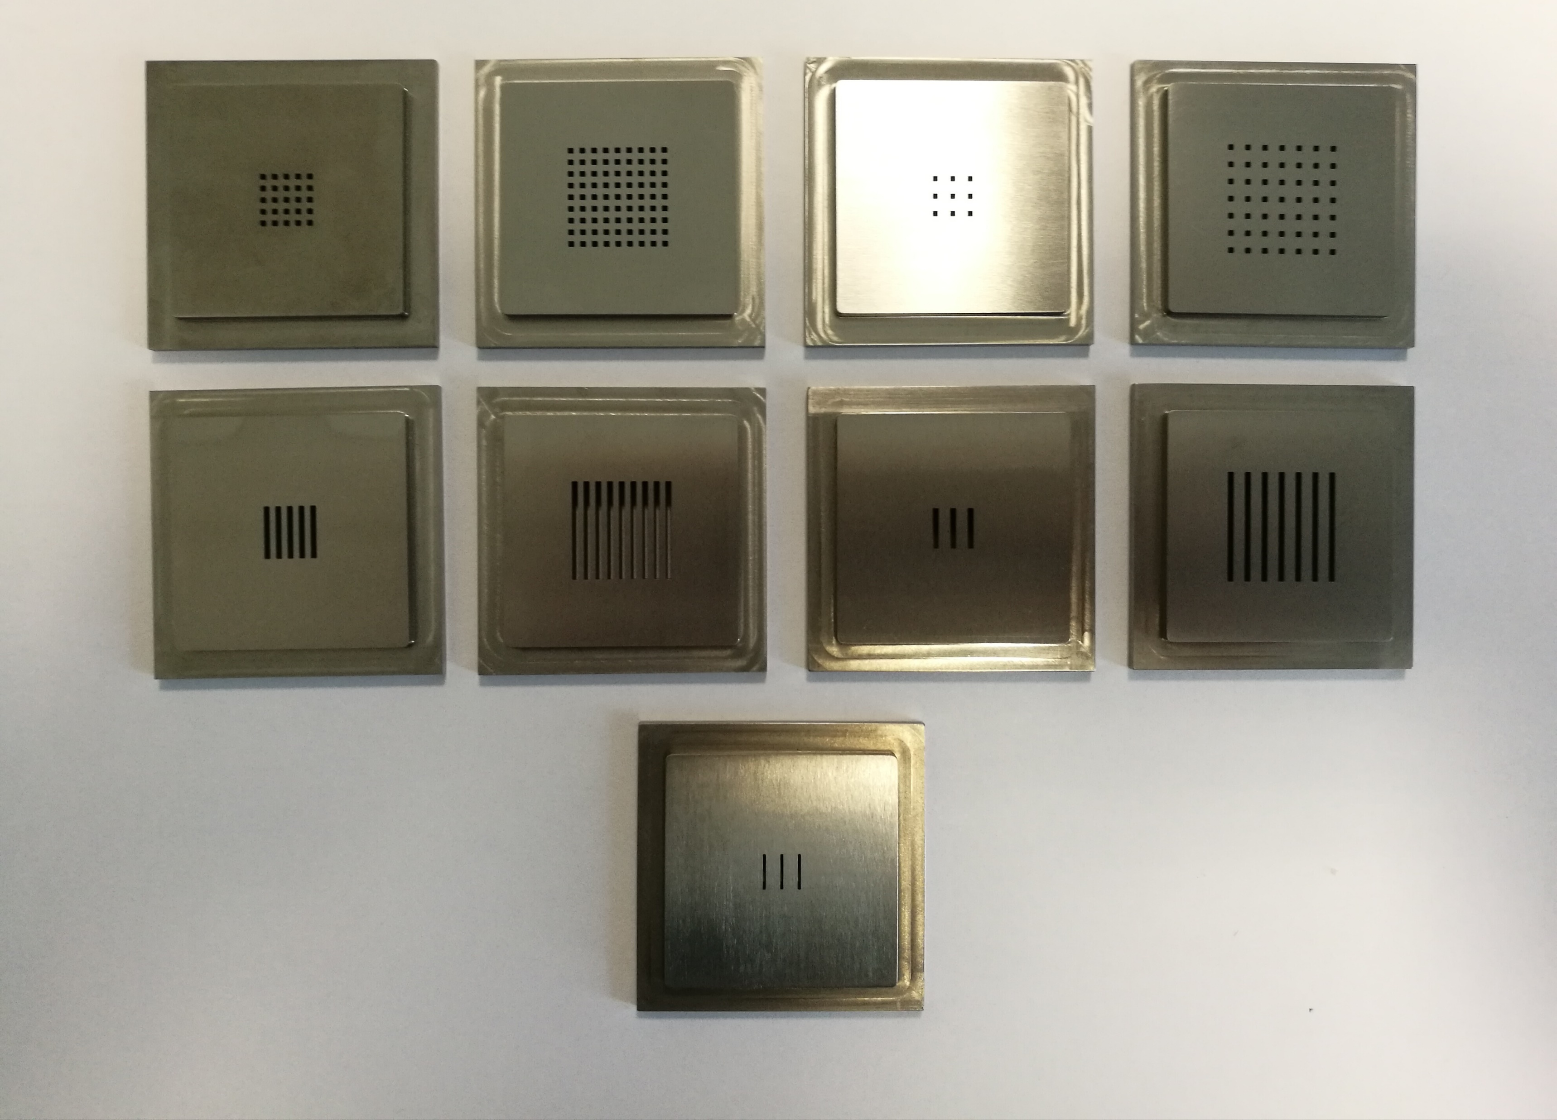
Mini-beam and CPFR: ElectronFLASH and Templates
Linac with FLASH capability: ElectronFLASH (Sordina IORT Technologies, S.I.T)
7 and 9 MeV, Dose rate > 5000 Gy/s, triode gun → independent study of various FLASH parameters
Mini-beam beamlet with beam optics modifications → Tungsten templates
Dosimetric characterization: FLASHDIAMOND, EBTXD, EGSnrc, GEANT4, FLUKA
Submitted to a Special Issue of Frontiers.

Slide 19
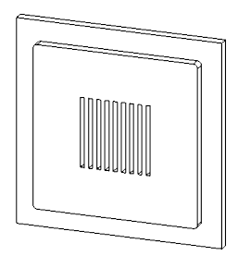
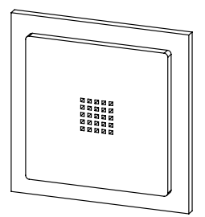
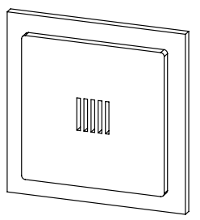
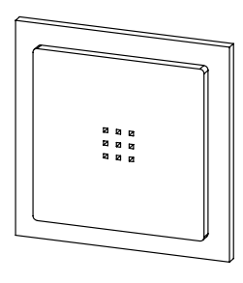
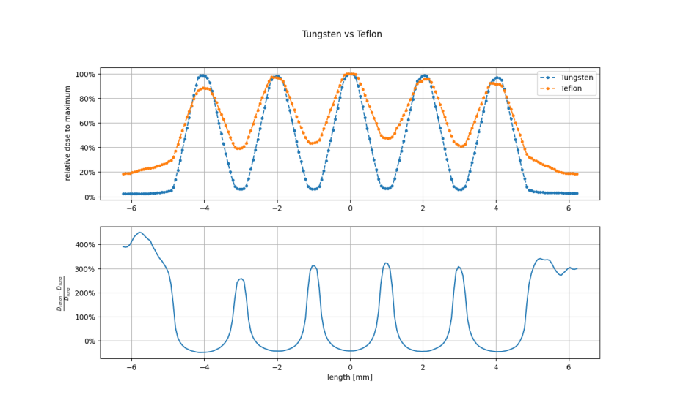
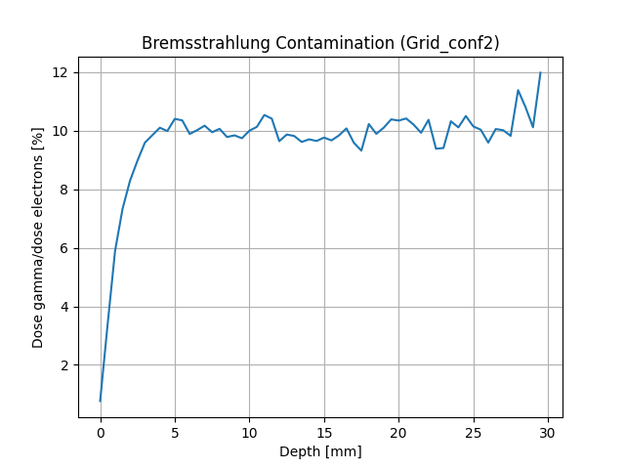
Mini-beam and CPFR: Template Specs
Templates are special collimators designed using Monte Carlo simulations to achieve Mini-Beams with specific performance characteristics (PVDR > 25).
There are a total of 9 different configurations, including both GRID and PLANAR Mini-Beams, which allow for variations in the geometric features of the Mini-Beams.
They are made of tungsten, a high-Z material essential for preventing electrons from passing laterally through the septa, which must be comparable to the practical range.
Bremsstrahlung is inconsequential for our purposes.

Slide 20
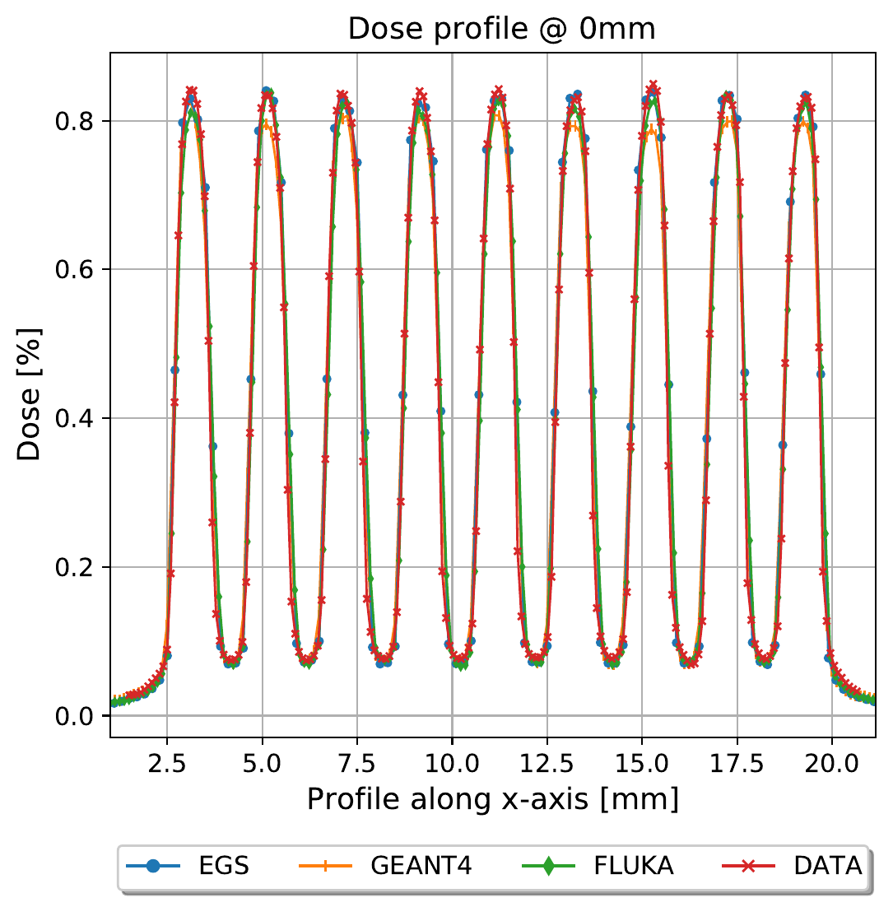
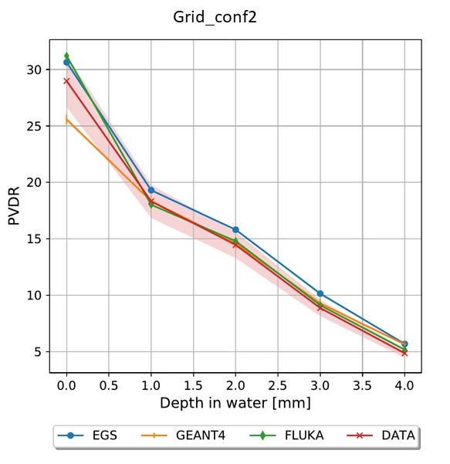
Mini-beam and CPFR: Beam Characterization
Characterization of the Mini-Beam from various templates: Peak-valley-dose-ratio (PVDR), center-to-center distance (CTC), GRID vs PLANAR, etc.
Good agreement between measurements and Monte Carlo simulations.
Different templates allow for obtaining Mini-Beams with varying characteristics, enabling multiple possible studies.
Upcoming plans include in vitro experiments and the development of planning for future in vivo experiments.

Slide 21
Mini-beam and CPFR: A MB-FLASH Center
The CPFR is now the first center equipped with an electron Mini-Beam-FLASH beam that has been dosimetrically characterized for the independent and combined study of both effects.
This involved experimental characterization and validation using multiple Monte Carlo codes.
The first in vitro experiments are in schedule.

Slide 22
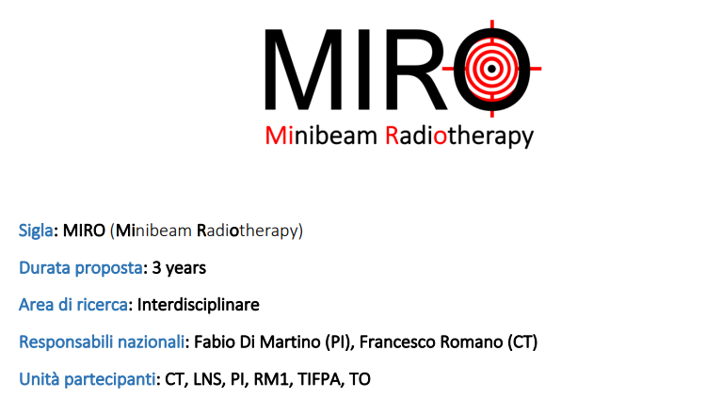
Future Perspectives

Slide 23
References
Bertho, Annaig, Lorea Iturri, and Yolanda Prezado. "Radiation-induced immune response in novel radiotherapy approaches FLASH and spatially fractionated radiotherapies." International Review of Cell and Molecular Biology 376 (2023): 37-68.
Prezado, Yolanda. "Divide and conquer: spatially fractionated radiation therapy." Expert reviews in molecular medicine 24 (2022): e3.
Bouchet A et al. (2015) Effects of microbeam radiation therapy on normal and tumoral blood vessels. Physica Medica: PM 31, 634–641.
Meyer, J., Eley, J., Schmid, T. E., Combs, S. E., Dendale, R., & Prezado, Y. (2019). Spatially fractionated proton minibeams. The British journal of radiology, 92(1095), 20180466.
Bertho A et al. (2021) First evaluation of temporal and spatial fractionation in proton minibeam radiation therapy of glioma-bearing rats. Cancers (Basel) 13, 4865–4879
Guardiola, C., Peucelle, C., & Prezado, Y. (2017). Optimization of the mechanical collimation for minibeam generation in proton minibeam radiation therapy. Medical physics, 44(4), 1470-1478.
Sotiropoulos, M., & Prezado, Y. (2021). A scanning dynamic collimator for spotscanning proton minibeam production. Scientific reports, 11(1), 1-11.
Schneider, T. (2022). Technical aspects of proton minibeam radiation therapy: Minibeam generation and delivery. Physica Medica, 100, 64-71

