Slide 1
UHDP electron LINACs for research in FLASH therapy
Damiano Del Sarto^{1,2,3,4}
1 Centro Pisano Multidisciplinare sulla Ricerca e Implementazione Clinica della Flash Radiotherapy (CPFR), Pisa, Italy
2 Centro per l’integrazione della Strumentazione dell’Università di Pisa (CISUP)
3 Scuola di Specializzazione in Fisica Medica (SSFM), University of Pisa, Pisa, Italy
4 INFN, Sezione di Pisa, Pisa, Italy
Notes:
Thanks for inviting me to this first edition of the INSIGT workshop. In this presentation I’ll focus on electron linacs operating with Ultra High Dose per pulse aimed at research in Flash Therapy

Slide 2
Outline
Brief description of Flash Effect related beam parameters
Characteristics of FLASH Capable electron LINACs
Architecture of ElectronFlash as a dedicated FLASH Research LINAC
Dosimetric characteristics of ElectronFlash
Notes:
So I’ll start giving a brief desciption of beam parameters linked to the flash effect. Thank I’ll move on describing the basic characteristic of FLASH electron linac that are common to all the accelerator used since today. Then I’ll move to the core of this talk as I’ll describe the achitecture of our electron LINAC dedicated to the FLASH research with its fulll dosimetric characterization.

Slide 3
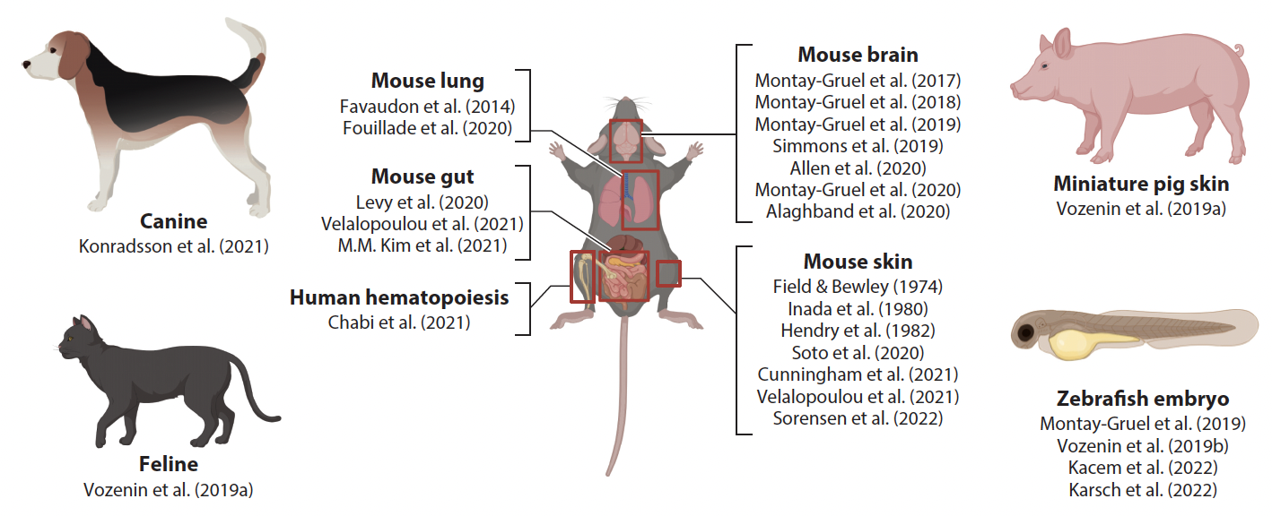
“The FLASH effect is an in vivo effect where normal tissue toxicities can be ameliorated while maintaining equal efficacy in tumor growth control, achieved by delivering radiation at ultrahigh dose rates above a prescribed threshold (mean dose rates ≥100 Gy/s).”
D. Del Sarto
FLASH effect: what we know - I
1/18
Notes:
Here yet another definition of the FLASH effect, this is taken from a work of Chaterine Vonnenzin. Aside from the whole definition I want to stress that as of today the major beam involved in the effect is the average dose rate that shoud exceed 100 Gy/s. I’ll show that there is much more and this focus was mainly because it was the feature shared among the majority of the biological experiments.
As we can see in the figure below the in vivo evidences for the flahs effect are plentiful so there is no doubt about its existance but several questions remains open.

Slide 4
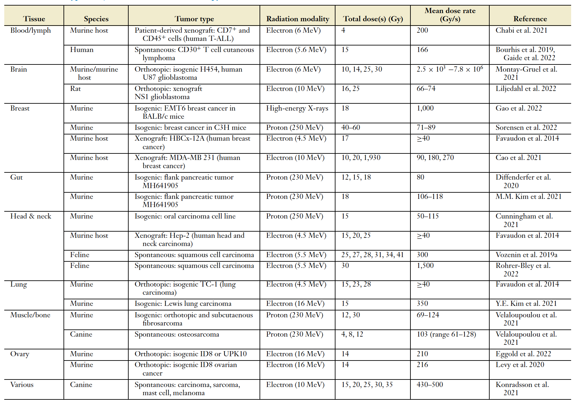
D. Del Sarto
FLASH effect: what we know - II
2/18
Notes:
This table summurized some expieriments done on on both healthy and tumor tissues from different anatomical sites. Apart from that we can see that the greatest amount of evicdences comes from expieriment with electrons beams so sticking to that kind of radiation is a sound path if we want to further knoledge on the effect. The electron beam that this tables refers to are of course pulsed.

Slide 5
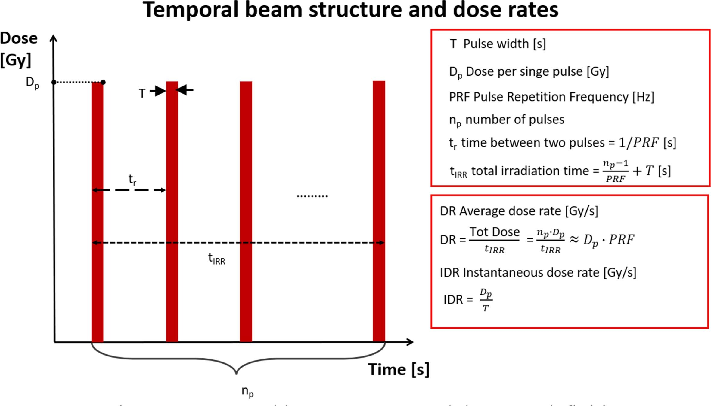
Experimental evidences on beam parameters needed to trigger the FLASH effect:
Dose D [Gy] | >5-10
Dose Rate DR [Gy/s] | >100
Dose per pulse Dp [Gy] | >1
Instantaneous Dose Rate IDR [Gy/s] | >10⁶
Irradiation Time T [ms] | < 100-200
D. Del Sarto
FLASH effect: what we know - III
3/18
Notes:
Let me remind briefiley the beam parameters that are involved in the FLASH EFFECT. First of all we have the dose per pulse. Well, this is pretty self explanatory is just the dose of a single pulse of radiation. Since the irradiation is usually composed of multiple pulses we can calculate the average dose rate as approximately the products of the number of pulses and the repetition frequency. Lastly the instantaneous dose rate is defined as the dose per pulse divided the pulse duration that is commonly of the order of few microseconds.
So what we know from the in vivo experiments? Well we need doses greater than 5 Gy, Average dose rates greater than 100 Gy/s, dose per pulses Grater than 1 Gy and IDR greater than 1MGy. Additionally, the total irradiation time should be under 200 ms.

Slide 6
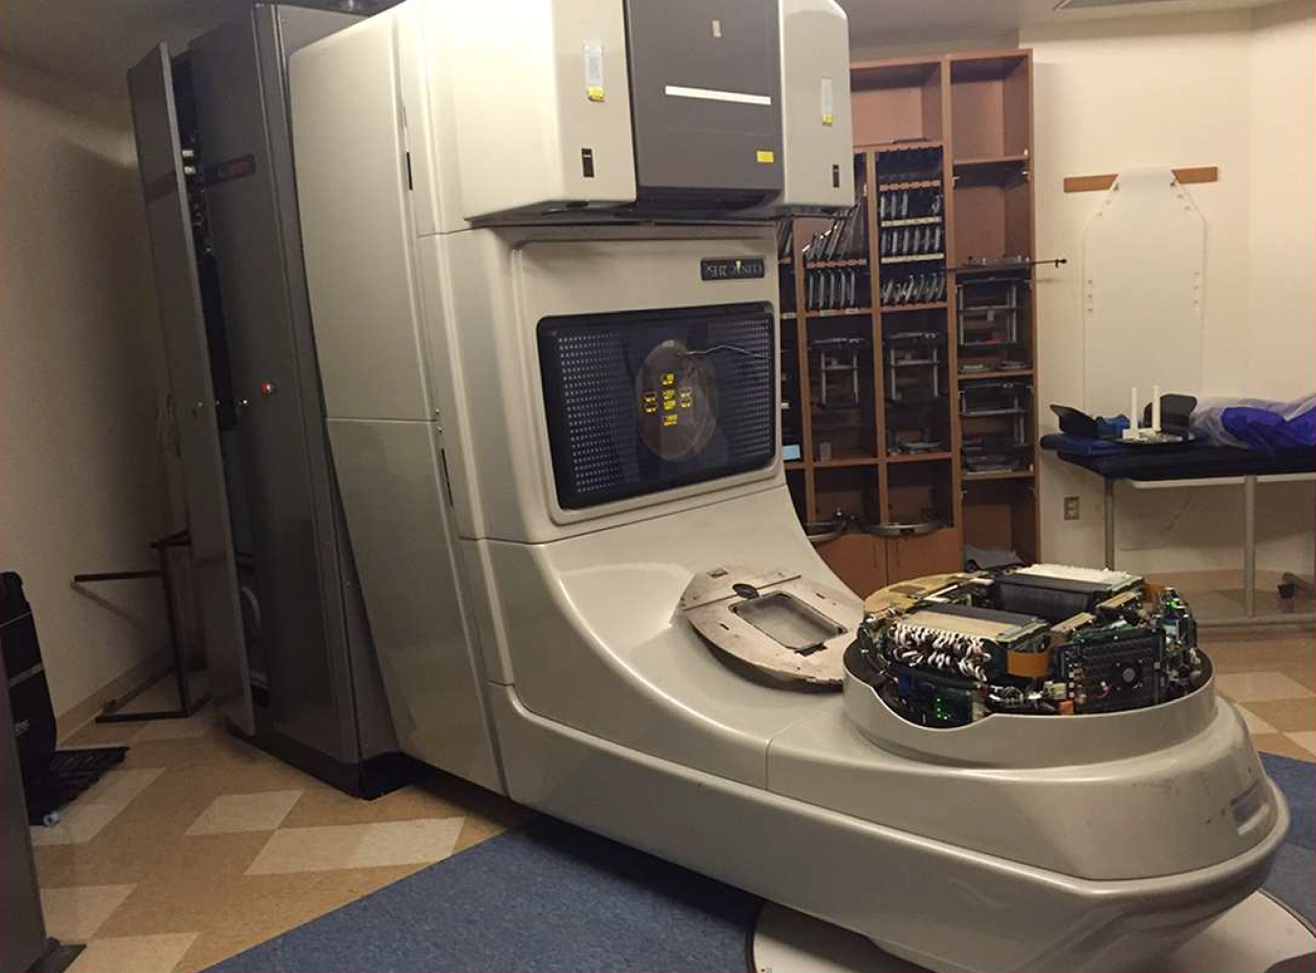
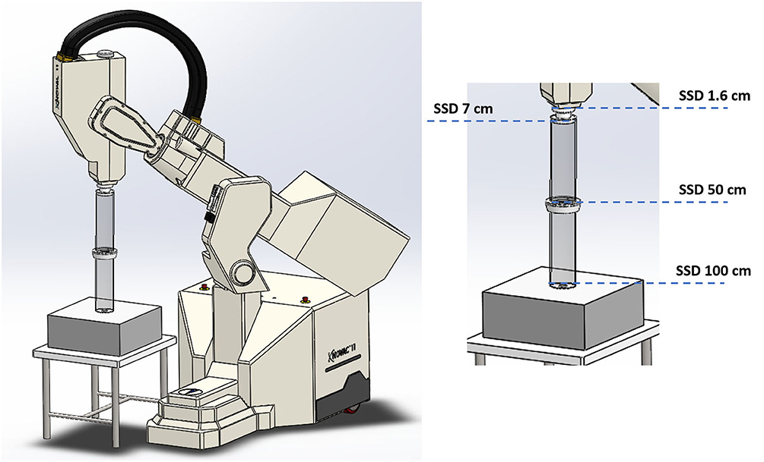
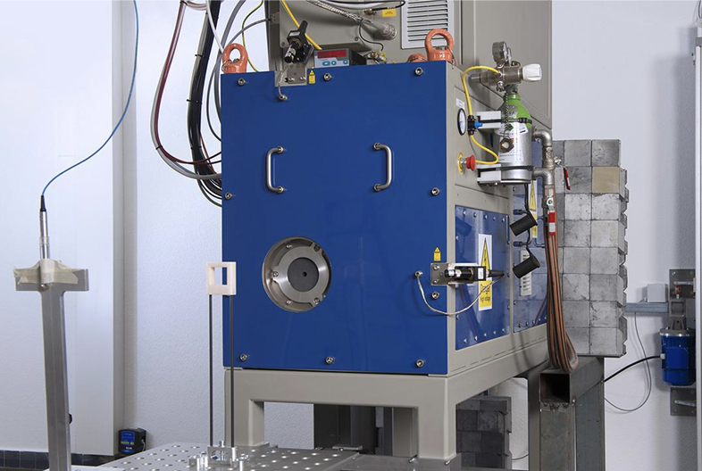
Modified Clinical LINAC
Modified IORT LINAC
Early Research LINAC
DR ~ 100 Gy/s
Dp <~ 1 Gy IDR ~ 100 kGy/s
Monitoring: no
DR > 100 Gy/s
Dp ~ 18 Gy IDR ~ 4 MGy/s
Monitoring: no
DR > 100 Gy/s
Dp ~ 20 Gy IDR > 4 MGy/s
Monitoring: some
D. Del Sarto
History of LINAC utilized for FLASH research
4/18
Notes:
Let’s take a glimpse at what kind of electron LINACS were and are used for flash research. A first attempt to obtain a flash beam was trying to modify a clinical accelerator (usually an obsolete but reliable one like the Varian CLINAC you see in the picture). The modification involved the removal of several accelerators part and lots of internal tweaking. The obtained parameter while not optimal were just enough to get a flash beam at least for the average dose rate. Of course having dismantled the monitor chambers no beam monitoring was avaiable. A more straighforward approch was trying to modify a IORT electron linac, the modification mainly involved the reduction of the SSD by the removal of the electron applicator. This approach lead to higher dose per pulse and a flash beam for all the beam parameters. We then had what I have called early research linac, that mainly are evolution of linac built for industrial applications, this kind of accelerator were engeniered with the flash research as the primary scope so the beam parameter were exceeding the flash requirements knonw at the time. This kind of accelerators hosted numerous radiobiological experiments but they have their limitation.

Slide 7
Modified Clinical LINAC
Modified IORT LINAC
Early Research LINAC
MAJOR PITFALLS
Output stability
Spectrum difference between conventional and FLASH irradiation
Constrained selection of FLASH beam parameter (no independence)
Limited irradiable volume
Little to no monitoring system
Limited beam optics choices
D. Del Sarto
History of LINAC utilized for FLASH research
5/18
Notes:
Indeed these three kinds of accelerators share several limitation. First of all their output is not very stable, this problems was mitigated in the research linacs but not fully resolved (we’ll see why in a moment). Morover the spetrum of the flash and conventional irradiation setups remain different and this complicates the comparison of the two irradiaiton modality.
Another crucial aspect is that this kind of accelerators lacks the flexibility needed to span the beam parameters over long ranges to explore the FLASH dependencies from one parameter at the time.
Also the uniformity is not that good constraining the flash beam to small spots limiting the experiments that can be done. The monitoring is either totally absent or very rudimental and the beam optics cannot be changed easly.

Slide 8
Magnitude of the effect when altering different beam parameters.
Clinical UHDR/UHDP LINAC
Inverse RBE Planning
UHDP Dosimeters
Quantitative radiobiological experiments
UHDP Dosimetry
Dedicated research UHDP LINAC
Clinical translation
Comprehension of the radiobiological mechanism underlying the effect
Modelling
D. Del Sarto
FLASH effect: what we would like to know
6/18
Notes:
Given the previous historical overview we can, as FLASH enthusiasts, make our wishlist about what we need to know to translate this effect into the clinical practice.
[…]
All thise knowledge wolud be the fundation for the realization of a clinical linac with its parameter tuned exactly to maximise the effect alongside with FLASH dosimeter engenerred for that specifical irradiation condition. Also we would be able to elaborate a RBE inverse planning and the

Slide 9
We need to independently manipulate the three beam parameters (DR, Dp, IDR) across a broad range while keeping the energy spectrum constant (experimental setup), to investigate their influence on the FLASH effect.
Accelerate
Energy E and Fluence $Φ$ real time monitoring
Measure Control
$$W_{TOT}=W_{LINAC}+W_{BEAM}$$
Conform Collimate
The specimen need to be irradiated with wide uniform fields. Different beam optics need to be obtained easily (passive collimation)
Radiation protection
No neutron production involved
Target activation negligible
Low energy secondary particle produced
LOW ENERGY ELECTRON LINAC (<10 MeV)
D. Del Sarto
Optimal characteristics of a FLASH LINAC
7/18
Notes:
We just see that a dedcated UHDP research linac is mandatory to obtain the data for clinical translation. Staing in the field of whishlist we can make one about what we need from that ideal accelerator:
[,,,[
As of today the span of this 4 basis or major characteristics is a low energy electron linac.

Slide 10
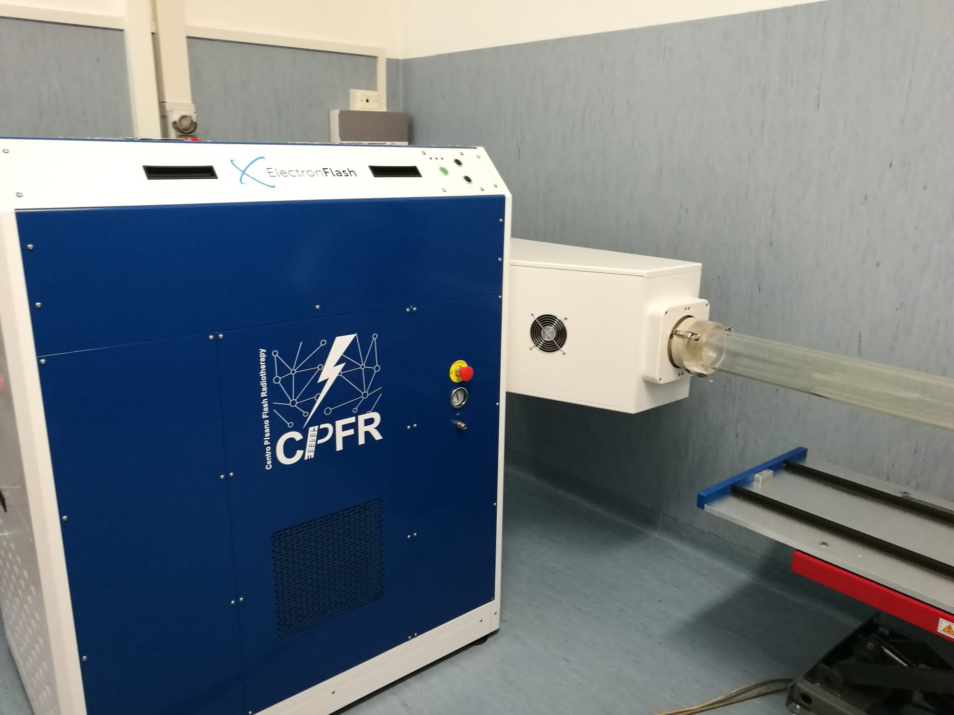
Designed from the experience of IORT modified devices by SIT
Produced and installed in 2022
Fully characterized and functional
D. Del Sarto
The ElectronFLASH research LINAC
8/18
Notes:
Having understood that for now the FLASH research is very conveninent when done with electrons, SIT Sordina an italian company developed the ElectronFLASH an ectron LINAC with all the needed characteristic. Here at the CPFR we have a unique model of this machine that was developed starting from the experience gathered by Fabio Di Martino with IORT modified devices, this machine was installed in 2022 and it has been fully characterized.

Slide 11
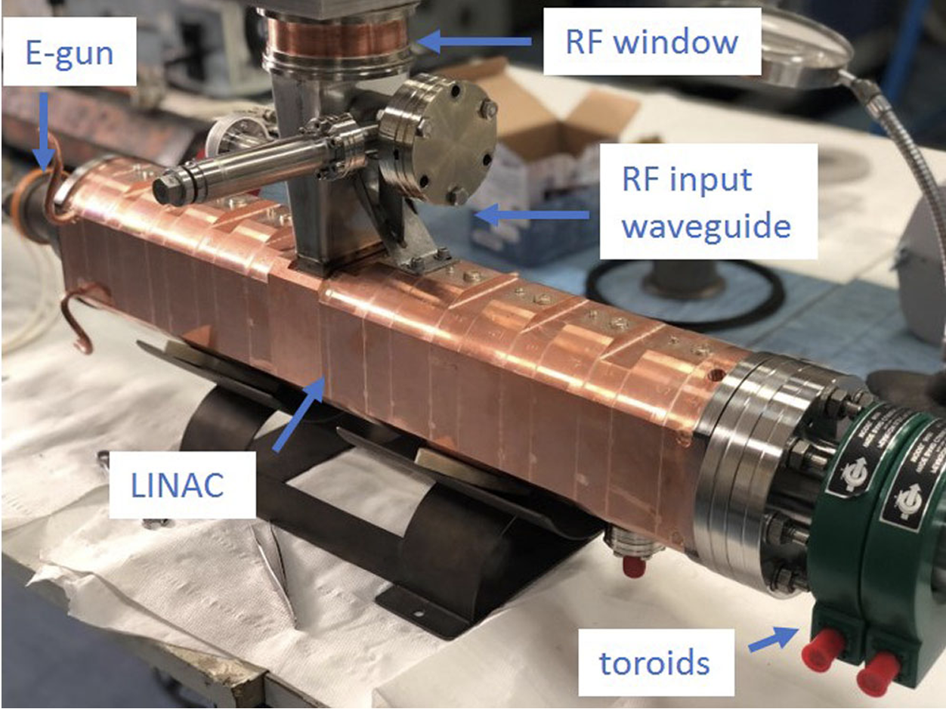
Electron LINAC, stationary wave, S band, π/2
2 Nominal Energies: 7MeV, 9MeV
Pulse Repetition Frequency: [1-245] Hz
Several beam optics avaiable [120-30 mm]
Radial focusing waveguide
Non-distruptive online output monitoring, via two dedicated induction thoroid (ACCT)
Triode gun (cathode, grid, anode), generating beam current from ~mA to 100 mA with adjustable pulse duration from 0.2 to 4 us
D. Del Sarto
Key features of ElectronFlash
9/18

Slide 12
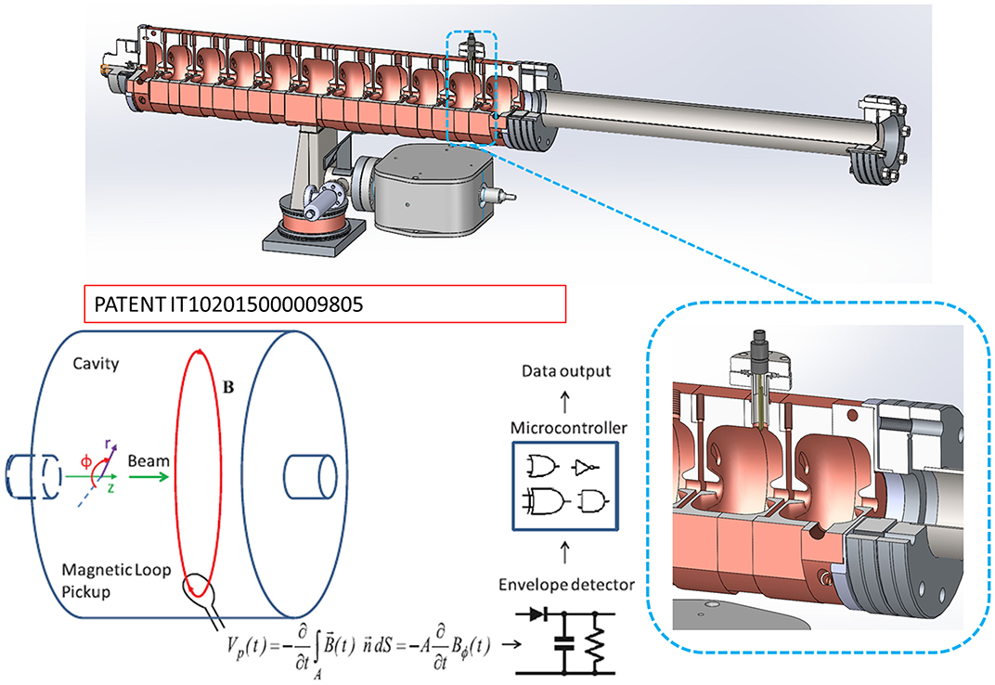
The extreme irradiation parameters are obtained accelerating very high currents
$$W_{TOT}=W_{LINAC}+W_{BEAM}$$
$$W_{BEAM}≅I_{BEAM}∙E_{BEAM}$$
$$\frac{∆E}{E}≅\sqrt{\frac{∆W_{BEAM}}{W_{TOT}}}$$
D. Del Sarto
Key features of ElectronFlash
10/18

Slide 13
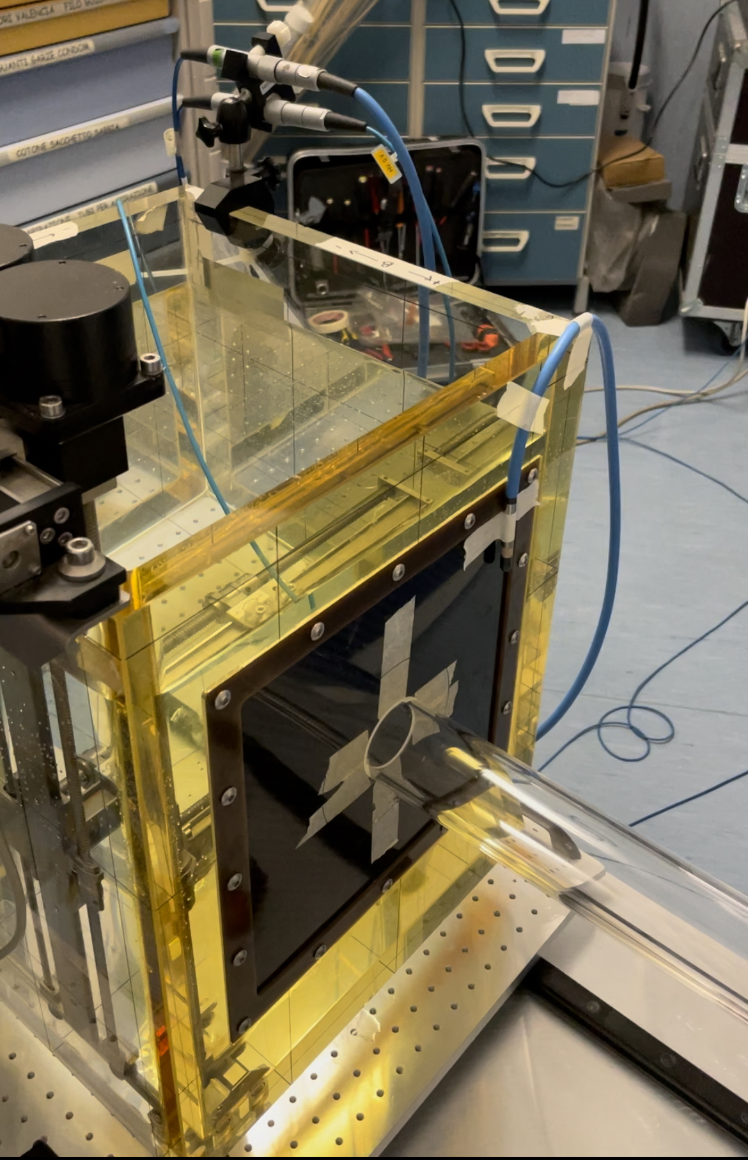
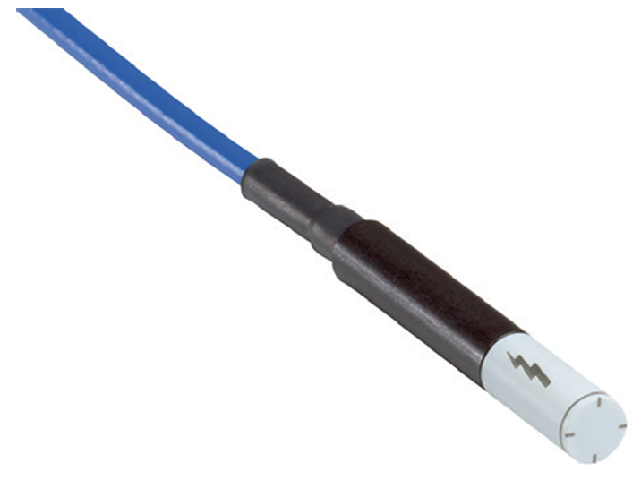
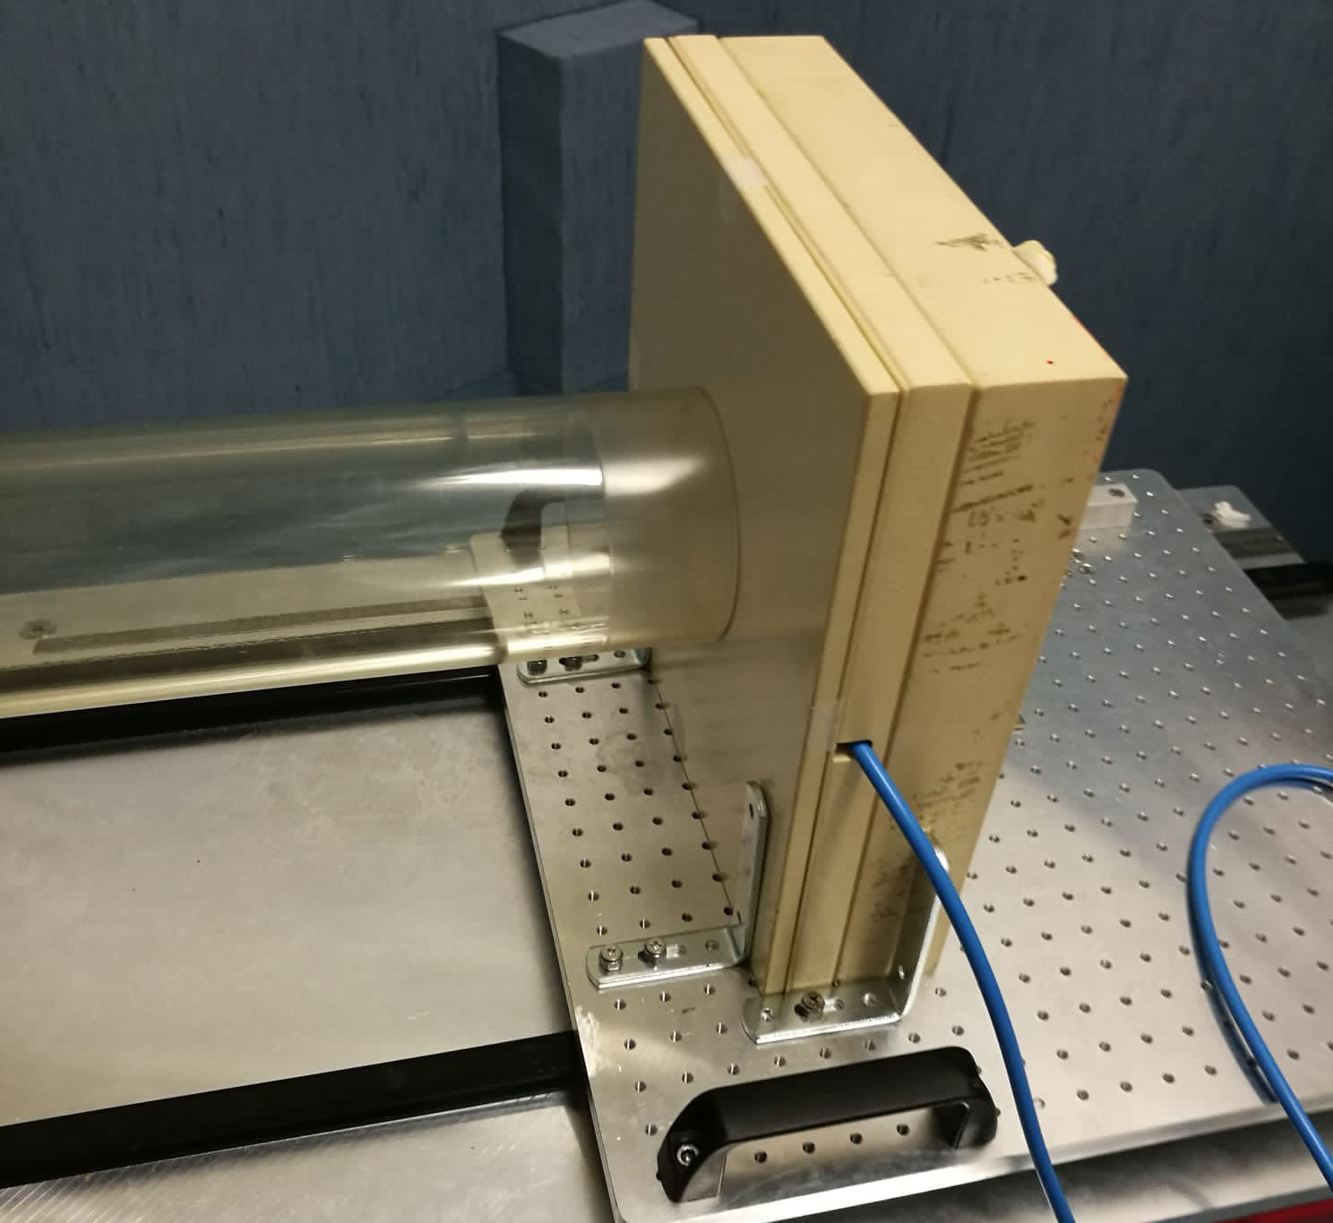
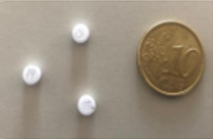
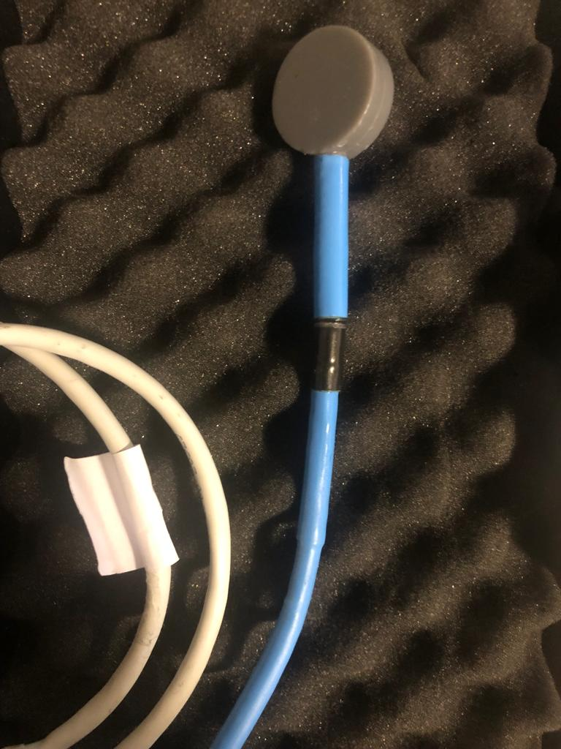
Reference active dosimeter: flashDiamond (fD) tested up to18Gy per pulse with alanine pellets and graphite calorimeter.
RELATIVE
PDD: fD, in water with MP3-XS customized with a window 1.2 mm thick.
Marinelli, M, Felici, G, Galante, F, et al. Design, realization, and characterization of a novel diamond detector prototype for FLASH radiotherapy dosimetry. Med. Phys. 2022; 49: 1902– 1910.
Profiles: in solid water at R₁₀₀. Passive dosimetry with EBT-XD calibrated in the same beam at low dose per pulse with Advanced Markus
ABSOLUTE
Dose: fD at R100 in water phantom.
Determination of ADR, D_{p}, IDR.
Output stability, PRF dependence, pulse duration dependence.
D. Del Sarto
Dosimeters and measuring setups
11/18

Slide 14
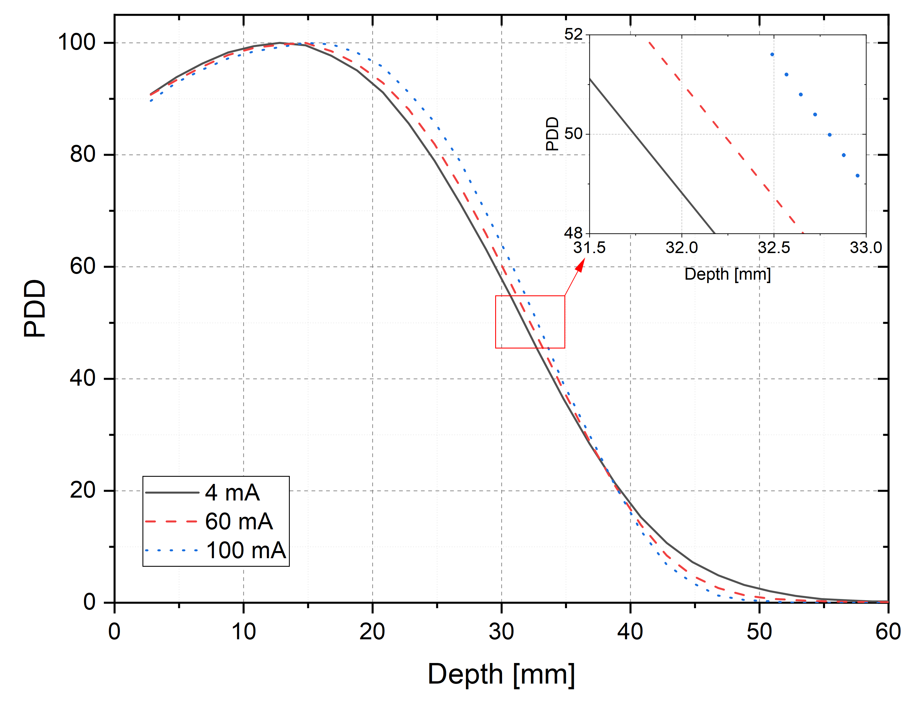
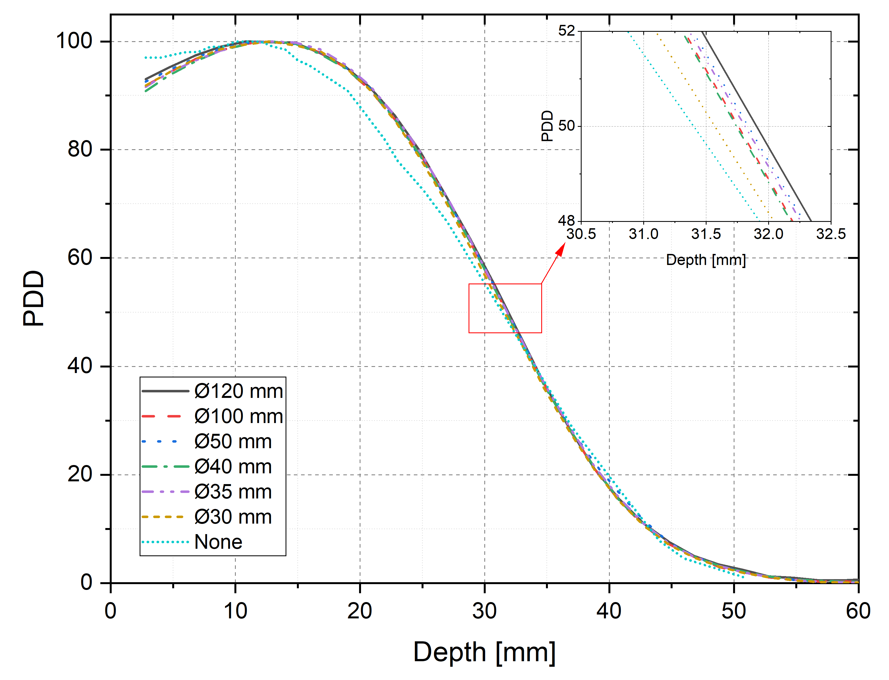
9 MeV
9 MeV
10 mm
Beam current independence
Beam optic independence
D. Del Sarto
PDD stability w/ beam current and beam optics
12/18

Slide 15
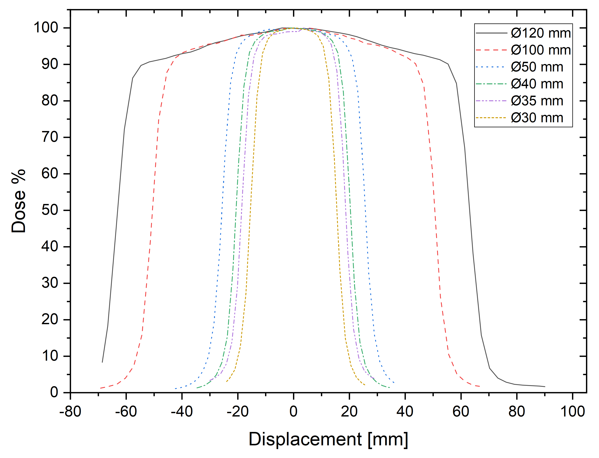
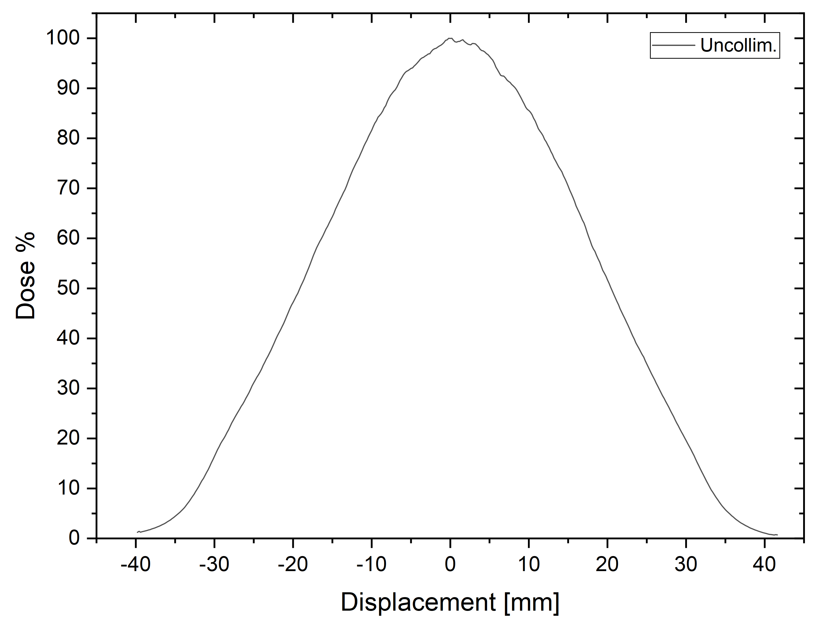
Applicator Ø [mm] | Flatness | Symmetry | Iso 97% Ø [mm]
120 | 4.65 | 1.49 | 70
100 | 4.03 | 1.02 | 60
50 | 3.79 | 0.69 | 36
40 | 5.02 | 1.25 | 30
35 | 5.97 | 2.05 | 26
30 | 7.20 | 1.50 | 20
D. Del Sarto
Beam profiles
13/18

Slide 16
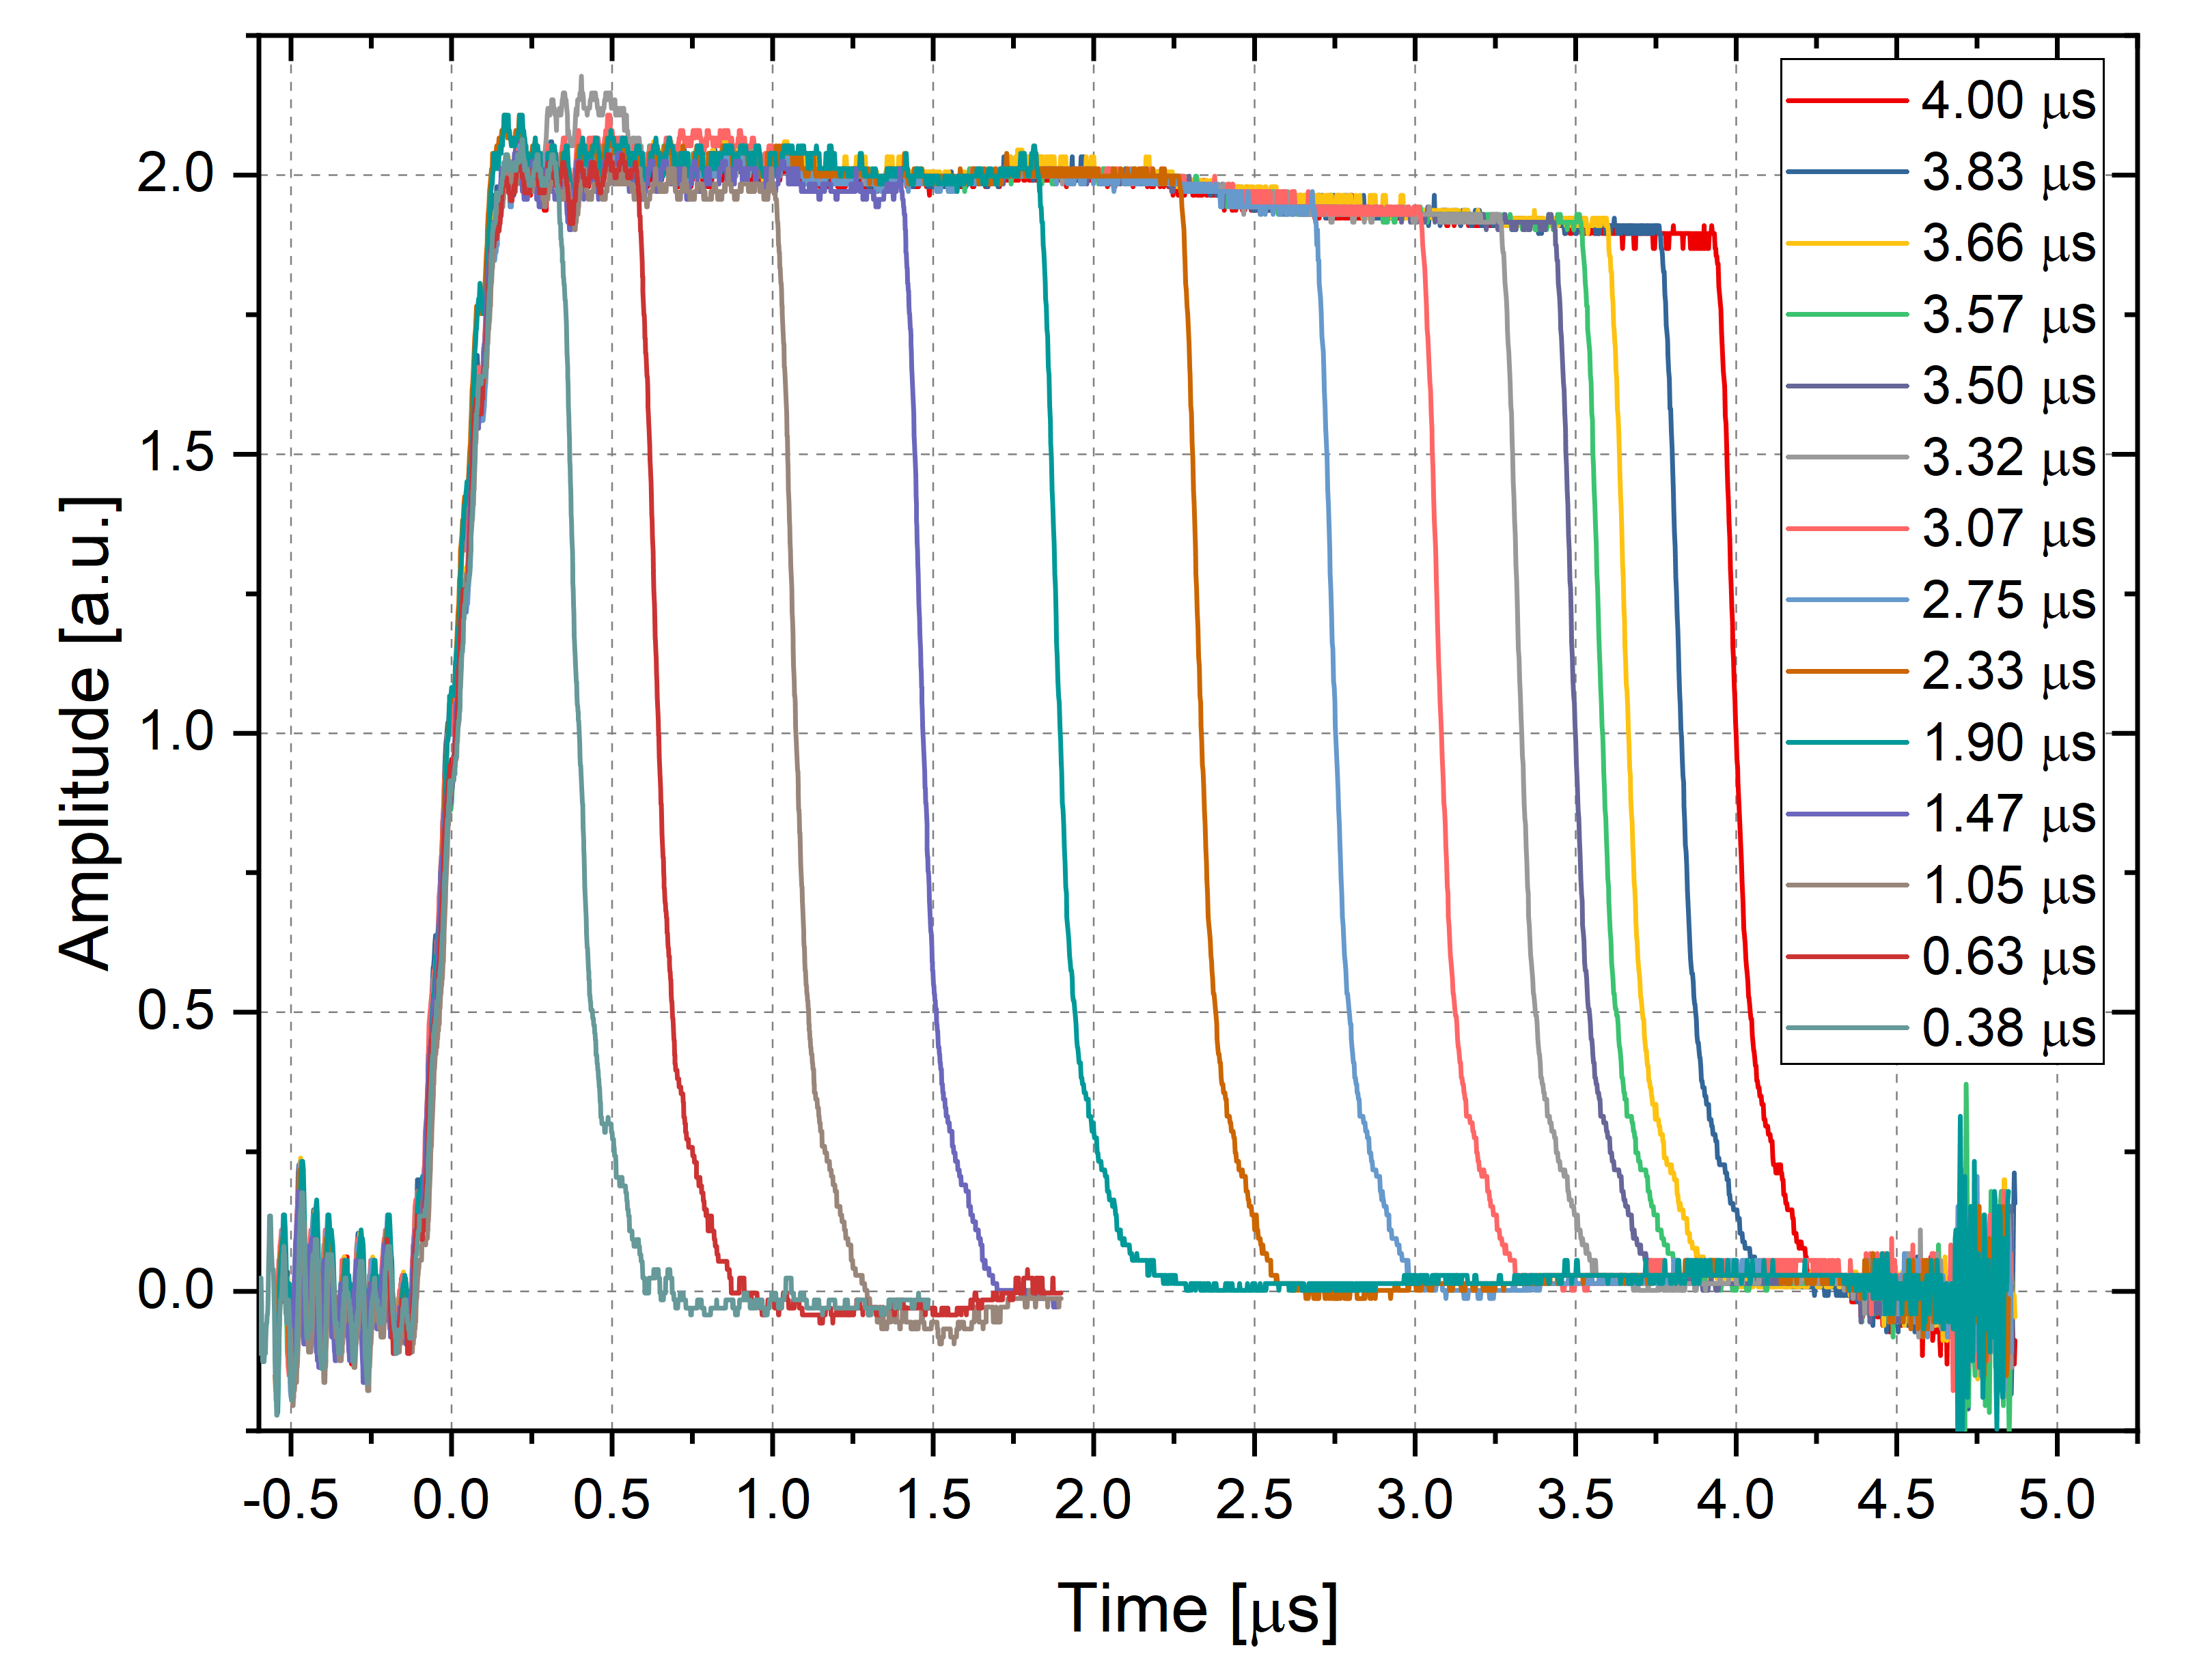
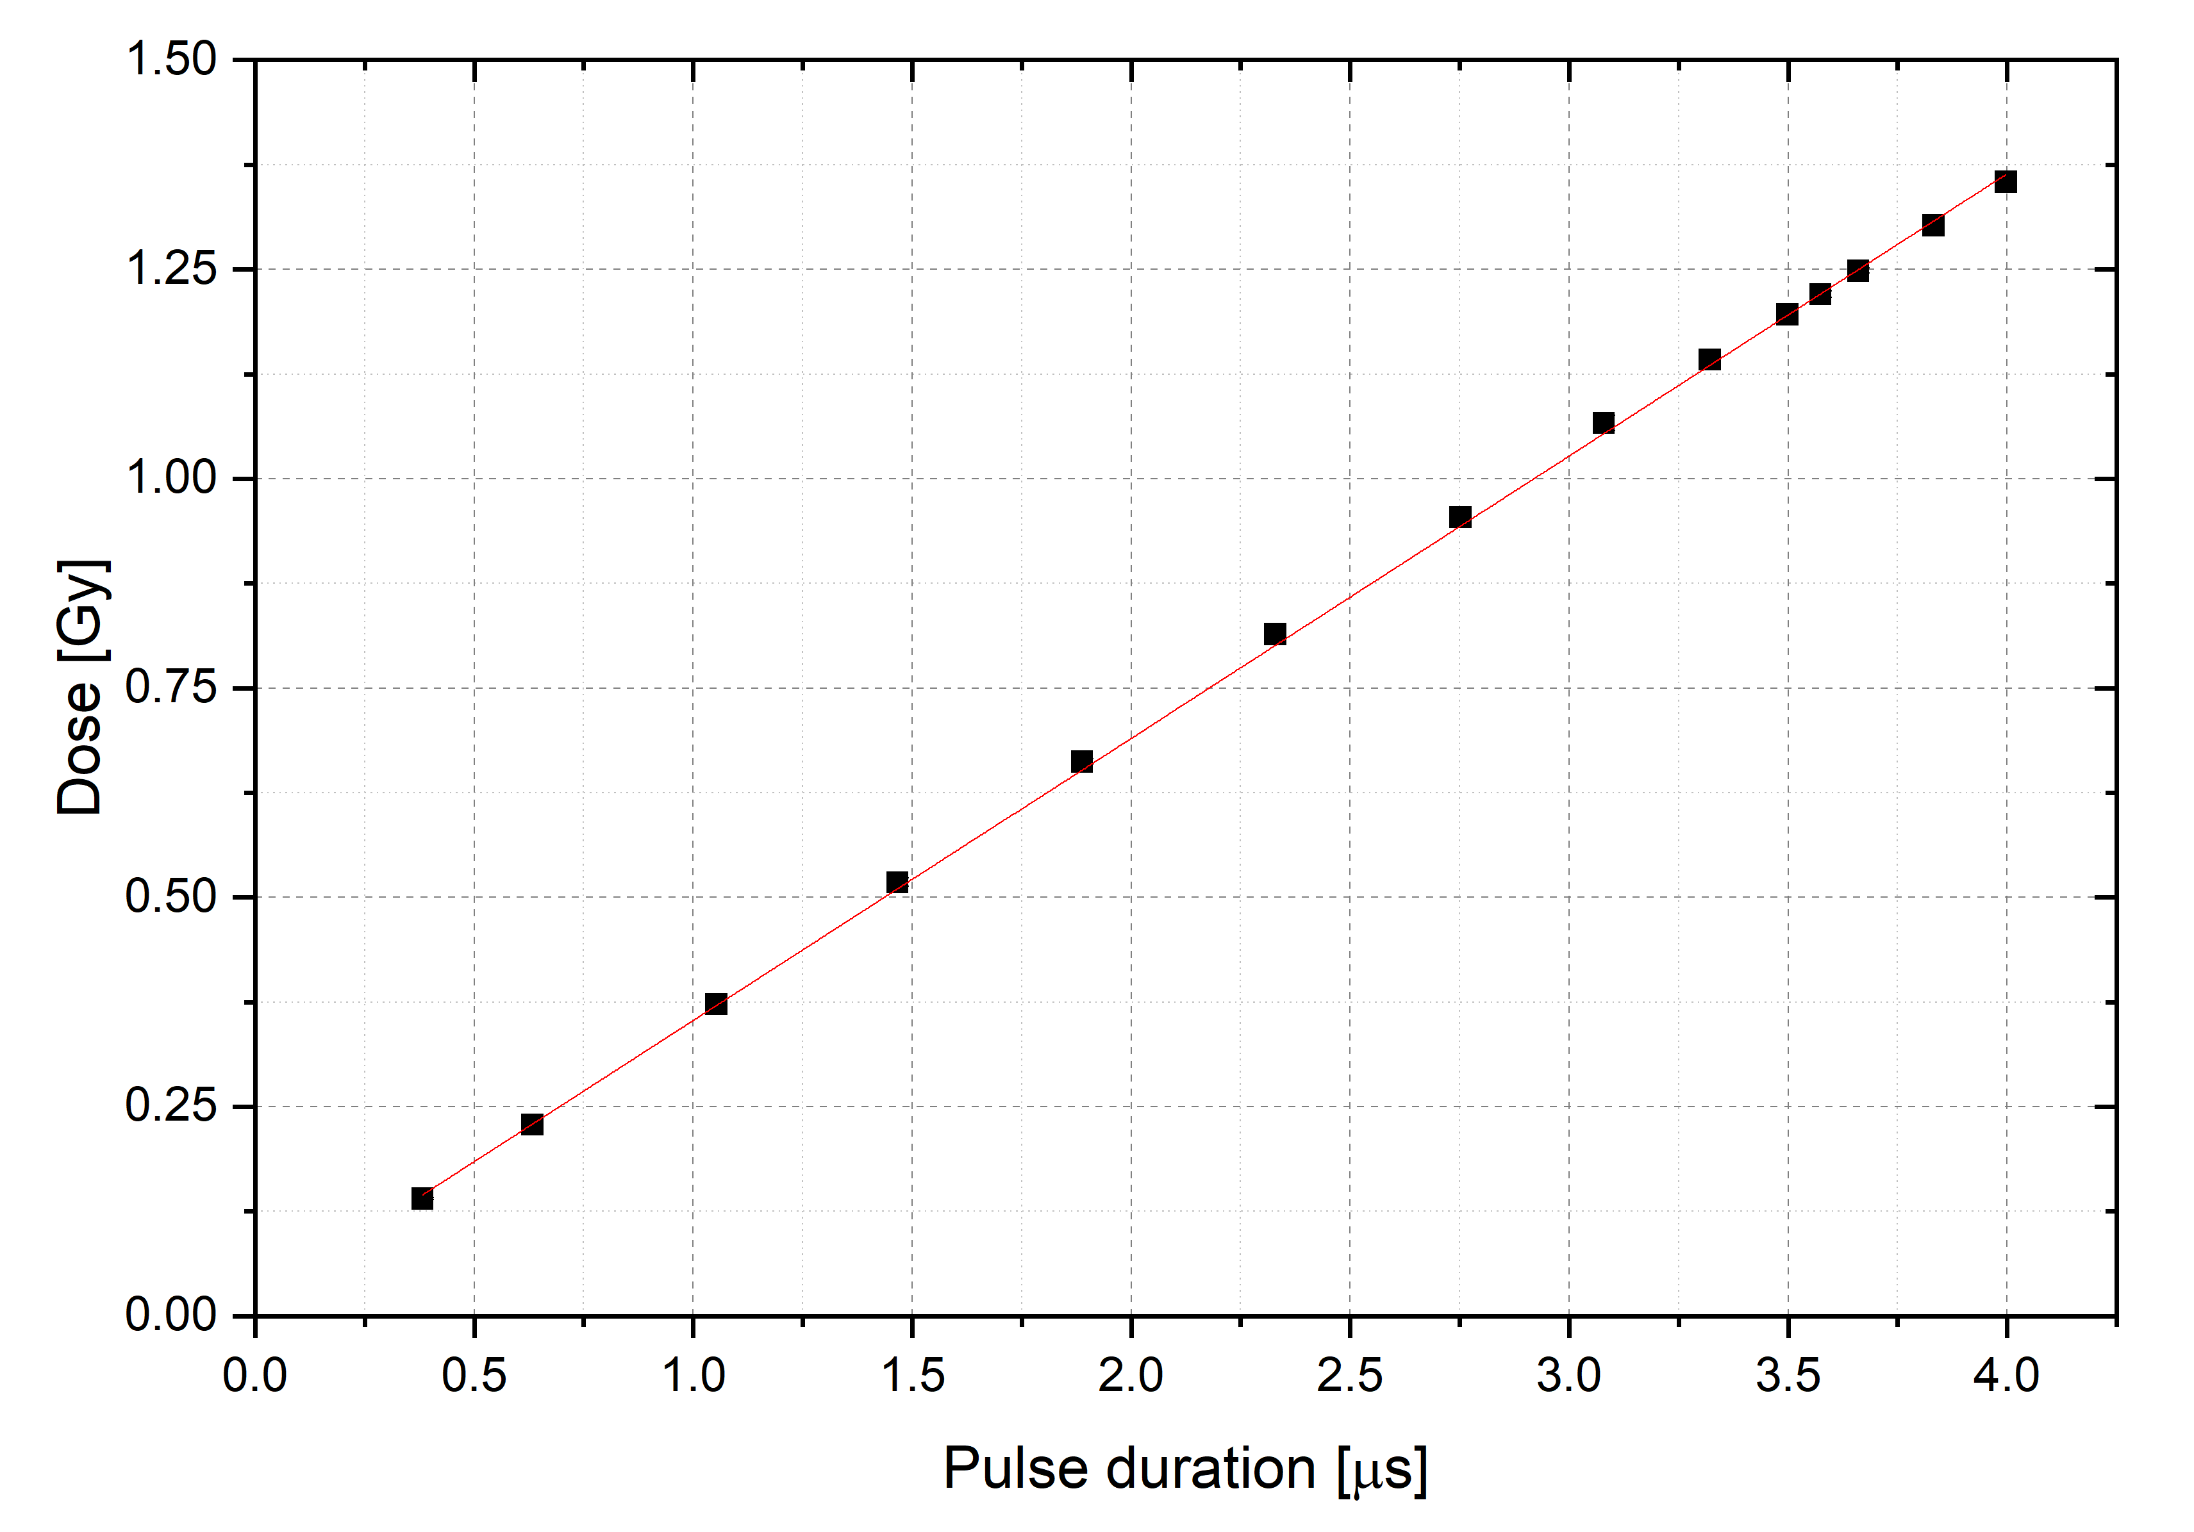
D. Del Sarto
Output linearity w/ Pulse duration
14/18

Slide 17
Applicator Diameter [mm] | Normalized Average Dose rate [Gy/s] | Dose per pulse [Gy] | Instantaneous Dose Rate [kGy/s]
120 | [0.023, 330] | [0.023, 1.36] | [5.8, 340]
100 | [0.035, 500] | 0.035, 0.069, 0.36, 0.54, 0.85, 1.16, 1.42, 1.66, 1.85, 2.05 | [8.8, 513]
50 | [0.097, 1390] | [0.097, 5.67] | [24.2, 1418]
40 | [0.116, 1660] | [0.116, 6.79] | [28.9, 1696]
35 | [0.131, 1880] | [0.131, 7.67] | [32.7, 1918]
30 | [0.132, 1900] | [0.132, 7.75] | [33.1, 1937]
Uncollimated | [0.33, 4890] | [0.33, 19.95] | [82.5, 4988]
D. Del Sarto
Absolute Dosimetry Values
15/18
Notes:
Variabili che non sono fissate ma che possiamo modificare grazie a partnership con sit sordina. Possiamo cambiare energia media, spettro, tensione di catodo e griglia. Questo per

Slide 18
CONVENTAIONAL/ FLASH IRRADIATION CONDITIONS. 120 mm Applicator | Normalized Average Dose rate [Gy/s] | Dose per pulse [Gy] | Instantaneous Dose Rate [kGy/s]
Irradiation Modality | Dose Rate [Gy/s] | Dose per pulse [Gy] | Instantaneous Dose Rate [Gy/s]
Conventional | ~0.04 | ~0.04 | 10000
FLASH | ~ 220 | ~ 1 | 250000
Dependency | PRF | Beam current | Pulse duration | Beam parameters
Average Dose Rate | Variable | Fixed | Fixed | ADR variabile Dp Fixed IDR Fixed
Dose per pulse | Variabile (linked) | Variabile | Fixed | ADR Fixed Dp variabile IDR variabile
Instantaneous Dose Rate | Fixed | Variabile (linked) | Variabile (linked) | ADR Fixed Dp Fixed IDR variabile
D. Del Sarto
Flexibility of the ElectronFlash for radiobiological experiments
16/18

Slide 19
Several electron LINACs are capable of producing FLASH beams. However, they have significant limitations that could impede our understanding of the FLASH mechanisms.
The characteristics of the ElectronFlash at the CPFR make it an optimal machine for investigating the FLASH effect and its dependencies on irradiation parameters.
The structure and flexibility of the machine allow for basic radiobiological experiments while minimizing experimental uncertainty arising from setup differences.
Ongoing improvement and optimization of the machine, with the development of dedicated advanced optics (e.g. minibeam FLASH).
General goal of ElectronFlash: speed up the clinical translation of the FLASH effect. Clinical trial on superficial tumour (dermathologic).
D. Del Sarto
Conclusion
17/18
Notes:
Obiettivo finale: I risultati della ricerca ottimizzino e velocizzino la traslazione clinica della flash. Come primo e unico obiettivo clinico realizzabile con questa macchina dei dermatologici (limite e’ il fascio superficiale), per mettere in piedi protocllo clinico dosimetrico e avere autorizzazione clinica.

Slide 20
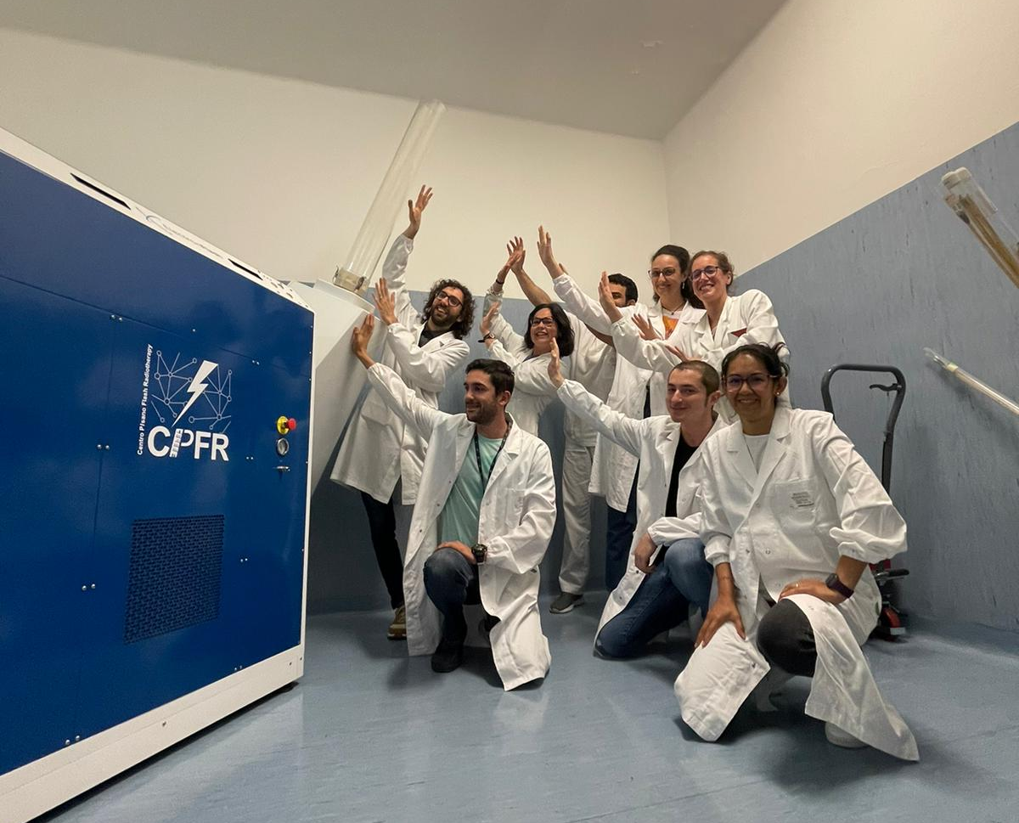
D. Del Sarto
Conclusioni
10/10

Slide 21
BACKUP
D. Del Sarto
Conclusioni
10/10

Slide 22
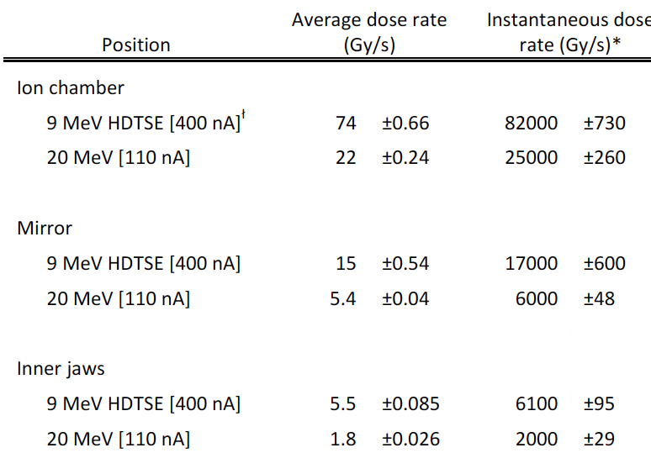
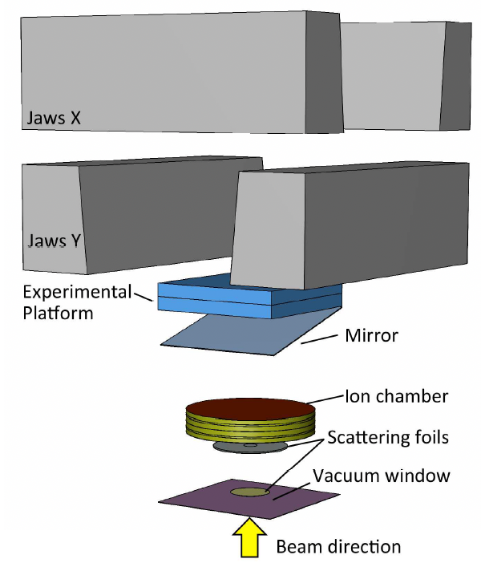
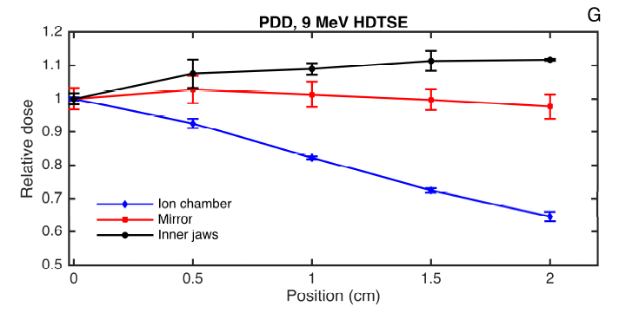
Schüler, Emil, et al. "Experimental platform for ultra-high dose rate FLASH irradiation of small animals using a clinical linear accelerator." International Journal of Radiation Oncology* Biology* Physics 97.1 (2017)
D. Del Sarto
Modified clinical LINAC
6/10

Slide 23
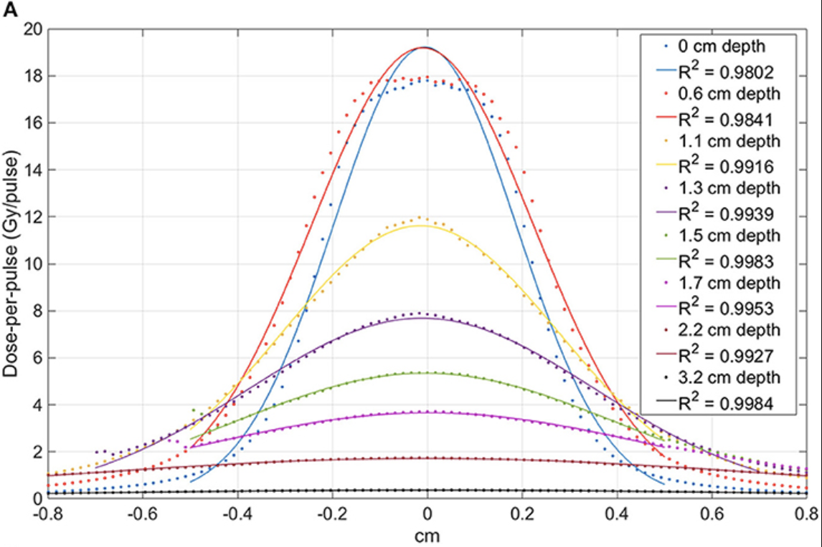
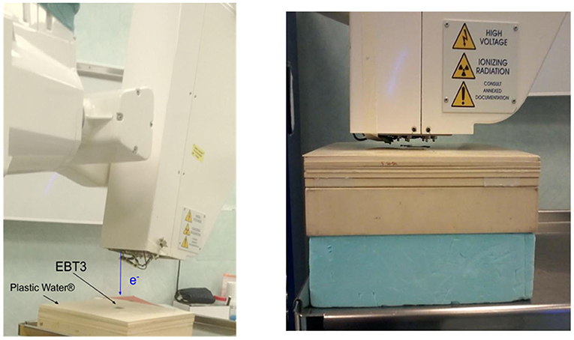
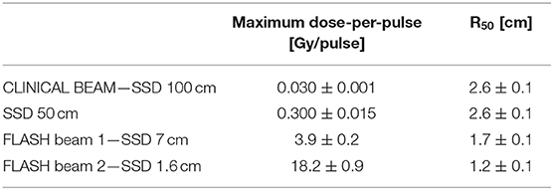
Felici, Giuseppe, et al. "Transforming an IORT linac into a FLASH research machine: procedure and dosimetric characterization." Frontiers in Physics 8 (2020): 374.
D. Del Sarto
Modified IORT LINAC
7/10

