Slide 1
Accurate and faster: probing the biochemical stage of radiation damage with the new TRAX-CHEMxt code
Gianmarco Camazzola
INSIGHTS workshop – 19/10/2023
GSI Helmholtz Center for Heavy Ion Research & Max Planck Institute for Nuclear Physics, Heidelberg University

Slide 2
1. Introduction

Slide 3
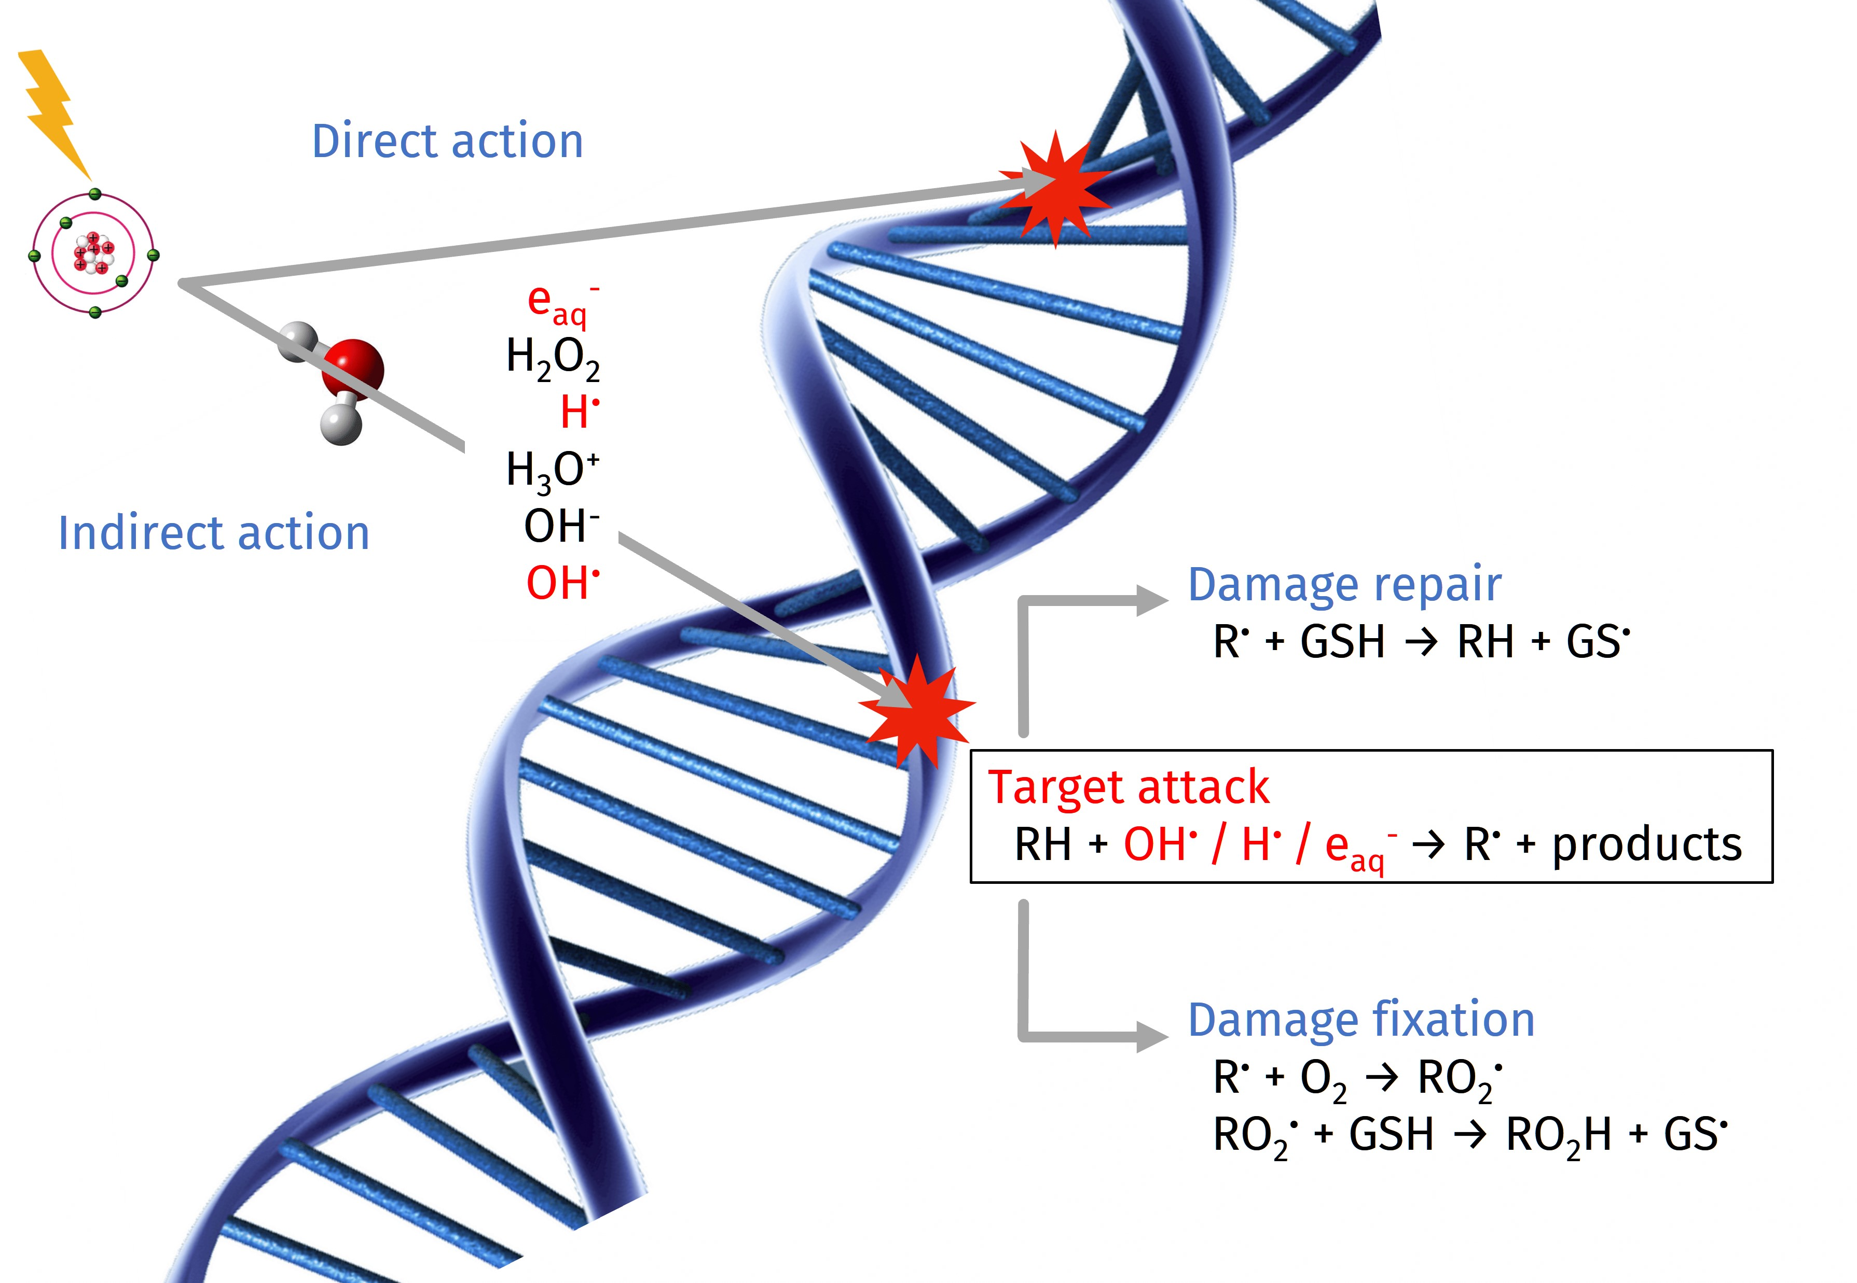
1.a (In-)Direct Radiation Damage...
Indirect/Total ratio:
150 MeV protons > 90%¹
150 MeV/u Helium ions ≈ 52%²
¹ Schlathölter et al., Int. J. Nanomed. (2016)
² Hirayama et al., Radiat. Phys. Chem. (2009)
Figure: Adapted from Boscolo, PhD thesis, TU Darmstadt (2018)

Slide 4
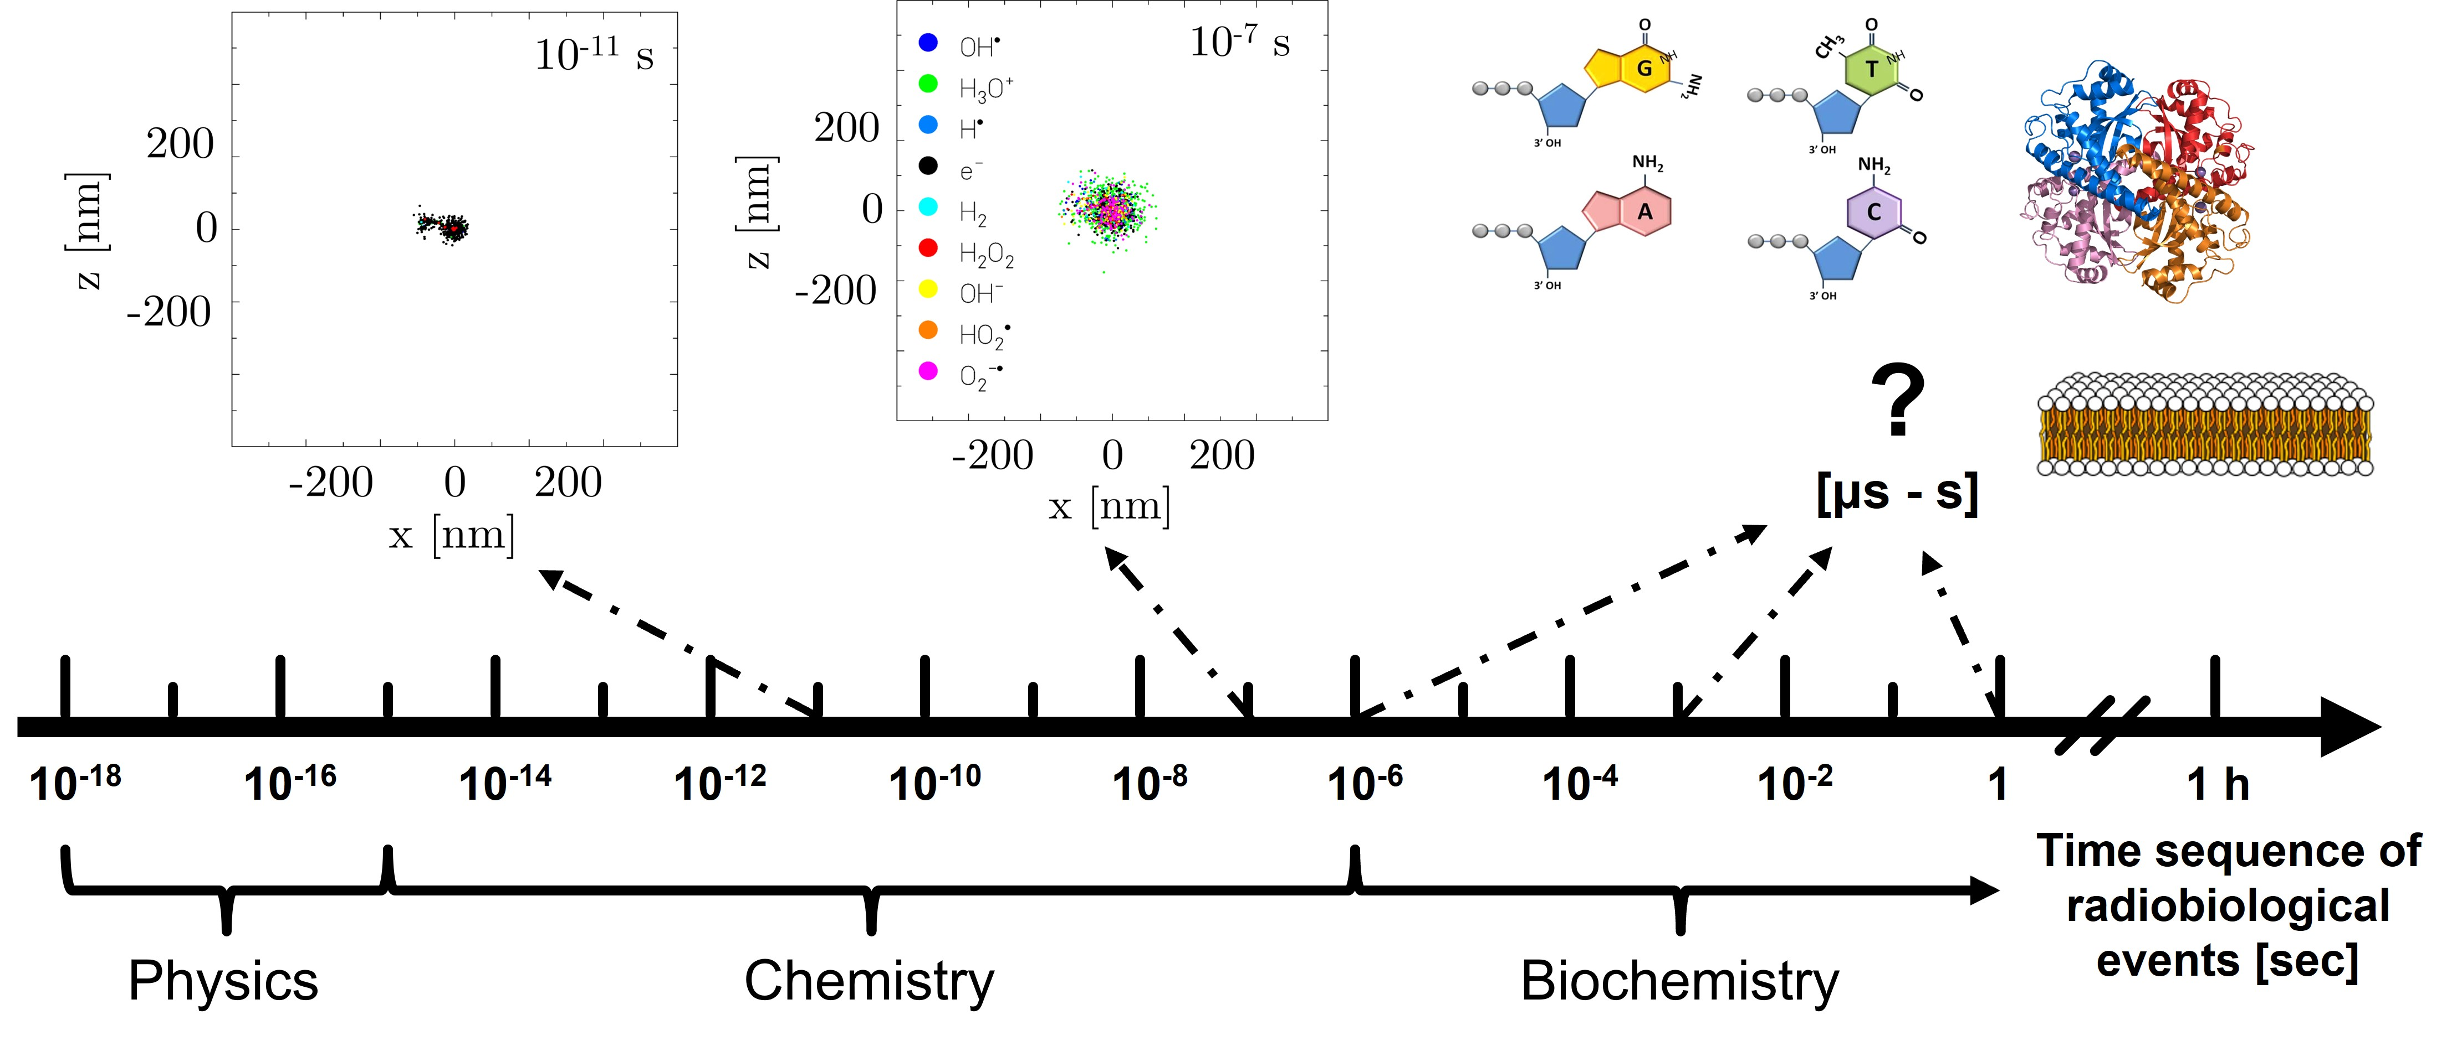
1.b ...on a Track Structure Level
TRAX¹ & TRAX-CHEM^{2,3}
EXTENSION
→ To longer time scales (μs - s) → Introduce biological environment (pH and biomolecular solutes) → Chemical endpoints under different radiation and environmental conditions
¹ Krämer & Kraft, Radiat. Environ. Biophys. (1994)
² Boscolo et al., Chem. Phys. Lett. (2018)
³ Boscolo et al., Int. J. Mol. Sci. (2020)
Chemical damage in a biological target

Slide 5
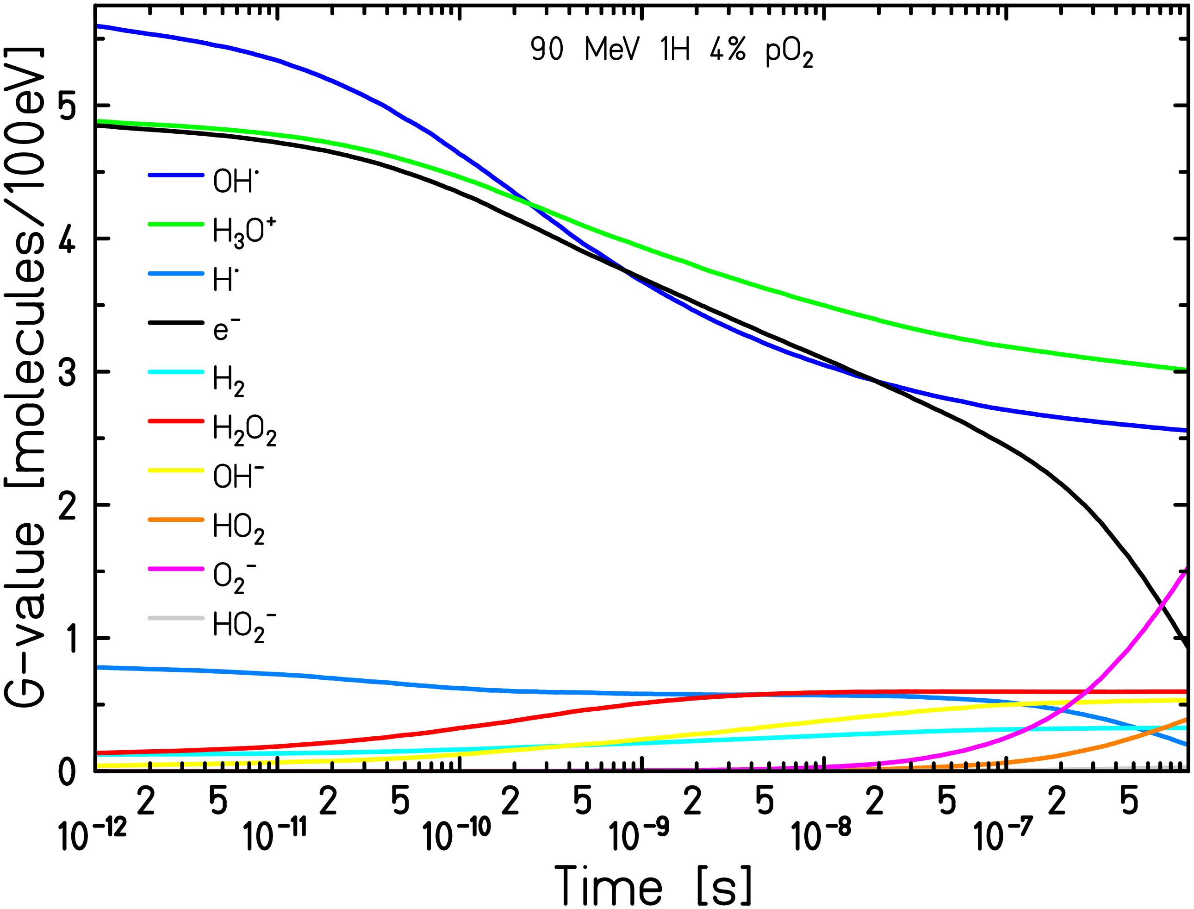
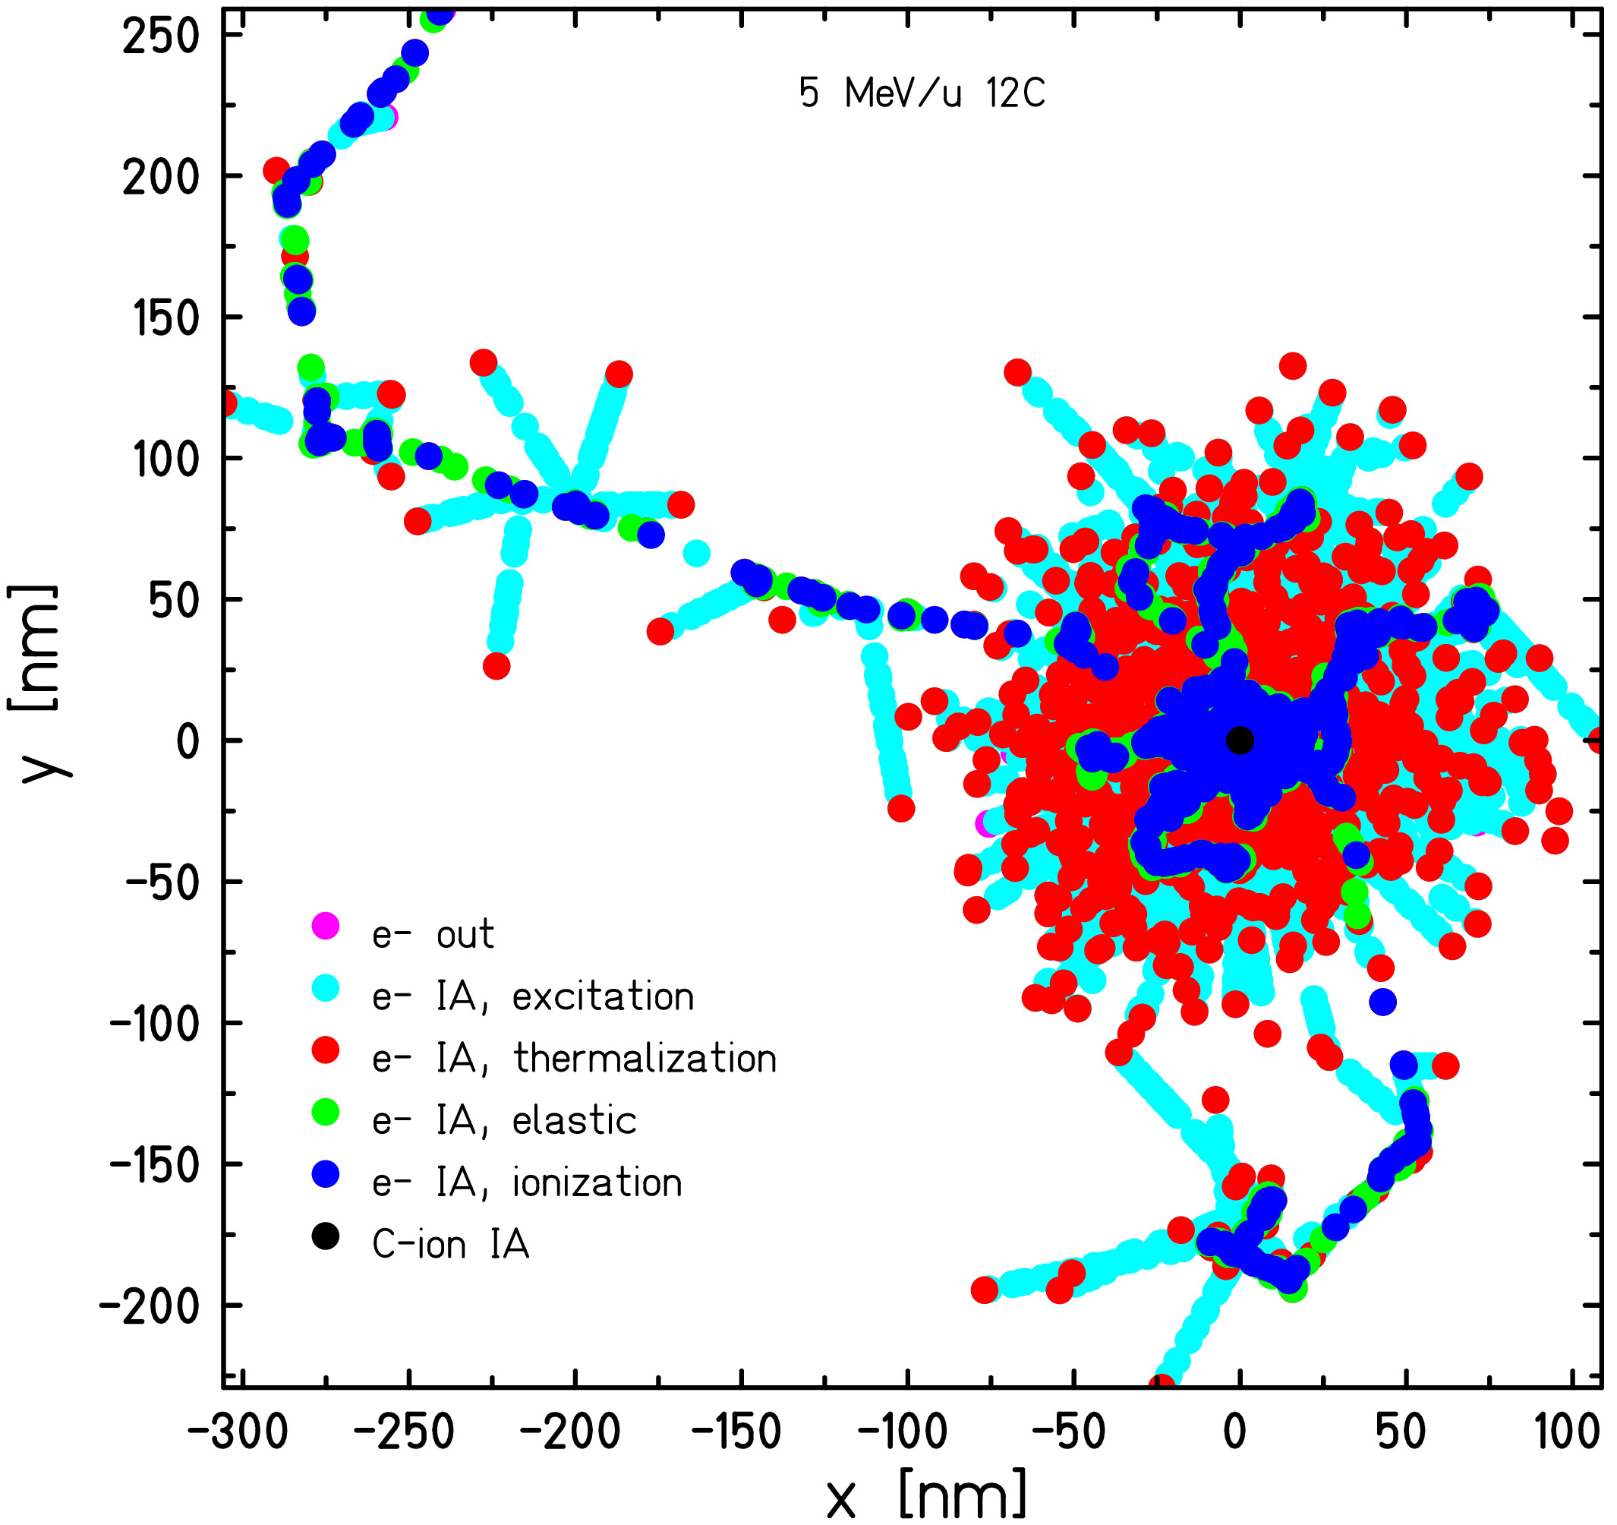
1.c TRAX & TRAX-CHEM
To handle the stochastic nature of radiation interactions → Monte Carlo simulations
Focus on track structure codes → follow all single events within the target (step-by-step approach)
TRAX
TRAX-CHEM
Heterogeneous chemical stage
Store the positions of all single radicals and molecules
Possibility to account for different oxygenation levels in the target
TRAX
Physical stage
Store the positions of all single interaction types
Ions up to few hundreds MeV/u, electrons up to 15 MeV
TRAX-CHEM
G-value: number of radicals/molecules produced per 100 eV of energy deposited

Slide 6
2. Methods

Slide 7
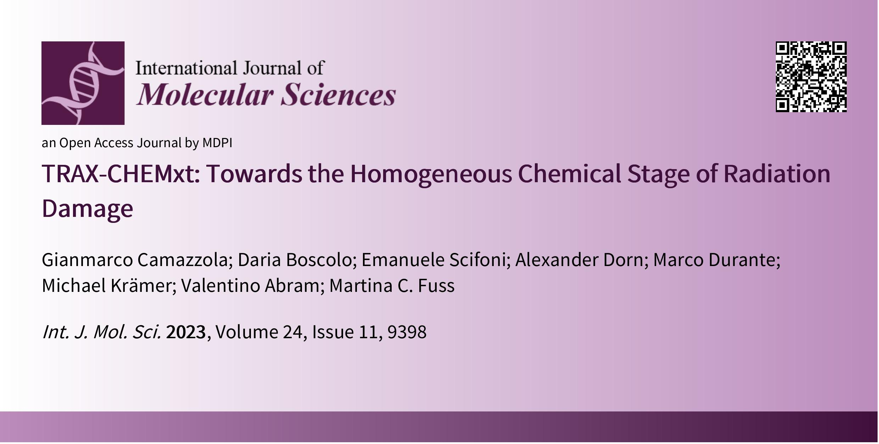
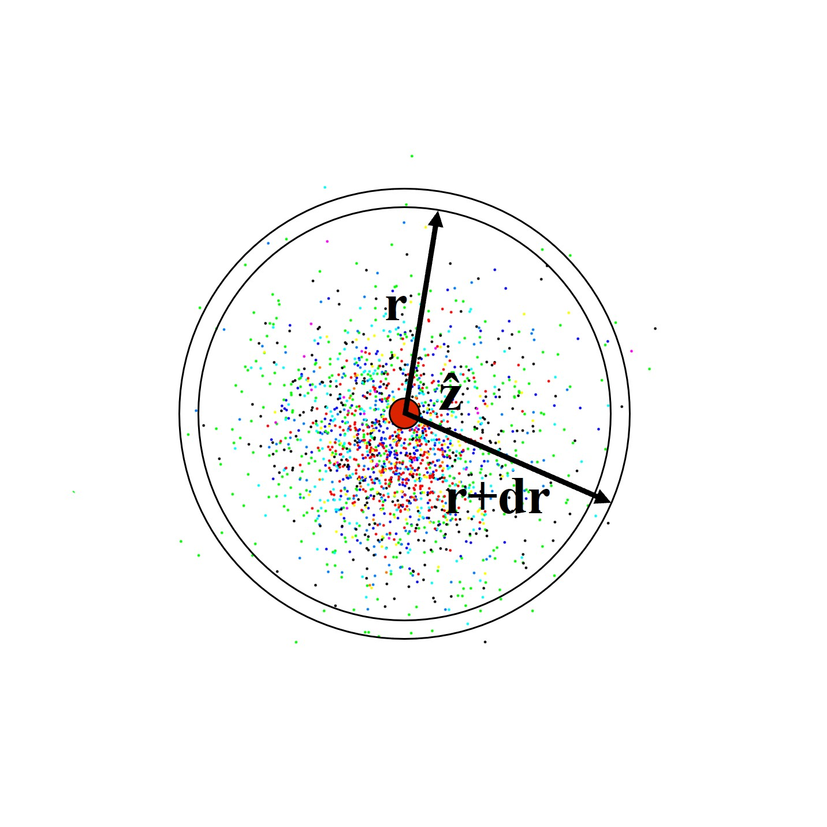
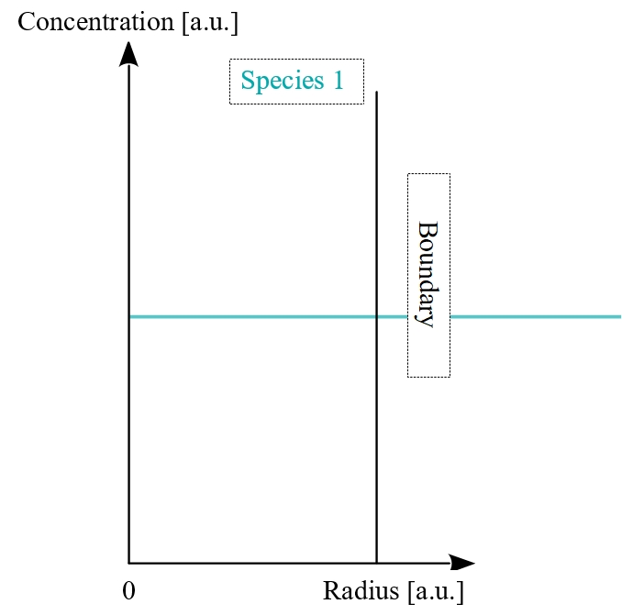
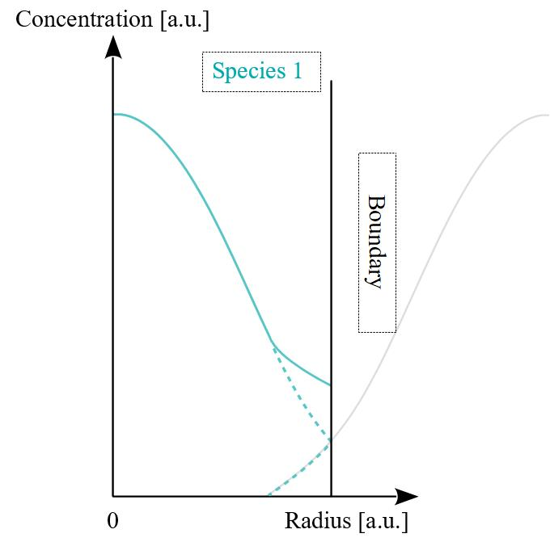
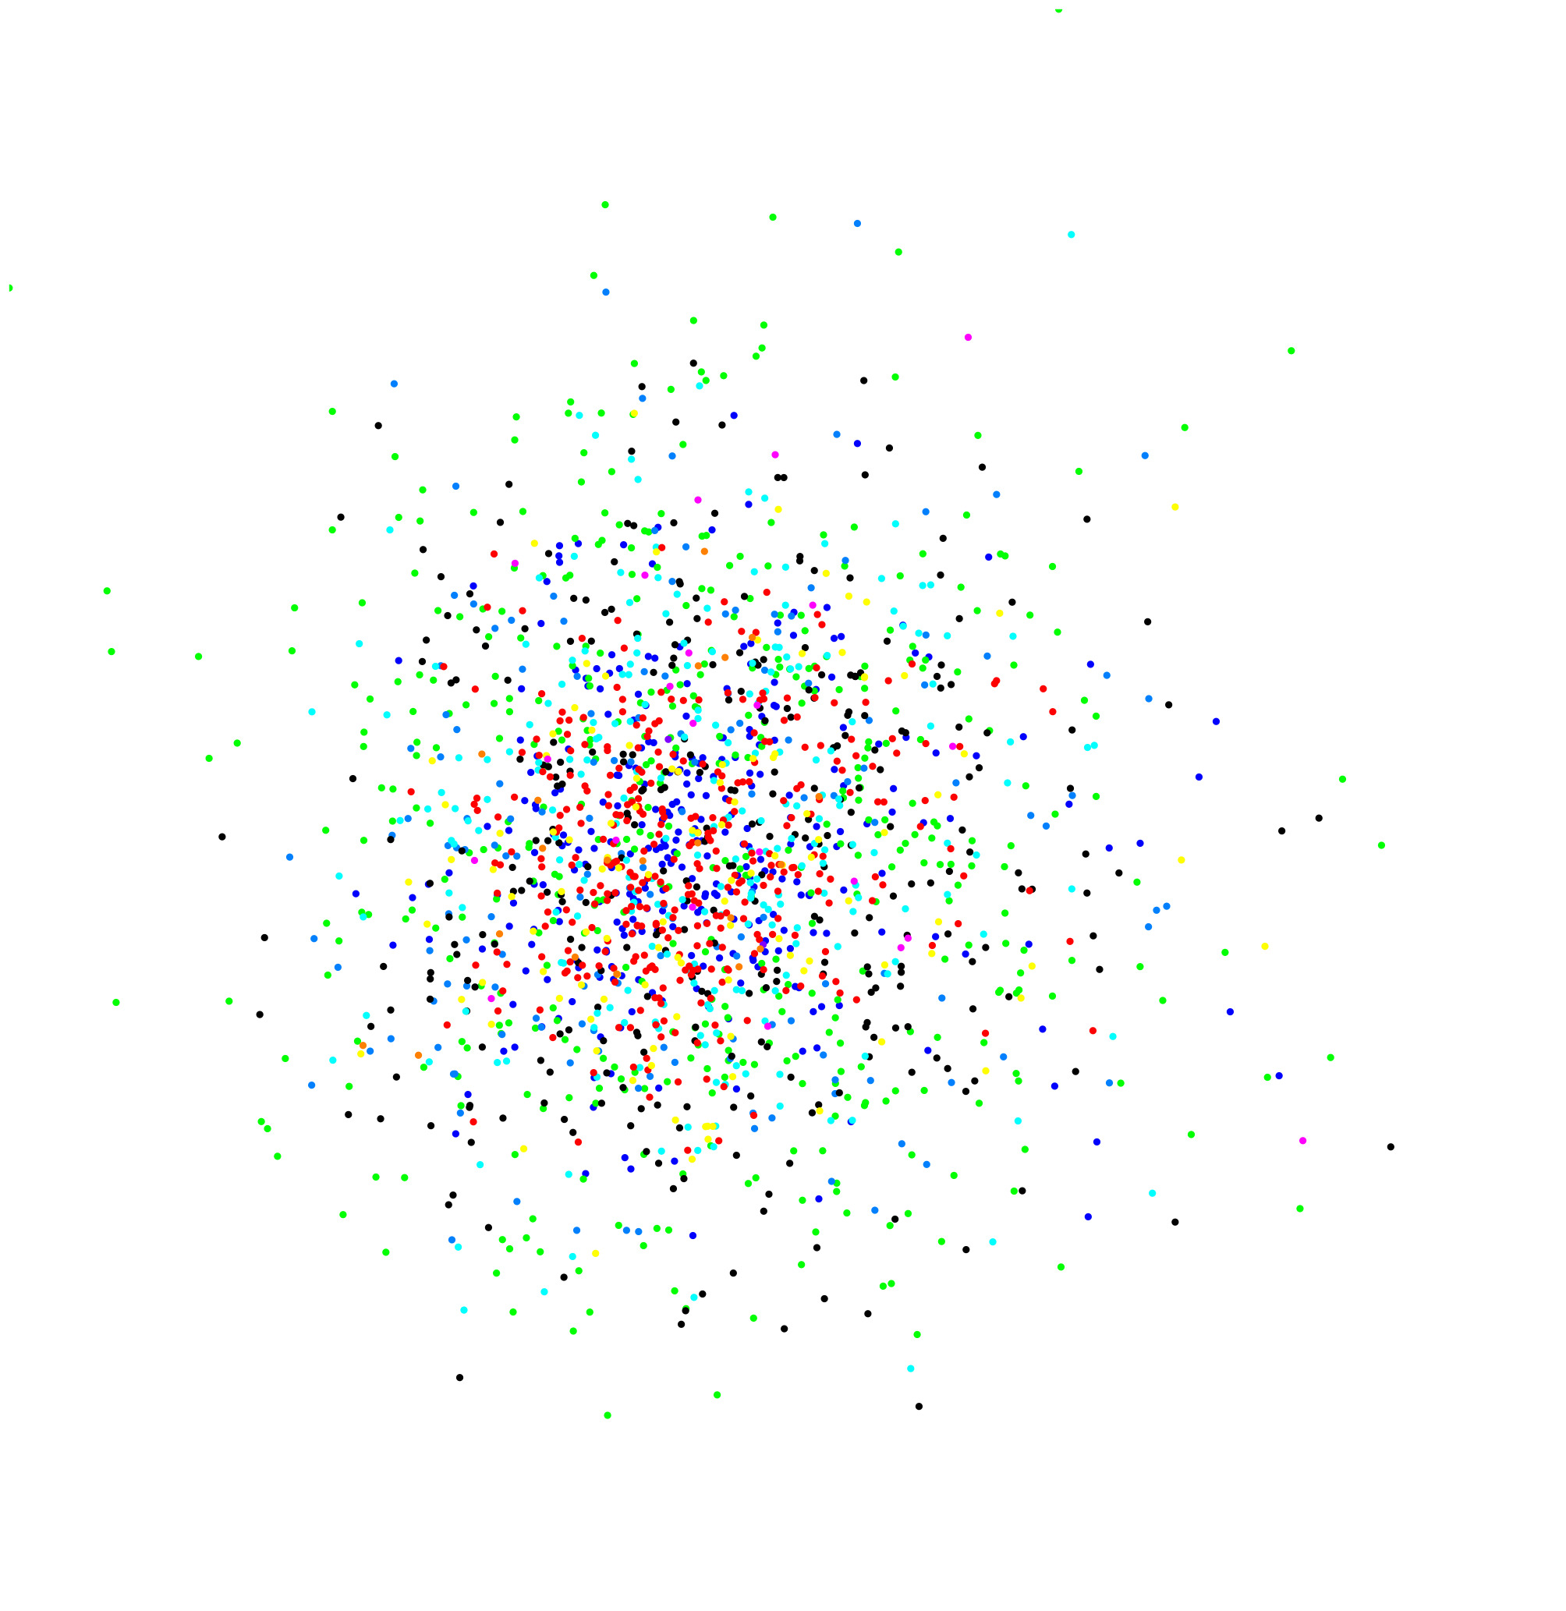
2. Phases of the Extended Simulation
From a cloud of single positions to species concentration distributions
Especially relevant for ions
Focus on one single track, accounting for "neighbours" through boundary conditions
Once concentration becomes flat, switch to one global value → diffusion step unnecessary, reactions simplified and sped up (only now homogeneous models are reliable)
«PHASE I» – heterogeneous, discrete reaction-diffusion model (TRAX-CHEM)
Highly stochastic events, dictated by physical track structure, with heterogeneous concentrations → Monte Carlo irreplaceable
Score all single radicals and molecules positions
y
«PHASE II» – transition, continuous reaction-diffusion model with concentration distributions
x
«PHASE III» – homogeneous, classical reaction model

Slide 8
3. Results

Slide 9
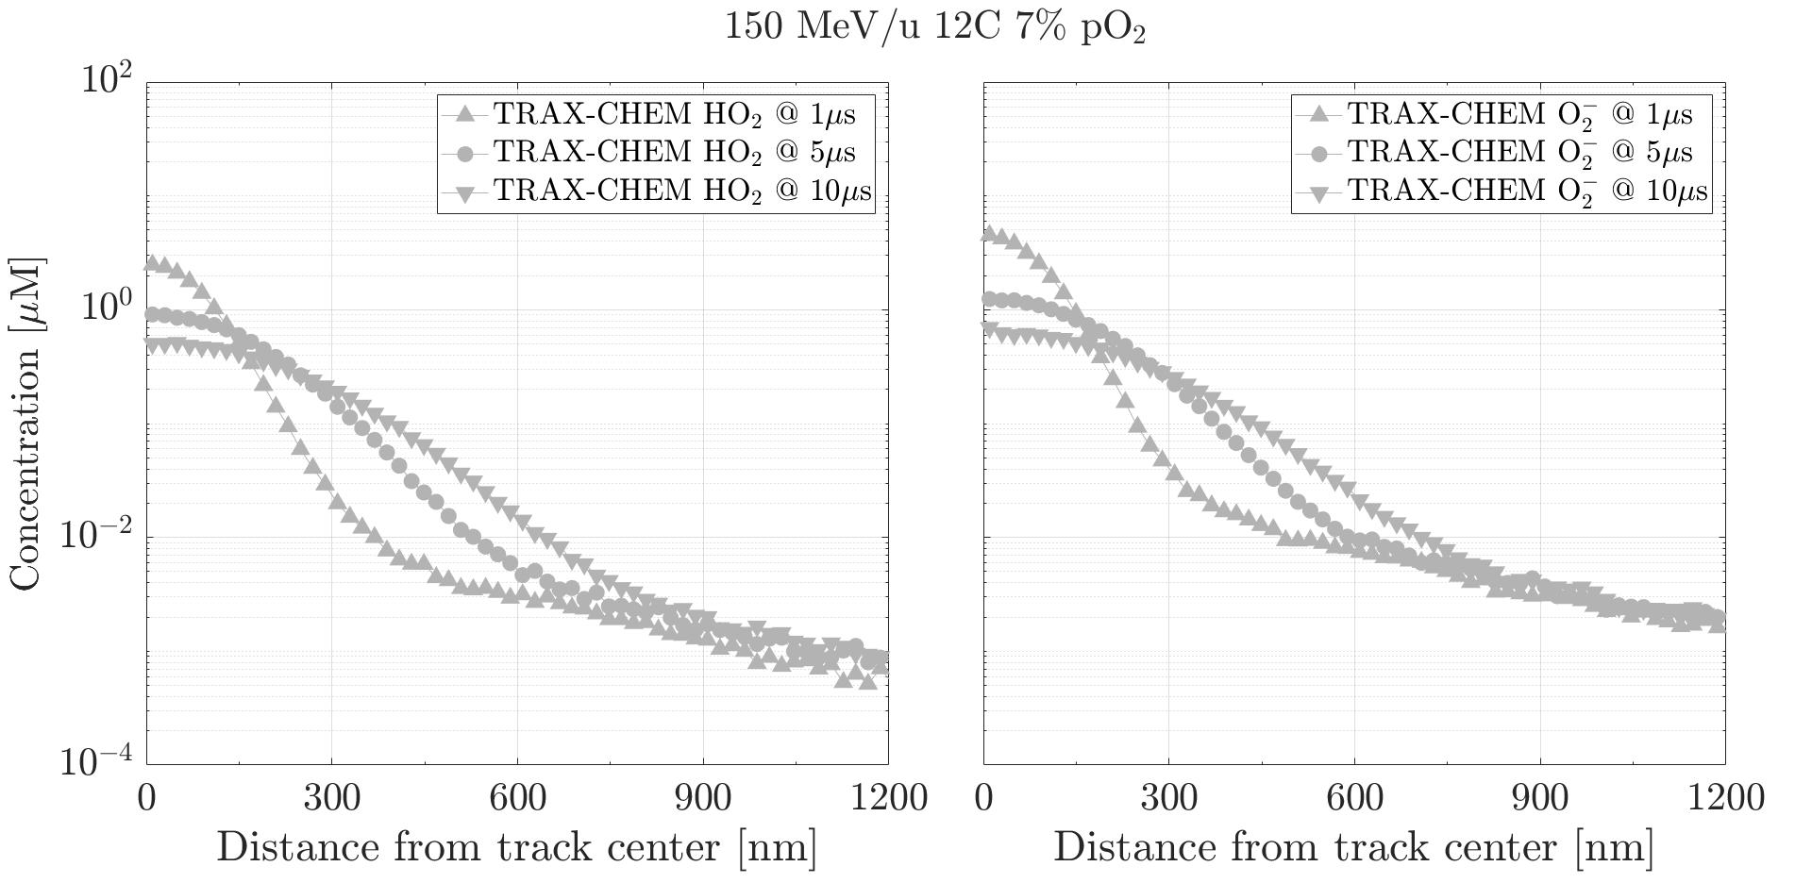
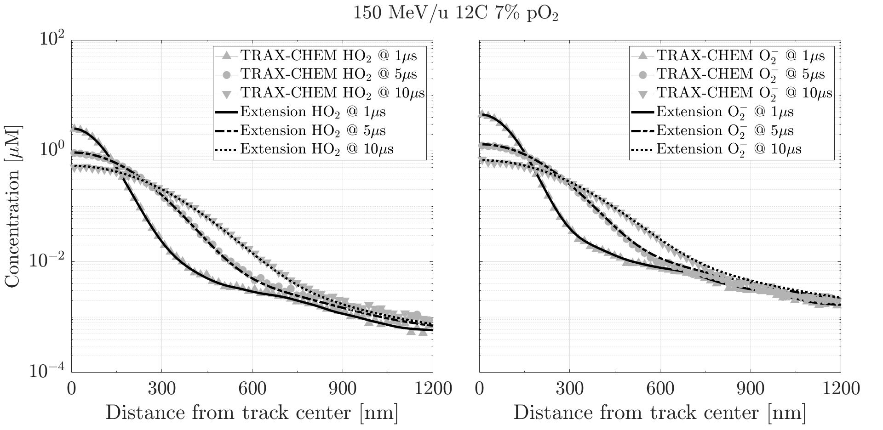
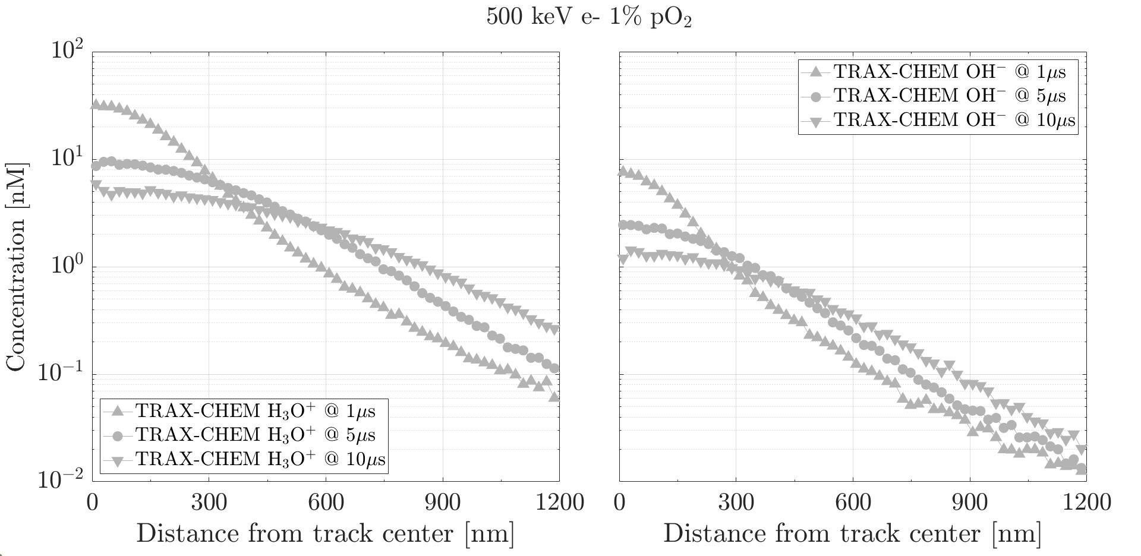
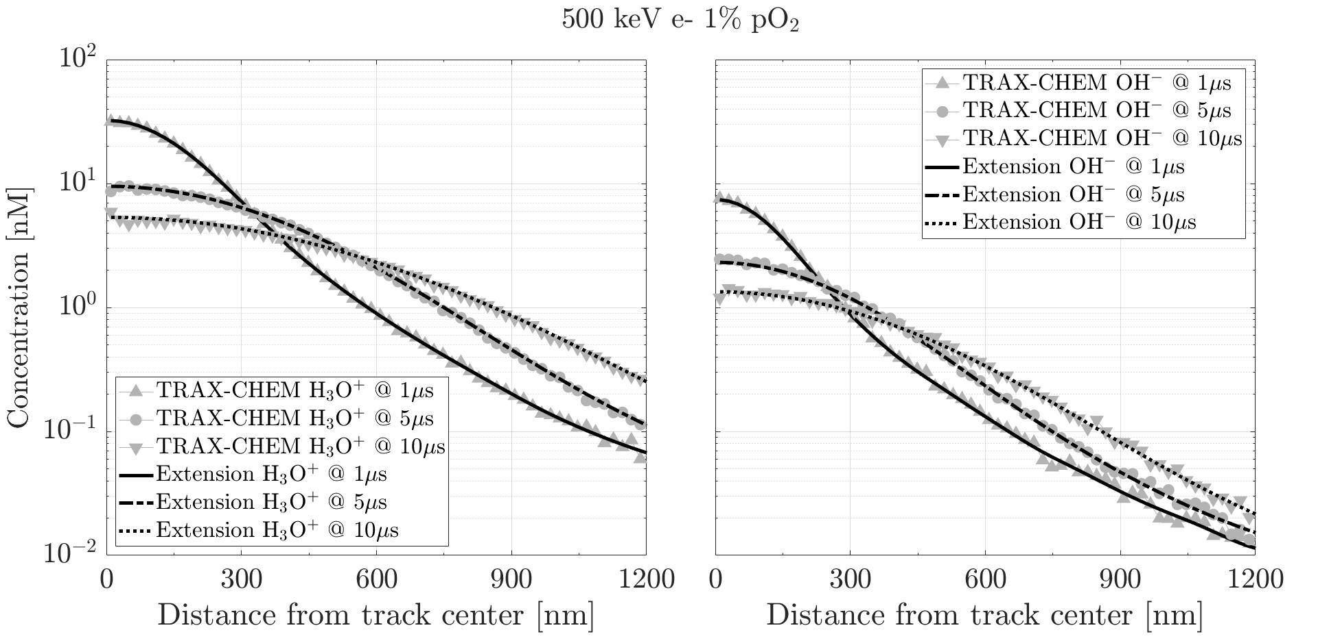
3.a Switching Time Point & Comparison with TRAX-CHEM (Phase I)
Computational time required
TRAX-CHEM (10 μs): 12 hrs – 2 days
Computational time required
TRAX-CHEM (10 μs): 12 hrs – 2 days
TRAX-CHEMxt (10 μs): ⁓ 70 s
Computing efficiency: > 3 orders of magnitude
Validity for
Switching time points around 500 ns
Validity for
Switching time points around 500 ns
Different species
Different beam qualities & linear energy transfer (LET)
Different oxygenations

Slide 10
3.b Comparison with Experimental Data & Different Monte Carlo Algorithm
Chemical yields [molecules/100 eV] from a 500 keV electron beam vs. 21% oxygenated water. Data recorded at 10 μs
Species | Experiment¹ | Colliaux et al.² | This work
OH• | 2.7 | 2.8 | 2.7
HO₂• + O₂^{•-} | 3.3 | 3.4 | 3.2
H₂O₂ | 0.67 | 0.61 | 0.61
¹ Delattre et al., Tec & Doc Editions medicales internationales (2005) ² Colliaux et al., Nucl. Instrum. Methods Phys. Res. B: Beam Interact. Mater. At. (2015)

Slide 11
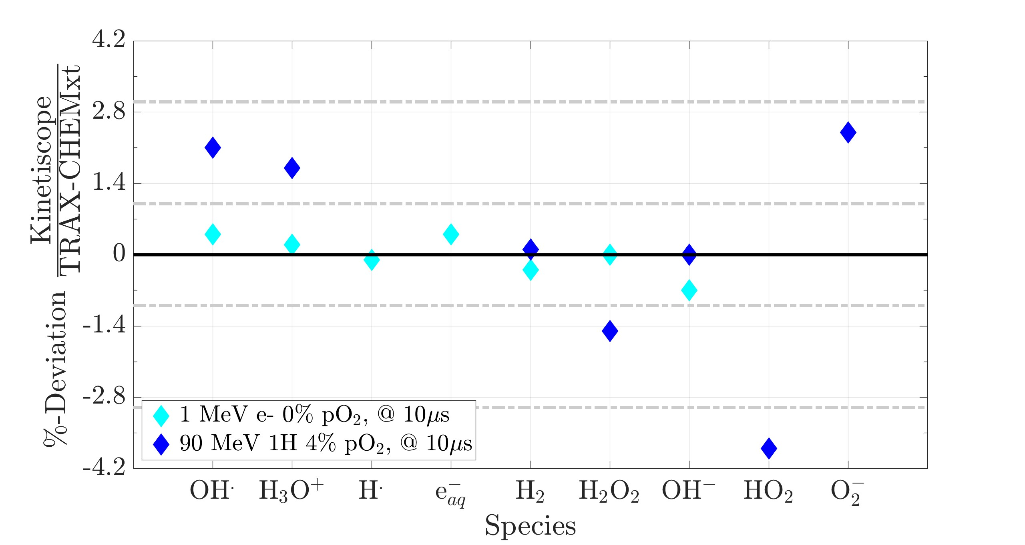
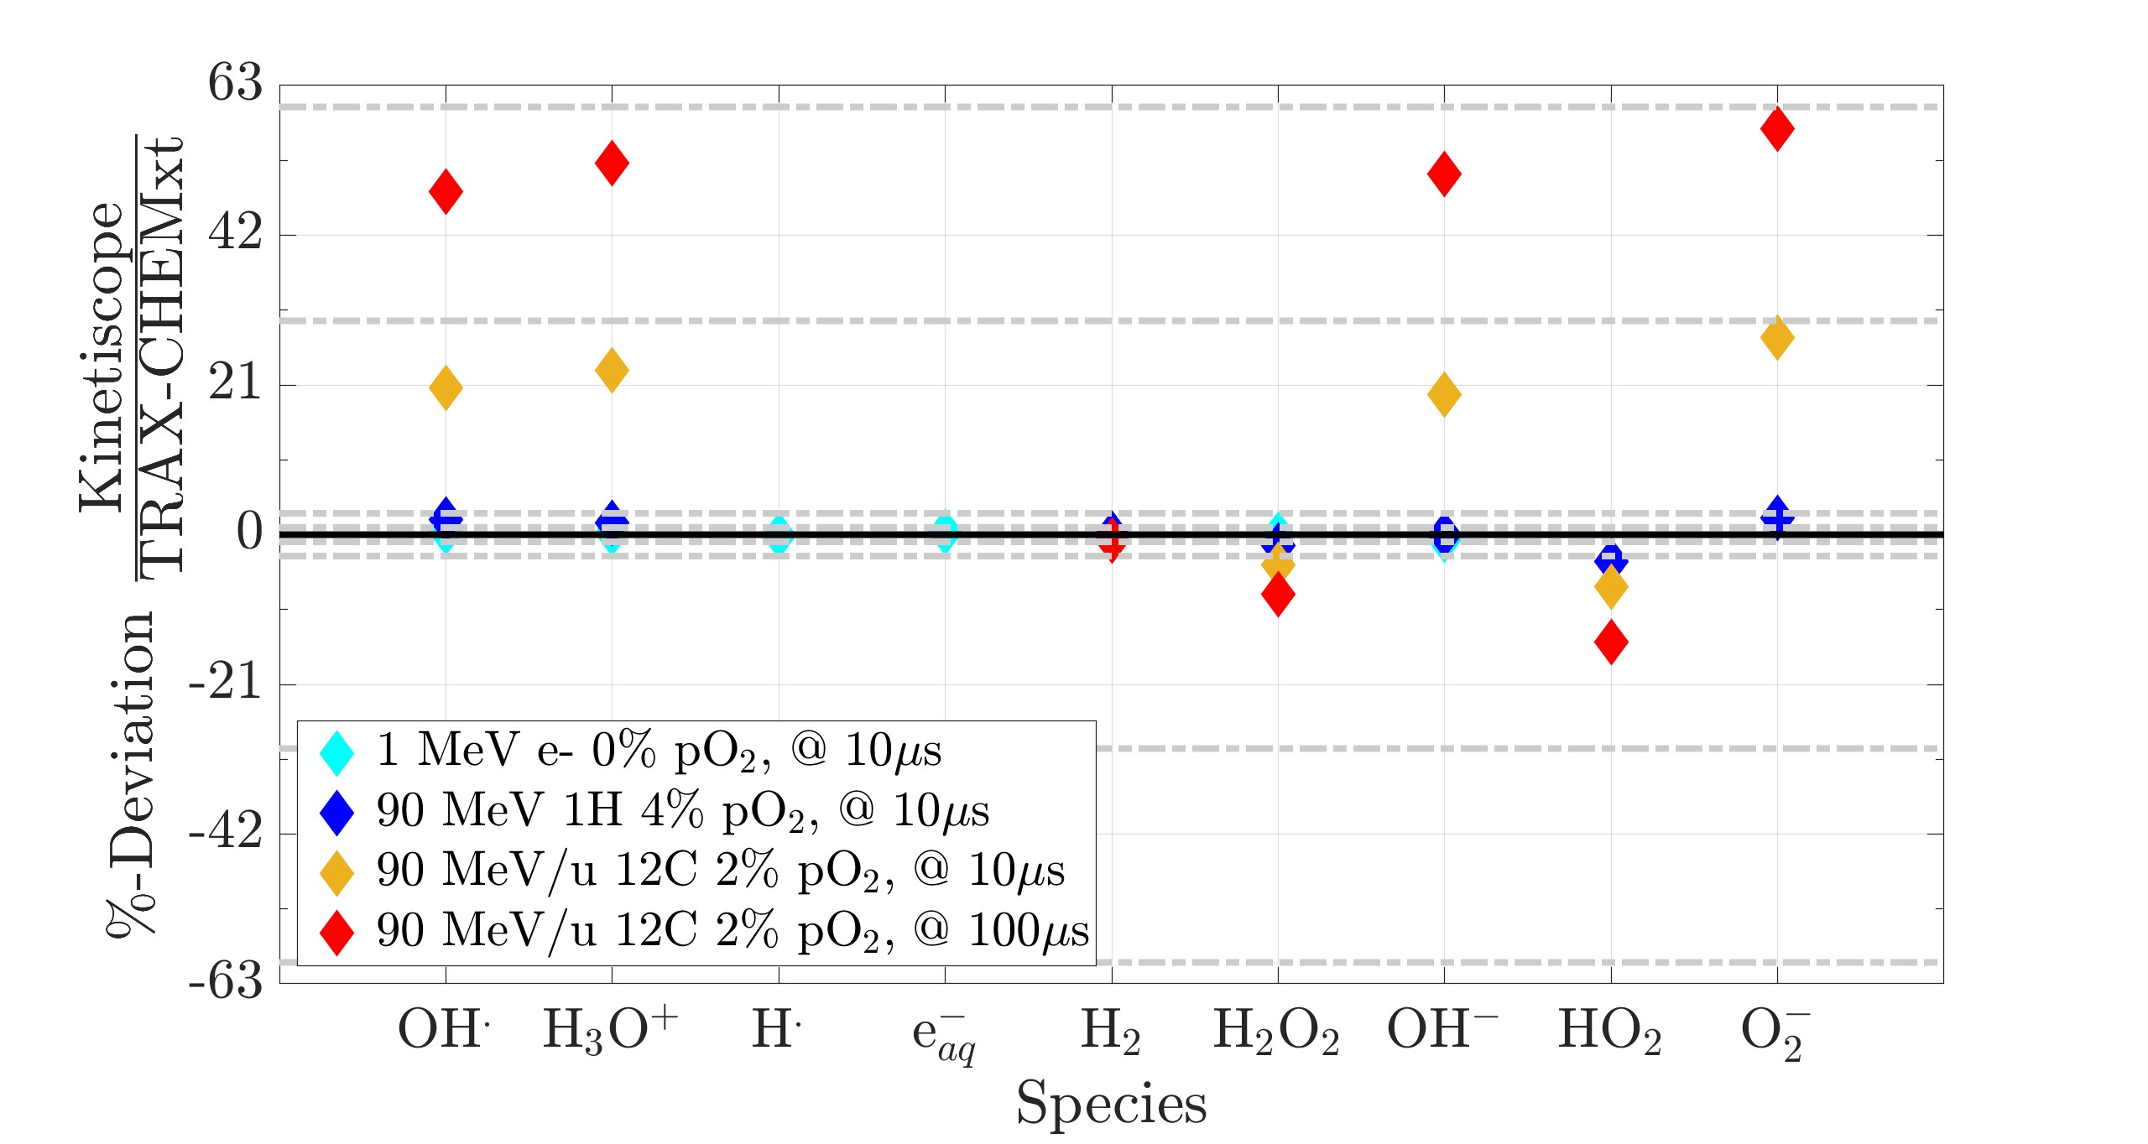
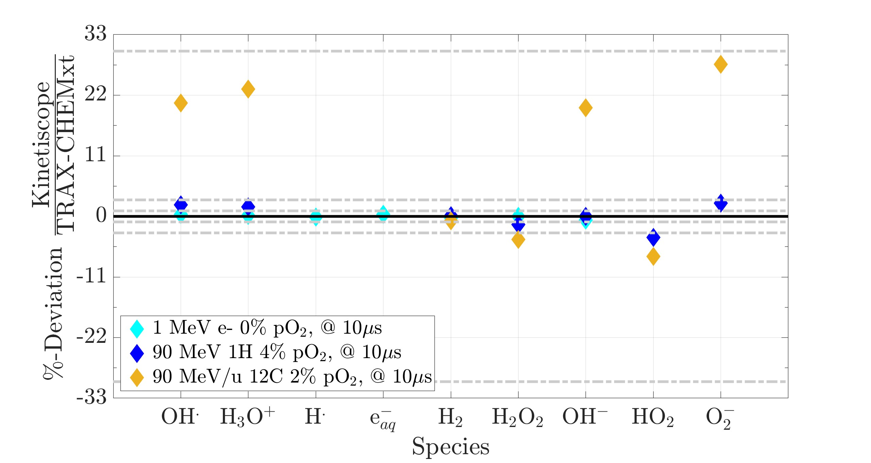
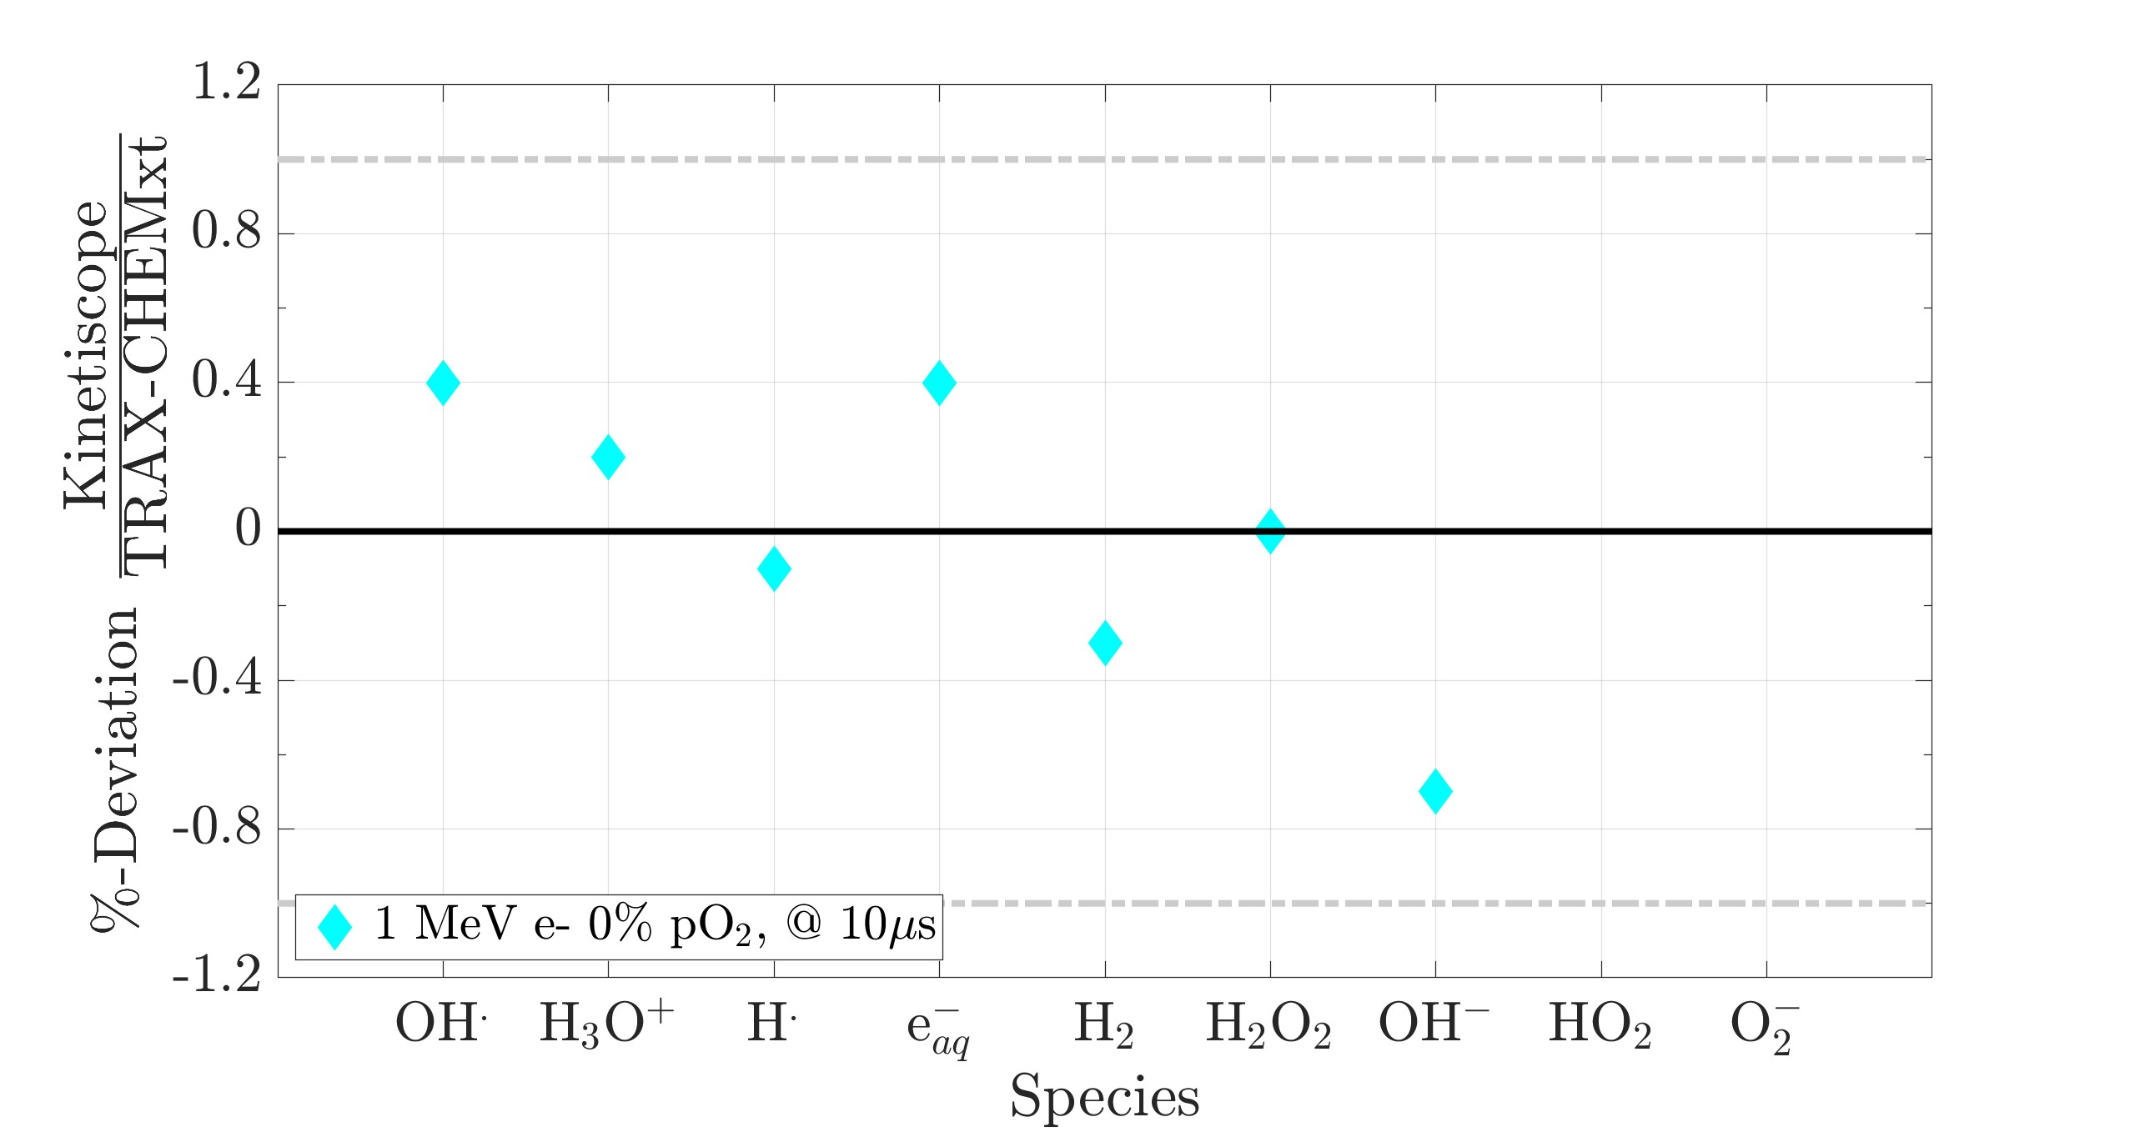
3.c Comparison with Kinetiscope¹ (Phase III)
¹ Gillespie, J. Comput. Phys. (1976)
Data from TRAX-CHEM to both softwares at 1 μs (uniform concentrations for Kinetiscope)
At final times, compute deviations from amount of species produced
Homogeneous approximation (Phase III) valid only for low LET radiation

Slide 12
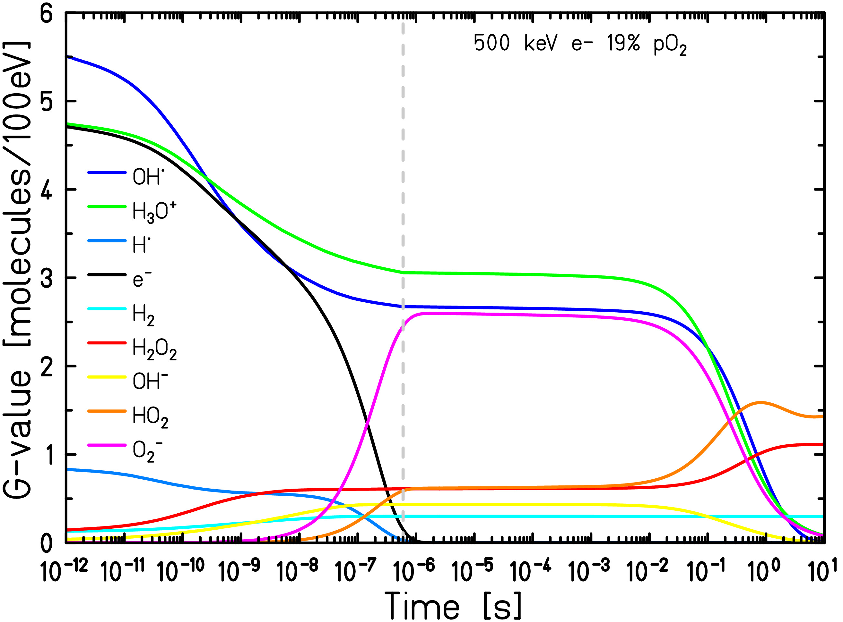
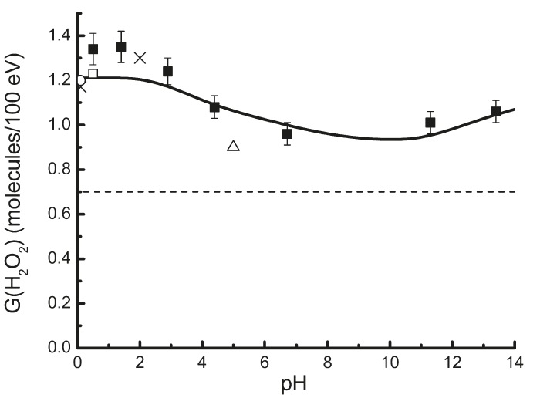
3.d To Longer Time Scales – Comparison with Experimental Data
G(H₂O₂) yields from ⁶⁰Co (■ – experimental data, left) and from 500 keV electrons (red curve – TRAX-CHEMxt, right) in oxygenated water
²
¹
Long time yield
Escape yield (1 µs, pH = 7)
¹ Roth & LaVerne, J. Phys. Chem. A (2011)
² Camazzola et al., in preparation

Slide 13
4. Conclusion & Outlook

Slide 14
4.a Take-Home Messages
New extension for the track structure code TRAX-CHEM, TRAX-CHEMxt
Probe homogeneous biochemical stage with fast algorithm based on concentration distributions
Results validated at both "extremes"
Full Monte Carlo approaches (& one experiment) in the heterogeneous chemical stage, for different initial conditions (Phase I)
Pure homogeneous approach, at low LET (Phase III)
At intermediate and high LET (track evolution still ongoing) discrepancies > 50% with respect to homogeneous approach
Necessity of intermediate transitional phase (Phase II)

Slide 15
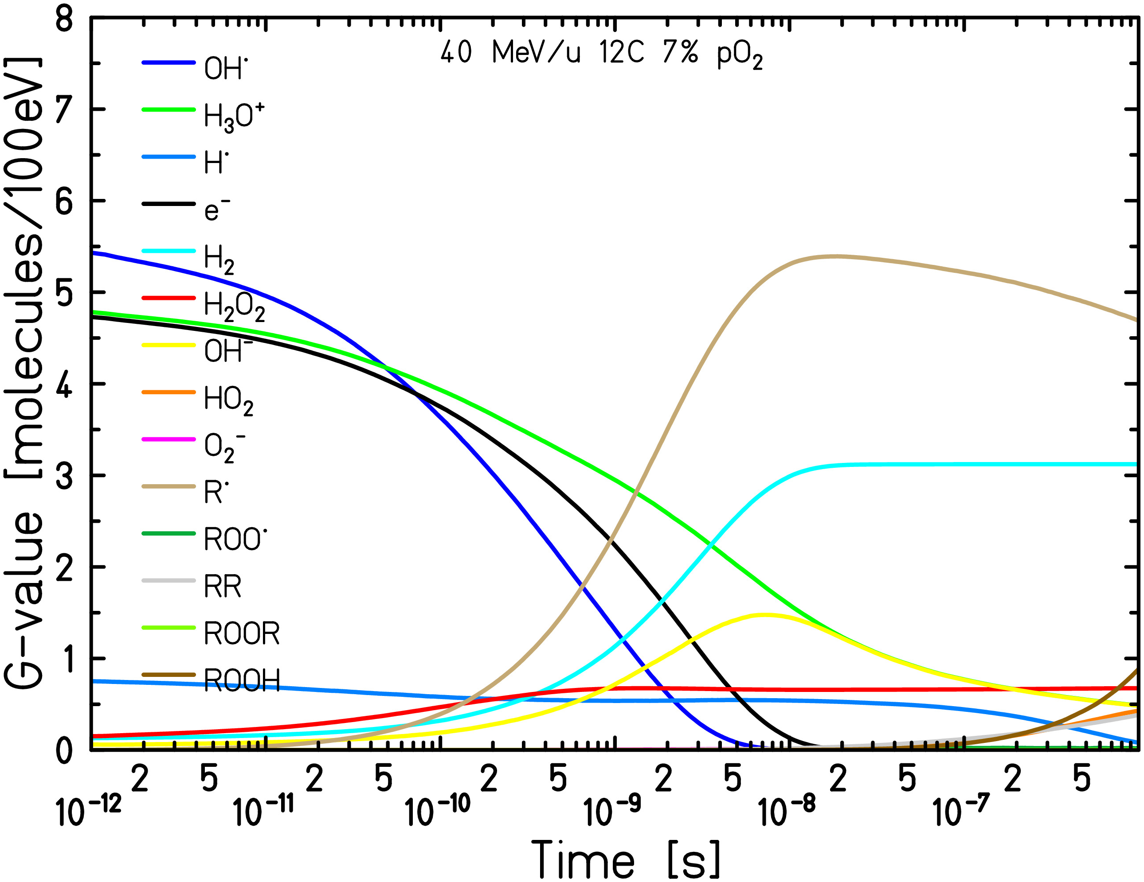
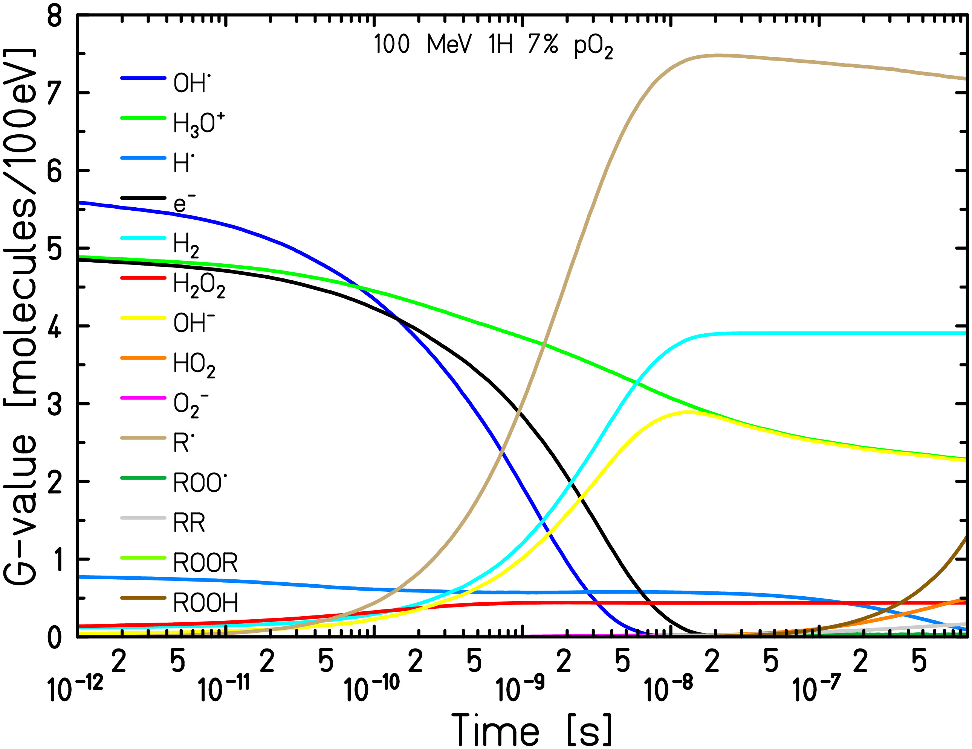
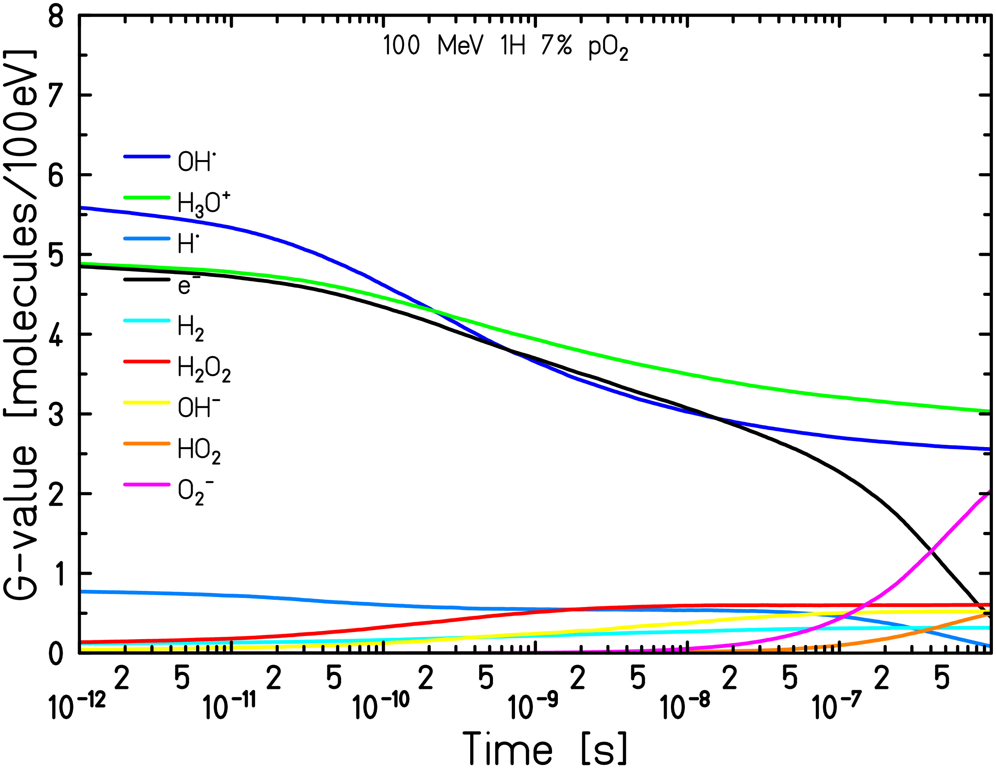
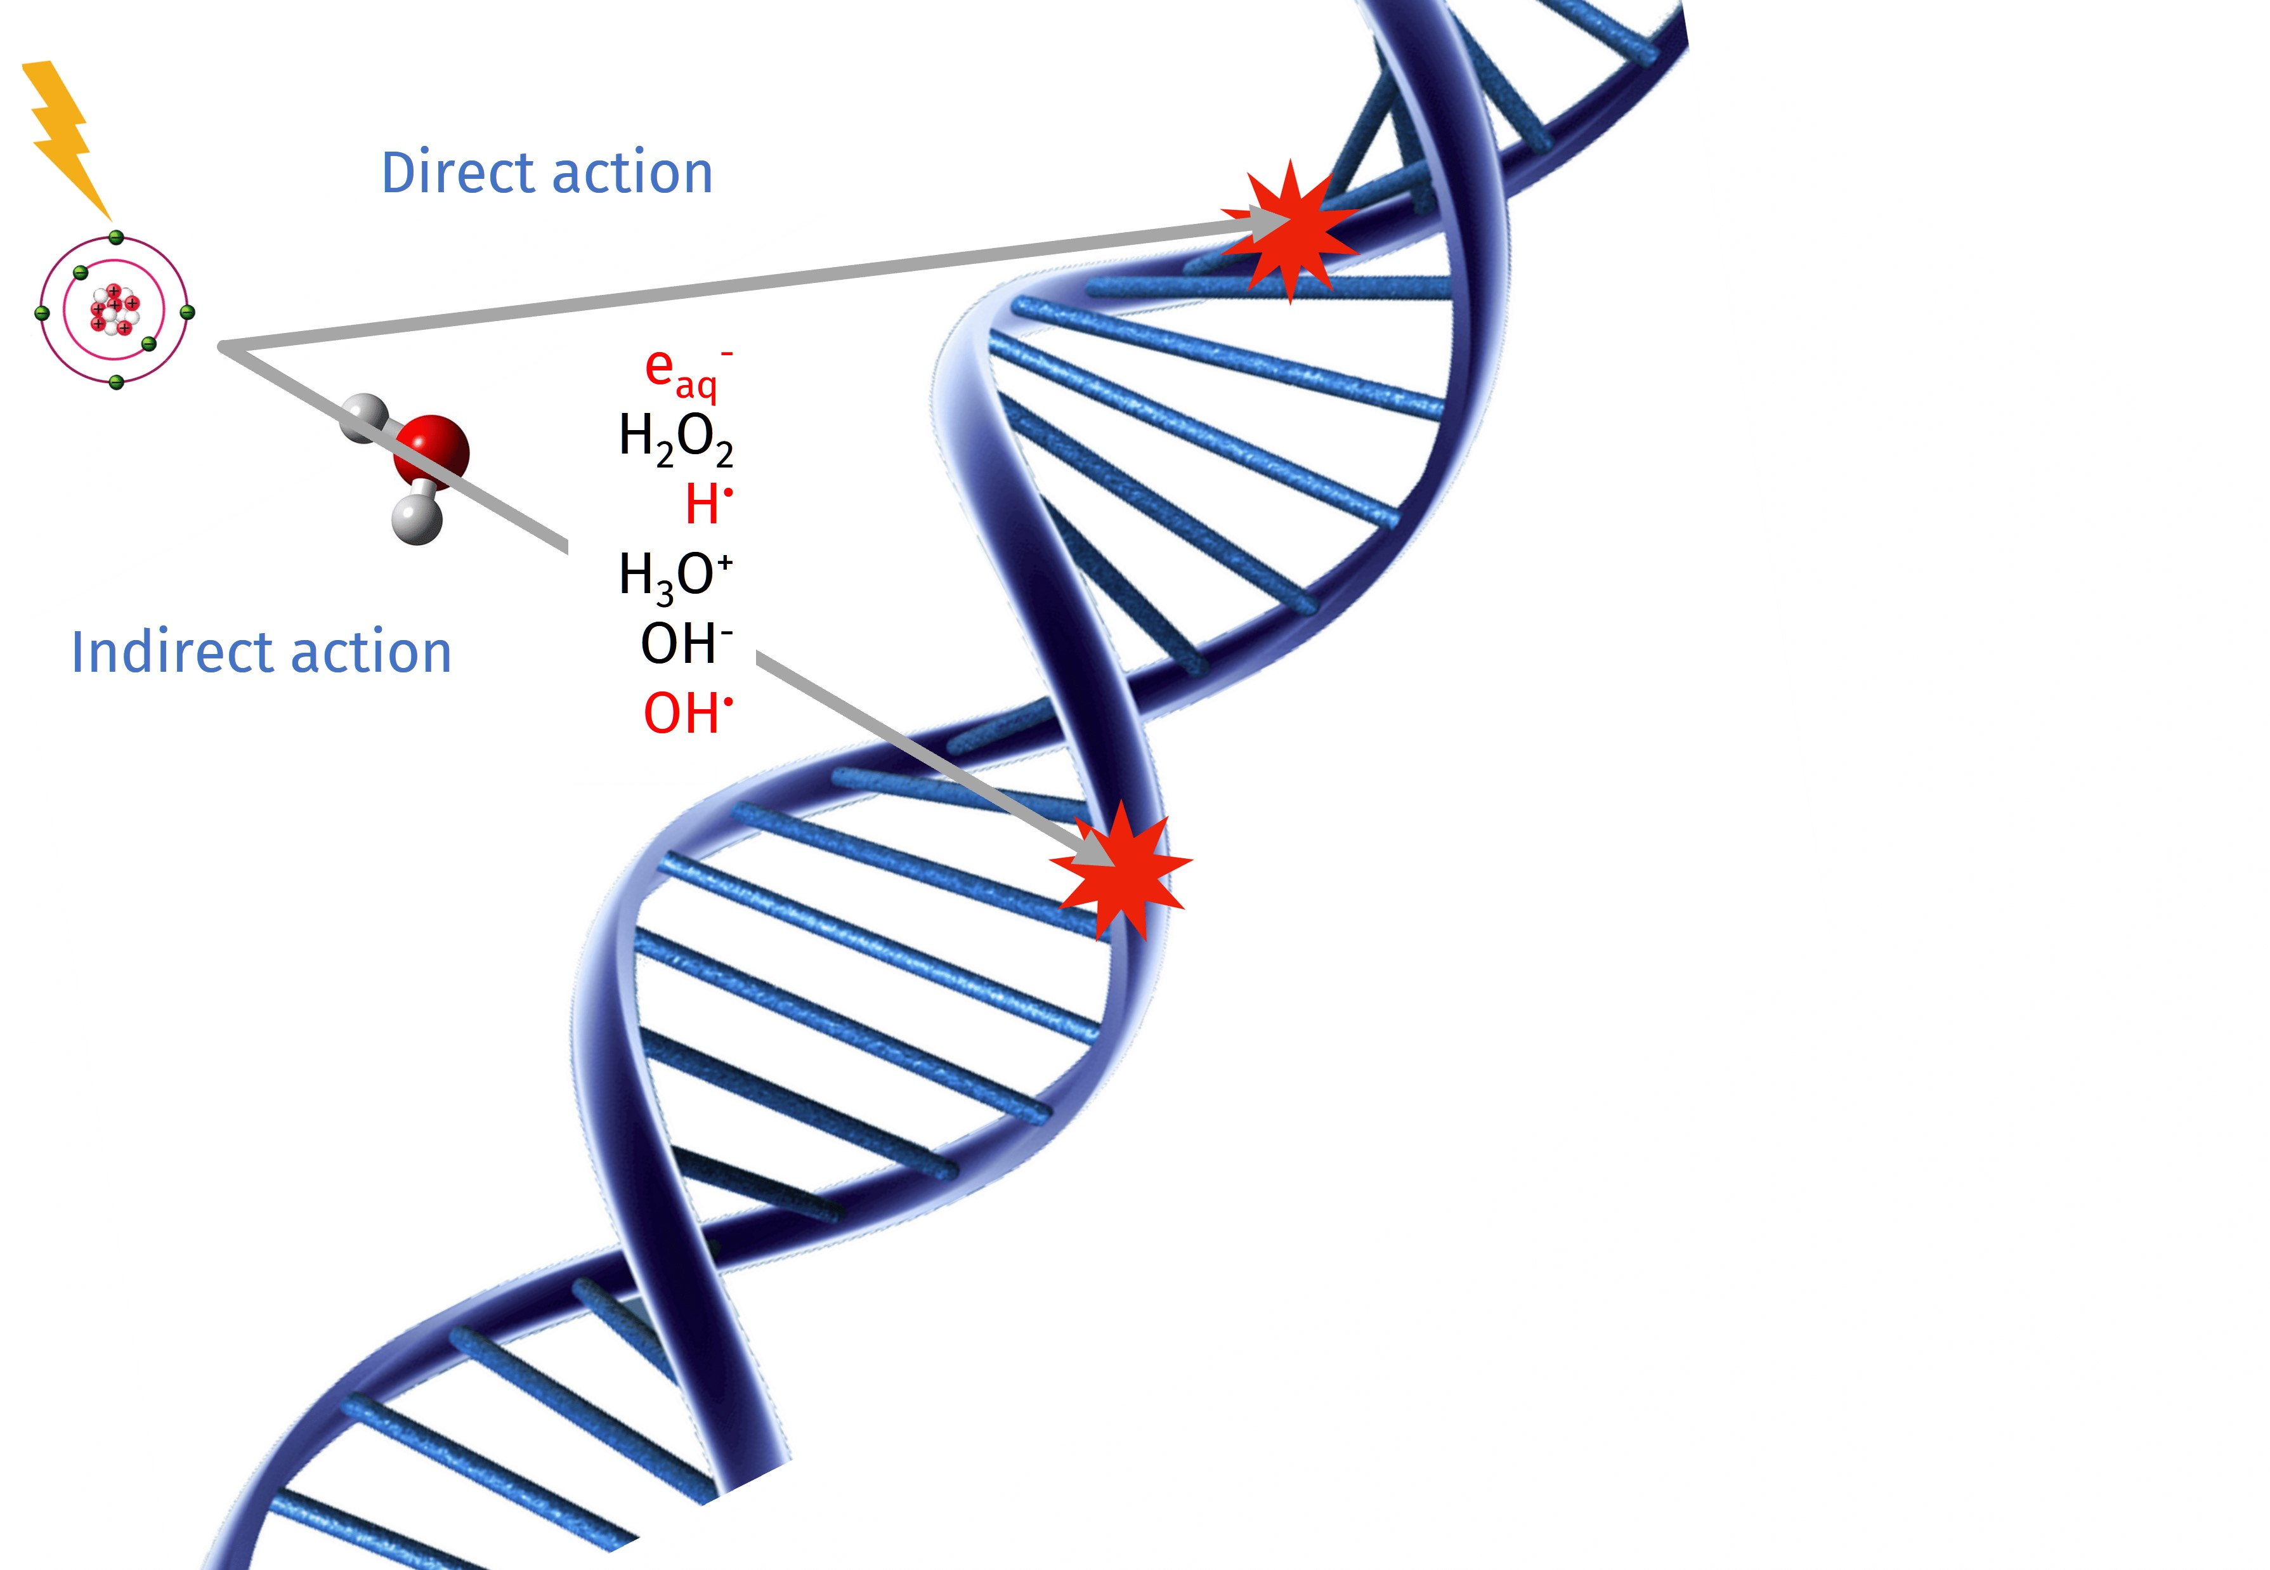
4.b Work in Progress & Outlook
Preliminary results
Introduce biomolecules
Consider “generic” organic molecule RH (proteins, amino acids & nucleotides)
[RH] ≈ 850 mM¹ >> [O₂]_{max} ≈ 0.273 mM (21% pO₂)
¹ Michaels & Hunt, Radiat. Res. (1978)
Reactions considered
RH + OH• → R• + H₂O
RH + e_{aq}⁻ + H₂O → H₂ + OH⁻ + R•
R• + O₂ → ROO•
RH + ROO• → ROOH + R•
R• + ROO• → ROOR
R• + R• → R₂
ROO• + ROO• → ROOR + O₂
Benchmark with experimental data
Investigate chemical yields under different initial conditions @ longer times: LET effects, target oxygenation, ultra-high dose rates

Slide 16
Acknowledgements
PD Dr. Alexander Dorn, PD Dr. Michael Krämer and Dr. Martina Fuß
M.Sc. Valentino Abram, Dr. Daria Boscolo and Dr. Emanuele Scifoni
IMPRS-QD
GSI Biophysics Department and MPI for Nuclear Physics

Slide 17
Backup

Slide 18
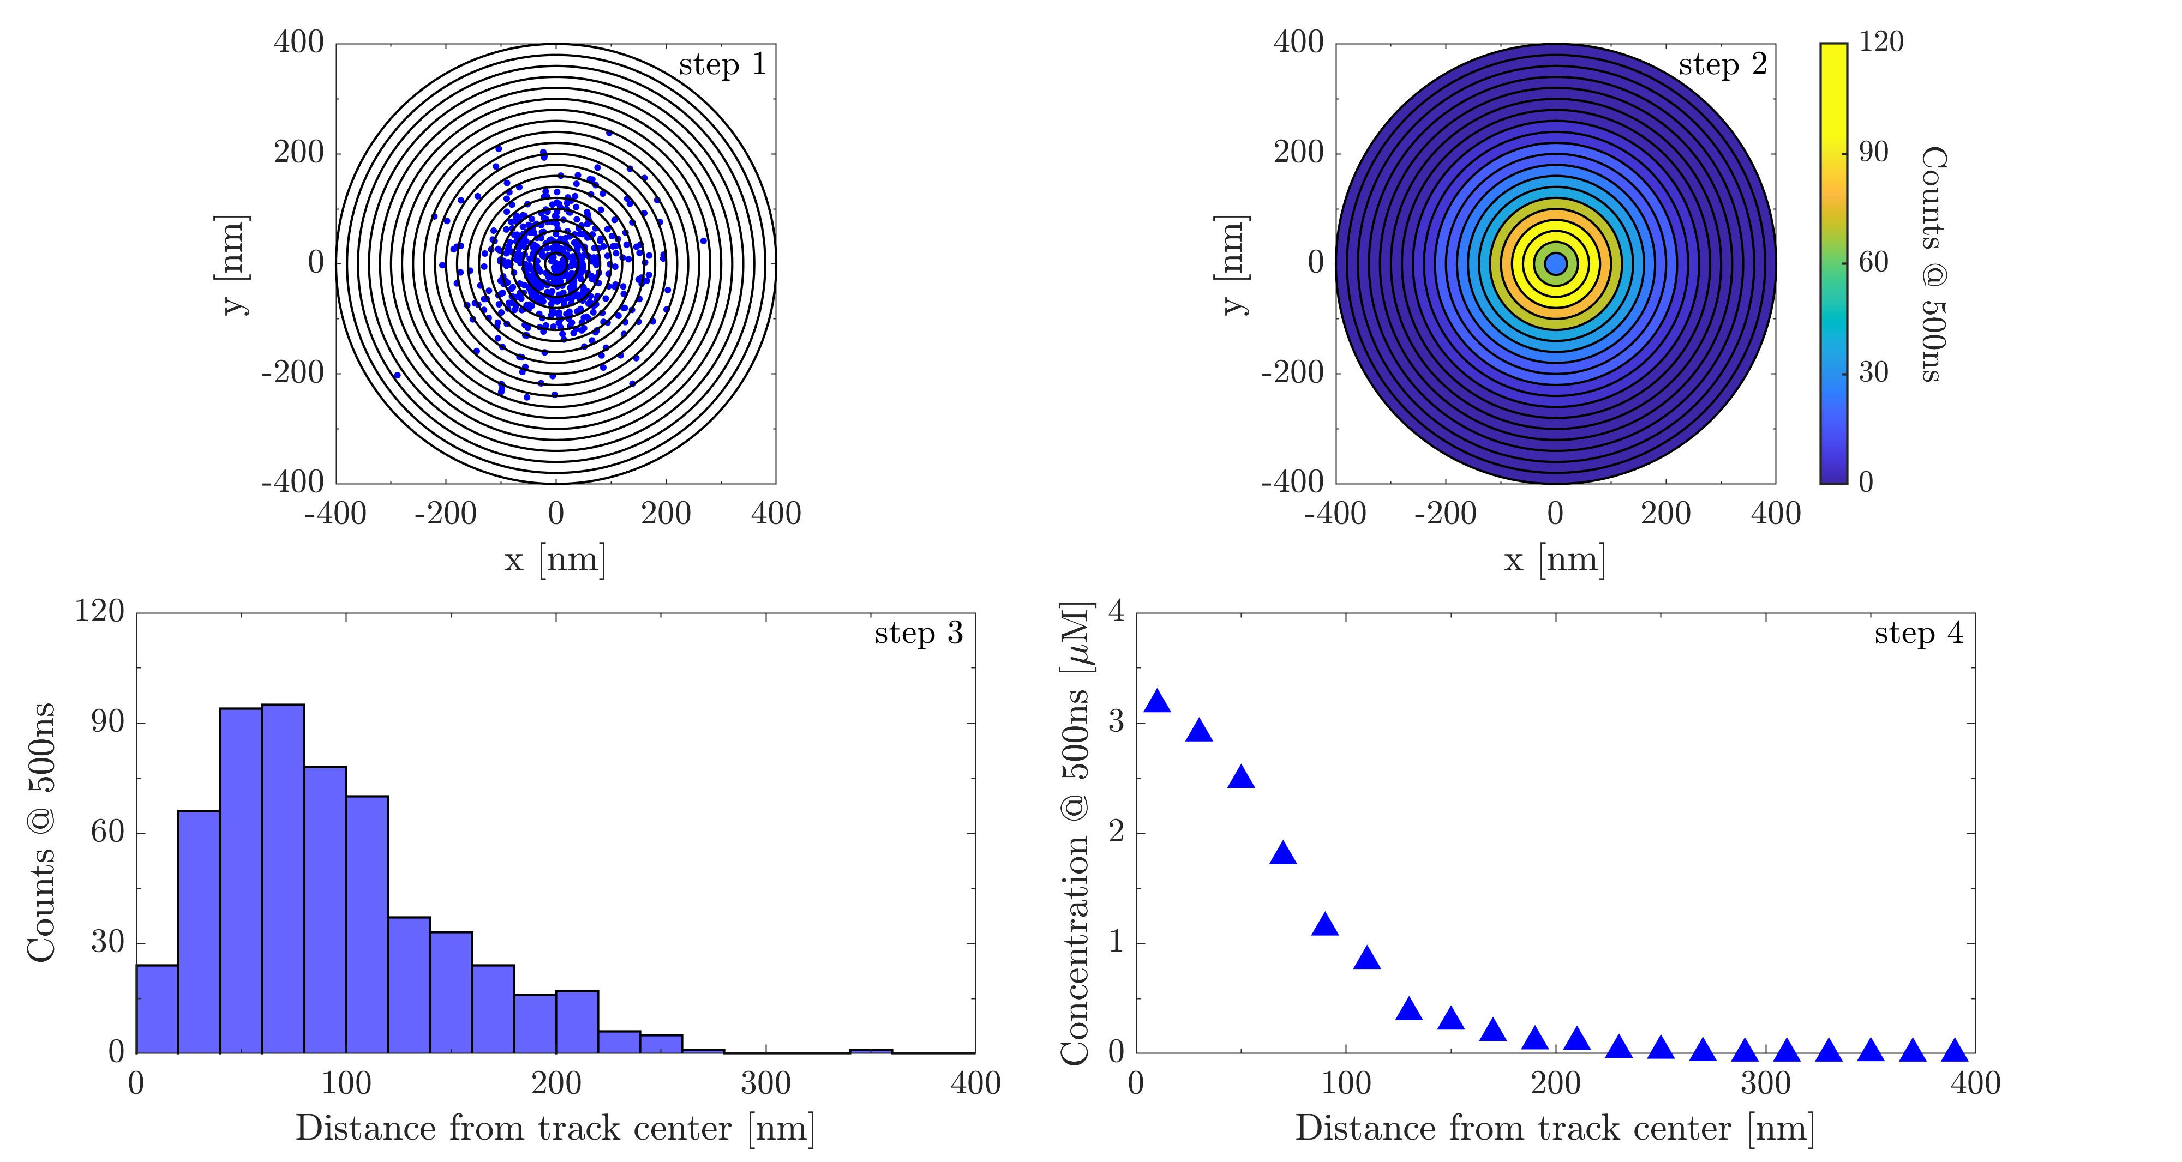
Backup – New Reaction-Diffusion Model with Concentration Distributions
Information conversion steps from TRAX-CHEM to TRAX-CHEMxt

Slide 19
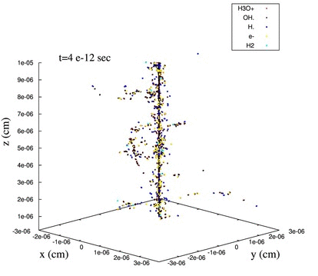
Backup – New Reaction-Diffusion Model with Concentration Distributions
Diffusion development – Matrix approach¹
Given the boundary value problem (Fick’s II law) for species $A$
$∂_{t}\left[A\right]\left(t,r\right) − D∂_{r}^{2}\left[A\right]\left(t,r\right) − \frac{D}{r}∂_{r}\left[A\right]\left(t,r\right) = 0$
by applying a finite difference approximation of the derivaties and recasting it in a matrix representation ($M$)², get distribution at time $t_{n+1} =t_{n} + dt$
$$\left[A\right]\left(t_{n+1},r\right) = M⋅\left[A\right]\left(t_{n},r\right)$$
¹ Quarteroni & Valli, SSCM (2008)
² Usmani, Comput. Math. with Appl. (1994)
Reactions development
Given a simple reaction for species $A, B, C$
$A+B →C$, $\frac{d\left[A\right]\left(t,r\right)}{dt} = −k_{AB}\left[A\right]\left(t,r\right)\left[B\right]\left(t,r\right)$
by defining the increments ($∆_{n}$), get distributions at time $t_{n+1} =t_{n}+ dt$. For $A$ have
$$∆_{n} = −k_{AB}\left[A\right]\left(t_{n},r\right)\left[B\right]\left(t_{n},r\right)dt$$
$$\left[A\right]\left(t_{n+1},r\right)=\left[A\right]\left(t_{n},r\right)+∆_{n}$$
Figure: Courtesy of Dr. Daria Boscolo

Slide 20
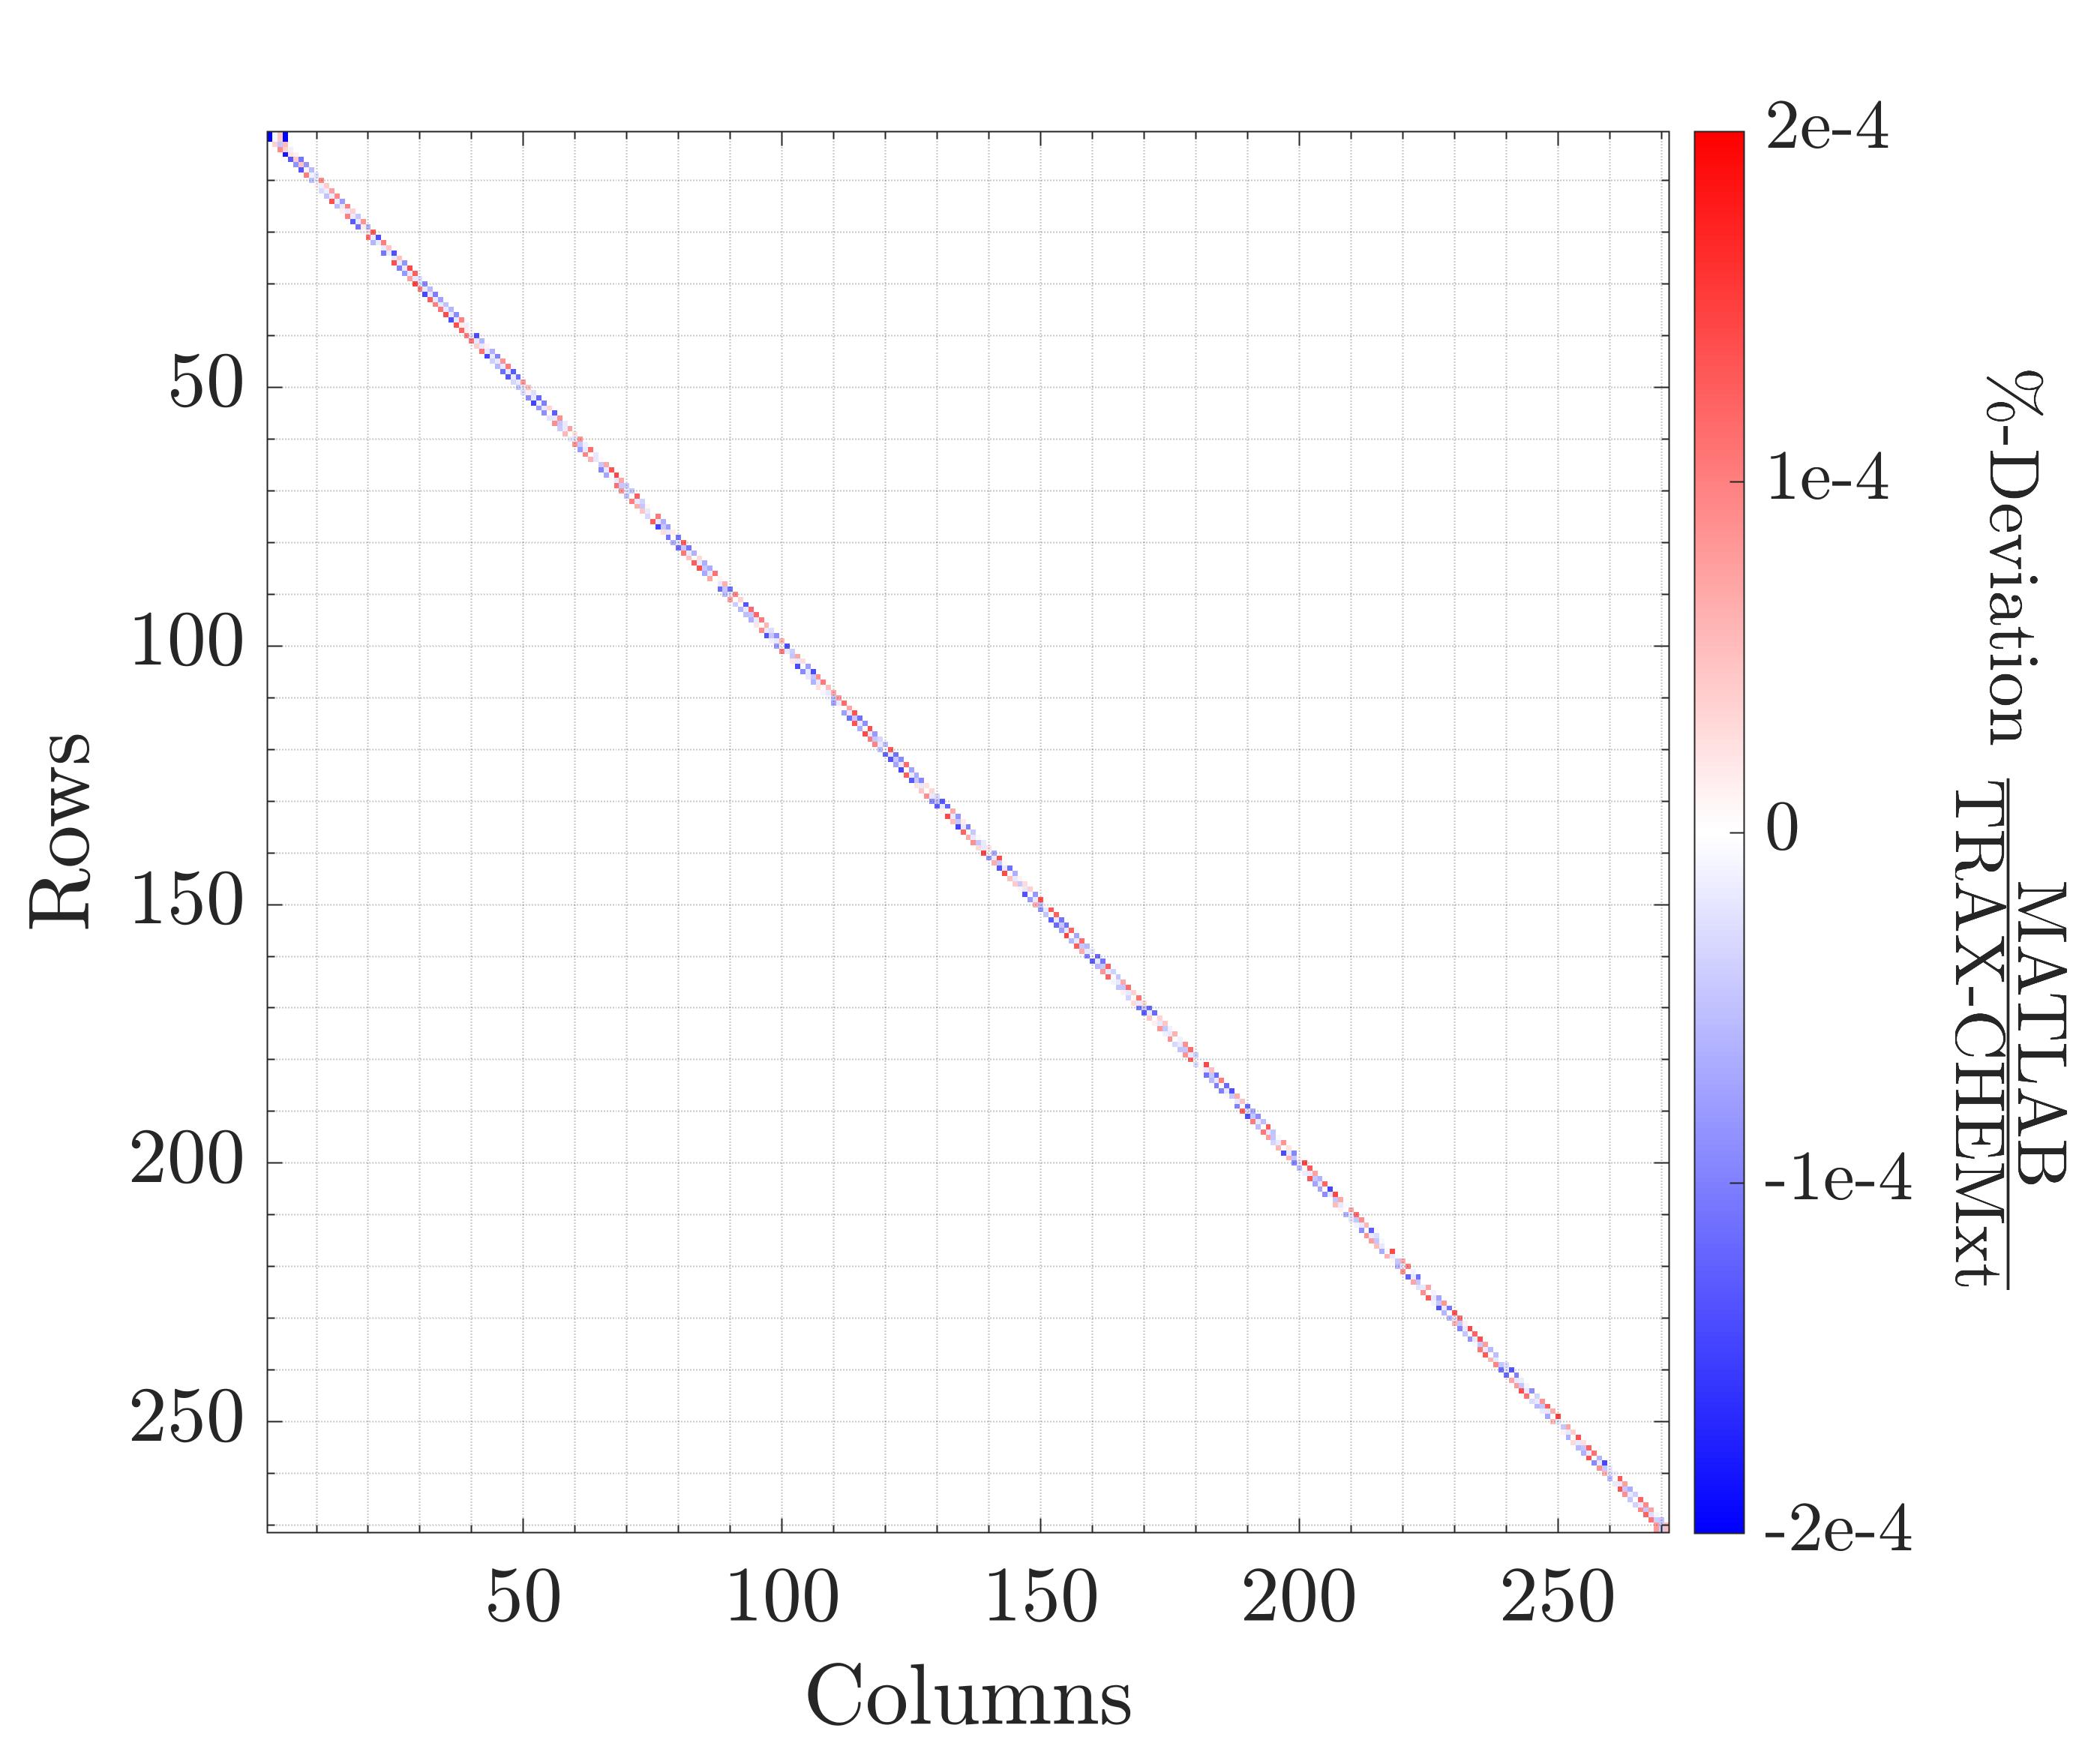
Backup – New Reaction-Diffusion Model with Concentration Distributions
Deviations between matrix $M$ values, computed by MATLAB and the implemented algorithm in TRAX-CHEMxt following Usmani, Comput. Math. with Appl. (1994)

Slide 21
Backup – New Reaction-Diffusion Model with Concentration Distributions
List of time steps $dt$ assigned to the respective time intervals
Time interval | $dt$ [ns]
t_{in} – 1 μs | 0.5
1 μs – 10 μs | 1
10 μs – 100 μs | 2.5
100 μs – 1 ms | 5
1 ms – t_{end} | 10

Slide 22
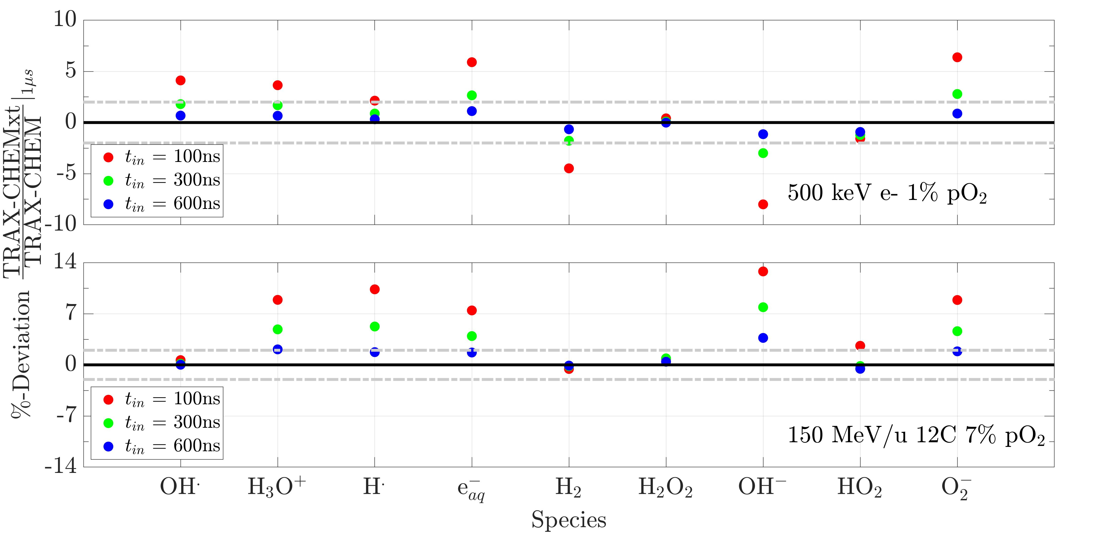
Backup – Switching Time Point Effects on Species Produced

Slide 23
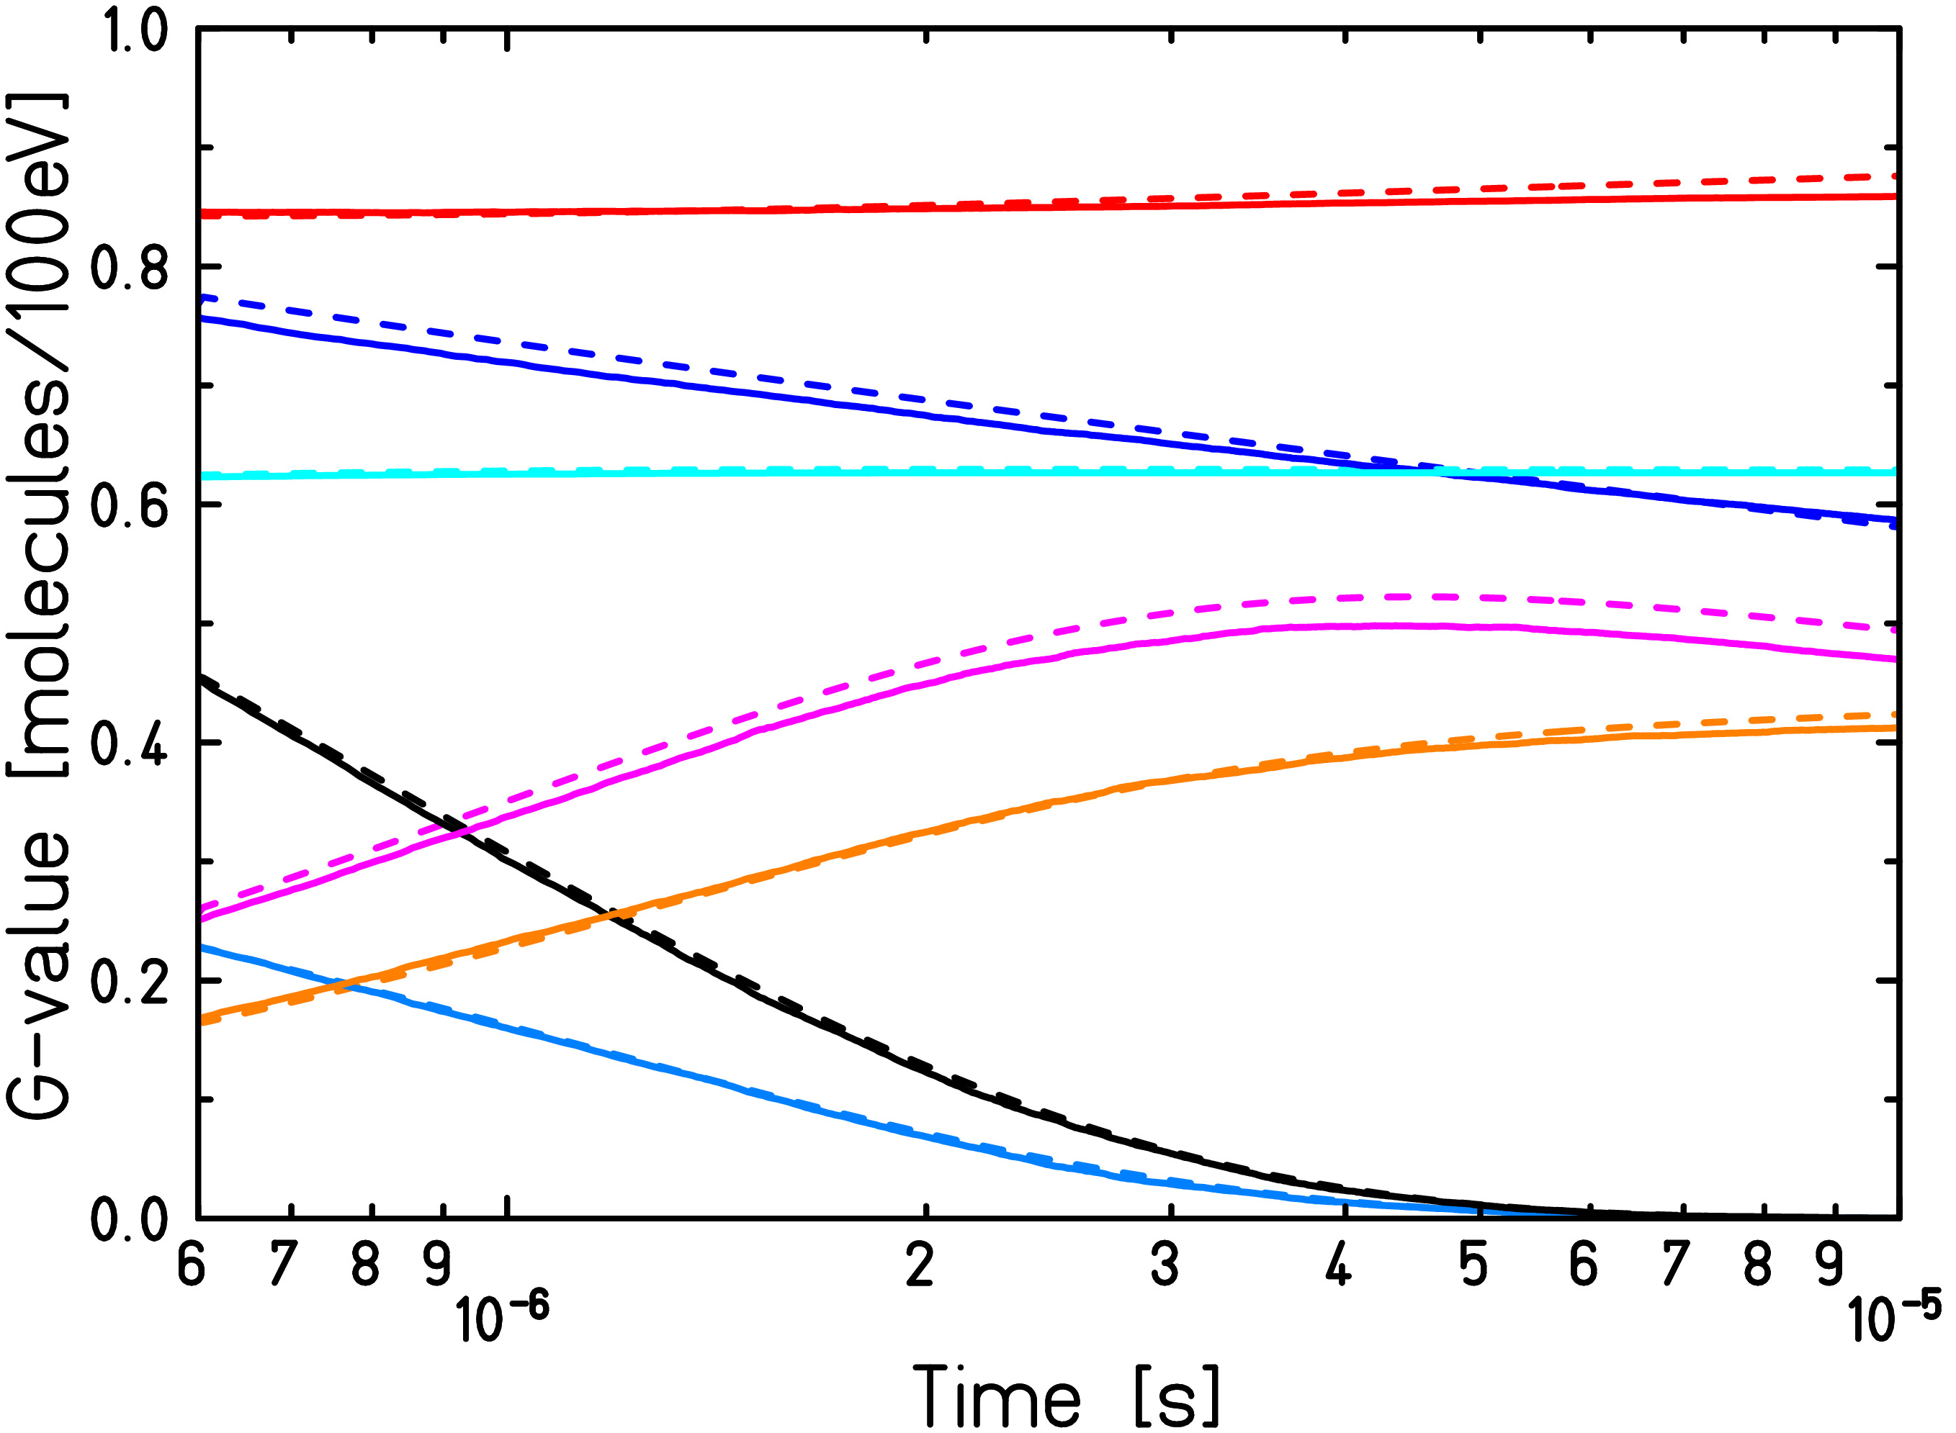
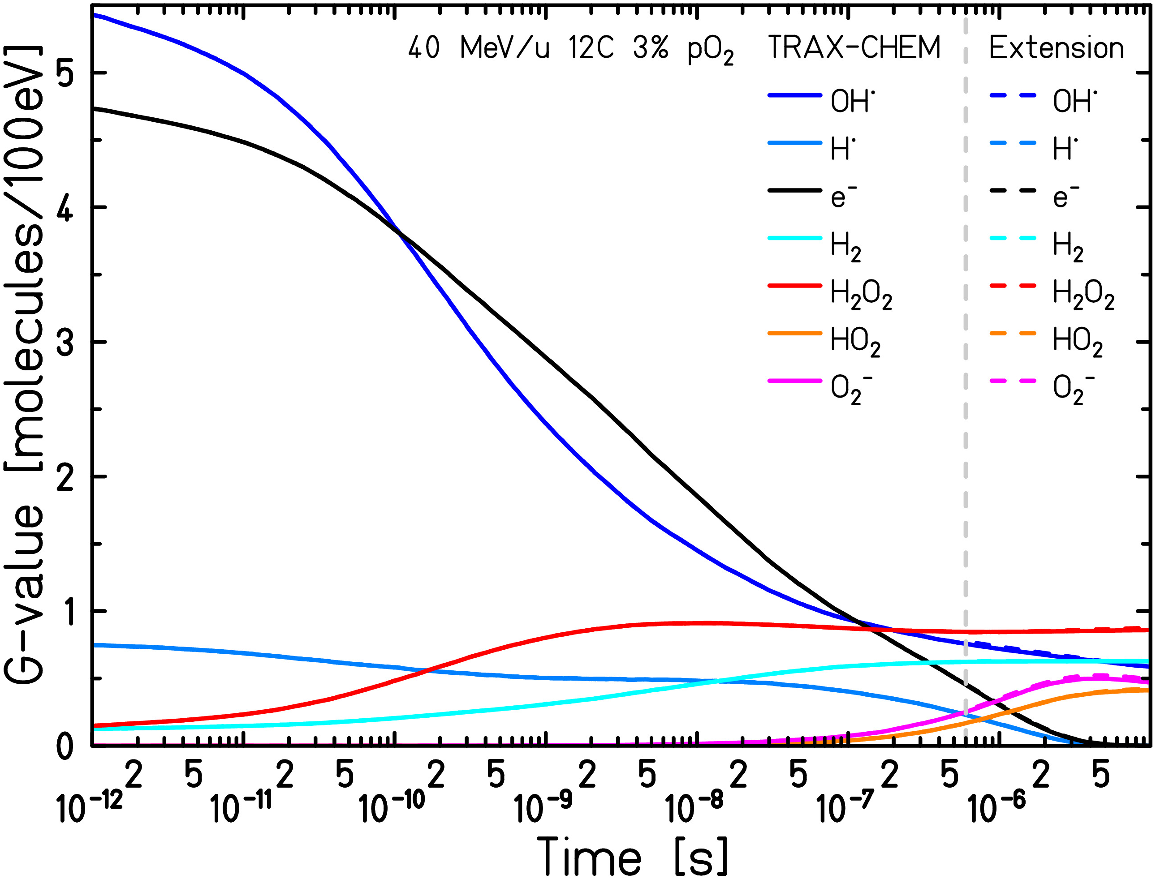
Backup – Comparison with TRAX-CHEM, G-values Analysis

Slide 24
Backup – Comparison with TRAX-CHEM, Oxygenation Analysis
Comparison between reactants’ yields (H• + e_{aq}⁻) in anoxia and respective products’ yields (HO₂• + O₂^{•-}) in normoxia at 1 μs after irradiation
Particle type | pO₂ [atm] | Species | Yield [molecules/100 eV]
500 keV e- | 0% | H• + e_{aq}⁻ | 3.19
 | 21% | HO₂• + O₂^{•-} | 3.21
90 MeV 1H | 0% | H• + e_{aq}⁻ | 3.12
 | 21% | HO₂• + O₂^{•-} | 3.15
90 MeV/u 12C | 0% | H• + e_{aq}⁻ | 1.40
 | 21% | HO₂• + O₂^{•-} | 1.56

Slide 25
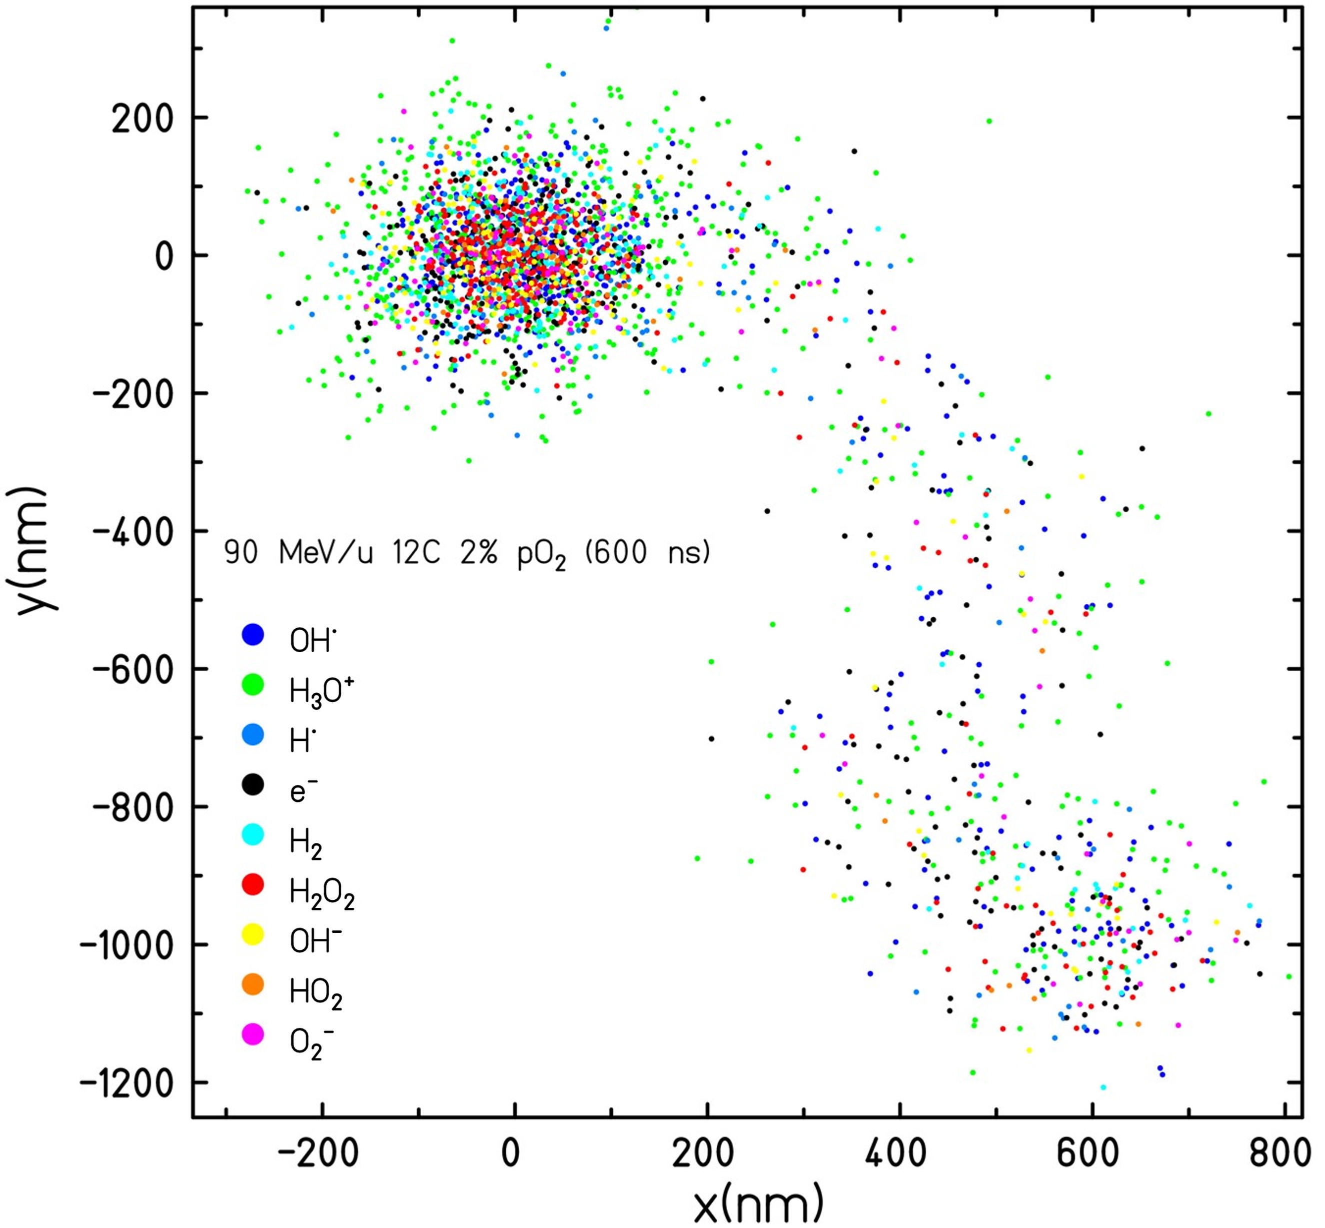
Backup – Comparison with TRAX-CHEM, TRAX-CHEMxt Accuracy
Particle type | Energy | pO₂ [atm] | Deviation at 1 μs
e- | up to 1 MeV | 0% – 7% | 1%
e- | 500 keV | 21% | 2%
1H | up to 90 MeV | 0% – 4% | 1%
1H | up to 90 MeV | 21% | 2%
4He | 150 MeV/u | 21% | 2%
12C | up to 300 MeV/u | 0% – 3% | 4%
12C | up to 90 MeV/u | 7% – 21% | 5%
12C | up to 20 MeV/u | 21% | 6%

Slide 26
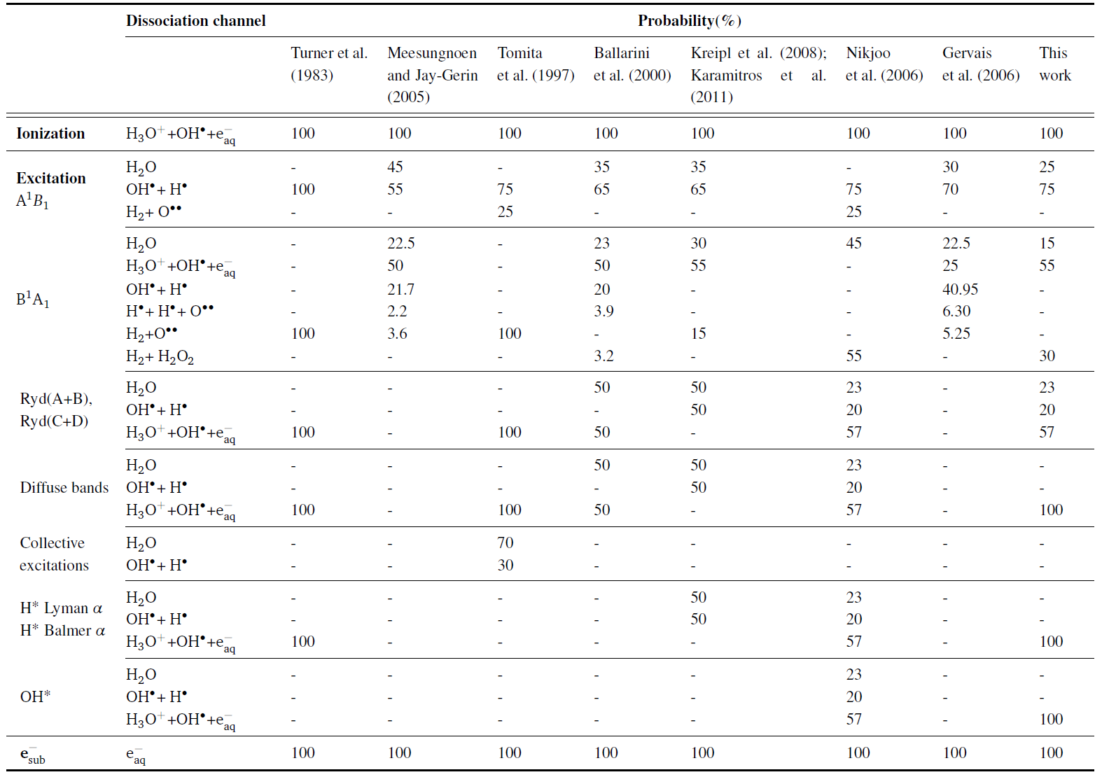
Backup – Comparison with Other Monte Carlo Algorithms
Figure: Adapted from Boscolo, PhD thesis, TU Darmstadt (2018)

Slide 27
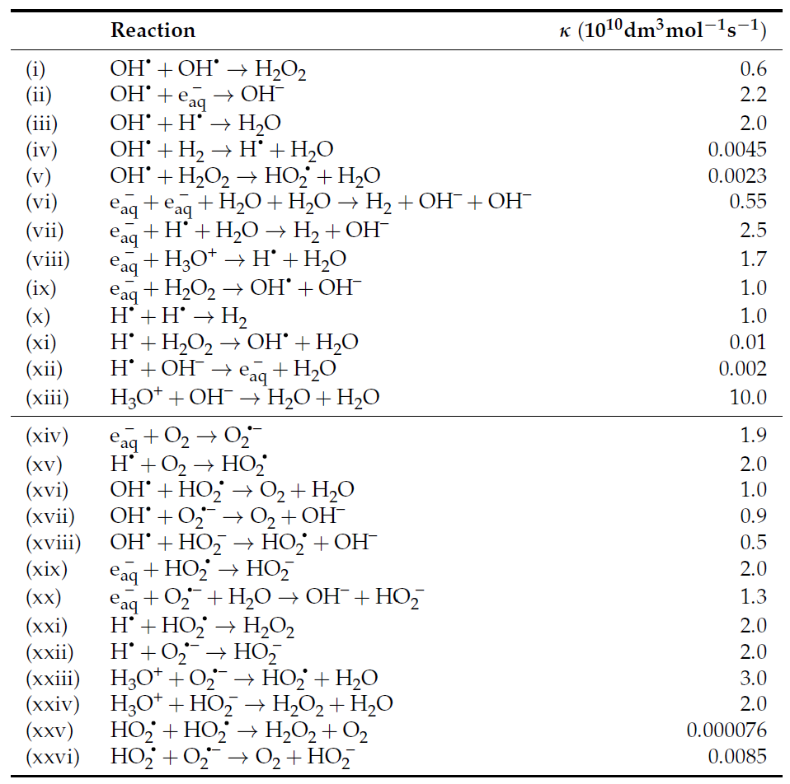
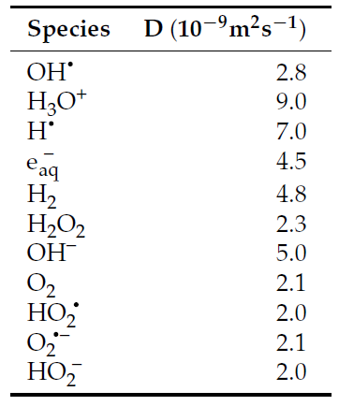
Backup – Comparison with Other Monte Carlo Algorithms
Figure: Adapted from Camazzola et al., Int. J. Mol. Sci. (2023)

Slide 28
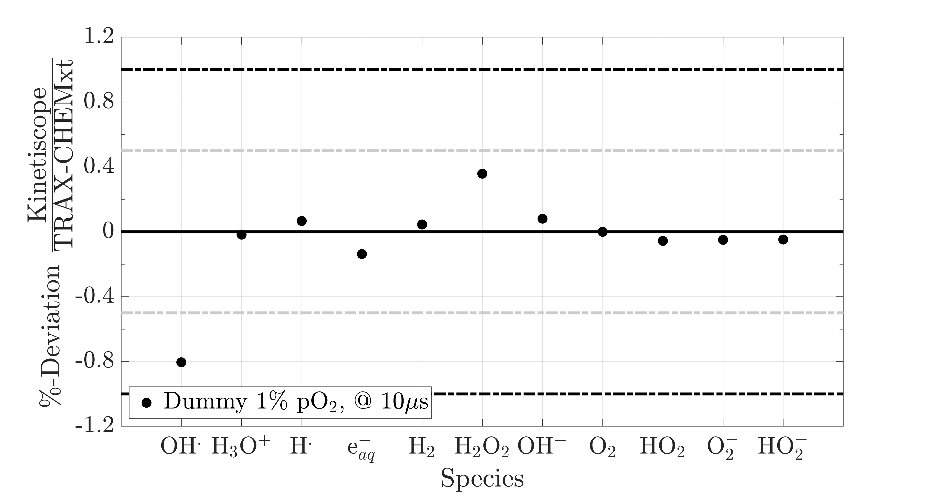
Backup – Comparison with Kinetiscope, «Dummy» Test
Uniform concentrations assigned randomly to each species
Chemical network in reaction-limited domain simulated between 1 µs and 10 µs

Slide 29
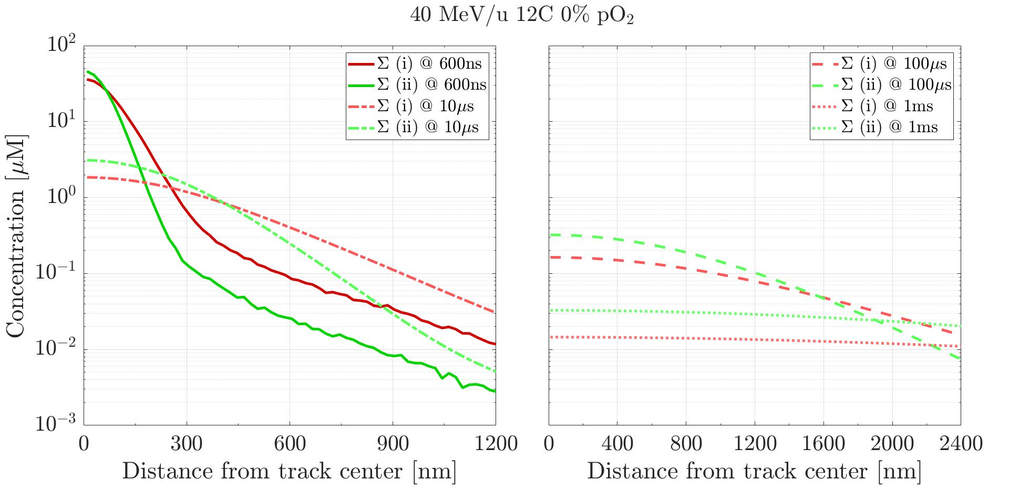
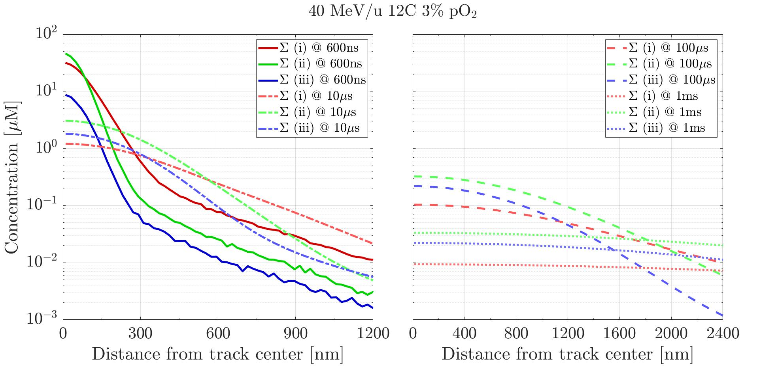
Backup – To Longer Time Scales, Distributions Evolution
Products of radiation vs. H₂O (i): OH•, H₃O⁺, H• and e_{aq}⁻
Intra-track products (ii): H₂, H₂O₂ and OH⁻
Products of reactions vs. O₂ (iii): HO₂•, O₂^{•-} and HO₂⁻

Slide 30
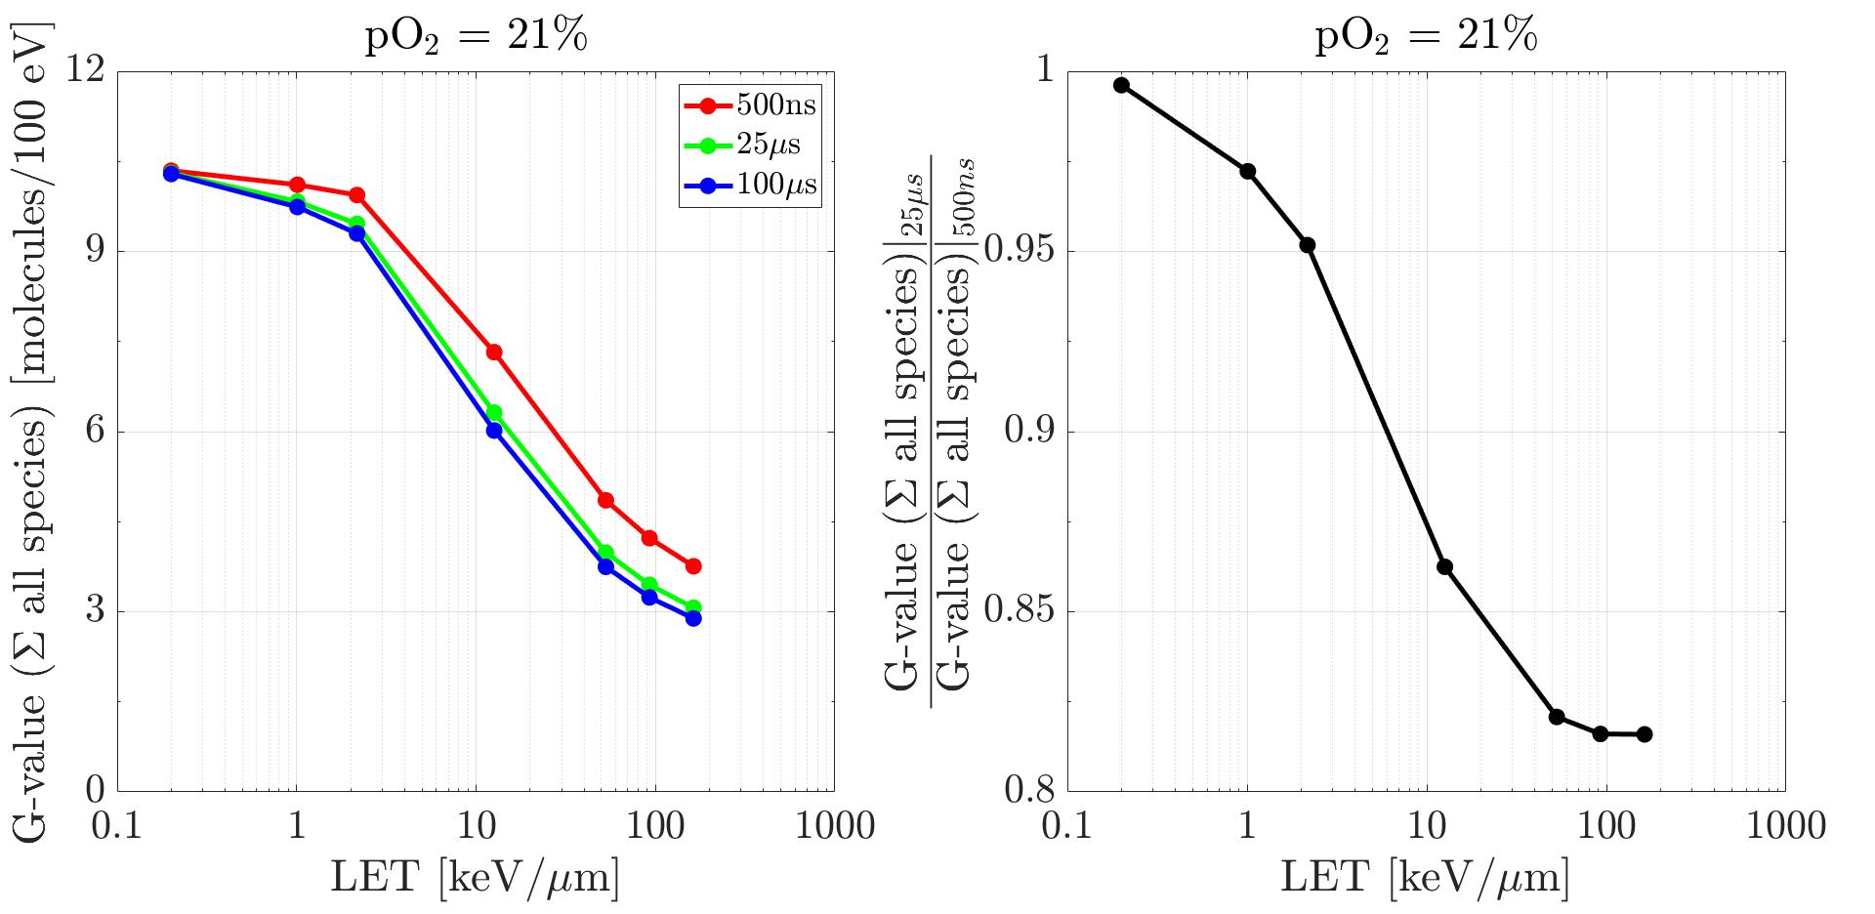
Backup – To Longer Time Scales, LET Impact

Slide 31
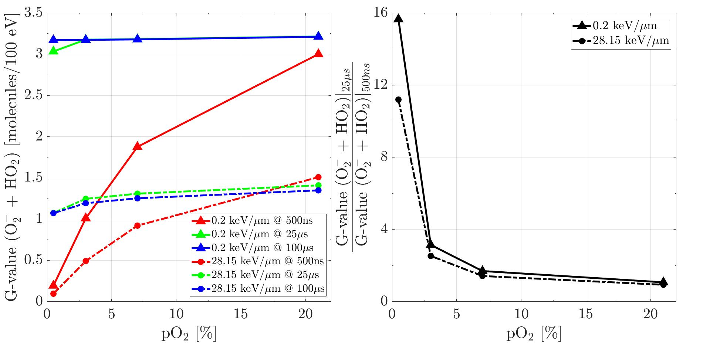
Backup – To Longer Time Scales, pO₂ Impact

Slide 32
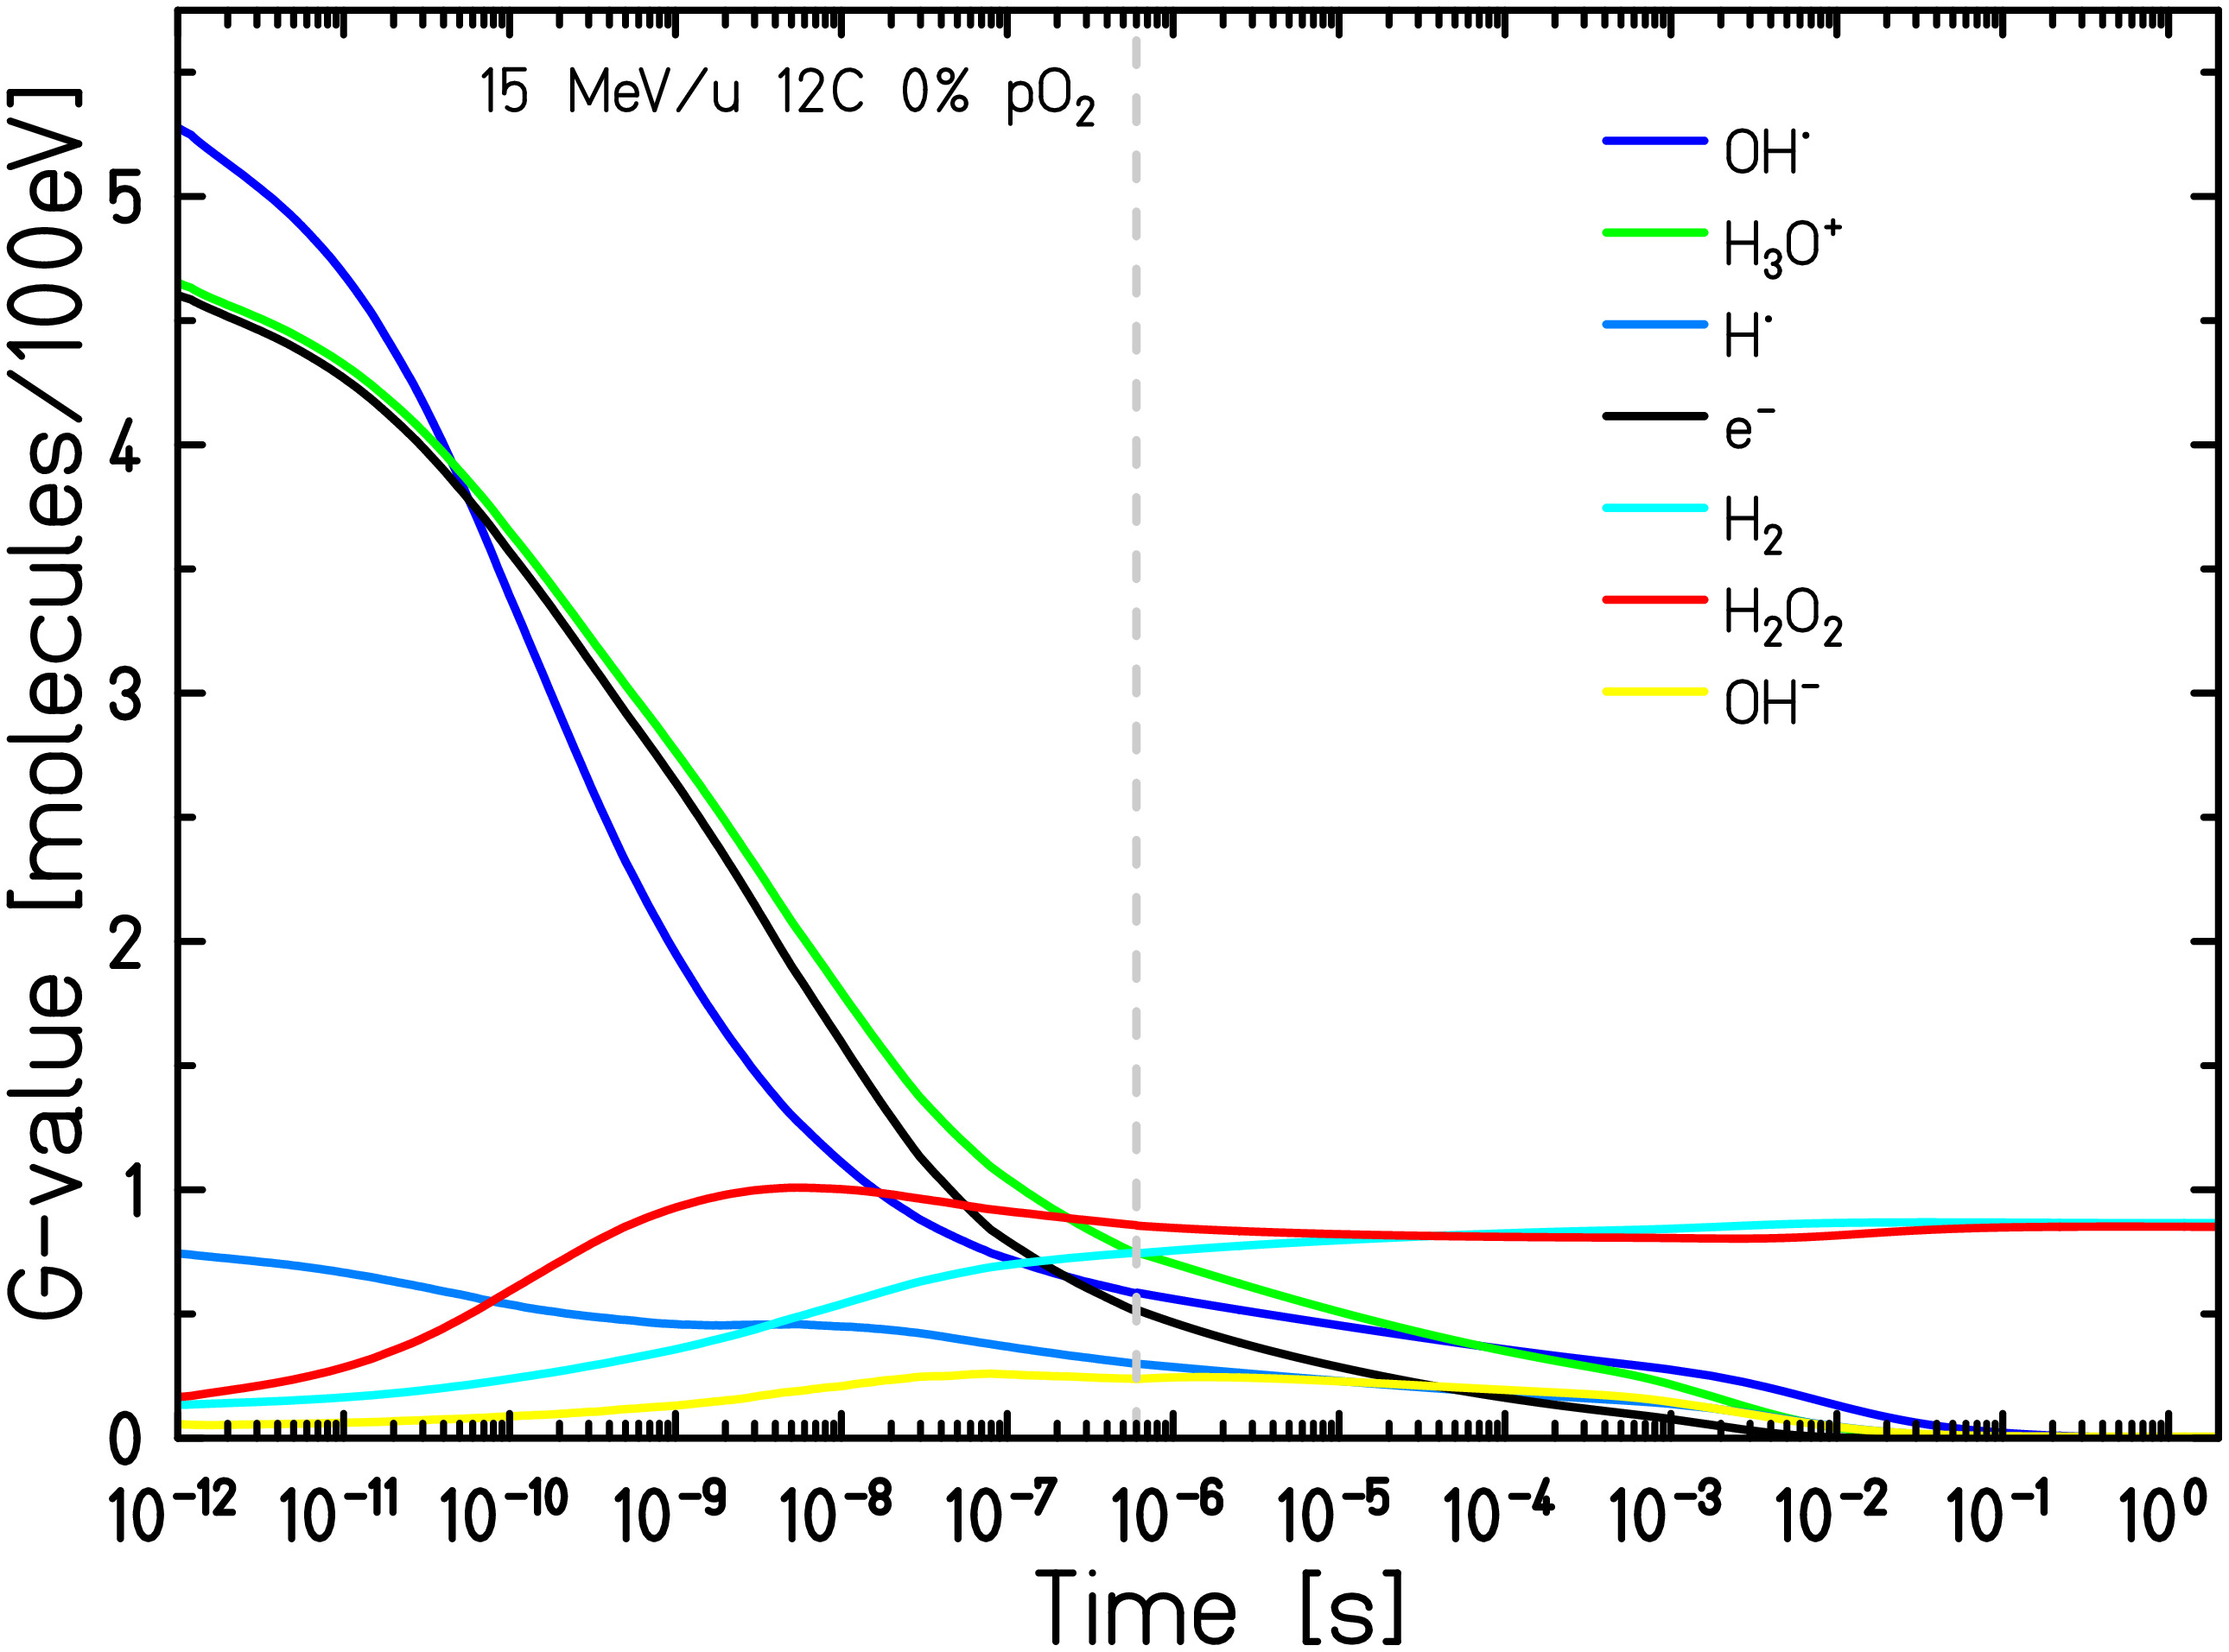
Backup – To Longer Time Scales, Comparison with Experimental Observations
From Wasselin-Trupin et al., Radiat. Phys. Chem. (2002); Burns & Sims, J. Chem. Soc. Faraday Trans. (1981); Pastina & LaVerne, J. Phys. Chem. A (1999); Roth & LaVerne, J. Phys. Chem. A (2011):
«G(H₂O₂) decrease after an average LET of 100 keV/µm, due to intra-track reactions with e_{aq}⁻, H• and OH•»
→ Simulation with 12C @ 117 keV/µm

