Slide 1
AI applications in image-guided radiotherapy:
current research at the LMU University
Hospital Munich
Christopher Kurz
Department of Radiation Oncology
LMU University Hospital, LMU Munich, Germany
christopher.kurz@med.uni-muenchen.de
INSIGHTS Workshop Pisa 19.10.2023

Slide 2
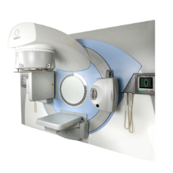
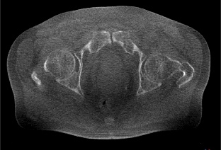
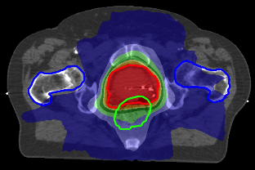
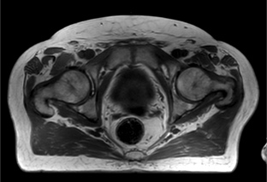
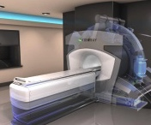
AI applications in adaptive image-guided radiotherapy
Background
In-room CBCT
Treatment optimization
Treatment
Baseline treatment planning
Follow up
In-room MRI
Treatment optimization
Treatment
Outcome prediction
Synthetic CT generation
Automatic segmentation
Dose calculation
Motion tracking and prediction

Slide 3
AI applications in adaptive image-guided radiotherapy
Outline
In-room CBCT
Treatment optimization
Treatment
Treatment
Baseline treatment planning
Follow up
In-room MRI
Treatment optimization
Treatment
Outcome prediction
Synthetic CT generation
Automatic segmentation
Dose calculation
Motion tracking and prediction

Slide 4
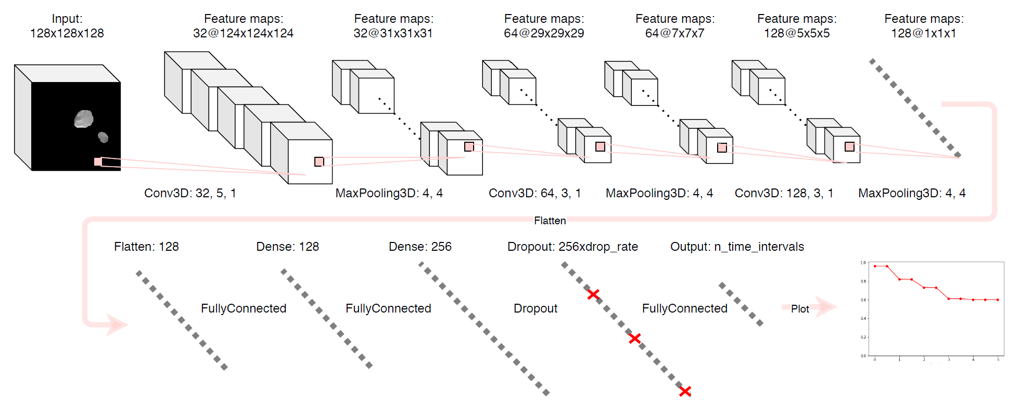
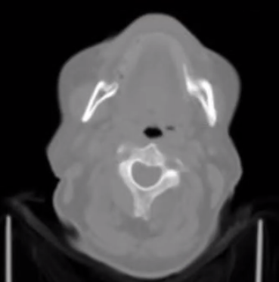
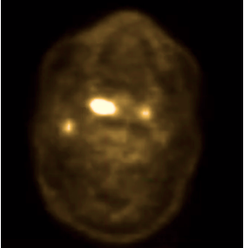
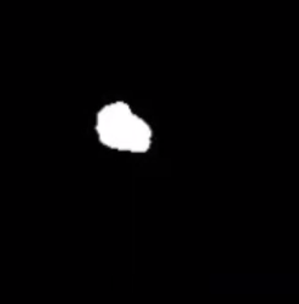
Outcome prediction
End-to-end radiomics
Predict probability of distant metastasis (DM) directly from H&N CT images
  Time-to-event analysis by using dedicated time-interval-based loss function
CNNs can handle various inputs via
channels to enhance performance
Future: pre-treatment dose adaptation
Input: GTV-masked CT
Lombardo et al., 2021, Sci Rep
Output: Cumulative DM-free probability
CT
FDG PET
GTV
Wang et al., 2022, Comput Meth Prog Bio
Notes:
Gensheimer et al. nnet_survival
Best results with only PET

Slide 5
AI applications in adaptive image-guided radiotherapy
Outline
In-room CBCT
Treatment optimization
Treatment
Treatment
Baseline treatment planning
Follow up
In-room MRI
Treatment optimization
Treatment
Outcome prediction
Synthetic CT generation
Automatic segmentation
Dose calculation
Motion tracking and prediction

Slide 6
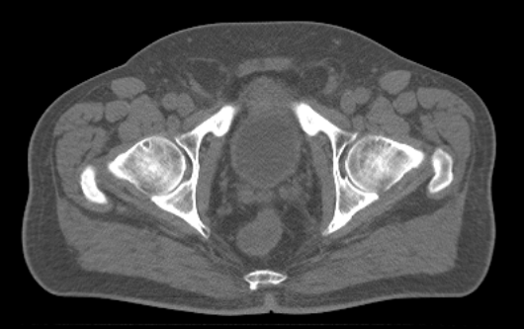
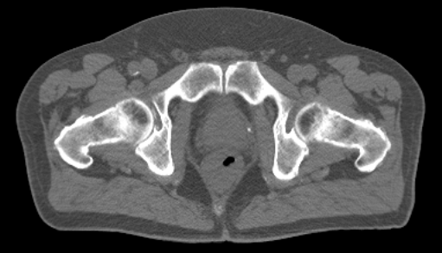
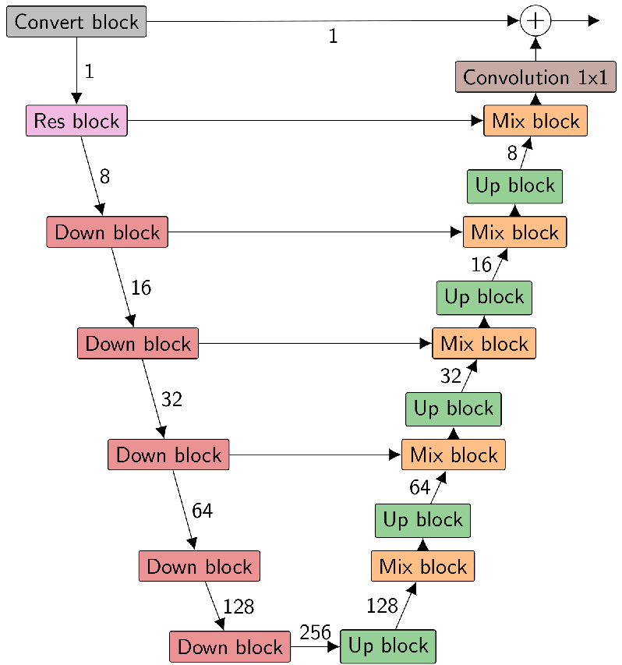
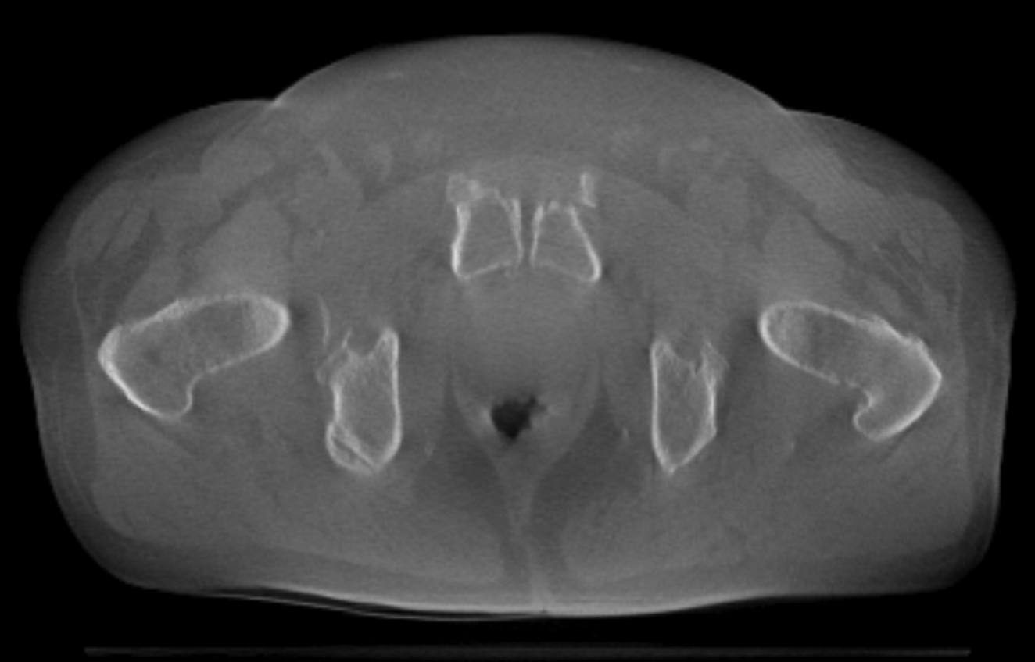
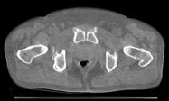
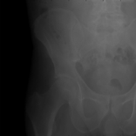
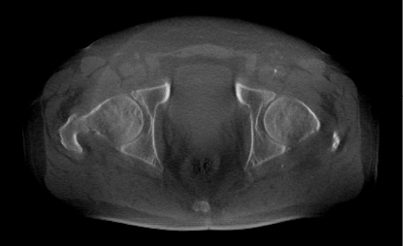
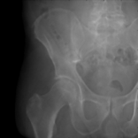
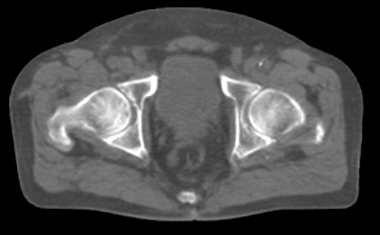
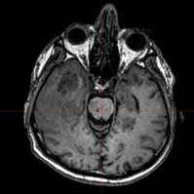
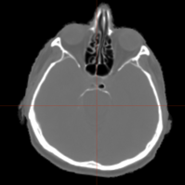
Synthetic CT generation
U-Net and cycleGAN for domain adaptation
In-room MR and CBCT images not suitable for dose calculation and adaptation
Employ U-Net for domain adaptation to CT
Alternatively, cycle-consistent GANs can be employed
Forward cycle:
CTs
Input
Unet
Output
Suitable where no paired training data is available
Output: diagnostic CT-equivalent image
Similar accuracy and speed as U-Net
Geometric fidelity to be checked
Raw CBCT → Virtual CT/corrected CBCT
Adversarial loss
D_{CT}
CBCT
G_{CT}
Raw CBCT proj. → Corrected projection
L1 norm
G_{CBCT}
G_{CT}(CBCT)
MRI → CT
Hansen et al., 2018, Med Phys
Landry et al., 2018, PMB
Neppl et al., 2019, Acta Oncol
Schmitz et al., 2023, phiRO
Kurz et al., 2019, PMB
G_{CBCT}(G_{CT}(CBCT))

Slide 7
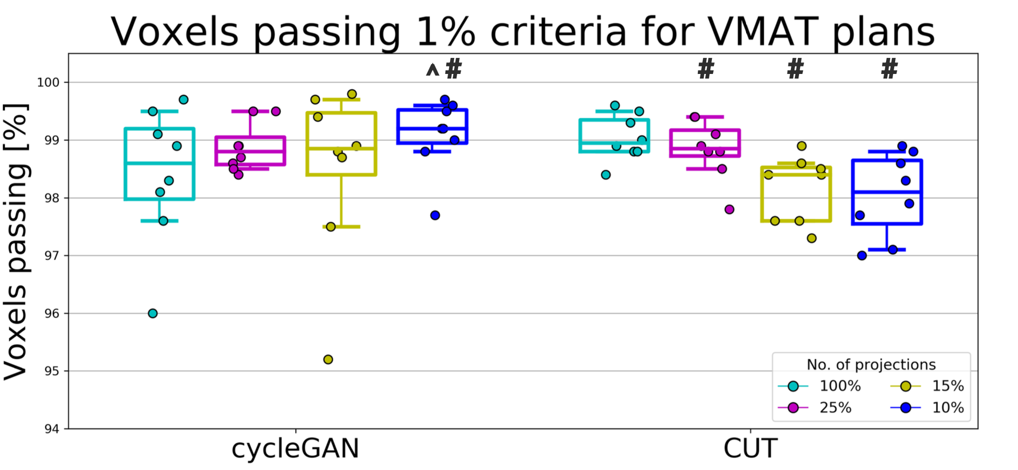
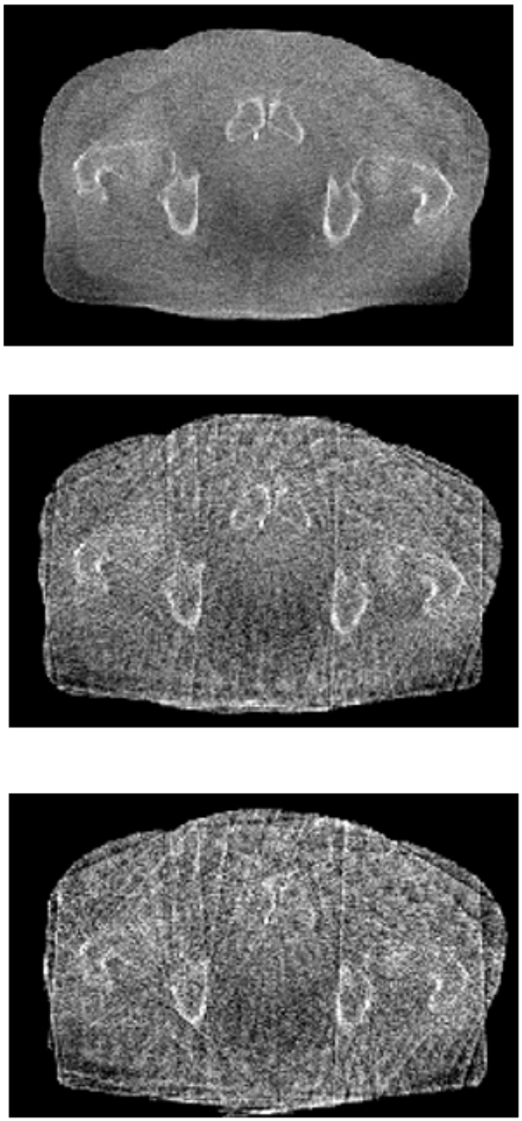
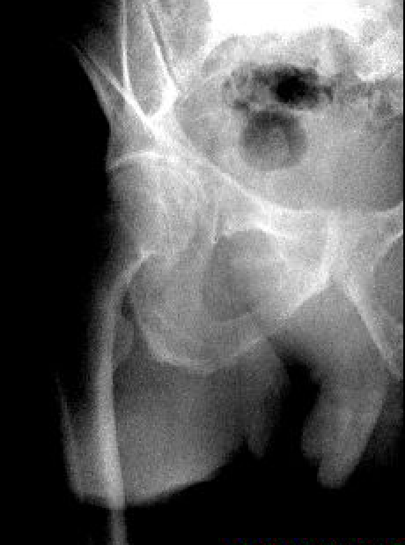
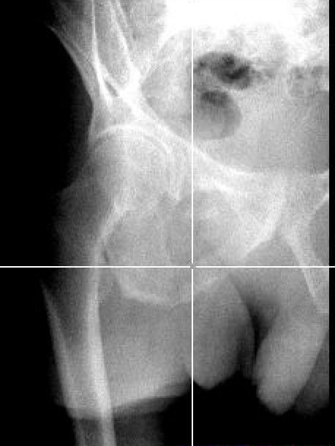
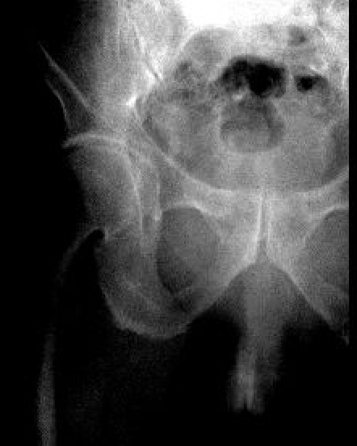
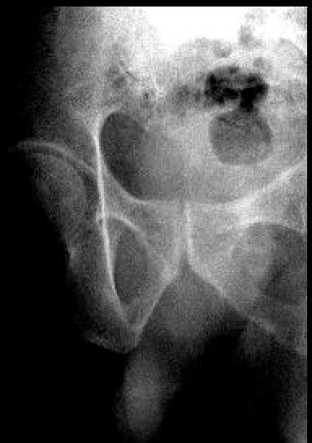
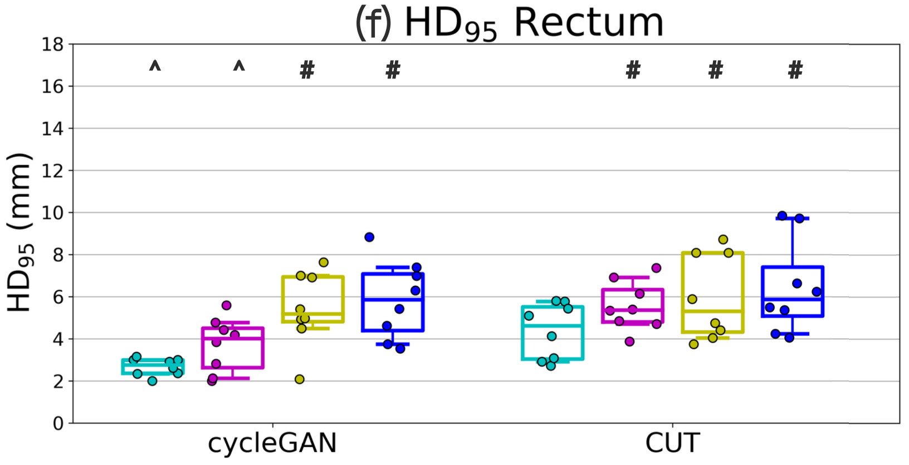
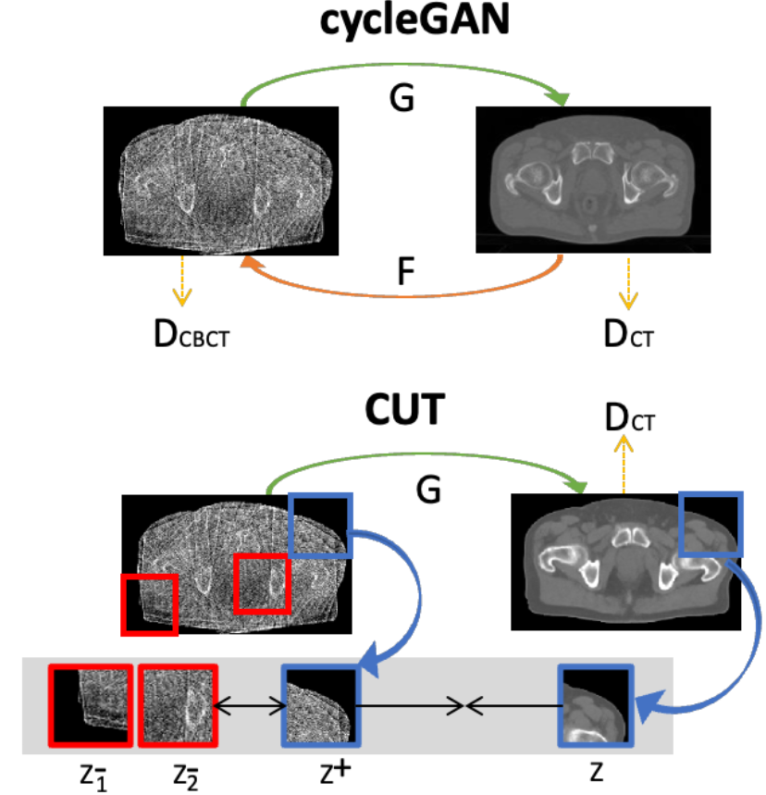
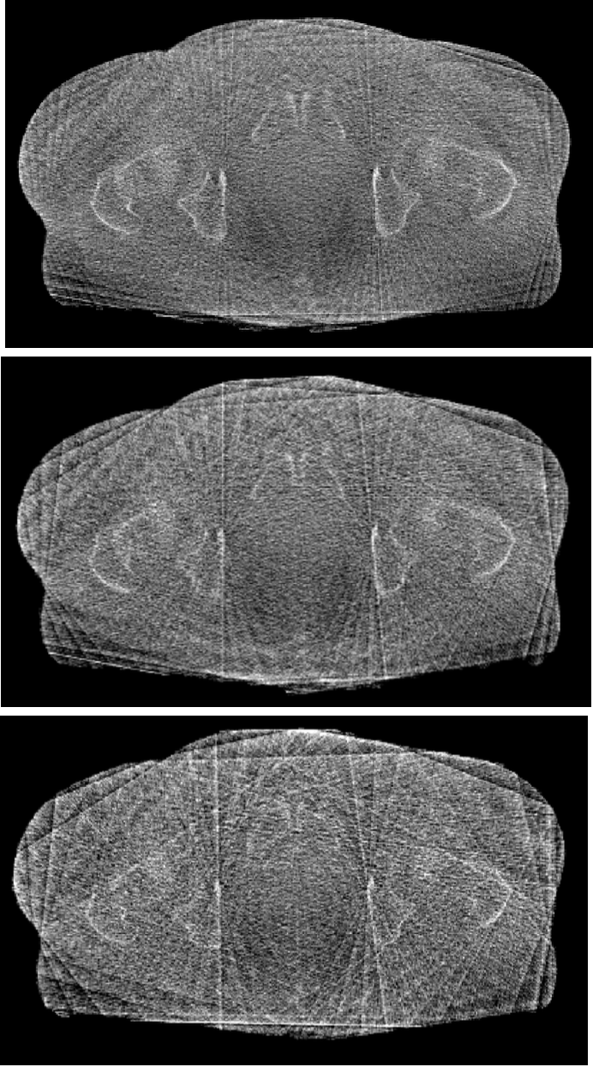
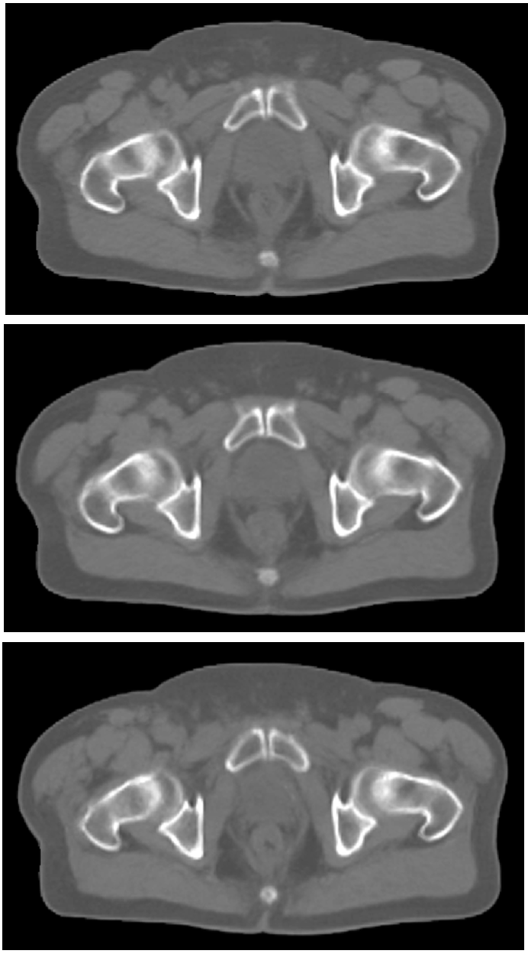
Synthetic CT generation
CycleGAN for CBCT dose reduction
Daily in-room CBCT imaging introduces
non-negligible imaging dose
  Dose reduction by projection subsampling
  CycleGAN and CUT* for synCT generation
  Streak removal and intensity correction
25%
FDK
recon
Subsampling
15%
~350 projections
~90/50/35 proj.
10%
25%
25%
15%
15%
10%
10%
Accurate VMAT dose calculation feasible
Geometric fidelity drops at 15% dose
Low dose CBCT
synCT
*Contrastive unpaired translation
Chan et al., 2023, PMB

Slide 8
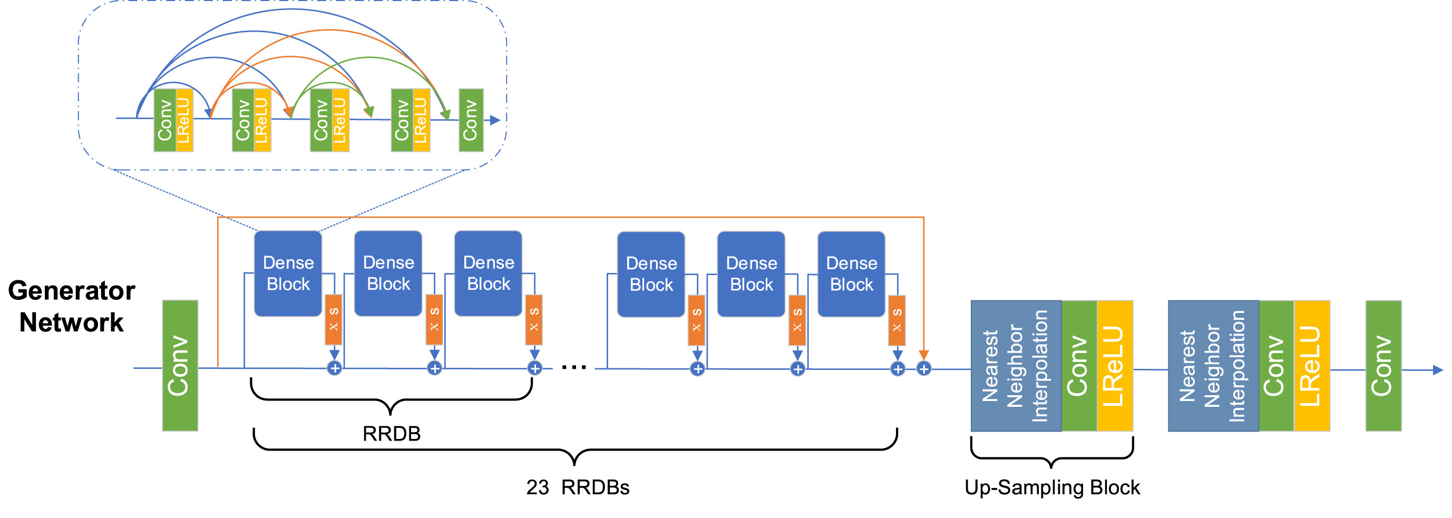
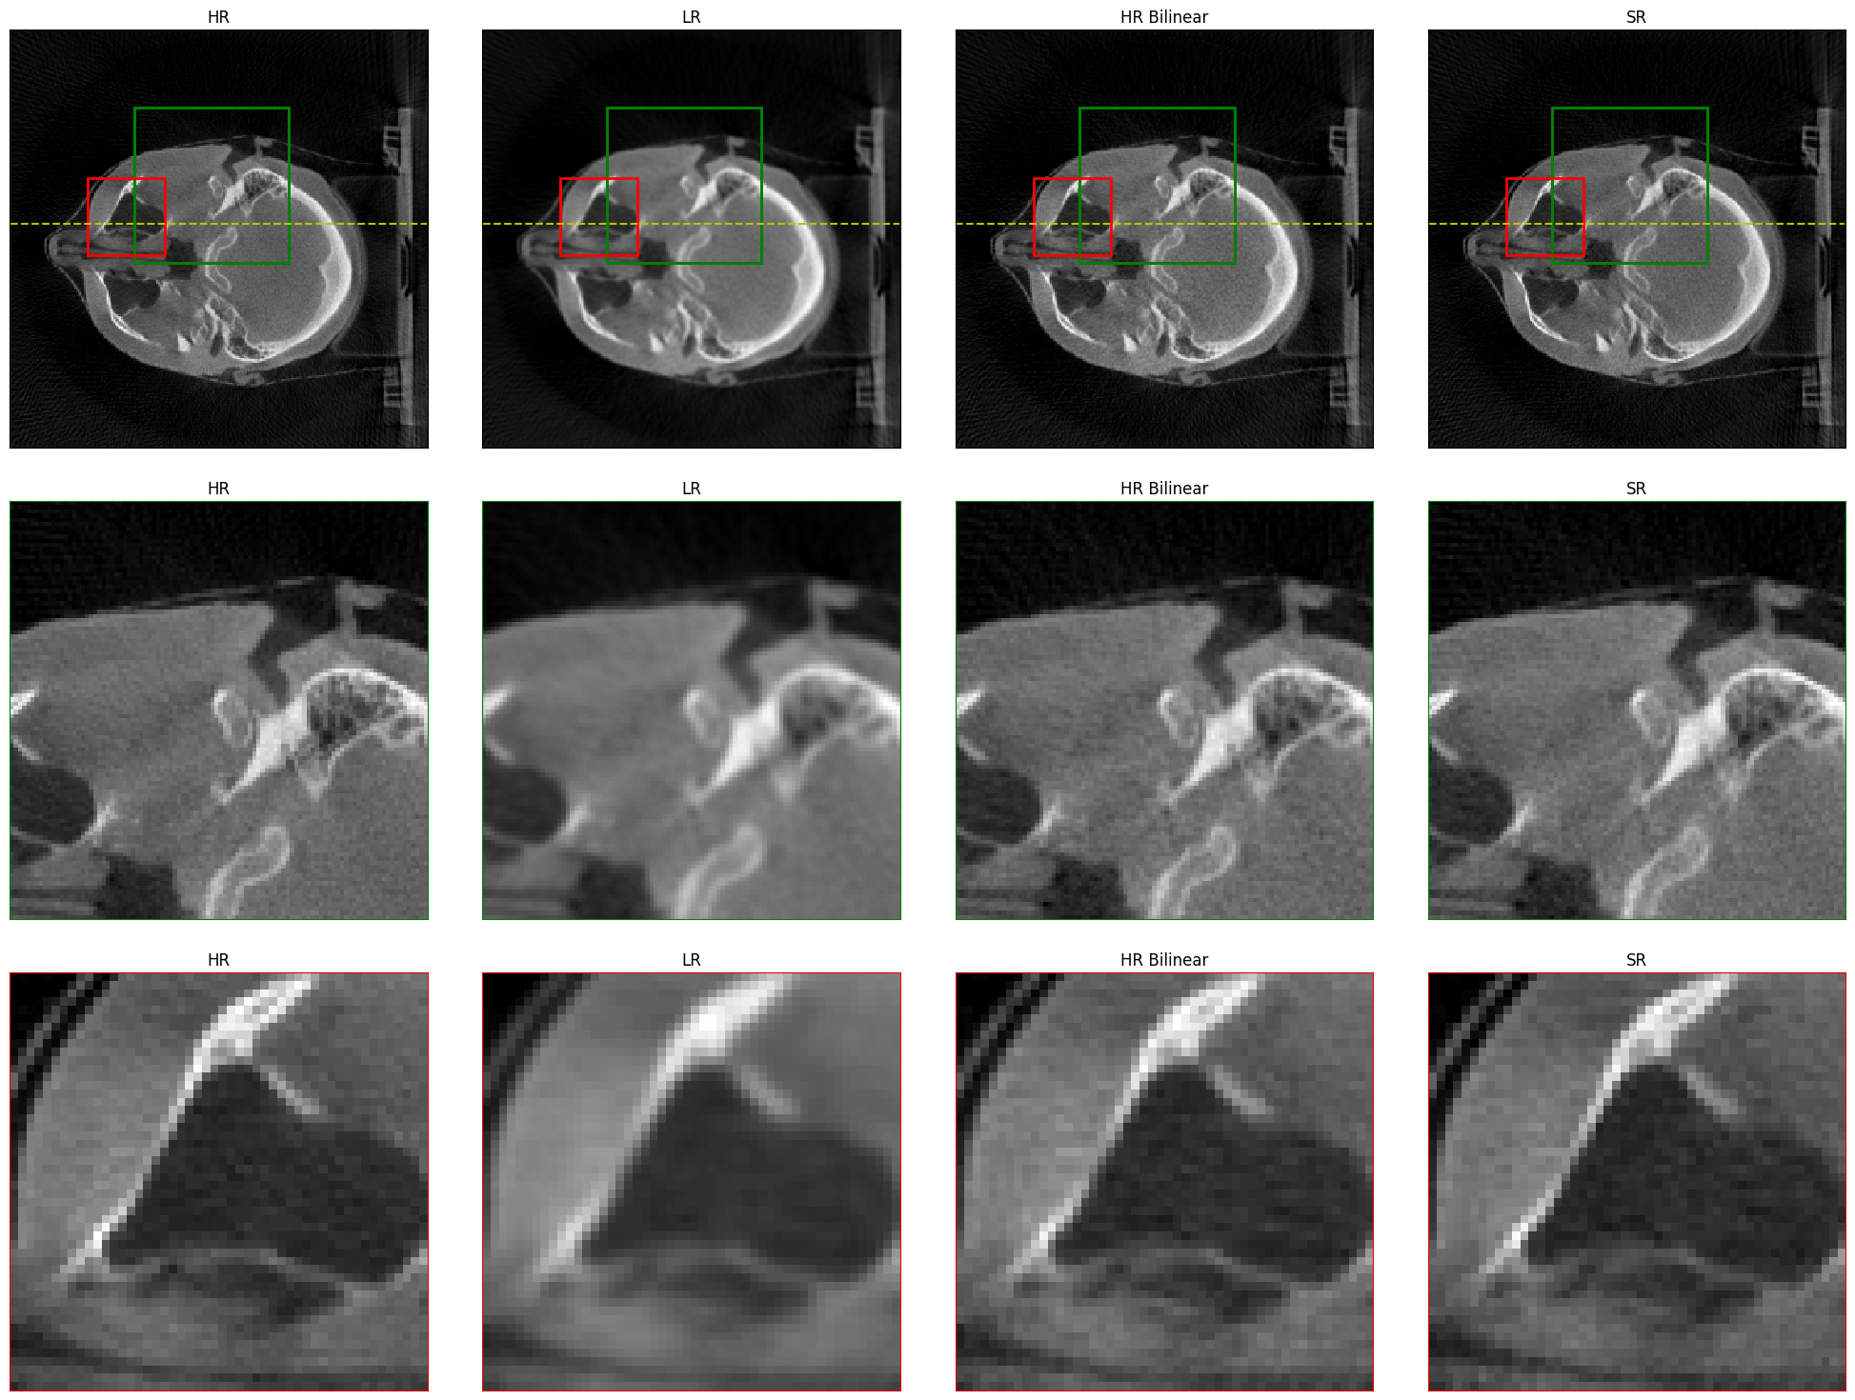
CBCT dose reduction
Projection super-resolution
Dose reduction by binning flat-panel detector pixels and AI super-resolution
Enhanced super-resolution GAN (ESRGAN)
  Generator and discriminator
  Adversarial, pixel and perceptual loss
  3000 H&N CBCTs with 600,000 projections
  Simulated binning of 2x2 pixels
  Measured dose reduction: 3x
  Promising initial results after
  image reconstruction
Song et al., Heliyon
Input: Low-res simulated
High-res
Output: High-res ground truth
Low-res
Super-res
Thummerer et al., in preparation

Slide 9
AI applications in adaptive image-guided radiotherapy
Outline
In-room CBCT
Treatment optimization
Treatment
Treatment
Baseline treatment planning
Follow up
In-room MRI
Treatment optimization
Treatment
Outcome prediction
Synthetic CT generation
Automatic segmentation
Dose calculation
Motion tracking and prediction

Slide 10
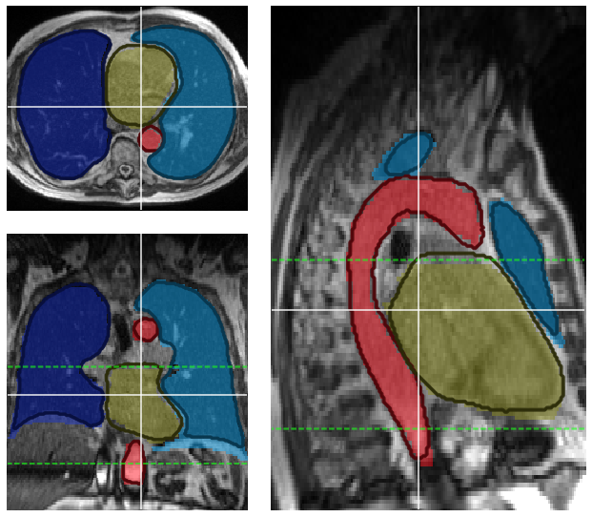
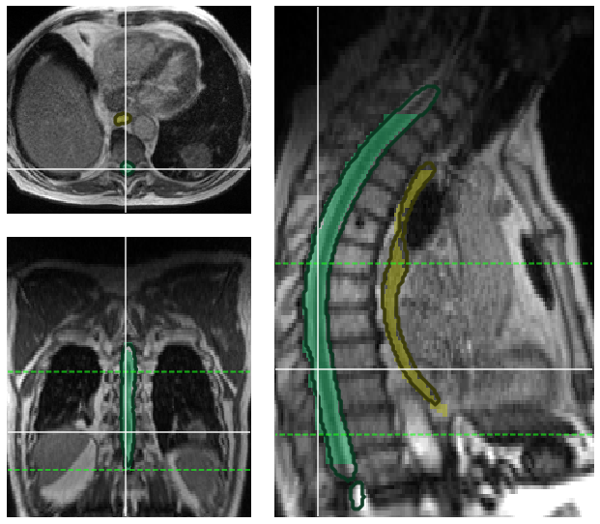
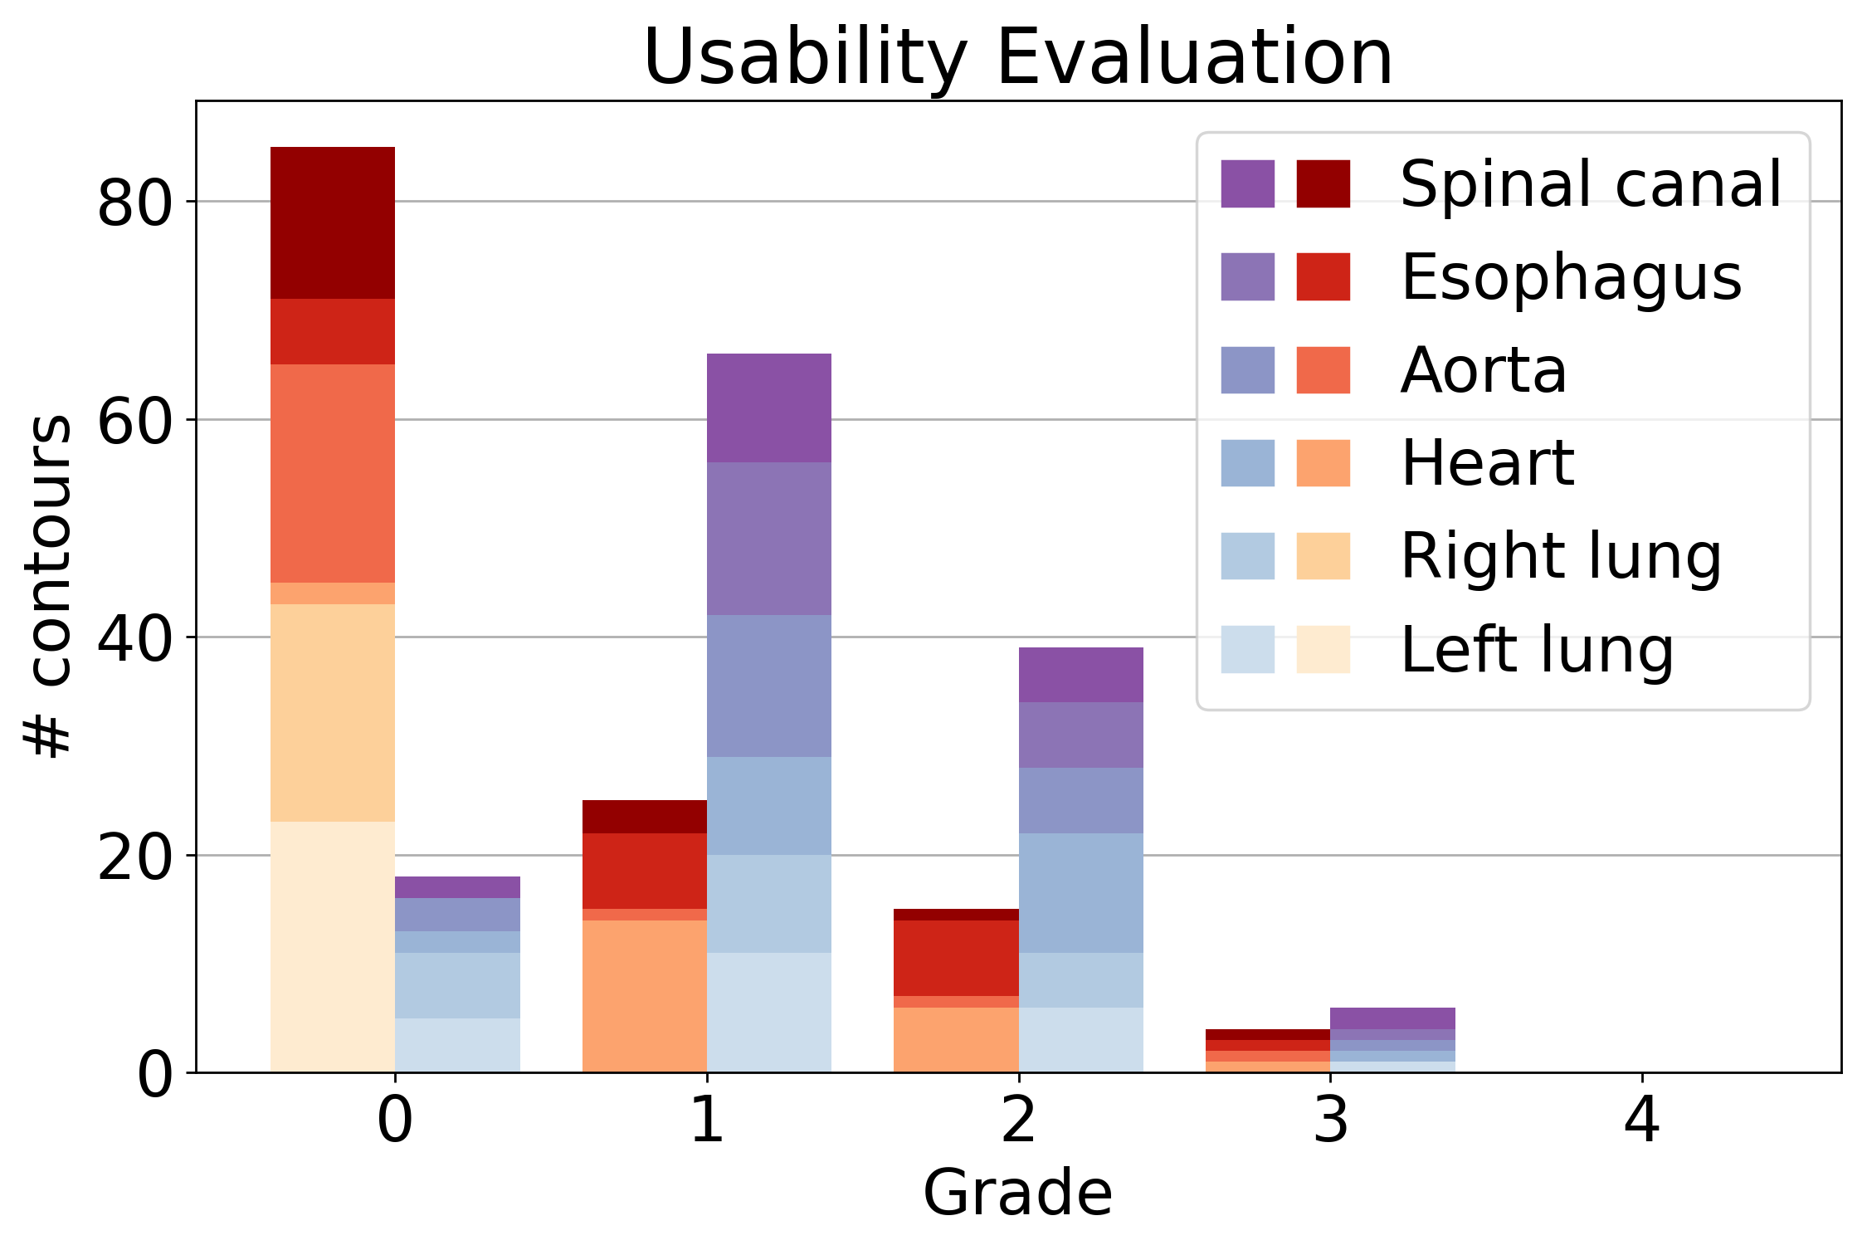
Automatic segmentation
MR-guided RT
Manual contouring suffers from
  inter- and intra-observer variability
  high expenditure of time
Deep learning auto-segmentation promising
  3D U-Net (DSC loss) trained for organs-at-risk
  segmentation using 80 lung cancer patients
  Evaluation on 23 unseen patients
  High DSC and Hausdorff accuracy
  Preferred by MD over clinical contours
  Clinical OARs segmentation time
  reduced from 33 min to 13 min
DL prediction
Clinical
Ribeiro et al., 2023, Radiat Oncol
No correction unusable

Slide 11
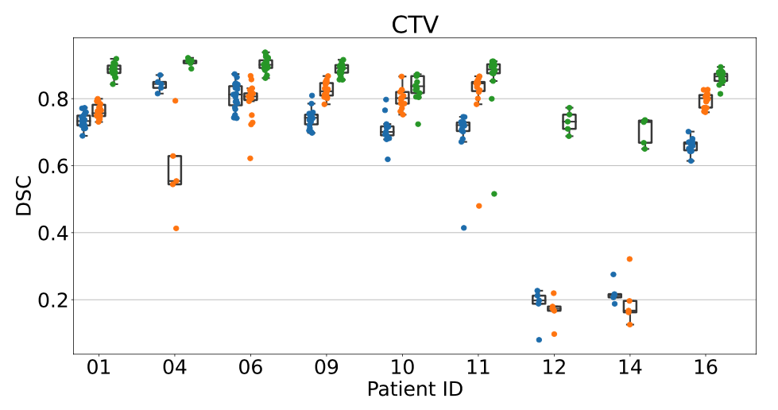
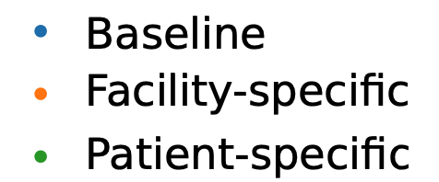
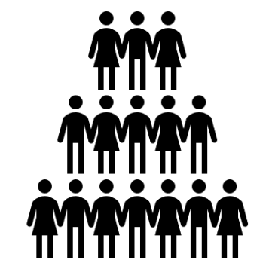
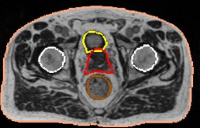
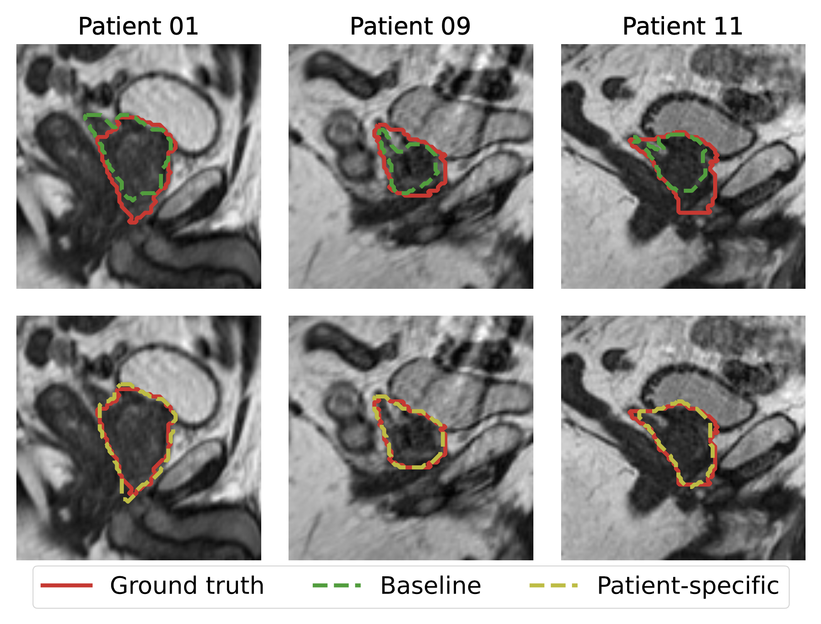
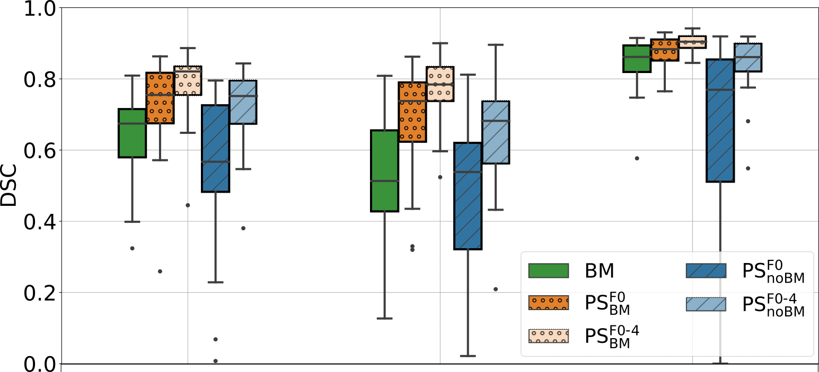
Automatic segmentation
Patient-specific models for adaptive MR-guided RT
Especially during online plan adaptation,
time for in-room MRI recontouring critical
  Exploit prior expert knowledge from planning
  for accurate fraction MRI auto-segmentation
  Improvements especially for prostate CTV
  No-baseline model trained on single patient
  Continuously updated models feasible
  Best: updated patient-specific models with BM
Fxs MRI
Train
Base
line
model
Finetune
Patientspecific model
Kawula et al., 2023, Med Phys
Plan. MRI
Intestines
Duodenum
Stomach

Slide 12
AI applications in adaptive image-guided radiotherapy
Outline
In-room CBCT
Treatment optimization
Treatment
Treatment
Baseline treatment planning
Follow up
In-room MRI
Treatment optimization
Treatment
Outcome prediction
Synthetic CT generation
Automatic segmentation
Dose calculation
Motion tracking and prediction

Slide 13
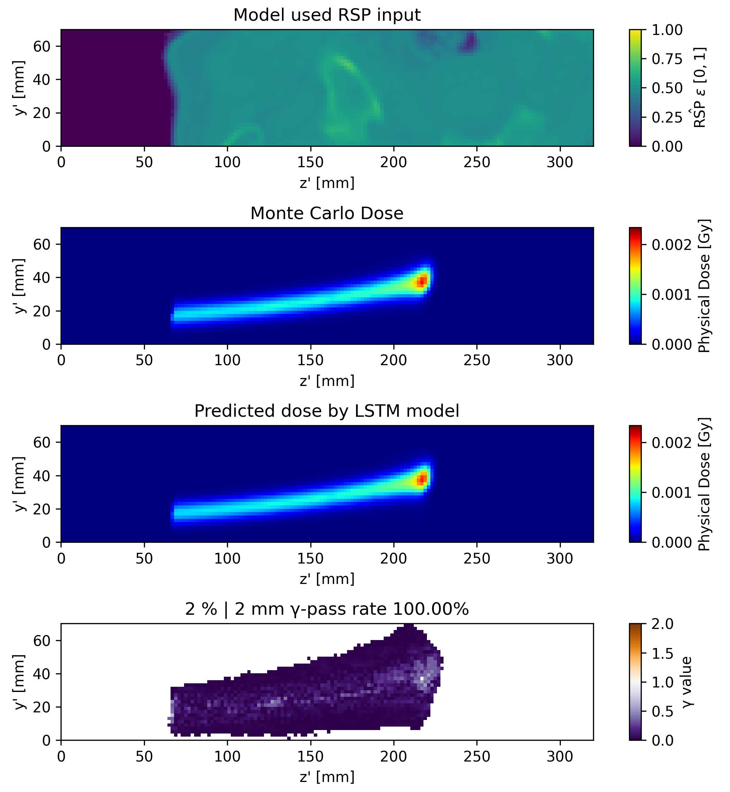
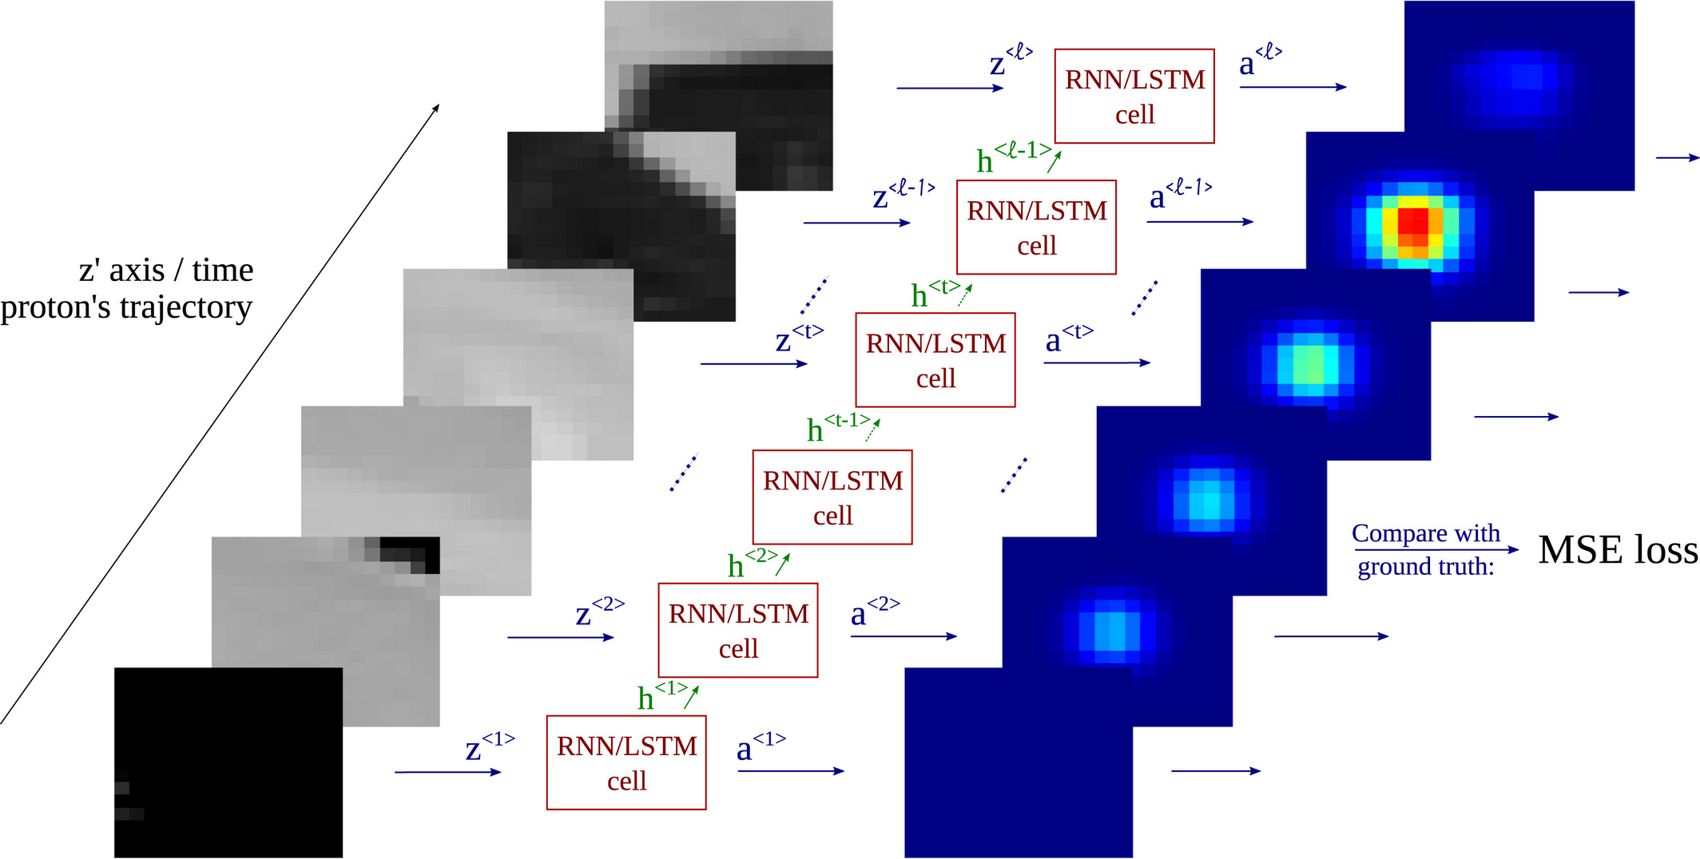
Dose estimation for MR-guided proton therapy
Long short-term memory networks
LSTMs employed for fast and accurate proton
dose calculation in B-fields
  Input: Beam’s eye view (BEV) sequence of CT
  Output: BEV sequence of proton dose
  Trained using Geant4 MC calculation
  High accuracy
  Milliseconds execution time per pencil-beam
  One model per energy
  Can also be used for prompt-gamma and
  beta-emitter estimation
Neishabouri et al., 2021, Med Phys
Radonic et al., 2023, Ion Imaging Workshop

Slide 14
AI applications in adaptive image-guided radiotherapy
Outline
In-room CBCT
Treatment optimization
Treatment
Treatment
Baseline treatment planning
Follow up
In-room MRI
Treatment optimization
Treatment
Outcome prediction
Synthetic CT generation
Automatic segmentation
Dose calculation
Motion tracking and prediction

Slide 15
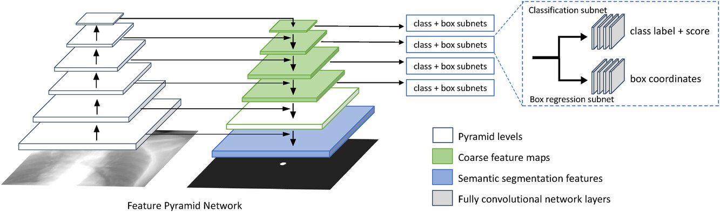
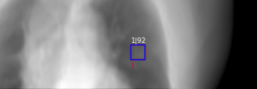
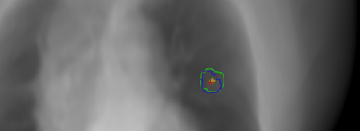
Motion tracking and prediction
CBCT/X-Ray-guided radiotherapy
Intra-fractional motion management requires real-time target localization
CNNs capable of marker-less lung
tumor tracking on X-Ray fluoroscopy
Combined localization/segmentation
network: Retina U-Net
  Bottom-levels extract bounding boxes
  High-level output is semantic segmentation
  Prior knowledge from planning (CT
  and delineation) can be employed
  for patient-specific models
Huang et al., 2023, Med Phys

Slide 16
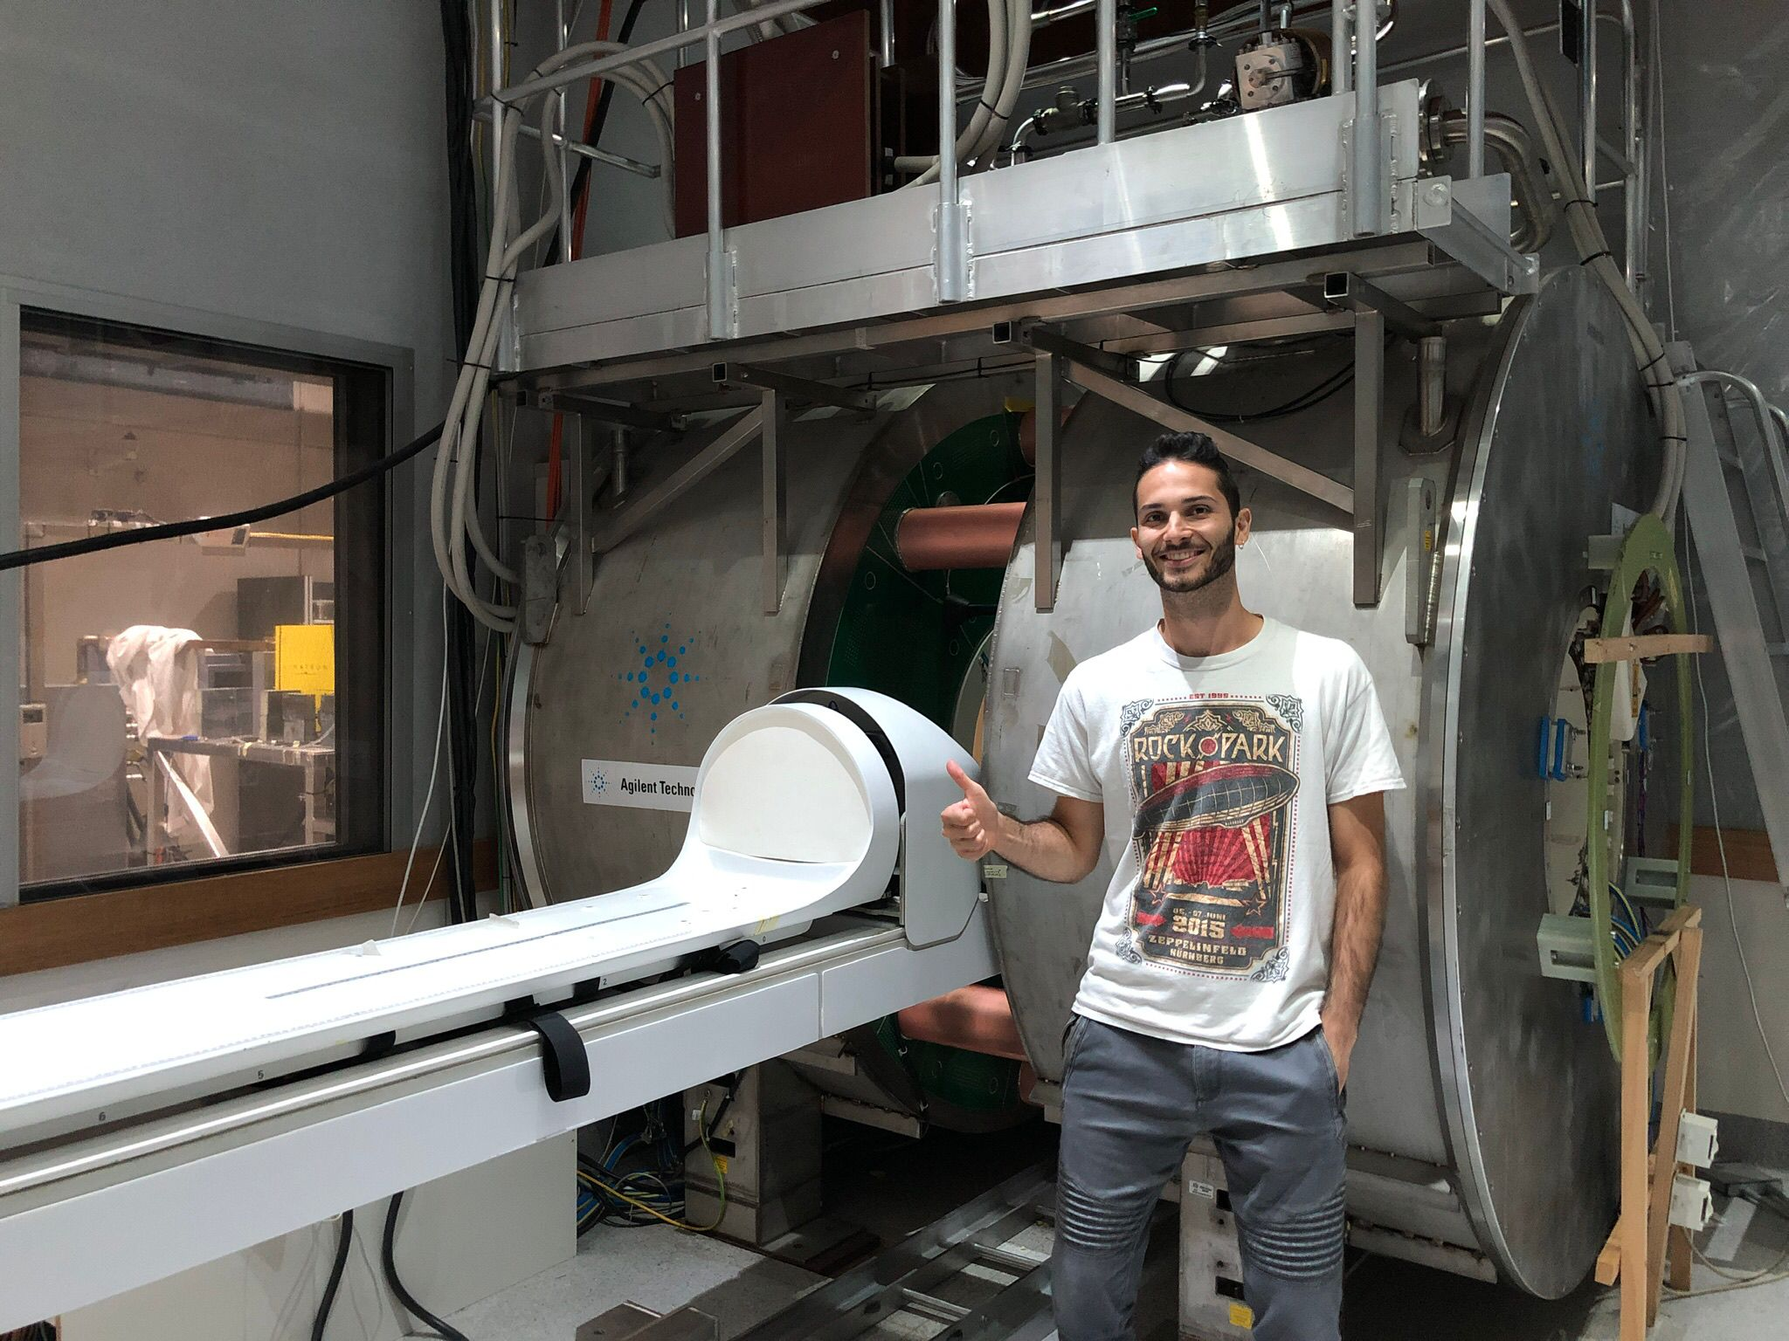
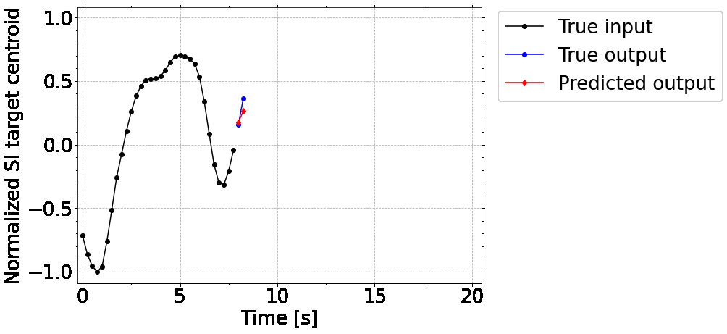
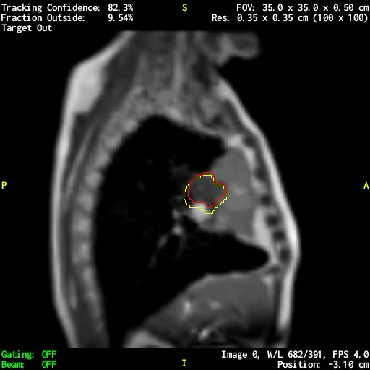
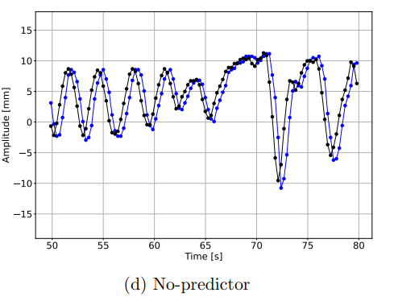



Motion tracking and prediction
Target motion prediction
Especially for beam tracking, system latencies ($\sim$300 ms) must be overcome
Future motion trajectory needs to be predicted
LSTM for tumor centroid prediction on
cine-MRI data
  Extension to 2D target shape
  via convolutional LSTM
  Sub-voxel accuracy at 500ms
  Implemented at Australian
  MR-Linac prototype
    390 ms prediction
    COM error: 4.4 mm → 2.8 mm
Lombardo et al.,
2022, PMB
2023, Radiother Oncol
2023, Med Phys
No predictor
LSTM

Slide 17
AI applications in image-guided radiotherapy
Conclusions and outlook
AI applications in image-guided adaptive radiotherapy are manifold
  Outcome prediction
  Synthetic CT generation and imaging dose reduction
  Auto-segmentation
  Dose calculation
  Motion tracking and prediction
Auto-segmentation is entering clinical practice
Area of AI is developing at light-speed (transformer, diffusion and
large foundation models, …)

Slide 18







Acknowledgements
LMU University Hospital
  Guillaume Landry
  Ahmad Ahmadi
  Sebastian Neppl
  Florian Kamp
  Domagoj Radonic
  Moritz Rabe
  Yiling Wang
  Maria Kawula
  Marvin Ribeiro
  Elia Lombardo
  Ivy Chan
  Lili Huang
  Adrian Thummerer
  Kristian Unger
  Stefanie Corradini
  Sebastian Marschner
  Claus Belka
LMU Physics
  Marco Riboldi
  Katia Parodi
  Goerge Dedes
Gemelli Rome
  Luca Boldrini
  Davide Cusumano
  Lorenzo Placidi
UMC Utrecht
  Nico van den Berg
  Matteo Maspero
Aarhus University:
  David Hansen
University of Sydney:
  Paul Keall
Thank
you!

