Slide 1
Uncertainty quantification in tumor segmentation using Bayesian Neural Networks
INSIGHTS WORKSHOP
Pisa, 18-20 October 2023
Elisa Scalco, Ettore Lanzarone, Giovanna Rizzo
Institute of Biomedical Technologies, National Research Council (ITB-CNR)
Department of Production & Management, University of Bergamo

Slide 2
Outline of the presentation
1 – DL for image segmentation in RT
2 - Uncertainty quantification in image segmentation using Bayesian CNNs
3 - Practicle example of uncertainty quantification for renal cancer
4 – Other applications in RT

Slide 3
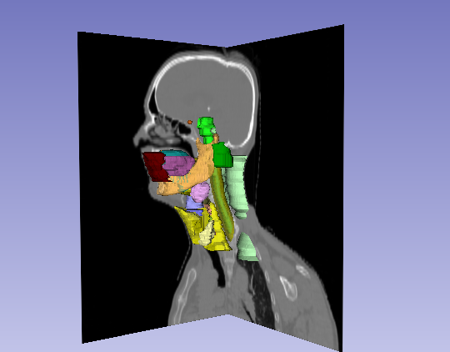
Organ Segmentation in RT
1 – DL for image segmentation in RT
2
4
3
Segmentation of tumor and organs at risk (OARs) is necessary for treatment planning and monitoring
- time-consuming task
- subject to inter-observer variability
Needs for accurate and trustable automatic segmentation procedures

Slide 4
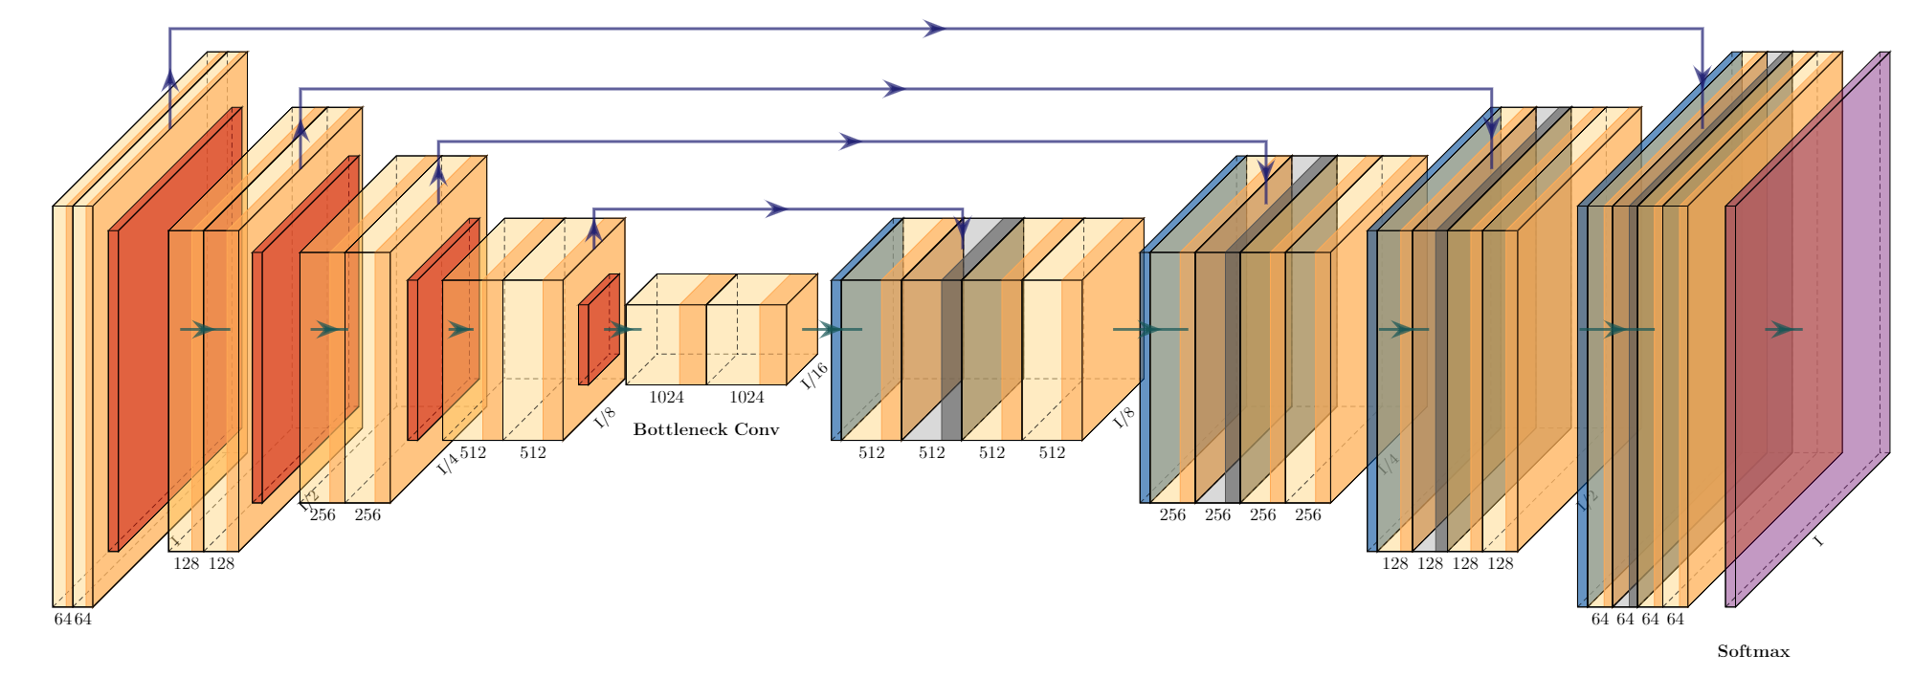
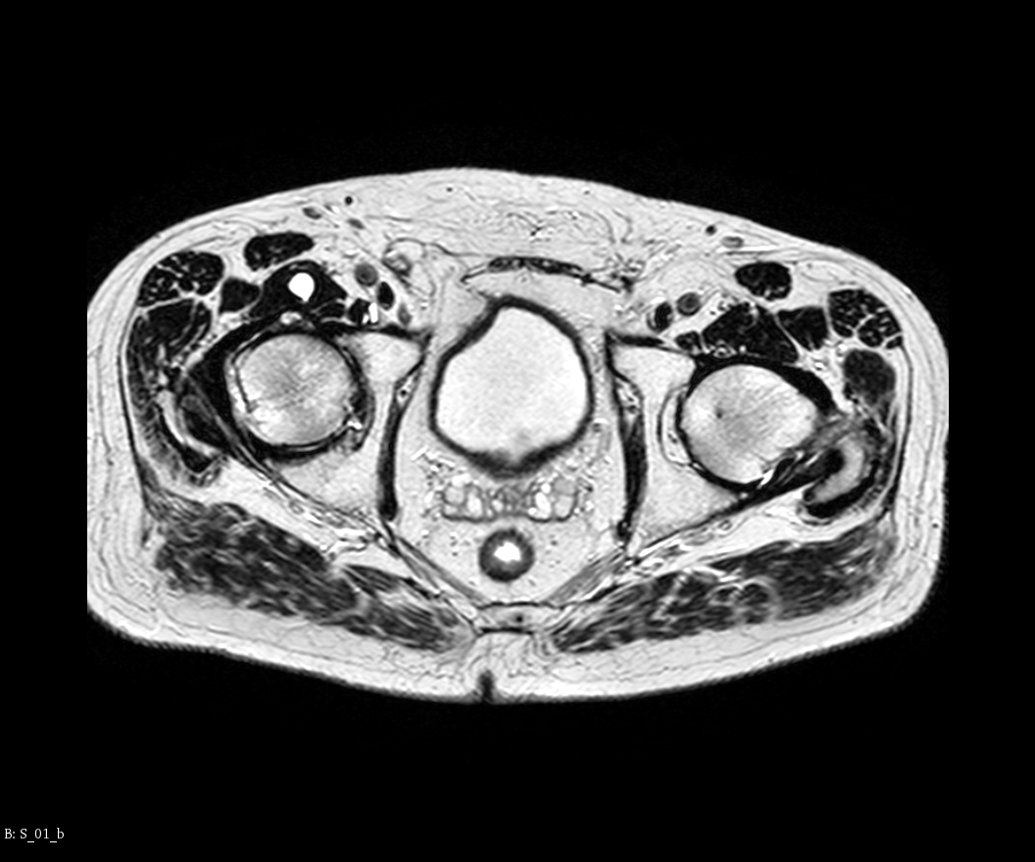
Deep Learning for medical image segmentation
1 – DL for image segmentation in RT
2
4
3
Higher accuracy than traditional approaches
Almost completely automatic
Fast (once the model is trained)
No needs of very large datasets (compared to other DL tasks)
Errors with out of distribution data
Overconfident predictions
Low trustability

Slide 5
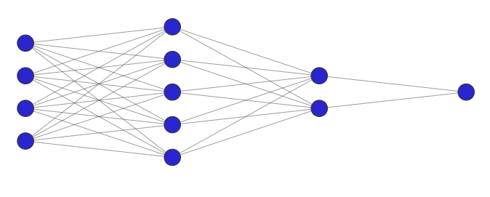
Types of uncertainty
1
4
3
2 - Uncertainty quantification in image segmentation using Bayesian CNNs
Aleatoric uncertainty
Reflects inherent randomness or variability in the data itself
Epistemic uncertainty
Arises from lack of knowledge or uncertainty about the model parameters
Not sure if it is 1 or 7
Not sure if it is 8
Overlap between the two classes.
It can’t be removed.
Image that it is not present in the training data
Epistemic uncertainty could be reduced by giving more examples in the training data

Slide 6
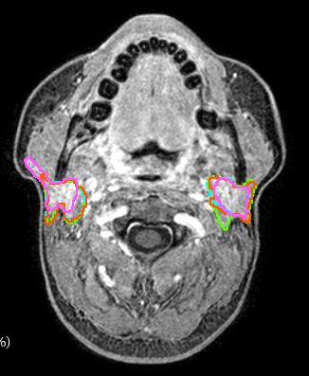
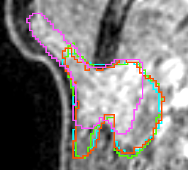
Sources of uncertainty in image segmentation
1
4
3
2 - Uncertainty quantification in image segmentation using Bayesian CNNs
Ambiguity in object boundaries
Overlap between classes
Variability in image quality or noise levels
Mismatch between test and training data
Different segmentations of the same object

Slide 7
Uncertainty quantification techniques
1
4
3
2 - Uncertainty quantification in image segmentation using Bayesian CNNs
Bayesian approaches
Ensemble techniques
Monte Carlo Dropout
Variational Inference
Bootstrap techniques
Markov Chain Monte Carlo
Variational autoencoder
Bayes by Backprop
Model calibration
Bayesian active learning
Laplacian approximations

Slide 8
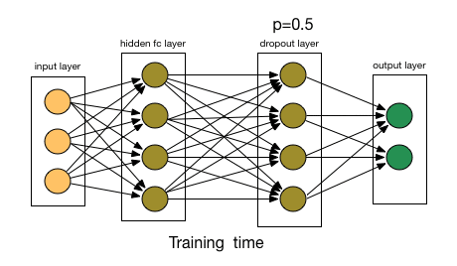
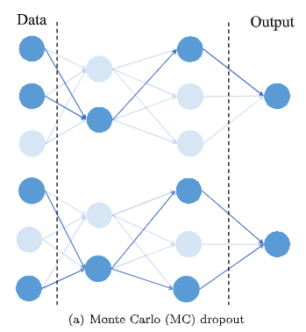
Monte carlo dropout
1
4
3
2 - Uncertainty quantification in image segmentation using Bayesian CNNs
Keeping dropout acrtive during inference integrates randomness in the model
The model gives different predictions for the same input if repeated N times, leaving as a result a distribution of the output predictions

Slide 9
Monte carlo dropout
1
4
3
2 - Uncertainty quantification in image segmentation using Bayesian CNNs
Advantages:
straightforward to implement
requires little additional knowledge or modeling effort compared to traditional methods
It often leads to a faster training phase compared to other variational inference approaches.
Able to quantify both aleatoric and epistemic uncertainty
Limitations:
Not very reliable for Out of Distribution data
Needs multiple sampling during inference
It lacks flexibility compared to other Bayesian methods for online or active learning

Slide 10
Uncertainty quantification for renal cancer segmentation
1
3 - Practicle example of uncertainty quantification for renal cancer
2
4
Practicle example

Slide 11
Motivation and background
1
3 - Practicle example of uncertainty quantification for renal cancer
2
4
Renal cancer (RC) is the eighth more frequent cancer in Europe.
Contrast-enhanced CT imaging is the preferred imaging technique for the diagnosis of kidney cancer, where enhancing solid masses are more likely to be RC.
The identification of tumor and surrounding structures, manually performed by expert radiologists, is a time-consuming task, subject to intra- and inter-variability.
Image segmentation based on deep learning (DL) approach is currently the most adopted technique that has shown high accuracy in several medical imaging applications.
Uncertainty quantification plays a relevant role in DL settings, trying to represent uncertainties in a trustworthy manner. Bayesian Neural Networks (BNNs) can be used to address this issue.

Slide 12
Aim
1
3 - Practicle example of uncertainty quantification for renal cancer
2
4
To assess whether the uncertainties quantified by a BCNN can give effective alerts about the trustiness and correctness of the segmentations provided for different kidney and RC-related structures from CT images
To compare the risk propensity between two Monte Carlo-based BCNN (Monte Carlo Dropout and Monte Carlo DropConnect), which is a key aspect when these approaches are applied in practice and also relevant for human operators.

Slide 13
MCD and MCDC
1
3 - Practicle example of uncertainty quantification for renal cancer
2
4
Two Monte-Carlo Dropout approaches considered:
MC Dropout (BDR): neurons are randomly dropped out
MC DropConnect (BDC): weights are randomly dropped out
MC Dropout
MC DropConnect
$$r=m∙a\left(Wv\right)$$
$$r=a\left(\left(M∗W\right)v\right)$$

Slide 14
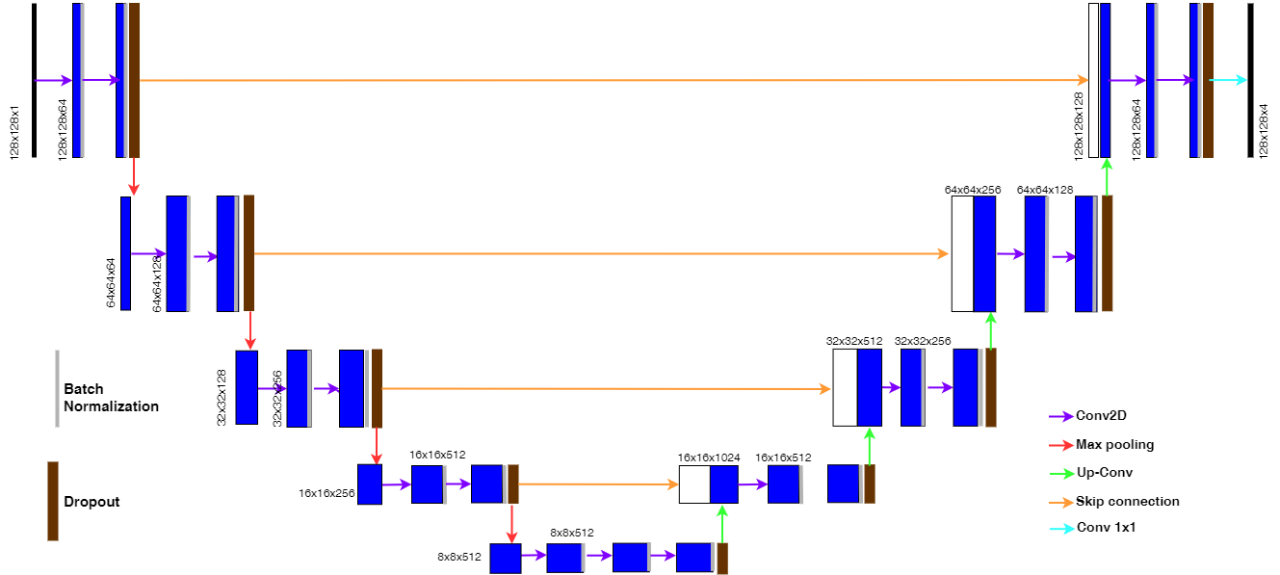
CNN architecture and training
1
3 - Practicle example of uncertainty quantification for renal cancer
2
4
2D Unet with Vgg16 as backbone encoder
Data augmentation | Rotation, width and heigth shift, x-axis shear, zoom
Loss function | Multi-class Weighted Dice
Metrics | Single class Dice
N. Epochs | 100 (BDR) – 125 (BDC)
Dropout rate | 0.30 (BDR) – 0.5 (BDC)
Batch size | 16
Optimizer | Adam [lr 10⁻⁴]
N. Of MC sampling | 10

Slide 15
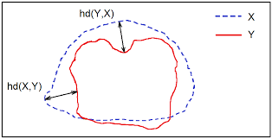
Accuracy evaluation
1
3 - Practicle example of uncertainty quantification for renal cancer
2
4
Dice:
Average Symmetric Distance
$$ASD = \frac{1}{{\left|B\right.}_{p}\left| + \right|\left.B_{g}\right|} × \left(\sum_{x∈B_{p}}{hd(x, B_{g})}+ \sum_{y∈B_{g}}{hd(y, B_{p})}\right)$$

Slide 16
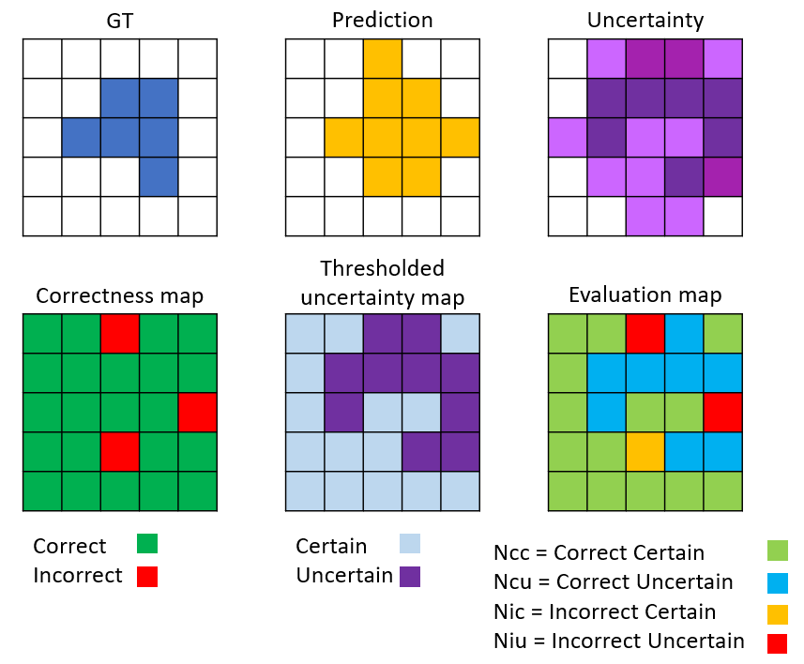
Uncertainty quantification and evaluation
1
3 - Practicle example of uncertainty quantification for renal cancer
2
4
$$Rcc=\frac{Ncc}{Ncc+Nic}$$
$$Riu=\frac{Niu}{Niu+Nic}$$
$$UA=\frac{Ncc+Niu}{Ncc+Niu+Nic+Ncu}$$

Slide 17
Dataset
1
3 - Practicle example of uncertainty quantification for renal cancer
2
4
The public Kits2021 dataset was considered, with 300 CT annotated images available. For each CT volume, manual segmentation of kidneys, renal tumor and cysts (when present) were available as ground truth.
Images were pre-processed (resampling, contrast enhancing and intensity standardization) before training.
20% of the patients were randomly extracted and included in the test set. A random split of the slices for each patient included in the learning phase was performed, with ratio 80% in the training set and 20% in the validation set.

Slide 18
Experimental design
1
3 - Practicle example of uncertainty quantification for renal cancer
2
4
Comparison between BCNN approaches (BDR and BDC) and deterministic network
Accuracy and uncertainty evaluation on the test set

Slide 19
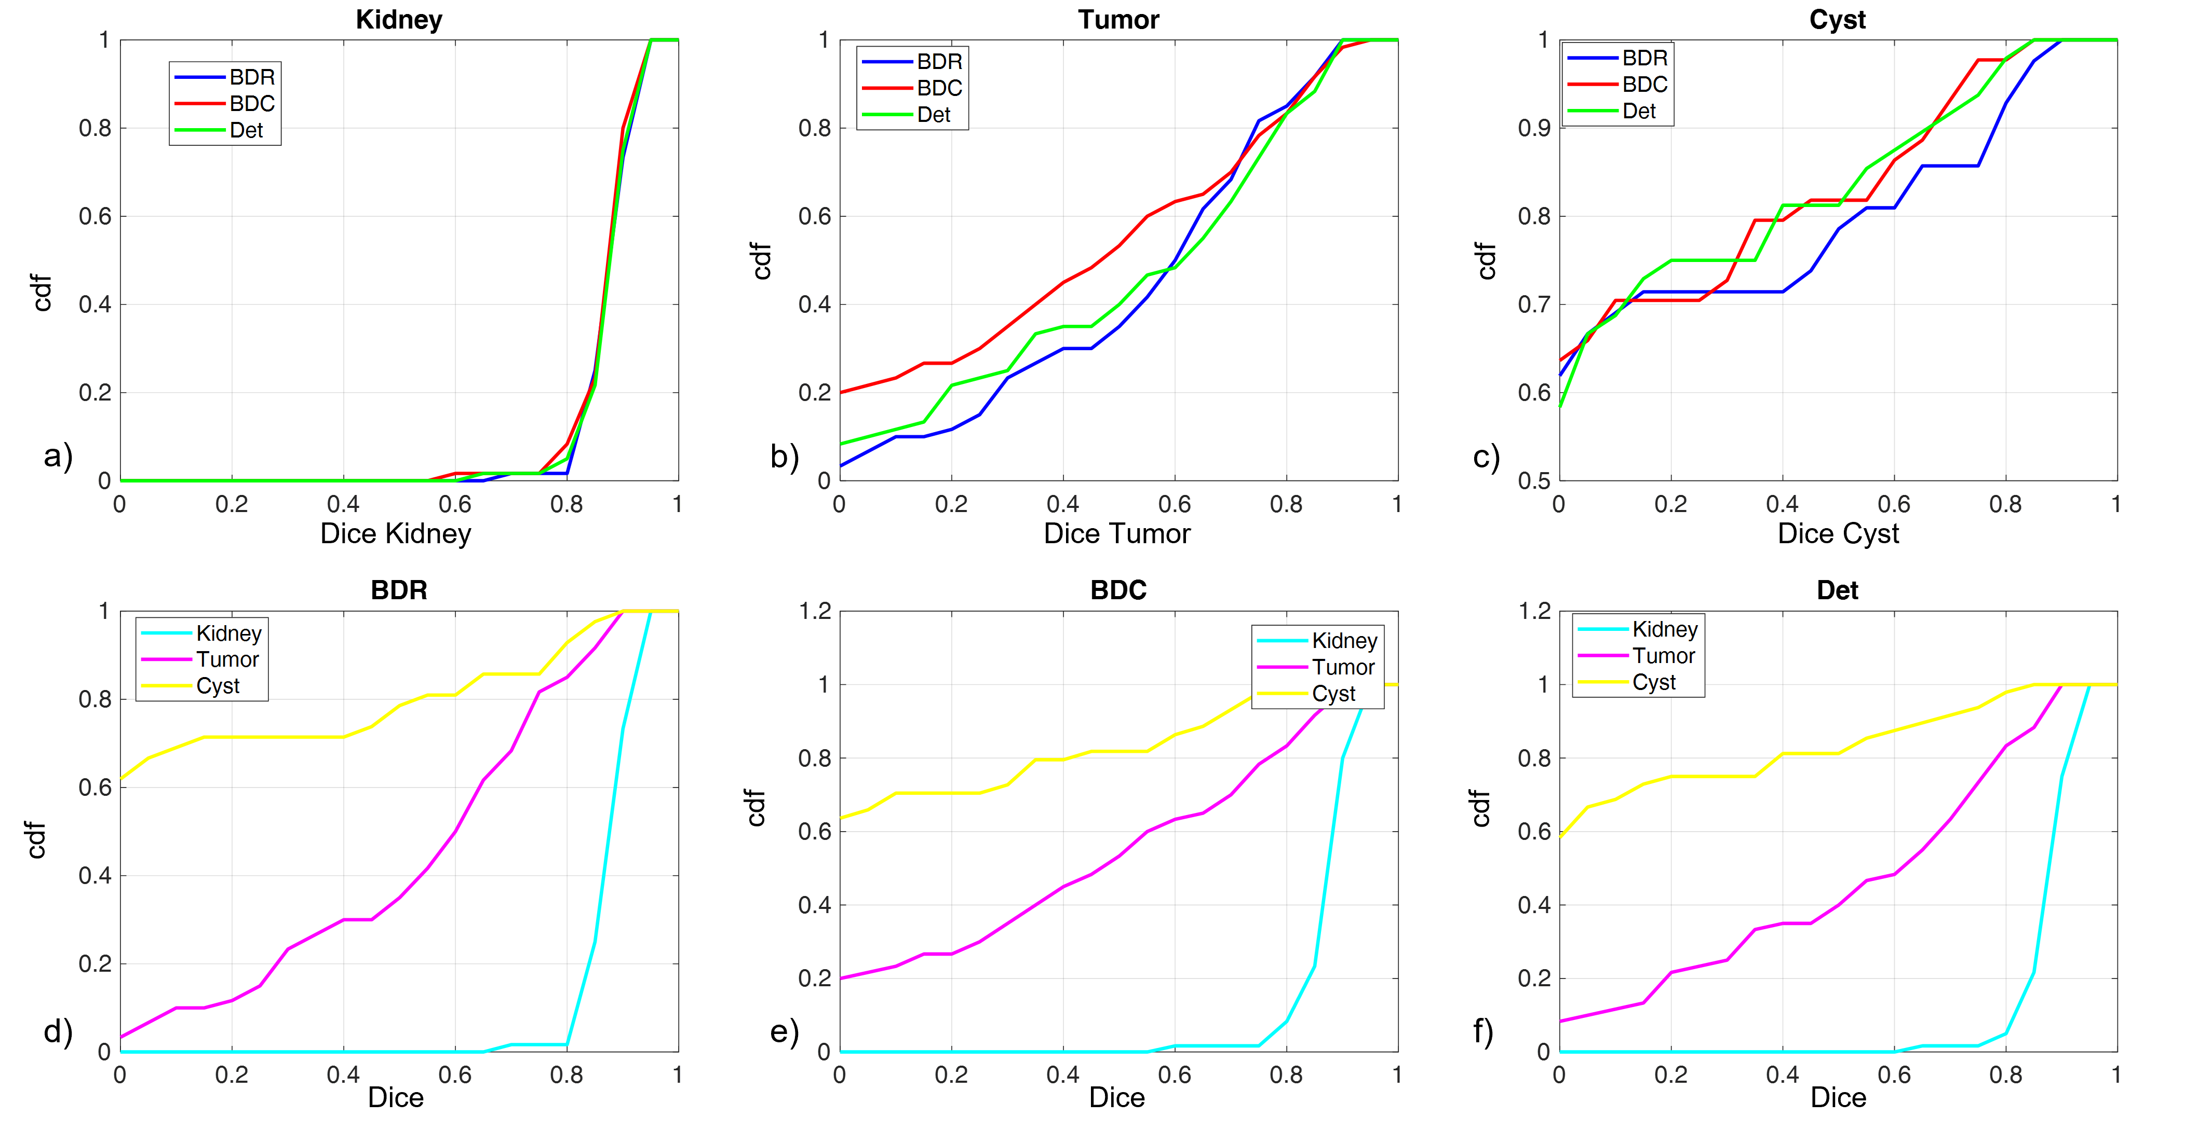
Results - accuracy
1
3 - Practicle example of uncertainty quantification for renal cancer
2
4
 |  | BDR |  | BDC |  | Det
Metric | Structure | mean | std | mean | std | mean | std | p-value
Dice | Kidney | 0.92 | 0.04 | 0.92 | 0.05 | 0.92 | 0.05 | 0.74
 | Tumor | 0.58 | 0.26 | 0.48 | 0.32 | 0.57 | 0.29 | 0.14
 | cyst | 0.22 | 0.33 | 0.19 | 0.29 | 0.18 | 0.28 | 0.86
 | total | 0.94 | 0.06 | 0.94 | 0.06 | 0.94 | 0.04 | 0.98
 | mass | 0.62 | 0.25 | 0.54 | 0.32 | 0.60 | 0.28 | 0.27
ASD [mm] | Kidney | 1.55 | 1.07 | 1.62 | 1.09 | 1.57 | 0.96 | 0.93
 | Tumor | 11.82 | 12.97 | 12.58 | 24.46 | 11.87 | 16.06 | 0.97
 | cyst | 23.85 | 38.98 | 19.29 | 19.81 | 15.59 | 16.42 | 0.58
 | total | 1.41 | 1.10 | 1.38 | 1.00 | 1.99 | 2.58 | 0.10
 | mass | 9.74 | 10.17 | 11.28 | 24.17 | 11.00 | 16.29 | 0.88

Slide 20
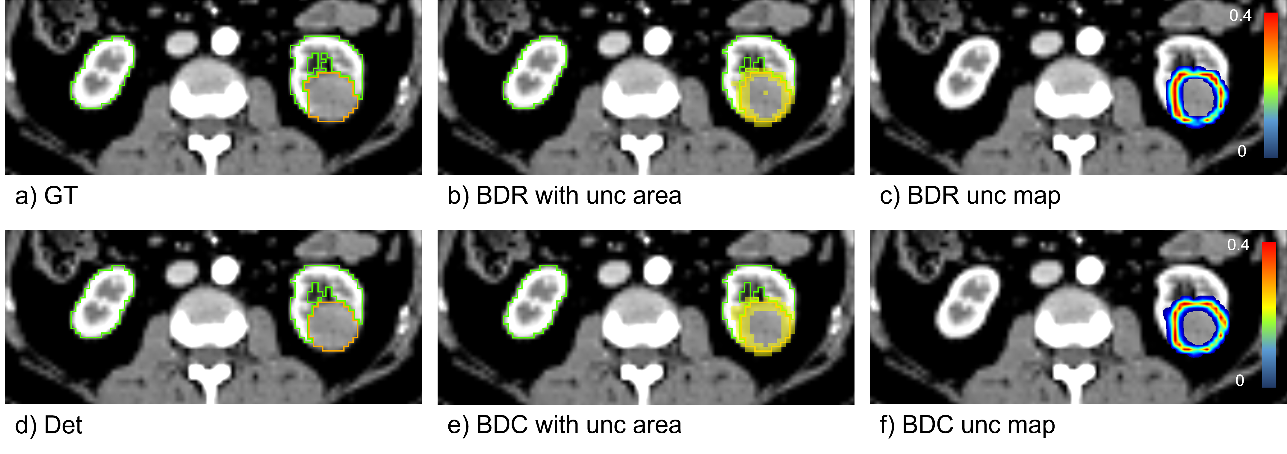
Results
1
3 - Practicle example of uncertainty quantification for renal cancer
2
4

Slide 21
Results
1
3 - Practicle example of uncertainty quantification for renal cancer
2
4

Slide 22
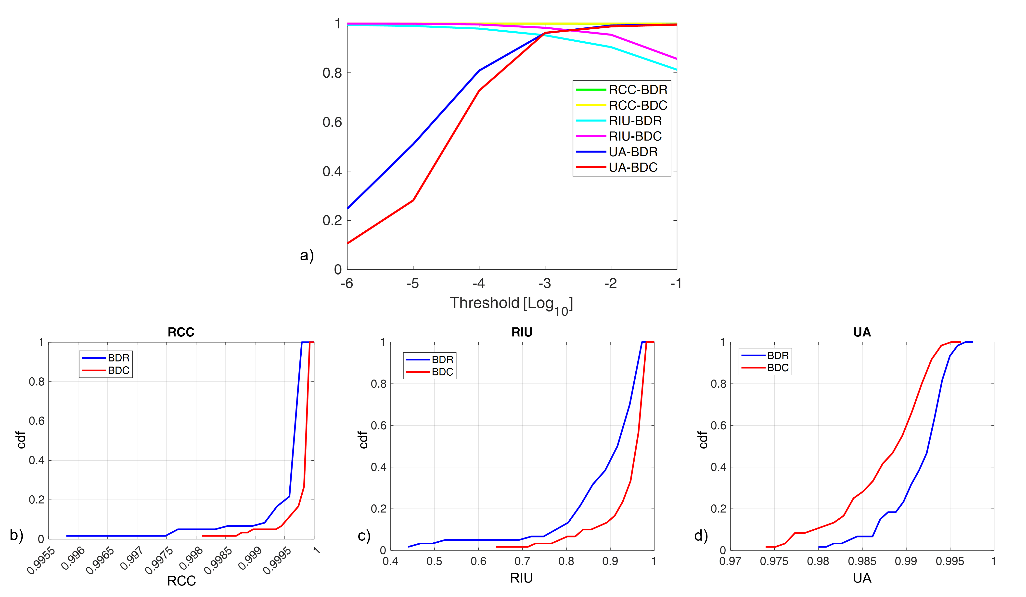
Results - uncertainty
1
3 - Practicle example of uncertainty quantification for renal cancer
2
4
 |  | BDR |  | BDC
Metric |  | mean | std | mean | std | p-value
Uncertainty |  | 4.62E-04 | 2.32E-04 | 5.31E-04 | 2.64E-04 | 2.66E-12
Epistemic |  | 2.91E-05 | 2.14E-05 | 4.81E-05 | 4.80E-05 | 2.14E-05
Aleatoric |  | 4.33E-04 | 2.13E-04 | 4.83E-04 | 2.27E-04 | 4.60E-15
RCC (th = 0.001) |  | 0.9998 | 0.0005 | 0.9999 | 0.0002 | 2.70E-02
RIU (th = 0.001) |  | 0.9523 | 0.0853 | 0.9830 | 0.0369 | 1.46E-04
UA (th = 0.001) |  | 0.9616 | 0.0086 | 0.9626 | 0.0124 | 2.48E-01
RCC (th = 0.01) |  | 0.9997 | 0.0007 | 0.9999 | 0.0003 | 1.07E-02
RIU (th = 0.01) |  | 0.9042 | 0.1122 | 0.9546 | 0.0678 | 1.76E-07
UA (th = 0.01) |  | 0.9922 | 0.0035 | 0.9885 | 0.0050 | 1.04E-19

Slide 23
Benefits and limitations
1
3 - Practicle example of uncertainty quantification for renal cancer
2
4
Benefits:
BCNNs can provide useful information about uncertainty in image segmentation
Uncertainty is maximized for incorrect pixels
In case of varying levels of difficulties, such as the segmentation of small structures like the renal tumor, or poorly represented organs like the cysts, uncertainty maps offer a reliable instrument to give prediction confidence and to set an alert in case of possible errors
BDR and BDC gives different levels of risk propensity (BDC more conservative, BDR more risk-taking)
Limitations:
Suboptimal accuracy for poorly represented structures (especially cyst)
Overconfidence of segmentation prediction for highly unbalanced dataset

Slide 24
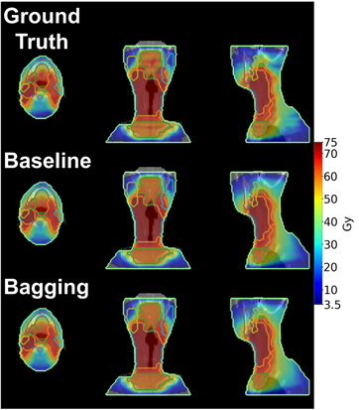
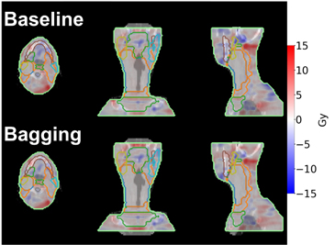
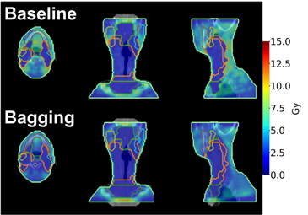
Other applications in rt
1
3
2
4 - Other applications in RT
Uncertainty quantification in dose prediction [Nguyen et al., 2021, Phys Med Biol, doi: 10.1088/1361-6560/abe04f]
High uncertainty regions correspond to regions with higher errors in dose prediction
Predicted dose
Error in dose prediction
Uncertainty in dose prediction

Slide 25
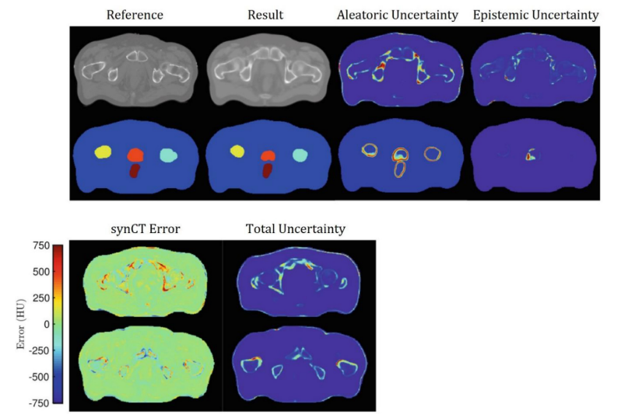
Other applications in rt
1
3
2
4 - Other applications in RT
Synthetic CT generation [Bragman et al., 2018, Proc MICCAI, doi: 10.1007/978-3-030-00937-3_1]
Generation of sunthetic CT from MRI + segmentation of OARs
Regions with high prediction errors present higher uncertainty

Slide 26
Conclusions
1
3
2
4 - Other applications in RT
Uncertainty quantification is a powerful tool to increase trustiness in CNN prediction
The key aim is to alert a human operator when the deep learning model performs a prediction with low conﬁdence
BCNN through Monte Carlo Dropout implementation is effective in quantifying uncertainty and can be easily integrated in traditional CNNs
Uncertainty quantification acts differently for segmentations with different levels of difficulty
Uncertainty quantification can be integrated in different RT applications, showing that high uncertainty is related to larger prediction errors

Slide 27
THANKS FOR YOUR ATTENTION!
Contact information:
Elisa Scalco
ITB-CNR
elisa.scalco@cnr.it

