Slide 1
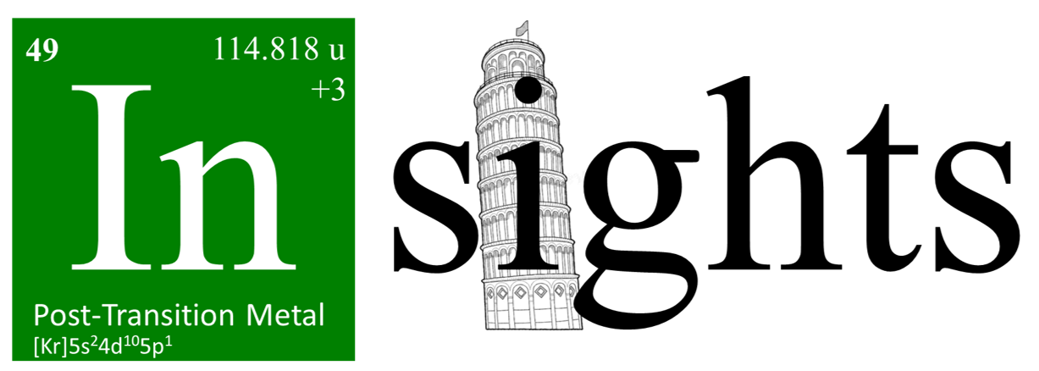
INSIGHTS 2023
—
Estimating the proton stopping power from prompt gamma timing data: algorithms, models, and first experiments
J. F. Werner¹, Veronica Ferrero², Niklas Schmid³, Elisa Fiorina², Davide Bersani⁴, Piergiorgio Cerello², Jona Kasprzak¹, Felix Mas Milan², Marco Pullia⁵, Sahar Ranjbar^{2,6}, Roberto Sacchi⁶, Anna Vignati⁶, Francesco Pennazio², Magdalena Rafecas¹
¹Institute of Medical Engineering, Universität zu Lübeck ³Automatic Control Laboratory (IfA), ETH Zürich ⁵National Center of Oncological Hadrontherapy, Fondazione CNAO, Pavia
²Istituto Nazionale di Fisica Nucleare, Sezione di Torino ⁴Istituto Nazionale di Fisica Nucleare, Sezione di Pisa ⁶Department of Physics, University of Turin

Slide 2
(Charged) particle therapy
Particle beam
A very brief introduction
Bragg peak
Irradiation of tumours with protons, carbon ions, ...
Particles gradually lose energy ↔ stopping power
Dose maximum just before particle has lost all kinetic energy
→ Stopping power is crucial for treatment planning
Lomax AJ. Br J Radiol 2020.

Slide 3
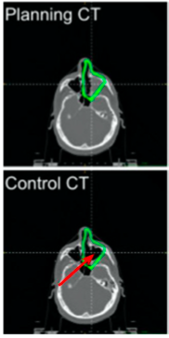
Adaptive treatment and treatment verification
Modified from Fiorina E. et al. Frontiers in Physics 2021
Planning CT
Control CT @ fx 22
Treatment is split into fractions
Changes between fractions can lead to mismatch between planning and execution of treatment
Treatment verification → Need for replanning
We propose:
Estimate the stopping power from measurements during the treatment
Compare stopping power used in planning to measurement
(Re-) planning
Treatment
Indication?

Slide 4
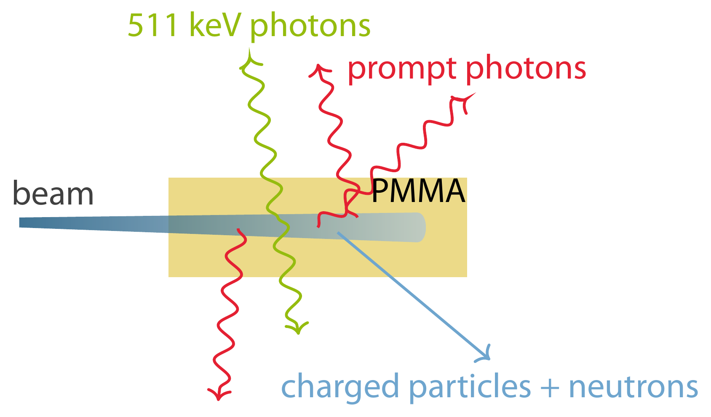
Interaction of charged particles with matter
Inelastic nuclear reactions
Neutrons
Secondary charged particles
$β^{+}$ emission (→ PET)
Prompt Gamma emission
Within < 10 ps
Few keV to several MeV
Prompt gamma radiation

Slide 5
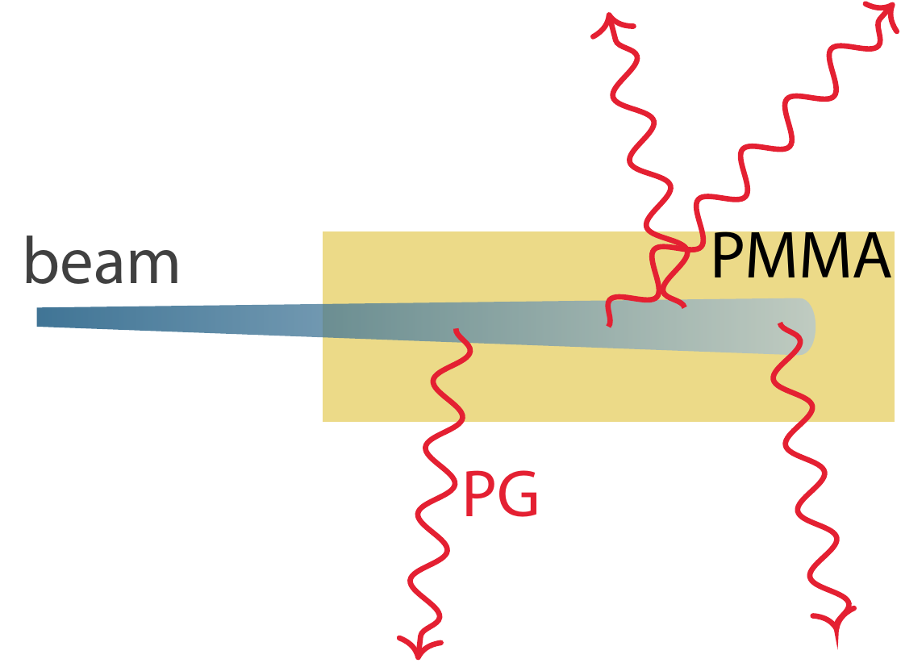
Charged particle therapy
Particle range
Treatment verification with secondary particles
Deviations along the beam path are mostly detected through (cumulative) changes of range
Time-structure of emission holds additional information
End of activation
CTV (clinical target volume)
PG Activation
Patient / Phantom
Young Investigator Forum – DGMP 2023

Slide 6
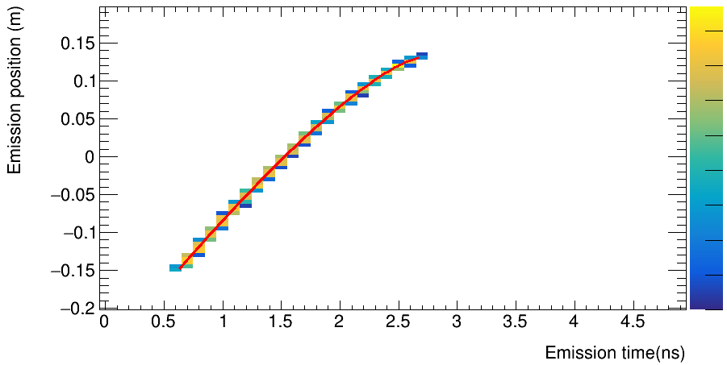
Rationale of the method
1
Red line: expected motion
15
10
5
0
-5
-10
-15
-20
Emission position (cm)
PG-Emission in MC-simulation of homogeneous PMMA and 219 MeV p⁺ proton beam
0
PG emission in time and space reveals the average speed of the charged particles in the patient.
→ From that distribution we should be able to estimate the tissues stopping power during the irradiation.

Slide 7
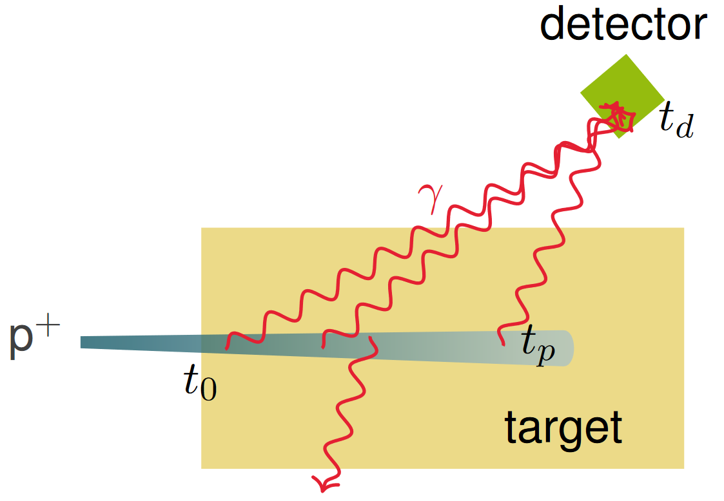
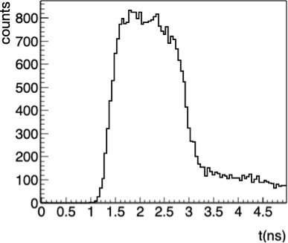
Prompt Gamma Timing (PGT)
Uncollimated time-sensitive photon counting
$$t_{γ}$$
Record reference plane time t₀
Record detector arrival time t_{d}
Time difference consists of
Proton travel time t_{p}
Deexcitation time of nucleus
Photon travel time t_{γ}
$t_{d}−t_{0}=t_{p}+t_{γ}$
See Golnik et. al. 2014
$t_{d}−t_{0}$ (ns)

Slide 8
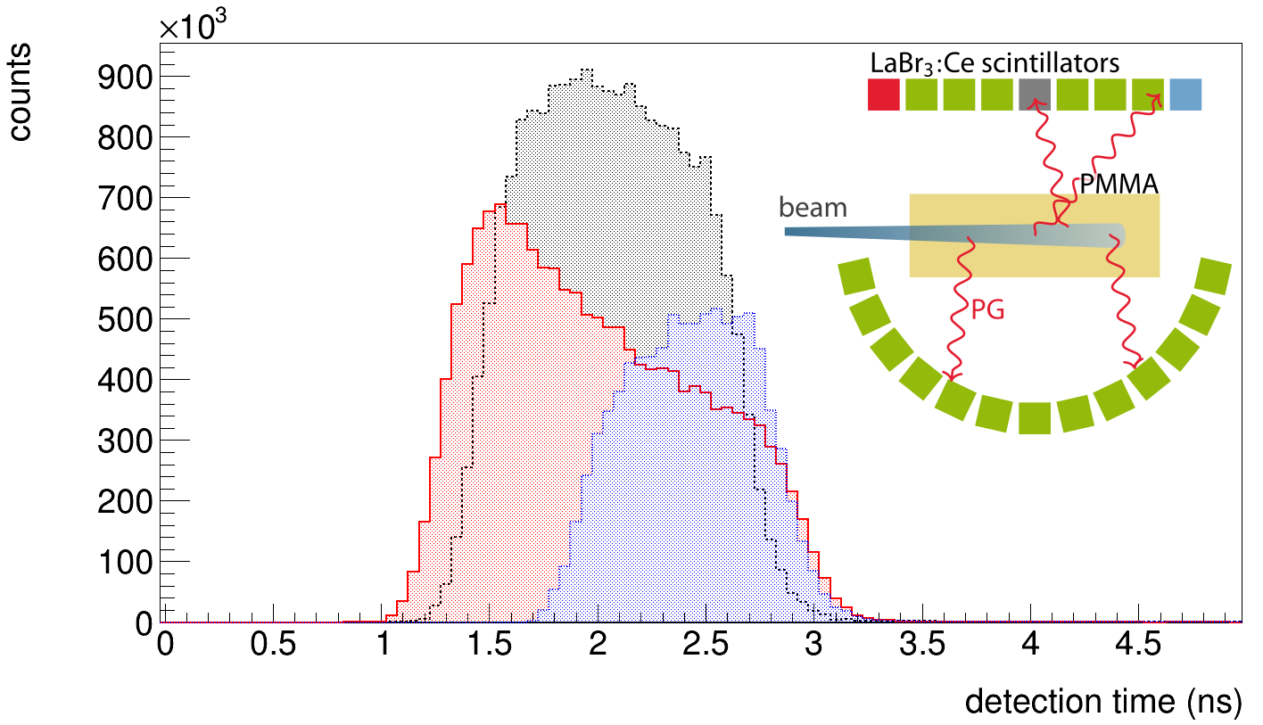
Prompt Gamma Timing (PGT)
Uncollimated time-sensitive photon counting
Record target entry time t₀
Record detector arrival time t_{d}
Time difference consists of
Proton travel time t_{p}
Photon travel time t_{γ}
$t_{d}−t_{0}=t_{p}+t_{γ}$
Different detector positions → complementary information
Detection time difference $t_{d}−t_{0}$ (ns)

Slide 9
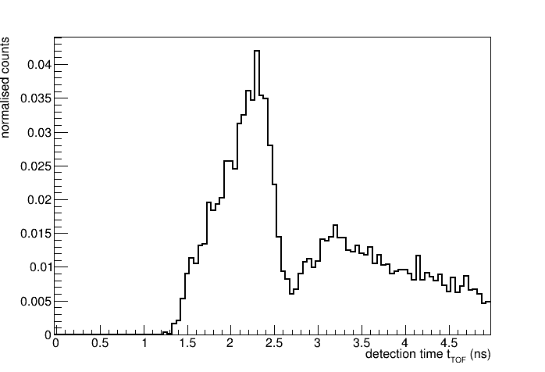
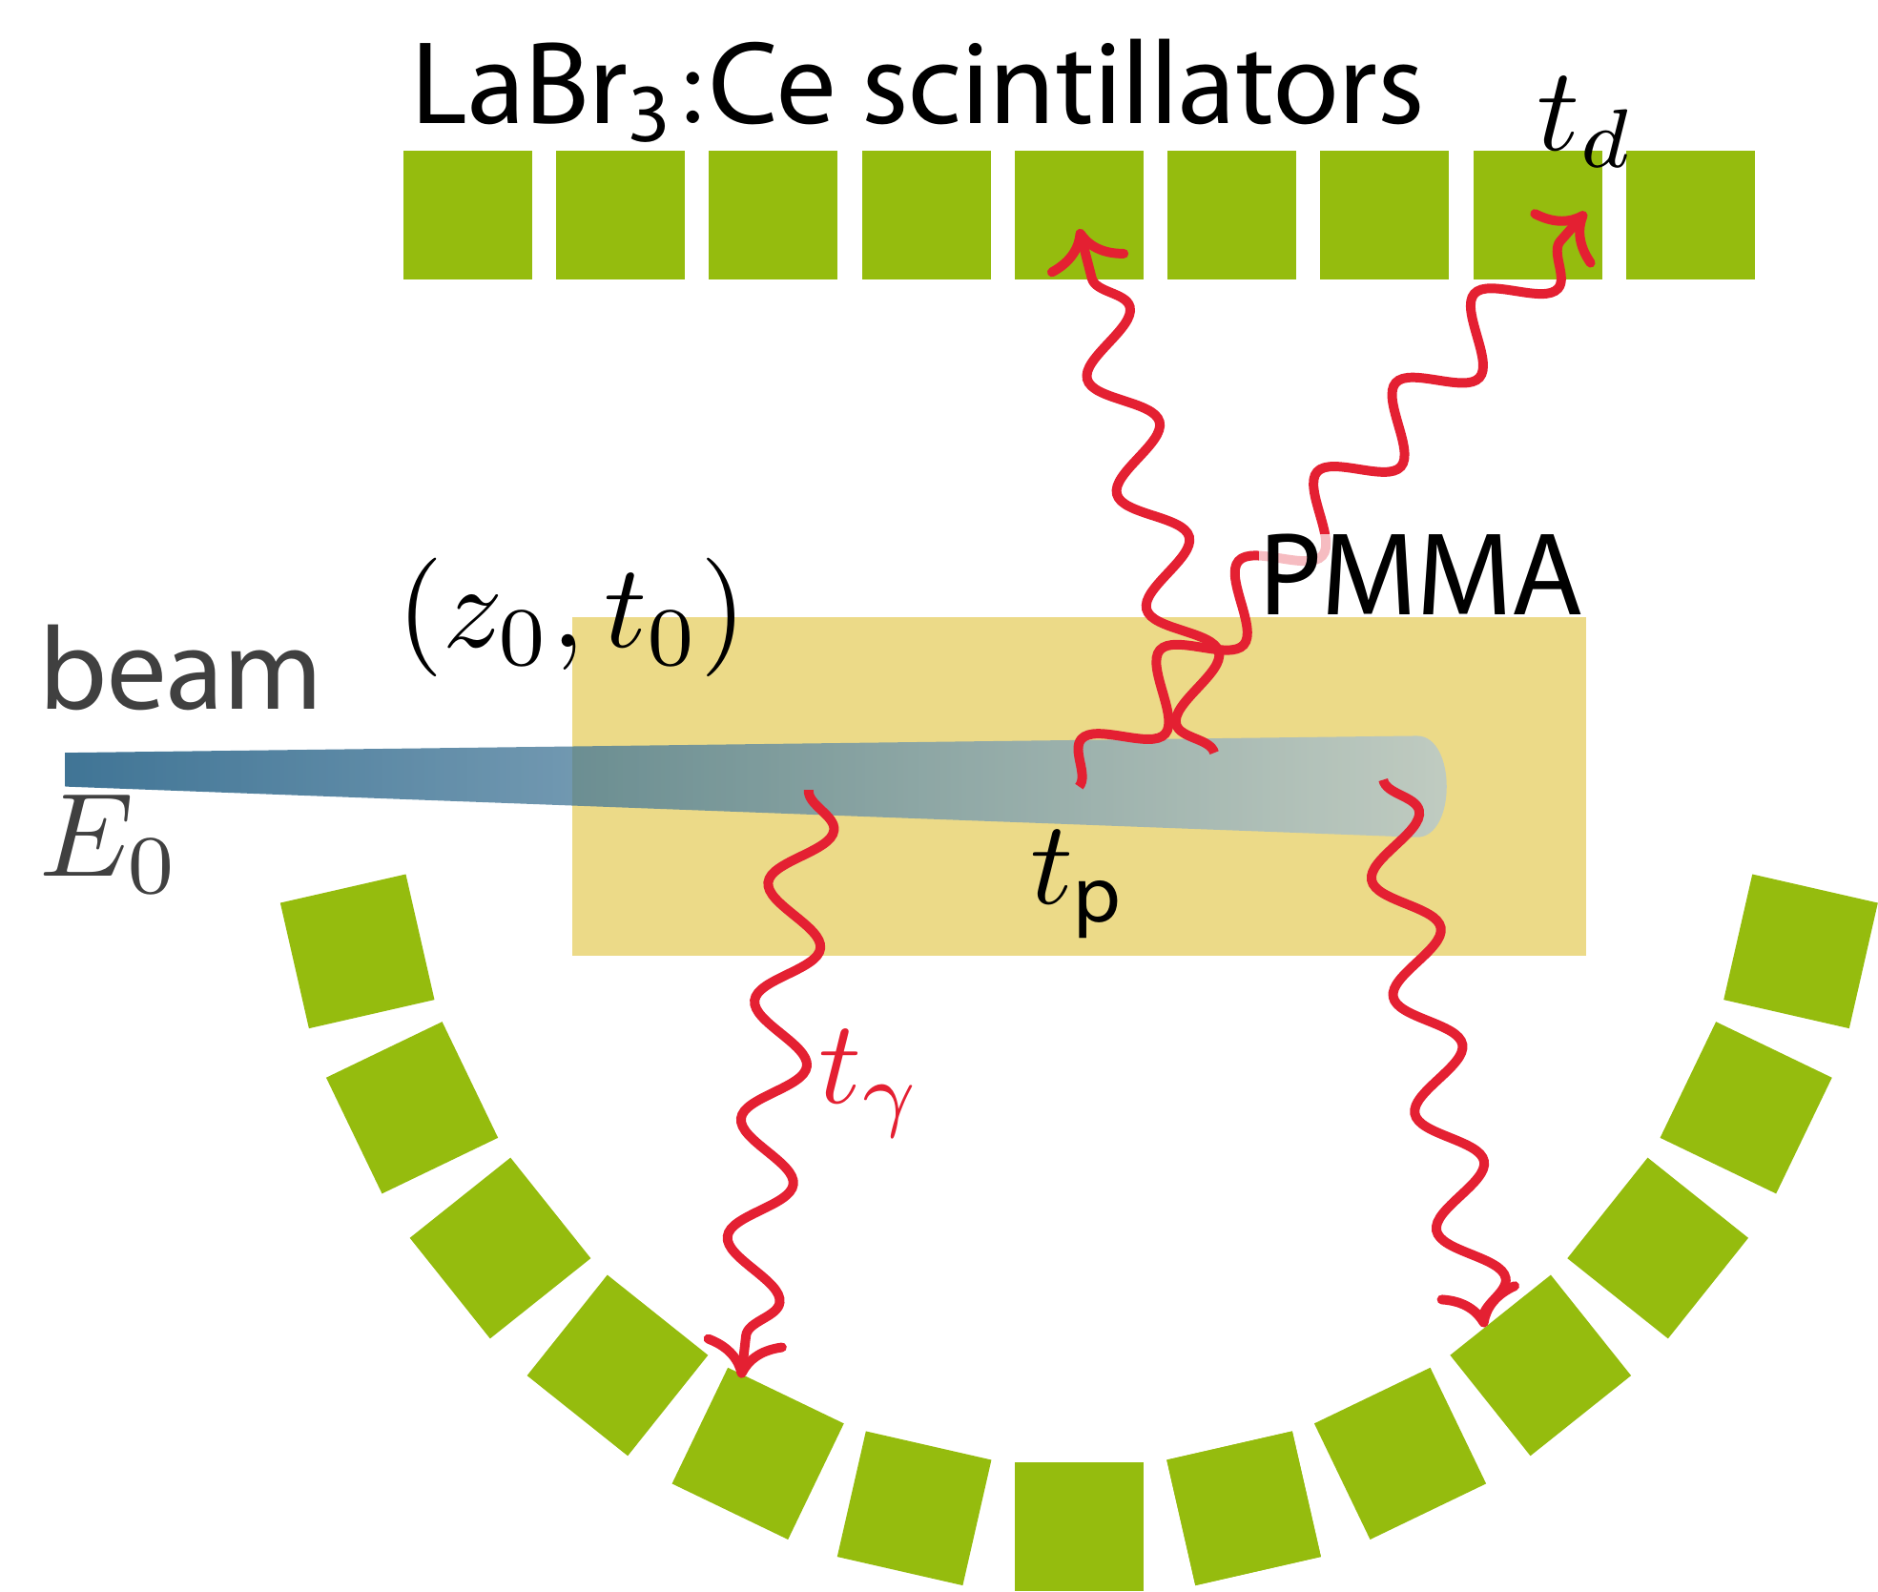
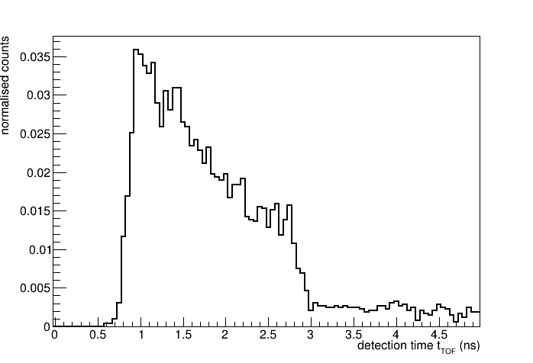
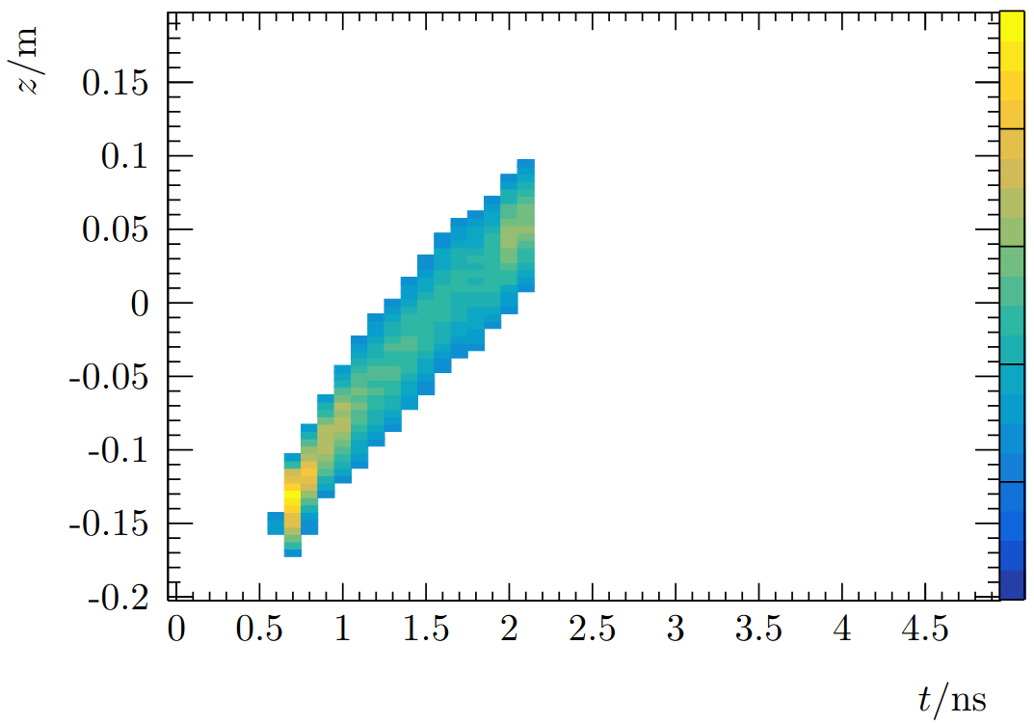
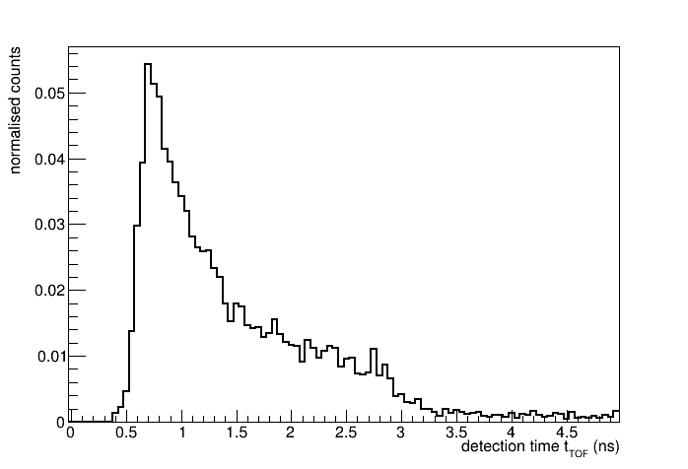
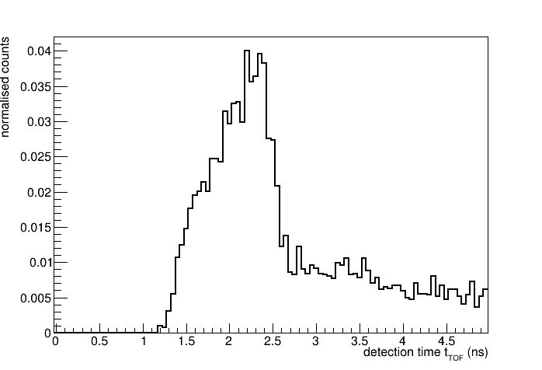
Spatiotemporal emission reconstruction
Approach first published: Pennazio et. al., PMB 2022
from Prompt Gamma Timing (SER-PGT)
15
10
5
0
-5
-10
-15
-20
Unknown emission
Measurement
Emisssion position (cm)
Reconstruction
15
10
5
0
-5
-10
-15
-20
Reconstructed emission
Emisssion time (ns)
Emission position (cm)
The (unkown) emission dictates the measured PGT data
Reconstruction: solution of inverse problem based on maximizing likelihood of measurement + threshold
Emisison time (ns)

Slide 10
Spatiotemporal emission reconstruction
First published: Pennazio et. al., PMB 2022
from Prompt Gamma Timing (SER-PGT)
Maximum Likelihood Expectation Maximization (ML-EM) $x_{jp}^{(k+1)}=\frac{x_{jp}^{(k)}}{s_{jp}}\sum_{d}{\sum_{n}{\frac{y_{dn}h_{ndjp}}{\sum_{j^{′}}{\sum_{p^{′}}{h_{ndj^{′}p^{′} }x_{j^{′}p^{′}}^{(k)}}}}}}$
$y_{nd}$: number of detections in temporal bin n of detector d
$x_{jp}$: spatiotemporal emission at spatial bin j and temporal bin p
$h_{ndjp}$ (system matrix element) is the probability of an emission in spatial bin j emitted in timebin p to be detected in detector d in timebin n → calculated using FLUKA
SER-PGT disentangles complementary information of multiple PGT detectors
15
10
5
0
-5
-10
-15
-20
Emisssion position (cm)
Emisssion time (ns)

Slide 11
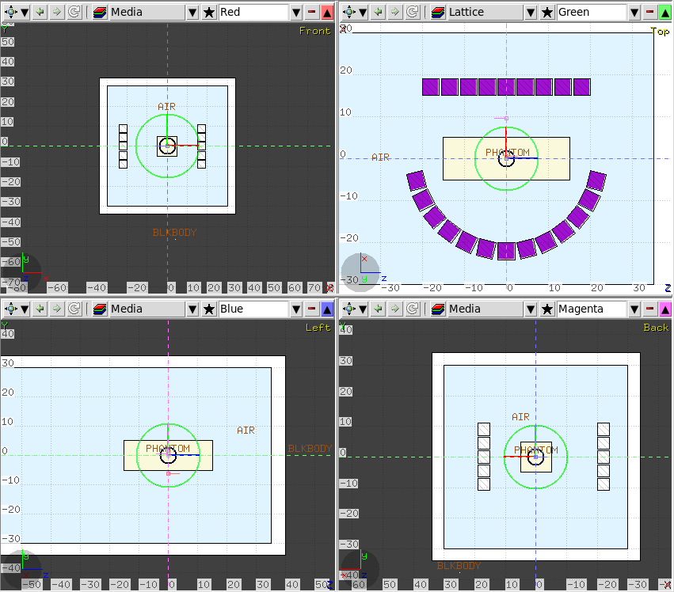
FLUKA simulation setup
1.18 g/cm³ PMMA block
62-227 MeV proton beams
Monochromatic, FWHM_{xy}=0
All emissions at time 0
50 realizations of 10⁷ p⁺ per energy
110 LaBr³:Ce crystals for PG detection
Homogeneous cylindrical crystals, length: 3.81 cm, radius 3.81 cm
Energy depositions recorded directly in custom user routine

Slide 12
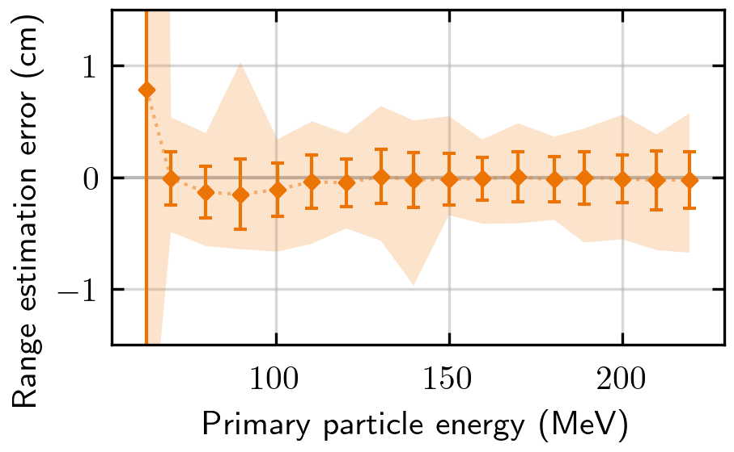
Reconstructed PG emissions
15
10
5
0
-5
-10
-15
-20
$$E_{0}=62 \text{MeV}$$
FLUKA simulations
Emisssion position (cm)
Expected range
10⁷ protons
30 cm PMMA cubic phantom
110 PG detectors
→ Range estimation errors:
15
10
5
0
-5
-10
-15
-20
$$E_{0}=160 \text{MeV}$$
Emisssion position (cm)
$$z_{0}$$
But can we get more?

Slide 13
1D-motion model of charged particles
$$R_{0}$$
$$E_{0}$$
For homogeneous media
$$S\left(z\right)=−\frac{dE}{dz}=\frac{1}{p\sqrt[p]{α}}{\left(R_{0}−z\right)}^{1/{p−1}}$$
Geiger‘s Range rule: $R_{0}=αE_{0}^{p}$
Kinetic energy must match range at each position $z$ $R_{0}−z=αE^{p}$ → $E\left(z\right)=\sqrt[p]{\frac{R_{0}−z}{α}}$ (see Bortfeld 1997)
Numerical integration yields position over time
$$S\left(z\right)=−\frac{dE}{dz}$$
Common parameters
$$E\left(z\right)=\sqrt[p]{\frac{R_{0}−z}{α}}$$
$$z\left(t\right)=z_{0}+\int_{t_{0}}^{t}{v\left(t\right) dt}$$
Numerical integration
$$z\left(t\right)≅z_{0}+Δt\sum_{i}{v({E(z}_{i−1}))}$$
Werner, Ferrero et. al., submitted to PMB, under review

Slide 14
Our Approach
30
25
20
15
10
5
0
-5
Reconstruction
$$S\left(z\right)=−\frac{dE}{dz}=\frac{1}{p\sqrt[p]{α}}{\left(R_{0}−z\right)}^{1/{p−1}}$$
Emisssion position (cm)
+
=
Stopping power estimation
Motion model
$$z\left(t\right)=\int_{t_{0}}^{t}{v\left(t\right) dt}$$

Slide 15
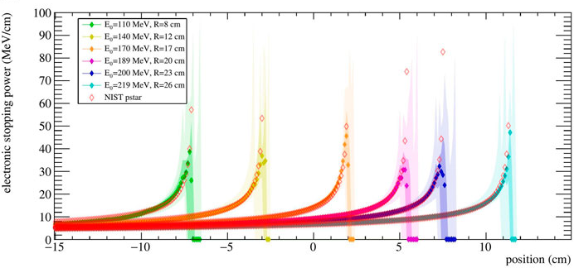
MC-simulation based results
Stopping power
10⁷ protons per run; 50 runs per energy
proton energies from 110 MeV to 220 MeV
30-cm PMMA phantom
110 PG detectors
Reproduced from Ferrero, Werner et al. Frontiers in Physics 2022

Slide 16
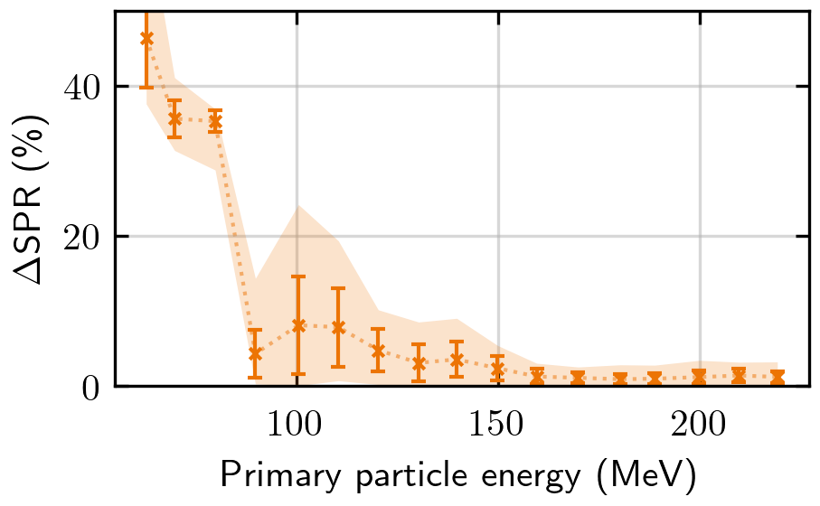
MC-simulation based results
Stopping power
10⁷ protons per run; 50 runs per energy
proton energies from 60 MeV to 220 MeV
30-cm PMMA phantom
110 PG detectors
→ Error of stopping power ratio to water: $$ΔSPR=\frac{\left|SPR_{NIST}−SPR_{Estimation}\right|}{SPR_{NIST}}<5\%$$ for protons with $E_{0}$ ≥ 160 MeV

Slide 17
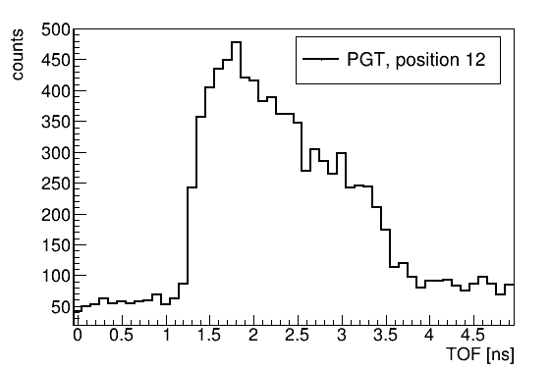
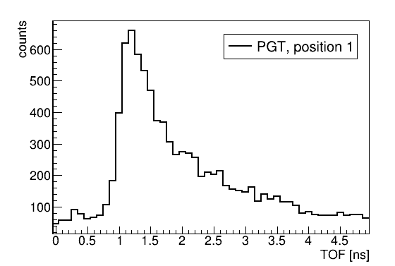
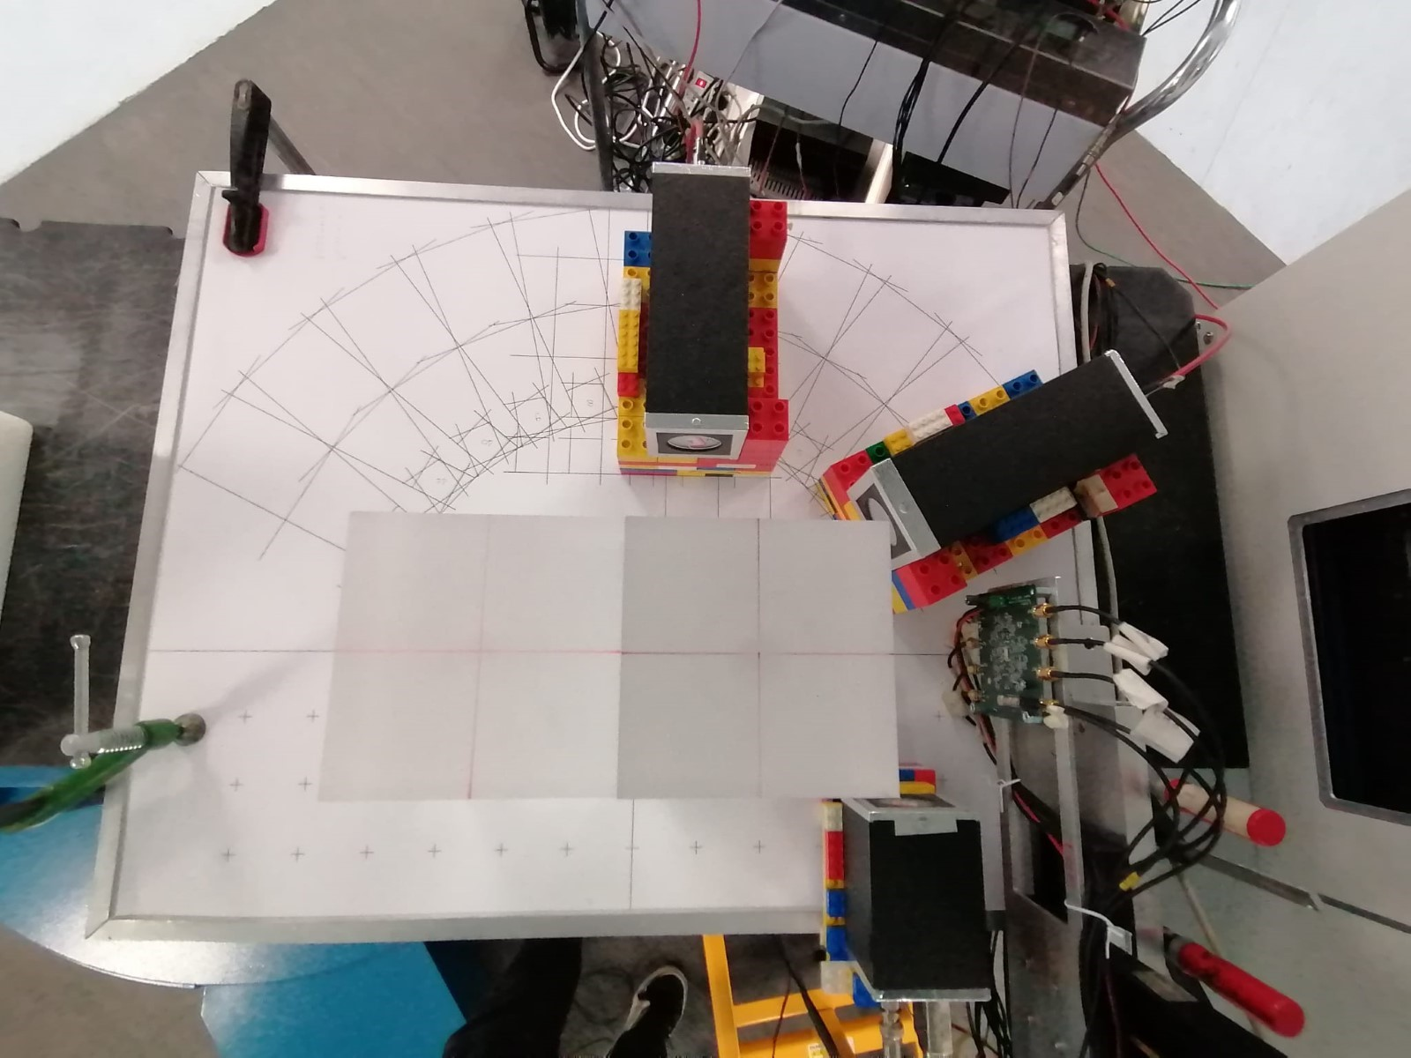
The MERLINO prototype
Measurement of the EneRgy Loss for IN-vivo Optimization in particle therapy
2 Photon detectors
LaBr₃:Ce monolythic crystals coupled to PMTs, 3.81 cm length, 3.81 cm diameter
In coincidence with Ultra Fast Silicon Detector (UFSD) between beam nozzle and patient
Challenge: clinical beam rates up to 10⁸ particles per second
Triggered acquisition with digitizer
Coincidence time resolution ~250-300 ps FWHM
LaBr3:Ce
PMMA
proton
UFSD
PI: V. Ferrero, INFN Turin

Slide 18
Preliminary reconstruction of experimental data
LaBr3:Ce
227 MeV proton beam @CNAO, 1E7 pps average rate
PMMA phantom without airgap, multiple measurements with different detector positions
PMMA
proton
UFSD
PGT1
PGT2
PGT3
PGT4
V. Ferrero and F. Pennazio
PGT5
PGT6
PGT7
PGT8
Experimental data
Simulated data
PGT9
PGT10
PGT11
PGT12
PGT13
PGT14

Slide 19
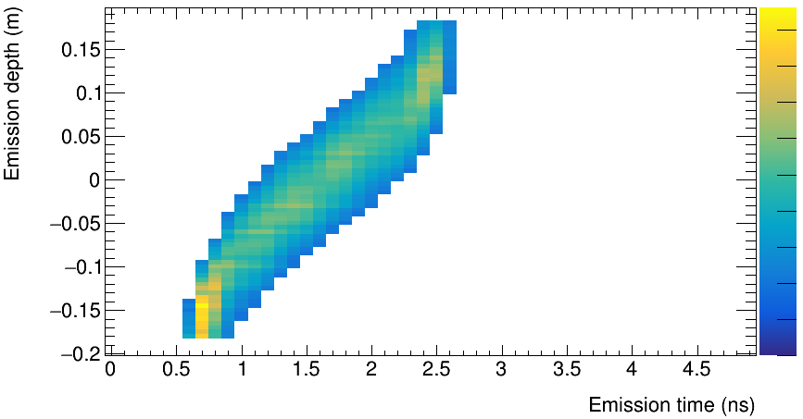
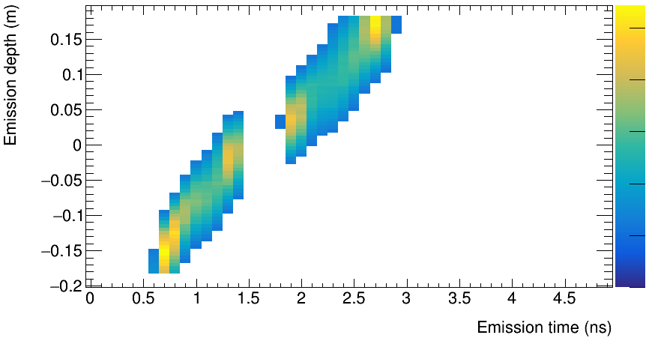
Preliminary reconstruction of experimental data
LaBr3:Ce
227 MeV proton beam @CNAO , 1E7 pps average rate
PMMA phantom with and without airgap
14 PG detector positions
Triggered acquisition with digitizer
PMMA
proton
UFSD
V. Ferrero and F. Pennazio
Homogeneous PMMA phantom
a.u.
PMMA phantom with 4 cm gap
a.u.
Preliminary
1
1
Preliminary
15
10
5
0
-5
-10
-15
-20
15
10
5
0
-5
-10
-15
-20
Emisison depth (cm)
Emisison depth (cm)
0
0

Slide 20
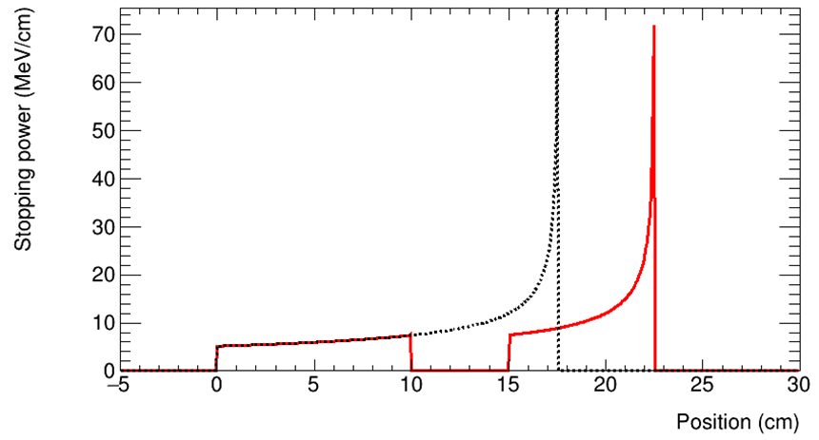
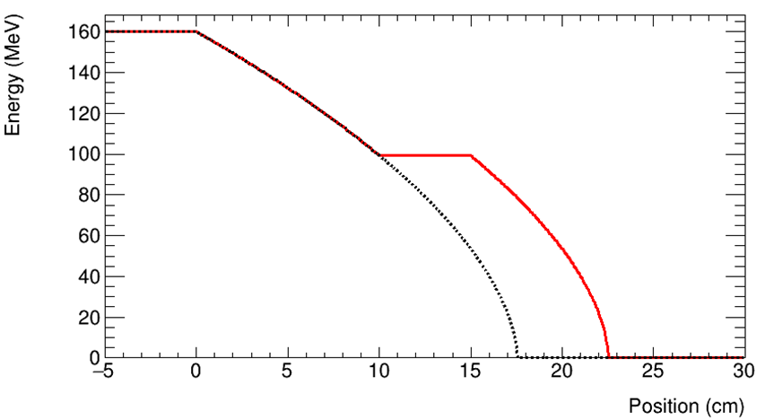
What about inhomogeneous materials?
$$E_{0}$$
Outlook
Separate material into homogeneous regions
Independent parameters for each region
Exploit beams of different energy crossing the same material
→ Tradeoff between number of regions, size of regions and number of free parameters

Slide 21
Conclusion & Outlook
PG emission in time and space
Reconstruction
PG emission in time and space can be reconstructed via Prompt Gamma Timing data from several detectors.
It reveals the average speed of the charged particles in the patient and by extension the stopping power during the irradiation.
Demonstrated using MC-simulations of homogeneous phantom.
→ Experimental validation and extension to inhomogeneous phantoms underway.
Prompt Gamma Timing spectra
Motion fit
Stopping power
Reproduced from Ferrero, Werner et al. Frontiers in Physics 2022

Slide 22
Thanks to
Nuclear imaging group – Institute of Medical Engineering, Universität zu Lübeck
Medical Physics group – INFN Torino and Department of Physics, Universitá degli Studi di Torino
Staff of the National Center of Oncological Hadrontherapy, Fondazione CNAO, Pavia Dr. Fernando Hueso-González – Instituto de Física Corpuscular IFIC Valencia

Slide 23
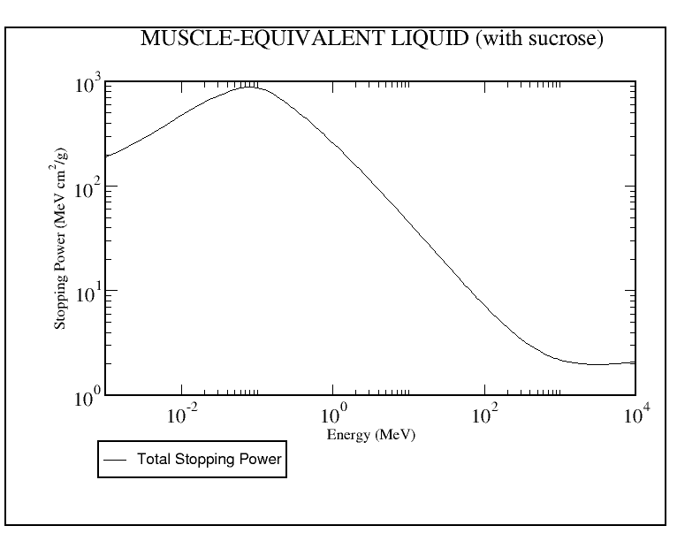
Motion of relativistic charged particles
Slowing down in electron cloud
Dominated by electronic stopping power
Full description with Bethe-Bloch equation
Dominated by sharp stopping power increase at end of the particle range
https://physics.nist.gov/PhysRefData/Star/Text/PSTAR.html

Slide 24
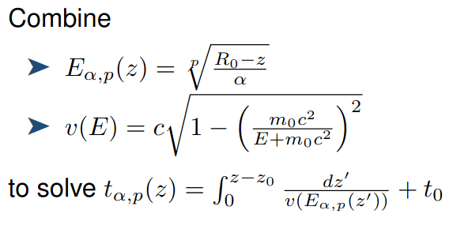
Details on the particle motion model
Calculating time and position profiles
(Bortfeld 1997)
Time:
$$∆t=2.5 ps$$
Position
$$z\left(t\right)=z_{0}+Δt\sum_{i}{v({E(z}_{i−1}))}$$

Slide 25
How do we fit a 1D-function to a 2D distribution?
After reconstruction:
Threshold
Calculate COG of each timebin
Range → last COG with emission over threshold
Fit motion-function to COG-Time pairs

Slide 26
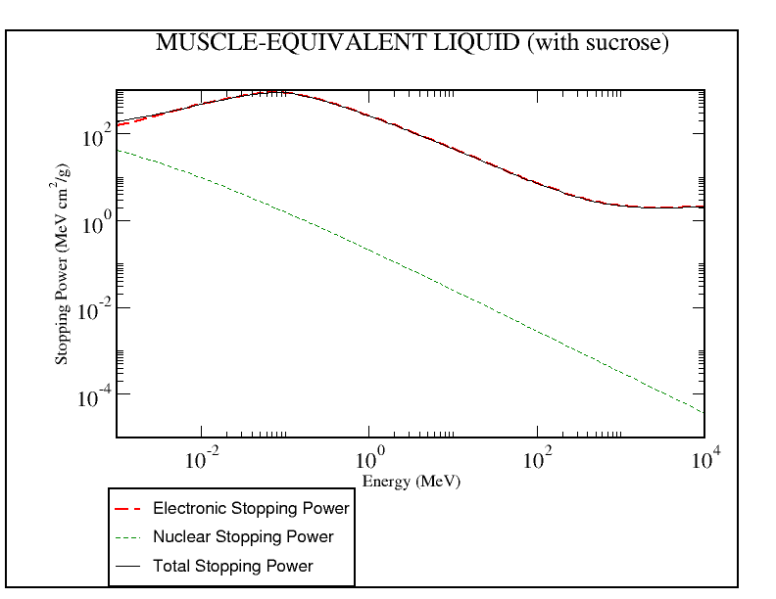
Interactions of charged particles with matter
Electromagnetic
Inelastic Coulomb interactions with electrons → quasi-continous slowing down
Elastic Coulomb scattering with nuclei → widening of beam
Nuclear
Significant energy loss (or fragmentation)
Induced radioactive decays
Prompt Gamma
β+
δ
Neutrons, …

Slide 27
Spatiotemporal PG emission
Gamma radiation from nuclear interactions
Emission within $≤$100 ps after interaction
Energies ranging up to 15 MeV
→ PG emission is closely linked in time and space with the particles

Slide 28
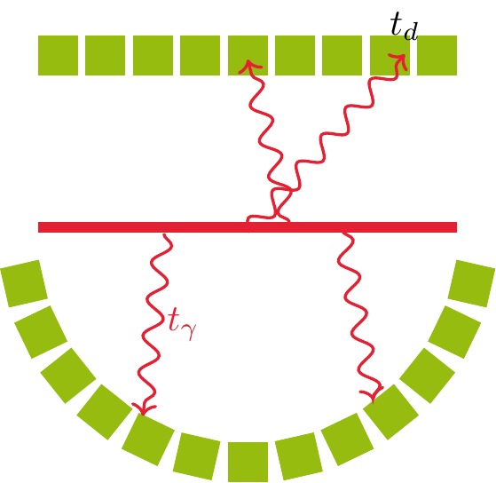
System matrix calculation
Via Monte Carlo simulation
Probability of a photon emitted in spatial bin j and temporal bin p to be detected by detector d in temporal bin n
Simulate photon emissions homogeniously distributed along the beam axis
Record number of detected events for each combination of detector, time and spatial bin
Add emission time dimension by shift

Slide 29
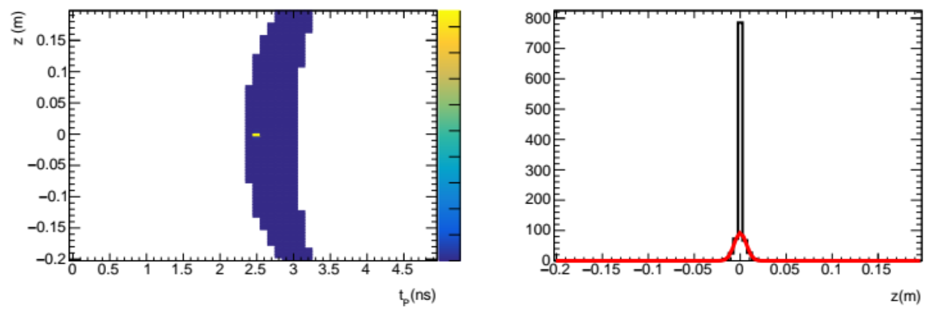
Point spread function
To test the inherent limits of the modelled system, reconstruct data forward projected from an optimal object using the same system matrix.
MC: significant tail in spatial PSF – likely due to 3.5 cm detector size
Analytical SM only considering center detectors face → perfekt PSF
28.09.2023

Slide 31
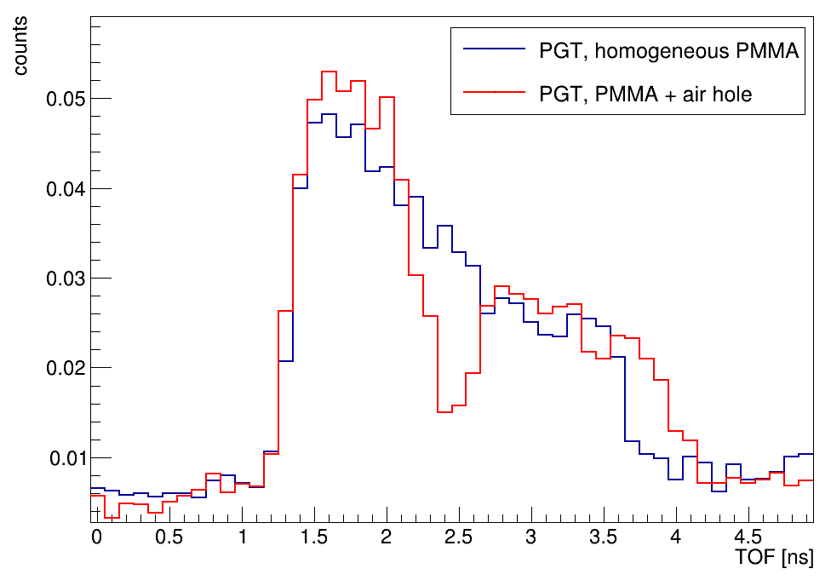
Preliminary reconstruction of experimental data
LaBr3:Ce
227 MeV proton beam @CNAO, 1E7 pps average rate
PMMA phantom with and without airgap
14 PG detector positions
Triggered acquisition with digitizer
PMMA
proton
UFSD
V. Ferrero and F. Pennazio

