Slide 1




Precision of the positron emission activity range during irradiation with radioactive carbon and oxygen beams
INFN Pisa – 23 January 2023
Peter Dendooven
PARTREC, Department of Radiation Oncology,
University Medical Center Groningen, the Netherlands
INnovative Systems In radiation therapy:
breakthrouGHs novel detectors, Treatments and AI techniqueS
Pisa, 18-20 October 2023

Slide 2
Contents
introduction
  PET imaging of ion beams
  radioactive ion beams for radiotherapy
experiments within the BARB and S533 projects at GSI/FAIR
  setup
  PET imaging of C-10, C-11, O-14 and O-15 radioactive ion beams
conclusions

Slide 3
Production of positron emitters along the beam path
measured positron annihilation activity profile along the beam path in PMMA
proton beam
carbon beam
K. Parodi, PhD Thesis, Dresden, 2004

Slide 4
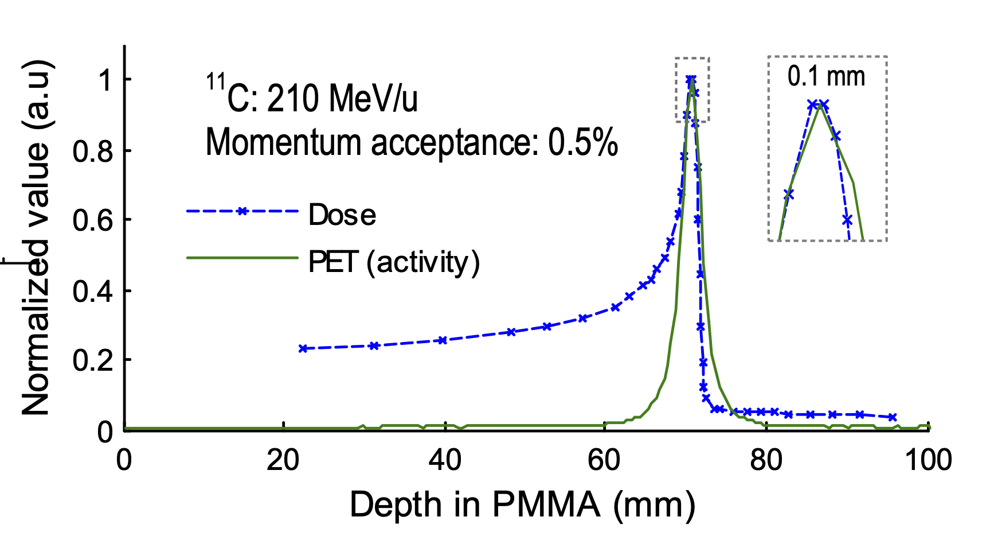
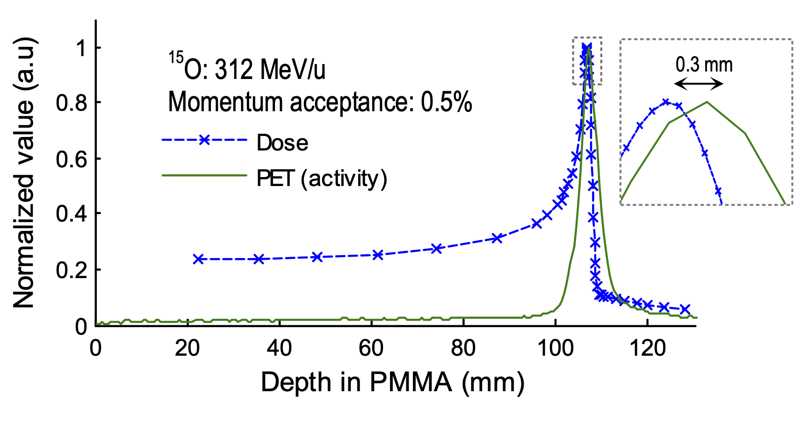
PET activity peak vs. Bragg peak for C-11 and O-15
shift between the Bragg peak and the PET activity peak positions for C-11 and O-15 beams with a momentum acceptance of 0.5%.
A. Mohammadi et al., Phys. Med. Biol. 65 (2020) 125006
radioactive ion beams: PET activity overlaps the Bragg peak 😄
How accurately can the PET activity peak position be measured ?
  (a proxy for the Bragg peak) ?
How quickly can a relevant accuracy be reached ? Real-time verification ?

Slide 5
Radioactive ion beams to image the range

Slide 6
Short-lived positron emitter beams at HIMAC

Slide 7
Short-lived positron emitter beams at HIMAC
Japanese Journal of Medical Physics (Igakubutsuri) Vol. 24 (2004) No. 2 p. 37-48
The examination of optimal positron emitting nuclide in the estimation of attainment depth within the body of RI beams by positron camera
H. Mizuno, Y. Iseki, E. Urakabe, M. Suda, M. Kanazawa, A. Kitagawa, T. Tomitani, Y. Nakamura, T. Kanai, K. Ishii

Slide 8





The BARB and S533 projects
ERC Advanced Grant
Biomedical Applications of Radioactive ion Beams
www.gsi.de/work/forschung/biophysik/erc_barb
PI: Marco Durante
Co-PI: Katia Parodi
produce high-intensity beams of short-lived isotopes of carbon and oxygen
use these beams for examination of simultaneous treatment and online imaging
GSI Experiment S533
nuclear and atomic interactions for ion-beam therapy with positron emitters of carbon
PI: Sivaji Purushothaman

Slide 9
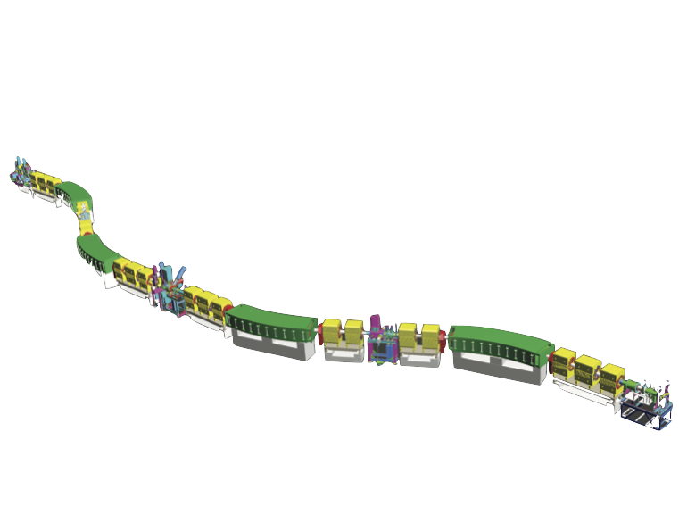
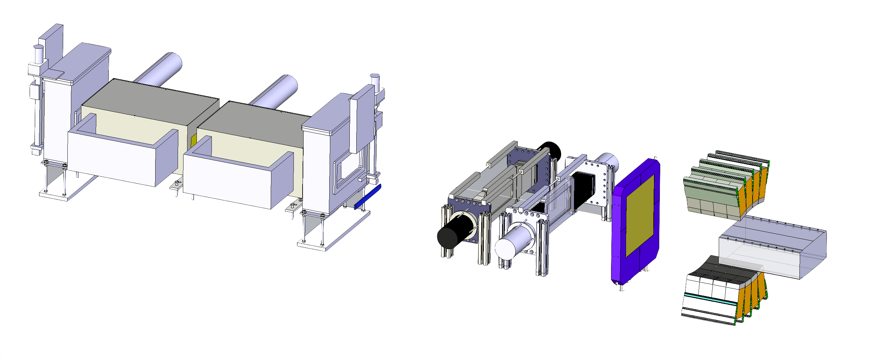
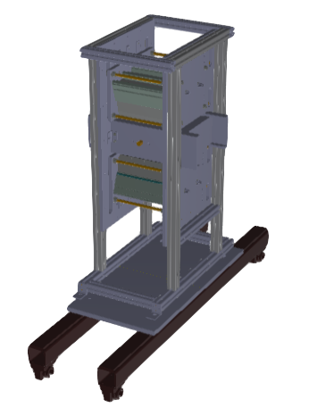
Experimental setup for radioactive ion beams
for O-14, O-15 beams:
O-16 primary beam
TPC
MUSIC
Primary beam: ¹²C
380 MeV/u & 290 MeV/u
MUSIC
TPC
SCI
SCI
PET imaging
setup
IC
Target Chamber
Production Traget
⁹Be ➔8 g/cm²
Experimental focal plane
Symmetric branch
Mid-focal plane
Aluminium disk degrader
SCI
TPC
TPC: Time Projection Chamber TPC
MUSIC: Multi-Sampling Ionization Chamber
SCI: Plastic scintillators
IC: Parallel plate Ionization Chamber

Slide 10
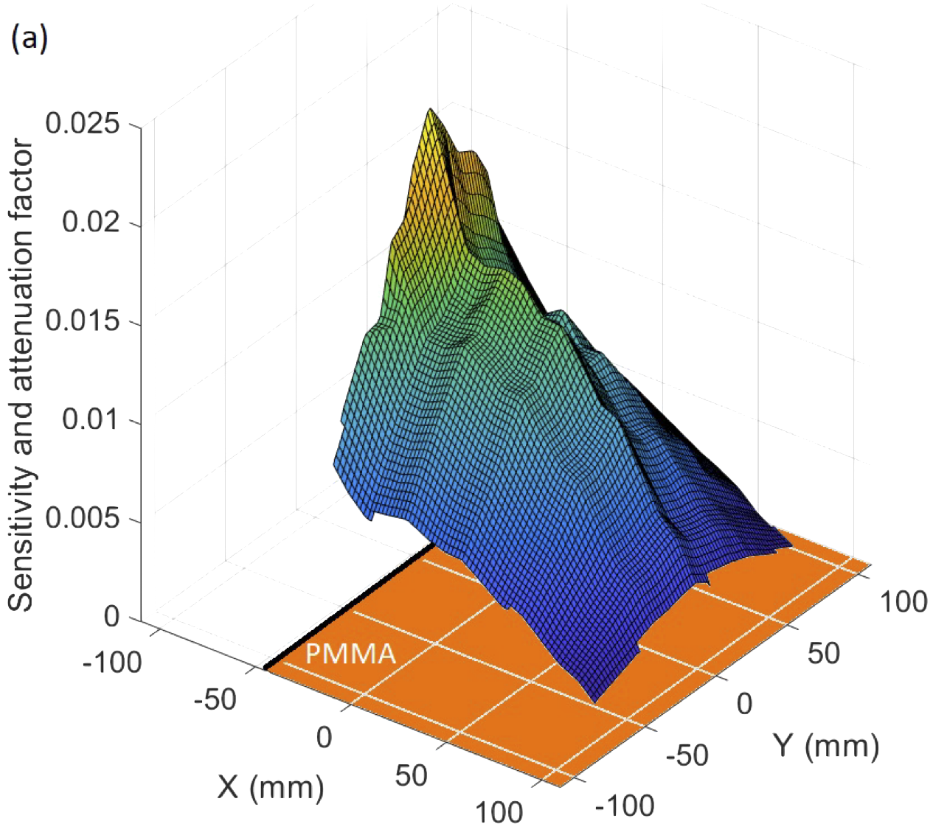
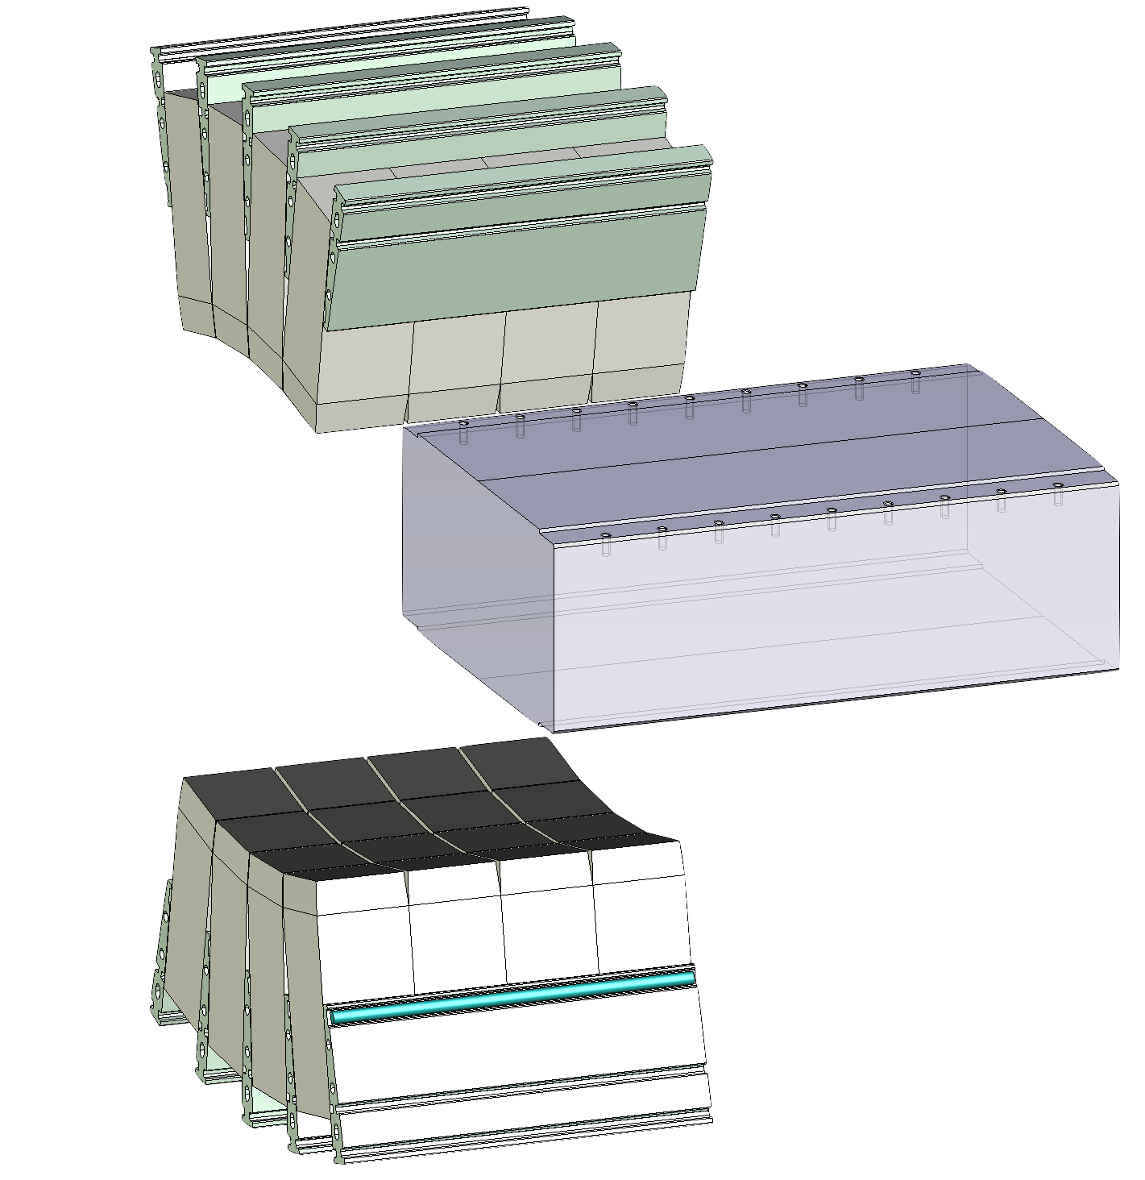
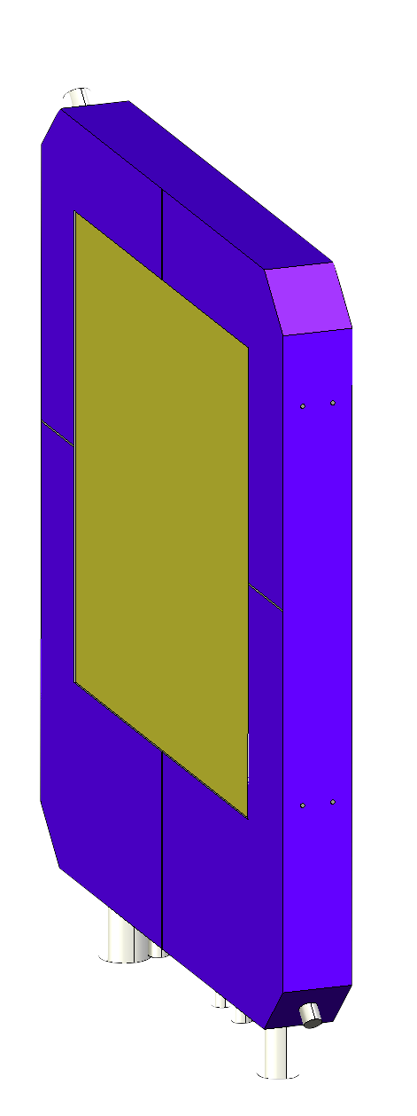
Intensity monitoring and PET imaging
parallel-plate
ionization chamber
dual-panel
PET scanner
sensitivity map
PMMA phantom
120×250×350 mm³
dual-panel
PET scanner
D Kostyleva et al, Phys Med Biol 68(2023)015003

Slide 11
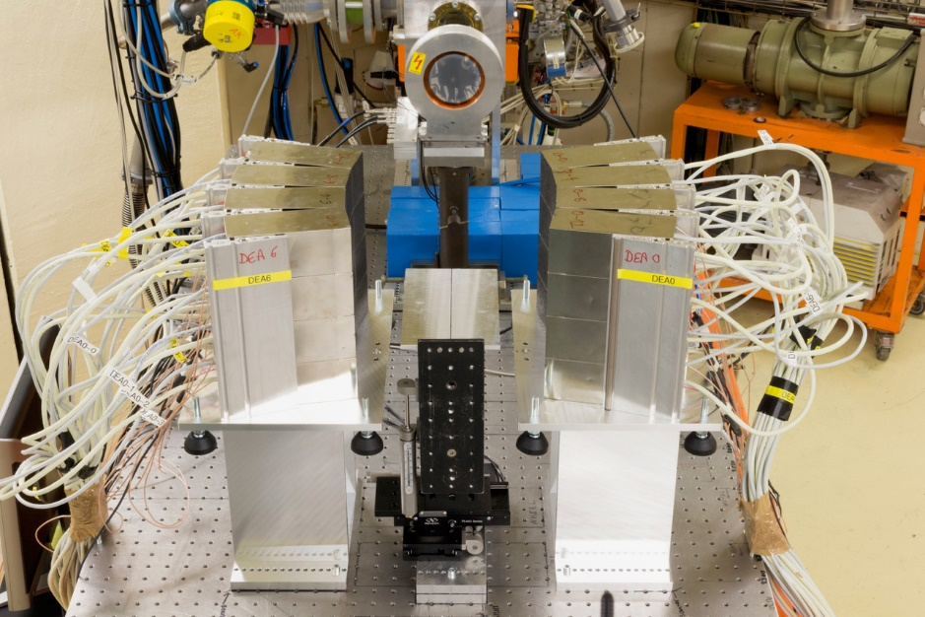
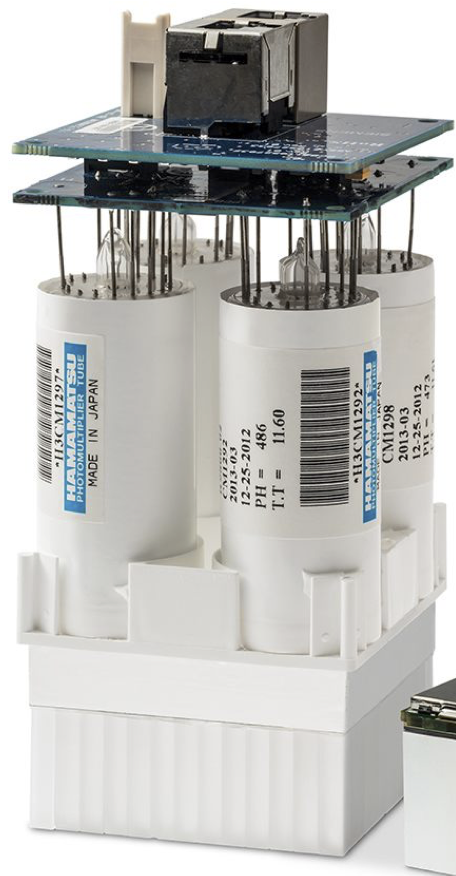
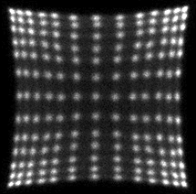

Dual-panel PET scanner
setup at UMCG PARTREC (Groningen)
each panel:
4×4 block detectors
13×13 scintillators
4×4×20 mm³ LSO
PET scanner
Biograph mCT technology
two 23 × 23 cm² panels
sensitivity center FoV = 2.2 %
angular coverage close to 50%
I. Rausch et al, Eur J Nucl Med Mol Imag Phys 2 (2015) 26

Slide 12
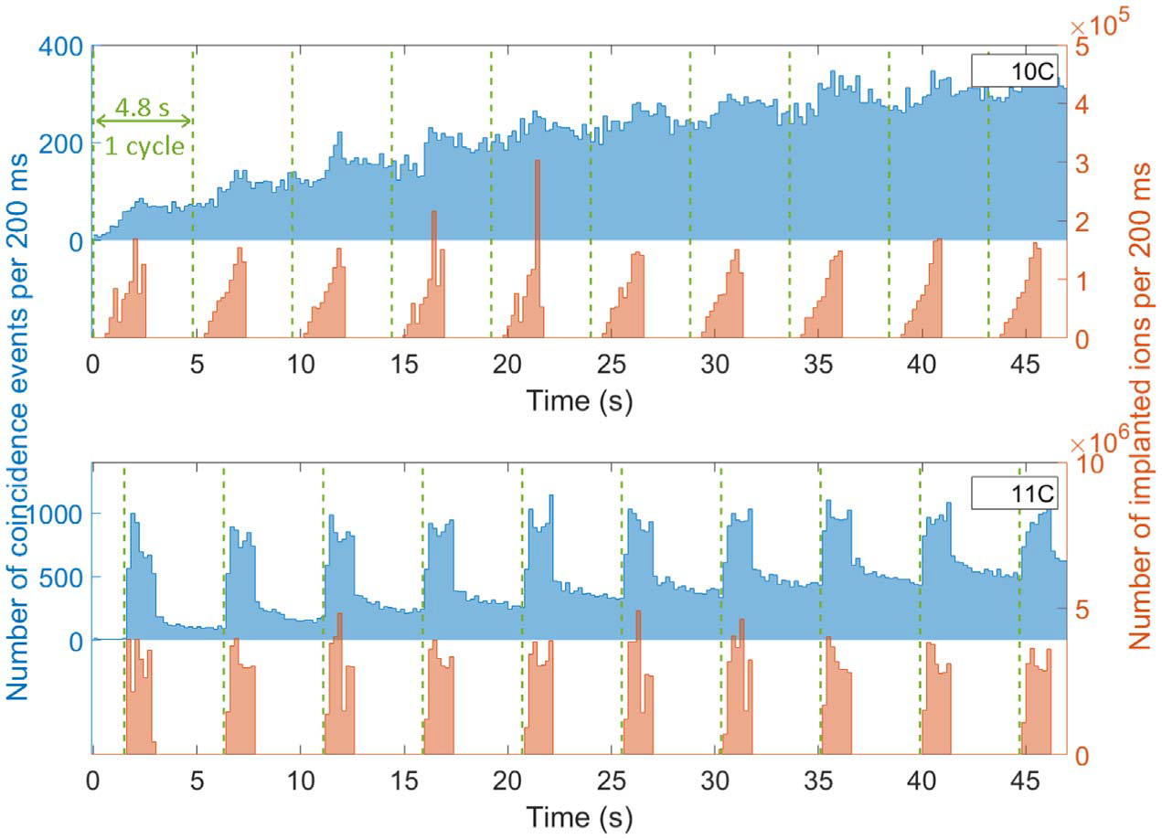
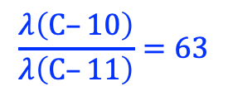
Number of coincidences vs. time
C-10
beam-on data is useful
$$\frac{λ\left(C–10\right)}{λ\left(C–11\right)}=63$$
C-11
beam-on data is
not useful

Slide 13
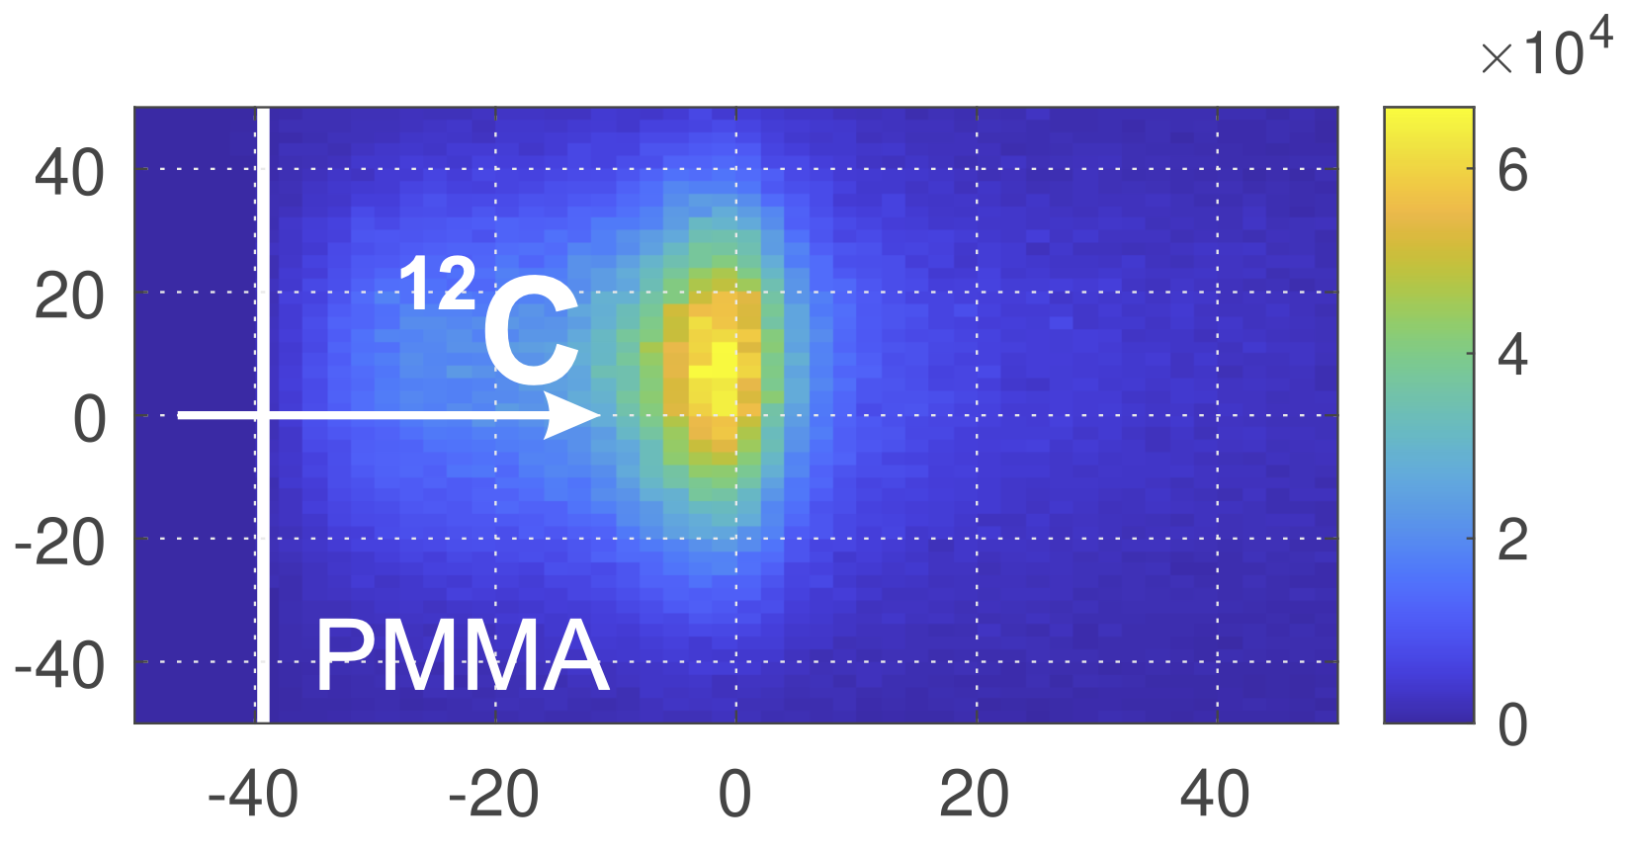
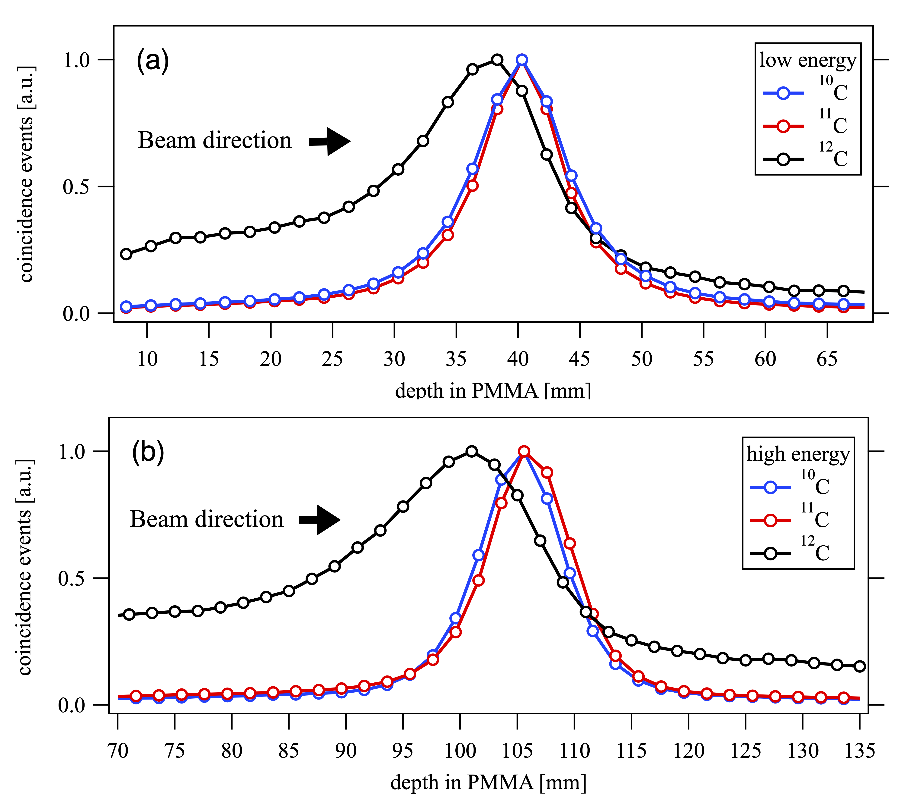
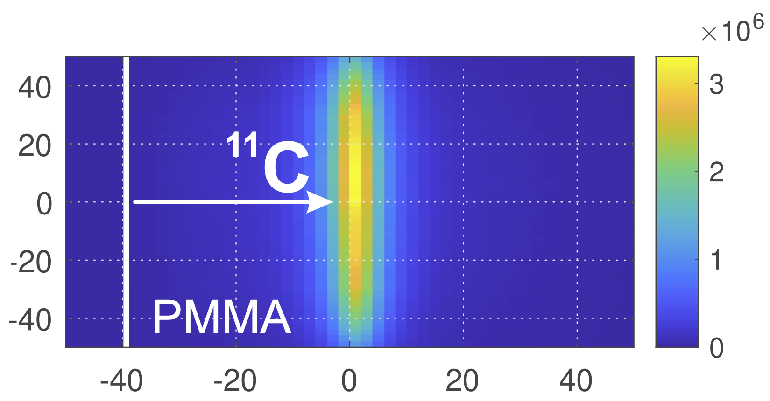
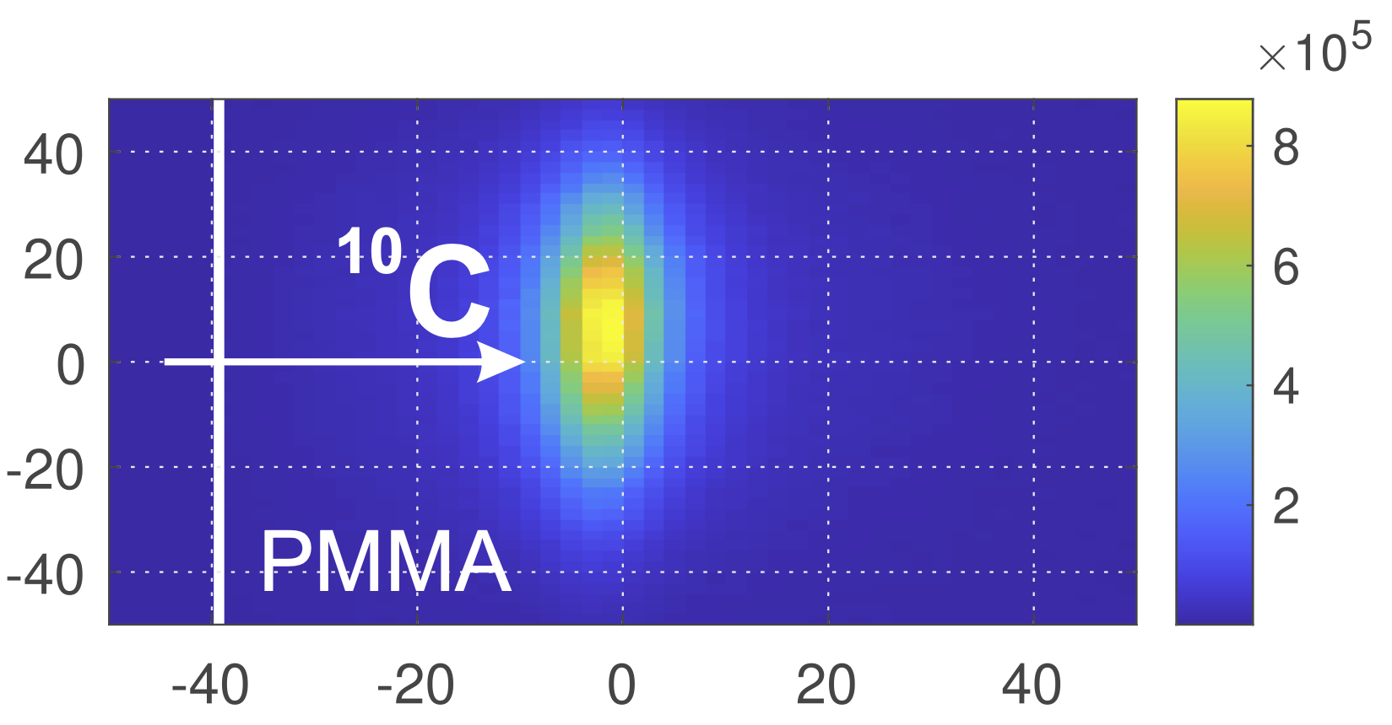
Positron emission images
1D profiles
short range
-o- C-10
-o- C-11
-o- C-12
Y [mm]
achromatic
80% dose range*
Y [mm]
number of coincidences
depth in PMMA [mm]
monoenergetic
long range
-o- C-10
-o- C-11
-o- C-12
Y [mm]
80% dose range*
achromatic
2×2 mm² pixels
X [mm]
depth in PMMA [mm]
*dose range from D Boscolo et al, NIM A 1043(2022)167464

Slide 14
Positron activity peak position & uncertanty
peak position = surrogate for the dose range
peak position accuracy is determined by counting statistics

Slide 15
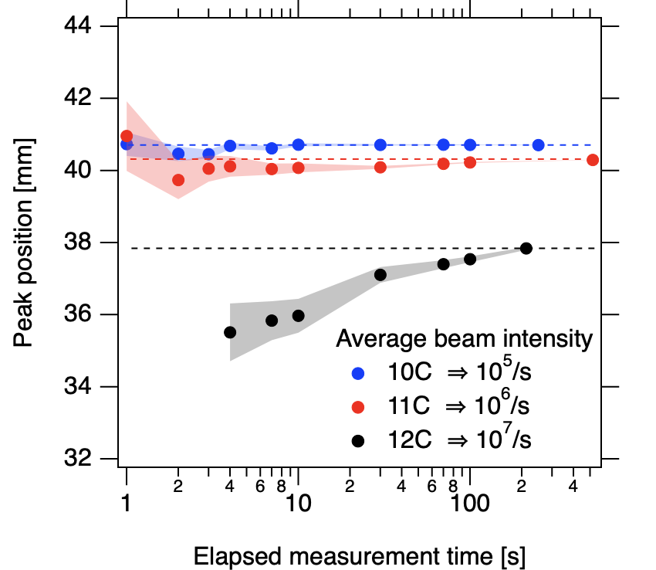
Positron emission activity peak position
radioactive beams show a stable peak position
change from C-10 to C-11 domination over time

Slide 16
Oxygen images vs. number of cycles
cycle:
1 s on
1.3/1.5 s off
O-14
O-15
O-16
ions/cycle
O-14: 1.1×10⁶
O-15: 1.1×10⁷
O-16: 6.0×10⁷
O-15 gives the
best images

Slide 17
Results from carbon ions
C-10
C-11
Peak position [mm]
C-10
C-11

Slide 18
Results from oxygen ions
O-15
O-14
Peak position [mm]
O-15
O-14

Slide 19
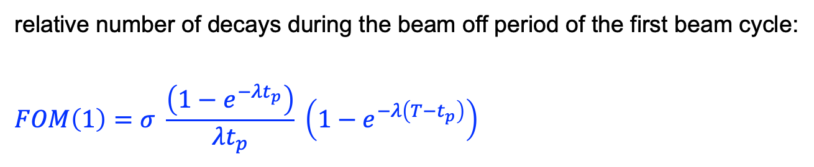
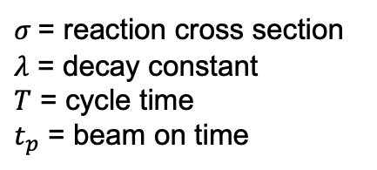
A figure-of-merit: O-15 “wins"
relative number of decays during the beam off period of the first beam cycle:
$$FOM\left(1\right)=σ \frac{\left(1−e^{−λt_{p}}\right)}{λt_{p}} \left(1−e^{−λ\left(T−t_{p}\right)}\right)$$
$σ$ = reaction cross section
$λ$ = decay constant
$T$ = cycle time
$t_{p}$ = beam on time

Slide 20
Conclusions
range uncertainty is dominated by counting statistics
C-11 shows a limited gain over C-12 for quick information
need to use C-10 for significant gain (much shorter half-life)
considering carbon and oxygen ions from in-flight: O-15 is preferred
  C-10 is not far behind
  biological and cost issues are also relevant in the choice of ion
using the ISOL method (production at low energy + acceleration):
  C-10 might be preferred
  C-9 is very appealing (T_{1/2} = 0.13 s)
all details of GSI/FAIR experiments in:
D. Kostyleva et al., Phys. Med. Biol. 68 (2023) 015003
S. Purushothaman et al., Sci. Rep. accepted for publication

Slide 21

Thank you
ERC Advanced Grant

