Slide 1
1 st INSIGHTS meeting on new horizons in radiation therapy
New image reconstruction approach for in-vivo range verification of multiple field carbon ion treatments by means of in-beam PET system
D. Bersani¹, M.G. Bisogni^{1, 2}, P. Carra^{1, 2}, P. Cerello³, M. Ciocca⁴, V. Ferrero³, M. Moglioni^{1, 2}, F. Pennazio³, M. Rafecas⁵, S. Ranjbar^{3, 6}, G. Sportelli ^{1, 2}, V. Vitolo⁴, J. Werner⁵, E. Fiorina³
1 Istituto Nazionale di Fisica Nucleare, Sezione di Pisa, Italy 2 Dipartimento di Fisica, University of Pisa, Italy 3 Istituto Nazionale di Fisica Nucleare, Sezione di Torino, Italy 4 Centro Nazionale di Adroterapia Oncologica, Fondazione CNAO, Pavia, Italy 5 Institute of Medical Engineering, Universität zu Lübeck 6 Dipartimento di Fisica, University of Torino, Italy

Slide 2
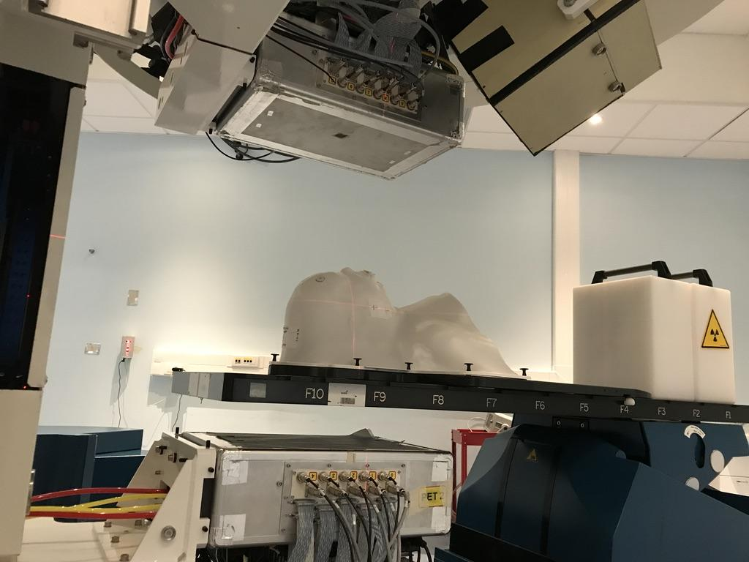
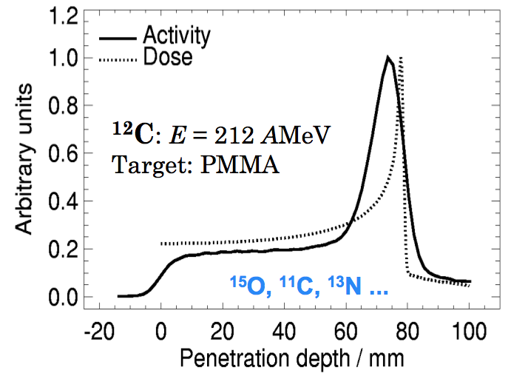
in-beam PET for carbon ion treatments
Bimodal imaging system for in-vivo range monitoring in particle therapy (in-beam PET + Dose profiler)
𝛄 511 keV
Dose
profiler
Irradiation-induced $β^{+}$activity inside the patient correlated to the delivered dose distribution
19 head-and-neck and brain patients treated with either protons or carbon ions monitored within a clinical trial (ID NCT03662373)
PET
scanner
12
Charged particles
C beam
𝛄 511 keV
Rotating
treatment couch
projectile fragmentation
¹¹C (T_{1/2}≈ 20.3 min)
¹⁰C (T_{1/2} ≈ 19.3 s)
¹⁵O (T_{1/2} ≈ 2.0 min)
¹³N (T_{1/2}≈ 10.0 min)
Ferrero, V. et al. Online proton therapy monitoring: clinical test of a Silicon-photodetector-based in-beam PET. Sci Rep 8, 4100 (2018)
target activation
Fischetti, M. et al. Inter-fractional monitoring of 12C ions treatments: results from a clinical trial at the CNAO facility. Sci Rep 10, 20735 (2020)
1 st INSIGHTS meeting Hadrontherapy, monitoring and new devices
2

Slide 3
in-beam PET for carbon ion treatments
Bimodal imaging system for in-vivo range monitoring in particle therapy (in-beam PET + Dose profiler)
𝛄 511 keV
Dose
profiler
Irradiation-induced $β^{+}$activity inside the patient correlated to the delivered dose distribution
19 head-and-neck and brain patients treated with either protons or carbon ions monitored within a clinical trial (ID NCT03662373)
PET
scanner
12
Charged particles
C beam
𝛄 511 keV
Rotating
treatment couch
projectile fragmentation
Improve PET image quality and detection of inter-fractional morphological changes during the treatment
¹¹C (T_{1/2}≈ 20.3 min)
¹⁰C (T_{1/2} ≈ 19.3 s)
¹⁵O (T_{1/2} ≈ 2.0 min)
¹³N (T_{1/2}≈ 10.0 min)
Ferrero, V. et al. Online proton therapy monitoring: clinical test of a Silicon-photodetector-based in-beam PET. Sci Rep 8, 4100 (2018)
target activation
Fischetti, M. et al. Inter-fractional monitoring of 12C ions treatments: results from a clinical trial at the CNAO facility. Sci Rep 10, 20735 (2020)
1 st INSIGHTS meeting Hadrontherapy, monitoring and new devices
2

Slide 4
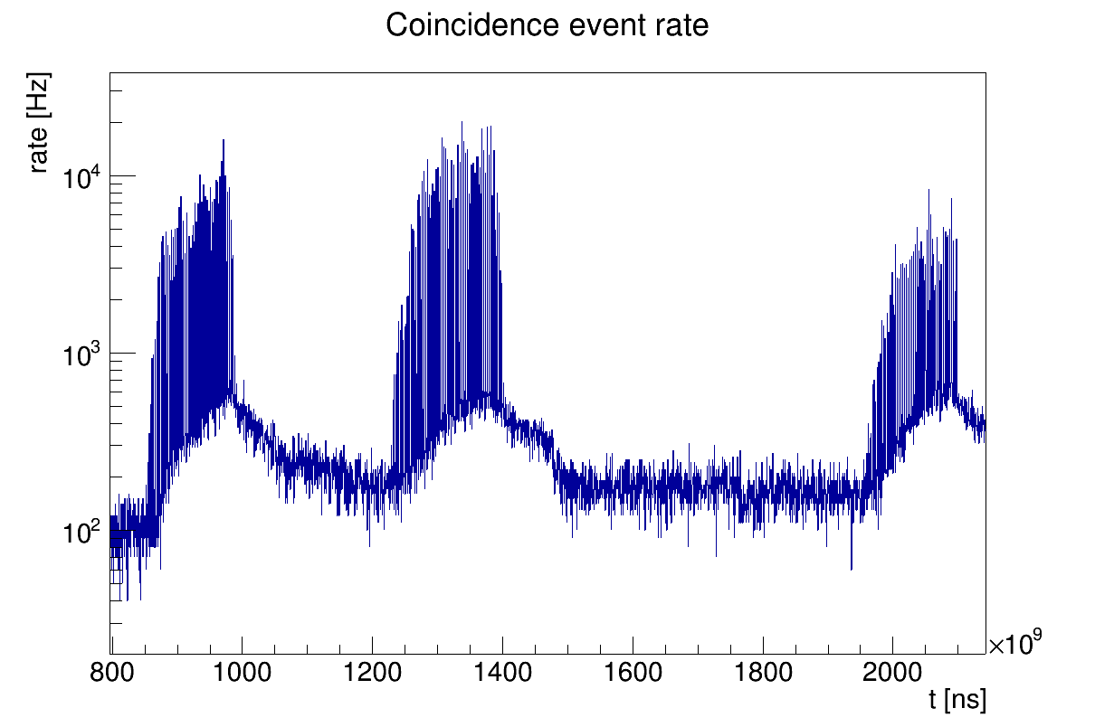
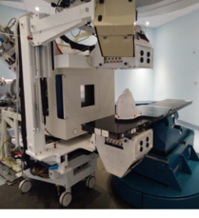
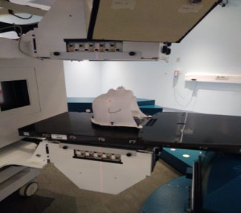
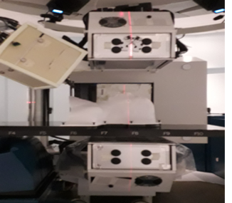
in-beam PET for carbon ion treatments
Coincidence event rate
Multiple fields irradiation
Low statistics of irradiation-induced positron emitters due to the reduced number of primary particles (at least 10x compared to protons)
1st field
0° IEC
2nd field
290° IEC
3rd field
180° IEC
1 st INSIGHTS meeting Hadrontherapy, monitoring and new devices
3

Slide 5
in-beam PET for carbon ion treatments
Coincidence event rate
Multiple fields irradiation
Low statistics of irradiation-induced positron emitters due to the reduced number of primary particles (at least 10x compared to protons)
Recover the signal of ¹¹C (T_{1/2}≈ 20.3 min) of previously irradiated fields and reconstruct only one PET image to increase statistical significance
1st field
0° IEC
2nd field
290° IEC
3rd field
180° IEC
1 st INSIGHTS meeting Hadrontherapy, monitoring and new devices
3

Slide 6
in-beam PET for carbon ion treatments
New approach hypotheses
Most of the activation is due to projectile fragmentation into ¹¹C (T_{1/2}≈ 20.3 min)
projectile fragmentation
increasing the acquisition time means increasing statistics​
Most of activation is located within the Clinical Target Volume (CTV) that is covered by INSIDE in-beam PET for all the irradiation beam fields
contributions from different irradiation angles can be summed
target activation
1 st INSIGHTS meeting Hadrontherapy, monitoring and new devices
4

Slide 7
in-beam PET for carbon ion treatments
New approach hypotheses
Most of the activation is due to projectile fragmentation into ¹¹C (T_{1/2}≈ 20.3 min)
projectile fragmentation
increasing the acquisition time means increasing statistics​
Most of activation is located within the Clinical Target Volume (CTV) that is covered by INSIDE in-beam PET for all the irradiation beam fields
contributions from different irradiation angles can be summed
target activation
The basic idea is:
convert all PET coincidences detected during a multiple field irradiation in a single space
reconstruct only one PET image comprising all the delivered beam fields
virtual detector
patient-tailored response model
1 st INSIGHTS meeting Hadrontherapy, monitoring and new devices
4

Slide 8
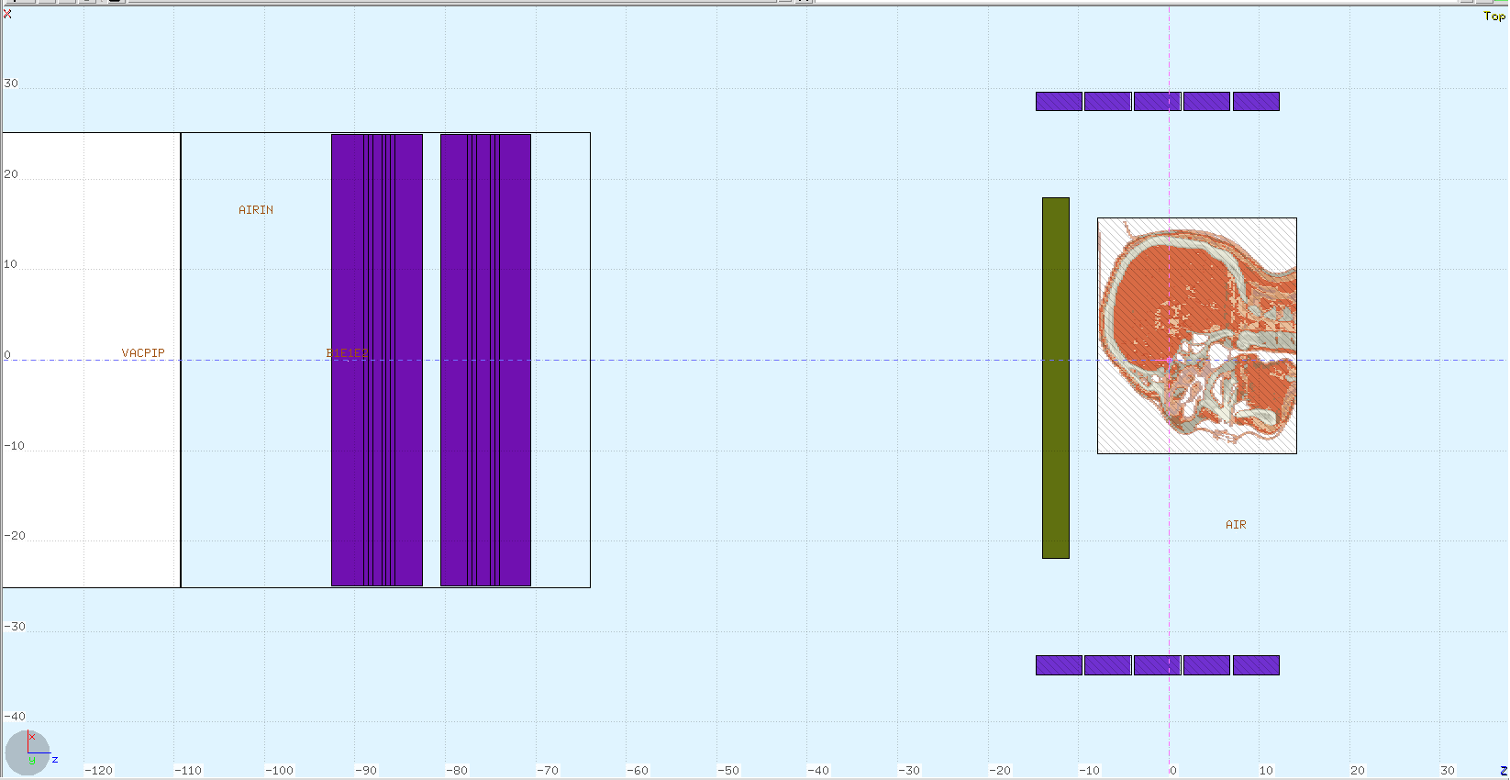
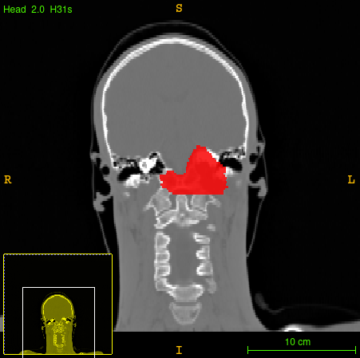
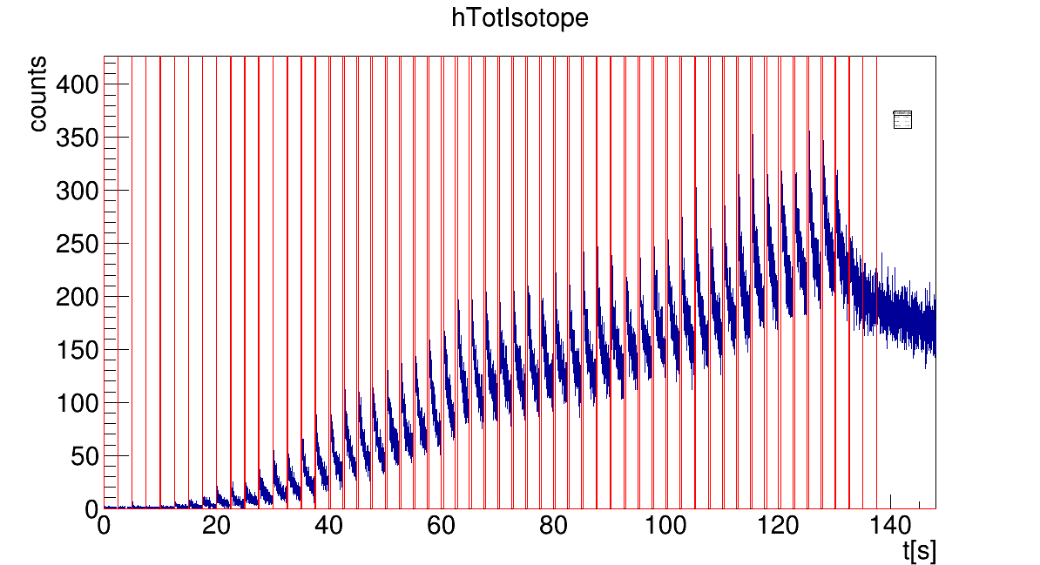
Hypotesis verification
Most of the β⁺ activity is located into the CTV
Monte Carlo simulation of 7 patients
Calculation of the Activity Volume Histogram (AVH) representing the annihilations occurred in any volume
Planning CT
Coincidence event rate
Coincidences
Primaries
f=1/10 of primary particles simulated
beam line
Beam time-space structure
Patient anatomy provided by the CT
1 st INSIGHTS meeting Hadrontherapy, monitoring and new devices
5

Slide 9
Hypotesis verification
Most of the β⁺ activity is located into the CTV
Monte Carlo simulation of 7 patients
Calculation of the Activity Volume Histogram (AVH) representing the annihilations occurred in any volume
Planning CT
Coincidence event rate
Coincidences
Primaries
f=1/10 of primary particles simulated
beam line
Beam time-space structure
Patient anatomy provided by the CT
Simulation of the $β^{+}$ emitting isotopes within the PET acquisition time of each beam field + residual activity backgroung from all previously irradiated beam fields (mainly ¹¹C)
1 st INSIGHTS meeting Hadrontherapy, monitoring and new devices
5

Slide 10
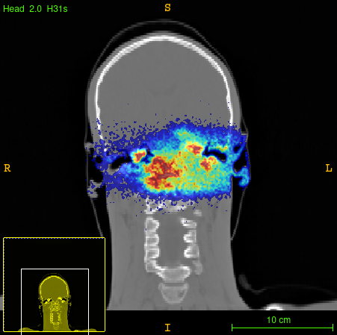
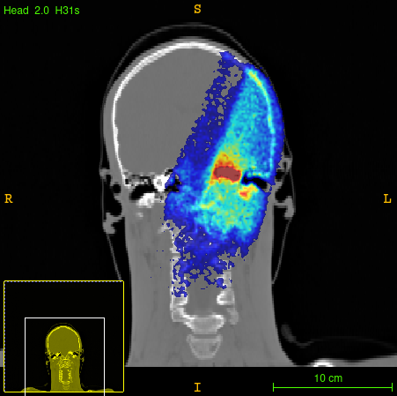
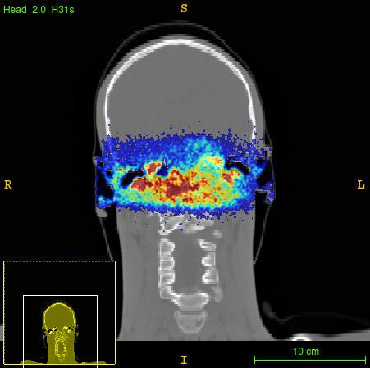
Hypotesis verification
Annihilation Maps
1st field 2nd field 3rd field
290°
0°
+
+
180°
1 st INSIGHTS meeting Hadrontherapy, monitoring and new devices
6

Slide 11
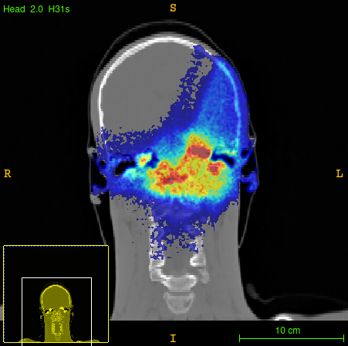
Hypotesis verification
Annihilation Maps
1st field 2nd field 3rd field
290°
0°
+
+
180°
Total
1 st INSIGHTS meeting Hadrontherapy, monitoring and new devices
6

Slide 12
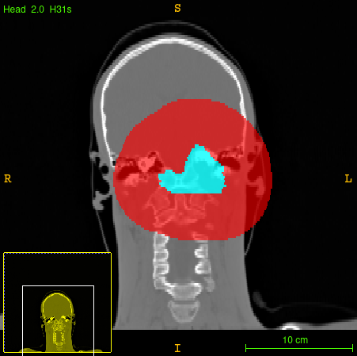
Hypotesis verification
Annihilation Maps
1st field 2nd field 3rd field
290°
0°
+
+
180°
CTV
5 cm dilated CTV
Total
1 st INSIGHTS meeting Hadrontherapy, monitoring and new devices
6

Slide 13
Hypotesis verification
Annihilation Maps
AVH - Patient 005C
1st field 2nd field 3rd field
95%
290°
0°
+
+
same activity level
180°
Volume fraction
CTV
5 cm dilated CTV
2%
Total
Activity threshold [counts]
Evaluation of the capability to identify the CTV from the background (ROI around CTV within 5 cm = dilated CTV) by setting an activity threshold
Considering the activity threshold corresponding to the 95% of the CTV, the percentage of voxels selected into the dilated CTV is in the range of 2-12%
1 st INSIGHTS meeting Hadrontherapy, monitoring and new devices
6

Slide 14
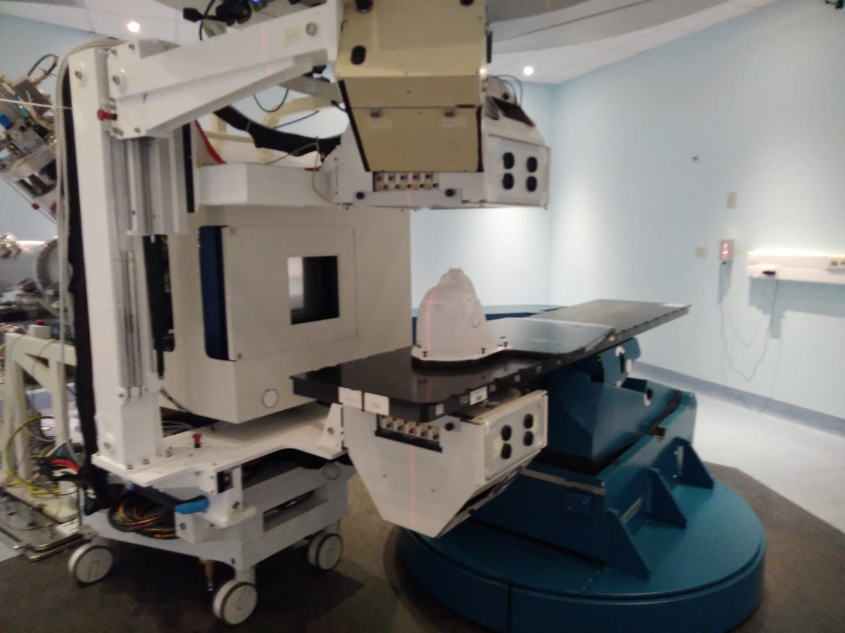
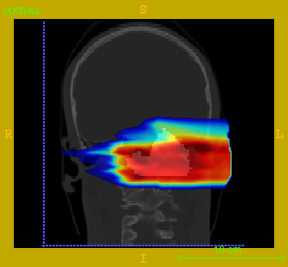
Virtual detector approach
Virtual detector to identify in a single space all the acquired coincidences and thus reconstruct only one PET image
REAL
VIRTUAL
y
1st FIELD – 0°
DOSE
VIRTUAL DETECTOR
DOSE
y
z
z
x
beam
0°
0°
0°
Fixed detector position
Rotating treatment couch
Rotating detector around the patient
Fixed treatment couch
1 st INSIGHTS meeting Hadrontherapy, monitoring and new devices
7

Slide 15
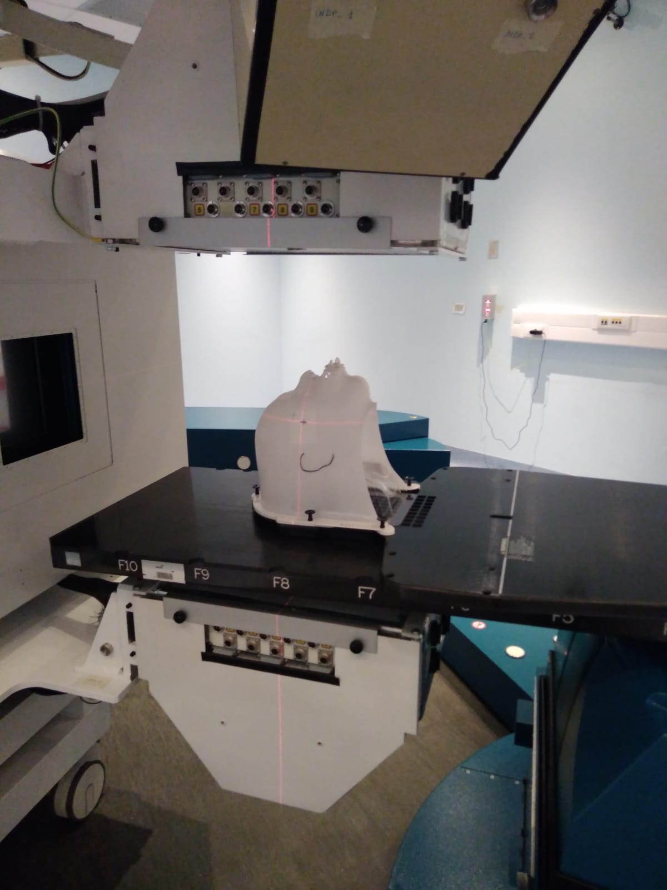
Virtual detector approach
Virtual detector to identify in a single space all the acquired coincidences and thus reconstruct only one PET image
REAL
VIRTUAL
2nd FIELD – 290°
DOSE
VIRTUAL DETECTOR
y
290°
290°
290°
z
x
beam
0°
0°
Fixed detector position
Rotating treatment couch
Rotating (real) detector around the patient
Fixed treatment couch
1 st INSIGHTS meeting Hadrontherapy, monitoring and new devices
8

Slide 16
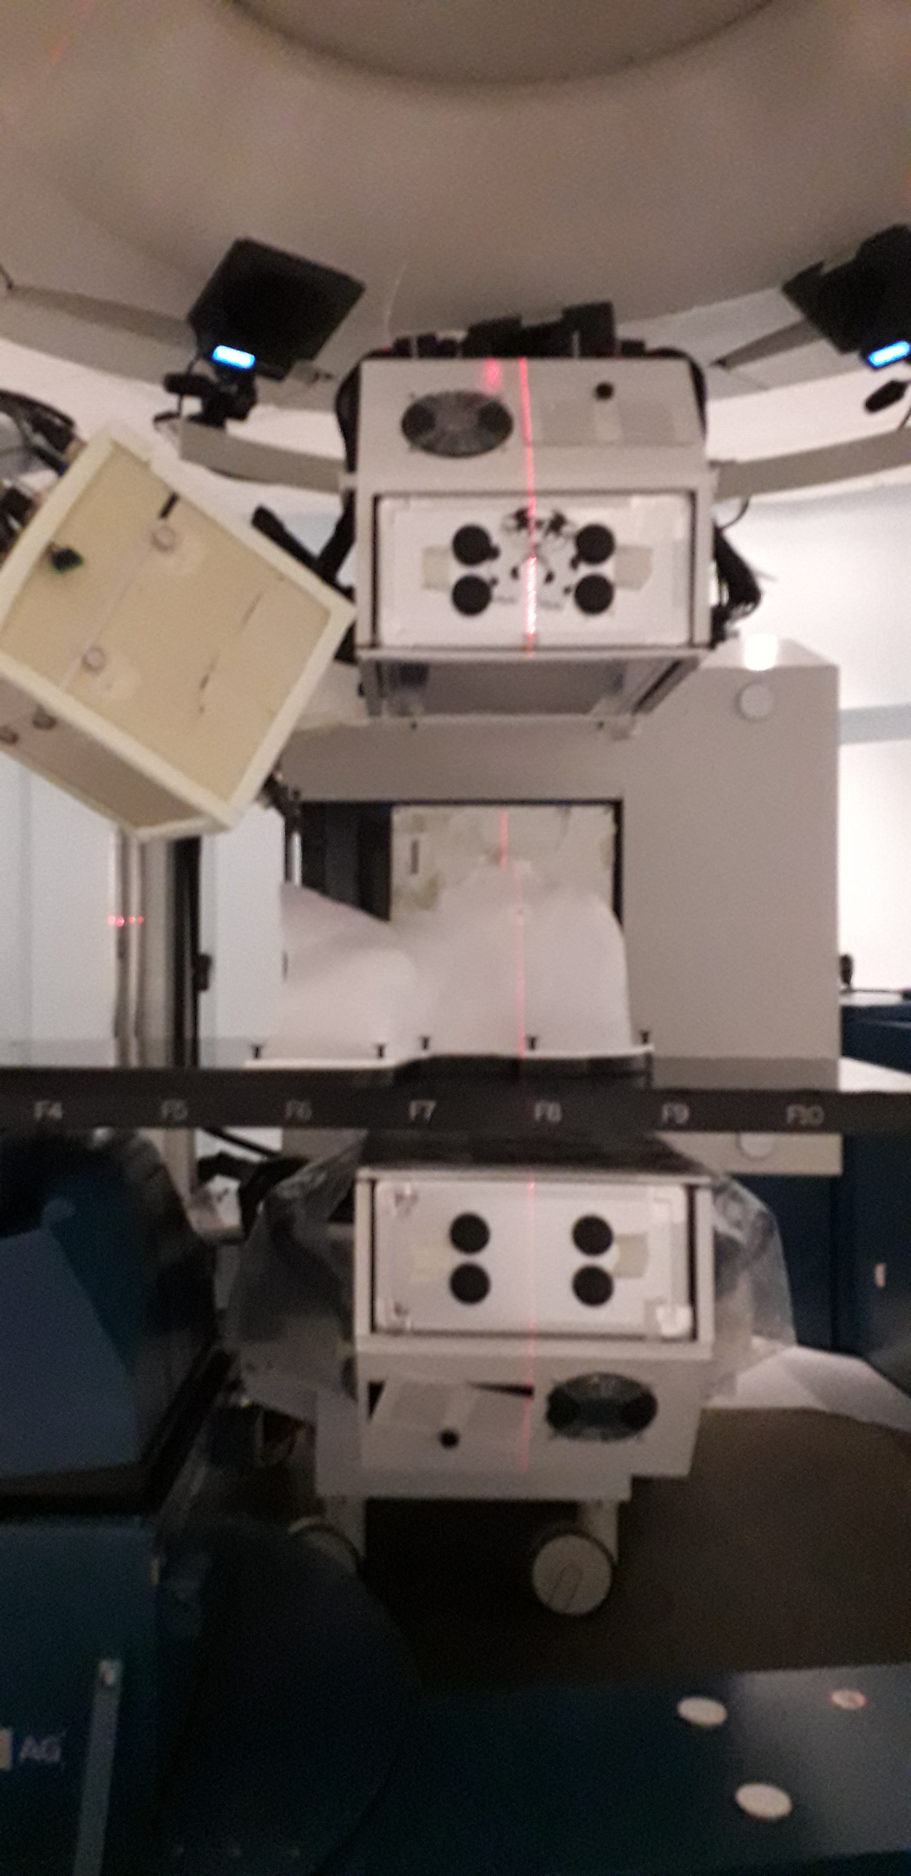
Virtual detector approach
Virtual detector to identify in a single space all the acquired coincidences and thus reconstruct only one PET image
REAL
VIRTUAL
3rd FIELD – 180°
DOSE
VIRTUAL DETECTOR
y
290°
290°
z
180°
x
beam
180°
180°
0°
0°
Fixed detector position
Rotating treatment couch
Rotating (real) detector around the patient
Fixed treatment couch
1 st INSIGHTS meeting Hadrontherapy, monitoring and new devices
9

Slide 17
PET reconstruction algorithm
List-mode Maximum Likelihood Expectation Maximization (MLEM) algorithm
$$λ_{j}^{\left(n+1\right)}=λ_{j}^{\left(n\right)}\sum_{k ∈ fields}{\frac{1}{\sum_{i_{k} ∈{ I}_{k}}{c_{i_{k}j}}}\sum_{\begin{aligned}m ∈ events \\ in field k \\ \end{aligned}}{c_{i_{m}j}}\frac{1}{\sum_{j′}{c_{i_{m}j′}λ_{j′}^{\left(n\right)}}}}$$
3 iterations and median filtering (5 mm kernel) between iterations
$λ_{j}^{\left(n\right)}$ intensity of the j-th voxel after iteration n
$c_{ij}$ (i,j) element of the system matrix
$I_{k}$ all possible LORs during field k
$\sum_{i_{k}}{c_{i_{k}j}}$sensitivity of the j-th voxel in field k
5
5
5
5
1 st INSIGHTS meeting Hadrontherapy, monitoring and new devices
10

Slide 18
PET reconstruction algorithm
List-mode Maximum Likelihood Expectation Maximization (MLEM) algorithm
$$λ_{j}^{\left(n+1\right)}=λ_{j}^{\left(n\right)}\sum_{k ∈ fields}{\frac{1}{\sum_{i_{k} ∈{ I}_{k}}{c_{i_{k}j}}}\sum_{\begin{aligned}m ∈ events \\ in field k \\ \end{aligned}}{c_{i_{m}j}}\frac{1}{\sum_{j′}{c_{i_{m}j′}λ_{j′}^{\left(n\right)}}}}$$
3 iterations and median filtering (5 mm kernel) between iterations
$λ_{j}^{\left(n\right)}$ intensity of the j-th voxel after iteration n
$c_{ij}$ (i,j) element of the system matrix
$I_{k}$ all possible LORs during field k
$\sum_{i_{k}}{c_{i_{k}j}}$sensitivity of the j-th voxel in field k
5
5
5
5
System matrix implemented with Siddon’s single ray-tracing
detector channel
i-th LOR
$$c_{ij}$$
j-th voxel
1 st INSIGHTS meeting Hadrontherapy, monitoring and new devices
10

Slide 19
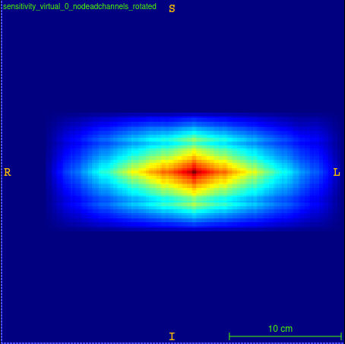
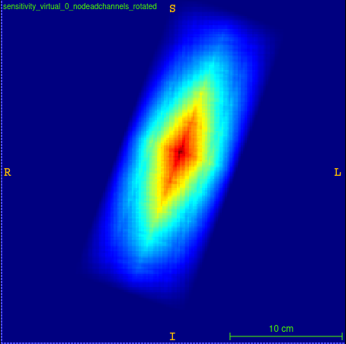
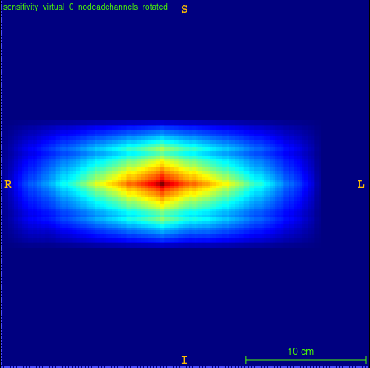
PET reconstruction algorithm
List-mode Maximum Likelihood Expectation Maximization (MLEM) algorithm
virtual
detector
Patient-talored sensitivity
real
detector
$$λ_{j}^{\left(n+1\right)}=λ_{j}^{\left(n\right)}\sum_{k ∈ fields}{\frac{1}{\sum_{i_{k} ∈{ I}_{k}}{c_{i_{k}j}}}\sum_{\begin{aligned}m ∈ events \\ in field k \\ \end{aligned}}{c_{i_{m}j}}\frac{1}{\sum_{j′}{c_{i_{m}j′}λ_{j′}^{\left(n\right)}}}}$$
1st field
2nd field
3rd field
290°
180°
3 iterations and median filtering (5 mm kernel) between iterations
$λ_{j}^{\left(n\right)}$ intensity of the j-th voxel after iteration n
$c_{ij}$ (i,j) element of the system matrix
$I_{k}$ all possible LORs during field k
$\sum_{i_{k}}{c_{i_{k}j}}$sensitivity of the j-th voxel in field k
5
5
5
0°
5
SENSITIVITY $\sum_{i_{1}}{c_{i_{1}j}}$
SENSITIVITY $\sum_{i_{2}}{c_{i_{2}j}}$
SENSITIVITY $\sum_{3}{c_{i_{3}j}}$
System matrix implemented with Siddon’s single ray-tracing
290°
detector channel
i-th LOR
$$c_{ij}$$
0°
180°
j-th voxel
FOV: 70×96×96, Voxel 3.2 mm
1 st INSIGHTS meeting Hadrontherapy, monitoring and new devices
10

Slide 20
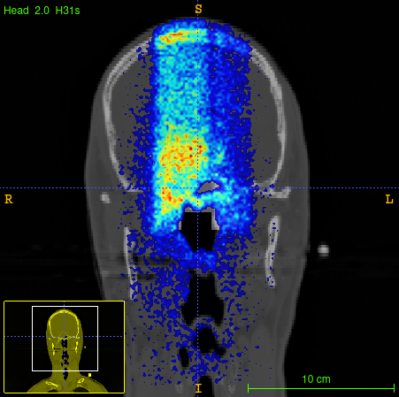
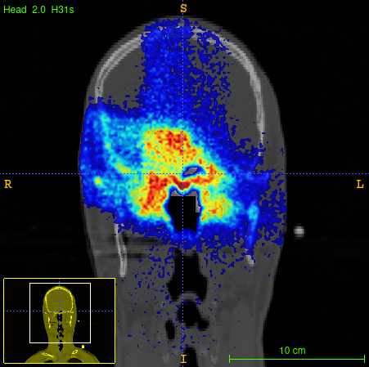
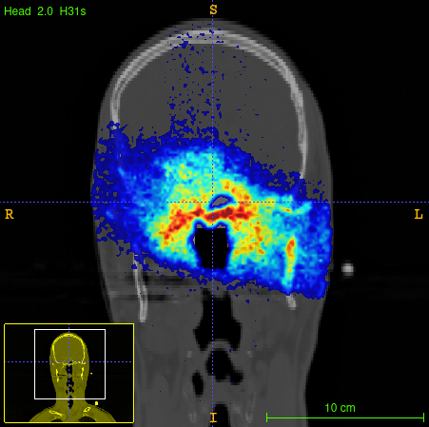
PET image simulation
STEP 1:
Beam simulation
Time-tagged
Positron emitter isotopes scoring
Annihilation Maps
1st field 2nd field 3rd field
270°
195°
15°
time
1/10 of primary particles
Fiorina E et al. Monte Carlo simulation tool for online treatment monitoring in hadrontherapy with in-beam PET: A patient study. Phys Med. 2018
1 st INSIGHTS meeting Hadrontherapy, monitoring and new devices
11

Slide 21
PET image simulation
STEP 1:
Beam simulation
Time-tagged
Positron emitter isotopes scoring
STEP 2:
PET simulation:
Annihilation Maps
1st field 2nd field 3rd field
270°
195°
15°
time
1/10 of primary particles
Isotope decays are simulated
All positrons are simulated x10
Photons transportation to the detector
Fiorina E et al. Monte Carlo simulation tool for online treatment monitoring in hadrontherapy with in-beam PET: A patient study. Phys Med. 2018
1 st INSIGHTS meeting Hadrontherapy, monitoring and new devices
11

Slide 22
PET image simulation
STEP 1:
Beam simulation
Time-tagged
Positron emitter isotopes scoring
STEP 2:
PET simulation:
Data analysis and
image reconstruction
Annihilation Maps
Coincidence window = 1 ns
Time resolution = 247 ps
Energy resolution = 15%
Energy window = 0.1 MeV
1st field 2nd field 3rd field
270°
195°
15°
time
1/10 of primary particles
Isotope decays are simulated
All positrons are simulated x10
Photons transportation to the detector
Fiorina E et al. Monte Carlo simulation tool for online treatment monitoring in hadrontherapy with in-beam PET: A patient study. Phys Med. 2018
1 st INSIGHTS meeting Hadrontherapy, monitoring and new devices
11

Slide 23
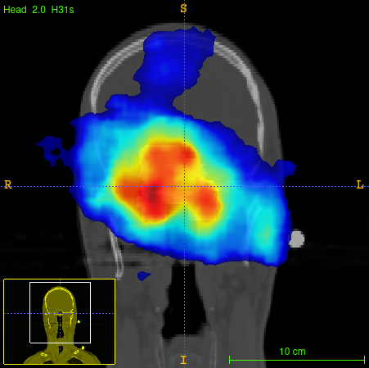
PET image simulation
STEP 1:
Beam simulation
Time-tagged
Positron emitter isotopes scoring
STEP 2:
PET simulation:
Data analysis and
image reconstruction
Annihilation Maps
Coincidence window = 1 ns
Time resolution = 247 ps
Energy resolution = 15%
Energy window = 0.1 MeV
1st field 2nd field 3rd field
270°
195°
15°
Multiple fields MLEM reconstruction
time
1/10 of primary particles
Isotope decays are simulated
All positrons are simulated x10
Photons transportation to the detector
Fiorina E et al. Monte Carlo simulation tool for online treatment monitoring in hadrontherapy with in-beam PET: A patient study. Phys Med. 2018
1 st INSIGHTS meeting Hadrontherapy, monitoring and new devices
11

Slide 24
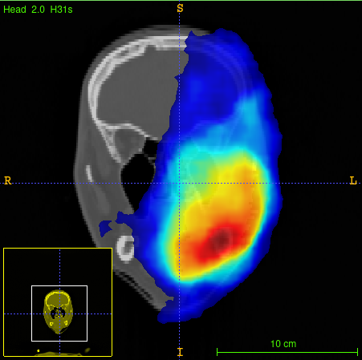
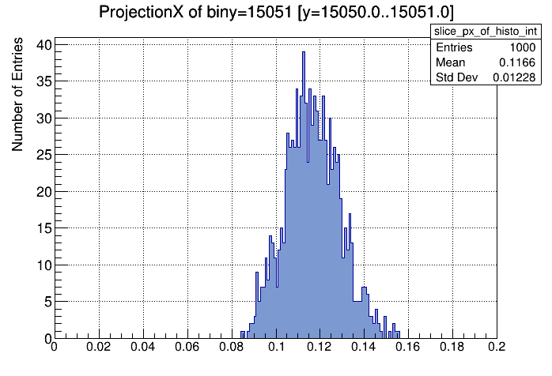
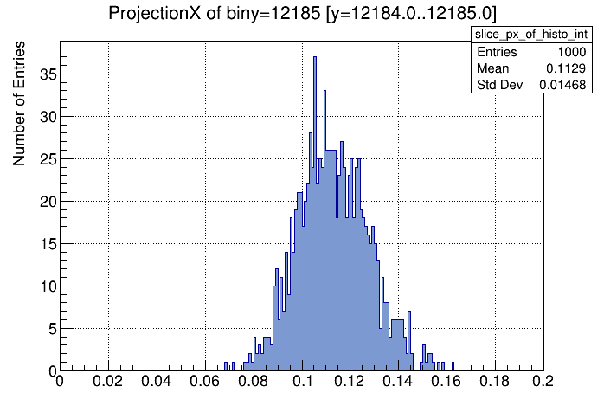
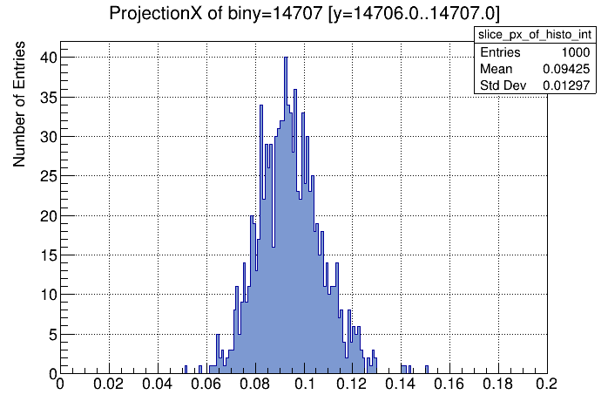
Voxel Based Morphometry
1) N = 500 simulated images on Planning/ Control CT
All positrons are simulated x1000 to increase the statistics by a factor 100
Random selection of simulated events (probability 0.01±20%) to get 500 datasets (list-mode coincidences file) with a statistics comparable to experimental data
Reference intensity distributions are obtained for each voxel
Statistical comparison of each voxel value with the reference intensity distribution p-value
Two tailed hypothesis test with significance level α = 0.01
2) Reference intensity distributions for each voxel i
<I_{i}^{sim}>
I_{i}^{obs}
3) p-value calculation
r_{i} = number of images in the tail [I_{i}^{obs}> < I_{i}^{sim} > or I_{i}^{obs>} < I_{i}^{sim} >]
N = 500
r_{i}
Kraan AC et al. Localization of anatomical changes in patients during proton therapy with in-beam PET monitoring: A voxel-based morphometry approach exploiting Monte Carlo simulations. Med Phys. 2022
1 st INSIGHTS meeting Hadrontherapy, monitoring and new devices
12

Slide 25
Voxel Based Morphometry
1) N = 500 simulated images on Planning/ Control CT
All positrons are simulated x1000 to increase the statistics by a factor 100
Random selection of simulated events (probability 0.01±20%) to get 500 datasets (list-mode coincidences file) with a statistics comparable to experimental data
Reference intensity distributions are obtained for each voxel
Statistical comparison of each voxel value with the reference intensity distribution p-value
Two tailed hypothesis test with significance level α = 0.01
2) Reference intensity distributions for each voxel i
<I_{i}^{sim}>
I_{i}^{obs}
3) p-value calculation
r_{i} = number of images in the tail [I_{i}^{obs}> < I_{i}^{sim} > or I_{i}^{obs>} < I_{i}^{sim} >]
N = 500
r_{i}
Kraan AC et al. Localization of anatomical changes in patients during proton therapy with in-beam PET monitoring: A voxel-based morphometry approach exploiting Monte Carlo simulations. Med Phys. 2022
1 st INSIGHTS meeting Hadrontherapy, monitoring and new devices
13

Slide 26
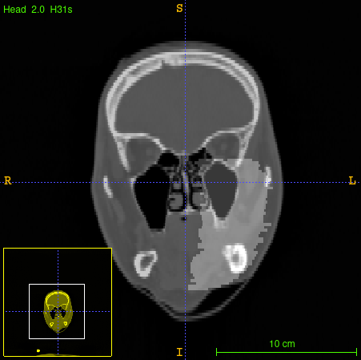
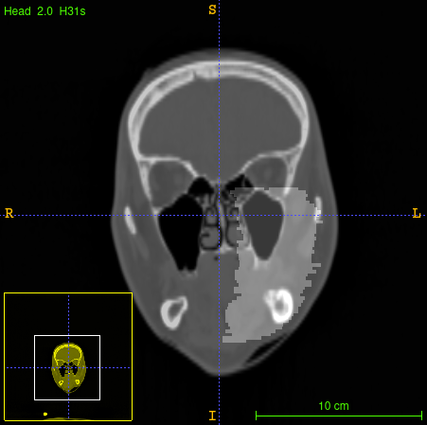
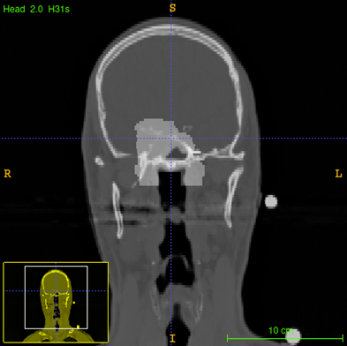
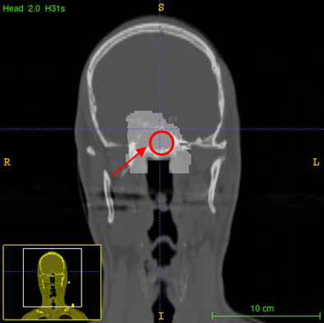
clinical trial
The
Patient 008C
Patient 006C
Planning CT
Control CT
Planning CT
Control CT
PZ008
ACC, 16 (64 Gy(RBE)) fractions, 4 Gy(RBE) per fraction
Monitored beam fields: 270° - 320° - 15°
Control CT after 7 fractions no replanning
PZ006
ITAC, 10 (41 Gy(RBE))+6 fractions, 4.1 Gy(RBE) per fraction
Monitored beam fields: 270° - 195° - 15°
Control CT after 7 fractions replanning
1 st INSIGHTS meeting Hadrontherapy, monitoring and new devices
14

Slide 27
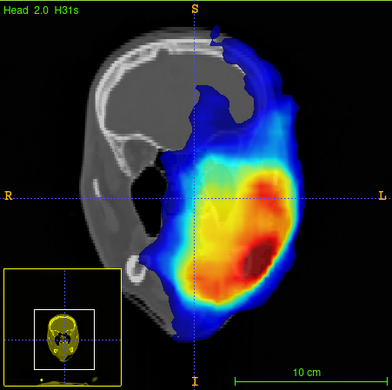
Voxel Based Morphometry results: patient 008C
500 simulated images on the control CT
Measured fraction 7
270°
320°
15°
1 st INSIGHTS meeting Hadrontherapy, monitoring and new devices
15

Slide 28
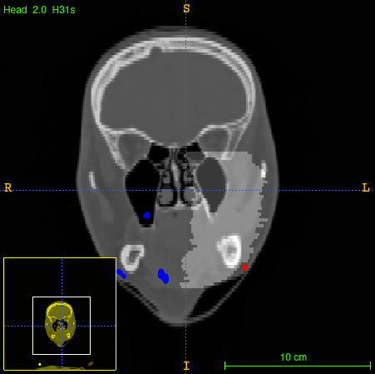
Voxel Based Morphometry results: patient 008C
p-value map
significance level α=0.01
500 simulated images on the control CT
Measured fraction 7
Fraction 7 vs Control CT
VBM
270°
320°
15°
CTV
less activity than expected
more activity than expected
1 st INSIGHTS meeting Hadrontherapy, monitoring and new devices
15

Slide 29
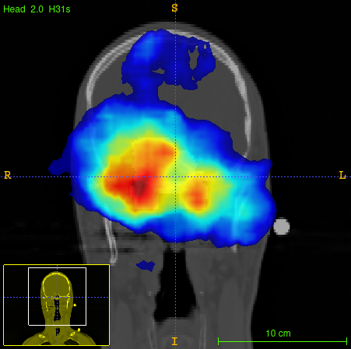
Voxel Based Morphometry results: patient 006C
500 simulated images on the control CT
Measured fraction 7
270°
195°
15°
1 st INSIGHTS meeting Hadrontherapy, monitoring and new devices
16

Slide 30
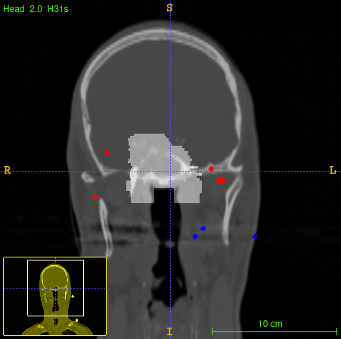
Voxel Based Morphometry results: patient 006C
p-value map
significance level α=0.01
500 simulated images on the control CT
Measured fraction 7
Fraction 7 vs Control CT
VBM
CTV
270°
195°
15°
less activity than expected
more activity than expected
1 st INSIGHTS meeting Hadrontherapy, monitoring and new devices
16

Slide 31
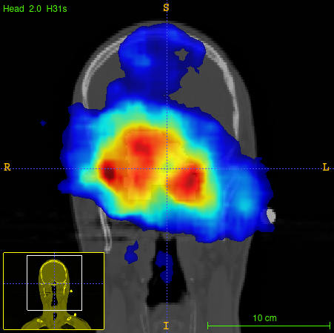
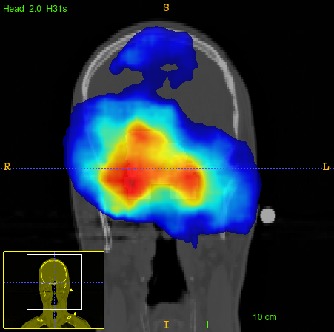
Voxel Based Morphometry results: patient 006C
500 simulated images on the planning CT
Measured fraction 2
270°
195°
15°
1 st INSIGHTS meeting Hadrontherapy, monitoring and new devices
17

Slide 32
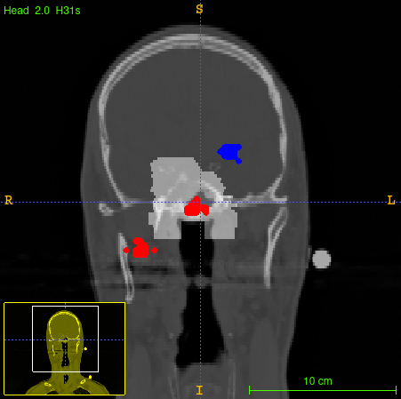
Voxel Based Morphometry results: patient 006C
p-value map
significance level α=0.01
500 simulated images on the planning CT
Measured fraction 2
Fraction 2 vs Planning CT
VBM
CTV
270°
195°
15°
less activity than expected
more activity than expected
1 st INSIGHTS meeting Hadrontherapy, monitoring and new devices
17

Slide 33
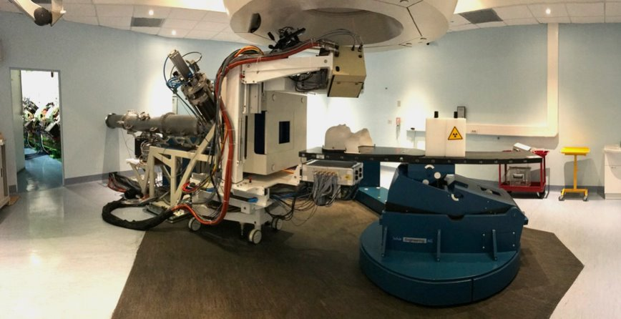
Conclusions and prespectives
The new proposed image reconstruction method is based on exploitation of the multiple field irradiation to improve PET image quality and detection of inter-fractional morphological changes during the treatment.
The hypothesis that most of the $β^{+}$ activity is located into the CTV was verified by using Monte Carlo simulation and Activity Volume Histograms.
A Voxel Based Morphometry method was implemented on patients enrolled into the INSIDE clinical trial (patients 008C and 006C) to locate spot inter-fractional morphological changes.
The proposed image reconstruction approach will be tested on more patient data.
Statistical variability in experimental data will be further investigated (e.g., different irradiation time, biological washout).
This research has received funding from the CNAO, the Tuscany Region under POR FSE 2014-2020 and INFN, project SYNCT CUP I55F21002760008, and the INSIDE project (PRIN 2013)
1 st INSIGHTS meeting Hadrontherapy, monitoring and new devices
18

Slide 34
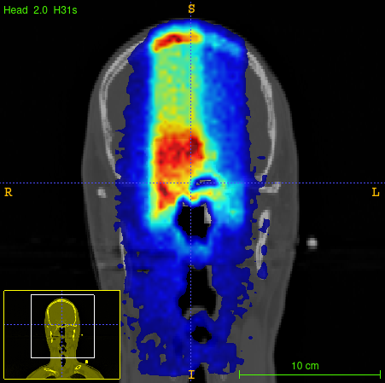
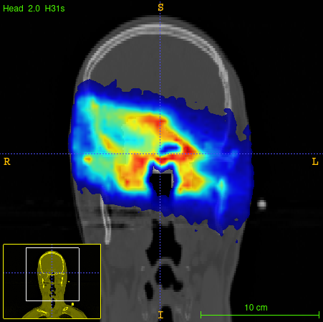
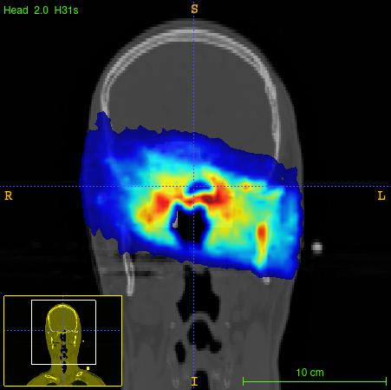
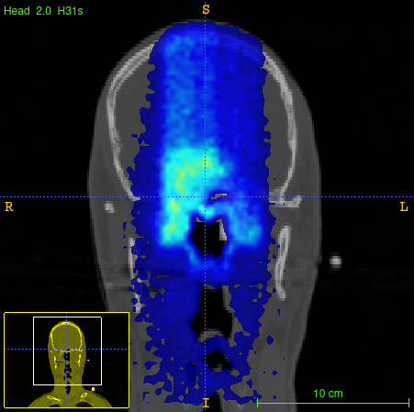
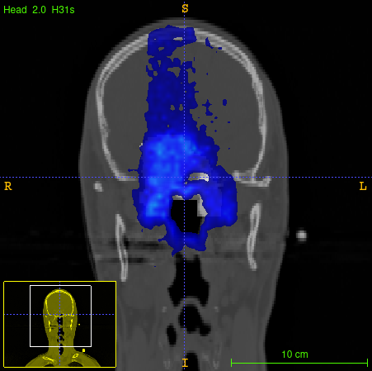
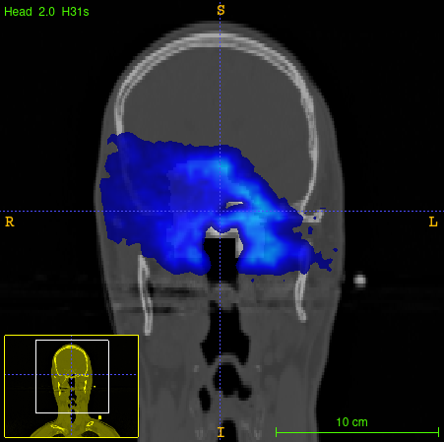
Hypotesis verification
Annihilation Maps
1° beam
acquisition time
2° beam
acquisition time
3° beam
acquisition time
Coincidence event rate
270°
195°
15°
+
+
+
1 st INSIGHTS meeting Hadrontherapy, monitoring and new devices
34

Slide 35
Hypotesis verification
AVH- Patient 001C
AVH- Patient 002C
AVH- Patient 004C
AVH- Patient 005C
95 %
CTV volume
12 %
7 %
2 %
2 %
AVH- Patient 006C
AVH- Patient 008C
AVH- Patient 009C
7 %
11 %
6 %
1 st INSIGHTS meeting Hadrontherapy, monitoring and new devices
35

Slide 36
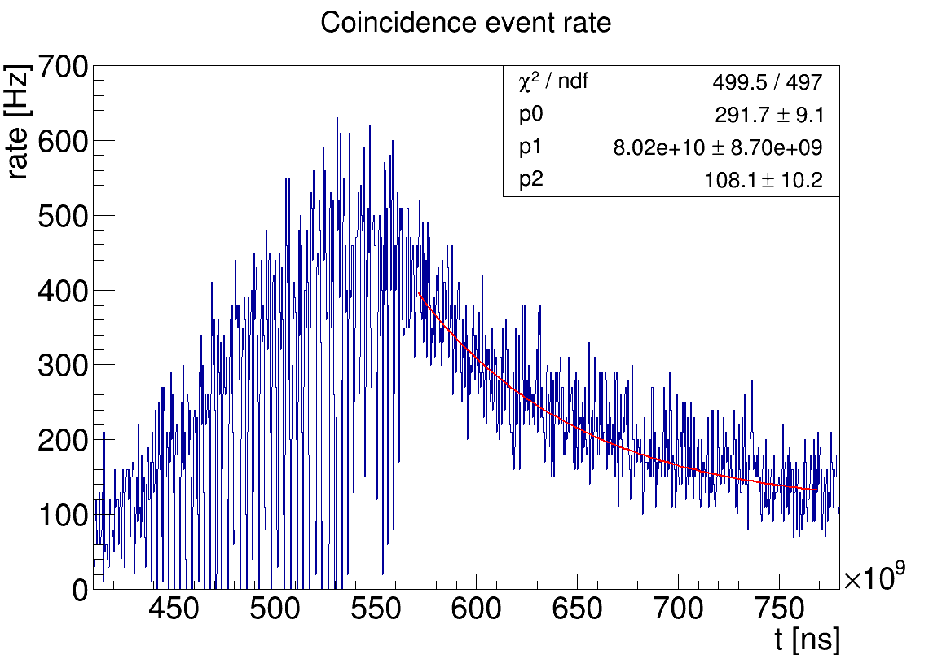
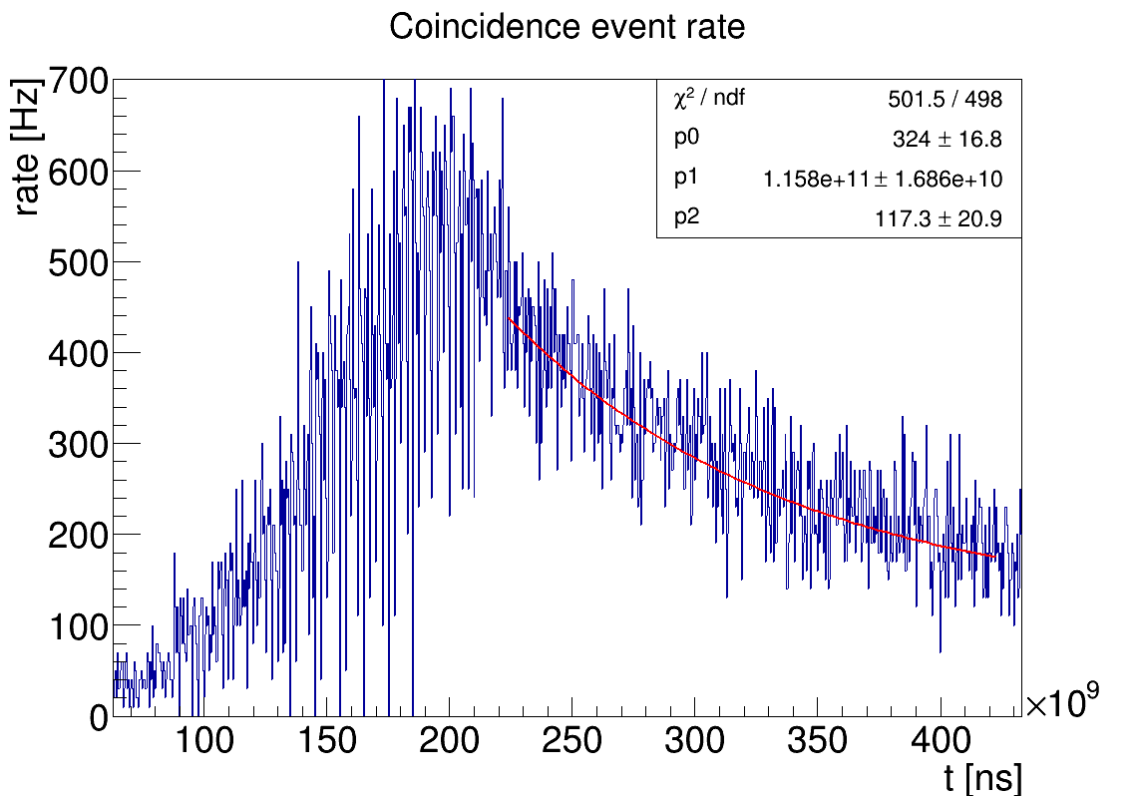
Biological washout
Estimation of the washout effect due to metabolic processes in living tissues
Exponential fit 200 s after the end of the first field irradiation
Patient 008C
MC Simulation
Experimental data
τ ≈ 80 s
τ ≈ 116 s
1 st INSIGHTS meeting Hadrontherapy, monitoring and new devices
36

Slide 37
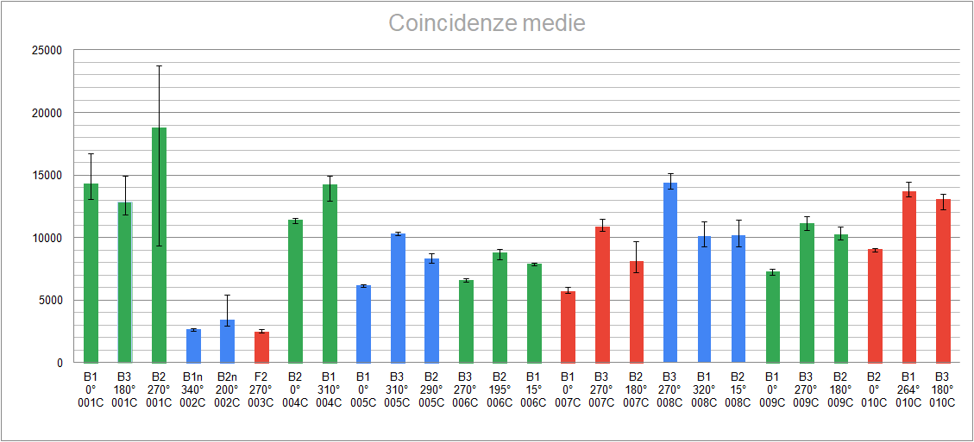
Statistical analysis
Mean value of PET coincidences of each field for each patientca
Coincidenze
PET coincidences
1 st INSIGHTS meeting Hadrontherapy, monitoring and new devices
37

