Slide 1




Dosimetric study of lung modulation and motion effects in carbon ion therapy for lung cancer
Maria Chiara Martire^{1,2}, Olga Sokol¹, Kilian Baumann^{3,4}, Klemens Zink^{4,5},Christian Graeff^{1,2}
¹Biophysics, GSI Helmholtzzentrum für Schwerionenforschung, Darmstadt, Germany
²Department of Electrical Engineering and Information Technology, Technical University of Darmstadt, Germany
³Department of Radiotherapy and Radiation Oncology, Philipps-University Marburg, Marburg, Germany
⁴University of Applied Sciences Giessen, Germany
⁵Institute of Medical Physics and Radiation Protection
Insights Pisa Workshop 18th – 20th October 2023
m.c.martire@gsi.de

Slide 2
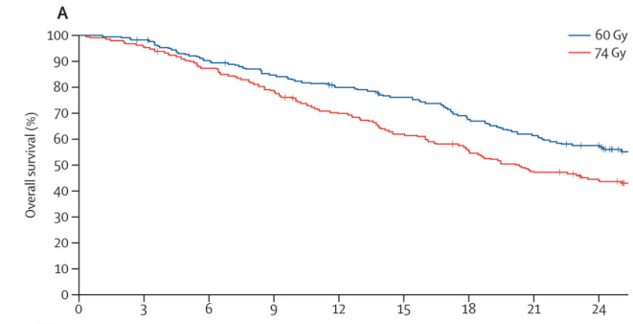
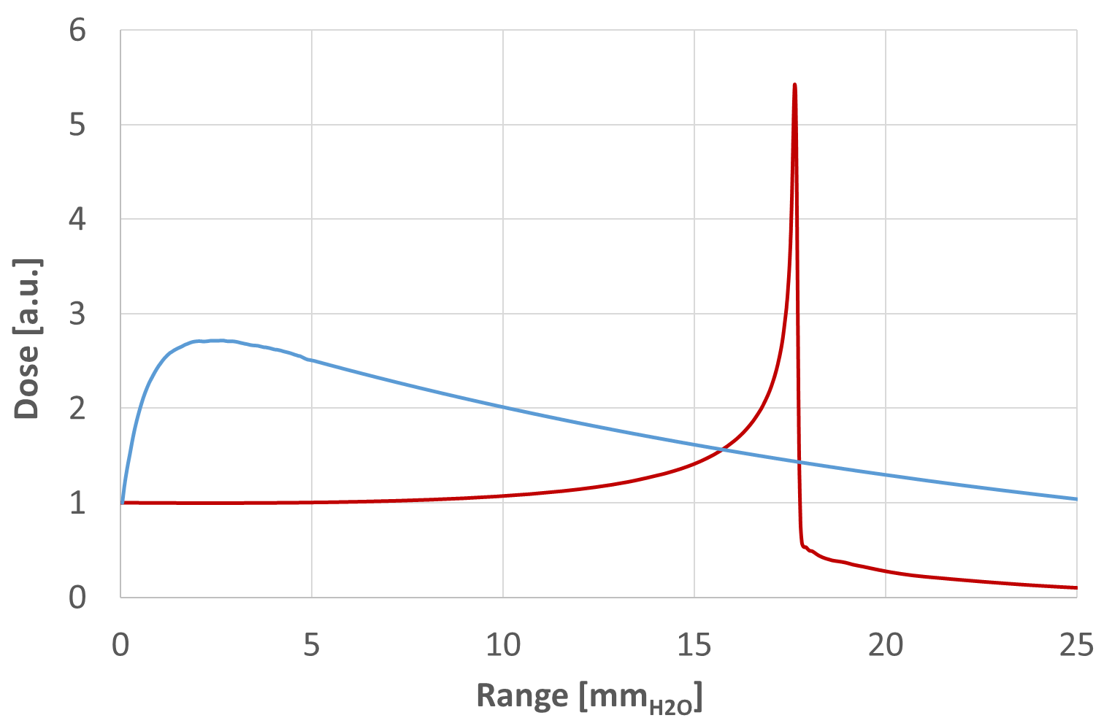
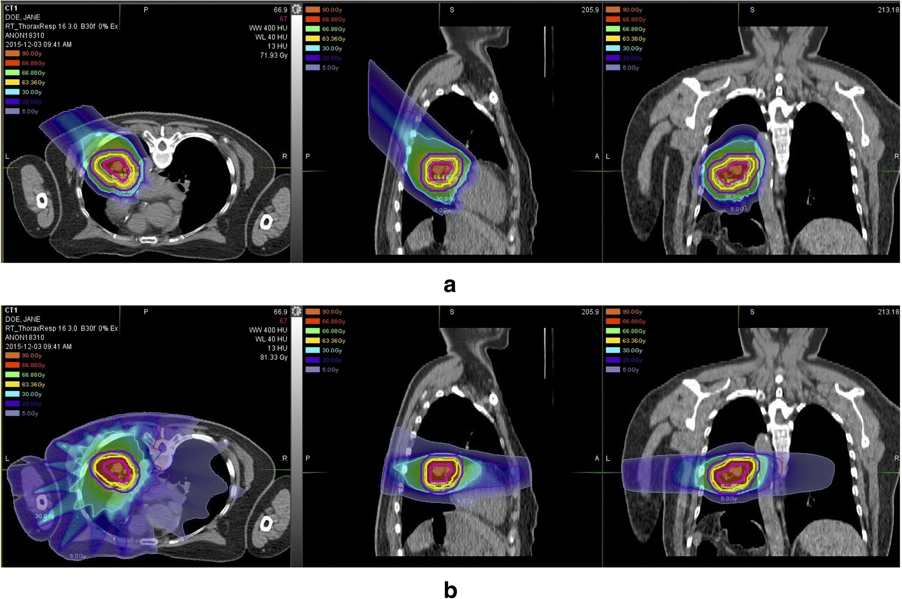
Why ¹²C ions therapy for lung cancer ?
Non-Small Cell Lung Cancer
(NSCLC):
“74 Gy radiation was not better than 60 Gy, and might be potentially harmful. Treatment-related deaths were more common in the high-dose group”
Inoperable
Metastatic
Radioresistant
Effective and precise radiotherapy treatment
Bradley et al., Lancet Oncol., 2015
Photon
Carbon
¹²C⁶⁺
300 MeV/u
photons
20 MV
normal tissue
target
Chen et al. Radiation Oncology 2019
Insights Pisa Workshop 18th – 20th October 2023
m.c.martire@gsi.de

Slide 3
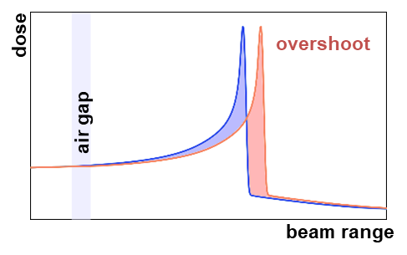
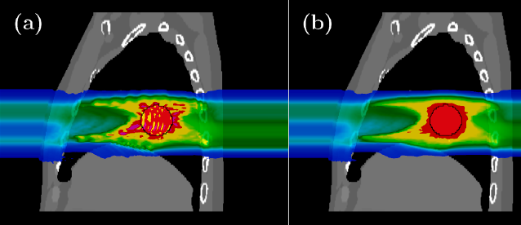
Why ¹²C ions therapy for lung cancer ?
¹²C Therapy :
Lower integral dose
Very sharp dose gradients
Increased biological effectiveness
Range and motion related uncertainties →INTERPLAY effect
Lung tissue heterogeneities → LUNG MODULATION effect
Investigate the radio-biological effect on normal tissue cells
Investigate and compare the clinical impact through dosimetric studies
T. Steinsberger et al., Physica Medica 2021
Insights Pisa Workshop 18th – 20th October 2023
m.c.martire@gsi.de

Slide 4
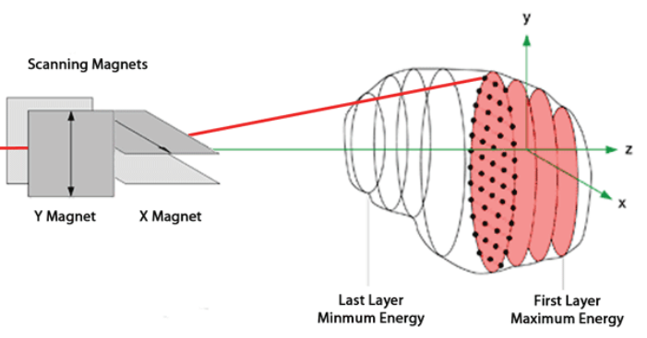
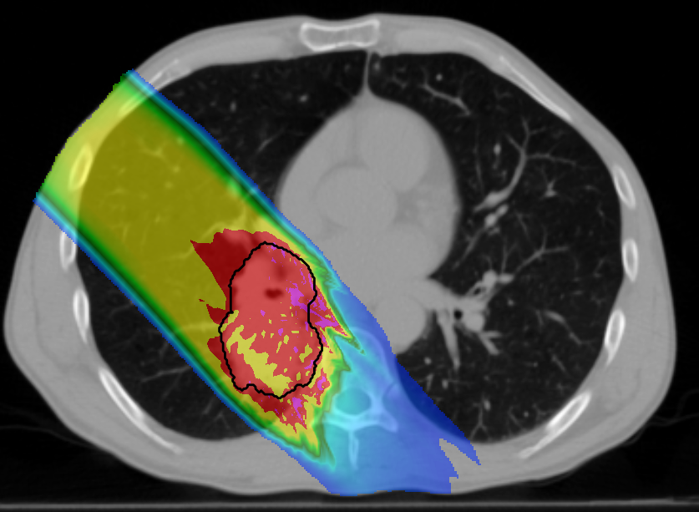
Motion related uncertainties – Interplay effect
Active scanned beam
Target motion
Interplay effect
B. Marchand et al., EPAC 2000
ACRF Image X Institute
4D dose calculation
From the 4DCT and the optimized 3D plan, a 4D plan is created
To each beam spot a motion state is assigned
4D dose calculation:
  Only tumor motion is considered (perfectrescan plan, interplay neglected)
  Tumor and beam motion considered (interplay plan)
Insights Pisa Workshop 18th – 20th October 2023
m.c.martire@gsi.de

Slide 5
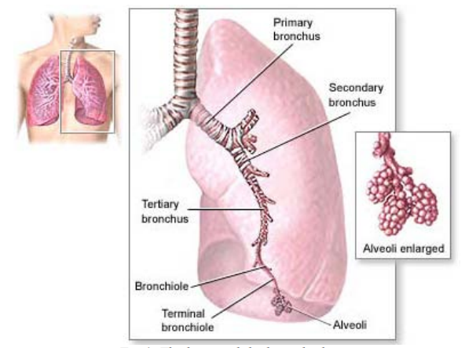
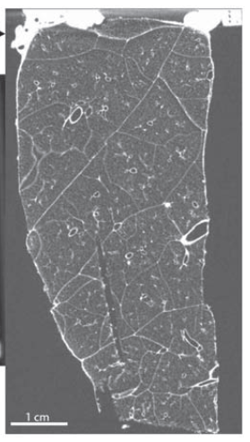
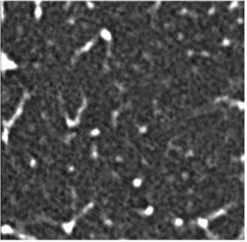
Lung tissue heterogeneities – Modulation effect
Micro-CT image of a porcine lung sample
Trachea
Diameter= 1.80 cm
Clinical CT
Resolution ~ mm
Not included in treatment plans optimization!
Diameter = 0.4 mm
Resolution ~ 10 μm
J. Burg et al Phys. Med. Biol. 2021
Larsson-Collerfelrt A., Ph.D. thesis 2007
Insights Pisa Workshop 18th – 20th October 2023
m.c.martire@gsi.de

Slide 6
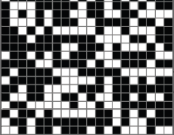
Lung tissue heterogeneities – Modulation effect
Mathematical model
Voxelised geometry
(sub-mm voxels randomly assigned to air/lung tissue)
D(z)
D_{mod} (z)
¹²C ions
Pore size = d
Pristine Bragg curve
Gaussian modulation function
Broadened Bragg curve
D(z)
⊛
σ
D_{mod} (z)
t
Ringbaek et al., Phys. Med. Biol. 2017.
Insights Pisa Workshop 18th – 20th October 2023
m.c.martire@gsi.de

Slide 7
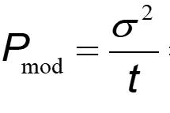
Lung tissue heterogeneities – Modulation effect
Mathematical model
Modulation Power
  Transfer the modulation effect to rougher structures (2mm CT voxels)
  Material-specific quantity (Lung ~ 208 μm)
σ
[mmH₂O]
t
  Lung modulation in TRiP98:
  Convolve in each voxel the Gaussian kernel to the pristine Bragg curve
  For biological doses, convolve the Gaussian kernel with the dose-averaged α, β and LET distributions of the unperturbed beam (computational demanding)
  Reproduce the dose degradation (dose calculation)
  Optimize for the lung modulation effect (optimization + dose calculation)
Insights Pisa Workshop 18th – 20th October 2023
m.c.martire@gsi.de

Slide 8
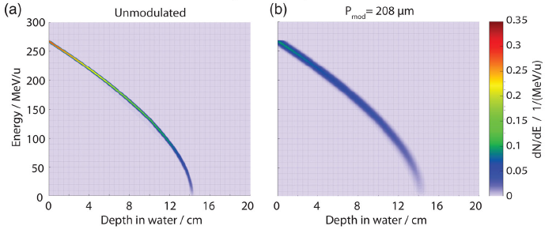
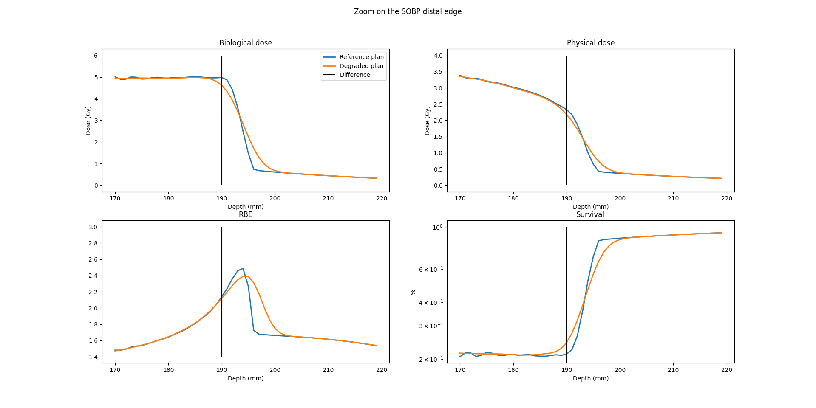
Lung tissue heterogeneities – Modulation effect
Radiobiological effect
Broadening of the primary ¹²C ions spectra
High-LET particles displaced in depth entails the shift in depth of the RBE maximum
Changes in the biological dose distribution (higher toxicity behind the target)
Validation of radio-biological effect through cell survival experiments
Target distal edge
A. Paz et al., Medical Physics, 2021
Insights Pisa Workshop 18th – 20th October 2023
m.c.martire@gsi.de

Slide 9
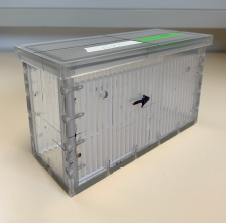
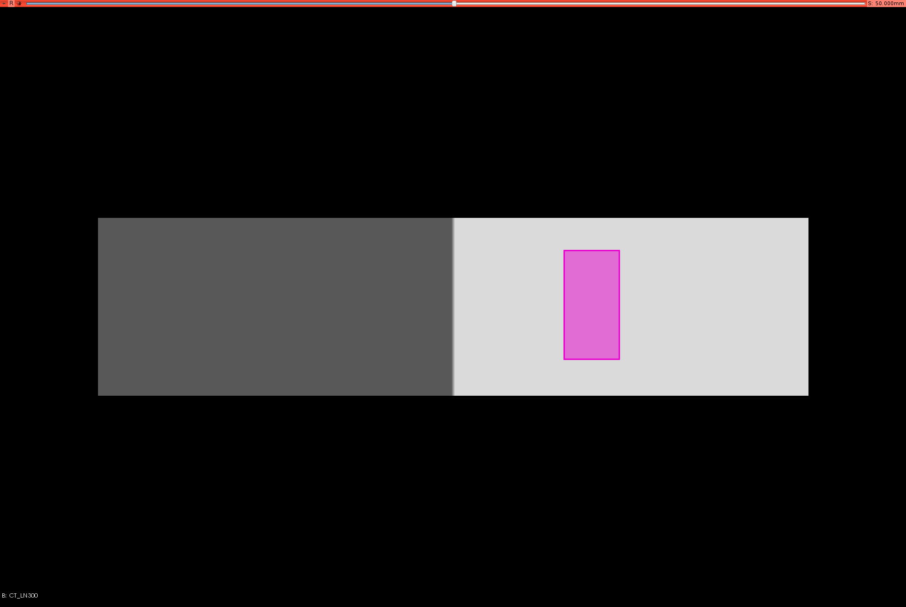
1. Validation of radio-biological effect with cell survival experiments
Materials & Methods
Experimental setup
Simulations setup
TARGET
P_{mod} = 208 μm
Beam
Porous material
(100 mm)
H₂O
(200 mm)
5 mm between two adjacent cell plates
(minimum phantom resolution)
Assess differences between reference and degraded plan comparing absorbed dose, RBE-weighted dose, RBE and survival
Cell plates position to detect differences maximum
¹²C unperturbed and degraded plans optimized in TRiP98
Insights Pisa Workshop 18th – 20th October 2023
m.c.martire@gsi.de

Slide 10
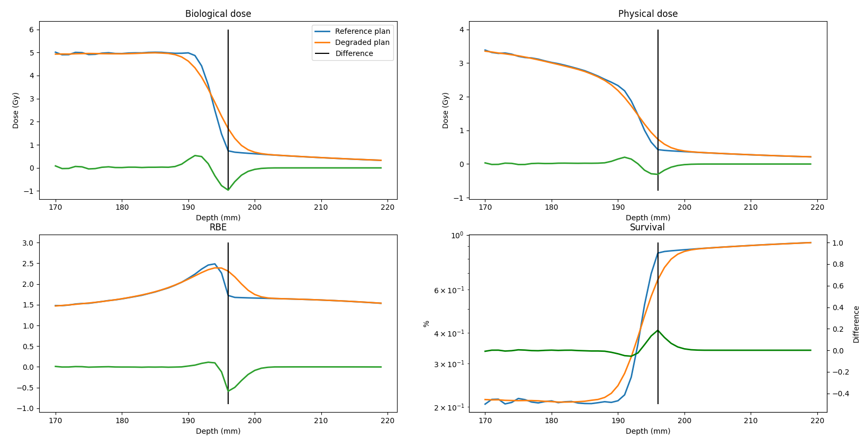
1. Validation of radio-biological effect with cell survival experiments
Results
Max difference’s
depth
RBE-weighted dose
-2 mm +2 mm
Depth (mm)
Max[ref-deg] 196 mm
 | 194 | 196 | 198
RBE-weighted dose (Gy) | 0.34 | 0.96 | 0.20
RBE | 0.01 | 0.59 | 0.33
Svv (%) (absolute values) | 5% (52 vs 47) | 18% (84 vs 66) | 6% (86 vs 80)
Difference
Differences
Survival
Setup errors
Phantom resolution
The biological error could cover the physical quantities differences
Insights Pisa Workshop 18th – 20th October 2023
m.c.martire@gsi.de

Slide 11

2. Clinical impact investigated with dosimetric study
Asses and compare the clinical impact of lung modulation and motion effects through dosimetric studies
Matherials & Methods
3 NSCLC 4DCTs data from the Cancer Imaging Archive
Different clinical scenarios are investigated
For each patient the Tumor + 3mm isotropic margins and Lung structure are created
For each patient 5 different plans are optimized and compared :
OPTIMIZATION | DOSE CALCULATION
Plan | 3D | 3D + Lungmod | 3D | 3D + Lungmod | 4D + Interplay | 4D + Perfectrescan
Reference | X |  | X
Lungmod dose | X |  |  | X
Lungmod opt |  | X |  | X
Interplay | X |  |  |  | X
Perfectrescan | X |  |  |  |  | X
Single field plan, with Tumor + 3mm target and a constant Pmod (208 μm) are optimized
Insights Pisa Workshop 18th – 20th October 2023
m.c.martire@gsi.de

Slide 12
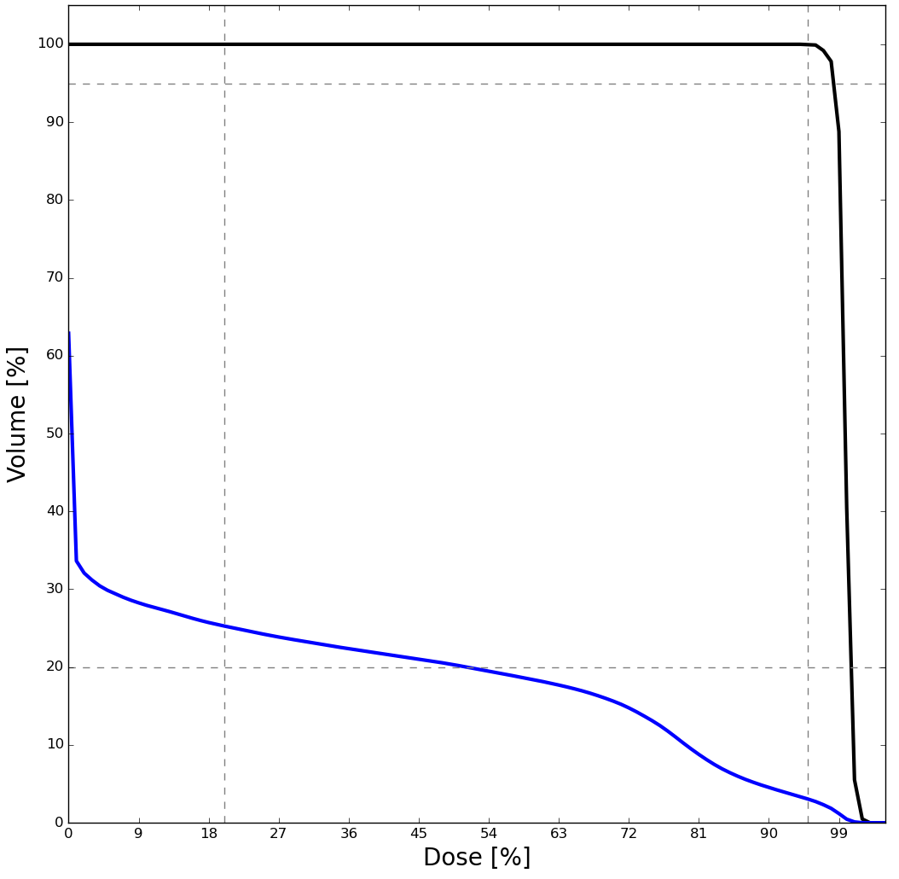
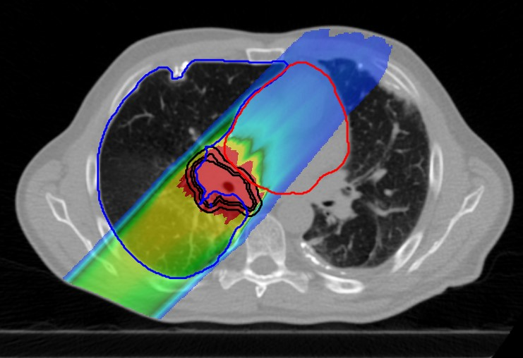
2. Clinical impact investigated with dosimetric study
Matherials & Methods
Plan quality assessed and compared through dose distributions, dose volume histograms (DVH) and dosimetric metrics
DVH
A
Dose distribution
Dosimetric metrics
Tumor
Target coverage:
D₉₅ ≥ 95% (A)
D_{mean} ~ 100%
Lung dose:
V₂₀ ≤ 20% (B)
Lung
B
Insights Pisa Workshop 18th – 20th October 2023
m.c.martire@gsi.de

Slide 13
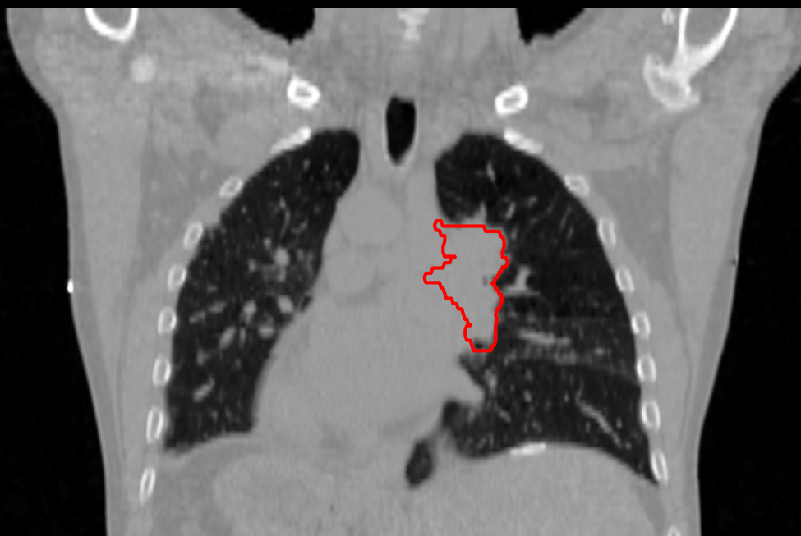
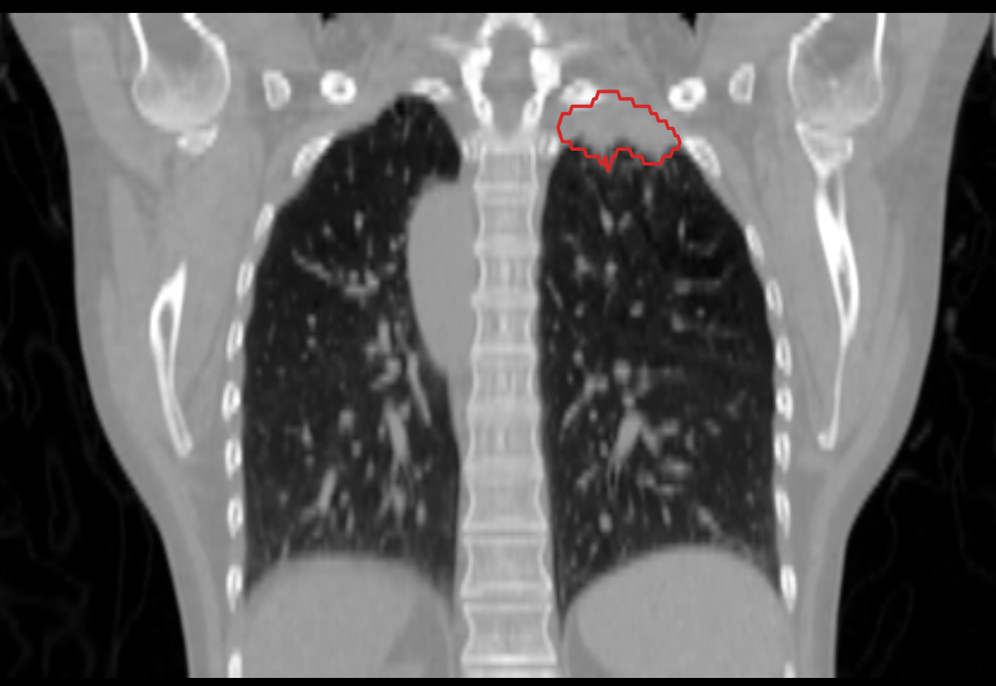
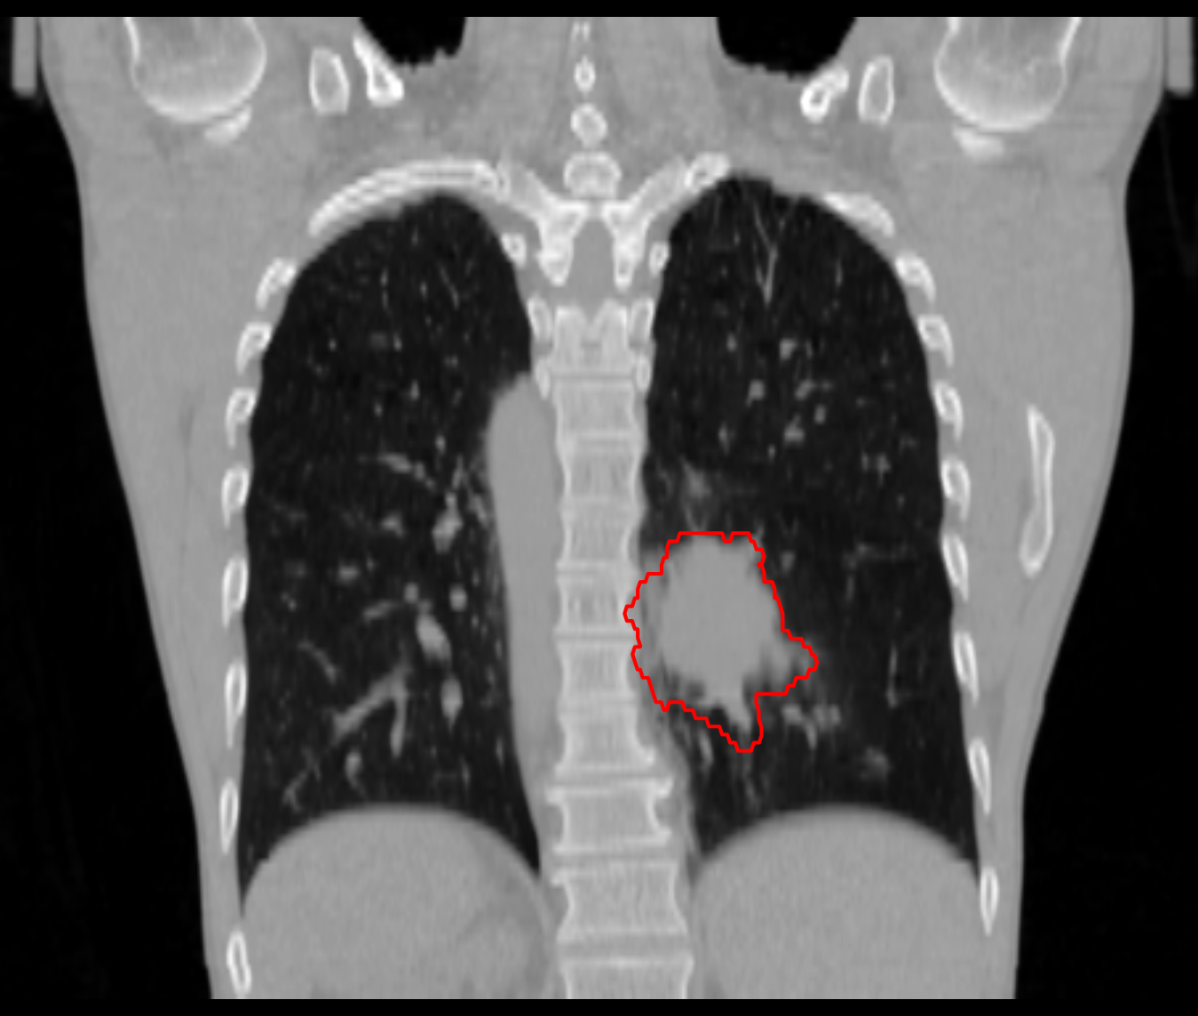
2. Clinical impact investigated with dosimetric study
Patient Data
Tumor in the middle lobe
Tumor volume = 80 cc
Tumor Δmotion = 3.8 mm
Depth in lung tissue ~ 7cm
P1
Lung modulation effect depends on:
Distance traversed by particles into the lung
Tumor dimension
Tumor position
Motion effect depends on:
Breathing motion aplitude (Δmotion)
Tumor in the upper lobe
Tumor volume = 18 cc
Tumor Δmotion = 0.7 mm
Depth in lung tissue ~ 3cm
P2
Tumor in the lower lobe
Tumor volume = 128 cc
Tumor Δmotion = 8 mm
Depth in lung tissue ~ 10cm
P3
Δmotion = Motion_{End-Inhale} – Motion_{End-Exhale}
Insights Pisa Workshop 18th – 20th October 2023
m.c.martire@gsi.de

Slide 14
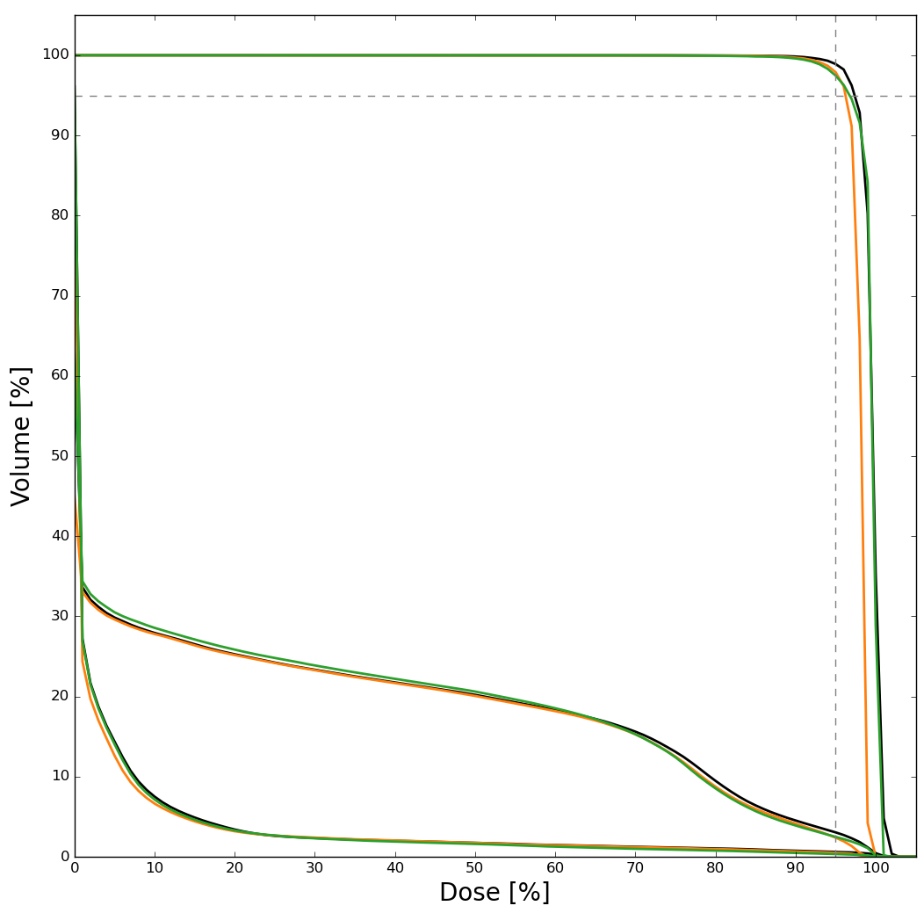
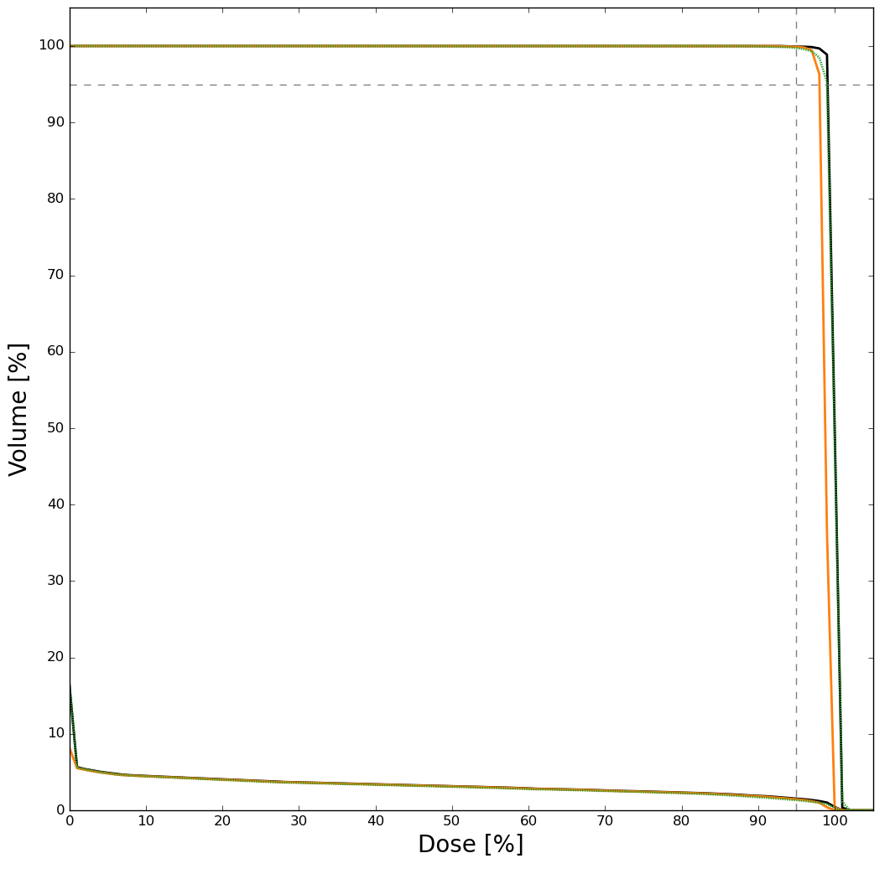
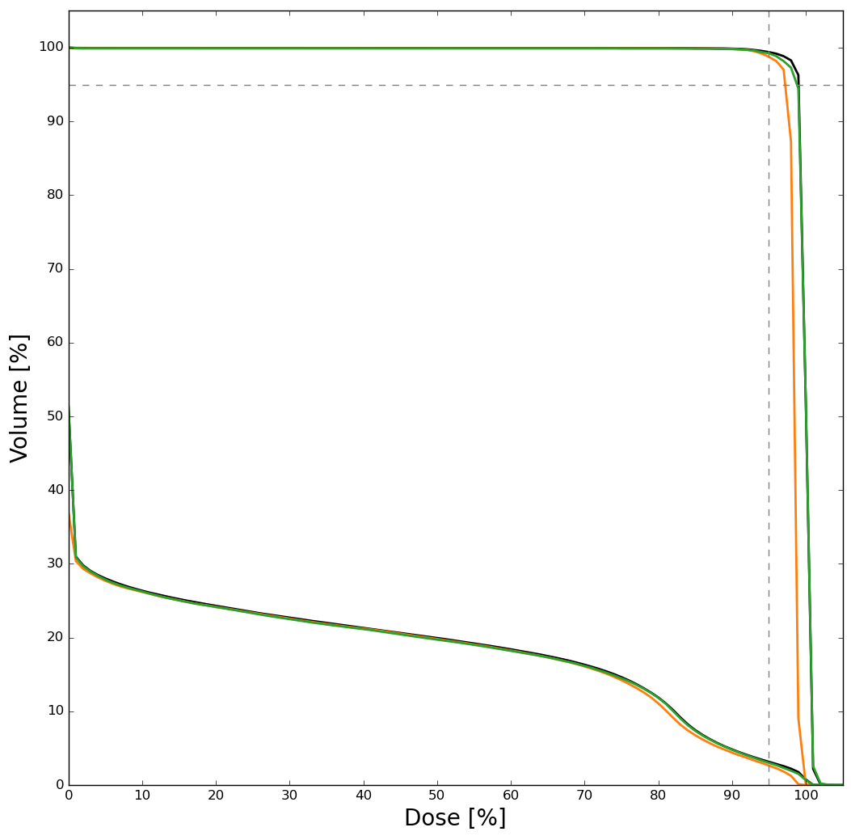
2. Clinical impact investigated with dosimetric study
Results – Lung modulation uncertainties
Tumor +3mm
Tumor + 3mm
Tumor + 3mm
Reference plan
Degraded plan
Re-optimized plan
Lung
Lung
Heart
Lung
P1 | Ref | Degraded | Re-optimized
D_{mean} (%) | 99.8 | 98.4 | 99.8
P2 | Ref | Degraded | Re-optimized
D_{mean}(%) | 100 | 98.8 | 100
P3 | Ref | Degraded | Re-optimized
D_{mean}(%) | 100 | 98.5 | 100
Insights Pisa Workshop 18th – 20th October 2023
m.c.martire@gsi.de

Slide 15
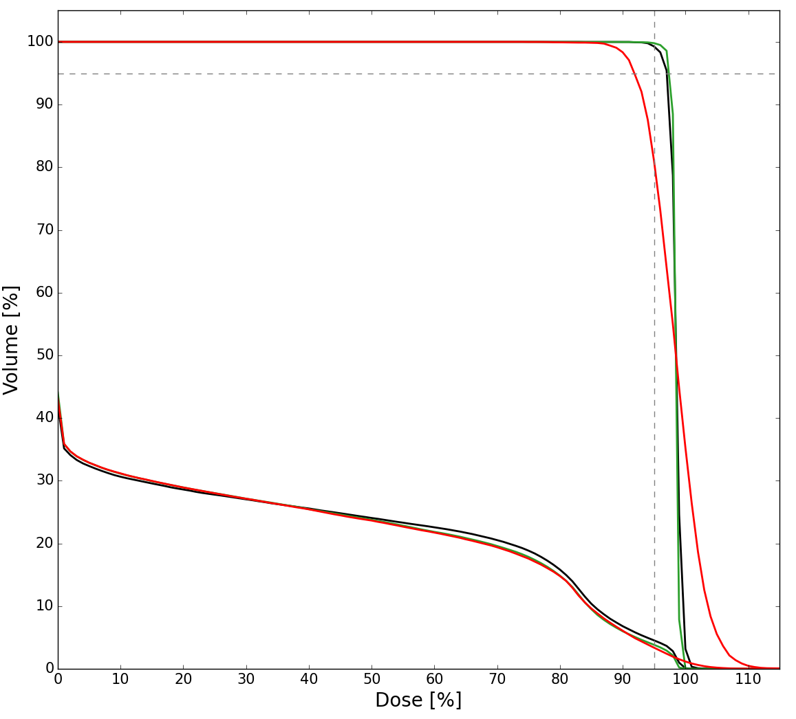
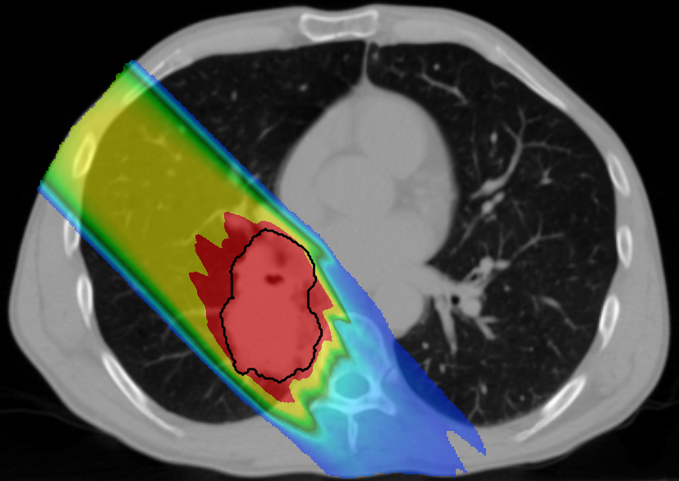
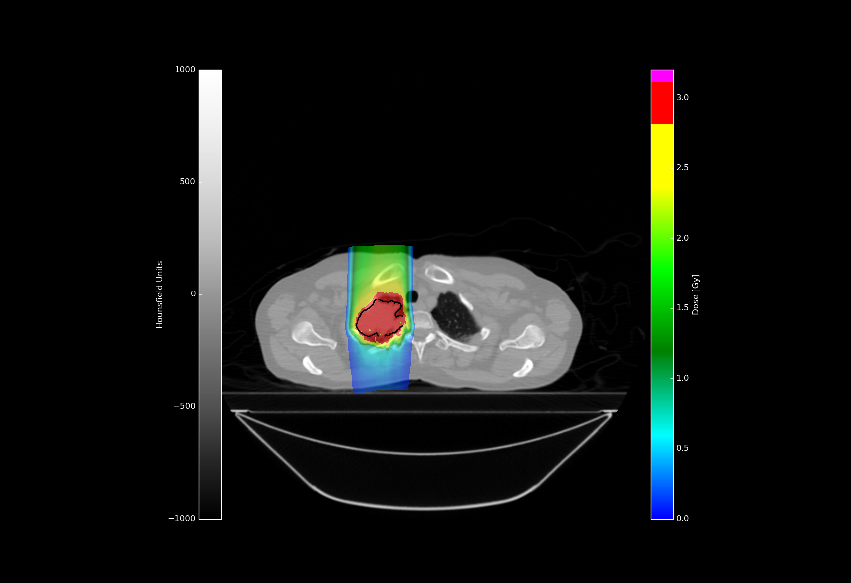
2. Clinical impact investigated with dosimetric study
Results – Motion uncertanties
Δmotion = 8 mm
Reference plan
Perfectrescan plan
Interplay plan
P3
Tumor +3mm
P3 | Ref | Perfectrescan | Interplay
D₉₅ (%) | 97 | 97.3 | 91.9
V₂₀(%) | 28.6 | 28.9 | 28.9
Reference
Δmotion = 0.7 mm
P2 | Ref | Perfectrescan | Interplay
D₉₅ (%) | 99 | 98 | 96
V₂₀(%) | 4 | 3.9 | 3.9
Interplay
Lung
Insights Pisa Workshop 18th – 20th October 2023
m.c.martire@gsi.de

Slide 16
Discussion
Small dose degradation caused by modulation effect, indipendently on patients characteristics (computational demanding)
Severe dose degradation caused by motion uncertanties (also with small Δmotion)
Dosimetric study results →
Cell survival experiments simulations→
Radiobiological effect not negligible for high-LET ions
Derivation of model of relative biological efficiency
The modulation effect is a systematic error (improves with hypo-fractionaction)
The interplay effect is a random error (averaged out in multiple fractions)
4D optimization techniques to deliver high conformal target dose in a single fraction
The more motion uncertanties are controlled, the more modulation effect has to be taken into account
Insights Pisa Workshop 18th – 20th October 2023
m.c.martire@gsi.de

Slide 17
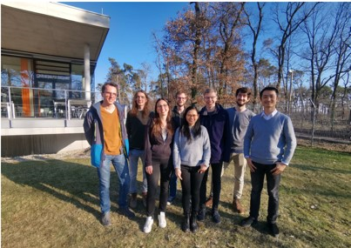

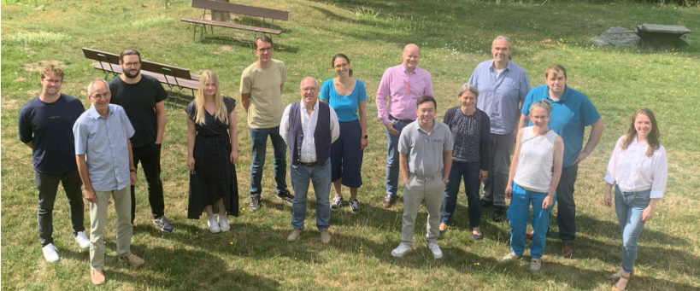

Acknowledgements
Thank you for your attention!
Insights Pisa Workshop 18th – 20th October 2023
m.c.martire@gsi.de

Slide 18
Lung tissue heterogeneities – Modulation effect
Implementation in TRiP4D
    Voxels with -900 ≤ HU ≤ -500 are identified as lung parenchyma.
    Construct the Gaussian modulation function
      Pmod : assumed constant in all voxels
      t(z) : water-equivalent thickness of lung tissues traversed by beam
      Thus,
    Convolve in each voxel the Gaussian kernel to the pristine Bragg curve to obtain the modulated dose
Gaussian modulation function
σ
t
Ringbaek et al., Phys. Med. Biol. 2017.
Insights Pisa Workshop 18th – 20th October 2023
Notes:
Fro each voxel the depth dose distribution should be convolved with the modulation function. Which means, for all energies, both primary and secondary particles. In TRiP the convolution is perfromed directly with alpha, beta and LET distributions, so only 3 times, instead of 18

