Slide 1
Real-time RBE-weighted 4D-dose calculation for carbon ion therapy
Cosimo Galeone^{1,2,3}, Timo Steinsberger¹, Lennart Volz¹, Marco Donetti⁴, Felix Mas Milian^{2,5,6}, Roberto Sacchi^{2,6}, Anna Vignati^{2,6}, Marco Durante^{1,7}, Simona Giordanengo⁶, Christian Graeff^{1,3} ¹GSI Helmholtzzentrum für Schwerionenforschung GmbH, Biophysics, Darmstadt, Germany. ²University of Torino, Physics, Torino, Italy. ³Technical University of Darmstadt, Department of Electrical Engineering and Information Technology, Darmstadt, Germany. ⁴Fondazione CNAO, Medical physics, Pavia, Italy. ⁵Universidade Estadual de Santa Cruz, Department of Exact and Technological Sciences, Ilheus, Brazil. ⁶National Institute of Nuclear Physics, Division of Torino, Torino, Italy. ⁷Technical University of Darmstadt, Condensed Matter Physics, Darmstadt, Germany
Funded by European Union’s Horizon 2020 research and innovation program under the Marie Sklodowska-Curie grant agreement No 955956

Slide 2
RAPTOR Consortium
RAPTOR = Real-Time Adaptive Particle Therapy of cancer
Particle Therapy academic and research institutes
Particle therapy clinics and companies
Online Adaptive Therapy in clinics
Funded by European Union’s Horizon 2020 research and innovation program under the Marie Sklodowska-Curie grant agreement No 955956

Slide 3
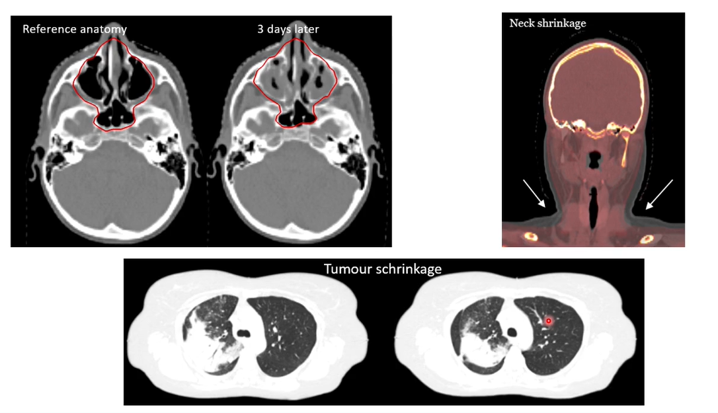
Rationale
Why do we need adaptation? Patient anatomy changes
F. Albertini, PTCOG 59 2021

Slide 4
Offline Adaptive Therapy
OFFLINE Adaptive Proton Therapy – status QUO
Control image:
regularly scheduled
ad hoc triggered
F. Albertini, PTCOG 59 2021
Improve the adaptation process

Slide 5
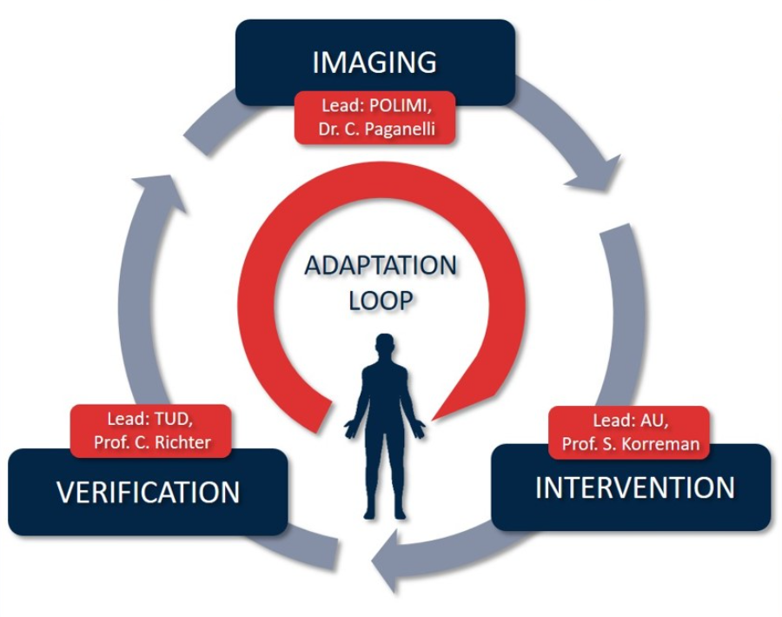
Outline
OFFLINE Adaptive Proton Therapy – status QUO
ONLINE Daily Adaptive Proton Therapy

Slide 6
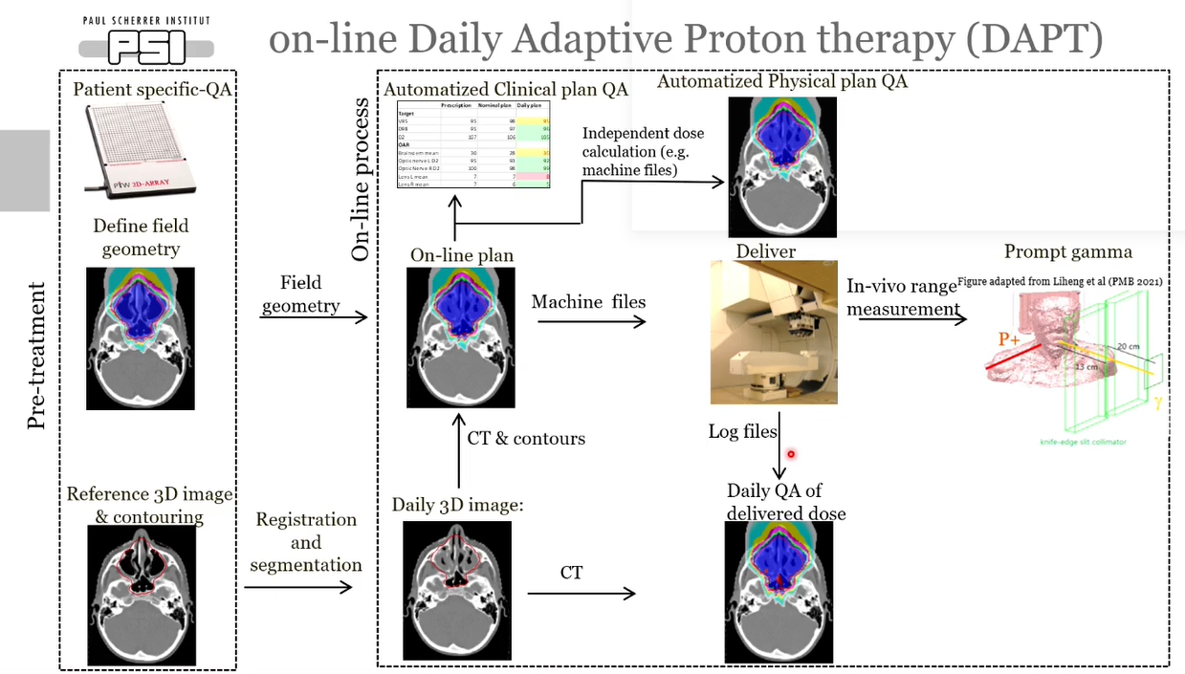
Online Daily Adaptive Therapy
Real-time delivery feedback
F. Albertini, PTCOG 59 2021

Slide 7
PhD : Objective
Tool for real-time 4D dose reconstruction
Dose delivery feedback for daily adaptive particle therapy
Assessment of efficacy of NEW motion mitigation strategies
CLINICS
EXPERIMENTAL
FAST
ACCURATE
FLEXIBLE
GPGPU = General Purpose computing
on Graphics Processing Units

Slide 8
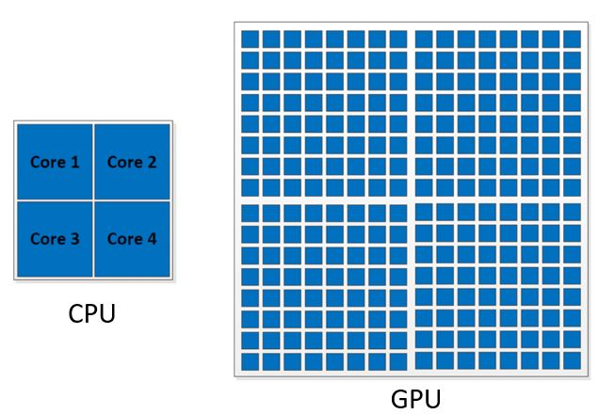
Why GPU?
M.A. Meselhi, et al., 2017
RIDOS LAPTOP WORKSTATION
CPU
GPU
Clock Speed
~ 3.5 GHz
~ 1.5 GHz
# of cores
6
6144
Few very high-speed cores
Thousands of medium-speed cores

Slide 9
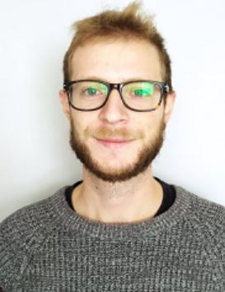
Why GPU?
CPU
GPU
1
2
3
4
5
6
Few the Flash
…
Thousands of Cosimo
998
999
1000

Slide 10
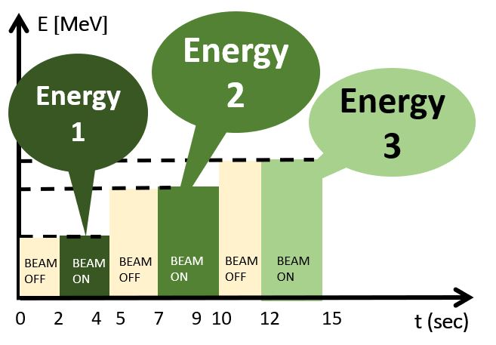
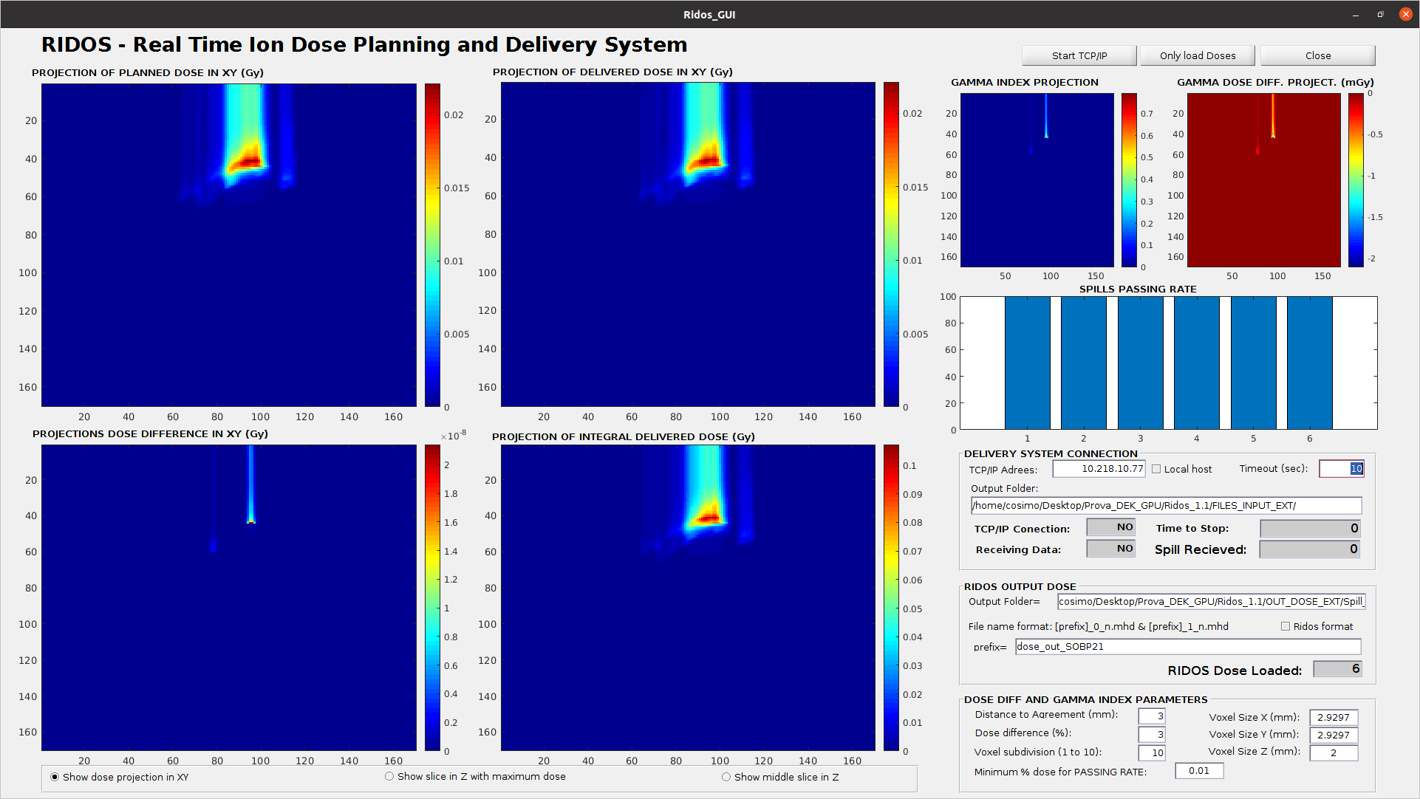
State-of-art
RIDOS= Real-Time Ion Dose Planning and Delivery System
S.Giordanengo et al., 2019
Gamma-index
Planned dose
Delivered dose
Dose delivery time structure with synchrotron
RIDOS GUI
3D
4D
Notes:
Controllare per bene quanto scritto nelle nuvole del dose delivery time structure

Slide 11
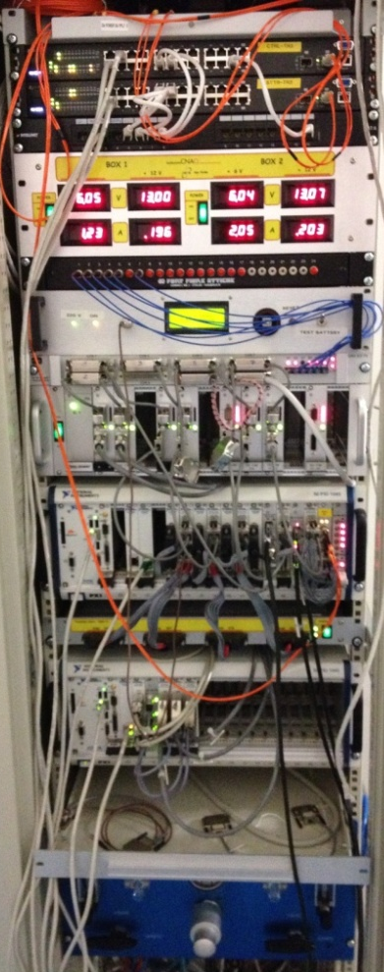
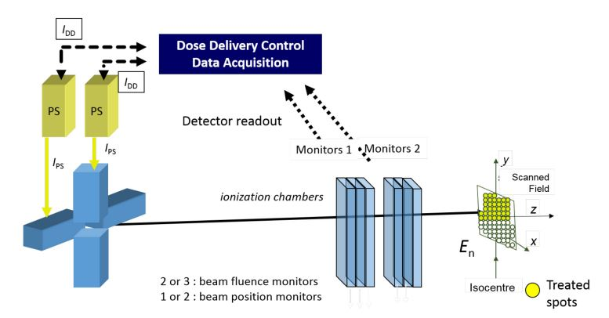
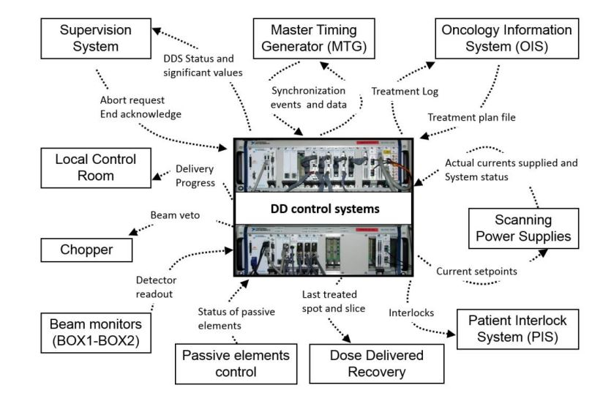
Dose Delivery System connection
Dose Delivery System
(DDS)
RIDOS
workstation
S.Giordanengo et al., 2018
S.Giordanengo et al., 2015

Slide 12
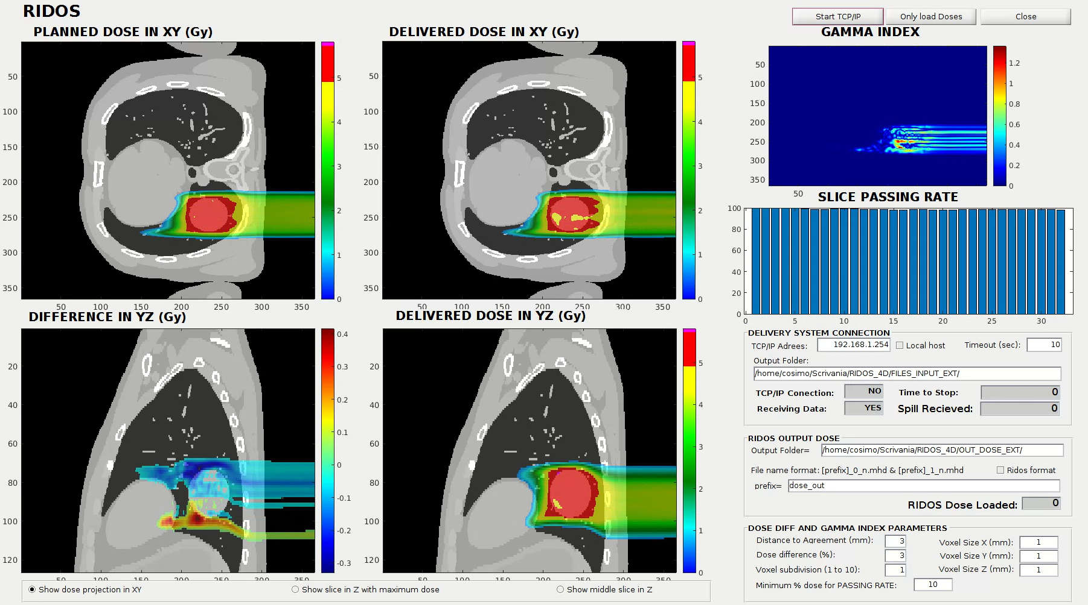
RIDOS 4D workflow
Dose Delivery System(DDS)
Prototype of future clinical CNAO DDS
Online inputs
Pre-treatment inputs
Update
GUI
PRE-TREATMENT
INPUT DATA:
4DCT;
Treatment plan;
Deformable Vector Fields
GPU dose calculation
DATA HANDLING INTERFACE
End Slice
…
Pre-treatment
Start Slice
End treatment
ONLINE INPUTS:
Beam position;
# of particles;
Motion phase
RIDOS WORKSTATION

Slide 13
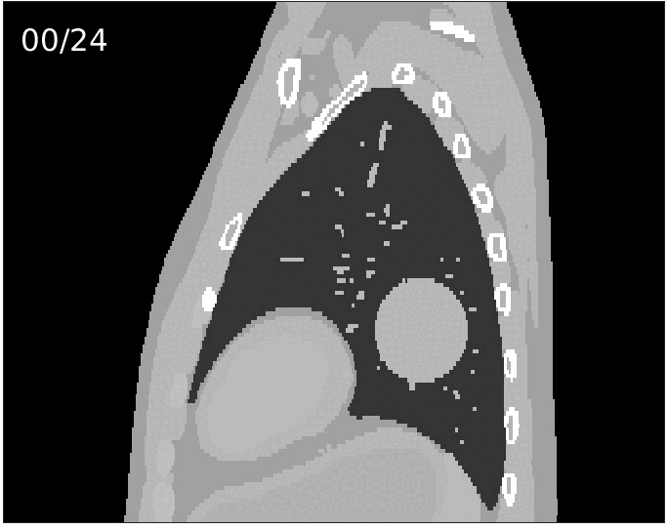
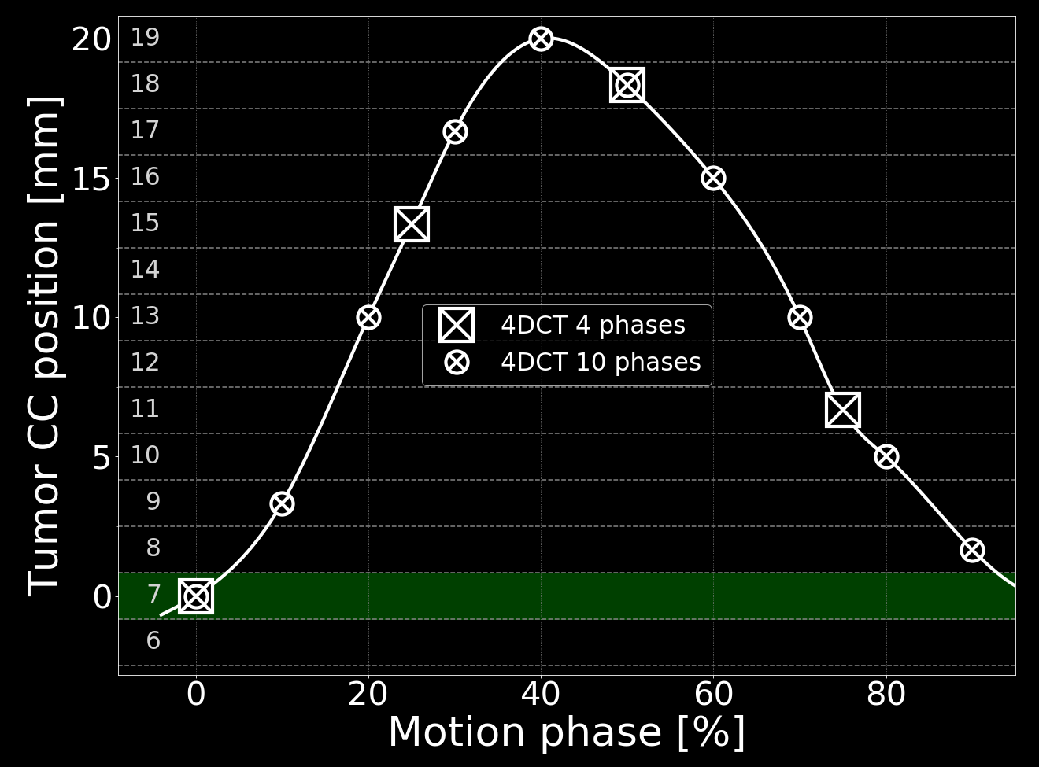
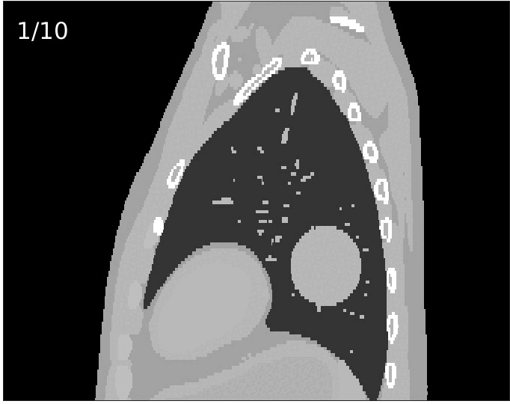
PATIENT FOR EXPERIMENTAL TESTS
25 phases
10 phases
PERIODIC MOTION
Half respiratory cycle
Full respiratory cycle
T. Steinsberger, PhD defense, 2023
4 phases
Cosimo Galeone, c.galeone@gsi.de

Slide 14
TREATMENT PLANS
Static Plan
Cosimo Galeone, c.galeone@gsi.de

Slide 15
TREATMENT PLANS
Motion including
Plan
4 phases
10 phases
Multi-Phase 4D (MP4D)
C.Graeff, 2014
Cosimo Galeone, c.galeone@gsi.de

Slide 16
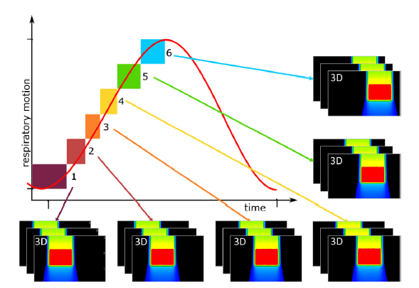
MP4D
3D plan phase 6
Multi Phase 4D dose delivery (MP4D)
Library of 3D sub-plans optimized on each of the motion phase considered
3D plan phase 5
Each spot has a specific assigned motion phase
3D plan phase 1
3D plan phase 2
3D plan phase 3
3D plan phase 4
M.Lis et al, 2020

Slide 17
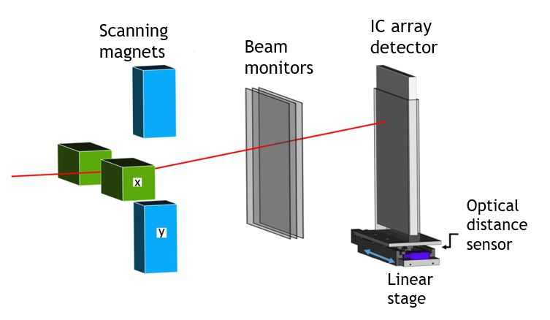
EXPERIMENTAL SETUP
Dose Delivery System(DDS)
DATA HANDLING INTERFACE
T. Steinsberger, PhD defense, 2023
Experimental room CNAO (Pavia, Italy);
Carbon ions;
ABSORBED DOSE!
RIDOS WORKSTATION
Cosimo Galeone, c.galeone@gsi.de

Slide 18
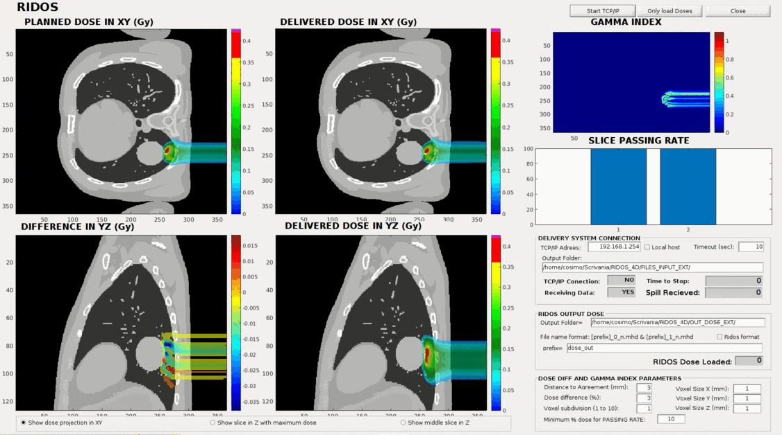
MP4D TEST (10 PHASES)
All calculations performed within next beam pause
~ 0.25 ms per spot reconstruction
~ 2.2 ms per spot delivery
Mini-talk ESTRO 2023

Slide 19
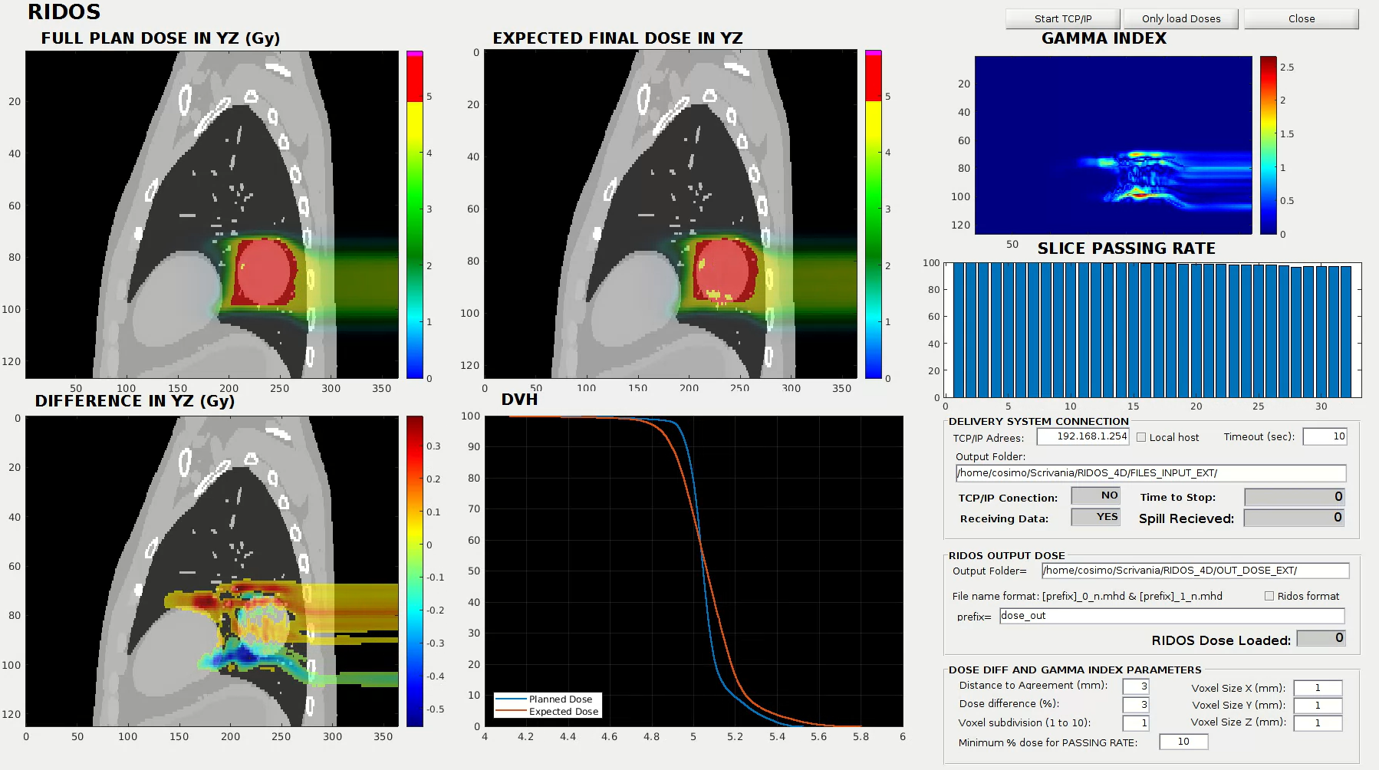
RIDOS EXPECTED DVH workflow
Pre-treatment inputs
Dose Delivery System(DDS)
Prototype of future clinical CNAO DDS
$${Expected Final Dose=Full Plan Dose −\sum_{i}^{Nspots}{{Plan Dose}_{i}}+\sum_{i}^{Nspots}{{Delivered Dose}_{i}}}_{ }$$
Online inputs
Update
GUI
PRE-TREATMENT
INPUT DATA:
4DCT;
Treatment plan;
Deformable Vector Fields
$Nspots$ = # of spots delivered up to that point
Full plan dose calculation
GPU dose calculation
Talk PTCOG 2023
DATA HANDLING INTERFACE
End Slice
…
Pre-treatment
Start Slice
End treatment
ONLINE INPUTS:
Beam position;
# of particles;
Motion phase
RIDOS WORKSTATION

Slide 20
INTERPLAY TEST (1)
Static Plan
T. Steinsberger, PhD defense, 2023
Dose Delivery System(DDS)
Cosimo Galeone, c.galeone@gsi.de

Slide 21
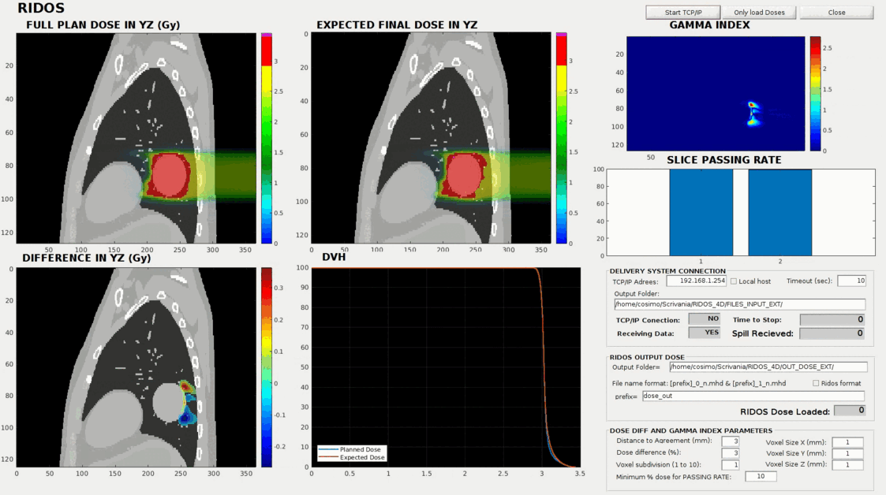
INTERPLAY TEST (2)
Static Plan
Full plan
Expected final
~ 0.5 ms per spot reconstruction
~ 6 ms per spot delivery
All calculations performed within next beam pause
Cosimo Galeone, c.galeone@gsi.de

Slide 22
RBE-weighted 4D dose
RIDOS
TRiP
MP4D (4 phases), carbon ions
~ 0.45 ms per spot reconstruction
Gamma-index comparison (3%/3mm) > 98%
Cosimo Galeone, c.galeone@gsi.de

Slide 23
CONCLUSIONS
Proved feasibility of real-time dose calculation in a clinical environment
NEXT STEPS
Extended experimental campaign with patient data;
Experimental tests with other
motion management strategies (Gating, ITV, Tracking);
Experimental tests with irregular motions
FUTURE PROSPECTIVES
THANK
YOU
Active intervention?
Real-time adaptive?
Funded by European Union’s Horizon 2020 research and innovation program under the Marie Sklodowska-Curie grant agreement No 955956
Cosimo Galeone, c.galeone@gsi.de

