Slide 1
Complement system:
a new role in combination with radiotherapy in tumour treatment.
Gaia Volpi
PhD student
¹Institute for Advanced Study, IUSS, Pavia, Italy
²National Center for Oncological Hadrotherapy (CNAO),
Radiobiology Unit, Research and Development, Pavia, Italy

Slide 2
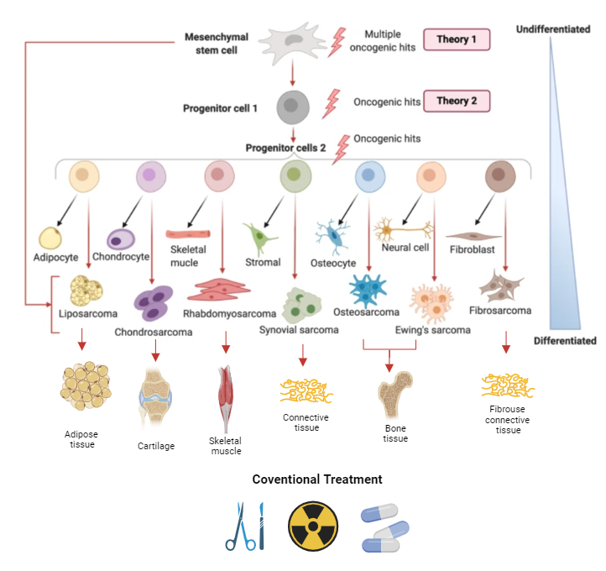
Sarcoma
Heterogeneous group of neoplasms derived from mesenchymal cells
The macro differentiation is between soft tissue sarcoma and bone sarcomas
Different conventional treatments
Modified from Damerell, Victoria et al.
Signal transduction and targeted therapy vol. 6,1 246 (2021)
INSIGHT workshop 18th -20th October – Gaia Volpi
Pag. 2

Slide 3
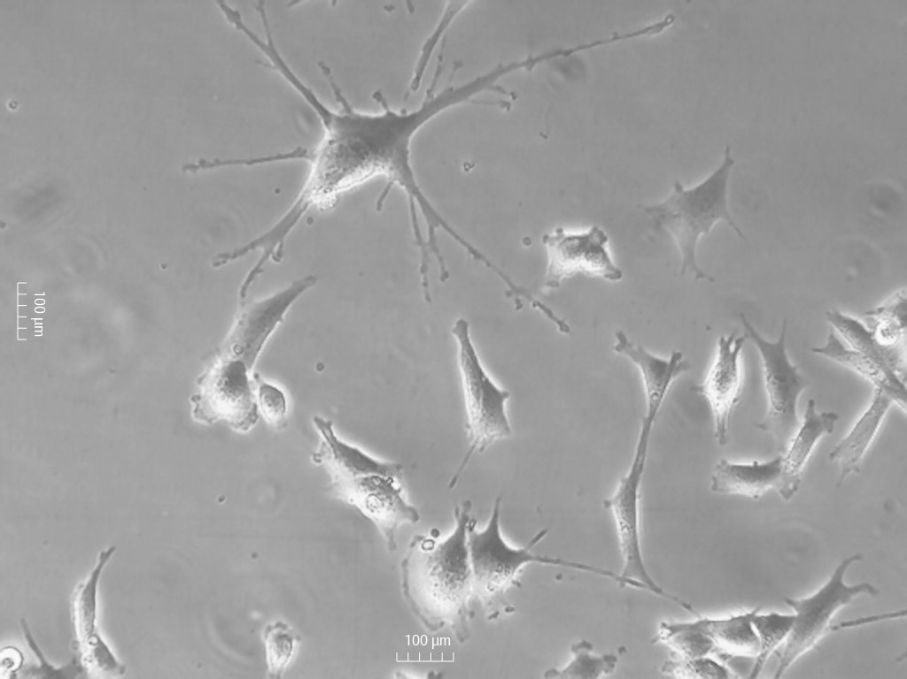
Sarcoma
MN/MCA1 murine fibrosarcoma cell line
Modified from Damerell, Victoria et al.
Signal transduction and targeted therapy vol. 6,1 246 (2021)
INSIGHT workshop 18th -20th October – Gaia Volpi
Pag. 3

Slide 4
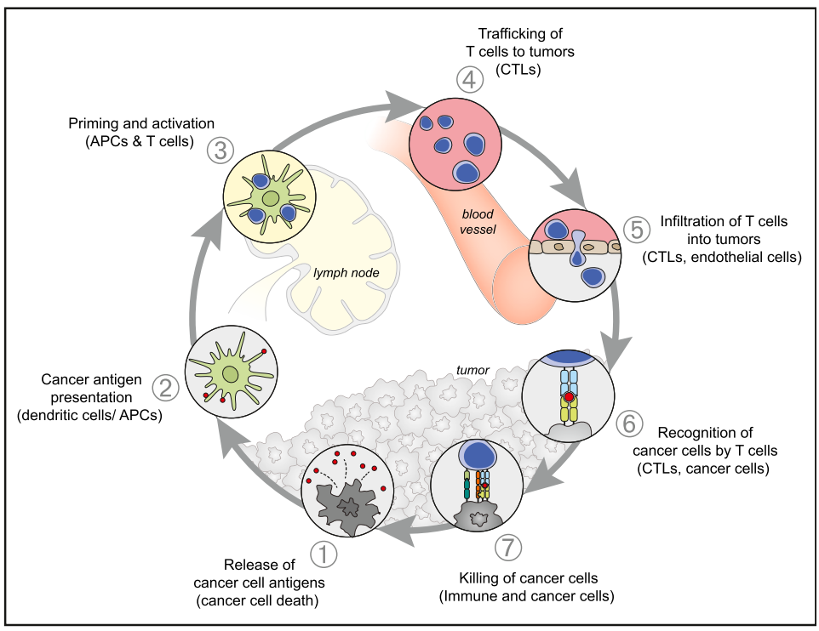
The cancer immunity-cycle
For an anticancer immune response to effectively kill cancer cells, a series of stepwise events must be initiated and allowed to proceed and expand iteratively.
Chen DS, Mellman I., Immunity. (2013)
INSIGHT workshop 18th -20th October – Gaia Volpi
Notes:
In the first step, neoantigens created by oncogenesis are released and captured by dendritic cells (DCs) for processing (step 1). In order for this step to yield an anticancer T cell response, it must be accompanied by signals that specify immunity lest peripheral tolerance to the tumor antigens be induced. Such immunogenic signals might include proinflammatory cytokines and factors released by dying tumor cells or by the gut microbiota (Figure 2, Table 1). Next, DCs present the captured antigens on MHCI and MHCII molecules to T cells (step 2), resulting in the priming and activation of effector T cell responses against the cancer-specific antigens (step 3) that are viewed as foreign or against which central tolerance has been incomplete. The nature of the immune response is determined at this stage, with a critical balance representing the ratio of T effector cells versus T regulatory cells being key to the final outcome. Finally, the activated effector T cells traffic to (step 4) and infiltrate the tumor bed (step 5), specifically recognize and bind to cancer cells through the interaction between its T cell receptor (TCR) and its cognate antigen bound to MHCI (step 6), and kill their target cancer cell (step 7). Killing of the cancer cell releases additional tumor-associated antigens (step 1 again) to increase the breadth and depth of the response in subsequent revolutions of the cycle. In cancer patients, the CancerImmunity Cycle does not perform optimally

Slide 5
The cancer immunity-cycle
Stimolatory factors
Inhibitors
For an anticancer immune response to effectively kill cancer cells, a series of stepwise events must be initiated and allowed to proceed and expand iteratively.
Each step of the Cancer-Immunity Cycle requires the coordination of numerous factors, both stimulatory and inhibitory in nature.
ATP, HMGB1, CRT, TNF-α
Complement system
IL-10, IL-4
Complement system
IFN-γ
PD-L1/PD-1
Chen DS, Mellman I., Immunity. (2013)
INSIGHT workshop 18th -20th October – Gaia Volpi
Notes:
In the first step, neoantigens created by oncogenesis are released and captured by dendritic cells (DCs) for processing (step 1). In order for this step to yield an anticancer T cell response, it must be accompanied by signals that specify immunity lest peripheral tolerance to the tumor antigens be induced. Such immunogenic signals might include proinflammatory cytokines and factors released by dying tumor cells or by the gut microbiota (Figure 2, Table 1). Next, DCs present the captured antigens on MHCI and MHCII molecules to T cells (step 2), resulting in the priming and activation of effector T cell responses against the cancer-specific antigens (step 3) that are viewed as foreign or against which central tolerance has been incomplete. The nature of the immune response is determined at this stage, with a critical balance representing the ratio of T effector cells versus T regulatory cells being key to the final outcome. Finally, the activated effector T cells traffic to (step 4) and infiltrate the tumor bed (step 5), specifically recognize and bind to cancer cells through the interaction between its T cell receptor (TCR) and its cognate antigen bound to MHCI (step 6), and kill their target cancer cell (step 7). Killing of the cancer cell releases additional tumor-associated antigens (step 1 again) to increase the breadth and depth of the response in subsequent revolutions of the cycle. In cancer patients, the CancerImmunity Cycle does not perform optimally

Slide 6
The cancer immunity-cycle
For an anticancer immune response to effectively kill cancer cells, a series of stepwise events must be initiated and allowed to proceed and expand iteratively.
Anti-CTLA4
Each step of the Cancer-Immunity Cycle requires the coordination of numerous factors, both stimulatory and inhibitory in nature.
There are different strategies to increase the anti-cancer immune response focused on different targets of the cycle
Vaccines
Chemotherapy
Radiation therapy
Chemotherapy
Radiation therapy
Anti-PD-L1
Anti-PD-1
Chen DS, Mellman I., Immunity. (2013)
INSIGHT workshop 18th -20th October – Gaia Volpi
Notes:
In the first step, neoantigens created by oncogenesis are released and captured by dendritic cells (DCs) for processing (step 1). In order for this step to yield an anticancer T cell response, it must be accompanied by signals that specify immunity lest peripheral tolerance to the tumor antigens be induced. Such immunogenic signals might include proinflammatory cytokines and factors released by dying tumor cells or by the gut microbiota (Figure 2, Table 1). Next, DCs present the captured antigens on MHCI and MHCII molecules to T cells (step 2), resulting in the priming and activation of effector T cell responses against the cancer-specific antigens (step 3) that are viewed as foreign or against which central tolerance has been incomplete. The nature of the immune response is determined at this stage, with a critical balance representing the ratio of T effector cells versus T regulatory cells being key to the final outcome. Finally, the activated effector T cells traffic to (step 4) and infiltrate the tumor bed (step 5), specifically recognize and bind to cancer cells through the interaction between its T cell receptor (TCR) and its cognate antigen bound to MHCI (step 6), and kill their target cancer cell (step 7). Killing of the cancer cell releases additional tumor-associated antigens (step 1 again) to increase the breadth and depth of the response in subsequent revolutions of the cycle. In cancer patients, the CancerImmunity Cycle does not perform optimally

Slide 7

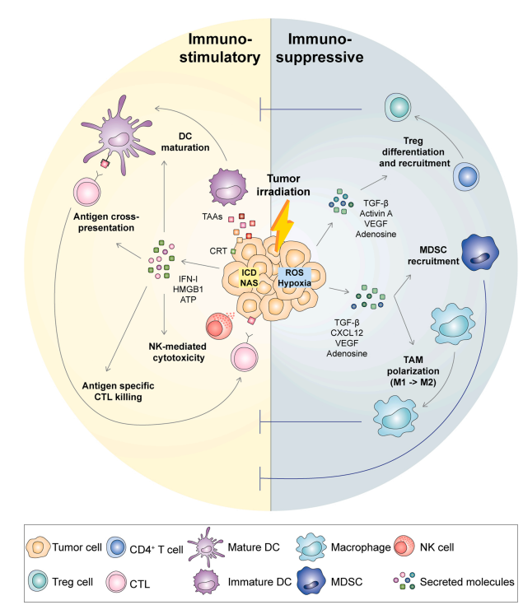
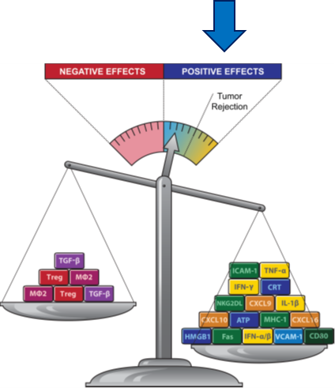
Immuno response after radiotherapy
Radiotherapy (RT) activates both
Immunosuppressive
immunostimulatory
pathways in the tumour microenvironment (TME)
C3a, C5a
Formenti SC, Demaria S., J Natl Cancer Inst. (2013)
Modified from De Martino, Mara et al., Seminars in immunology vol. 52 (2021)
INSIGHT workshop 18th -20th October – Gaia Volpi

Slide 8
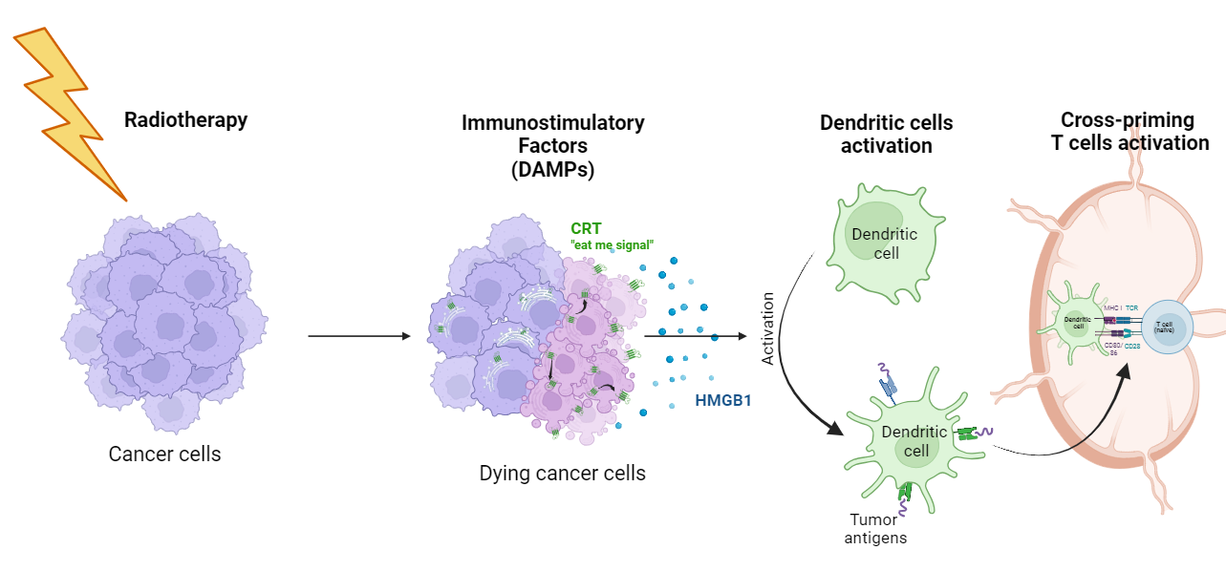
Radiotherapy induces immunogenic cell death (ICD)
radiation-induced cell death generates key molecular signals, shown to promote uptake and presentation of tumour-derived antigens by DCs (dendritic cells)
Chen DS, Mellman I., Immunity. (2013)
Created with Biorender
INSIGHT workshop 18th -20th October – Gaia Volpi
Notes:
Local radiation therapy (RT) causes an immunogenic death of cancer cells characterized by calreticulin (CRT) translocation to the surface of dying tumor cells together with high-mobility group box-1 (HMGB-1) and adenosine triphosphate (ATP) release, which coordinately promote uptake and cross-presentation of tumor antigens by dendritic cells (DC) to T cells in the draining lymph node. Activation of DNA-sensing pathways by tumor-derived DNA induces interferon β (IFNβ) production by DC, required for DC activation. These proimmunogenic “go” signals (green) are countered by immunosuppressive “stop” signals (red) such as transforming growth factor β (TGFβ) activation and colony stimulating factor 1 (CSF-1) induction, which result in increased infiltration by Tregs and by myeloid-derived suppressor cells (MDSCs). The balance of stop and go signals determines the development of effective antitumor immune responses. CTL indicates cytotoxic CD8+ T cell.

Slide 9
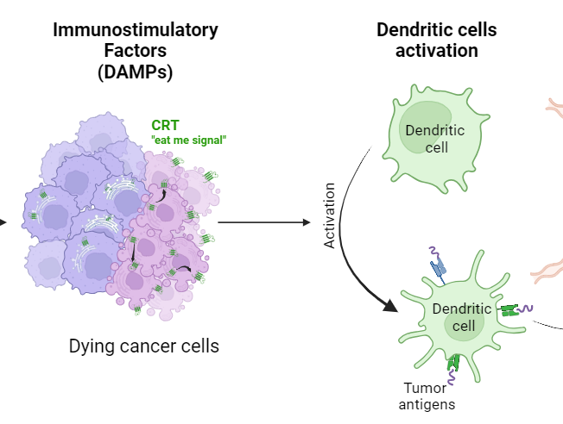
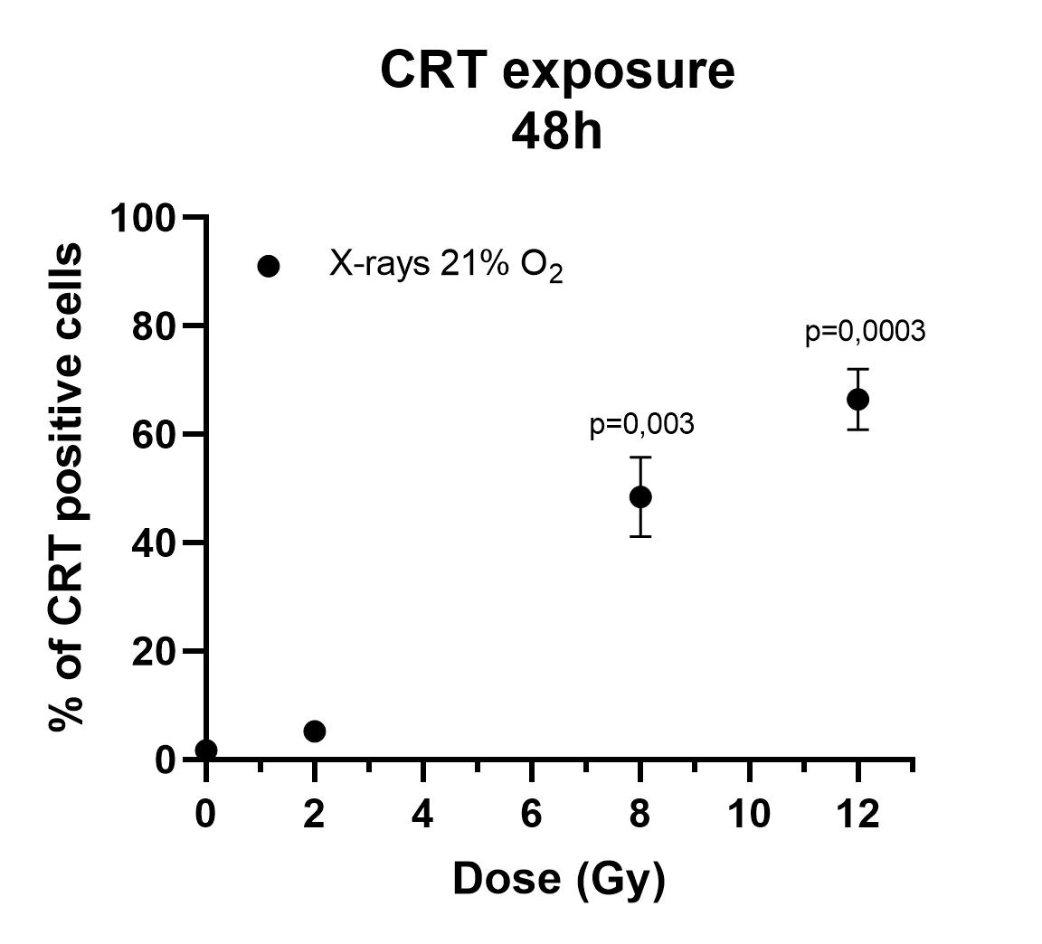
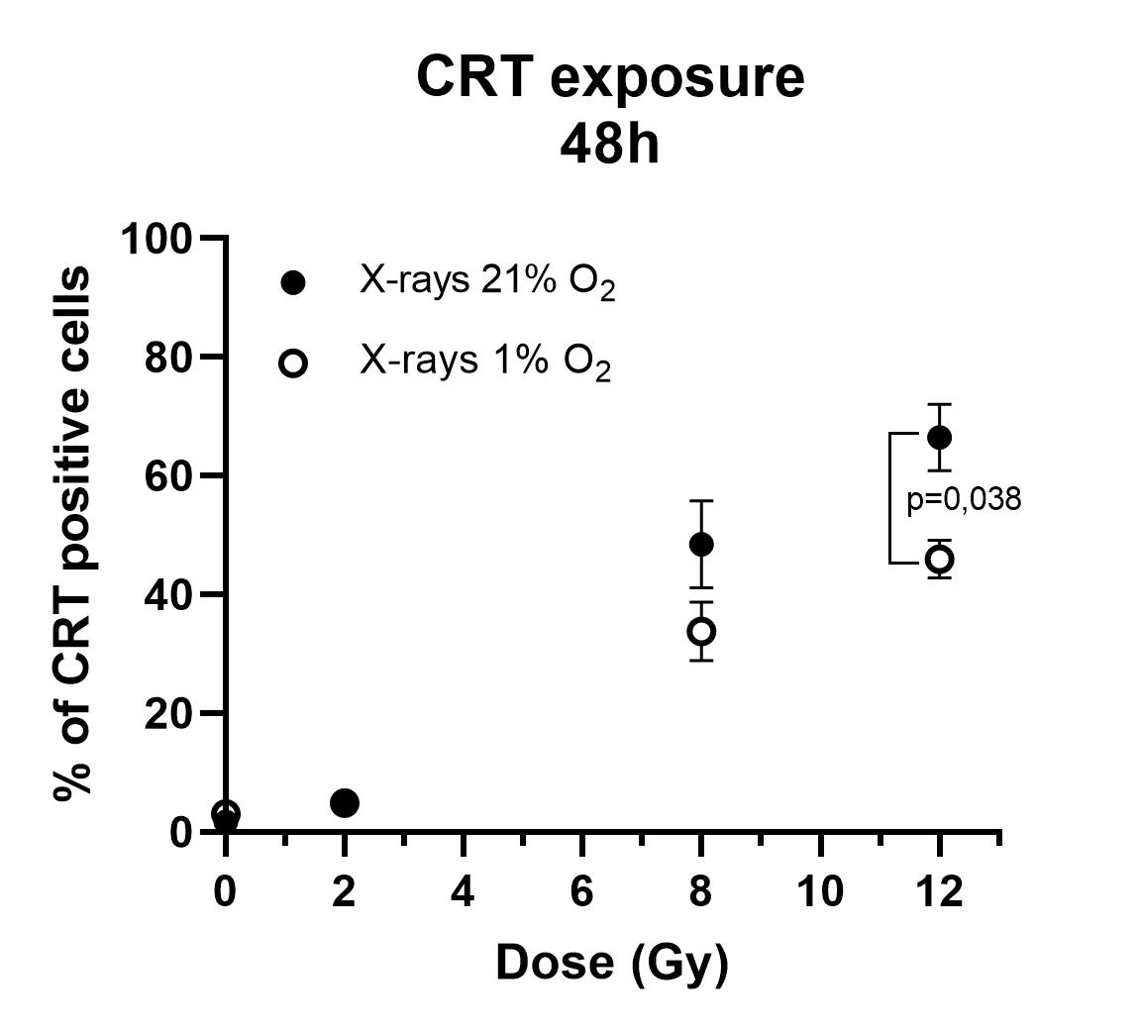
Calreticulin exposure
Dose-dependent increase in exposure
of calreticulin, more significant up to
8Gy photon irradiation
Unpublished results
Created with Biorender
p:p-value Unpaired two-tailed t-Test
Notes:
Photon, proton, and carbon-ion radiation could increase the expression of CRT in all four tumor cell lines in normoxic conditions. Consistent with our previous study, carbon-ion radiation could increase CRT expression compared with photon and proton radiation at the same physical dose (4Gy) (11). These results indicated that carbon-ion radiation might be able to enhance immunogenic cell death and enhance anti-tumorigenic responses compared with photon and proton radiation. When under hypoxic conditions, we found that the baseline (0Gy, group) CRT expression levels in the four tumor cell lines were significantly increased compared with those under normoxia. The expression level was upregulated by 2.21- to 4.27-fold for tongue squamous carcinoma cell lines, and by 1.18- to 1.63-fold for glioma cell lines (all p < 0.05). This upregulation of CRT expression might result from endoplasmic reticulum stress (ER stress) induced by hypoxia (16). When under the pressure of ER stress, large amounts of CRT (which is originally located in the endoplasmic reticulum cavity) would translocate to the surface of the cell membrane. Radiation can also induce ER stress mediated by reactive oxygen species (ROS) (17). Based on this study, CRT expression was not further increased by radiation compared with the control group in hypoxic conditions. Even carbon-ion radiation could not further increase the expression of CRT expression under hypoxic conditions. This phenomenon suggested that there might be an overlapping effect between CRT expression during hypoxia and radiation, which were both mediated by ER stress. The pressure of hypoxia induced abundant CRT translocation to the surface of the cell membrane and therefore radiation could not increase this further.

Slide 10
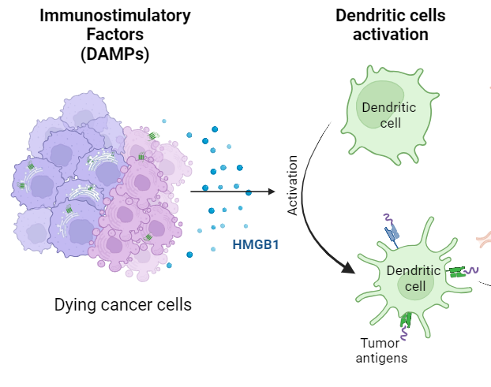
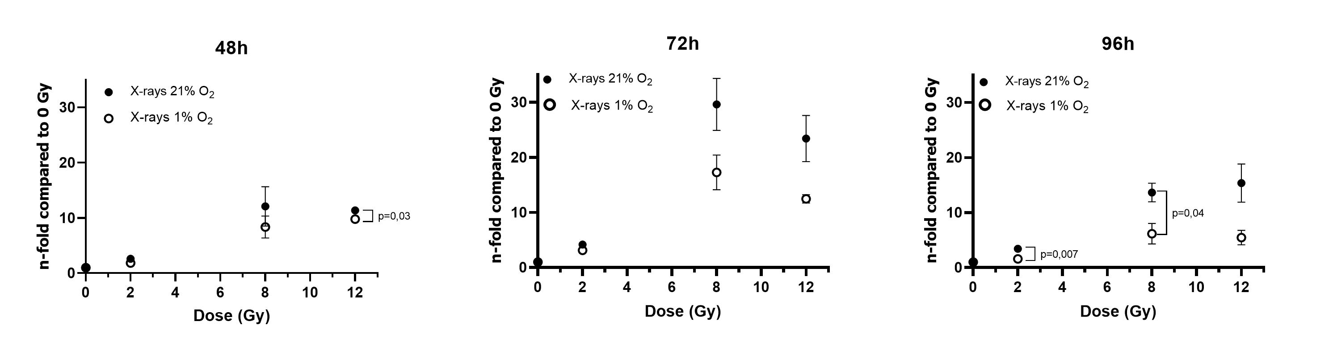
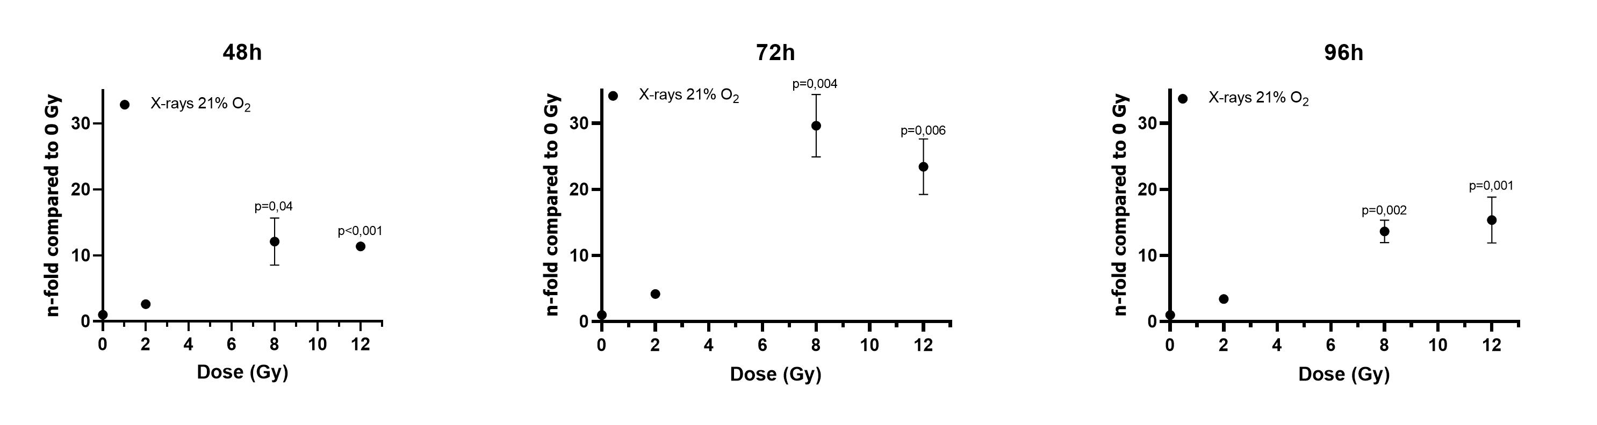
HMGB1 release
Dose-dependent increase in HMGB1 release after photon irradiation, with a significant increase 72h after treatment
Unpublished results
Created with Biorender
p:p-value Unpaired two-tailed t-Test

Slide 11

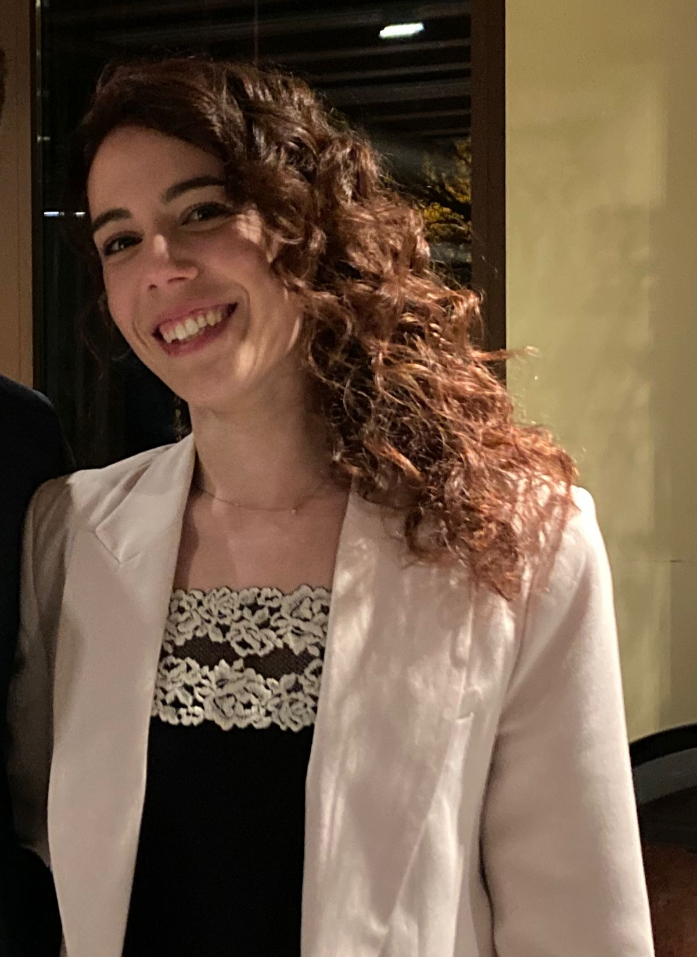
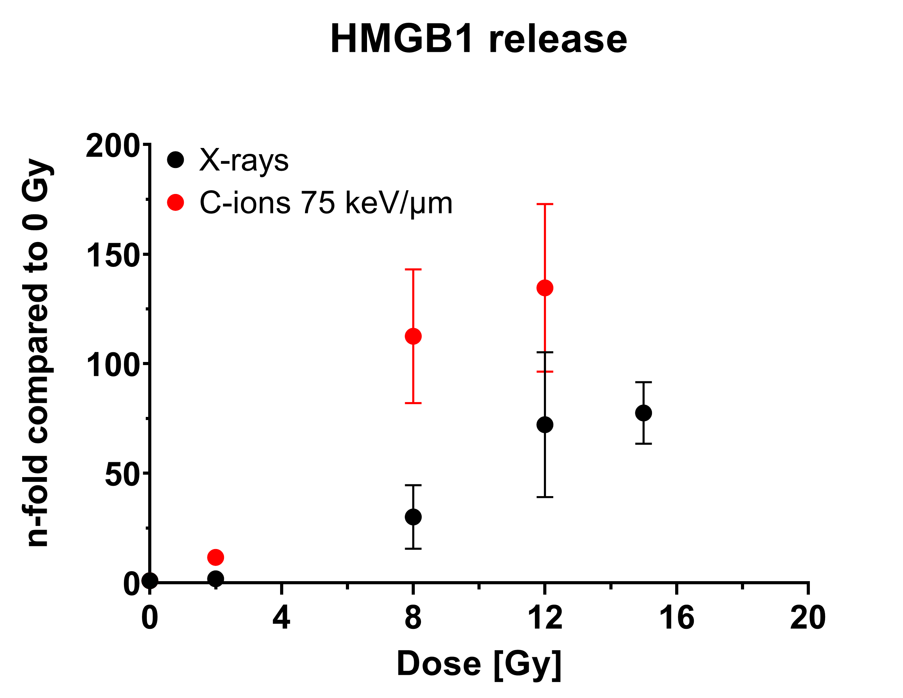
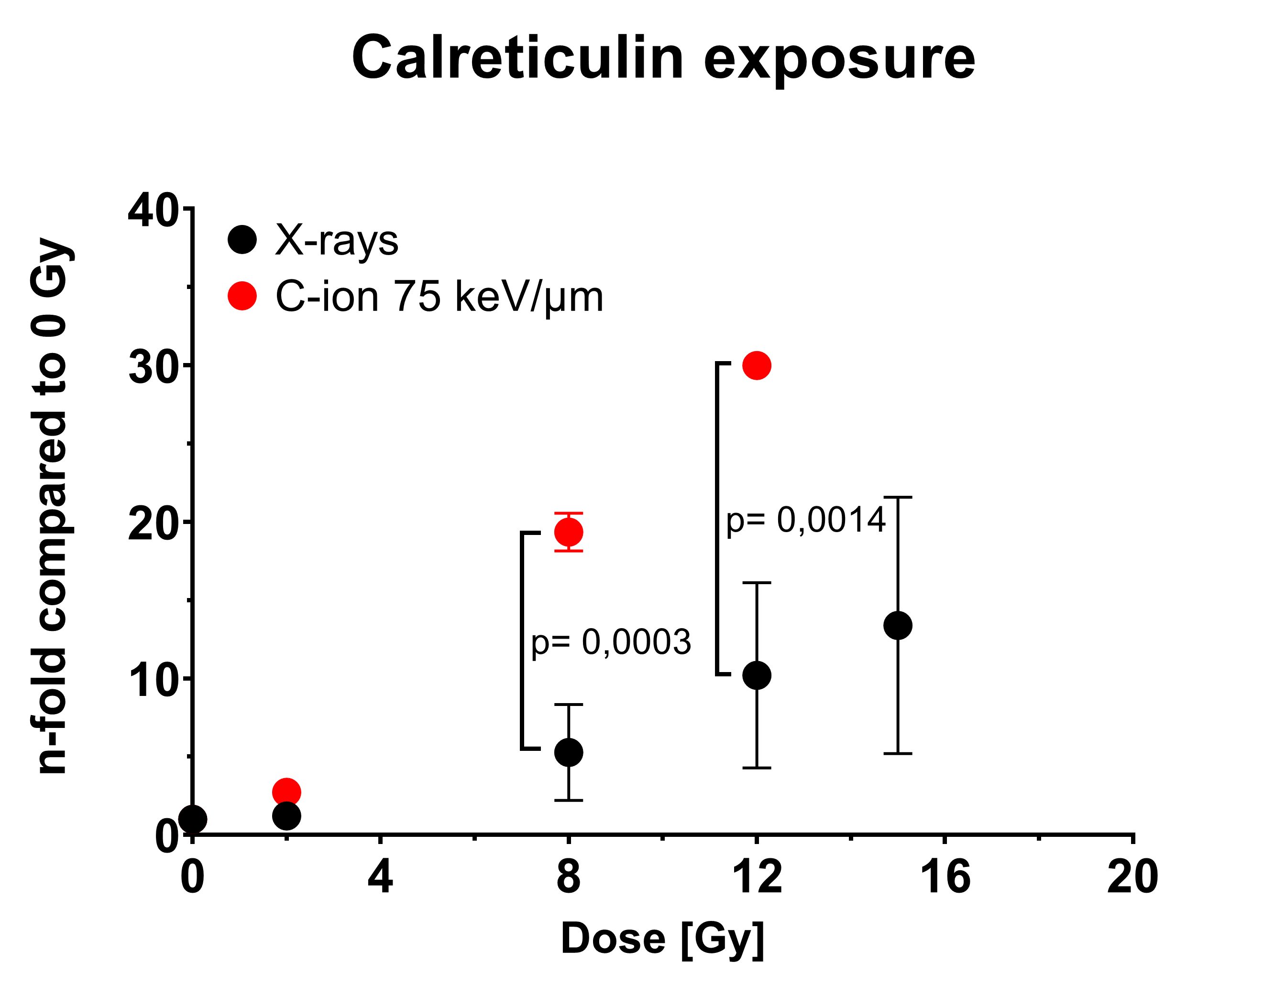
Calreticulin exposure in osteosarcoma cell line after C-ion irradiation
Courtesy of
Cristina Totis
Unpublished results
mean ± SD;
p: p-value;
unpaired two-tailed t-test
Carbon ions are more efficient in enhancing immunogenic effect in osteosarcoma cell line:
Increase HMGB1 release
Improve Calreticulin exposure

Slide 12

Immuno response after radiotherapy
C3a, C5a
Formenti SC, Demaria S., J Natl Cancer Inst. (2013)
Modified from De Martino, Mara et al., Seminars in immunology vol. 52 (2021)
INSIGHT workshop 18th -20th October – Gaia Volpi

Slide 13
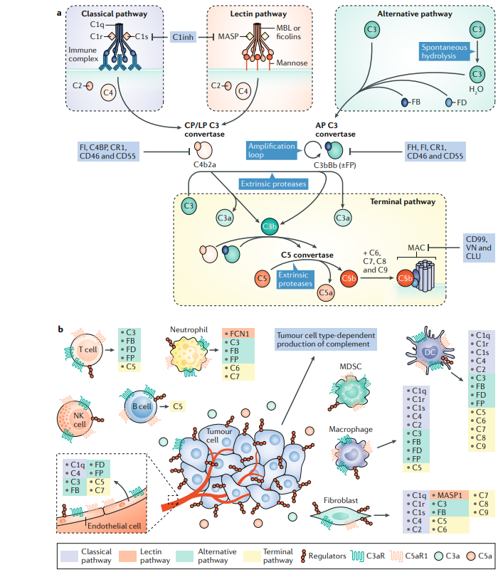
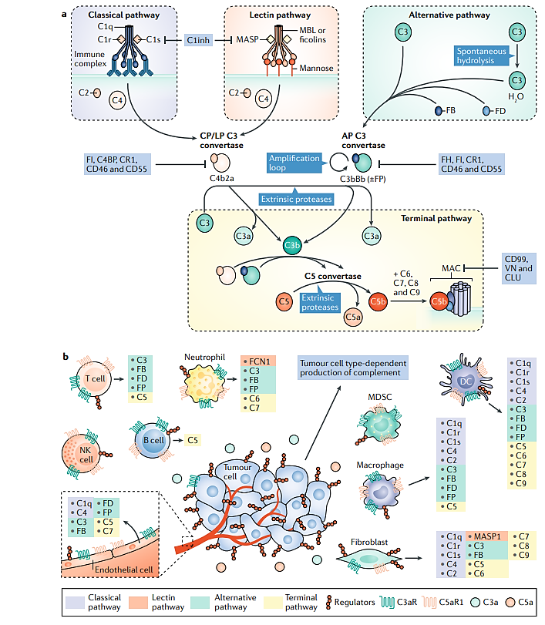
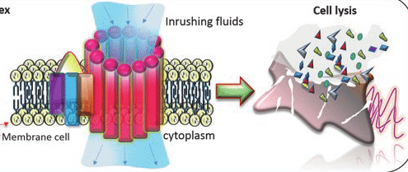
Complement system
First line of immune defense against pathogens and stressed host cells
3 pathways share the step of activating C3 but differ according to their activation mechanisms of target recognition
Regulation
Regulation
C3 with its products C3a and C5a are the most important factors
Regulation of complement activation, is important for the homeostasis of the organism
Roumenina, Lubka T et al., Nature reviews. Cancer vol. 19,12 (2019)
Andrade F et al., (2017)

Slide 14
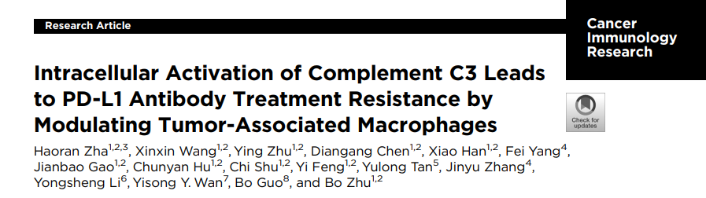
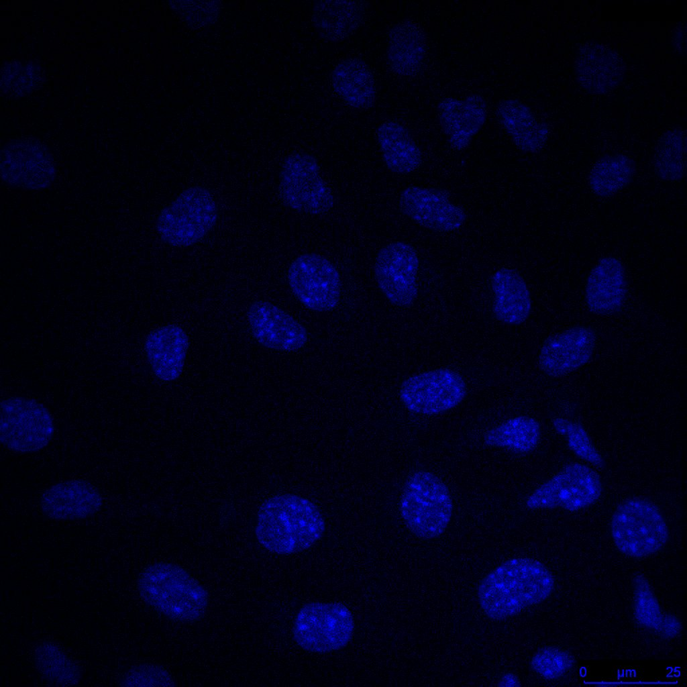
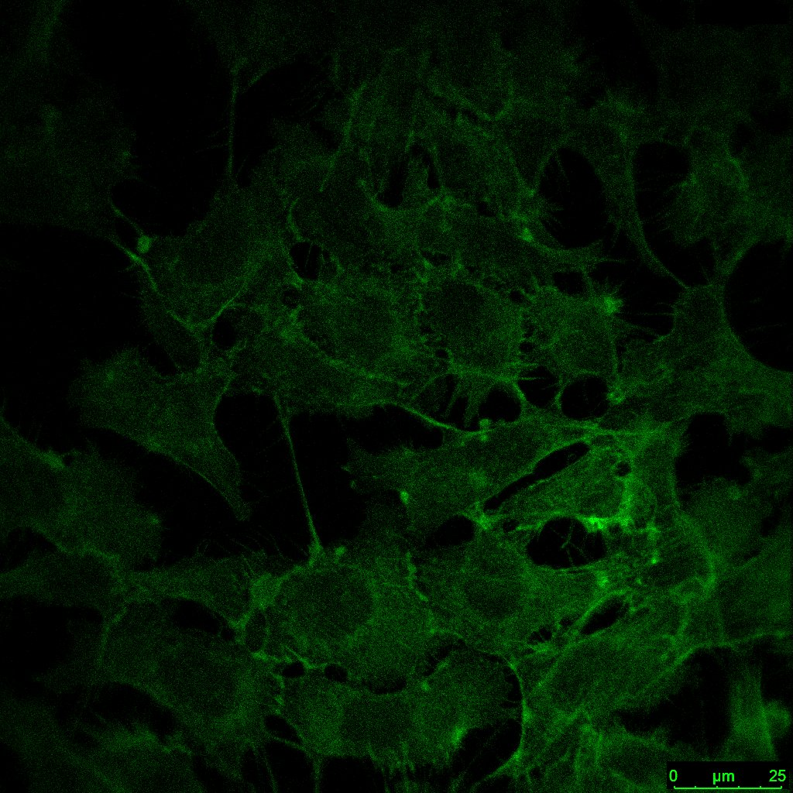
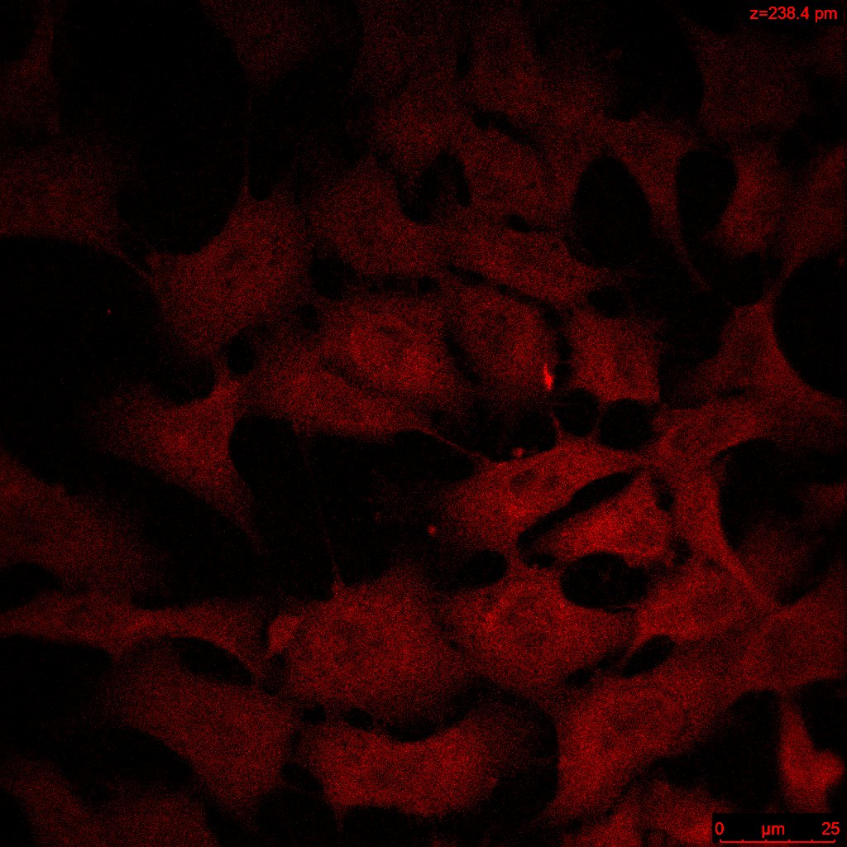

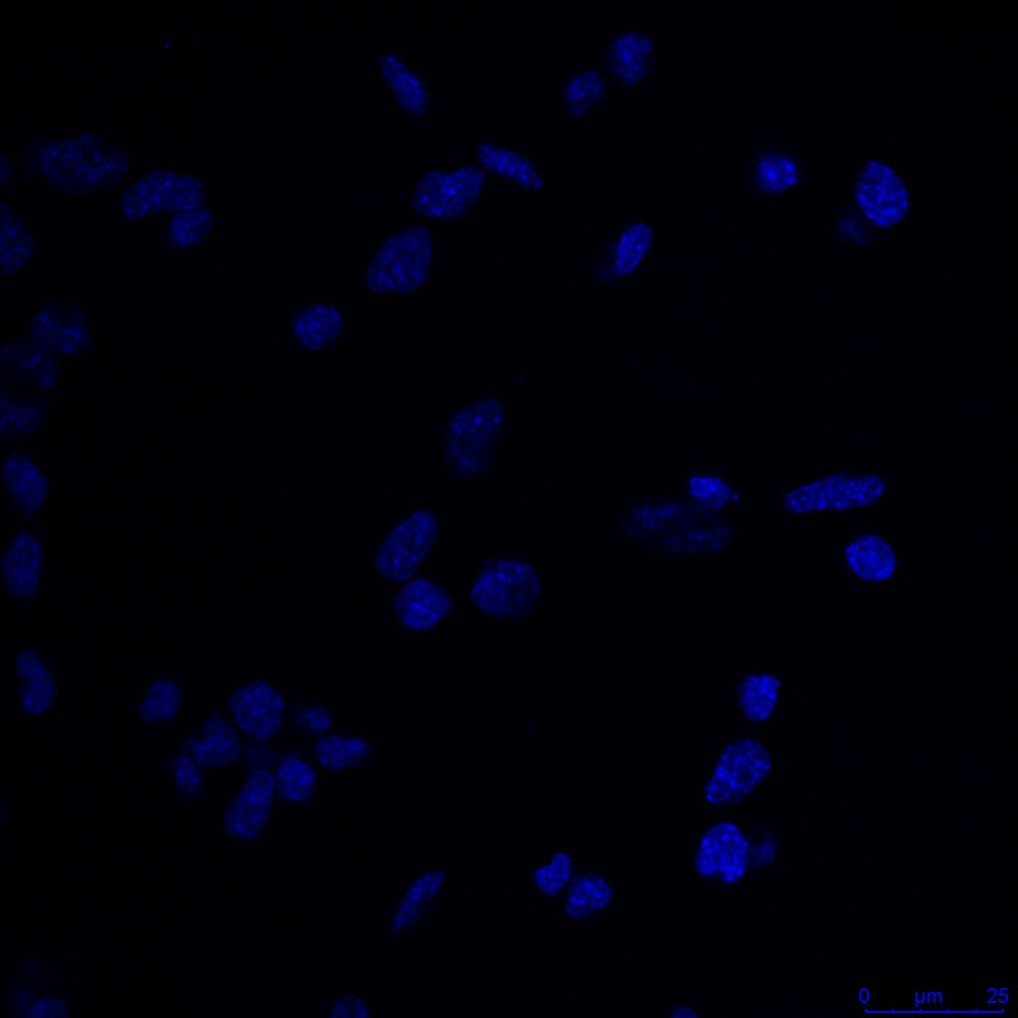
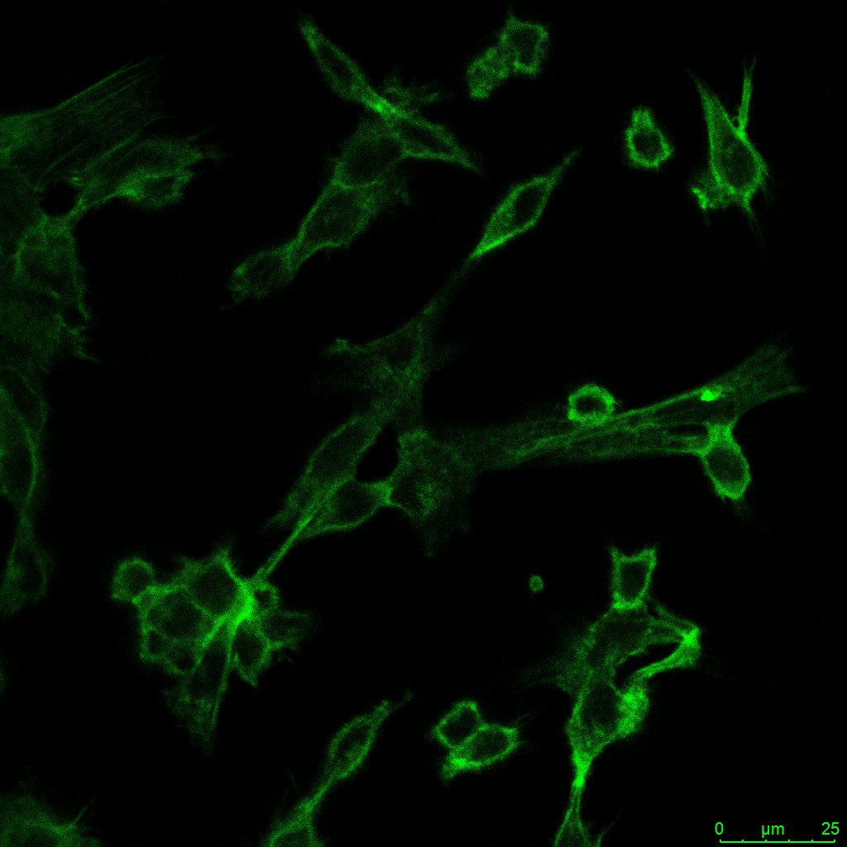
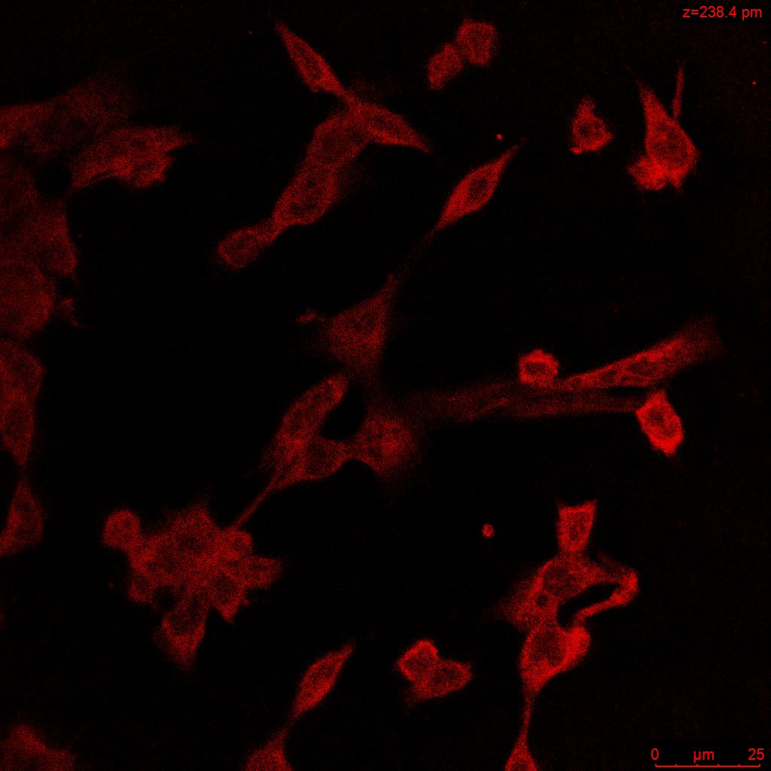
C3 expression in fibrosarcoma cells
Nuclei
Cytoskeleton
C3
Merge
Condition:
cultured in RPMI with Heat inactivated serum
Antibody:
Dapi: Nuclei
FITC phalloidin: cytoskeleton
C3 polyclonal antibody: C3
Microscope:
Leica confocal
Magnification: 40X
4T1- Brest cancer cells
MN/MCA1 fibrosarcoma cells

Slide 15
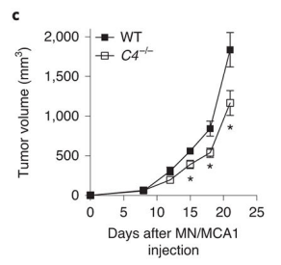
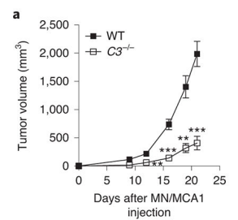
Complement system
Tumour Progression
a
b
X
X
Magrini E. et al., Nat Cancer (2021)
Roumenina, Lubka T et al., Nature reviews. Cancer vol. 19,12 (2019)

Slide 16
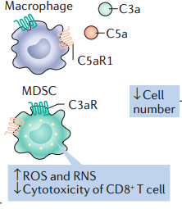


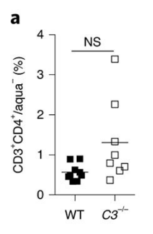
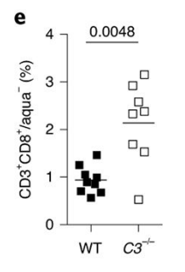

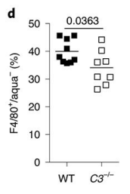
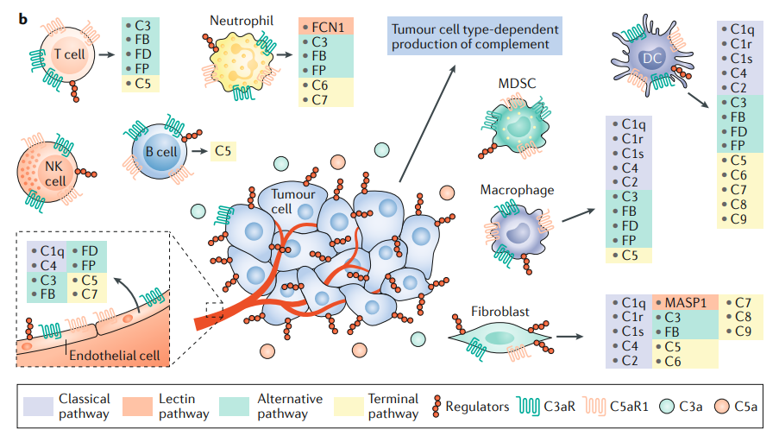
Complement system
Changes in tumour microenvironment
immunosuppressive
cells
pro-inflammatory
cells
Lymphocytes (CD4⁺ CD8⁺ T cells)
Macrophages
c
Magrini E. et al. Nat Cancer (2021)
Modified from Roumenina, Lubka T et al., Nature reviews. Cancer vol. 19,12 (2019)

Slide 17

Complement system
Combination with radiotherapy
immunosuppressive
Tumour
growth
pro-inflammatory
.
CRT
.
.
.
HMGB1
Immunogenic death (DAMPs release)
.
.
.
.
.
.
.
ATP
Formenti SC, Demaria S., J Natl Cancer Inst. (2013)
Modified from Roumenina, Lubka T et al., Nature reviews. Cancer vol. 19,12 (2019)

Slide 18
Next steps
In vitro experiments
To characterize fibrosarcoma cell line (MN/MCA1) in Normoxia and Hypoxia conditions before and after Carbon Ion irradiation
  Clonogenic assay
  Immune response (release of DAMPs)
  Variation in complement system factors’ concentration
In vivo experiments
To investigate if combining complement inhibition and radiotherapy (photon/carbon) could be a new and successful strategy to improve the control of a tumour and metastasis in a preclinical mouse model system.

Slide 19


Acknowledgements
Radiobiology Group
(CNAO, Pavia)
Prof. Dr. Angelica Facoetti, CNAO (Pavia, Italy)
Immune system and tissue radiobiology group, Biophysics departments (GSI, Darmstadt)
Prof. Dr. Marco Durante
Prof. Dr. Claudia Fournier
Humanitas Research Hospital, Prof. Dr. A. Mantovani and his group (Milan, Italy)
Thank you for your attention!

Slide 20
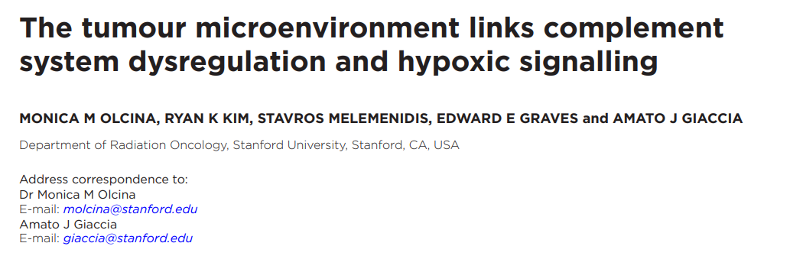
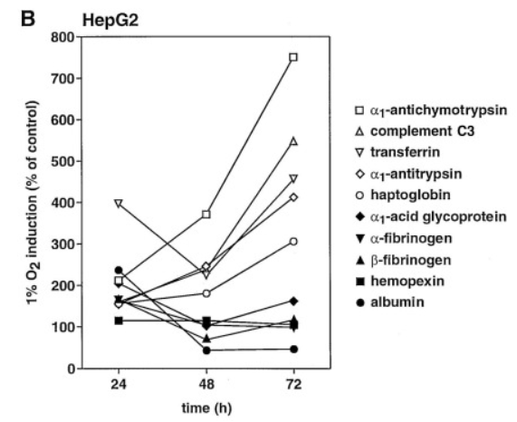
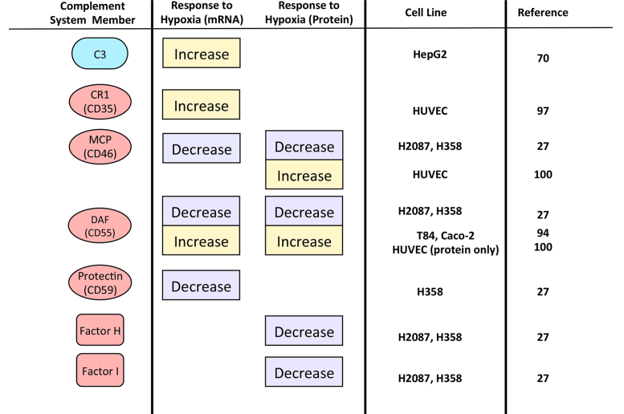
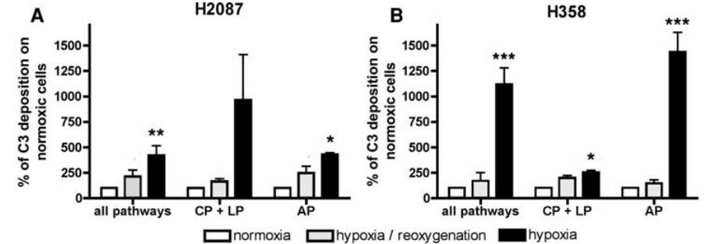
Hypoxia and complement system
HepG2:human hepatoma cell line
Wenger RH et al., J Biol Chem (1995)
NSCLC (non-small cell lung cancer )
Olcina MM et al., Br J Radiol (2019)
Okroji M et al., Cancer Immunol Immunother (2009)

