Slide 1


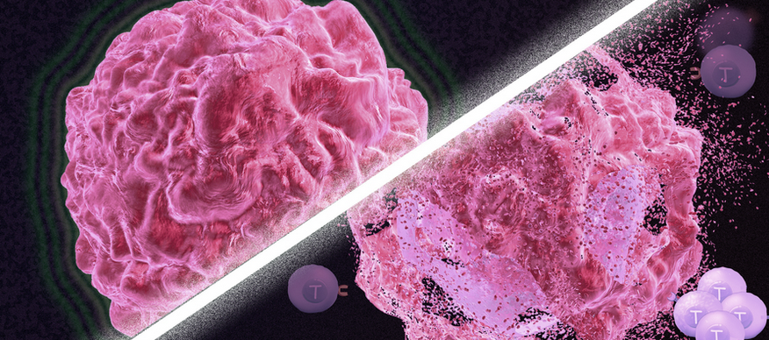
Towards a combination of heavy ion and immunotherapy: putative mechanisms behind the immunogenicity of carbon ions
Cristina Totis
GSI Helmholtz Center for Heavy Ion Research
Darmstadt, Germany
INSIGHTS Workshop Pisa 18th October 2023

Slide 2
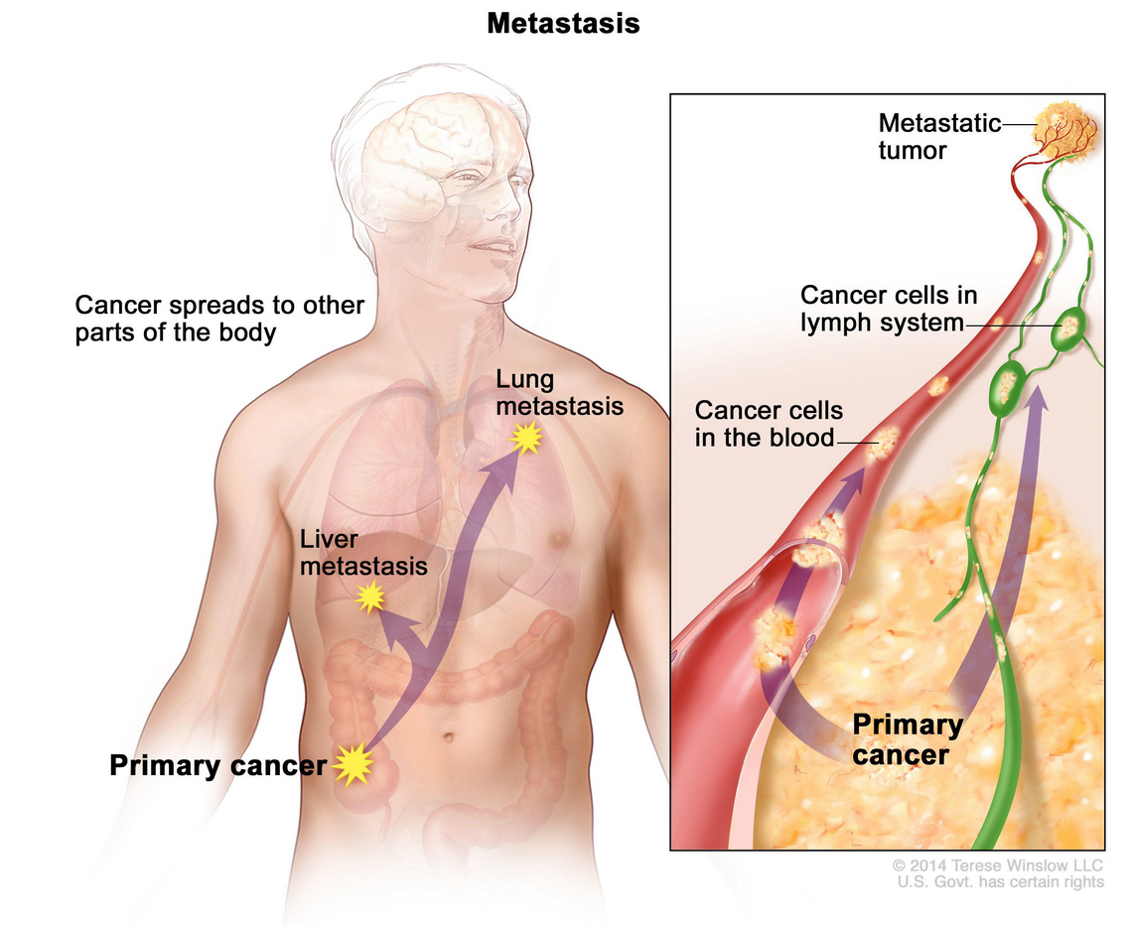
Metastatic cancer disease
Cancer is the second leading cause of death globally, accounting for an estimated 9.6 million deaths, or 1 in 6 deaths, in 2018 (WHO)
At least 2/3 of deaths from solid tumors are caused by metastasis (Dillekas et al., 2019, Canc. Med.)
Therapy of metastatic cancer is normally palliative with the goal of improving the quality of life
Metastatic cancer is a systemic disease -> need for systemic treatment -> immune system
INSIGHTS Workshop Pisa 18th October 2023
c.totis@gsi.de

Slide 3
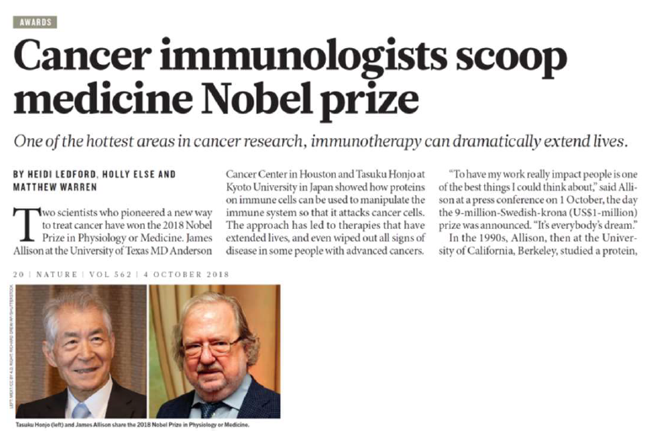
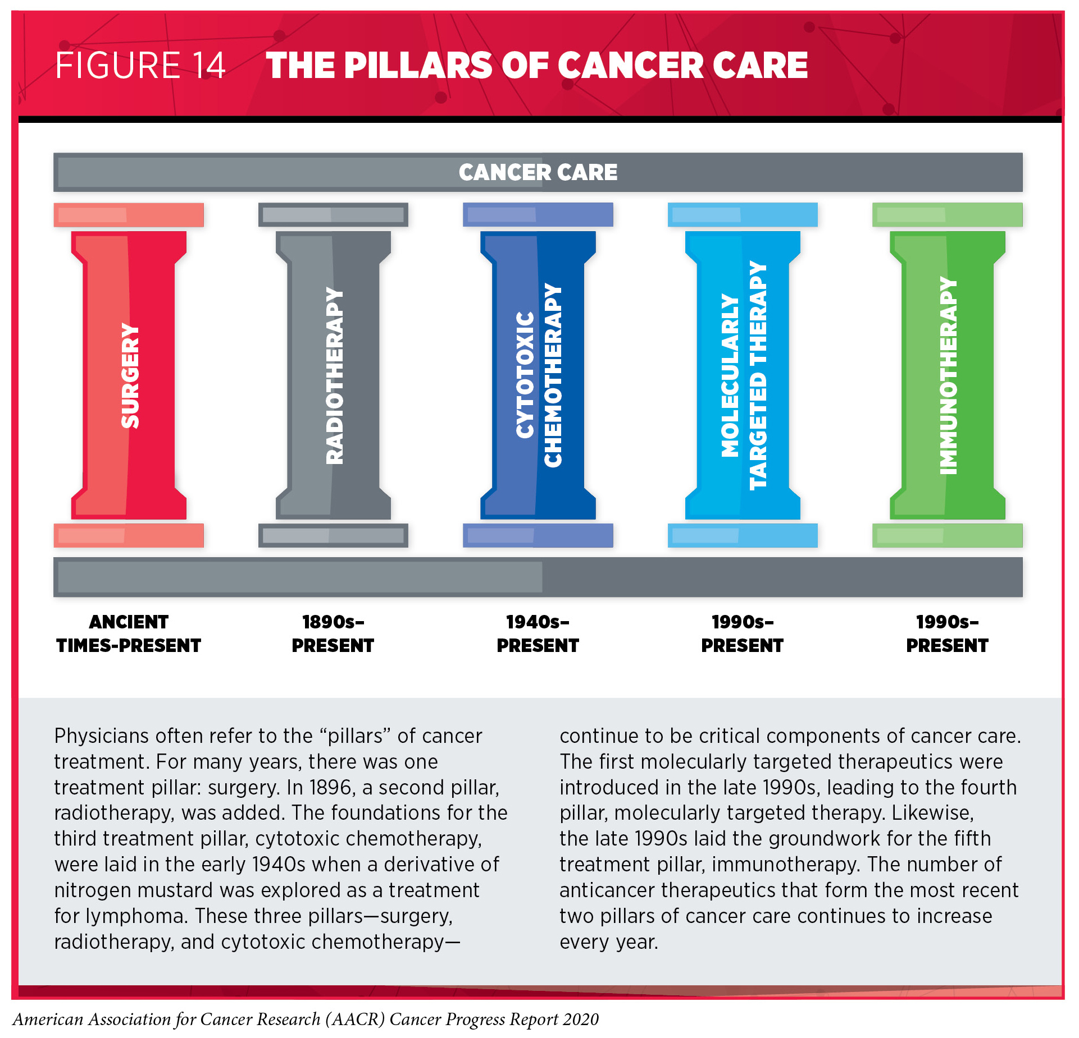
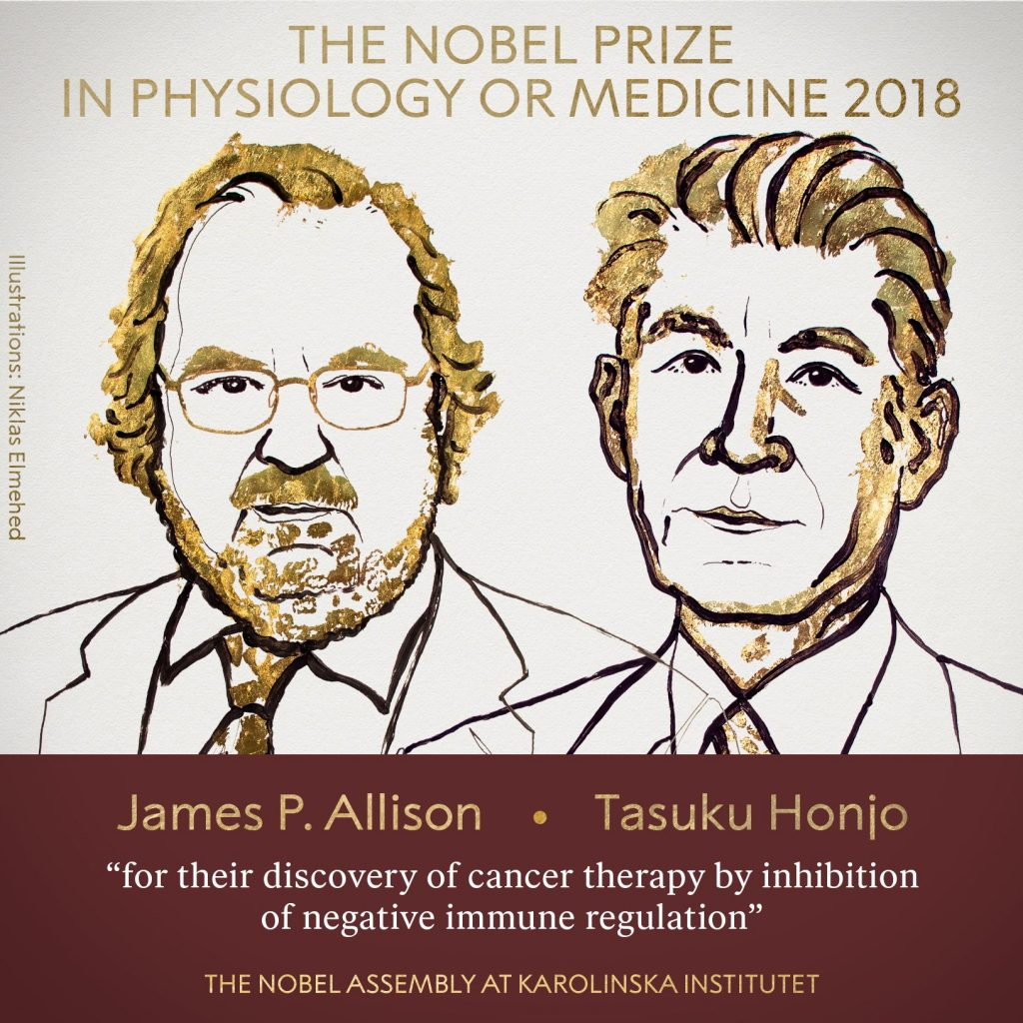
Exploiting the immune system: immunotherapy
The goal is to reach a long-lasting tumor control.
Clinical studies using combination treatment have yielded promising results (Ko et al., 2018, Clin. Cancer. Res.)
INSIGHTS Workshop Pisa 18th October 2023
c.totis@gsi.de
Notes:
local treatment with radiotherapy that can be boosted by a systemic treatment to reach a long lasting tumor control

Slide 4
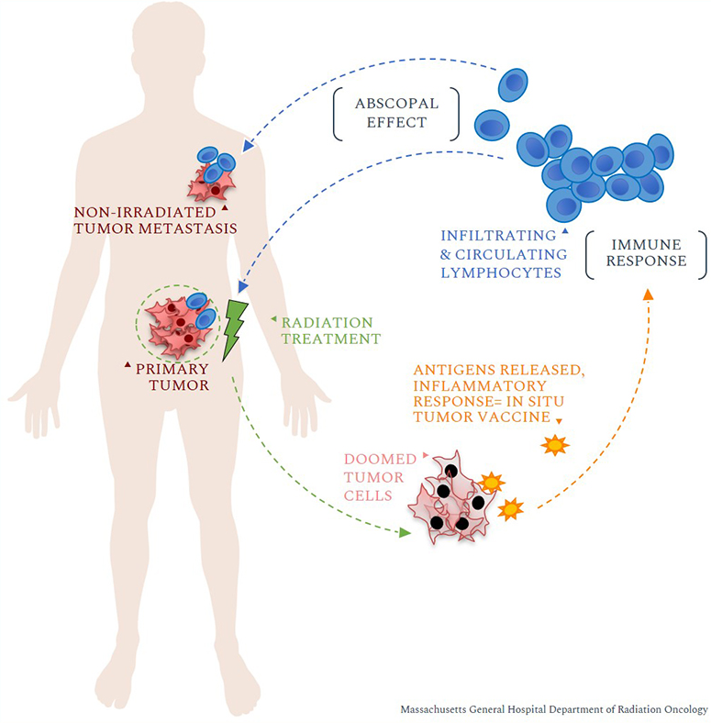
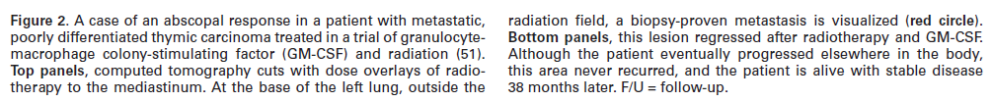
Combination of radiotherapy and immunotherapy: a paradigm shift
There is more in radiotherapy than „simple“ cell inactivation
Formenti and Demaria, 2013, J Natl Cancer Inst
Traditional palliative role of radiotherapy in metastatic disease is evolving into that of a powerful adjuvant for immunotherapy
INSIGHTS Workshop Pisa 18th October 2023
c.totis@gsi.de

Slide 5
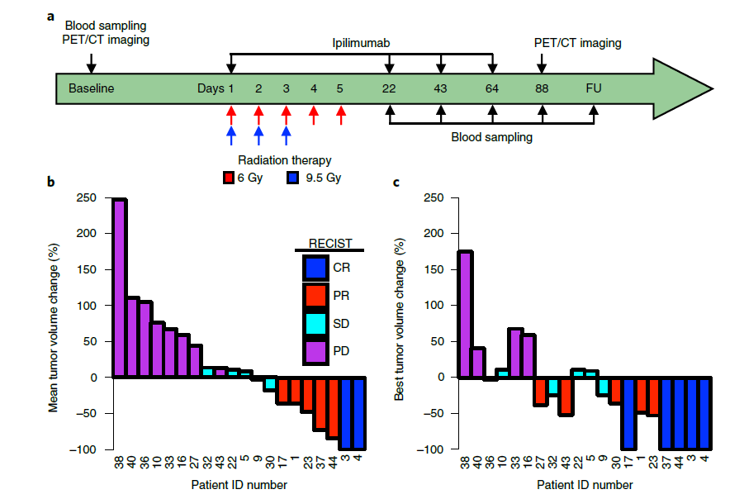
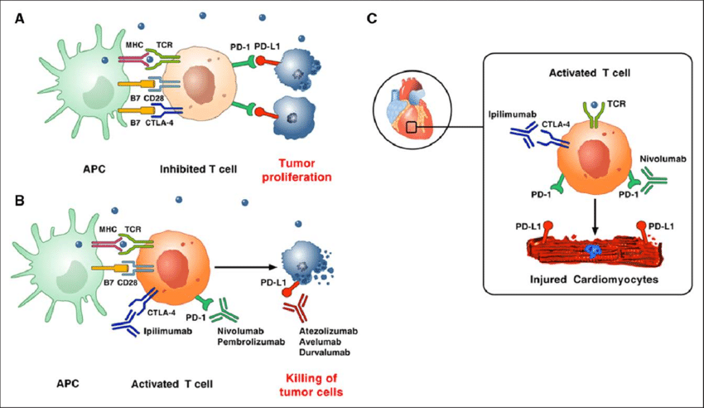
Combination of radiotherapy and immunotherapy
CR = complete response
PR = partial response
SD = stable disease
PD = progressive disease
RECIST = Response Criteria In Solid Tumors
Chemo-refractory metastatic NSCLC patients where anti-CTLA-4 antobodies had failed to demonstrate efficacy alone or in combination with chemotherapy
Disease control (CR+PR+SD) in ∼31%
Adapted from Varricchi et al., 2017, Circulation
INSIGHTS Workshop Pisa 18th October 2023
c.totis@gsi.de

Slide 6
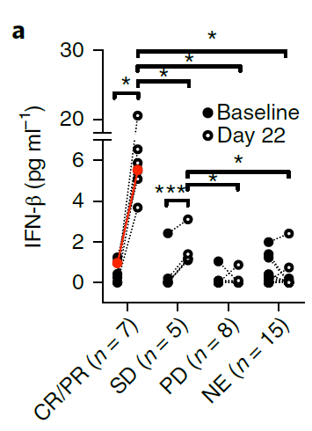
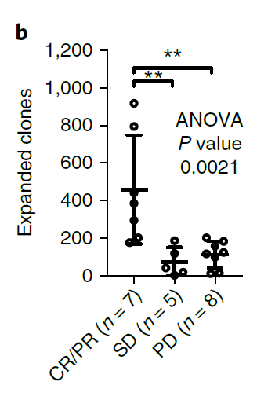
Combination of radiotherapy and immunotherapy
CR = complete response
PR = partial response
SD = stable disease
PD = progressive disease
(a) Radiation therapy induction of interferon-β (IFN-β) correlates with the abscopal response.
(b) Expansion of a large number of tumor-specific T cell
clones in peripheral blood and their persistence over time correlate with achievement of abscopal responses
In patients who achieved disease control, the median OS was 20.4 months compared to 3.5 months in patients who did not.
INSIGHTS Workshop Pisa 18th October 2023
c.totis@gsi.de
Notes:
Changes in circulating soluble markers and immune cells occurring during treatment were evaluated by comparing values obtained at day 22 versus baseline.
Serum IFN-β showed the most significant increase after completion of radiation therapy in responders.
Collectively these results demonstrate that radiation therapy
in combination with CTLA-4 blockade induces systemic tumor
responses in patients with NSCLC
Thanks to preclinical data we know the reason for the importance of IFN-B for achieving the immune system activation.

Slide 7
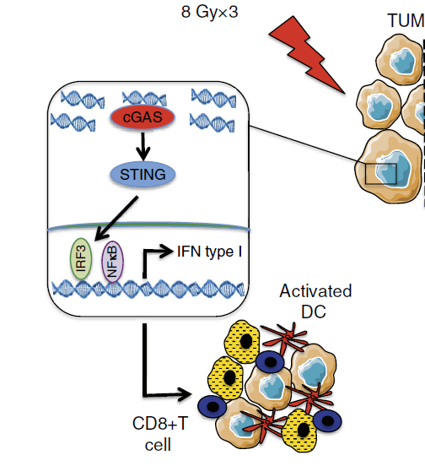
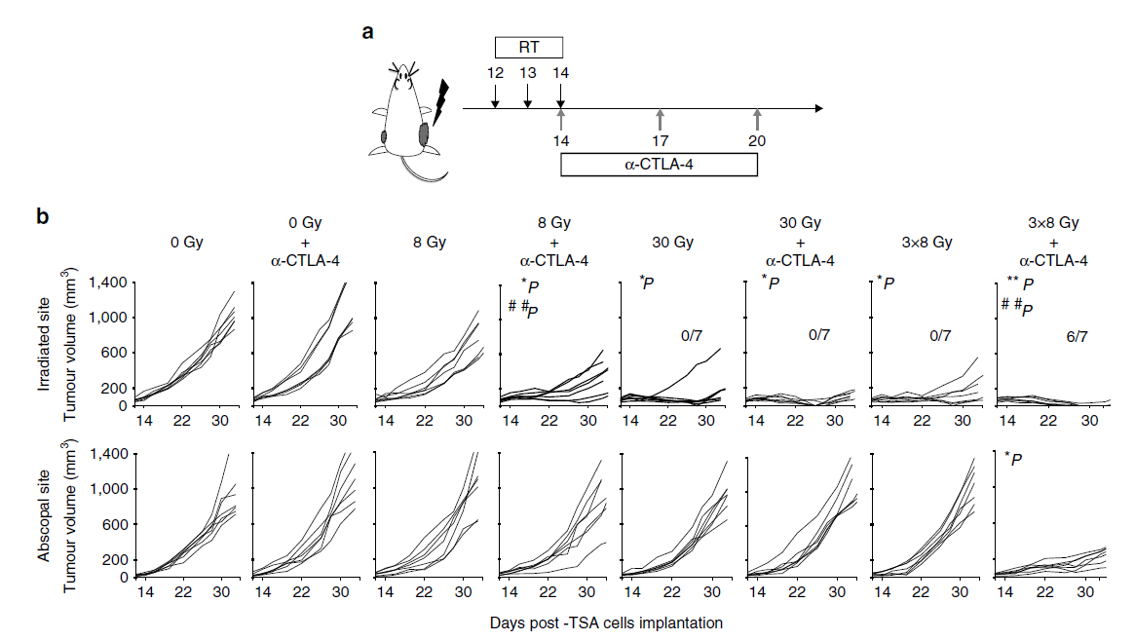
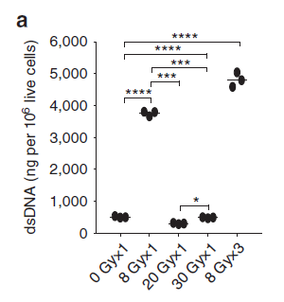
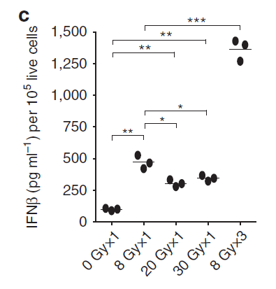
Molecular mechanisms: the cGAS/STING pathway
Vanpouille-Box et al., 2017, Nat. Communications
INSIGHTS Workshop Pisa 18th October 2023
c.totis@gsi.de
Notes:
the starting point of this project was this paper of 2017, in which….

Slide 8
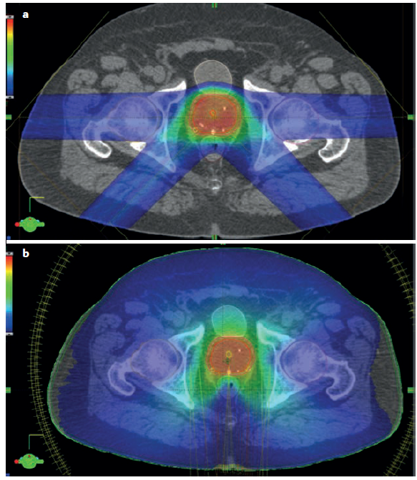
Charged particles advantages
Charged particles and especially C-ion radiotherapy (CIRT) offer:
  High tumor control probability, high local control in patients
  Treatment of radio-resistant and hypoxic tumors
  Reduced integral dose to healthy tissues and sparing of circulating immune cells, that are available for an efficient immune response
Treatment plan with particles
Durante, 2018, BJC
Treatment plan with photons
Durante et al., 2000, IJROBP
Durante et al., 2017, Nat. Rev. Clin. Oncol.
INSIGHTS Workshop Pisa 18th October 2023
c.totis@gsi.de

Slide 9
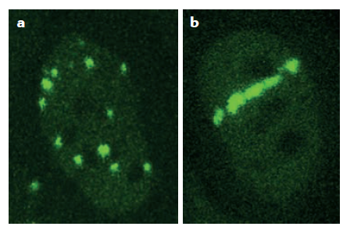
Charged particles advantages
HMGB1
X-rays
C-ions
Onishi et al., Rad Res. 2018
More complex DNA damage: higher mutagenicity?
Indications for a stronger induction of immune stimulatory signals: higher adjuvanticity?
Durante et al., 2017, Nat. Rev. Clin. Oncol.
INSIGHTS Workshop Pisa 18th October 2023
c.totis@gsi.de

Slide 10
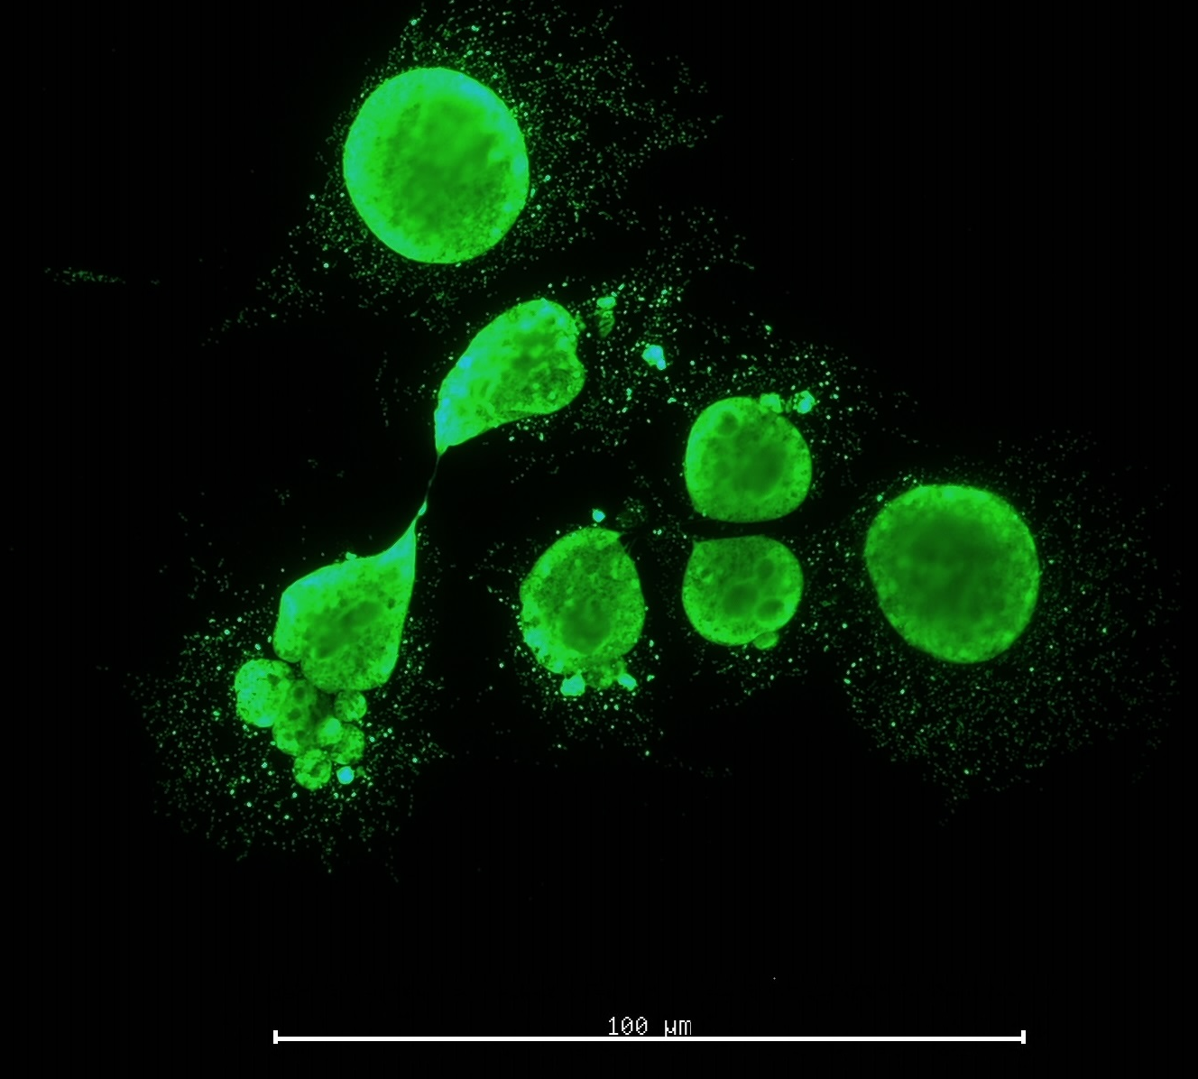
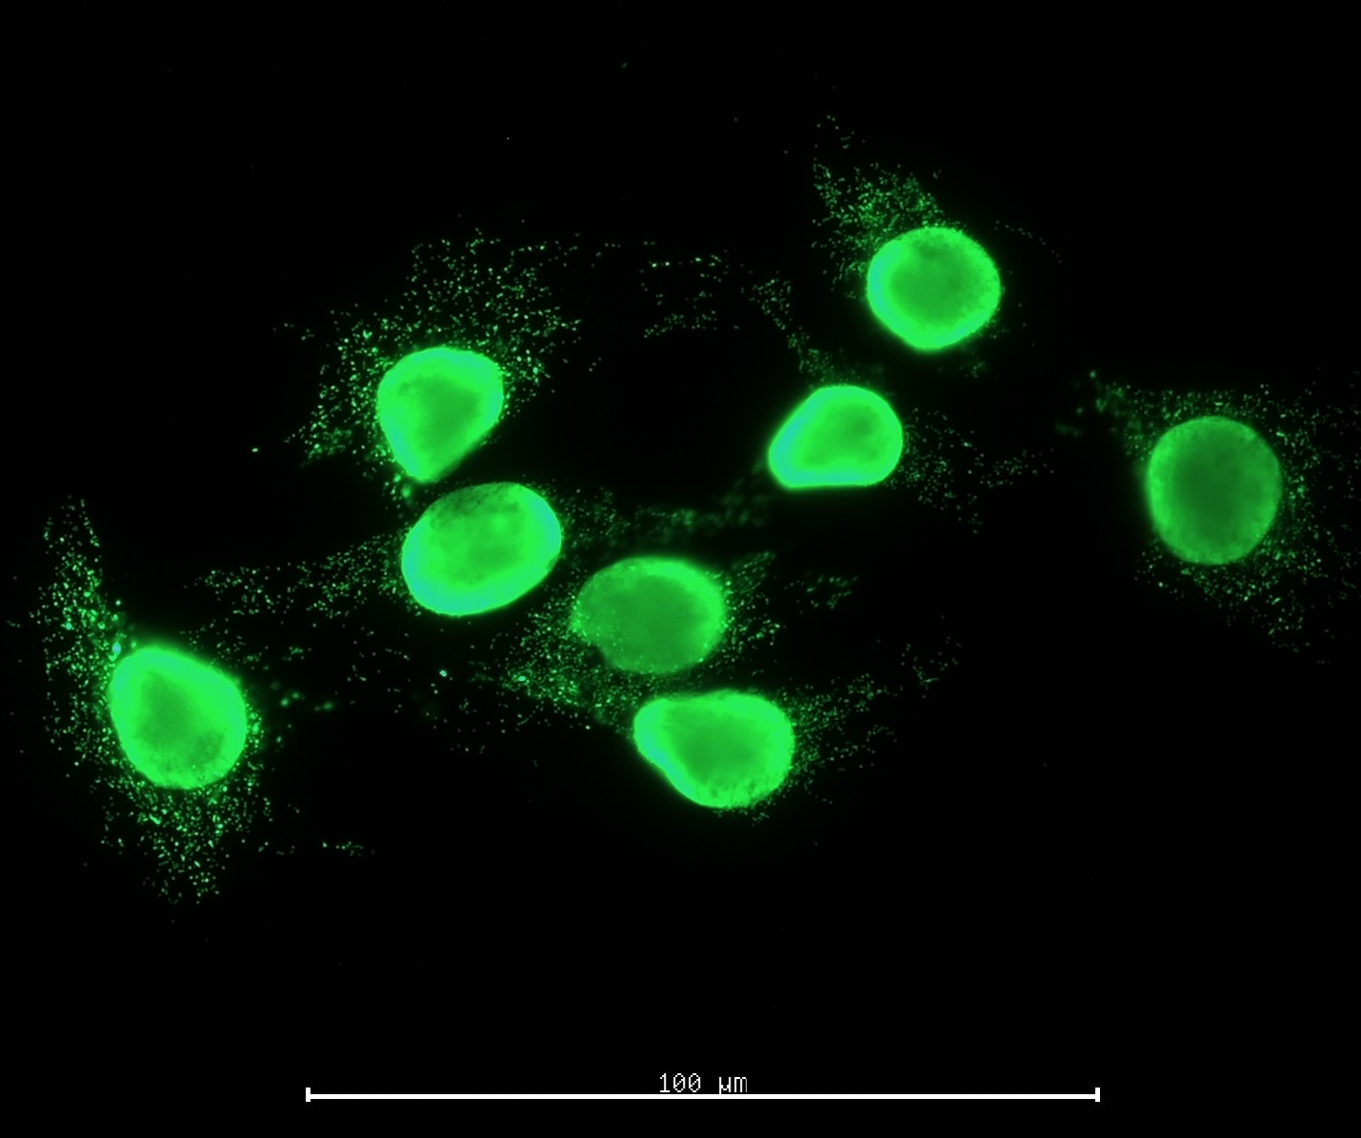
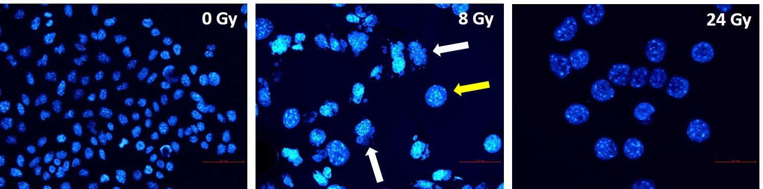
Linear increase in cytoplasmic dsDNA
8 Gy X-rays
dsDNA
20 Gy X-rays
dsDNA
Vanpouille-Box et al., 2017, Nat. Com.
100 µm
100 µm
p<0.0001
Linear dose-dependent increase in cytoplasmic dsDNA, more pronounced after C-ion in a mouse mammary carcinoma cell line
100 µm
100 µm
100 µm
Fragmented nuclei
Giant nuclei
INSIGHTS Workshop Pisa 18th October 2023
unpublished
c.totis@gsi.de

Slide 11
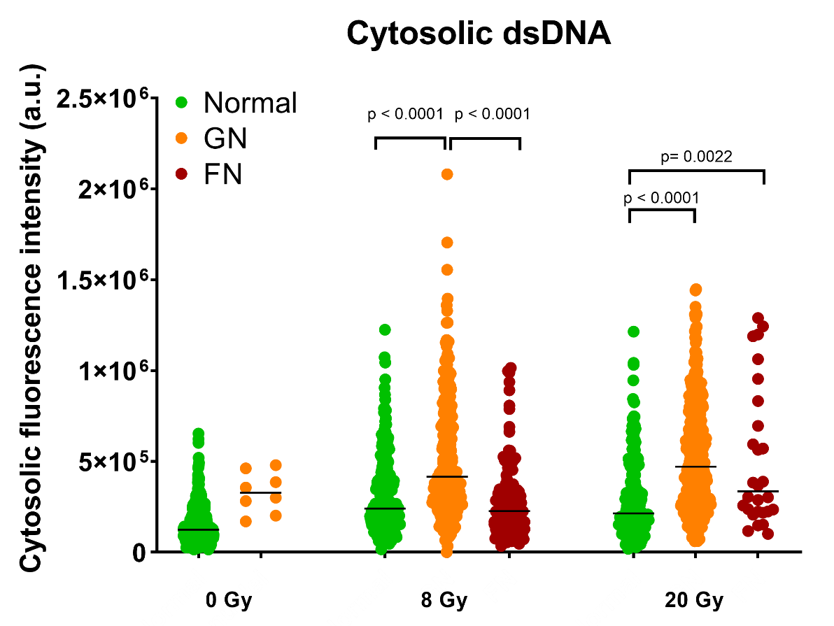
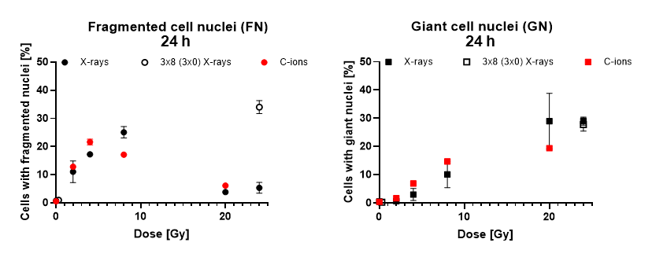
Is mitotic catastrophe correlated to cytoplasmic dsDNA?
100 µm
100 µm
100 µm
Fragmented nuclei
Giant nuclei
Line: median
Kruskall-Wallis test
The results suggest that mitotic catastrophe plays a role in cytoplasmic dsDNA formation
Mean±SEM
Fragmented nuclei and giant cell nuclei are hallmarks of mitotic catastrophe
INSIGHTS Workshop Pisa 18th October 2023
unpublished
c.totis@gsi.de
Notes:
the starting point of this project was this paper of 2017, in which….

Slide 12
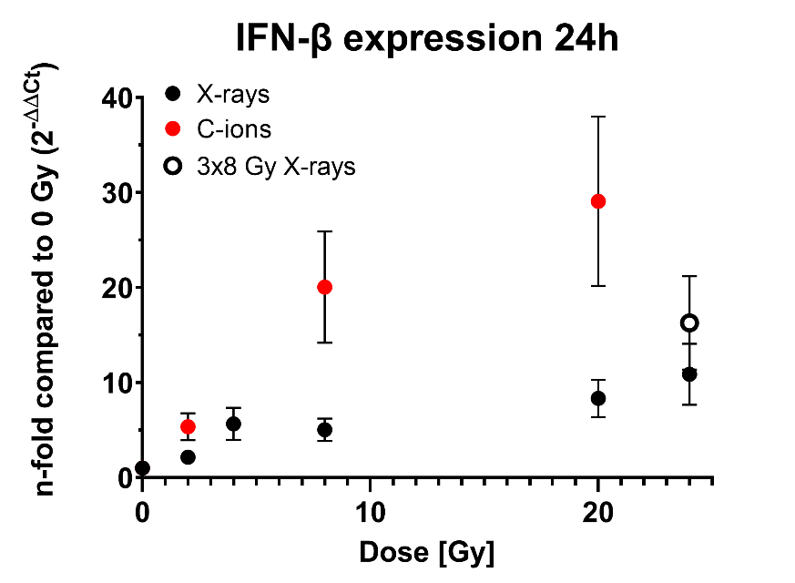
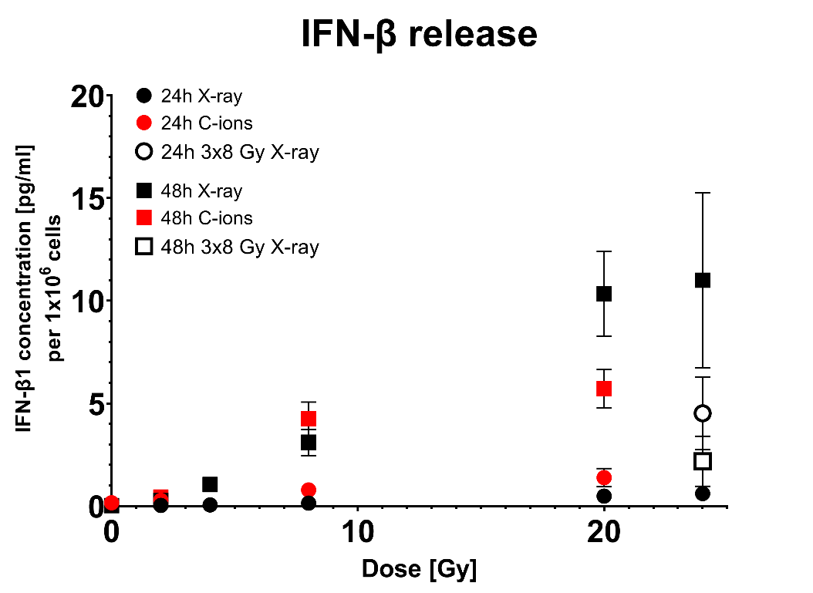
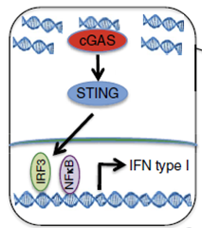
From cytosolic dsDNA to type I IFN release
Vanpouille-Box et al., 2017, Nat Communications
Mean±SEM
Linear dose-dependent increase in IFN-β gene expression and release.
IFN-β reflects the linear dose response of cytoplasmic dsDNA.
C-ions tend to have a higher efficiency
INSIGHTS Workshop Pisa 18th October 2023
unpublished
c.totis@gsi.de

Slide 13
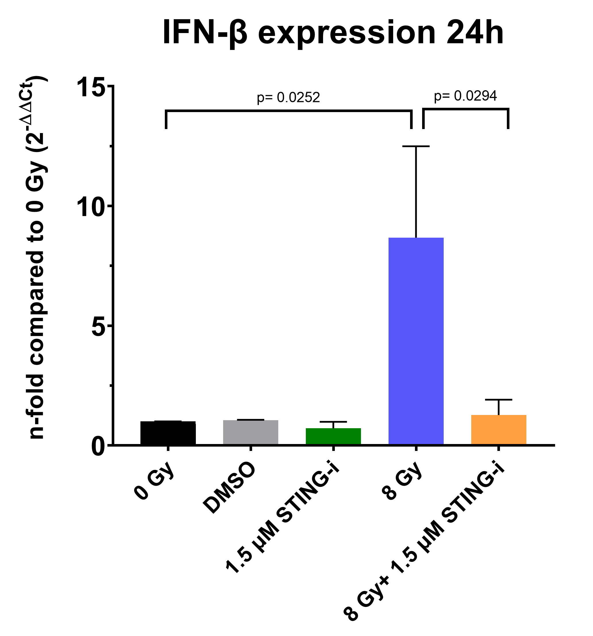
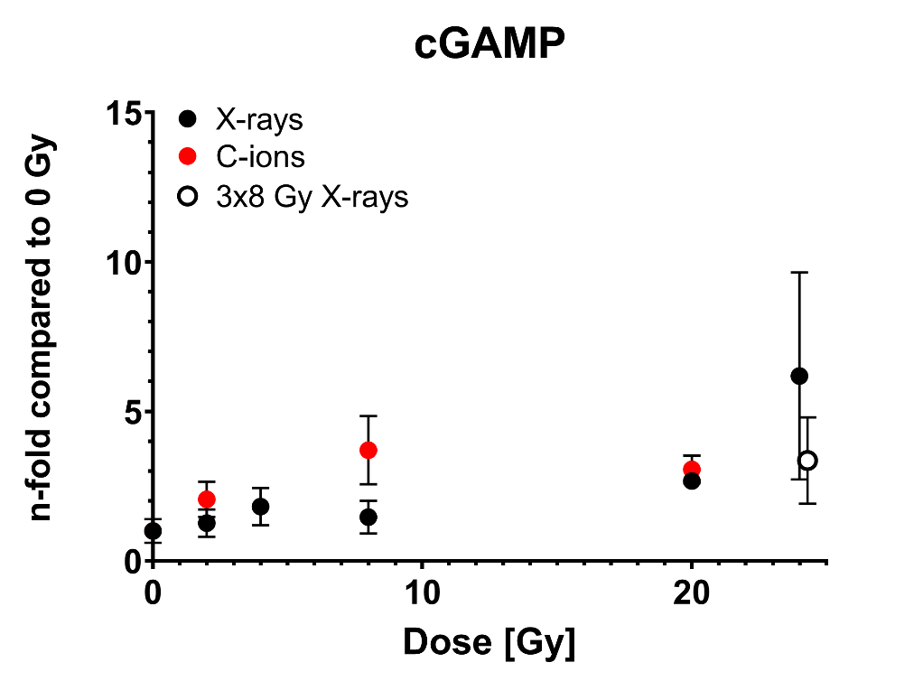
cGAS/STING pathway activation
Vanpouille-Box et al., 2017, Nat Communications
Mean±SEM
Mean±SEM
Confirmation of cGAS activation following photon and C-ion irradiation
STING inhibition (H-151, small molecule inhibitor) hampers IFN-β induction by radiation
INSIGHTS Workshop Pisa 18th October 2023
unpublished
c.totis@gsi.de
Notes:
the starting point of this project was this paper of 2017, in which….

Slide 14
Take home messages
The immune system plays an important role in the treatment of metastatic cancer
  Immunotherapy is established as additional pillar in cancer therapy
    Understanding the mechanisms by which the immune system is triggered and interacts with radiotherapy is essential for a wider application of a combined treatment
      Hadrontherapy has the potential to improve the outcome of a combined therapy:
        more immune cells available can be involved in anti-tumor immune responses
        for some immunogenic mechanisms (cytoplasmic dsDNA formation, IFN-β expression)
        C-ions show a higher efficiency than photons
INSIGHTS Workshop Pisa 18th October 2023
c.totis@gsi.de
Notes:
the starting point of this project was this paper of 2017, in which….

Slide 15

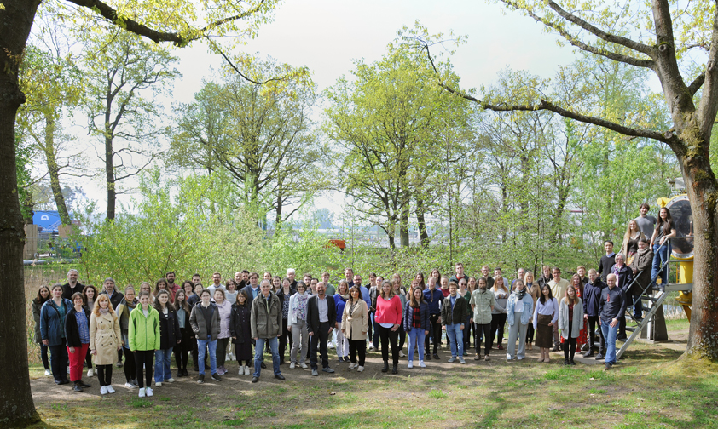

Acknowledgments
THANK YOU VERY MUCH FOR YOUR ATTENTION
  Prof. Marco Durante
Immune system and tissue radiobiology
  Prof. Claudia Fournier
  Dr. Alexander Helm
  Gaia Volpi
  Dr. Daniela Kraft
  Dr. Aylin Benzer
  Dr. Liliana Davkova
  Dennis Hintze
  Paul Schulte
Molecular radiobiology and imaging
  Prof. Burkhard Jakob
  Dr. Nicole Averbeck
Marburger Ionenstrahl-Therapiezentrum (MIT)
Biophysics department, GSI
Cristina Totis; c.totis@gsi.de

