Slide 1
Preclinical studies with radioactive ion beams: the BARB project
Tamara Vitacchio*¹, Olga Sokol¹, Daria Boscolo¹, Anggraeini Puspitasari^{1,2}, Julius Oppermann¹, Walter Tinganelli¹, Marco Durante^{1,3}.
*lead presenter
1st Meeting
18 - 20 October 2023

Slide 2
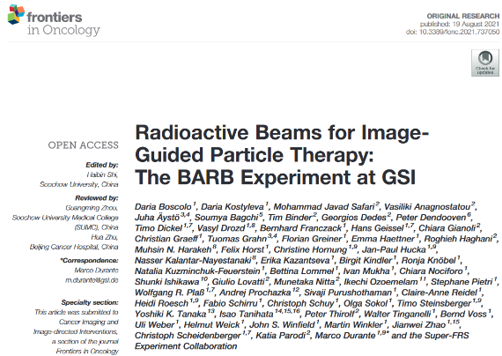
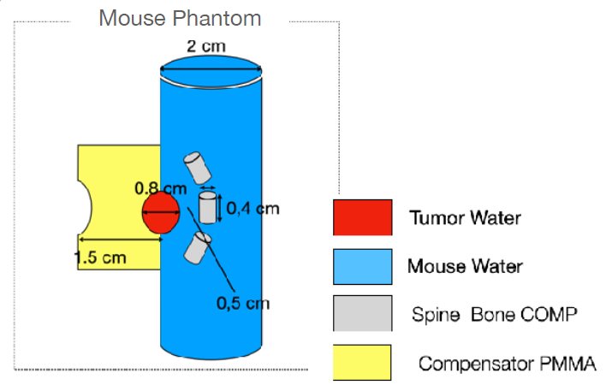
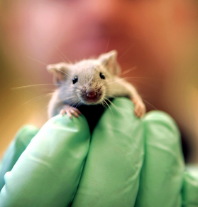
Context
Physicists´ mouse
Biologists´ mouse
Radiobiological validation in a preclinical context
→ From the physics model to the human health application
18 October 2023

Slide 3
BARB – Biomedical Application of Radioactive Ion Beams
The potential application of radioactive ion beams (RIBs) of heavy ions in the field of radiotherapy
Study I:
Tumor margin reduction with RIBs combined with PET
Study II:
RIBs as in vivo tracers for vasculature damage
18 October 2023

Slide 4
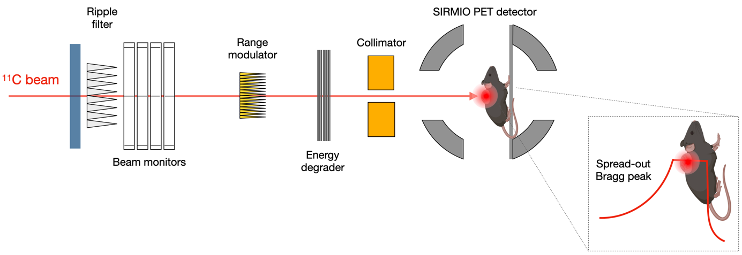
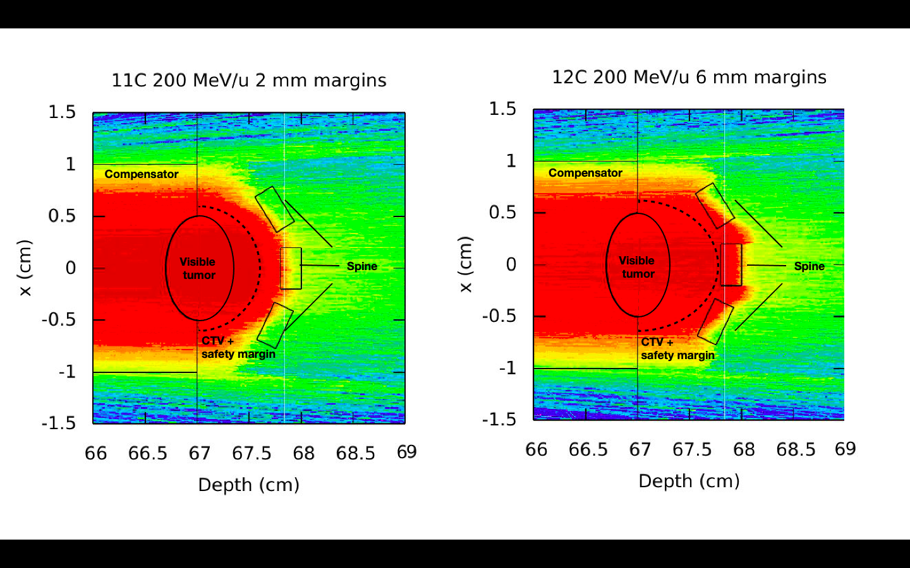
Aims of the project - 1
Produce radioactive (ß⁺-emitters) ion beams (¹⁰C, ¹¹C, ¹⁵O) at high intensities
Real-time beam monitoring with a new gamma-PET hybrid detector Improved image-guided treatment
Treat a small tumour in a murine model with sub-millimeter precision
Less damage to healthy tissue, while maintaining the same tumour control
Study I:
Tumor margin reduction with ¹¹C
With range verification
(Reduced tumor margins)
Without range verification
(Normal tumor margins)
Model: tumor close to the cervical area of the spinal cord (OAR)
18 October 2023

Slide 5
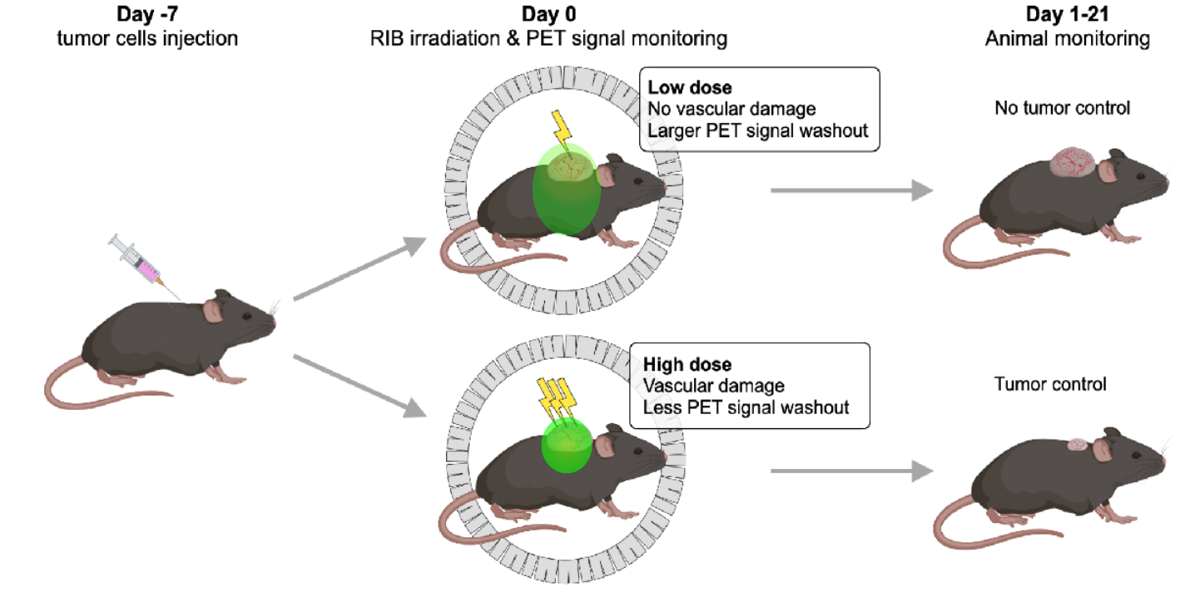
Aims of the project - 2
Day -21 Day 0 Day +28
Tumor cells injection RIB irradiation & PET signal monitoring Animal monitoring
Study II:
RIBs as in vivo tracers for vasculature damage
Aim: To investigate the correlation between vascular permeability and tumor control
Method: measure the PET signal washout online, to check eventual changes in the vascular system of the tumor induced by high radiation doses
18 October 2023

Slide 6
Experiments timeline
So far…
Tumor model development studies
→ Osteosarcoma tumor in the cervical area of the spinal cord (organ at risk)
Paralysis development and assessment protocols
Post-irradiation follow-up protocol
Vasculature mapping studies
November 2023
X- rays dose escalation study
Doses: 0 Gy (control), 5 Gy, 10, 15, 20 Gy)
Finding the dose leading to tumor control
Finding the dose leading to paralysis
February 2024
¹¹C Beamtime
Irradiation with range verification
Irradiation without range verification
Vasculature damage studies
Aim: demonstrate the potential application of RIBs in radiotherapy
18 October 2023

Slide 7
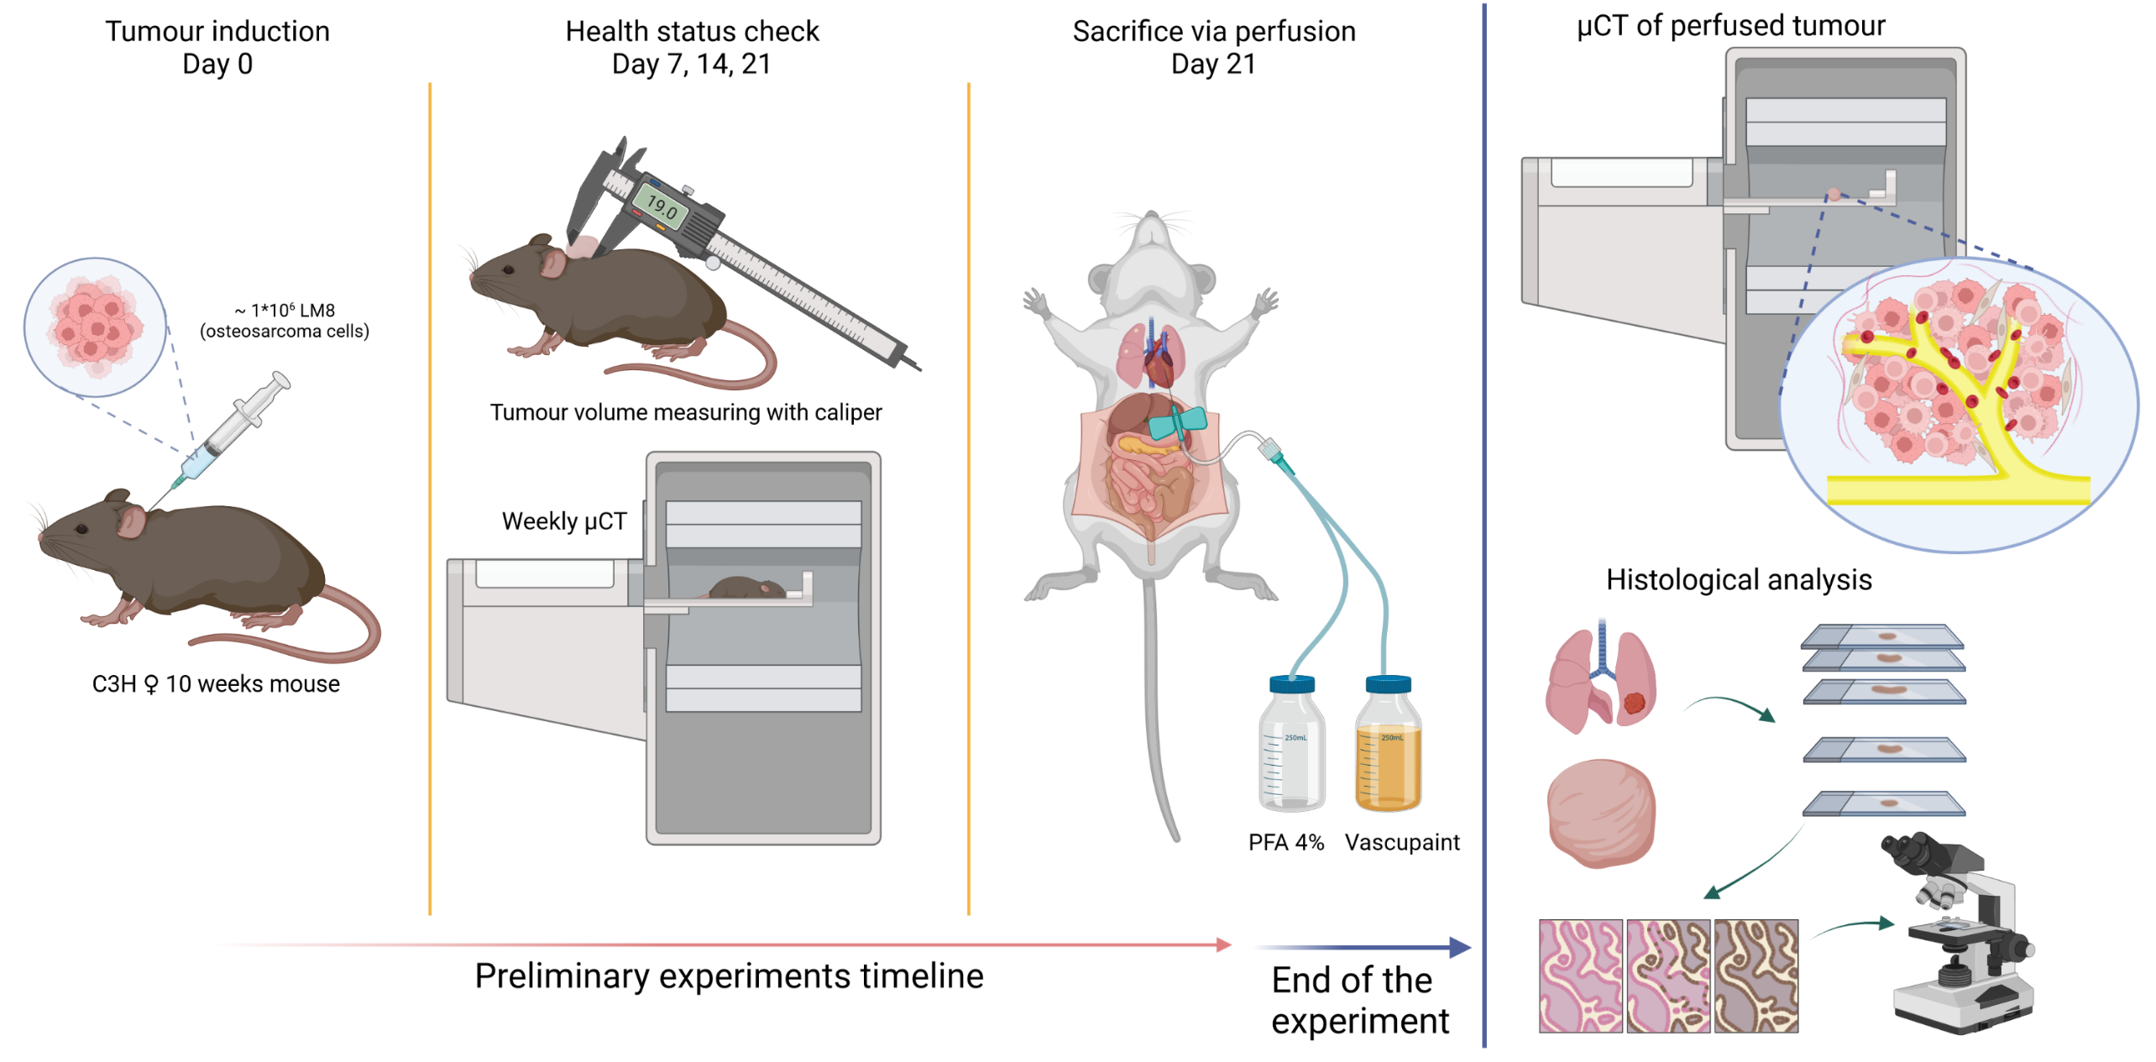
Establishment of the osteosarcoma tumor model
Created with BioRender.com
18 October 2023

Slide 8
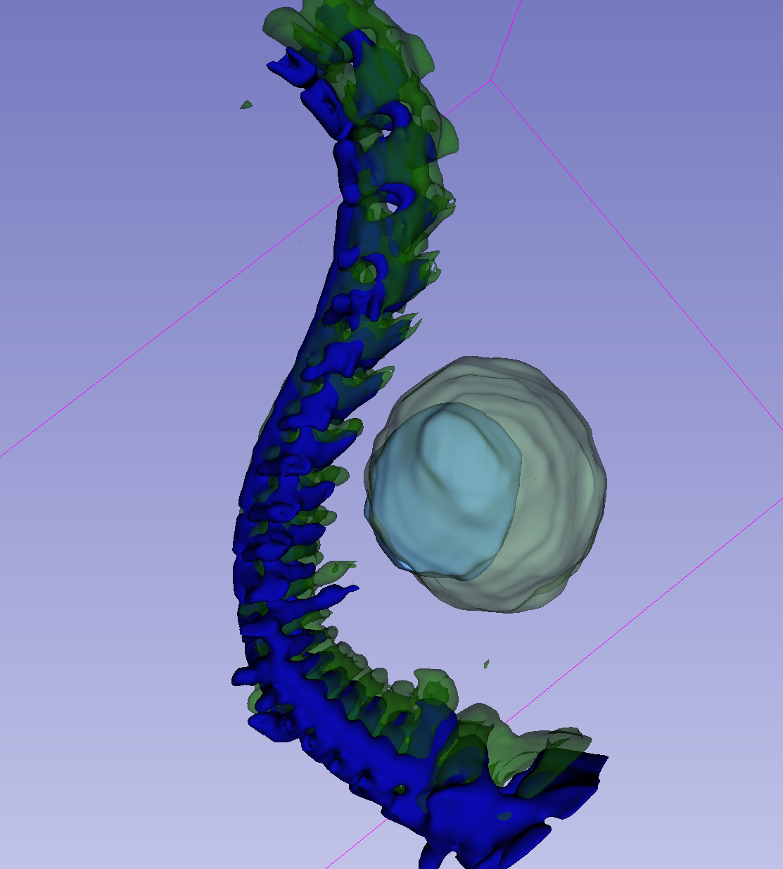
Results – Tumour growth rate
µCT scans, resolution 100 µm
Week 1 Week 2 Week 3 Week 4
2 weeks
3 weeks
Slicer reconstructions from µCT
18 October 2023

Slide 9
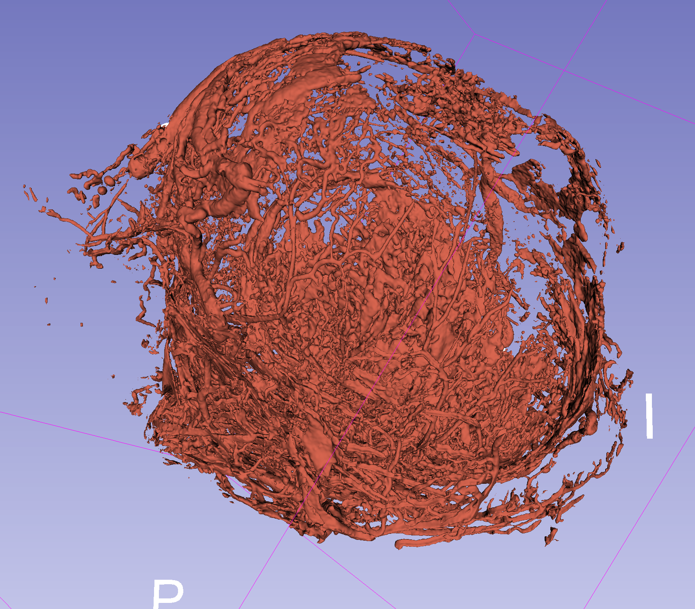
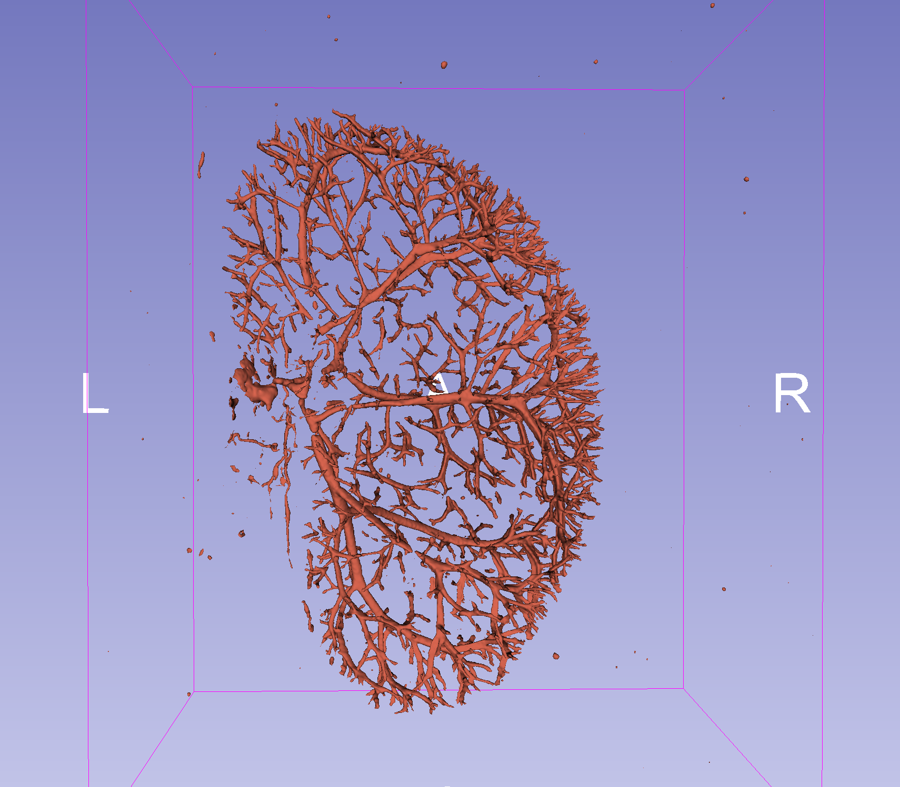
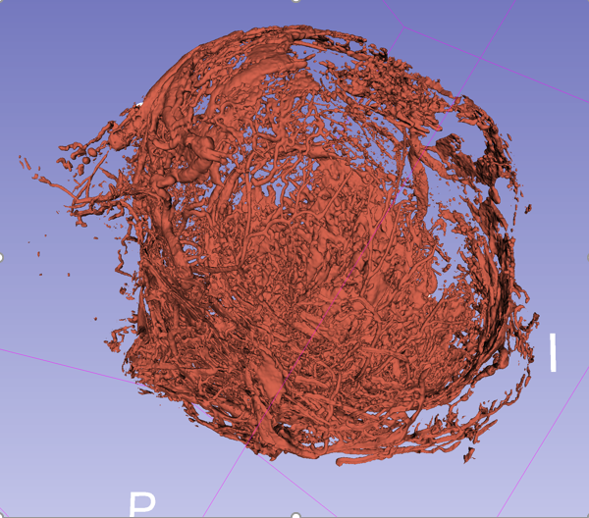
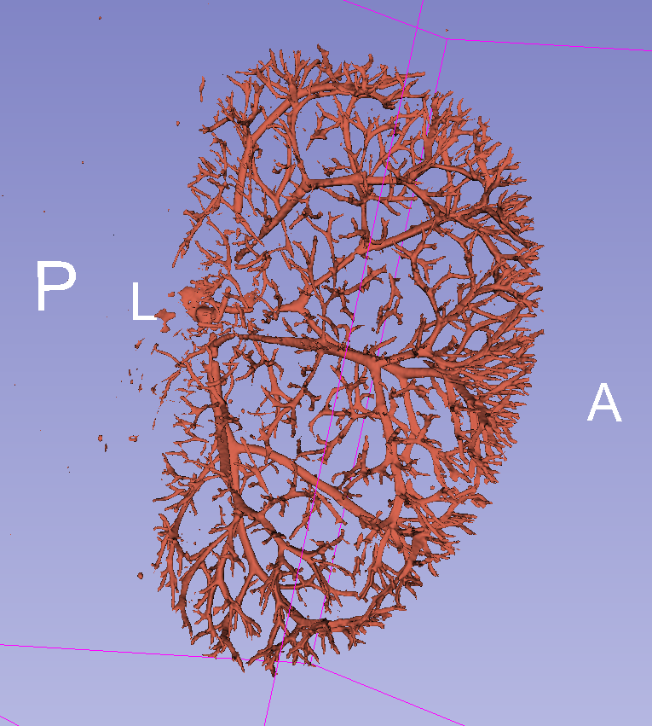
Results – Vascupaint perfusion: 3D maps of vasculature
10 mm
7,5 mm
Parameters:
Vessel volume | [mm³]
Density | [%]
Number | [mm⁻¹]
Thickness | [mm]
Separation | [mm]
Connectivity | [mm⁻³]
Surface area | [mm²]
Tumour
Kidney
Resolution: 10 µm
18 October 2023

Slide 10
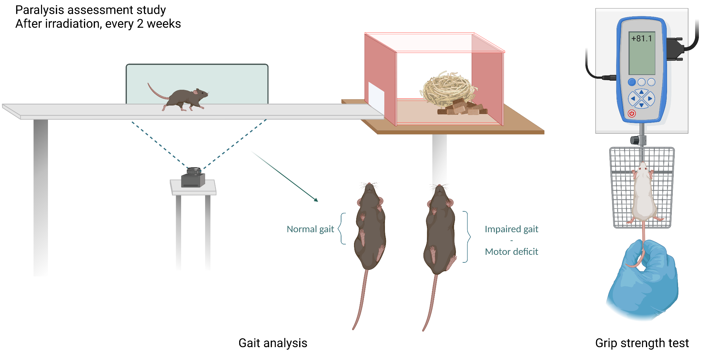
Post-irradiation follow-up: paralysis
If the spinal cord is damaged during irradiation, the signal can´t be transmitted from the brain to the limbs
The gait of the animals will be affected (speed, stride length and other parameters)
Paralysis is expected in the forelimbs, with a reduction in the grip strength of the animals
Adapted from: Paw-Print Analysis of Contrast-Enhanced Recordings (PrAnCER): A Low-Cost, Open-Access Automated Gait Analysis System for Assessing Motor Deficits
Created with BioRender.com
18 October 2023

Slide 11
Preliminary results – Gait analysis
The PrAnCER software (custom version) measures for how long a paw is in contact with the floor and it contours it, distinguishing the four different paws
An “ink track” is produced
The gait of the animals can be visualized and neatened (e. g. if the tail is present in the field of view)
HR
HR
FR
FR
HL
HL
FL
FL
Legend: HL (hind left), FL (front left), HR (hind right), FR (front right)
18 October 2023

Slide 12
Preliminary results – Gait analysis
Normally behaving mouse
Mouse with stereotypical behaviour
HR
HR
FR
FR
FR
FR
HR
HR
FR
HL
HL
FL
FL
FL
FL
HL
HL
Legend: HL (hind left), FL (front left), HR (hind right), FR (front right)
18 October 2023

Slide 13
Preliminary results – Gait analysis
Intra-mouse variability
(six runs)
Name | Gait parameter
Stride Length | Distance between successive contacts of the same paw
Step Length | Distance between successive contacts of contralateral front or hind paws along the axis of the direction of motion
Stance Duration | The length of time a paw was in contact with the ground
Inter-mouse variability
(between three animals)
18 October 2023

Slide 14
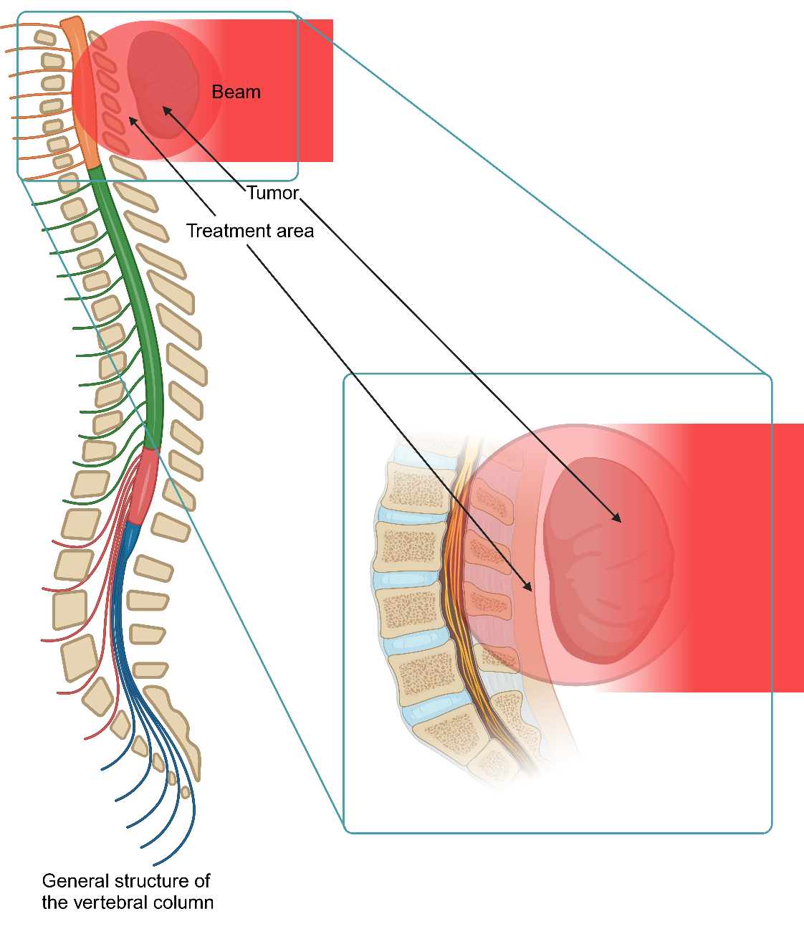
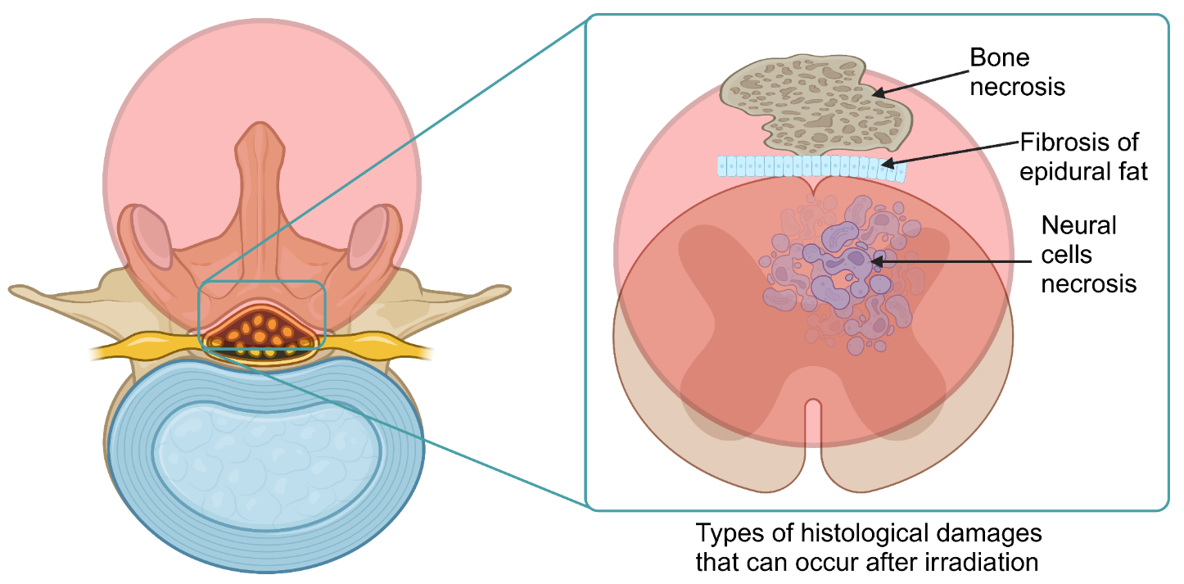
Histology protocols
If the spinal cord is hit during irradiation, there will be damages that can be visualized via histology sampling
This technique can also show the inner structure of the tumor tissue and the presence of metastasis in the lung
18 October 2023

Slide 15
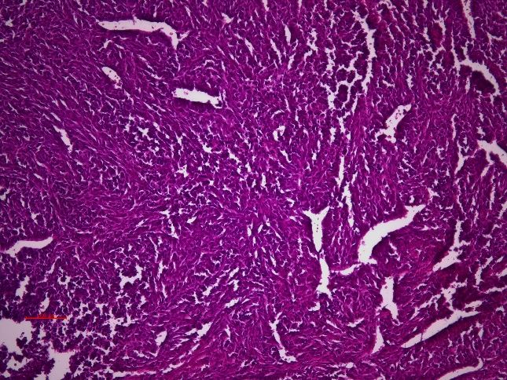
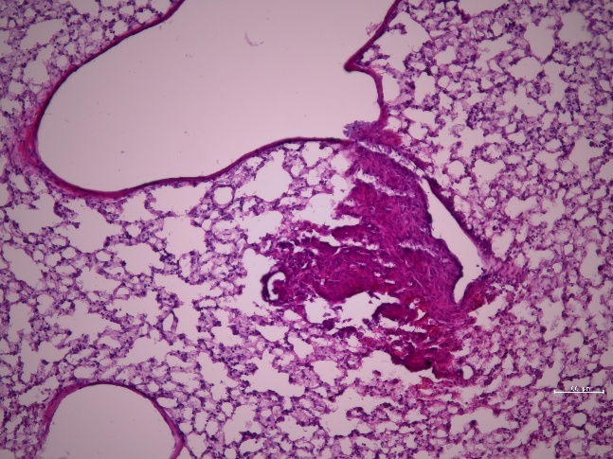
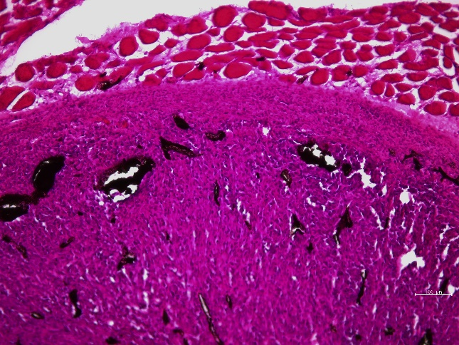
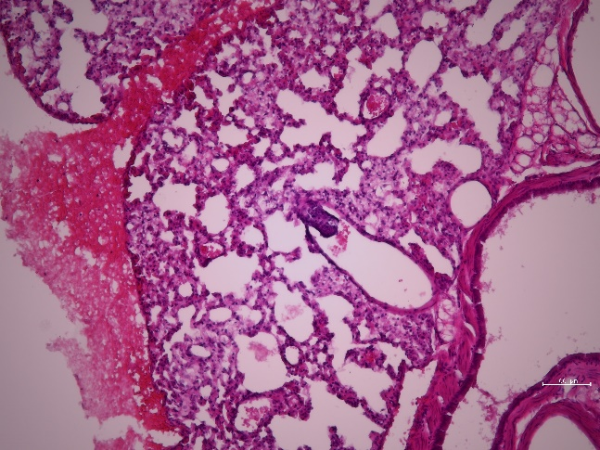
Results – Histology of tumors and lungs
Tumor
Lung + metastasis
Slices of 10 µm
Hematoxylin-eosin staining
10x magnification
Tumor histology useful to confirm the presence or abscence of tumor tissue
Animals will be kept for 6 months
Osteosarcoma is highly metastatic to the lungs
The presence of metastases will be monitored on the µCT during the health checks
50 µm
50 µm
Tumor + Vascupaint
Lung + metastasis
Metastases in the lung
50 µm
50 µm
Vessels filled with Vascupaint
18 October 2023

Slide 16
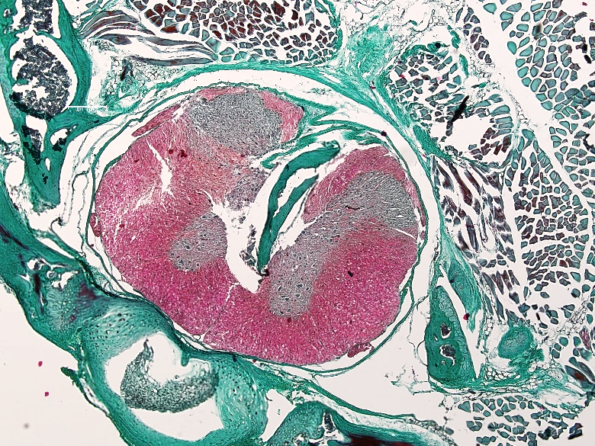
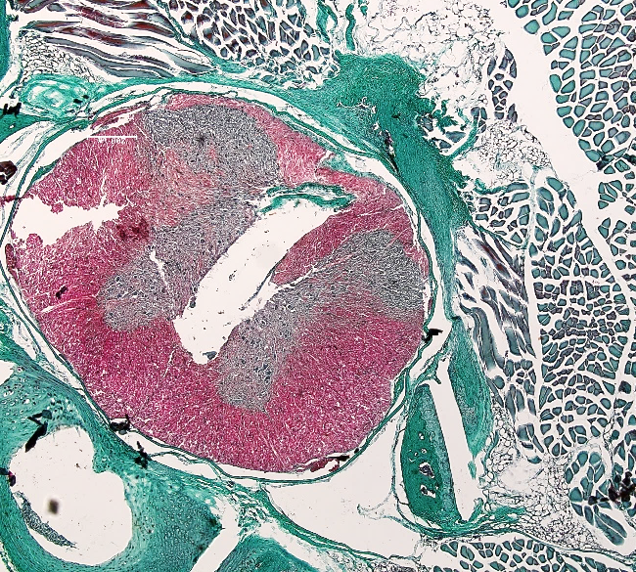
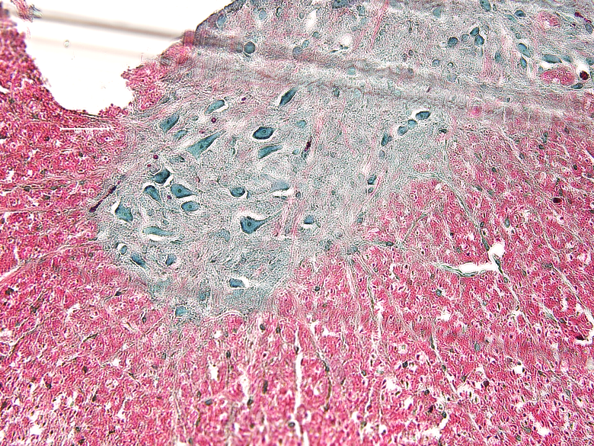
Results – Histology of the spinal cord
Healthy mouse spinal cord
Slices of 10 µm
Masson´s Goldner Staining Kit (Merck)
200 µm
Supraspinal process
of vertebra
Subcutaneous
muscle tissue
Subcutaneous
fat tissue
200 µm
4x
White matter
Epidural space
Grey matter
25 µm
Spinal cord
Vertebral body
20x
18 October 2023

Slide 17
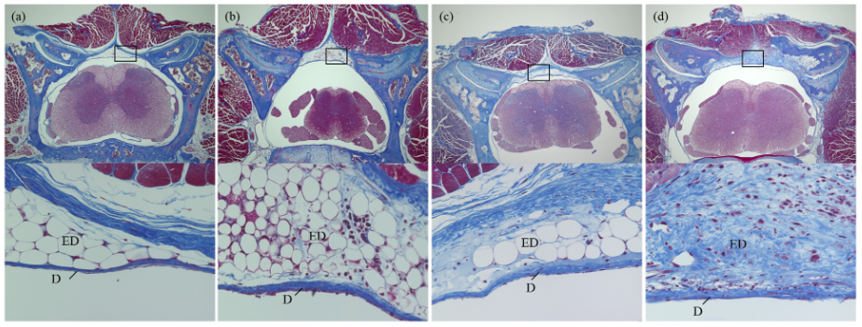
Expected results from histology
Radiation-induced epidural fibrosis
Radiation-induced demyelination
Grade 0
No fibrosis
Grade 1
Minimum fibrosis
Grade 2
Moderate fibrosis
Grade 3
Severe fibrosis
C
D
No irradiation = no demyelination
Demyelination after 22 Gy
(Masson’s trichrome stain; above, magnification ×40; below, magnification ×400 objective). Abbreviations: D, dura mater; ED, epidural space. Section from the thoracolumbar trasition region of the spine. From Yokogawa et al., 2015
From https://radiologykey.com/spinal-cord-radiobiology/
Expected results: differences in the dorsal part of the spinal cord and surrounding tissues (e.g., radiation-induced epidural fibrosis, differences inside in the myelin, radiation-induced necrosis of the bones)
18 October 2023

Slide 18
Conclusions and future outlook
The murine tumor model in the proximity of the spinal cord was established
The following endpoints and the respective protocols for the post-irradiation follow-up were identified:
Tumor control and metastases: caliper, µCT, histology
Spinal cord damage: gait analysis, grip strength test, histology
Vasculature damage: perfusion and µCT assessment
X-rays irradiation in November
Animals will be followed-up for six months for tumor growth and paralysis development
Beamtime with C-ions in February 2024
Irradiation with range verification
Irradiation without range verification
Low-dose and high dose irradiation (PET signal washout)
Same follow-up of the animals
18 October 2023

Slide 19
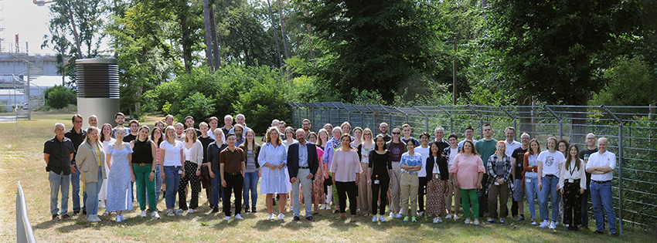
Acknowledgements
GSI Biophysics Department - Director: Prof. Dr. Marco Durante
Clinical Radiobiology Group
Group leader: Dr. Walter Tinganelli
Post-docs:
Dr. Olga Sokol
Dr. MD. Anggraeini Puspitasari
Dr. Reema Chowdhury
Technical Assistants:
Julius Oppermann
Leonie Hartig
PhD student:
Tamara Vitacchio
Students:
Katelin Sherman
Dennis Fritsche
Radiation Physics Group
Dr. Daria Boscolo
Dr. Christoph Schuy
Dr. Uli Weber
LMU Group
Prof. Dr. Katia Parodi
Giulio Lovatti
18 October 2023

Slide 20
Thank you for your attention!
1st Meeting
18 October 2023

