Slide 1
Using Cold Target Recoil Ion Momentum Spectroscopy for Polarization Characterization of SASE Pulses
Antoine Sarracini :: Postdoc | Maloja | SwissFEL :: Paul Scherrer Institute
EuPRAXIA Electron & Photon Diagnostics
June 13 2023

Slide 2
The ATHOS Beamline at SwissFEL
Up to 3.4 GeV linac, 16 APPLE X undulators
250 – 1800 eV soft X-ray beamline
80 fs pulse duration @ 100 Hz with special modes (short pulse 20 fs, two color X-ray pump-probe up to 500 fs delay)
Maloja: modular atomic, molecular and nonlinear X-ray physics

Slide 3
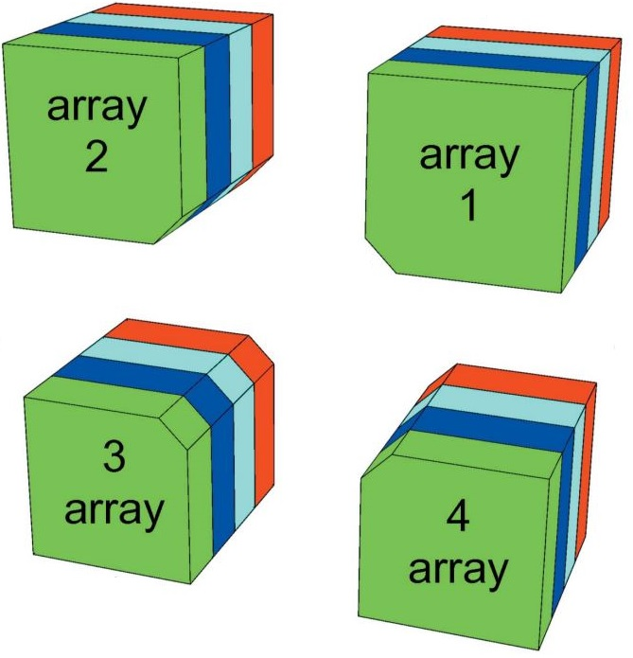
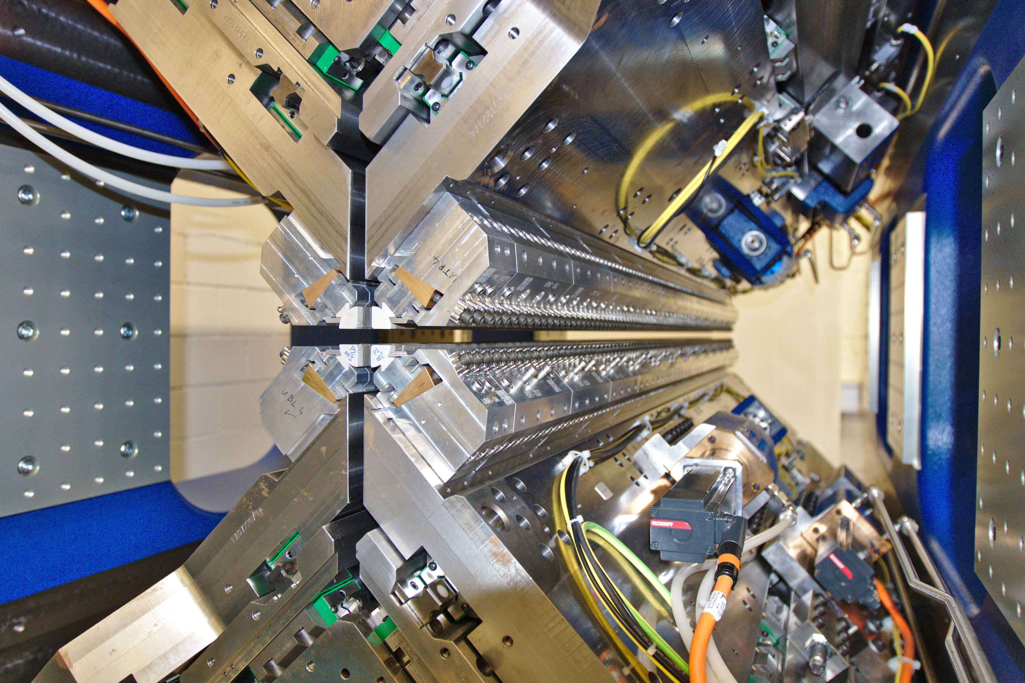
APPLE X Soft X-Ray Undulators
Symmetric and compact 2m long design
Can arbitrarily tune sinusoidal electron trajectory by independent adjustment of phase and gap of magnet arrays
4x translation degrees of freedom
4x radial degrees of freedom
φ₂
APPLE X
φ₁
r₂
r₁
Arbitrary polarization control
φ₃
r₃
r₄
φ₄
M. Calvi et al. J. Synchrotron. Rad. 2017

Slide 4
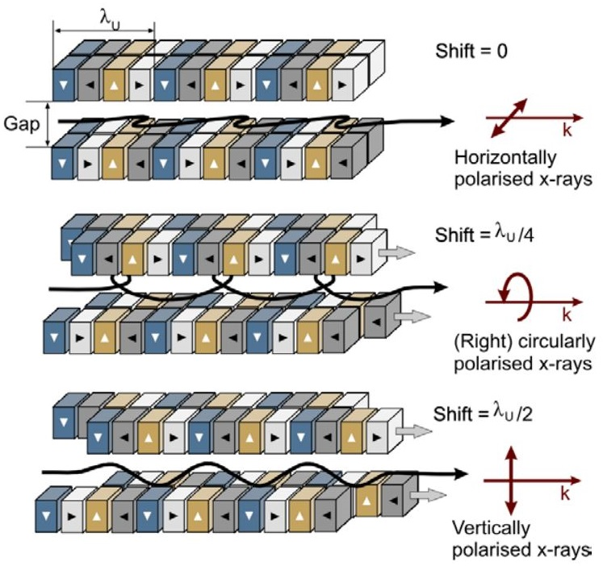
Polarization Control with APPLE X
Diagonal magnet arrays shifted to produce different polarizations
Linear Polarizations:
Horizontal $α=0°$: $φ_{U}=0$
Vertical $α=90°$: $φ_{U}={λ_{U}}/2$
Other $α$: Shift arrays in opposite direction
$$α=\tan^{−1}\left(\cot^{2}\left(\frac{1}{2}φ_{U}\right)\right)$$
Circular Polarizations:
Fully circular: $φ_{U}=λ_{U}/4$
Elliptical: $φ_{U}=0−{λ_{U}}/4 || λ/{4_{U}}−π/2$
C. Schmitz-Antoniak. Rep. Prog. Phys. 2015

Slide 5
Polarization Control with APPLE X
M. Calvi. 2021

Slide 6
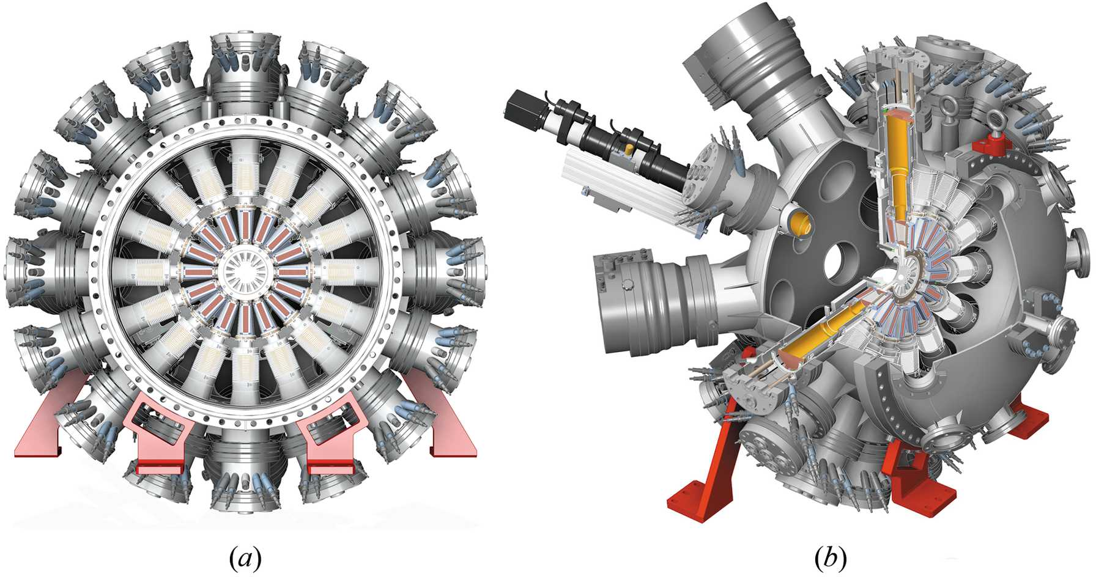
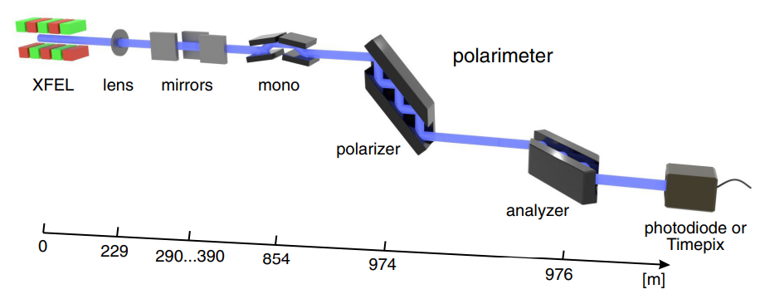
Measuring Polarization at XFEL Facilities
P. Walter et al. J. Synchrotron. Rad. 2021
“Cookiebox” e⁻-TOF
16 TOF spectrometers arranged radially
Developed at Petra III - P04 beamline
In use at Eu-XFEL, LCLS, FLASH, FERMI
Silicon channel-cut crystal
Bragg reflections from crystal select polarization
Rotatable analyzer
Photodiodes measures X-rays downstream of analyzer
Tested at Eu-XFEL
K. S. Schultze et al. Phys. Rev. Res. 2022

Slide 7
Measuring SASE Polarization: COLTRIMS
Ion Detector
Ionizing Radiation
Electron Detector
Supersonic Gas Jet
Use XFEL beam of varying polarization to ionize He gas target
Measure angular distribution of photoelectron momentum
Cold Target Recoil Ion Momentum Spectroscopy (COLTRIMS)
Fit photoelectron momentum distribution to dipole & extract angle
H. Schmidt-Böcking et al. Ann. Phys. 2021

Slide 8
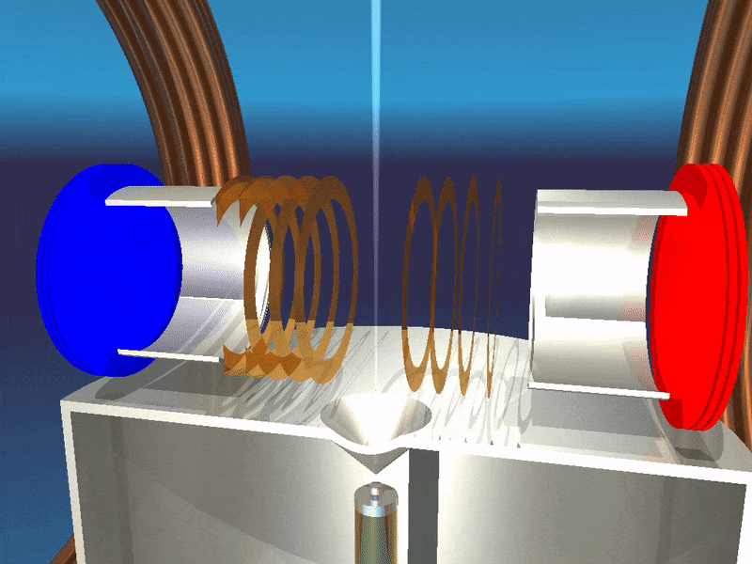
Cold Target Recoil Ion Spectroscopy Basics
Momentum imaging technique
Δp < 0.1 a.u. momentum resolution and 4π solid angle collection
Uses time-of-flight and ion / e⁻ position detection to reconstruct momenta in ionization / fragmentation processes
4π solid angle collection by confining ions and electrons to detector areas
Ions accelerated to detector using E-field
Electrons confined to detector area using B-field
Resolution limited by gas velocity spread (temperature)
Supersonic gas jet into vacuum cools target to < 1K
R. Doerner, Uni. Frankfurt.

Slide 9
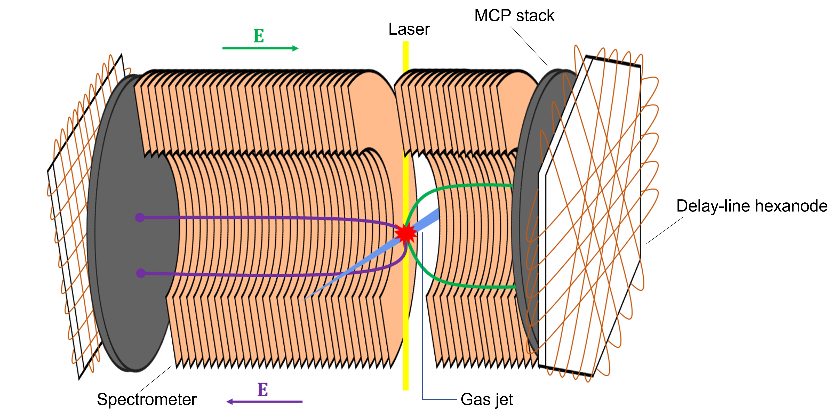
The COLTRIMS Detector at Maloja
Slow ion detection on long side (photoemission)
Fast ion detection on short side (Coulomb explosion)
No direct electron detection (yet)
I. Swiderska MSc Thesis. 2022

Slide 10
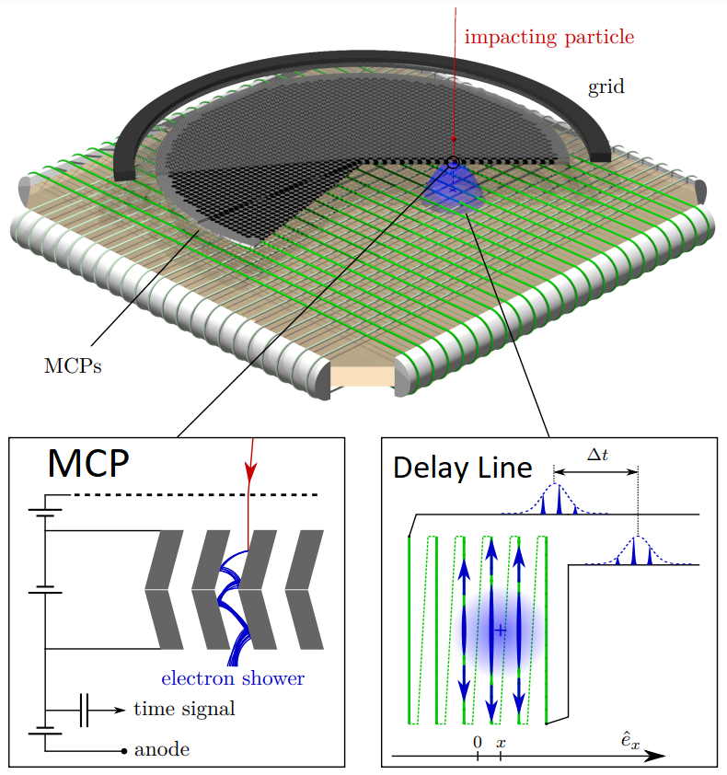
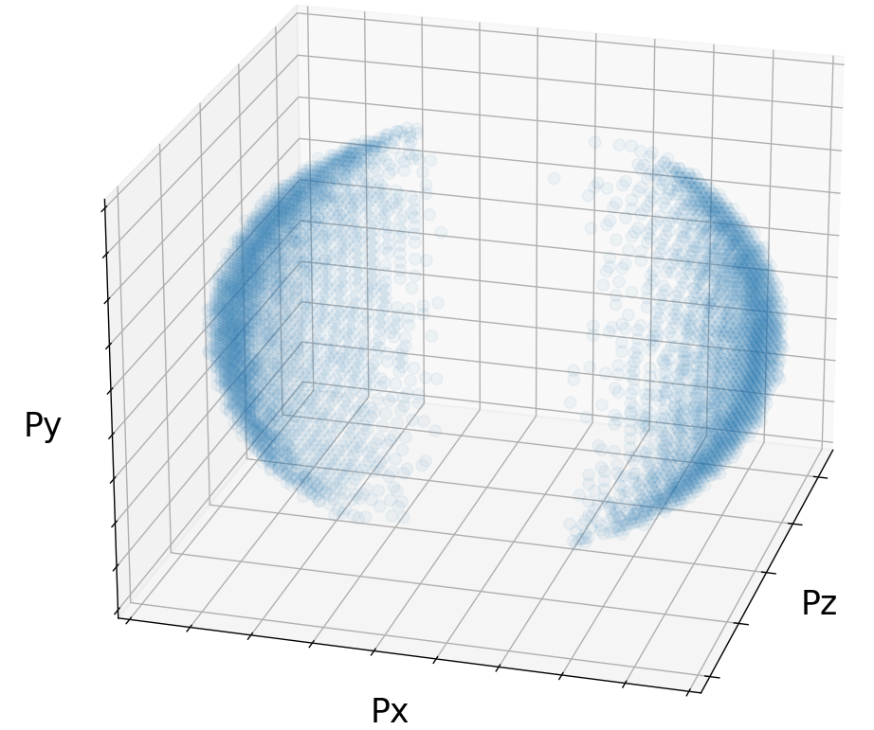
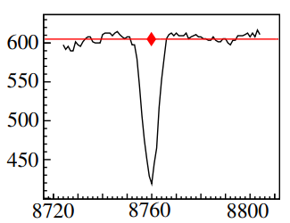
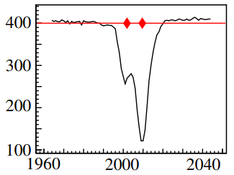
Momentum Reconstruction Process
L. Fechner PhD Thesis. 2014
MCP Signal
Delay Line Signal
$$p_{x}=m\left(\frac{x_{DL}}{t}−v_{jet}\right)$$
$$p_{z}=\frac{my_{DL}}{t}$$
$$x_{DL}$$
$$z_{DL}$$
$$p_{y}=\frac{2md^{2}−UQt_{MCP}^{2}}{2t_{MCP}d}$$
K. Schnorr. PhD Thesis. 2014

Slide 11
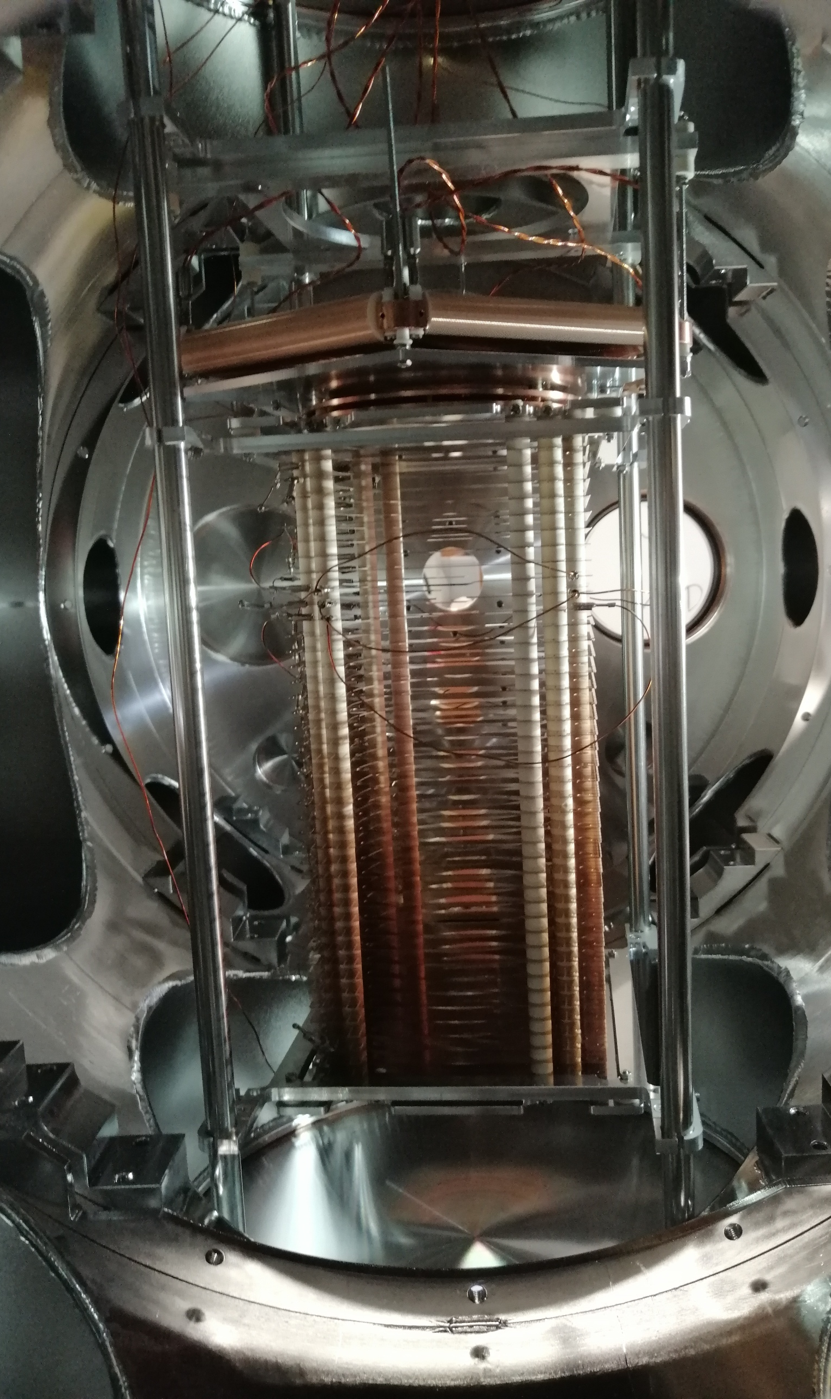
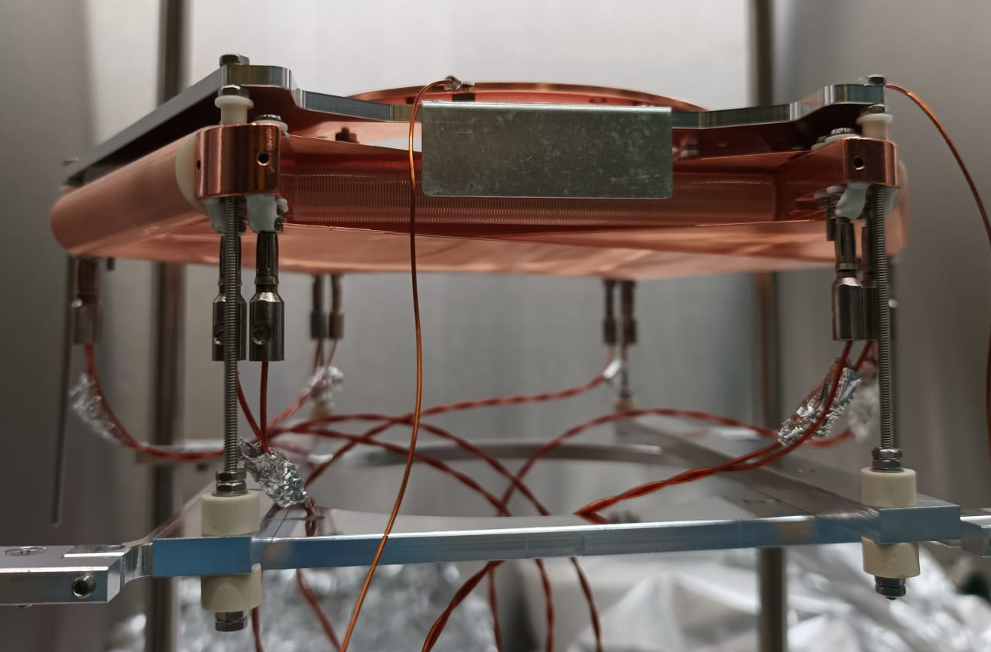
The COLTRIMS Detector at Maloja
I. Swiderska MSc Thesis. 2022

Slide 12
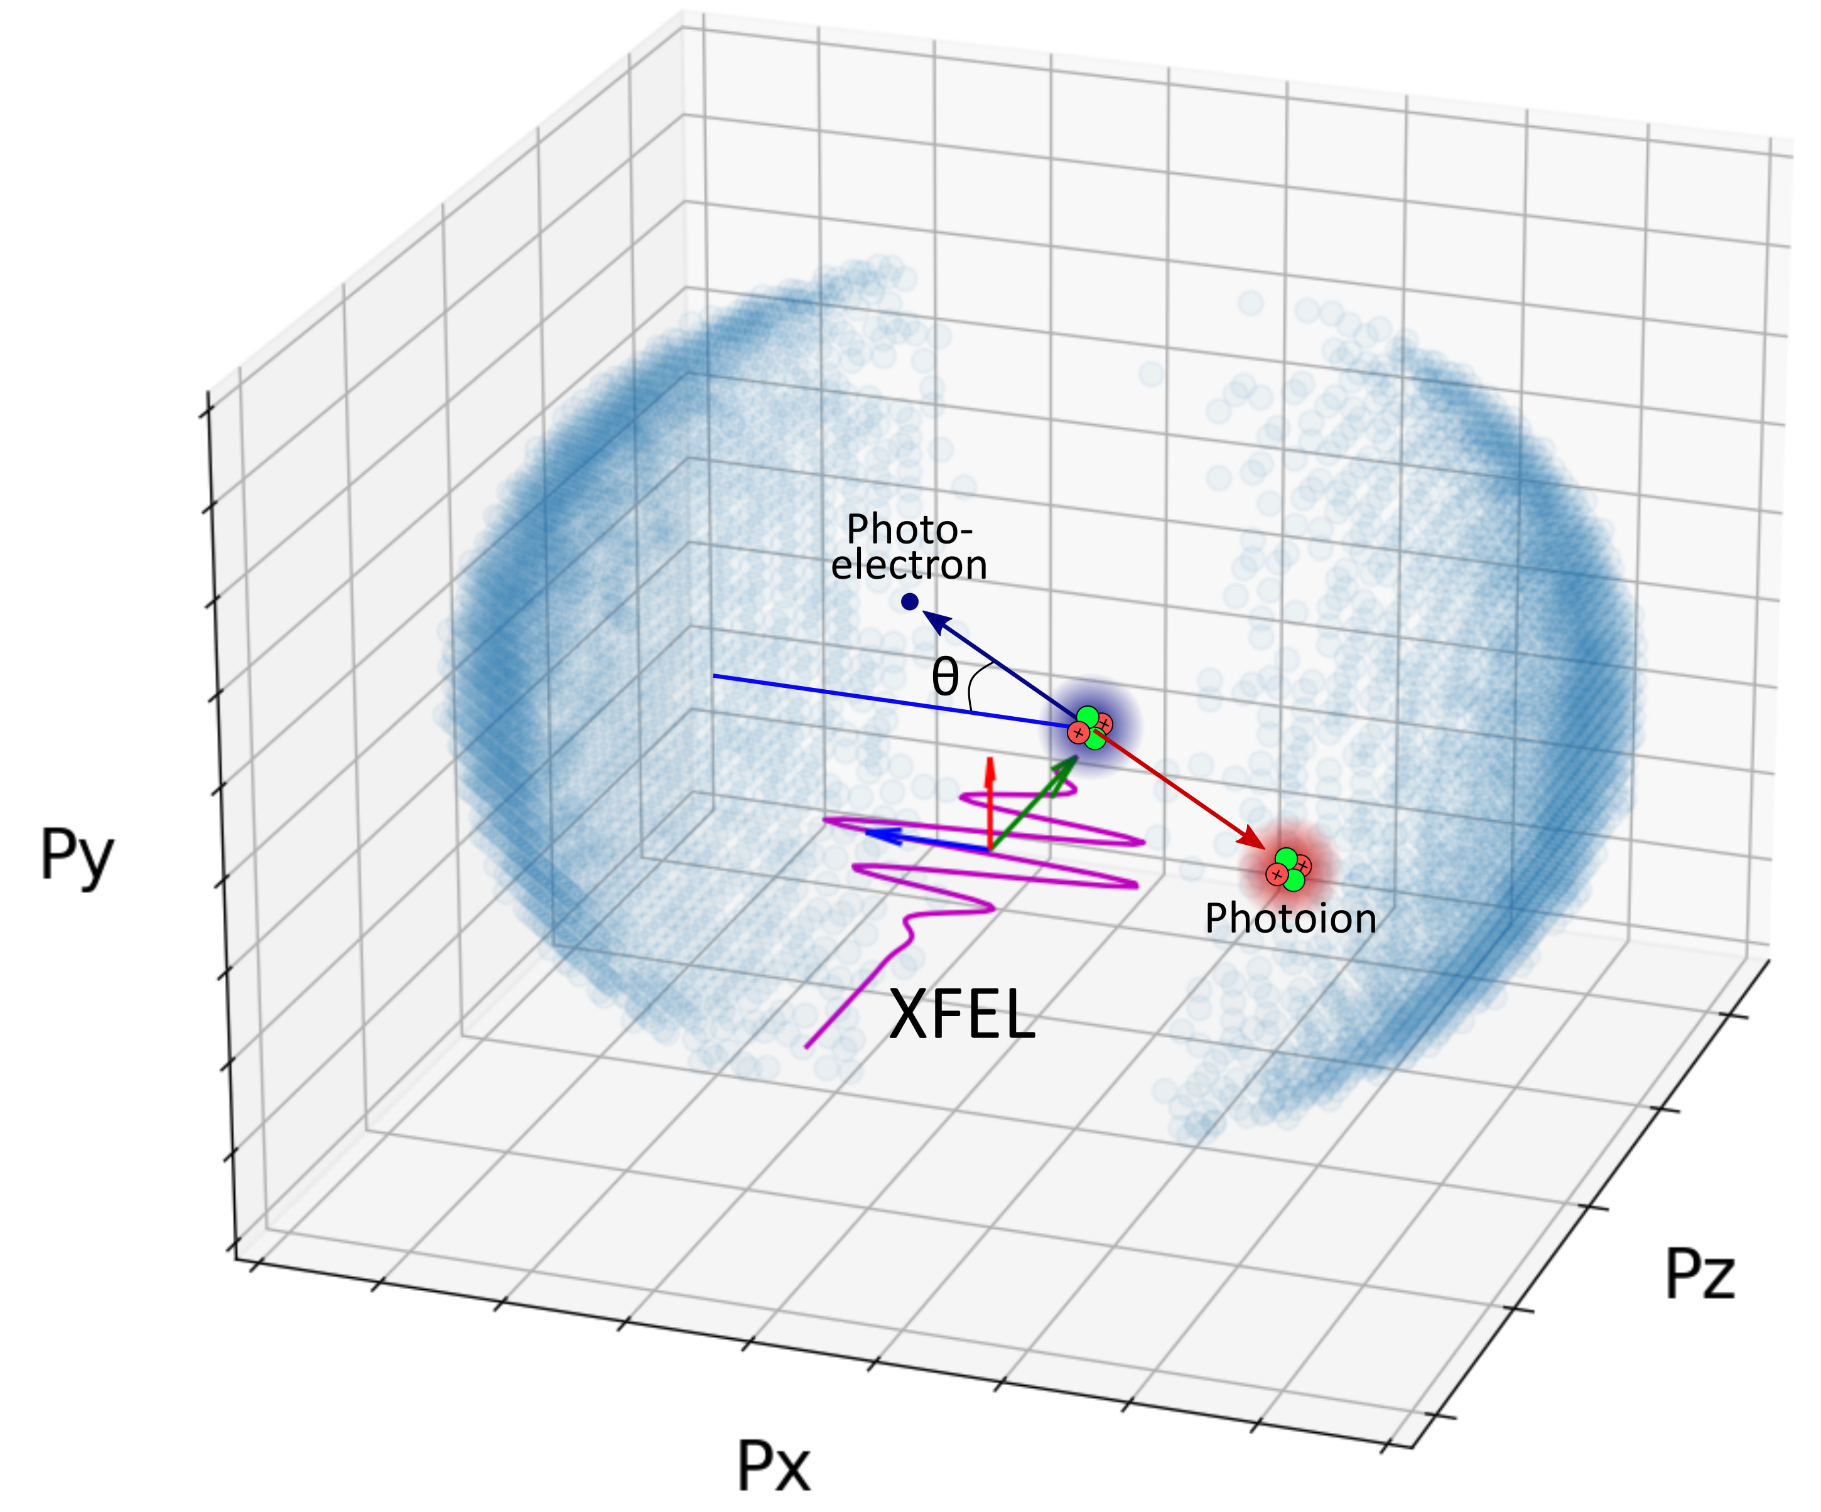
Angular Dependence of Photoelectron Momenta
Angular dependence comes from initial angular momentum of electron in atom
Angular dependence of cross section for single photon ionization:
$$\frac{dσ}{dΩ}=\frac{σ}{4π}\left(1+β P_{2}\left(cosθ\right)\right)$$
$θ:$ Angle between electric field vector and electron momentum
$β:$ Asymmetry parameter, depends on photon energy

Slide 13
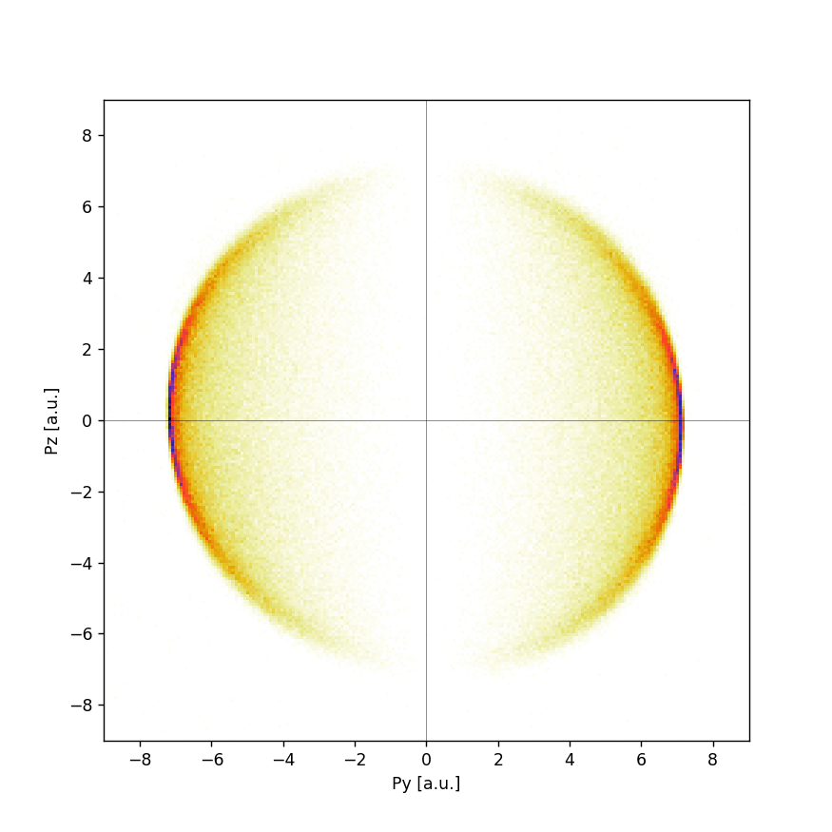
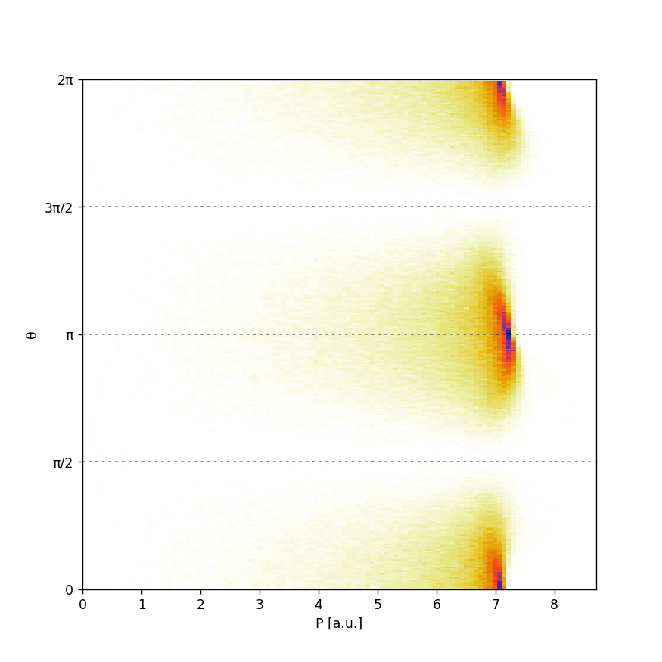
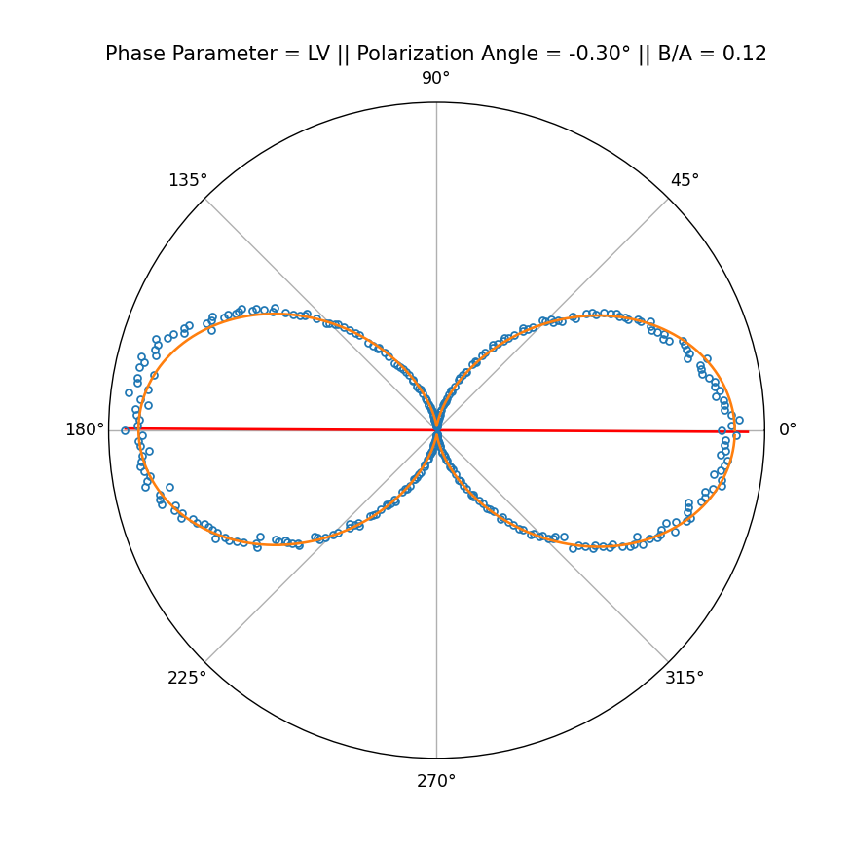
Angular Dependence of Photoelectron Momenta
Angular distribution of emitted photoelectrons described by:
$$\frac{dσ}{dΩ}=\frac{σ}{4π}\left(1+β P_{2}\left(cosθ\right)\right)$$
$σ$ – Partial cross-section
$β=2$ – Asymmetry parameter
$P_{2}\left(cosθ\right)=\frac{1}{2}(3\cos^{2}{θ−1})$ – 2nd Order Legendre Polynomial
Convert to Polar Coordinates
Integrate &
Fit to Dipole
$$\frac{dσ}{dΩ}\left(α\right)∝\cos^{2}\left(θ−α\right)$$

Slide 14
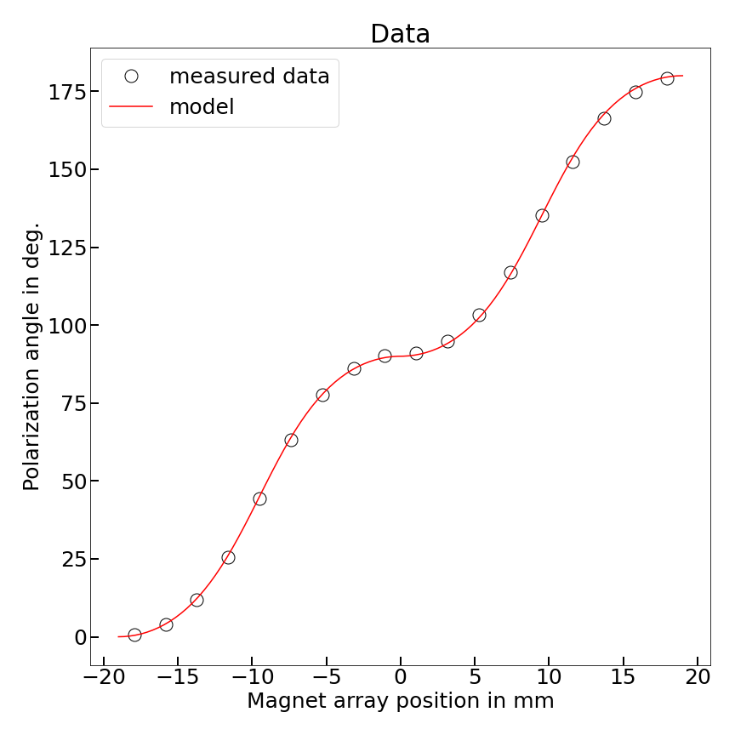
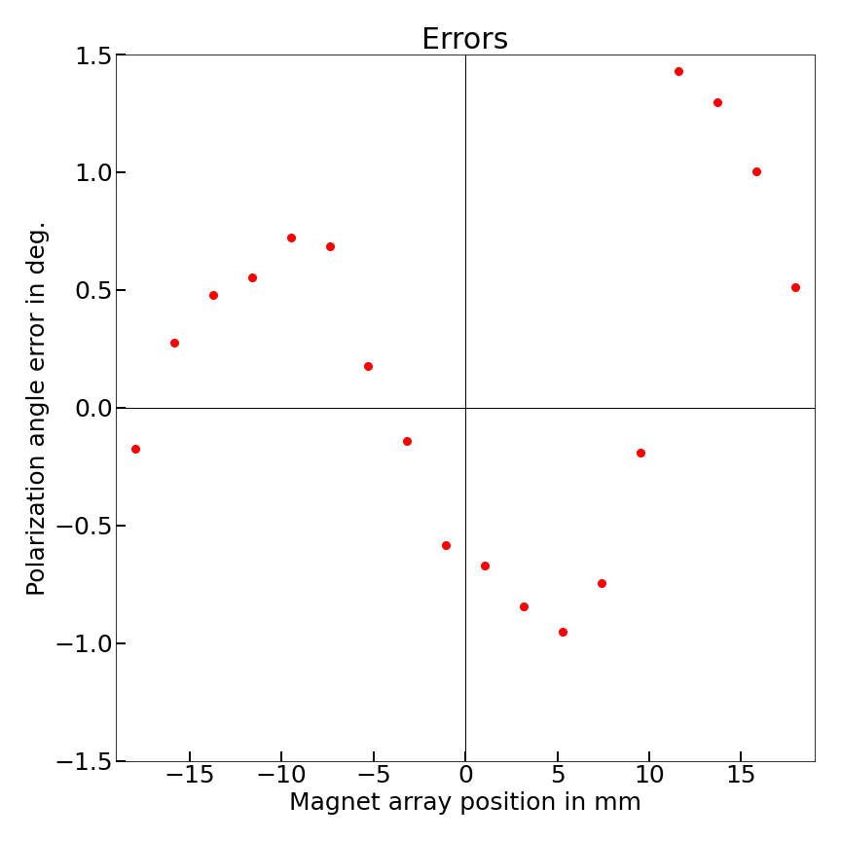
Undulator Scan
Model for polarization of beam ($α$) vs undulator phase parameter ($φ$):
$$α=\arctan\left(\cot^{2}\left(\frac{1}{2}φ\right)\right)$$

Slide 15
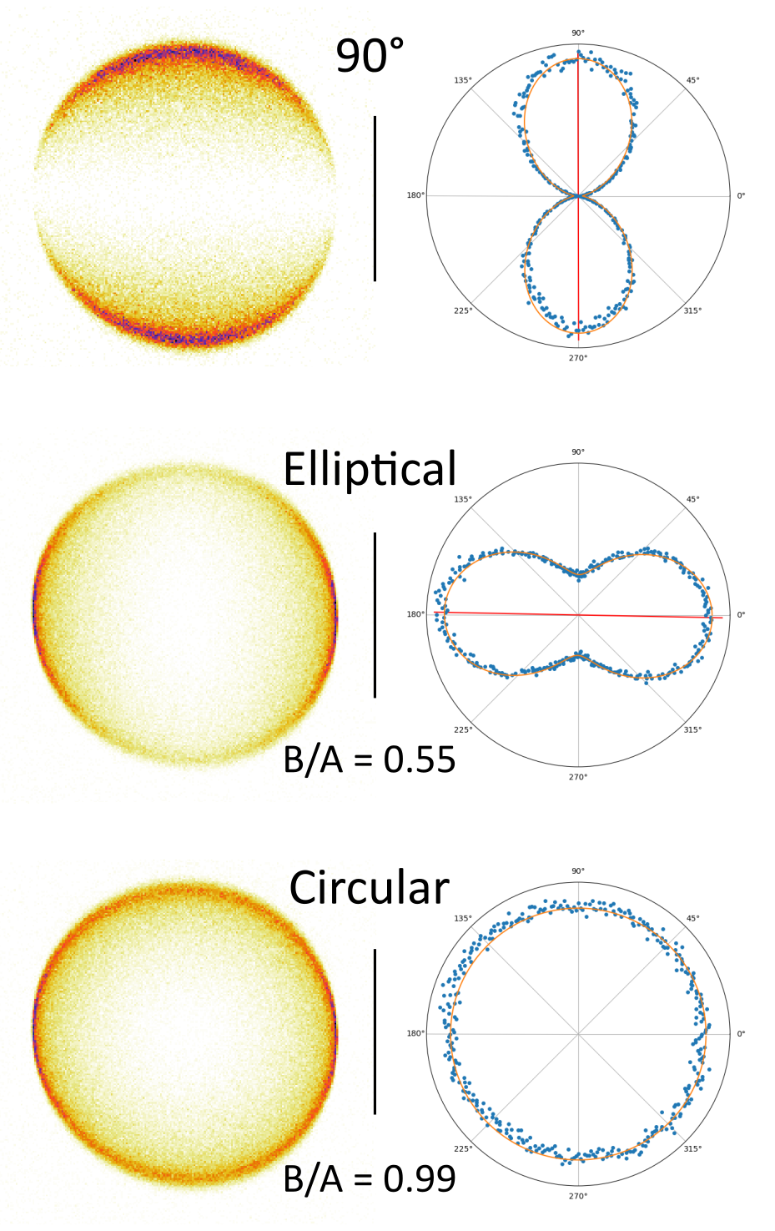
Circular and Elliptical Polarizations
Ellipticity were also characterized by fitting to perpendicular dipoles:
$$\frac{dσ}{dΩ}\left(α\right)=A^{2}\cos^{2}\left(θ−α\right)+B^{2}\sin^{2}{(θ−α)}$$
Ratio of B/A gives degree of ellipticity
B/A = 0 is purely linear
B/A = 1 is purely circular
B/A = 0.18

Slide 16
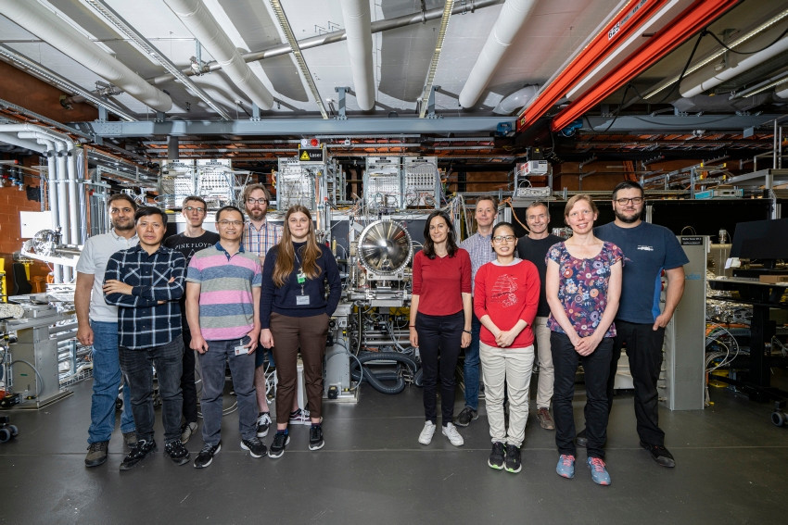
Summary
Arbitrary linear, elliptical and circular polarization of XFEL beam achieved in Athos by SwissFEL undulator / operations groups
Polarizations characterized at Maloja endstation using COLTRIMS
Excellent agreement with theoretical model
Nice example of collaboration between machine development groups and experimental endstations (more in the future)

Slide 17
Wir schaffen Wissen – heute für morgen
Many thanks to:
Maloja Group
Undulator Group
Operations Group
Science IT Group
Everyone who contributed!

